Slide 1
Click on “Slide Show”
Click “Play from Beginning”

Slide 2
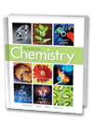
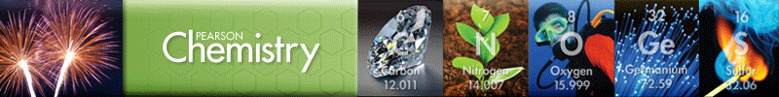
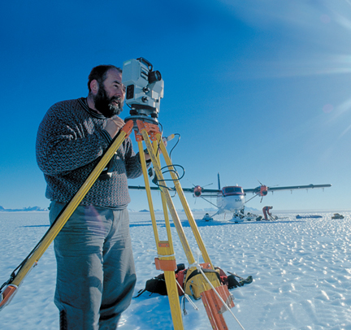
Chapter 3
Scientific Measurement
Using & Expressing Measurements
*Units of Measurement
*Solving Conversion Problems
*Density (Mass/Volume)

Slide 3
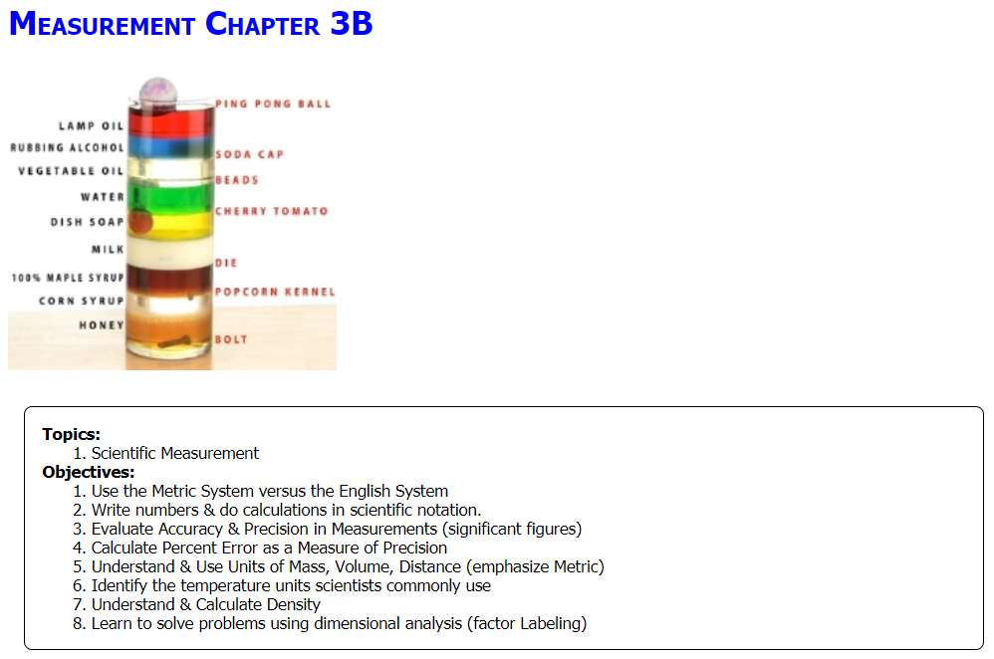

Slide 4
Measurement
What is the metric progression from milli to kilo?
Write 34597 in scientific notation
Write 0.000128 in scientific notation
Write 89.3 x 10³ in standard notation
Write 26.9 x 10⁻⁴ in standard notation
Notes:
Timing ≈ 1 min
Entry Audio: We all know a liquid when we see it, but how would you describe a liquid in words? For each property, check the corresponding phase or phases.
Hint Audio: Some properties are shared by more than one state.
Exit Audio: Let’s examine just how the microscopic interactions of molecules give rise to these properties in liquids.

Slide 5
Measurement
What is the metric progression from milli to kilo?
milli, centi, deci, standard, deka, hecta, kilo
Write 34597 in scientific notation
3.4597 x 10⁴ (#↓ E↑)
Write 0.000128 in scientific notation
1.28 x 10⁻⁴ (#↑ E↓)
Write 89.3 x 10³ in standard notation
89300 (E↓ #↑)
Write 26.9 x 10⁻⁴ in standard notation
0.00269 (E↑ #↓)
Notes:
Timing ≈ 1 min
Entry Audio: We all know a liquid when we see it, but how would you describe a liquid in words? For each property, check the corresponding phase or phases.
Hint Audio: Some properties are shared by more than one state.
Exit Audio: Let’s examine just how the microscopic interactions of molecules give rise to these properties in liquids.

Slide 6
Measurement
The boiling point of ethanol is known to be 78.0 C. A student observes the following temperatures for the boiling point of ethanol: 69.43 C, 73.8 C, and 74 C. Are these numbers accurate and/or precise? Explain.
Use the value, 73.8 to determine how accurate the student’s temperature is.
Notes:
Timing ≈ 1 min
Entry Audio: We all know a liquid when we see it, but how would you describe a liquid in words? For each property, check the corresponding phase or phases.
Hint Audio: Some properties are shared by more than one state.
Exit Audio: Let’s examine just how the microscopic interactions of molecules give rise to these properties in liquids.

Slide 7

Measurement
The boiling point of ethanol is known to be 78.0 C. A student observes the following temperatures for the boiling point of ethanol: 69.43 C, 73.8 C, and 74 C. Are these numbers accurate and/or precise? Explain.
Inaccurate → they miss the target (accepted value)
Not precise → all different decimal places
Use the value, 73.8 to determine how accurate the student’s temperature is.
% Error = (78.0 C – 73.8 C) / 78.0 C x 100% = 5.38%
Notes:
Timing ≈ 1 min
Entry Audio: We all know a liquid when we see it, but how would you describe a liquid in words? For each property, check the corresponding phase or phases.
Hint Audio: Some properties are shared by more than one state.
Exit Audio: Let’s examine just how the microscopic interactions of molecules give rise to these properties in liquids.

Slide 8
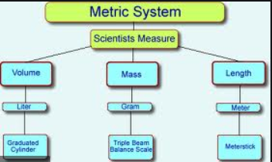
Measures
Units of Measurement
Temperature
Kelvin
Thermometer
Density
d = m / v
d = g / L = g / m³
8

Slide 9
Regular Solids
2 Units of Measurement
Units of Volume - liter
  Volume is the amount of space a substance occupies.
  Volume measurements depend on the state of matter (solid (s), liquid (l), or gas (g), and the shape of the matter.
  Volume measurements are obtained related to:
REGULARLY shaped solids
Liquids
Irregularly shaped solids

Slide 10
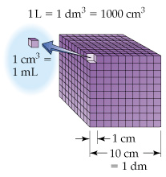
Regular Solids
2 Units of Measurement
Units of Volume - liter
  Length (L) x Width (W) x Height (H) calculates volume.
  Notice
  the equalities
cm³ is used to find the volume of a REGULARLY shaped solid

Slide 11
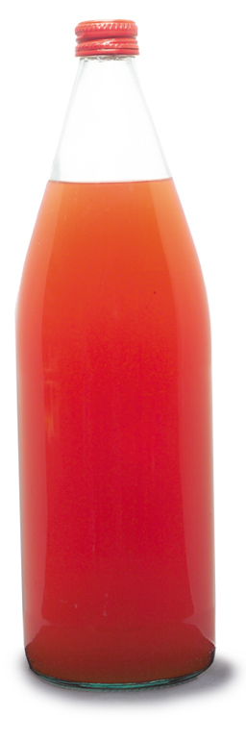
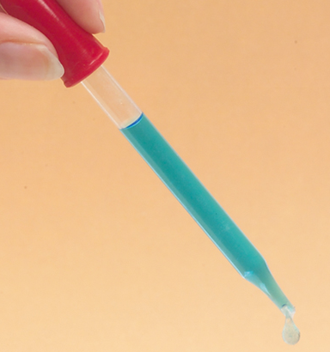
Volume (Liquids)
Units of Measurement
How do these two volumes compare?
?
1 L
1 mL

Slide 12
Volume (liquids)
Units of Measurement
1 L = 1000 ml
↓ ↑ liters are the bigger unit and have a smaller number
↑ ↓ milliliters are the smaller unit and have a bigger number
1 L
1 mL

Slide 13
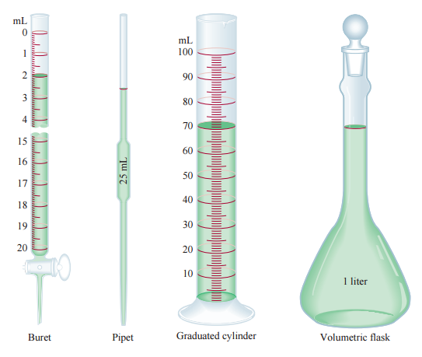
2 Units of Measurement
Volume (liquids)
Laboratory glassware used in measuring liquids

Slide 14
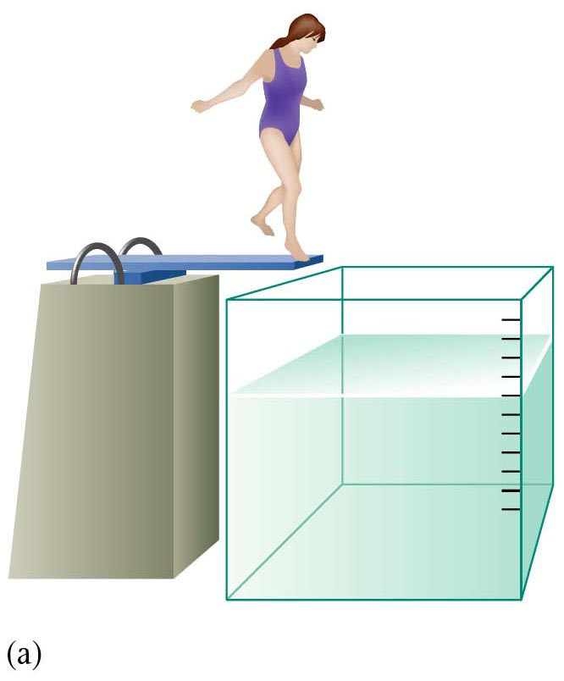
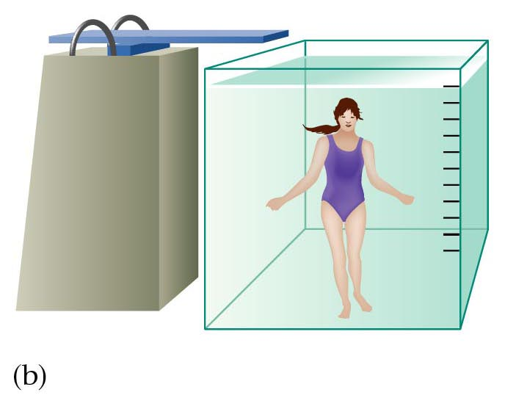
2 Units of Measurement
Irregular Solids
Water displacement can be used to find volume of irregularly shaped objects.

Slide 15
2 Units of Measurement
Volume
Units of Volume
The relationships among common metric units of volume are shown in the table below.
Metric Units of Volume
Unit | Symbol | Relationship | Example
Liter | L | base unit | quart of milk ≈ 1 L
Milliliter | mL | 10³ mL = 1 L | 20 drops of water ≈ 1 mL
Cubic centimeter | cm³ | 1 cm³ = 1 mL | cube of sugar ≈ 1 cm³
Microliter | μL | 10⁶ μL = 1 L | crystal of table salt ≈ 1 μL

Slide 16

2 Units of Measurement
Volume
Name three ways (with units) to measure volume.

Slide 17
2 Units of Measurement
Volume
Name three ways (with units) to measure volume.
Regularly shaped objects
cm³
Liquids
ml
Irregularly shaped objects
  water displacement (ml)

Slide 18
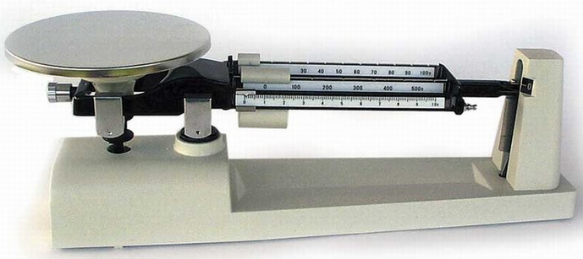
Mass
2 Units of Measurement
Units of Mass - kilogram
  The mass of an object is the amount of matter an object contains. A typical classroom uses a triple beam balance to measure mass in grams.
  1 kilogram (kg) is the basic SI unit of mass.

Slide 19
Mass
2 Units of Measurement
Units of Mass
The relationships among units of mass are shown in the table below.
Metric Units of Mass
Unit | Symbol | Relationship | Example
Kilogram (base unit) | kg | 1 kg = 10³ g | small textbook ≈ 1 kg
Gram | g | 1 g = 10⁻³ kg | dollar bill ≈ 1 g
Milligram | mg | 10³ mg = 1 g | ten grains of salt ≈ 1 mg
Microgram | μg | 10⁶ μg = 1 g | particle of baking powder ≈ 1 μg

Slide 20
Enrichment
2 Units of Measurement
Mass Versus Weight
  Weight = mass x gravity
  W = mg
  The weight of an object can change with its location, but mass does not. An astronaut in orbit is weightless, but not massless.
  Weight is a FORCE,
  measured in Newtons (SI unit) or pounds (English)

Slide 21
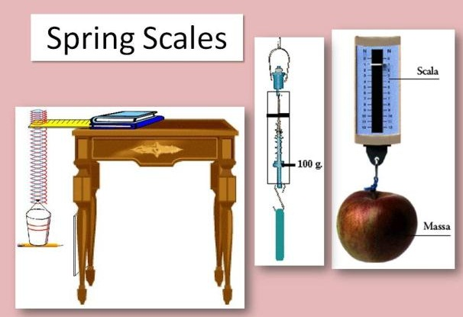
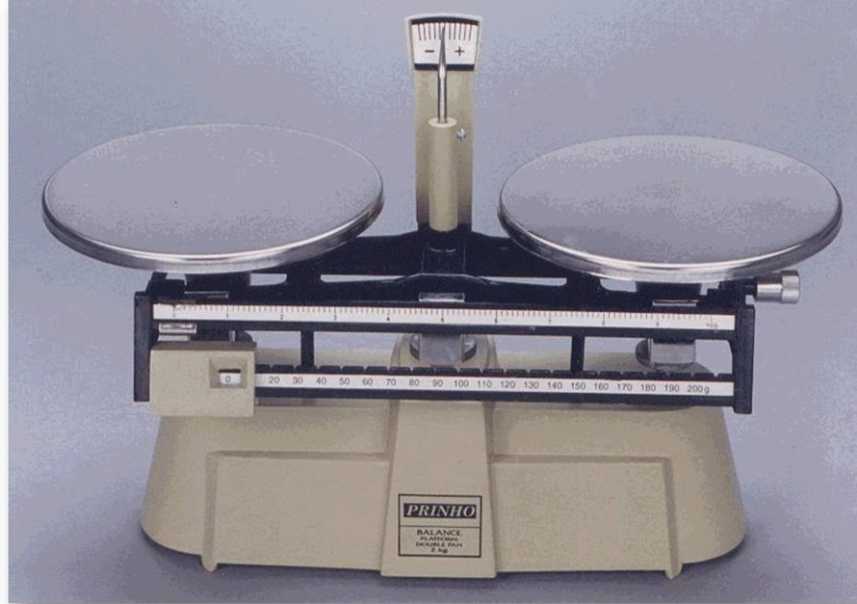
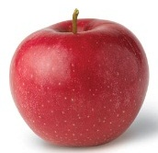
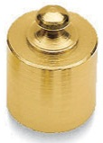
Measuring
Mass vs.
Weight
2 Units of Measurement
Enrichment
Two-pan balance
Mass – uses a balance
Weight – uses a spring scale (force).

Slide 22

Using SI Units
2 Units of Measurement
Units of Energy
  The capacity to do work or to produce heat is called energy.
  The SI unit of energy is the Joule (J)
  One calorie (cal) is the quantity of heat that raises the temperature of 1 g of pure water by 1°C.
  Conversions between joules and calories can be carried out using the following relationships.
    1 J = 0.2390 cal
    1 cal = 4.184 J
  1 kilojoule (KJ) = 1000 joules
  1 kilocalorie (Kcal) = 1000 calories … “food calorie”

Slide 23
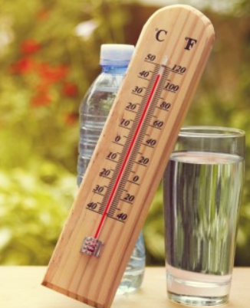
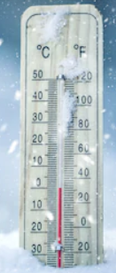
Temperature Scales
Units of Measurement
  Temperature
  A measure of the average kinetic energy (motion) of molecules in a substance.
  Most people equate temperature with how “hot” or “cold” an object is. But an Alaskan or an Egyptian would define hot and cold differently than you and I.
  80 ⁰F (27 ⁰C) would be “hot” to an Alaskan
  But “cool” to an Egyptian

Slide 24
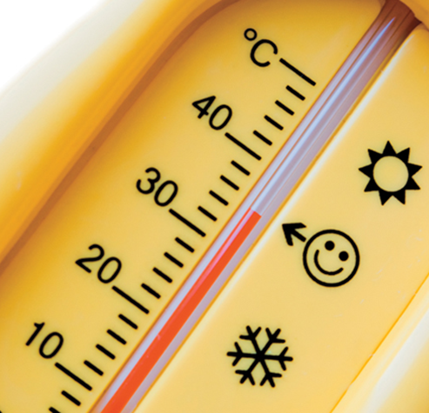
Temperature Scales
Units of Measurement
  Temperature
  A measure of the average kinetic energy (motion) of molecules in a substance.
  Most substances expand with an increase in temperature and contract as the temperature decreases. (e.g. sidewalks in winter versus summer).
  This explains how thermometers work (the liquid inside expands & contracts).

Slide 25
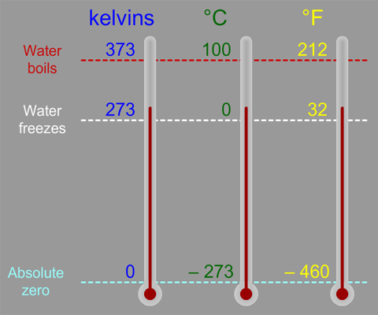
Temperature Scales
2 Units of Measurement
  The SI (Metric) unit of temperature is the Kelvin scale, K, also known as the absolute temperature scale because it begins at zero … equal to –273.15°C.
  CONVERSIONS:
  K = ºC + 273.15
  ºC = K - 273.15
  ºF = 9/5 ºC + 32
  ºC = 5/9(ºF-32)

Slide 26
Units of Measurement
ºC | K
0
 | 0
100
 | 100
Convert 80 ºF to ºC Convert 100 ºC to ºF

Slide 27
Temperature
The measure of heat intensity: describes the average kinetic energy (KE) of the molecules in a system
      Fahrenheit and Celsius
        F = 9/5 C + 32 … 100 °C = 212 °F
        C = 5/9 (F - 32) … 80 °F = 26.7 °C
      Kelvin vs. Celsius
        K = C + 273 C = K - 273
        1 K increment = 1 C
C | K
0
 | 0
100
 | 100
273
-273
373
-173

Slide 28
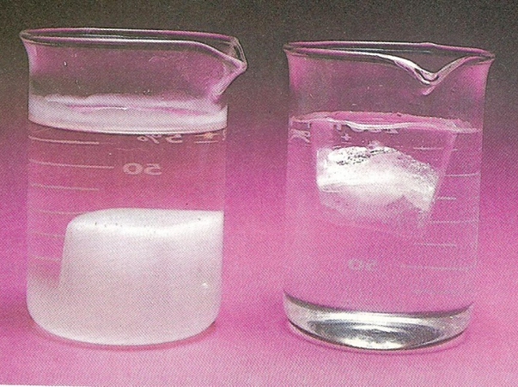
2 Units of Measurement
What accounts for the difference in the two beakers?

Slide 29


Density
Units of Measurement
Density – A measure of how tightly packed matter is;
Defined as an object's mass divided by its volume.
Write an equation for density:

Slide 30
Density
Units of Measurement
Density – A measure of how tightly packed matter is;
Defined as an object's mass divided by its volume.
ρ = m / V
“d” is also fine
More DENSE
Less DENSE
I “love” density

Slide 31
Density
2 Units of Measurement
Density Overview
Soda Pop Cans in a Beaker of water. (1:02)
https://screencast-o-matic.com/watch/cFQ6reqGli
Density An Intensive Property
Beware of Whacky Scientist. (1:12)
https://screencast-o-matic.com/watch/cFQi2Cqp7O

Slide 32
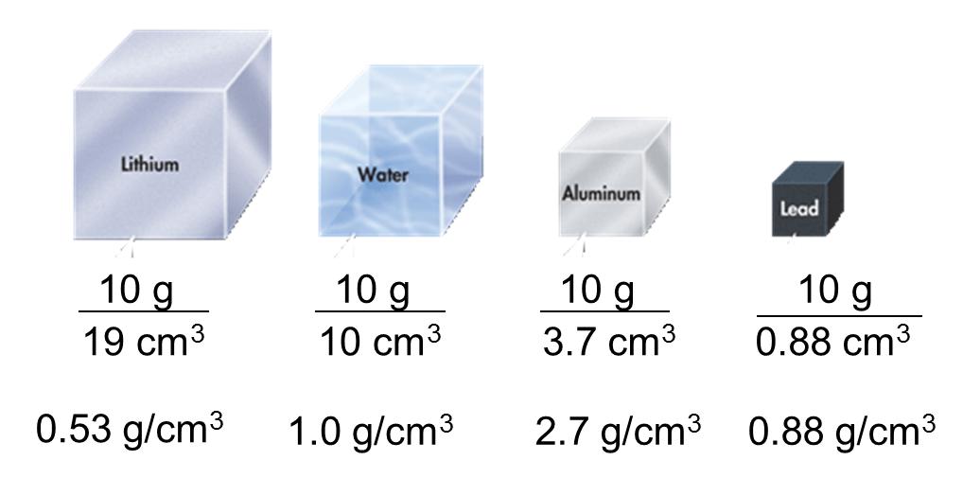
Density
2 Units of Measurement
8.8
Describe the relationship between volume and mass for the cubes above. Notice the densities.

Slide 33
Density
2 Units of Measurement
8.8
Density and volume are inversely proportional: ↑ ↓
If one keeps the mass the same, as the density increases, the volume the substance occupies decreases.

Slide 34
Density
2 Units of Measurement
  Density is an intensive property that depends only on the composition of a substance, not the size of the sample.
Measuring Density 1: (0:17)
https://screencast-o-matic.com/watch/cFQ6r3qGIz
Measuring Density 2: (2:57)
https://screencast-o-matic.com/watch/cFQ60NqG0I

Slide 35
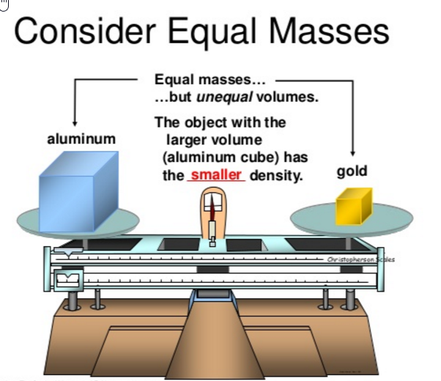
Density
3.2 Units of Measurement
Why would the two sides be balanced (as shown in the picture)?

Slide 36
Density
3.2 Units of Measurement
Why would the two sides be balanced (as shown in the picture)?
The mass of the objects must be the same since they balance out.
Aluminum has a larger volume, but a lesser density.
Density accounts for them being balanced

Slide 37
Identify the Correct Units
A chemical reaction produces solid sulfur as a product. Which unit should be used to describe the mass of the sulfur produced?
O milliliters
O grams
O kilometers
O Kelvin
Explain why one substance will float in another:
helium balloons in air
Ice or wood in water
The volume of a gas must be measured at several points during an experiment. Which units should be used to describe the volume of the gas?
O liters
O centimeters
O degrees Celsius
O milligrams
Which has more mass, a ton of bricks or a ton of feathers? What measure would be different?
Notes:
Timing ≈ 0.5 min
Entry Audio: It is important to know the correct units for different types of measurements.
Hint 1 Audio: Which unit is a unit of mass?
Hint 2 Audio: Which unit is a unit of volume?
Exit Audio: Knowing the correct units for different quantities is only half the story. You must also know how to convert from one unit to another, which we study next.

Slide 38
Identify the Correct Units
A chemical reaction produces solid sulfur as a product. Which unit should be used to describe the mass of the sulfur produced?
O milliliters … volume
O grams
O kilometers … distance
O Kelvin … temperature
Explain why one substance will float in another:
helium balloons in air
Ice or wood in water
DENSITY
The volume of a gas must be measured at several points during an experiment. Which units should be used to describe the volume of the gas?
O liters
O centimeters … distance
O degrees Celsius … temperature
O milligrams … mass
Which has more mass, a ton of bricks or a ton of feathers? What measure would be different?
Same mass. The brick would take up a much smaller volume than the feathers because its density is so much larger.
Notes:
Timing ≈ 0.5 min
Entry Audio: It is important to know the correct units for different types of measurements.
Hint 1 Audio: Which unit is a unit of mass?
Hint 2 Audio: Which unit is a unit of volume?
Exit Audio: Knowing the correct units for different quantities is only half the story. You must also know how to convert from one unit to another, which we study next.

Slide 39
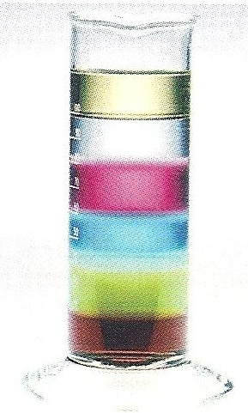
Density
2 Units of Measurement
Experiment :
The Density of Liquids
Which layer represents which substance?
Antifreeze 1.13 g/ml
Corn oil 0.93 g/ml
Dish detergent 1.03 g/ml
Maple syrup 1.32 g/ml
Shampoo 1.01 g/ml
Water 1.00 g/ml

Slide 40
Density
2 Units of Measurement
Experiment :
The Density of Liquids
Which layer represents which substance?
Corn oil 0.93 g/ml
Water 1.00 g/ml
Shampoo 1.01 g/ml
Dish detergent 1.03 g/ml
Antifreeze 1.13 g/ml
Maple syrup 1.32 g/ml

Slide 41
2 Units of Measurement
Densities of Some Common Materials
Solids and Liquids |  | Gases
Material | Density at 20°C (g/cm³) | Material | Density at 20°C (g/L)
Gold | 19.3 | Chlorine | 2.95
Mercury | 13.6 | Carbon dioxide | 1.83
Lead | 11.3 | Argon | 1.66
Aluminum | 2.70 | Oxygen | 1.33
Table sugar | 1.59 | Air | 1.20
Corn syrup | 1.35–1.38 | Nitrogen | 1.17
Water (4°C) | 1.000 | Neon | 0.84
Corn oil | 0.922 | Ammonia | 0.718
Ice (0°C) | 0.917 | Methane | 0.665
Ethanol | 0.789 | Helium | 0.166
Gasoline | 0.66–0.69 | Hydrogen | 0.084

Slide 42
Density
2 Units of Measurement
m
Calculating Density
Triangle and Criss Cross Methods
http://somup.com/crnlDvD2GC (7:01)
ρ
V

Slide 43
Density
2 Units of Measurement
A copper penny has a mass of 3.1 g and a volume of 0.35 cm³. What is the density of copper? (“AGES”)

Slide 44
Density
2 Units of Measurement
Calculating Density
A copper penny has a mass of 3.1 g (2 sig figs)
and a volume of 0.35 cm³(2 sig figs).
What is the density of copper?
m
ρ = m / V
ρ
V
3.1 g
Density =
= 8.8571 g/cm³ = 8.9 g/cm³
0.35 cm³
(2 sig figs)

Slide 45
Density
2 Units of Measurement
What is the volume of a pure silver coin that has a mass of
14.0 g? The density of silver (Ag) is 10.5 g/cm³. (“AGES”)

Slide 46
Density
2 Units of Measurement
What is the volume of a pure silver coin that has a mass of
14.0 g (3 sig figs)? The density of silver (Ag) is 10.5 g/cm³ (3 sig figs).
V = m / ρ
V = 14.0 g / 10.5 g/cm³ = 1.33 cm³
(3 sig figs)
m
ρ
V

Slide 47
Density
2 Units of Measurement
A gold bar displaces water 4.7 ml. The density of gold (Au) is 19.0 g/cm³. What is the mass of the gold bar? (“AGES”)

Slide 48
Density
2 Units of Measurement
A gold bar displaces water 4.7 ml. The density of gold (Au) is 19.0 g/cm³. What is the mass of the gold bar?
Displacement → volume
m = ρ x V
1 cm³ = 1 ml
m = 19.0 g/cm³ x 4.7 ml x 1 cm³/1 ml
= 89.3 g → 89 g (2 sig figs)
m
ρ
V

Slide 49
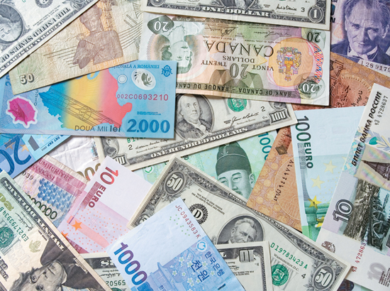
3 Solving Conversion Problems
Scientists constantly convert measurements according to units.
This is called dimensional analysis or factor labeling.
We are constantly converting measurements according to units.
1 U.S. dollars = 0.89 euros
For money we call it “exchange rate”

Slide 50
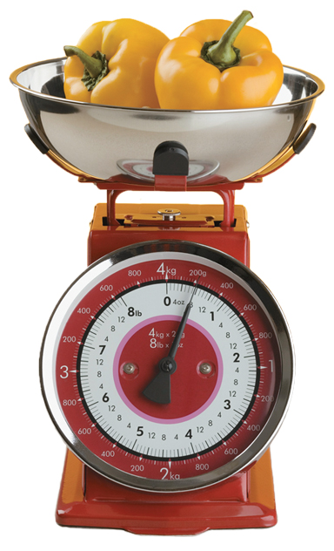
Equalities
Converting Metric Units
  To convert units
  cancel out the undesired unit
  leave the desired unit.
  Begin with Equalities.
  1000 g = 1 kg
  Create Conversion Factors.
?

Slide 51
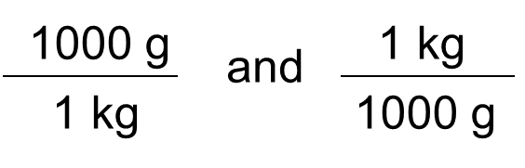
Equalities
Converting Metric Units
  To convert units
  cancel out the undesired unit
  leave the desired unit.
  Begin with Equalities.
  1000 g = 1 kg
  Create Conversion Factors.

Slide 52
Conversion Factors
Converting Metric Units
  Conversion factors:
  Allow us to convert units
  Use equalities as a ratio of equivalent measurements
  The measurement in the numerator is equivalent to the measurement in the denominator.
  Are MULTIPLYING by “ONE”
  Convert 2.4 kg to g

Slide 53
Conversion Factors
Converting Metric Units
  Convert 2.4 kg to g
  Kg are larger than g … # kg ↓ # g ↑
  g → kg … milli, centi, deci, gram, deka, hecta, kilo
  … 3 multiples of ten … move decimal to the right … E↓
  2.4 = 2,400 g
  Equality: 1000 g = 1 kg
  Conversion Factor: 1000 g/1 kg
  2.4 kg x 10³ g/1 kg = 2.4 x 10³ g
NOTE: kg cancels out … g are left

Slide 54
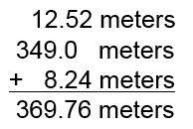
Significant Figures
Calculations
  In general, a calculated answer cannot be more precise than the least precise measurement from which it was calculated.
  The calculated value must be rounded to make it consistent with the measurements from which it was calculated.
  Addition and Subtraction
  The answer to an addition or subtraction calculation should be rounded to the same place (units, tens, etc.) as the least precise measurement.

Slide 55
Significant Figures
Calculations
  In general, a calculated answer cannot be more precise than the least precise measurement from which it was calculated.
  The calculated value must be rounded to make it consistent with the measurements from which it was calculated.
  Addition and Subtraction
  The answer to an addition or subtraction calculation should be rounded to the same place (units, tens, etc.) as the least precise measurement.
369.8 meters (nearest tenth)
3.698 x 10² m

Slide 56
Significant Figures
Calculations
Multiplication and Division
  In calculations involving multiplication and division, you need to round the answer to the same number of significant figures as the measurement with the least number of significant figures.
  The position of the decimal point has nothing to do with the rounding process when multiplying and dividing measurements.
e.g. 7.55 meters x 0.34 meter = ?

Slide 57
Significant Figures
Calculations
Multiplication and Division
  In calculations involving multiplication and division, you need to round the answer to the same number of significant figures as the measurement with the least number of significant figures.
  The position of the decimal point has nothing to do with the rounding process when multiplying and dividing measurements.
e.g. 7.55 meters x 0.34 meter = 2.567 meters²
3 Sig Figs 2 Sig Figs = 2.6 meters²
2 Sig Figs

Slide 58
Practice
3 Solving Conversion Problems
Converting Between Metric Units
The diameter of a sewing needle is 0.073 hm. What is the diameter in millimeters?

Slide 59
Practice
Converting Metric Units
  Convert 0.073 hm to mm
  hm are larger than mm … # hm ↓ # mm ↑
  mm → hm … milli, centi, deci, meter, deka, hecta, kilo
  … 5 multiples of ten … move decimal to the right … E↓
  0.073 = 7,300 mm
  Equalities: 100 m = 1 hm; 1000 mm = 1 m
  Create conversion factors.

Slide 60
Converting Metric Units
Practice
Converting Between Metric Units
The diameter of a sewing needle is 0.073 hm. What is the diameter in millimeters?
A: mm
G: 0.073 hm
E: 1 hm = 10² m … go to the “standard”
10³ mm = 1 m
S: begin with the amount GIVEN
0.073 hm … change to scientific notation
# 1 to 9 7.3 (# ↑ , therefore Exp. ↓) x 10⁻² dm

Slide 61

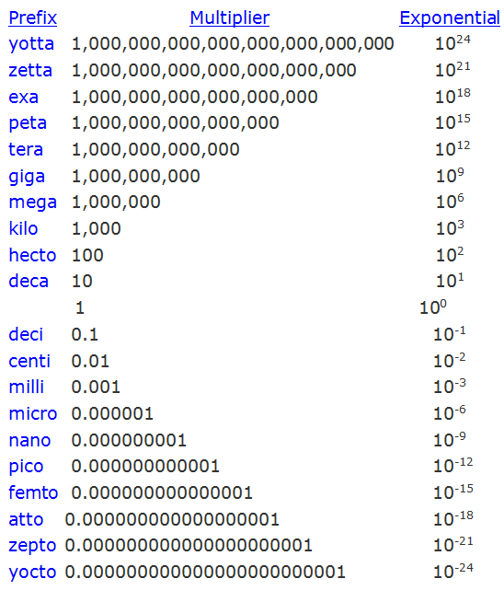
m, l, g → standards

Slide 62
Practice
Converting Metric Units
Converting Between Metric Units
The diameter of a sewing needle is 0.073 hm. What is the diameter in millimeters?
10² m = 1 hm … 10³ mm = 1 m
Remember: when dividing exponents, subtract superscripts
  when multiplying exponents, add superscripts
1 m
10⁶ μm
7.3 x 10⁻² hm x
x
=
7.3 x 10² mm
10² cm
1 m

Slide 63
Practice
Converting Metric Units
Converting Between Metric Units
The diameter of a sewing needle is 0.073 dm. What is the diameter in millimeters?
Remember: when dividing exponents, subtract superscripts
  when multiplying exponents, add superscripts
  NOTE: hm cancels out … mm are left
10² m
10³ mm
7.3 x 10⁻² hm x
x
=
7.3 x 10² mm
1 hm
1 m

Slide 64
Practice
3 Solving Conversion Problems
Converting Between Metric Units
The density of manganese (Mn), a metal, is 7.21 g/cm³. What is the density of manganese expressed in units of kg/m³?

Slide 65
Practice
3 Solving Conversion Problems
Converting Between Metric Units
The density of manganese (Mn), a metal, is 7.21 g/cm³. What is the density of manganese expressed in units of kg/m³?
A: kg/m³
G: 7.21 g/cm³
E: 10³ g = 1 kg
10² cm = 1 m … therefore, cube this relationship:
  10² cm ∙ 10² cm ∙ 10² cm = 10⁶ cm³ = 1 m³
S: begin with the amount GIVEN: 7.21 g/cm³

Slide 66
m, l, g → standards

Slide 67
Practice
3 Solving Conversion Problems
Converting Between Metric Units
The density of manganese (Mn), a metal, is 7.21 g/cm³. What is the density of manganese expressed in units of kg/m³?
Remember: Go ONE step at a time! (K. I. S.)
  factor label grams to kg first, then deal with cm³ to m³
10³ g = 1 kg … 10⁶ cm³ = 1 m³
7.21 g
1 kg
10⁶ cm³
x
x
= 7.21 x 10³ kg/m³
cm³
10³ g
1 m³

Slide 68
Practice
3 Solving Conversion Problems
Converting Between Metric Units
The density of manganese (Mn), a metal, is 7.21 g/cm³. What is the density of manganese expressed in units of kg/m³?
7.21 g
1 kg
10⁶ cm³
x
x
= 7.21 x 10³ kg/m³
1 cm³
10³ g
1 m³

Slide 69
Practice
Units of Measurement
Practice: Convert 1453 g/cm³ to kg/L

Slide 70
Practice
Units of Measurement
Practice: Convert 1453 g/cm³ to kg/L
A: kg/L
G: 1453 g/cm³
E: 10³ g = 1 kg
1 cm³ = 1 mL
10³ mL = 1 L
S: begin with the amount GIVEN: 1453 g/cm³

Slide 71
m, l, g → standards

Slide 72
Practice
Units of Measurement
Practice: Convert 1453 g/cm³ to kg/L
Use equalities and conversion factors to cancel undesired units and leave desired units.
1453 g/cm³ x 1 kg/10³ g

Slide 73
Practice
Units of Measurement
Practice: Convert 1453 g/cm³ to kg/L
Use equalities and conversion factors to cancel undesired units and leave desired units.
1453 g/cm³ x 1 kg/10³ g
1453 g/cm³ x 1 kg/10³ g x cm³/1 ml
1453 g/cm³ x 1 kg/10³ g x cm³/1 ml x 10³ ml / 1 L =
1453 kg/L … change to scientific notation
= 1.453 x 10³ kg/L
(# ↓, therefore Exp. ↑)

