Slide 1
Click on “Slide Show”
Click “Play from Beginning”

Slide 2


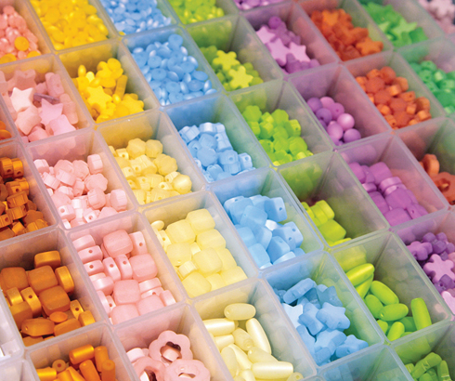
Chapter 6
The Periodic Table
Organizing the Elements
Classifying the Elements
Periodic Trends

Slide 3
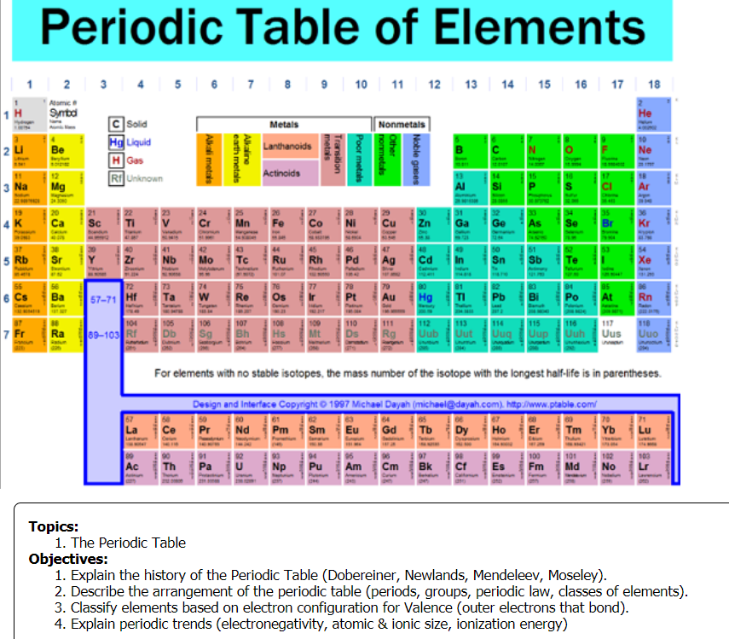

Slide 4
Copy the chart below in your notebook:
The top row is the order of the EM spectra
radio | microwave | infrared | Visible ROY | Visible GBIV | ultraviolet | x-rays | gamma

Slide 5
Observe the items in all 24 squares below in terms of similar characteristics.
Fill in the columns and rows (for the chart you copied) based on a recognizable & sensible pattern of the items.
radio | microwave | infrared | Visible ROY | Visible GBIV | ultraviolet | x-rays | gamma
Pork 0.5 lb radio | Salmon steak microwave | Beans 5 pods ultraviolet | Milk 1 gallon visible ROY | Grapes 1 twig gamma | Beef 0.25 lb radio | Tomato Soup 8 oz infrared | Rye 1 loaf visible GBIV
Stew 32 oz infrared | Spaghetti 1 pot x-rays | Bananas 1 bunch gamma | Clams 1 bushel microwave | Cheese 1 slice visible ROY | Celery 1 stalk ultraviolet | Eggs 1 dozen visible ROY | Barley 1 stalk visible GBIV
Chicken Noodle 16 oz infrared | Wheat flour 2 lbs visible GBIV | Shrimp Cocktail microwave | Rigatoni 1 bite x-rays | Chicken 1 lb radio | Apple 1 bushel gamma | Cucumber 1 plant ultraviolet | Macaroni 1 bowl x-rays

Slide 6
Observe the items in all 24 squares below in terms of similar characteristics.
Fill in the columns and rows (for the chart you copied) based on a recognizable & sensible pattern of the items.
Meat radio | Seafood microwave | Soup infrared | Dairy Visible ROY | Breads Visible GBIV | Vegetables ultraviolet | Pasta x-rays | Fruit gamma
Pork 0.5 lb radio | Salmon steak microwave | Beans 5 pods ultraviolet | Milk 1 gallon visible ROY | Grapes 1 twig gamma | Beef 0.25 lb radio | Tomato Soup 8 oz infrared | Rye 1 loaf visible GBIV
Stew 32 oz infrared | Spaghetti 1 pot x-rays | Bananas 1 bunch gamma | Clams 1 bushel microwave | Cheese 1 slice visible ROY | Celery 1 stalk ultraviolet | Eggs 1 dozen visible ROY | Barley 1 stalk visible GBIV
Chicken Noodle 16 oz infrared | Wheat flour 2 lbs visible GBIV | Shrimp Cocktail microwave | Rigatoni 1 bite x-rays | Chicken 1 lb radio | Apple 1 bushel gamma | Cucumber 1 plant ultraviolet | Macaroni 1 bowl x-rays

Slide 7
Answers
Meat radio | Seafood microwave | Soup infrared | Dairy Visible ROY | Breads Visible GBIV | Vegetables ultraviolet | Pasta x-rays | Fruit gamma
Beef 0.25 lb | Shrimp cocktail | Tomato Soup 8 oz | Cheese 1 slice | Rye 1 loaf | Beans 5 pods | Rigatoni 1 bite | Grapes 1 twig
Pork 0.5 lb | Salmon steak | Chicken Noodle 16 oz | Eggs 1 dozen | Barley 1 stalk | Cucumber 1 plant | Macaroni 1 bowl | Bananas 1 bunch
Chicken 1.0 lb | Clams 1 bushel | Stew 32 oz | Milk 1 gallon | Wheat flour 2 lbs | Celery 1 stalk | Spaghetti 1 pot | Apple 1 bushel
What guidelines did you use to make your Periodic Table of Foods? How did you determine “Groups”?
Food groups & EM radiation order
How did you determine “Periods” or “Rows”?
Amounts within each food group

Slide 8
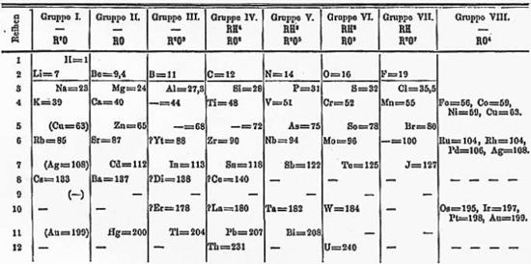
How was the periodic table developed and how is it arranged?
Notes:
Timing ≈ 0.5 min
Recap: Mendeleev was a scientist during the mid to late 1800s. Mendeleev was one of the first organizers of all of the known elements into the periodic table. The picture shown is a copy of a modern periodic table, which is based on Mendeleev’s work.
Connect: In this section, we will be looking at the structure of the modern periodic table. Studying the arrangement of the modern periodic table will provide the pattern by which predictions of chemical behavior can be based.
Preview: In this section, we will look at the periods, groups, and information found in the cells of the modern periodic table.
SOURCE:
http://www.chem1.com/acad/webtext/atoms/atpt-6.html

Slide 9
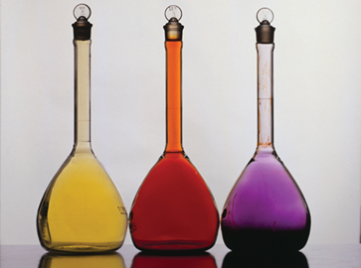
Searching for an Organizing Principle
  In 1829, a German chemist, J. W. Dobereiner, published a classification system. He grouped known elements into triads, sets of three elements with similar properties.
  One triad consisted of chlorine, bromine, and iodine.
  They each look different, but have very similar chemical properties.

Slide 10
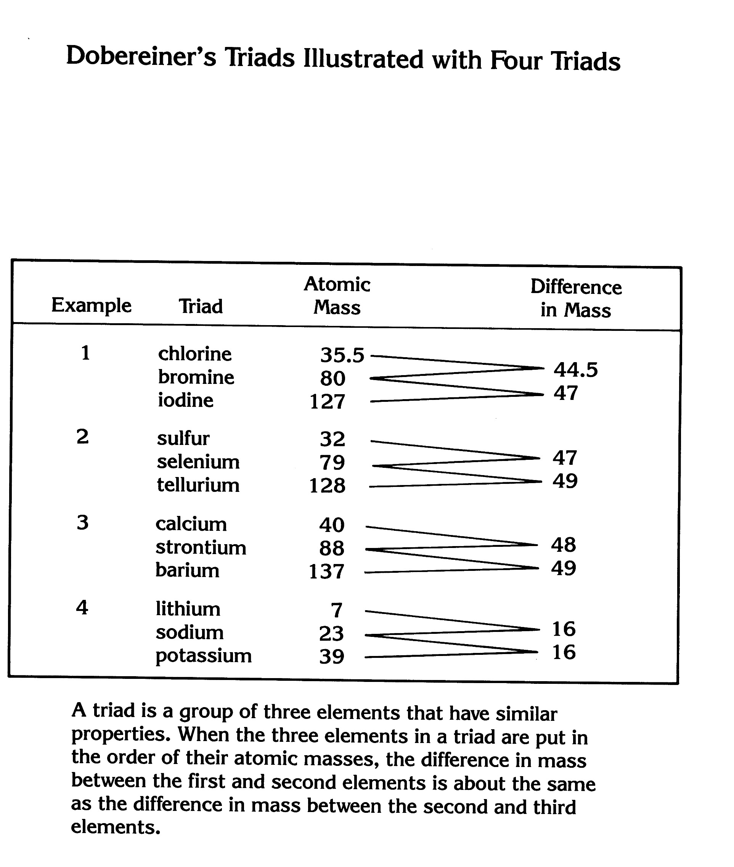
Dobereiner’s Triads
When the 3 elements in a triad are put in the order of their atomic masses,
the difference in mass between the first and second elements
is about the same as the difference in mass between the second and third elements.

Slide 11
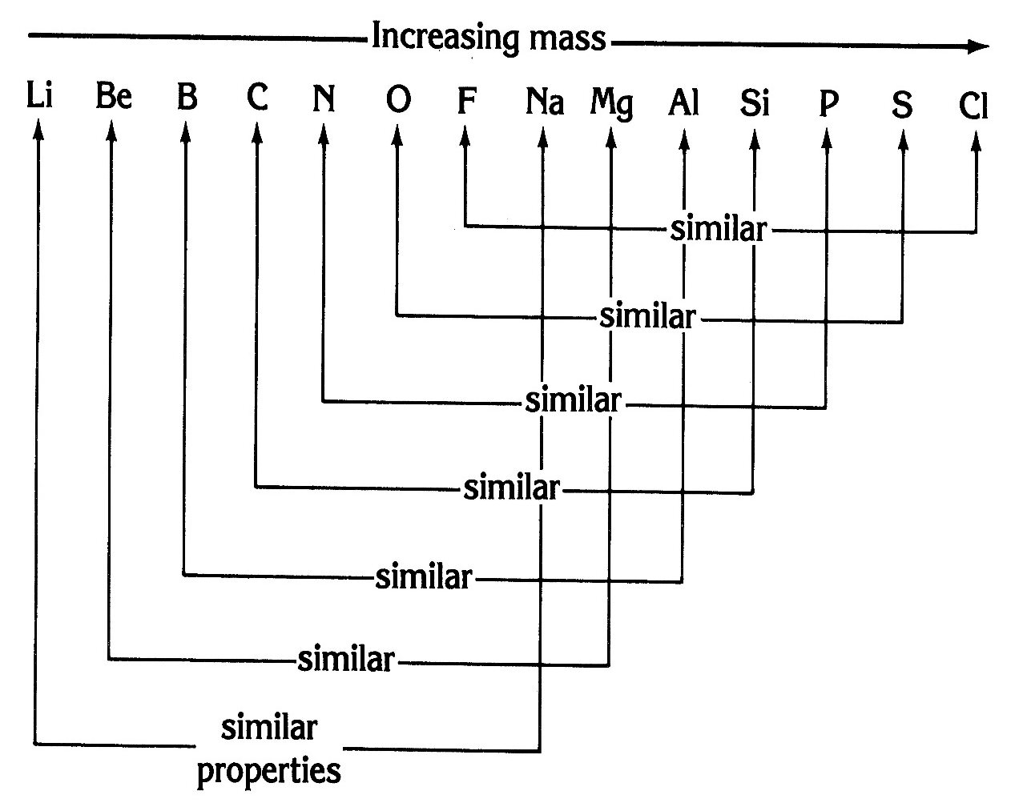
Newland’s Law of Octaves
John Newlands (1865)
He arranged the Periodic Table according to increasing atomic mass.
He established the “Law of Octaves” → noticing a repeating pattern of SIMILAR PROPERTIES every eight elements on the Periodic table.

Slide 12
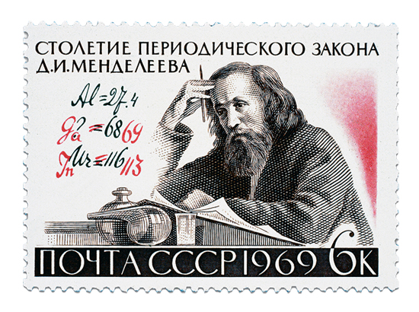
Mendeleev’s Periodic Table
In 1869, the Russian chemist Dmitri Mendeleev produced the first orderly arrangement, or periodic table, of all 63 elements known at the time.
Mendeleev wrote the symbol for each element, along with the physical and chemical properties.
Mendeleev arranged the elements in order of increasing atomic mass.

Slide 13
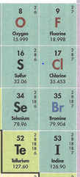
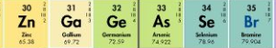
Mendeleev’s Periodic Table
Mendeleev noticed that similar properties of elements occurred after “periods” of varying lengths (rows on Periodic Table).
He established “Families” or “Groups” (columns) on the Periodic Table, possessing similar chemical properties.
Mendeleev predicted properties and masses of
unknown elements that he knew existed.
(e.g. scandium, gallium, germanium).
  Mendeleev could NOT account for Iodine whose atomic mass was less than Tellurium, but whose chemical properties belonged with Br and Cl’s group .

Slide 14
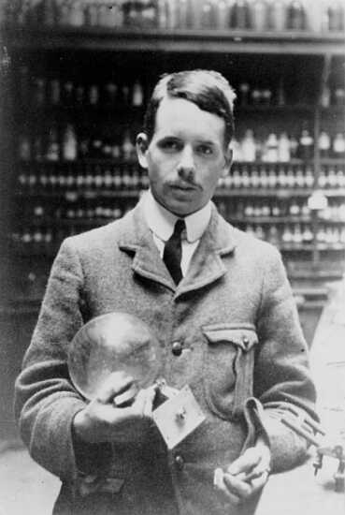
The Modern Periodic Table
Henry Moseley (1887-1915)
  Contributed to the modern version of the periodic table.
  Arranged all the elements in order of increasing atomic number.
  Accounted for variations resulting from isotopes.
Notes:
Timing ≈ 0.5 min
Forty years after Mendeleev published his periodic table, an English chemist named [Animate stem and picture and bullet 1] Henry Moseley found a different physical basis for the arrangement of elements.
Moseley discovered that appropriate structure of the periodic table correlated to the atomic number (teacher, remind students of definition), rather than atomic mass, which is what most other scientists had used before.
[Animate bullet 2] He arranged all the elements in order of increasing atomic number, not atomic mass.
[Animate bullet 3] By using atomic number instead of atomic mass, Moseley enabled the establishment of a more accurate periodic table because he accounted for the effects of isotopes on atomic mass.
SOURCES:
http://commons.wikimedia.org/wiki/File:Henry_Moseley.jpg

Slide 15
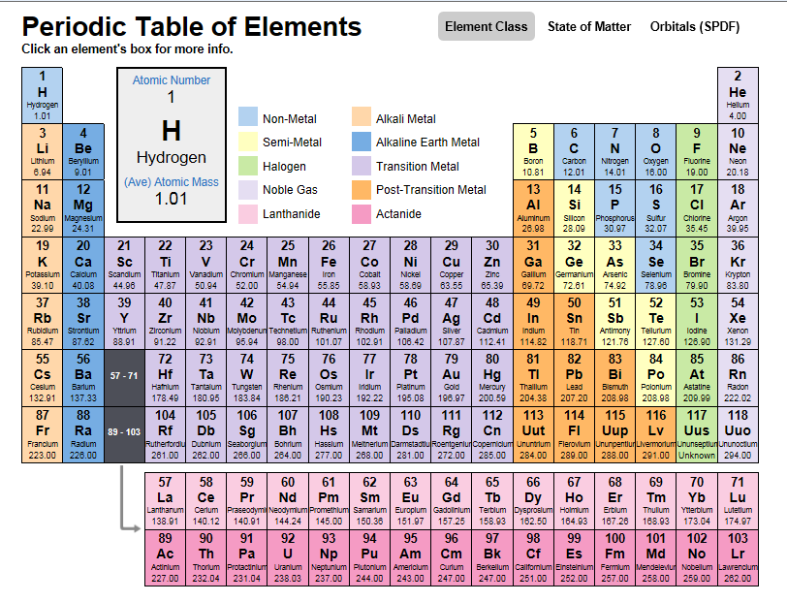
The Modern Periodic Table
The periodic table of elements is an organized display of the chemical elements.
In order of increasing atomic number (protons)
Similarities in chemical properties
  Similarities in electron configurations
Notes:
Timing ≈ 0.5 min
[Animate stem and picture] What you see is the modern periodic table: an organized display of the elements.
[Animate bullet 1] The elements are arranged in the periodic table in order of increasing atomic number.
The periodic table also groups the elements according to similarities in [Animate bullet 2] chemical properties and [Animate bullet 3] electron configuration (state that they will be learning about electron configuration later in this lesson)
You will be using the periodic table if you have not yet throughout this course.
In order for you to use the periodic table properly, you must have an understanding of how elements are arranged in the periodic table and what kind of information you can get from the periodic table. The periodic table has come a long way. Take a look at the early attempts at creating a periodic table.
SOURCES:
http://commons.wikimedia.org/wiki/File:Lavoisier.jpg

Slide 16
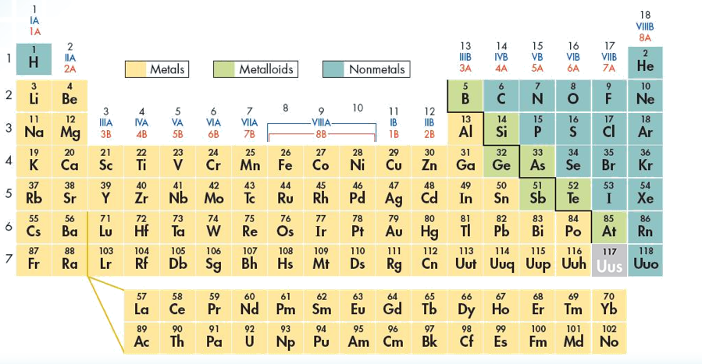
Metals, Nonmetals, and Metalloids
Metals
As one goes across a period, the properties of elements become less metallic and more nonmetallic. About 80% of the elements are metals.

Slide 17
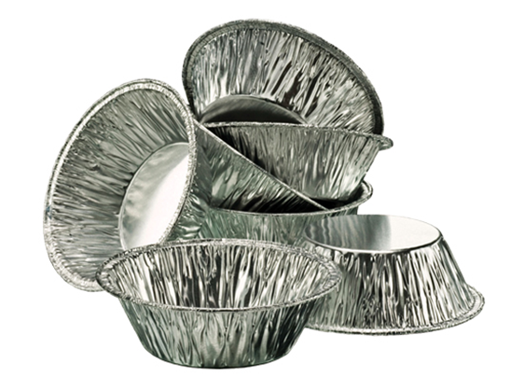
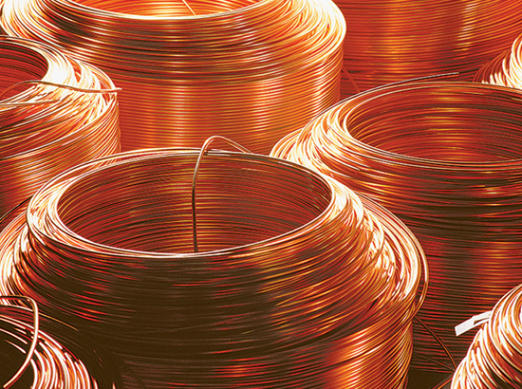
Metals, Nonmetals, & Metalloids
Metals
Good conductors of heat and electric current.
High luster, or sheen … ability to reflect light.
Solids at room temperature, except for mercury (Hg).
Ductile, can be drawn into wires.
Malleable, can be hammered into thin sheets without breaking.
Hard & Strong

Slide 18
Metals, Nonmetals, and Metalloids
Nonmetals
Tend to have properties opposite of metals.
Usually poor conductors & brittle.

Slide 19
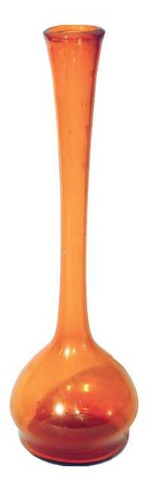
Metals, Nonmetals, and Metalloids
Metalloids
“Staircase Elements” that sometimes behave like metals.
Under other conditions, they may behave like nonmetals.
Silicon is also present as the compound silicon dioxide in glass items and the earth’s crust (silica).

Slide 20
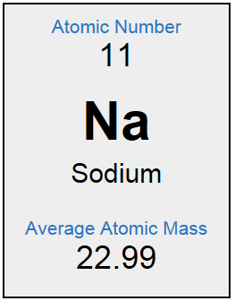
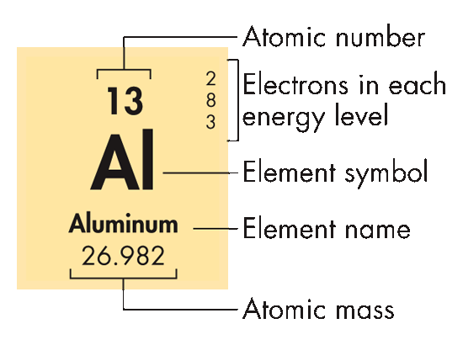
Information for Each Element
Each element’s entry on the periodic table shows:
  Chemical symbol
  Element name
  Atomic number
  Average atomic mass
  Electron configuration
Notes:
Timing ≈ 0.5 min
[Animate stem and image] Cells of the periodic table provide information about each element’s [Animate bullet 1] chemical symbol (teacher circle), [Animate bullet 2] element name (teacher circle), [Animate bullet 3] atomic number (teacher circle), and [Animate bullet 4] average atomic mass (teacher circle).
Many times other information is also included, such as oxidation numbers, ionization energy, electronegativity, and atomic size (to name a few). Knowledge of the information provided in the cell of the periodic table, plus the chemical properties of the major groups, allows scientists as well as students to predict how elements will interact.
SOURCE:

Slide 21
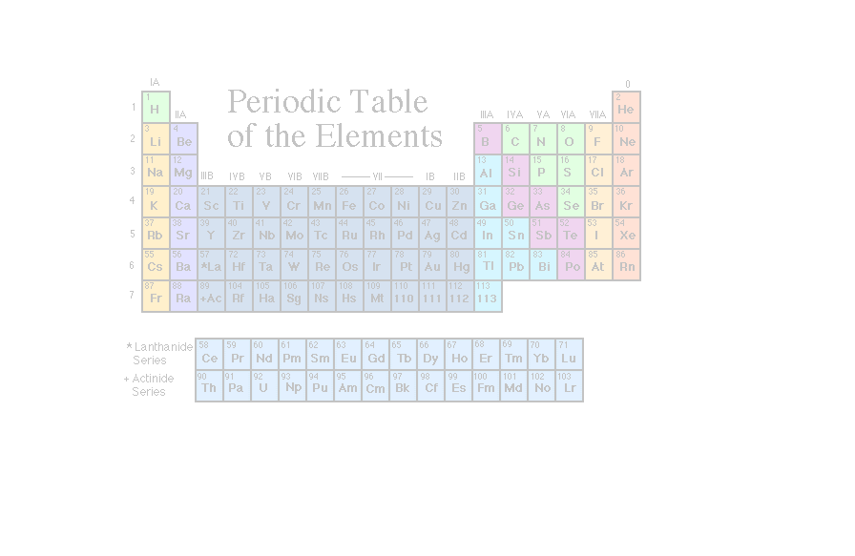
Periodic Law
When elements are arranged in order of increasing atomic number, there is a periodic pattern in their physical and chemical properties.

Slide 22
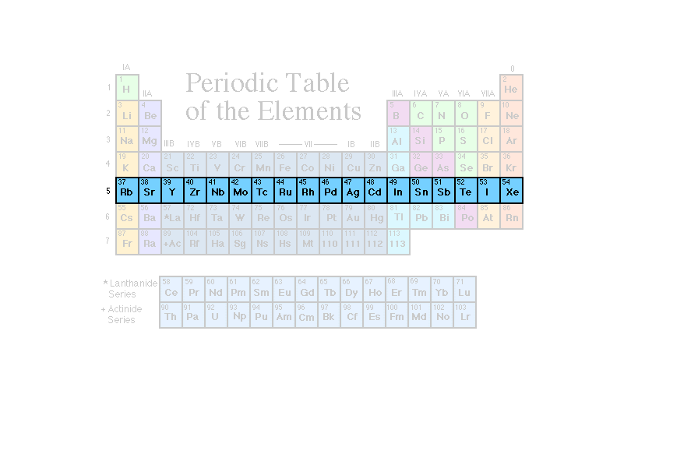
Periods
  Horizontal rows on the periodic table
  Indicate principal energy level of valence electrons (Quantum number 1, n).
  Atomic number increases from left to right across the period.
  In each period the number of valence electrons increases from left to right.
  Chemical properties change systematically across the periodic table.

Slide 23
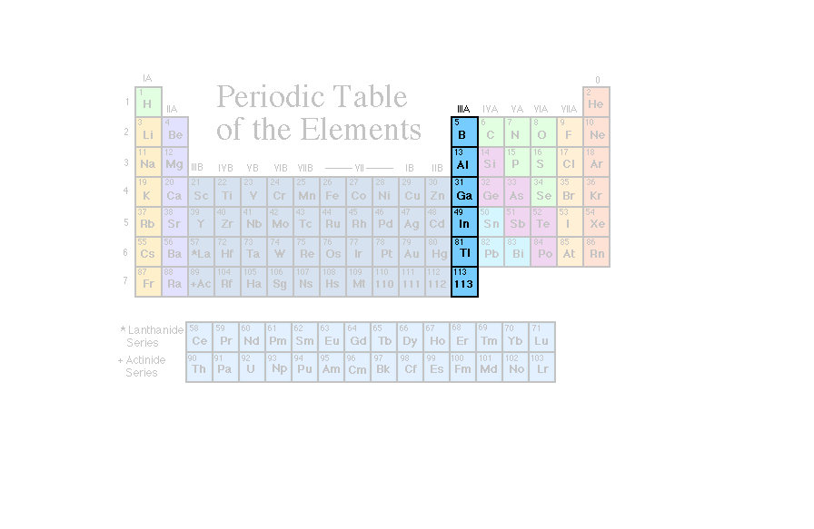
Groups or Families
  Groups: columns or families on the periodic table
Elements within a group have the same chemical properties.
Groups contain the same number of electrons in outermost level (valence electrons), which explains why groups have the same properties.
“A” groups → electrons filling s and p valence orbitals.
Magic number is “8” … s2 + p6

Slide 24
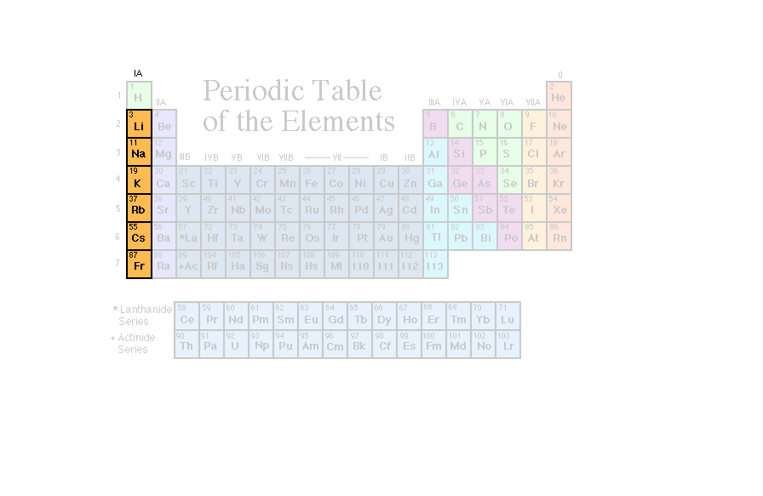
Alkali Metals
S¹
^{valence}

Slide 25
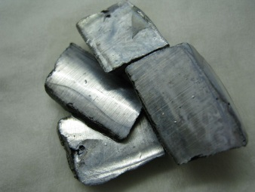

Alkali Metals (Group IA)
  Group 1 or IA
  Easily lose an electron to form a +1 cation in order to gain ideal electron configuration
  Typical properties:
    Silver in color
    Soft (can be cut with a knife)
    Highly reactive with oxygen and water
    Able to oxidize in air
Notes:
Timing ≈ 1 min
[Animate stem and pictures] Alkali metals are found in [Animate bullet 1] (teacher pull up periodic table) Group 1 or 1A of the periodic table. Teacher point out each element down group 1) Lithium (Li), sodium (Na), potassium (K), rubidium (Rb), cesium (Cs), and francium (Fr) are the alkali metals.
[Animate bullet 2] These metals are noted for being [Animate sub-bullet 1] silver in color, [Animate sub-bullet 2] soft, [Animate sub-bullet 3] highly reactive (teacher point to picture), and [Animate sub-bullet 4] able to oxidize in air. They must be stored in oil or some other inert material.
[Animate bullet 3] These are the most reactive metals and some of the most reactive elements on the periodic table
The pictures show pure potassium metal and the reaction of sodium metal with water. Each of the alkali metals reacts with water (the exception is francium, due to its radioactivity).
[Animate bullet 3] They easily lose that electron to obtain a full valence, becoming a cation (a positive ion)
Mention common uses of common elements belonging to this group.
SOURCES:
http://commons.wikimedia.org/wiki/File:Potassium.JPG
http://commons.wikimedia.org/wiki/File:Large_Sodium_Explosion.jpg

Slide 26
Alkali Metals (Group IA)
  Group 1 or IA
  Easily lose an electron to form a +1 cation in order to gain ideal electron configuration
  “Magic number is “8” … s2 + p6
  Is it easier for the metals to gain 7 electrons to make 8 or to lose 1 electron to have a full valence in the next lowest energy level?
₁₁Na²³
+11 p
-11 e
0
+11 p
-10 e
+1 charge
1s² 2s² 2p⁶ 3s¹
1s² 2s² 2p⁶
Notes:
Timing ≈ 1 min
[Animate stem and pictures] Alkali metals are found in [Animate bullet 1] (teacher pull up periodic table) Group 1 or 1A of the periodic table. Teacher point out each element down group 1) Lithium (Li), sodium (Na), potassium (K), rubidium (Rb), cesium (Cs), and francium (Fr) are the alkali metals.
[Animate bullet 2] These metals are noted for being [Animate sub-bullet 1] silver in color, [Animate sub-bullet 2] soft, [Animate sub-bullet 3] highly reactive (teacher point to picture), and [Animate sub-bullet 4] able to oxidize in air. They must be stored in oil or some other inert material.
[Animate bullet 3] These are the most reactive metals and some of the most reactive elements on the periodic table
The pictures show pure potassium metal and the reaction of sodium metal with water. Each of the alkali metals reacts with water (the exception is francium, due to its radioactivity).
[Animate bullet 3] They easily lose that electron to obtain a full valence, becoming a cation (a positive ion)
Mention common uses of common elements belonging to this group.
SOURCES:
http://commons.wikimedia.org/wiki/File:Potassium.JPG
http://commons.wikimedia.org/wiki/File:Large_Sodium_Explosion.jpg

Slide 27
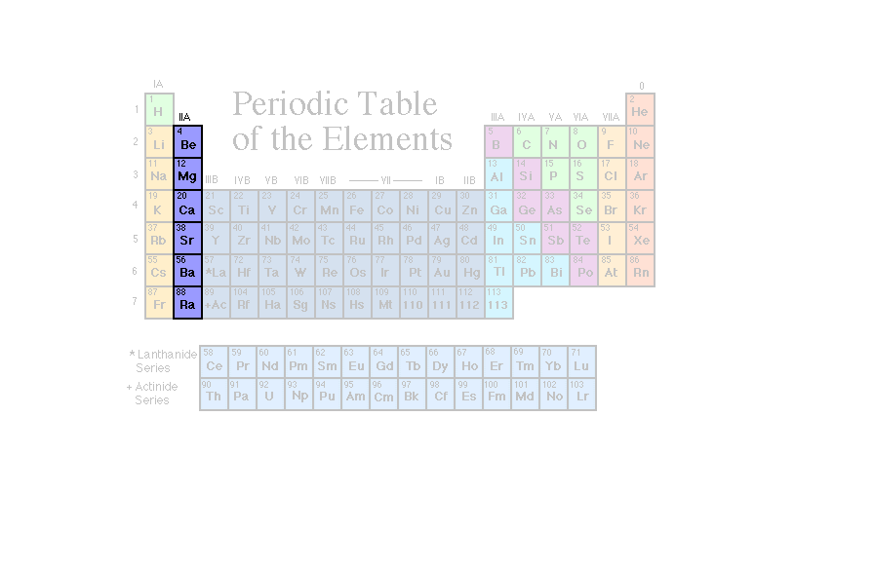
Alkaline Earth Metals
S²
^{valence}

Slide 28
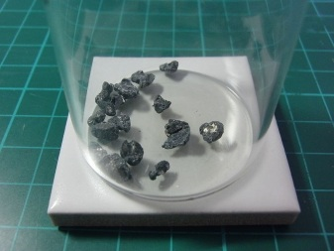
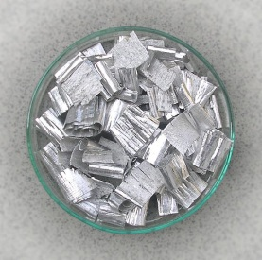
Alkaline Earth Metals (Group IIA)
  Group 2 or IIA
  Lose two electrons to form a +2 cation in order to gain ideal electron configuration
  Typical properties:
    Silver in color
    More brittle than alkali metals
    Somewhat reactive
    Low in density, with low melting and boiling points
Notes:
Timing ≈ 1 min
[Animate stem and pictures] Alkaline Earth metals are found in [Animate bullet 1] (teacher pull up periodic table) Group 2 or 2A of the periodic table. Teacher point out each element down group 2 on the periodic table) Alkaline earth metals are beryllium (Be), magnesium (Mg), calcium (Ca), strontium (Sr), barium (Ba), radium (Ra).
[Animate bullet 2] These metals are [Animate sub-bullet 1 and pictures] silver in color, [Animate sub-bullet 2] more brittle than alkali metals, [Animate sub-bullet 3] somewhat reactive, and [Animate sub-bullet 4] have low density, melting point, and boiling point.
[Animate bullet 3] Alkaline Earth Metals possess two valence electrons. They lose those electrons to obtain a full valence, becoming a positive 2 cation.
Mention common uses of common elements belonging to this group.
SOURCES
http://commons.wikimedia.org/wiki/File:Calcium_metal.jpg
http://commons.wikimedia.org/wiki/File:Magnesium.jpg

Slide 29
Alkaline Earth Metals (Group IIA)
  Group 2 or IIA
  Lose two electrons to form a +2 cation in order to gain ideal electron configuration
  “Magic number is “8” … s2 + p6
  Is it easier for the metals to gain 6 electrons to make 8 or to lose 2 electron to have a full valence in the next lowest energy level?
₁₂Mg²⁴
+12 p
-12 e
0
+12 p
-10 e
+2 charge
1s² 2s² 2p⁶ 3s²
1s² 2s² 2p⁶
Notes:
Timing ≈ 1 min
[Animate stem and pictures] Alkali metals are found in [Animate bullet 1] (teacher pull up periodic table) Group 1 or 1A of the periodic table. Teacher point out each element down group 1) Lithium (Li), sodium (Na), potassium (K), rubidium (Rb), cesium (Cs), and francium (Fr) are the alkali metals.
[Animate bullet 2] These metals are noted for being [Animate sub-bullet 1] silver in color, [Animate sub-bullet 2] soft, [Animate sub-bullet 3] highly reactive (teacher point to picture), and [Animate sub-bullet 4] able to oxidize in air. They must be stored in oil or some other inert material.
[Animate bullet 3] These are the most reactive metals and some of the most reactive elements on the periodic table
The pictures show pure potassium metal and the reaction of sodium metal with water. Each of the alkali metals reacts with water (the exception is francium, due to its radioactivity).
[Animate bullet 3] They easily lose that electron to obtain a full valence, becoming a cation (a positive ion)
Mention common uses of common elements belonging to this group.
SOURCES:
http://commons.wikimedia.org/wiki/File:Potassium.JPG
http://commons.wikimedia.org/wiki/File:Large_Sodium_Explosion.jpg

Slide 30
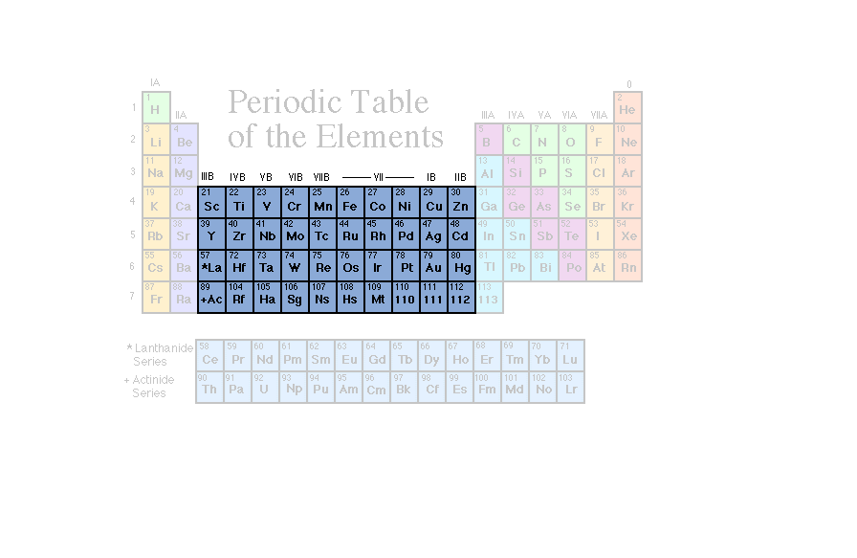
Transition Metals
B Groups

Slide 31
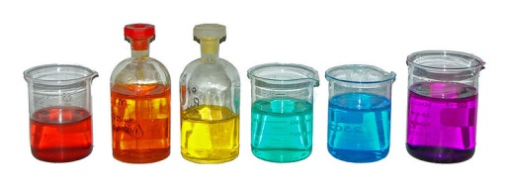
Transition Metals (B Groups)
  Characterized by the presence of electrons in d orbitals
  E.g. Copper, silver, gold, iron
  Form colored compounds
  May have unusual properties:
      Magnetism
      High conductivity
Notes:
Timing ≈ 1 min
[Animate stem and picture] Transition elements are metals found in [Animate bullet 1] (teacher pull up periodic table) Groups 3 through 12. They are also called the “B” group elements because their valence is affected by the “d” and “f” sublevels in terms of electron configuration, meaning that the electrons that combine with other elements are present in more than one energy level.
Teacher point out each element on the periodic table. Some of the more common transition metals are iron (Fe), copper (Cu), gold (Au), mercury (Hg), cobalt (Co), silver (Ag), nickel (Ni), and tungsten (W). Notice that the chemical symbol for all of these examples comes from the Latin origin of the element.
[Animate bullet 2] The transition metals display many interesting properties.
[Animate sub-bullet 1] Most form colored compounds. (teacher point to picture of colorful solutions)
[Animate sub-bullet 2] Some, such as iron, cobalt and nickel are [Animate level 3 bullet 1] magnetic.
Transition elements are known to help reactions work more efficiently.
[Animate level 3 bullet 2] As metals, they conduct electricity. Copper, silver, and gold are noted to be great conductors of electricity.
Money (i.e. coins) is made from different transition metals (silver, nickel, zinc).
Sources:
http://commons.wikimedia.org/wiki/File:Coloured-transition-metal-solutions.jpg

Slide 32
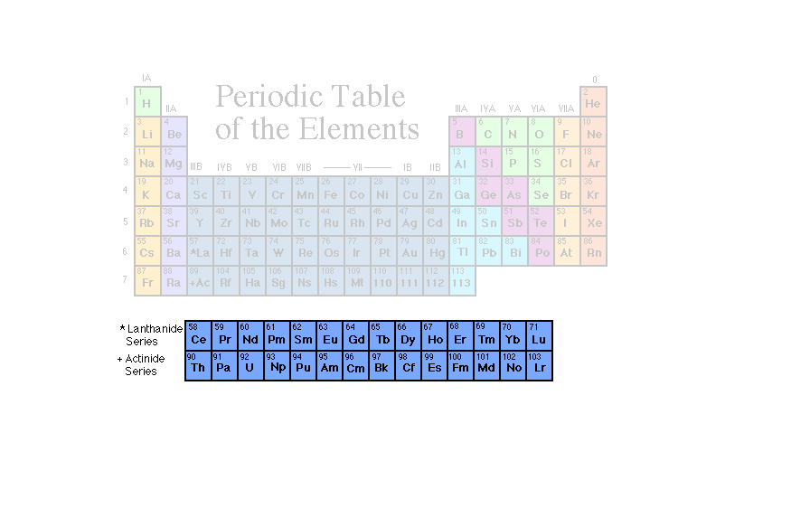
InnerTransition Metals
These elements are also called the rare-earth elements.
B Groups

Slide 33
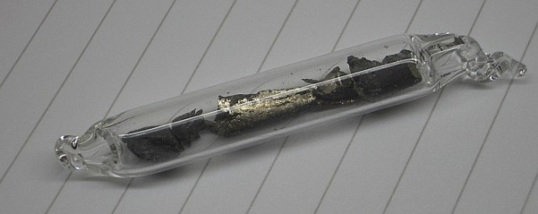
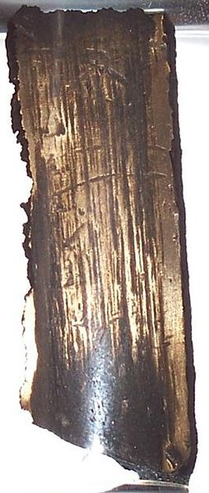
Inner Transition Metals (B Groups)
  Characterized by the presence of electrons in f orbitals
  Lanthanides: elements 57-71
  Actinides: elements 89-103
  Radioactive (e.g. U-92)
  Present in only trace amounts on Earth
Notes:
Timing ≈ 1 min
[Animate stem and pictures] There is a section of elements on the periodic table that is part of [Animate bullet 1] (teacher pull up the periodic table) the “B” group transition metals.
They are placed below the rest of the transition metals in the same period. (teacher point out)
The inner transition metals are made up of two series: [Animate bullet 2] lanthanides (elements 57 to 71) and [Animate bullet 3] actinides (elements 89 to 103). (teacher point out the lanthanide series first, then the actinides)
[Animate bullet 4] Both lanthanides and actinides have [Animate sub-bullet 1] radioactive elements.
Lanthanide elements are used to produce lasers, sunglasses, and strong magnets.
Notable actinides are uranium and plutonium. (teacher point to U and Pu) They are noted as being used in nuclear weapons and as fuel for nuclear power plants to generate electricity.
The transuranium elements (teacher point out) were synthesized and identified in laboratory experiments through the use of nuclear accelerators.
[Animate sub-bullet 2] These elements are present in only trace amounts on Earth.
SOURCE:
http://commons.wikimedia.org/wiki/File:Neodymium_ampoule.jpg
http://commons.wikimedia.org/wiki/File:2Uranium.jpg

Slide 34
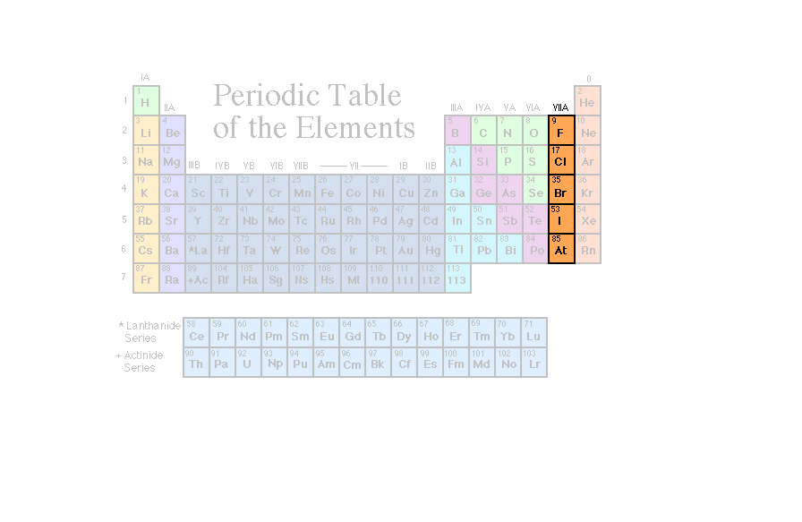
Halogens
S²p⁵
^{valence}

Slide 35
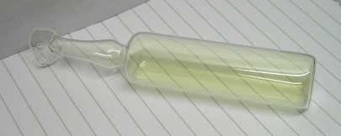
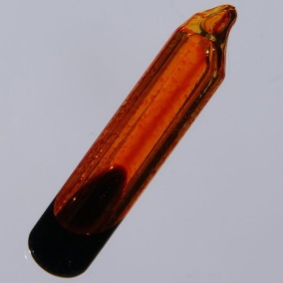
Halogens (Group VIIA)
  Group 17 or VIIA
  Easily gain an electron to form a –1 anion in order to gain ideal electron configuration
  Typical properties
    Highly reactive with metals
    Toxic to organisms
    Most occur as diatomic molecules (F₂, Cl₂, Br₂, I₂)
    React with metals to form salts
Notes:
Timing ≈ 1 min
[Animate stem and pictures] Halogens are nonmetals found in [Animate bullet 1] (teacher pull up periodic table) Group 17 or 7A of the periodic table. Teacher point out each element down group 17 on the periodic table] fluorine (F), chlorine (Cl), bromine (Br), iodine (I), astatine (At) are nonmetal elements known as halogens.
[Animate bullet 2 and sub-bullet 1] These elements are highly reactive, especially with alkali metals and alkaline earth metals.
[Animate sub-bullet 2] Halogens can be lethal to biological organisms.
(teacher point to pictures) Chlorine and bromine are used to kill microorganisms in pools, surfaces, wounds, spas, sewage treatment plants and dishes. Chlorine is an element found in bleach.
[Animate sub-bullet 3] Most halogens occur as diatomic molecules
[Animate sub-bullet 4] Halogens react with metals to form salts (NaCl as an example).
These are the most reactive non-metals and some of the most reactive elements on the periodic table because they possess seven valence electrons (one short of a stable octet). They easily gain one electron to obtain a full valence, becoming a -1 anion (a negative ion). They are highly reactive, especially with alkali metals and alkaline earth metals.
SOURCES:
http://commons.wikimedia.org/wiki/File:Chlorine_ampoule.jpg
http://commons.wikimedia.org/wiki/File:Bromine-ampoule.jpg

Slide 36
Halogens (Group VIIA)
  Group 17 or VIIA
  Easily gain an electron to form a –1 anion in order to gain ideal electron configuration
  “Magic number is “8” … s2 + p6
  Is it easier for the non-metal to gain 1 electron to make 8 or to lose 7 electrons to have a full valence in the energy level?
₁₇Cl³⁵
+17 p
-17 e
0
+17 p
-18 e
-1 charge
1s² 2s² 2p⁶ 3s² 3p⁵
1s² 2s² 2p⁶ 3s² 3p⁶
Notes:
Timing ≈ 1 min
[Animate stem and pictures] Halogens are nonmetals found in [Animate bullet 1] (teacher pull up periodic table) Group 17 or 7A of the periodic table. Teacher point out each element down group 17 on the periodic table] fluorine (F), chlorine (Cl), bromine (Br), iodine (I), astatine (At) are nonmetal elements known as halogens.
[Animate bullet 2 and sub-bullet 1] These elements are highly reactive, especially with alkali metals and alkaline earth metals.
[Animate sub-bullet 2] Halogens can be lethal to biological organisms.
(teacher point to pictures) Chlorine and bromine are used to kill microorganisms in pools, surfaces, wounds, spas, sewage treatment plants and dishes. Chlorine is an element found in bleach.
[Animate sub-bullet 3] Most halogens occur as diatomic molecules
[Animate sub-bullet 4] Halogens react with metals to form salts (NaCl as an example).
These are the most reactive non-metals and some of the most reactive elements on the periodic table because they possess seven valence electrons (one short of a stable octet). They easily gain one electron to obtain a full valence, becoming a -1 anion (a negative ion). They are highly reactive, especially with alkali metals and alkaline earth metals.
SOURCES:
http://commons.wikimedia.org/wiki/File:Chlorine_ampoule.jpg
http://commons.wikimedia.org/wiki/File:Bromine-ampoule.jpg

Slide 37
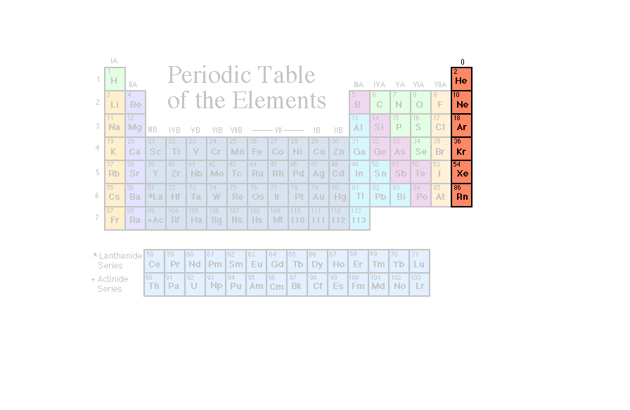
Noble Gases
S²p⁶
^{valence}

Slide 38


Noble Gases (Group VIIIA)
  Group 18 or VIIIA
  Inert gases (nonreactive) have ideal electron configuration
  Typical properties
    Odorless and tasteless
    Nonreactive and nonflammable
    Have extremely low boiling points (i.e. gases)
    Produce characteristic colors when excited electrically
Notes:
Timing ≈ 0.5 min
[Animate stem and pictures] Noble gases are found in [Animate bullet 1] (teacher pull up periodic table) Group 18 or 8A of the periodic table. Teacher point out each element down group 18 on the periodic table] Noble Gases are helium (He), neon (Ne), argon (Ar), krypton (Kr), xenon (Xe), radon (Rn)
Noble gases are made up of stable atoms and do not bond with other elements. For this reason, [Animate bullet 2] they are also called “inert gases.”
[Animate bullet 3] These [Animate sub-bullet 1] odorless and tasteless gases are known to [Animate sub-bullet 2] have low chemical reactivity.
[Animate sub-bullet 3] Since the gases have extremely low boiling points, they are used as cryogenic refrigerants.
[Animate sub-bullet 4] A more common use is in lighting, such as in neon lights (teacher point to picture).
Helium, of course, is commonly used (teacher point to picture) to inflate balloons and other objects. Because it is less dense than air and very unreactive, it makes an excellent filler for buoyant objects.
SOURCES:
http://commons.wikimedia.org/wiki/File:Toy_balloons_2011_G1.jpg
http://commons.wikimedia.org/wiki/File:Neon_light_sculpture_behind_King%27s_Cross_station.jpg

Slide 39
Songs
The Periodic Table Song (2:44)
http://somup.com/cF6QFinnyQ
Tom Lehrer (1970 … 1:47)
The Elements Song http://somup.com/cFQ22hVSKJ
Notes:
Timing ≈ 0.5 min
[teacher points out the “A” groups (left and right side of periodic table) and explains that valence electrons fill the s and p orbitals…(circle the “s” and “p” sublevels shown on table)]]
[teacher points out the “B” groups (middle of periodic table) and explains that valence is affected by the d and f sublevels … (circle the “d” and “f” sublevels shown on table)]
SOURCE:

Slide 40
Octet Rule – Stability of Atoms When Bonding
The stability of an atom is associated with electron configuration:
The maximum number of electrons in outer level is 8e⁻ [ s orbital holds up to 2 e⁻, p orbitals hold up to 6 e⁻ ].
8e- represents a very stable arrangement (noble gas configuration).
Helium (₂He⁴) has only 2e- but a complete outer shell.
Atoms tend to combine with other atoms in such a way that each atom has eight electrons in its valence shell, giving it the same electron configuration as a noble gas.

Slide 41
Electron Configurations in Groups
Valence Electrons
The number of electrons in the highest occupied energy level (n) level (valence electrons.)
Lithium (Li) | 1s²2s¹
Sodium (Na) | 1s²2s²2p⁶3s¹
Potassium (K) | 1s²2s²2p⁶3s²3p⁶4s¹
Carbon (C) | 1s²2s²2p²
Silicon (Si) | 1s²2s²2p⁶3s²3p²
Helium (He) | 1s²
Neon (Ne) | 1s²2s²2p⁶
Argon (Ar) | 1s²2s²2p⁶3s²3p⁶
Krypton (Kr) | 1s²2s²2p⁶3s²3p⁶2d¹⁰4s²4p⁶

Slide 42
Kernel & Valence Electrons in A Groups
  Example:
  Phosphorus (₁₅P³¹)
    Highest n orbitals = valence electrons
1s²2s²2p⁶
3s²3p³
Core
kernel
Notes:
Timing ≈ 1 min
It may not be apparent when you look at the longhand notation of an element’s electron configuration, but there are two sets of electrons present in an atom: the core electrons and the valence electrons. These two sets of electrons differ in reactivity.
The least reactive electrons in an atom are the core electrons. [animate core electrons in longhand notation] Notice that these electrons are the same as those abbreviated in the noble-gas notation [animate blue [Ne] box]. Noble gases are very nonreactive as you may recall. These elements have every atomic orbital filled with electrons, which makes them very stable. Likewise, core electrons are very stable and generally nonreactive.
The most reactive electrons in an atom are the valence electrons [animate valence electrons in longhand notation]. These electrons are located outside of the noble-gas core [animate valence electrons in noble-gas notation] and are the electrons called out in more detail whenever you write a noble-gas notation.
In periods 1, 2, and 3, all of the electrons located in the orbitals with the highest value of n [animate first green bullet] are valence electrons. For example, in phosphorus, the valence electrons all have n=3.
All other electrons [animate second bullet] are core electrons. In phosphorus, the core electrons have n=1 and n=2.
If you look on the periodic table [pull up periodic table and animate third green bullet] for the first three periods, the number of valence electrons is related to the group number. [teacher show how group number is related to # valence electrons--e.g., group 1/IA has one valence electron, group 15/VA has five.]
The noble gases [animate last green bullet] have a full valence shell, which is why they are nonreactive. When we talk about valence electrons, we're talking about reactivity, so we often say that noble gases have no valence electrons--they have only core electrons.

Slide 43
Kernel & Valence Electrons in A Groups
  Example:
  Phosphorus (₁₅P³¹)
    Highest n orbitals = valence electrons.
    All other orbitals = kernel electrons (use [Ne]).
    Group number relates to the number of valence electrons.
    Noble gases (group VIII or 18): full valence shell.
1s²2s²2p⁶
3s²3p³
[Ne]
3s²3p³
Core
kernel
valence
Notes:
Timing ≈ 1 min
It may not be apparent when you look at the longhand notation of an element’s electron configuration, but there are two sets of electrons present in an atom: the core electrons and the valence electrons. These two sets of electrons differ in reactivity.
The least reactive electrons in an atom are the core electrons. [animate core electrons in longhand notation] Notice that these electrons are the same as those abbreviated in the noble-gas notation [animate blue [Ne] box]. Noble gases are very nonreactive as you may recall. These elements have every atomic orbital filled with electrons, which makes them very stable. Likewise, core electrons are very stable and generally nonreactive.
The most reactive electrons in an atom are the valence electrons [animate valence electrons in longhand notation]. These electrons are located outside of the noble-gas core [animate valence electrons in noble-gas notation] and are the electrons called out in more detail whenever you write a noble-gas notation.
In periods 1, 2, and 3, all of the electrons located in the orbitals with the highest value of n [animate first green bullet] are valence electrons. For example, in phosphorus, the valence electrons all have n=3.
All other electrons [animate second bullet] are core electrons. In phosphorus, the core electrons have n=1 and n=2.
If you look on the periodic table [pull up periodic table and animate third green bullet] for the first three periods, the number of valence electrons is related to the group number. [teacher show how group number is related to # valence electrons--e.g., group 1/IA has one valence electron, group 15/VA has five.]
The noble gases [animate last green bullet] have a full valence shell, which is why they are nonreactive. When we talk about valence electrons, we're talking about reactivity, so we often say that noble gases have no valence electrons--they have only core electrons.

Slide 44
Kernel & Valence Electrons in B Groups
  Examples:
  Cobalt (₂₇Co⁵⁹)
  NOTICE that valence electrons are still in the highest “n” s and p orbitals.
  Partially filled d and f orbitals = valence electrons
1s²2s²2p⁶3s²3p⁶
4s²3d⁷
Core / kernel
valence
Notes:
Timing ≈ 1 min
For elements in period 4 and higher, valence and core electrons become slightly more complicated.
For example, consider cobalt. [pull up periodic table and show cobalt.] It is a transition metal, so we know that electrons are filling its 3d orbital. It has two electrons in the 4s subshell and 7 electrons in the 3d subshell. Both the 4s and the 3d electrons are considered to be valence electrons.
However, for arsenic [pull up periodic table and show arsenic], the 3d orbital is completely full. It is not available to participate in bonding, so the 3d electrons are considered to be core electrons, not valence electrons. For arsenic, only the 4s and 4p electrons are valence electrons. This makes sense--arsenic is in the same group as phosphorus, so it should have the same number of valence electrons.
Here are the rules for determining core & valence electrons for periods 4 and above.
[animate first bullet] Just like in periods 1-3, the s and p orbitals that have the highest value of n are valence orbitals.
[animate 2nd bullet] Any partially filled d or f orbitals are also considered to be valence orbitals.
[animate 3rd bullet] Any full d or f orbitals are considered to be core orbitals, not valence orbitals.

Slide 45
Core and Valence Electrons in B Groups
  Examples:
  Cobalt (₂₇Co⁵⁹)
Mercury (₈₀Hg²⁰¹)
  NOTICE that valence electrons are still in the highest “n” s and p orbitals
  Partially filled d and f orbitals = valence electrons
[Ar]
4s²3d⁷
Core / kernel
valence
[Xe]
4f¹⁴
5d¹⁰
6s²
  Full d and f orbitals = Core electrons
Core / kernel
valence
Notes:
Timing ≈ 1 min
For elements in period 4 and higher, valence and core electrons become slightly more complicated.
For example, consider cobalt. [pull up periodic table and show cobalt.] It is a transition metal, so we know that electrons are filling its 3d orbital. It has two electrons in the 4s subshell and 7 electrons in the 3d subshell. Both the 4s and the 3d electrons are considered to be valence electrons.
However, for arsenic [pull up periodic table and show arsenic], the 3d orbital is completely full. It is not available to participate in bonding, so the 3d electrons are considered to be core electrons, not valence electrons. For arsenic, only the 4s and 4p electrons are valence electrons. This makes sense--arsenic is in the same group as phosphorus, so it should have the same number of valence electrons.
Here are the rules for determining core & valence electrons for periods 4 and above.
[animate first bullet] Just like in periods 1-3, the s and p orbitals that have the highest value of n are valence orbitals.
[animate 2nd bullet] Any partially filled d or f orbitals are also considered to be valence orbitals.
[animate 3rd bullet] Any full d or f orbitals are considered to be core orbitals, not valence orbitals.

Slide 46
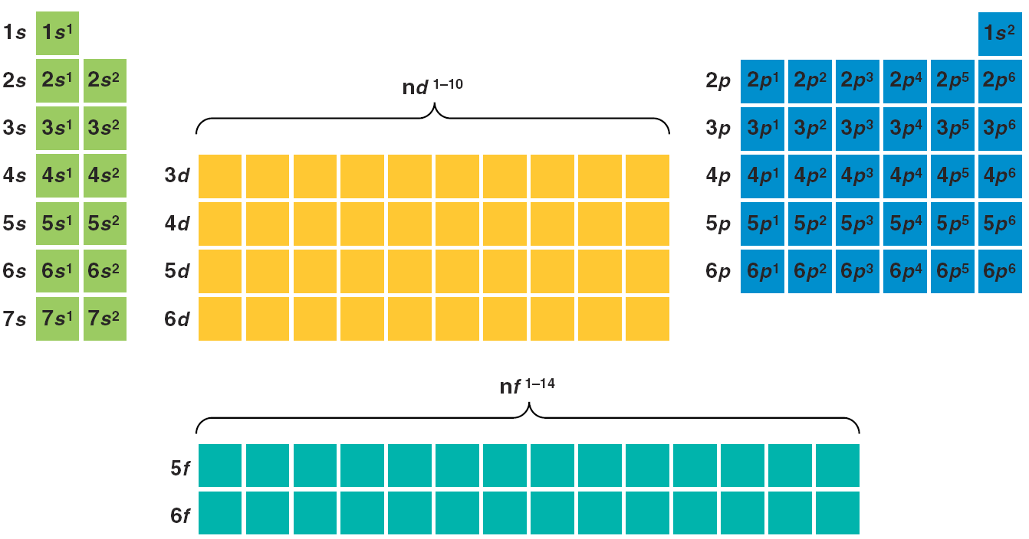
Group “A” & “B” Elements distinguished by sublevels
A Groups
s block
A Groups
p block
B Groups
Transition
d block
B Groups – f block
Notes:
Timing ≈ 0.5 min
[teacher points out the “A” groups (left and right side of periodic table) and explains that valence electrons fill the s and p orbitals…(circle the “s” and “p” sublevels shown on table)]]
[teacher points out the “B” groups (middle of periodic table) and explains that valence is affected by the d and f sublevels … (circle the “d” and “f” sublevels shown on table)]
SOURCE:

Slide 47
Review of the Periodic Table
Copy the Blank table and LABEL
A Groups with valence electron configuration
B Groups (transition elements, inner transition)
Metals, non-metals, metalloids
Alkali & Alkaline Earth Metals, Halogens, Noble Gases
What ion would the major groups form?

Slide 48
Review of the Periodic Table
s¹
A Groups
s²p⁶
+1
+2
-1
0
s²
s²p¹
s²p²
s²p³
s²p⁴
s²p⁵
Metals
Noble Gases
Alkali Metals
Halogens
Metalloids
Alkaline Earth Metals
B Groups Transition Elements
^{(d block)}
Non-Metals
Inner Transition Metals (f block)

Slide 49
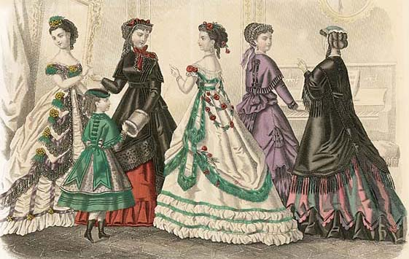

Periodic trends
Atomic and ionic radii
Ionization energy
Electron affinity and electronegativity
Notes:
Timing ≈ 0.5 min
Greeting: Teacher will do this.
Picture: The clothes you are wearing right now are influenced by today’s fashion trends.
Fashion trends have changed drastically since Dmitri Mendeleev organized elements into the first periodic table.
Title: Unlike fashion trends, the trends in the periodic table are predictable because they depend on the arrangement of electrons and atomic number.
Transition: In this lesson, you will learn about some important trends in properties of elements in the periodic table. To understand these trends, you need to know how an element’s valence electron configuration relates to its position in the periodic table.
SOURCES:
http://commons.wikimedia.org/wiki/File:Godesy_fashion_plate_1869.jpg, Public Domain - This applies to Australia, the European Union and those countries with a copyright term of life of the author plus 70 years.
(Should also be public domain in US because published before 1920.)
http://www.aip.org/history/curie/periodic.htm

Slide 50
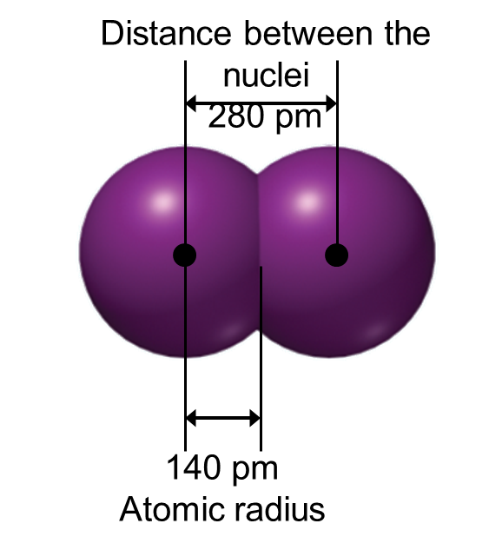
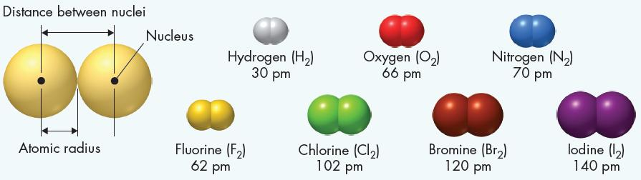
3 Periodic Trends
Trends in Atomic Size
Atomic Radii (Size)
This size is expressed as an atomic radius, and is one-half of the distance between the nuclei of two atoms of the same element when the atoms are joined. (picometers or 10⁻¹² m)

Slide 51
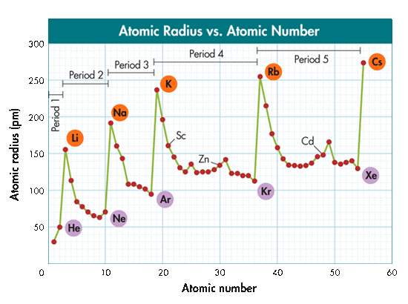
Trends in Atomic Size
3 Periodic Trends
Trends in Atomic Size
  In general, atomic size
  decreases from left to right across a period.
  increases going down a group.
Atomic radius (pm)
Atomic number

Slide 52
Trends of Atomic Radii
Electrons are added:
  To the same energy level across a period (stronger nuclear charge draws them in).
  E.g. using a larger magnet to pick up metals.
  To a higher energy level down a group (the atom is much larger and electrons more energetic).
  E.g. placing the electrons in a bigger room to accommodate the larger atom.
Atomic radii tend to:
  Decrease across a period.
  Increase down a group.
Notes:
Timing ≈ 1.5 min
[Animate definition] The atomic radius is a measure of the size of an atom and is defined as half the distance between two identical atoms in a diatomic molecule. (teacher sketch a diatomic molecule and show atomic radius)
The atomic radius of an atom depends on how many electron energy levels contain electrons, and on the attraction between the electrons and the protons in the nucleus.
(teacher pull up periodic table and use in explanation where appropriate)
[Animate left stem] Electrons are added [Animate left bullet 1] to the same energy level across a period, so the distance from the nucleus does not increase. However, the positive charge on the nucleus increases because the number of protons increases. Electrons are pulled closer to the nucleus.
[Animate right stem and right bullet 1] So atomic radii tend to decrease across a group. [Animate horizontal group of circles]
[Animate left bullet 2] Electrons are added to a higher energy level that is farther away from the nucleus going down each group in the periodic table. Even though the charge on the nucleus also increases, the valence electrons or electrons in the outer energy levels are shielded by the inner energy levels.
[Animate right bullet 2] This means that atomic radii tend to increase from the top to the bottom of a group. [Animate vertical group of circles] The increase down a group is much more significant than the decrease across a period.
Putting it all together, we see that the element with the largest atomic radius should be located in the lower left corner of the periodic table.

Slide 53
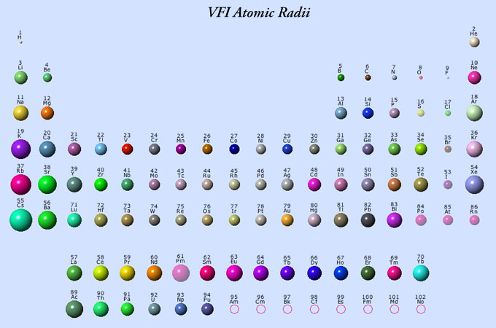
3 Periodic Trends
Trends in Atomic Size

Slide 54
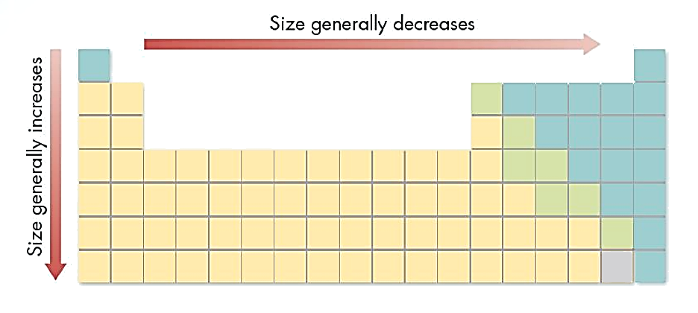
3 Periodic Trends
Trends in Atomic Size
The Shielding Effect
The increase in the number of occupied orbitals shields electrons in the highest occupied energy level from the attraction of protons in the nucleus (e.g. solar eclipse).
Shielding Effect is constant across a period
Shielding Effect increases down a group

Slide 55
Trends of Ionic Radii
  DECREASE for cations across a period.
    Groups 1A – 3A elements lose electrons to become cations.
  INCREASE for anions across a period.
    Groups 4A – 7A elements gain electrons to become anions.
  Increase down a group.
Ionic radius is a measure of the size of an ion.
Cation e.g. Na → Na⁺
Anion e.g. Cl → Cl⁻
+
−
Notes:
Timing ≈ 1.5 min
[Animate definition] Ionic radius is the measure of the size of an ion. (teacher remind students what an ion is)
The size of an ion compared with its atom depends on the type of ion that is formed.
[Animate appearance of first group of spheres on left] Atoms gain electrons to form negative ions, or anions. Oxygen forms an anion by gaining two electrons. The added electrons increase the electron repulsion between atoms since they are added to an energy level that already has electrons. There are no added protons to counter this repulsion, so anions are bigger than the corresponding atom.
[Animate appearance of bottom group of sphere on left] Cations form when an atom loses electrons to form a positive ion. Losing an atom reduces the electron repulsion between atoms in the same energy level. If all of the atoms in an energy level are lost, like when magnesium forms the magnesium two plus, that cation is much smaller than the atom.
Because ionic radii depend on whether a cation or anion is formed, the trends in the periodic table are not as straightforward as for atomic radii.
Like atomic radii, ionic radii tend to increase down a group because electrons are added in higher energy levels.
Within a period, metals tend to form cations and nonmetals tend to form anions.
So, ionic radii tend to decrease for the elements that form cations because more electrons are removed from the same energy level at the same time that the charge on the nucleus is increasing. For example, in period 2, the atomic radius decreases going from lithium to beryllium to boron.
Then, carbon has a much larger ionic radii than a boron ion. Carbon forms an anion that has 4 extra electrons. In general, there is a large increase in ionic radii when elements begin forming anions instead of cations.
Once elements start forming anions, ionic radii tend to start decreasing again. Fewer electrons are added to form the ions moving from left to right while the nuclear charge is increasing. So, a nitrogen ion with 3 extra electrons is smaller than a carbon ion.
SOURCES:
http://acswebcontent.acs.org/games/pt.html

Slide 56
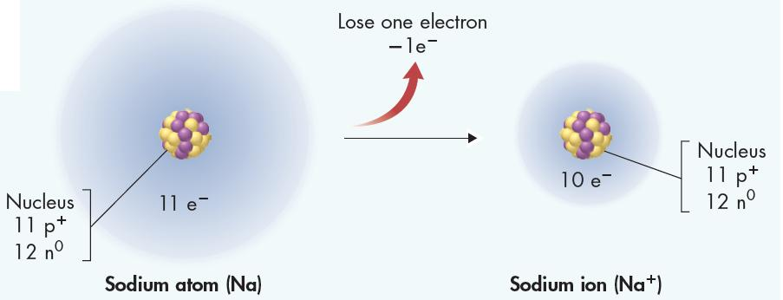
Ions
3 Periodic Trends
Metals, such as Sodium lose electrons when bonding, giving the sodium ion a net positive charge (11 protons - 10 electrons).
The positive ion is called a cation and is written as Na⁺. The ionic size is SMALLER than the atomic size.

Slide 57
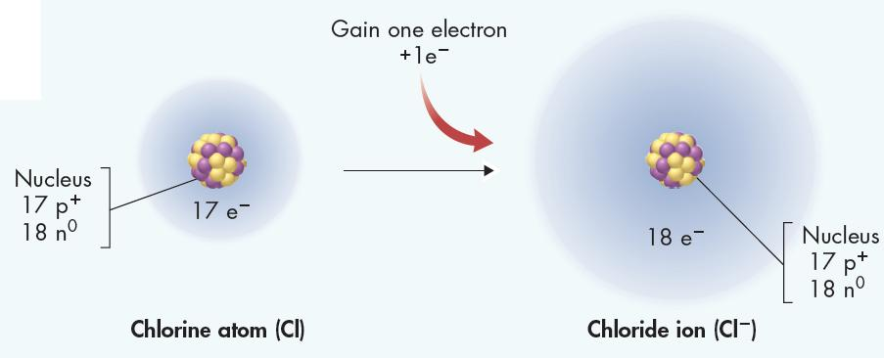
Ions
3 Periodic Trends
Nonmetals, such as chlorine, gain electrons when bonding, producing an anion (negative ion): (+17 p – 18 e-). This is written: Cl⁻. The ionic size is GREATER than the atomic size.
In general, metals tend to form cations. Nonmetals tend to form anions.

Slide 58

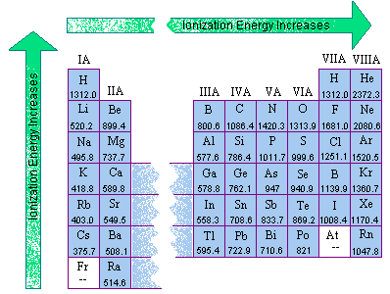
Ionization Energy
3 Periodic Trends
Ionization Energy
The energy required to remove an electron from an atom.
The tendency to lose electrons is evidence of ???? character (to gain ideal electron configuration).
The energy required to remove the first electron from an atom is called the first ionization energy.
Ionization energy ???? across a period & ???? down a group.

Slide 59
Ionization Energy
3 Periodic Trends
Ionization Energy
The energy required to remove an electron from an atom.
The tendency to lose electrons is evidence of metallic character (to gain ideal electron configuration).
The energy required to remove the first electron from an atom is called the first ionization energy.
Ionization energy increases across a period & decreases down a group.

Slide 60
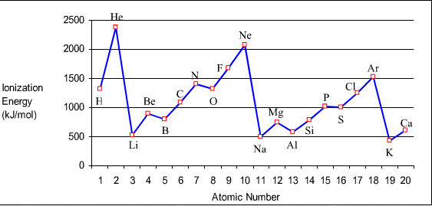
Trends in Ionization Energy
3 Periodic Trends
Metals tend to lose/gain electrons, meaning it takes less/more energy (lower/higher I.E.)?
Non-metals tend to lose/gain electrons, meaning it would require less/more energy (lower/higher I.E.)?

Slide 61
Trends in Ionization Energy
3 Periodic Trends
Metals tend to lose electrons, meaning it takes LESS energy (lower I.E.)
Non-metals tend to gain electrons, meaning it would require MORE energy (higher I.E.)
Why the irregularities?

Slide 62
Enrichment
3 Periodic Trends
The irregularities are produced when electrons enter the “p” sublevel (e.g. Be, Mg) and again when the electrons fill the first “p” orbital (Hund’s Rule) [e.t. N, P]
Why the irregularities?

Slide 63
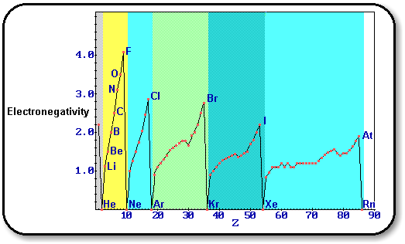
Trends in Electronegativity
3 Periodic Trends
Electronegativity
The measure of the electron attracting power (ELECTRON AFFINITY) of an atom when it bonds with another atom (to gain ideal electron configuration).
A property used to predict Bonding type during a reaction.
Increase/decrease along a period or row?
Increase/decrease down a group or family?
Halogens “really want electrons”

Slide 64
Trends in Electronegativity
3 Periodic Trends
Electronegativity
The measure of the electron attracting power (ELECTRON AFFINITY) of an atom when it bonds with another atom (to gain ideal electron configuration).
A property used to predict Bonding type during a reaction.
INCREASES along a period or row.
DECREASES down a group or family.
Halogens “really want electrons”

Slide 65
Trends in Electronegativity
3 Periodic Trends
Describe metals in terms of electrons and electronegativity.
Describe non-metals in terms of electrons and electronegativity.
Electronegativity Values for Selected Elements
H 2.1
Li 1.0 | Be 1.5 | B 2.0 | C 2.5 | N 3.0 | O 3.5 | F 4.0
Na 0.9 | Mg 1.2 | Al 1.5 | Si 1.8 | P 2.1 | S 2.5 | Cl 3.0
K 0.8 | Ca 1.0 | Ga 1.6 | Ge 1.8 | As 2.0 | Se 2.4 | Br 2.8
Rb 0.8 | Sr 1.0 | In 1.7 | Sn 1.8 | Sb 1.9 | Te 2.1 | I 2.5
Cs 0.7 | Ba 0.9 | Tl 1.8 | Pb 1.9 | Bi 1.9

Slide 66
Trends in Electronegativity
3 Periodic Trends
Metals do not “gain” electrons, meaning LESS electronegativity.
Non-metals DO gain electrons, meaning MORE electronegativity.
Electronegativity Values for Selected Elements
H 2.1
Li 1.0 | Be 1.5 | B 2.0 | C 2.5 | N 3.0 | O 3.5 | F 4.0
Na 0.9 | Mg 1.2 | Al 1.5 | Si 1.8 | P 2.1 | S 2.5 | Cl 3.0
K 0.8 | Ca 1.0 | Ga 1.6 | Ge 1.8 | As 2.0 | Se 2.4 | Br 2.8
Rb 0.8 | Sr 1.0 | In 1.7 | Sn 1.8 | Sb 1.9 | Te 2.1 | I 2.5
Cs 0.7 | Ba 0.9 | Tl 1.8 | Pb 1.9 | Bi 1.9

Slide 67
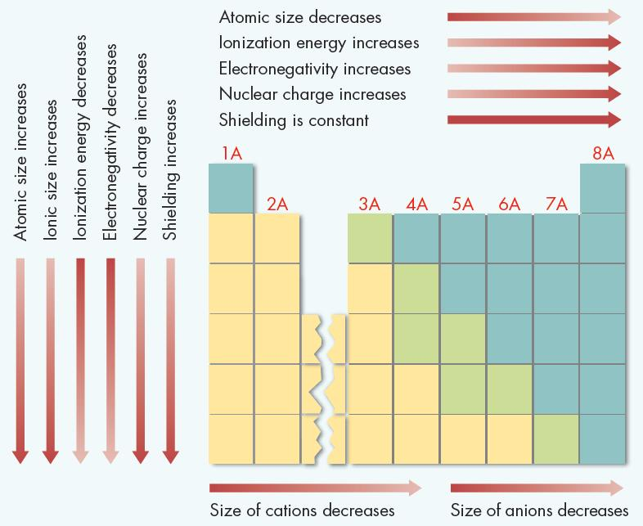
SUMMARY
3 Periodic Trends
Determine whether each Trend increases or decreases.
… going across a period →
… going down a group ↓

Slide 68
SUMMARY
3 Periodic Trends

Slide 69
The Arrangement of the Periodic Table
  The periodic table contains a great deal of information on the elements.
  Periods refer to horizontal rows of the periodic table.
  Groups or families refer to vertical columns of the periodic table.
  Cells of the periodic table contain information such as the atomic symbol, atomic number, atomic mass, name of the element, electron configuration, and possible oxidation numbers.
  Elements can be categorized broadly as metals, nonmetals, or semimetals (metalloids).
Notes:
Timing ≈ 0.5 min
[Animate stem] The periodic table contains a great deal of information on the elements.
[Animate bullets one by one] (teacher reads through slide)

Slide 70
Classifying the Elements
Groups
  Alkali metals: most reactive metals, soft, oxidize quickly.
  Alkaline earth metals: not as reactive as alkali metals, brittle, shiny.
  Transition metals: form colored compounds, good conductors of electricity.
  Halogens: most reactive nonmetals.
  Noble gases: lowest chemical reactivity, used in lighting.
  Inner transition metals: radioactive, used in nuclear power plants.
Notes:
Timing ≈ 0.5 min
[Animate stem] More specific groups on the Modern periodic table include (teacher reads through slide):
[Animate bullet 1] the alkali metals,
[Animate bullet 2] alkaline earth metals,
[Animate bullet 3] transition metals,
[Animate bullet 4] halogens,
[Animate bullet 5] noble gases, and
[Animate bullet 6] inner transition metals.

Slide 71
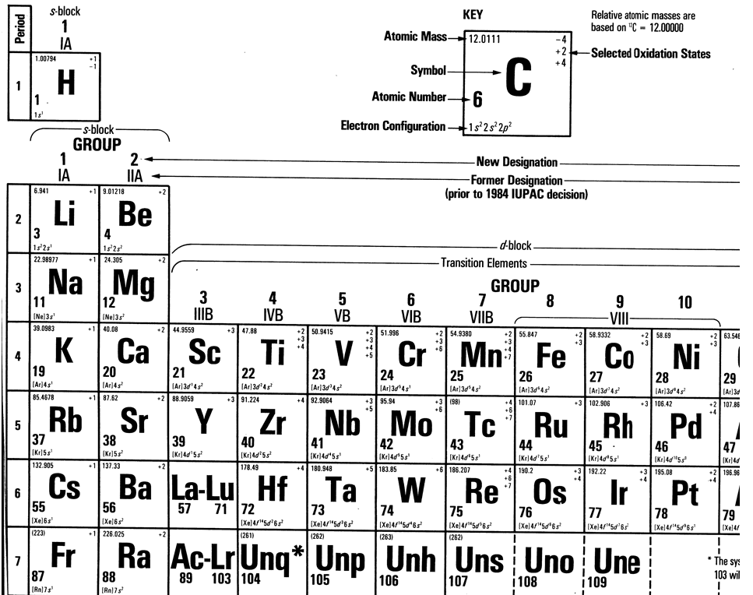

Slide 72
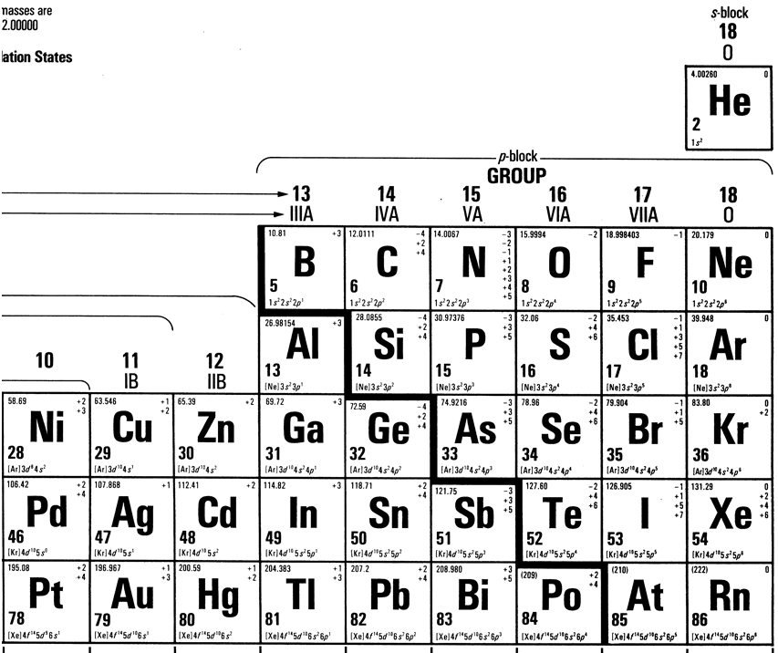

Slide 73
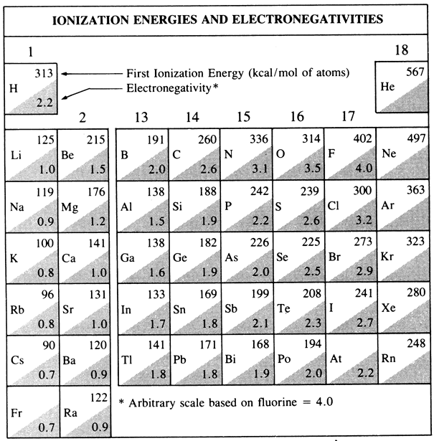

Slide 74


