Slide 1
Go to the “Slide Show” shade above
Click on “Play from Beginning”

Slide 2
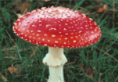
Bacteria, Protists, Fungi
Chapters 21-23

Slide 3
Chapter 23: Kingdom Fungi

Slide 4
https://somup.com/c3j6qEu7Xf Bacteria Protists Fungi Lab (14:44)

Slide 5
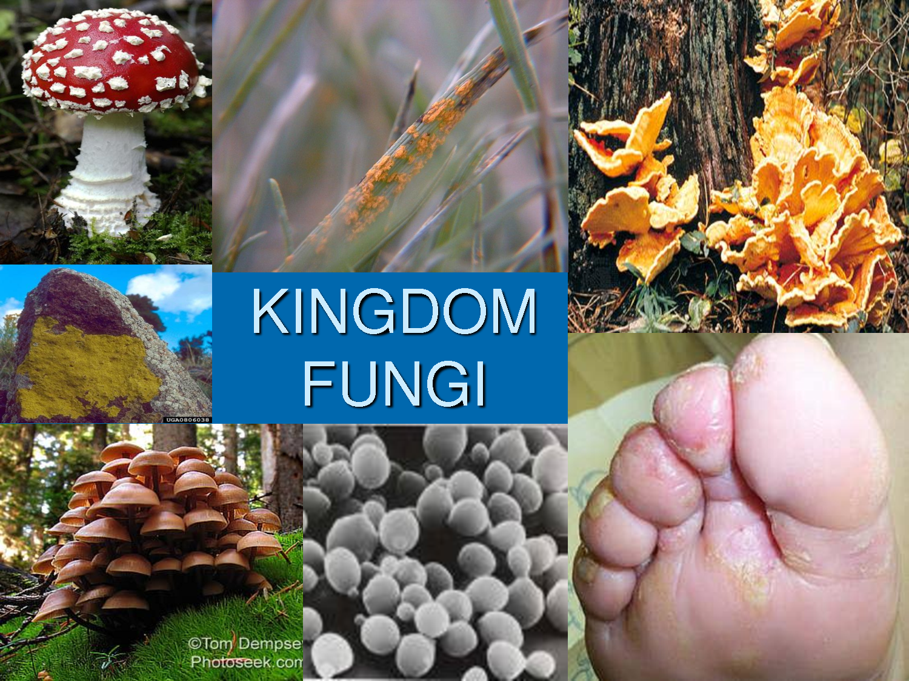
CHARACTERISTICS OF FUNGI
Fungi are NOT plants (No Chlorophyll)
Eukaryotes
Heterotrophic
Non-motile
Grow best in warm, moist environments
Most are saprophytes
(decomposers)

Slide 6
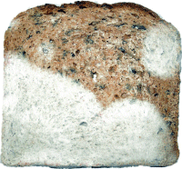
THE CHARACTERISTICS OF FUNGI
Absorptive heterotrophs: digest food first and then absorb it into their bodies (Extracellular Digestion).
Release digestive enzymes to break down organic material or their host.
BREAD MOLD

Slide 7
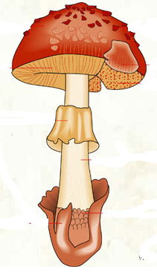
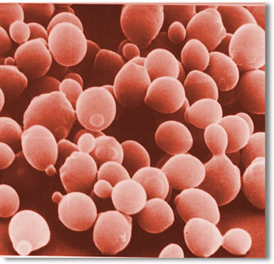
THE CHARACTERISTICS OF FUNGI
Important decomposers and recyclers of nutrients in the environment.
Most are multicellular, except unicellular yeast.
Lack true roots, stems or leaves (no tissues).
MYCOLOGY is the study of fungi.
MULTICELLULAR MUSHROOM
UNICELLULAR YEAST

Slide 8
CHARACTERISTICS OF FUNGI
The visible body and underground structure of a multicellular fungus are made up of long chains of cells called HYPHAE, that are entwined to form a mass, the MYCELIUM.
Mycelia digest, absorb, and transport nutrients for the rest of the fungus.
A multicellular fungus consists of an above-ground FRUITING BODY and a below-ground MYCELIUM.
Cell walls are made of CHITIN (complex carbohydrate).

Slide 9
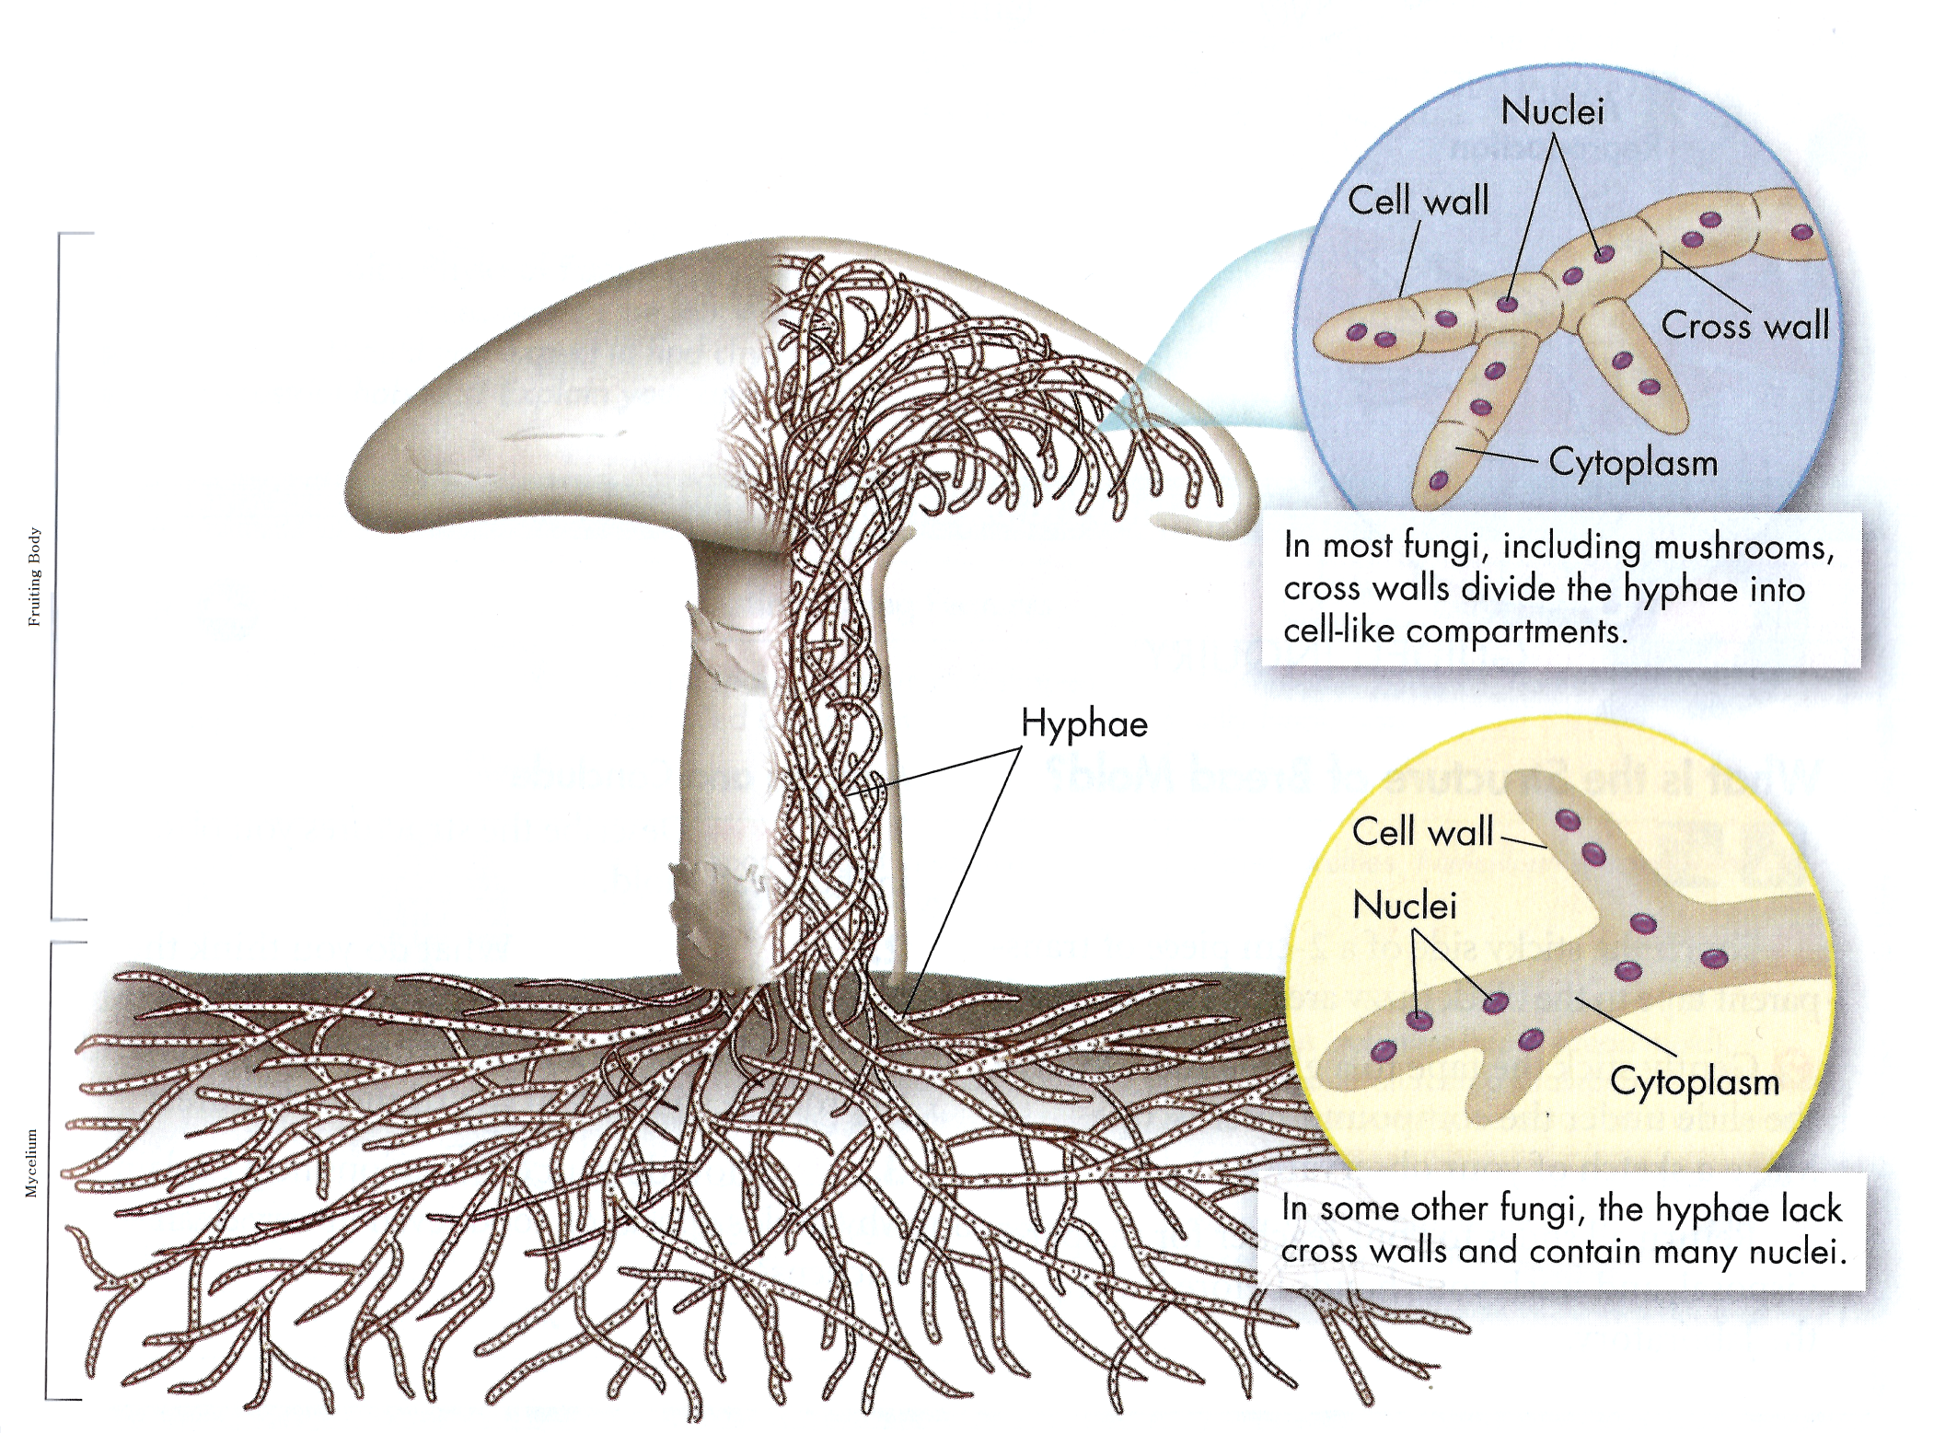
HYPHAE: Thin filaments that compose a fungus.
Septated
Coenocytic (No Septa)

Slide 10
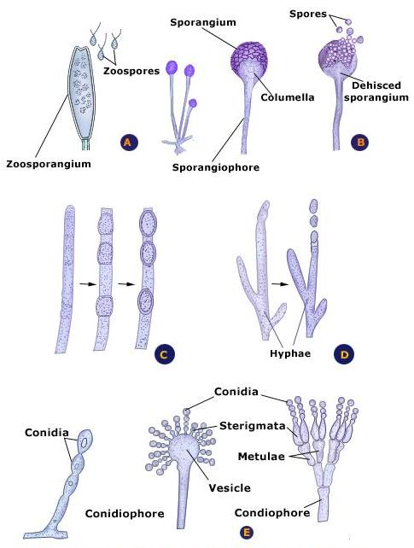
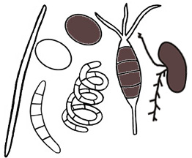
THE CHARACTERISTICS OF FUNGI
Reproduce sexually and asexually through SPORES.
Fungi are classified by the form of sexual reproduction it carries out.
Spores come in various shapes

Slide 11
REPRODUCTION
Most fungi exist in the haploid state and reproduce by SPORES, that are produced asexually or sexually.
Either way, spores that land on a suitable habitat can germinate and give rise to haploid hyphae, starting a new organism.
ASEXUAL reproduction is the most common method and produces genetically identical organisms (mitosis).
Fungi reproduce SEXUALLY when conditions are poor and nutrients scarce.

Slide 12
ASEXUAL REPRODUCTION: THREE TYPES
FRAGMENTATION – part of the mycelium becomes separated and begins a life of its own.
BUDDING – a small cell forms and gets pinched off as it grows to full size.
Used by Yeasts
ASEXUAL SPORE PRODUCTION –
Most common method
Sporangiophore: Specialized hyphae where spores are formed within an enclosure, called Sporangium.
Conidiophore: Specialized hyphae where spores are formed at the tips of the hyphae.
Spores are called = Conidia

Slide 13
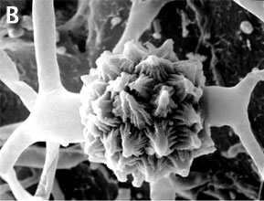
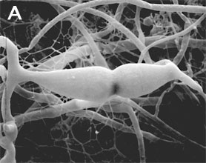
SEXUAL REPRODUCTION
Haploid hyphae from 2 mating types (+ and -) FUSE (Fertilization).
Form a FRUITING BODY (DIPLOID) that will produce diploid Zygotes.
Zygotes go through meiosis to produce haploid SPORES.
Haploid Spores germinate and give rise to haploid hyphae, starting a new organism.
-
+
SPORES Forms

Slide 14
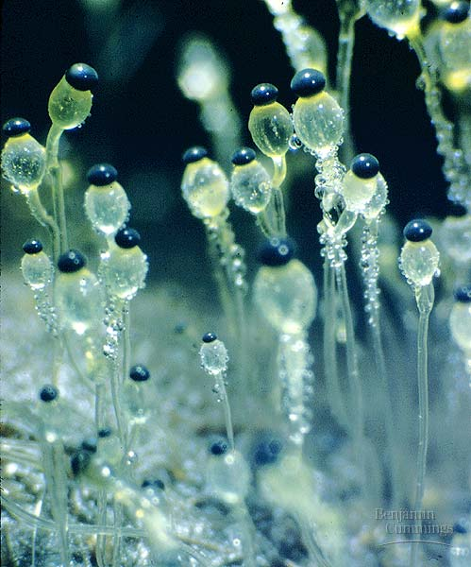
REPRODUCTION BY SPORES
Spores may be Formed:
Directly on tips of Hyphae (asexual)
Inside Sporangia (asexual)
On Fruiting Bodies (sexual)
Penicillium Hyphae
Amanita Fruiting Body
Pilobolus Sporangia

Slide 15
Fungi are classified according to….
….the form of sexual reproduction they carry out.
The Kingdom Fungi has over 100,000 species.
The four main groups of fungi are:
Phylum Zygomycota:
The common Molds
Bread mold; Penicillium
Phylum Ascomycota:
The Sac fungi
Yeasts
Phylum Basidiomycota:
The Club fungi
(Mushrooms)
Phylum Deuteromycota
The Imperfect fungi
(athlete’s foot)

Slide 16
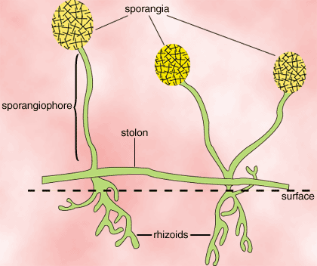
ZYGOMYCOTA (Molds)

Slide 17
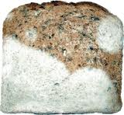
ZYGOMYCOTA
Commonly called Molds
Includes bread mold Rhizopus stolonifer
Rhizopus on strawberries
Rhizopus on bread
Notes:
Most of the 600 zygomycote, or zygote fungi, are terrestrial, living in soil or on decaying plant and animal material.
Asexual reproduction in sporangia
One zygomycote group form mycorrhizas, mutualistic associations with the roots of plants.

Slide 18
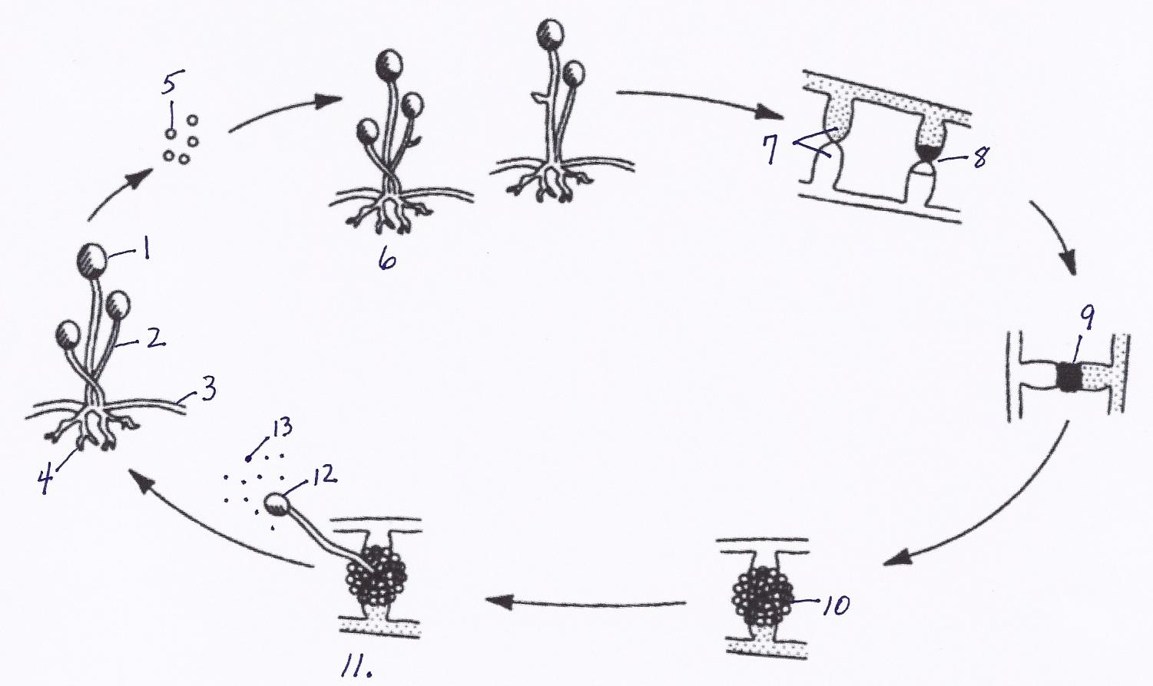
The life cycle of the common bread mold has both asexual and sexual components.
The sporangium produces asexual spores.

Slide 19
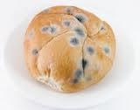
The sporangium is held up in the air by a Sporangiophore (special kind of hyphae).

Slide 20
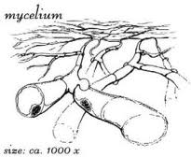
Stolons spread the fungus across the surface of the substrate.

Slide 21
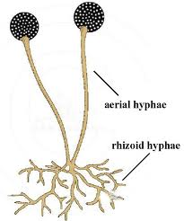
Rhizoids anchor the fungus in the bread.
They absorb water and nutrients.

Slide 22
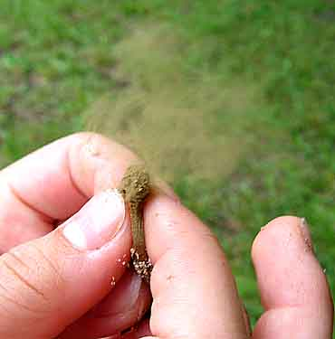
The spores produced by the sporangium are released.

Slide 23
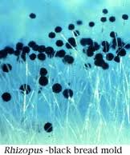
Spores germinate into new hyphae.

Slide 24
Hyphae containinghaploid gametes (+ and -) fuse.
The tips of the hyphae contain gametes that are neither male nor female, but rather, are referred to as “plus” and “minus”.

Slide 25
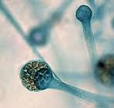
Fusion of gametes produces a diploid zygote.

Slide 26
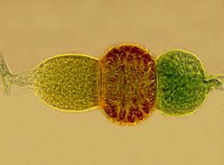
Zygotes develop into thick walled zygospores.
The zygospore may remain dormant for months, and can withstand unfavorable conditions.

Slide 27
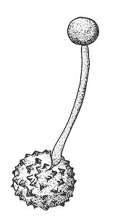
When conditions become favorable, the zygospore germinates, and undergoes meiosis.

Slide 28
The sporangium releases new, haploid spores.
The spores germinate and grow into new hyphae.

Slide 29
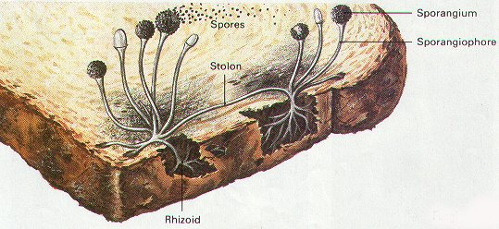
This process insures genetic variation.
It produces new combinations of genetic information that may help the organism meet changing environmental conditions.

Slide 30
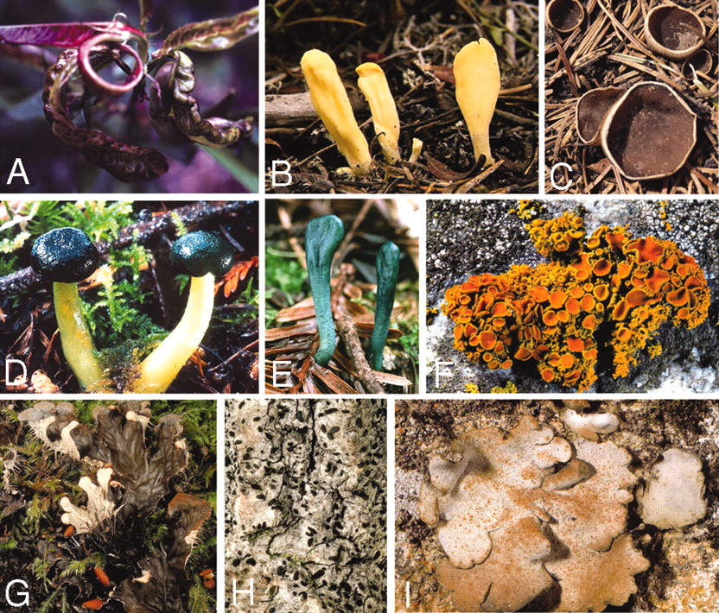
ASCOMYCOTA

Slide 31
Phylum Ascomycota – The Sac Fungi
All of the fungi in this phylum are so named because they have an “ascus” or sac.
An ascus is a reproductive structure that contains sexual ascospores.
This is the largest phylum of fungi, containing over 30,000 different species.

Slide 32
CHARACTERISTICS
Includes Cup fungi, morels, truffles, yeasts, and mildew.
May be plant parasites (Dutch Elm disease and Chestnut Blight).
Penicillium
Asexual spores called Conidia form on the tips of special hyphae called Conidiophores.
Ascus (fruiting body): visual Sexual reproductive structure that produces sexual spores (Ascospores).

Slide 33
ASCOMYCOTA
Penicillium

Slide 34
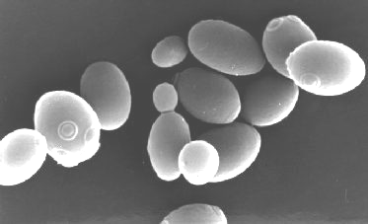
ASCOMYCOTA
Yeasts reproduce asexually by budding (buds break off to make more yeast cells).
Saccharomyces

Slide 35
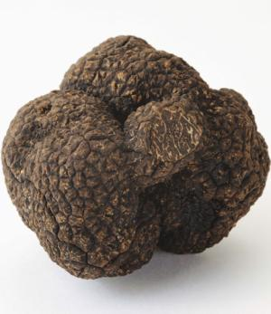
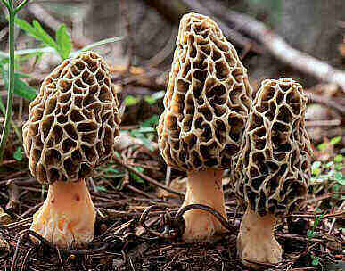
USES OF ASCOMYCOTA
Truffles and morels are good examples of edible ascomycota.
Penicillium mold makes the antibiotic penicillin.
Some ascomycota also give flavor to certain cheeses.
Saccharomyces cerevesiae (yeast) is used to make bread rise & to ferment beer & wine.

Slide 36
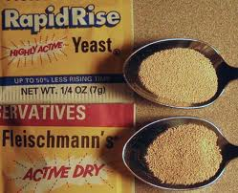
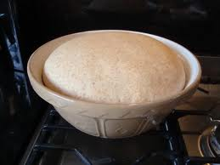
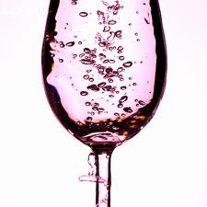
A package of yeast contains dry granules containing ascospores. These ascospores become active when placed in a moist environment.
Prior to baking, yeasts are mixed with a thick, rich dough. This is an environment containing very little oxygen.
Yeasts survive using the process of alcoholic fermentation. In fermentation, the sugar of the bread dough is converted to energy.
Two waste products are produced: carbon dioxide and alcohol. The carbon dioxide gas makes beverages bubble and breads rise.
The alcohol evaporates during baking.

Slide 37
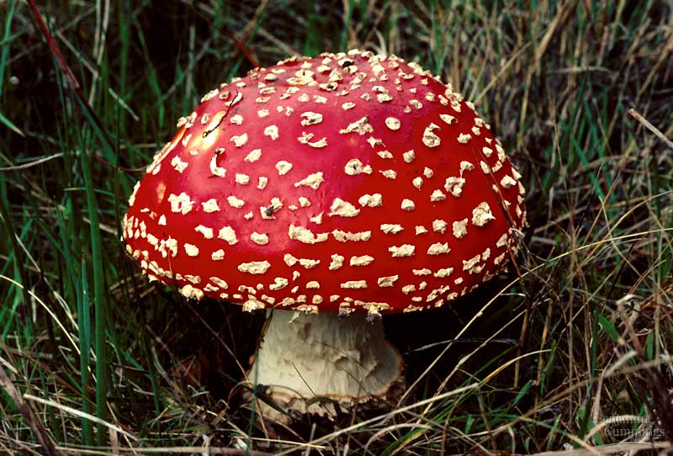
BASIDIOMYCOTA (Club Fungi)

Slide 38
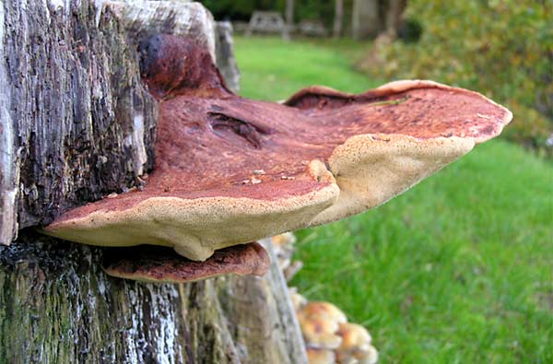
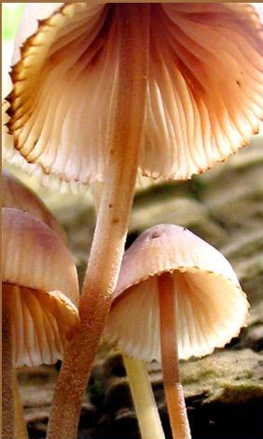
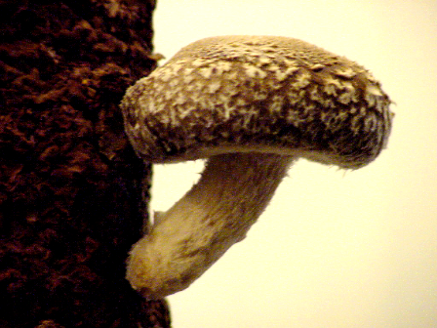
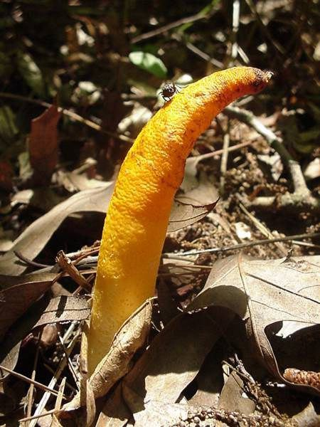
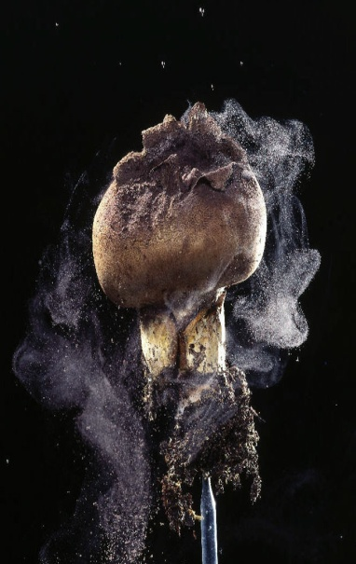
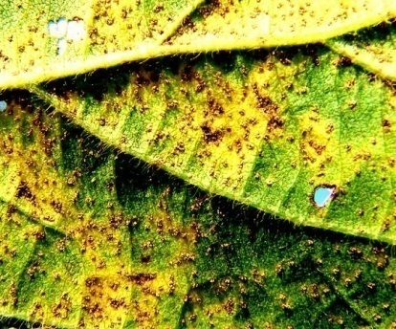
BASIDIOMYCOTA
Called Club fungi
Toadstools
Bracket & Shelf fungi
Mushrooms
Puffballs
Stinkhorns
Rusts & Smuts
Notes:
Asexual spores conidia
Ecologically important on wood as decomposers and parasites
Half the mushrooms form mycorrhizas

Slide 39
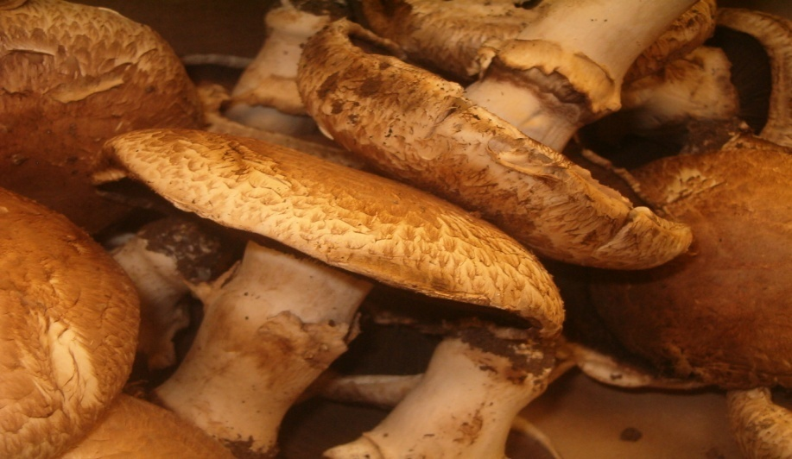
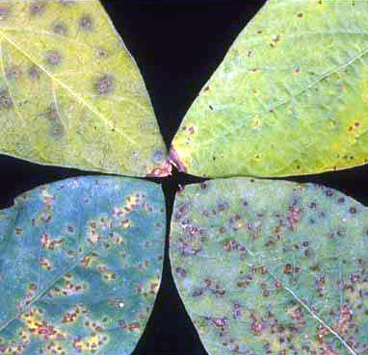
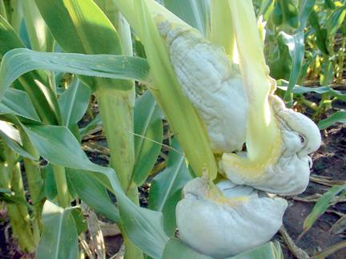
USES FOR BASIDIOMYCOTA
Some are used as food (mushrooms)
Others damage crops (rusts and smuts)
Portobello Mushrooms
Corn Smut
Soybean Rust

Slide 40
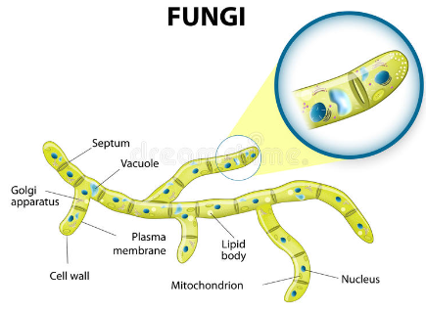
CHARACTERISTICS OF CLUB FUNGI
Seldom reproduce asexually
Septated Hyphae
The visible mushroom is a Fruiting Body (sexual reproductive structure)
Fruiting Body (Basidiocarp) is made of a stalk called the Stipe and a flattened Cap with Gills.

Slide 41
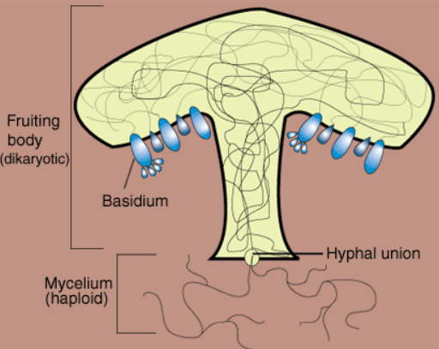
CHARACTERISTICS OF CLUB FUNGI
Inside walls of gills: Basidia (club-shaped hyphae that produce spores sexually).
Basidiospores (sexually produced gametes found in Basidia) are released during reproduction and are dispersed by wind, water, or animals.
Mycelium network found below ground.

Slide 42
Basidiomycota Structure

Slide 43
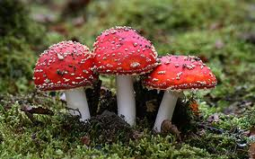
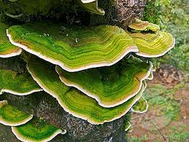
Life Cycle of Club Fungi
The mycelium lives underground and may grow for years, reaching an enormous size.
When the favorable conditions of moisture and nutrients are present, fruiting bodies will appear above ground.
These fruiting bodies are mushrooms.
Mushrooms appear and grow at a very rapid rate. Their growth is caused by cell enlargement, not cell division. The cells enlarge by rapidly taking in water.
The mushroom opens, exposing hundreds of tiny gills. Each gill is lined with basidia.
A diploid zygote in the basidium undergoes meiosis forming clusters of haploid basidiospores.
A single mushroom can produce billions of spores and a giant puffball can produce trillions!

Slide 44
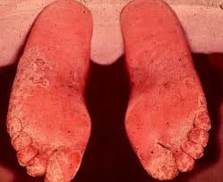
DEUTEROMYCOTA
“Imperfect Fungi”
Not known to have any sexual reproductive cycle.
Ringworm, Athlete’s foot, and some other human parasitic fungi.

Slide 45
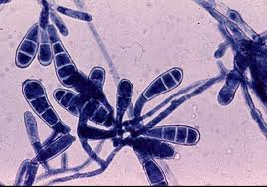
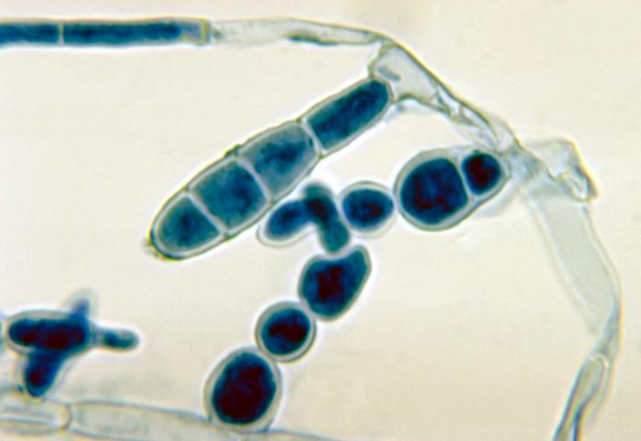
The term “imperfect fungi” does not mean that there’s anything wrong with the organism. It simply means that our understanding of the life cycle is “imperfect”.
Ringworm hyphae
Athlete’s Foot hyphae
Whenever a mycologist discovers a sexual stage in one of these fungi, the species is moved from the imperfect category to a particular phylum, depending on the type of sexual structures.

Slide 46
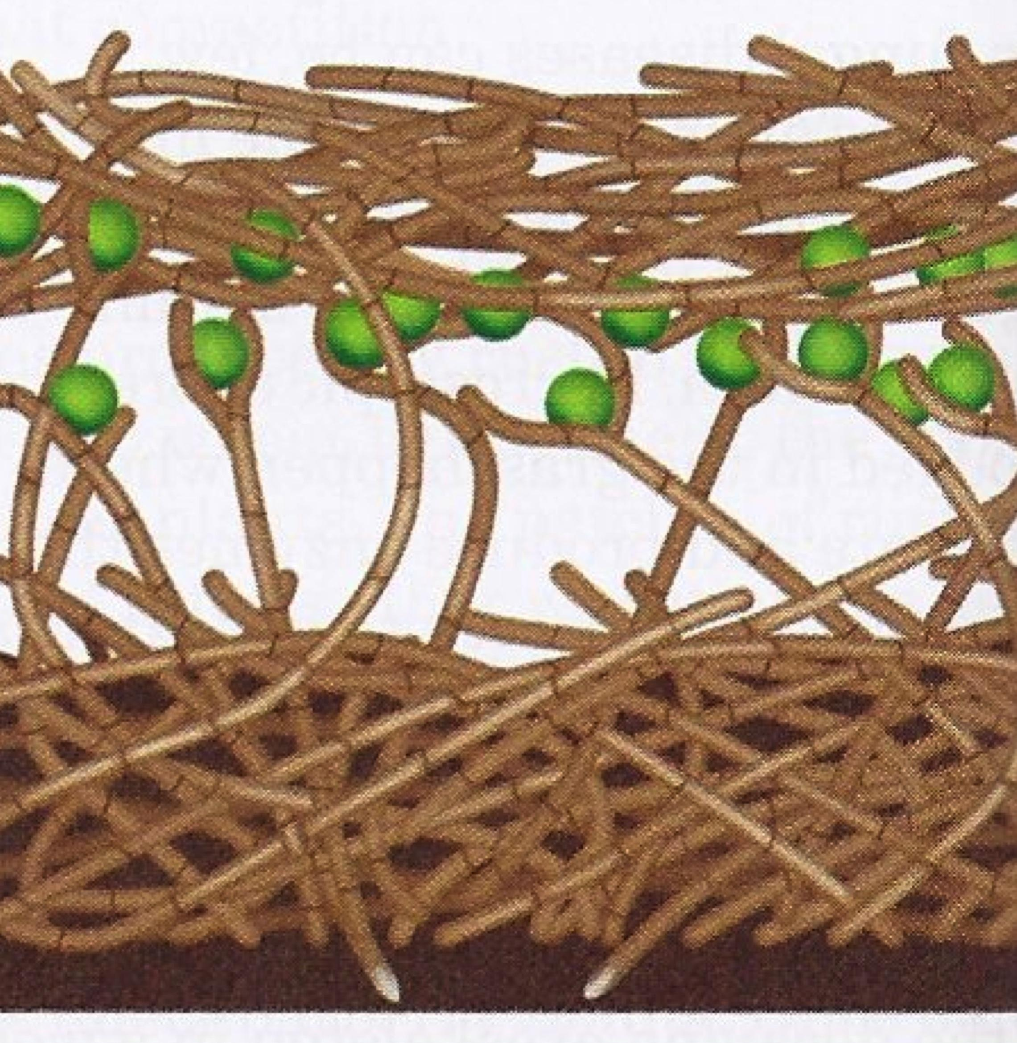
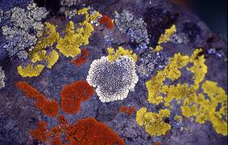
Lichens
A lichen is a combination of a specific fungus and a green algae.
Green algae
Fungal hyphae
A lichen shows the biological relationship of mutualism.
The algae provides food for the fungi. The fungus provides water and shelter in which to live for the algae. Both benefit.

Slide 47
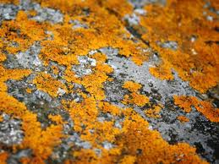
Since they are very resistant to drought and cold, they are often the first organisms to begin the colonization of barren environments.
They break down the rocks upon which they grow, the first step in the formation of soil.
They are very sensitive to air pollution
and are often used as an indicator of
poor air quality.

Slide 48
Mycorrhizae
This is a symbiotic (mutualistic) relationship between a fungus and the roots of plants.
The mass of fungal hyphae is found wrapped around the true roots of plants.
The fungal hyphae helps to increase the surface area for the absorption of water.
The hyphae also improve the delivery of phosphate ions and other minerals to plants.

Slide 49
Mycorrhizae
The plant provides food for the fungus.
Almost all vascular plants have mycorrhizae and rely on their fungal partners for essential nutrients.

Slide 50
FUNGI: PRACTICAL ASPECTS
Primary decomposers in the world
They break down organic substances into simple, soluble forms that plants can use.
Ergot of Rye: fungus that causes a purplish black swelling in rye grain.
“St. Anthony’s Fire”: Vomiting, Gangrene, Hallucinations, etc.
Believed to have been the cause behind accusations of witchcraft in Massachusetts in 1600s.
Chestnut Blight and Dutch Elm disease
Have destroyed many trees in the USA
Notes:
Half of the mushroom-forming fungi (basidiomycota) form mycorrhizas with trees
Some people think that the spongy tissue in roots evolved as a place where fungi could invade to form early links with plants that helped them survive the harsh life on early earth

Slide 51
The Importance of Decomposition
Fungi play an essential role in nearly every ecosystem by breaking down the bodies and wastes of other organisms.
This promotes the recycling of nutrients and essential chemicals.
Without decomposition, these elements and compounds would be forever locked in the bodies of dead organisms.

Slide 52
Life on Earth depends upon the chemical elements being returned to the ecosystem so that they may be used in the bodies of new organisms.
The Importance of Decomposition
If these materials were not returned, the soil would quickly be depleted, and Earth would become lifeless.

Slide 53
PRACTICAL ASPECTS
Dutch Elm disease

Slide 54
PRACTICAL ASPECTS
Edible Mushrooms
Making of Cheese
Yeast in Baking
Notes:
Half of the mushroom-forming fungi (basidiomycota) form mycorrhizas with trees
Some people think that the spongy tissue in roots evolved as a place where fungi could invade to form early links with plants that helped them survive the harsh life on early earth

Slide 55
PRACTICAL ASPECTS
Yeast to ferment beer and wine
Yeast to make ethanol added to gasoline
Antibiotics - Penicillin

