Slide 1
Click on “Slide Show”
Click “Play from Beginning”

Slide 2
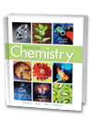
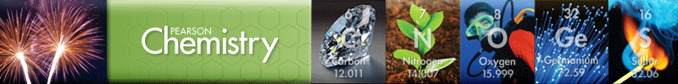
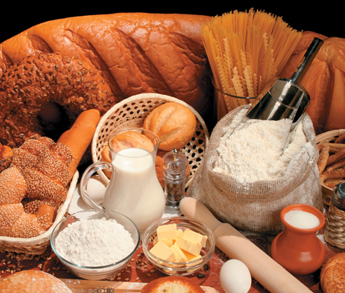
Chapter 12
Stoichiometry
The Arithmetic of
Equations
Chemical Calculations
Limiting Reagent and
Percent Yield

Slide 3
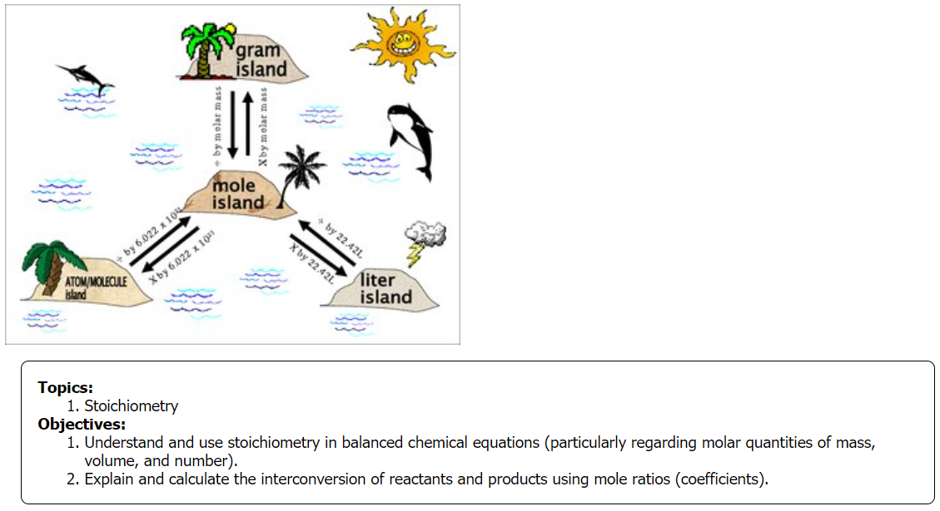

Slide 4
Molar Quantities
What is the Gram Formula Mass of Potassium Chlorate?
How many moles are in 350. g CaCO₃?

Slide 5
Molar Quantities
What is the Gram Formula Mass of Potassium Chlorate?
K⁺Cl⁺⁵O₃⁻² K 1 x 39.1 = 39.1
Cl 1 x 35.5 = 35.5 GFM = 123 g/mol
O 3 x 16.0 = 48.0
How many moles are in 350. g CaCO₃?
Ca 1 x 40.1 g/mole = 40.1 g/mol
C 1 x 12.0 g/mole = 12.0 g/mol GFM 100. g/mol
O 3 x 16.0 g/mole = 48.0 g/mol
350. g x 1 mol / 100 g = 3.50 moles

Slide 6
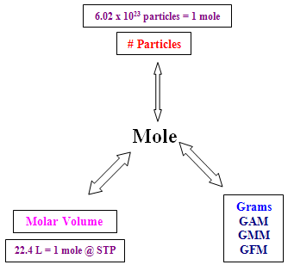
Molar Quantities
How many grams are there in 4.00 x 10²³ particles AlCl₃?
How many grams of Hydrogen gas are in 44.8 liters @ STP?
Molar mass

Slide 7
Molar Quantities
How many grams are there in 4.00 x 10²³ particles AlCl₃?
Always convert to MOLES as the standard
4.00 x 10²³ particles x 1 mole/6.02 x 10²³ particles = 0.664 mol
Molar Mass of AlCl₃ = ~133.5 g/mol
Al⁺³Cl₃⁻ Al 1 x 27.0 = 27.0
Cl 3 x 35.5 = 106.5
0.664 mol x 133.5 g/mole = 88.6 g
How many grams of Hydrogen gas are in 44.8 liters @ STP?
H_{2 (g)} 44.8 L x 1 mol / 22.4 L = 2.00 mol
Molar Mass of H₂ = ~2.00 g/mol
2.00 mol x 2 g / mol = 4.00 g
Molar mass

Slide 8
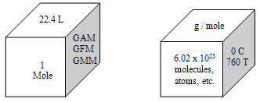
Stoichiometry of Equations
The goal in manipulating molar mass, molar volume, and representative particles (N_{A}) was to be able to determine exact quantities of a substance in a reaction [analytical or quantitative analysis] AND how they relate to each other.

Slide 9
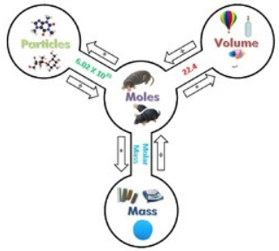
Stoichiometry of Equations
The calculations of reactants and products in chemical reactions is called stoichiometry.
For chemists, stoichiometry is a form of bookkeeping.

Slide 10
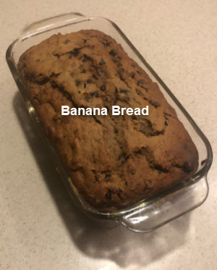
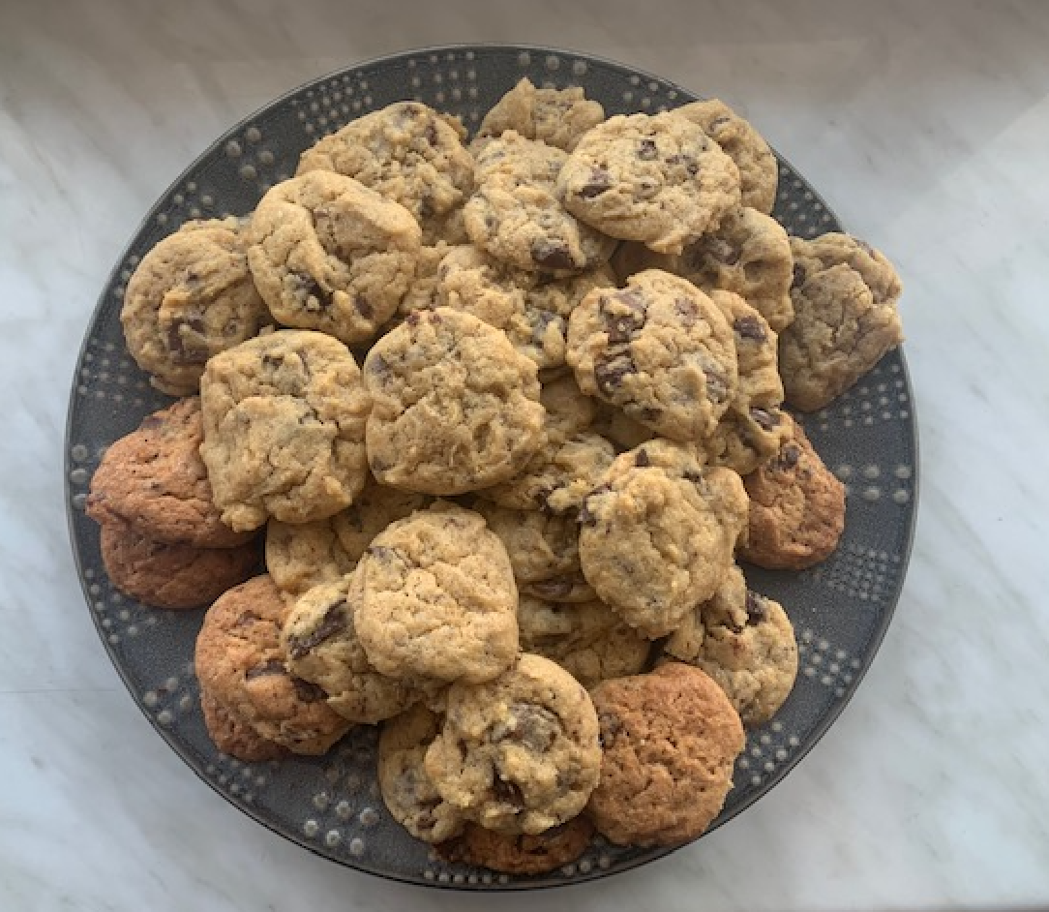
Stoichiometry of Cooking
Stoichiometry is experienced when cooking. Whenever you adjust a recipe, you are doing stoichiometry.
e.g. make a half batch or a double batch.
Chocolate Chips

Slide 11
Stoichiometry of Equations
A balanced chemical equation tells you the relative amounts of reactants and product in the reaction.
N₂(g) + 3H₂(g) → 2NH₃(g)
The balanced chemical equation can be interpreted using different quantities including numbers of atoms, molecules, moles, mass, and/or volume.
What are the mole ratios of the molecules?

Slide 12
Stoichiometry of Equations
A balanced chemical equation tells you the relative amounts of reactants and product in the reaction.
N₂(g) + 3H₂(g) → 2NH₃(g)
The coefficients in the equation represent moles and establish mole ratios between any two reactants or products.
For instance:
N₂:H₂ = 1:3 N₂:NH₃ = 1:2 H₂:NH₃ = 3:2

Slide 13
Learning Mole Ratios
2 C₂H_{2 (l)} + 5 O_{2 (g)} → 4 CO_{2 (g)} + 2 H₂O _{(g)}
__ mol of C₂H_{2 (l)} react with __ mol O_{2 (g)} to yield __ mol of CO₂ and __ mol of water.
6 mol of C₂H_{2 (l)} would react with __ mol O_{2 (g)} to yield __ mol of CO₂ and __ mol of water.
If only 1 mol of CO₂ is produced, then __ mol of C₂H_{2 (l)} react with __ mol O_{2 (g)} to yield __ mol of water.
All of these represent Theoretical Yield.

Slide 14
Learning Mole Ratios
2 C₂H_{2 (l)} + 5 O_{2 (g)} → 4 CO_{2 (g)} + 2 H₂O _{(g)}
2 mol of C₂H_{2 (l)} react with 5 O_{2 (g)} to yield 4 mol of CO₂ and 2 mol of water.
6 mol of C₂H_{2 (l)} would react with 15 O_{2 (g)} to yield 12 mol of CO₂ and 6 mol of water.
If only 1 mol of CO₂ is produced, then 0.5 mol of C₂H_{2 (l)} react with 1.25 mol O_{2 (g)} to yield 0.5 mol of water.
Theoretical Yield is the expected moles.

Slide 15

Stoichiometry of Equations
Atoms or Molecules
N₂(g) + 3H₂(g) → 2NH₃(g)
Based on the equation, how many molecules are represented?
How many atoms are represented?

Slide 16
Stoichiometry of Equations
Atoms or Molecules
N₂(g) + 3H₂(g) → 2NH₃(g)
2 atoms/molecule
How many molecules are represented?
1 × ( )
6.02 × 10²³ molecules N₂
6.02 × 10²³ molecules N₂
How many atoms are represented?
2 × ( )
6.02 × 10²³ molecules N₂
12.0 × 10²³ atoms N in 1 mol N₂

Slide 17
Stoichiometry of Equations
Atoms or Molecules
N₂(g) + 3H₂(g) → 2NH₃(g)
2 atoms/molecule 2 atoms/molecule
How many molecules are represented?
1 × ( ) + 3 × ( )
6.02 × 10²³ molecules N₂
6.02 × 10²³ molecules H₂
6.02 × 10²³ molecules N₂
18.1 × 10²³ molecules H₂
How many atoms are represented?
2 × ( ) + 2 × ( )
6.02 × 10²³ molecules N₂
18.1 × 10²³ molecules H₂
12.0 × 10²³ atoms N in 1 mol N₂
36.2 × 10²³ atoms H in 3 mol H₂

Slide 18
Stoichiometry of Equations
Atoms or Molecules
N₂(g) + 3H₂(g) → 2NH₃(g)
2 atoms/molecule 2 atoms/molecule 4 atoms/molecule
How many molecules are represented?
1 × ( ) + 3 × ( ) → 2 × ( )
6.02 × 10²³ molecules N₂
6.02 × 10²³ molecules H₂
6.02 × 10²³ molecules NH₃
6.02 × 10²³ molecules N₂
18.1 × 10²³ molecules H₂
12.0 × 10²³ molecules NH₃
How many atoms are represented?
2 × ( ) + 2 × ( ) → 4 × ( )
6.02 × 10²³ molecules N₂
18.1 × 10²³ molecules H₂
12.0 × 10²³ molecules NH₃
12.0 × 10²³ atoms N in 1 mol N₂
36.2 × 10²³ atoms H in 3 mol H₂
48.2 × 10²³ atoms in 2 mol NH₃

Slide 19
Stoichiometry of Equations
Atoms or Molecules
N₂(g) + 3H₂(g) → 2NH₃(g)
2 atoms/molecule 2 atoms/molecule 4 atoms/molecule
How many molecules are represented?
1 × ( ) + 3 × ( ) → 2 × ( )
6.02 × 10²³ molecules N₂
6.02 × 10²³ molecules H₂
6.02 × 10²³ molecules NH₃
6.02 × 10²³ molecules N₂
18.1 × 10²³ molecules H₂
12.0 × 10²³ molecules NH₃
How many atoms are represented?
2 × ( ) + 2 × ( ) → 4 × ( )
6.02 × 10²³ molecules N₂
18.1 × 10²³ molecules H₂
12.0 × 10²³ molecules NH₃
12.0 × 10²³ atoms N in 1 mol N₂
36.2 × 10²³ atoms H in 3 mol H₂
48.2 × 10²³ atoms in 2 mol NH₃

Slide 20
Stoichiometry of Equations
Molar Mass
N₂(g) + 3H₂(g) → 2NH₃(g)
Based on the equation, how many grams of each molecule are represented?
N₂(g)
3H₂(g)
2NH₃(g)

Slide 21
Stoichiometry of Equations
Molar Mass
N₂(g) + 3H₂(g) → 2NH₃(g)
Based on the equation, how many grams of each molecules are represented?
N₂(g) N 2 x 14.0 g/mol = 28.0 g/mole x 1 mol = 28.0 g
3H₂(g) H 2 x 1.00 g/mol = 2.00 g/mole x 3 mol = 6.00 g
2NH₃(g) N 1 x 14.0 g/mol = 14.0 g/mol
H 3 x 1.00 g/mol = 3.00 g/mol
17.0 g/mol x 2 mol = 34.0 g
The coefficients represent moles and form mole ratios.

Slide 22
Stoichiometry of Equations
Molar Volume
N₂(g) + 3H₂(g) → 2NH₃(g)
Based on the equation, how many liters of each molecules are represented? 1 mol of any gas at STP occupies a volume of 22.4 L.
N₂(g)
3H₂(g)
2NH₃(g)

Slide 23
Stoichiometry of Equations
Molar Volume
N₂(g) + 3H₂(g) → 2NH₃(g)
Based on the equation, how many liters of each molecules are represented? 1 mol of any gas at STP occupies a volume of 22.4 L.
N₂(g) 1 mol x 22.4 L/mol = 22.4 L
3H₂(g) 3 mol x 22.4 L/mol = 67.2 L
2NH₃(g) 2 mol x 22.4 L/mol = 44.8 L
The coefficients represent moles and form mole ratios.

Slide 24
Stoichiometry of Equations
Molar Mass
Hydrogen sulfide is found in volcanic gases and combusts to form sulfur dioxide and water. What is the molar mass of each substance?
2H₂S(g) + 3O₂(g) → 2SO₂(g) + 2H₂O(g)
H₂S(g)
O₂(g)
SO₂(g)
H₂O(g)

Slide 25
Stoichiometry of Equations
Molar Mass
Hydrogen sulfide is found in volcanic gases and combusts to form sulfur dioxide and water. What is the molar mass of each substance?
2H₂S(g) + 3O₂(g) → 2SO₂(g) + 2H₂O(g)
H₂S(g) H 2 x 1.00 g/mol = 2.00 g/mol
S 1 x 32.1 g/mol = 32.1 g/mol 34.1 g/mol
O₂(g) O 2 x 16.0 g/mol = 32.0 g/mol
SO₂(g) S 1 x 32.1 g/mol = 32.1 g/mol
O 2 x 16.0 g/mol = 32.0 g/mol 64.1 g/mol
H₂O(g) H 2 x 1.00 g/mol = 2.00 g/mol
O 1 x 16.0 g/mol = 16.0 g/mol 18.0 g/mol

Slide 26
Stoichiometry of Equations
Mole Ratios
Hydrogen sulfide is found in volcanic gases and combusts to form sulfur dioxide and water (use previous problem). What is the theoretical mass of each substance based on the equation? Prove the law of conservation of mass.
2H₂S(g) + 3O₂(g) → 2SO₂(g) + 2H₂O(g)
Use the coefficients to find mass of reactants & products.

Slide 27
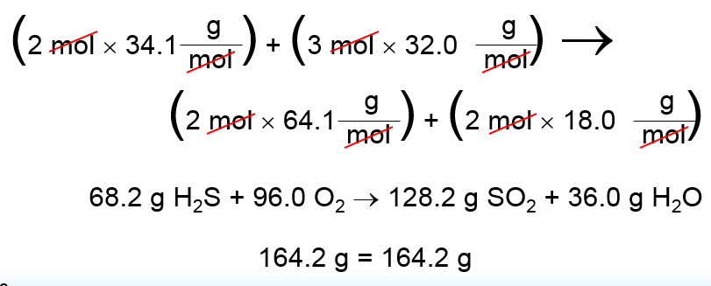
Stoichiometry of Equations
Learning Mole Ratios
Hydrogen sulfide is found in volcanic gases and combusts to form sulfur dioxide and water (use previous problem). What is the theoretical mass of each substance based on the equation? Prove the law of conservation of mass.
2H₂S(g) + 3O₂(g) → 2SO₂(g) + 2H₂O(g)
Use the coefficients to find mass of reactants & products.
2 mol H₂S + 3 mol O₂ 2 mol SO₂ + 2 mol H₂O
164 g = 164 g
This shows the law of Conservation of Mass

Slide 28
Stoichiometry of Equations
General Problem Solving Rules
1. Write a balanced equation
Based on the information given and using the knowledge gained in stoichiometry of formulas
2. Determine MOLES of reactants and products
The “MOLE” concept is the basis, the standard, for Quantitative Analysis
3. Use the MOLE RATIOs to interconvert between reactants and products
Coefficients in an equation represent the number of moles of any molecule or compound in that equation
Since “MOLES” is a standard among all substances, we can use a MOLE RATIO to interconvert different quantitative measurements
4. Convert moles to the desired unit or quantity

Slide 29
Stoichiometry of Equations
Using Mole Ratios
How many moles of NH₃ are produced when 0.60 mol of nitrogen reacts with hydrogen?
N₂(g) + 3H₂(g) → 2NH₃(g)
Determine moles:
Determine mole ratio:
Use mole ratio to interconvert:

Slide 30
Stoichiometry of Equations
Using Mole Ratios
How many moles of NH₃ are produced when 0.60 mol of nitrogen reacts with hydrogen?
N₂(g) + 3H₂(g) → 2NH₃(g)
Determine moles:
1 mol N₂ combines with 3 mol H₂ to produce 2 mol NH₃
Determine mole ratio: N₂:NH₃ =
Use mole ratio to interconvert to find mol NH_{3(g)}:

Slide 31
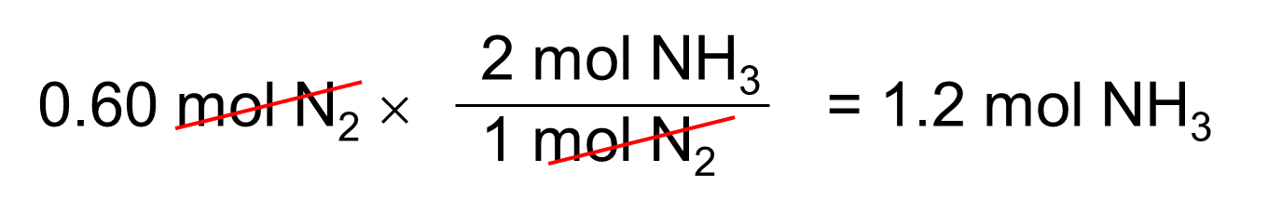
Stoichiometry of Equations
Using Mole Ratios
How many moles of NH₃ are produced when 0.60 mol of nitrogen reacts with hydrogen?
N₂(g) + 3H₂(g) → 2NH₃(g)
Determine moles:
1 mol N₂ combines with 3 mol H₂ to produce 2 mol NH₃
Determine mole ratio: N₂:NH₃ = 1:2
Use mole ratio to interconvert: 0.60/1 mol = X/2
X =
The math can be done in more than one way.

Slide 32
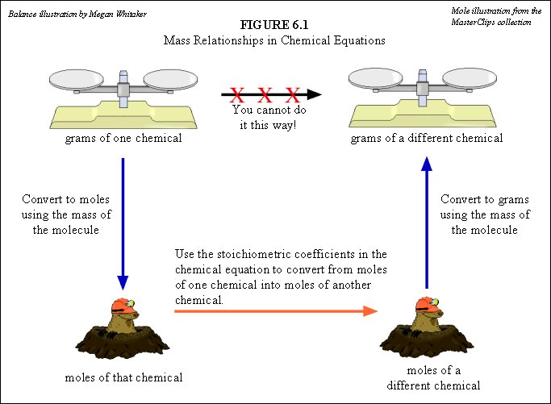
You MUST always use MOLES as the standard of conversion.

Slide 33
You MUST always use MOLES as the standard of conversion.
Mole ratio

Slide 34
You MUST always use MOLES as the standard of conversion.
Mole ratio

Slide 35
You MUST always use MOLES as the standard of conversion.
Volume
Mass
Number
Volume
Mass
Number
Desired unit
Mole ratio

Slide 36
Mass-Mass Calculations
Calculate the number of grams of NH₃ produced by the reaction of 5.40 g of hydrogen with an excess of nitrogen. The balanced equation is:
Find mol H₂:
Mole ratio H₂:NH₃ =
Convert to mol NH₃ →
Convert mol to grams

Slide 37
Mass-Mass Calculations
Calculate the number of grams of NH₃ produced by the reaction of 5.40 g of hydrogen with an excess of nitrogen. The balanced equation is:
N₂(g) + 3H₂(g) → 2NH₃(g)
Find mol H₂: GMM = 2.00 g/mol
5.40 g H₂ x 1 mol/2.00 g = 2.70 mol H₂
Mole ratio H₂:NH₃ = 3:2
Convert to mol NH₃ → 2.70/3 = X/2 → 3X = 5.40
X = 1.80 mol NH₃
Convert mol to grams GMM NH₃ = 17.0 g/mol
1.80 mol x 17.0 g/mol = 30.6 g NH₃

Slide 38
Volume – Volume Calculations
Nitrogen monoxide and oxygen gas combine to form nitrogen dioxide, which contributes to photochemical smog. How many liters of nitrogen dioxide are produced when 34.0 L of oxygen react with an excess of nitrogen monoxide? Assume conditions are at STP.
Find mol O₂:
Mole ratio O₂ :NO₂ =
Convert to mol NO₂ →
Convert mol to liters

Slide 39
Volume – Volume Calculations
Nitrogen monoxide and oxygen gas combine to form nitrogen dioxide, which contributes to photochemical smog. How many liters of nitrogen dioxide are produced when 34.0 L of oxygen react with an excess of nitrogen monoxide? Assume conditions are at STP.
2NO(g) + O₂(g) → 2NO₂(g)
Find mol O₂: 34.0 L x 1 mol/22.4 L = 1.52 mol O₂
Mole ratio O₂ :NO₂ = 1:2
Convert to mol NO₂ → 1.52/1 = X/2 → 3.04 mol NO₂
Convert mol to liters
3.04 mol x 22.4 L/mol = 68.1 L NO₂

Slide 40
Volume – Mass Calculations
Methane burns in air by the following reaction:
CH₄(g) + 2O₂(g) → CO₂(g) + 2H₂O(g)
What volume of water vapor is produced at STP by burning 501 g of methane?
Find mol CH₄:
Mole ratio CH₄:H₂O =
Convert to mol H₂O →
Convert mol to liters

Slide 41
Volume – Mass Calculations
Methane burns in air by the following reaction:
CH₄(g) + 2O₂(g) → CO₂(g) + 2H₂O(g)
What volume of water vapor is produced at STP by burning 501 g of methane?
Find mol CH₄: GMM = 16.0 g/mol
501 g x 1 mol/16 g = 31.3 mol
Mole ratio CH₄:H₂O = 1:2
Convert to mol H₂O → 31.3 mol/1 mol = X/2
X = 62.6 mol
Convert mol to liters
62.6 mol x 22.4 L/mol = 1403 L H₂O = 1.40 x 10³ L H₂O

Slide 42
Review
The following balanced equation shows the decomposition of ammonia (NH₃) into nitrogen (N₂) and hydrogen (H₂):
2NH₃ ⟶ N₂ + 3H₂
A quantity of NH₃ decomposes to produce 0.0351 mol N₂. How many moles of H₂ are produced?
For the reaction:
2Fe + 3Cl₂ ⟶ 2FeCl₃
What is the mole ratio of all substances?
If only 1.5 mol of chlorine gas was available, how much product could be produced theoretically?

Slide 43
Review
The following balanced equation shows the decomposition of ammonia (NH₃) into nitrogen (N₂) and hydrogen (H₂):
2NH₃ ⟶ N₂ + 3H₂
A quantity of NH₃ decomposes to produce 0.0351 mol N₂. How many moles of H₂ are produced?
Mole ratio N₂:H₂ = 1:3
0.0351/1 mol = X/3 mol
X = 0.105 mol H₂
For the reaction:
2Fe + 3Cl₂ ⟶ 2FeCl₃
What is the mole ratio of all substances?
2:3:2
If only 1.5 mol of chlorine gas was available, how much product could be produced theoretically?
1.5/3 = X/2 → 3X = 3
X = 1.0 mol

Slide 44
Review
Phosphorus burns in air to produce a phosphorus oxide. If 403 g of Phosphorus react with oxygen, how many grams of tetra phosphorus decaoxide are produced?

Slide 45
Review
Phosphorus burns in air to produce a phosphorus oxide. If 403 g of Phosphorus react with oxygen, how many grams of tetra phosphorus decaoxide are produced?
4P(s) + 5O₂(g) → P₄O₁₀(s)
Find mol P: GAM = 31 g/mol
403 g P x 1 mol/31.0 g = 13.0 mol P
Mole ratio P:P₄O₁₀ = 4:1
Convert to mol P₄O₁₀ → 13.0/4 = X/1 → 3.25 mol P₄O₁₀
Convert mol to grams GMM P₄O₁₀ = 284 g/mol
3.25 mol x 284 g/mol = 923 g P₄O₁₀

Slide 46
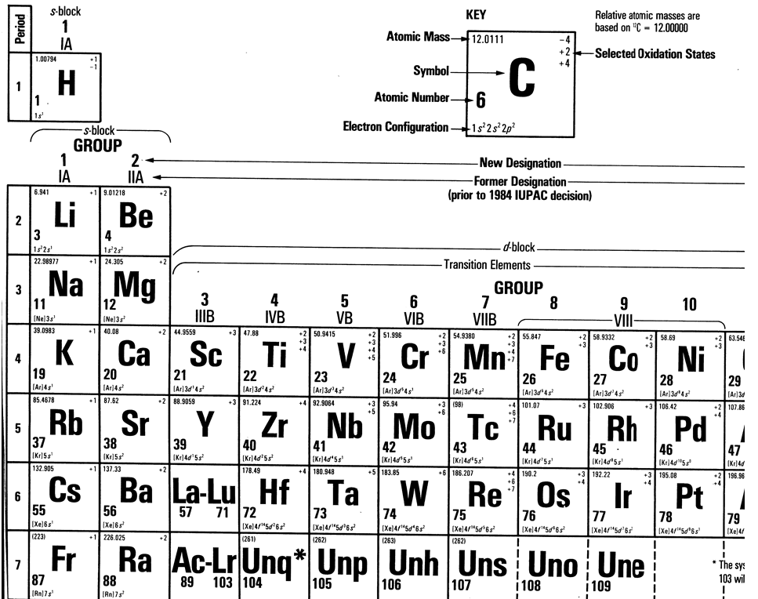

Slide 47
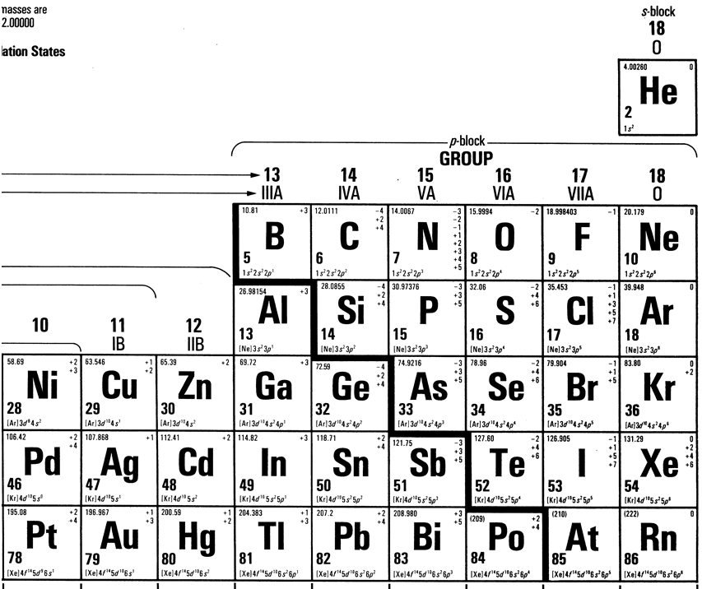

Slide 48
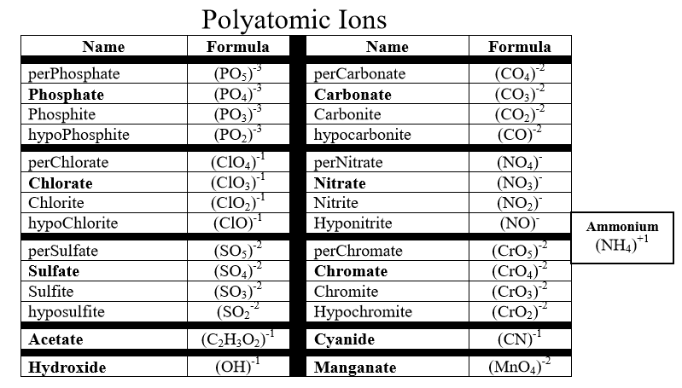

Slide 49
