Slide 1
Click on “Slide Show”
Click “Play from Beginning”

Slide 2
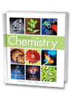
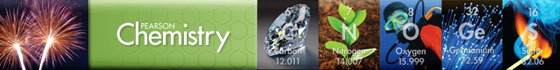
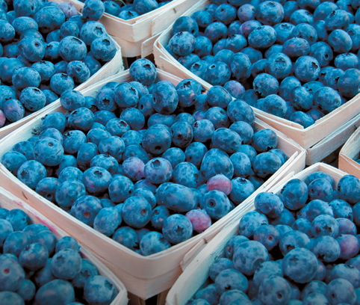
Chapter 10
Chemical Quantities
The Mole: A Measurement of Matter
Mole-Mass and Mole-Volume Relationships
Percent Composition and Chemical Formulas

Slide 3
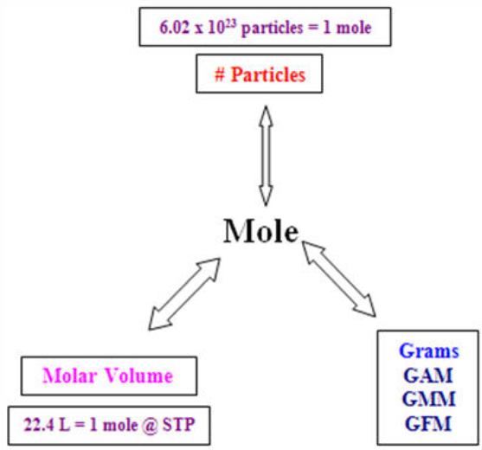
Molar Mass (g/mol)

Slide 4
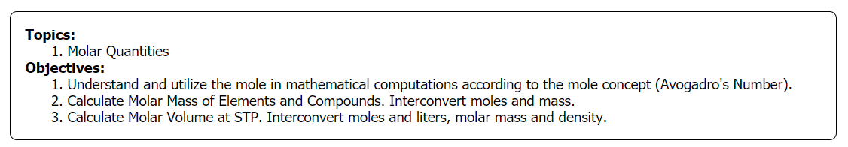

Slide 5
Name Examples of Standards in Real Life
Notes:
Timing ≈ 1 min
Entry Audio: In this warm-up, we review the addition of positive and negative integers. Ionic compounds are made of a positive ion (cation) and a negative ion (anion). Stable ionic compounds are electrically neutral, meaning the overall charge of an ionic compound adds up to zero. While doing this activity, you will notice that the ratio of positive to negative ions can be different than one-to-one.
Exit Audio: Just like integers, oxidation numbers of ions are whole numbers that can be positive or negative. You should have noticed that each of the problems were set to equal zero just like the overall charge of an ionic compound. Last, adjusting the number of positive or negative ions to achieve a zero sum is similar to adjusting the ratio of positive and negative ions in an ionic compound to make the overall charge equal to zero.

Slide 6
Name Examples of Standards in Real Life
Safety standards
Quality standards
Standards of Use
Inclusion standards (who can use it)
Sustainability Standards
Privacy Standards
Electrical Standards
Boarding pass on an airline
Passport
Driver’s license
Gas is sold by the gallon
Paying by credit card
Vehicle standards (mirrors, seat belts, lights, etc.)
Notes:
Timing ≈ 1 min
Entry Audio: In this warm-up, we review the addition of positive and negative integers. Ionic compounds are made of a positive ion (cation) and a negative ion (anion). Stable ionic compounds are electrically neutral, meaning the overall charge of an ionic compound adds up to zero. While doing this activity, you will notice that the ratio of positive to negative ions can be different than one-to-one.
Exit Audio: Just like integers, oxidation numbers of ions are whole numbers that can be positive or negative. You should have noticed that each of the problems were set to equal zero just like the overall charge of an ionic compound. Last, adjusting the number of positive or negative ions to achieve a zero sum is similar to adjusting the ratio of positive and negative ions in an ionic compound to make the overall charge equal to zero.

Slide 7
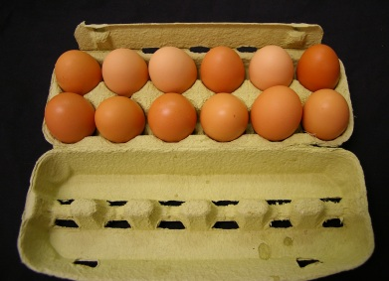
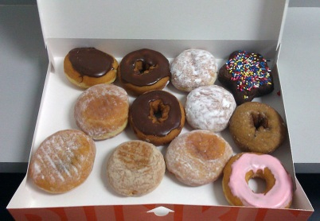
How Are Scientists Able to Count the Number of Particles in Matter?
Avogadro’s Number N_{a}
= 6.02 x 10²³
GET YOUR CALCULATORS READY!!
Notes:
Timing ≈ 0.5 min
Recap: Because atoms are so tiny, huge numbers of them are present in even small samples of a substance.
Connect: When we go to the grocery store we often purchase items in a single unit called a dozen. We know that there are 12 items in a dozen, no matter if the items are eggs, donuts, or containers of yogurt. A dozen means twelve.
Preview: In this part of the lesson, you will learn about the chemistry equivalent of a repeating quantity like the dozen. Chemists use the mole.
SOURCES:
http://www.flickr.com/photos/raeallen/96238870/sizes/o/in/photostream/
http://commons.wikimedia.org/wiki/File:Dozendunkindonuts.jpg

Slide 8

Measuring Matter
  Chemistry is both a qualitative and a quantitative science, meaning we observe and describe matter, and we measure and quantify matter.
To effectively measure and quantify matter, scientists use STANDARDS. Just as a “meter” is the standard unit of distance in the Metric system, scientists use the “MOLE” as a standard of chemical quantities.

Slide 9
Practical Example of Measuring Matter
Apples can be measured in different ways.
At a fruit stand, they are often sold by number.
In a supermarket, you usually buy them by weight or mass.
At an orchard, you can buy apples by volume.
Using factor labeling we can interchange the various measurements.
Assume that 1 dozen apples = 2.0 kg = 0.20 bushels
Create conversion factors:

Slide 10
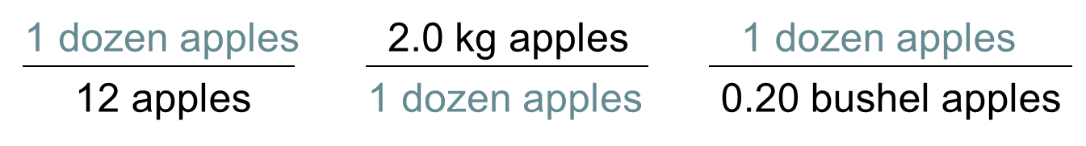
Practical Example of Measuring Matter
Apples can be measured in different ways.
At a fruit stand, they are often sold by number.
In a supermarket, you usually buy them by weight or mass.
At an orchard, you can buy apples by volume.
Using factor labeling we can interchange the various measurements.
Assume that 1 dozen apples = 2.0 kg = 0.20 bushels
1 doz/2.0 kg = 2.0 kg/1 doz = 12 apples/2.0 kg
2.0 kg/0.20 B = 0.2 B/1 doz = 0.20 B/2.0 kg

Slide 11
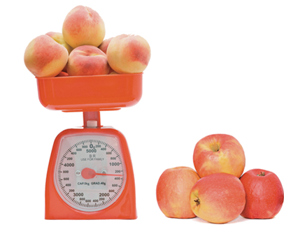
Practical Example of Measuring Matter
From the conversion factors, one may determine number, mass, or volume depending on what is given.
Therefore, scientists need a STANDARD of comparison.
[e.g. just as the Spirit and the Bible are the standard for the universe.]

Slide 12
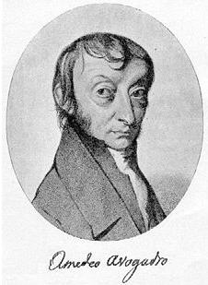
The Mole
The standard for mathematical (quantitative) measurement in chemical equations is the mole.
A mole (mol) of a substance is the SI unit for measuring the amount of a substance and is based on Avogadro’s number.
  The number of particles in a mole is
  N_{a} = 6.022 x 10²³
  … particles, atoms, molecules, you name it

Slide 13
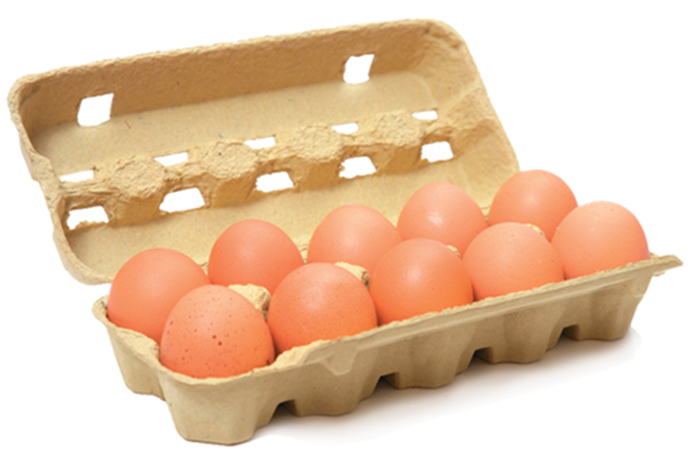
The Mole
Avogadro’s number.
  N_{a} = 6.022 x 10²³
  … particles, atoms, molecules, you name it
One mole of anything is N_{a} of that item.
A mole refers to a specific quantity (count / number, mass in grams, or volume in liters.
The mole concept is analogous to any set unit … e.g. a dozen (12 of anything)

Slide 14
Mole Song
Happy Mole Day! (October 23)
http://somup.com/cF6Qr8nnzh (1:58)

Slide 15
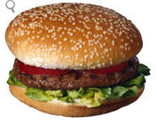


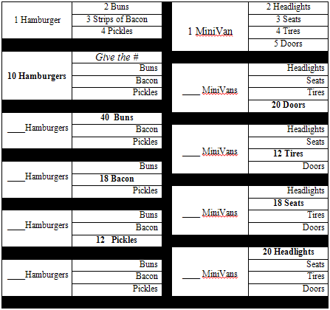
Simple Analogy
Fill in the table below:

Slide 16
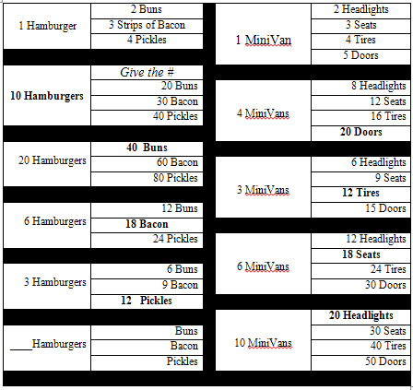
Simple Analogy
Fill in the table below:
NOTE:
The number of hamburgers & minivans were the STANDARDs of comparison.
It works the same way using “Moles”.
This is why we use COEFFICIENTS in chemical equations.

Slide 17
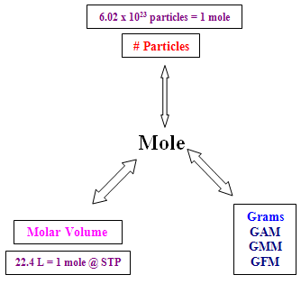
The Mole Concept
A mole refers to a specific quantity: number, mass, volume.
Molar Mass (g/mol)
GAM (gram atomic mass)
GMM (gram molecular mass)
(covalent)
GFM = (gram formula mass)
(ionic)

Slide 18
The Mole Concept
If 1.00 mole of mercury has 6.02 × 10²³ atoms (or particles). How many will be in 2.00 moles? 4.00 moles?
Molar Mass
If 22.4 L is 1.00 mole of a gas, how many liters are in 5.00 moles? 10.0 moles?
How many grams are in 1.00 mole of Copper? (Use Periodic Table) 3.00 moles? 6.00 moles?

Slide 19
The Mole Concept
If 1 mole of mercury has 6.02 × 10²³ atoms (or particles). How many will be in 2.00 moles? 4.00 moles?
2.00 mol x (6.02 × 10²³ atoms/mol) = 12.04 × 10²³ atoms
1.20 × 10²⁴ atoms
4.00 mol x (6.02 × 10²³ atoms/mol) = 24.08 × 10²³ atoms
2.41 × 10²⁴ atoms
Molar Mass
number, volume, mass
If 22.4 L is 1.00 mole of a gas, how many liters are in 5.00 moles? 10.0 moles?
5.00 mol x 22.4 L/mol = 112 liters
10.0 mol x 22.4 L/mol = 224 liters
How many grams are in 1.00 mole of Copper? (Use Periodic Table) 3.00 moles? 6.00 moles?
1.00 mol Cu = 63.5 g
3.00 mol x 63.5 g/mol = 191 g
6.00 mol x 63.5 g/mol = 381 g

Slide 20
The Mole Concept
How many moles of NaCl are in 78.48 × 10²³ particles?
Molar Mass
How many moles of CO_{2 (g)} are in 356 Liters?
How many moles of calcium are there if one has 242 g?

Slide 21
The Mole Concept
How many moles of NaCl are in 78.48 × 10²³ particles?
78.48 × 10²³ particles x 1 mol / 6.022 × 10²³ particles)
= 13.04 moles
Molar Mass
number, volume, mass
How many moles of CO_{2 (g)} are in 356 Liters?
356 L x 1 mol/22.4 L = 15.9 moles
How many moles of calcium are there if one has 242 g?
242 g Ca x 1 mol/40.08 g =
= 6.04 moles

Slide 22
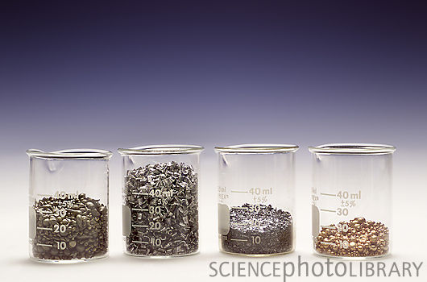
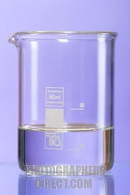
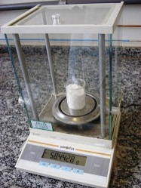
The Chemist’s Dozen
mole (mol): the SI unit for the amount of a substance; a mole is defined as the number of atoms in 12 g of C-12, or 6.02 × 10²³
GAM
GMM
GFM
1 mole Mg
? g
? atoms
? L if a gas
1 mole H₂O
? g
? molecules
? L if a gas
1 mole NaCl
? g
? formula units
? L if a gas
Notes:
Timing ≈ 1 min
Chemists have a similar unit of measure that allows them to conveniently deal with large numbers of atoms of a particular substance – this unit is called the mole. Just as a dozen of anything is 12 of that thing, a mole of anything is 6.02 × 10²³ of that thing.
[animate 3 photos] each of these photos shows one mole of a substance.
[animate NaCl text box] one mole of sodium chloride has a mass of 58.44 g. It contains 6.02 × 10²³ formula units of NaCl.
[animate H2O text box] One mole of water has a mass of 18.01 g. It contains 6.02 × 10²³ molecules of water.
[animate Mg text box] One mole of magnesium has a mass of 24.31 g. It contains 6.02 × 10²³ atoms of Mg.
Even though these three samples have different masses and take up different volumes, they represent the same number of atoms, molecules, or formula units.
Source:
http://commons.wikimedia.org/wiki/File:Balance-NaCl-1mol.jpg
http://www.photographersdirect.com/buyers/stockphoto.asp?imageid=2153453
http://www.sciencephoto.com/media/1978/enlarge

Slide 23
The Chemist’s Dozen
mole (mol): the SI unit for the amount of a substance; a mole is defined as the number of atoms in 12 g of C-12, or 6.02 × 10²³
GAM
GMM
GFM
1 mole Mg
Periodic Table → 24.31 g
6.02 × 10²³ atoms
22.4 L if a gas
1 mole H₂O
2(1.008) + 16.00 = 18.01 g
6.02 × 10²³ molecules
22.4 L if a gas
1 mole NaCl
22.99 + 35.45 = 58.44 g
6.02 × 10²³ formula units
22.4 L if a gas
Notes:
Timing ≈ 1 min
Chemists have a similar unit of measure that allows them to conveniently deal with large numbers of atoms of a particular substance – this unit is called the mole. Just as a dozen of anything is 12 of that thing, a mole of anything is 6.02 × 10²³ of that thing.
[animate 3 photos] each of these photos shows one mole of a substance.
[animate NaCl text box] one mole of sodium chloride has a mass of 58.44 g. It contains 6.02 × 10²³ formula units of NaCl.
[animate H2O text box] One mole of water has a mass of 18.01 g. It contains 6.02 × 10²³ molecules of water.
[animate Mg text box] One mole of magnesium has a mass of 24.31 g. It contains 6.02 × 10²³ atoms of Mg.
Even though these three samples have different masses and take up different volumes, they represent the same number of atoms, molecules, or formula units.
Source:
http://commons.wikimedia.org/wiki/File:Balance-NaCl-1mol.jpg
http://www.photographersdirect.com/buyers/stockphoto.asp?imageid=2153453
http://www.sciencephoto.com/media/1978/enlarge

Slide 24
Calculating Avogadro’s Number
Enrichment
  One atom of carbon-12 has a mass of 12.00 amu. How many atoms of carbon-12 are in 12.00 g? [1.66 × 10⁻²⁴ g = 1 amu]
  Set up calculation:
  Cancel units and solve:
Notes:
Timing ≈ 1 min
Let's look at how to calculate the value of Avogadro's number.
We use the same calculation setup that we used in the warm-up [animate first bullet and equation], except we use a sample mass of 12.00 g and an atomic mass of 12.00 amu. [teacher explain where each number in the equation comes from (i.e., 12.00 g = given in problem statement, 1.66 x 10-24 = # g in 1 amu, mass of one C-12 atom given in problem statement)]
[animate 2nd bullet and equation] Cancelling like units and solving yields the value for Avogadro's number.

Slide 25

Calculating Avogadro’s Number
Enrichment
  One atom of carbon-12 has a mass of 12.00 amu. How many atoms of carbon-12 are in 12.00 g?
  Set up calculation (use AGES & factor label):
  Cancel units and solve:
Notes:
Timing ≈ 1 min
Let's look at how to calculate the value of Avogadro's number.
We use the same calculation setup that we used in the warm-up [animate first bullet and equation], except we use a sample mass of 12.00 g and an atomic mass of 12.00 amu. [teacher explain where each number in the equation comes from (i.e., 12.00 g = given in problem statement, 1.66 x 10-24 = # g in 1 amu, mass of one C-12 atom given in problem statement)]
[animate 2nd bullet and equation] Cancelling like units and solving yields the value for Avogadro's number.

Slide 26
Determining Moles using Number
How many moles of the element magnesium is equal to 1.25 × 10²³ atoms of magnesium? How many grams does this represent?

Slide 27
Determining Moles using Number
How many moles of the element magnesium is equal to 1.25 × 10²³ atoms of magnesium? How many grams does this represent?
Multiply the number of atoms of Mg by the conversion factor.
1.25 x 10²³ atoms Mg x 1 mol Mg __ = 0.208 mol Mg
6.02 x 10²³ atoms Mg
Multiply the number of moles of Mg by GAM.
0.208 mol Mg x 24.305 g/mol = 5.06 g
Molar Mass

Slide 28
Converting Moles to Number of Atoms
Propane is a gas used for cooking and heating. How many atoms are in 2.12 moles of propane (C₃H₈)?

Slide 29
Converting Moles to Number of Atoms
Propane is a gas used for cooking and heating. How many atoms are in 2.12 moles of propane (C₃H₈)? There are 11 atoms/molecule of propane and 6.022 x 10²³ molecules in a mole:
Multiply the number of molecules of propane conversion factor.
2.12 mol C₃H₈ x 6.022 x 10²³ molecules = 12.77 x 10²³ molecules
1 mol C₃H₈
Multiply the number of atoms / molecule conversion factor.
12.77 x 10²³ molecules C₃H₈ x 11 atoms = 140.4 x 10²³ atoms
1 molecule C₃H₈
= 1.40 x 10²⁵ atoms
Molar Mass

Slide 30
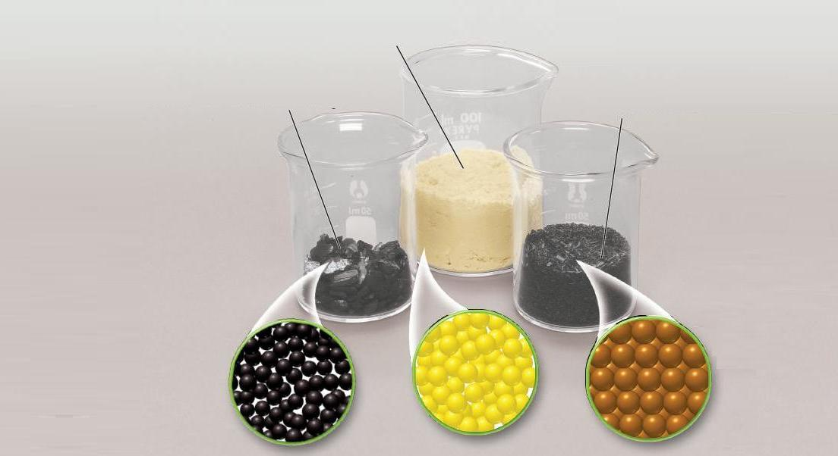
Molar Mass
Molar mass (g/mol) is when there is 1 mol or 6.02 x 10²³ atoms/units of a particular element or compound.
1 mol of sulfur atoms = 32.1 g
1 mol of carbon atoms = 12.0 g
1 mol of iron atoms = 55.8 g

Slide 31
Molar Mass
GAM (Gram Atomic Mass)
E.g. ₃₄Se⁷⁹ atomic mass =
Similarly, ____ is the molar mass of magnesium, meaning that 1 mol (or 6.02 x 10²³ atoms of magnesium) has a mass of ? g.
What are the molar mass (GAM) of the following elements?
1 mole of potassium atoms (K) = ?
1 mole of aluminum atoms (Al) = ?
1 mole of oxygen molecules (O₂) = ?
The molar mass of an element, in grams per mole, has the same value as the average atomic mass of the element in amu’s.

Slide 32
Molar Mass
GAM (Gram Atomic Mass)
E.g. ₃₄Se⁷⁹ atomic mass = 79.0 amu GAM = 79.0 g/mol
Similarly, 24.3 g/mol is the molar mass of magnesium, meaning that 1 mol (or 6.02 x 10²³ atoms of magnesium) has a mass of 24.3 g.
What are the molar mass (GAM) of the following elements?
1 mole of potassium atoms (K) = 39.1 g/mol
1 mole of aluminum atoms (Al) = 27.0 g/mol
1 mole of oxygen molecules (O₂) = 16.0 x 2 = 32.0 g/mol
Remember Professor HOFBrINCl? (diatomic elements)
The molar mass of an element, in grams per mole, has the same value as the average atomic mass of the element in amu’s.

Slide 33
Molar Mass
The Mass of a Mole of a Compound
To find the molar mass of a compound, add the atomic masses of the atoms that make up the molecule.
A molecule of H₃PO₄ is composed of three Hydrogen atoms, one Phosphorus atom, and four of oxygen atoms (round masses).
H₃PO₄
Atom | # atoms in Formula | X | Atomic Mass | = | Total Mass of Element
H
P
O

Slide 34
Molar Mass
The Mass of a Mole of a Compound
To find the molar mass of a compound, add the atomic masses of the atoms that make up the molecule.
A molecule of H₃PO₄ is composed of three Hydrogen atoms, one Phosphorus atom, and four of oxygen atoms (round masses).
H₃PO₄
Atom | # atoms in Formula | x | Atomic Mass | = | Total Mass of Element
H | 3 |  | 1 |  | 3
P | 1 |  | 31 |  | 31
O | 4 |  | 16 |  | 64
 |  |  |  |  | 98 amu
  1 mol of H₃PO₄ has a mass of 98 g.
  This is the mass of 6.02 x 10²³ molecules of H₃PO₄ .

Slide 35
Molar Mass of a Compound
Determine the molar masses of table salt and carbon dioxide.
1 compound NaCl =
1 molecule CO₂ =

Slide 36
Molar Mass of a Compound
Determine the molar masses of table salt and carbon dioxide.
1 compound NaCl = (1 x 23 amu) + (1 x 35 amu) = 58 amu
1 mol of NaCl = 6.02 x 10 ²³ NaCl cmpds = 58 grams → “GFM”
Na 1 x 23 g/mol
Cl 1 x 35 g/mol
58 g/mol
1 molecule CO₂ = (1 x 12 amu) + (2 x 16 amu) = 44 amu
1 mole CO₂ = 6.02 x 10 ²³ CO₂ molecules = 44 grams → “GMM”
C 1 x 12 g = 12 g/mol
O 2 x 16 g = 32 g/mol
44 grams/mol
Molar Mass

Slide 37
Molar Mass of a Compound
Determine the molar mass of 1 mol of glucose (C₆H₁₂O₆) molecules (blood sugar).
The molar mass of an element, in grams per mole, has the same value as the average atomic mass of the element in amu’s.
Molar Mass

Slide 38
Molar Mass of a Compound
Determine the molar mass of 1 mol of glucose (C₆H₁₂O₆) molecules (blood sugar).
C 6 x 12 g/mol = 72 g/mol
H 12 x 1 g/mol = 12 g/mol
O 6 x 16 g/mol = 96 g/mol
180 g/mol C₆H₁₂O₆
Molar Mass
The molar mass of an element, in grams per mole, has the same value as the average atomic mass of the element in amu’s.

Slide 39
Converting Moles to Mass
What is the mass, in grams, of 9.45 mol of aluminum oxide, (Al₂O₃)?

Slide 40
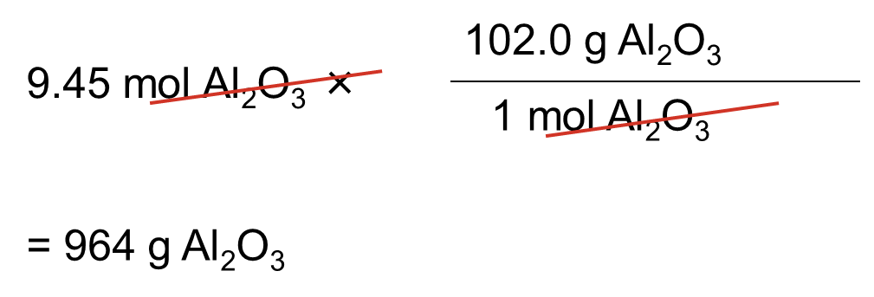
Converting Moles to Mass
What is the mass, in grams, of 9.45 mol of aluminum oxide, (Al₂O₃)? First determine the mass of 1 mol of Al₂O₃:
Al 2 x 27.0 g/mol = 54.0 g/mol
O 3 x 16.0 g/mol = 48.0 g/mol
102.0 g/mol Al₂O₃
Multiply the given number of moles by the conversion factor.
Molar Mass

Slide 41
Converting Mass to Moles
Rust is iron(III) oxide (Fe₂O₃). How many moles of iron(III) oxide are contained in 92.2 g of pure Fe₂O₃?
.

Slide 42
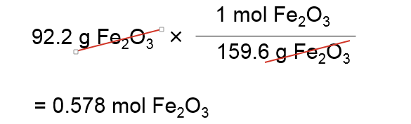
Converting Mass to Moles
Rust is iron(III) oxide (Fe₂O₃). How many moles of iron(III) oxide are contained in 92.2 g of pure Fe₂O₃?
Fe 2 x 55.8 g/mol = 111.6 g/mol
O 3 x 16.0 g/mol = 48.0 g/mol
159.6 g/mol Fe₂O₃
Multiply the given mass by the conversion factor.
Molar Mass

Slide 43
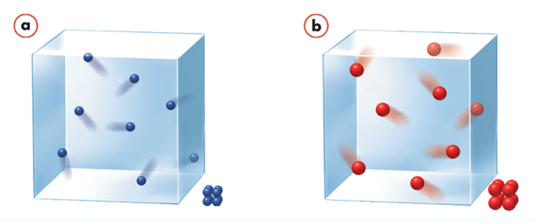
Molar Volume
  Avogadro’s hypothesis
  Equal volumes of gases at the same temperature and pressure contain equal numbers of particles.
  Standard temperature and pressure (STP) means a temperature of 0 ⁰C (273 K) and a pressure of 101.3 kPa, or 1 atm.
  At STP, 1 mol, or 6.02 x 10²³ particles, of any gas occupies a volume of 22.4 L.
  The quantity, 22.4 L, is called the molar volume of a gas.

Slide 44
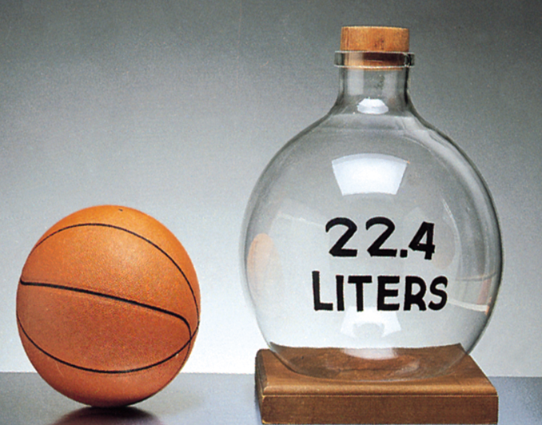
Molar Volume
Sulfur dioxide (SO₂) gas is an air pollutant produced by burning coal. Determine the volume, in liters, of 0.60 mol SO₂ gas at STP.

Slide 45
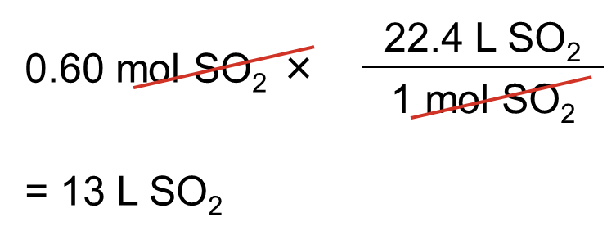
Molar Volume
Sulfur dioxide (SO₂) gas is an air pollutant produced by burning coal. Determine the volume, in liters, of 0.60 mol SO₂ gas at STP.
1 mol gas @ STP = 22.4 L →
Multiply the given number of moles by the conversion factor.
22.4 L
1 mol
and
1 mol
22.4 L
Molar Mass

Slide 46
Calculating Molar Mass and Density
Using factor labelling, one can interconvert density & molecular mass. Usually the density of a gas is measured in grams per liter (g/L) and at a specific temperature.
The density of a gaseous compound containing carbon and oxygen is found to be 1.964 g/L at STP. What is the molar mass of the compound?

Slide 47
Calculating Molar Mass and Density
Using factor labelling, one can interconvert density & molecular mass. Usually the density of a gas is measured in grams per liter (g/L) and at a specific temperature.
The density of a gaseous compound containing carbon and oxygen is found to be 1.964 g/L at STP. What is the molar mass of the compound?
Set it up to find molar mass → g/mol
1.964 g/L = ? g/mol

Slide 48
Calculating Molar Mass and Density
Using factor labelling, one can interconvert density & molecular mass. Usually the density of a gas is measured in grams per liter (g/L) and at a specific temperature.
The density of a gaseous compound containing carbon and oxygen is found to be 1.964 g/L at STP. What is the molar mass of the compound?
Since density is g/L, we know that liters and moles are related.
Factor label the given density by the molar volume conversion factor.
1.964 g
22.4 L
×
= 44.0 g/mol
1 L
1 mol
Molar Mass

Slide 49
Calculating Molar Mass and Density
200 ml of a gas (@STP) has a mass of 0.396 g. What is the molecular mass of this gas?

Slide 50
Calculating Molar Mass and Density
200 ml of a gas (@STP) has a mass of 0.396 g. What is the molecular mass of this gas?
Set it up to find molar mass → g/mol
Put mass over volume (density):
0.396 g / 200 mL = ? g/mol
0.396 g / 200 mL x 1000 ml / 1 L x 22.4 L/mol = 44.4 g/mol
OR
Next slide …

Slide 51
Calculating Molar Mass and Density
200 ml of a gas (@STP) has a mass of 0.396 g. What is the molecular mass of this gas?
Since mass and volume are given, determine the density of the gas [hint: set up units to solve for molar mass → g/mol]
D = M/V D = 0.396 g / 200 ml x 1000 ml / 1 L = 1.98 g/L
Factor label the density into molecular mass
1.98 g/L x 22.4 L / mol @ STP = 44.4 g/mol
Molar Mass

Slide 52
Calculating Molar Mass and Density
Determine the density of SO₂ gas @ STP.

Slide 53
Calculating Molar Mass and Density
Determine the density of SO₂ gas @ STP.
Since the molecular formula is given, determine the molecular mass of the gas
S 1 x 32.1 g/mol = 32.1 g/mol
O 2 x 16.0 g/mol = 32.0 g/mol
64.1 g/mol SO₂ gas
Convert molecular mass into density @ STP (factor label the UNITS)
64.1 g/mole x 1 mol / 22.4 L @ STP = 2.9 g / L
Confirm your answer by checking Reference Table C
Molar Mass

Slide 54
Review
Determine the number of moles in 56.0 g of magnesium phosphate (Mg₃(PO₄)₂):

Slide 55
Review
Determine the number of moles in 56.0 g of magnesium phosphate (Mg₃(PO₄)₂):
Mg 3 x 24.3 g/mol = 72.9 g/mol
P 2 x 31.0 g/mol = 62.0 g/mol
O 8 x 16.0 g/mol = 128.0 g/mol
262.9 g/mol Mg₃(PO₄)₂
56.0 g x 1 mol = 0.213 mol Mg₃(PO₄)₂
262.9 g
Molar Mass

Slide 56
Review
The molar mass of water (H₂O) is 18.00 g/mol. What is the mass of 8.21 × 10²⁵ molecules of water?

Slide 57
The molar mass of water (H₂O) is 18.00 g/mol. What is the mass of 8.21 × 10²⁵ molecules of water?
  Go to the STANDARD first (moles)
  Convert moles to grams
  1.36 x 10² mol H₂O x 18.00 g/mol = 2.45 x 10³ g H₂O
8.21 x 10²⁵ molecules H₂O x 1 mol Mg = 1.36 x 10² mol H₂O
6.02 x 10²³ molecules H₂O
1
2
Molar Mass

Slide 58
Calculate Molar Mass
Calculate the molar mass of each compound.
Ammonia (NH₃):
Lead(II) chloride (PbCl₂):
Acetic acid (CH₃COOH):
Magnesium hydroxide (Mg(OH)₂):
Iron(III) oxide (Fe₂O₃):
Give the molar mass of each element.
Use the Periodic Table
Potassium (K):
Osmium (Os):
Manganese (Mn):
The isotope lead-208 (²⁰⁸Pb):
The isotope strontium-87 (⁸⁷Sr):
Notes:
Timing ≈ 8 min
Hint1 audio: Remember that the atomic mass of an isotope is given in its name. For example, the atomic mass of oxygen-16 is 16 amu.

Slide 59
Calculate Molar Mass
Calculate the molar mass of each compound.
Ammonia (NH₃):
N 1 x 14.0 g/mol = 14.0 g/mol
H 3 x 1.00 g/mol = 3.00 g/mol
= 17.0 g/mol
Lead(II) chloride (PbCl₂):
Pb 1 x 207.2 g/mol = 207.2 g/mol
Cl 2 x 35.5 g/mol = 71.0 g/mol
= 278 g/mol
Acetic acid (CH₃COOH):
C 2 x 12.0 g/mol = 24.0 g/mol
H 4 x 1.0 g/mol = 4.0 g/mol
O 2 x 16.0 g/mol = 32.0 g/mol
= 60.0 g/mol
Magnesium hydroxide (Mg(OH)₂):
Mg 1 x 24.3 g/mol = 24.3 g/mol
H 2 x 1.00 g/mol = 2.00 g/mol
O 2 x 16.0 g/mol = 32.0 g/mol
= 58.3 g/mol
Iron(III) oxide (Fe₂O₃):
Fe 2 x 55.8 g/mol = 111.6 g/mol
O 3 x 16.0 g/mol = 48.0 g/mol
= 160. g/mol
Give the molar mass of each of the following elements.
Use the Periodic Table
Potassium (K):
39.1 g/mol
Osmium (Os):
190. g/mol
Manganese (Mn):
54.9 g/mol
The isotope lead-208 (²⁰⁸Pb):
208 g/mol
The isotope strontium-87 (⁸⁷Sr):
87.6 g/mol
Notes:
Timing ≈ 8 min
Hint1 audio: Remember that the atomic mass of an isotope is given in its name. For example, the atomic mass of oxygen-16 is 16 amu.

Slide 60
Convert between Mass, Particles, & Volume
How many atoms of phosphorus (P) are in a sample that has a mass of 172.90 g?
A gas cylinder contains 9.03 × 10²⁴ molecules of oxygen gas (O₂). How many liters of oxygen are in the cylinder?
Determine the mass of the sample described below.
8.32 × 10²⁰ formula units CaBr₂
Notes:
Timing ≈ 7 min

Slide 61
Convert between Mass, Particles, & Volume
How many atoms of phosphorus (P) are in a sample that has a mass of 172.9 g?
172.9 g x 1 mol/30.97 g P = 5.583 mol
5.583 mol x 6.022 × 10²³ atoms/mol =
= 3.362 × 10²⁴ atoms
A gas cylinder contains 9.03 × 10²⁴ molecules of oxygen gas (O₂). How many liters of oxygen are in the cylinder?
9.03 × 10²⁴ molecules x 1 mol/6.02 × 10²³ molecules = 15.0 moles
15.0 mol x 22.4 L/mol = 336 L O₂
Determine the mass of the sample described below.
8.32 × 10²⁰ formula units CaBr₂
8.32 × 10²⁰ f units x 1 mol/6.02 × 10²³ f. units = 1.38 x 10⁻³ moles
Ca 1 x 40.1 g/mol = 40.1 g/mol
Br 2 x 79.9 g/mol = 159.8 g/mol
= 199.9 g/mol CaBr₂
1.38 x 10⁻³ mol x 199.9 g/mol = 0.276 g CaBr₂
Molar Mass
Notes:
Timing ≈ 7 min

Slide 62
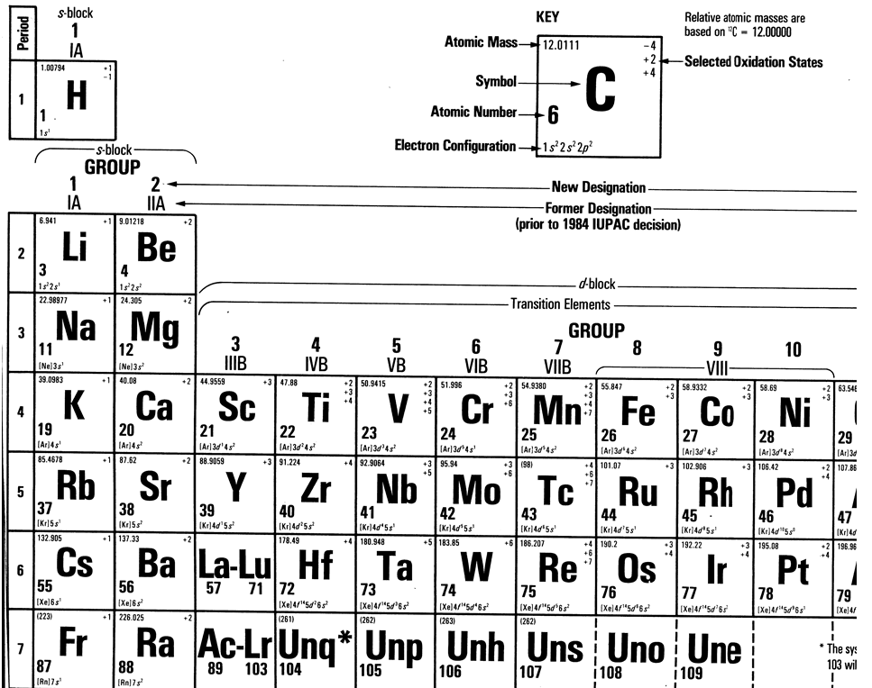

Slide 63
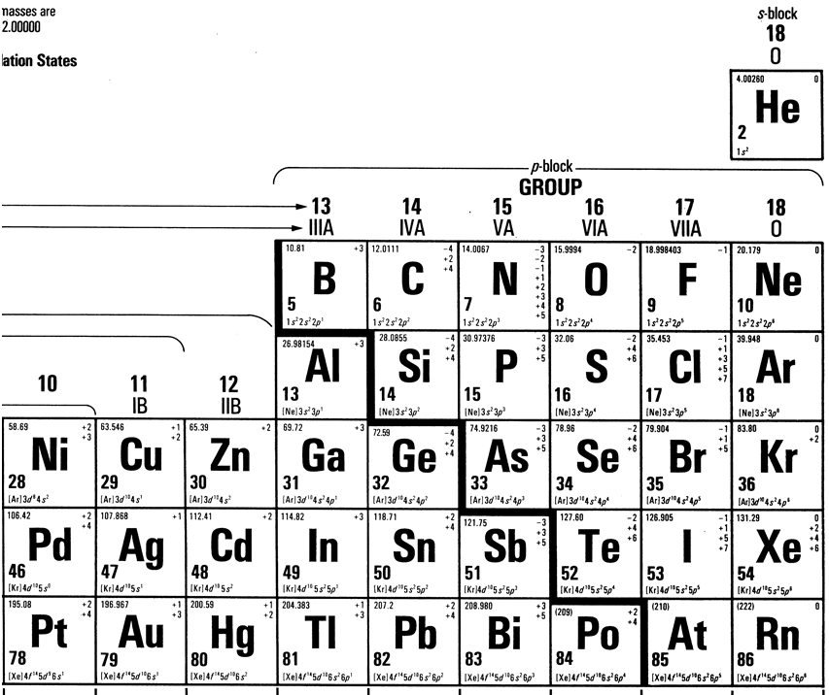

Slide 64
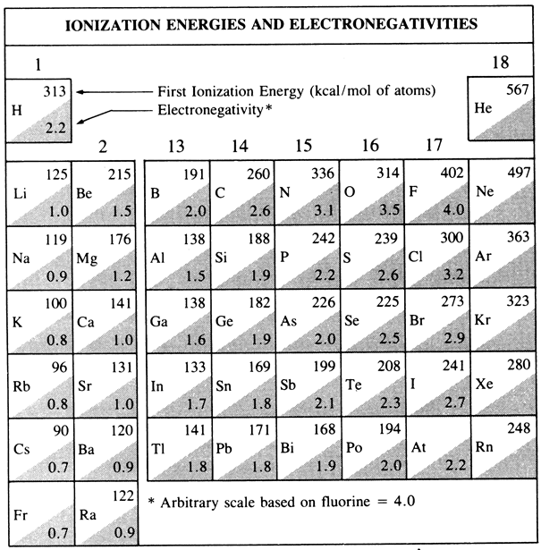

Slide 65
