Slide 1
Click on “Slide Show”
Click “Play from Beginning”

Slide 2
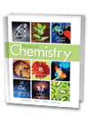


Chapter 10
Chemical Quantities
The Mole: A Measurement of Matter
Mole-Mass and Mole-Volume Relationships
Percent Composition and Chemical Formulas

Slide 3
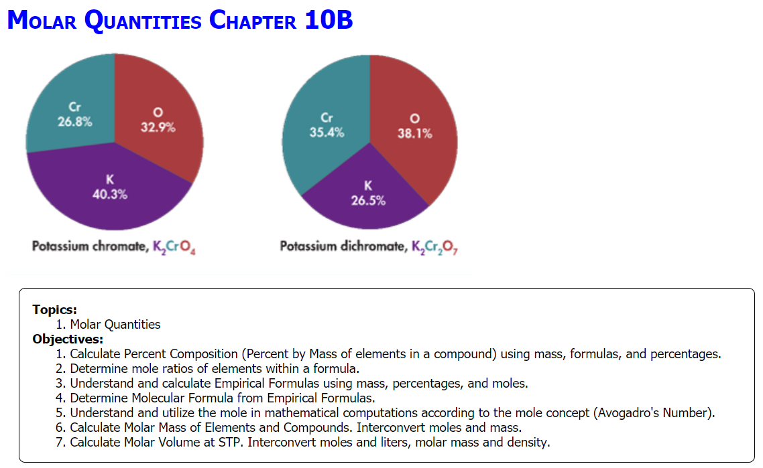

Slide 4
Review Molar Quantities
Consider calcium nitrate, Ca(NO₃)₂. What do the subscripts represent? How many atoms of each element are there?
What is the molar mass of calcium nitrate?
If a sample contains 21.2 g N₂, how many moles of N₂ does it contain?
How many liters of N₂ gas is this?
How many molecules of N₂ gas is this?
Use the periodic table to find the molar mass of each of the following elements.
Sodium (Na):
Oxygen (O):
Carbon (C):
Consider sodium oxide, Na₂O. What do the subscripts represent?
What is the molar mass of sodium oxide?
Notes:
Timing ≈ 1 min
Entry audio: Chemical formulas can be used to calculate molar mass.
Hint1 audio: Remember to multiply the molar mass of each element by its subscript when calculating the molar mass of the compound.
Hint2 audio: If an entity in parentheses has a subscript, that subscript applies to all elements inside the parentheses.
Exit Audio: To determine the molar mass of a compound, use the subscripts in the formula to determine how many moles of an element is needed. Multiply the subscript times the gram atomic mass and add all the gram atomic masses of the compound to determine the molar mass.

Slide 5
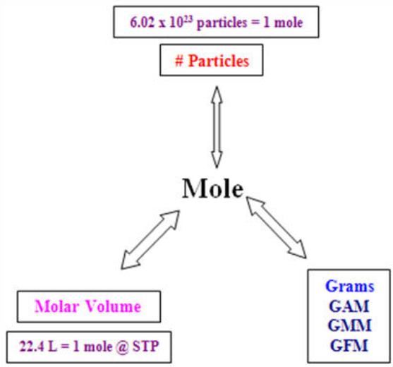
Molar Mass (g/mol)

Slide 6
Review Molar Quantities
Consider calcium nitrate, Ca(NO₃)₂. What do the subscripts represent? How many atoms of each element are there?
There are two nitrate ions.
1 Ca, 2 N, 6 O
What is the molar mass of calcium nitrate?
Ca 1 x 40.1 g/mol = 40.1 g/mol
N 2 x 14.0 g/mol = 28.0 g/mol
O 6 x 16.0 g/mol = 96.0 g/mol
= 164 g/mol
If a sample contains 21.2 g N₂, how many moles of N₂ does it contain?
21.2 g x 1 mol/28.0 g = 0.757 mol
How many liters of N₂ gas is this?
0.757 mol x 22.4 L/1 mol = 17.0 L
How many molecules of N₂ gas is this?
0.757 mol x 6.02 × 10²³ molecules/1 mol
= 4.56 × 10²³ molecules
Use the periodic table to find the molar mass of each of the following elements.
Sodium (Na): 22.99 g/mol
Oxygen (O): 16.00 g/mol
Carbon (C): 12.01 g/mol
Consider sodium oxide, Na₂O. What do the subscripts represent?
There are two atoms of sodium and one atom of oxygen.
What is the molar mass of sodium oxide?
Na 2 x 23.0 g/mol = 46.0 g/mol
O 1 x 16.0 g/mol = 16.0 g/mol
= 62.0 g/mol
Notes:
Timing ≈ 1 min
Entry audio: Chemical formulas can be used to calculate molar mass.
Hint1 audio: Remember to multiply the molar mass of each element by its subscript when calculating the molar mass of the compound.
Hint2 audio: If an entity in parentheses has a subscript, that subscript applies to all elements inside the parentheses.
Exit Audio: To determine the molar mass of a compound, use the subscripts in the formula to determine how many moles of an element is needed. Multiply the subscript times the gram atomic mass and add all the gram atomic masses of the compound to determine the molar mass.

Slide 7
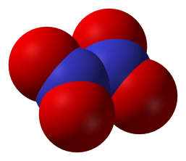
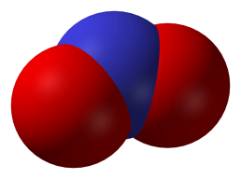
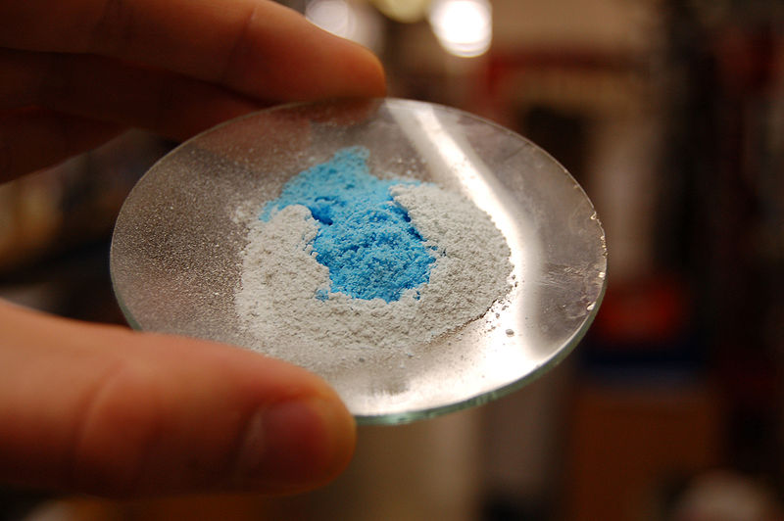
How Do Scientists Calculate the Composition of Elements in a Compound?
N₂O₄
NO₂
CuSO₄ hydrate
Notes:
Timing ≈ 0.5 min
Recap: You have learned and reviewed the concept of molar mass. You know that to calculate the molar mass of a compound, you need to use the subscripts of the elements from the chemical formula.
Connect: The subscripts of the elements in a chemical formula provide the ratio of the elements that make up the compound. This ratio of moles can be use to provide more information about the compound.
Preview: Mole ratios that are in the simplest form provide an empirical formula of a compound. The actual molar ratio of elements in a compound provides the molecular formula. In this segment, we will compare and contrast empirical and molecular formulas.
SOURCES:
http://en.wikipedia.org/wiki/File:Nitrogen-dioxide-3D-vdW.png
http://en.wikipedia.org/wiki/File:Dinitrogen-tetroxide-3D-vdW.png

Slide 8
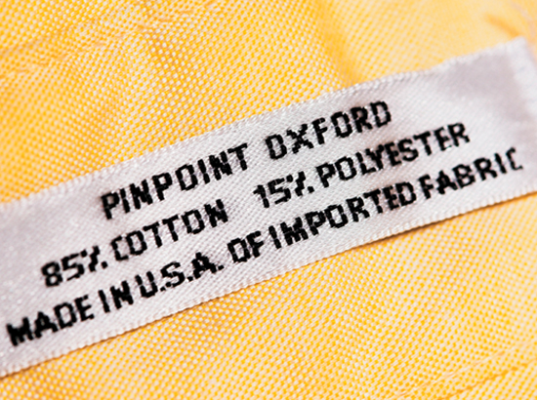
Percent composition of a compound
The basis for accurate quantitative analysis is the proportion by weight or mass of elements in a formula.
If we added the individual masses of each atom in a formula, we will obtain the total mass for the compound or molecule:
Total % of all elements in a formula = 100 %
It follows that the proportion of any ONE element in a sample is equal to the mass of the sample divided by the total mass, therefore:
% element = mass of the element / total mass x 100 %

Slide 9
Percent composition of a compound
The relative amounts of the elements in a compound are expressed as the percent composition or the percent by mass of each element in the compound.
Determine the percent composition of potassium chromate, K₂CrO₄:
K = ? %
Cr = ? %
O = ? %
100.0 %

Slide 10
Percent composition of a compound
The relative amounts of the elements in a compound are expressed as the percent composition or the percent by mass of each element in the compound.
Determine the percent composition of potassium chromate, K₂CrO₄:
% element = mass of the element / total mass x 100 %
K = 2 x 39.1 g/mol = 78.2 g/mol
Cr = 1 x 52.0 g/mol = 52.0 g/mol
O = 4 x 16.0 g/mol = 64.0 g/mol
Molar Mass = 194.2 g/mol
K = 78.2/194.2 x 100% = 40.3%
Cr = 52.0/194.2 x 100% = 26.8%
O = 64.0/194.2 x 100% = 32.9%

Slide 11
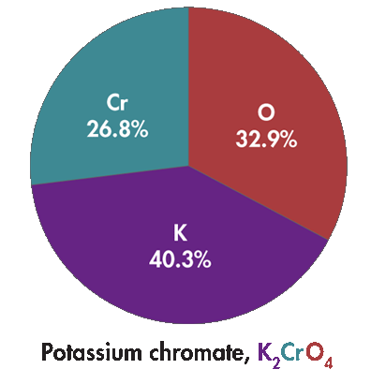
Percent composition of a compound
Percentages must total 100%. The percent composition of any compound is always the same (law of definite proportions.)
The percent composition of potassium chromate, K₂CrO₄, is:
K = 40.3%
Cr = 26.8%
O = 32.9%
100.0 %
Note: 100% = 1
The percentages can be set equal to “1” as follows:
0.403 + 0.268 + 0.329 = 1

Slide 12


A sample of a compound containing carbon and oxygen had a mass of 88 grams. Experimental procedures determined that 24 grams of the sample was carbon and 64 grams was oxygen. Find the % composition (of each element) of the compound.

Slide 13
A sample of a compound containing carbon and oxygen had a mass of 88 grams. Experimental procedures determined that 24 grams of the sample was carbon and 64 grams was oxygen. Find the % composition (of each element) of the compound.
% C = mass of C / Total Mass x 100% → 24 g / 88 g x 100 % = 27% Carbon
% O = mass of O / Total Mass x 100% → 64 g / 88 g x 100 % = 73% Oxygen
Note: The percentages can be set equal to “1” as follows:
0.27 g + 0.73 g = 1 g
… for every 1 g of sample, there is 0.27 g C & 0.73 g O

Slide 14
Calculating Percent Composition from Mass Data
A compound is formed when 9.03 g Mg combines completely with 3.48 g N. What is the percent composition of this compound?

Slide 15
Calculating Percent Composition from Mass Data
A compound is formed when 9.03 g Mg combines completely with 3.48 g N. What is the percent composition of this compound?
1. Find total mass 9.03 g Mg + 3.48g N = 12.51 g of compound
2. Find % by mass
% Mg = mass of Mg / Total Mass x 100% → 9.03 g / 12.51 g x 100 % = 72.2% Mg
% N = mass of N / Total Mass x 100% → 3.48 g / 12.51 g x 100 % = 27.8% N
Show the percentages of the elements adding up to 100% and 1.

Slide 16
Calculating Percent Composition from Mass Data
A compound is formed when 9.03 g Mg combines completely with 3.48 g N. What is the percent composition of this compound?
1. Find total mass 9.03 g Mg + 3.48g N = 12.51 g of compound
2. Find % by mass
% Mg = mass of Mg / Total Mass x 100% → 9.03 g / 12.51 g x 100 % = 72.2% Mg
% N = mass of N / Total Mass x 100% → 3.48 g / 12.51 g x 100 % = 27.8% N
NOTE: the percentages of the elements add up to 100% or 1.
72.2% + 27.8% = 100%
0.722 + 0.278 = 1

Slide 17
Calculating Percent Composition from a Formula
Determine the % composition of Sulfuric Acid
What is the formula?
Find GFM or GMM
Find percent composition

Slide 18
Calculating Percent Composition from a Formula
Determine the % composition of Sulfuric Acid (H₂SO_{4 aq})
Find GFM or GMM
H 2 x 1.00 g/mol = 2.00 g/mol
S 1 x 32.1 g/mol = 32.1 g/mol
O 4 x 16.0 g/mol = 64.0 g/mol
= 98.1 g/mol
Find percent composition
% H GAM/Total Mass → 2.00 g / 98.1 g/mol = 0.0204 = 2 %
% S GAM/Total Mass → 32.1 g / 98.1 g/mol = 0.327 = 33 %
% O GAM/Total Mass → 64.0 g / 98.1 g/mol = 0.652 = 65 %

Slide 19
Calculating Percent Composition from a Formula
Calculate the percent composition of ethane (C₂H₆).

Slide 20
Calculating Percent Composition from a Formula
Calculate the percent composition of ethane (C₂H₆).
Find the molar mass of ethane (C₂H₆)
mass of C in 1 mol C₂H₆ = 2 mol × 12.0 g/mol = 24.0 g
mass of H in 1 mol C₂H₆ = 6 mol × 1.00 g/mol = 6.00 g
molar mass of C₂H₆ = 24.0 g/mol + 6.00 g/mol = 30.0 g/mol
Find percent composition
% C GAM/Total Mass → 24.0 g / 30.0 g/mol = 0.80 = 80 %
% H GAM/Total Mass → 6.00 g / 30.0 g/mol = 0.20 = 20 %

Slide 21
Calculating Mass from Percent Composition
Calculate the mass of the elements in 350 g of ethane (C₂H₆).

Slide 22
Calculating a Formula from Percent Composition
Calculate the mass of the elements in 350 g of ethane (C₂H₆).
Rearrange % mass equation
% mass = mass of element / total mass
Mass of element = (% mass)(total mass)
Find percent composition
% C GAM/Total Mass → 24.0 g / 30.0 g/mol = 0.80 = 80 %
% H GAM/Total Mass → 6.00 g / 30.0 g/mol = 0.20 = 20 %
Find the mass of each element in 350 g of ethane (C₂H₆)
mass of C = 350 g x 80 % = 280 g
mass of H = 350 g x 20 % = 70 g

Slide 23
Mole Ratios (Divide “moles” by “moles”)
  CaCl₂
    Ratio of subscripts = __:__
    Mole ratio of Ca:Cl = __:__
  Ca₃(PO₄)₂
    Ratio of subscripts = __:__:__
    Mole ratio of Ca:P:O = __:__:__
  C₆H₁₂O₆
    Ratio of subscripts = __:__:__
    Mole ratio C:H:O = __:__:__
  NO₂
    Ratio of subscripts = __:__
    Mole ratio of N:O = __:__
  N₂O₄
    Ratio of subscripts = _:_
    Mole ratio of N:O = 2:4 = __:__
    EMPIRICAL → smallest whole number ratio
Notes:
Timing ≈ 2 min
The mole ratios of elements in a compound are given by the chemical formula.
[animate 1st left-hand bullet] Consider the compound calcium chloride. Its chemical formula shows that each formula unit of calcium chloride contains one calcium ion and two chloride ions. Similarly, one mole of CaCl2 contains one mole of calcium ions and two moles of chloride ions. [animate 1st sub-bullet] the ratio of the subscripts is 1:2--one calcium to two chloride. [animate 2nd sub-bullet] Therefore, the mole ratio of calcium to chlorine in CaCl2 is 1:2.
[animate 2nd left-hand bullet & sub-bullets] We can apply the same thought process to any compound. In Na3PO4, the ratio of subscripts is 3:1:4, and the mole ratio of Na:P:O is 3:1:4. For every three sodium ions, there is one phosphorus atom and four oxygen atoms. Remember that the order of substances in a ratio matters. The ratio of Na:P is 3:1, not 1:3.
[animate 3rd left-hand bullet & sub-bullets] It doesn't matter how many elements or atoms are in a compound. In the organic molecule, C2H3O5N, the mole ratio of C:H:O:N is 2:3:5:1, as indicated by the subscripts.
Like all ratios, mole ratios can be reduced to their simplest whole number form. For example, consider the compound NO2 [animate 1st right-hand bullet & sub-bullets]. Its mole ratio of N:O is 1:2.
[animate 2nd right-hand bullet] However, what about the compound N₂O₄? [animate 1st sub-bullet] Its ratio of subscripts is 2:4, but that is the same as 1:2. [animate 2nd sub-bullet] therefore, we can write the mole ratio of N:O in this compound as 2:4 or as 1:2. If you consider the simplest mole ratio, then NO2 and N2O4 have the same N:O mole ratio.

Slide 24
Mole Ratios (Divide “moles” by “moles”)
  CaCl₂
    Ratio of subscripts = 1:2
    Mole ratio of Ca:Cl = 1:2
  Ca₃(PO₄)₂
  Ratio of subscripts = 3:2:8
    Mole ratio of Ca:P:O = 3:2:8
  C₆H₁₂O₆
    Ratio of subscripts = 6:12:6
    Mole ratio C:H:O = 1:2:1
  NO₂
    Ratio of subscripts = 1:2
    Mole ratio of N:O = 1:2
  N₂O₄
    Ratio of subscripts = 2:4 = 1:2
    Mole ratio of N:O = 2:4 = 1:2
    Both molecules are nitrous oxide
    EMPIRICAL → smallest whole number ratio
Notes:
Timing ≈ 2 min
The mole ratios of elements in a compound are given by the chemical formula.
[animate 1st left-hand bullet] Consider the compound calcium chloride. Its chemical formula shows that each formula unit of calcium chloride contains one calcium ion and two chloride ions. Similarly, one mole of CaCl2 contains one mole of calcium ions and two moles of chloride ions. [animate 1st sub-bullet] the ratio of the subscripts is 1:2--one calcium to two chloride. [animate 2nd sub-bullet] Therefore, the mole ratio of calcium to chlorine in CaCl2 is 1:2.
Like all ratios, mole ratios can be reduced to their simplest whole number form. For example, consider the compound NO2 [animate 1st right-hand bullet & sub-bullets]. Its mole ratio of N:O is 1:2.
[animate 2nd right-hand bullet] However, what about the compound N₂O₄? [animate 1st sub-bullet] Its ratio of subscripts is 2:4, but that is the same as 1:2. [animate 2nd sub-bullet] therefore, we can write the mole ratio of N:O in this compound as 2:4 or as 1:2. If you consider the simplest mole ratio, then NO2 and N2O4 have the same N:O mole ratio.

Slide 25
Calculating a Formula from Percent Composition
A compound contains 11% hydrogen and 89 % oxygen. What is its formula?

Slide 26
Calculating a Formula from Percent Composition
A compound contains 11% hydrogen and 89 % oxygen. What is its formula?
Remember that percentage can be made into decimals equaling 1 g:
11 % + 89 % = 100 % → 0.11 g + 0.89 g = 1.0 g
Find Moles using the grams:
H 0.11 g x 1 mol/1.00 g = 0.110 mol H
O 0.89 g x 1 mol/16.0 g = 0.0556 mol O
Find the Mole Ratio (divide moles by moles): law of definite proportions
0.110 mol / 0.0556 mol = 2:1
Since the mole ratio = 2:1, the formula is H₂O (water)

Slide 27
Calculating a Formula from Percent Composition
Done WITHOUT Decimals
A compound contains 11% hydrogen and 89 % oxygen. What is its formula?
Percentage can be made into numbers equaling 100 g:
11 % + 89 % = 100 % → 11 g + 89 g = 100 g
Find Moles using the grams:
H 11 g x 1 mol/1.00 g = 11.0 mol H
O 89 g x 1 mol/16.0 g = 5.56 mol O
Find the Mole Ratio (divide moles by moles): law of definite proportions
11.0 mol / 5.56 mol = 2:1
Since the mole ratio = 2:1, the formula is H₂O (water)

Slide 28
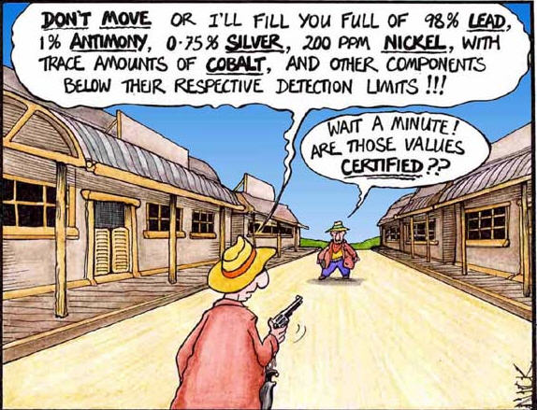

Slide 29
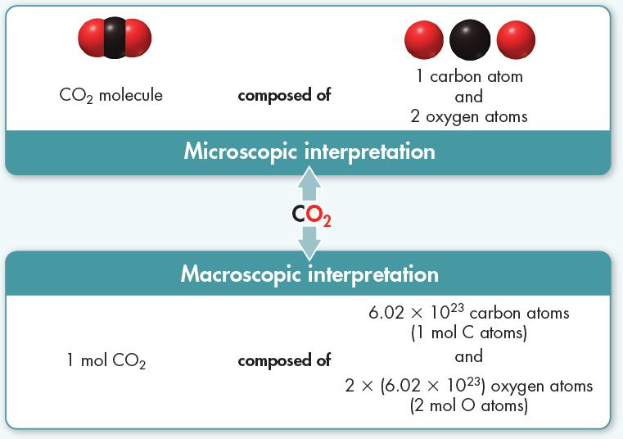
Empirical Formulas
The empirical formula of a compound gives the lowest whole-number ratio of the atoms or moles of the elements in a compound.
An empirical formula may or may not be the same as a molecular formula.
For carbon dioxide, the empirical and molecular formulas are the same: CO₂, both having mole ratios of 1:2.
For calcium sulfide the molecular formula is Ca₂S₂, so the mole ratio is 2:2. The empirical formula of calcium sulfide is CaS since the simplest whole number mole ratio is 1:1.

Slide 30
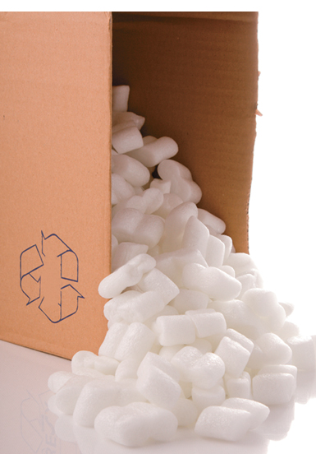

Empirical Formulas
The figure below shows two compounds of carbon and hydrogen having the same empirical formula (CH)_{x} but different molecular formulas.
Ethyne (C₂H₂), also called acetylene, is a gas used in welders’ torches.
Styrene (C₈H₈) is used in making polystyrene.

Slide 31
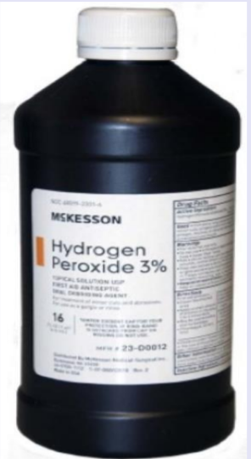
Empirical Formulas
Empirical formula (CH)_{x} can be included in a molecular formula to distinguish molecules:
(CH)₈
(HO)₂
(CH)₂
Ethyne (C₂H₂)
Styrene (C₈H₈)
Peroxide (H₂O₂)

Slide 32
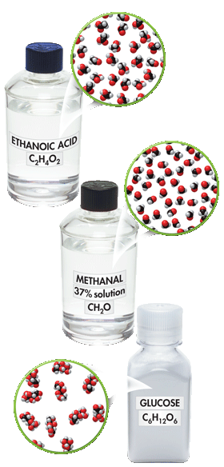
Determining Empirical Formulas
… the simplest mole ratio of elements in a compound
Step 1 → find the number of moles of each element in the compound
Step 2 → divide the # moles by the smallest # moles (from step 1)
Step 3 → determine a whole # mole ratio
Ethanoic acid, methanal, and glucose all have the same empirical formula — CH₂O.

Slide 33
A compound composed of Nickel and fluorine contains 9.11 g Ni and 5.89 g F. What is the empirical formula of this compound?
Step 1 → find the number of moles of each element in the compound
Step 2 → divide the # moles by the smallest # moles (from step 1)
Step 3 → determine a whole # mole ratio

Slide 34
A compound composed of Nickel and fluorine contains 9.11 g Ni and 5.89 g F. What is the empirical formula of this compound?
Step 1 → find the number of moles of each element in the compound
9.11 g x 1 mol / 58.7 g Ni = 0.155 mol Ni
5.89 g x 1 mol / 19.0 g F = 0.310 mol F
Step 2 → divide the # moles by the smallest # moles (from step 1)
0.155 mol / 0.155 mol = 1
0.310 mol / 0.155 mol = 2.01
Step 3 → determine a whole # mole ratio … law of definite proportions
1:2 NiF₂
Note: remember, the metal comes first in a formula while the non-metal is listed last

Slide 35
1,6 diaminohexane is used to make nylon. What is the empirical formula of this compound if its percent composition is 62.1 % C, 13.8 % H, and 24.1 % N?

Slide 36
1,6 diaminohexane is used to make nylon. What is the empirical formula of this compound if its percent composition is 62.1 % C, 13.8 % H, and 24.1 % N?
DONE WITH DECIMALS
Change % into grams: 62.1 % = .621 g C, 13.8% = 13.8 g H, etc.
Find the number of moles of each element in the compound
0.621 g x 1 mol / 12.0 g C = 0.0518 mol C
0.138 g x 1 mol / 1.00 g H = 0.138 mol H
0.241 g x 1 mol / 14.0 g N = 0.0172 mol N
Divide the # moles by the smallest # moles
0.0518 mol / 0.0172 mol = 3.01 C
0.138 mol / 0.0172 mol = 8.02 H
0.0172 mol / 0.0172 mol = 1.00 N
Determine a whole # mole ratio … law of definite proportions
C:H:N 3:8:1 C₃H₈N

Slide 37
1,6 diaminohexane is used to make nylon. What is the empirical formula of this compound if its percent composition is 62.1 % C, 13.8 % H, and 24.1 % N?
DONE WITHOUT DECIMALS
Change % into grams: 62.1% = 62.1 g C, 13.8% = 13.8 g H, etc.
Find the number of moles of each element in the compound
62.1 g x 1 mol / 12.0 g C = 5.18 mol C
13.8 g x 1 mol / 1.00 g H = 13.8 mol H
24.1 g x 1 mol / 14.0 g N = 1.72 mol N
Divide the # moles by the smallest # moles
5.18 mol / 1.72 mol = 3.01 C
13.8 mol / 1.72 mol = 8.02 H
1.72 mol / 1.72 mol = 1.00 N
Determine a whole # mole ratio … law of definite proportions
C:H:N 3:8:1 C₃H₈N

Slide 38
Determining Molecular Formulas
The molecular formula of a compound is either the same as its experimentally determined empirical formula, or it is a simple whole-number multiple of its empirical formula.
Step 1 → Determine the molar mass of the empirical formula.
Step 2 → Determine the mass ratio of the molecular formula / empirical formula.
Step 3 → Multiply subscripts by the mass ratio.

Slide 39
Determining Molecular Formulas
What is the molecular formula of a compound with the empirical formula CClN and a molar mass of 184.5 g/mol?
Step 1 → determine the molar mass of the empirical formula
Step 2 → determine the mass ratio of the molecular formula / empirical formula
Step 3 → multiply subscripts by the mass ratio

Slide 40
Determining Molecular Formulas
What is the molecular formula of a compound with the empirical formula CClN and a molar mass of 184.5 g/mol?
Step 1 → determine the molar mass of the empirical formula
C 1 x 12.01 g/mol
Cl 1 x 35.45 g/mol
N 1 x 14.01 g/mol
= 61.47 g/mol
Step 2 → determine the mass ratio of the molecular formula / empirical formula
Step 3 → multiply subscripts by the mass ratio
C₁Cl₁N₁ x 3 = C₃Cl₃N₃
Mass Ratio:
184.5 g/mol = 3.001
61.47 g/mol

Slide 41
Calculate Empirical Formula from Percent Composition
A compound contains 75% carbon and 25% hydrogen by mass. What is the empirical formula for this compound?
A compound is 42% sodium, 19% phosphorus, and 39% oxygen by mass. What is the empirical formula of this compound?
Notes:
Timing ≈ 1 min
Entry audio: Test your understanding by solving these two problems.
Hint1 audio: Remember to assume 100 g of the substance to start with.
Hint2 audio: Make sure you are comparing molar amounts, not masses, when you calculate mole ratios.
Exit Audio: Our next segment extends our calculations to determine the molecular formula of the compound. Knowing the molar mass of the compound allows us to determine the molecular formula from the empirical formula.

Slide 42
Calculate Empirical Formula from Percent Composition
A compound contains 75% carbon and 25% hydrogen by mass. What is the empirical formula for this compound?
Change % into grams:
75% = 0.750 g C 25% = 0.250 g H
Find the number of moles:
0.750 g x 1 mol/12.0 g C = 0.0625 mol C
0.250 g x 1 mol/1.00 g H = 0.25 mol H
Divide by the smallest # moles:
0.0625 mol / 0.0625 mol = 1 C
0.25 mol / 0.0625 mol = 4 H
Determine a whole # mole ratio:
C:H 1:4 CH₄
A compound is 42% sodium, 19% phosphorus, and 39% oxygen by mass. What is the empirical formula of this compound?
Change % into grams:
0.42 g Na 0.19 g P 0.39 g O
Find the number of moles:
0.420 g x 1 mol/23.0 g Na = 0.0183 mol Na
0.190 g x 1 mol/31.0 g P = 0.0061 mol P
0.390 g x 1 mol/16.0 g O = 0.0244 mol P
Divide by the smallest # moles:
0.0183 mol / 0.0061 mol = 3 Na
0.0061 mol / 0.0061 mol = 1 P
0.0244 mol / 0.0061 mol = 4 O
Determine a whole # mole ratio:
Na:P:O 3:1:4 Na₃PO₄
Notes:
Timing ≈ 1 min
Entry audio: Test your understanding by solving these two problems.
Hint1 audio: Remember to assume 100 g of the substance to start with.
Hint2 audio: Make sure you are comparing molar amounts, not masses, when you calculate mole ratios.
Exit Audio: Our next segment extends our calculations to determine the molecular formula of the compound. Knowing the molar mass of the compound allows us to determine the molecular formula from the empirical formula.

Slide 43
Calculate Empirical Formula from Percent Composition (Done ANOTHER WAY)
A compound contains 75% carbon and 25% hydrogen by mass. What is the empirical formula for this compound?
Change % into grams:
75% = 75 g C 25% = 25 g H
Find the number of moles:
75 g x 1 mol/12.0 g C = 6.25 mol C
25 g x 1 mol/1.00 g H = 25 mol H
Divide by the smallest # moles:
62.5 mol / 6.25 mol = 1 C
25 mol / 6.25 mol = 4 H
Determine a whole # mole ratio:
C:H 1:4 CH₄
A compound is 42% sodium, 19% phosphorus, and 39% oxygen by mass. What is the empirical formula of this compound?
Change % into grams:
42% = 42 g Na 19% = 19 g P 39% = 39 g O
Find the number of moles:
42 g x 1 mol/23.0 g Na = 1.83 mol Na
19 g x 1 mol/31.0 g P = 0.61 mol P
39 g x 1 mol/16.0 g O = 2.44 mol P
Divide by the smallest # moles:
1.83 mol / 0.61 mol = 3 Na
0.61 mol / 0.61 mol = 1 P
2.44 mol / 0.61 mol = 4 O
Determine a whole # mole ratio:
Na:P:O 3:1:4 Na₃PO₄
Notes:
Timing ≈ 1 min
Entry audio: Test your understanding by solving these two problems.
Hint1 audio: Remember to assume 100 g of the substance to start with.
Hint2 audio: Make sure you are comparing molar amounts, not masses, when you calculate mole ratios.
Exit Audio: Our next segment extends our calculations to determine the molecular formula of the compound. Knowing the molar mass of the compound allows us to determine the molecular formula from the empirical formula.

Slide 44
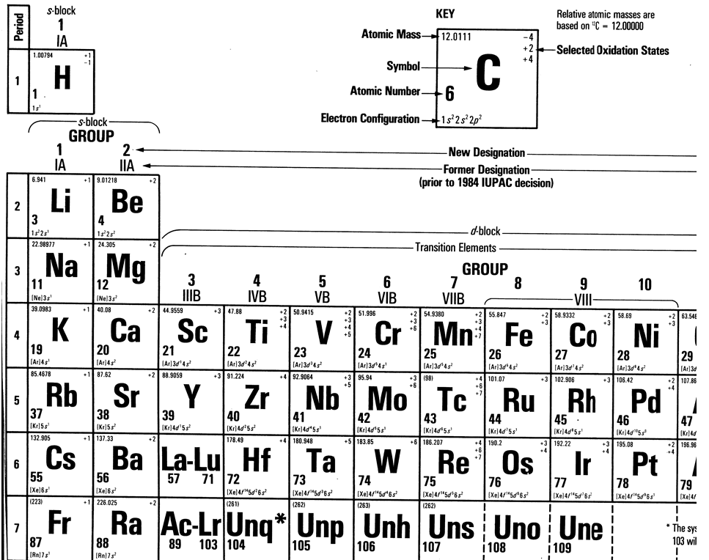

Slide 45
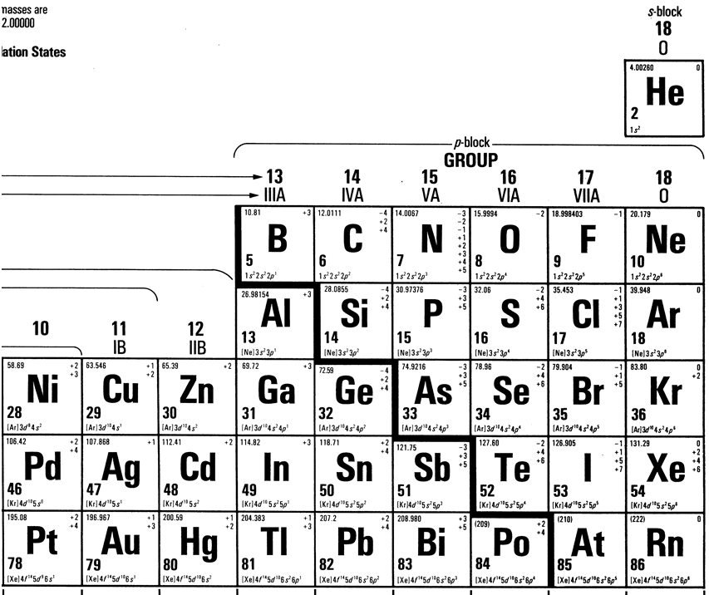

Slide 46
