Slide 1
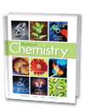
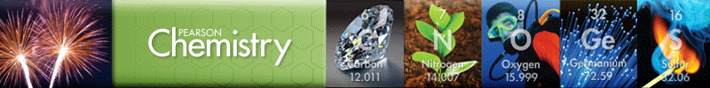
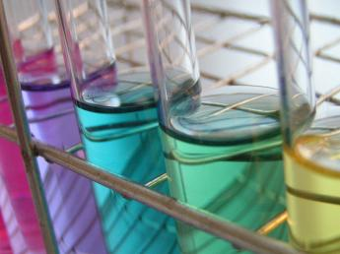
Chapter 15.1-2
Water and Aqueous
Systems
Chapter 16
Solutions
Properties of Solutions
Concentrations of Solutions
Colligative Properties
of Solutions
Calculations Involving
Colligative Properties

Slide 2
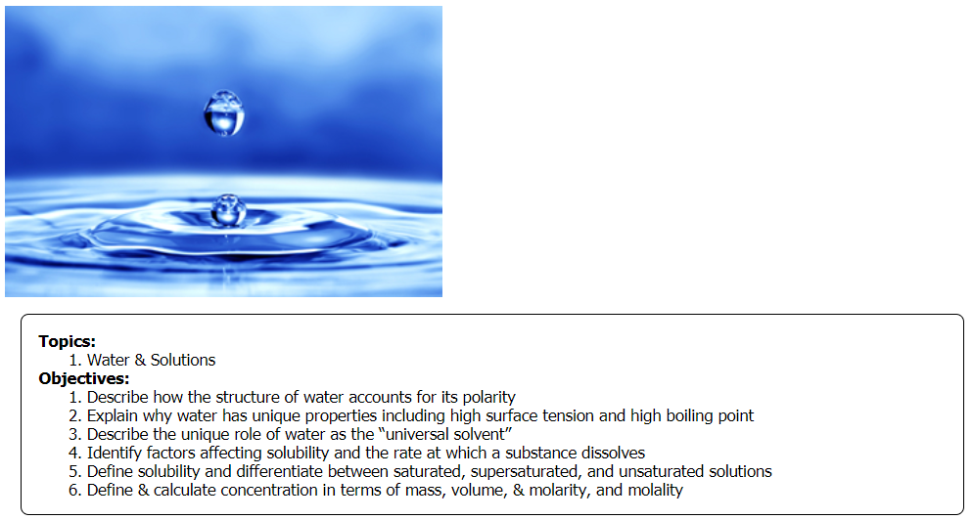
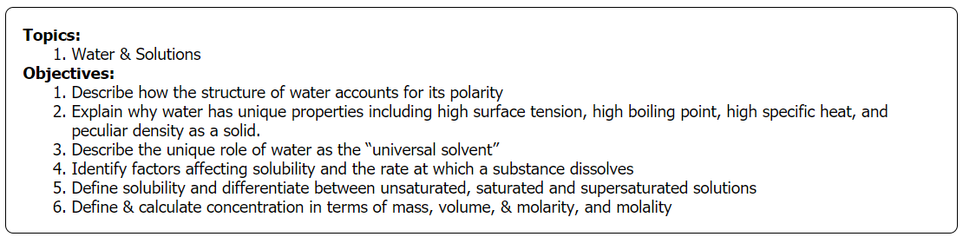

Slide 3
Solutions
For each pair of coffee samples below, select the sample that contains more grams of sugar per gram of coffee.
O 5 grams of sugar added to 50 grams of coffee
O 5 grams of sugar added to 100 grams of coffee
O 2 grams of sugar added to 50 grams of coffee
O 5 grams of sugar added to 50 grams of coffee
Rank the following coffee samples in terms of likely sweetness based on the amount of sugar added. Use 1 for the sweetest coffee and 4 for the least-sweet coffee.
5 grams of sugar added to 50 grams of coffee
5 grams of sugar added to 100 grams of coffee
2 grams of sugar added to 100 grams of coffee
2 grams of sugar added to 50 grams of coffee
Notes:
Timing ≈ 0.5 min
Entry audio: The amount of solute dissolved in a solvent affects the resulting solution.
Hint 1 Audio: The sweeter coffee will have more grams of sugar dissolved in it per gram of coffee.
Hint2 audio: [none]
Hint3 audio: Calculate the number of grams of sugar per gram of coffee and compare those numbers.
Exit Audio: Instead of describing the coffee as sweet or bitter, how else can you express the amount of sugar dissolved in the coffee? In this lesson, you will find out how.
SOURCES:

Slide 4
Solutions
For each pair of coffee samples below, select the sample that contains more grams of sugar per gram of coffee.
5 grams of sugar added to 50 grams of coffee
5 grams of sugar added to 100 grams of coffee
2 grams of sugar added to 50 grams of coffee
5 grams of sugar added to 50 grams of coffee
Rank the following coffee samples in terms of likely sweetness based on the amount of sugar added. Use 1 for the sweetest coffee and 4 for the least-sweet coffee.
1 5 grams of sugar added to 50 grams of coffee
2 5 grams of sugar added to 100 grams of coffee
4 2 grams of sugar added to 100 grams of coffee
3 2 grams of sugar added to 50 grams of coffee
Notes:
Timing ≈ 0.5 min
Entry audio: The amount of solute dissolved in a solvent affects the resulting solution.
Hint 1 Audio: The sweeter coffee will have more grams of sugar dissolved in it per gram of coffee.
Hint2 audio: [none]
Hint3 audio: Calculate the number of grams of sugar per gram of coffee and compare those numbers.
Exit Audio: Instead of describing the coffee as sweet or bitter, how else can you express the amount of sugar dissolved in the coffee? In this lesson, you will find out how.
SOURCES:

Slide 5
Objectives
  Describe how the structure of water accounts for its polarity
  Explain why water has unique properties including high surface tension and high boiling point
  Describe the unique role of water as the “universal solvent”
  Identify factors affecting solubility and the rate at which a substance dissolves
  Define solubility and differentiate between saturated, supersaturated, and unsaturated solutions
Notes:
Timing ≈ 0.5 minutes
Review the lesson’s objectives, which are listed on the slide. As a result of this lesson, you now should be able to do all of these things.
Sources: XXX

Slide 6
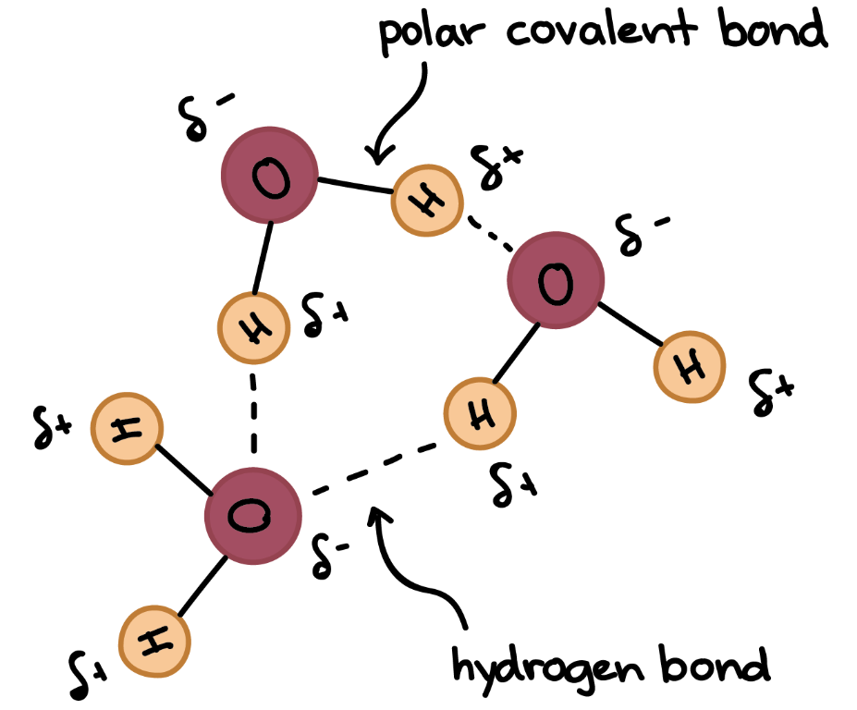
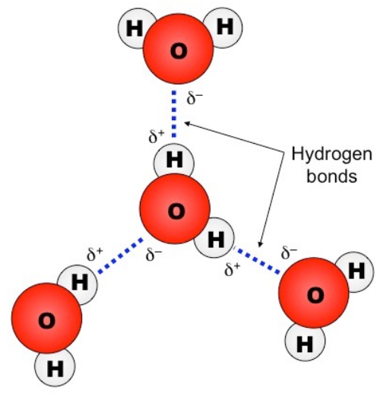
The Properties of Water
  Water’s polarity gives it the ability to form hydrogen bonds and thereby giving water many unique and special properties.
https://screencast-o-matic.com/watch/cFXiD9YP5e (1:09)
Notes:
Timing ~0.5 min
Many of water's properties are unusual or unique.

Slide 7
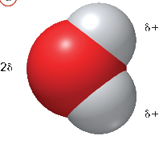
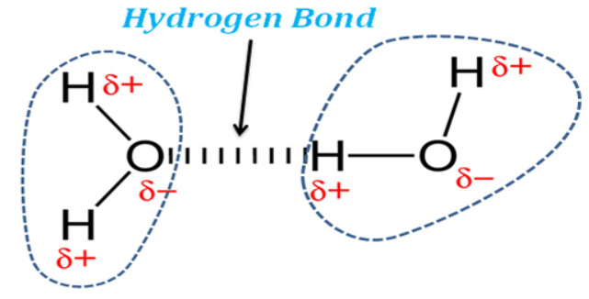
Hydrogen Bonds
Water is a polar molecule and therefore, is attracted to other water molecules (dipole interactions).
δ⁺
The negative end of one water molecule attracts the positive end of another water molecule.
δ–
δ⁺
Hydrogen bonds arise when a hydrogen atom (small) is covalently bonded to a highly electronegative larger atom.

Slide 8
The Properties of Water
  Hydrogen bonding produces many of water’s properties:
  Water's melting and boiling points are higher than expected.
  Water exhibits strong surface tension and capillary action due to adhesion & cohesion.
  Water’s specific heat is second highest of all liquids. As a result, it can store large amounts of thermal energy. This allows it to moderate climate.
  Water is one of the few substances whose solid state is LESS dense than its liquid state. Ice is less dense than liquid water because when water reaches 4 ⁰C, it expands.
Notes:
Timing ~0.5 min
Many of water's properties are unusual or unique.

Slide 9
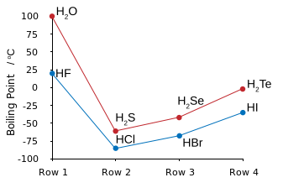
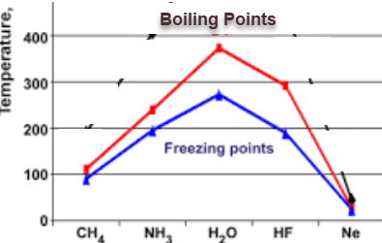
High Boiling & Melting Point of Water
Molecular compounds of low molecular mass are usually gases or liquids with low boiling points at normal atmospheric pressure.
Water has a molar mass of 18.0 g/mol, but it has a HIGH boiling point of 100˚C. Ammonia (NH₃) has a molar mass of 17.0 g/mol and boils at about –33˚C. Look at the graph for a comparison.
This is due to hydrogen bonding.

Slide 10
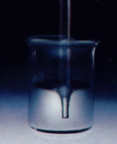


Properties of Water
Surface Tension
  The property of the surface of a liquid that allows it to resist an external force.
  Strong intermolecular forces produce higher surface tension (hydrogen bonding).
meniscus
Shape & size of droplets
Skiing anyone?

Slide 11
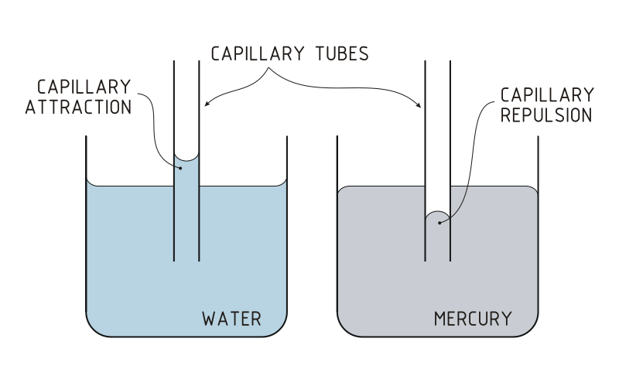
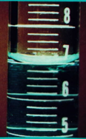
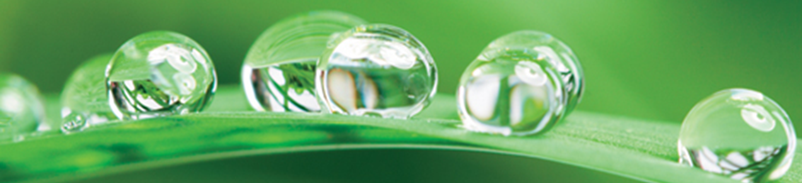
Adhesion & Cohesion produce Surface Tension
  adhesion
  attraction of molecules of different substances
    meniscus in glass tubes
    capillary action
  cohesion
  attraction of molecules within a substance (e.g. formation of droplets)
Notes:
Timing ~1.5 min
Two other important properties of water are adhesion and cohesion.
(animate 1st bullet & subs and 1st images) Adhesion is the attraction of water molecules to molecules in other substances. Because water is polar, it is attracted to other polar substances, such as glass. This is why water placed in a tube, such as a test tube or graduated cylinder, will form a U-shaped surface or bubble called a meniscus. (teacher point out meniscus in tube in image and mention that sometimes water forms a bubble meniscus (point out grad cylinder image) and that one should read the bottom of the meniscus) Adhesion allows water to “stick” to other surfaces.
(animate 2nd bullet & definition) Cohesion is the attraction of water to itself. We've already seen how water's polarity produces hydrogen bonding interactions between the molecules. These interactions tend to pull water molecules closely together in the liquid state. Adhesion and cohesion explain capillary action, the movement of water up a narrow tube due to attractions with the surface of the tube. (teacher point out capillary action in image). Adhesion and cohesion is what allows sponges and paper towels to absorb water, and it plays an important role in the movement of water through the vascular tissues of plants. This makes water is easy to syphon in straws or hoses.
(animate “formation of droplets” and 3rd image (spider web); exit first image of capillary action/grad cylinder) It is cohesion that causes water to bead up and form droplets--the water molecules tend to stick together or clump. Without water's strong intermolecular forces, the delicate droplets on this spider web would not form. Cohesion holds the drops together, and adhesion holds them to the threads of the web. This is also true when water “beads” up on a waxed surface (e.g. waxed paper or freshly waxed vehicle).
SOURCES:
http://commons.wikimedia.org/wiki/File:Capillary_Attraction_Repulsion_%28PSF%29_%28bjl%29.svg
http://commons.wikimedia.org/wiki/File:Spider_web_Luc_Viatour.jpg

Slide 12
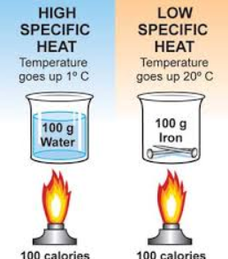
Specific Heat
  Resistance to change in temperature
    Higher specific heat means a substance can hold more heat or release more heat depending on temperature.
  Hydrogen bonds increase the amount of energy required for the average KE (temperature) to change.
Notes:
Timing ~1 min
The last property of water issuing from its hydrogen bonding ability that we will cover is its high specific heat.
(animate 1st bullet & sub) Specific heat is a measure of how much a substance resists changes in temperature. The higher the specific heat, the more energy the substance must absorb before its temperature changes. A good example of this is seen in the saying, “A watched pot never boils,” showing that water takes a long time to heat up.
Water has the second highest specific heat of all liquids. Again, this is because of the hydrogen bonds between the water molecules.
(animate 2nd bullet) Remember that temperature is a measure of the average kinetic energy of the molecules in a substance. Kinetic energy is a measure of the speed of the molecules in a system → the faster the particles are moving, the more kinetic energy they have. The faster the molecules move, the higher their average KE, and thus, their temperature. Because the hydrogen bonds hold water molecules together, the molecules must absorb more energy before their speed increases. So, water must absorb more thermal energy before its temperature increases.
The reverse is also true. The slower the molecules move, the lower their average KE, and thus, their temperature. Since the hydrogen bonds hold more energy, water must release more thermal energy before its temperature decreases.
[animate map; exit pan of boiling water on stove] The high specific heat of water allows it to store large amounts of thermal energy. This allows it to affect weather and climate significantly. Land areas that are closer to large bodies of water typically have more moderate climates than do areas at the same latitude and altitude that are far from water. [teacher point out examples: the “plains states” in the US have very cold winters and very hot summers, but mid-Atlantic region and west coast region like San Francisco have much milder climates because of location. Explain why this is → water warms/cools more slowly than land, so provides extra warmth in winter and absorbs more heat in summer]
SOURCES:
http://commons.wikimedia.org/wiki/File:Map_North_America.PNG

Slide 13
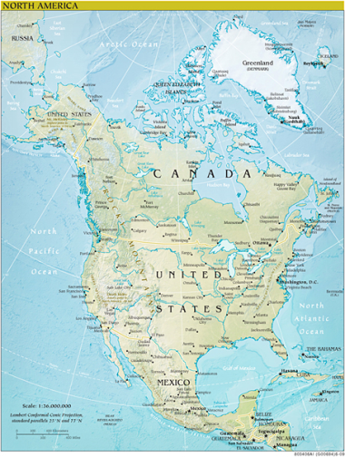
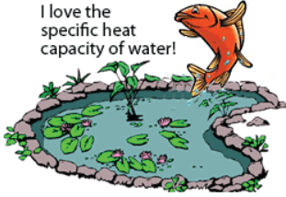
Specific Heat
  Resists change in temperature
    Water takes a long time to heat up and a long time to cool down.
Water’s high specific heat produces moderate climates in places with a lot of water : warmer winters and cooler summers.
Notes:
Timing ~1 min
The last property of water issuing from its hydrogen bonding ability that we will cover is its high specific heat.
(animate 1st bullet & sub) Specific heat is a measure of how much a substance resists changes in temperature. The higher the specific heat, the more energy the substance must absorb before its temperature changes. A good example of this is seen in the saying, “A watched pot never boils,” showing that water takes a long time to heat up.
Water has the second highest specific heat of all liquids. Again, this is because of the hydrogen bonds between the water molecules.
(animate 2nd bullet) Remember that temperature is a measure of the average kinetic energy of the molecules in a substance. Kinetic energy is a measure of the speed of the molecules in a system → the faster the particles are moving, the more kinetic energy they have. The faster the molecules move, the higher their average KE, and thus, their temperature. Because the hydrogen bonds hold water molecules together, the molecules must absorb more energy before their speed increases. So, water must absorb more thermal energy before its temperature increases.
The reverse is also true. The slower the molecules move, the lower their average KE, and thus, their temperature. Since the hydrogen bonds hold more energy, water must release more thermal energy before its temperature decreases.
[animate map; exit pan of boiling water on stove] The high specific heat of water allows it to store large amounts of thermal energy. This allows it to affect weather and climate significantly. Land areas that are closer to large bodies of water typically have more moderate climates than do areas at the same latitude and altitude that are far from water. [teacher point out examples: the “plains states” in the US have very cold winters and very hot summers, but mid-Atlantic region and west coast region like San Francisco have much milder climates because of location. Explain why this is → water warms/cools more slowly than land, so provides extra warmth in winter and absorbs more heat in summer]
SOURCES:
http://commons.wikimedia.org/wiki/File:Map_North_America.PNG

Slide 14
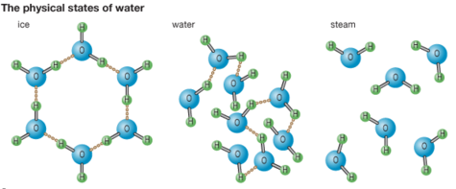
Density of Ice
As water temperature drops below 4˚C, it no longer behaves like a typical liquid, but expands. Ice at 0˚C, has about a 10% lower density than water at 0˚C.
Density of Liquid Water and Ice
Temperature (˚C) | Density (g/cm³)
100 (liquid water) | 0.9584
50 | 0.9881
25 | 0.9971
10 | 0.9997
4 | 1.0000
0 (liquid water) | 0.9998
0 (ice) | 0.9168

Slide 15
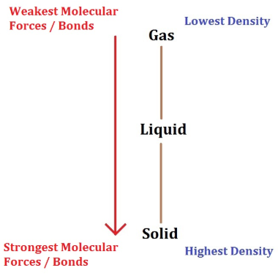
Density of Ice
Over 99% of chemical substances are MOST dense as solids.
Ice is LESS dense.

Slide 16
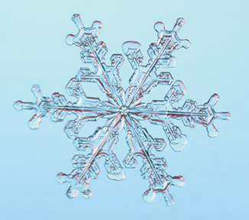
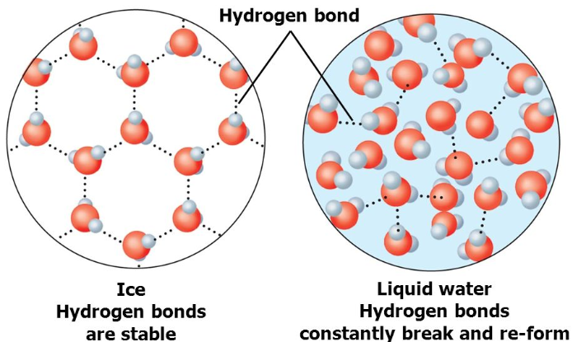
Density of Ice
Ice is one of only a few solids that floats in its own liquid due to hydrogen bonding.

Slide 17
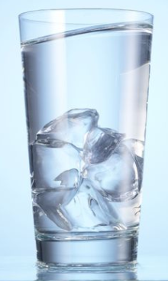
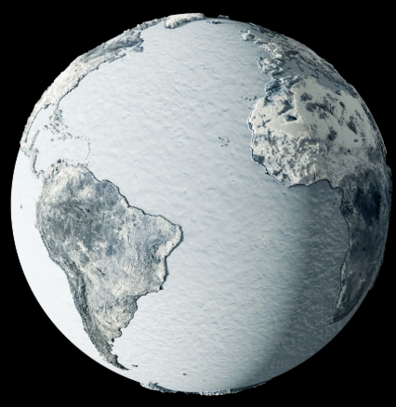
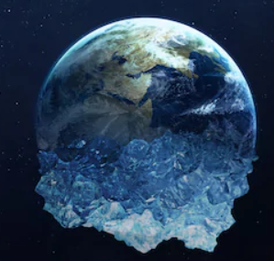
Density of Ice
What would happen if ice was MORE dense than water?
Imagine rivers, lakes, and ocean water in the winter if water was like most other substances … the earth would be a glacier.

Slide 18
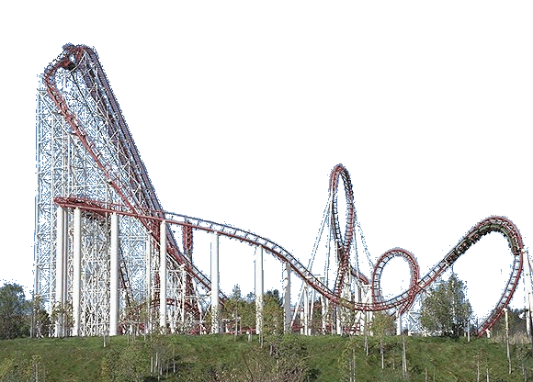
Solutions

Slide 19
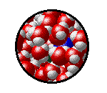
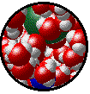
Solutions are homogeneous mixtures of two or more pure substances (elements and/or compounds).
A solution is made of a solute (the substance being dissolved) and a solvent (the substance doing the dissolving).

Slide 20
Solute Versus Solvent
In the following solutions, identify the solute (what is being dissolved) and the solvent (what does the dissolving).
Sea water, a solution composed of a variety of salts.
Soda water, a solution composed of carbon dioxide gas.
Air, a solution composed of 78% nitrogen and 21% oxygen.
Choose the factors that help you to identify the solute and the solvent in a solution.
[ ] In a solution, the solvent is present in a greater amount.
[ ] In a solution, the solute dissolves in a solvent.
[ ] In a solution, the solute is the dissolving agent.
Notes:
Timing ≈ 0.5 min
Entry audio: Let’s look at these common solutions and identify the solute and the solvent.
Hint 1 Audio: Remember that in a solution, the substance being dissolved is the solute.
Exit Audio: In a solution a solute is broken up and evenly distributed in a solvent.
SOURCES:

Slide 21
Solute Versus Solvent
In the following solutions, identify the solute (what is being dissolved) and the solvent (what does the dissolving).
Sea water, a solution composed of a variety of salts.
Solute: salts solvent: water
Soda water, a solution composed of carbon dioxide gas.
Solute: CO₂ solvent: water
Air, a solution composed of 78% nitrogen and 21% oxygen.
Solute: O₂ solvent: N₂
Choose the factors that help you to identify the solute and the solvent in a solution.
[X] In a solution, the solvent is present in a greater amount.
[X] In a solution, the solute dissolves in a solvent.
[ ] In a solution, the solute is the dissolving agent.
Notes:
Timing ≈ 0.5 min
Entry audio: Let’s look at these common solutions and identify the solute and the solvent.
Hint 1 Audio: Remember that in a solution, the substance being dissolved is the solute.
Exit Audio: In a solution a solute is broken up and evenly distributed in a solvent.
SOURCES:

Slide 22
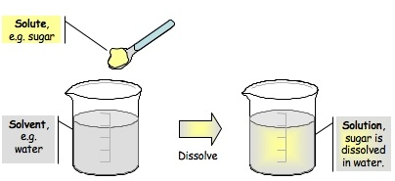
Water
is considered a universal solvent for inorganic (no C-H bonds) substances, meaning that it dissolves most non-organic matter ...
due to Polarity.

Slide 23
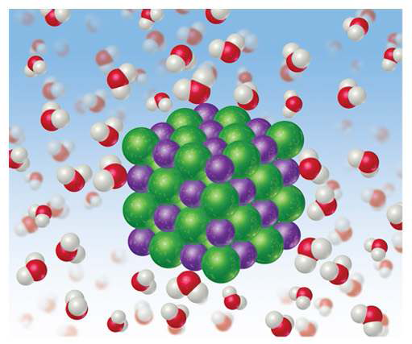
How Does a Solution Form?
The inTERmolecular attraction between SOLUTE and SOLVENT particles become stronger than the attraction between solute particles themselves or between solvent particles themselves.

Slide 24
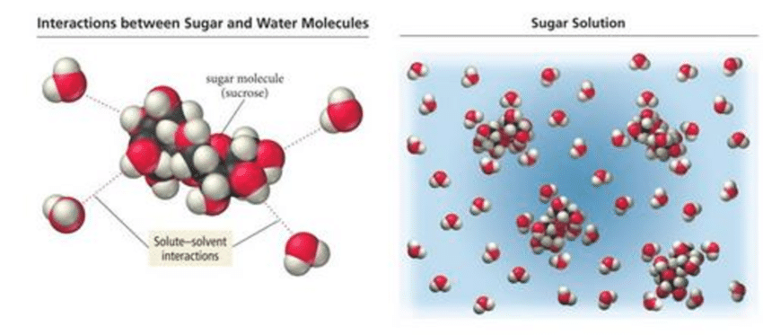
How Does a Solution Form?
As a solution forms, the solvent pulls solute particles apart at the surface of the solute. This dissolving process is called dissolution. Then, water surrounds the “broken apart” particles. This process is called hydration.

Slide 25
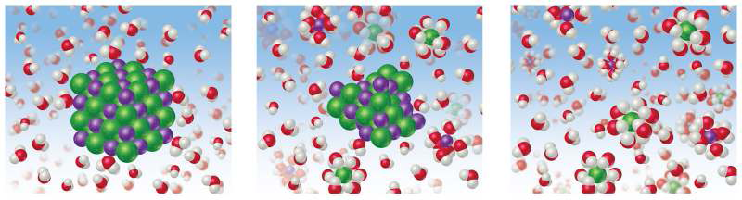
How Does a Solution Form?
Solute/Solvent Dissolution Hydration
Salt / Water Breaking Apart
Water Surrounds particles

Slide 26
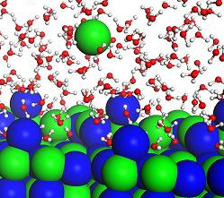
Dissolving (dissolution)
involves a Physical Change
You can get back the original solute by evaporating the solvent. In other words, NO new substance is produced.
Solute particles are “pulled apart” by the solvent. NON ionic molecules break apart from each other remaining whole molecules.
http://somup.com/cFXjnmninF (1:19)

Slide 27
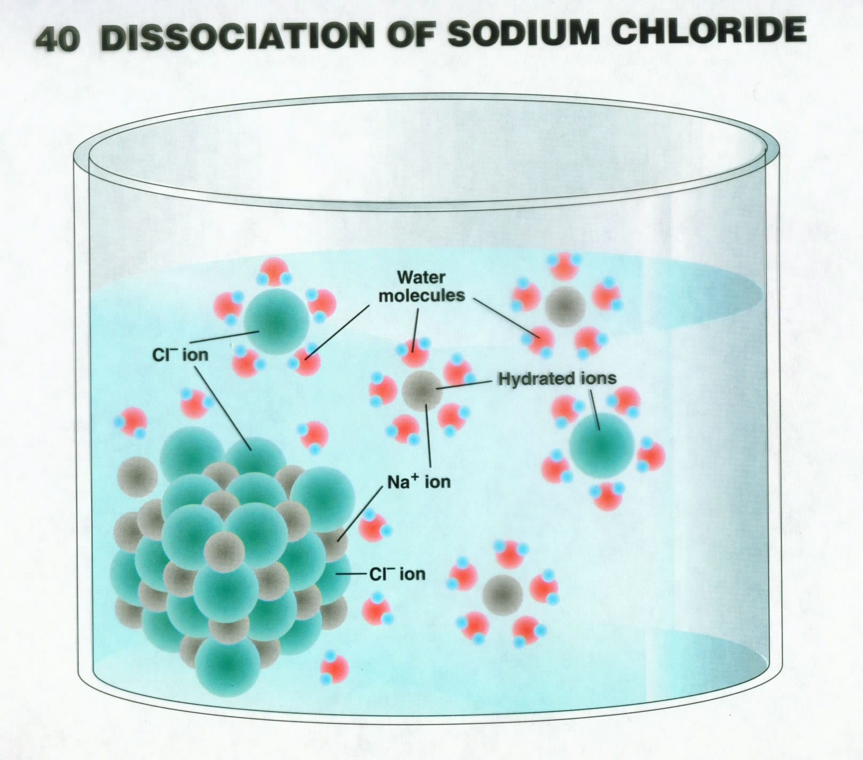
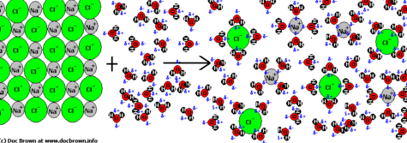
Dissociation is a form of dissolving in which ionic compounds break apart into its ions.

Slide 28
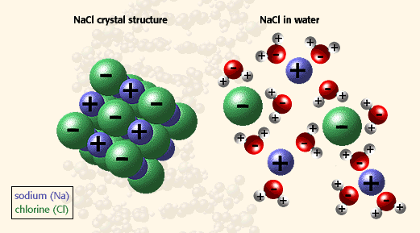
Salt Dissociation & Hydration

Slide 29
Solution Dissociation Hydration
Water Surrounds IONS
Solute/Solvent Breaking Apart
http://somup.com/cFliqOnXI0 (0:46)

Slide 30
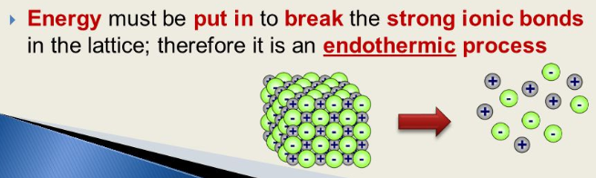
Solutions & Energy Changes
Solvent particles engage undissolved solute particles at their surface and SEPARATE them. This is always endothermic … requires some heat/energy to be added).

Slide 31
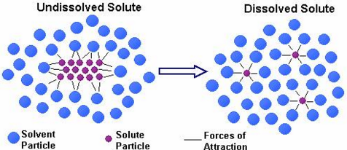
Solutions & Energy Changes
Solvent particles engage undissolved solute particles at their surface and SEPARATE them. This is always endothermic … requires some heat/energy to be added).
The solvent particles surround the solute particles (hydration), forming solute / solvent interactions & is always exothermic … releases heat/energy into the solution).

Slide 32
Solutions & Energy Changes
Endothermic Exothermic
Dissolution Hydration

Slide 33
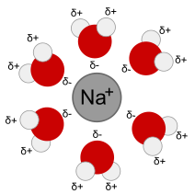
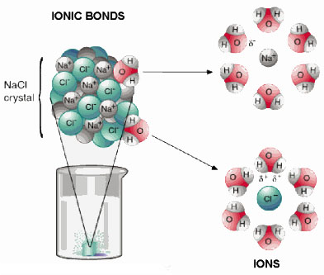
How Does a Solution Form?
In a solution, the solute is dispersed uniformly throughout the solvent. Therefore, we say it is homogeneous.
dissociation
hydration

Slide 34
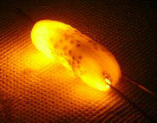
Solutes: Electrolytes & Nonelectrolytes
An electrolyte is a compound that conducts an electric current when it is in an aqueous solution or in the molten state.
All ionic compounds are electrolytes because they dissociate into ions when aqueous or molten.
http://somup.com/cFXjenninr
(2:07)
Electric Pickle

Slide 35
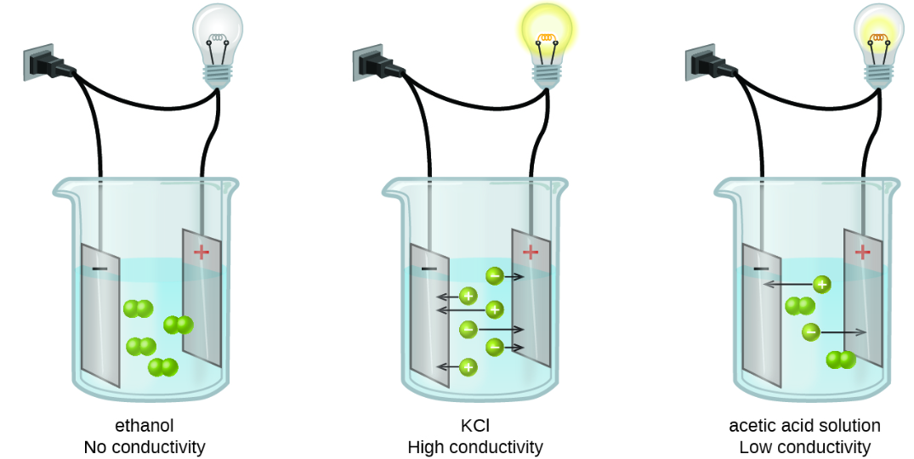
Solutes: Electrolytes & Nonelectrolytes
An electrolyte is a compound that conducts an electric current when it is in an aqueous solution or in the molten state.
All ionic compounds are electrolytes because they dissociate into ions when aqueous or molten.
A non-electrolyte is a compound that does NOT conduct an electric current when it is in an aqueous solution, but its non-dissociated particles are surrounded by the solvent.
Electric Pickle

Slide 36
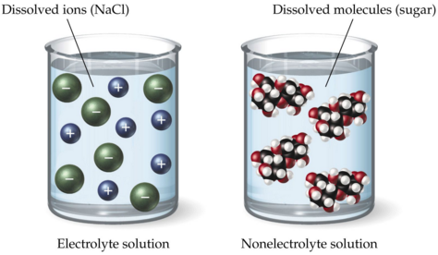
Solutions
  Solute (substance being dissolved)
  Solvent (dissolving substance)
  Nonelectrolyte
    Dissolving particles are not charged (Example: glucose)
  Electrolyte
    Dissolving particles are charged & free to move (e.g. Na⁺Cl⁻)
  Solute types
Notes:
Timing ≈ 0.5 min
[Animate 1st and 2nd bullets] Recall that a solution is a homogeneous mixture composed of a solute uniformly distributed throughout a solvent. The solute is dissolved in the solvent.
A solvent can be a liquid or a gas. A solute can be a solid, liquid, or gas.
When solutes dissolve in a solvent, the particles making up the solute break apart so the particles are no longer associated with one another, but become associated with solvent particles.
[Animate 3rd bullet, its sub-bullet, and 1st image] Solutes that are nonelectrolytes do not carry an electric charge in water. Molecular compounds are nonelectrolytes. When these solutes dissolve in solution, any intermolecular forces of attraction between solute molecules are broken and the separated molecules become surrounded by solvent molecules. These compounds do not have full electrical charges because they are not ions. They often carry partial charges and this property causes attractive forces to form between solute and solvent molecules. An example of a nonelectrolyte is glucose dissolved in water.
[Animate 4th bullet, its sub-bullet, and 2nd image] Solutes that are electrolytes carry an electric charge in water. Ionic compounds produce electrolytes when dissolved in water. Ionic compounds are composed of positively charged ions and negatively charged ions. When these solutes dissolve in solution, the crystal lattice holding the ions in the solid state breaks apart. The forces of attraction between positively charged ions and negatively charged ions are broken and the dissociated ions become surrounded by solvent molecules. An example of an electrolyte is sodium chloride dissolved in water.
Source: sketch created by writer

Slide 37
    BOTH are “dissolving”
    Electrolyte Nonelectrolyte
    Dissociation Dissolution
  Solute types
Notes:
Timing ≈ 0.5 min
[Animate 1st and 2nd bullets] Recall that a solution is a homogeneous mixture composed of a solute uniformly distributed throughout a solvent. The solute is dissolved in the solvent.
A solvent can be a liquid or a gas. A solute can be a solid, liquid, or gas.
When solutes dissolve in a solvent, the particles making up the solute break apart so the particles are no longer associated with one another, but become associated with solvent particles.
[Animate 3rd bullet, its sub-bullet, and 1st image] Solutes that are nonelectrolytes do not carry an electric charge in water. Molecular compounds are nonelectrolytes. When these solutes dissolve in solution, any intermolecular forces of attraction between solute molecules are broken and the separated molecules become surrounded by solvent molecules. These compounds do not have full electrical charges because they are not ions. They often carry partial charges and this property causes attractive forces to form between solute and solvent molecules. An example of a nonelectrolyte is glucose dissolved in water.
[Animate 4th bullet, its sub-bullet, and 2nd image] Solutes that are electrolytes carry an electric charge in water. Ionic compounds produce electrolytes when dissolved in water. Ionic compounds are composed of positively charged ions and negatively charged ions. When these solutes dissolve in solution, the crystal lattice holding the ions in the solid state breaks apart. The forces of attraction between positively charged ions and negatively charged ions are broken and the dissociated ions become surrounded by solvent molecules. An example of an electrolyte is sodium chloride dissolved in water.
Source: sketch created by writer

Slide 38
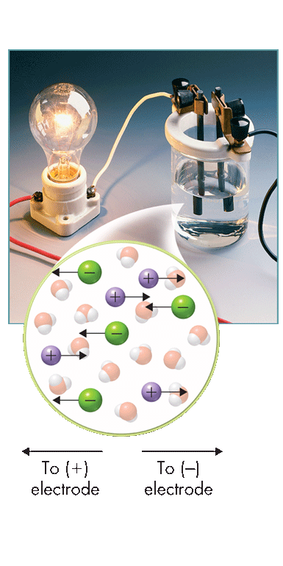
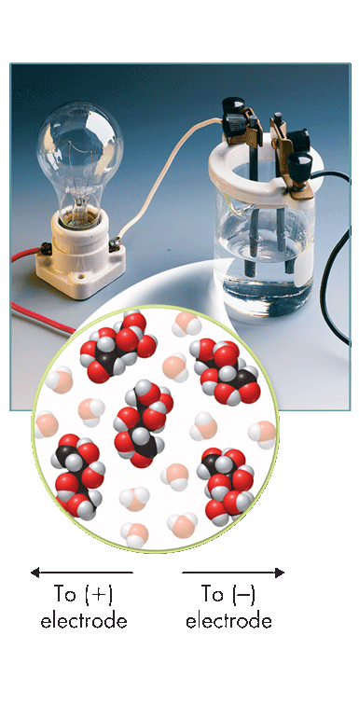
Electrolytes Non-Electrolyte
NaCl vs Glucose
To (+) electrode
To (–) electrode
To (+) electrode
To (–) electrode
Notes:
Timing ≈ 0.5 min
[Animate 1st and 2nd bullets] Recall that a solution is a homogeneous mixture composed of a solute uniformly distributed throughout a solvent. The solute is dissolved in the solvent.
A solvent can be a liquid or a gas. A solute can be a solid, liquid, or gas.
When solutes dissolve in a solvent, the particles making up the solute break apart so the particles are no longer associated with one another, but become associated with solvent particles.
[Animate 3rd bullet, its sub-bullet, and 1st image] Solutes that are nonelectrolytes do not carry an electric charge in water. Molecular compounds are nonelectrolytes. When these solutes dissolve in solution, any intermolecular forces of attraction between solute molecules are broken and the separated molecules become surrounded by solvent molecules. These compounds do not have full electrical charges because they are not ions. They often carry partial charges and this property causes attractive forces to form between solute and solvent molecules. An example of a nonelectrolyte is glucose dissolved in water.
[Animate 4th bullet, its sub-bullet, and 2nd image] Solutes that are electrolytes carry an electric charge in water. Ionic compounds produce electrolytes when dissolved in water. Ionic compounds are composed of positively charged ions and negatively charged ions. When these solutes dissolve in solution, the crystal lattice holding the ions in the solid state breaks apart. The forces of attraction between positively charged ions and negatively charged ions are broken and the dissociated ions become surrounded by solvent molecules. An example of an electrolyte is sodium chloride dissolved in water.
Source: sketch created by writer

Slide 39
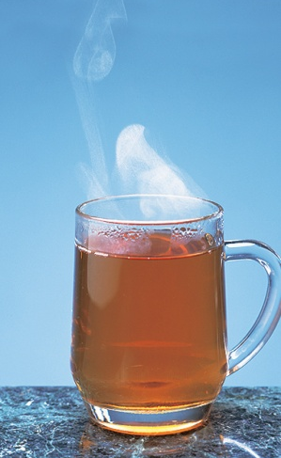
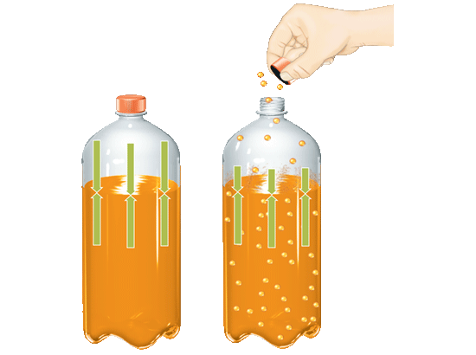
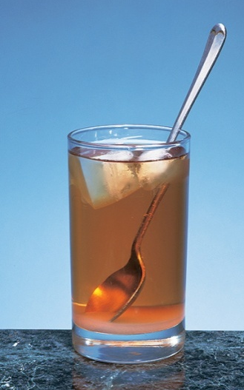
Factors Affecting Solubility & Rate of Dissolving
http://somup.com/cFXQoVnioR (4:08)
Factors that Affect Rate of Dissolution
Factors that Affect Solubility
Stirring
(agitation)
Particle size
(surface area)
Pressure
Nature of solute
temperature
Nature of solvent
Notes:
Time ≈ 1.0
Solubility depends on the nature of the solute and solvent. It also depends on pressure and temperature. For gas solutes, solubility increases as pressure increases and decreases as temperature increases. For liquid or solid solutes, solubility usually increases as temperature increases. Graphs are used to show the relationship between solubility and temperature.
The rate of dissolution also increases as temperature increases. It also increases with stirring and decreasing the particle size of the solute.

Slide 40
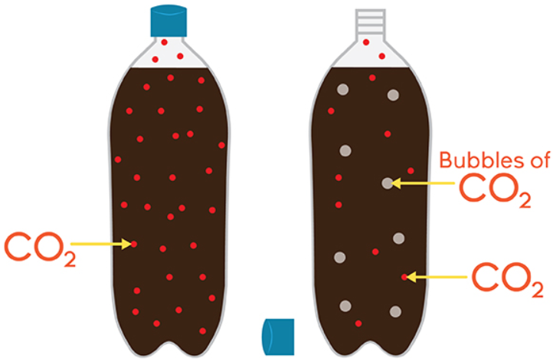
Henry’s Law: Solubility & Pressure
What relationship is shown between solubility (S) of a gas in a liquid and the pressure (P) of the gas above the liquid at a given temperature?

Slide 41
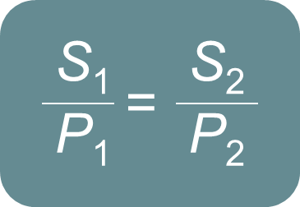
Henry’s Law: Solubility & Pressure
The solubility (S) of a gas in a liquid is directly proportional to the pressure (P) of the gas above the liquid at a given temperature.
As the pressure of the gas above the liquid increases, the solubility of the gas increases.
As the pressure of the gas decreases, the solubility of the gas decreases.
Calculations using this equation are enrichment. They will not be assessed on your test, except for bonus.

Slide 42
Henry’s Law: Solubility & Pressure
Carbonated beverages contain large amounts of carbon dioxide (CO_{2 (g)}) dissolved in water.
The drinks are bottled under a high pressure of CO₂ gas, which INCREASES solubility of the gas in solution.
When the container is opened, the pressure of CO₂ above the liquid decreases.
Immediately, bubbles of CO₂ form in the liquid & escape from the bottle [Solubility DECREASES].

Slide 43

Henry’s Law: Solubility & Pressure
AEROSOL CANS
The "head space" of the aerosol can is filled with highly pressurized gas dissolved in the product. When the nozzle is depressed, the pressure DECREASES so solubility of the gas also DECREASES and sprays out.

Slide 44

Henry’s Law: Solubility & Pressure
Fire Extinguishers

Slide 45

Henry’s Law: Solubility & Pressure
Scuba Divers & the “Bends”
The air scuba divers breathe is ~78% nitrogen. As one dives deeper pressure increases, meaning the solubility of nitrogen increases. Surfacing causes pressure to decrease, making nitrogen less soluble (i.e. “boils out”). If the divers surface too quickly, nitrogen bubbles just as in carbonated soda pop (the Bends). Helium is added to oxygen tanks, reducing this affect.

Slide 46

Solubility also describes the concentration of solutions by using three terms
The maximum amount of a solute that can be dissolved in a solvent is called that substance’s solubility.

Slide 47


Unsaturated, Saturated, & Supersaturated Solutions
  Unsaturated solution
  the concentration of solute is less than the maximum concentration the solvent can dissolve
  Saturated solution
  the concentration of solute is equal to the maximum concentration the solvent can dissolve
  Supersaturated solution
  the concentration of solute is greater than the maximum concentration the solvent was expected to dissolve
Notes:
Timing ≈ 1.5
Most solutions you make have less than the maximum amount of solute that will go into solution. They are unsaturated.
[Animate] An unsaturated solution is a solution in which the concentration of solute is less than the maximum concentration predicted from the solute's solubility. You make an unsaturated solution when you stir a spoonful of sugar into a glass of water. You could can still add more sugar to the water and the sugar will dissolve.
Suppose you keep adding sugar to the water. Eventually, no more sugar will dissolve, no matter how much you stir the solution. The solution is saturated.
[Animate] A saturated solution is a solution in which the concentration of solute is equal to the maximum concentration predicted from the solute's solubility. In a saturated solution, solute particles continue to be carried into solution. However, they also reform the solid solute at the same speed. You know you have a saturated solution when no more solute will dissolve.
The concentration of a saturated solution depends on the solubility of the solute. A saturated sugar solution is very concentrated because sugar has a high solubility. A saturated solution of aspirin in water would dilute because aspirin has a low solubility.
[Animate] Some solutions have more solute than is expected based on the solubility. A supersaturated solution is a solution in which the concentration of solute is greater than the maximum concentration predicted from the solute's solubility.
Sugar and water can form a supersaturated solution. Supersaturated solutions are usually made by heating the solution until the solute dissolves and then cooling slowly. Supersaturated solutions are unstable. A single crystal can make the excess solute precipitate out of solution.
[Animate] Rock candy is made from a supersaturated solution of sugar.
SOURCES:
http://www.morguefile.com/archive/display/732673
Salt In Water Solution by Chris 73 Creative Commons/GNU http://en.wikipedia.org/wiki/File:SaltInWaterSolutionLiquid.jpg#filelinks
http://commons.wikimedia.org/wiki/File:Rock-Candy-Sticks.jpg

Slide 48


Types of Solutions
Unsaturated
When LESS than the maximum amount of solute is dissolved in the solvent at a given temperature.

Slide 49

Types of Solutions
Saturated
When the solvent holds as much solute as possible at a particular temperature.
Notice particles have settled out in solution.

Slide 50



Types of Solutions
No particles have settled out.
Super Saturated
When the solvent holds more solute than is normally possible at that temperature by heating gently and stirring the excess solute into the solution until the solute dissolves. Allow the solution to cool slowly without disturbing it. [e.g. hand warmers]

Slide 51
Seeding a Super Saturated Solution
These solutions are unstable; crystallization can usually be stimulated by adding a “seed crystal” or scratching the side of the flask or agitation.
http://somup.com/cFXjebninU (1:29)

Slide 52


Solubility of SOLIDS Graph
Notice that solubility of solids (y axis) is shown based on varying temperature
(x axis).
Except for Ce₂SO₄, what trend do you observe on the graph?

Slide 53
Solubility of SOLIDS Graph
Generally, the
solubility of solid
solutes in liquid
solvents increases
with increasing
temperature.
What kind of relationship is this?

Slide 54
Solubility of SOLIDS Graph
Solubility of solids exhibits a Direct
relationship with temperature.

Slide 55
Practice Problems
If the temperature is 50 C, how much K₂Cr₂O₇ can normally dissolve in 100 grams of water?

Slide 56
Practice Problems
If the temperature is 50 C, how much K₂Cr₂O₇ can normally dissolve in 100 grams of water?
29 - 30 g

Slide 57
Practice Problems
A student has 88 g of KNO₃ in 100 g of water. At what temperature will this solution be saturated?

Slide 58
Practice Problems
A student has 88 g of KNO₃ in 100 g of water. At what temperature will this solution be saturated?
49 - 50 C

Slide 59
Reading the Slope Line
The slope line for each compound represents a saturated solution.
BELOW the slope line is a unsaturated solution.
ABOVE the slope line is a supersaturated solution.

Slide 60
Reading the Slope Line
At 75 g of solute and 20 C, CaCl₂ is a saturated solution. (on slope line)
At 60 g of solute and 70 C, KNO₃ is an unsaturated solution. (below slope line)
At 60 g of solute and 70 C, KCl is a supersaturated solution. (above slope line)

Slide 61
Practice Problems
Using 60 grams of any substance, which solutions would be supersaturated at any temperature?

Slide 62
Practice Problems
Using 60 grams of any substance, which solutions would be supersaturated at any temperature?
Any of the solutions below the red arrow are supersaturated if 60 grams are dissolved.

Slide 63

Solubility of GASES Graph
Notice that solubility of gases (y axis) is shown based on varying temperature
(x axis).
What relationship is shown?

Slide 64
Solubility of GASES Graph
Generally, the
solubility of gas
solutes in liquid
solvents decreases
with increasing
temperature.

Slide 65
Solubility of GASES Graph
Solubility of gases displays an Inverse
relationship with temperature.

Slide 66
Solubility of GASES Graph
Carbonated soft
drinks are more
“bubbly” if stored in
the refrigerator. Warm soda is “flat.”
Warm lakes have
less O₂ dissolved in
them than cool lakes. This affects the fish & other life.

Slide 67
Describe Solutions
Check factors that affect solubility.
[ ] Increasing temperature decreases the solubility of gases.
[ ] Stirring increases the solubility of solids.
[ ] Increasing pressure increases the solubility of liquids.
[ ] Decreasing temperature decreases the solubility of solids.
[ ] Increasing pressure increases the solubility of gases.
[ ] Decreasing the amount of solvent decreases the solubility of solids, liquids, and gases.
A solution is made by adding 200 g table salt to 1 L water. The solubility of salt is 36 g/100 mL water.
Which of the following best describes this solution?
O dilute
O saturated
O supersaturated
O unsaturated
Notes:
Timing ≈ 1.0
Entry Audio: Pick the best definition of solubility, then use solubility to describe a solution.
Hint1 Audio: Solubility depends on the solute and the solvent.
Hint2 Audio: [none]
Exit Audio: A solution that contains less than the maximum amount of solvent predicted from the solubility is unsaturated. For salt, 360 grams should be able to dissolve in 1 liter of water, so a solution that contains 200 grams in 1 liter of water is unsaturated.

Slide 68
Describe Solutions
Check factors that affect solubility.
[X] Increasing temperature decreases the solubility of gases.
[ ] Stirring increases the solubility of solids. Just dissolves faster.
[ ] Increasing pressure increases the solubility of liquids. Only gases.
[X] Decreasing temperature decreases the solubility of solids.
[X] Increasing pressure increases the solubility of gases.
[ ] Decreasing the amount of solvent decreases the solubility of solids, liquids, and gases. The solubility is the same, but the amount of solute dissolved is less.
A solution is made by adding 200 g table salt to 1 L water. The solubility of salt is 36 g/100 mL water.
Which of the following best describes this solution?
O dilute
O saturated
O supersaturated
!!! unsaturated
Notes:
Timing ≈ 1.0
Entry Audio: Pick the best definition of solubility, then use solubility to describe a solution.
Hint1 Audio: Solubility depends on the solute and the solvent.
Hint2 Audio: [none]
Exit Audio: A solution that contains less than the maximum amount of solvent predicted from the solubility is unsaturated. For salt, 360 grams should be able to dissolve in 1 liter of water, so a solution that contains 200 grams in 1 liter of water is unsaturated.

Slide 69
Identify Factors that Affect Dissolving Rate
A spoon of salt is added to water. Which of the following will increase how fast the salt dissolves? Check all that apply.
[ ] adding another spoon of salt
[ ] stirring the salt and water
[ ] cooling the water
[ ] crushing the salt so the grains are smaller
[ ] removing some water
Order the steps in the dissolving process from first to fourth.
__ the solvent molecules surround the solute molecules or ions (hydration).
__ the solute molecules break apart into solution (dissociation).
__ the solute is mixed with the solvent.
__ the solvent molecules are attracted to the molecules at the surface of the solute particles.
Notes:
Timing ≈ 1.0
Entry Audio: Identify the ways you can make salt dissolve faster in water. Check all of the answers that apply.
Hint Audio: Adding more solute or solvent will not make the solute dissolve faster.
Exit Audio: Stirring, crushing the solute to increase its surface area, and heating the solvent are all ways to make the solute dissolve faster.

Slide 70
Identify Factors that Affect Dissolving Rate
A spoon of salt is added to water. Which of the following will increase how fast the salt dissolves? Check all that apply.
[ ] adding another spoon of salt
[X] stirring the salt and water
[ ] cooling the water
[X] crushing the salt so the grains are smaller
[ ] removing some water
Order the steps in the dissolving process.
_4_ the solvent molecules surround the solute molecules or ions (hydration).
_3_ the solute molecules break apart into solution (dissociation).
_1_ the solute is mixed with the solvent.
_2_ the solvent molecules are attracted to the molecules at the surface of the solute particles.
Notes:
Timing ≈ 1.0
Entry Audio: Identify the ways you can make salt dissolve faster in water. Check all of the answers that apply.
Hint Audio: Adding more solute or solvent will not make the solute dissolve faster.
Exit Audio: Stirring, crushing the solute to increase its surface area, and heating the solvent are all ways to make the solute dissolve faster.

Slide 71
Practice Problems
Describe the Pb(NO₃)₂ and KCl solutions if 70 grams of solute are dissolved in 100 g of water at 60 C.

Slide 72
Practice Problems
Describe the Pb(NO₃)₂ and KCl solutions if 70 grams of solute are dissolved in 100 g of water at 60 C.
Pb(NO₃)₂ is unsaturated
(below the line)
KCl is supersaturated (above the line)

Slide 73
Practice Problems
At what temperature and solute amount are NaNO₃ and CaCl₂ both saturated?

Slide 74
Practice Problems
At what temperature and solute amount are NaNO₃ and CaCl₂ both saturated?
~93 g of solute
~27 C

Slide 75
Classify Matter
What is a compound?
O a combination of two or more substances that are not chemically combined
O a combination of two or more elements that are combined in a definite ratio
What is a solution?
O a mixture of two or more substances that are mixed evenly throughout
O a mixture of two or more substances that are chemically combined
What is a solute?
O the liquid in a solution
O the solid in a solution
O the substance that dissolves
What is a solvent?
O always water
O the liquid in the solution
O the substance that the solute dissolves in
Notes:
Timing ≈ 1.0
Entry Audio: Matter can be classified as elements, compounds, and mixtures. Describe compounds and solutions.
Hint1 Audio: [none]
Hint2 Audio: The elements in a compound are bonded together in a specific ratio, whereas the amounts of the substances in a mixture can vary. A solution is a special type of mixture in which the parts are evenly distributed throughout the entire mixture.
Hint3 Audio: [none]
Hint4 Audio: [none]
Exit Audio To make a solution, you dissolve the solute in the solvent. Sugar is a solid solute that dissolves in water, a solvent. However, solutes may also be liquids or gases, and solvents may be solids or gases.

Slide 76
Classify Matter
What is a compound?
O a combination of two or more substances that are not chemically combined
!!! a combination of two or more elements that are combined in a definite ratio
What is a solution?
!!! a mixture of two or more substances that are mixed evenly throughout
O a mixture of two or more substances that are chemically combined
What is a solute?
O the liquid in a solution
O the solid in a solution
!!! the substance that gets dissolved
What is a solvent?
O always water
O the liquid in the solution
!!! the substance that the solute dissolves in
Notes:
Timing ≈ 1.0
Entry Audio: Matter can be classified as elements, compounds, and mixtures. Describe compounds and solutions.
Hint1 Audio: [none]
Hint2 Audio: The elements in a compound are bonded together in a specific ratio, whereas the amounts of the substances in a mixture can vary. A solution is a special type of mixture in which the parts are evenly distributed throughout the entire mixture.
Hint3 Audio: [none]
Hint4 Audio: [none]
Exit Audio To make a solution, you dissolve the solute in the solvent. Sugar is a solid solute that dissolves in water, a solvent. However, solutes may also be liquids or gases, and solvents may be solids or gases.

Slide 77
Identify Solutions, Solutes, and Solvents
Choice A or B for each statement:
A) a mixture and a solution
B) a mixture but not a solution
Honey
Grape juice
Sand on the beach
A mixture of carbon dioxide and nitrogen gases
Rubbing alcohol
Mayonnaise
paint
Determine whether each item describes a solute or a solvent.
When acetic acid is dissolved in water to make vinegar, acetic acid is the ____.
When a small amount of carbon is dissolved in iron to make steel, the iron is the ____.
When a small amount of hydrogen gas mixes with nitrogen gas, hydrogen is the ____.
When carbon dioxide gas dissolves in water, water is the ____.
When a small amount of solid iodine is mixed with ethanol, ethanol is the ____.
Notes:
Timing ≈ 1.0
Entry Audio: Use what you know about solutions to identify which of these mixtures are solutions.
Hint1 Audio: Solutions appear to be a single substance, which means one part of the solution is the same as any other part.
Hint2 Audio: [none]
Exit Audio: The solute in a solution in the substance that is present in a smaller amount.

Slide 78
Identify Solutions, Solutes, and Solvents
Choice A or B for each statement:
A) a mixture and a solution
B) a mixture but not a solution
Honey
Grape juice
Sand on the beach
A mixture of carbon dioxide and nitrogen gases
Rubbing alcohol
Mayonnaise
paint
Determine whether each item describes a solute or a solvent.
When acetic acid is dissolved in water to make vinegar, acetic acid is the solute.
When a small amount of carbon is dissolved in iron to make steel, the iron is the solvent.
When a small amount of hydrogen gas mixes with nitrogen gas, hydrogen is the solute. (N₂ is more abundant)
When carbon dioxide gas dissolves in water, water is the solvent.
When a small amount of solid iodine is mixed with ethanol, ethanol is the solvent.
Notes:
Timing ≈ 1.0
Entry Audio: Use what you know about solutions to identify which of these mixtures are solutions.
Hint1 Audio: Solutions appear to be a single substance, which means one part of the solution is the same as any other part.
Hint2 Audio: [none]
Exit Audio: The solute in a solution in the substance that is present in a smaller amount.

Slide 79
Henry’s Law practice
(ENRICHMENT)
The solubility of a gas in water is 0.16 g/L at 104 kPa. What is the solubility when the pressure of the gas is increased to 288 kPa? (Assume constant temperature)

Slide 80
Henry’s Law practice
(ENRICHMENT)
The solubility of a gas in water is 0.16 g/L at 104 kPa. What is the solubility when the pressure of the gas is increased to 288 kPa? (Assume constant temperature)
Rearrange to solve for S₂
S₂ = S₁P₂/P₁
S₂ = (0.16 g/L)(288 kPa)/(104 kPa)
S₂ = 0.44 g/L = 4.4 x 10⁻¹ g/L

Slide 81
Henry’s Law practice
(ENRICHMENT)
A gas has a solubility in water at 0º C of 3.6 g/L at a pressure of 1.0 atm. What pressure is needed to produce an aqueous solution containing 9.5 g/L of the same gas at 0º C?

Slide 82
Henry’s Law practice
(ENRICHMENT)
A gas has a solubility in water at 0º C of 3.6 g/L at a pressure of 1.0 atm. What pressure is needed to produce an aqueous solution containing 9.5 g/L of the same gas at 0º C?
Rearrange to solve for P₂
P₂ = S₂P₁ / S₁
P₂ = (9.5 g/L)(1.0 atm)/(3.6 g/L)
P₂ = 2.6 atm

