Slide 1
Click on “Slide Show”
Click “Play from Beginning”

Slide 2

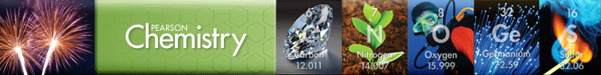
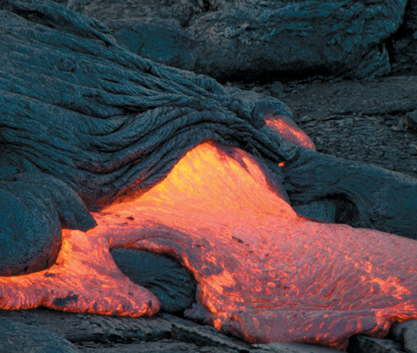
Chapter 13
States of Matter
The Nature of Gases
The Nature of Liquids
The Nature of Solids
Changes of State

Slide 3
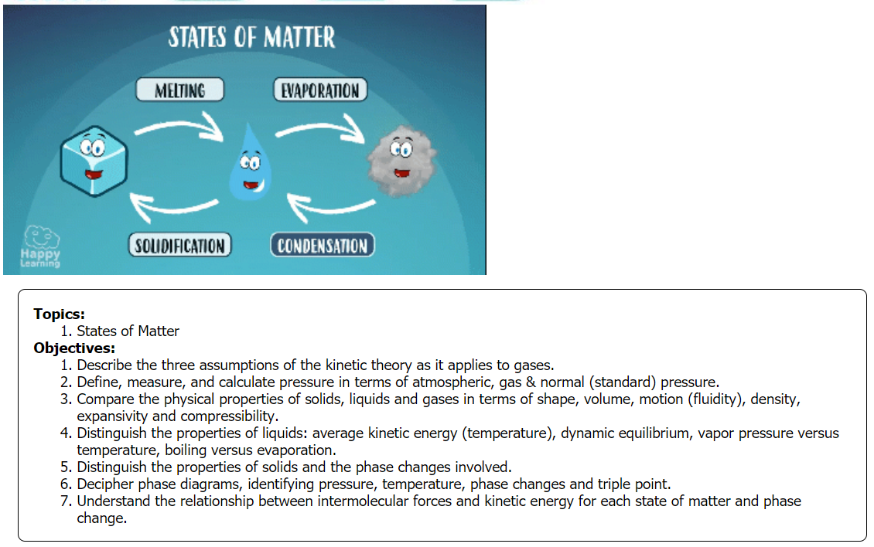

Slide 4
Properties of Solids, Liquids, and Gases
Identify the state(s) of matter that each property describes.
Takes the shape of its container:
Fills all available space:
Maintains its shape:
Changes shape but not volume:
Is greatly compressible & expansive:
Has a fixed volume:
Least dense:
Greatest molecular attractions:
Notes:
Timing ≈ 1 min
Entry Audio: We all know a liquid when we see it, but how would you describe a liquid in words? For each property, check the corresponding phase or phases.
Hint Audio: Some properties are shared by more than one state.
Exit Audio: Let’s examine just how the microscopic interactions of molecules give rise to these properties in liquids.

Slide 5
Properties of Solids, Liquids, and Gases
Identify the state(s) of matter that each property describes.
Takes the shape of its container:
Fills all available space:
Maintains its shape:
Changes shape but not volume:
Is greatly compressible & expansive:
Has a fixed volume:
Least dense:
Greatest molecular attractions:
Gas & liquid
Gas
Solid
Liquid
Gas
Liquid & solid
Gas
solid
Notes:
Timing ≈ 1 min
Entry Audio: We all know a liquid when we see it, but how would you describe a liquid in words? For each property, check the corresponding phase or phases.
Hint Audio: Some properties are shared by more than one state.
Exit Audio: Let’s examine just how the microscopic interactions of molecules give rise to these properties in liquids.

Slide 6
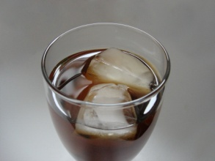

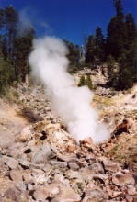
Label the states of matter, describe the temperature and motion of the particles in each picture (relative to each other).
ice
drops
steam
Notes:
Timing ≈ 1 min
Review the states of matter.
Explain that as the temperature of a substance increases, the motion of the particles of the substance increase.
Use water as an example: solid, liquid, gas
Relate to the kinetic molecular theory:
Part of kinetic molecular theory deals with kinetic energy of molecules. Temperature is related to kinetic energy. The higher the temperature, the more kinetic energy a molecule has.
SOURCES:
CC: http://upload.wikimedia.org/wikipedia/commons/6/6a/Iced_tea_with_ice_cubes.jpg
CC: http://upload.wikimedia.org/wikipedia/commons/6/6e/TauTropfenGerbera1.JPG
CC: http://commons.wikimedia.org/wiki/File:Lassen_Volcanic_National_Park-Terminal_Geyser.jpg

Slide 7
Label the states of matter, describe the temperature and motion of the particles in each picture (relative to each other).
Temperature increases from the solid to gas state. Temperature is related to kinetic energy (motion of particles ). The higher the temperature, the more kinetic energy a molecule has.
ice
drops
steam
Solid
Liquid
Gas
Cold Hot
Notes:
Timing ≈ 1 min
Review the states of matter.
Explain that as the temperature of a substance increases, the motion of the particles of the substance increase.
Use water as an example: solid, liquid, gas
Relate to the kinetic molecular theory:
Part of kinetic molecular theory deals with kinetic energy of molecules. Temperature is related to kinetic energy. The higher the temperature, the more kinetic energy a molecule has.
SOURCES:
CC: http://upload.wikimedia.org/wikipedia/commons/6/6a/Iced_tea_with_ice_cubes.jpg
CC: http://upload.wikimedia.org/wikipedia/commons/6/6e/TauTropfenGerbera1.JPG
CC: http://commons.wikimedia.org/wiki/File:Lassen_Volcanic_National_Park-Terminal_Geyser.jpg

Slide 8
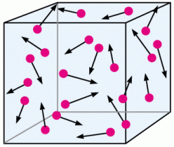
Kinetic Theory – Model of a Gas
Properties of Gases
Describe the kind of motion the particles in the box are displaying. Give at least 3 descriptions (Hint: pretend you are describing it to a blind person).

Slide 9
Kinetic Theory – Model of a Gas
Properties of Gases (Postulates or Assumptions)
A gas is composed of individual PARTICLES which are in continuous, random, straight-line motion
a. Collisions may result in a transfer of energy [elastic collisions], but the total net energy of the system remains constant.
b. The volume of particles is ignored in comparison with the space in which they are contained (i.e. earth’s volume compared to the volume of the solar system).
Gas particles are considered as having no attraction for each other.
https://screencast-o-matic.com/watch/cqQXrhtCnf (2:01)

Slide 10
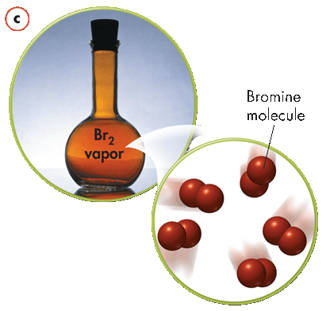
Kinetic Theory – Model of a Gas
Gases take the shape and volume of whatever container, room, or space they occupy.
The particles change direction only when they rebound from collisions.
If no particles are present, no collisions can occur, meaning there is no pressure. An empty space with no particles and no pressure is called a vacuum.
The collisions of atoms and molecules in air with objects results in atmospheric pressure.
Bromine molecule

Slide 11
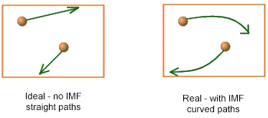
Kinetic Theory – Model of a Gas
REALITY: Deviations in the gas laws
a. This model is not perfect especially under conditions of low temperature & high pressure.
b. Particles do have some volume.
c. Particles do have some attractive forces toward each other (Van der Waals forces).

Slide 12
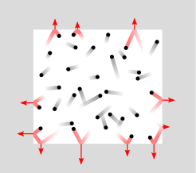
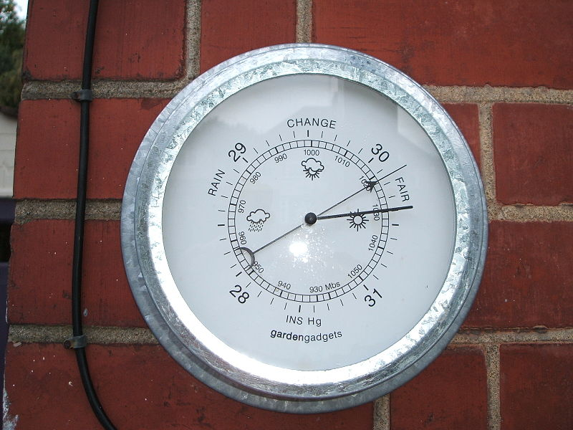
Gas Pressure
The force exerted by the particles of a gas colliding with the surface of an object.
Notes:
Timing ≈ 2 min
You probably have an intuition about what pressure is. You have probably seen it used in scientific or everyday situations--for example, a caution label on an aerosol can saying "caution: contents under pressure". But what is pressure in the scientific sense?
[animate 1st image of particle collisions] Remember that according to KMT, the particles in a gas are in constant, random motion. These motions occasionally cause gas particles to collide with the walls of the container. Each time a gas particle collides with the container walls, it exerts a force on the container. [animate definition] The pressure of a gas is the force exerted by the particles of a gas colliding with the walls of the container the gas is in or of any other surface they strike.
[fade out 1st image, bring in 2nd image of force on a surface] We define pressure as the force exerted on a given area [teacher explain equation for pressure].
With this definition of pressure we can infer some relationships based on KMT.
[animate 1st bullet] First, we can reason that if the kinetic energy of the particles in a gas increases--that is, if the particles move faster--then they will hit a surface with more force (just as a fastball will break a car window, but a slow lob probably won't). As the force increases [teacher circle force in pressure equation], pressure should also increase.
[animate 2nd bullet] We can also reason that if the number of collisions with the walls increases, the pressure should also increase, because the total force applied will increase. This means that the pressure of a gas is also related to the number of gas particles colliding with a surface and to the volume in which those gas particles are enclosed. If there are more particles in a given volume, there will be more collisions, and pressure will increase. Looking at it another way, if you take a given number of gas particles and put them in a smaller volume, they will strike the walls more often, so the number of collisions will increase and so will the pressure.
SOURCES:
http://commons.wikimedia.org/wiki/File:Pressure_exerted_by_collisions.svg
http://commons.wikimedia.org/wiki/File:Pressure_diagram.jpg

Slide 13
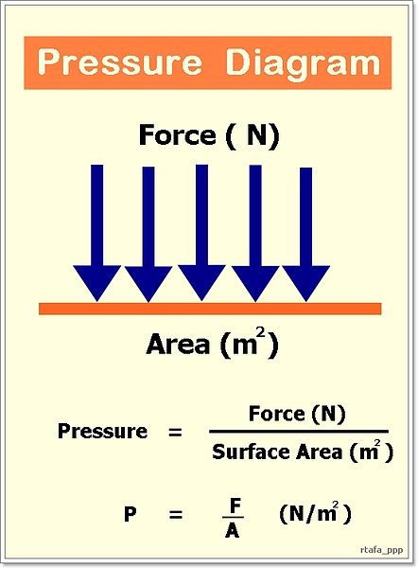
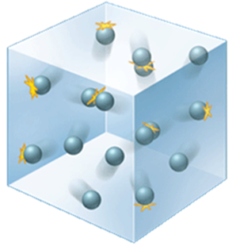
Pressure
  Higher KE greater collision force higher pressure
  More collisions greater collision force higher pressure
Notes:
Timing ≈ 2 min
You probably have an intuition about what pressure is. You have probably seen it used in scientific or everyday situations--for example, a caution label on an aerosol can saying "caution: contents under pressure". But what is pressure in the scientific sense?
[animate 1st image of particle collisions] Remember that according to KMT, the particles in a gas are in constant, random motion. These motions occasionally cause gas particles to collide with the walls of the container. Each time a gas particle collides with the container walls, it exerts a force on the container. [animate definition] The pressure of a gas is the force exerted by the particles of a gas colliding with the walls of the container the gas is in or of any other surface they strike.
[fade out 1st image, bring in 2nd image of force on a surface] We define pressure as the force exerted on a given area [teacher explain equation for pressure].
With this definition of pressure we can infer some relationships based on KMT.
[animate 1st bullet] First, we can reason that if the kinetic energy of the particles in a gas increases--that is, if the particles move faster--then they will hit a surface with more force (just as a fastball will break a car window, but a slow lob probably won't). As the force increases [teacher circle force in pressure equation], pressure should also increase.
[animate 2nd bullet] We can also reason that if the number of collisions with the walls increases, the pressure should also increase, because the total force applied will increase. This means that the pressure of a gas is also related to the number of gas particles colliding with a surface and to the volume in which those gas particles are enclosed. If there are more particles in a given volume, there will be more collisions, and pressure will increase. Looking at it another way, if you take a given number of gas particles and put them in a smaller volume, they will strike the walls more often, so the number of collisions will increase and so will the pressure.
SOURCES:
http://commons.wikimedia.org/wiki/File:Pressure_exerted_by_collisions.svg
http://commons.wikimedia.org/wiki/File:Pressure_diagram.jpg

Slide 14
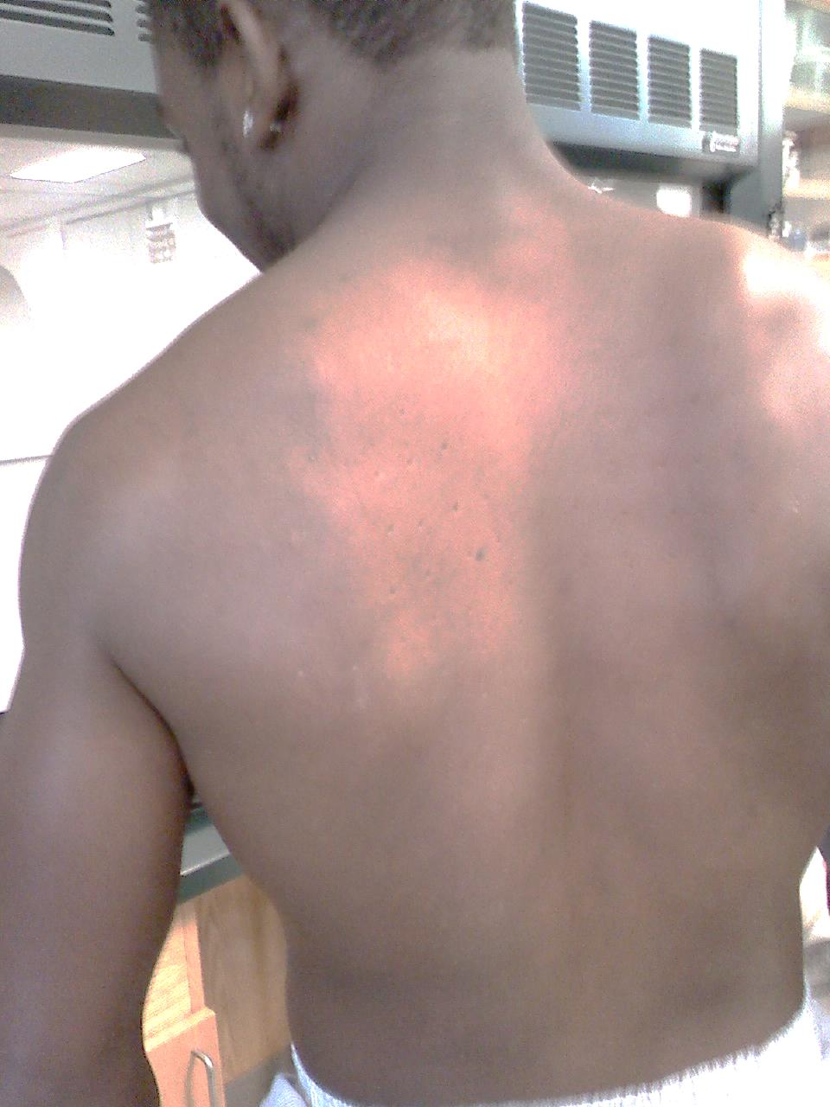

Nailed Again!
Force/Area
This guy surely got the “point” … he was deeply “impressed”.

Slide 15
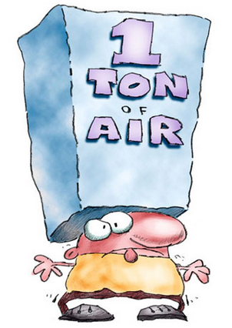
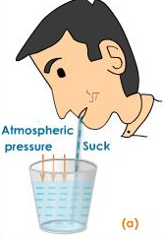
Atmospheric Pressure
The pressure exerted on all objects.
[force/area]
Gas pressure is actually the air molecules colliding with surfaces. The more molecules, the more collisions → the more pressure.

Slide 16
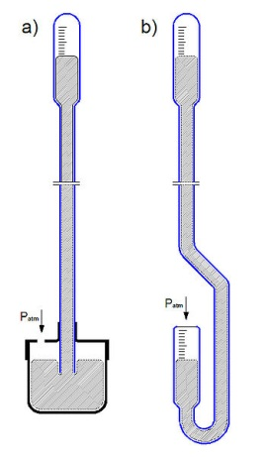
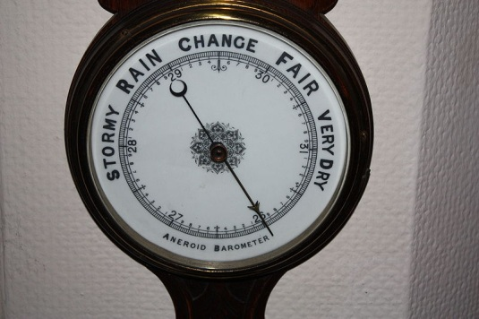
Measuring Pressure of a Gas (Manometers)
Barometer
device used to measure atmospheric pressure
  Original barometers used mercury
    Dense
    Low evaporation rate
  Modern barometers use small cells of air
    Expansion or contraction moves dial
The pressure of gases can vary greatly. Not so with liquids and solids.
Notes:
Timing ≈ 1 min
[animate definition] A barometer is the tool used to measure atmospheric pressure.
[animate 1st bullet & subs and first image of tubes] Original barometers used liquid mercury. Mercury was used because it is dense--so less of it was necessary--and because it does not easily evaporate. These early barometers generally had two components: a tube that was sealed at one end and open at the other, and a reservoir of mercury. The atmospheric pressure on the mercury in the reservoir [teacher indicate on image] pushed downward on the mercury, causing it to rise in the tube. As the mercury rises, it compresses the air in the closed end of the tube [teacher indicate]. As we've discussed, as the volume shrinks, the pressure exerted by the air increases. Eventually, the downward pressure from the trapped air equals the atmospheric pressure and the mercury level stops changing. The atmospheric pressure can then be determined by measuring the height of the mercury in the tube. If the height of the mercury increases, atmospheric pressure has increased; if it decreases, atmospheric pressure has decreased.
[animate 2nd bullet & sub and fade out first image and replace with 2nd image of dial] Because mercury is toxic and difficult to transport, other types of barometers are more common now. The most commonly used modern barometer contains small cells of air attached to a dial. As the air in the cells expands or contracts, the dial moves to indicate the pressure.
SOURCES:
http://commons.wikimedia.org/wiki/File:Hydrostatic_barometer.jpg
http://commons.wikimedia.org/wiki/File:Barometer_in_Wein_2009_gesehen_PD_IMG_7428.JPG

Slide 17
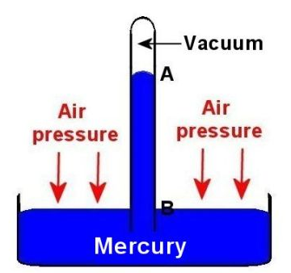
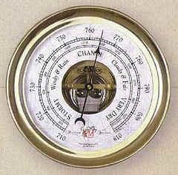
Measuring Pressure
Gas pressure
Barometer
liquid
Air pressure = atmospheric pressure

Slide 18

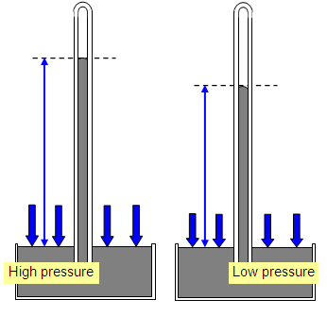
Describe the pressures: Atmospheric versus “gas” pressure (inside the tube). Which is higher and why?

Slide 19
Describe the pressures: Atmospheric versus “gas” pressure (inside the tube). Which is higher and why?
“gas” inside the tube has greater pressure than before so the liquid in the tube is pushed down more than before.
Atmospheric PUSHES down much more than the “gas” inside the tube. So P_{atm} > P_{g}
Less gas pressure
More gas pressure

Slide 20
Reading a Barometer
https://vimeo.com/thepottersschool/review/151725420/987039a6cf
https://vimeo.com/thepottersschool/review/151725420/987039a6cf
Describe the atmospheric pressure in each manometer.
https://screencast-o-matic.com/watch/cFeY3gDvx1 (5:32)

Slide 21
Reading a Barometer
https://vimeo.com/thepottersschool/review/151725420/987039a6cf
https://vimeo.com/thepottersschool/review/151725420/987039a6cf
Describe the atmospheric pressure in each manometer.
https://screencast-o-matic.com/watch/cFeY3gDvx1 (5:32)
Less than “gas” pressure
Greater than “gas” pressure
Equal
Atm pressure
“gas” pressure
Atm pressure

Slide 22
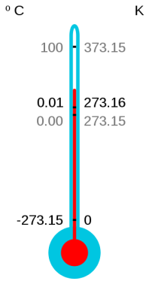
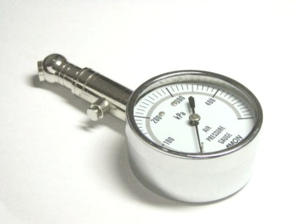
Standard Temperature and Pressure
Standard Temperature and Pressure (STP) standard conditions used to compare gas measurements; defined as an absolute temperature of 273.15 K and a pressure of 101.325 kPa.
  Scientists use absolute temperature (K) in all gas calculations.
Notes:
Timing ≈ 1 min
We've seen that pressure, especially for a gas, is highly dependent on temperature and volume, as well as the amount of gas present. Therefore, it can be difficult to directly compare gas samples. To make these comparisons more straightforward, scientists have established a standard set of conditions for comparing gases. This is known as standard temperature and pressure, or STP.
STP is defined to be 273.15 K and 101.325 kPa. By using the phrase "STP" for these conditions, scientists can quickly and easily compare gases without having to spend a lot of time or space identifying specific temperature and pressure conditions.
An important thing to note is that standard temperature is given in kelvins. It's very important when doing any calculations involving gas temperature that you use absolute (kelvin) temperature, not Celsius.
SOURCES
http://commons.wikimedia.org/wiki/File:Air_pressure_gauge.jpg
http://commons.wikimedia.org/wiki/File:CelsiusKelvin.svg

Slide 23
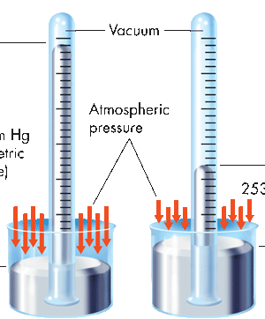
Gas Pressure
Two older units of pressure are still commonly used:
millimeters of mercury (mm Hg) and atmospheres (atm).
One standard atmosphere (atm) is the pressure required to support 760 mm of mercury in a mercury barometer at 25°C.
Gas
760 mm Hg (barometric pressure)
Atmospheric pressure
253 mm Hg
1 atm = 760 mm Hg = 101.3 kPa
Sea level
On top of Mount Everest
Standard temperature & pressure (STP)
0⁰ C or 273.15 K 101.3 kPa, 760 mm Hg, or 1 atm
The pressure in mm Hg inside a vacuum is 0 mm Hg.

Slide 24

Collapsing Can Experiment
Click on the link: (0:47)
https://screencast-o-matic.com/watch/cFQ6XyqEwm
Why did the can collapse?
See the link on L CTR:
FUN Pressure Activities Labs

Slide 25
A pressure gauge records a pressure of 450 kPa. Convert this measurement to atmospheres and millimeters of mercury.

Slide 26
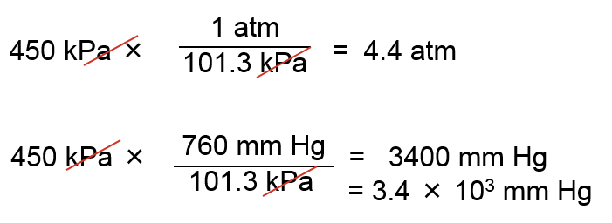
A pressure gauge records a pressure of 450 kPa. Convert this measurement to atmospheres and millimeters of mercury.
Based on the equalities: 1 atm = 760 mm Hg = 101.3 kPa
Multiply the given pressure by the appropriate conversion factor.

Slide 27
Temperature & Average Kinetic Energy
Potential Energy
As any substance is heated, its particles absorb energy, some of which is stored within the particles. This stored portion of the energy is potential energy (PE). PE is responsible for phase changes (solid to liquid to gas, gas to liquid to solid, etc.) but does NOT raise the temperature of the substance.
Kinetic Energy
The remaining absorbed energy speeds up the motion of particles, which is their kinetic energy (KE). The particles in any collection of atoms or molecules at a given temperature have a wide range of kinetic energies. The average kinetic energy of particles in a system is called its temperature.

Slide 28
Temperature & Average Kinetic Energy
The average kinetic energy of the particles in a substance is directly related to the substance’s temperature in Kelvin (K).
When average KE increases, K temperature also increases.
As a substance cools, the particles tend to move more slowly, and their average kinetic energy decreases.
Absolute zero (0 K, or –273.15ºC) is a theoretical temperature at which there is NO motion of particles; and there is NO volume at 0 K.
No temperature can be lower than absolute zero.

Slide 29
Kinetic Theory (pressure, volume, temperature)
Demonstrations (5:55)
https://screencast-o-matic.com/watch/cFQiDiqp9D

Slide 30
Properties of Liquids
NO definite shape, but a definite volume
Fluidity → Less tightly packed molecules that take the shape of the container and flow readily
Less dense than solids, but greater than gases (usually d ∞ 1/T)
Relatively non-compressible except for extreme temperatures and pressures
Diffusion → high concentration or pressure toward a lower concentration or pressure
Evaporation → surface liquid changing to gas

Slide 31
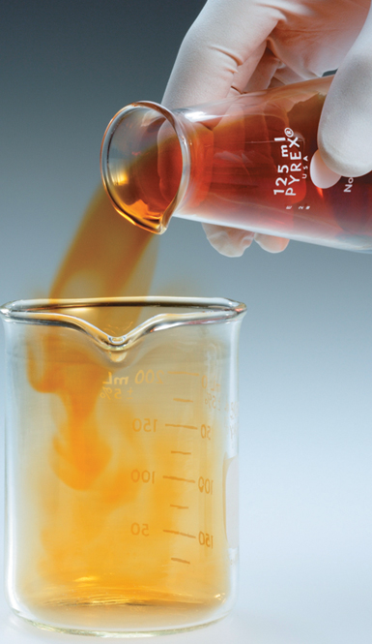
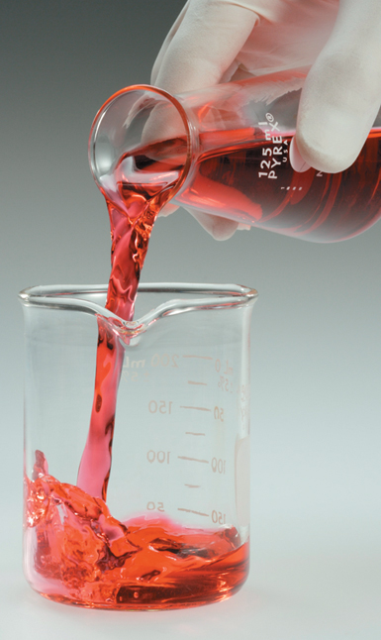
Properties of Liquids
According to kinetic theory, there are NO intermolecular attractions between the particles in the gas state.
The particles in a liquid are attracted to each other. These intermolecular attractions keep the particles in a liquid close together, which is why liquids have a definite volume.

Slide 32
Describe Particles
Label the state of matter that best represents each image and describe their densities.

Slide 33
Describe Particles
Label the state of matter that best represents each image and describe their densities.
solid
liquid
gas
Gases are least dense. Liquids are dense but flow. Solids are most dense, but particles vibrate.

Slide 34
Intermolecular Forces and Condensation
  Intermolecular forces
  Affect interactions between particles
  Stronger forces more energy to overcome
  Condensation:
  KE < intermolecular forces
  Particles condense together, forming liquid
  Evaporation & Boiling:
  KE > intermolecular forces
  Particles expand apart forming gas
liquid
gas
Notes:
Timing ≈ 2 min
Recall that the particles in matter experience intermolecular forces: attractive or repulsive forces due to molecular dipoles, or uneven electronic distribution. [animate image; teacher explain that blue = negative partial charge, pink = positive partial charge, and show how intermolecular forces would affect the molecules shown]
[animate 1st bullet] These forces affect how molecules interact. Dipole-dipole attractions tend to hold molecules close together.
[animate 2nd bullet] The stronger the intermolecular forces are, the more kinetic energy molecules must have to be able to overcome those attractions.
[animate 3rd bullet] The particles in a gas have enough kinetic energy to overcome the intermolecular forces between them. If the gases lose energy (for example, when the gas is cooled), eventually their kinetic energy becomes insufficient to overcome the intermolecular forces ( the particles now attract each other easier) and the gas condenses into a liquid.
[animate 4th bullet] The opposite process can also occur. If the particles in a liquid gain enough energy (e.g., from heating) that their kinetic energy overcomes the intermolecular forces between them, the liquid boils or evaporates to become a gas. Evaporation happens at the surface of a liquid, when small numbers of individual particles gain energy due to random collisions. Boiling happens throughout the volume of a liquid, when large numbers of molecules attain enough energy to overcome intermolecular forces all at once.
Because the strengths of intermolecular forces determine how much kinetic energy is necessary to overcome them, we would expect that boiling point would correlate with intermolecular forces, and this is what we observe. Substances with strong intermolecular forces, such as ionic compounds and polar covalent compounds, tend to have much higher boiling points than do nonpolar covalent compounds. Ionic compounds have higher boiling points than polar covalent compounds because ionic bonds are much stronger than dipole-dipole interactions.

Slide 35
Intermolecular Forces and Freezing
  Liquid particles have constant, random motion
  Solid particles are fixed in place, but vibrate
  Freezing:
  KE < intermolecular forces
  Particles fuse together, forming solid
  Melting:
  KE > intermolecular forces
  Particles break away, forming liquid
Notes:
Timing ≈ 2 min
Intermolecular forces affect particles at all energy levels. According to the kinetic molecular theory, particles are in constant, random motion.
[animate 1st bullet and right-hand box] In a liquid, as we have seen, the particles do not have enough kinetic energy to completely overcome their intermolecular attractions. However, they do have enough energy to be able to "stretch" those interactions, allowing them to slide past one another in constant, random motion.
[animate 2nd bullet and left-hand box] In solids, molecules don’t have enough kinetic energy to un-stick themselves from where they are. Instead, they remain in a fixed position, but vibrate in place. Liquids and solids are referred to as condensed phases because the attractive forces that hold the molecules together leave very little space between the molecules.
[animate 3rd bullet and blue arrow] Just as a loss of kinetic energy (cooling) can cause a gas to condense into a liquid, further loss can cause a liquid to freeze into a solid.
[animate 4th bullet and pink arrow] If the temperature of a solid rises, the molecules can acquire enough kinetic energy to get past each other and the solid melts into a liquid.

Slide 36
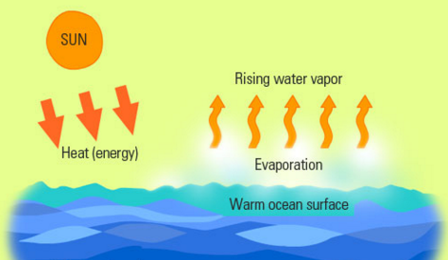
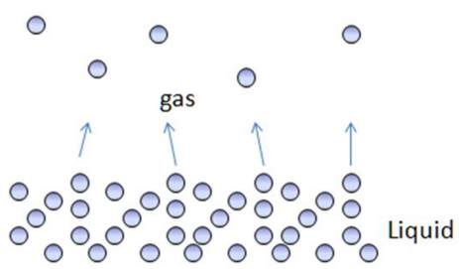
Evaporation
The conversion of a liquid to a gas or vapor is called vaporization. When this conversion occurs at the surface of a liquid that is not boiling, the process is called evaporation.
Evaporation is DIRECTLY related to surface area, temperature, wind, and moisture (humidity).

Slide 37
The Irony of Evaporation
Evaporation is a liquid becoming a gas, meaning that heat must be absorbed by the liquid. YET, evaporation is a cooling process. How can this be?

Slide 38
The Irony of Evaporation
Evaporation is a liquid becoming a gas, meaning that heat must be absorbed by the liquid. YET, evaporation is a cooling process. How can this be?
Let’s consider it in two ways:
1) The particles that evaporate (escape) from a liquid MUST have greater KE that the particles left in the liquid.
In this case, the escaped (vapor or gas) particles are taking energy (in the form of heat) AWAY from the liquid, cooling it.
2) You can experience the effects of evaporation cooling you off on hot days. When you perspire, water molecules in your perspiration absorb heat from your body, gaining enough KE to evaporate from the skin’s surface (taking heat with it).
The perspiration (sweat) that remains cools you further by absorbing more body heat.

Slide 39
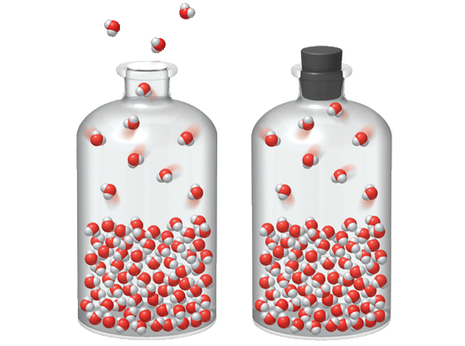
Vapor Pressure
In an open system, molecules that evaporate can escape from the system.
In an OPEN system, equilibrium is NOT established and various factors must be considered:
temperature → > T, > evaporation
surface area → > SA, > evaporation
air currents → > AC, > evaporation

Slide 40
Vapor Pressure
In a closed system, the molecules collect as a vapor above the liquid, increasing pressure of the air above the liquid. Some condense back into a liquid.
These particles collide with the walls of the sealed container, producing pressure. A measure of the force exerted by a gas above a liquid is called vapor pressure = the TENDENCY TO BOIL.
Over time, liquid particles continue to evaporate and gas particles condense and return to the liquid state.

Slide 41
ESTABLISHING Equilibrium
In a CLOSED system, equilibrium is established.
Dynamic Equilibrium is a state of balance in which opposing processes (s ↔ l … l ↔ g ... s ↔ g ) are proceeding at equal rates. Must be in a CLOSED system.
Liquid + energy → vapor [evaporation] – heat added
Liquid + energy ← vapor [condensation] – heat released
Before equilibrium … evaporation > condensation
At equilibrium… evaporation RATE = condensation RATE

Slide 42
Dynamic Equilibrium l ↔ g
Liquid Vapor (gas)
In a closed system, eventually, the number of particles condensing will equal the number of particles evaporating.
The system is in equilibrium because the rate of evaporation of liquid equals the rate of condensation of the vapor.
At equilibrium, the particles in the system continue to evaporate and condense, but no net change occurs in the number of particles in the liquid or vapor phases.

Slide 43
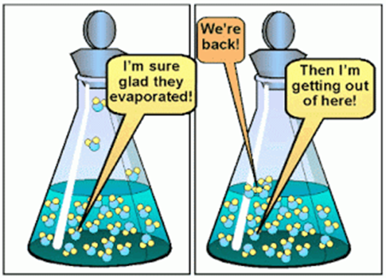
Dynamic Equilibrium l ↔ g
evaporation
Liquid Vapor (gas)
condensation
EXAMPLES
  Football (11 players total) → 2-3 sub in & out
  Basketball (5 players total) → 1-2 sub in & out
  Riding a carnival ride → get off & get on
  The overall # stays EQUAL
The system is in equilibrium because the rate of evaporation of liquid equals the rate of condensation of the vapor.

Slide 44
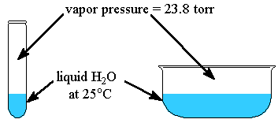
Vapor Pressure
Indicates how easily a liquid will boil or evaporate. This can be referred to as how volatile a given liquid is.
Depends on the nature of the liquid:
liquids have characteristic forces of attraction between their molecules
  hydrogen bonding
  Van der Waals forces (temporary dipoles that exist between virtually every molecule)
Depends on temperature (avg KE)
23.8 mm Hg
Is water likely to boil at 25 C?
Does water have a high or low VP?

Slide 45
Vapor Pressure ~ “Peer Pressure”
Temp (C) | Vapor Pressure in mm Hg
 | Water | Ethyl Alcohol | Ethyl Ether
0 | 4.6 | 12.2 | 185.3
20 | 17.5 | 43.9 | 442.2
40 | 55.3 | 135.3 | 921.3
60 | 149.4 | 352.7 | 1729.0
80 | 355.1 | 812.6 | 2993.6
100 | 760.0* | 1693.3 | 4859.4
When does water “normally” boil?

Slide 46
Vapor Pressure ~ “Peer Pressure”
“Peer pressure” causes us to do things we normally wouldn’t do.
Temp = # peers: >T >P
VP: Doing what we are pressured to do
Temp (C) | Vapor Pressure in mm Hg
 | Water | Ethyl Alcohol | Ethyl Ether
0 | 4.6 | 12.2 | 185.3
20 | 17.5 | 43.9 | 442.2
40 | 55.3 | 135.3 | 921.3
60 | 149.4 | 352.7 | 1729.0
80 | 355.1 | 812.6 | 2993.6
100 | 760.0* | 1693.3 | 4859.4
When does water “normally” boil?
Normal means Standard Pressure
(760 mm Hg, 1 atm, or 101.3 kPa) … 100°C

Slide 47
Vapor Pressure ~ “Peer Pressure”
Temp (C) | Vapor Pressure in mm Hg
 | Water | Ethyl Alcohol | Ethyl Ether
0 | 4.6 | 12.2 | 185.3
20 | 17.5 | 43.9 | 442.2
40 | 55.3 | 135.3 | 921.3
60 | 149.4 | 352.7 | 1729.0
80 | 355.1 | 812.6 | 2993.6
100 | 760.0* | 1693.3 | 4859.4
When does water “normally” boil?
When does Ethyl Alcohol “normally” boil?

Slide 48
Vapor Pressure ~ “Peer Pressure”
“Peer pressure” causes us to do things we normally wouldn’t do.
Temp = # peers: >T >P
VP: Doing what we are pressured to do
Temp (C) | Vapor Pressure in mm Hg
 | Water | Ethyl Alcohol | Ethyl Ether
0 | 4.6 | 12.2 | 185.3
20 | 17.5 | 43.9 | 442.2
40 | 55.3 | 135.3 | 921.3
60 | 149.4 | 352.7 | 1729.0
80 | 355.1 | 812.6 | 2993.6
100 | 760.0* | 1693.3 | 4859.4
When does water “normally” boil? Normal means Standard Pressure (760 mm Hg, 1 atm, or 101.3 kPa) … 100° C
When does Ethyl Alcohol “normally” boil? Close to 80° C

Slide 49
Vapor Pressure ~ “Peer Pressure”
Temp (C) | Vapor Pressure in mm Hg
 | Water | Ethyl Alcohol | Ethyl Ether
0 | 4.6 | 12.2 | 185.3
20 | 17.5 | 43.9 | 442.2
40 | 55.3 | 135.3 | 921.3
60 | 149.4 | 352.7 | 1729.0
80 | 355.1 | 812.6 | 2993.6
100 | 760.0* | 1693.3 | 4859.4
When does water “normally” boil?
When does Ethyl Alcohol “normally” boil?
When does Ethyl Ether “normally” boil?

Slide 50
Vapor Pressure ~ “Peer Pressure”
“Peer pressure” causes us to do things we normally wouldn’t do.
Temp = # peers: >T >P
VP: Doing what we are pressured to do
Temp (C) | Vapor Pressure in mm Hg
 | Water | Ethyl Alcohol | Ethyl Ether
0 | 4.6 | 12.2 | 185.3
20 | 17.5 | 43.9 | 442.2
40 | 55.3 | 135.3 | 921.3
60 | 149.4 | 352.7 | 1729.0
80 | 355.1 | 812.6 | 2993.6
100 | 760.0* | 1693.3 | 4859.4
When does water “normally” boil? Normal means Standard Pressure (760 mm Hg, 1 atm, or 101.3 kPa) … 100° C
When does Ethyl Alcohol “normally” boil? Close to 80° C
When does Ethyl Ether “normally” boil? Close to 40° C

Slide 51
Vapor Pressure ~ “Peer Pressure”
Temp (C) | Vapor Pressure in mm Hg
 | Water | Ethyl Alcohol | Ethyl Ether
0 | 4.6 | 12.2 | 185.3
20 | 17.5 | 43.9 | 442.2
40 | 55.3 | 135.3 | 921.3
60 | 149.4 | 352.7 | 1729.0
80 | 355.1 | 812.6 | 2993.6
100 | 760.0* | 1693.3 | 4859.4
When does water “normally” boil?
When does Ethyl Alcohol “normally” boil?
When does Ethyl Ether “normally” boil?
Can Water boil at 0 C?

Slide 52
Vapor Pressure ~ “Peer Pressure”
“Peer pressure” causes us to do things we normally wouldn’t do.
Temp = # peers: >T >P
VP: Doing what we are pressured to do
Temp (C) | Vapor Pressure in mm Hg
 | Water | Ethyl Alcohol | Ethyl Ether
0 | 4.6 | 12.2 | 185.3
20 | 17.5 | 43.9 | 442.2
40 | 55.3 | 135.3 | 921.3
60 | 149.4 | 352.7 | 1729.0
80 | 355.1 | 812.6 | 2993.6
100 | 760.0* | 1693.3 | 4859.4
When does water “normally” boil? Normal means Standard Pressure (760 mm Hg, 1 atm, or 101.3 kPa) … 100° C
When does Ethyl Alcohol “normally” boil? Close to 80° C
When does Ethyl Ether “normally” boil? Close to 40° C
Can Water boil at 0° C? Yes, because it has vapor pressure.

Slide 53
Vapor Pressure ~ “Peer Pressure”
Temp (C) | Vapor Pressure in mm Hg
 | Water | Ethyl Alcohol | Ethyl Ether
0 | 4.6 | 12.2 | 185.3
20 | 17.5 | 43.9 | 442.2
40 | 55.3 | 135.3 | 921.3
60 | 149.4 | 352.7 | 1729.0
80 | 355.1 | 812.6 | 2993.6
100 | 760.0* | 1693.3 | 4859.4
When does water “normally” boil?
When does Ethyl Alcohol “normally” boil?
When does Ethyl Ether “normally” boil?
Can Water boil at 0° C?
Which liquid is most volatile? Least volatile?

Slide 54
Vapor Pressure ~ “Peer Pressure”
“Peer pressure” causes us to do things we normally wouldn’t do.
Temp = # peers: >T >P
VP: Doing what we are pressured to do
Temp (C) | Vapor Pressure in mm Hg
 | Water | Ethyl Alcohol | Ethyl Ether
0 | 4.6 | 12.2 | 185.3
20 | 17.5 | 43.9 | 442.2
40 | 55.3 | 135.3 | 921.3
60 | 149.4 | 352.7 | 1729.0
80 | 355.1 | 812.6 | 2993.6
100 | 760.0* | 1693.3 | 4859.4
When does water “normally” boil? Normal means Standard Pressure (760 mm Hg, 1 atm, or 101.3 kPa) … 100° C
When does Ethyl Alcohol “normally” boil? Close to 80° C
When does Ethyl Ether “normally” boil? Close to 40° C
Can Water boil at 0° C? Yes, because it has vapor pressure.
Which liquid is most volatile? (Greatest VP) Least volatile?
Ethyl ether is most volatile & water is least volatile (Lowest VP)

Slide 55
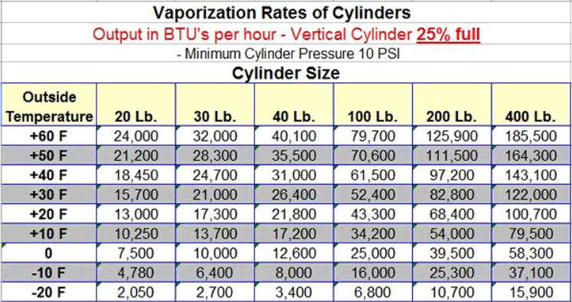
Vapor Pressure Propane (BBQ)
Notice for each sized tank, the vapor pressure drops significantly with temperature.
Typical home BBQ tanks hold only 4 Lb. of propane. Winter?

Slide 56
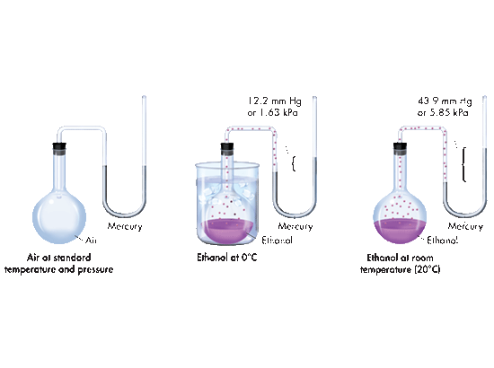
Measuring Vapor Pressure
The vapor pressure of a liquid can be determined with a manometer. The vapor pressure is equal to the difference in height of the mercury in the two arms of the U-tube.
12.2 mm Hg or 1.63 kPa
43.9 mm Hg or 5.85 kPa
Notice how vapor pressure increased with temperature.
Mercury
Mercury
Ethanol
Ethanol
Ethanol at 0°C
Ethanol at room temperature (20°C)

Slide 57
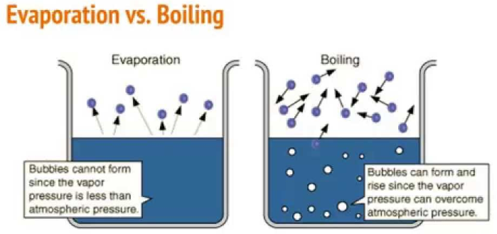
Boiling of Liquids
Atmospheric pressure acts on the surface of a vapor bubble, causing it to collapse.
Evaporation only occurs at the SURFACE of an object or liquid
Boiling occurs throughout a liquid, beginning at the heat source
Avg KE increases so bubbles (vapor) form throughout the liquid, rise to the surface, and escape into the air.

Slide 58
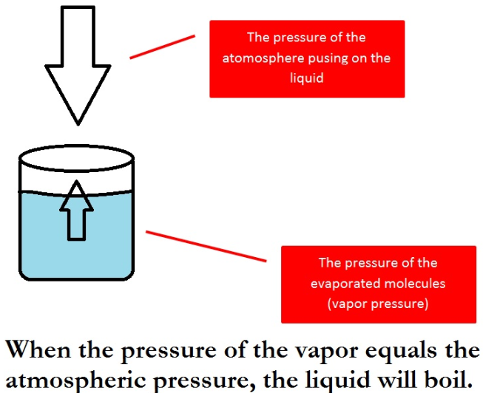
Boiling of Liquids
Boiling Point (bp)
The temperature at which the equilibrium vapor pressure of the liquid is equal to the prevailing atmospheric pressure
Boiling points decrease at higher altitudes
Atmospheric pressure decreases with altitude, so less vapor pressure is needed to bring a liquid to boiling.
“Normal” Boiling Point means at STP

Slide 59
Boiling & Pressure
Temp (C) | Vapor Pressure in mm Hg
 | Water | Ethyl Alcohol | Ethyl Ether
0 | 4.6 | 12.2 | 185.3
20 | 17.5 | 43.9 | 442.2
40 | 55.3 | 135.3 | 921.3
60 | 149.4 | 352.7 | 1729.0
80 | 355.1 | 812.6 | 2993.6
100 | 760.0* | 1693.3 | 4859.4
If atmospheric pressure decreases, liquids will boil at lower than expected temperatures (e.g like doing push ups with people helping lift you)
If atmospheric pressure increases, liquids will boil at higher than expected temperatures (e.g like doing push ups with people sitting on you)

Slide 60
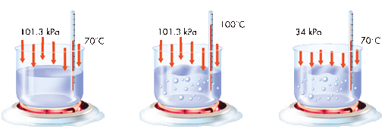
Boiling & Pressure
Temp (C) | Vapor Pressure in mm Hg
 | Water | Ethyl Alcohol | Ethyl Ether
0 | 4.6 | 12.2 | 185.3
20 | 17.5 | 43.9 | 442.2
40 | 55.3 | 135.3 | 921.3
60 | 149.4 | 352.7 | 1729.0
80 | 355.1 | 812.6 | 2993.6
100 | 760.0* | 1693.3 | 4859.4
Consider each example given below:
760 torr
760 torr
100°C
255 torr
70°C
70°C
Does not BOIL
BOILS
BOILS
255 torr
760 torr
255 torr
Sea Level
Sea Level
Atop Mount Everest

Slide 61
Boiling & Pressure
Temp (C) | Vapor Pressure in mm Hg
 | Water | Ethyl Alcohol | Ethyl Ether
0 | 4.6 | 12.2 | 185.3
20 | 17.5 | 43.9 | 442.2
40 | 55.3 | 135.3 | 921.3
60 | 149.4 | 352.7 | 1729.0
80 | 355.1 | 812.6 | 2993.6
100 | 760.0* | 1693.3 | 4859.4
Consider each example given below:
760 torr
760 torr
100°C
255 torr
70°C
70°C
Does not BOIL
BOILS
BOILS
255 torr
760 torr
255 torr
Sea Level
Sea Level
Atop Mount Everest

Slide 62
Boiling & Pressure
Temp (C) | Vapor Pressure in mm Hg
 | Water | Ethyl Alcohol | Ethyl Ether
0 | 4.6 | 12.2 | 185.3
20 | 17.5 | 43.9 | 442.2
40 | 55.3 | 135.3 | 921.3
60 | 149.4 | 352.7 | 1729.0
80 | 355.1 | 812.6 | 2993.6
100 | 760.0* | 1693.3 | 4859.4
Consider each example given below:
760 torr
760 torr
100°C
255 torr
70°C
70°C
Does not BOIL
BOILS
BOILS
255 torr
760 torr
255 torr
Sea Level
Sea Level
Atop Mount Everest

Slide 63
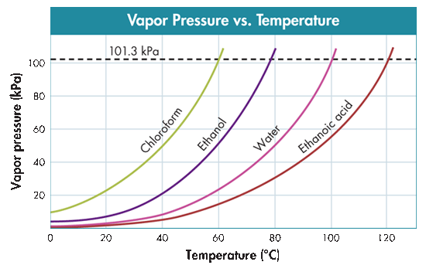
Vapor Pressure vs. Temperature
Normal boiling point of each liquid:
See “States of Matter Graphs Worksheet”

Slide 64
Vapor Pressure vs. Temperature
60 C
78 C
100 C
125 C
Normal boiling point of each liquid:
60 C, 78 C, 100 C, 125 C
See “States of Matter Graphs Worksheet”

Slide 65
Vapor Pressure vs. Temperature
Pressure necessary to boil 60 ºC:
See “States of Matter Graphs Worksheet”

Slide 66
Vapor Pressure vs. Temperature
101 kPa
50 kPa
23 kPa
16 kPa
Pressure necessary to boil 60 ºC:
16, 23, 50, 101 kPa
See “States of Matter Graphs Worksheet”

Slide 67
Vapor Pressure vs. Temperature
Which liquid is LEAST likely to boil under given conditions?
Which liquid is MOST likely to boil under given conditions?
See “States of Matter Graphs Worksheet”

Slide 68
Vapor Pressure vs. Temperature
Which liquid is LEAST likely to boil under given conditions?
Ethanoic acid (lower VP)
Which liquid is MOST likely to boil under given conditions?
Chloraform (higher VP)
See “States of Matter Graphs Worksheet”

Slide 69
Determine Properties of Liquids
Which of the following is most likely for a liquid with large, attractive intermolecular forces?
[ ] low melting point and high boiling point
[ ] high melting point and low boiling point
[ ] high melting point and high boiling point
Water (H₂O) is a liquid at room temperature. Ammonia (NH₃) is a gas at room temperature. Both are polar covalent compounds. Which compound most likely has the strongest intermolecular forces?
Explain IF or WHY water can boil below 100° C.
Notes:
Timing ≈ 1 min
Entry Audio: The temperature at which the solid form of a substance melts depends on how strong the particles attract each other. The boiling point of the liquid form also depends on the same attractive forces. If the forces of attraction are large, which set of melting and boiling points would you expect?
Hint1 Audio: Stronger attractive forces require more motion (kinetic energy) to break the particles free.
Hint2 audio: If a substance is a gas at room temperature, that means its boiling point is below room temperature.
Exit Audio: Both water and ammonia form hydrogen bonding interactions, but the interactions in water are stronger than those in ammonia.

Slide 70
Determine Properties of Liquids
Which of the following is most likely for a liquid with large, attractive intermolecular forces?
[ ] low melting point and high boiling point
[ ] high melting point and low boiling point
[X] high melting point and high boiling point
Water (H₂O) is a liquid at room temperature. Ammonia (NH₃) is a gas at room temperature. Both are polar covalent compounds. Which compound most likely has the strongest intermolecular forces?
Water … water is a liquid at room temperature while ammonia is a gas, water must have stronger intermolecular forces holding the atoms together.
Explain IF or WHY water can boil below 100° C.
As long as the atmospheric pressure matches the vapor pressure at a given temperature, water can boil. At 60 C, the VP = 19.9 kPa.
Notes:
Timing ≈ 1 min
Entry Audio: The temperature at which the solid form of a substance melts depends on how strong the particles attract each other. The boiling point of the liquid form also depends on the same attractive forces. If the forces of attraction are large, which set of melting and boiling points would you expect?
Hint1 Audio: Stronger attractive forces require more motion (kinetic energy) to break the particles free.
Hint2 audio: If a substance is a gas at room temperature, that means its boiling point is below room temperature.
Exit Audio: Both water and ammonia form hydrogen bonding interactions, but the interactions in water are stronger than those in ammonia.

Slide 71
Liquid Equilibrium & Vapor Pressure
Notes (6:17)
https://screencast-o-matic.com/watch/cFQiDvqpRM

Slide 72
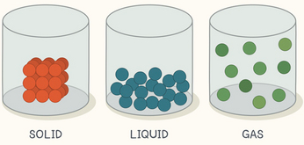
Properties of Solids
  < Temperature < kinetic energy < particle motion
a. Definite shape
b. Definite volume
c. Tightly packed molecules
d. Greater density than liquids or gases
e. Usually least compressible of phases
f. Molecules move slowest of all the phases
g. Particles vibrate about fixed points, and do NOT flow

Slide 73
Phase Changes for Solids
equilibrium
melting
Solid Liquid
freezing
melting point (mp)
The temperature at which a solid changes into a liquid.
The disruptive vibrations of the particles are strong enough to overcome the attractions that hold them in fixed positions.
Melting: kinetic energy > intermolecular forces
freezing point (fp)
The temperature at which a liquid changes into a solid.
Freezing: kinetic energy < intermolecular forces
T_{mp} = T_{fp}

Slide 74
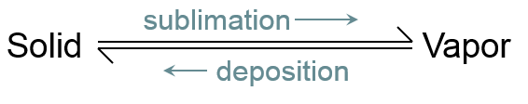
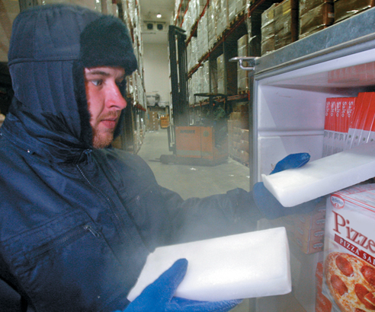
Phase Changes for Solids
Sublimation
The change of a substance from a solid to a vapor without passing through the liquid state is called sublimation. Sublimation occurs in solids with vapor pressures that exceed atmospheric pressure at or near room temperature.
Sublimation: KE > intermolecular forces
Deposition: KE < intermolecular forces
Solid carbon dioxide (dry ice) is often used as a coolant for goods.
https://screencast-o-matic.com/watch/cFQ6XCqEx2 (1:59)

Slide 75
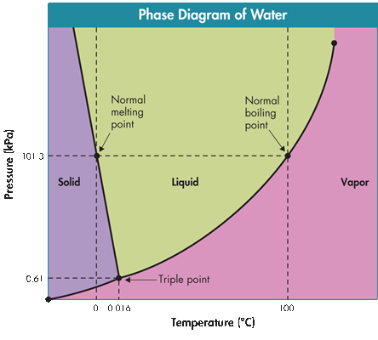
Phase Diagrams
Represent the relationships among the solid, liquid, and vapor states (or phases) of a substance in a sealed container
The conditions of pressure and temperature at which two phases exist in equilibrium are indicated on the phase diagram by a line separating the phases.
The phase diagram of water shows the relationship among pressure, temperature, and the physical states of water (s, l, g).

Slide 76
Phase Diagrams
Each slope line represent the equilibrium conditions for one of the phase changes. Label each phase change on the phase diagram:

Slide 77
Phase Diagrams
Each slope line represent the equilibrium conditions for one of the phase changes. Label each phase change on the phase diagram:
mp = melting pt
fp = freezing pt
bp = boiling pt
cp = condensation pt
sp = sublimation pt
dp = deposition pt
mp - fp
bp - cp
sp - dp

Slide 78

Phase Diagrams
Triple Point
The point on the diagram at which all three phases can exist in equilibrium with one another.
Water’s triple point is 0.016⁰ C & 0.61 kPa.
The flask is at the triple point. Freezing, melting, boiling, condensation, sublimation, & deposition are all occurring at the same time.

Slide 79
What does “normal” mean (mp, bp)? Give all units.

Slide 80
What does “normal” mean (mp, bp)? Give all units.
Standard pressure
101.3 kPa
1 atm
760 mm Hg
solid
What phase exists at 50 kPa & -10º C?
What phase exists at Standard pressure & 50º C?
What phase exists at 10 kPa & 80º C?
See “States of Matter Graphs Worksheet”
liquid
vapor

Slide 81
Phase Diagrams
Notice that water is unique: As pressure increases on solid water (move up the slope line for s ↔ l), it will eventually melt into liquid water, EXPANDING as it FREEZES.
For all other substances in creation solids CONTRACT as they freeze, meaning that the s ↔ l line on the phase diagram will slope the opposite direction. God is very cool, isn't He?

Slide 82

Name the Postulates of Kinetic Theory
  All matter is composed of small particles.
  These particles are in constant random motion.
  Collisions between particles are perfectly elastic.
When does the kinetic theory break down?
At very low temperatures, gases expand less for a given pressure change than they do at high temperatures.
Notes:
Timing ≈ 1 min
You have probably heard of kinetic molecular theory in terms of gases. However, several of the postulates of the theory apply to all matter, not just gases.
First, all matter is composed of particles--atoms, molecules, or ions.
Second, these particles are in constant, random motion.
Third, when particles collide with each other or with the walls of their container, the collisions are perfectly elastic. In other words, no energy is lost during the collision.
Finally, the particles obey Newton's laws of motion.
SOURCES:
This graphic is a place holder. There wasn’t anything appropriate for free but this is not a difficult picture to draw. The direction of the arrows and position of the particles is random.

Slide 83
Practice Reading Graphs
Equilibrium Vapor Pressure
Phase Diagrams
Pause the video as needed (5:08)
https://screencast-o-matic.com/watch/cFQiopqp82

