Slide 1
Click on “Slide Show”
Click on
“From Current Slide”
or “From Beginning”

Slide 2
Review
Elementary
Particles

Slide 3
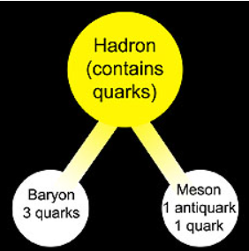
Review Quarks
Hadrons are particles that experience the strong nuclear force.
Quarks are particles with fractional electric charge (e) and mass. Standard electric charge (e) is defined as:
-1.6 x 10⁻¹⁹ coulombs for an electron (-e)
+ 1.6 x 10⁻¹⁹ C for a proton (+e).
Baryons are composed of 3 quarks so their charges are +1/3 e.
Mesons are composed of a quark and an antiquark so their charges are +1 e, 0, or -1 e.
All hadrons have antimatter.
There’s More!!
fermions, bosons, leptons, pions, gluons, muons, tau

Slide 4
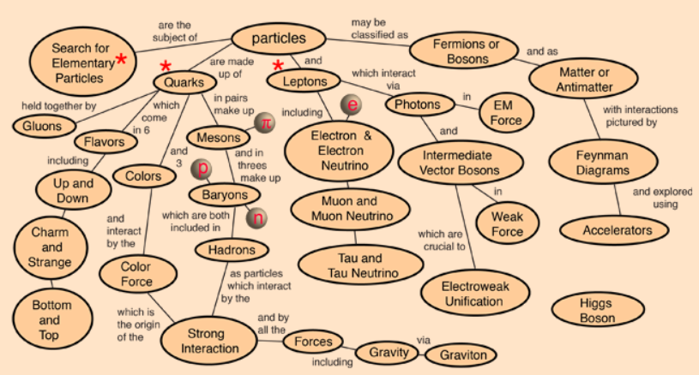
Elementary Particles

Slide 5
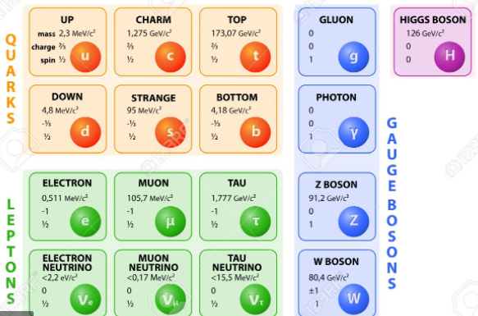
Elementary Particles

Slide 6
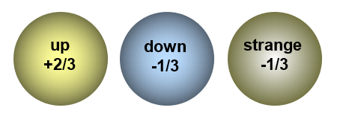
SubAtomic Particles: Quarks
There are six quarks with anti-quarks (same magnitude, but opposite sign): up quark, down quark, strange quark, charm quark, top quark, and bottom quark.
charm
top
+2/3
bottom

Slide 7
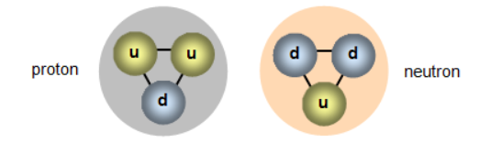
SubAtomic Particles
Protons and the Neutrons
Proton Neutrons
u+2/3 d-1/3
u+2/3 d-1/3
d -1/3 u+2/3
+1 0

Slide 8
Neutron Transformation
Antineutrino)
Up down down → up up down +
Proton Neutrons
u+2/3 d-1/3
u+2/3 d-1/3
d-1/3 u+2/3
+1 0
Standard Electric Charge
1.6 x 10⁻¹⁹ coulombs

Slide 9
Nuclear Energy
Fission & Fusion

Slide 11
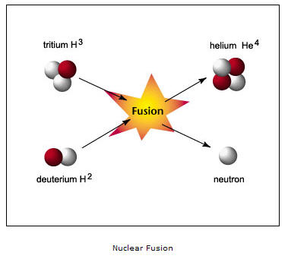

Slide 12
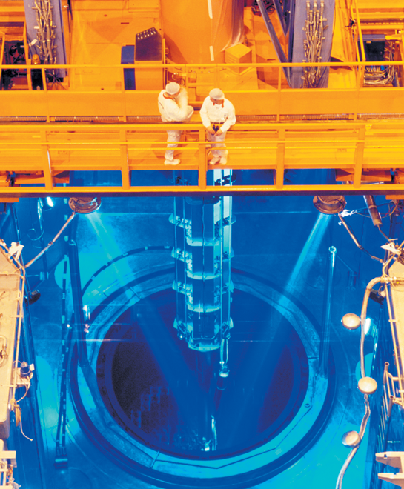
Transmutations involve more than just the conversion of one element into another—they also involve the conversion of mass into energy.
Nuclear energy released by nuclear reactions is used as an alterative source of energy.

Slide 13
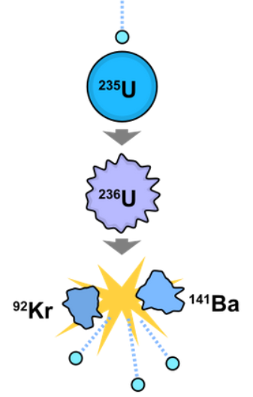
Transmutation
Most nuclear reactions involve the artificial transmutation of elements, although they are generally referred to more specifically as "fission", "fusion", or "irradiation" instead of being referred to broadly as transmutation.

Slide 14
Nuclear Forces
Under what conditions does the strong nuclear force overcome electric forces in the nucleus?

Slide 15
Nuclear Forces
The strong nuclear force is the attractive force that binds protons and neutrons together in the nucleus.
Over very short distances, the strong nuclear force is much greater than the electric forces among protons.

Slide 16
Nuclear Forces
The protons in the nucleus are all positively charged, so they tend to repel one another.
The strong nuclear force binds protons and neutrons together in the nucleus.
The strong nuclear force does not depend on charge.
It acts among protons, among neutrons, and among protons and neutrons.

Slide 17
Nuclear Forces
At the distance of a proton width, the strong nuclear force is more than 100 times greater than the electric force that repels protons.
The strong nuclear force quickly weakens as protons and neutrons get farther apart.

Slide 18
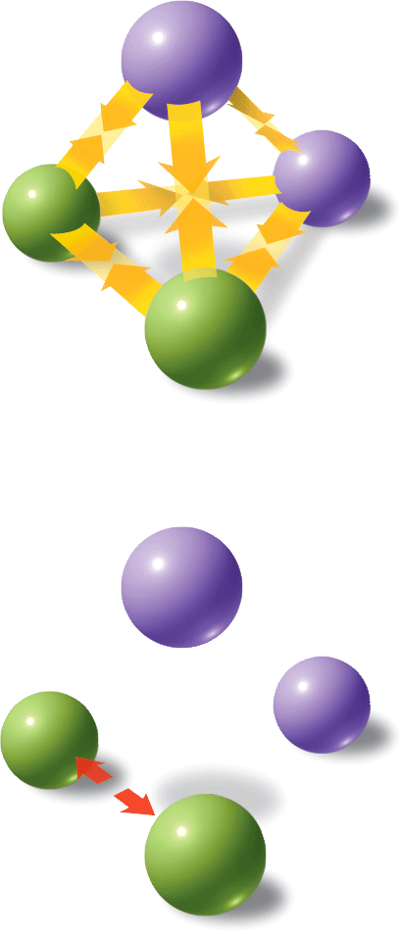
Nuclear Forces
Strong nuclear forces and electric forces act upon particles in the nucleus.
Strong Nuclear Forces
Neutron
Neutron
Proton
Proton
Electric Forces
Neutron
Neutron
Proton
Proton

Slide 19
Nuclear Forces
The Effect of Size on Nuclear Forces
The greater the number of protons in a nucleus, the greater is the electric force that repels those protons.
The more protons and neutrons in a nucleus, the more possibilities there are for strong nuclear force attractions.
Because the strong nuclear force only acts over short ranges, the possibility of many attractions is never realized in a large nucleus.

Slide 20
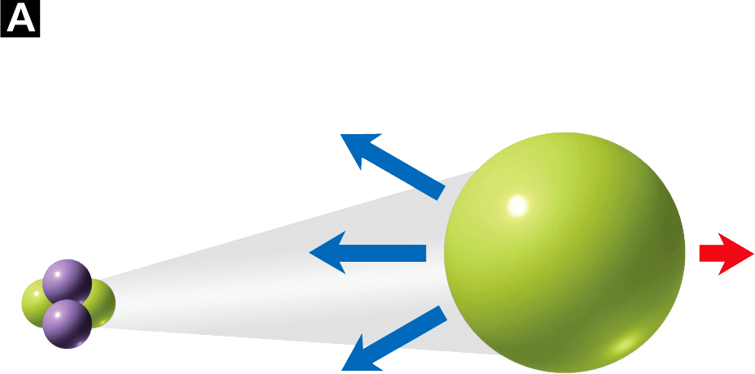
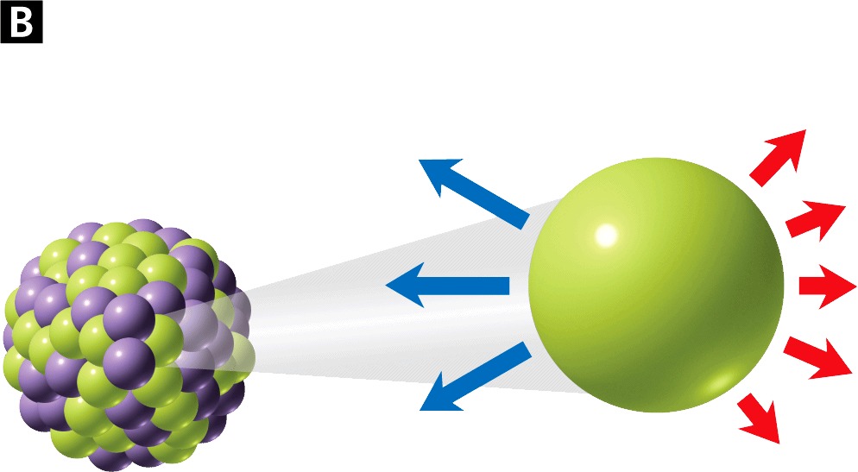
Nuclear Forces
The strong nuclear forces easily overcome the electric force between the protons.
The larger number of electric forces makes the nucleus less stable.
Nuclear Forces Acting on a Proton of a Small Nucleus
Nuclear Forces Acting on a Proton of a Large Nucleus

Slide 21
Nuclear Forces
Unstable Nuclei
A nucleus becomes unstable, or radioactive, when the strong nuclear force can no longer overcome the repulsive electric forces among protons.
While the strong nuclear force does not increase with the size of the nucleus, the electric forces do.
All nuclei with more than 83 protons are radioactive.

Slide 22
Fission
What property of fission makes it so useful?
Fission is the splitting of an atomic nucleus into two smaller parts.
In nuclear fission, tremendous amounts of energy can be produced from very small amounts of mass.

Slide 23
Fission
In 1938, Otto Hahn and Fritz Strassman bombarded uranium-235 with high-energy neutrons to produce more massive elements.
Their experiments instead produced isotopes of a smaller element, barium.
Lise Meitner and Otto Frisch determined that uranium-235 nuclei had been broken into smaller fragments.

Slide 24
Fission
Meitner predicted that fission releases energy.
The nuclear energy released by the fission of 1 kilogram of uranium-235 is equivalent to the chemical energy produced by burning more than 17,000 kilograms of coal.

Slide 25
Fission
The fission of uranium-235 yields smaller nuclei, neutrons, and energy.
Neutron

Slide 26
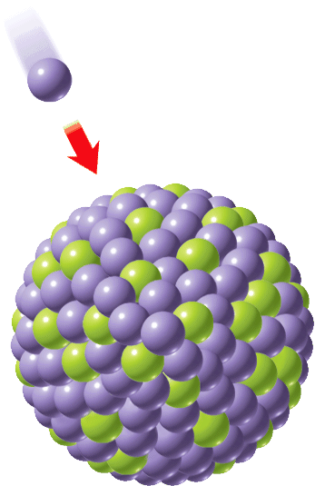
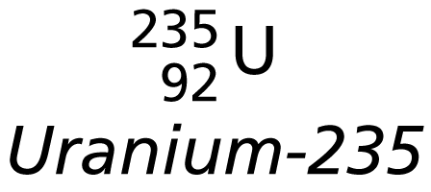
Fission
The fission of uranium-235 yields smaller nuclei, neutrons, and energy.
Neutron

Slide 27
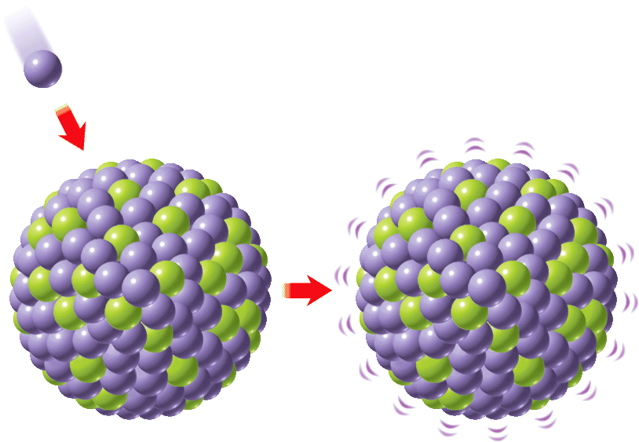
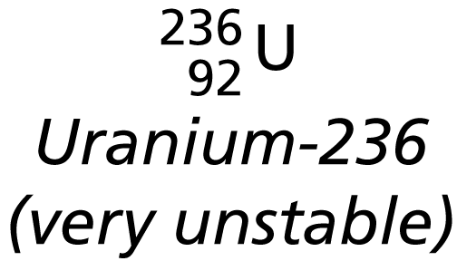
Fission
The fission of uranium-235 yields smaller nuclei, neutrons, and energy.
Neutron

Slide 28
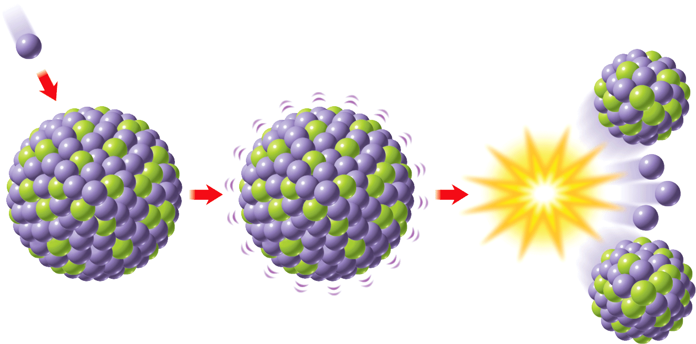
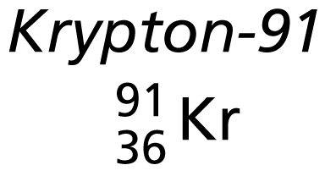
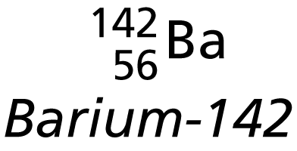
Fission
The fission of uranium-235 yields smaller nuclei, neutrons, and energy.
Neutron
Energy

Slide 29
Fission
Converting Mass Into Energy
When the fission of uranium-235 is carried out, about 0.1 percent of the mass of the reactants is lost during the reaction. This “lost” mass is converted into energy.
In 1905, Albert Einstein had introduced the mass-energy equation.

Slide 30
Fission
E represents energy, m represents mass, and c represents the speed of light (3.0 × 10⁸ m/s).
The conversion of a small amount of mass releases an enormous amount of energy.
According to the law of conservation of mass and energy, the total amount of mass and energy remains constant.

Slide 31
Fission
Triggering a Chain Reaction
A uranium-235 nucleus decays into two smaller nuclei and releases two or three neutrons.
If one of the neutrons is absorbed by another uranium-235 nucleus, another fission can result.
In a chain reaction, neutrons released during the splitting of an initial nucleus trigger a series of nuclear fissions and is considered self-sustaining.

Slide 32
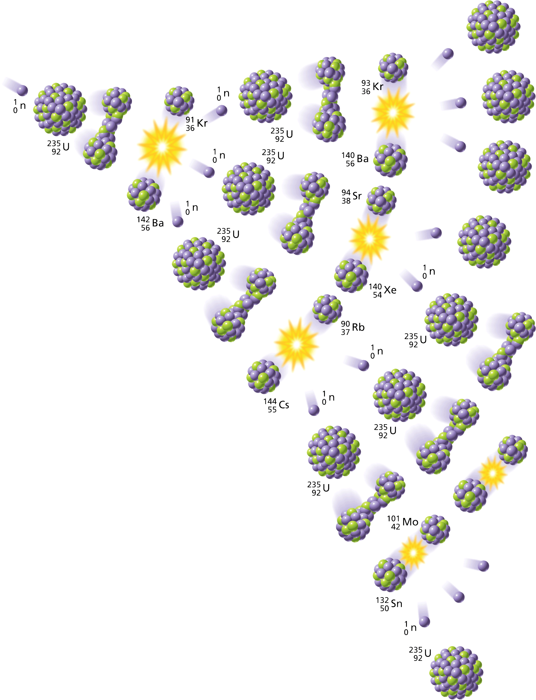
Fission
The fission of one nucleus can trigger a chain reaction.

Slide 33
Fission
In an uncontrolled chain reaction, all of the released neutrons are free to cause other fissions.
The result is a fast, intense release of energy.
Nuclear weapons are designed to produce uncontrolled chain reactions.

Slide 34
Fission
In a controlled chain reaction, some of the neutrons are absorbed by other materials resulting in only one new fission for each splitting of an atom.
The heat from controlled chain reactions can be used to generate electrical energy.

Slide 35
Fission
In order to sustain a chain reaction, each nucleus that is split must produce, on average, one neutron that causes the fission of another nucleus.
This condition corresponds to a specific mass of fissionable material. A critical mass is the smallest possible mass of a fissionable material that can sustain a chain reaction.

Slide 36
Fission
Nuclear Energy from Fission
Nuclear power plants generate about 20 percent of the electricity in the United States.
In a nuclear power plant, controlled fission of uranium-235 occurs in a vessel called a fission reactor.
Nuclear power plants do not emit air pollutants.

Slide 37
Fission
Nuclear power plants do have safety and environmental issues.
Workers in nuclear power plants need to wear protective clothing to reduce their exposure to nuclear radiation.
Nuclear power produces radioactive isotopes with half-lives of hundreds or thousands of years.

Slide 38
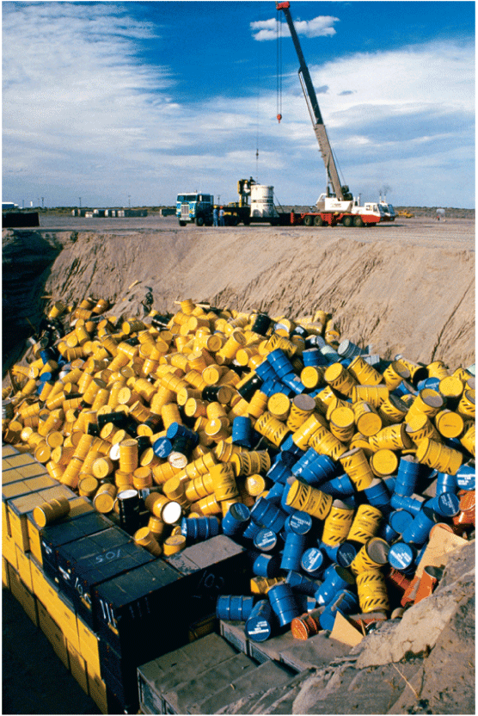
Fission
Unfortunately, a product of controlled chain reactions is radioactive waste.
A crane lowers drums of radioactive waste into a landfill in Hanford, Washington.

Slide 39
Fusion
Fusion is a process in which the nuclei of two atoms combine to form a larger nucleus.
As in fission, during fusion a small fraction of the reactant mass is converted into energy.

Slide 40
Fusion
The sun and other stars are powered by the fusion of hydrogen into helium. Inside the sun, an estimated 600 million tons of hydrogen undergo fusion each second.
Fusion requires extremely high temperatures.
Inside the sun, matter exists as plasma, a state of matter in which atoms have been stripped of their electrons.

Slide 41
Fusion
Scientists envision fusion reactors fueled by two hydrogen isotopes, deuterium (hydrogen-2) and tritium (hydrogen-3). The fusion of deuterium and tritium produces helium, neutrons, and energy.
Two main problems in designing a fusion reactor are achieving the high temperatures required and containing the plasma.

Slide 42
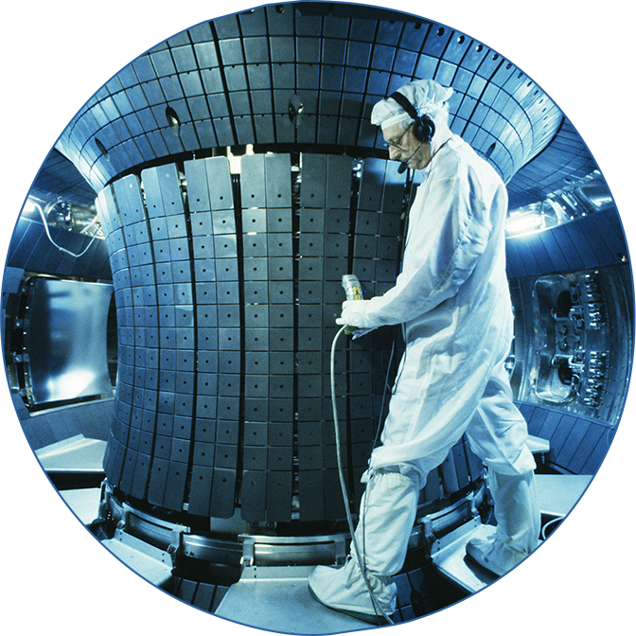
Fusion
The Tokamak Fusion Test Reactor at the Princeton Plasma Physics Laboratory was one of the very few fusion reactors that have been built.

Slide 43
Assessment Questions
Why do nuclei become less stable as the atomic number increases?
The strong nuclear forces become too strong and expel particles.
The strong nuclear forces become weaker and cannot overcome electrical forces.
The electrical forces become stronger and overcome strong nuclear forces.
The electron cloud becomes too large and increases pressure on the nucleus.

Slide 44
Assessment Questions
Why do nuclei become less stable as the atomic number increases?
The strong nuclear forces become too strong and expel particles.
The strong nuclear forces become weaker and cannot overcome electrical forces.
The electrical forces become stronger and overcome strong nuclear forces.
The electron cloud becomes too large and increases pressure on the nucleus. ANS: C

Slide 45
Assessment Questions
Which of the following statements about nuclear fission is FALSE?
Fission is the splitting of a nucleus into two smaller parts.
Fission produces tremendous amounts of energy from a small mass.
Mass is conserved during nuclear fission.
Fission does not always yield the same products.

Slide 46
Assessment Questions
Which of the following statements about nuclear fission is FALSE?
Fission is the splitting of a nucleus into two smaller parts.
Fission produces tremendous amounts of energy from a small mass.
Mass is conserved during nuclear fission.
Fission does not always yield the same products. ANS: C

Slide 47
Assessment Questions
How is nuclear energy converted to electrical energy in a nuclear power plant?
Nuclear fusion releases electrons that then flow through wires.
Fission reactions in the core of the reactor release charged particles that form the current.
A fission reaction produces energy as heat, which converts water to steam that drives a turbine connected to a generator.
Neutrons from the nuclear fission process drive a turbine that is connected to a generator.

Slide 48
Assessment Questions
How is nuclear energy converted to electrical energy in a nuclear power plant?
Nuclear fusion releases electrons that then flow through wires.
Fission reactions in the core of the reactor release charged particles that form the current.
A fission reaction produces energy as heat, which converts water to steam that drives a turbine connected to a generator.
Neutrons from the nuclear fission process drive a turbine that is connected to a generator. ANS: C

Slide 49
Assessment Questions
Why has nuclear fusion not been used to produce power on Earth.
Fusion only occurs in high temperature plasmas, which cannot yet be controlled.
Nuclear fusion requires deuterium, which is not available on Earth.
Fusion does not produce enough energy to justify its use.
Scientists do not yet know how to start a fusion reaction.

Slide 50
Assessment Questions
Why has nuclear fusion not been used to produce power on Earth.
Fusion only occurs in high temperature plasmas, which cannot yet be controlled.
Nuclear fusion requires deuterium, which is not available on Earth.
Fusion does not produce enough energy to justify its use.
Scientists do not yet know how to start a fusion reaction. ANS: A

