Slide 1
Edible Wild Plants

Slide 2
Animate Slides
Click on “Slide Show”
Click “From Beginning”

Slide 3
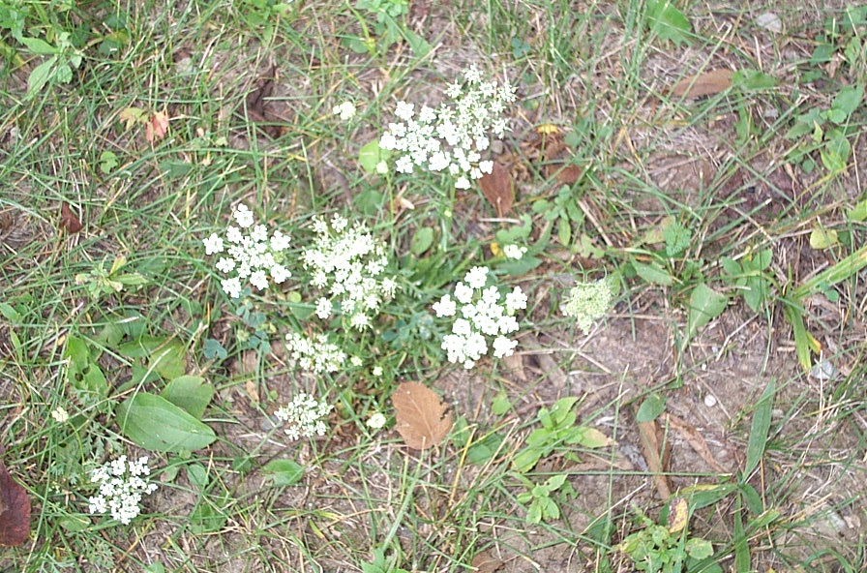
Wild Carrot

Slide 4
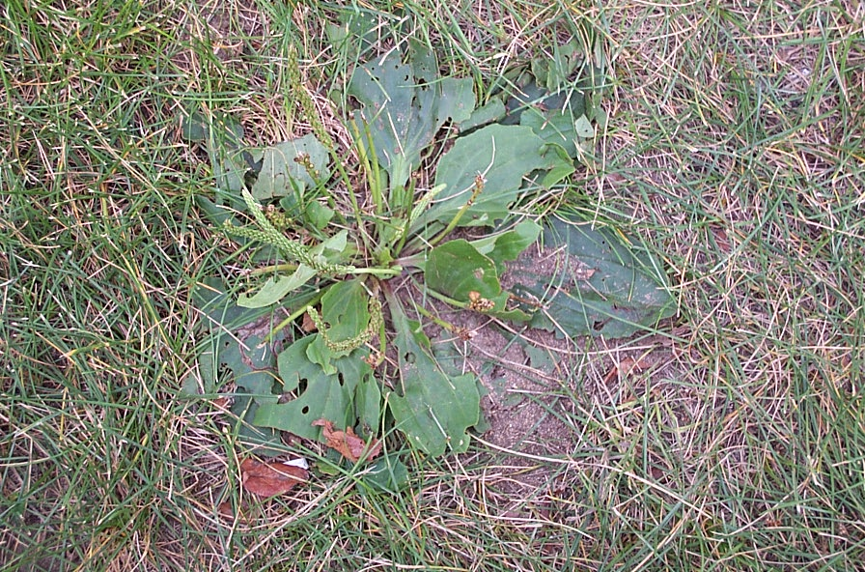
Plantain
(Common )

Slide 5
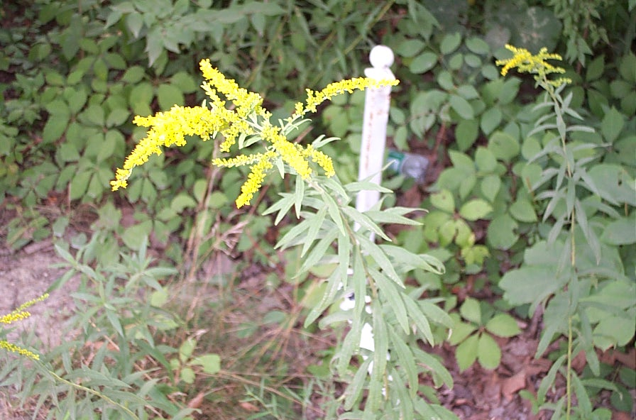
Goldenrod

Slide 6
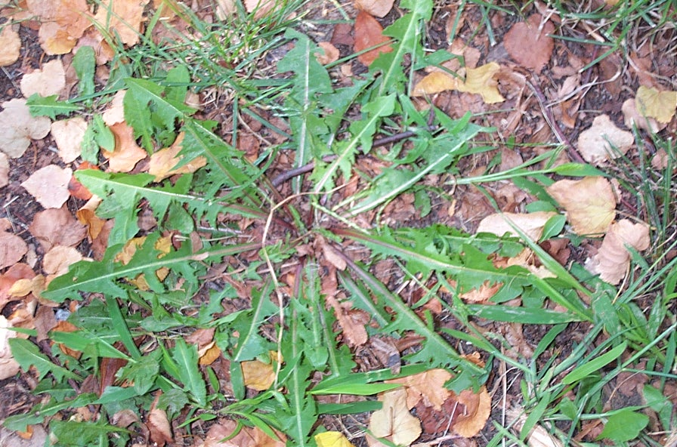
Dandelion

Slide 7
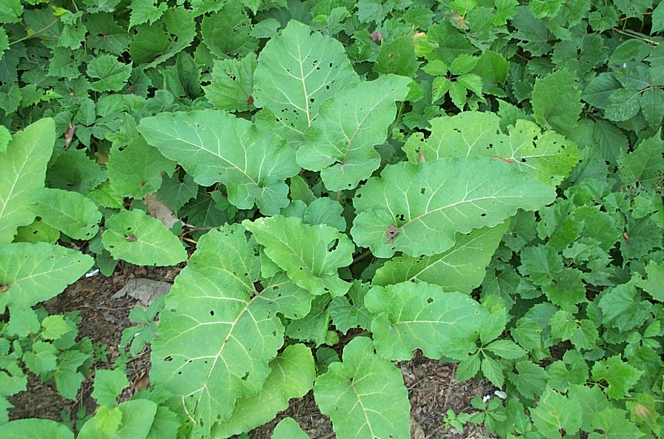
Burdock

Slide 8
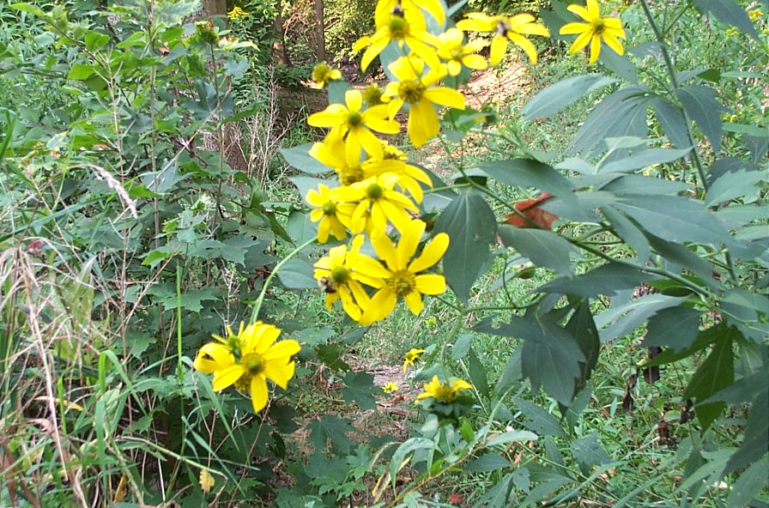
Jerusalem Artichoke

Slide 9
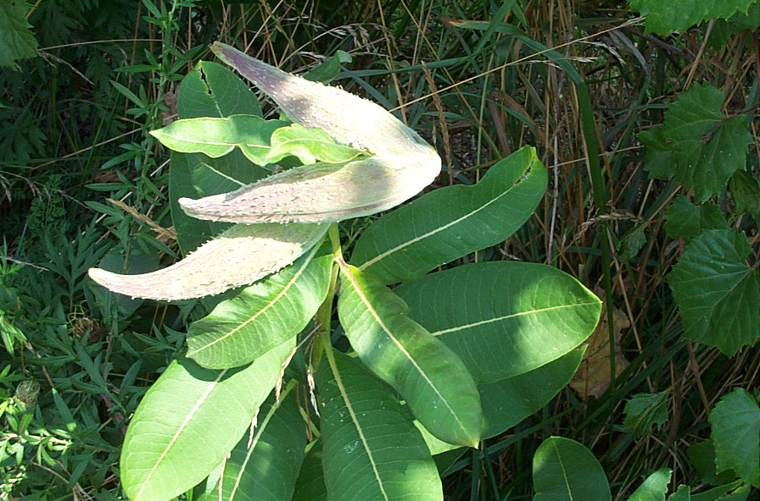
Milkweed

Slide 10
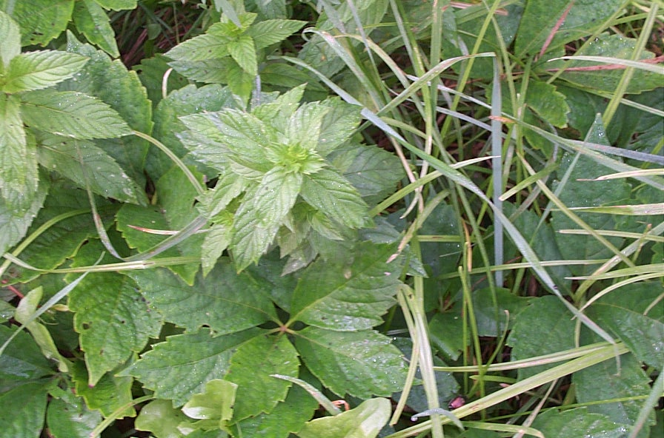
Wild Mint

Slide 11
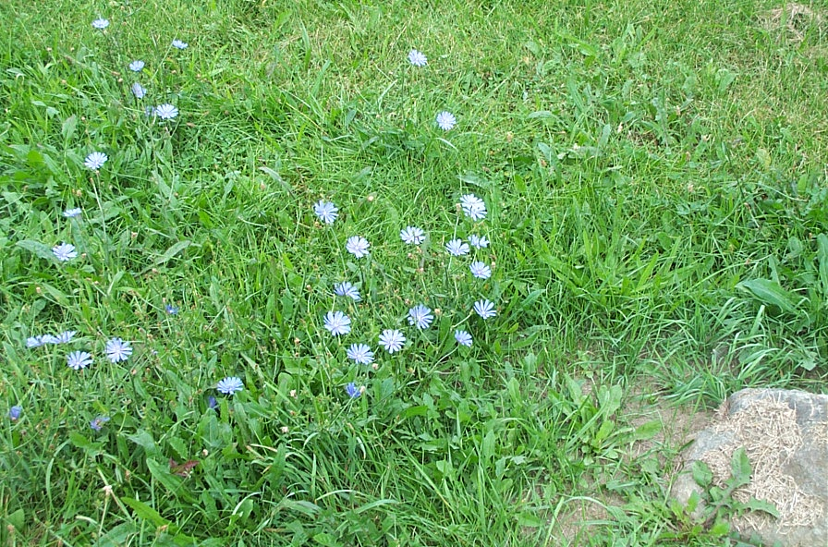
Chicory

Slide 12
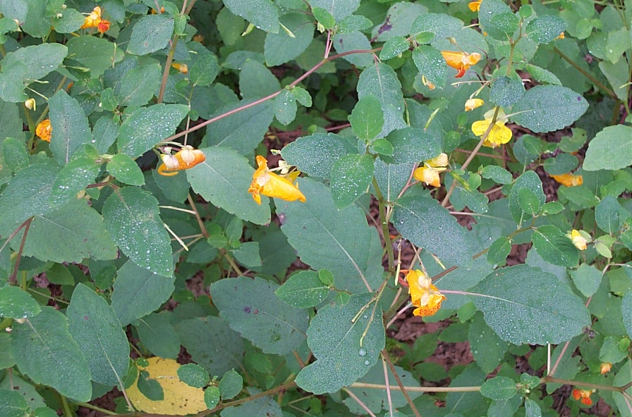
Jewelweed
(Touch Me Not)

Slide 13
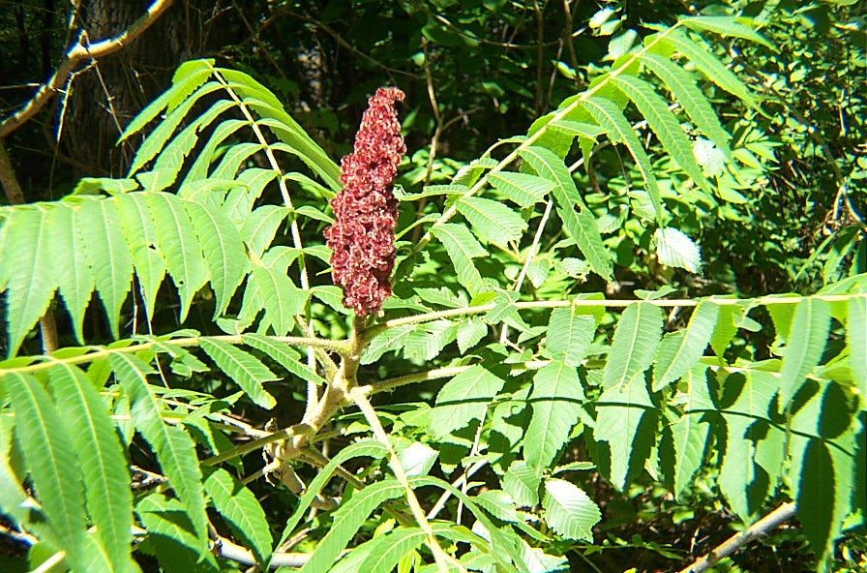
Sumac

Slide 14
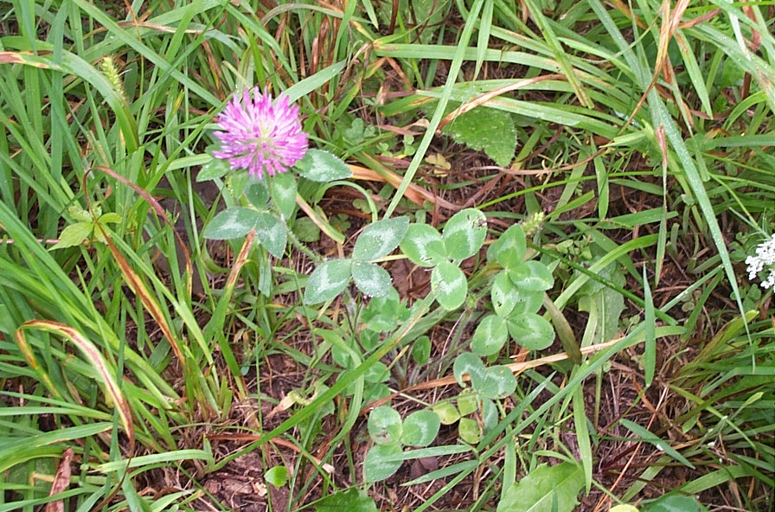
Clover

Slide 15
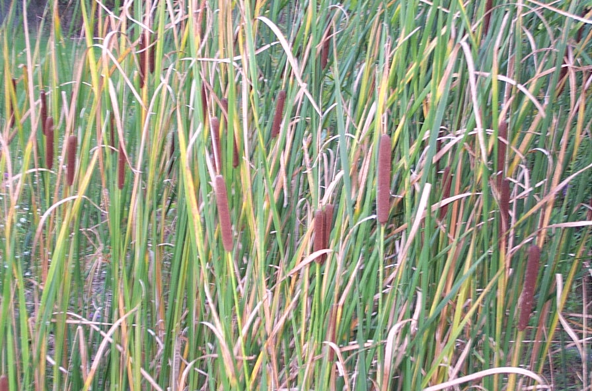
Cattail

Slide 16
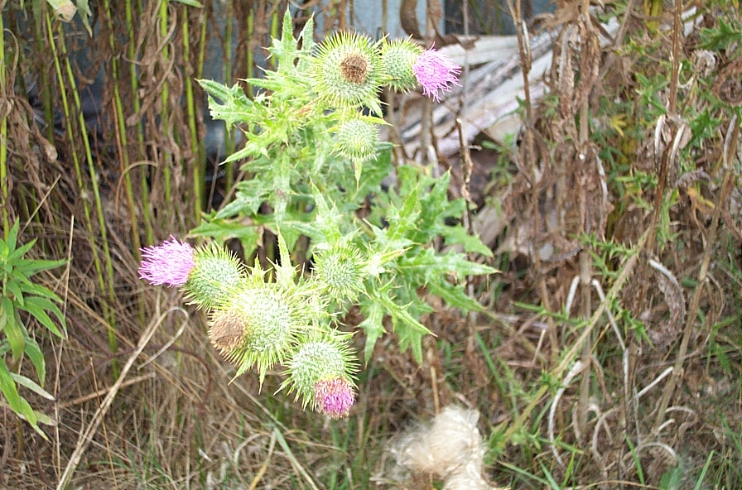
Bull Thistle

Slide 17
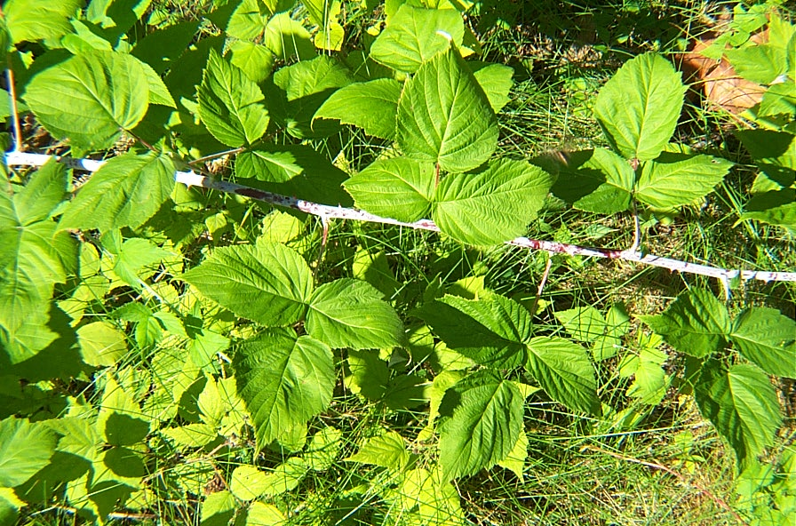
Raspberry

Slide 18
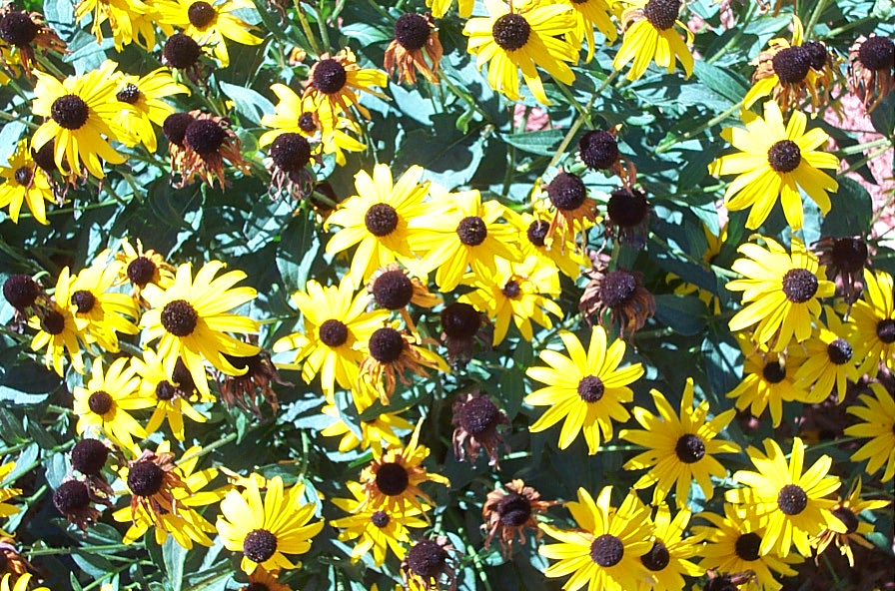
Black eyed Susan

Slide 19
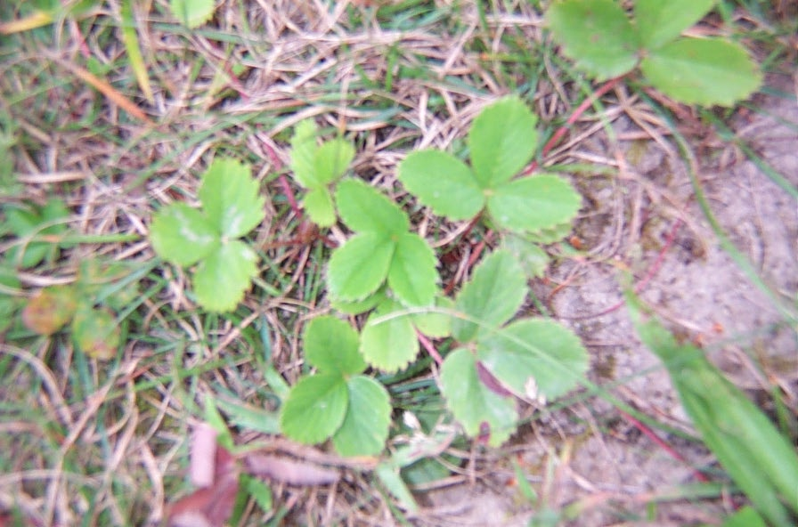
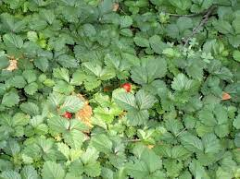
Wild Strawberry

Slide 20
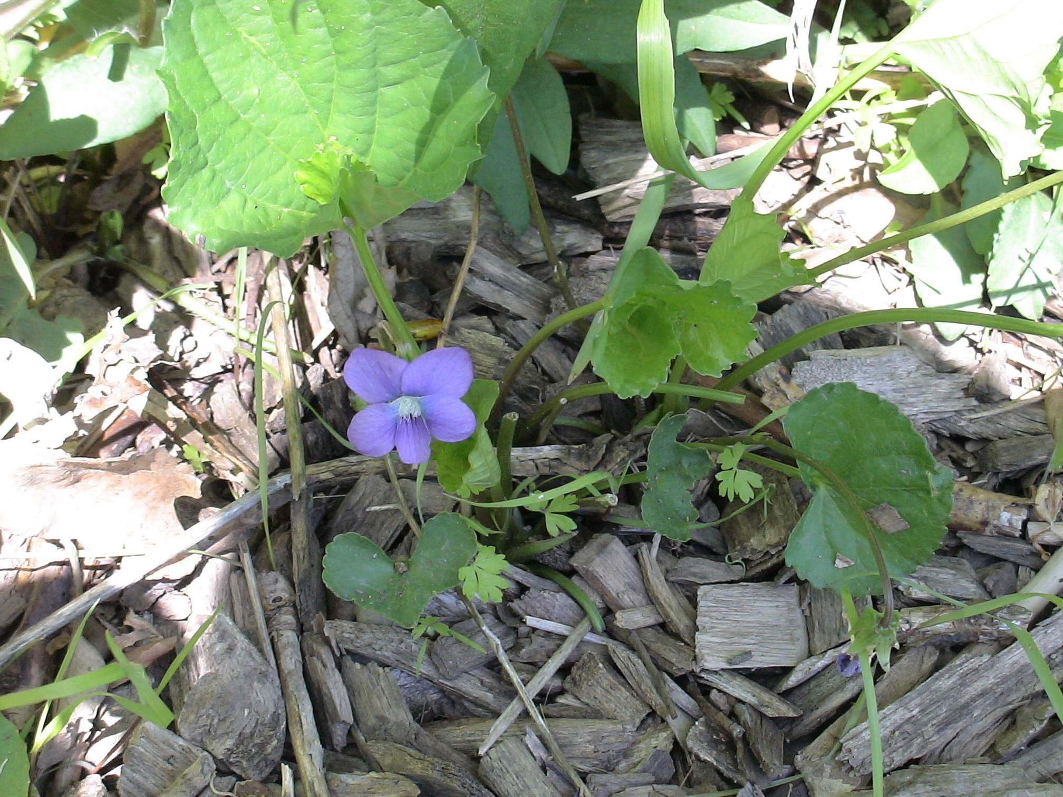
Violet

Slide 21
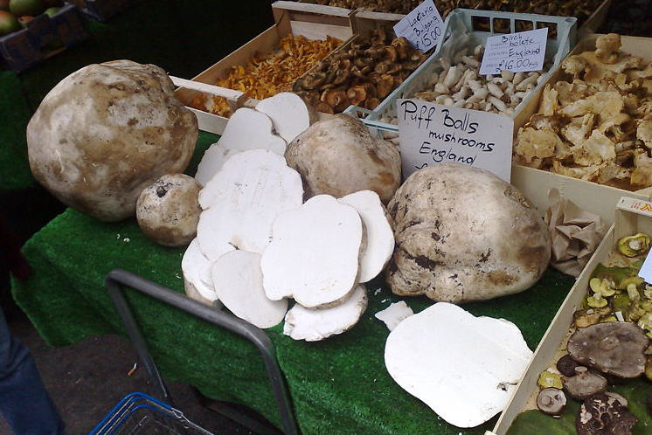
Puffballs

Slide 22
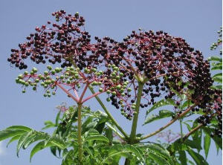
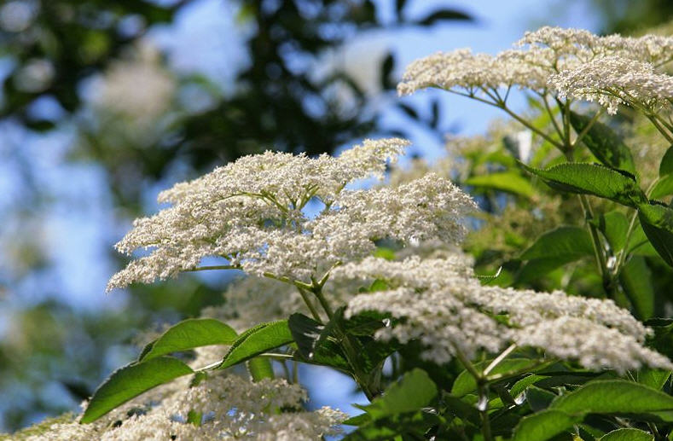
Elderberry

Slide 23
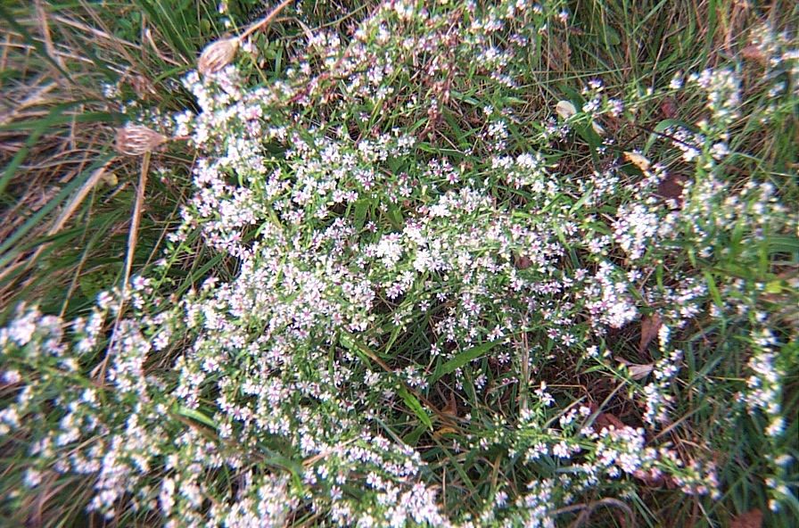
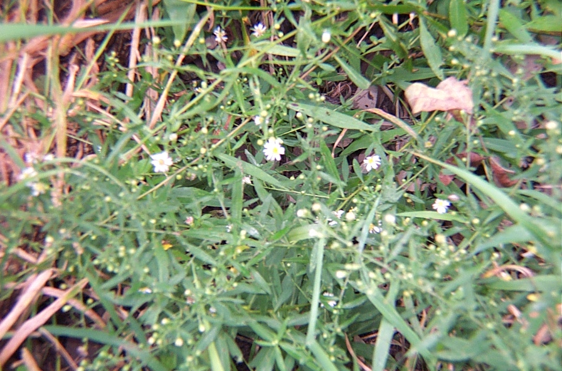
Aster

Slide 24
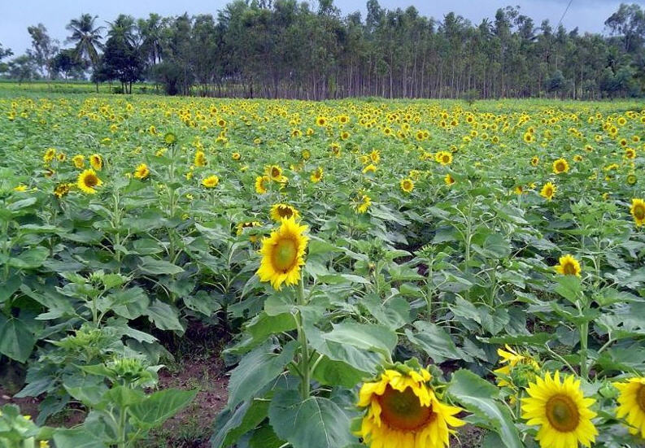
Sunflower

Slide 25
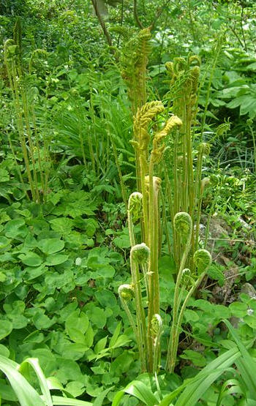
Fiddlehead fern

Slide 26
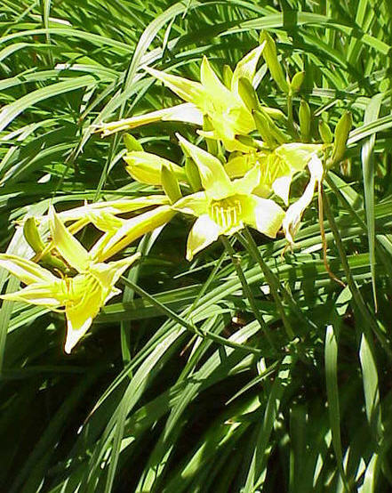
Daylily

Slide 27
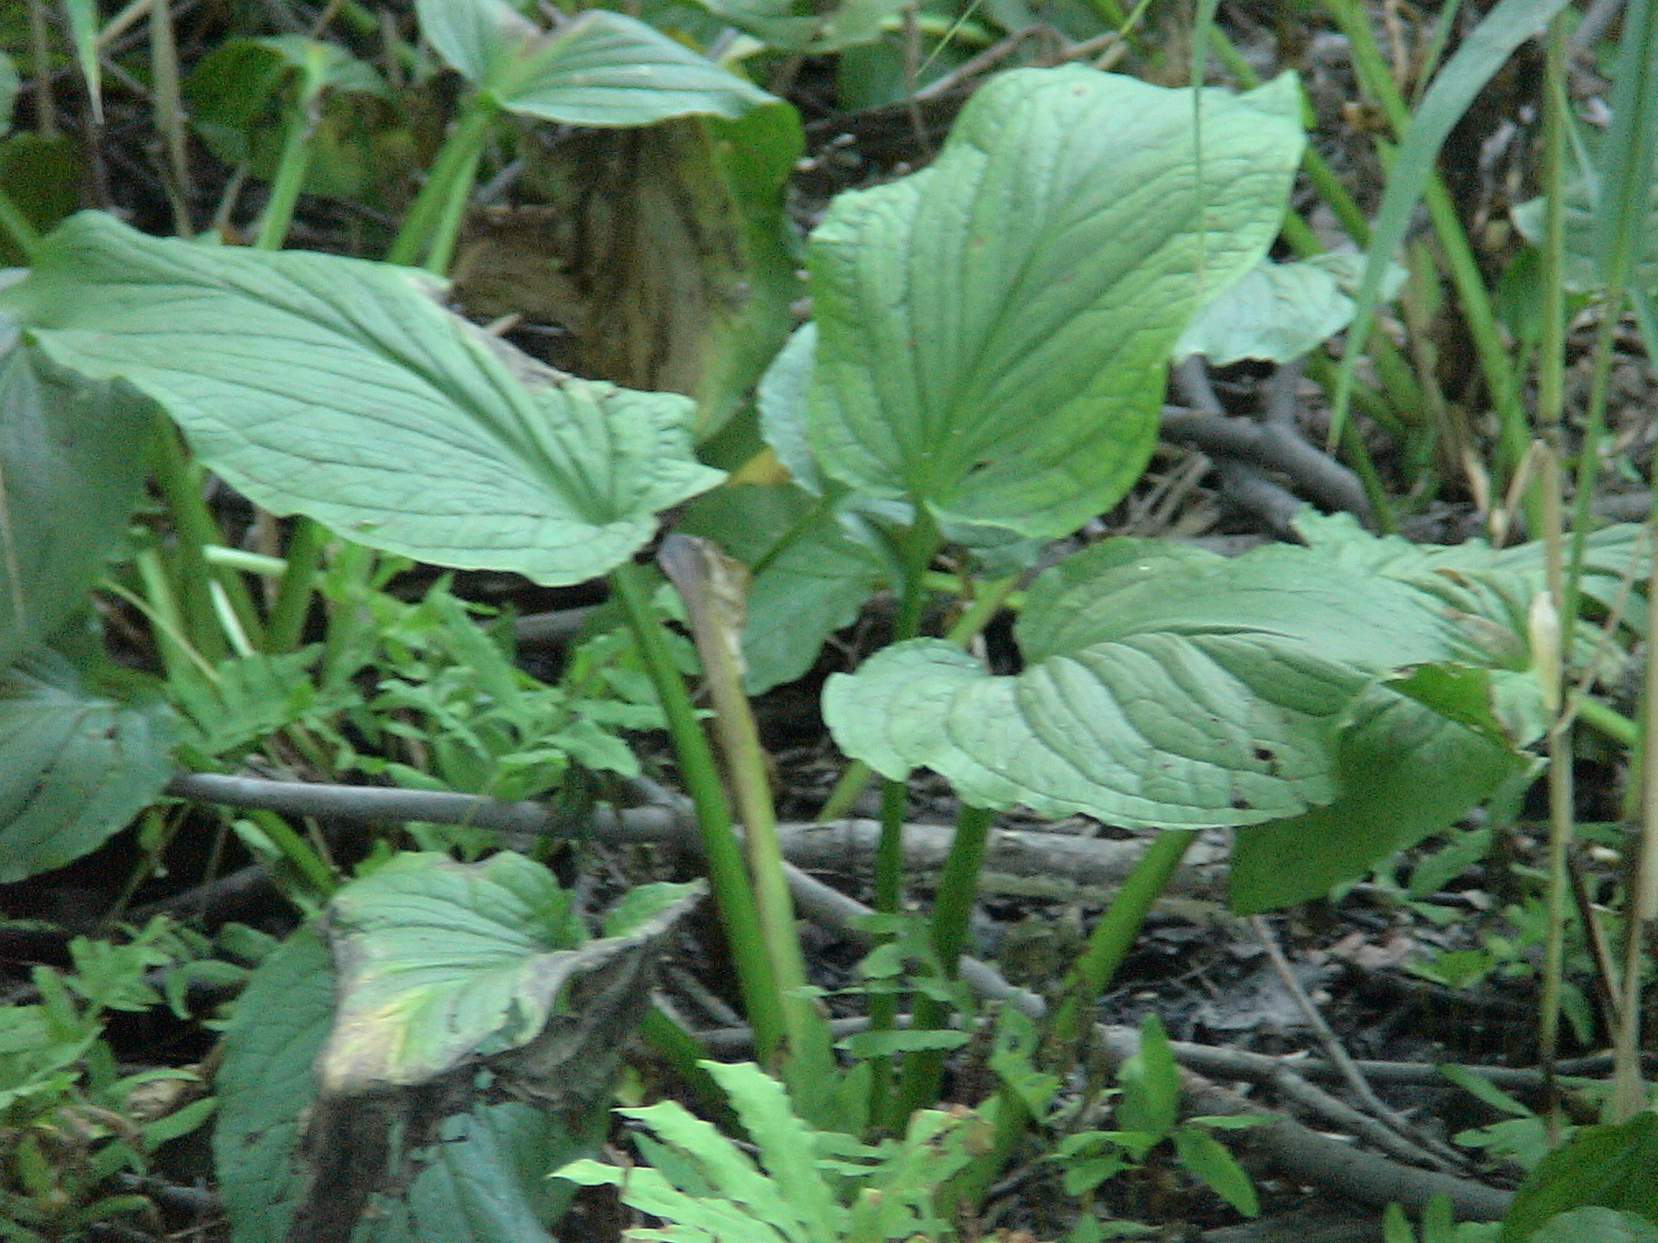
Skunk Cabbage

Slide 28
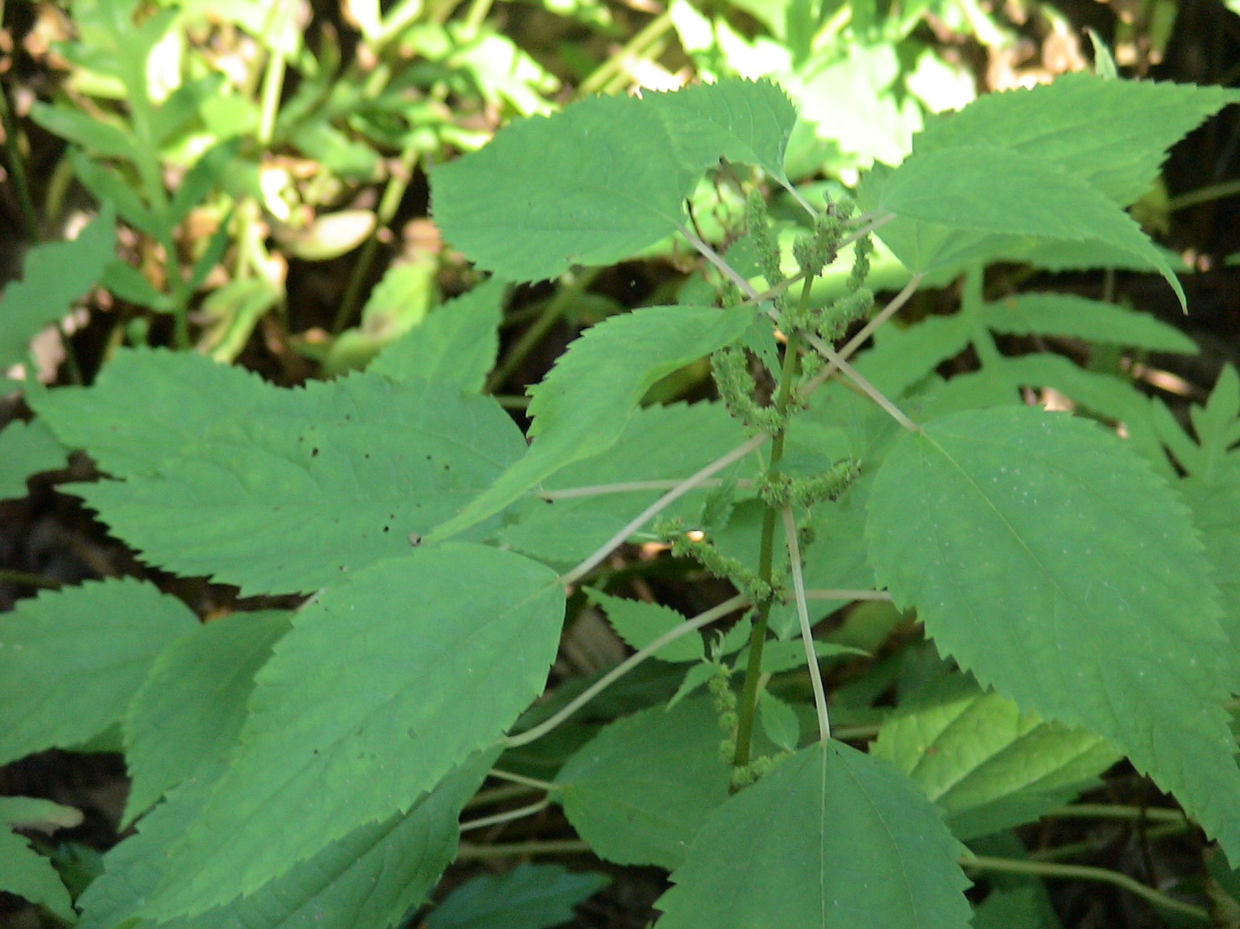
Stinging Nettle

Slide 29
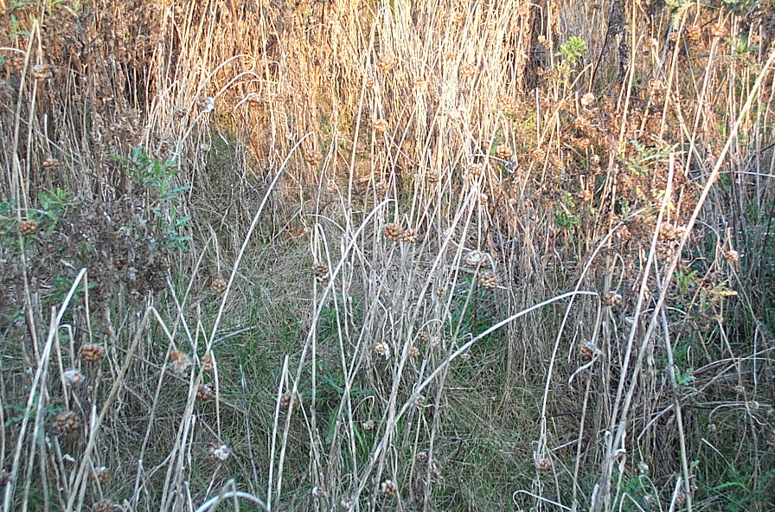
Wild Garlic

Slide 30
Round Two

Slide 31
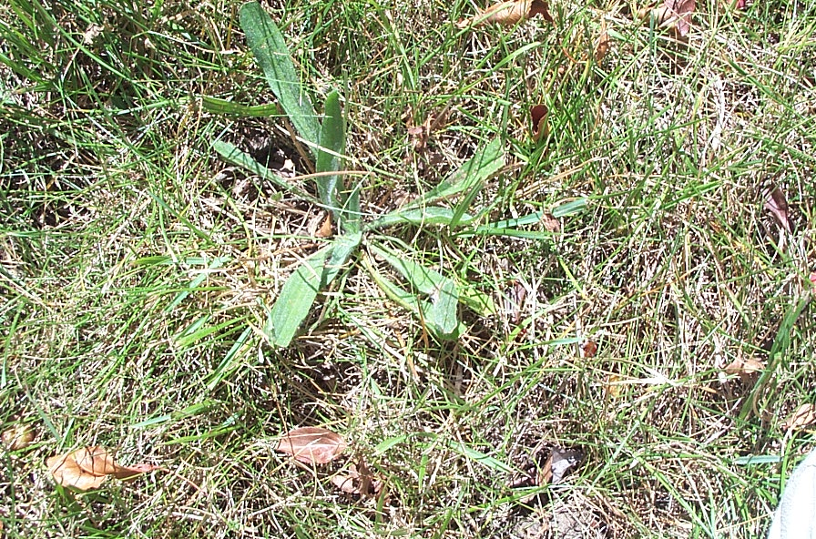
Plantain
(English )

Slide 32
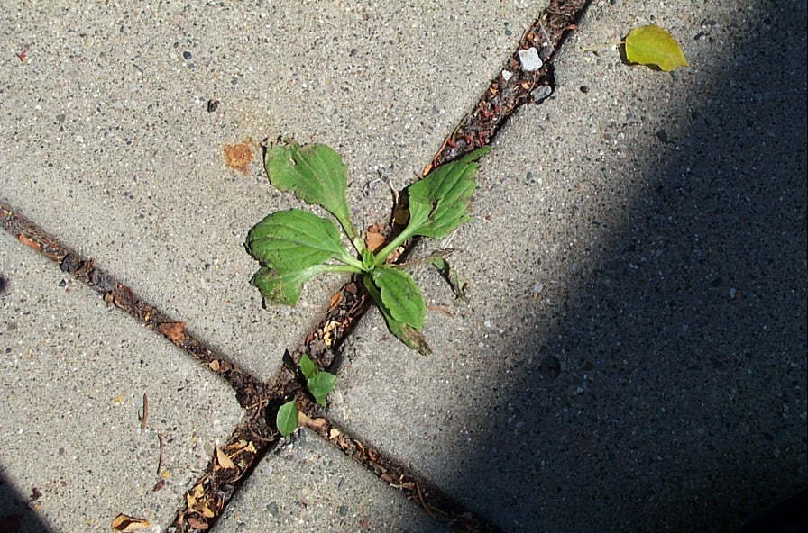
Common Plantain

Slide 33
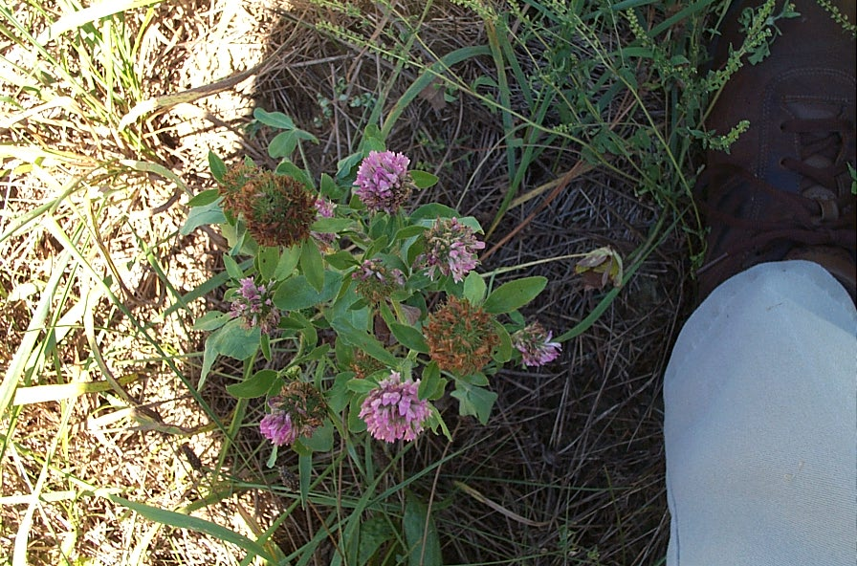
Clover

Slide 34
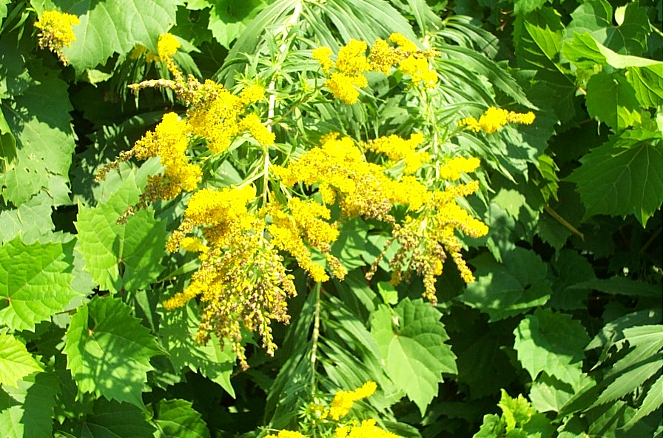
Goldenrod

Slide 35
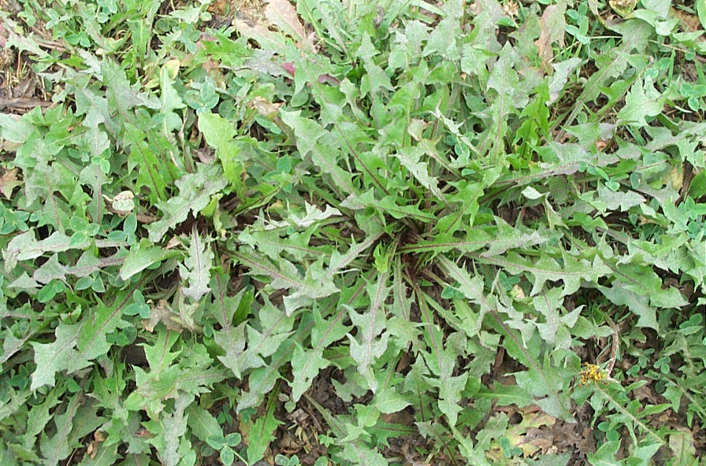
Dandelion

Slide 36
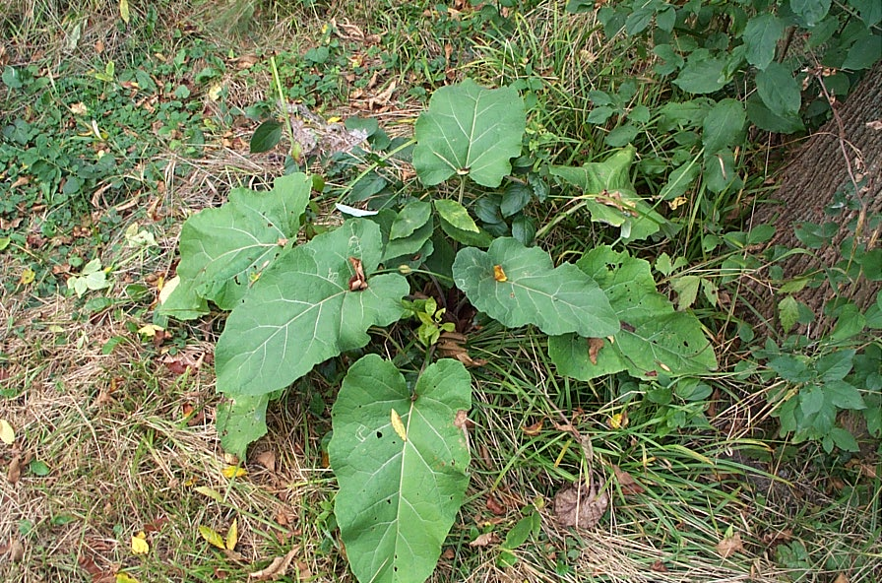
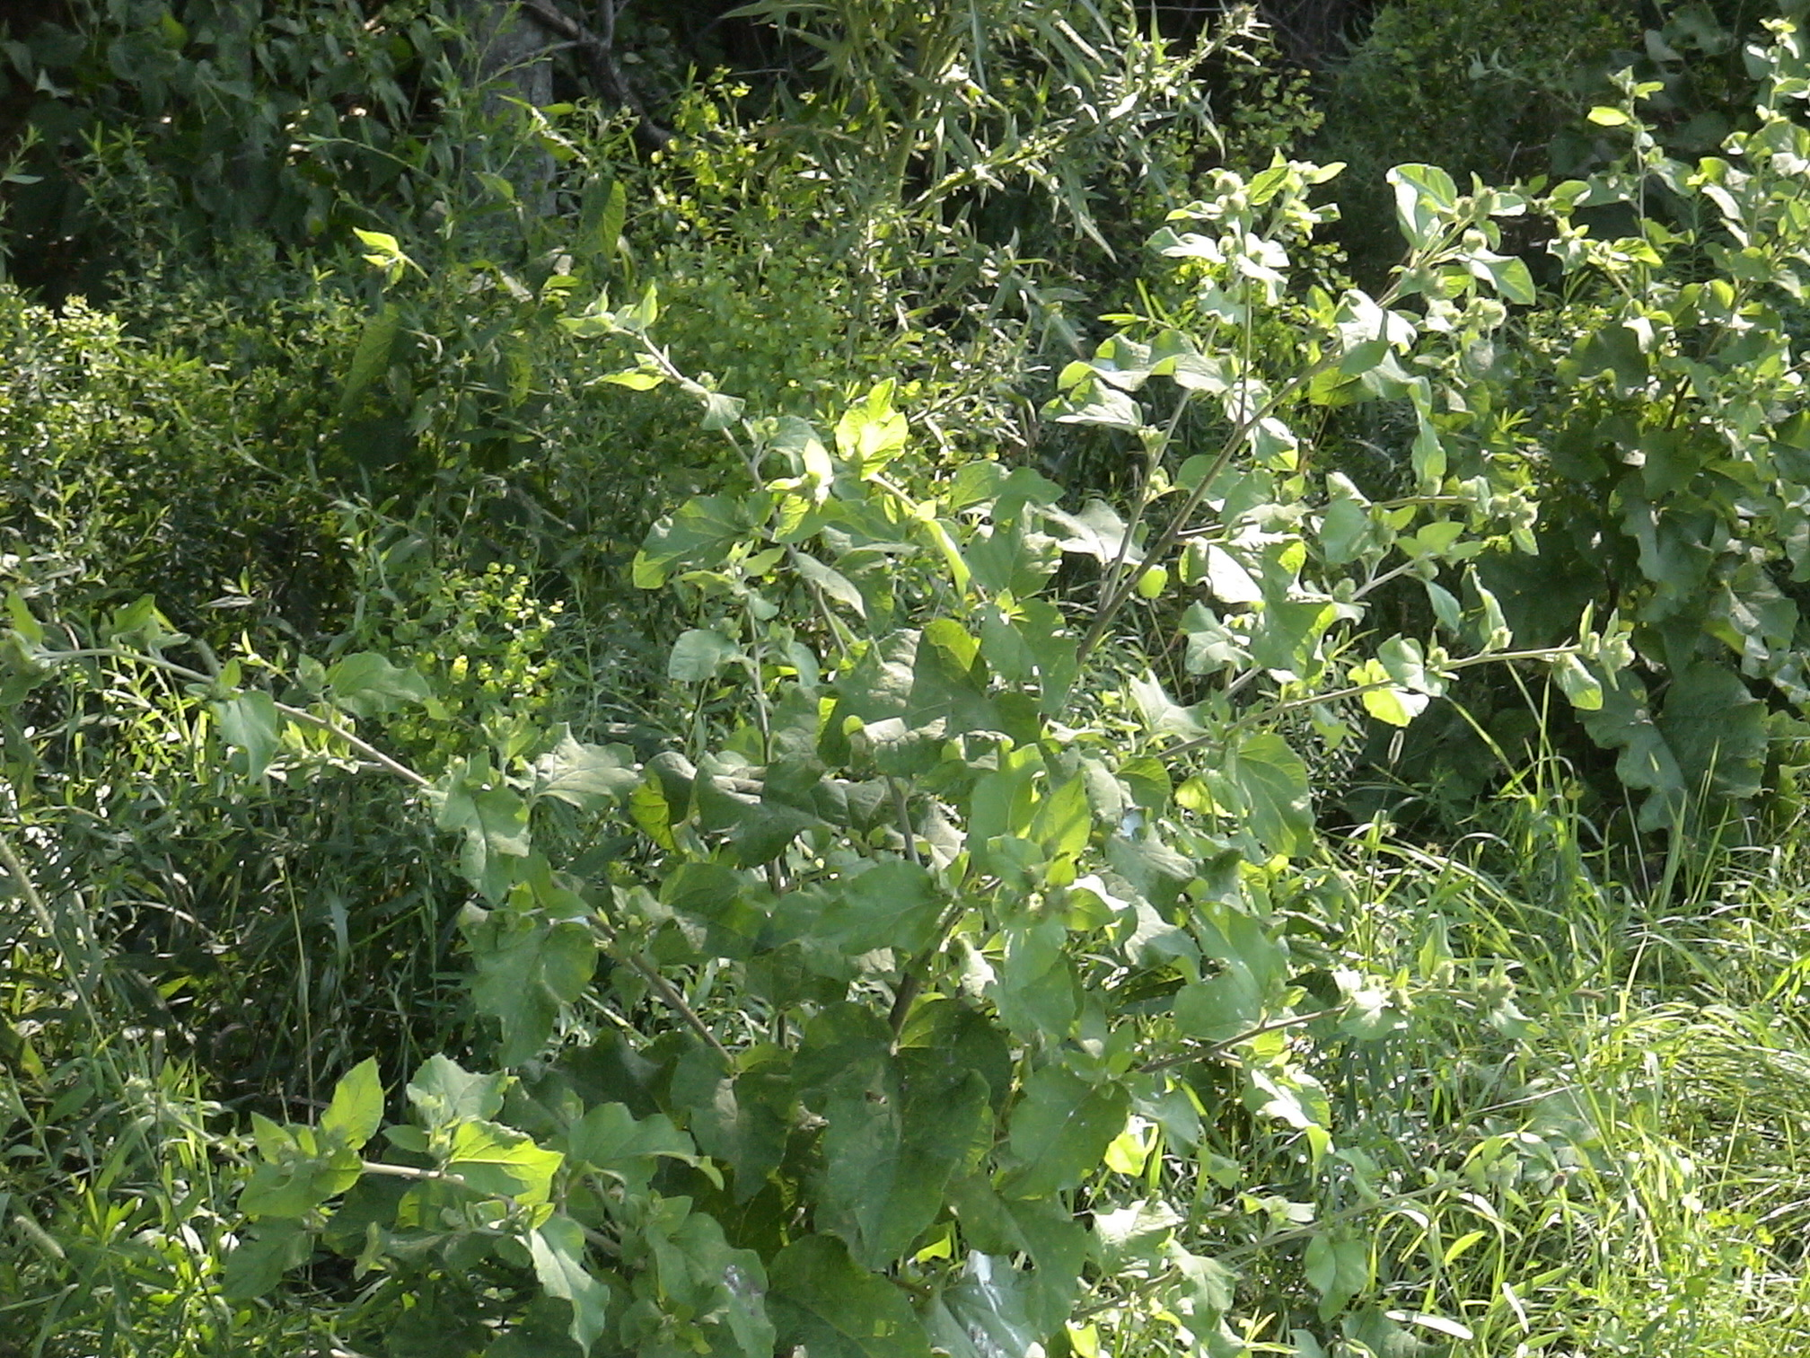
Burdock

Slide 37
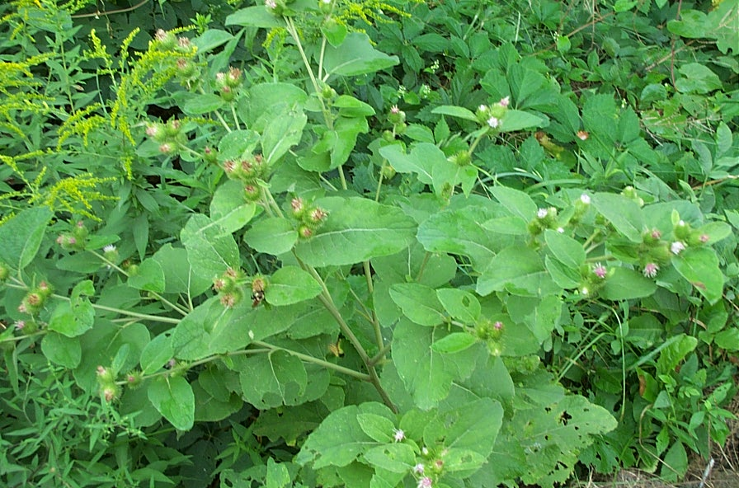
Burdock

Slide 38
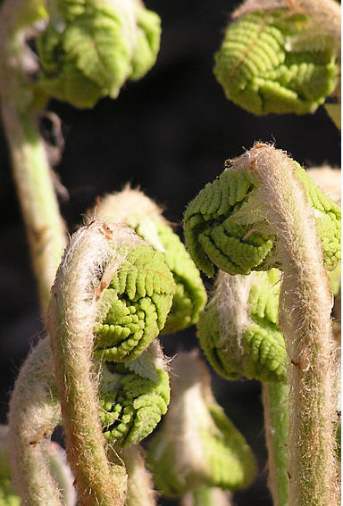
Fiddlehead fern

Slide 39
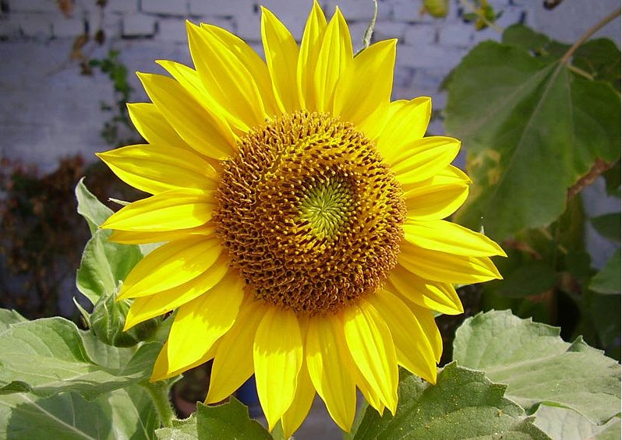
Sunflower

Slide 40
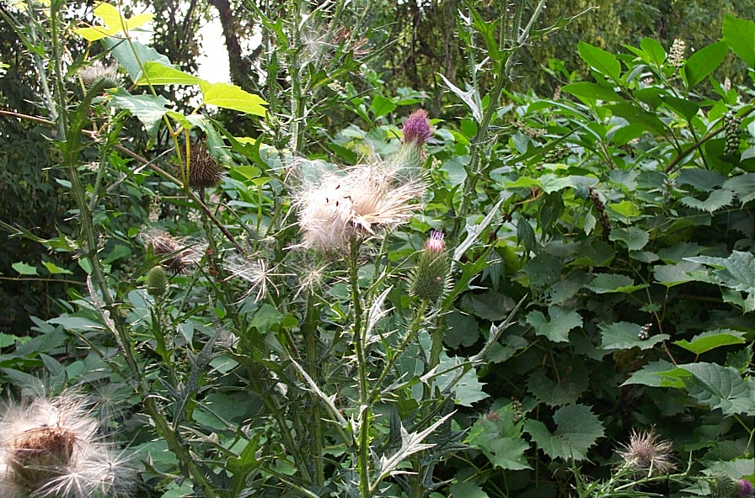
Bull Thistle

Slide 41
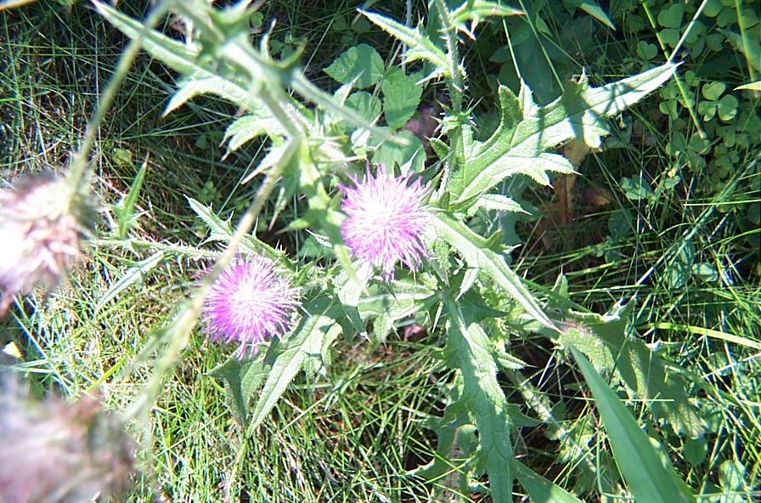
Bull thistle

Slide 42
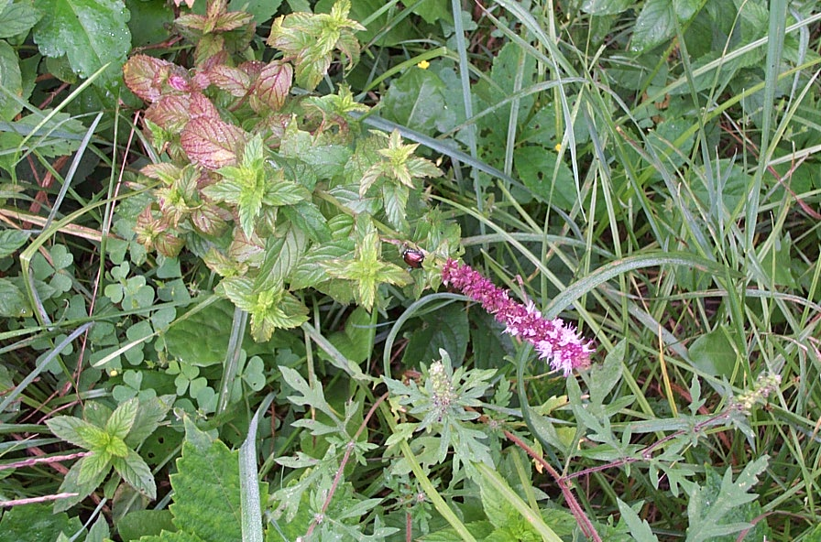
Wild Mint

Slide 43
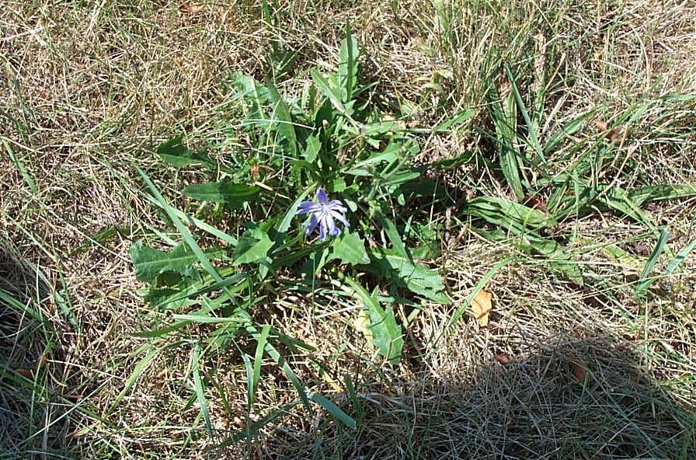
Chicory
(blue lettuce)

Slide 44
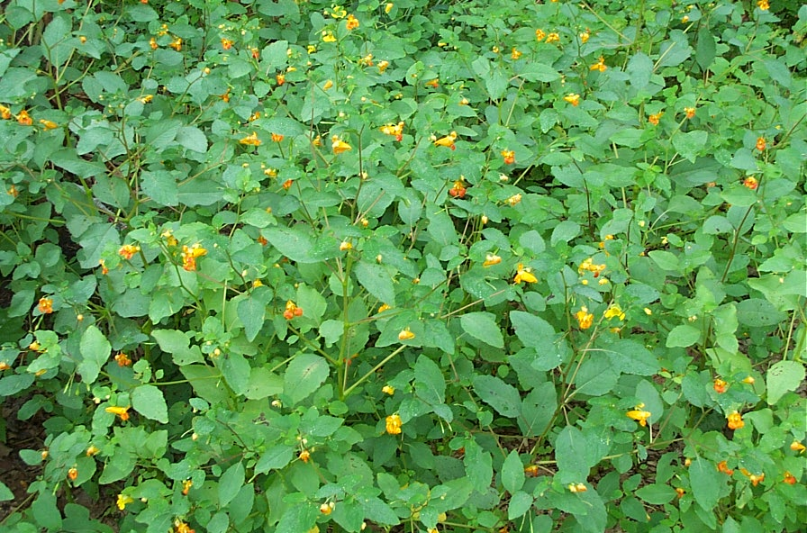
Jewelweed
(Touch Me Not)

Slide 45
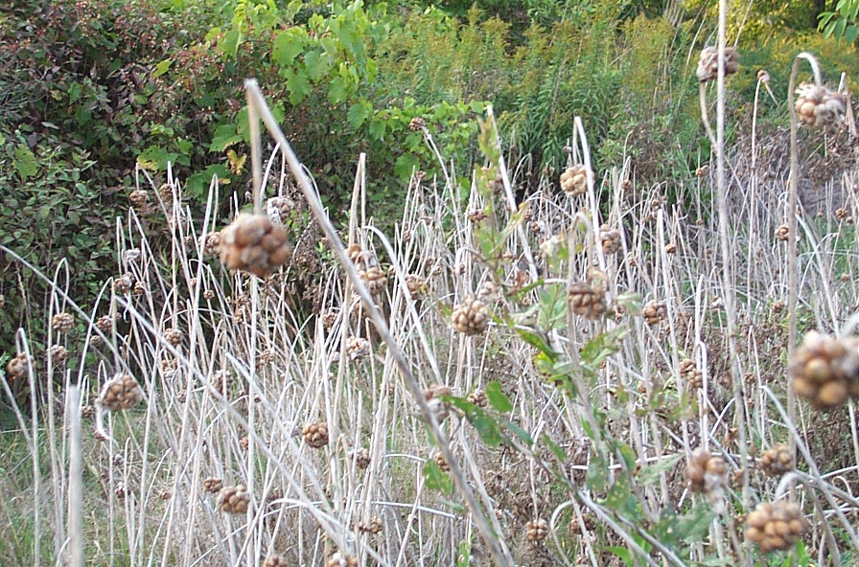
Wild Garlic

Slide 46
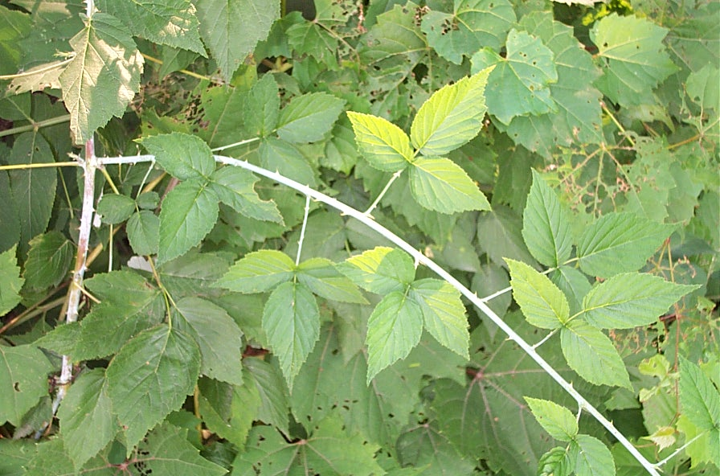
Raspberry

Slide 47
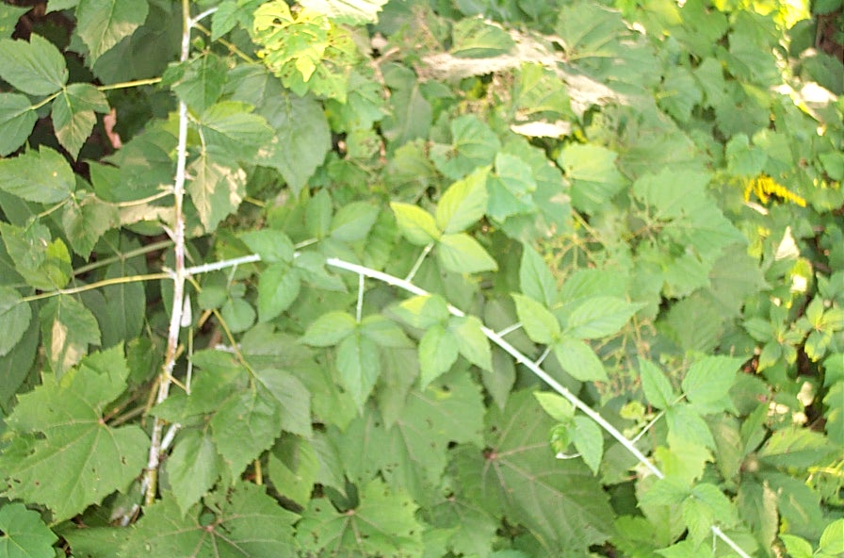
Raspberry

Slide 48
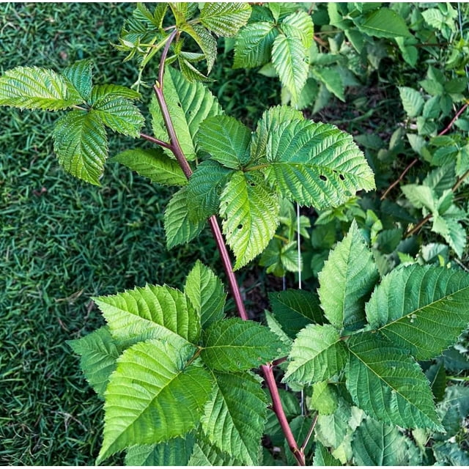
Blackberry

Slide 49
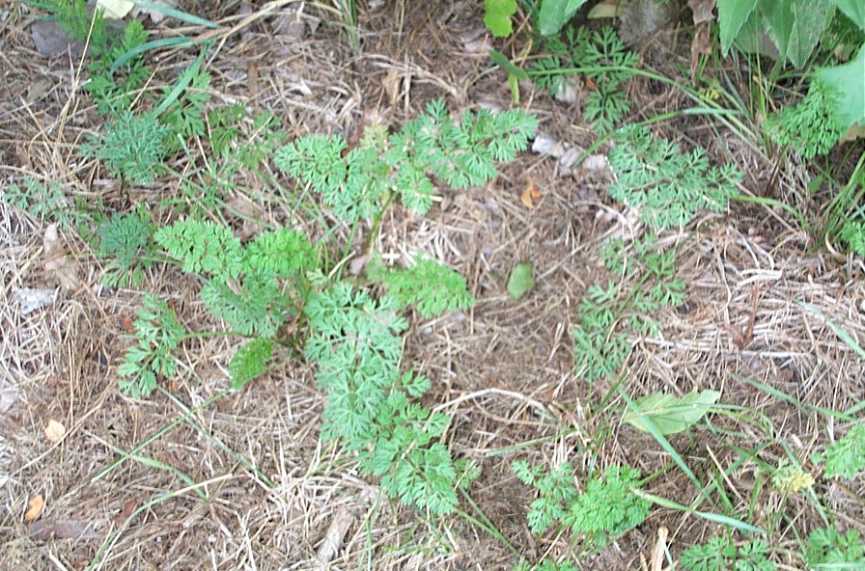
Wild Carrot

Slide 50

Wild Carrot
(Queen Anne's Lace)

Slide 51

Sumac

Slide 52

Sumac

Slide 53

Cattail

Slide 54

Goldenrod

Slide 55

Chicory

Slide 56

Wild
Mint

Slide 57

Burdock

Slide 58

Daylily

Slide 59

Jewelweed
(Touch Me Not)

Slide 60
Jewelweed
(Touch Me Not)

Slide 61

Milkweed

Slide 62
Jerusalem Artichoke

Slide 63

Bull Thistle

Slide 64

Dandelion

Slide 65

Jewelweed
(Touch Me Not)

Slide 66

Violets

Slide 67

Wild Asparagus

Slide 68

skunk cabbage

Slide 69



skunk cabbage

