Slide 1
Click on “Slide Show”
Click “Play from Beginning”

Slide 2



Chapter 9
Chemical Names and Formulas
Naming and Writing Formulas for
Ionic Compounds
Molecular Compounds
Acids and Bases
The Laws Governing How
Compounds Form

Slide 3
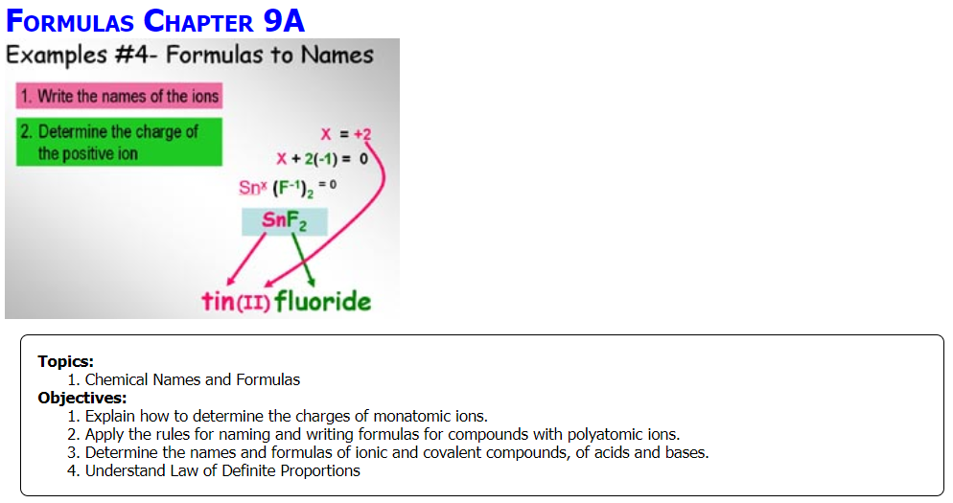

Slide 4
Inquiry: Use Your Knowledge of Algebra in Chemistry
Ionic compounds can be made from a m______ ion and a ___metallic ion. Metallic ions are p___________ (c______). Nonmetallic ions are n_______ (a______). Find the net charge when the following atoms combine (use octet rule):
Alkali metal + halogen
Alkaline earth metal + Group VIA
Group IA and Group VIA
Group IIIA and Group VIIA
Group IIA and Group VA
M(+1) + (–2) = 0 Groups?
What does M have to be? ____
(+2) + N(–1) = 0 Groups?
What does N have to be? ____
M(+2) + N(–3) = 0 Groups?
What do M and N have to be?
M(+3) + N(–3) = 0 Groups?
What do M and N have to be? _______________
(+3) + N(–1) = 0 Groups?
What does N have to be? ____
Notes:
Timing ≈ 1 min
Entry Audio: In this warm-up, we review the addition of positive and negative integers. Ionic compounds are made of a positive ion (cation) and a negative ion (anion). Stable ionic compounds are electrically neutral, meaning the overall charge of an ionic compound adds up to zero. While doing this activity, you will notice that the ratio of positive to negative ions can be different than one-to-one.
Exit Audio: Just like integers, oxidation numbers of ions are whole numbers that can be positive or negative. You should have noticed that each of the problems were set to equal zero just like the overall charge of an ionic compound. Last, adjusting the number of positive or negative ions to achieve a zero sum is similar to adjusting the ratio of positive and negative ions in an ionic compound to make the overall charge equal to zero.

Slide 5
Inquiry: Use Your Knowledge of Algebra in Chemistry
Ionic compounds can be made from a metallic ion and a nonmetallic ion. Metallic ions are positive (cations). Nonmetallic ions are negative (anions). Find the net charge when the following atoms combine (use octet rule):
Alkali metal + halogen
(+1) + (–1) = 0
Alkaline earth metal + Group VIA
(+2) + (–2) = 0
Group IA and Group VIA
2(+1) + (–2) = 0
Group IIIA and Group VIIA
(+3) + 3(–1) = 0
Group IIA and Group VA
3(+2) + 2(–3) = 0
M(+1) + (–2) = 0 Group IA + VIA
What does M have to be? 2
(+2) + N(–1) = 0 Group IIA + VIIA
What does N have to be? 2
M(+2) + N(–3) = 0 Group IIA + VA
What do M and N have to be?
M = 3 and N = 2
M(+3) + N(–3) = 0 Group IIIA + VA
What do M and N have to be?
M = 1 and N = 1
(+3) + N(–1) = 0 Group IIIA + VIIA
What does N have to be? 3
Bonding requires:
Electrical neutrality
Full valence
Notes:
Timing ≈ 1 min
Entry Audio: In this warm-up, we review the addition of positive and negative integers. Ionic compounds are made of a positive ion (cation) and a negative ion (anion). Stable ionic compounds are electrically neutral, meaning the overall charge of an ionic compound adds up to zero. While doing this activity, you will notice that the ratio of positive to negative ions can be different than one-to-one.
Exit Audio: Just like integers, oxidation numbers of ions are whole numbers that can be positive or negative. You should have noticed that each of the problems were set to equal zero just like the overall charge of an ionic compound. Last, adjusting the number of positive or negative ions to achieve a zero sum is similar to adjusting the ratio of positive and negative ions in an ionic compound to make the overall charge equal to zero.

Slide 6
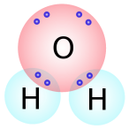
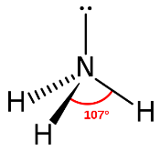
What are the Basics of Naming Compounds and Molecules?
Formula
Name
Na
Cl
Name
Formula
Ionic Compounds
Na
Cl
Ammonia
Covalent Molecules
Notes:
Timing ≈ 0.5 min
[start slide with top two atoms on screen, but no arrows]
Recap: Ionic compounds have a ratio of positive and negative ions to keep the overall charge of the compound to zero.
Connect: Ions form when an atom loses [animate purple arrow] an electron to another atom, which gains it. The atom that loses the electron becomes positively charged [animate blue arrow and Na+ ion]. The atom that gains the electron becomes negatively charged [animate Cl- ion]. The electrostatic attraction between the ions forms an ionic bond.
Preview: In this lesson, we will use the IUPAC nomenclature rules to name ionic compounds. In addition, we will use the name of the compound to write a balanced formula.
SOURCE:

Slide 7
Chemical Symbols
Chemical Symbols on the Periodic Table are a Shorthand for the elements — Symbols are either ONE or TWO letters
The first letter is ALWAYS capitalized, while the second letter is small case Na (for sodium)
Letters for the symbols are derived in various ways:
Use the first letter of the Chemical Element
Use the first and second letter of the Chemical Element.
Use the first and third letter of the Chemical Element.
Some symbols are derived from the Latin origin of the element.

Slide 8
Chemical Symbols
Chemical Symbols on the Periodic Table are a Shorthand for the elements — Symbols are either ONE or TWO letters
The first letter is ALWAYS capitalized, while the second letter is small case Na (for sodium)
Letters for the symbols are derived in various ways:
Use the first letter of the Chemical Element
Carbon, Nitrogen, Boron, Hydrogen
Use the first and second letter of the Chemical Element.
Beryllium (Be), Helium (He), Neon (Ne), Calcium (Ca), Lithium (Li)
Use the first and third letter of the Chemical Element.
Cesium (Cs), Chlorine (Cl), Magnesium (Mg)
Some symbols are derived from the Latin origin of the element.
e.g. Mercury (Hg), Sodium (Na), Tin (Sn), Silver (Ag), Gold (Au), Iron (Fe), Potassium (K), Tungsten (W), etc.

Slide 9
Chemical Formulas
Chemical Formulas are used to represent the composition of elements in a compound or molecule.
Subscripts
Indicate the number of atoms within ONE compound or molecule.
Ca(ClO₃)₂ → CaCl₂ + __ O_{2 (g)}

Slide 10
Chemical Formulas
Chemical Formulas are used to represent the composition of elements in a compound or molecule.
Subscripts
Indicate the number of atoms within ONE compound or molecule
Ca(ClO₃)₂ → CaCl₂ + __ O_{2 (g)}
ClO₃ + ClO₃ = 2 Cl + 6 O
Notice, that there are 6 oxygen atoms on the left (reactants) but only 2 on the right (products) …

Slide 11
Chemical Formulas
Coefficients are used to balance chemical equations:
Coefficients
Indicate the number of compounds or molecules (“moles”) and are used to balance Chemical Equations or reactants & products.
Ca(ClO₃)₂ → CaCl₂ + 3 O_{2 (g)}
Ca(ClO₃)₂ → CaCl₂ + O_{2 (g)} + O_{2 (g)} + O_{2 (g)}
There are the same number of each element on each side of the equation.
1 Ca, 2 Cl, 6 O → 1 Ca, 2 Cl, 6 O

Slide 12
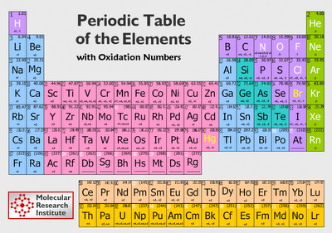
Typical Patterns of Ions
  Metals:
  form cations (positive charge)
    Group IA: +1
    Group IIA: +2
    Group IIIA: +3
  Nonmetals:
  form anions (negative charge)
    Group 16 (VIA): –2
    Group 17 (VIIA): –1
1A
2A
3A
6A
7A
Notes:
Timing ≈ 2 min
The Periodic Table sheds some light on knowing which oxidation charge an element will have. The alkali metals have a (+1) oxidation state. Alkaline earth metals have a (+2) oxidation state. The boron group has a (+3) oxidation state. Transition metals are known for multiple oxidation states. But, as metals, they are all positive.
Nonmetals form negative ions, known as anions. The oxygen group forms ions with a (-2) oxidation state. The halogens form a (-1) oxidation state.
Noble gases are known for limited chemical reactivity. Their oxidation state is typically neutral or zero.
Ionic compounds are typically made of a metal and a nonmetal. As stated before, metals are the positive ion or cation. They are stated first in the ionic compound name. Non-metals are negative ions or anions. They are stated second in the ionic compound name.
SOURCE: http://www.therationaltheorist.org/2011_01_01_archive.html

Slide 13
Naming Ionic Compounds
Nomenclature: “rules” for “naming” compounds
  Name the cation(s) first, then anion(s)
  Metal cations: name of metal (“as is”)
  Nonmetal anions: replace ending with -ide
Example
  KBr
    K⁺¹ = potassium cation
    Br¹⁻ = bromide anion
  Name: potassium bromide
Notes:
Timing ≈ 1 min
Nomenclature refers to the system of rules that govern how all chemical compounds are named. Nomenclature rules have been developed by the International Union of Applied and Pure Chemistry or (IUPAC).
For ionic compounds, naming is straightforward. In general, the name of an ionic compound is the [animate first bullet on left] name of the cation(s) followed by the name of the anion(s).
[animate second bullet on left] For simple binary compounds consisting of two elements (a metal and a nonmetal), the cation name is simply the name of the metal from the Periodic Table. If the cation is something other than a metal, the cation name is kept as is.
[animate third bullet on left] For non-metal anions, name these last by keep the beginning of the non-metal name and replace the ending with “ide.” [teacher give a couple of examples of replacing endings]
[animate first bullet on right] For example, take the compound KBr. K is the symbol for potassium, and Br is the symbol for bromine. K is the metal cation, so we know that [animate first two words of bullet on right] the beginning of the name is potassium. Bromine is the anion so we replace the ending -ine with –ide [teacher show], yielding [animate remainder of bullet] potassium bromide.

Slide 14
Write the Chemical Name from the formula (Identify the cations & anions using the Octet rule)
LiBr
    MgS
Al₂O₃
  CaCl₂
  Na₃N
BF₃
Notes:
Timing ≈ 1 min
We can also name ionic compounds from their formulas. Let's look at a general strategy for writing names of binary ionic compounds from their formulas.
First, identify the cation present in the formula (positive oxidation state) and write its name.
Then, identify the anion present in the formula and write its name, but replace the ending of any nonmetal anion with -ide.
Write the formula name as the name of the cation followed by the name of the anion.
For example, consider CaCl₂. Ca is calcium. Cl is chlorine. The metal, calcium, is named first, and then the non-metal, chlorine is named by replacing -ine with -ide. The formula name is calcium chloride.
Similarly, for Na₂O. Na is sodium, and O is oxygen. The metal, sodium, is named first, and then the non-metal, oxygen, is named by replacing the end of oxygen with –ide, thus, giving oxide. The formula name is sodium oxide.

Slide 15
Write the Chemical Name from the formula (Identify the cations & anions using the Octet rule)
LiBr
    Li⁺ = lithium cation
    Br– = Bromide anion
    Name → lithium bromide
    MgS
    Mg²⁺ = magnesium cation
    S^{–2} = sulfide anion
    Name → magnesium sulfide
Al₂O₃
    Al⁺³ = aluminum cation
    O^{–2} = oxide anion
    Name → aluminum oxide
  CaCl₂
    Ca²⁺ = calcium cation
    Cl– = chloride anion
    Name → calcium chloride
  Na₃N
    Na⁺ = sodium cation
    N^{3–} = nitride anion
    Name → sodium nitride
BF₃
    B⁺³ = boron cation
    F– = fluoride anion
    Name → boron fluoride
Note: for IONIC compounds, the number of atoms does NOT matter in the naming.
Notes:
Timing ≈ 1 min
We can also name ionic compounds from their formulas. Let's look at a general strategy for writing names of binary ionic compounds from their formulas.
First, identify the cation present in the formula (positive oxidation state) and write its name.
Then, identify the anion present in the formula and write its name, but replace the ending of any nonmetal anion with -ide.
Write the formula name as the name of the cation followed by the name of the anion.
For example, consider CaCl₂. Ca is calcium. Cl is chlorine. The metal, calcium, is named first, and then the non-metal, chlorine is named by replacing -ine with -ide. The formula name is calcium chloride.
Similarly, for Na₂O. Na is sodium, and O is oxygen. The metal, sodium, is named first, and then the non-metal, oxygen, is named by replacing the end of oxygen with –ide, thus, giving oxide. The formula name is sodium oxide.

Slide 16
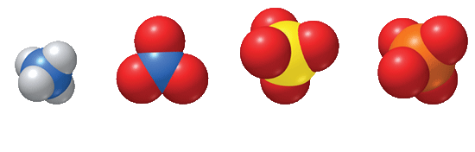
Polyatomic Ions
    Polyatomic ions are covalently bonded atoms (composed of more than one atom), which behave as ONE unit and carry a charge.
    The sulfate anion (SO₄^{2–}) consists of one sulfur atom and four oxygen atoms, but chemically acts as ONE molecule. These five atoms together comprise a single anion with an overall 2– charge.
Ammonium ion
(NH₄⁺)
Nitrate ion
(NO₃–)
Sulfate ion
(SO₄^{2–})
Phosphate ion
(PO₄^{3–})
The atoms are held together by polar covalent bonds, but the overall polyatomic ion bonds IONICally.

Slide 17
Naming Polyatomic Ions
You may use a reference table when naming polyatomic ions (download from Course Resources).
Common Polyatomic Ions
Charge | Formula | Name
1– | HSO₄– NO₂– ClO– | Hydrogen sulfate Nitrite Hypochlorite
2– | SO₃^{2–} SO₄^{2–} CO₃^{2–} | Sulfite Sulfate Carbonate
3– | PO₄^{3–} | Phosphate
1+ | NH₄⁺ | Ammonium
Name a polyatomic ion “as is” whether it is a cation or an anion.
Polyatomic ions may be listed first (cations) or last (anions).
e.g. (NH₄⁺)(PO₄^{3–})
Ammonium phosphate
Using parenthesis helps.

Slide 18
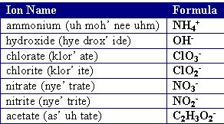
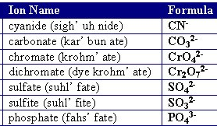
Name the compounds & determine the # of atoms:
Na₃⁺(PO₄^{3–}) (NH₄⁺)₂(CO₃^{2–})
Mg⁺²(ClO₃–)₂ Al₂⁺³(SO₄^{2–})₃

Slide 19
Name the compounds & determine the # of atoms:
Na₃⁺(PO₄^{3–}) … 3 + 1 + 4 = 8 atoms (NH₄⁺)₂(CO₃^{2–})… 2 + 8 + 1 + 3 = 14
atoms
sodium phosphate ammonium carbonate
Mg⁺²(ClO₃–)₂ … 1 + 2 + 6 = 9 atoms Al₂⁺³(SO₄^{2–})₃ … 2 + 3+ 12 = 17 atoms
magnesium chlorate aluminum sulfate

Slide 20
Balancing Charges
  How many –1 ions would bond with a +2 ion?
  What is the ratio of +3 ions to
  –2 ions in a neutral compound?
+2
–1
–1
+3
+3
–2
–2
–2
Notes:
Timing ≈ 2 min
All ionic compounds have a net charge of zero. As we saw in the warm up, the ratio of cations to anions in an ionic compound will depend on the charges of the ions.
[animate first bullet] For example, suppose we have a +2 cation [animate +2 orange circle]. How many -1 anions are needed to balance the charge? [teacher show how to solve the equation to obtain N = 2] Two -1 anions [animate blue -1 circles] are needed to balance the charge. [teacher point out that in this diagram, the size of the circles represents the charge, not the size of the actual ions, and that the arrangement of the circles does not show the actual arrangement of ions in the compound]
[animate second bullet] what if we have +3 cations and -2 anions? [teacher show how to solve the equation to obtain M = 2 and N =3] So we know we need 3 -2 anions [animate blue -2 circles] and two +3 cations [animate orange +3 circles] to have a neutral compound.

Slide 21
Balancing Charges
  How many –1 ions would bond with a +2 ion?
    (+2) + N(–1) = 0
  What is the ratio of +3 ions to
  –2 ions in a neutral compound?
    M(+3) + N(–2) = 0
+2
–1
–1
    two -1 atoms balance the one +2 atom
+3
+3
–2
–2
–2
    Three -2 atoms balance two +3 atoms
Notes:
Timing ≈ 2 min
All ionic compounds have a net charge of zero. As we saw in the warm up, the ratio of cations to anions in an ionic compound will depend on the charges of the ions.
[animate first bullet] For example, suppose we have a +2 cation [animate +2 orange circle]. How many -1 anions are needed to balance the charge? [teacher show how to solve the equation to obtain N = 2] Two -1 anions [animate blue -1 circles] are needed to balance the charge. [teacher point out that in this diagram, the size of the circles represents the charge, not the size of the actual ions, and that the arrangement of the circles does not show the actual arrangement of ions in the compound]
[animate second bullet] what if we have +3 cations and -2 anions? [teacher show how to solve the equation to obtain M = 2 and N =3] So we know we need 3 -2 anions [animate blue -2 circles] and two +3 cations [animate orange +3 circles] to have a neutral compound.

Slide 22
Writing Chemical Formulas from the Name
Write the metallic “ion” (cation) first and the non-metallic “ion” (anion) last.
Metals lose electrons … therefore, become positively charged (cations).
Non-metals gain electrons … become negatively charged (anions).
e.g. sodium chloride:
Na⁺¹Cl⁻¹
NOT Cl⁻¹Na⁺¹

Slide 23

Write the Chemical Formulas from the Name
  sodium phosphate
  ammonium carbonate

Slide 24
Write the Chemical Formulas from the Name
  sodium phosphate
    Sodium: Na⁺ Phosphate: PO₄^{3–}
    (3)(+1) + (–3) = 0
    Na₃⁺(PO₄)^{3–}
    Na⁺(PO₄)^{3–}
  ammonium carbonate
    Ammonium: NH₄⁺ Carbonate: CO₃^{2–}
    (2)(+1) + (–2) = 0
    (NH₄)₂⁺(CO₃)⁻²
    NH₄⁺(CO₃)^{2–}

Slide 25
Writing Chemical Formulas using the Criss-Cross Method
  The numerical value of the charge of each ion (oxidation state) is crossed over and becomes the subscript for the other ion.
  Notice that the signs of the charges are dropped.
  The formula is correct because the overall charge of the formula is zero, and the subscripts are expressed in the lowest whole-number ratio.
  Write the chemical formula for Iron III Oxide

Slide 26
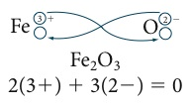
Writing Chemical Formulas using the Criss-Cross Method
  The numerical value of the charge of each ion (oxidation state) is crossed over and becomes the subscript for the other ion.
  Notice that the signs of the charges are dropped.
  The formula is correct because the overall charge of the formula is zero, and the subscripts are expressed in the lowest whole-number ratio.
  http://somup.com/cF6QITnnU5 (4:18)
+3
-2

Slide 27


Slide 28
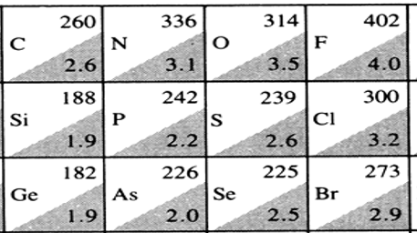
Naming Covalent Molecules
  Covalently bonded molecules usually involve non-metals bonding with non-metals.
  Generally, the MORE electronegative element is listed SECOND because it draws the electrons more and becomes the “anion”.
  e.g. Carbon dioxide → carbon is named first because it is the less electronegative, more “metallic”, than oxygen.
Fluorine is always listed second (highest electronegativity).
e.g. Chlorate ion (ClO₃)⁻¹ → Chlorine is listed first (less electronegative)

Slide 29
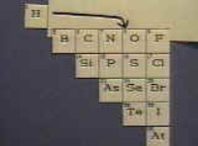
Naming Covalent Molecules
  Generally, one names the non-metals from left-to-right order as found on the periodic table, EXCEPT that you would have to squeeze hydrogen in between nitrogen and oxygen.
Nitrogen trihydride (NH₃) → (ammonia) nitrogen is named first, then hydrogen
Dihydrogen monoxide (H₂O) → (water) Hydrogen is named first.

Slide 30
Naming Covalent Molecules
  Name the NONMETAL farthest to the left on the periodic table first. It is the most metallic element.
    CO₂ = carbon dioxide, not oxygen carbide
  The second element is given an –ide ending.
    CO₂ = carbon dioxide, not carbon dioxygen
  Prefixes are used to indicate how many atoms of each element are present in the compound.
    Mono* = one, ONLY used for the second element in compound; e.g. carbon monoxide, CO
    Di = two; e.g. sulfur dioxide, SO₂
    Tri = three; e.g. phosphorus trihydride, PH₃
    Tetra = four; e.g. carbon tetrachloride, CCl₄

Slide 31
Exceptions: Common Names & Hydrogen
  Some common compounds that contain hydrogen have non-IUPAC names that do not indicate the number of hydrogen atoms (related to acids).
  Examples:
    Hydrogen sulfide (H₂S)
    Hydrogen fluoride (HF)
    Hydrogen chloride (HCl)
    Hydrogen sulfate (H₂SO₄)
Some common (traditional) names are still used.
Formula | Common Name | IUPAC Name
H₂O | Water | dihydrogen monoxide
NH₃ | Ammonia | nitrogen trihydride
NO | Nitric oxide | nitrogen monoxide
NO₂ | Nitrous oxide | nitrogen dioxide
PH₃ | Phosphine | phosphorus trihydride
Notes:
Timing ≈ 0.5 min
Another group of substances that illustrate exceptions to IUPAC naming rules is many compounds that contain hydrogen atoms. Many of these substances do not use prefixes to indicate the number of hydrogens. [teacher give examples] Many of these compounds are acids, which we will learn about shortly.

Slide 32
Name the Covalent Molecules
NH₃
XeF₆
N₂O₄
CBr₄
PCl₃
SiO₂
P₄O₆
H₂O
Notes:
Timing ≈ 1 min
Entry audio: Practice applying the naming rules you have learned.
Hint audio: Remember that the names for covalent compounds may contain prefixes, but they do not contain Roman numerals.
Exit audio: You can use naming rules to write formulas for covalent compounds from their names.

Slide 33
Name the Covalent Molecules
NH₃
Ammonia, nitrogen trihydride
XeF₆
xenon hexafluoride
N₂O₄
dinitrogen tetroxide
CBr₄
carbon tetrabromide
PCl₃
phosphorus trichloride
SiO₂
silicon dioxide
P₄O₆
tetraphosphorus hexoxide
H₂O
Water, dihydrogen monoxide
If there is only ONE of the 1st element, do not use “mono”
Notes:
Timing ≈ 1 min
Entry audio: Practice applying the naming rules you have learned.
Hint audio: Remember that the names for covalent compounds may contain prefixes, but they do not contain Roman numerals.
Exit audio: You can use naming rules to write formulas for covalent compounds from their names.

Slide 34
Expected Oxidation States of Atoms
Oxidation States
The number representing the charge of an atom when its valence is complete in the formation of a compound or molecule (octet rule).
Group | IA | IIA | IIIA | IVA | VA | VIA | VIIA
Valence | 1 | 2 | 3 | 4 | 5 | 6 | 7
Expected Charge | +1 | +2 | +3 | +/- 4 | -3 | -2 | -1
 | Lose 1 e- | Lose 2 e- | Lose 3 e- | Lose or gain 4 e- | Gain 3 e- | Gain 2 e- | Gain 1 e-
Naming Compounds with expected Oxidation States
Use the naming method we have been using: cation first, anion second with suffix of “-ide”.
e.g. K₃⁺P⁻³ → potassium phosphide

Slide 35
Expected Oxidation States of Atoms
Free Elements
The oxidation number is zero for all unbonded free elements → this includes all the elements on the Periodic Table EXCEPT:
These diatomic elements are considered free elements as well:
“H O F Br I N Cl” → H₂ O₂ F₂ Br₂ I₂ N₂ Cl₂
“Charged” Atoms or Ions
Whenever a chemical reaction takes place, a free element must take on an “ionic” form as a cation or an anion
The oxidation number of the “ion” produced in a chemical reaction is determined the same way as the oxidation state of an atom filling its valence (octet rule)
Oxygen
oxidation number = -2 exception: peroxides (e.g. H₂O₂) … -1
Hydrogen
oxidation number = +1 exception: hydrides (e.g. NaH, CaH₂) … -1

Slide 36
Multiple Oxidation States of Atoms
Many elements have multiple oxidation states that do not match the expected oxidation state based on valence.
If the charge of the atom does not match the expected charge, assume a multiple oxidation state.
N is in Group V (gains 3 e-)… expected oxidation of N⁻³
N⁺⁵ N⁺⁴ N⁺³ N⁺² N⁺¹ N⁻¹ N⁻² N⁻³
In order to distinguish between molecules containing an atom whose oxidation is not expected (like N), one needs a different name. E.g. imagine having triplets … they each need their own name.

Slide 37
Determining NON-expected Oxidation States of Atoms
For a compound or molecule (electrically neutral overall), the sum of the oxidation numbers of all the elements must total ZERO.
Carbon dioxide CO₂ →
Carbon monoxide CO →
Hydrogen Phosphate H₃(PO₄)

Slide 38
Determining NON-expected Oxidation States of Atoms
For a compound or molecule (electrically neutral overall), the sum of the oxidation numbers of all the elements must total ZERO.
Carbon dioxide CO₂ → Use “oxygen” as the standard for oxid. #
C⁺⁴ + 2O⁻² = 1(+4) + 2(-2) = 0
The total charge around oxygen is 2(-2) = -4
Therefore, C must have an oxidation of +4 when bonded
Carbon monoxide CO → Use “oxygen” as the standard for oxid. #
C⁺² + O⁻² = 1(+2) + (-2) = 0
The total charge around oxygen is 1(-2) = -2
Therefore, C must have an oxidation of +2 when bonded
Hydrogen Phosphate H₃(PO₄)
Use “hydrogen” and “oxygen” as the standard for oxid. #
3H⁺¹ + 1P⁺⁵ + 4O⁻² = 3(+1) + 1(+5) + 4(-2) = 0
The P atom must have an oxidation of +5 when bonded

Slide 39
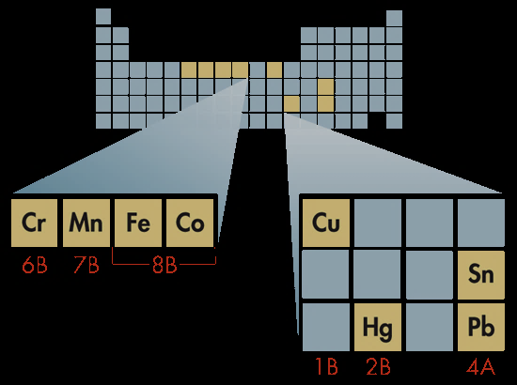
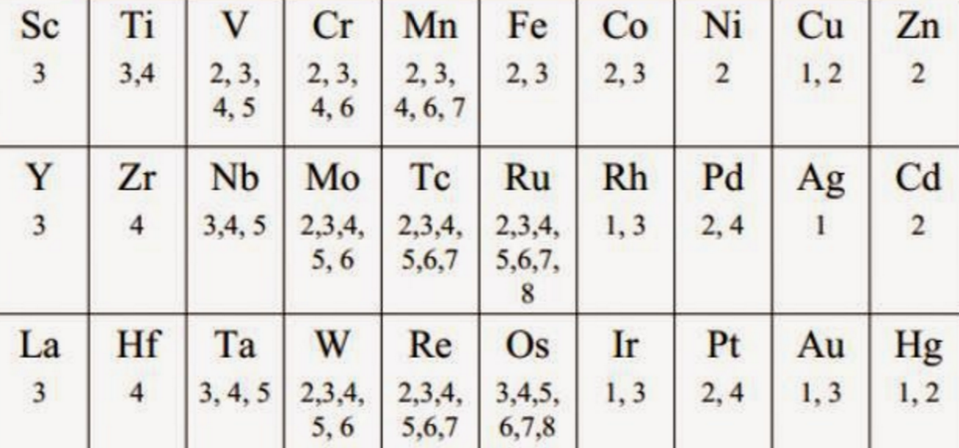
Multiple Oxidation States of Atoms
Transition metals (Groups 1B–8B) typically form more than one cation with different ionic charges.
Cu⁺²Cl₂⁻
Cu⁺Cl⁻

Slide 40
Naming Molecules containing atoms with Multiple Oxidation States
Binary Molecules
Covalently bonded molecules usually have multiple oxidation states
Commonly found with N, S, and P
OPTION 1 → IUPAC naming system
Use a Roman Numeral to indicate the oxidation of the most metallic element which has the multiple oxidation state (“Stock” system)
N₂⁺¹O⁻²
N₂⁺³O₃⁻²
N₂⁺⁵O₅⁻²
The expected oxidation for N = -3

Slide 41
Naming Molecules containing atoms with Multiple Oxidation States
Binary Molecules
Covalently bonded molecules usually have multiple oxidation states
Commonly found with N, S, and P
OPTION 1 → IUPAC naming system
Use a Roman Numeral to indicate the oxidation of the most metallic element which has the multiple oxidation state (“Stock” system)
N₂⁺¹O⁻² | Nitrogen I Oxide
N₂⁺³O₃⁻² | Nitrogen III Oxide
N₂⁺⁵O₅⁻² | Nitrogen V Oxide
The expected oxidation for N = -3

Slide 42
Naming Compounds containing atoms with Multiple Oxidation States
Binary Compounds
Transition Elements usually exhibit multiple oxidation due to the filling of “d” and “f” sublevel orbitals
OPTION 1 → IUPAC naming system
Use a Roman Numeral to indicate the oxidation of the most metallic element which has the multiple oxidation state (“Stock” system)
Containing Transition Metals
Cu⁺¹ | CuCl
Cu⁺² | CuCl₂

Slide 43
Naming Compounds containing atoms with Multiple Oxidation States
Binary Compounds
Transition Elements usually exhibit multiple oxidation due to the filling of “d” and “f” sublevel orbitals
OPTION 1 → IUPAC naming system
Use a Roman Numeral to indicate the oxidation of the metallic element which has the multiple oxidation state (“Stock” system)
Containing Transition Metals
Cu⁺¹ | CuCl | Copper(I) Chloride
Cu⁺² | CuCl₂ | Copper(II) Chloride

Slide 44
Naming Molecules containing atoms with Multiple Oxidation States
Binary Molecules
OPTION 2 → Greek prefixes
Add a prefix to EACH element, indicating the number of atoms of a particular element within the compound or molecule
mono- di- tri- tetra- penta- hexa- hepta- octa-
1 2 3 4 5 6 7 8
Covalent Molecules
N₂⁺¹O⁻²
N₂⁺³O₃⁻²
N₂⁺⁵O₅⁻²

Slide 45
Naming Molecules containing atoms with Multiple Oxidation States
Binary Molecules
OPTION 2 → Greek prefixes
Add a prefix to EACH element, indicating the number of atoms of a particular element within the compound or molecule.
mono- di- tri- tetra- penta- hexa- hepta- octa-
1 2 3 4 5 6 7 8
Covalent Molecules
N₂⁺¹O⁻² | diNitrogen monOxide
N₂⁺³O₃⁻² | diNitrogen triOxide
N₂⁺⁵O₅⁻² | diNitrogen pentOxide

Slide 46
Naming Compounds containing atoms with Multiple Oxidation States
OPTION 3 → Transition Elements
Transition elements are characterized by their multiple oxidations
“-OUS” and “-IC” (“Classical” Naming)
Use “-ous” for the first oxidation number listed
Use “-ic” for the second oxidation number listed
Ion | Formula | Option 3 | Option 1
Cu⁺¹ | CuCl | Cuprous Chloride | Copper I Chloride
Cu⁺² | CuCl₂ | Cupric Chloride | Copper II Chloride
Hg⁺¹ | Hg₂Cl₂ | Mercurous Chloride | Mercury I Chloride
Hg⁺² | HgCl₂ | Mercuric Chloride | Mercury II Chloride
Fe⁺² | FeCl₂ | Ferrous Chloride | Iron II Chloride
Fe⁺³ | FeCl₃ | Ferric Chloride | Iron III Chloride
Co⁺² | CoCl₂ | Cobaltous Chloride | Cobalt II Chloride
Co⁺³ | CoCl₃ | Cobaltic Chloride | Cobalt III Chloride
Pb⁺² | PbCl₂ | Plumbous Chloride | Lead II Chloride
Pb⁺⁴ | PbCl₄ | Plumbic Chloride | Lead IV Chloride
Sn⁺² | SnCl₂ | Stannous Chloride | Tin II Chloride
Sn⁺⁴ | SnCl₄ | Stannic Chloride | Tin IV Chloride

Slide 47
Naming Compounds containing atoms with Multiple Oxidation States
  A few transition metals have only ONE ionic charge. The names of these cations do NOT have a Roman numeral.
  These metals include the silver 1+ cation (Ag⁺) [Ag₂O → silver oxide], & cadmium & zinc with 2+ cations (Cd²⁺ & Zn²⁺).
  The “classical” naming system does not indicate oxidation states:
Symbols and Names of Common Metal Ions With More Than One Ionic Charge
Symbol | Stock Name | Classical Name
Cu⁺ | Copper(I) ion | Cuprous ion
Cu²⁺ | Copper(II) ion | Cupric ion
Pb²⁺ | Lead(II) ion | Plumbous ion
Pb⁴⁺ | Lead(IV) ion | Plumbic ion

Slide 48
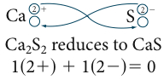
Empirical Formulas
  For ionic compounds and many covalent molecules, formulas should be written with the LOWEST whole number ratio of atoms.
  Calcium sulfide (Ca²⁺ and S^{2–}) → Ca₂S₂.
  The 2:2 ratio can be reduced to CaS.
  This is called an empirical formula.

Slide 49
Review
  The remainder of the slides are for review.

Slide 50
Bonding Elements | Name of Compound
Sodium + Sulfur
Calcium + Fluorine
Oxygen + Silver
Chlorine + Magnesium
Lithium + Nitrogen
Strontium + Sulfur
Barium + Bromine
Oxygen + Potassium
Copper (+2) + Sulfur
Copper (+1) + Sulfur
Iron (+2) + Oxygen
Iron (+3) + Oxygen

Slide 51
Bonding Elements | Name of Compound
Sodium + Sulfur | Sodium sulfide
Calcium + Fluorine | Calcium fluoride
Oxygen + Silver | Silver oxide (Ag only has 1 oxid. #)
Chlorine + Magnesium | Magnesium chloride
Lithium + Nitrogen | Lithium nitride
Strontium + Sulfur | Strontium sulfide
Barium + Bromine | Barium bromide
Oxygen + Potassium | Potassium oxide
Copper (+2) + Sulfur | Copper(II) sulfide, cupric sulfide
Copper (+1) + Sulfur | Copper(I) sulfide, cuprous sulfide
Iron (+2) + Oxygen | Iron(II) oxide, Ferrous Oxide
Iron (+3) + Oxygen | Iron(III) oxide, Ferric Oxide

Slide 52
Write the Chemical Formulas (Use Criss Cross Method, showing cations/anions)
Sodium oxide
Barium phosphide
Potassium chloride
Lithium sulfide
Copper(I) nitrate
Manganese(IV) sulfate
Ammonium phosphate
Cobalt(II) chloride
Notes:
Timing ≈ 5 min

Slide 53
Write the Chemical Formulas (Use Criss Cross Method, showing cations/anions)
Sodium oxide
Na₂⁺O⁻² → Na₂O
Barium phosphide
Ba₃⁺²P₂⁻³ → Ba₃P₂
Potassium chloride
K⁺Cl⁻ → KCl
Lithium sulfide
Li₂⁺S⁻² → Li₂S
Copper(I) nitrate
Cu⁺(NO₃)⁻ → Cu(NO₃)
Manganese(IV) sulfate
Mn₂⁺⁴(SO₄)₄⁻² → Mn(SO₄)₂
Ammonium phosphate
(NH₄)₃⁺(PO₄)⁻³ → (NH₄)₃(PO₄)
Cobalt(II) chloride
Co⁺²Cl₂⁻² → CoCl₂
Ionic compounds do not need special naming, but transition elements do.
Notes:
Timing ≈ 5 min

Slide 54
Name the Following Ionic Compounds
MgCl₂
B₂O₃
CsF
BaS
Na₃N
Fe₂(SO₄)₃
Mn(NO₃)₂
Cu₂CO₃
NH₄I
Na₃PO₄
Notes:
Timing ≈ 1.5 min

Slide 55
Name the Following Ionic Compounds
MgCl₂
magnesium chloride
B₂O₃
boron oxide
CsF
cesium fluoride
BaS
barium sulfide
Na₃N
sodium nitride
Fe₂⁺³(SO₄)₃
iron(III) sulfate, Ferric sulfate
Mn⁺²(NO₃)₂
manganese(II) nitrate
Cu₂⁺¹CO₃
copper(I) carbonate,
cuprous carbonate
NH₄I
ammonium iodide
Na₃PO₄
sodium phosphate
Ionic compounds do not need special naming, but transition elements do.
Notes:
Timing ≈ 1.5 min

Slide 56
Compounds With Polyatomic Ions
  Determine the formula: use the criss-cross method with polyatomic ions, treating the polyatomic ion as ONE unit:
  Calcium nitrate
  Lithium Carbonate
  Magnesium Hydroxide

Slide 57
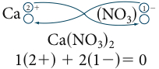
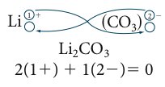
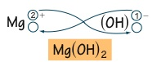
Compounds With Polyatomic Ions
  Determine the formula: use the criss-cross method with polyatomic ions, treating the polyatomic ion as ONE unit:
  Calcium nitrate
  Lithium Carbonate
  Magnesium Hydroxide
  1(2+) + 2(1-) = 0

Slide 58
Oxidation State of Elements in Polyatomic Ions
  Determine the oxidation state of the elements in a polyatomic ion:
  Nitrate (NO₃)⁻¹ …
  Carbonate (CO₃)⁻² …
  Chlorite (ClO₂)⁻¹ …
  Perphosphate (PO₅)⁻³ …

Slide 59
Oxidation State of Elements in Polyatomic Ions
  The sum of the oxidation states of elements in a polyatomic ion equals the charge given:
  Oxygen’s oxidation is -2 in each case.
  Nitrate (NO₃)⁻¹ … N + 3(-2) = -1 … therefore, N⁺⁵
  Carbonate (CO₃)⁻² … C + 3(-2) = -2 … therefore, C⁺⁴
  Chlorite (ClO₂)⁻¹ … C + 2(-2) = -1 … therefore, Cl⁺³
  Perphosphate (PO₅)⁻³ … P + 5(-2) = -3 … P⁺⁷

Slide 60
Name the Covalent Compounds or Give the Formula
NI₃
SulfurVI Fluoride
Dinitrogen tetroxide
CarbonII Oxide
N₄O
CS₂
Diphosphorous pentoxide
H₂O
Notes:
Timing ≈ 1 min
Entry audio: Practice applying the naming rules you have learned.
Hint audio: Remember that the names for covalent compounds may contain prefixes, but they do not contain Roman numerals.
Exit audio: You can use naming rules to write formulas for covalent compounds from their names.

Slide 61
Name the Covalent Compounds or Give the Formula
NI₃
Nitrogen tri-iodide
SulfurVI Fluoride
S⁺⁶F₆⁻¹
Dinitrogen tetroxide
N₂O₄
CarbonII Oxide
C⁺²O⁻² (carbon monoxide)
N₄O
Tetranitrogen monoxide
CS₂
Carbon disulfide
Diphosphorous pentoxide
P₂O₅
H₂O
Dihydrogen monoxide
Notes:
Timing ≈ 1 min
Entry audio: Practice applying the naming rules you have learned.
Hint audio: Remember that the names for covalent compounds may contain prefixes, but they do not contain Roman numerals.
Exit audio: You can use naming rules to write formulas for covalent compounds from their names.

Slide 62
Elements | Formula | Name of Compound
Sodium, Sulfur
Calcium, Fluorine
Silver, Oxygen
Magnesium, Chlorine
Lithium, Nitrogen
Strontium, Sulfur
Barium, Bromine
Potassium, Oxygen
Copper (+2), Sulfur
Copper (+1), Sulfur
Iron (+2), Oxygen
Iron (+3) Oxygen
Aluminum, Chlorine
Aluminum, Sulfur
Ammonium, Sulfur
Copper (+2), Nitrate
Calcium, Phosphate
Potassium, Chlorine
Hydrogen, Oxygen
Lead (+2), Oxygen
Sodium, Hydroxide
Ammonium, Sulfate
Zinc, Acetate
Barium, Chlorate

Slide 63
Elements | Formula | Name of Compound
Sodium, Sulfur | Na₂⁺¹S⁻² | Sodium sulfide
Calcium, Fluorine | Ca⁺²F₂⁻¹ | Calcium fluoride
Silver, Oxygen | Ag₂⁺¹O⁻² | Silver oxide
Magnesium, Chlorine | Mg⁺²Cl₂⁻¹ | Magnesium chloride
Lithium, Nitrogen | Li₃⁺¹N⁻³ | Lithium nitride
Strontium, Sulfur | Sr⁺²S⁻² | Strontium sulfide
Barium, Bromine | Ba⁺²Br₂⁻¹ | Barium bromide
Potassium, Oxygen | K₂⁺¹O⁻² | Potassium oxide
Copper (+2), Sulfur | Cu⁺²S⁻² | Copper(II) sulfide, cupric sulfide
Copper (+1), Sulfur | Cu₂⁺¹S⁻² | Copper(I) sulfide, cuprous sulfide
Iron (+2), Oxygen | Fe⁺²O⁻² | Iron(II) oxide, Ferrous Oxide
Iron (+3) Oxygen | Fe₂⁺³O₃⁻² | Iron(III) oxide, Ferric Oxide
Aluminum, Chlorine | Al⁺³Cl₃⁻¹ | Aluminum chloride
Aluminum, Sulfur | Al₂⁺³S₃⁻² | Aluminum sulfide
Ammonium, Sulfur | (NH₄)₂⁺¹S⁻² | Ammonium sulfide
Copper (+2), Nitrate | Cu⁺²(NO₃)₂⁻¹ | Copper(II) nitrate, cupric nitrate
Calcium, Phosphate | Ca₃⁺²(PO₄)₂⁻³ | Calcium phosphate
Potassium, Chlorine | K⁺¹Cl⁻¹ | Potassium chloride
Hydrogen, Oxygen | H₂⁺¹O⁻² | diHydrogen monoxide, water
Lead (+2), Oxygen | Pb⁺²O⁻² | Plumbous oxide
Sodium, Hydroxide | Na⁺¹(OH) ⁻¹ | Sodium hydroxide
Ammonium, Sulfate | (NH₄)₂⁺¹(SO₄) ⁻² | Ammonium sulfate
Zinc, Acetate | Zn⁺¹(C₂H₃O₂)₂⁻¹ | Zinc acetate
Barium, Chlorate | Ba⁺²(ClO₃)₂⁻¹ | Barium chlorate

Slide 64
  General guidelines for writing the name and formula of a chemical compound:
  1. Follow the rules for naming acids when H is the first element in the formula and it is aqueous (dissolved in water).
  If the compound is binary, generally the non-metal name ends with the suffix -ide.
  If the compound is a molecular (covalently bonded) binary compound, use prefixes to indicate the number of atoms.
  4. When a polyatomic ion that includes oxygen is in the formula, the compound name generally ends in -ite or -ate.
  5. If the compound contains a metallic cation that can have different ionic charges (transition, group B metals), use a Roman numeral to indicate the numerical value of the ionic charge in the compound.

Slide 65
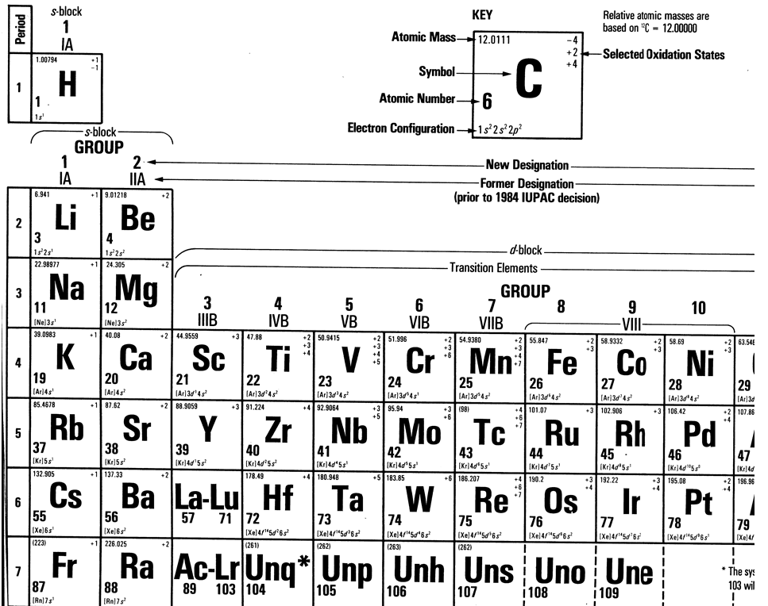

Slide 66
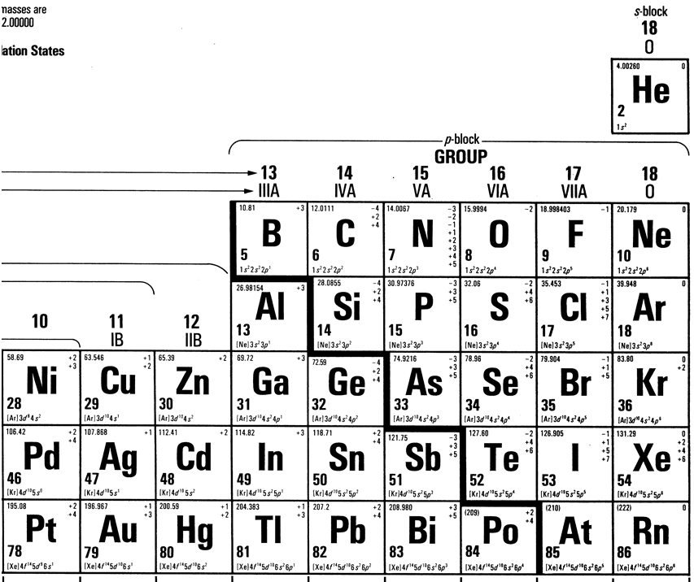

Slide 67
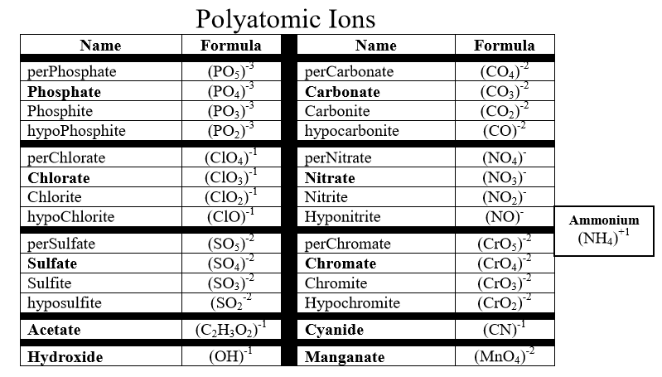

Slide 68
