Slide 1
Go to the “Slide Show” shade above
Click on “Play from Beginning”

Slide 2
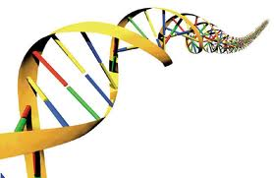
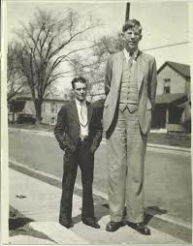
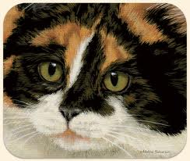
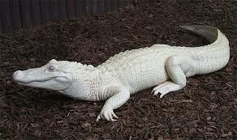
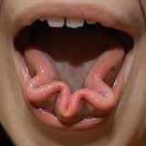
Chapter 12
GENES & HEREDITY

Slide 3
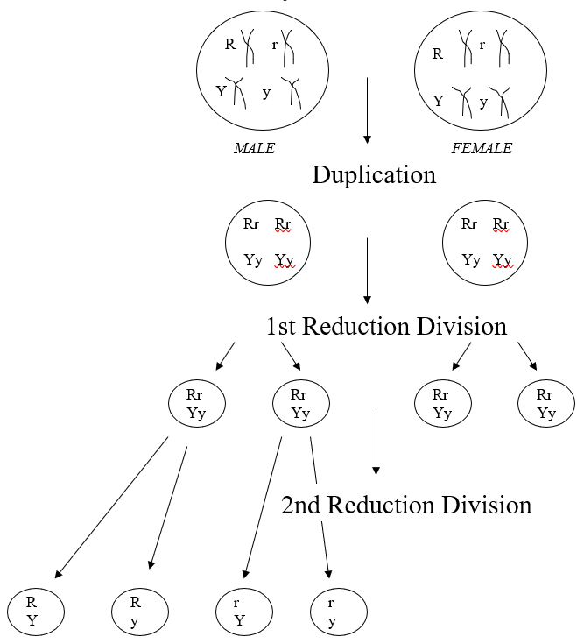
Show the Meiotic Division

Slide 4
Show the Meiotic Division

Slide 5
Show the Meiotic Division

Slide 6
Show the Meiotic Division

Slide 7
Lesson Objectives
  By the end of this lesson, you should be able to:
Define genetics and heredity, distinguishing characteristics from traits, genes, and alleles.
Describe the history of genetics and Mendel’s role.
Delineate the science of heredity in terms of generations (P, F₁, F₂), differentiating genotype from phenotype.
Understand and use the law of segregation to show monohybrid test crosses.
Understand and use the law of independent assortment to show dihybrid test crosses.
  Science Practice: Monohybrid Test Cross
Notes:
#frame
instructional video
Timing ≈ 0.5 minutes
Living organisms need energy to accomplish the wide variety of tasks they attempt each day.
You will begin learning about how energy is captured from the Sun and stored in organic molecules.
[read objectives]

Slide 8
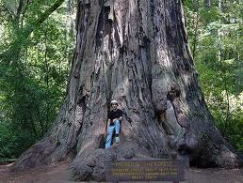
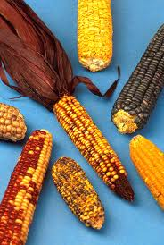

GENETICS
The scientific study of the transmission of traits from parent to offspring through successive generations.

Slide 9
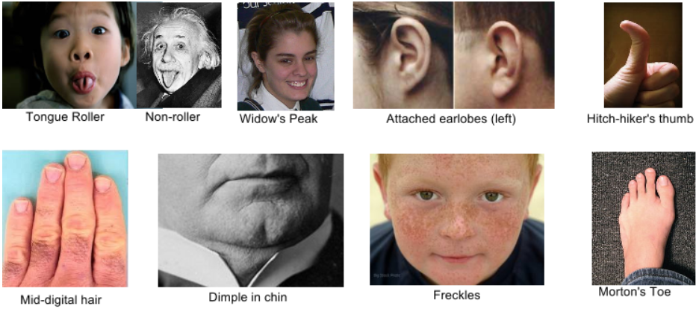
Genetics is the study of HEREDITY
Transmission of traits from one generation to the next.

Slide 10
    Species Traits
      Traits that ALL members of a given species share.
        humans – walk erect, highly developed nervous system, opposable thumb, flat fingernail (primate), limited body hair.
        Eagles – wing span up to 6 feet; large talons; double fovia in eyes; hooked beak for tearing up prey;
      Affect the entire species in terms of survival vs. extinction.
    Individual Traits
      Traits that distinguish individual members within a given species.
        humans – color of eyes, skin, hair; stature (height, weight, bone structure); metabolic rate (thin, fat).
        Eagles – Bald Eagle; golden eagle; white-tailed eagle; Sea eagle.
      Normally does not affect the entire species in terms of survival vs. extinction.

Slide 11
    Genetics was founded on Observation
    (not science)
    Traits were thought to be passed from generation to generation through the blood. Hence, the concept of “blood lines” or “blue blood” (royalty) was commonly accepted.
      “Blood Brothers” or Blood Sisters
      “Orientals are short”
    Actually only due to dietary shortages (Yao is 7’7” tall in the NBA). Chinese people are as tall as Americans now that nutritional information was discovered.
      Knights of the round table were only 5’4” tall, yet were esteemed, revered for their stature in the medieval times (again, nutrition was the issue, not genetics).

Slide 12
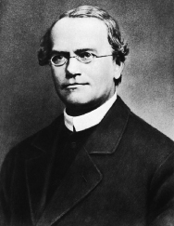
Gregor Mendel
Austrian monk (1822-1884)
Called the “Father of Genetics“.
Began the field of Genetics in the 1860s.
Deduced the Principles of Genetics by breeding garden peas.

Slide 13
Gregor Mendel
(1822-1884)
        Entered a Monastery in Brunn, Czechoslovakia to get an education
          It was common (for centuries) for people who wanted to be spiritual to pursue monastic life.
          Prior to Reformation - mainly priests, nuns in Catholicism or Eastern Orthodoxy.
          After Reformation - monks, friars, bishops, reverends, pastors – depending on the religious persuasion … concept of clergy-laity was strong … still is).
        University of Vienna – Pursued mathematics and science for 2 years hoping to become a teacher … but he failed the certification exams.
        Became an Abbot in a Monastery

Slide 14
The Science of Genetics began in an Abbey Garden
        Mendel is famous for his work with pea plants while in the monastery.
        Repeatable results
Many had previously done studies with plants, but their results were not conclusive or scientific.
Mendel choose definite and measurable hereditary traits.
Mendel applied mathematics to his observations (objective, not “subjective” or philosophical in nature).
Mendel took a scientific approach in all his work using a logical sequence with proper methodology.
Mendel received world-wide recognition in 1901 for his work and scientific approach which he published (the recognition came AFTER HE DIED).

Slide 15
The Science of Genetics began in an Abbey Garden
In 1866, Mendel
  correctly argued that parents pass on to their offspring discrete “heritable factors” and
  stressed that the heritable factors (today called GENES) retain their individuality generation after generation.
A heritable feature that varies among individuals, such as flower color, is called a CHARACTER.
Each variant for a character, such as purple or white flowers, is a TRAIT.

Slide 16
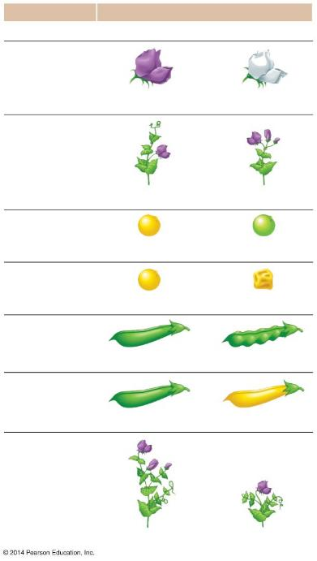
Character
Traits
Dominant
Recessive
Flower color
Purple
White
Flower position
Axial
Terminal
Seed color
Yellow
Green
Seed shape
Round
Wrinkled
Pod shape
Inflated
Constricted
Pod color
Green
Yellow
Stem length
Tall
Dwarf
Notes:
Figure 9.2d-0 The seven pea characters studied by Mendel

Slide 17
The Science of Genetics began in an Abbey Garden
True-Breeding varieties result when self-fertilization produces offspring all identical to the parent.
The offspring of two different varieties are Hybrids.
The cross-fertilization is a hybridization, or Genetic Cross.
True-breeding parental plants are the P Generation.
Hybrid offspring are the F₁ Generation (1st “filial” gen.).
A cross of F₁ plants produces an F₂ Generation (2nd “filial” generation.).

Slide 18
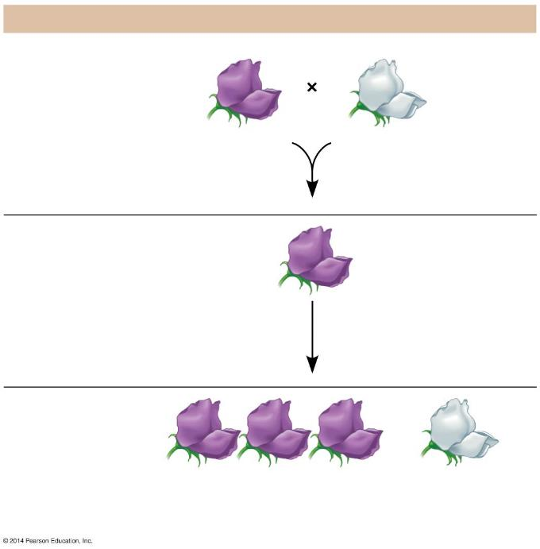
The Experiment
P generation
(true-breeding
parents)
Purple flowers
White flowers
All plants have
purple flowers
F₁ generation
Fertilization
among F₁ plants
(F₁ × F₁)
F₂ generation
3
4
1
4
of plants have purple flowers
of plants
have white flowers
Notes:
Figure 9.3a-3 Crosses tracking one character (flower color) (step 3)

Slide 19
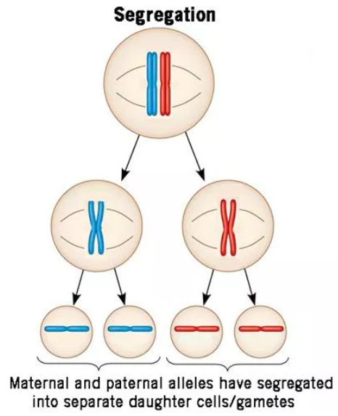
Mendel’s LAW OF SEGREGATION describes the Inheritance of a Single Character
    During fertilization, gametes randomly pair to produce combinations of alleles.
    Two alleles for each trait must separate when gametes are formed.
    A parent passes only one allele for each trait to their offspring.
    This is a random process.

Slide 20
Mendel’s LAW OF SEGREGATION describes the Inheritance of a Single Character
A sperm or egg carries only one allele for each inherited character…
  Because allele pairs separate (segregate) from each other during the production of gametes (Meiosis).
  This statement is called the LAW OF SEGREGATION.
  The fusion of gametes at fertilization creates allele pairs once again.

Slide 21
Mendel’s LAW OF SEGREGATION describes the Inheritance of a Single Character
A cross between two individuals differing in a single character is a Monohybrid Cross.
Mendel performed a monohybrid cross between a plant with purple flowers and a plant with white flowers.
  The F₁ Generation produced all plants with purple flowers.
  A cross of F₁ plants with each other produced an F₂ Generation with ¾ purple and ¼ white flowers.

Slide 22
Mendel’s LAW OF SEGREGATION describes the Inheritance of a Single Character
The all-purple F₁ Generation did not produce white flowers.
Mendel needed to explain
  why white color seemed to disappear in the F₁ generation and
  why white color reappeared in one-quarter of the F₂ offspring.

Slide 23
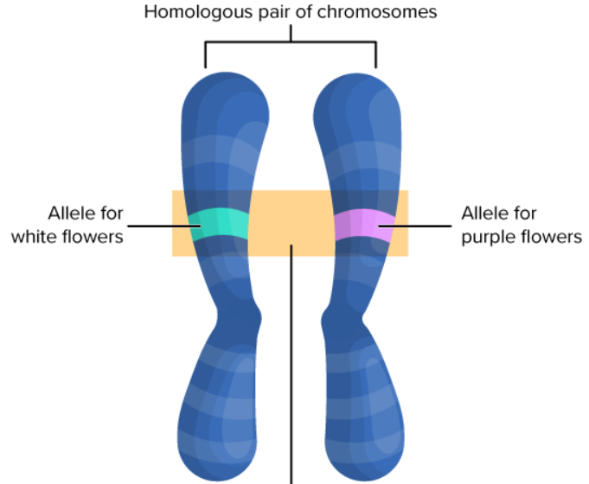
Mendel’s LAW OF SEGREGATION describes the Inheritance of a Single Character

Slide 24
Mendel’s LAW OF SEGREGATION describes the Inheritance of a Single Character
Mendel developed four hypotheses, described below using modern terminology:
  Alleles are alternative versions of genes that account for variations in inherited characters.
  For each character, an organism inherits two alleles, one from each parent. The alleles can be the same or different.
    A Homozygous genotype has identical alleles.
    A Heterozygous genotype has two different alleles.

Slide 25
Mendel’s LAW OF DOMINANCE
  For each trait, one gene Allele can mask the expression of the other gene allele.
  If the alleles of an inherited pair differ, then one determines the organism’s appearance. The gene allele that masks over another allele is called the Dominant allele.
  The other gene allele has no noticeable effect on the organism’s appearance and gets masked. This is called the Recessive Allele.
  E.g. Tall (T) is the dominant allele while Short (t) is the recessive allele.

Slide 26
Mendel’s LAW OF SEGREGATION describes the Inheritance of a Single Character
  The Phenotype is the appearance or expression of a trait.
    The PHYSICAL appearance of an organism – what you see.
    TALL pea plants, BLONDE hair, BLUE eyes, etc.
  The Genotype is the actual genetic makeup of a trait.
    There are three possible genotypic expressions for every trait:
Homozygous Dominant – “pure bred”
Heterozygous Dominant – “Hybrid”
Both genotypes give the same phenotype (appearance).
The offspring give away what the genotype of the parents is.
Homozygous Recessive
  The same phenotype may be determined by more than one genotype.

Slide 27
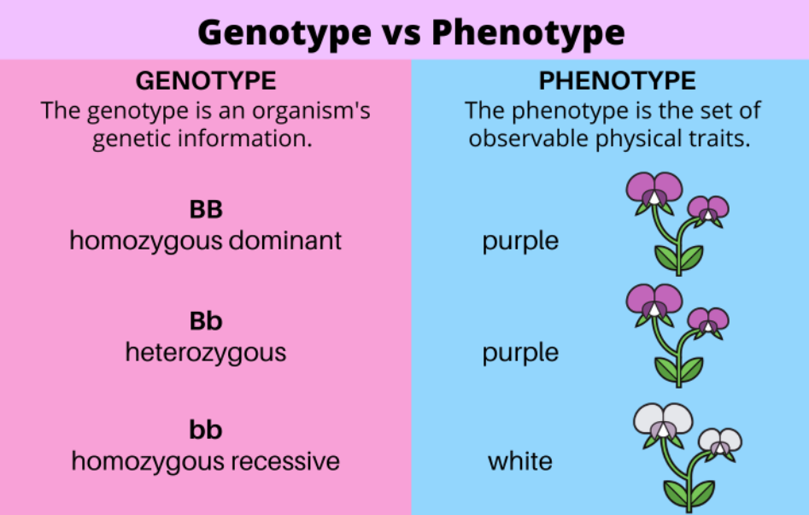
Mendel’s LAW OF SEGREGATION describes the Inheritance of a Single Character

Slide 28
Mendel’s LAW OF SEGREGATION describes the Inheritance of a Single Character
Mendel’s hypotheses also explain the 3:1 ratio in the F₂ Generation.
  The F₁ Hybrids all have a Pp genotype.
  A Punnett Square shows the four possible combinations of alleles that could occur when these gametes combine (probability).

Slide 29
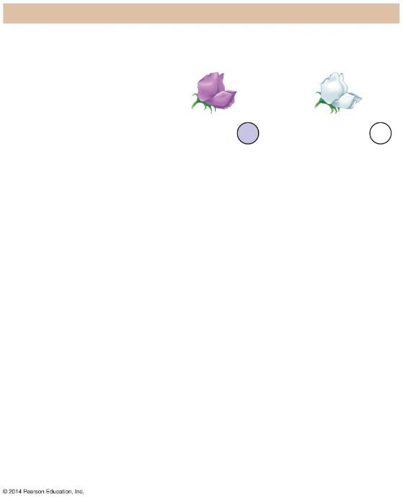
The Explanation
P generation
Genetic makeup (alleles)
Purple flowers
White flowers
PP
pp
Gametes
All
P
All
p
Notes:
Figure 9.3b-0-1 An explanation of the crosses in Figure 9.3a (step 1)

Slide 30
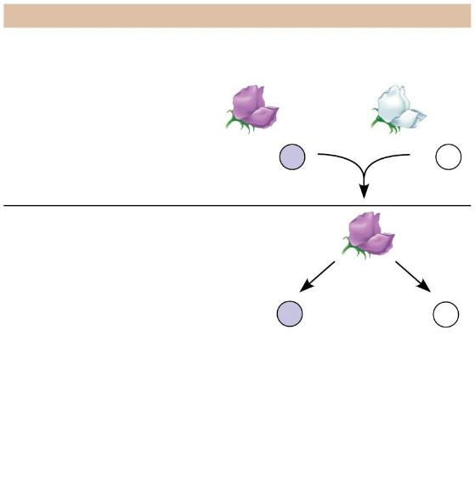
The Explanation
P generation
Genetic makeup (alleles)
Purple flowers
White flowers
PP
pp
Gametes
All
P
All
p
F₁ generation
(hybrids)
All
Pp
Alleles
segregate
Gametes
1
2
P
1
2
p
Notes:
Figure 9.3b-0-2 An explanation of the crosses in Figure 9.3a (step 2)

Slide 31
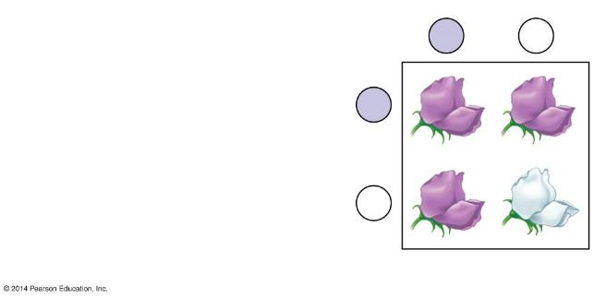
F₂ generation
Sperm from F₁ plant
P
p
Results:
Phenotypic ratio
3 purple : 1 white
P
PP
Pp
Eggs
from F₁
plant
Genotypic ratio
1 PP : 2 Pp : 1 pp
p
Pp
pp
Results
Notes:
Figure 9.b-1 An explanation of the crosses in Figure 9.3a (part 2)

Slide 32
F₂ generation
Sperm from F₁ plant
P
p
Results:
Phenotypic ratio
3 purple : 1 white
P
PP
Pp
Eggs
from F₁
plant
Genotypic ratio
1 PP : 2 Pp : 1 pp
25% homozygous dom
50% heterozygous dom
25% homozygous rec
p
Pp
pp
Results
Notes:
Figure 9.b-1 An explanation of the crosses in Figure 9.3a (part 2)

Slide 33
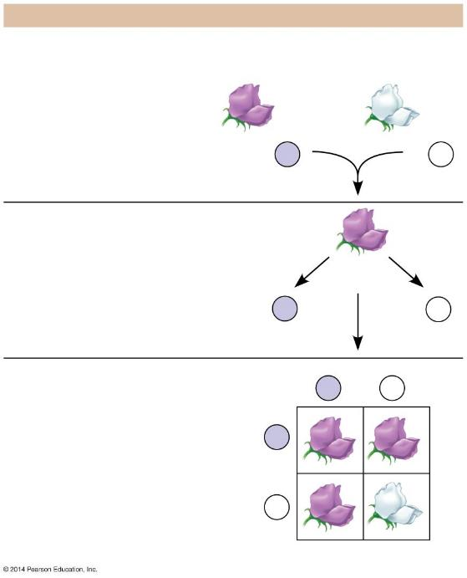
The Explanation
P generation
Genetic makeup (alleles)
Purple flowers
White flowers
PP
pp
Gametes
All
P
All
p
F₁ generation
(hybrids)
All
Pp
Alleles
segregate
Gametes
1
2
P
1
2
p
Fertilization
F₂ generation
Sperm from F₁ plant
P
p
Results:
Phenotypic ratio
3 purple : 1 white
P
PP
Pp
Eggs
from F₁
plant
Genotypic ratio
1 PP : 2 Pp : 1 pp
25% homozygous dom
50% heterozygous dom
25% homozygous rec
Pp
pp
p
Results
Notes:
Figure 9.3b-0-3 An explanation of the crosses in Figure 9.3a (step 3)

Slide 34
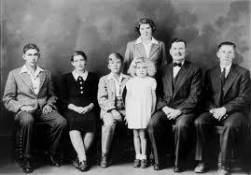
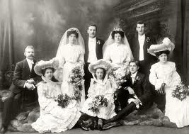
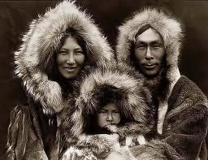
If we know the genetic makeup of parents, what type of offspring might they produce?
What is the probability of producing different types of offspring?
Probability
The likelihood that a particular event will occur.

Slide 35
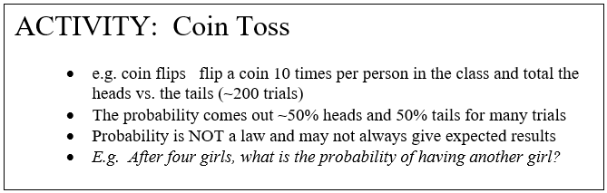
Using Probability and Punnett Squares to Work Genetics Problems
R. C. Punnett Mathematician
    Use of Punnett Squares and even Genetics itself is a method of studying the probability or chance of various offspring.

Slide 36

Using Probability and Punnett Squares to Work Genetics Problems
Punnett Square
A Punnett square is a diagram showing the allele combinations that might result from a genetic cross between two parents.
It is a “Test Cross” or Back Cross to determine if alleles are homozygous or heterozygous.
Mendel began his experiments using true-breeding parents.
He soon discovered that the tall trait was dominant over the dwarf trait.
Let’s cross a true-breeding tall pea plant [genotype TT] to a true-breeding dwarf pea plant [genotype tt].

Slide 37
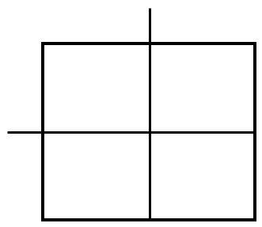
Using Probability and Punnett Squares to Work Genetics Problems
Punnett Square
A Punnett square is a diagram showing the allele combinations that might result from a genetic cross between two parents.
It is a “Test Cross” or Back Cross to determine if alleles are homozygous or heterozygous.
t
t
Place the alleles of the first parent on the top of the square.
Place the alleles for the second parent on the left of the square.
T
T

Slide 38
Using Probability and Punnett Squares to Work Genetics Problems
Punnett Square
Fill in the squares to show all the possible combinations of alleles that the offspring might inherit.
t
t
T
Tt
Tt
T
Tt
Tt

Slide 39
F₁ Generation offspring of P generation
    What are the different kinds of offspring that can be formed from parent cells?
    What is the probability for each trait being expressed phenotypically and genotypically?
    The F₁ Generation is the first “Filial” generation of the parents.
P Generation
Sperm + egg → zygote
TT tt → F₁
F₁ Generation
Phenotype:
? Tall
Genotype:
? Heterozygous

Slide 40
F₁ Generation offspring of P generation
    What are the different kinds of offspring that can be formed from parent cells?
    What is the probability for each trait being expressed phenotypically and genotypically?
    The F₁ Generation is the first “Filial” generation of the parents.
P Generation
Sperm + egg → zygote
TT tt → F₁
F₁ Generation
Phenotype:
100% Tall
Genotype:
100% Heterozygous
 | t | t
T | Tt | Tt
T | Tt | Tt

Slide 41
Using Probability and Punnett Squares to Work Genetics Problems
Punnett Square
Use the law of segregation to perform the Punnett square of the F₁ generation (both F₁ parents are Tt).
T
t
T
TT
Tt
t
Tt
tt

Slide 42
F₂ Generation offspring of F₁ generation
    Mendel assumed that an equal number of male and female gametes are produced that could contribute to fertilization (zygote).
    Mendel also assumed that gametes combine at RANDOM.
F₁ Generation
Sperm + egg → zygote
Tt Tt → F₂
F₂ Generation
Phenotype:
75% Tall
25% Short
Genotype:
25% Homozygous Tall
50% Heterozygous Tall
25% Homozygous Short
 | T | t
T | TT | Tt
t | Tt | tt

Slide 43
Using Probability and Punnett Squares to Work Genetics Problems
Punnett Square
The alleles of the first parent will be placed across the top of the square.
The alleles of the second parent will be placed along the left side of the square.
The possible gene combinations of the offspring will be placed inside the squares.
T
t
T
TT
Tt
T
TT
Tt
Letters represent the alleles.
Capital letters represent Dominant alleles.
Lower case letters represent Recessive alleles.

Slide 44
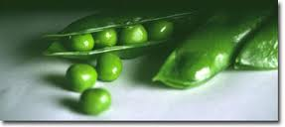
In the original Test Cross (TT with tt), the dwarf trait disappeared.
Mendel allowed the F₁ generation to self-pollinate.
Show this cross using the Punnett square below.
What is the genotype of each parent?
Set up the Punnett Square.
Give the results.

Slide 45
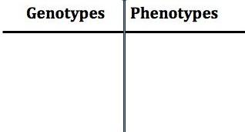
In the original Test Cross (TT with tt), the dwarf trait disappeared.
Mendel allowed the F₁ generation to self-pollinate.
Show this cross using the Punnett square below.
The genotype of each parent? Tt x Tt
T
t
T
TT
Tt
1/4 TT
2/4 Tt
1/4 tt
¾ Tall
¼ dwarf
t
Tt
tt

Slide 46
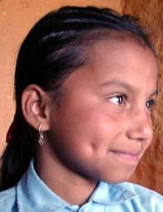
Having dimples is dominant over the absence of dimples. Cross a heterozygous dimpled man with a woman who does not have dimples. Show all work in the Punnett square and summarize your findings in the table
What is the genotype of the man?
What is the genotype of the woman?

Slide 47
Having dimples is dominant over the absence of dimples. Cross a heterozygous dimpled man with a woman who does not have dimples. Show all work in the Punnett square and summarize your findings in the table
What is the genotype of the man?
What is the genotype of the woman?
Dd
dd
D d
d
d
Dd
Dd
dd
dd
2/4 Dd
2/4 dd
2/4 dimples
2/4 no dimples

Slide 48

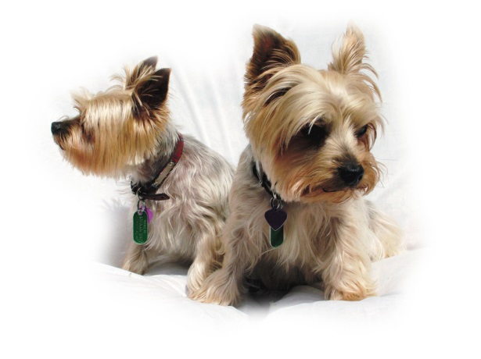
In dogs, the allele for short hair (B) is dominant over the allele for long hair (b). Two short haired dogs have a litter of puppies. Some of the puppies have short hair and some of the puppies have long hair.
What are the genotypes of the parents?
If the litter of puppies contained 12 pups, how many would you expect to have short hair?
How many would you expect to have long hair?

Slide 49
In dogs, the allele for short hair (B) is dominant over the allele for long hair (b). Two short haired dogs have a litter of puppies. Some of the puppies have short hair and some of the puppies have long hair.
The genotypes of the parents?
Bb and Bb
B b
B
b
BB Bb
Bb bb
1/4 BB
2/4 Bb
1/4 bb
¾ short hair
¼ long hair
If the litter of puppies contained 12 pups, how many would you expect to have short hair?
How many would you expect to have long hair?
¾ of the 12 should have short hair. ¾ of 12 = 9 pups
¼ of 12 = 3 pups

Slide 50
Homologous Chromosomes bear the Alleles for Each Character
A LOCUS (plural, loci) is the specific location of a gene along a chromosome.
For a pair of homologous chromosomes (homologs), alleles of a gene reside at the same locus.
  Homozygous individuals have the same allele on both homologs.
  Heterozygous individuals have a different allele on each homolog.

Slide 51
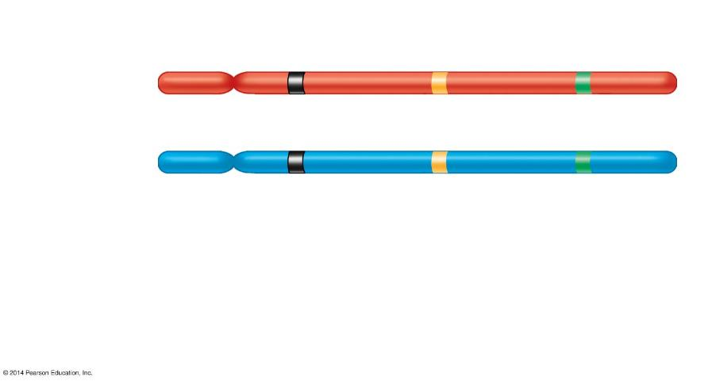
Gene loci
Dominant
allele
P
a
B
Homologous
chromosomes
P
a
b
Recessive
allele
Genotype:
PP
aa
Bb
Homozygous
for the
dominant
allele
Homozygous
for the
recessive
allele
Heterozygous,
with one
dominant and
one recessive
allele
Notes:
Figure 9.4 Three gene loci on homologous chromosomes

Slide 52
The LAW OF INDEPENDENT ASSORTMENT is revealed by tracking Two Characters at once
Involves TWO traits and their inheritance.
The LAW of INDEPENDENT ASSORTMENT
  Each trait is inherited separately or independently – they do not influence one another in heredity.
  Each trait (allele) is found on a different chromosome.
Mendel studied crosses between the Pea Plants that simultaneously differed in TWO characteristics.
  He crossed Round, yellow seeds (RRYY) with wrinkled, green seeds (rryy) and found that their offspring expressed completely different characteristics.

Slide 53
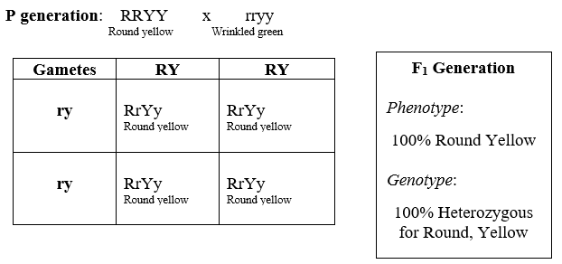
The LAW OF INDEPENDENT ASSORTMENT is revealed by tracking Two Characters at once
Traits: Seed shape and Seed color

Slide 54
The LAW OF INDEPENDENT ASSORTMENT is revealed by tracking Two Characters at once
Traits: Seed shape and Seed color
ry
ry
RY
RrYy
RrYy
RY
RrYy
RrYy

Slide 55
The LAW OF INDEPENDENT ASSORTMENT is revealed by tracking Two Characters at once
Traits: Seed shape and Seed color

Slide 56
The LAW OF INDEPENDENT ASSORTMENT is revealed by tracking Two Characters at once
Traits: Seed shape and Seed color
Alleles: R round r wrinkled
Y yellow y green
F₁ generation
RrYy x RrYy
All possible gamete combinations?

Slide 57
The LAW OF INDEPENDENT ASSORTMENT is revealed by tracking Two Characters at once
Traits: Seed shape and Seed color
Alleles: R round r wrinkled
Y yellow y green
F₁ generation
RrYy x RrYy
RY Ry rY ry
RY Ry rY ry
All possible gamete combinations

Slide 58
When two traits are being considered (dihybrid cross), the Punnett square will need 16 squares.
Each parent will pass one allele of each gene pair to the offspring. RrYy x RrYy

Slide 59
When two traits are being considered (dihybrid cross), the Punnett square will need 16 squares.
Each parent will pass one allele of each gene pair to the offspring.
RY
rY
Ry
ry
RY
RRYY
RrYY
RRYy
RrYy
rY
RrYY
rrYY
RrYy
rrYy
Ry
RRYY
RrYy
RRyy
Rryy
RrYy
rrYy
Rryy
rryy
ry

Slide 60
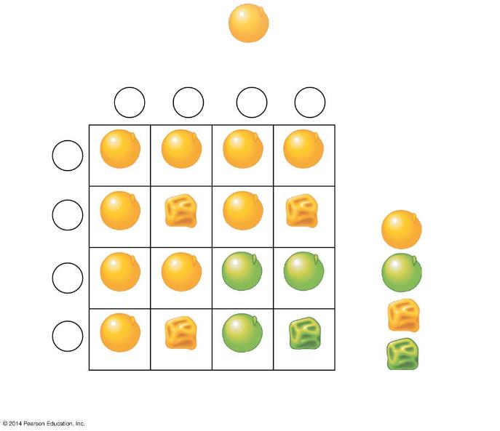
F₁ generation
RrYy
9:3:3:1
phenotypic
ratio
Sperm
1
4
RY
1
4
rY
1
4
Ry
1
4
ry
1
4
RY
RRYY
RrYY
RRYy
RrYy
Results:
1
4
rY
Yellow
round
9
16
Eggs
RrYY
rrYY
RrYy
rrYy
3
16
Green
round
1
4
Ry
RRYy
RrYy
RRyy
Rryy
Yellow
wrinkled
3
16
1
4
ry
1
16
Green
wrinkled
RrYy
rrYy
Rryy
rryy
The hypothesis of independent assortment

Slide 61
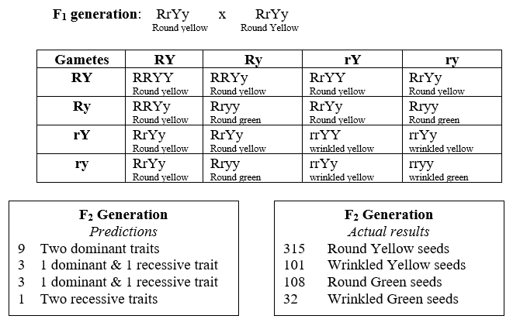
The LAW OF INDEPENDENT ASSORTMENT is revealed by tracking Two Characters at once

Slide 62
The LAW OF INDEPENDENT ASSORTMENT is revealed by tracking Two Characters at once
A Dihybrid Cross is a mating of parental varieties that differ in two characters.
Mendel performed the following dihybrid cross with the following results:
  P Generation: round yellow seeds × wrinkled green seeds
  F₁ Generation: all plants with round yellow seeds
  F₂ Generation:
    9/16 had round yellow seeds
    3/16 had wrinkled yellow seeds
    3/16 had round green seeds
    1/16 had wrinkled green seeds

Slide 63
The LAW OF INDEPENDENT ASSORTMENT is revealed by tracking Two Characters at once
Mendel needed to explain why the F₂ offspring
  had new nonparental combinations of traits and
  had a 9:3:3:1 phenotypic ratio.
Mendel
  suggested that the inheritance of one character has no effect on the inheritance of another.
  suggested that the dihybrid cross is the equivalent to two monohybrid crosses.
  established the LAW of INDEPENDENT ASSORTMENT.

Slide 64

SUMMARY OF MENDEL’S PRINCIPLES
Mendel’s Principles form the basis of Modern Genetics include the following:
1. The inheritance of traits is determined by individual units known as ___.
2. ___ are passed from parent to offspring.
3. Each gene has two or more forms called ____.
4. Some alleles are ____, while other alleles are ____.
5. Each parent has ____ alleles for a particular trait that they inherited from their parents. They will pass ____ allele to their offspring when the alleles are segregated into ____.
6. The alleles for one trait segregate ____ of the alleles for another trait.

Slide 65
SUMMARY OF MENDEL’S PRINCIPLES
Mendel’s Principles form the basis of Modern Genetics include the following:
1. The inheritance of traits is determined by individual units known as genes.
2. Genes are passed from parent to offspring.
3. Each gene has two or more forms called alleles.
4. Some alleles are dominant, while other alleles are recessive.
5. Each parent has two alleles for a particular trait that they inherited from their parents. They will pass one allele to their offspring when the alleles are segregated into gametes.
6. The alleles for one trait segregate independently of the alleles for another trait.

