Slide 1
Go to the “Slide Show” shade above
Click on “Play from Beginning”

Slide 2
Chapter 9:
DNA, RNA, and Proteins

Slide 3
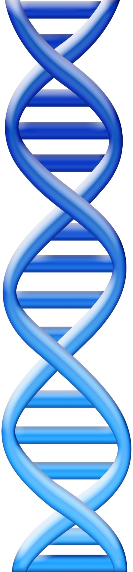
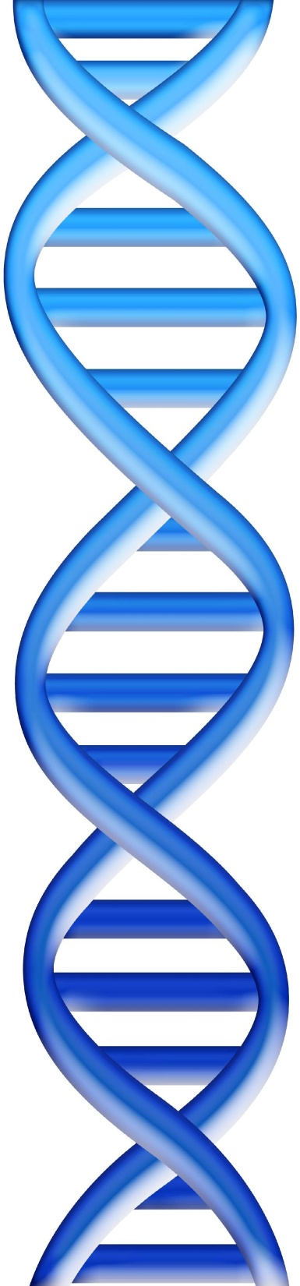
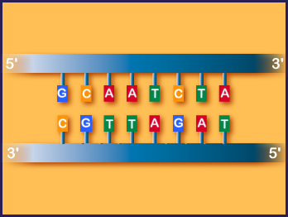
DNA stands for …
What?

Slide 4
DNA stands for …
DeoxyriboNucleic Acid

Slide 5
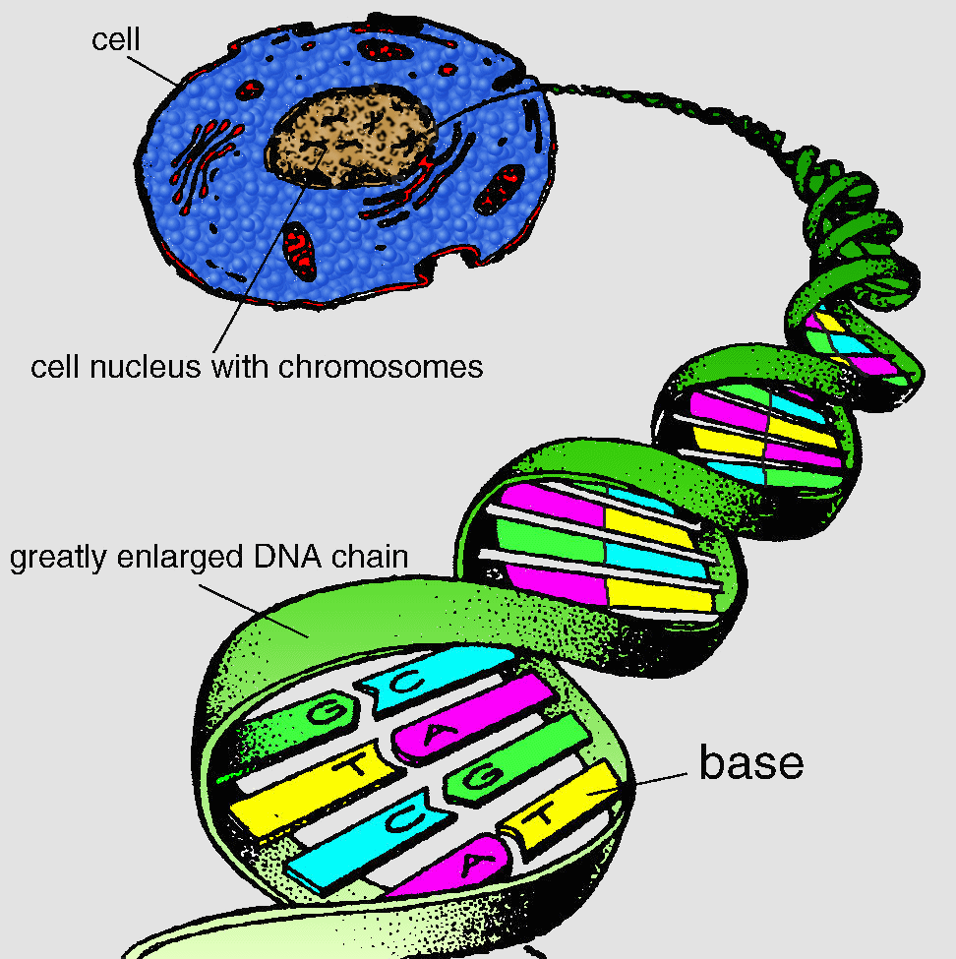
DNA comes from the ___ of the cell.
What comprises DNA?
What type of bonds hold the complimentary strands together?

Slide 6
DNA comes from the nucleus of the cell.
Nucleotides comprise DNA?
Hydrogen bonds hold the complimentary strands together?

Slide 7
___ bonds with ___ using 2 hydrogen bonds.
___ bonds with ___ using 3 hydrogen bonds.

Slide 8
Adenine bonds with Thymine using 2 hydrogen bonds.
Guanine bonds with Cytosine using 3 hydrogen bonds.

Slide 9
Lesson Objectives
  By the end of this lesson, you should be able to:
Distinguish chromosome, gene, and DNA.
Identify and label the anatomy of chromosomes and DNA.
Name the scientists who discovered DNA and their contributions.
Review the process of DNA replication.
Contrast DNA and RNA, introducing protein synthesis.
Explain gene expression.
  Science Practice: DNA Extraction
Notes:
#frame
instructional video
Timing ≈ 0.5 minutes
Living organisms need energy to accomplish the wide variety of tasks they attempt each day.
You will begin learning about how energy is captured from the Sun and stored in organic molecules.
[read objectives]

Slide 10
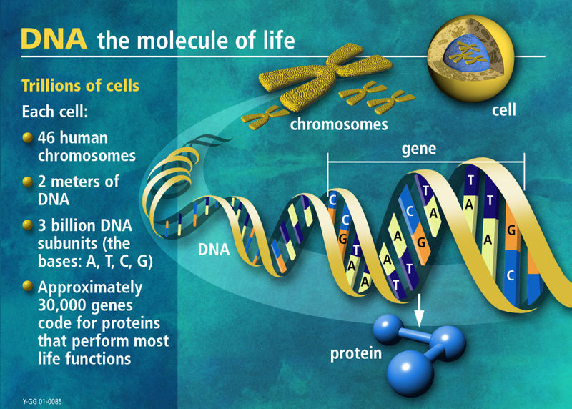

Slide 11
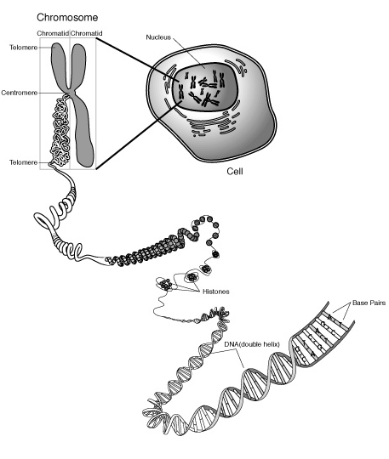
Chromosomes are made of DNA
).

Slide 12
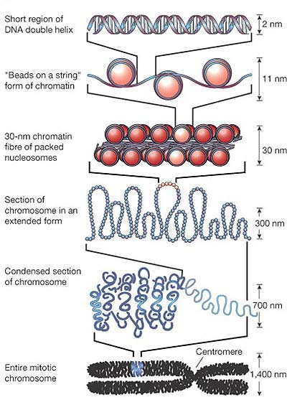
How a chromosome forms.
1. The DNA wraps around proteins called histones to form beads on a string or chromatin.
2. The chromatin fibers further condenses into a fiber.

Slide 13
How a chromosome forms.
3. The condensed chromatin fibers continues to coil around itself.
4. The condensed and coiled chromatin fibers become a section of a chromosome.
This is one entire chromosome coiled and condensed.

Slide 14
How a chromosome forms.
1. The DNA wraps around proteins called histones to form beads on a string or chromatin.
2. The chromatin fibers further condenses into a fiber.
3. The condensed chromatin fibers continues to coil around itself.
4. The condensed and coiled chromatin fibers become a section of a chromosome.
This is one entire chromosome coiled and condensed.

Slide 15
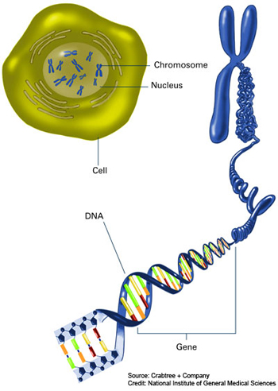
DNA, Genes and Chromosomes
What is DNA?
  - Double stranded molecule that contains genetic information about the function and development of all living things.
What is a gene?
  - A segment of DNA that codes for a protein (polypeptide).
What is a chromosome?
  A molecule of DNA that contains many genes.

Slide 16
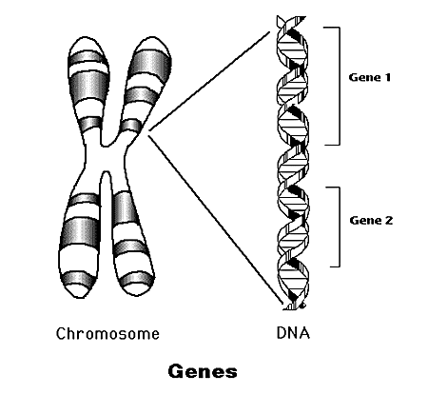
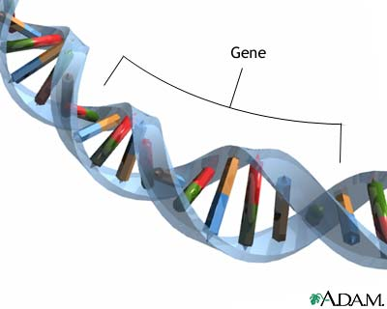
DNA, Genes & Chromosomes
Genes are segments of DNA that code for proteins
Chromosomes consist of segments of coding DNA (string of genes that code for various proteins in between non-coding DNA.

Slide 17
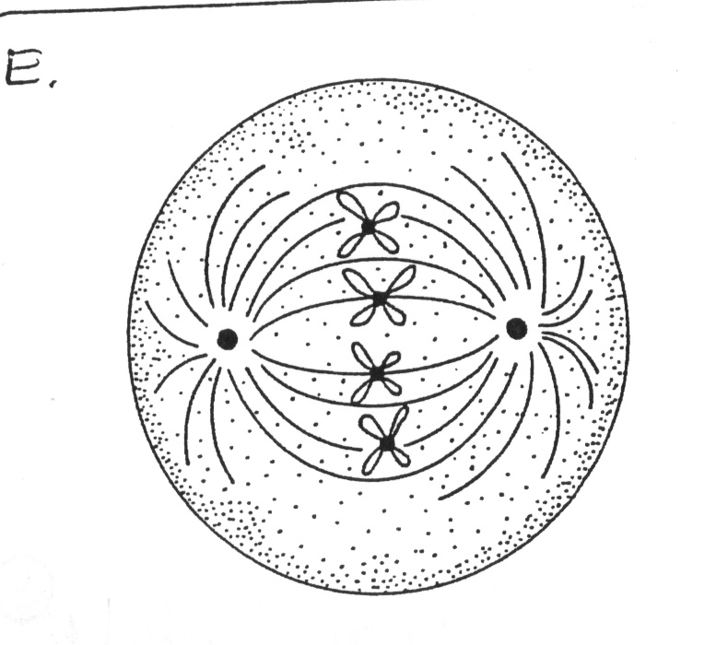
METAPHASE
The chromosomes can be most easily seen during the Metaphase portion of Mitosis.
spindle fibers
What are the phases of Mitosis in order?
centrioles
Prophase
Metaphase
Anaphase
Telophase

Slide 18
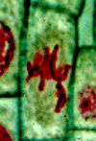
Chromosomes of an onion root cell
Metaphase
The chromosomes have been dyed red and the cell walls have been dyed green.

Slide 19
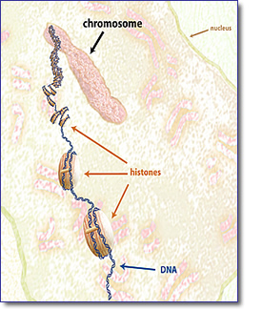
To form chromosomes, the DNA compacts itself into very tight coils.
Initially, the DNA coils itself around proteins called histones.

Slide 20
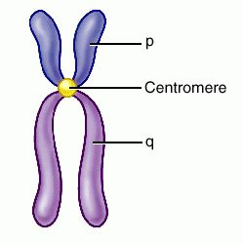
The left side
is a copy of the right side!
The general shape of an eukaryotic chromosome.
p arm → short side
The p is French for “petit” which means short.
q arm → longer side
q is just the next letter of the alphabet.

Slide 21

Not-so-Random Fact Time
One nm (or nanometer) is one billionth of a meter.
A human hair is 80,000 nm thick.
The DNA from one chromosome when stretched out can be anywhere from 1 to 3 meter long…(yes! meters).

Slide 22
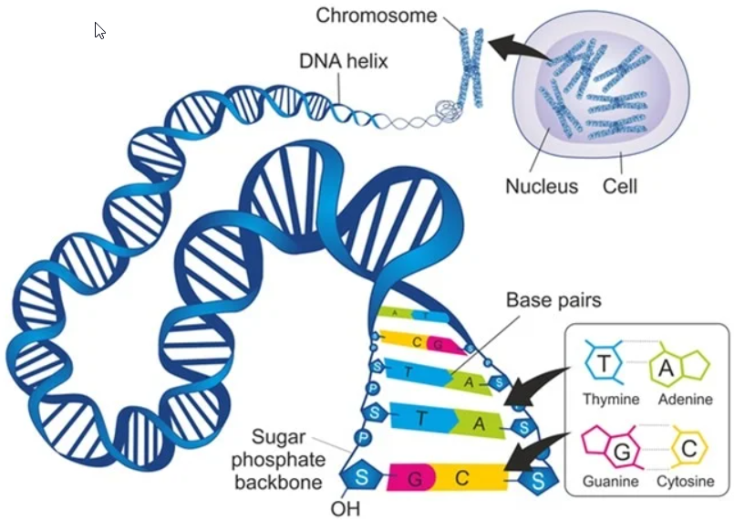
History of DNA

Slide 23
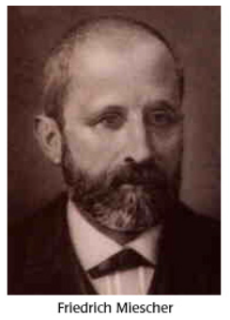
Discovery of DNA
Friedrich Miescher (Swiss, 1869) experimented and isolated a new molecule - nuclein - from the cell nucleus.
He determined that nuclein was made up of hydrogen, oxygen, nitrogen and phosphorus and there was an unique ratio of phosphorus to nitrogen.
Nuclein, found in the nucleus, is now known as DNA.
He extracted and observed DNA from white blood cells.
Miescher, himself, believed that proteins were the molecules of heredity.

Slide 24
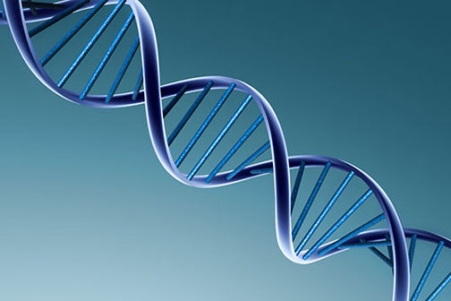
The Race for the Structure of DNA
The Contestants:
Maurice Wilkins and Rosalind Franklin
Watson and Crick

Slide 25
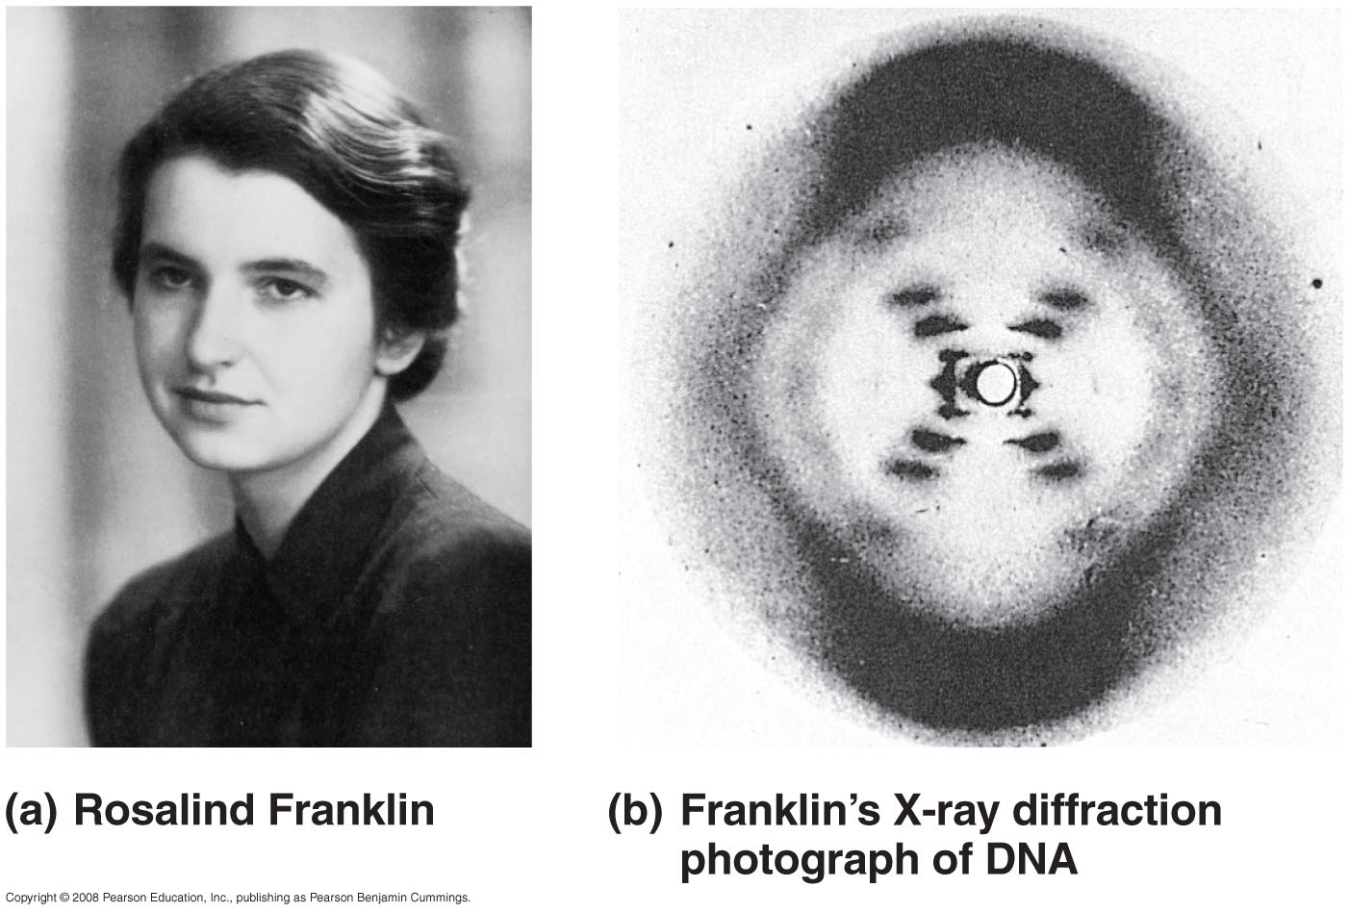
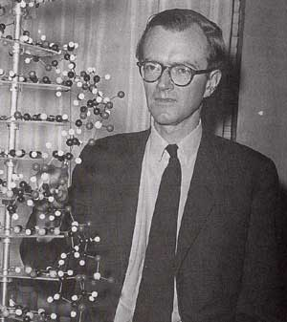
Wilkins & Franklin
Rosalind Franklin
Maurice Wilkins
X-ray crystallography images

Slide 26
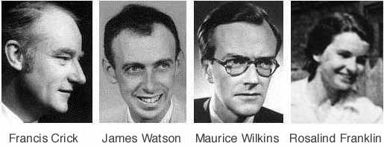
DNA is a Double-Stranded Helix
American James D. Watson journeyed to Cambridge University in England, where the more senior Francis Crick was studying protein structure with a technique called X-Ray Crystallography.

Slide 27
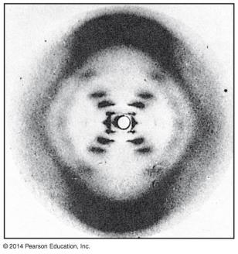
DNA is a Double-Stranded Helix
While visiting the laboratory of Maurice Wilkins at King’s College in London, Watson saw an X-ray image of DNA produced by Wilkins’s colleague, Rosalind Franklin.

Slide 28
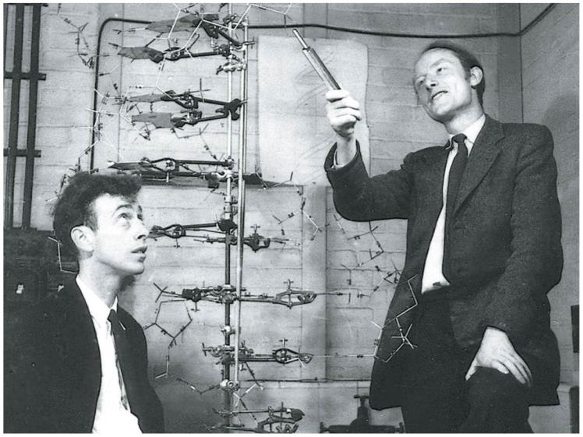
Notes:
Figure 10.3b Watson and Crick in 1953 with their model of the DNA double helix

Slide 29
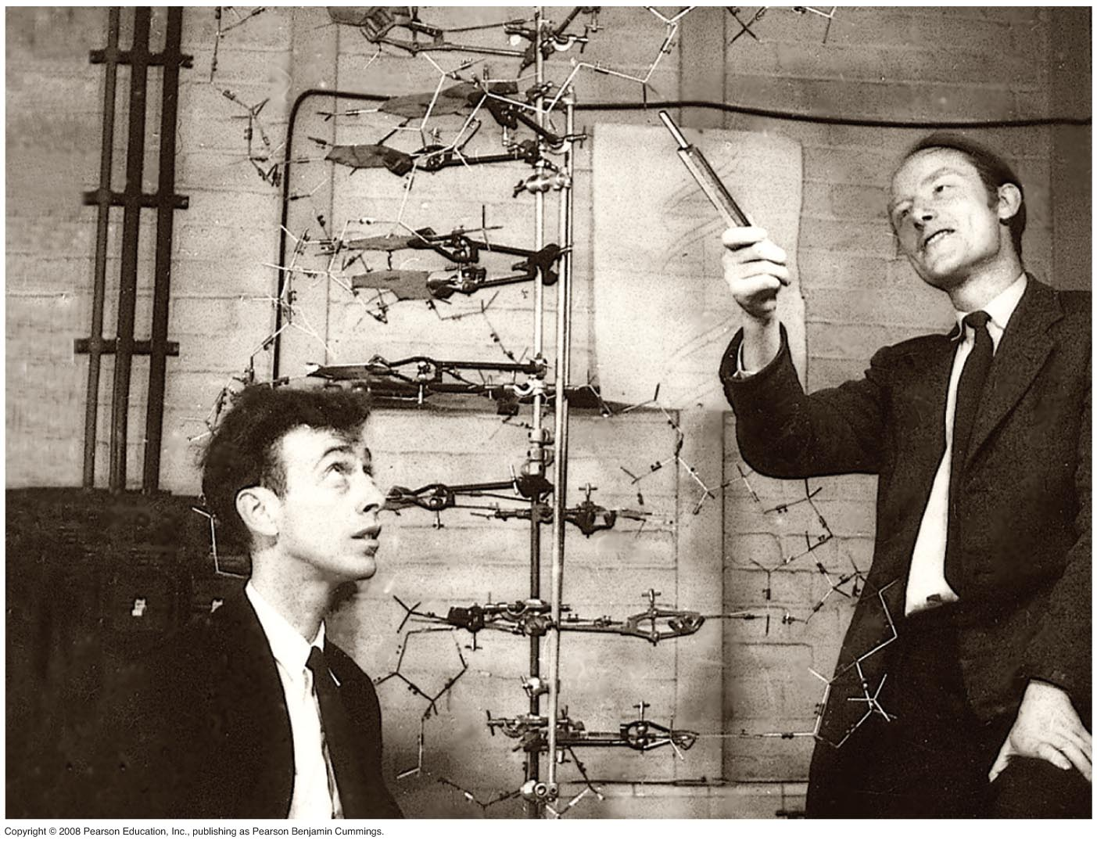
Watson and Crick put it all together
3-D structure of DNA = Double Helix
What they used to figure out the structure:
1. Basic components were
sugar,
phosphates
nitrogenous bases
Franklin’s X-ray crystallography photos
Chargaff’s Rule (to be discussed in a few slides)

Slide 30
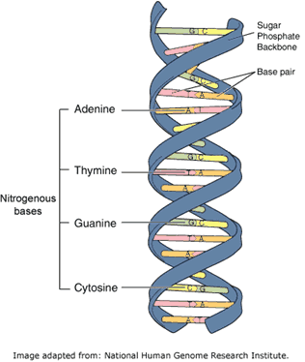
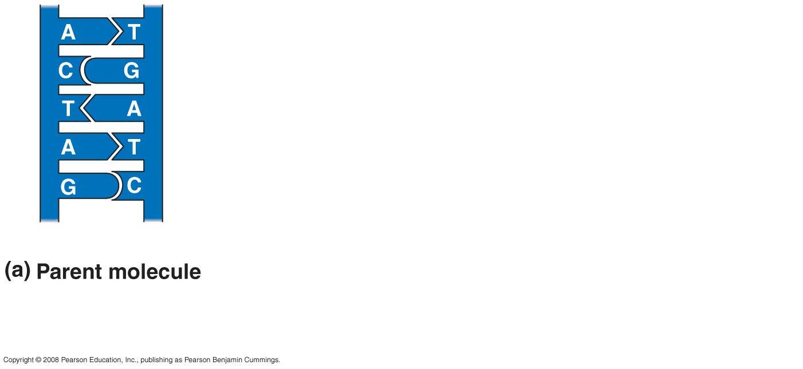
Watson and Crick and the double helix (twisted ladder)

Slide 31
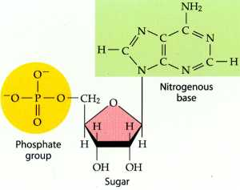
DNA is made up of repeating units called nucleotides
A nucleotide:
A nitrogenous base
  - organic
A sugar = deoxyribose
  - organic
Phosphate group
  - inorganic

Slide 32
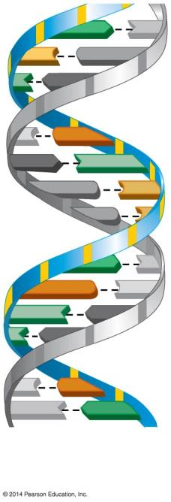
A
T
C
G
T
A
C
G
A
T
G
C
G
A
T
G
C
T
A
T
A
C
G
T
A
A DNA
double helix
Notes:
Figure 10.2a-1 The structure of a DNA polynucleotide (part 1)

Slide 33
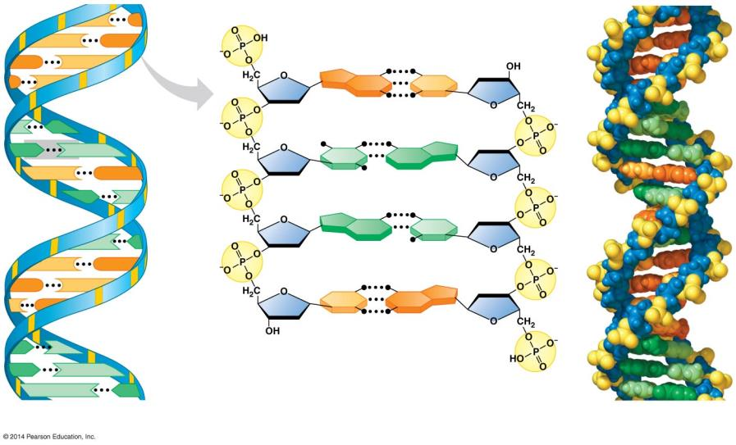
C
G
C
G
Hydrogen bond
G
C
G
C
G
C
Base pair
T
A
A
T
T
A
C
G
A
T
A
T
T
A
C
G
G
C
C
G
C
G
A
T
A
T
T
A
Ribbon model
Partial chemical structure
Computer model
Notes:
Figure 10.3d-0 Three representations of DNA

Slide 34
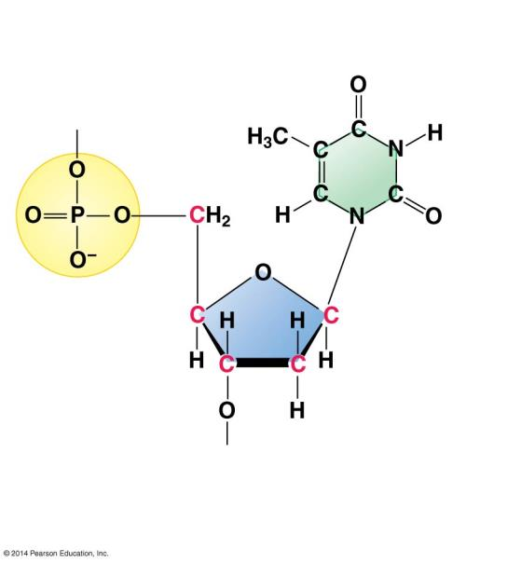
Nitrogenous base
(can be A, G, C, or T)
Thymine
(T)
Phosphate
group
Sugar
(deoxyribose)
DNA nucleotide
Notes:
Figure 10.2a-3 The structure of a DNA polynucleotide (part 3)

Slide 35
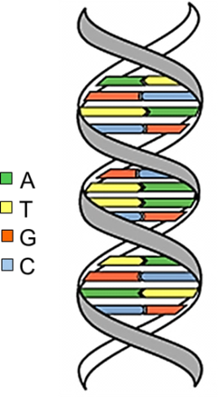
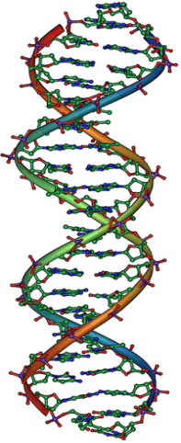
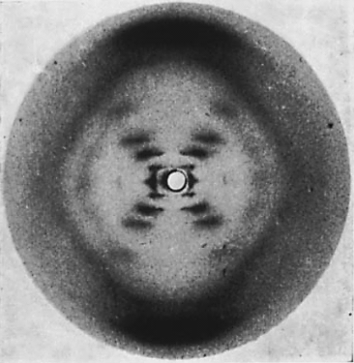
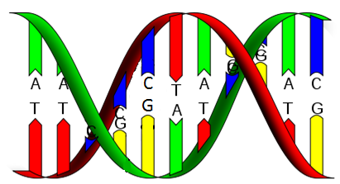
The Discovery of DNA
1860s: Friedrich Miescher identified DNA.
1940s: Erwin Chargaff created a rule for DNA bases.
  1952: Rosalind Franklin created a photo of DNA structure.
1953: James Watson and Francis Crick created an accurate model
of DNA.
Notes:
Timing ≈ 3 min
[animate] DNA was identified by Friedrich Miescher in 1860s. He identified DNA in the nucleus of white blood cells. Miesher was the first to extract and observe DNA.
[animate] In the 1940s, while studying the chemical composition of DNA, Erwin Chargaff, noticed a pattern in the amounts of the bases contained in DNA: adenine, guanine, cytosine, and thymine. After taking DNA from numerous cells he discovered that adenine levels were equal to thymine levels in the cells and guanine and cytosine levels were equal in the cells. Relate back to table students saw in the warm up and the reason the genetic code is considered universal. Thus he created a rule for the chemical composition of DNA: A=T and G=C.
[animate] Still, scientists wanted to know more about the makeup of DNA. Rosalind Franklin worked to create a DNA crystal so she could photograph the structure of DNA. In 1952, she succeeded. She placed the DNA through Xray and recorded its interference pattern. This type of photo is known as a diffraction photo. Her specific photo is famously known as Photo 51, seen here.
Please point out the DNA structure in the photo for students and explain the structure briefly so they can see what scientists observed: Photo 51 showed an x-shaped pattern angled to suggest that there were two strands in the structure. Franklin noted that DNA had two strands twisted into a double helix with a phosphate backbone and bases arranged inside.
Based on her observation, Franklin worked on creating an accurate model of DNA.
[animate] Using the photo created by Franklin, James Watson and Francis Crick correctly identified the structure of DNA and were able to create an accurate model, showing a double helix with rungs connecting the two strands.
At first, the two were unsure at first how to pair the bases together to create the double helix. They noticed if they did not pair the bases in a certain pattern that the helix model was wobbly and uneven. They recognized that if they paired adenine and thymine together and then paired guanine and cytosine together, the bases fit together on the DNA model and the structure was perfect, a double helix of base pairs together, bonded by hydrogen (the rung on the ladder). This also complimented Chargaff’s rule (A=T, G=C)
Once scientists figured out the structure of DNA, they knew that the sequence of bases adenine, guanine, cytosine and thymine coded for the synthesis of proteins, which are responsible for the structure and function of all living organisms. However, they did not know how this happened, or how many bases were used at a time in the code.
SOURCES:
DNA bases. “DNA UV mutation.gif,” David Herring (NASA). 2006 as PD, Digital Image. http://commons.wikimedia.org/wiki/File:DNA_UV_mutation.gif (accessed June 6, 2011).
DNA SNP. “Dna-SNP.svg,” David Hall. 2007 as CC-SA/GNU, Digital Image. http://commons.wikimedia.org/wiki/File:Dna-SNP.svg (accessed June 6, 2011).
Molecular configuration photo. “Photo 51,” from “Molecular Configuration in Sodium Thymonucleate”, Rosalind Franklin. R.G. Gosling, Nature, Vol. 171, April 25, 1953. (Permission to use image was obtained from the publisher. Must be attributed in citation format)

Slide 36
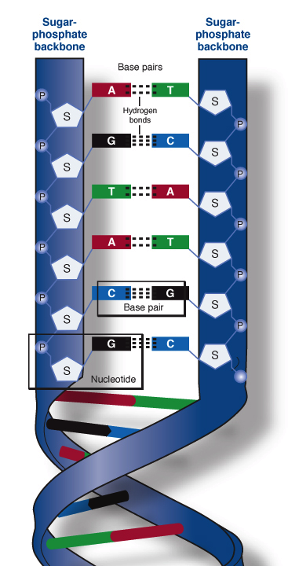
The Watson and Crick Model of DNA
A double helix looks like a ____________.
twisted ladder
Alternating sugar and phosphate groups connected by phosphodiester bonds.
The backbone:
Sugar
Phosphate groups
(Phosphodiester bonds)
Two nitrogen bases connected across the center of the helix by weak hydrogen bonds.
The Rungs:
Two nitrogen bases that pair together across the center of the helix.
Hydrogen Bonds (weak): join the bases together.

Slide 37
DNA is a Double-Stranded Helix
Watson and Crick realized that DNA consisted of two polynucleotide strands wrapped into a Double Helix.
  The sugar-phosphate backbone is on the outside.
  The nitrogenous bases are perpendicular to the backbone in the interior.
  Specific pairs of bases give the helix a uniform shape:
    A pairs with T, forming two hydrogen bonds
    G pairs with C, forming three hydrogen bonds

Slide 38
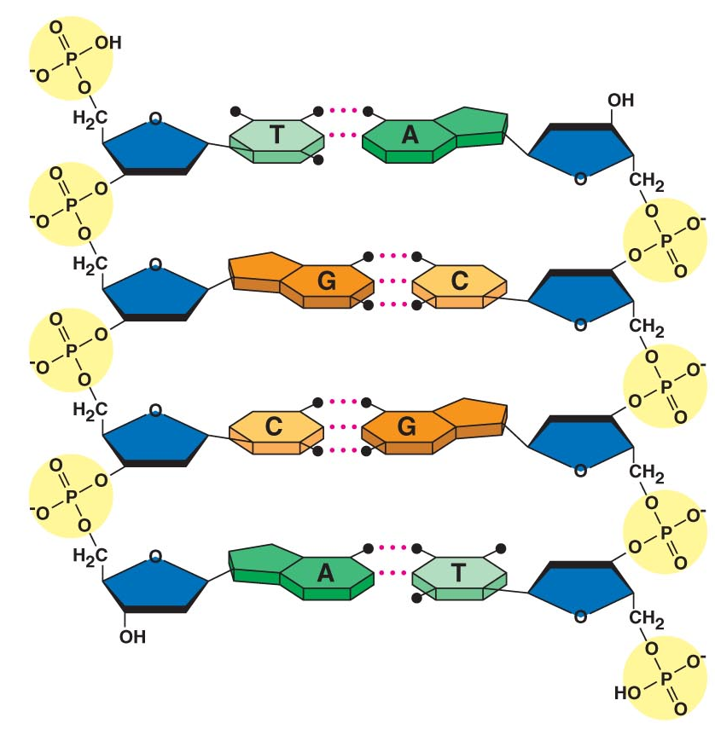
Structure of DNA … A Closer Look
Nitrogen Bases
Nitrogen Bases
Sugar / Phosphate
Backbone
Sugar Phosphate
backbone
Hydrogen Bonds
Hydrogen Bonds

Slide 39
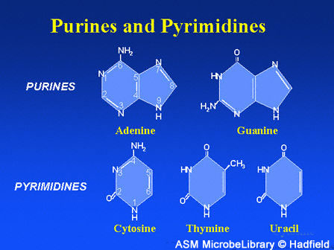
4 Nitrogenous Bases
Adenine
Guanine
Cytosine
Thymine
Two families of bases:
A & G are purines
C & T are pyrimidines

Slide 40
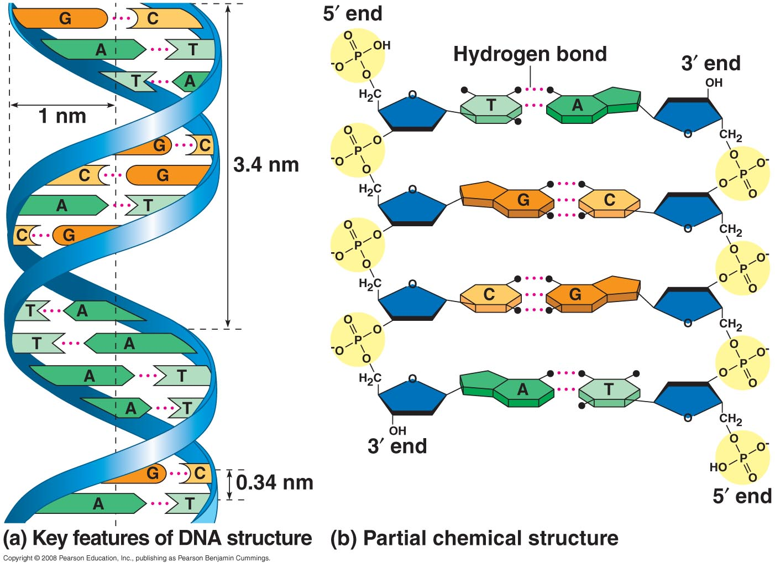
DNA Double Helix
Sugar-Phosphate ‘Backbone’
- Covalently bonded
Chargaff’s Rule:
# A = # T
#C ≡ # G
Complementary Base Pairs in DNA:
- Adenine always pairs with Thymine
- Cytosine always pairs with Guanine

Slide 41
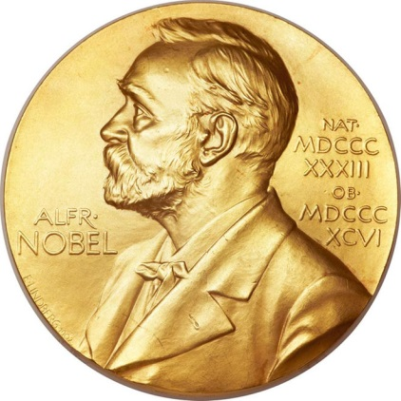
DNA is a Double-Stranded Helix
In 1962, the Nobel Prize in Physiology or Medicine was awarded to James D. Watson, Francis Crick, and Maurice Wilkins.
  Rosalind Franklin probably would have received the prize as well but for her death from cancer in 1958.
  Nobel Prizes are never awarded posthumously.

Slide 42
DNA is a Double-Stranded Helix
The Watson-Crick Model gave new meaning to the words genes and chromosomes. It showed:
  1) The structure of DNA.
  2) How DNA could carry genetic information and copy it.
The genetic information in a chromosome is encoded in the nucleotide sequence of DNA.

Slide 43
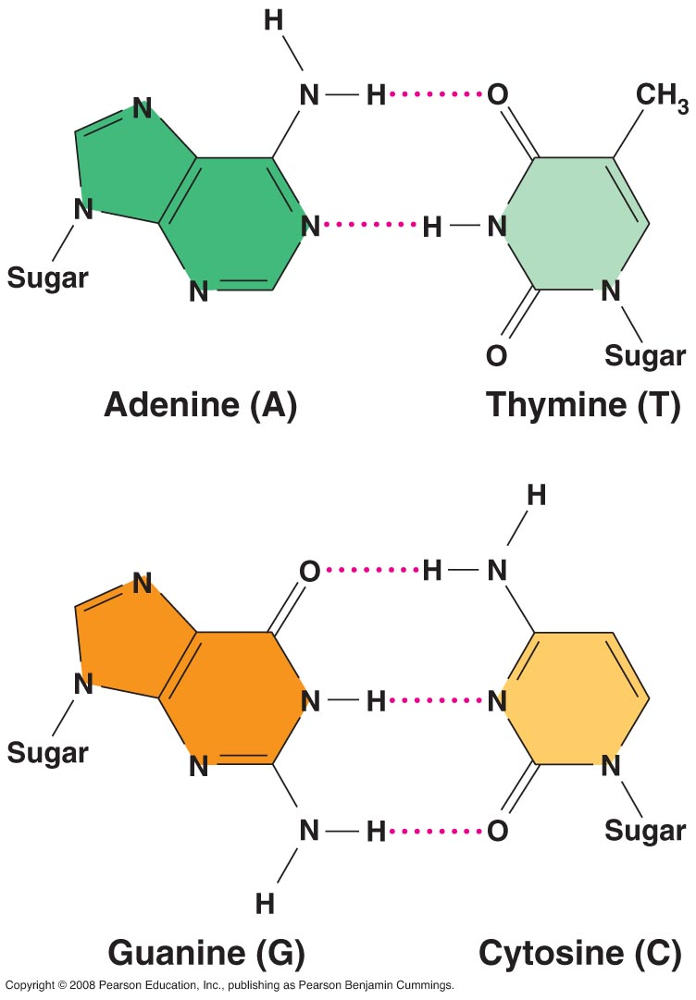
Complementary Pairs A-T, G-C
What type of bond holds the left side of the ladder to the right side?
Why is this important?
How many hydrogen bonds between each?

Slide 44
Complementary Pairs A=T, G≡C
What type of bond holds the left side of the ladder to the right side?
  Hydrogen bonds hold the rungs together
Why is this important?
  Easier to break than covalent bonds
How many hydrogen bonds between each?
A=T (2), C≡G (3)

Slide 45
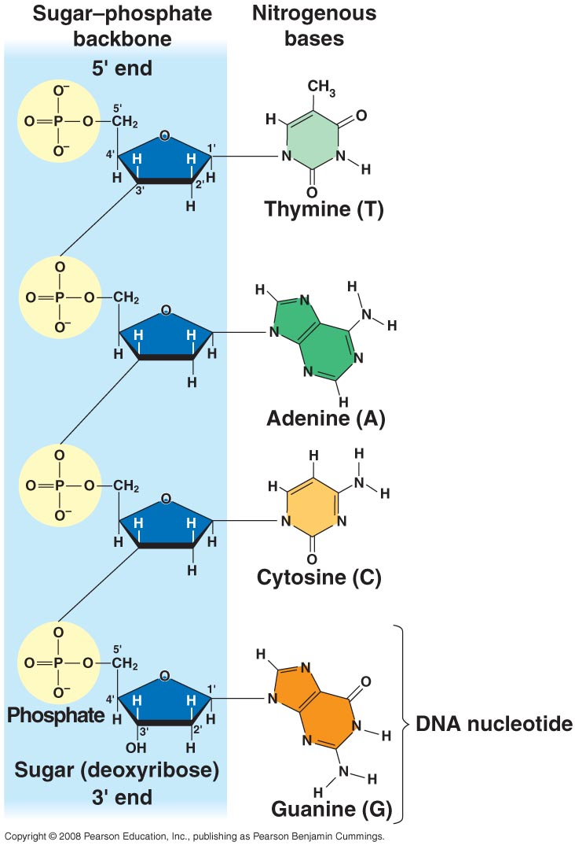
Nucleotides are the building blocks of DNA
How do you make the other side??
P
S - T
P
S - A
P
S - C
P
S - G
left side

Slide 46
Nucleotides are the building blocks of DNA
P
S – T =
P
S – A =
P
S – C ≡
P
S - G ≡
left side
P
A - S
P
T - S
P
G - S
P
C – S
right side

Slide 47
DNA Replication
When does this occur?
  - End of Interphase (S)
Why does this occur?
  - Need to make another copy of DNA for the new cell.
How does this occur?
  Semi-Conservative Replication
  Each copy contains one original strand and one newly-synthesized strand.

Slide 48
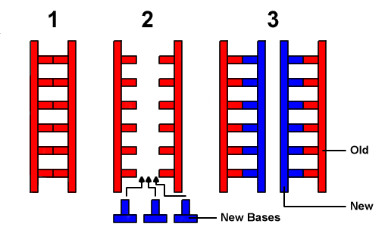
Steps Involved in DNA
Semi-Conservative Replication
Unwind helix
Unzip Helix
Replicate Helix
What tells the DNA to do this?
  - Enzymes

Slide 49
Step 1: Unwind

Slide 50
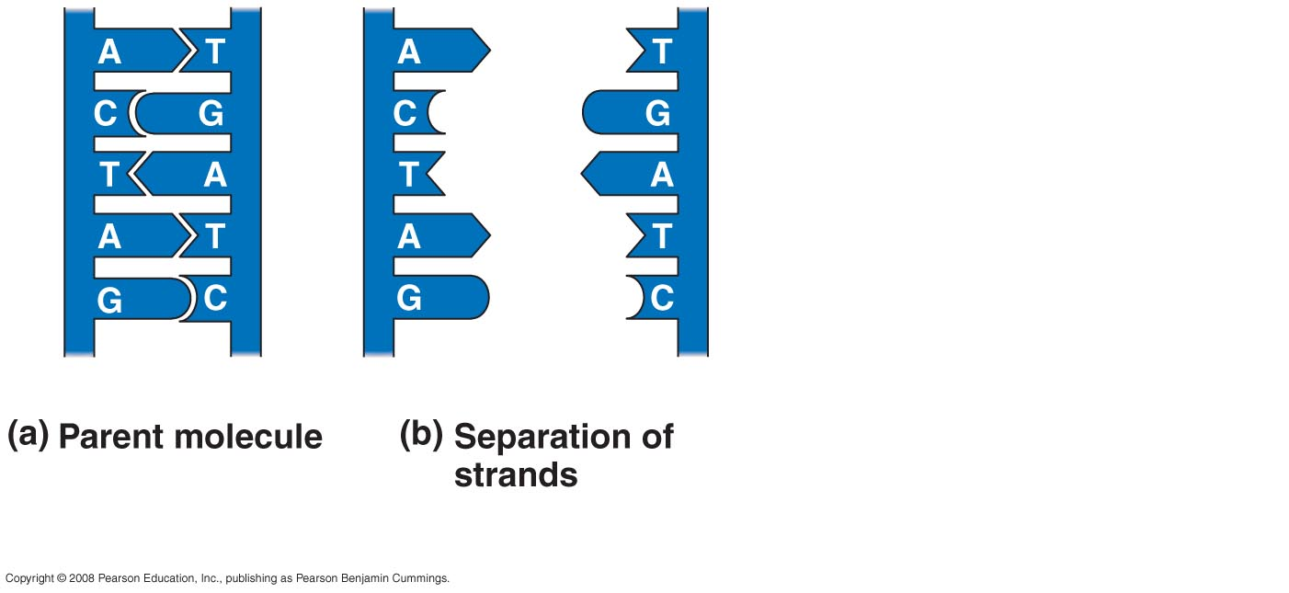
Step 2: Unzip
Old Left
Old Right

Slide 51
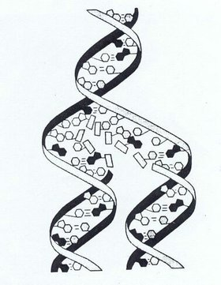
The DNA is unzipped and reconstructed into duplicate strands during the S phase of the cell cycle.
What does the S stand for and when does it occur?

Slide 52
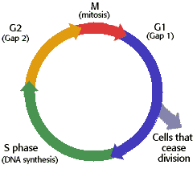
The DNA is unzipped and reconstructed into duplicate strands during the S phase of the cell cycle.
Interphase
“Synthesis”

Slide 53
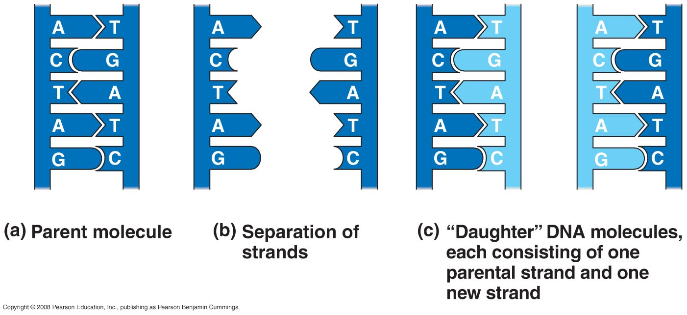
Step 3: Replicate
Old Left
New Right
New Left
Old Right
(Semi-conservative)

Slide 54
Step 3: Replicate
Old Left
New Right
New Left
Old Right
(Semi-conservative)

Slide 55
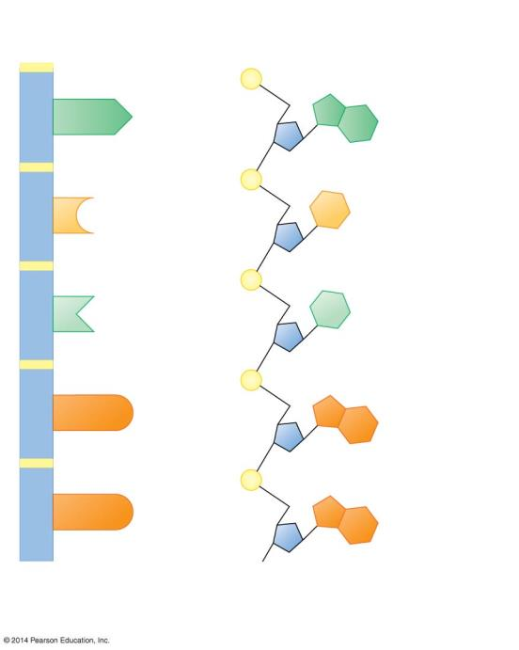
1
2
A
A
3
5
4
C
C
6
T
T
G
G
G
G
Two representations
of a DNA polynucleotide
Notes:
Figure 10.2a-2 The structure of a DNA polynucleotide (part 2)

Slide 56
Sugar-phosphate
backbone
Phosphate group
A
A
Nitrogenous base
Covalent
bond
joining
nucleotides
Sugar
C
C
DNA
nucleotide
T
T
G
G
G
G
Two representations
of a DNA polynucleotide
Notes:
Figure 10.2a-2 The structure of a DNA polynucleotide (part 2)

Slide 57
DNA and RNA are Polymers of Nucleotides
The full name for DNA is Deoxyribonucleic Acid, with nucleic referring to DNA’s location in the nuclei of eukaryotic cells.
RNA (ribonucleic acid) is unlike DNA in that it
  uses the sugar Ribose (instead of deoxyribose in DNA).
  has a nitrogenous base Uracil (U) instead of Thymine (T).

Slide 58
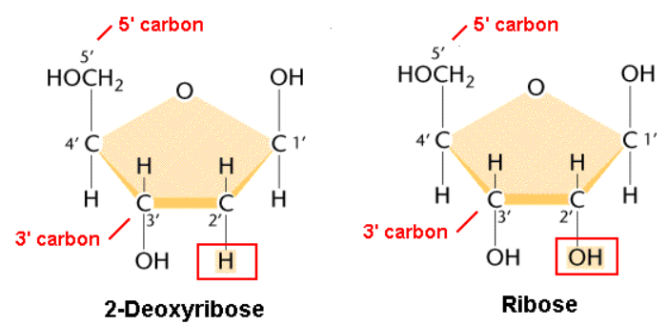
RNA Differs from DNA
1. Sugar
RNA’s sugar: Ribose
DNA’s sugar: Deoxyribose

Slide 59
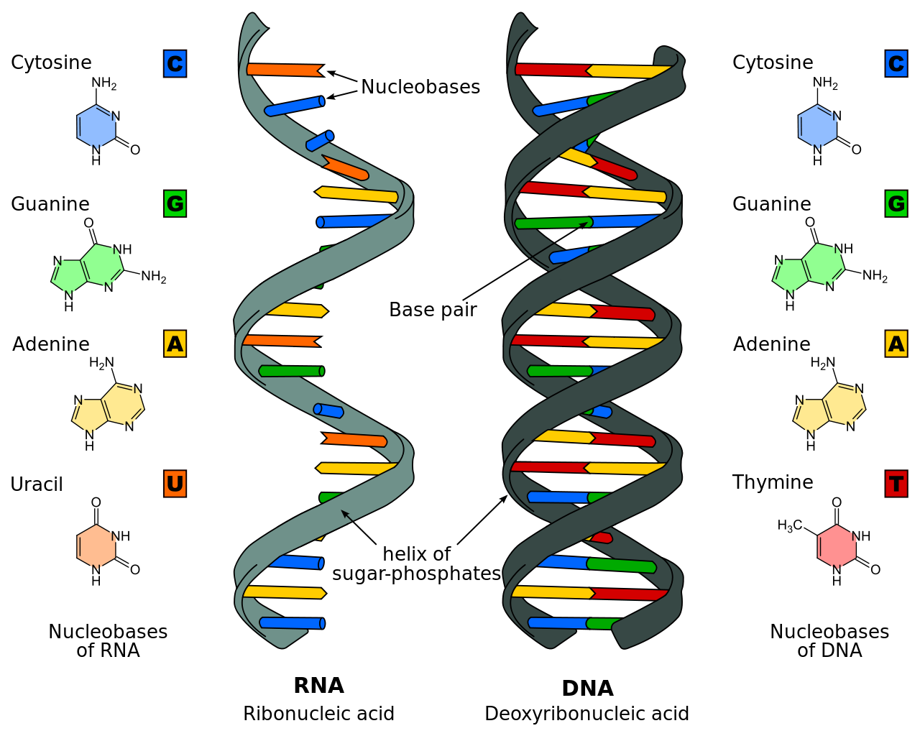
RNA Differs from DNA
2. Bases
RNA has Uracil (U)
DNA has Thymine (T)

Slide 60
RNA Differs from DNA
3. Structure
RNA is single-stranded
DNA is double-stranded

Slide 61
DNA and RNA are Polymers of ?
DNA and RNA are ? consisting of long chains (?) of monomers called ?.
Each of the #? strands of DNA is a DNA nucleotide polymer (chain).
A Nucleotide is composed of a
  ?
  ?
  ?
The nucleotides are joined to one another by a ? backbone

Slide 62
DNA and RNA are Polymers of Nucleotides
DNA and RNA are nucleic acids consisting of long chains (polymers) of monomers called Nucleotides.
Each of the two strands of DNA is a DNA nucleotide polymer (chain).
A Nucleotide is composed of a
  nitrogenous base
  five-carbon sugar
  phosphate group
The nucleotides are joined to one another by a Sugar-Phosphate backbone.

Slide 63
Genes control Phenotypic Traits through the Synthesis of Proteins
DNA specifies Traits by dictating Protein Synthesis.
Proteins are the links between genotype (genetic make up) and phenotype (appearance).
The molecular chain of command is from
  DNA in the nucleus to RNA.
  RNA in the cytoplasm to protein.

Slide 64
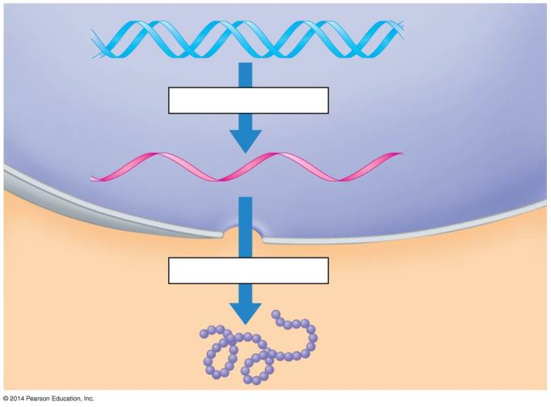
DNA
Transcription
RNA
NUCLEUS
CYTOPLASM
Translation
Protein
Notes:
Figure 10.6a-3 The flow of genetic information in a eukaryotic cell (step 3)

Slide 65
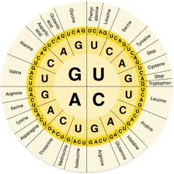
Gene Expression
The DNA molecule, with its four nitrogenous bases, is the code for all proteins that are made in a cell.
Genes make up a portion of the DNA strand. A gene is the coded DNA instructions that controls the production of specific proteins, such as enzymes, structural proteins, etc.

Slide 66
Gene Expression
Proteins are the link between
genes and traits of an organism.
The proteins that are made will determine the traits of the offspring.
Gene Expression:
The process by which DNA directs the synthesis of proteins.
The expression of genes includes two stages:
Transcription and Translation.

