Slide 1
Go to the “Slide Show” shade above
Click on “Play from Beginning”

Slide 2

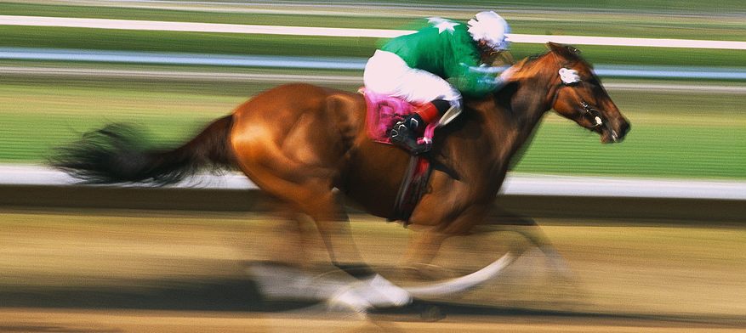
Organic Chemistry
Carbon Chemistry

Slide 3
Organics is Based on Carbon
http://somup.com/cY1FYPQTW9
Carbon: The Basis of Life,
Hydrocarbons & Fossil Fuels
(5:41)

Slide 4
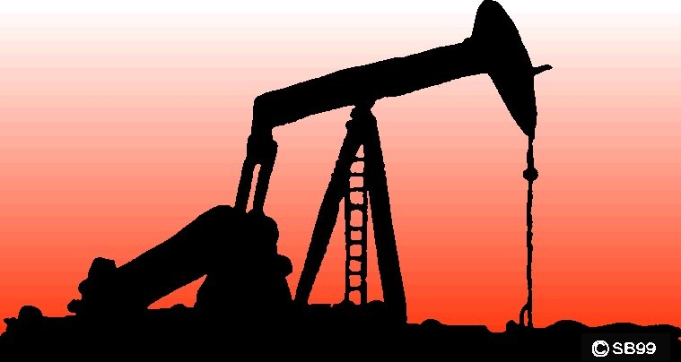
Origin of Organic Molecules
Naturally occurring organic molecules are found in PLANTS, animals, and fossil fuels

Slide 5
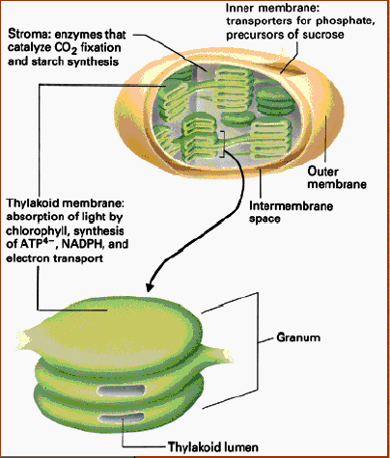
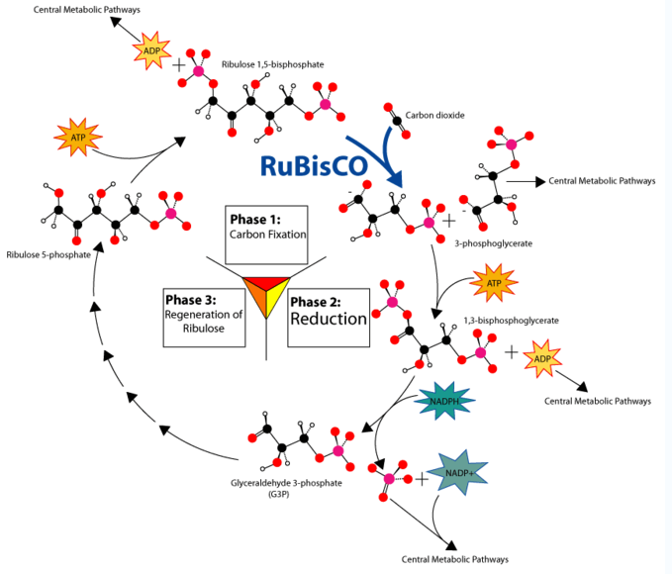
Origin of Organic Molecules
PLANTS take carbon dioxide from the atmosphere to produce most of the chemicals and molecules that comprise life:
Carbon gets “fixed”
into molecules to produce:
carbohydrates, proteins, fats, oils, nucleic acids, fatty acids, vitamins

Slide 6
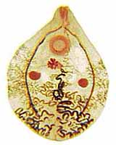
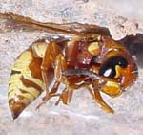
Origin of Organic Molecules
Animals are composed of organic molecules (carbon based life forms) … mainly proteins

Slide 7
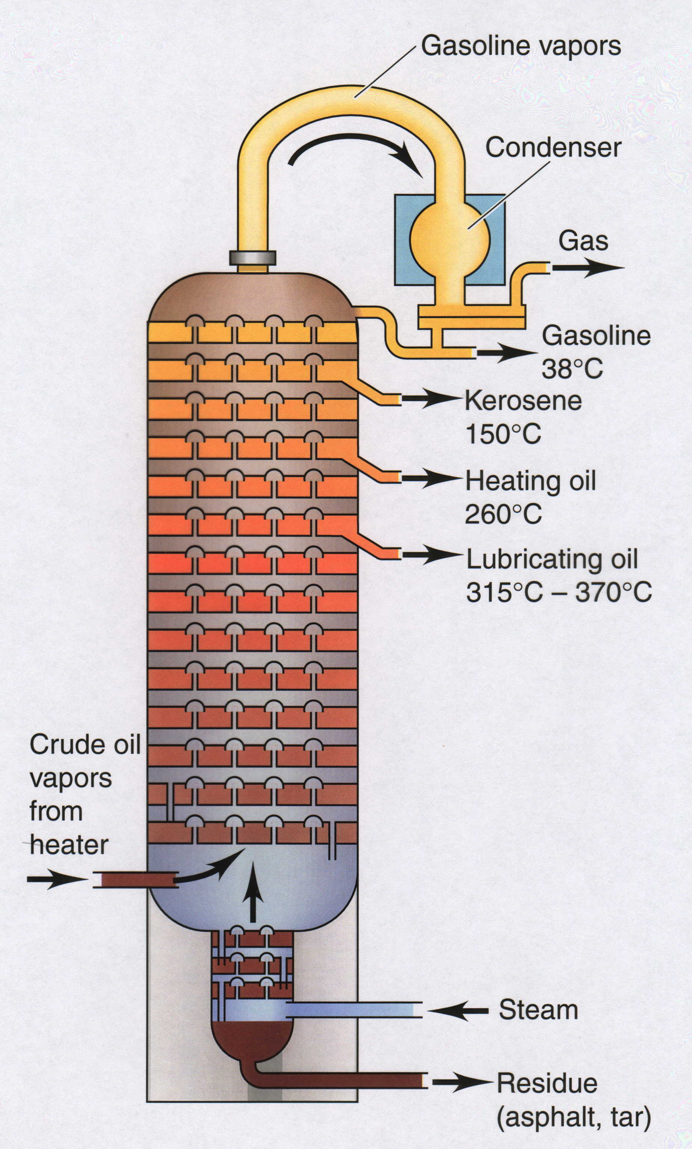
Origin of Organic Molecules
Fossil Fuels include coal, natural gas, petroleum (oil, diesel, etc.)
Synthetic organic molecules are derived from fossil fuels or plant material

Slide 8
So what’s a “Fossil Fuel?”
Plants and animals die and are buried for many years under high temperature and pressure, produces fossil fuels.
The type of fossil fuel depends on the origin of the organic (formerly alive) material and the conditions of temperature and pressure under which they decay.

Slide 9
How do we use “Fossil Fuels?”
Fossil fuels are burned in combustion reactions.
CH + O₂ → CO₂ + H₂0
Hydrocarbon + Oxygen → Carbon Dioxide + Water
Burning fossil fuels gives off pollutants and damages the environment.

Slide 10
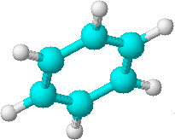
Carbon is the BACKBONE
the
center
of
all
organic molecules

Slide 11
Carbon forms four bonds
Carbon usually forms FOUR strong covalent bonds, with other elements
Notice that around each “carbon” atom are FOUR dashes
(each representing 1 bond of 2 electrons)

Slide 12
Carbon forms four bonds
The FOUR bonds to the carbon atom can be represented in many ways …

Slide 13
Organic Molecules Can be Divided into GROUPS
The largest group of Organic Molecules are the “HYDROCARBONS”
The second largest group of Organic Molecules contain OXYGEN
Other groups contain NITROGEN and / or PHOSPHORUS and / or SULFUR

Slide 14
Organic Molecules Can be Divided into GROUPS
We will focus on the “HYDROCARBONS”
And the Organic Molecules containing OXYGEN

Slide 15
Hydrocarbons
are the simplest and most abundant class of organic compounds
• consist entirely and ONLY of carbon and hydrogen
Copyright 2007 Pearson Benjamin Cummings. All rights reserved.

Slide 16
There are FOUR types of Hydrocarbons:
1. Alkanes — contain only carbon-hydrogen and carbon-carbon SINGLE COVALENT bonds
2. Alkenes — contain at least one carbon-carbon DOUBLE COVALENT bond
3. Alkynes — contain a least one carbon-carbon TRIPLE COVALENT bond
4. Aromatics — contain RING of SIX carbon atoms that can be drawn with alternating single and double bonds
Copyright 2007 Pearson Benjamin Cummings. All rights reserved.

Slide 17
Hydrocarbons
Alkanes
C C
Alkenes
C C
Alkynes
C C
Aromatics

Slide 18
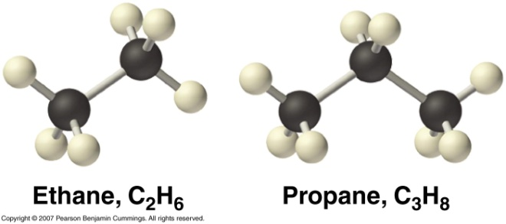
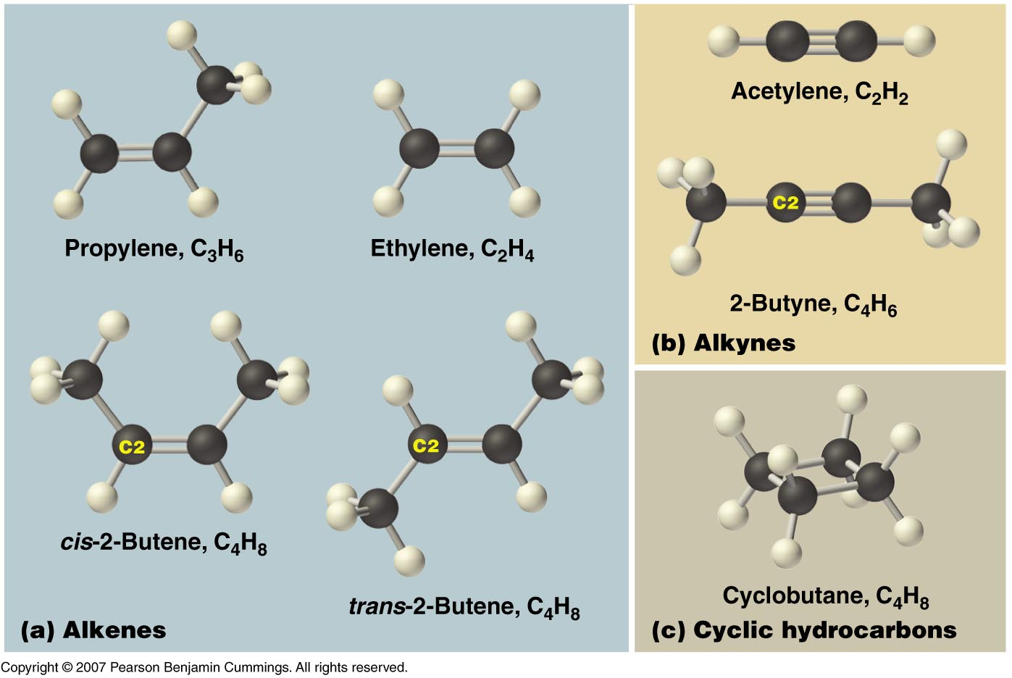

Slide 19
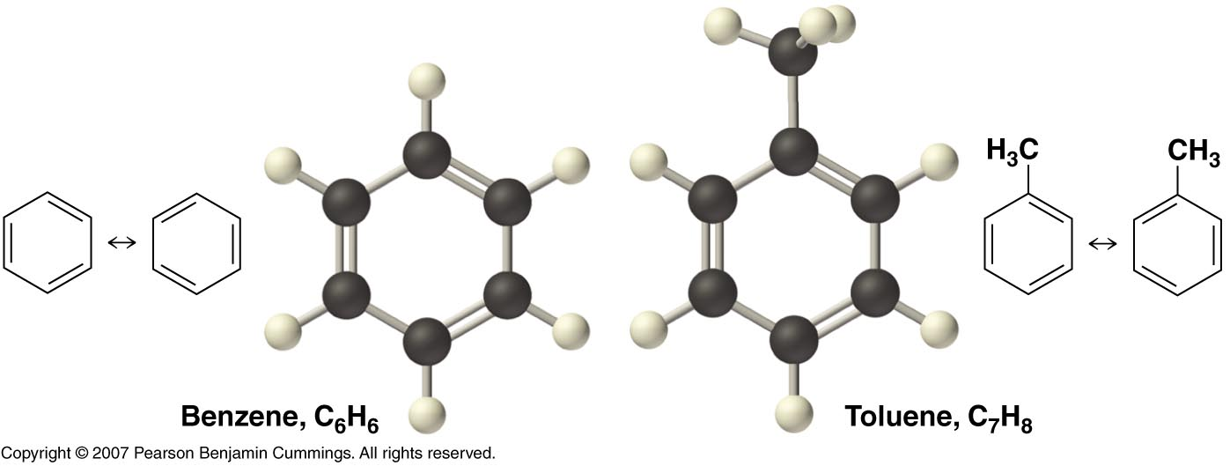
Aromatic Hydrocarbons
Copyright © 2007 Pearson Benjamin Cummings. All rights reserved.

Slide 20
We use Latin Prefixes to describe them
Naming Hydrocarbons (nomenclature)

Slide 21
Mnemonic for first four prefixes
First four prefixes
Meth-
Eth-
Prop-
But-
  Monkeys
  Eat
  Peeled
  Bananas

Slide 22
Other prefixes
Pent-
Oct-
?
Hex-, Hept-, Non-
Decade
Decimal
Decathalon
Dec-

Slide 23
Names of Linear Alkanes
# of
C atoms
Alkane
1
2
3
4
5
6
7
8
9
10
CH₄
CH₃CH₃
CH₃CH₂CH₃
CH₃CH₂CH₂CH₃
methane
ethane
propane
butane
pentane
hexane
heptane
octane
nonane
decane
Notes:
23

Slide 24
Names of Alkyl Substituents
# of
C atoms
Alkyl substituents
Alkane
1
2
3
CH₄
CH₃CH₃
CH₃CH₂CH₃
CH₃CH₂CH₂CH₃
methane
ethane
propane
butane
-CH₃
-CH₂CH₃
-CH₂CH₂CH₃
-CH3CH2CH2CH3
methyl
ethyl
Propyl
Butyl
Alkyl Groups:
The alkane groups are used as “BRANCHES” in other hydrocarbons.
Notes:
24

Slide 25
Names of Alkyl Substituents
# of
C atoms
Alkyl substituents
Alkane
1
2
3
CH₄
CH₃CH₃
CH₃CH₂CH₃
CH₃CH₂CH₂CH₃
methane
ethane
propane
butane
-CH₃
-CH₂CH₃
-CH₂CH₂CH₃
-CH3CH2CH2CH3
methyl
ethyl
Propyl
Butyl
METHYL Alcohol → contains 1 carbon
ETHYL Alcohol → contains 2 carbons
PROPYL Alcohol → contains 3 carbons
BUTYL Alcohol → contains 4 carbons
Notes:
25

Slide 26
Where R is an alkyl group of any other C atom or arrangement of C atoms for the rest of the organic molecule
H
H
H
H
C
H
H
C
C
H
H
H
H
Methane
CH₄
Ethane
C₂H₆
H
H
H
?
R
C
H
R
?
C
C
H
H
H
H
Methyl group
-CH₃
Ethyl group
-C₂H₅
Notes:
26

Slide 27
H
H
H
H
Where R is an alkyl group of any other C atom or arrangement of C atoms for the rest of the organic molecule
H
H
H
H
C
C
C
H
H
C
C
C
C
H
H
H
H
H
H
H
H
Propane
C₃H₈
Butane
C₄H₁₀
H
H
H
H
H
H
H
?
C
C
C
H
R
R
?
C
C
C
C
H
H
H
H
H
H
H
H
Propyl group
-C₃H₇
Butyl group
-C₄H₉
Notes:
27

Slide 28
There are specialized groups that bonds with hydrocarbons
We call these FUNCTIONAL groups.
“Alkyl” groups are one kind of functional group
But there are many other specialized groups

Slide 29
Organic Chemistry:
Functional Groups

Slide 30
Functional groups
Functional groups are parts of organic molecules that result in characteristic features:
Properties such as melting point, boiling point, solubility change due to functional groups
About 100 functional groups exist, we will focus on a few more (besides “alkyl” groups)

Slide 31
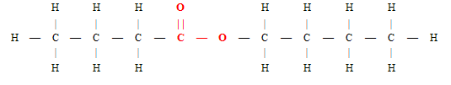
EXAMPLES of “functional Groups” are:
ester

Slide 32
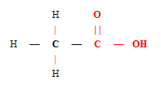
EXAMPLES of “functional Groups” are:
Carboxylic acid

Slide 33
EXAMPLES of “functional Groups” are:
aldehyde

Slide 34
EXAMPLES of “functional Groups” are:
ketone

Slide 35
EXAMPLES of “functional Groups” are:
ether

Slide 36
EXAMPLES of “functional Groups” are:
alcohols

Slide 37
EXAMPLES of “functional Groups” are:
ester
Carboxylic acid
aldehyde
ketone
ether
alcohols

Slide 38
Hydroxyl, Carbonyl, Carboxyl
Probably the most common
functional groups:
“Hydroxyl” refers to –OH
“Carbonyl” refers to C=O
“Carboxyl” refers to COOH
For more lessons, visit www.chalkbored.com

Slide 39
Hydroxyl, carbonyl, carboxyl
Which organic molecules contain a hydroxyl group?
A: alcohols, carboxylic acids
Carboxylic acid
alcohols
For more lessons, visit www.chalkbored.com

Slide 40
Hydroxyl, carbonyl, carboxyl
Which organic molecules contain a carbonyl group?
aldehydes, ketones, carboxylic acids, esters
ester
ketone
aldehyde
Carboxylic acid
For more lessons, visit www.chalkbored.com

Slide 41
Hydroxyl, carbonyl, carboxyl
Which organic molecules contain a carboxyl group?
A: carboxylic acids
Carboxylic acid
For more lessons, visit www.chalkbored.com

Slide 42
Isomers
C₆H₁₂O₆
is a molecular formula for
THREE
different organic compounds
Notes:
42

Slide 43
Isomers
C₆H₁₂O₆
Can be glucose (blood sugar)
Can be fructose (fruit sugar)
Can be galactose (milk sugar)
So how can we tell which is which?
Notes:
43

Slide 44
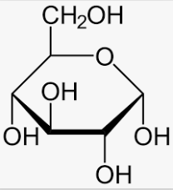
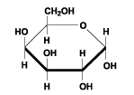
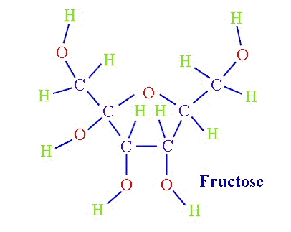
Isomers
C₆H₁₂O₆
C₆H₁₂O₆
Notice the different STRUCTURAL formulas
C₆H₁₂O₆
galactose
Notes:
44

Slide 45
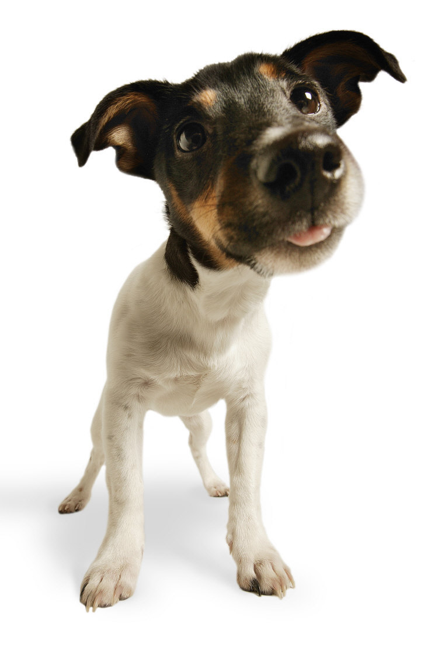
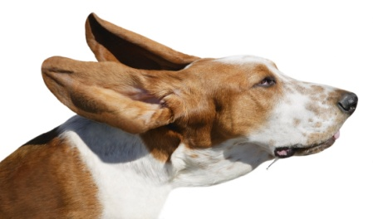
Isomers
“Iso” means similarity
“Mer” means unit
Notice that we could call each
of the animals above a “dog”
Notes:
45

Slide 46
Isomers
Yet, each is clearly unique
and can be classified differently
How would we tell them apart?
Notes:
46

Slide 47
Isomers
Let’s assume we make a statement using common words.
LIKE
The fat dog shook himself,
and then rolled over on the wet rug.
Is it possible to reuse these exact same words, yet say something completely different?
Notes:
47

Slide 48

Isomers
The fat dog shook himself,
and then rolled over on the wet rug.
Could be rearranged to say:
The dog shook the fat rug,
then rolled over and wet on himself.
Notes:
48

Slide 49
Isomers
The fat dog shook himself,
and then rolled over on the wet rug.
OR
The dog shook the fat rug,
then rolled over and wet on himself.
These two statements use the same words...
but have very different meanings!
Likewise, ISOMERS may have the same formula, but have very different STRUCTURES…
Notes:
49

Slide 50
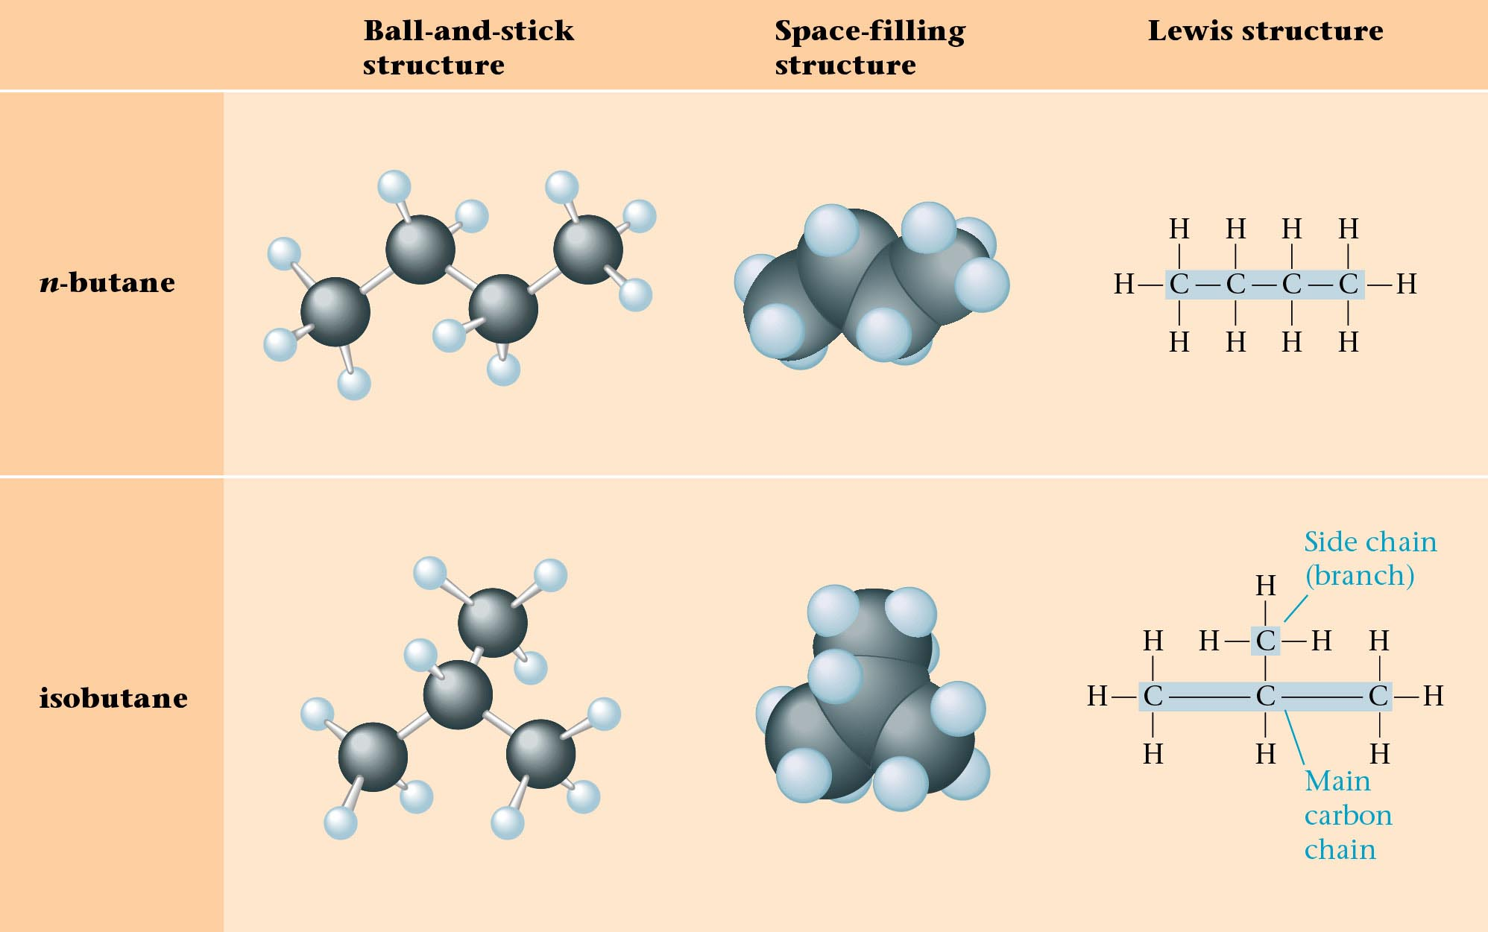
Structural Isomers of C₄H₁₀
Butane contains 4 Carbon Atoms
Can the atoms of Butane be rearranged to form another molecule?
Notes:
50

Slide 51
Structural Isomers of C₄H₁₀
2-methylpropane
or
Notes:
51

Slide 52

Structural Isomer Practice
  Pentane
Molecular Formula
C₅H₁₂
Structural Formula
Notes:
52

Slide 53

Structural Isomer Practice
  ISOMER of Pentane
Molecular Formula
C₅H₁₂
Structural Formula
Methyl Butane
Notes:
53

Slide 54
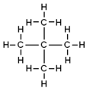
Structural Isomer Practice
  ISOMER of Pentane
Molecular Formula
C₅H₁₂
Structural Formula
DiMethyl Propane
Notes:
54

Slide 55
Structural Isomer Practice
Formulas
# isomers
  Pentane
C₅H₁₂
3
Pentane
Methyl Butane
DiMethyl Propane
Notes:
55

Slide 56
Structural Isomer Practice
Let’s practice making some isomers.
On a piece of paper, draw ALL of the isomers for the following alkanes:
Formulas
  Pentane
  Hexane
  Heptane
C₅H₁₂
C₆H₁₄
C₇H₁₆
Determine the # of isomers
Notes:
56

Slide 57
Structural Isomer Practice
Formulas
# isomers
  Pentane
  Hexane
  Heptane
C₅H₁₂
C₆H₁₄
C₇H₁₆
3
5
9
Check to see if you determined the right amount of isomers for the “alkanes” above
Notes:
57

Slide 58
Structural Isomers
C₄H₈
1-butene 2-butene
2-methylpropene cyclobutane methylcyclopropane

