Slide 1
Click on “Slide Show”
Click “Play from Beginning”

Slide 2



Chapter 8
Covalent Bonding
Polar Bonds and Molecules
Molecular Compounds
The Nature of Covalent Bonding
Bonding Theories

Slide 3
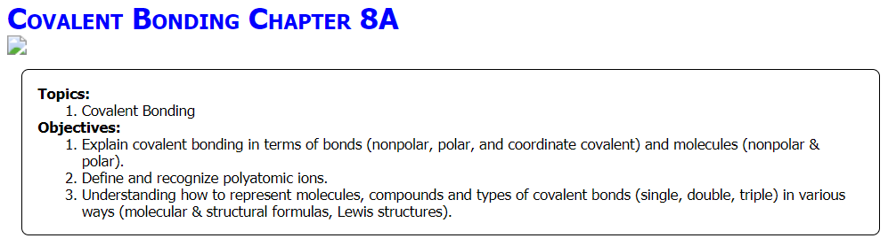

Slide 4
Identify Electrons Available for Bonding
For each of the following elements, identify: (1) the “A” Group, (2) the number of valence electrons available for bonding, and (3) how the atom would behave according to the Octet Rule (gain/lose e-, how many e-?), (4) cation or anion? Use your Periodic Table.
  C
  H
  N
  Al
  Ne
  O
  P
  Cl
  Mg
Notes:
Timing ≈ 1 min [provide popup periodic table]
Entry Audio: The valence electrons in an atom are used for bonding. The first step in thinking about bonding is to determine the number of valence electrons in the atoms involved in a bond.
Hint 1 audio: Recall that you can determine the number of valence electrons in an atom of a particular element from the position of that element on the periodic table.
Hint 2 audio: For elements in the first three periods of the periodic table, the number of valence electrons begins at one on the far left and increases up to a maximum of eight in the noble gases found at the far right of the table.
Exit Audio: The number of valence electrons in an atom corresponds to its position on the periodic table. You will be using the number of valence electrons to construct pencil-and-paper models of covalent bonds between atoms.
[Note: answers would not fit on the notes pane, so I’m putting answers here:
DD2: *one, two, three, four, five, six, seven, eight
DD3: one, two, three, four, *five, six, seven, eight
DD4: one, two, three, four, five, *six, seven, eight
DD5: one, two, three, four, *five, six, seven, eight
DD6: one, two, three, four, five, six, *seven, eight]

Slide 5
Identify Electrons Available for Bonding
For each of the following elements, identify: (1) the “A” Group, (2) the number of valence electrons available for bonding, and (3) how the atom would behave according to the Octet Rule (gain/lose e-, how many e-?), (4) cation or anion? Use your Periodic Table.
  C … IVA, 4 e-, gain or lose 4 e-, ±4
  H⁺ … IA, 1 e-, lose 1 e-, +1 cation
  N⁻³ … VA, 5 e-, gain 3 e-, -3 anion
  Al⁺³ … IIIA, 3 e-, lose 3 e-, +3 cation
  Ne⁰ … VIIIA, 8 e-, no bond, 0
  O⁻² … VIA, 6 e-, gain 2 e-, -2 anion
  P⁻³ … VA, 5 e-, gain 3 e-, -3 anion
  Cl⁻¹ … VIIA, 7 e-, gain 1 e-, -1 anion
  Mg⁺² … IIA, 2 e-, lose 2 e-, +2 cation
Notes:
Timing ≈ 1 min [provide popup periodic table]
Entry Audio: The valence electrons in an atom are used for bonding. The first step in thinking about bonding is to determine the number of valence electrons in the atoms involved in a bond.
Hint 1 audio: Recall that you can determine the number of valence electrons in an atom of a particular element from the position of that element on the periodic table.
Hint 2 audio: For elements in the first three periods of the periodic table, the number of valence electrons begins at one on the far left and increases up to a maximum of eight in the noble gases found at the far right of the table.
Exit Audio: The number of valence electrons in an atom corresponds to its position on the periodic table. You will be using the number of valence electrons to construct pencil-and-paper models of covalent bonds between atoms.
[Note: answers would not fit on the notes pane, so I’m putting answers here:
DD2: *one, two, three, four, five, six, seven, eight
DD3: one, two, three, four, *five, six, seven, eight
DD4: one, two, three, four, five, *six, seven, eight
DD5: one, two, three, four, *five, six, seven, eight
DD6: one, two, three, four, five, six, *seven, eight]

Slide 6
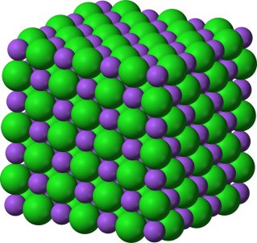
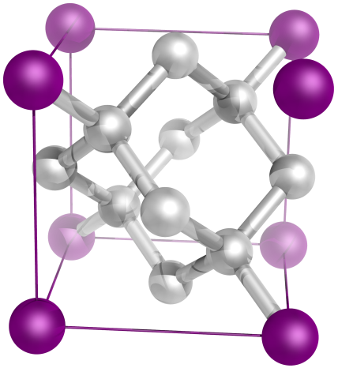
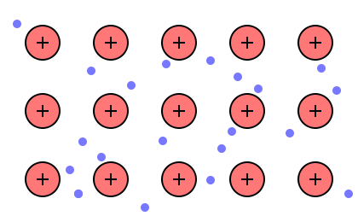
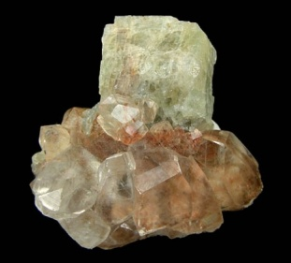


There are three main ways that elements can come together to form bonds.
Ionic
Covalent
Metallic
Notes:
#frame
Anchor Video
Timing ≈ 0.5 min
Recap: You've now learned about the three main types of bonds: ionic bonds, covalent bonds, and metallic bonds.
Connect: Each type of bond forms in a different way, and different types of atoms tend to form specific kinds of bonds.
Preview: Next, we will learn about how ionic and covalent bonds form.
SOURCES:
”Sodium-chloride-3D,” Ben Mills. 2010 as PD, Digital Image. http://commons.wikimedia.org/wiki/File:Sodium-chloride-3D-ionic.png (accessed August 3, 2012).
“Diamond crystal structure consists of a face centered cubic lattice, each edge measures 3.6 Å.,” Yassine Mrabet. 2009 as PD, Digital Image. http://commons.wikimedia.org/wiki/File:Carbon_lattice_diamond.png (accessed August 3, 2012).

Slide 7
Bonding & END
Electrons may be transferred or shared between atoms
Ionic compounds are formed when electrons are transferred (lost or gained) between atoms
Covalent molecules are formed when electrons are shared (equally or unequally) between atoms
Bonding type between atoms depends upon electronegativity differences (END) → electron attracting power
If the END is < 1.7 expect covalent bonds (e- sharing) between atoms
If the END is > 1.7 expect ionic bonds (e- transfer)

Slide 8
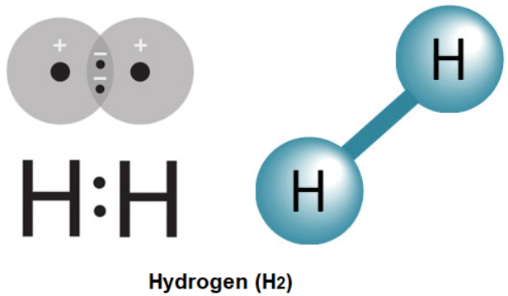
Bonding & END
In real life, bonds usually possess both
IONIC character (END > 1.7)
and COVALENT character (END < 1.7)
END → | 0 | 0.94 | 1.67 | 2.54 | 3.30
% ionic | 0 % | 20 % | 50 % | 80% | 90 %
% covalent | 100% | 80% | 50 % | 20 % | 10 %
Examples | H₂ O₂ F₂ Br₂ I₂ N₂ Cl₂ _{Non-polar Organic Molecules} | Al₂ Se₃ | CaS | Al F₃ | FrF CsF

Slide 9
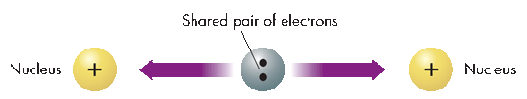

Covalent Bonds
4 Polar Bonds & Molecules
A covalent bond is formed when two or more atoms SHARE electrons [END < 1.7] ... but we need to focus on HOW the electrons are shared.
There are three types
of covalent bonds:
Non-polar covalent
Polar covalent
Coordinate covalent

Slide 10
  Covalent Bonds (Polar & Non-Polar) Notes (5:53)
https://screencast-o-matic.com/watch/cF6nINY67j
Recap Notes (4:13) using Molecular Models
https://screencast-o-matic.com/watch/cF6hDuYoAV

Slide 11


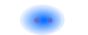
Non-Polar Covalent Bonds
4 Polar Bonds & Molecules
Non-Polar bonds mean that Electrons are shared EQUALLY between atoms of EQUAL electronegativity
Electron configuration of F₂
Electron dot diagram of F₂
Symbol of bond F–F
END 4.0 – 4.0 = 0
Electron cloud graphic →

Slide 12

Polar Bonds
4 Polar Bonds & Molecules
Polar Covalent Bonds [END > 0 < 1.7]
When electrons are shared UNEQUALLY between atoms of unequal electronegativity
δ+ δ–
H—Cl

Slide 13


Polar Bonds
4 Polar Bonds & Molecules
Polar Covalent Bonds [END > 0 < 1.7]
When electrons are shared UNEQUALLY between atoms of unequal electronegativity
Formation of HCl [END 1.0]
Chlorine [3.2] – Hydrogen [2.2] electronegativities
The chlorine atom [higher electronegativity] acquires a partial negative charge, pulling the electrons closer to its nucleus.
The hydrogen atom acquires a slightly positive charge.
δ+ δ–
H—Cl

Slide 14
Bond Polarity
4 Polar Bonds & Molecules
There is no sharp boundary between ionic and covalent bonds.
As the electronegativity difference between two atoms increases, the polarity of the bond increases, meaning the electrons are pulled more strongly to the more electronegative atom.
Electronegativity Differences and Bond Types
Electronegativity difference range | Most probable type of bond | Example
0.0 – 0.4 | Nonpolar covalent | H—H (0.0)
0.4 – 1.0 | Moderately polar covalent | δ+ δ– H—Cl (1.0)
1.0 – 1.7 | Very polar covalent; 50% ionic | δ+ δ– H—F (1.8) [borderline]
> 1.7 – 3.3 | Ionic (electrostatic attraction) | Na⁺Cl– (2.1)

Slide 15
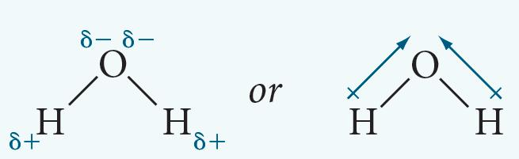
Bond Polarity
4 Polar Bonds & Molecules
Based on the electronegativity difference, determine the bond type. Use the Reference Table.
N – H
F – F
Ca⁺² Cl⁻¹
Al – Cl

Slide 16
Bond Polarity
4 Polar Bonds & Molecules
Based on the electronegativity difference, determine the bond type.
N(3.1), H(2.2); 0.9; moderately polar covalent
F(4.0), F(4.0); 0.0; nonpolar covalent
Ca⁺²(1.0), Cl⁻¹(3.2); 2.2; ionic
Al(1.5), Cl(3.2); 1.7; strongly polar covalent/ionic
O(3.5), H(2.2); 1.3; moderately polar covalent
Na₂SO₄ ??

Slide 17

2 Nature of Covalent Bonding
Coordinate Covalent Bonds
Coordinate Covalent Bonds form when the electrons being shared between two atoms are both donated by the same atom.
[e.g. similar to borrowing/renting books or videos ... the books are given to you and you treat them essentially as if they belonged to you; yet at the same time the books are counted as being part of the library collection or rental store.]

Slide 18
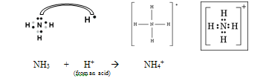
2 Nature of Covalent Bonding
Coordinate Covalent Bonds
Coordinate Covalent Bonds form when the electrons being shared between two atoms are both donated by the same atom.
Coordinate covalent bonds occur when the donating atom has an unbonded electron pair in its valence

Slide 19
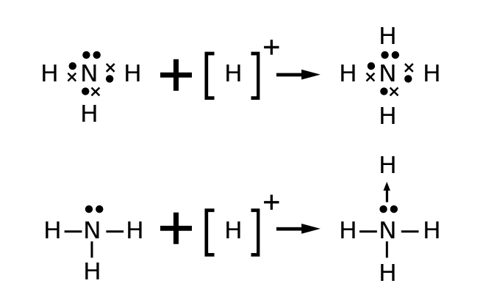
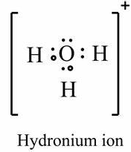
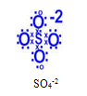
2 Nature of Covalent Bonding
Coordinate Covalent Bonds
Once coordinate covalent bonds are formed, they are no different than ordinary covalent bonds
Polyatomic Ions often have coordinate covalent bonds as well as covalent bonds.
They are composed of many atoms, but act as ONE ion.
Compounds containing polyatomic ions include both ionic and covalent bonding.
+1
NH₄⁺¹

Slide 20
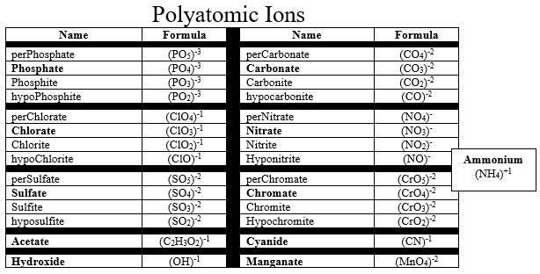

Slide 21
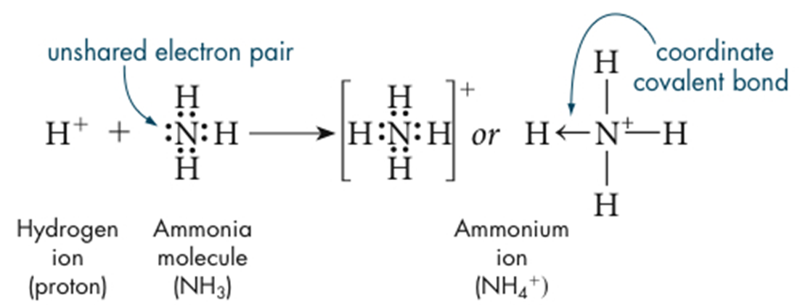
Polyatomic Ions
2 Nature of Covalent Bonding
The ammonium ion (NH₄⁺) forms when a positively charged hydrogen ion (H⁺) attaches to the unshared electron pair of an ammonia molecule (NH₃).
Many ionic compounds (e.g. acids & bases, salts) contain polyatomic ions with covalent & coordinate covalent bonds.
H₂SO₄ HNO₃ H₃PO₄ HClO₃

Slide 22
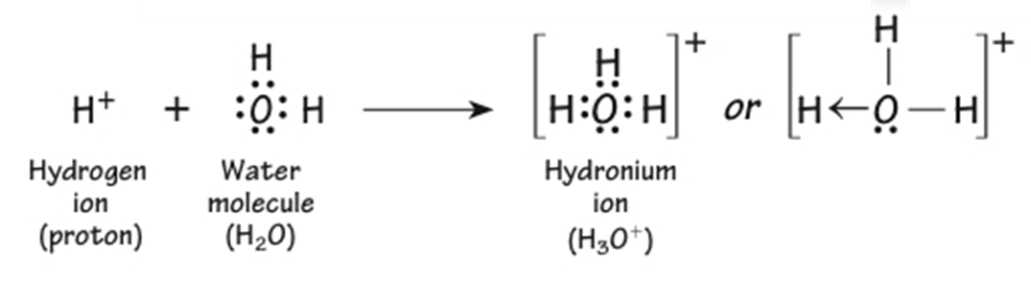
Polyatomic Ions
2 Nature of Covalent Bonding
A hydrogen ion (+1 charge) is attracted to an unshared and unbonded electron pair (negative region) in a water molecule.
The H₃O⁺ ion (hydronium ion) forms (product) as oxygen shares its UNBONDED pair of electrons with the hydrogen ion to form a coordinate covalent bond.

Slide 23
Polyatomic Ions
2 Nature of Covalent Bonding
After bonding, the O in the H₃O⁺ has 8 valence electrons, & each H shares 1 valence electron to complete its 1 s sublevel, satisfying the octet rule for all atoms.
Note, that H₃O⁺ has a charge of 1+.

Slide 24

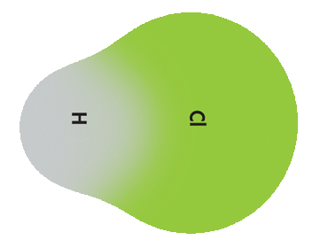
Bond Polarity
2 Nature of Covalent Bonding
What kind of bonds are represented?
?? bonds A B
Equal Distribution of electrons in the bond
?? bonds A B A B
Unequal Distribution of electrons in the bond
Cl – Cl ? bond ? bond ? bond
What happens if atom A or B donates Both of the electrons to make the bond? ? bond

Slide 25
Bond Polarity
2 Nature of Covalent Bonding
What kind of bonds are represented?
Non-Polar bonds A A or B B
Equal Distribution of electrons in the bond
Polar Bonds A B A B
Unequal Distribution of electrons in the bond
Cl – Cl Non-polar polar polar
What happens if A or B donates both of the electrons to make the bond? Coordinate Covalent Bond

Slide 26
Polar Bonding
Covalent Bond
Polar & Non-Polar
(5:52)
https://screencast-o-matic.com/watch/cF6nINY67j

Slide 27
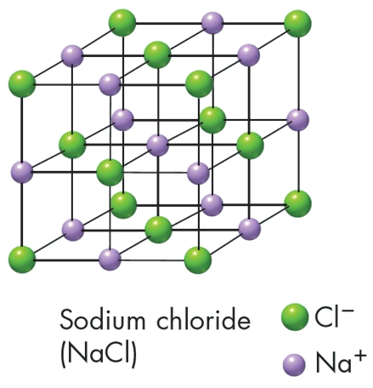
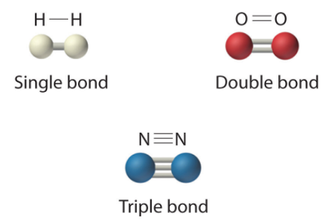
Molecules & Covalent Compounds
2 Nature of Covalent Bonding
  Atoms are covalently bonded together to form Covalent Molecules
  A molecule is a discrete, neutral particle which results from covalent bonding as compared to a compound:
Compound

Slide 28


Molecules & Covalent Compounds
2 Nature of Covalent Bonding
  Types of Covalent Molecules
  Non-Polar Molecule
  Electrons are shared equally
  throughout the molecule.
  Polar Molecule
  Electrons are shared UNequally
  throughout the molecule.
  Be sure to distinguish between polarity in bonds & polarity in molecules. Both molecules above have polar bonds between atoms.
cancels out
polarity
polarity

Slide 29

Molecules & Covalent Compounds
2 Nature of Covalent Bonding
  Non-polar Covalent Molecules
  Diatomic (2 atoms) Molecules of One element are non-polar.
  There are 7 non-polar diatomic molecules:
  H₂ O₂ F₂ Br₂ I₂ N₂ Cl₂
  “Professor HOFBrINCl”
  All other non-polar molecules have at least two different elements. E.g. F−Be−F

Slide 30
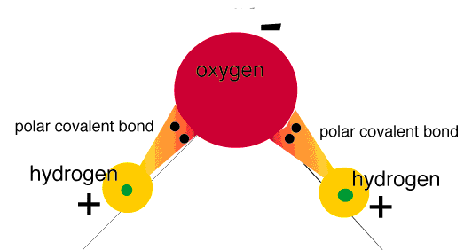
Molecular Polarity
2 Nature of Covalent Bonding
  Polar Covalent Molecules
In a polar molecule, there is a separation of positive and negative charge within the molecule.
“Dipoles” ( + and - ends of a molecule)
Any diatomic molecule made of 2 different elements (there is an END between the atoms that are covalently bonded).
Polyatomic ATOMS are “polar” IF the + and – poles of the molecule are not centered between both atoms → the negative pole exists closer to one atom(s) and the positive pole exists closer to the other atom(s).

Slide 31
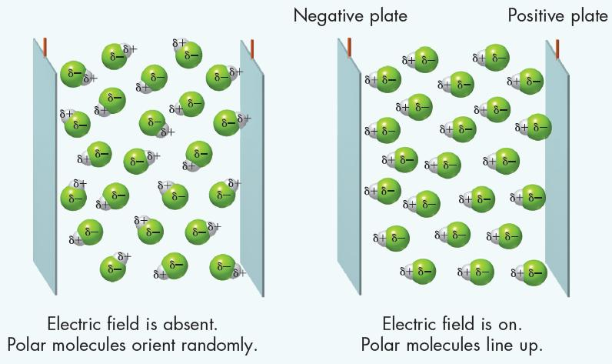
Molecular Polarity
2 Nature of Covalent Bonding
Polar molecules (“dipoles”) align themselves based on their polarity.

Slide 32

Non-polar Molecular Polarity
2 Nature of Covalent Bonding
Distinguishing Polarity in Covalent Molecules
A molecule may be non-polar and contain POLAR bonds if geometric SYMMETRY exists for that molecule.
A CO₂ molecule has two polar bonds and is linear. The bond polarity cancels, but the molecule is nonpolar.

Slide 33
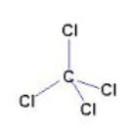

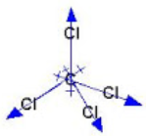
Non-polar Molecular Polarity
2 Nature of Covalent Bonding
Distinguishing Polarity in Covalent Molecules
Symmetry means that if any plane is cut down the center, the resulting planes are identical
Symmetry is a kind of geometric “balance” of molecules on all sides.
F−Be−F

Slide 34
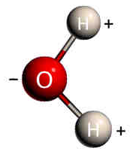
Polar Molecular Polarity
2 Nature of Covalent Bonding
Distinguishing Polarity in Covalent Molecules
The water molecule, just like carbon dioxide, has two polar bonds.
However, the water molecule is “bent” rather than linear. Therefore, the bond polarities do not cancel (as in CO₂) and a water molecule is polar.

Slide 35

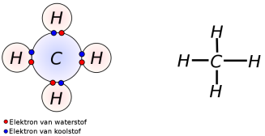
Bond Polarity & Molecular Polarity
  ___ bonds have little or no difference in _______ because they have ____ sharing of _______. (e.g. F-F)
  ____ bonds are formed by atoms that ____ in electronegativity and exhibit _____ sharing of electrons. Therefore, ___ charges develop at opposite ends of the molecule. (e.g. H-F)
  Look at the molecules below and determine the types of bonds and the types of molecules:
Notes:
Timing ≈ 0.5 min
In the example of the H₂ molecule shown earlier and in the F₂ molecule shown here, the bonding electrons are shared equally between the two atoms forming the bond.
The electrons are shared equally because each atom exerts the same attractive pull on the bonding electrons. Both atoms have the same electronegativity. This type of bond is said to be nonpolar. Nonpolar bonds form between identical atoms and between atoms with very similar electronegativities.
However, when the two atoms have very different electronegativities, as in the case of HF, the bonding electrons are not shared equally. The bonding electrons experience a greater pull from the more electronegative atom of the pair. In this case, fluorine [teacher circle & label] is much more electronegative than hydrogen [teacher circle & label]. The bonding electrons spend more time nearer the fluorine nucleus than near the hydrogen nucleus.
This sets up a partial charge difference shown as the greek symbol δελτα [τεαχηερ ποιντ] with a negative sign associated with it. The hydrogen has a partial positive charge [teacher point].
The unequal sharing of electrons between two atoms with different electronegativities results in a polar bond.
SOURCE:
http://commons.wikimedia.org/wiki/File:Elektronenformule_CH4.svg

Slide 36
Bond Polarity & Molecular Polarity
  Nonpolar bonds have little or no difference in electronegativity because they have equal sharing of electrons.
  Polar bonds are formed by atoms that differ in electronegativity and exhibit unequal sharing of electrons. Therefore, partial charges develop at opposite ends of the molecule.
  Look at the molecules below and determine the types of bonds and the types of molecules:
  Non-polar bond/molecule polar bond/molecule polar bond/nonpolar molecule
Notes:
Timing ≈ 0.5 min
In the example of the H₂ molecule shown earlier and in the F₂ molecule shown here, the bonding electrons are shared equally between the two atoms forming the bond.
The electrons are shared equally because each atom exerts the same attractive pull on the bonding electrons. Both atoms have the same electronegativity. This type of bond is said to be nonpolar. Nonpolar bonds form between identical atoms and between atoms with very similar electronegativities.
However, when the two atoms have very different electronegativities, as in the case of HF, the bonding electrons are not shared equally. The bonding electrons experience a greater pull from the more electronegative atom of the pair. In this case, fluorine [teacher circle & label] is much more electronegative than hydrogen [teacher circle & label]. The bonding electrons spend more time nearer the fluorine nucleus than near the hydrogen nucleus.
This sets up a partial charge difference shown as the greek symbol δελτα [τεαχηερ ποιντ] with a negative sign associated with it. The hydrogen has a partial positive charge [teacher point].
The unequal sharing of electrons between two atoms with different electronegativities results in a polar bond.
SOURCE:
http://commons.wikimedia.org/wiki/File:Elektronenformule_CH4.svg

Slide 37
  Covalent Molecules (Polarity & Geometry) Notes (4:24)
https://screencast-o-matic.com/watch/cF6nFEYXoI
Recap Notes (2:05) using Molecular Models
https://screencast-o-matic.com/watch/cF6hDGYoBr

Slide 38
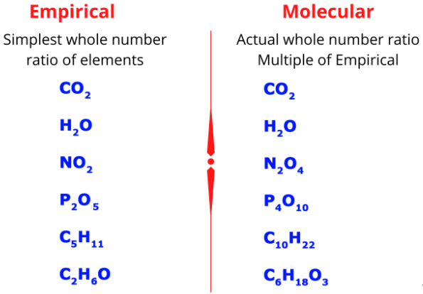
Molecules and
Covalent Compounds
  Representing Molecules
    A molecular formula is the chemical formula of a molecular compound. A molecular formula shows how many atoms of each element a substance contains.
    E.g. Butane’s molecular formula (C₄H₁₀) shows 4 carbon atoms & 10 hydrogen atoms.

Slide 39
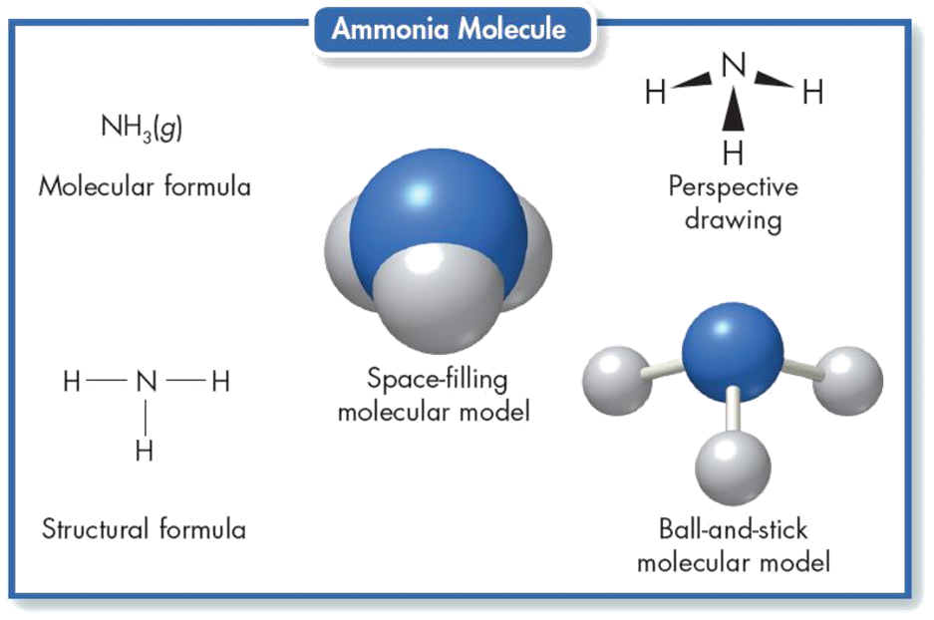
Molecules and
Covalent Compounds
  Representing Molecules
  Molecular Formulas do not show the arrangement of the atoms in space or which atoms are bonded to which. Diagrams, models, and structural formulas can.

Slide 40
Comparing Molecular and
Ionic Compounds
  Covalent Molecules
      Most molecular compounds are composed of atoms of two or more nonmetals.
      The combined atoms usually acquire a total of eight electrons, or an octet, by sharing electrons (octet rule).
    Ionic compounds
    The smallest representative unit is a formula unit, which is the lowest whole-number ratio of ions in an ionic compound.
      Ionic compounds are formed from a metal combined with a nonmetal.

Slide 41
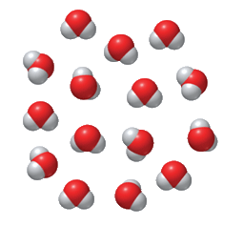
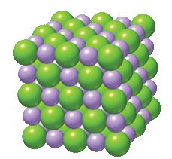
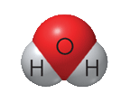

Formula Units Vs. Molecules
  Molecules Formula units
  - Discrete unit of atoms - No discrete units
  - Molecules collect together - Continuous array of ions.
Array of
sodium ions and
chloride ions
Collection of
water molecules
Molecule of
water
Formula unit of
sodium chloride
Chemical formula
Molecular Formula
H₂O
NaCl
Chemical formula

Slide 42
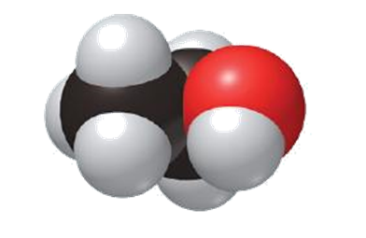
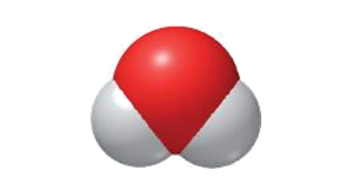
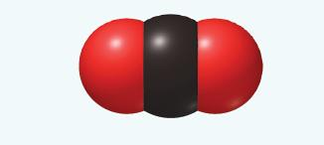

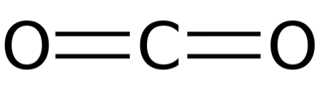
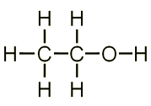
Molecules and
Covalent Compounds
  Structural Formulas
  Show the spatial arrangement of atoms in the molecule of a compound.
  It shows which atom bonds to which atom.
  “DASHES” represent ONE shared pair of electrons in a covalent bond.
Molecular Formula
H₂O
Molecular Formula
CH₃CH₂OH
CO₂

Slide 43
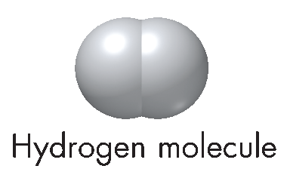
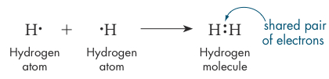
Single Covalent Bonds
2 Nature of Covalent Bonding
  Single Covalent Bonds
  Form from the sharing of ONE pair of electrons between atoms.
  E.g. TWO hydrogen atoms are held together mainly by the attraction of the shared electrons to the positive nuclei.
  Hydrogen gas consists of diatomic molecules whose atoms share only one pair of electrons, forming a single covalent bond.
H₂
H—H

Slide 44
Single Covalent Bonds
2 Nature of Covalent Bonding
  Atoms bond to complete their valence (octet rule) and achieve the electron configuration of a noble gas.
  Two atoms of fluorine bond to make a F₂ molecule, each fluorine atom contributing one electron to complete the octet.

Slide 45
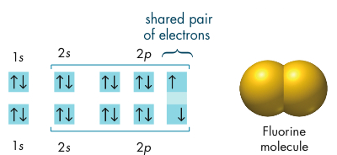
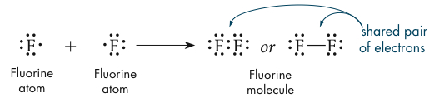
Single Covalent Bonds
2 Nature of Covalent Bonding
  Atoms bond to complete their valence (octet rule) and achieve the electron configuration of a noble gas.
  Two atoms of fluorine bond to make a F₂ molecule, each fluorine atom contributing one electron to complete the octet.
F₂
Notice that there are unbonded or unshared pairs of electrons.
F—F

Slide 46
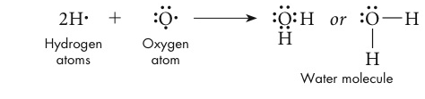
The Octet Rule in
Covalent Bonding
2 Nature of Covalent Bonding
The oxygen atom in water has two unshared pairs of valence electrons.
Once bonded it has a full octet (8 valence e-).

Slide 47
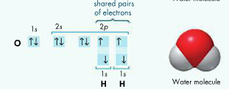
The Octet Rule in
Covalent Bonding
2 Nature of Covalent Bonding
The oxygen atom in water has two unshared pairs of valence electrons. Once bonded it has a full octet (8 valence e-).
H₂O
H—O—H

Slide 48
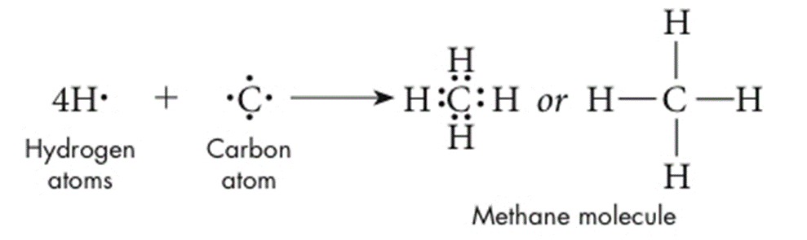
Single Covalent Bond
2 Nature of Covalent Bonding
Methane contains four SINGLE covalent bonds.
The carbon atom has four valence electrons and needs four more valence electrons to attain a noble-gas configuration (full octet).

Slide 49
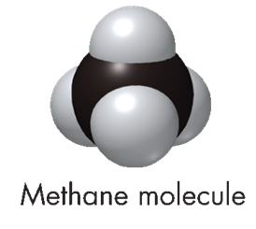
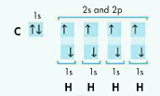
Single Covalent Bond
2 Nature of Covalent Bonding
Methane contains four SINGLE covalent bonds. The carbon atom has four valence electrons and needs four more valence electrons to attain a noble-gas configuration (full octet).
CH₄

Slide 50
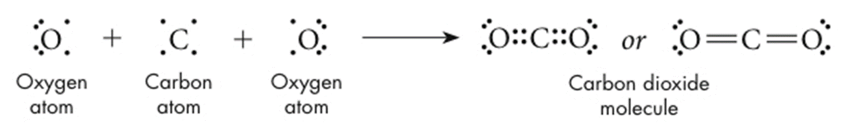
Multiple Covalent Bonds
2 Nature of Covalent Bonding
  Double Covalent Bonds
  A double covalent bond is a bond that involves TWO shared PAIRS of electrons (4 e- are shared in each C=O bond).
  Both oxygen atoms in a carbon dioxide (CO₂) molecule share two electrons with carbon to form a total of TWO carbon–oxygen double bonds.

Slide 51
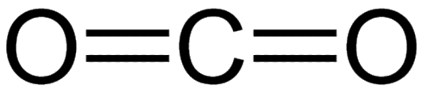
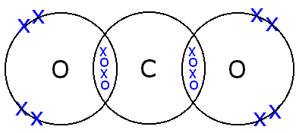

Multiple Covalent Bonds
2 Nature of Covalent Bonding
  Double Covalent Bonds
  A double covalent bond is a bond that involves TWO shared PAIRS of electrons (4 e- are shared in each C=O bond).
  Both oxygen atoms in a carbon dioxide (CO₂) molecule share two electrons with carbon to form a total of TWO carbon–oxygen double bonds.

Slide 52
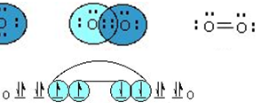
Multiple Covalent Bonds
2 Nature of Covalent Bonding
  Double Covalent Bonds
  Oxygen gas is a diatomic molecule containing a double bond (4 e- are shared in each O=O bond).
  Both oxygen atoms share two electrons to form a double bond.
  Notice that both oxygen atoms have a full octet (8 valence e-).

Slide 53
Multiple Covalent Bonds
2 Nature of Covalent Bonding
  Double Covalent Bonds
  Oxygen gas is a diatomic molecule containing a double bond (4 e- are shared in each O=O bond).
  Both oxygen atoms share two electrons to form a double bond.
  Notice that both oxygen atoms have a full octet (8 valence e-).
O₂
O=O

Slide 54

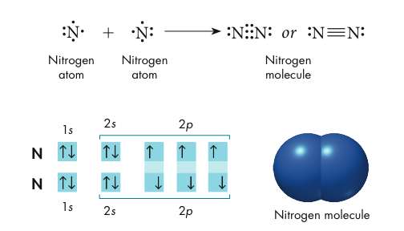
Multiple Covalent Bonds
2 Nature of Covalent Bonding
  Triple Covalent Bonds
  A triple covalent bond forms when two atoms share THREE PAIRS of electrons (6 e- are shared in bond).

Slide 55
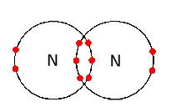

Multiple Covalent Bonds
2 Nature of Covalent Bonding
  Triple Covalent Bonds
  A triple covalent bond forms when two atoms share THREE PAIRS of electrons (6 e- are shared in bond).
N₂

Slide 56



1-3 Review

Slide 57
1-3 Review

Slide 58



1-3 Review
The P-Cl bond in a molecule of PCl₃ is:
a) non-polar covalent c) coordinate covalent
b) polar covalent d) electrovalent
PCl₃ is a(n):
a) non-polar molecule c) ionic compound
b) polar molecule d) coordinate covalent molecule

Slide 59
1-3 Review
The P-Cl bond in a molecule of PCl₃ is:
a) non-polar covalent c) coordinate covalent
b) polar covalent d) electrovalent
PCl₃ is a(n):
a) non-polar molecule c) ionic compound
b) polar molecule d) coordinate covalent molecule

Slide 60


1-3 Review
Which of the following does not promote an electron being gained by an atom?
a) ionization energy c) non-metallic character
b) electronegativity d) electron affinity
Which atom has the strongest attraction for electrons?
a) Cl b) F c) Br d) I

Slide 61



1-3 Review
Which of the following does not promote an electron being gained by an atom?
a) ionization energy c) non-metallic character
b) electronegativity d) electron affinity
Which atom has the strongest attraction for electrons?
a) Cl b) F c) Br d) I

Slide 62
1-3 Review
Show the Lewis structure, electron configuration, the molecular formula, and the structural formula of ammonia (nitrogen bonding with hydrogen).

Slide 63


1-3 Review
Show the Lewis structure, electron configuration, the molecular formula, and the structural formula of ammonia (nitrogen bonding with hydrogen).
NH₃

Slide 64


Slide 65


Slide 66


Slide 67


