Slide 1
Click on “Slide Show”
Click “Play from Beginning”

Slide 2
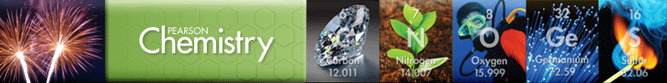
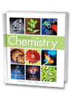
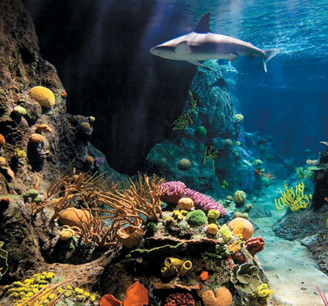
Chapter 11
Chemical Reactions
Describing Chemical Reactions
Types of Chemical Reactions
Reactions in Aqueous Solution

Slide 3
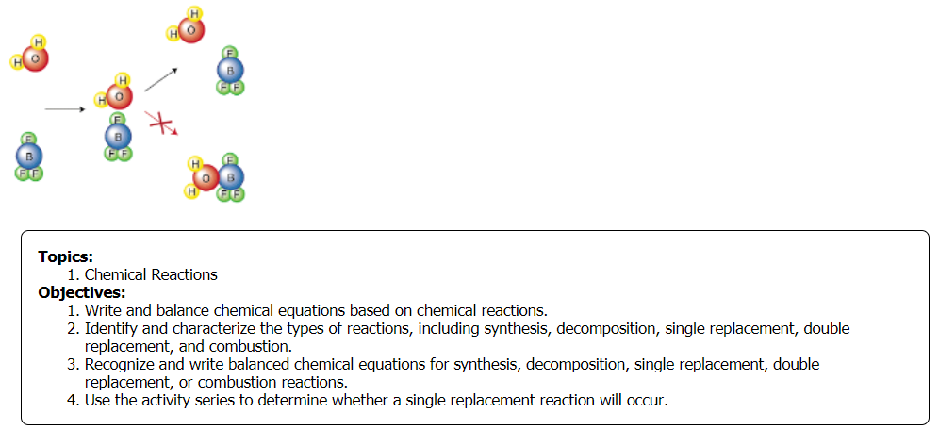
Week 1

Slide 4
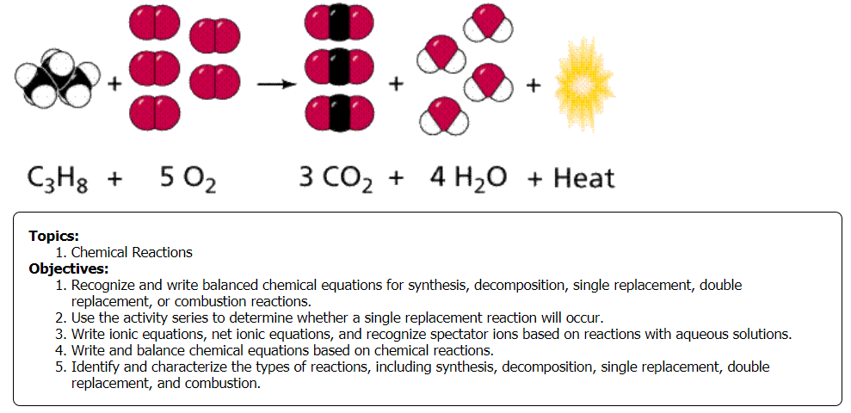
Week 2

Slide 5
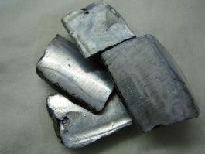
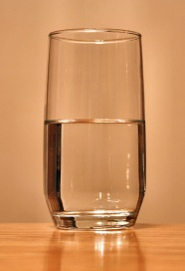
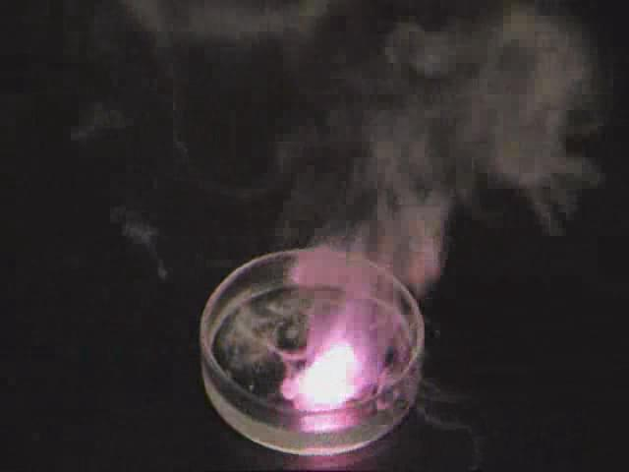
Describe the chemical reaction here.
2K _{(s)} + 2H₂O _{(l)} ⟶ 2KOH + H_{2 (g)} + heat
Reaction of potassium with water:
Notes:
Timing ≈ 1 min
The reaction here involves the combination of potassium metal [animate photo of potassium; teacher circle potassium in equation] and water [animate photo of water; teacher circle water in equation].
The products are potassium hydroxide [teacher circle in equation] and hydrogen gas [teacher circle in equation]. The intense heat generated by the reaction causes the hydrogen gas to ignite [animate photo of reaction].
SOURCES:
http://commons.wikimedia.org/wiki/File:Potassium.JPG
http://commons.wikimedia.org/wiki/File:Glass-of-water.jpg
https://commons.wikimedia.org/wiki/File:Potassium_water_20.theora.ogv

Slide 6
Describe Evidence of Reactions
Some signs of a chemical reaction observed in the reaction of potassium with water:
temperature change
gas produced
color change
Smoke
Flame
Notes:
Timing ≈ 0.5 min
Entry audio: There are some signs you can look for to determine whether a chemical reaction has taken place.
Hint audio: Hydrogen and potassium hydroxide are odorless.
Exit audio: Certain types of chemical reactions are more likely to produce specific signs than others.
SOURCE:
https://commons.wikimedia.org/wiki/File:Potassium_water_20.theora.ogv

Slide 7
By the end of this lesson, you should be able to:
  Write and balance a chemical equation based on a chemical reaction.
  Identify and characterize the types of reactions, including synthesis, decomposition, single replacement, double replacement, and combustion.
  Classify a reaction as synthesis, decomposition, single replacement, double replacement, or combustion
  Use the activity series to determine whether a single replacement reaction will occur.
  Write ionic equations, net ionic equations, and recognize spectator ions based on reactions with aqueous solutions.
Notes:
Timing ≈ 0.5 min
read the objectives. You will learn how to predict the products of different types of reactions.

Slide 8
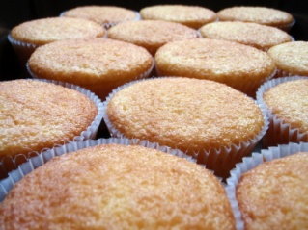
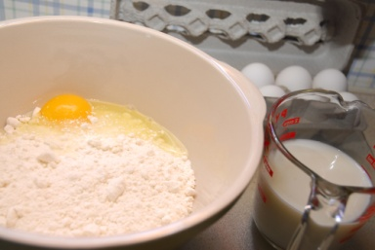
What Is the Proper Method for Writing and Balancing Chemical Equations?
Writing Chemical Equations
Balancing Chemical Equations
Notes:
Timing ≈ 0.5 min
Connect: A recipe tells you what you need to combine to make a vanilla cupcake. The recipe for a banana cupcake is slightly different. A chemical equation is a little bit like a recipe. It tells you exactly what goes into and what comes out of a chemical reaction.
Recap: Knowing how to use chemical formulas will help you properly represent the substances in a chemical equation.
Transition: You’ll learn how to write equations using words and how to use word equations to write chemical equations with formulas.
SOURCES:
http://commons.wikimedia.org/wiki/File:Yellow_butter_cupcakes,_undecorated,_April_2009.jpg

Slide 9


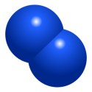
Word & Formula Equations
Reactants are the substances that enter into a chemical reaction.
Products are the substances that form.
A chemical equation is a group of chemical formulas & symbols that represent the reactants & products in a chemical reaction, expressed in words or formulas.
Model
+
Hydrogen + Nitrogen → Ammonia
3H_{2 (g)} + N_{2 (g)} → 2NH_{3 (g)}
Notes:
Timing ≈ 1.5 min
[show space-filling diagrams] This model shows that hydrogen reacts with nitrogen to form ammonia.
[Animation:] The reactants are the substances that enter into or are starting materials in a chemical reaction. In this reaction, hydrogen and nitrogen are the reactants. [Use pen tool to circle reactants in model.]
[Animation:] The products are the substances that form. In this reaction, ammonia is the product. [Use the pen tool to circle the ammonia.]
[Animation:] A chemical equation is a group of chemical formulas and symbols that represents the reactants and products in a chemical reaction.
Chemical equations can start as a word equation. The word equation describes the reactants and products using the names of the substances. [Animate appearance of word equation.]
This word equation is read as hydrogen plus nitrogen yields or produces ammonia. Notice that the reactants are on the left [use pen tool to circle reactants in equation] and the products are on the right. [Use pen tool to circle products.] All chemical equations are written from left or right, the same way you read a sentence.
An arrow separates the reactants from the products. It points from the reactants to the products.
Plus signs are used to separate multiple products or multiple reactants.
SOURCES
http://commons.wikimedia.org/wiki/File:Ammoniakkmolekyl.pngCES
http://commons.wikimedia.org/wiki/File:Nitrogen2.svg
http://commons.wikimedia.org/wiki/File:Hydrogengassmolekyl.png

Slide 10
Word & Formula Equations
+
Reactants → Products
3H_{2 (g)} + N_{2 (g)} → 2NH_{3 (g)}
Hydrogen + Nitrogen → Ammonia
Notes:
Timing ≈ 1.5 min
[show space-filling diagrams] This model shows that hydrogen reacts with nitrogen to form ammonia.
[Animation:] The reactants are the substances that enter into or are starting materials in a chemical reaction. In this reaction, hydrogen and nitrogen are the reactants. [Use pen tool to circle reactants in model.]
[Animation:] The products are the substances that form. In this reaction, ammonia is the product. [Use the pen tool to circle the ammonia.]
[Animation:] A chemical equation is a group of chemical formulas and symbols that represents the reactants and products in a chemical reaction.
Chemical equations can start as a word equation. The word equation describes the reactants and products using the names of the substances. [Animate appearance of word equation.]
This word equation is read as hydrogen plus nitrogen yields or produces ammonia. Notice that the reactants are on the left [use pen tool to circle reactants in equation] and the products are on the right. [Use pen tool to circle products.] All chemical equations are written from left or right, the same way you read a sentence.
An arrow separates the reactants from the products. It points from the reactants to the products.
Plus signs are used to separate multiple products or multiple reactants.
SOURCES
http://commons.wikimedia.org/wiki/File:Ammoniakkmolekyl.pngCES
http://commons.wikimedia.org/wiki/File:Nitrogen2.svg
http://commons.wikimedia.org/wiki/File:Hydrogengassmolekyl.png

Slide 11
Introduction to Chemical Equations
A chemical equation is a representation of a chemical reaction.
The reactants are written on the left separated by an arrow from the products on the right.
The arrow signifies “yields”, “gives”, or “reacts to produce …”.
e.g. Fe + O₂ → Fe₂O₃ iron plus oxygen reacts to produce (yields) IronIII Oxide
Physical states of substances are indicated by (s) for solid, (l) for liquid, (g) for gas, or (aq) for a substance dissolved in water:
e.g., Fe _{(s)} + O_{2 (g)} → Fe₂O₃ _{(s)}

Slide 12
Introduction to Chemical Equations
Chemical equations are balanced using coefficients.
e.g., Fe _{(s)} + O_{2 (g)} → Fe₂O₃ _{(s)}
# atoms =1 Fe, 2 O → 2 Fe, 3 O
2Fe _{(s)} + ?O_{2 (g)} → Fe₂O₃ _{(s)}
# atoms = 2 Fe, 2 O → 2 Fe, 3 O
4Fe _{(s)} + 3O_{2 (g)} → 2Fe₂O₃ _{(s)}
# atoms = 4 Fe, 6 O → 4 Fe, 6 O

Slide 13
Introduction to Chemical Equations
Chemical reactions represent changes in bonding & energy
Endothermic Reactions → What happens to energy?
2 KClO_{3 (s)} + energy → 2 KCl _{(s)} + 3 O_{2 (g)}
Potassium Chlorate Potassium Chloride Oxygen
Is energy a reactant or product?

Slide 14
Introduction to Chemical Equations
Chemical reactions represent changes in bonding & energy
Exothermic Reactions → What happens to energy?
2 H_{2 (g)} + O_{2 (g)} → H₂O _{(g)} + energy
Hydrogen Oxygen diHydrogen monOxide
Is energy a reactant or product?

Slide 15
Introduction to Chemical Equations
Chemical reactions represent changes in bonding & energy
Endothermic Reactions → energy is absorbed during the reaction
2 KClO_{3 (s)} + energy → 2 KCl _{(s)} + 3 O_{2 (g)}
Potassium Chlorate Potassium Chloride Oxygen
Energy is commonly added in the form of heat & electricity
Notice that energy is a reactant.
Exothermic Reactions → energy is released during the reaction
2 H_{2 (g)} + O_{2 (g)} → H₂O _{(g)} + energy
Hydrogen Oxygen diHydrogen monOxide
Notice that energy is a product.

Slide 16
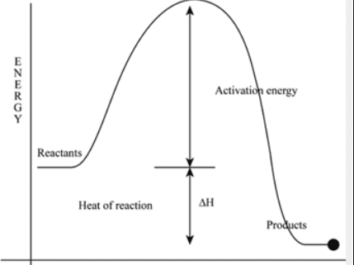
Introduction to Chemical Equations
All Chemical Reactions require Activation Energy:
the minimum energy needed for a reaction to begin.
Enzymes, heat, or electricity commonly yield the activation energy needed in chemical reactions
In many chemical reactions, a catalyst is added to the reaction mixture. A catalyst is a substance that speeds up the reaction but is not used up (or part of) in the reaction.

Slide 17
Introduction to Chemical Equations
All Chemical Reactions require Activation Energy:
the minimum energy needed for a reaction to begin.
Activation Energy Demo → Add sulfuric acid to sugar [1:05]
http://somup.com/cF6vqVnhdn
C₁₂H₂₂O₁₁ → 12C _{(s)} + 11H₂O _{(g)}
Sulfuric acid is a catalyst (not part of the reaction)
Stirring Provided “Activation Energy”

Slide 18
Introduction to Chemical Equations
Symbols Used in Chemical Equations
Symbol | Explanation
+ | Separates two reactants or two products
→ | “Yields,” separates reactants from products
 | Use in place of → for reversible reactions
(s), (l), (g) | Designates a reactant or product in the solid state, liquid state, or gaseous state; placed after the formula
(aq) | Designates an aqueous solution; the substance is dissolved in water; placed after the formula
 | Indicates that heat is supplied to the reaction
 | A formula written above or below the yields sign indicates its use as a catalyst (in this example, platinum).
Δ
heat
Pt

Slide 19

Hydrochloric acid reacts with solid sodium hydrogen carbonate. The products formed are aqueous sodium chloride, water, and carbon dioxide gas. Write a skeleton equation for this chemical reaction.

Slide 20
Hydrochloric acid reacts with solid sodium hydrogen carbonate.
The products formed are aqueous sodium chloride, water, and
carbon dioxide gas. Write a skeleton equation for this chemical reaction.
1. Write the correct formula for each substance in the reaction.
2. Indicate the state of each substance.
3. Separate the reactants from the products with an arrow.
4. Use plus signs to separate the two reactants and each of the three products.
HCl _{(aq)} + NaHCO_{3 (s)} → NaCl _{(aq)} + H₂O _{(l)} + CO_{2 (g)}

Slide 21
Writing a Formula Equation & Identify Symbols
What do the symbols tell you about the conditions of the two reactions shown below?
What do the symbols tell you about the conditions of the reaction shown below?
Propane (C₃H₈) burns in oxygen to produce carbon dioxide and water. What are the reactants and products? Formulas?
450⁰
3H_{2 (g)} + N_{2 (g)} → 2NH_{3 (g)}
Notes:
Timing ≈ 1 min
Entry audio: Use the symbols in the chemical equations to describe the reaction conditions.
Hint1 audio: [none]
Hint2 audio: [none]
Exit audio: The temperature and catalyst used are added over the reaction arrow in an equation. Double arrows means that the reaction goes both ways. The products and reactants may be in different phases. You need to look at the symbols after the formula to determine the phase of each product and each reactant.

Slide 22
Writing a Formula Equation & Identify Symbols
What do the symbols tell you about the conditions of the two reactions shown below?
(1)
(2)
The products and reactants of both reactions are gases.
Heat is used for reaction 1 while a catalyst is used for reaction 2.
What do the symbols tell you about the conditions of the reaction shown below?
The reactant is dissolved in water.
A gas and a liquid are produced.
Reversible reaction (2 arrows).
Propane burns in oxygen to produce carbon dioxide and water. What are the reactants and products? Formulas?
The reactants are propane (C₃H₈) & oxygen (O₂). The products are CO₂ and H₂O.
450⁰
3H_{2 (g)} + N_{2 (g)} → 2NH_{3 (g)}
Notes:
Timing ≈ 1 min
Entry audio: Use the symbols in the chemical equations to describe the reaction conditions.
Hint1 audio: [none]
Hint2 audio: [none]
Exit audio: The temperature and catalyst used are added over the reaction arrow in an equation. Double arrows means that the reaction goes both ways. The products and reactants may be in different phases. You need to look at the symbols after the formula to determine the phase of each product and each reactant.

Slide 23
Writing a Formula Equation & Identify Symbols
Propane burns in oxygen to produce carbon dioxide and water. What are the reactants and products? Formulas?
The reactants are propane (C₃H₈) & oxygen (O₂). The products are CO₂ and H₂O.
C₃H_{8 (g)} + O_{2 (g)} → CO_{2 (g)} + H₂O_{(l)}
Notes:
Timing ≈ 1 min
Entry audio: Use the symbols in the chemical equations to describe the reaction conditions.
Hint1 audio: [none]
Hint2 audio: [none]
Exit audio: The temperature and catalyst used are added over the reaction arrow in an equation. Double arrows means that the reaction goes both ways. The products and reactants may be in different phases. You need to look at the symbols after the formula to determine the phase of each product and each reactant.

Slide 24
Writing a Formula Equation & Identify Symbols
Propane burns in oxygen to produce carbon dioxide and water. What are the reactants and products? Formulas?
The reactants are propane (C₃H₈) & oxygen (O₂). The products are CO₂ and H₂O.
C₃H_{8 (g)} + O_{2 (g)} → CO_{2 (g)} + H₂O_{(l)}
3C, 8H, 2O 1C, 2H, 3O
Choose an “ODD” # to make even (C or O).
Since O is split on the right of the arrow, start there.
Notes:
Timing ≈ 1 min
Entry audio: Use the symbols in the chemical equations to describe the reaction conditions.
Hint1 audio: [none]
Hint2 audio: [none]
Exit audio: The temperature and catalyst used are added over the reaction arrow in an equation. Double arrows means that the reaction goes both ways. The products and reactants may be in different phases. You need to look at the symbols after the formula to determine the phase of each product and each reactant.

Slide 25
Writing a Formula Equation & Identify Symbols
Propane burns in oxygen to produce carbon dioxide and water. What are the reactants and products? Formulas?
The reactants are propane (C₃H₈) & oxygen (O₂). The products are CO₂ and H₂O.
C₃H_{8 (g)} + O_{2 (g)} → CO_{2 (g)} + 4H₂O_{(l)}
Insert a coefficient before water
3C, 8H, 2O 1C, 8H, 6O
Notice the Hydrogen is balanced (8H atoms on each side of arrow).
Now, insert a coefficient before carbon dioxide to balance C.
Notes:
Timing ≈ 1 min
Entry audio: Use the symbols in the chemical equations to describe the reaction conditions.
Hint1 audio: [none]
Hint2 audio: [none]
Exit audio: The temperature and catalyst used are added over the reaction arrow in an equation. Double arrows means that the reaction goes both ways. The products and reactants may be in different phases. You need to look at the symbols after the formula to determine the phase of each product and each reactant.

Slide 26
Writing a Formula Equation & Identify Symbols
Propane burns in oxygen to produce carbon dioxide and water. What are the reactants and products? Formulas?
The reactants are propane (C₃H₈) & oxygen (O₂). The products are CO₂ and H₂O.
C₃H_{8 (g)} + O_{2 (g)} → 3CO_{2 (g)} + 4H₂O_{(l)}
3C, 8H, 2O 3C, 8H, 10-O
Notice the Hydrogen and Carbon are balanced (8H and 3C atoms on each side of arrow).
Now, insert a coefficient before oxygen (reactant).
Notes:
Timing ≈ 1 min
Entry audio: Use the symbols in the chemical equations to describe the reaction conditions.
Hint1 audio: [none]
Hint2 audio: [none]
Exit audio: The temperature and catalyst used are added over the reaction arrow in an equation. Double arrows means that the reaction goes both ways. The products and reactants may be in different phases. You need to look at the symbols after the formula to determine the phase of each product and each reactant.

Slide 27
Writing a Formula Equation & Identify Symbols
Propane burns in oxygen to produce carbon dioxide and water. What are the reactants and products? Formulas?
The reactants are propane (C₃H₈) & oxygen (O₂). The products are CO₂ and H₂O.
C₃H_{8 (g)} + 5O_{2 (g)} → 3CO_{2 (g)} + 4H₂O_{(l)}
3C, 8H, 10-O 3C, 8H, 10-O
Notice all atoms are balanced, meaning there are the same number and type of atoms on each side of the arrow.
Notes:
Timing ≈ 1 min
Entry audio: Use the symbols in the chemical equations to describe the reaction conditions.
Hint1 audio: [none]
Hint2 audio: [none]
Exit audio: The temperature and catalyst used are added over the reaction arrow in an equation. Double arrows means that the reaction goes both ways. The products and reactants may be in different phases. You need to look at the symbols after the formula to determine the phase of each product and each reactant.

Slide 28
Balanced Chemical Equations
Hydrogen + Nitrogen → Ammonia
H_{2 (g)} + N_{2 (g)} → NH_{3 (g)}
  Is this a balanced chemical equation?
  Are there the same number of each type of atom on both sides of the equation?
  Does it show conservation of mass?
Notes:
Timing ≈ 1.5 min
According to the Law of Conservation of Mass, atoms are not created or destroyed by chemical reactions. This means that the products can only have atoms of elements that were in the reactants. For this reaction, ammonia has only hydrogen and nitrogen, so the elements in the products and reactants are the same.
[Animate:] However, the way this reaction is written, there are more hydrogen atoms in the products and more nitrogen atoms in the products. For mass to be conserved, the number of each type of atom needs to be the same on both sides of the equation. Hydrogen atoms cannot be created and nitrogen atoms cannot be destroyed.
[Animate:] Balanced chemical equations show how mass is conserved. Coefficients are added to balance equations. They show the relative amount in molecules or moles. If 3 molecules of hydrogen react with 1 molecule of nitrogen to produce 2 molecules of ammonia, the number and type of each atom is the same on both sides of the equation.
To find the total number of each type of atom, multiply the coefficient by the subscript for each atom. 3 times 2 gives 6 hydrogen atoms and 1 times 2 gives 2 nitrogen atoms in the reactants. In the products, 2 times 1 gives 2 nitrogen atoms and 2 times 3 gives 6 hydrogen atoms. This equation is balanced.
SOURCES
http://commons.wikimedia.org/wiki/File:Ammoniakkmolekyl.pngCES
http://commons.wikimedia.org/wiki/File:Nitrogen2.svg
http://commons.wikimedia.org/wiki/File:Hydrogengassmolekyl.png

Slide 29
Balanced Chemical Equations
  Have the same types of atoms (elements) on both sides of equations
  Have the same number of each type of atom
  Show conservation of mass
Hydrogen + Nitrogen → Ammonia
3H_{2 (g)} + N_{2 (g)} → 2NH_{3 (g)}
3H_{2 (g)} + N_{2 (g)} → 2NH_{3 (g)}
6 H 2 N → 2 N 6 H
+
Notes:
Timing ≈ 1.5 min
According to the Law of Conservation of Mass, atoms are not created or destroyed by chemical reactions. This means that the products can only have atoms of elements that were in the reactants. For this reaction, ammonia has only hydrogen and nitrogen, so the elements in the products and reactants are the same.
[Animate:] However, the way this reaction is written, there are more hydrogen atoms in the products and more nitrogen atoms in the products. For mass to be conserved, the number of each type of atom needs to be the same on both sides of the equation. Hydrogen atoms cannot be created and nitrogen atoms cannot be destroyed.
[Animate:] Balanced chemical equations show how mass is conserved. Coefficients are added to balance equations. They show the relative amount in molecules or moles. If 3 molecules of hydrogen react with 1 molecule of nitrogen to produce 2 molecules of ammonia, the number and type of each atom is the same on both sides of the equation.
To find the total number of each type of atom, multiply the coefficient by the subscript for each atom. 3 times 2 gives 6 hydrogen atoms and 1 times 2 gives 2 nitrogen atoms in the reactants. In the products, 2 times 1 gives 2 nitrogen atoms and 2 times 3 gives 6 hydrogen atoms. This equation is balanced.
SOURCES
http://commons.wikimedia.org/wiki/File:Ammoniakkmolekyl.pngCES
http://commons.wikimedia.org/wiki/File:Nitrogen2.svg
http://commons.wikimedia.org/wiki/File:Hydrogengassmolekyl.png

Slide 30
Balancing Chemical Equations
Determine the reactants and products for the chemical reaction … write a skeletal equation.
All symbols and formulas must be correct BEFORE balancing the chemical equation.
Zinc + Hydrochloric acid → ZincII Chloride + Hydrogen

Slide 31
Balancing Chemical Equations
Determine the reactants and products for the chemical reaction … write a skeletal equation.
All symbols and formulas must be correct BEFORE balancing the chemical equation.
Zinc + Hydrochloric acid → ZincII Chloride + Hydrogen
Zn⁰ _{(s)} + H⁺Cl⁻ _{(aq)} → Zn⁺²Cl₂⁻ _{(s)} + H₂⁰ _{(g)}
NEVER change a subscript or formula when balancing the overall equation

Slide 32
Balancing Chemical Equations
ONLY coefficients are used when balancing equations.
A chemical equation must have the same number of atoms on each side of the arrow (conservation of matter, mass & energy)
Coefficients indicate the number of formula units (compounds or molecules) represented by the formula in a chemical reaction.
Zinc + Hydrochloric acid → ZincII Chloride + Hydrogen
Zn _{(s)} + 2 HCl _{(aq)} → ZnCl₂ _{(s)} + H_{2 (g)}
Coefficients are understood to be 1 if not written.
Compare the number of each element on each side of the equation.
NEVER change a subscript or formula when balancing the overall equation.

Slide 33
How to Balance Equations
Write & balance a chemical equation for the decomposition of hydrogen peroxide to oxygen and water.
Write the formula equation
Count each type of atom
Use coefficients to balance
Count atoms again
Notes:
Timing ≈ 2 min
Discuss steps to balancing chemical equations.
[Animate:] Before you can balance a chemical equation, you need to write the formula equation showing the reactants and products. For example, hydrogen peroxide reacts to produce oxygen and water.
[Animate:] It is possible that the equation is already balanced. You need to count the atoms on each side to find out. Sometimes, atoms appear in multiple substances, so you need to add the number in each substance to get the total. For this reaction there are 2 atoms of hydrogen and two atoms of the oxygen in peroxide. There are 2 atoms of oxygen in elemental oxygen and 1 atom in water, so there are 3 atoms of oxygen in the products. There are also 2 atoms of hydrogen. The products have more oxygen that the reactants, so the equation needs to be balanced.
[Animate:] You need to use coefficients to balance the equation. You cannot change the subscript after the oxygen in peroxide to a 3 because then the formula will no longer represent peroxide. You cannot add oxygen to the reactants or remove it from the products because then you are describing a different reaction. For this reaction, adding a 2 in front of the peroxide and then a 2 in front of water balances the number of oxygen atoms. Often, adjusting the number of one atom will affect the number of another atom. In this case, balancing the number of oxygen atoms also affects the number of hydrogen atoms.
[Animate:] After you think you have balanced the reaction, count the atoms again to make sure. After balancing this reaction, there are 4 atoms of hydrogen and 4 atoms of oxygen in both the reactants and products.

Slide 34
How to Balance Equations
Write & balance a chemical equation for the decomposition of hydrogen peroxide to oxygen and water.
Write the formula equation
H₂O_{2 (aq)} → O_{2 (g)} + H₂O _{(l)}
Count each type of atom
2H, 2O → 2H, 3O
Use coefficients to balance
2H₂O_{2 (aq)} → O_{2 (g)} + 2H₂O _{(l)}
Count atoms again
4H, 4O → 4H, 4O
Notes:
Timing ≈ 2 min
Discuss steps to balancing chemical equations.
[Animate:] Before you can balance a chemical equation, you need to write the formula equation showing the reactants and products. For example, hydrogen peroxide reacts to produce oxygen and water.
[Animate:] It is possible that the equation is already balanced. You need to count the atoms on each side to find out. Sometimes, atoms appear in multiple substances, so you need to add the number in each substance to get the total. For this reaction there are 2 atoms of hydrogen and two atoms of the oxygen in peroxide. There are 2 atoms of oxygen in elemental oxygen and 1 atom in water, so there are 3 atoms of oxygen in the products. There are also 2 atoms of hydrogen. The products have more oxygen that the reactants, so the equation needs to be balanced.
[Animate:] You need to use coefficients to balance the equation. You cannot change the subscript after the oxygen in peroxide to a 3 because then the formula will no longer represent peroxide. You cannot add oxygen to the reactants or remove it from the products because then you are describing a different reaction. For this reaction, adding a 2 in front of the peroxide and then a 2 in front of water balances the number of oxygen atoms. Often, adjusting the number of one atom will affect the number of another atom. In this case, balancing the number of oxygen atoms also affects the number of hydrogen atoms.
[Animate:] After you think you have balanced the reaction, count the atoms again to make sure. After balancing this reaction, there are 4 atoms of hydrogen and 4 atoms of oxygen in both the reactants and products.

Slide 35
Rules for Writing and Balancing Equations
1. Determine the correct formulas for all the reactants and products. 2. Write the skeleton equation by placing the formulas for the reactants on the left and the formulas for the products on the right with a yields sign (→) in between. If two or more reactants or products are involved, separate their formulas with plus signs. 3. Determine the number of atoms of each element in the reactants and products. Count a polyatomic ion as a single unit if it appears unchanged on both sides of the equation. | 4. Balance the elements one at a time by using coefficients. When no coefficient is written, it is assumed to be 1. Begin by balancing elements that appear only once on each side of the equation. Never balance an equation by changing the subscripts in a chemical formula. Each substance only has one correct formula. 5. Check each atom or polyatomic ion to be sure that the number is equal on both sides of the equation. 6. Make sure all the coefficients are in the lowest possible ratio.

Slide 36
Balancing Chemical Equations
Carbon burns in the presence of oxygen to produce carbon dioxide. Write a balanced equation of this reaction.

Slide 37
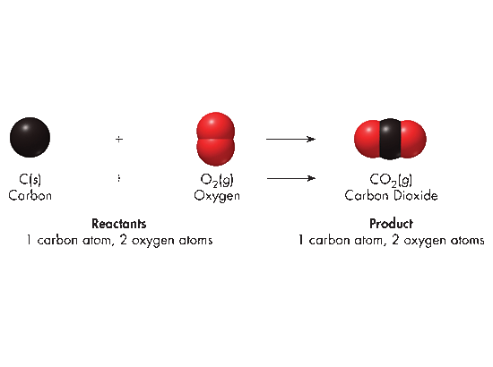
Balancing Chemical Equations
Carbon burns in the presence of oxygen to produce carbon dioxide. Write a balanced equation of this reaction.
C _{(s)}
Carbon
+
O_{2 (g)}
Oxygen
CO_{2 (g)}
Carbon dioxide
Reactants
1 carbon atom, 2 oxygen atoms
Products
1 carbon atom, 2 oxygen atoms
This equation is balanced “as is”.
The coefficients are correct.
Coefficients are understood to be 1 if not written.

Slide 38
Aluminum is a good choice for outdoor furniture because it reacts with oxygen in the air to form a thin protective coat of aluminum oxide. Write a balanced equation for this reaction.

Slide 39
Aluminum is a good choice for outdoor furniture because it reacts with oxygen in the air to form a thin protective coat of aluminum oxide. Write a balanced equation for this reaction. Formulas:
Al⁰ _{(s)} + O₂⁰ _{(g)} → Al₂⁺³O₃⁻² _{(s)}

Slide 40
Aluminum is a good choice for outdoor furniture because it reacts with oxygen in the air to form a thin protective coat of aluminum oxide. Write a balanced equation for this reaction. Formulas:
Al⁰ _{(s)} + O₂⁰ _{(g)} → Al₂⁺³O₃⁻² _{(s)}
For oxygen, use a common multiple (6) to determine coefficients.
To get 6 oxygens on the right, place the coefficient 2 in front of Al₂O₃.
Al _{(s)} + O_{2 (g)} → 2Al₂O_{3 (s)}

Slide 41
Aluminum is a good choice for outdoor furniture because it reacts with oxygen in the air to form a thin protective coat of aluminum oxide. Write a balanced equation for this reaction. Formulas:
Al⁰ _{(s)} + O₂⁰ _{(g)} → Al₂⁺³O₃⁻² _{(s)}
For oxygen, use a common multiple (6) to determine coefficients.
To get 6 oxygens on the right, place the coefficient 2 in front of Al₂O₃.
Al _{(s)} + O_{2 (g)} → 2Al₂O_{3 (s)}
To get 6 oxygens on the left, place the coefficient 3 in front of O_{2 (g)}.
Al _{(s)} + 3O_{2 (g)} → 2Al₂O_{3 (s)}

Slide 42
Aluminum is a good choice for outdoor furniture because it reacts with oxygen in the air to form a thin protective coat of aluminum oxide. Write a balanced equation for this reaction. Formulas:
Al⁰ _{(s)} + O₂⁰ _{(g)} → Al₂⁺³O₃⁻² _{(s)}
For oxygen, use a common multiple (6) to determine coefficients.
To get 6 oxygens on the right, place the coefficient 2 in front of Al₂O₃.
Al _{(s)} + O_{2 (g)} → 2Al₂O_{3 (s)}
To get 6 oxygens on the left, place the coefficient 3 in front of O_{2 (g)}.
Al _{(s)} + 3O_{2 (g)} → 2Al₂O_{3 (s)}
Lastly, since there are 4 Al in the products, there must also be 4 Al in the reactants. Place the coefficient 4 in front of Al _{(s)}.
4 Al _{(s)} + 3 O_{2 (g)} → 2 Al₂O_{3 (s)}
Do a final inspection.

Slide 43
Working the Law of Conservation of Mass
How do balanced chemical equations show the conservation of mass?
Which equation obeys the law of conservation of mass?
H₂(g) + O₂(g) → H₂O(g)
H₂(g) + O₂(g) → H₂O(g) + 4He(g)
2H₂(g) + O₂(g) → 2H₂O(g)
H₂(g) + O₂(g) → 2H₂O(g)
Count the number of each type of atom in the equation below, and then balance the equation.
CS₂(l) + O₂(g) → CO₂(g) + SO₂(g)
SiO₂(s) + HF(g) → SiF₄(g) + H₂O(l)
Notes:
Timing ≈ 0.5 min
Entry audio: Equations are balanced to show that mass is conserved during chemical reactions. How do they show this?
Hint1 audio: [none]
Hint2 audio: Count the number of each type of atom in the reactants and the products.
Exit audio: Coefficients are added before chemical formulas to balance equations. Count the number of atoms by multiplying the coefficient by the subscript after each atom in the chemical formula.

Slide 44
Working the Law of Conservation of Mass
How do balanced chemical equations show the conservation of mass?
They show that the number of atoms of each element is the same in the products and reactants.
Which equation obeys the law of conservation of mass?
H₂(g) + O₂(g) → H₂O(g)
H₂(g) + O₂(g) → H₂O(g) + 4He(g)
2H₂(g) + O₂(g) → 2H₂O(g)
H₂(g) + O₂(g) → 2H₂O(g)
Count the number of each type of atom in the equation below, and then balance the equation.
CS₂(l) + O₂(g) → CO₂(g) + SO₂(g)
1C 2S 2O → 1C 4O 1S
CS₂(l) + 3O₂(g) → CO₂(g) + 2SO₂(g)
1C 2S 6O → 1C 6O 2S
SiO₂(s) + HF(g) → SiF₄(g) + H₂O(l)
1Si 2O 1H 1F → 1Si 4F 2H 1O
1SiO₂(s) + 4HF(g) → 1SiF₄(g) + 2H₂O(l)
1Si 2O 4H 4F → 1Si 4F 4H 2O

Slide 45
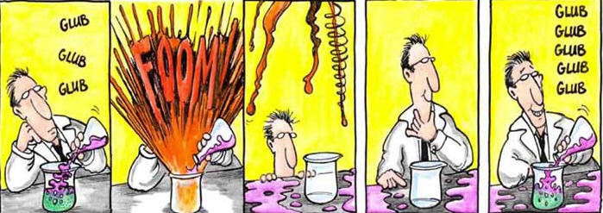


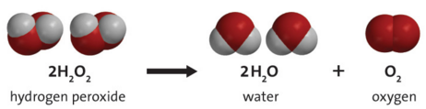
What are the Types of Chemical Reactions?
Notes:
0.5 min
Recap: Many chemical reactions have distinct signs that they have occurred.
Connect: On the lab bench are several chemicals. Will a reaction occur when we mix them? How do we know?
Preview: In this part of the lesson, you will learn about the different types of reactions.
SOURCES:
https://commons.wikimedia.org/wiki/File:Chemicals_in_flasks.jpg
https://commons.wikimedia.org/wiki/File:Chemicals-HP.jpg

Slide 46
Types of Chemical Reactions
There are FIVE general types of Chemical reactions:
synthesis
decomposition
single-replacement
double-replacement
combustion
Not all chemical reactions fit uniquely into one category, but may fit equally well into two categories. For instance:
e.g. If one of the reactants in a synthesis reaction is oxygen gas [O₂], the reaction is also a combustion reaction.

Slide 47
Types of Chemical Reactions
There are FIVE general types of Chemical reactions:
synthesis
decomposition
single-replacement
double-replacement
combustion
https://screencast-o-matic.com/watch/cF6wqiYJWW
(3:56)

Slide 48
Types of Chemical Reactions
  Synthesis or Combination Reactions
  A synthesis or combination reaction is a chemical change in which two or more substances react to form ONE single new substance (ONE PRODUCT): A + X → AX
  e.g. Magnesium metal and oxygen gas react chemically. Write a balanced equation for this synthesis reaction:
http://somup.com/cF6wlpnh8s (3:21)

Slide 49
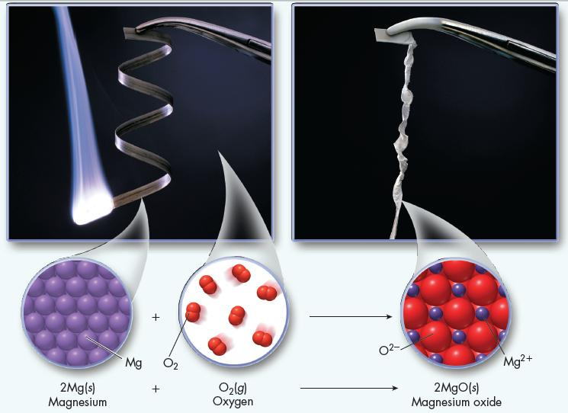
Synthesis Reactions
  e.g. Magnesium metal and oxygen gas combine to form the compound magnesium oxide. Write a balanced equation for this synthesis reaction (one product):
2Mg⁰ (s) + O₂⁰ → 2Mg⁺²O⁻²(s)

Slide 50
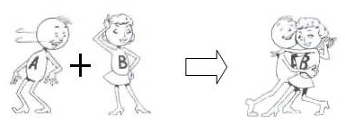
Synthesis Reactions
  When a Group A metal and a nonmetal react, the product is a binary ionic compound. What is the synthesis reaction of potassium and chlorine gas?

Slide 51
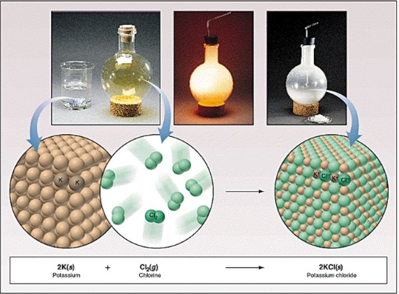
Synthesis Reactions
  When a Group A metal and a nonmetal react, the product is a binary ionic compound. What is the synthesis reaction of potassium and chlorine gas?
  2K⁰ (s) + Cl₂⁰ (g) → 2K⁺¹Cl⁻¹(s)

Slide 52
Synthesis Reactions
  Two nonmetals can react in a combination reaction. What is the synthesis reaction of sulfur and oxygen gas?

Slide 53
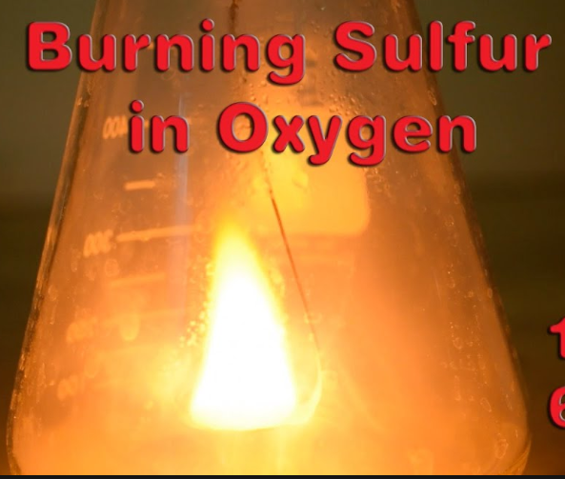
Synthesis Reactions
  Two nonmetals can react in a combination reaction. What is the synthesis reaction of sulfur and oxygen gas?
  S⁰ (s) + O₂⁰ (g) → S⁺⁴O₂⁻²(g)
  sulfur + oxygen → sulfur dioxide

Slide 54
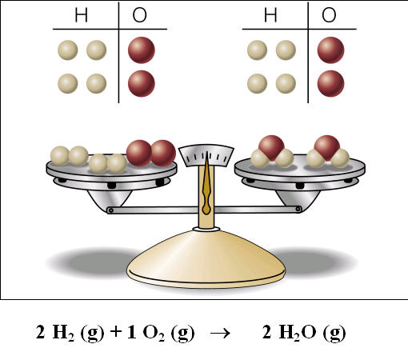
Synthesis Reactions
  Synthesis of Water
  http://somup.com/cF6vqBnhdt (2:15)
  http://somup.com/cF6vqwnhdr (0:38)
  hydrogen + oxygen → water

Slide 55
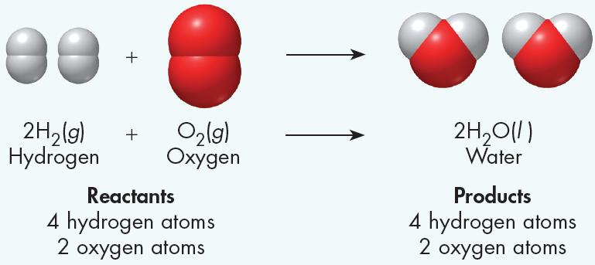
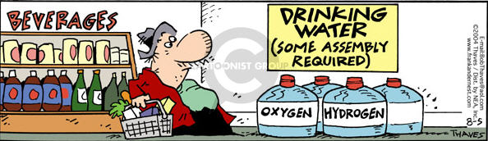
Synthesis Reactions
Notice the balanced chemical equation for synthesis of water.

Slide 56
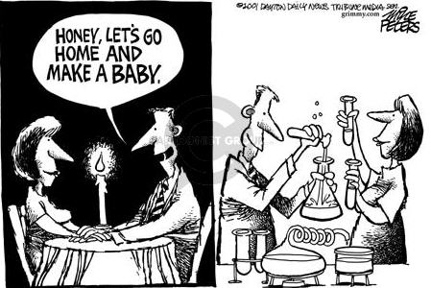
Synthesis Reactions

Slide 57
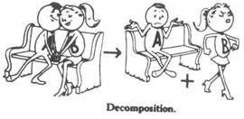
Types of Chemical Reactions
Decomposition Reactions
  Decomposition reactions are the opposite of synthesis reactions.
  ONE substance breaks down into simpler substances.
  ONE REACTANT breaks down to more than one product.
  AX → A + X
  Most decomposition reactions require energy in the form of heat, light, or electricity (ENDOthermic).
∆

Slide 58
Decomposition Reactions
  e.g. When mercury(II) oxide is heated, it decomposes or breaks down into two simpler substances. Write a balanced equation for this decomposition reaction:

Slide 59
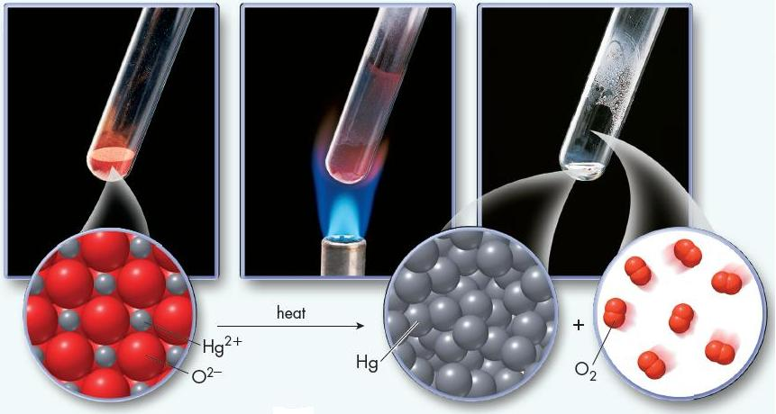
Decomposition Reactions
  e.g. When mercury(II) oxide is heated, it decomposes or breaks down into two simpler substances. Write a balanced equation for this decomposition reaction:
2Hg⁺²O⁻²(s) 2Hg⁰ (l) + O₂⁰ (g)
heat

Slide 60
Decomposition Reactions
At room temperature and pressure magnesium nitride is a greenish yellow powder sometimes used as a catalyst. Write and balance the equation for the decomposition of magnesium nitride.

Slide 61
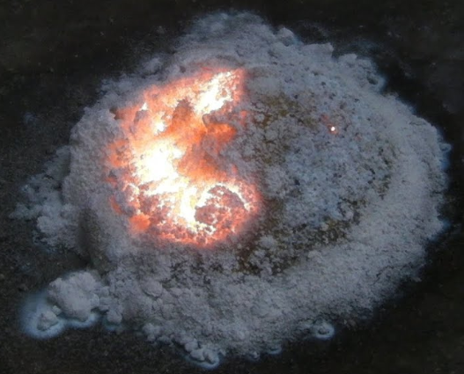
Decomposition Reactions
At room temperature and pressure magnesium nitride is a greenish yellow powder sometimes used as a catalyst. Write and balance the equation for the decomposition of magnesium nitride.
  Mg₃⁺²N₂⁻³(s) → 3Mg⁰ (s) + N₂⁰ (g)

Slide 62

Types of Chemical Reactions
Single-Replacement Reactions:
A more ACTIVE element will displace a less active element that is already part of a compound.
A + BC → AC + B
A metal may displace another metal:
AN + B → BN + A
A non-metal may displace another non-metal:
MX + Y → MY + X

Slide 63
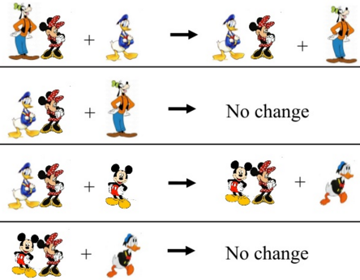
Single Replacement Reactions
Whether a certain metal replaces another metal or a non-metal replaces another non-metal is determined by the activity series.
2 K⁰ + LiCl → no reaction Li > K
2 NaF + Cl₂⁰ → no reaction F > Cl

Slide 64
Activity Series: description of the relative reactivity of elements
Single Replacement Reactions
Metals:
Non-Metals: (activity series for halogens)
See REFERENCE TABLE N
Li > Rb > K > Cs > Ba > Sr > Ca > Na > Mg > Al > Mn > Zn > Cr
> Fe > Cd > Co > Ni > Sn > Pb > Sb > Bi > Cu > Ag > Hg > Au > Pt
F₂ > Cl₂ > Br₂ > I₂
more reactive less reactive
Notes:
Timing ≈ 2 min
Chemists use activity series to predict the outcomes of reactions. An activity series is a description of the relative reactivity of a set of elements.
In an activity series, elements are listed from most reactive to least reactive. [animate arrow]
[animate white box] Here we see the activity series for many common metals. [teacher point out that list continues from Cr to second row--i.e., it's all one series, just shown in two parts here for space--Fe is not more reactive than Zn]
[teacher walk through a couple of examples of relative reactivity, e.g., Sr is more reactive than Mn but less reactive than K]
We can also write an activity series for halogens. [animate grey box]

Slide 65
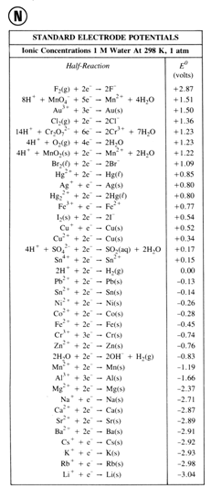
Single Replacement Reactions
The activity series of Metals & Non-metals
As one proceeds DOWN the table, metals become more active, meaning a metal listed LOWER on the table will replace a metal listed higher on the table.
As one proceeds UP the table, non-metals become more active, meaning a non-metal listed HIGHER on the table will replace a non-metal listed lower on the table.
Increasing non-metallic reactivity
Increasing metallic reactivity

Slide 66
Activity Series of Metals
 | Name | Symbol
 | Lithium | Li
 | Potassium | K
 | Sodium | Na
 | Magnesium | Mg
 | Aluminum | Al
 | Zinc | Zn
 | Iron | Fe
 | Lead | Pb
 | Copper | Cu
 | Mercury | Hg
 | Silver | Ag
Single Replacement Reactions
Decreasing reactivity
The activity series of Metals
A reactive metal will replace any metal listed below it in the activity series.
Will copper displace silver from a silver compound in solution?
Cu⁰ _{(s)} + AgNO_{3 (aq)} → ?

Slide 67
Activity Series of Metals
 | Name | Symbol
 | Lithium | Li
 | Potassium | K
 | Sodium | Na
 | Magnesium | Mg
 | Aluminum | Al
 | Zinc | Zn
 | Iron | Fe
 | Lead | Pb
 | CopperII | Cu
 | Mercury | Hg
 | Silver | Ag
Single Replacement Reactions
Decreasing reactivity
The activity series of Metals
A reactive metal will replace any metal listed below it in the activity series.
Copper will displace silver from a silver compound in solution, but copper will not displace zinc, calcium, or any other metal higher up on the activity series.
Cu⁰ _{(s)} + 2 AgNO_{3 (aq)} → Cu(NO₃)_{2 (aq)} + 2 Ag⁰ _{(s)}
Cu > Ag

Slide 68
Single Replacement Reactions
(metals)
  Consider the following and determine whether a reaction will occur. If so, write a balanced equation to show the reaction.
Aluminum added to IronIII Oxide
Potassium added to ZincII Chloride
Potassium added to Lithium Chloride
Activity Series of Metals
Lithium | Li
Potassium | K
Sodium | Na
Magnesium | Mg
Aluminum | Al
Zinc | Zn
Iron | Fe
Lead | Pb
Copper | Cu
Mercury | Hg
Silver | Ag

Slide 69
Single Replacement Reactions
(metals)
  Consider the following and determine whether a reaction will occur. If so, write a balanced equation to show the reaction.
Aluminum added to IronIII Oxide
2Al⁰ + Fe₂⁺³O₃⁻² → Al₂⁺³O₃⁻² + 2Fe⁰
… Al > Fe
Potassium added to ZincII Chloride
2 K⁰ + Zn⁺²Cl₂⁻¹ → 2 K⁺¹Cl⁻¹ + Zn⁰
… K > Zn
Potassium added to Lithium Chloride
K⁰ + Li⁺¹Cl⁻¹ → no reaction
… Li > K
Activity Series of Metals
Lithium | Li
Potassium | K
Sodium | Na
Magnesium | Mg
Aluminum | Al
Zinc | Zn
Iron | Fe
Lead | Pb
Copper | Cu
Mercury | Hg
Silver | Ag

Slide 70
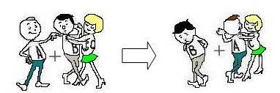
Single Replacement Reactions
F₂ > Cl₂ > Br₂ > I₂
  Activity Series for Halogens (non-metals)
  A halogen can also replace another halogen from a compound.
  The activity of halogens decreases as you go down Group VIIA of the periodic table — fluorine, chlorine, bromine, and iodine.
  Consider the following:
  Br₂⁰ (aq) + Na⁺I⁻(aq) →
  Br₂⁰ (aq) + Na⁺Cl⁻(aq) →
  Na⁺Br⁻(aq) + Cl₂⁰ _{(g)} →
  Na⁺F⁻(aq) + Cl₂⁰ →

Slide 71
Single Replacement Reactions
F₂ > Cl₂ > Br₂ > I₂
  Activity Series for Halogens (non-metals)
  Br₂⁰ (aq) + 2Na⁺I⁻(aq) → 2NaBr(aq) + I₂(aq) … Br > I
  Br₂⁰ (aq) + Na⁺Cl⁻(aq) → No reaction … Cl > Br
  2Na⁺Br⁻(aq) + Cl₂⁰ _{(g)} → 2NaCl(aq) + Br₂⁰ _{(s)} … Cl > Br
  Na⁺F⁻(aq) + Cl₂⁰ → no reaction … F > Cl

Slide 72
Polyatomic Ions
Single Replacement Reactions
A copper wire suspended in an aqueous solution of silver nitrate developed a deposit of silver crystals on it when the copper II reacted with the silver nitrate. Write a skeletal equation for this reaction:
Balance the chemical equation as normal, treating the polyatomic ion as one unit.
Inspect the equation for conservation of mass.

Slide 73
Polyatomic Ions
Single Replacement Reactions
A copper wire suspended in an aqueous solution of silver nitrate developed a deposit of silver crystals on it when the copper II reacted with the silver nitrate. Write a skeletal equation for this reaction:
… Cu > Ag
Cu⁰ (s) + Ag⁺NO₃⁻(aq) → Cu⁺²(NO₃)₂⁻(aq) + Ag⁰ (s)
Because the nitrate polyatomic ion appears as a reactant and a product, this ion can be balanced as a unit.
Balance the chemical equation as normal, treating the polyatomic ion as one unit.
Cu(s) + 2AgNO₃(aq) → Cu(NO₃)₂(aq) + 2Ag(s)
Inspect the equation for conservation of mass.

Slide 74
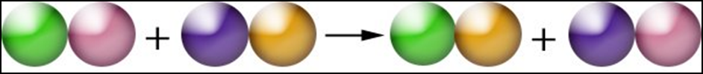
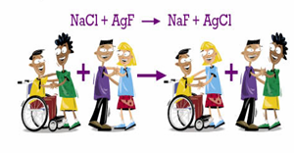
Types of Chemical Reactions
  Double-Replacement Reactions
  When two ionic compounds are mixed and they react, the positive and negative ions of the two compounds are interchanged
AX + BY → AY + BX

Slide 75
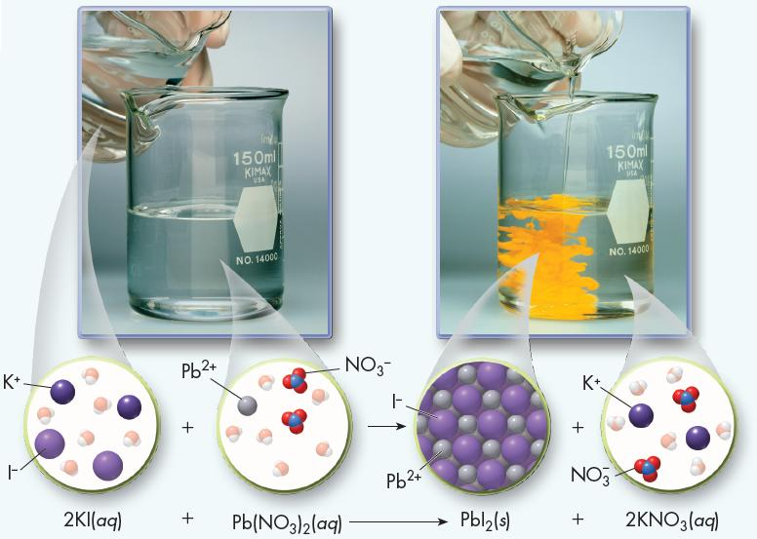
Double Replacement Reactions
  Mixing aqueous solutions of potassium iodide and lead(II) nitrate results in a chemical reaction in which a yellow precipitate of solid lead(II) iodide is formed.

Slide 76
Double Replacement Reactions
  AQUEOUS (dissolved in water) means to “dissociate” or split into ions. Notice how both aqueous solutions became “free” ions that can rearrange to form a new product when mixed.

Slide 77
Double Replacement Reactions
  Mixing aqueous solutions of potassium iodide and lead(II) nitrate results in a chemical reaction in which a yellow precipitate of solid lead(II) iodide is formed.
  2KI(aq) + Pb(NO₃)₂(aq) → PbI₂(s) + 2KNO₃(aq)
  This is an example of a double-replacement reaction, which is a chemical change involving an exchange of positive ions between two compounds.

Slide 78
Double Replacement Reactions
Double-replacement reactions are also referred to as ION exchange or double-displacement reactions.
To determine if a double displacement reaction has taken place, look at the PRODUCTS of the reaction.
One of the following products will have formed:
a gas is evolved in the reaction (g) or ↑
Precipitate formation (s) or ↓
A molecular (covalently bonded) substance, water is formed

Slide 79
Double Replacement Reactions
Look at the following Double-Replacement Reactions. Write a balanced chemical equation based on the type of product formed:
Barium Chloride + Potassium Carbonate → precipitate
IronII Sulfide + Hydrochloric Acid → gas
Sodium Hydroxide + Sulfuric Acid → water
Refer to REFERENCE TABLE E

Slide 80
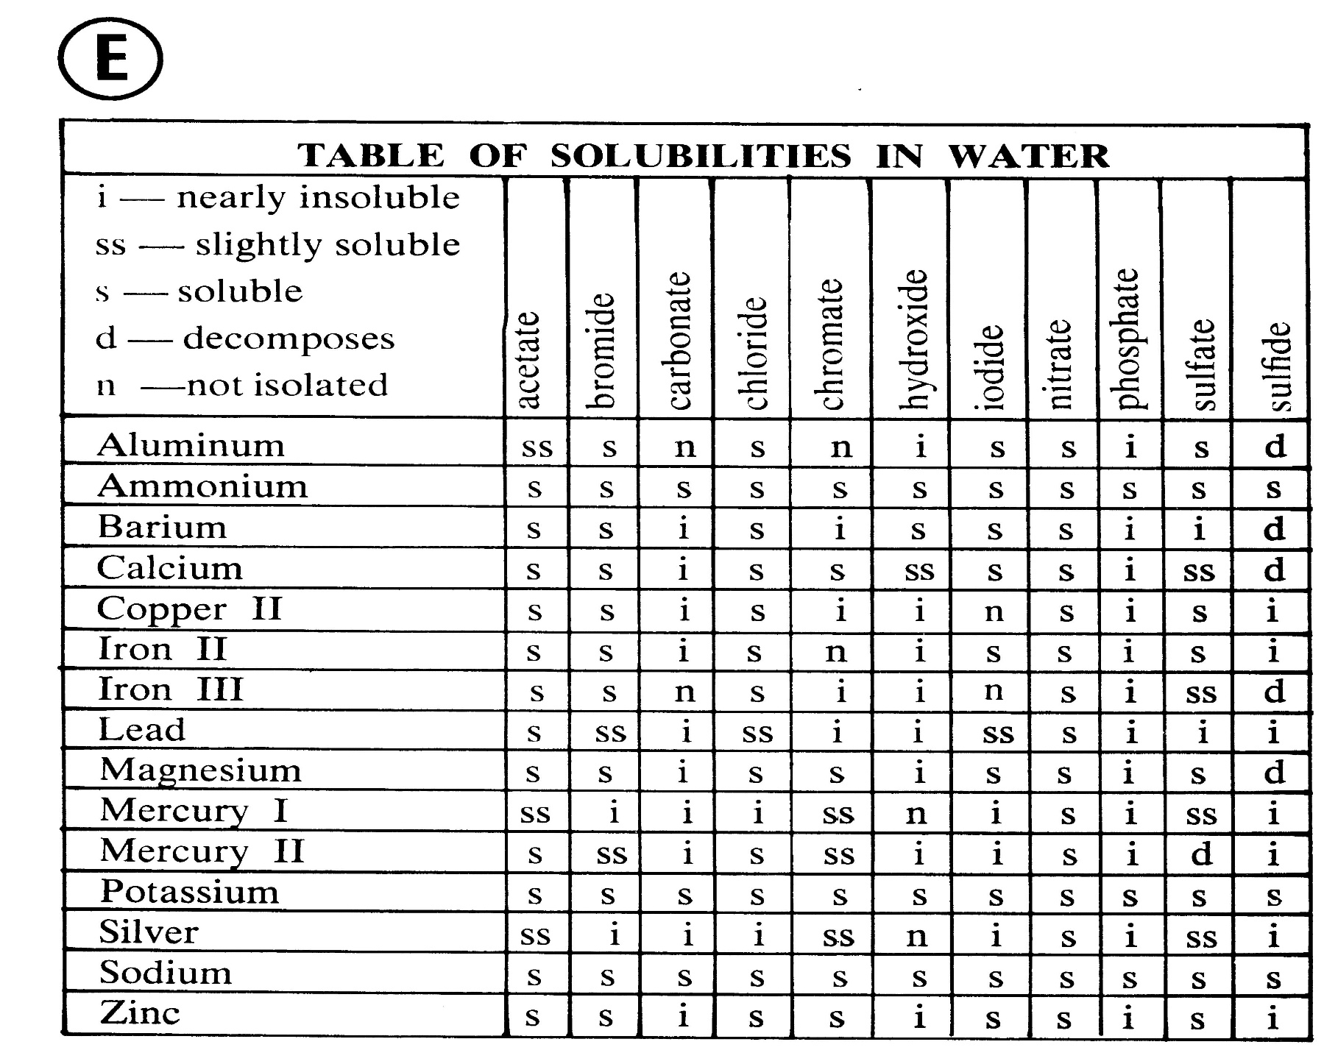
Refer to REFERENCE TABLE E
i → precipitate forms

Slide 81
Double Replacement Reactions
Look at the following Double-Replacement Reactions. Write a balanced chemical equation based on the type of product formed:
Barium Chloride + Potassium Carbonate → precipitate
Ba⁺²Cl₂⁻ _{(aq)} + K₂⁺CO₃⁻²_{(aq)} → Ba⁺²CO₃⁻²↓ + 2 K⁺Cl⁻_{(aq)}
IronII Sulfide + Hydrochloric Acid → gas
Fe⁺²S⁻²_{(aq)} + 2 HCl⁻_{(aq)} → Fe⁺²Cl₂⁻ _{(aq)} + H₂S⁻² ↑
Sodium Hydroxide + Sulfuric Acid → water
2 Na⁺OH⁻_{(aq)} + H₂SO₄⁻²_{(aq)} → Na₂⁺SO₄⁻²_{(aq)} + 2 HOH⁻
Refer to REFERENCE TABLE E

Slide 82
Net Ionic Equations
  Since double displacement reactions involve ONLY ionic compounds, we use ionic equations to represent the ion exchange.
Zn⁺²Br₂⁻¹ _{(aq)} + 2 Ag⁺¹NO₃⁻¹ _{(aq)} → 2 Ag⁺Br⁻ ↓ + Zn⁺²(NO₃)₂⁻¹ _{(aq)}
In aqueous solutions, ionic compounds dissociate (ions break apart in water).

Slide 83
Net Ionic Equations
  Since double displacement reactions involve ONLY ionic compounds, we use ionic equations to represent the ion exchange.
Zn⁺²Br₂⁻¹ _{(aq)} + 2 Ag⁺¹NO₃⁻¹ _{(aq)} → 2 Ag⁺Br⁻ ↓ + Zn⁺²(NO₃)₂⁻¹ _{(aq)}
Zn⁺²_{(aq)} + 2Br⁻¹_{(aq)} + 2Ag⁺¹_{(aq)} + 2NO₃⁻¹_{(aq)} → 2AgBr ↓ + Zn⁺²_{(aq)} + 2NO₃⁻¹_{(aq)}
In aqueous solutions, ionic compounds dissociate (ions break apart in water).
What produced the “precipitate”?

Slide 84
Net Ionic Equations
Zn⁺²Br₂⁻¹ _{(aq)} + 2 Ag⁺¹NO₃⁻¹ _{(aq)} → 2 Ag⁺Br⁻ ↓ + Zn⁺²(NO₃)₂⁻¹ _{(aq)}
Zn⁺²_{(aq)} + 2Br⁻¹_{(aq)} + 2Ag⁺¹_{(aq)} + 2NO₃⁻¹_{(aq)} → 2AgBr ↓ + Zn⁺²_{(aq)} + 2NO₃⁻¹_{(aq)}
Since only certain ions are actually involved in the recognizable reaction, we can write a NET ionic equation to show what actually took place:
Ag⁺¹ _{(aq)} + Br⁻¹ _{(aq)} → AgBr ↓
The other ions in the reaction were not involved in the reaction, therefore, we call these spectator ions.
Zn⁺², NO₃⁻¹

Slide 85
Net Ionic Equations
  Get out an 8.5 x 11” sheet of paper.
  Fold it down the middle and tear it in half (8.5 x 5.5”).
  On one half write the formula for Barium chloride
  On the other half write the formula for Aluminum sulfate (assume aqueous solutions)
  Include oxidation states and write BIG (fill each half).
  half sheet half sheet
  Ba⁺²Cl₂⁻¹_{(aq)} Al₂⁺³(SO₄)₃⁻²_{(aq)}

Slide 86
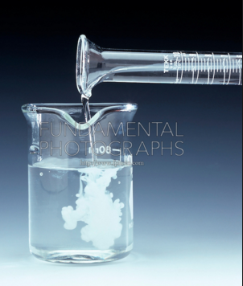
Net Ionic Equations
  Fold each paper again to SPLIT up the ions.
  You will have 4 separate ions (dissociated in water)
  Ba⁺² Cl₂⁻¹ Al₂⁺³ (SO₄)₃⁻²
  The picture shows the reaction of barium chloride added to aluminum sulfate. Notice a precipitate forms meaning the reaction took place.
  Rearrange the ions to show the products.

Slide 87

  Ba⁺² SO₄⁻² Al⁺³ Cl⁻¹
  Notice the TWO possible precipitates.
  Use Reference Table E to determine which is the actual precipitate in the reaction.

Slide 88
Refer to REFERENCE TABLE E
i → precipitate forms

Slide 89
  Ba⁺² SO₄⁻² Al⁺³ Cl⁻¹
  Notice the TWO possible precipitates.
  Use Reference Table E to determine which is the actual precipitate in the reaction.
  Barium sulfate is INSOLUBLE → precipitate ↓
  Aluminum Chloride is SOLUBLE → aqueous.

Slide 90

Skeletal Equation:

Slide 91
Skeletal Equation:
Ba⁺²Cl₂⁻¹ _{(aq)} + Al₂⁺³(SO₄)₃⁻² _{(aq)} → BaSO₄ ↓ + Al⁺³Cl₃⁻¹ _{(aq)}

Slide 92
Skeletal Equation:
Ionic Equation:
Ba⁺²Cl₂⁻¹ _{(aq)} + Al₂⁺³(SO₄)₃⁻² _{(aq)} → BaSO₄ ↓ + Al⁺³Cl₃⁻¹ _{(aq)}

Slide 93
Skeletal Equation:
Ba⁺²Cl₂⁻¹ _{(aq)} + Al₂⁺³(SO₄)₃⁻² _{(aq)} → BaSO₄ ↓ + Al⁺³Cl₃⁻¹ _{(aq)}
Ionic Equation: (assume all ions are aqueous, dissociated free ions)
Ba⁺²_{(aq)} + 2Cl⁻¹_{(aq)} + 2Al⁺³_{(aq)} + 3SO₄⁻²_{(aq)} → BaSO₄↓ + Al⁺³_{(aq)} + 3Cl⁻¹ _{(aq)}

Slide 94
Skeletal Equation:
Ba⁺²Cl₂⁻¹ _{(aq)} + Al₂⁺³(SO₄)₃⁻² _{(aq)} → BaSO₄ ↓ + Al⁺³Cl₃⁻¹ _{(aq)}
Ionic Equation: (assume all ions are aqueous, dissociated free ions)
Ba⁺²_{(aq)} + 2Cl⁻¹_{(aq)} + 2Al⁺³_{(aq)} + 3SO₄⁻²_{(aq)} → BaSO₄↓ + Al⁺³_{(aq)} + 3Cl⁻¹ _{(aq)}
NET Ionic Equation:

Slide 95
Skeletal Equation:
Ba⁺²Cl₂⁻¹ _{(aq)} + Al₂⁺³(SO₄)₃⁻² _{(aq)} → BaSO₄ ↓ + Al⁺³Cl₃⁻¹ _{(aq)}
Ionic Equation: (assume all ions are aqueous, dissociated free ions)
Ba⁺²_{(aq)} + 2Cl⁻¹_{(aq)} + 2Al⁺³_{(aq)} + 3SO₄⁻²_{(aq)} → BaSO₄↓ + Al⁺³_{(aq)} + 3Cl⁻¹ _{(aq)}
NET Ionic Equation:
Ba⁺² _{(aq)} + SO₄⁻² _{(aq)} → BaSO₄ ↓

Slide 96
Skeletal Equation:
Ba⁺²Cl₂⁻¹ _{(aq)} + Al₂⁺³(SO₄)₃⁻² _{(aq)} → BaSO₄ ↓ + Al⁺³Cl₃⁻¹ _{(aq)}
Ionic Equation: (assume all ions are aqueous, dissociated free ions)
Ba⁺²_{(aq)} + 2Cl⁻¹_{(aq)} + 2Al⁺³_{(aq)} + 3SO₄⁻²_{(aq)} → BaSO₄↓ + Al⁺³_{(aq)} + 3Cl⁻¹ _{(aq)}
NET Ionic Equation:
Ba⁺² _{(aq)} + SO₄⁻² _{(aq)} → BaSO₄ ↓
Spectator Ions:

Slide 97
Skeletal Equation:
Ba⁺²Cl₂⁻¹ _{(aq)} + Al₂⁺³(SO₄)₃⁻² _{(aq)} → BaSO₄ ↓ + Al⁺³Cl₃⁻¹ _{(aq)}
Ionic Equation: (assume all ions are aqueous, dissociated free ions)
Ba⁺²_{(aq)} + 2Cl⁻¹_{(aq)} + 2Al⁺³_{(aq)} + 3SO₄⁻²_{(aq)} → BaSO₄↓ + Al⁺³_{(aq)} + 3Cl⁻¹ _{(aq)}
NET Ionic Equation:
Ba⁺² _{(aq)} + SO₄⁻² _{(aq)} → BaSO₄ ↓
Spectator Ions: Al⁺³Cl₃⁻¹(aq) is soluble in water
Al⁺³, 3Cl⁻¹

Slide 98
Skeletal Equation:
Ba⁺²Cl₂⁻¹ _{(aq)} + Al₂⁺³(SO₄)₃⁻² _{(aq)} → BaSO₄ ↓ + Al⁺³Cl₃⁻¹ _{(aq)}
Ionic Equation: (assume all ions are aqueous, dissociated free ions)
Ba⁺²_{(aq)} + 2Cl⁻¹_{(aq)} + 2Al⁺³_{(aq)} + 3SO₄⁻²_{(aq)} → BaSO₄↓ + Al⁺³_{(aq)} + 3Cl⁻¹ _{(aq)}
NET Ionic Equation:
Ba⁺² _{(aq)} + SO₄⁻² _{(aq)} → BaSO₄ ↓
Spectator Ions: Al⁺³Cl₃⁻¹(aq) is soluble in water
Al⁺³, 3Cl⁻¹
Balanced Equation:

Slide 99
Skeletal Equation:
Ba⁺²Cl₂⁻¹ _{(aq)} + Al₂⁺³(SO₄)₃⁻² _{(aq)} → BaSO₄ ↓ + Al⁺³Cl₃⁻¹ _{(aq)}
Ionic Equation: (assume all ions are aqueous, dissociated free ions)
Ba⁺²_{(aq)} + 2Cl⁻¹_{(aq)} + 2Al⁺³_{(aq)} + 3SO₄⁻²_{(aq)} → BaSO₄↓ + Al⁺³_{(aq)} + 3Cl⁻¹ _{(aq)}
NET Ionic Equation:
Ba⁺² _{(aq)} + SO₄⁻² _{(aq)} → BaSO₄ ↓
Spectator Ions: Al⁺³Cl₃⁻¹(aq) is soluble in water
Al⁺³, 3Cl⁻¹
Balanced Equation:
3Ba⁺²Cl₂⁻¹_{(aq)} + Al₂⁺³(SO₄)₃⁻²_{(aq)} → 3BaSO₄ ↓ + 2Al⁺³Cl₃⁻¹_{(aq)}

Slide 100
General Rules for Solubility of Ionic Compounds
Solubility Rules for Ionic Compounds
Compounds | Solubility | Exceptions
Salts of alkali metals and ammonia | Soluble | Some lithium compounds
Nitrate salts and chlorate salts | Soluble | Few exceptions
Sulfate salts | Soluble | Compounds of Pb, Ag, Hg, Ba, Sr, and Ca
Chloride salts | Soluble | Compounds of Ag and some compounds of Hg and Pb
Carbonates, phosphates, chromates, sulfides, and hydroxides | Most are insoluble | Compounds of the alkali metals and of ammonia

Slide 101
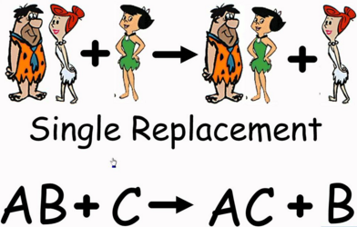
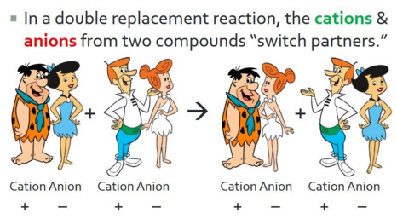
Review 4 Chemical Reactions
Synthesis

Slide 102
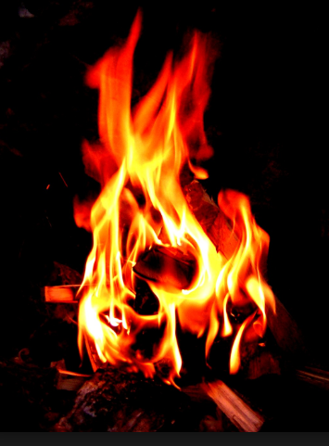
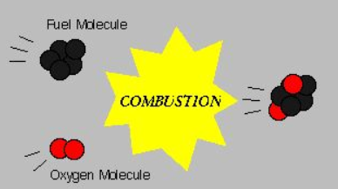
Types of Chemical Reactions
Combustion Reactions
A combustion reaction is a chemical change in which an element or a compound reacts with oxygen, often producing energy in the form of heat and light.

Slide 103
Types of Chemical Reactions
Combustion Reactions
A combustion reaction is a chemical change in which an element or a compound reacts with oxygen, often producing energy in the form of heat and light.
Often the other reactant (fuel) is a hydrocarbon, which is a compound composed of hydrogen and carbon. The complete combustion of a hydrocarbon produces carbon dioxide and water.
CH₄ + 2 O₂ → CO₂ + H₂O
hydrocarbon + oxygen → carbon dioxide + water

Slide 104
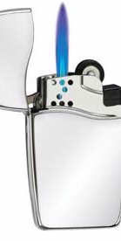
Complete combustion
A butane lighter works by evaporating liquid butane and then burning it. Write the balanced equation for the complete combustion of butane (C₄H₁₀). Start with the skeletal equation:

Slide 105
Complete combustion
A butane lighter works by evaporating liquid butane and then burning it. Write the balanced equation for the complete combustion of butane (C₄H₁₀).
C₄H₁₀ (g) + O₂ (g) → CO₂ (g) + H₂O (g)
Notice in the skeletal formula:
that oxygen is “even” as a reactant (2 atoms),
but “odd” as a product (3 → 2 atom + 1 atom).
This means that the coefficient with water MUST be “even.”
Continue balancing …

Slide 106
Complete combustion
A butane lighter works by evaporating liquid butane and then burning it. Write the balanced equation for the complete combustion of butane (C₄H₁₀).
C₄H₁₀ (g) + O₂ (g) → CO₂ (g) + H₂O (g)
Notice in the skeletal formula that oxygen is “even” as a reactant (2), but “odd” as a product (3). This means that the coefficient with water MUST be “even.”
Use trial and error to determine what coefficients work for each element (e.g. oxygen).
C₄H₁₀ (g) + O₂ (g) → CO₂ (g) + 2H₂O (g)
This equation does NOT account for the # of hydrogens (left).
There must be 10 H atoms on both sides.

Slide 107
Complete combustion
A butane lighter works by evaporating liquid butane and then burning it. Write the balanced equation for the complete combustion of butane (C₄H₁₀).
C₄H₁₀ (g) + O₂ (g) → CO₂ (g) + H₂O (g)
Notice in the skeletal formula that oxygen is “even” as a reactant (2), but “odd” as a product (3). This means that the coefficient with water MUST be “even.” Use trial and error to determine what coefficients work for each element.
C₄H₁₀ (g) + O₂ (g) → CO₂ (g) + 5H₂O (g)
There is still an “ODD” number of O atoms on the right.

Slide 108
Complete combustion
A butane lighter works by evaporating liquid butane and then burning it. Write the balanced equation for the complete combustion of butane (C₄H₁₀).
C₄H₁₀ (g) + O₂ (g) → CO₂ (g) + H₂O (g)
Notice in the skeletal formula that oxygen is “even” as a reactant (2), but “odd” as a product (3). This means that the coefficient with water MUST be “even.” Use trial and error to determine what coefficients work for each element.
C₄H₁₀ (g) + O₂ (g) → CO₂ (g) + 10H₂O (g)
This equation does NOT account for the # of hydrogens (left).
Balanced equation:
2C₄H₁₀ (g) + 13O₂ (g) → 8CO₂ (g) + 10H₂O (g)

Slide 109
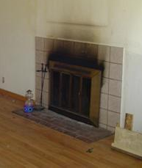
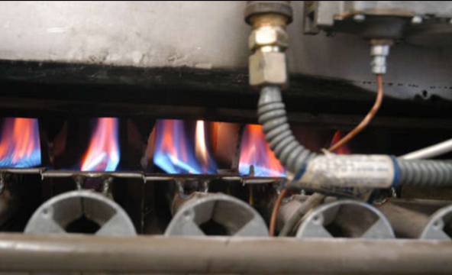
Incomplete Combustion Enrichment
Complete combustion:
2CH₄ (g) + 4O₂ (g) → 2CO₂ (g) + 4H₂O (g)
Incomplete combustion can produce pure carbon (e.g. soot in chimneys).
Incomplete combustion is characterized by an orange colored flame.

Slide 110
Incomplete Combustion Enrichment
Complete combustion:
2CH₄ (g) + 4O₂ (g) → 2CO₂ (g) + 4H₂O (g)
If the supply of oxygen is limited during a reaction, the combustion will be incomplete. Even more toxic CO gas may be formed instead of CO₂.
Incomplete combustion:
2CH₄ (g) + 3O₂ (g) → 2CO (g) + 4H₂O (g)

Slide 111
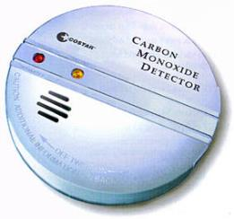
Incomplete Combustion Enrichment
Incomplete combustion:
2CH₄ (g) + 3O₂ (g) → 2CO (g) + 4H₂O (g)
If even less oxygen is present:
2CH₄ (g) + 2O₂ (g) → 2C (s) + 4H₂O (g)
Product: soot
It’s a good idea to have CO detector in home

Slide 112
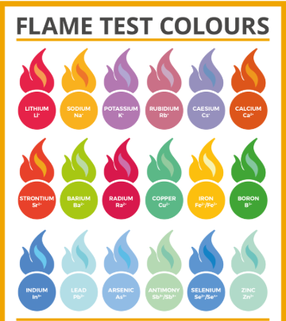
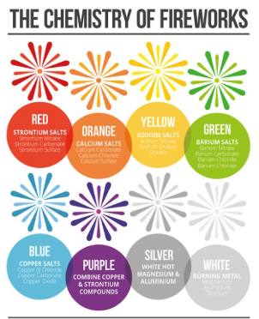
Metals Exhibit Combustion
Metals react with oxygen in the air to produce metal oxides and give off heat and light.

Slide 113
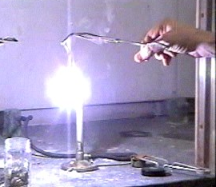
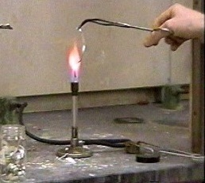
Metals Exhibit Combustion
If you heat the metal magnesium to a high enough temperature in the presence of oxygen, the following synthesis reaction occurs:
2Mg (s) + O₂ (g) → 2MgO (s)
Mg burns HOT (2200 ◦C) with an extremely bright light, and also produces UV light; and it burns in the presence of CO₂, so a CO₂ fire extinguisher won’t put out the flame; a dry-chemical fire extinguisher must be used instead.
Watch at:
http://somup.com/cF6vqrnhdl (1:22)

Slide 114
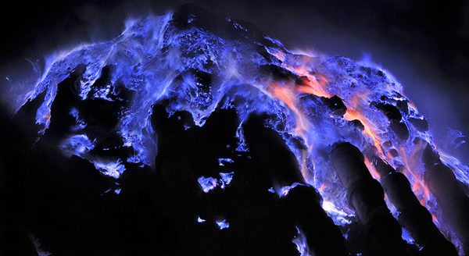
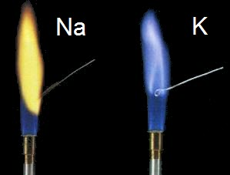


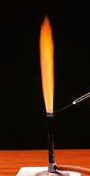

Other Combustion Reactions Enrichment
Sulfur is only mildly flammable under normal atmospheric conditions, but in pure oxygen, it burns with a blue
flame. The products of the
combustion are SO₂ and SO₃:
S(s) + O₂(g) → SO₂(g)
2S(s) + 3O₂(g) → 2SO₃(g)
Many elements burn with characteristic colored flames.
Flame tests for Na, K, Cu, Li, Ca, Ba

Slide 115
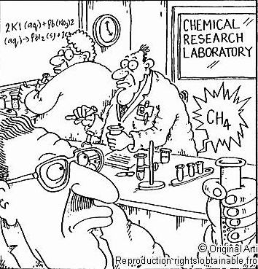

Slide 116
Name the type of Chemical Reactions.
2 K + F₂ → 2 KF
Ca(ClO₃)₂ → CaCl₂ + 3 O₂
CaCl₂ + 2AgNO₃ ⟶ Ca(NO₃)₂ + 2AgCl
C₃H₈ + 5O₂ ⟶ 3CO₂ + 4H₂O
Fe₂O₃ + 2Al ⟶ Al₂O₃ + 2Fe
Cl₂ + 2 NaBr → 2 NaCl + Br₂

Slide 117
Name the type of Chemical Reactions.
2 K + F₂ → 2 KF
Synthesis
Ca(ClO₃)₂ → CaCl₂ + 3 O₂
Decomposition reaction
CaCl₂ + 2AgNO₃ ⟶ Ca(NO₃)₂ + 2AgCl
Double Displacement reaction
C₃H₈ + 5O₂ ⟶ 3CO₂ + 4H₂O
Combustion reaction
Fe₂O₃ + 2Al ⟶ Al₂O₃ + 2Fe
Single replacement (metals)
Cl₂ + 2 NaBr → 2 NaCl + Br₂
Single replacement (non-metals)

Slide 118

Review
In a synthesis (combination) reaction, two or more reactants (elements or compounds) combine to form a single product.

Slide 119

Review
In a decomposition reaction, a single compound is the reactant; two or more substances are the products.
Notes:
119

Slide 120

Review
An element and a compound are the reactants in a single-replacement reaction.
Notes:
120

Slide 121

Review
In a double-replacement reaction, two ionic compounds are the reactants; two new compounds are the products.
Notes:
121

Slide 122

Review
The reactants in a complete combustion reaction are oxygen and a hydrocarbon. The products of most complete combustion reactions are carbon dioxide and water.
Metals react with oxygen for a combustion reaction as well, which is often a synthesis reaction as well.
Notes:
122

Slide 123

Review
Aqueous solutions of silver nitrate and sodium chloride react as shown to the right. What type of chemical reaction is this? Write a balanced equation, the net ionic equation and name the spectator ions.

Slide 124
Refer to REFERENCE TABLE E
i → precipitate forms

Slide 125
Review
Aqueous solutions of silver nitrate and sodium chloride react as shown to the right. What type of chemical reaction is this? Write a balanced equation, the net ionic equation and name the spectator ions.
This is a double displacement reaction.
silver nitrate sodium chloride silver chloride sodium nitrate
AgNO₃(aq) + NaCl(aq) → AgCl(s) + NaNO₃(aq)
Ag⁺(aq) + NO₃–(aq) + Na⁺(aq) + Cl–(aq) → AgCl(s) + Na⁺(aq) + NO₃–(aq)
NET Ionic Equation: Ag⁺(aq) + Cl–(aq) → AgCl(s)
Spectator ions: Na⁺(aq), NO₃–(aq)

Slide 126
Review
  Of the five types of reactions identified in this chapter, both single- and double-replacement reactions can be written as net ionic equations.
  Problem:
  Will a precipitate form when aqueous solutions of Na₂CO₃(aq) and Ba(NO₃)₂(aq) are mixed? If so, write ionic & net ionic equations.
Notes:
126

Slide 127
Review
  Of the five types of reactions identified in this chapter, both single- and double-replacement reactions can be written as net ionic equations.
  Problem:
  Will a precipitate form when aqueous solutions of Na₂CO₃(aq) and Ba(NO₃)₂(aq) are mixed? If so, write ionic & net ionic equations.
Referring to the solubility rules or Reference Table N:
2Na⁺(aq) + CO₃^{2–}(aq) + Ba²⁺(aq) + 2NO₃–(aq) → BaCO₃(s)
The net ionic equation for this reaction is:
Ba²⁺(aq) + CO₃^{2–}(aq) → BaCO₃(s)
Spectator ions: Na⁺(aq), NO₃–(aq)
Notes:
127

Slide 128
Solutions of potassium carbonate and strontium nitrate react. Complete the following:
Skeletal Equation:
Ionic Equation: (assume all ions are aqueous, dissociated free ions)
NET Ionic Equation:
Spectator Ions:
Balanced Equation:

Slide 129
Solutions of potassium carbonate and strontium nitrate react. Complete the following:
Skeletal Equation:
K₂⁺CO₃^{2–}(aq) + Sr²⁺(NO₃–)₂(aq) → SrCO₃(s) + 2K⁺NO₃–(aq)
Ionic Equation: (assume all ions are aqueous, dissociated free ions)
2K⁺(aq) + CO₃^{2–}(aq) + Sr²⁺(aq) + 2NO₃–(aq) → SrCO₃ ↓ + 2K⁺(aq) + 2NO₃–(aq)
NET Ionic Equation:
CO₃^{2–}(aq) + Sr²⁺(aq) → SrCO₃ ↓
Spectator Ions: K⁺NO₃–(aq) is soluble in water
2K⁺(aq), 2NO₃–(aq)
Balanced Equation:
K⁺₂CO₃^{2–}(aq) + Sr²⁺(NO₃–)₂(aq) → SrCO₃(s) + 2K⁺NO₃–(aq)

Slide 130


Slide 131


Slide 132


Slide 133


