Slide 1
To View Slide Show
Click on “Slide Show” above
  Click on “From Current Slide”

Slide 2
Objectives: Earth’s History
1. Understand and frame Geologic time & the geologic time scale.
2. Explain how geologic time was derived and potential problems with the time scale.
3. Define radioactive dating and elements that contribute to it (index fossils, marker beds)
4. Explain variables involved with relative dating.
5. Distinguish relative dating from absolute dating.
6. List some radioactive dating “clocks”.

Slide 3
Objectives: Climate
1. Understand 5 major factors that influence global climate.
2. Explain the relationship between Carbon Dioxide levels in the atmosphere, and global temperature.
3. Describe how ocean currents and global wind patterns are created?
4. Explain thermohaline circulation.
5. Define El Niño. How do it affect climate. (optional)
6. Understand the difference between a maritime and a continental climate.
7. Define and expound global warming.
8. List the most significant greenhouse gases.
9. Distinguish between a “good” & “bad” greenhouse gas.
10. Define the major function of ozone. Explain negative issues related to ozone.

Slide 4
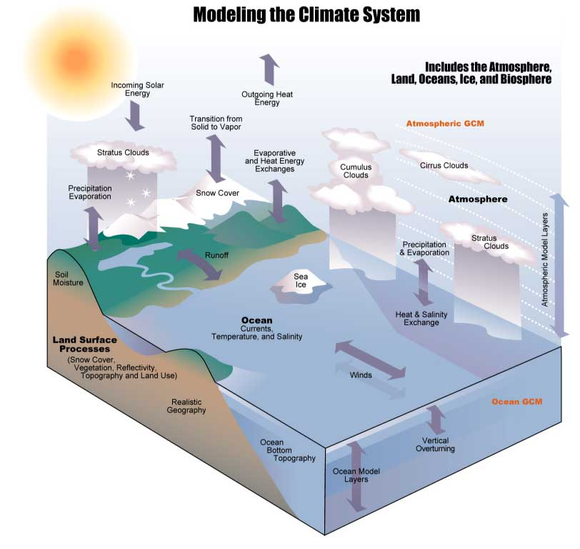
Earth History and Climate

Slide 5
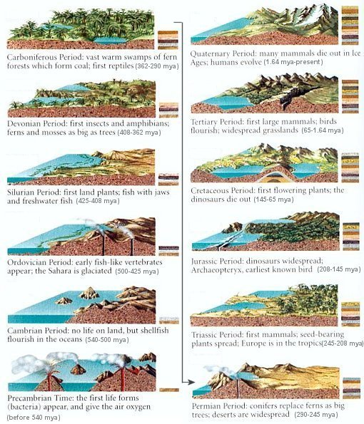
Part 1: Earth History

Slide 7
Geologic Time
Geologic time is very hard to comprehend.
Our 60-80 year life span is minimal compared to the earth’s age of 4.6 billion years.
The geologic time line is divided into Eons, Eras, Periods and Epochs.
We currently live in the part of earth history referred to as the Cenozoic Era, Quaternary Period, Holocene Epoch.

Slide 8
Geologic Time Scale
This scale outlines the development of Earth and of life on earth.
By studying fossils and applying the principle that older rock layers lie below younger rock layers, scientists determined relative ages in sedimentary rock.
Scientists use radiometric dating and geologic (rock) columns to determine relative age.

Slide 9
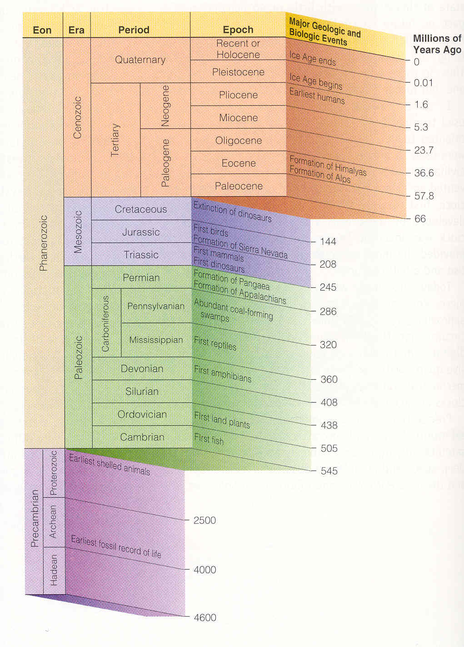
Geologic Time Scale
Notice that there are more divisions in the geologic time scale the closer we get to present day.
WHY?
(due to a better fossil record).

Slide 10
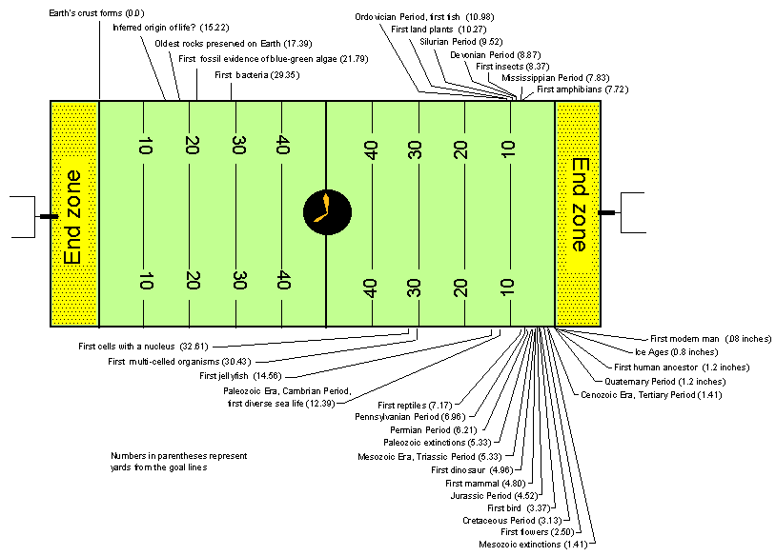
Geologic Time (“Deep Time”)
Analogy

Slide 11
Geologic Time (“Deep Time”)
Analogy

Slide 12
Geologic Time (“Deep Time”)
Analogy

Slide 13
End Zone

Slide 14
Geologic Time (“Deep Time”)
Analogy

Slide 15
Where does the Geologic Time Scale Come From?
Scientists use radiometric dating and geologic (rock) columns to determine relative age.

Slide 16
Geologic Columns
The theoretical classification system for the layers of rocks and fossils that make up the Earth's crust with the oldest rock layers are at the bottom of the column.
Geologists have associated layers of rocks with sequence of events thought to have occurred over hundreds of millions of years.

Slide 17
Problems with Geologic Columns
Fossils do not always line up in layers.
One would expect to find a lesser quality of the fossil record going down the column.
This is due to the fact that older rocks would be more likely to have been distorted then younger ones.
Unconformities exist in the expected rock layers.

Slide 18
Relative Dating
Relative dating is using rock layers and their positions to tell how old something is relative to something else. Relative dating uses:
  Index Fossils
  Marker Beds
  Principle of Fossil Succession

Slide 19
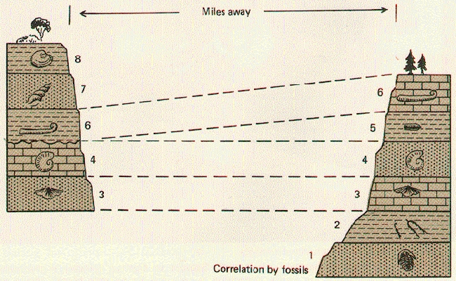
Index Fossils
Fossils that only occur in a specific time period.
These fossils must :
  have a short time period of existence
  be distinguishable
  occur over a large area.

Slide 20
Marker Beds
  A rock unit with distinctive stratigraphic (rock layer) features which can be traced over a wide area.
  A bed of rock layers that are readily distinguishable by reason of physical characteristics and are traceable over large horizontal distances.
  Stratigraphic examples include coal beds and beds of volcanic ash after a volcanic eruption.
  The term marker bed is also applied to sedimentary strata (rock layers) that provide distinctive seismic reflections.

Slide 21
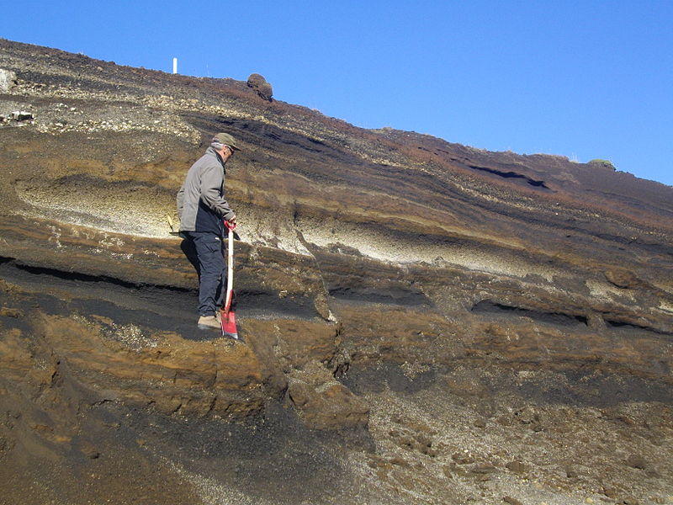
Marker Beds – Relative Age

Slide 22
Fossil Succession – Relative Age
  Principle of Fossil Succession – Rocks that have the same fossils were deposited at the same time.
  Fossil organisms originate, coexist, and disappear from the geologic record in a definite sequential order.

Slide 23
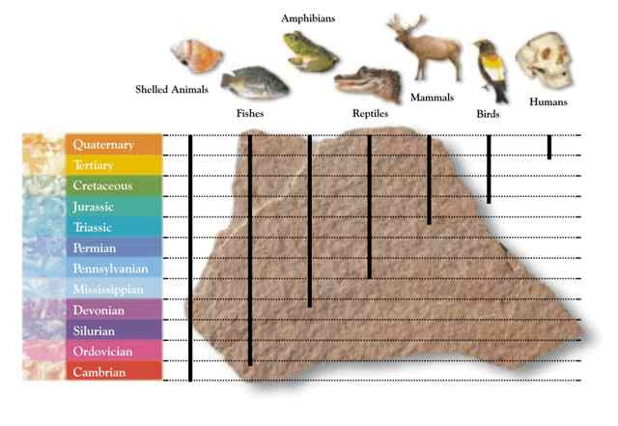

Slide 24
Relative Dating Laws:
  Superposition
    The oldest rock layers are on the bottom, youngest on the top.
  Original Horizontality
    Layers of sediment are deposited horizontally.
  Crosscutting Relationships
    Any fault, or intrusion is younger than the material it cuts through.

Slide 25
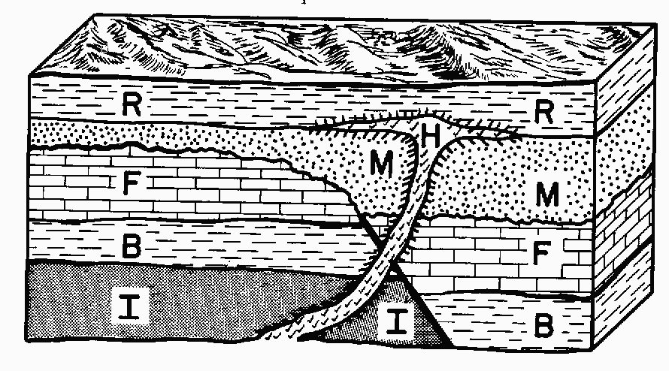
H represents an intrusion and is the younger than all layers except R
A fault caused layers F & B to shift

Slide 26
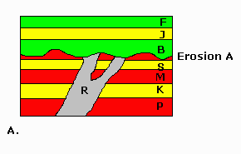
Layer R is an intrusion that is younger than layers P, K, M & S, but older than the other layers
The rock layer between layers B & S is eroding away

Slide 27
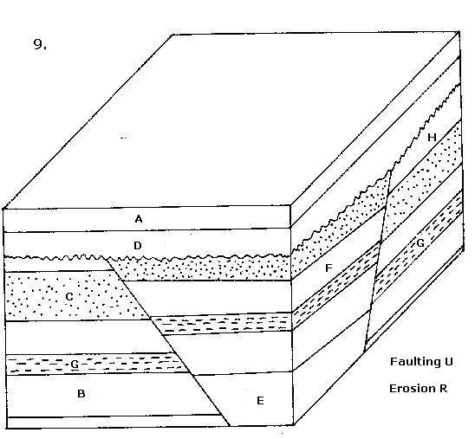
Identify the layers/events from oldest to youngest
The fault caused the middle rock layers to rise up
E – B – G – F – C – H – D - A
Part of layer H eroded away

Slide 28
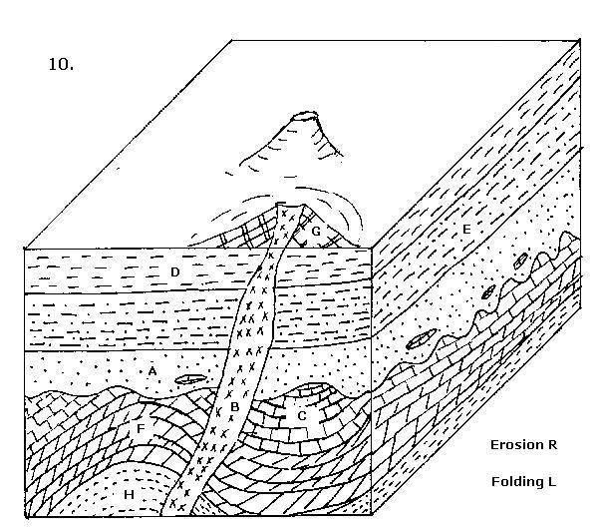
Identify the layers/events from oldest to youngest
H – F – C – A – E – D – G - B
Layers H, F & C represent folding
Most of layer C eroded away

Slide 29
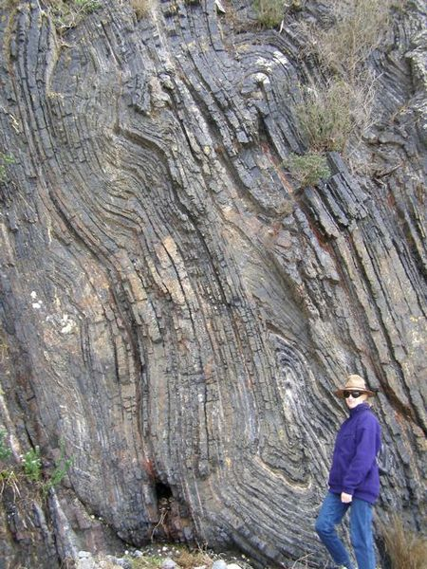
Folding

Slide 30
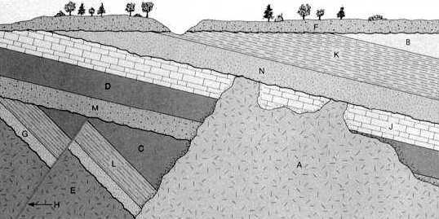
Identify the layers/events from oldest to youngest
Layer F is eroding away
E – G – L – C – M – D – J – A – N – K –B – F
Fault H caused the rock layers to shift

Slide 31
Absolute Dating
Uses methods such as radiometric dating or rates of geologic processes to determine a specific age of a rock.
Radiometric dating uses the known half-life values of radiometric isotopes found in certain rocks to determine the age of those rocks.

Slide 32
Radiometric dating: Clocks
A technique used to date materials such as rocks.
Usually based on a comparison between the observed abundance of a naturally occurring radioactive isotope and its decay products, using known decay rates.
Among the best-known techniques are radiocarbon dating, potassium-argon dating, and uranium-lead dating.

Slide 33
Radiometric dating: Clocks
Radiometric dating is based on the decay of specific atomic nuclei.
The moment in time at which a particular nucleus decays is unpredictable.
However, a collection of atoms of a radioactive nuclide decays exponentially at a rate described by half-life.
Half-life is usually given in units of years.

Slide 34
Half-Life
Measures the rate of decay of a radioactive isotope.
The time it takes for ½ of an original quantity of a radioactive element to decay into another element.

Slide 35
Radiometric dating: Clocks
Different methods of radiometric dating vary in the timescale over which they are accurate and the materials to which they can be applied.
Decay series Half life
⁴⁰K to ⁴⁰Ar → 1250 My
¹⁴⁷Sm to ¹⁴³Nd → 1060 My
²³⁵U to ²⁰⁷Pb → 704 My
²³⁸U to ²⁰⁶Pb → 4468 My
¹⁴C to ¹⁴N → 5730 years

Slide 36
Radiometric dating: Clocks
Different radioactive isotopes have different half-lives.
Isotopes with long half-lives are useful for dating older rocks.
It is important to use the right tool for the right job.

Slide 37
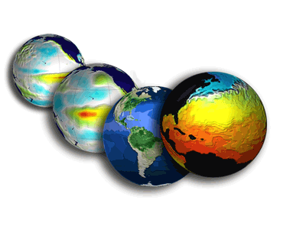
Part 2: Factors that Affect Climate

Slide 38
Global Climate
The global climate is affected by
  Extra-terrestrial factors
  Atmospheric factors
  Land and Oceanic factors
  Tectonic factors
  Human Activity

Slide 39
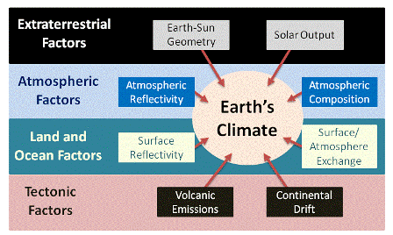
Global Climate

Slide 40
Extra-terrestrial factors
  Earth to Sun Orientation
  Changes in the shape of Earth’s orbit as well as the tilt and position of Earth’s axis can affect the amount of sunlight reaching Earth’s surface.
    The relationship between the Earth's orbit and the orientation (tilt of the planet's axis of rotation) vary systematically over time.
      This causes cyclic shifts of solar energy input that can produce climate modulations. These variations are termed Milankovitch cycles.

Slide 41
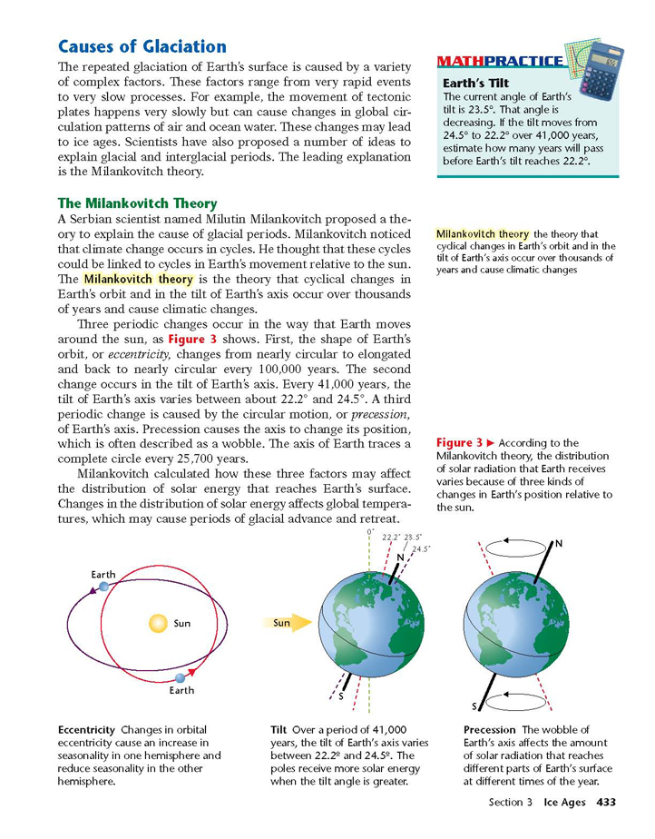
Extra-terrestrial factors
  Earth to Sun Orientation
  The tilt of Earth's axis results in the seasons.
    The earth is closest to the sun on January 3rd (147 million km) … winter in the northern hemisphere
    The earth is farthest from the sun on July 4th (152 million km) … summer in the northern hemisphere

Slide 42
Extra-terrestrial factors
  Solar Output
    The intensity of the sunlight can cause either warming (during periods of stronger solar intensity) or cooling (during periods of weaker solar intensity).
    The sun follows a natural 11-year cycle of small ups and downs in intensity, but the effect on Earth’s climate is small.

Slide 43
  Atmospheric factors
  Atmospheric Albedo (reflectivity)
  When sunlight reaches Earth, the amount that is reflected or absorbed depends on Earth’s surface and atmosphere.
  Earth as a whole has an albedo of about 30%, meaning that 70% of the sunlight that reaches the planet is absorbed.
  Reflectivity is also affected by aerosols. Aerosols are small particles or liquid droplets in the atmosphere that can absorb or reflect sunlight.

Slide 44
  Atmospheric factors
  Composition of the Atmosphere
    An important aspect of global air circulation is the movement of water through the atmosphere.
      evaporating from the surface,
      condensing to form clouds blown by the winds
      returning to the Earth as precipitation.
    The evaporation-condensation cycle is an important mechanism for transferring heat energy from the Earth's surface to its atmosphere and in moving heat around the Earth.
    Aerosols absorb or reflect sunlight
      black carbon (soot from burning), have a warming effect
      Sulfur emissions from burning coal have a cooling effect.

Slide 45
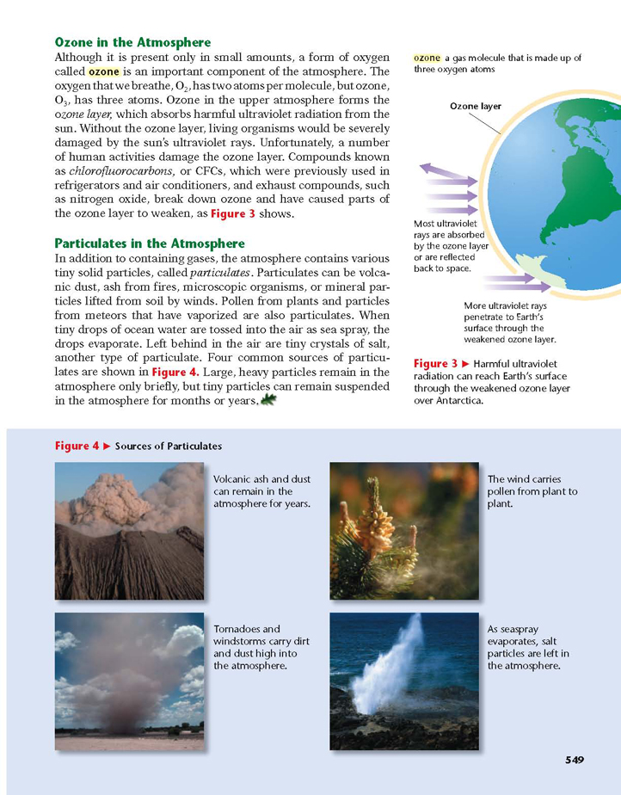
Atmospheric factors

Slide 46
Atmospheric Composition & Climate
Another factor that influences climate is the chemistry of the atmosphere.
Most of the atmosphere is Nitrogen and Oxygen gases, but a small portion of the atmosphere are heat trapping gasses such as Water Vapor, Carbon Dioxide and Methane. These gases are called green house gases.
Although they are small by amounts, they play a key role in their ability to trap heat, in particular Carbon Dioxide is the most significant (due to its fluctuations) in climate influence.

Slide 47
  Land and Oceanic factors
  Surface Albedo (reflectivity)
  When sunlight reaches Earth, the amount that is reflected or absorbed depends on Earth’s surface and atmosphere.
  Light-colored objects and surfaces, like snow and clouds, tend to reflect most sunlight, while darker objects and surfaces, like the ocean, forests, or soil, tend to absorb more sunlight.

Slide 48
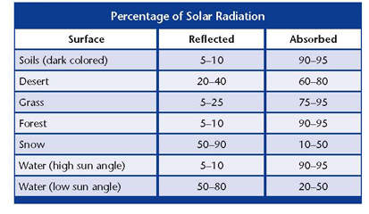
  Land and Oceanic factors
  Surface Albedo (reflectivity)

Slide 49
  Land and Oceanic factors
  Surface/Atmosphere exchange
  An important aspect of global air circulation is the movement of water through the atmosphere.
  Water vapor is constantly cycling through the atmosphere.
  Water has a much higher heat capacity than the atmospheric gases and rocks.
  The oceans cover about 70% of the Earth surface and are the major heat buffer of the planet and serve as temperature buffers for the ocean/atmosphere system.
  The bulk of the thermal energy at the Earth surface is stored in the oceans and a key factor in stabilizing Earth's climate.

Slide 50
  Tectonic factors
  Continental Drift
  About 250 million years ago, all the continents were merged in one large land mass known as Pangaea.
  Continents gradually began to drift apart.
  The formation of separate continental land masses changed the flow of ocean currents and winds, and isolated Antarctica.
    Physical features of the lithosphere
    Position of the land masses
    Mountains and water bodies

Slide 51
  Tectonic factors
  Volcanic Emissions
  Volcanic particles that reach the upper atmosphere can reflect enough sunlight back to space to cool the surface of the planet by a few tenths of a degree for several years.
  These particles are an example of cooling aerosols.
  Aerosols that reflect sunlight, such as particles from volcanic eruptions or sulfur emissions from burning coal, have a cooling effect.

Slide 52
Volcanic Eruptions and Climate
Volcanic eruptions can influence the amount of energy from the sun that reaches the earth’s surface.
Large volcanic eruptions can release tons of ash to block energy from the sun and cause a cooler climate for months to years.

Slide 53
Volcanic Eruption Example
Mt. Tambora erupted in Indonesia in 1815.
Large amounts of ash were sent into the atmosphere and circulated around most of the planet, blocking energy from the sun.
1816 was known world wide as the year without a summer.
Notes:
Caused snowfall in northeastern portion of north america… killed crops

Slide 54
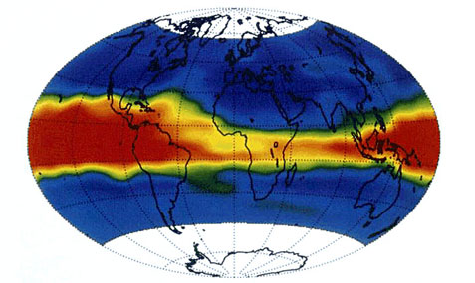
Mt. Pinatubo 1991
(Red and yellow is volcanic ash plume that wrapped all the way around the planet)
Notes:
Showing the amounts of aerosols put out by eruption

Slide 55
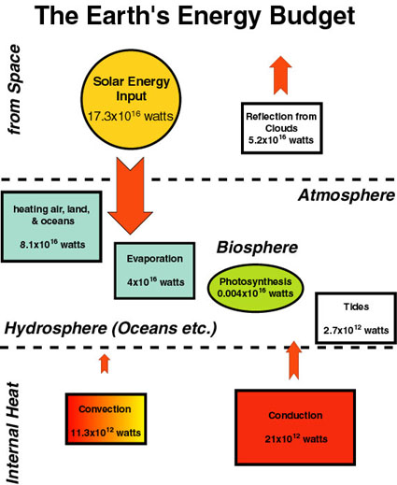
Factors Affecting Global Climate
radiation
The global climate is affected by
  Extra-terrestrial factors
  Atmospheric factors
  Land and Oceanic factors
  Tectonic factors
  Human Activity
Lithosphere

Slide 56
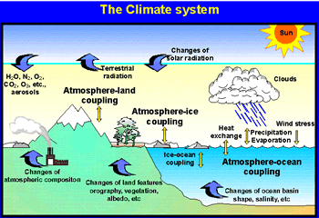
Climate
Climate is affected by the interaction of the solar factors, atmospheric factors, land & ocean factors, and tectonic factors.
Climate is most observed in the atmosphere

Slide 57
Solar Cycle & Climate
The sun goes through time periods where it radiates more energy from it’s surface.
This corresponds to the sun spot cycle.
When a decrease in solar activity occurs (coupled with a significant volcanic eruption), temperatures have decreased.

Slide 58
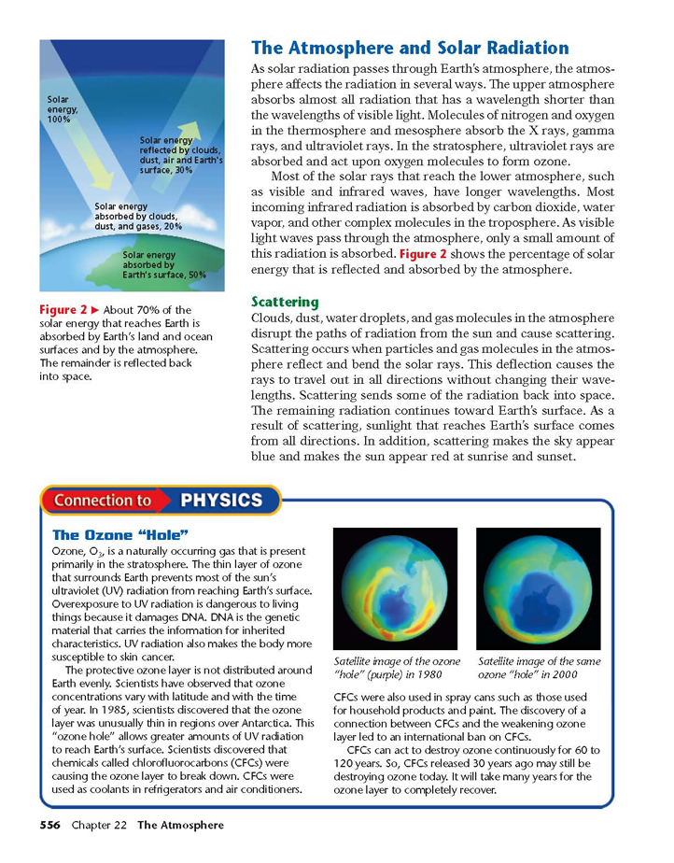

Slide 59
Atmospheric Composition & Climate
Earth is the only planet in the solar system with an atmosphere that can sustain life.
The blanket of gases not only contains the air that we breathe but also protects us from the blasts of heat and radiation emanating from the sun.
It warms the planet by day and cools it at night.
Carbon Dioxide is the most significant gas that influences climate.

Slide 60
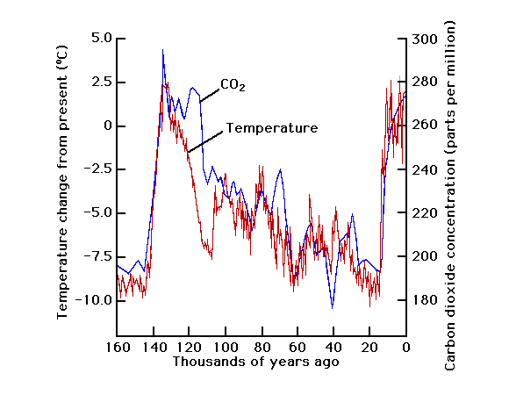
Carbon Dioxide & Temperature Relationship

Slide 61
Climate and Oceans
The oceans and the atmosphere have a direct relationship which influences the global and regional climate.
Because the earth is unequally heated, the energy from the equator is continually being transported towards the poles.
As a result of this process (and our rotating planet), global circulation patterns of wind and ocean currents have developed.

Slide 62
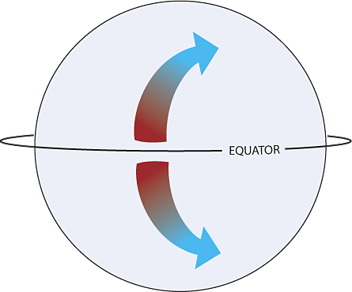
The Coriolis Effect
The circulation of the atmosphere and oceans is affected by the earth’s rotation (clockwise)
  Free moving objects appear to curve to the right of their intended path in the northern hemisphere
  and appear to curve to the left in the southern hemisphere.

Slide 63
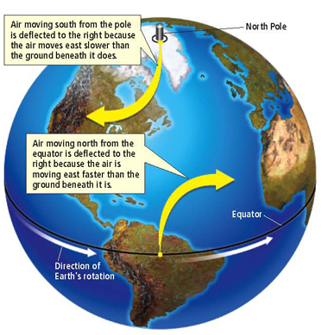
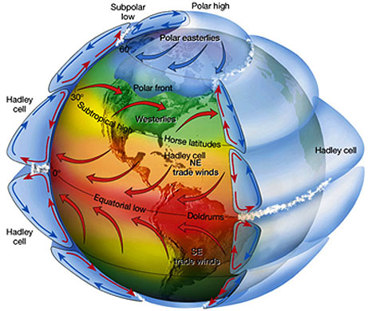
Global Circulation Patterns: Wind
Air Pressure changes along bands of latitude (equator, 30°, 60°)
Winds blow from higher to lower pressure
As the earth rotates (clockwise), winds curve
Notes:
The Hadley cell is a circulation pattern that dominates the tropical atmosphere, with rising motion near the equator, poleward flow 10-15 kilometers above the surface, descending motion in the subtropics, and equatorward flow near the surface. This circulation is intimately related to the trade winds, tropical rainbelts, subtropical deserts and the jet streams.

Slide 64
The Oceans and Currents
Winds produce ocean water surface currents.
Density differences produce ocean water deep currents.
Cooler, denser water at higher latitudes sinks down when the wind brings warmer water from lower latitudes.

Slide 65
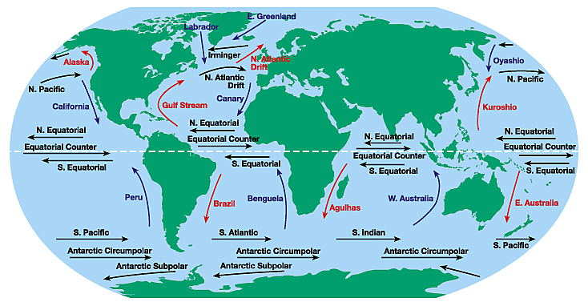
Global Winds Produce Ocean Currents

Slide 66
Thermohaline Circulation and Climate
Ocean currents are the result of differences in density.
  (created by differences in temperature and salinity (salt content – “haline”))
These ocean currents produce extensive mixing between the ocean basins, making the Earth's oceans a global system.

Slide 67
Thermohaline Circulation and Climate
Water masses transport both
  energy (in the form of heat) and
  matter (solids, dissolved substances and gases) around the globe.
This circulation creates patterns of air movement affecting global and regional climate.
Warm water / air move from the equator towards the poles, and vice versa.

Slide 68
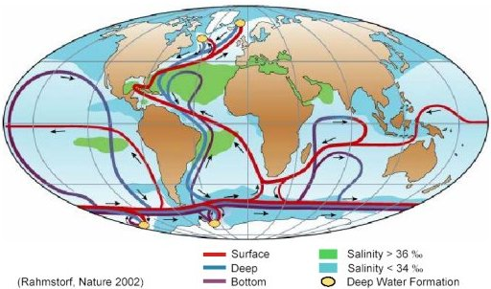
Thermohaline Circulation

Slide 69
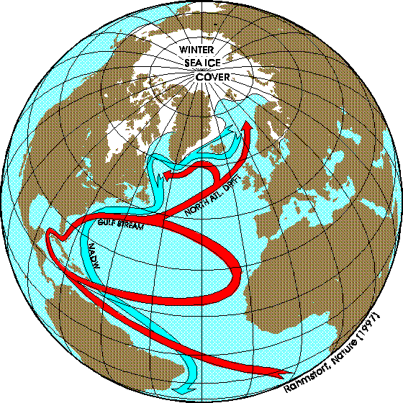
Thermohaline Circulation

Slide 70
Changes in the Thermohaline
An increase in global temperature could lead to more fresh water at higher latitudes (due to glacial melting). This could change the thermohaline system.
It is not clear what effects could result in changing the thermohaline, but climate will be influenced.

Slide 71
El Niῆo
Warm ocean water temperatures that periodically develops off the western coast of South America and can cause climatic changes across the Pacific Ocean.
The extremes of this climate pattern's oscillations cause extreme weather (such as floods, typhoons, cyclones, and droughts) in many regions of the world.

Slide 72
El Niῆo
El Niῆo is a result of the reversing (or weakening) of the Southern Oscillation – A regular flow of ocean water from the East Pacific Ocean to the West Pacific Ocean.
During an El Niῆo, the Southern Oscillation is diminished.
  The trade winds weaken and the pressure decreases off the Pacific coast of S. America;
  This offsets the paths of the jet streams that affect weather in North America.
El Niῆa, is the cool water phase.

Slide 73
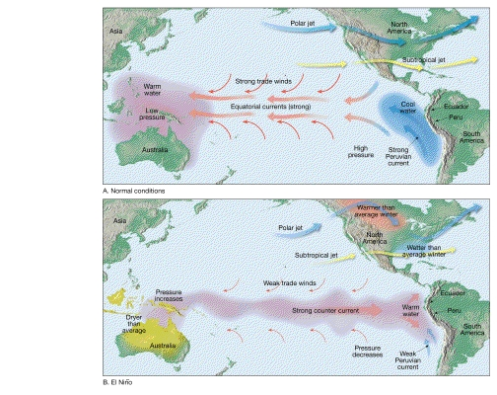
El Niῆo

Slide 74
The Oceans are Sinks
The oceans work to dissolve much of the gases in the atmosphere, and help to regulate the temperature of our planet by doing this.
The oceans are a major absorber of CO₂, and they also release CO₂.

Slide 75
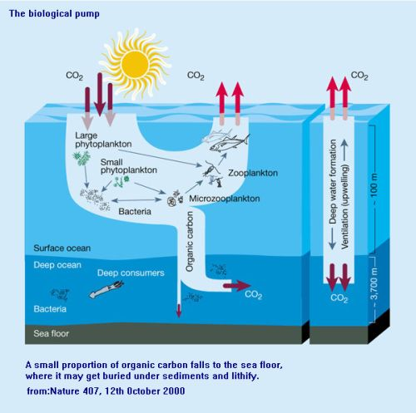

Slide 76
Regional Climates
Regions of our planet have distinct climates due to these factors:
  Latitude
  Elevation
  Ocean currents
  Albedo
  Position relative to large bodies of water

Slide 77
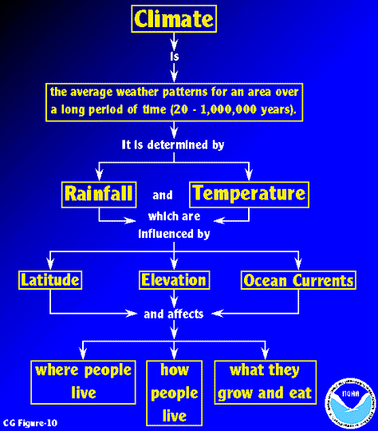

Slide 78
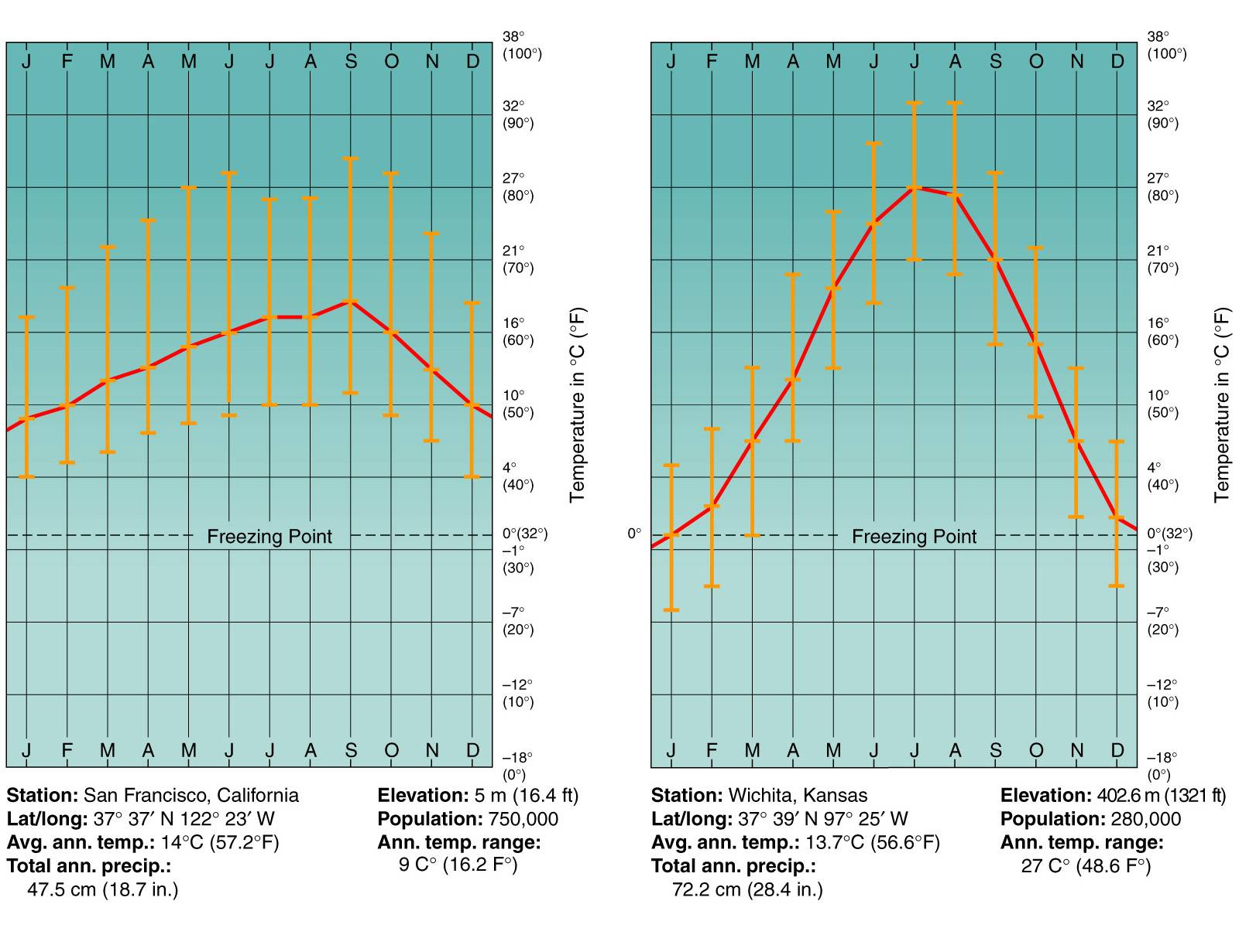
Maritime vs. Continental Climates
Notice that Maritime climates are moderate compared to continental

Slide 79
Green House Effect
The atmosphere (and the gases in the atmosphere) work like the glass of a green house.
The atmosphere allows short wavelength (visible and ultraviolet) radiation to enter the atmosphere, but does not allow most of the long wavelength (infrared) radiation to escape.
Green house gases in the atmosphere work to trap heat.
This is similar to the glass of a green house.

Slide 80
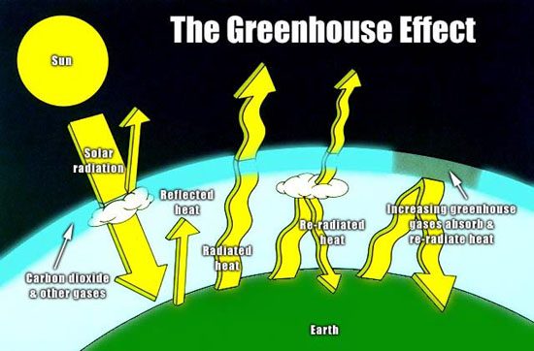

Slide 81
“Good” Green House Effect
This trapping of the long wavelength radiation (infrared) results in warmer temperature for us on this planet, this is good.
If there is too much heat trapped, then we have a “Run away green house effect”, also known as “global warming”.

Slide 82
Green House
Green House Gases (Water, Carbon Dioxide, Methane, Nitrous oxide) trap heat in our atmosphere. (Listed in order of abundance)
Our atmosphere allows the short wavelength Ultraviolet Radiation from the sun in, but the long Infrared Radiation that the earth re-radiates, is trapped by the Green House Gases.

Slide 83
Green House Gases (GHG)
Green House Gases are good at trapping long wavelength (infrared) radiation that the earth radiates out.
This allows heat to be trapped in the lower atmosphere.
Greenhouse Gases Trapping Heat https://screenpal.com/watch/cFQ6q6qGeF (0:17)
Four main GHG’s are (in order of significance)
  Water Vapor (H₂O)
  Carbon Dioxide (CO₂)
  Methane (CH₄)
  Nitrous Oxide (N₂O)

Slide 84
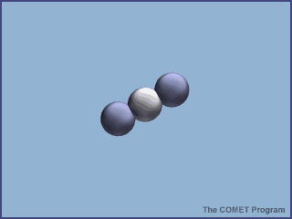
Why are GHG’s Considered GHG’s?
GHG’s are each composed of two different elements, bound loosely enough together, to allow vibration and energy release to occur.
This effect creates an overall heating (Kinetic to Thermal energy transfer) of the atmosphere.
Nitrogen and Oxygen (most abundant atmospheric Gases) are bound too tightly to allow energy to vibrate them.
Carbon Dioxide

Slide 85
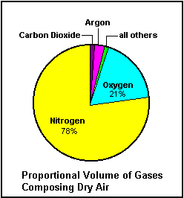
Composition of the Atmosphere

Slide 86
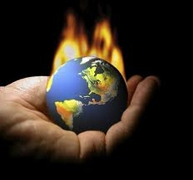
Global Warming

Slide 87
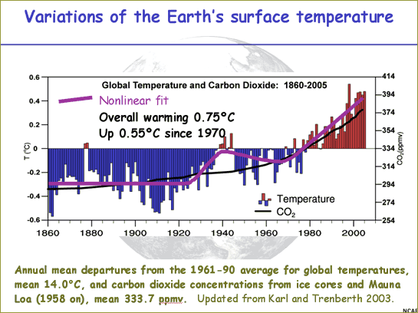

Slide 88
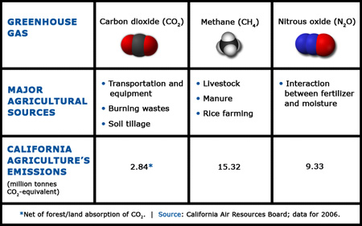
GHG (Green House Gases)

Slide 89
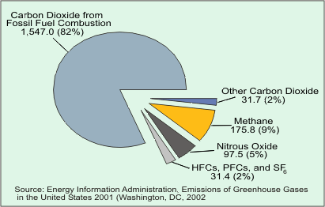
GHG Emissions

Slide 90
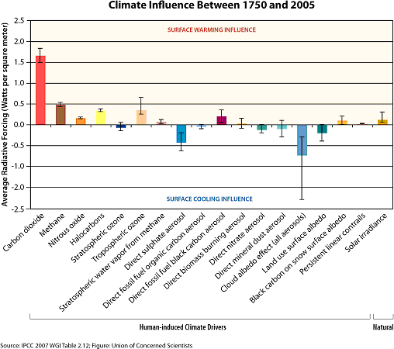
Human Activity Affects Climate
Burning fossil fuels (among other substances) produces many green house (and other) gases that enter the atmosphere
It is believed that these additional gases have a direct and significant impact on climate

Slide 91
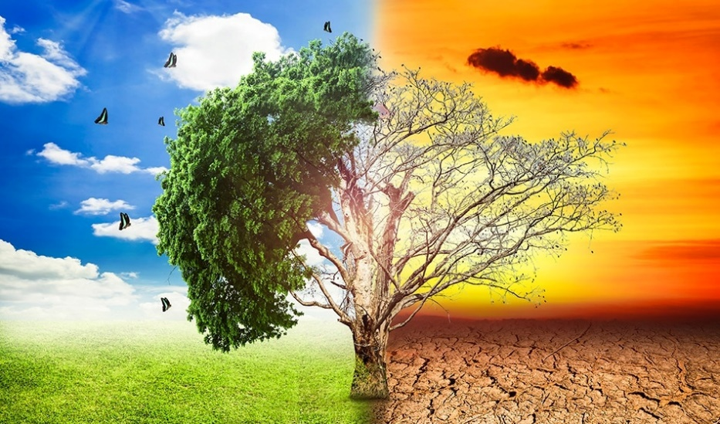
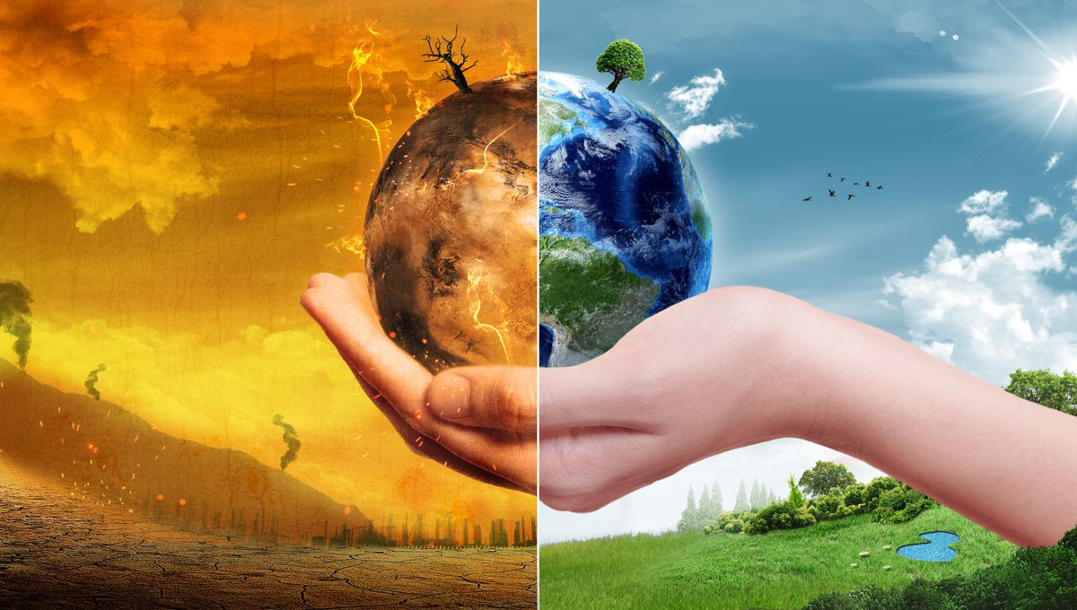
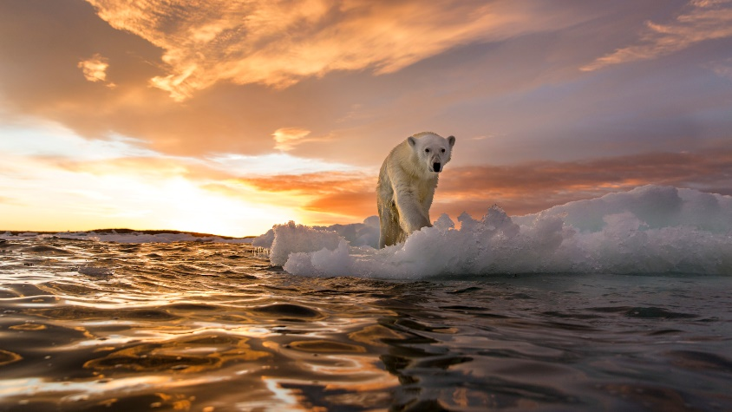
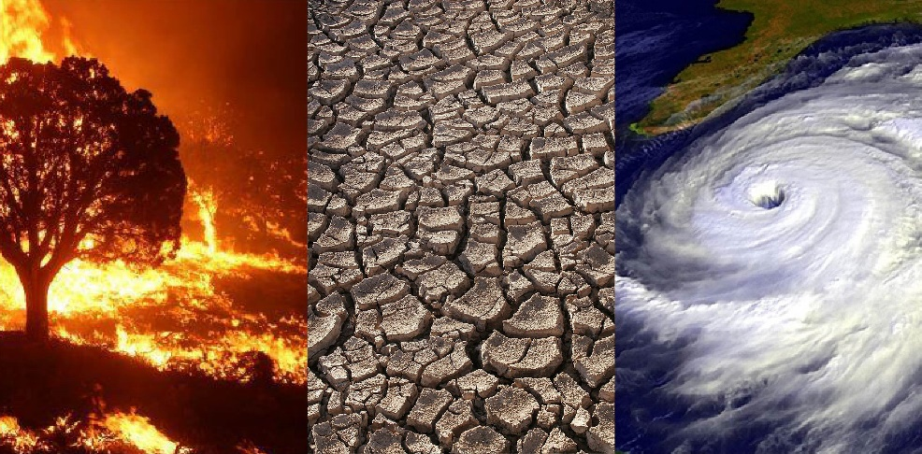
Left wing politicians and progressive scientist blame the Earth’s warming trend on human activity.
In particular, burning fossil fuels produces many green house gases that increase the temperature.
These additional gases have a direct and significant impact on climate.

Slide 92
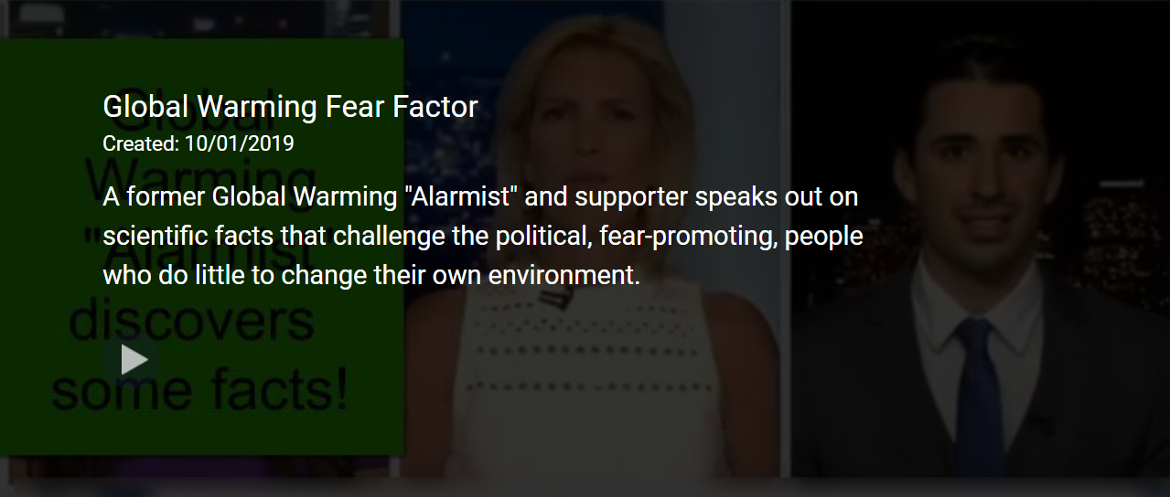
Global Warming Fear Factor https://screenpal.com/watch/cq6VIEu6JC (2:24)

Slide 93
Global Warming
Deforestation removes trees that absorb CO₂ .
Polar icecaps melt adding freshwater to the oceans (salt water). Because of the density differences, convection currents are created. Water is transported in a way that did not occur previously, changing weather patterns.
Carbon Dioxide Greenhouse Effect Explained https://screenpal.com/watch/cFQr2HqRaT (2:04)

Slide 94
Ozone
Ozone (O₃) is three Oxygen molecules that are bonded together.
In the upper atmosphere, Ozone works to filter UV radiation, so that not all of the UV radiation is reaching the surface.
Some gases work to destroy Ozone, such as CFC’s (Chlorofluorocarbons)
Specifically the Chlorine in CFC’s

Slide 95
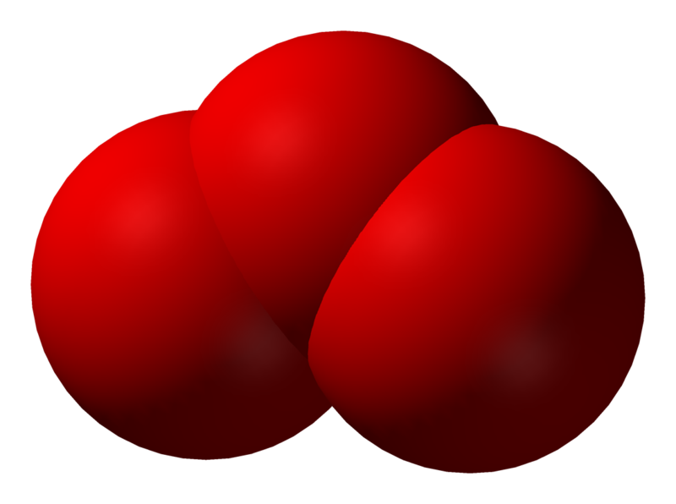
Ozone

Slide 96
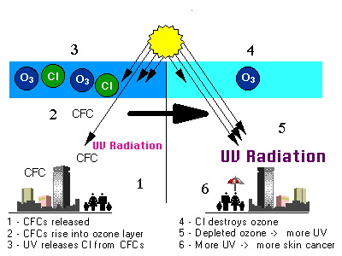
Ozone Depletion

Slide 97
What Hole?!
Very cold temperatures will make it easier for Chlorine to destroy ozone.
These conditions exist at the poles, but more so at the South Pole.
  The South Pole has cooler temperatures because a land mass (continent of Antarctica) exists there and land has a lower specific heat (this means it can get much colder than an area covered in water)
For this reason a “hole”, or more correctly described as a lower concentration, in the ozone develops to significant size near the end of the Antarctic Winter.

Slide 98
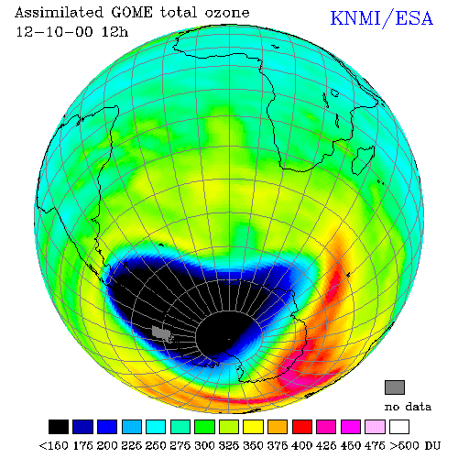
Ozone “Hole”

Slide 99
Good Ozone / Bad Ozone
Ozone that is in the stratosphere is good – it helps filter damaging Ultraviolet radiation.
Ozone that is at the ground level is damaging to breath in (burns the lungs).
Ground level ozone is created when Nitrogen Oxide combines with Volatile organic compounds and hot weather with direct sun.

Slide 100
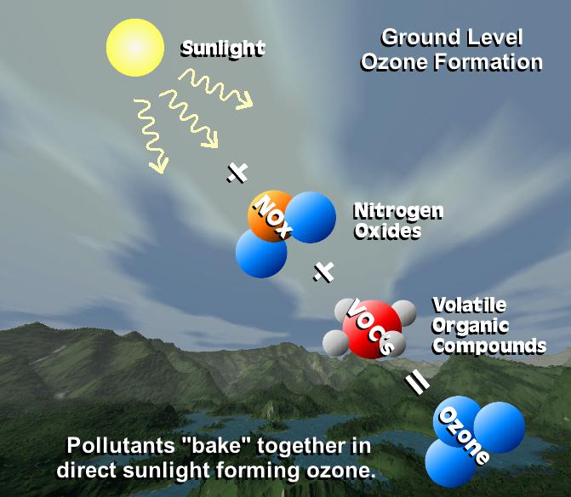

Slide 101
Positives of Ozone
It is a common misconception in political circles that greenhouse gases like CO₂ are breaking down the ozone layer, making the earth warmer.
The ozone layer in the stratosphere filters the harmful ultra violet portion of the solar radiation
Otherwise, the earth would be HOTTER and we will be affected by skin cancer.
Some vegetation which are sensitive to ultra violet radiation may not survive at all.

Slide 102
Before We Stop Using CFC’s:
The advantages of CFCs:
Excellent refrigerants: low boiling point, unreactive
Very good propellants: low toxicity, no fire risk
Very inexpensive compared to other compounds for similar uses.
Very useful in firefighting: no fire risk, easy to store and use
Useful in precursors for Teflon and other related compound production.
Useful in drycleaning: low toxicity to humans

Slide 103
Is Ozone involved with Global Warming?
The primary greenhouse gases in Earth’s atmosphere are water vapor, CO₂, methane, nitrous oxide and ozone.
What’s wrong with this picture?
  Politicians have changed laws (remove CFC’s) in order to decrease the ozone depletion.
  If there is less ozone (GHG) … shouldn’t the earth’s temperature cool down?

Slide 104

Temperature Versus Altitude
Temperature changes in a fluctuating way as the altitude increases.
Notice where Temperature increases. This is a temperature gradient.

Slide 105
Temperature Versus Altitude
The “Thermosphere” has a temperature increase. [It gets warmer at that altitude]
Temperature increases in the stratosphere above the Ozone layer.

