Slide 1
To View Slide Show
Click on “Slide Show” above
Click on “From Current Slide”

Slide 2
Jeopardy
Review Game for Earth’s History & Climate Change
Click on the “Instructions” button:
Instructions

Slide 3
Jeopardy
Begin
Click the “Begin” button when ready to begin.
The categories will be given.
Click on the HOME screen button provided - the category board will appear – Choose a category and click on a point amount for that category.
Give an answer. Then, click on the screen to see the answer.
After completing each answer, click on the HOME screen button to return to the category screen.
When completed with all categories and point amounts, click the final jeopardy button.

Slide 4
Ice Age
Theory
Glaciers
Final Jeopardy
Ozone
Layer
Climate
Factors
Climate
Factors
Greenhouse
Effect
100
100
100
100
100
100
200
200
200
200
200
200
300
300
300
300
300
300
400
400
400
400
400
400
500
500
500
500
500
500
600
600
600
600
600
600

Slide 5
We are in this portion of an ice age right now.

Slide 6
What is an interglacial period?

Slide 7
Ice Age theory seeks to explain this.

Slide 8
What is how do we go from glacial to interglacial periods?

Slide 9
There have been this many major ice ages in Earth’s history.

Slide 10
What is 5?

Slide 11
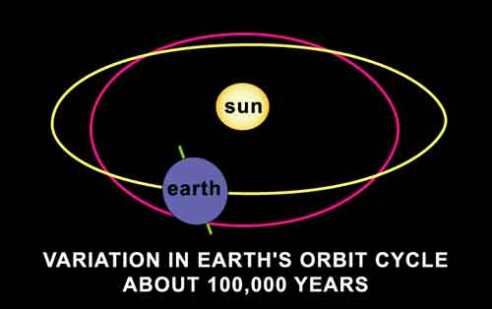
Eccentricity refers to this process taking place.

Slide 12
What is stretching of the Earth’s orbit?

Slide 13
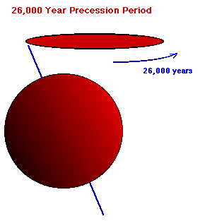
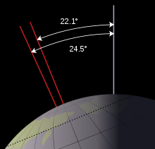
Obliquity refers to this process whereas precession refers to this process.

Slide 14
What is axial tilt and wobble of the Earth?

Slide 15
This is how obliquity would affect Earth’s climate.

Slide 16
What is more tilt, then more exposure to sun on the poles and less tilt, less exposure?

Slide 17
This is the name given to an object that was transported far from its place of origin during glacial movement.

Slide 18
What is erratic?

Slide 19
These are the types of glaciers we refer to when talking about an ice age.

Slide 20
What are continental glaciers?

Slide 21
This is the phenomenon in which the heavy ice sheet pushes deeper into the asthenosphere, but slowly “pops” back up as the glacial sheet melts.

Slide 22
What is isostatic rebound?

Slide 23
This is the THREE step process of how a glacier advances.

Slide 24
What is 1) snow piles up, 2) pressure builds up & compacts to ice, 3) pressure makes bottom unstable & snow sloughs forward in response to pressure building up?

Slide 25
These show contour lines, which are lines of equal elevation. The closer the lines, the steeper the terrain.

Slide 26
What are topographic maps?

Slide 27
These are glaciers formed in mountainous areas and are relatively small in size.

Slide 28
What are alpine glaciers?

Slide 29
Runaway greenhouse effect or greenhouse effect “gone wrong” is referred to as this ... Especially by politicians.

Slide 30
What is global warming or climate change?

Slide 31
This is why the Earth’s atmosphere is analogous to a greenhouse.

Slide 32
What is it lets heat in, but does not let heat escape (traps heat)?

Slide 33
Even though carbon dioxide is not the most significant GHG, this is why it is so widely discussed.

Slide 34
What is human contribute this GHG to the atmosphere by burning fossil fuels?

Slide 35
This is the relationship between carbon dioxide and temperature over the past 130 years.

Slide 36
What is a direct relationship – when carbon dioxide increases so does temperature?

Slide 37
These are the top three GHGs (in order of abundance).

Slide 38
What are water, carbon dioxide, and methane?

Slide 39
From sunlight to trapped heat, explain (in detail) how the greenhouse effect works (include wavelengths of light).

Slide 40
What is 1) the sun’s rays travel through Earth’s atmosphere 2) the Earth absorbs and reradiates the Infrared (longer) wavelengths 3) as the heat radiates upwards, it hits GHGs which absorb and reradiate heat back towards Earth?

Slide 41
The ozone layer functions to do this (good ozone).

Slide 42
What is absorb ultraviolet (UV) radiation before reaching the Earth’s surface?

Slide 43
This is the formula for the molecule of ozone.

Slide 44
What is O₃?

Slide 45
The ozone layer is found in which layer of the Earth’s atmosphere?

Slide 46
What is the stratosphere (layered sphere)?

Slide 47
These gases destroy the ozone layer.

Slide 48
What are CFCs (clorofluorocarbons)?

Slide 49
Politicians do not tell the full truth about ozone. What important detail do they leave out as they think that they support global warming.

Slide 50
What is ozone is a GHG?

Slide 51
This is why a “hole” in the ozone layer exists at the south pole, but not at the north pole.

Slide 52
What is the south pole is covered with a continent and the north pole is covered in water and water has a high specific heat (slow to heat up and cool down). Colder temperatures at the south pole allow for CHLORINE to destroy ozone better than warmer temperatures at the north pole?

Slide 53
This is how latitude and elevation affect climate.

Slide 54
What is the farther away from the equator and the higher up one goes, the colder the climate?

Slide 55
This is what albedo is and how it impacts climate.

Slide 56
What is the amount of light reflected off a surface? The higher the albedo, the lower the temperatures … and the lower albedo, the higher the temperatures?

Slide 57
Produces deep ocean currents.

Slide 58
What is difference in density?

Slide 59
Result of the reversing (or weakening) of the Southern Oscillation – A regular flow of ocean water from the East Pacific Ocean to the West Pacific Ocean.

Slide 60
What is El Niňo?

Slide 61
Moderate climate compared to continental.

Slide 62
What is maritime?

Slide 63
Ocean currents and climate resulting from salt content in the water (versus freshwater).

Slide 64
What is thermohaline circulation?

Slide 65
The age of the earth according to macroevolution.

Slide 66
What is 4.6 Billion years old?

Slide 67
Eon.

Slide 68
What is the longest time period in Earth’s history?

Slide 69
Measuring half-life decay of radioactive isotopes to determine age.

Slide 70
What is radiometric dating?

Slide 71
The oldest rock layers are on the bottom, youngest on the top.

Slide 72
What is superposition?

Slide 73
Cenozoic Era, Quaternary Period, Holocene Epoch

Slide 74
What is the part of Earth’s history that we currently live in?

Slide 75
The isotopes used to date the Earth’s oldest ages.

Slide 76
What are potassium-argon ⁴⁰K to ⁴⁰Ar → 1250 My and uranium-lead ²³⁵U to ²⁰⁷Pb → 704 My?

Slide 77
Jeopardy
Review Game for Earth’s History & Climate Change

Slide 78
Today’s Categories Are:

Slide 79
Today’s Categories Are:
Ice Age
Theory

Slide 80
Today’s Categories Are:
Glaciers

Slide 81
Today’s Categories Are:
Greenhouse
Effect

Slide 82
Today’s Categories Are:
Ozone
Layer

Slide 83
Today’s Categories Are:
Climate
Factors

Slide 84
Today’s Categories Are:
Earth History & Oceans
Click

Slide 85
Final Jeopardy Category
Geologic Time

Slide 86
Final Jeopardy
Relative dating is using rock layers and their positions to tell how old something is relative to something else. Name 2 of the 3 items that relative dating uses:

Slide 87
Final Jeopardy
What are
Index Fossils
Marker Beds
Principle of Fossil Succession?
Done

