Slide 1
Click “Slide Show”
Click “From Beginning”
or
“From Current Slide”

Slide 2



Chapter 21
Electrochemistry
Electrochemical Cells
Half-Cells and Cell Potentials
Electrolytic Cells

Slide 3
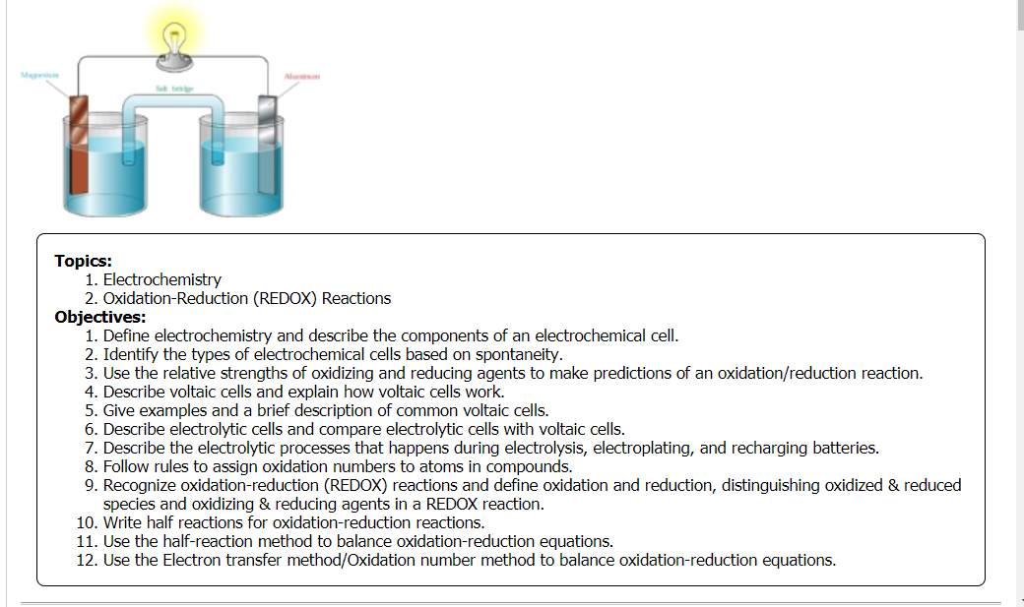

Slide 4
Oxidation-Reduction Reactions
Identify the reducing & oxidizing agents, the species that is oxidized and reduced, and state what happens to the electrons in oxidation and reduction.
Zn⁰+ Cu²⁺ → Cu⁰ + Zn²⁺
Notes:
Oxidation-reduction reactions involve the transfer of electrons from one reactant to another.
[animate top orange box] Oxidation is the loss of electrons while [animate bottom orange box] reduction is the gain of electrons.
In the example shown, zinc is oxidized because it gives up electrons to copper. Copper accepts these electrons and becomes reduced.
Zinc is called the reducing agent in this reaction because it donates electrons to copper—it reduces copper.
Copper is called the oxidizing agent in this reaction because it accepts electrons from zinc—it oxidizes zinc.

Slide 5
Oxidation-Reduction Reactions
oxidation
reduction
Zn⁰+ Cu²⁺ → Cu⁰ + Zn²⁺
Oxidation
loss of electrons
reducing agent becomes oxidized
oxidizing agent becomes reduced
Reduction
gain of electrons
Notes:
Oxidation-reduction reactions involve the transfer of electrons from one reactant to another.
[animate top orange box] Oxidation is the loss of electrons while [animate bottom orange box] reduction is the gain of electrons.
In the example shown, zinc is oxidized because it gives up electrons to copper. Copper accepts these electrons and becomes reduced.
Zinc is called the reducing agent in this reaction because it donates electrons to copper—it reduces copper.
Copper is called the oxidizing agent in this reaction because it accepts electrons from zinc—it oxidizes zinc.

Slide 6
Assigning Oxidation Numbers
The oxidation number of an atom in its elemental form is always ____ (include the Professor “HOFBrINCl” diatomic molecules).
The oxidation number of a monatomic ion is ________ to the charge on the ion.
The sum of all oxidation numbers of atoms in a neutral compound must be _____. The sum of all oxidation numbers of atoms in a ________________ ion is the charge of the ion.
The oxidation number of fluorine is always ___, alkali metals ___, and alkaline earth metals ___ in compounds.
The oxidation number of oxygen in a compound is usually ___ [exception: a peroxide (___)].
The oxidation number of hydrogen is usually ___ [exception: hydrides containing a metal (___)].
Notes:
Timing ≈ 1.0 minutes
Oxidation numbers are basically a bookkeeping method devised by chemists.
The oxidation number of an element is zero.
The oxidation number of a monatomic ion is the charge on the ion.
The sum of the oxidation numbers of atoms in a neutral compound is zero.
The sum of the oxidation numbers of an ion is equal to the charge of the ion.
The oxidation number of halogens (other than fluorine) is in combination is typically -1.
SOURCES:

Slide 7
Assigning Oxidation Numbers
The oxidation number of an atom in its elemental form is always zero (include the Professor “HOFBrINCl” diatomic molecules).
The oxidation number of a monatomic ion is equal to the charge on the ion.
The sum of all oxidation numbers of atoms in a neutral compound must be zero. The sum of all oxidation numbers of atoms in a polyatomic ion is the charge of the ion.
The oxidation number of fluorine is always –1, alkali metals +1, and alkaline earth metals +2 in compounds.
The oxidation number of oxygen in a compound is usually –2 [exception: a peroxide (–1)].
The oxidation number of hydrogen is +1 [exception: hydrides containing a metal (–1)].
Notes:
Timing ≈ 1.0 minutes
Oxidation numbers are basically a bookkeeping method devised by chemists.
The oxidation number of an element is zero.
The oxidation number of a monatomic ion is the charge on the ion.
The sum of the oxidation numbers of atoms in a neutral compound is zero.
The sum of the oxidation numbers of an ion is equal to the charge of the ion.
The oxidation number of halogens (other than fluorine) is in combination is typically -1.
SOURCES:

Slide 8
Oxidation Information
In redox reactions, the more ______________ element gets reduced, (gains / loses electrons) and acts as the (reducing / oxidizing) agent.
Give the oxidation number of each element in the following compounds or molecules. Note the oxidation of iodine (I) in each:
HIO₄ NaI
I₂ HIO₃
Notes:
Timing ≈ 1.0 minutes
Entry Audio: There are seven diatomic elements:
Hydrogen (H₂)
Nitrogen (N₂)
Oxygen (O₂)
Fluorine (F₂)
Chlorine (Cl₂)
Iodine (I₂)
Bromine (Br₂)
Use the rules of oxidation number assignment to answer the questions on the slide.
Hint 1 Audio: Oxidation numbers can show more than one thing.
Hint 2 Audio: Some atoms’ elemental state is binary, for example O₂.
Exit Audio: Next, we’ll look at distinguishing oxidation and reduction.

Slide 9
Oxidation Information
In redox reactions, the more electronegative element gets reduced, (gains electrons) and acts as the oxidizing agent.
Give the oxidation number of each element in the following compounds or molecules. Note the oxidation of iodine (I) in each:
H⁺¹I⁺⁷O₄⁻² Na¹⁺I¹⁻
H + I + 4O = 0
(+1) + I + 4(-2) = 0
I₂⁰ H⁺¹I⁺⁵O₃⁻²
H + I + 3O = 0
(+1) + I + 3(-2) = 0
Notice the change in Iodine’s oxidation states.
Notes:
Timing ≈ 1.0 minutes
Entry Audio: There are seven diatomic elements:
Hydrogen (H₂)
Nitrogen (N₂)
Oxygen (O₂)
Fluorine (F₂)
Chlorine (Cl₂)
Iodine (I₂)
Bromine (Br₂)
Use the rules of oxidation number assignment to answer the questions on the slide.
Hint 1 Audio: Oxidation numbers can show more than one thing.
Hint 2 Audio: Some atoms’ elemental state is binary, for example O₂.
Exit Audio: Next, we’ll look at distinguishing oxidation and reduction.

Slide 10
Lesson Objectives
  Define electrochemistry and describe the components of an electrochemical cell.
  Identify the types of electrochemical cells based on spontaneity.
  Use the relative strengths of oxidizing and reducing agents to make predictions of an oxidation/reduction reaction.
  Describe voltaic cells and explain how voltaic cells work.
  Give examples and a brief description of common voltaic cells.
  Describe electrolytic cells and compare electrolytic cells with voltaic cells.
  Describe the electrolytic processes that happens during electroplating and recharging batteries.
Notes:
Timing ≈ 0.5
Atoms are oxidized or reduced when they gain or lose electrons to form ions. In this lesson, you’ll learn how oxidation and reduction are defined as well as how to identify what is oxidized and what is reduced.
You will learn how to assign oxidation numbers to atoms and how to recognize an oxidation-reduction, or redox, reaction. You will also learn about common redox reactions.

Slide 11
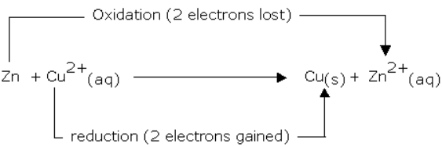
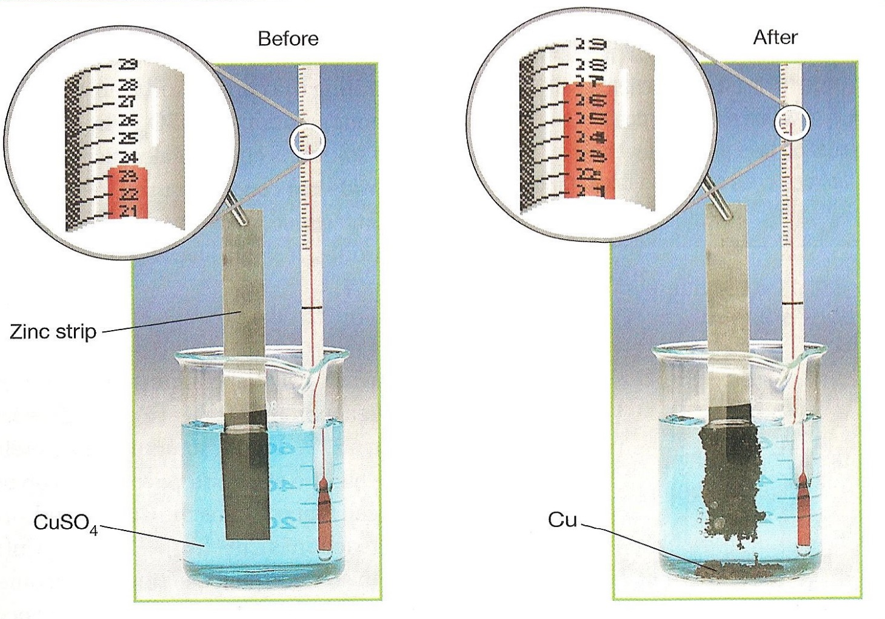
Electrochemistry
Electrochemistry translates the chemical energy of a reduction–oxidation reaction into electrical energy.
In a redox reaction, if the substance being oxidized and the substance being reduced are in contact with one another, a transfer of energy as heat accompanies the transfer of electrons.
24 C
27 C

Slide 12
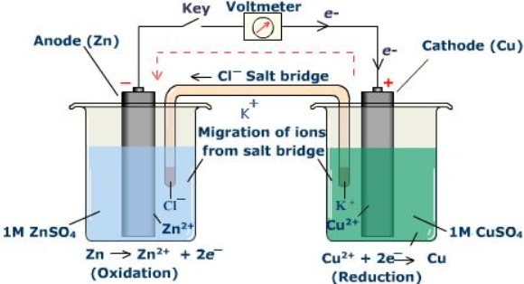
Electrochemistry
Electrochemistry relates the chemical energy of a reduction–oxidation reaction with electrical energy.
When the substances being oxidized and reduced are separated from one another, the electron transfer is accompanied by a transfer of electrical energy instead of heat energy.

Slide 13
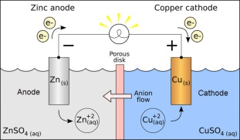
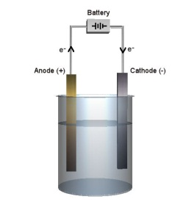
Two Types of Electrochemical Cells
Voltaic cells:
Chemical reactions generate electrical energy;
spontaneous
Electrolytic cells:
Electrical energy decomposes chemical compounds;
non-spontaneous
Notes:
[display both images to the right only] In all electrochemical cells (voltaic & electrolytic cells) oxidation takes place at the anode [teacher point anode in both images] and reduction takes place at the cathode. [teacher point out cathode in both images]
Therefore, in both voltaic and electrolytic cells, electrons flow from the anode to the cathode in the external circuit. [teacher show flow in both images from anode to cathode and then through solution to complete circuit]
[animate 1st text line & sub-bullets] In voltaic cells: Chemical reactions are used to generate electrical energy. Electrons are produced at the anode, making it negative. [teacher circle negative anode on top image] Electrons are consumed at the cathode, making it positive. [teacher circle positive cathode on top image]
[animate 2nd major text line & sub-bullets] In electrolytic cells: Electrical energy provided to the cell is being used to decompose chemical compounds. This requires a power source. The anode is positive because it is connected to the positive terminal of the battery which attracts ions). [teacher circle positive anode on bottom image] The cathode is negative because it is connected to the negative terminal of the battery (which produces electrons). [teacher point out battery (power source) and circle negative cathode on bottom image]
The charges are reversed in an electrolytic cell because the anode is attached to the positive terminal of the voltage source (battery), which attracts ions to be oxidized. However, oxidation always takes place at the anode and reduction at the cathode in all electrochemical cells.
[teacher point out electrolytes in both images and then explain] Both electrochemical cells rely on solutions of electrolytes to provide ions that flow to and from the electrodes, allowing electric current to flow.
SOURCES:
“Galvanic cell with no cation flow.png,” Ohiostandard, CCA-SA 3.0, http://en.wikipedia.org/wiki/File:Galvanic_cell_with_no_cation_flow.png
“Electrólisis.png,” Mbarousse, Public Domain, http://commons.wikimedia.org/wiki/File:Electr%C3%B3lisis.png

Slide 14
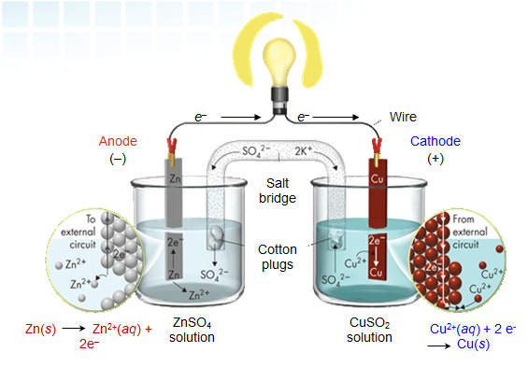
Electrochemical Cells
1. When the substances involved in oxidation and reduction half–reactions are physically separated, it is called an electrochemical cell.
2. Each half reaction occurs on the surface of an electrically conductive solid called an electrode.
3. Each electrode is immersed in an aqueous solution containing ions needed for the half–reaction.
4. The electrodes are connected by a wire so that electrons can move from the oxidation half–reaction to the reduction half–reaction.
5. The solutions are connected by a salt bridge or porous membrane so ions can move between solutions.
6. The chemical potential energy can be harnessed as the substances undergoing oxidation push electrons through the wire to the substances undergoing reduction.

Slide 15
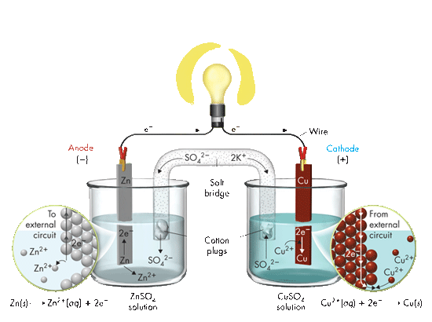
Components of Electrochemical Cells
ANODE
The electrode in the electrochemical cell where oxidation occurs.
Anions are attracted to the anode (negatively charged in this case) that is losing electrons in the half reaction.
i.e. Zn⁰(s) → Zn⁺²(aq) + 2 e-
e–
e–
Wire
Anode
(–)
Cathode
(+)
Salt bridge
Cotton plugs
Zn(s) Zn²⁺(aq) + 2e–
ZnSO₄ solution
CuSO₂ solution
Cu²⁺(aq) + 2 e⁻ Cu(s)

Slide 16
Components of Electrochemical Cells
CATHODE
The electrode in the electrochemical cell where reduction occurs.
Cations are attracted to the cathode (positively charged in this case) that is gaining electrons in the half reaction.
i.e. Cu⁺²(aq) + 2 e- → Cu⁰(s)
e–
e–
Wire
Anode
(–)
Cathode
(+)
Salt bridge
Cotton plugs
Zn(s) Zn²⁺(aq) + 2e–
ZnSO₄ solution
CuSO₂ solution
Cu²⁺(aq) + 2 e⁻ Cu(s)

Slide 17
Components of Electrochemical Cells
Salt Bridge
The salt bridge (porous membrane) allows movement of ions into those solutions to maintain electric neutrality without mixing of solutions.
Different kinds of electrochemical cells (electrolytic vs. voltaic) use different kinds of salt bridges or solutions.
e–
e–
Wire
Anode
(-)
Cathode
(+)
Salt bridge
Cotton plugs
Zn(s) Zn²⁺(aq) + 2e–
ZnSO₄ solution
CuSO₂ solution
Cu²⁺(aq) + 2 e⁻ Cu(s)

Slide 18
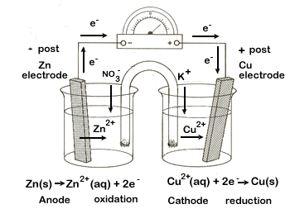
The Salt Bridge
  contains electrolyte solution.
  allows ions to flow between half-cells.
  prevents buildup of charge on the electrodes.
    anions flow to the anode
    cations flow to the cathode
  completes the electrical circuit by allowing ions to flow.
Notes:
The diagrams of electrochemical cells that you have been studying so far all included a salt bridge that connects the solutions in the two half-cells.
The purpose of a salt bridge is to allow the flow of ions from one half-cell to the other. Without a salt bridge, the cell would not function because a positive charge would build up at the anode as electrons moved away from this site, and a negative charge would build up at the cathode because electrons would be moving toward this site.
Allowing for a flow of ions allows the net charge across the cell to remain constant, which allows the cell to continue to run.
Negatively charged ions, the anions, flow through the salt bridge in the direction of the anode where positive charge develops. Positively charged ions, the cations, flow through the salt bridge in the direction of the cathode where negative charge develops.
SOURCES:
http://www.saskschools.ca/curr_content/chem30_05/6_redox/redox2_2.htm (PD based on information at: http://www.saskschools.ca/curr_content/chem30_05/appendix/credits.htm and http://www.saskschools.ca/curr_content/chem30_05/appendix/faq.htm)

Slide 19
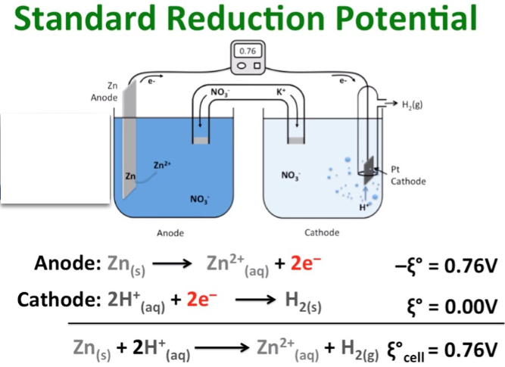
STANDARD REDUCTION POTENTIAL (SRP)
Since one half-reaction does not occur without the other half-reaction, it is impossible to measure electrode potentials of the separate half-reactions directly.
The STANDARD cell potential is the difference between the reduction potential of the cathode and the reduction potential of the anode (reverse reaction to oxidation): E⁰_{cell} = E⁰_{red} + E⁰_{oxid} .

Slide 20
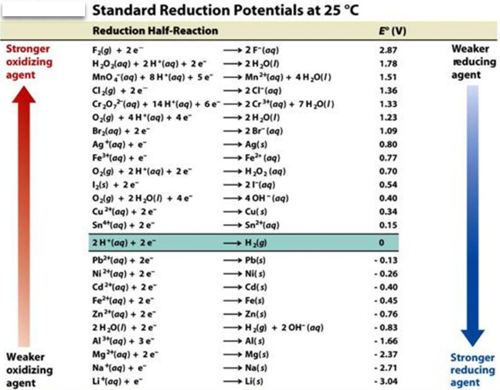
STANDARD REDUCTION POTENTIAL (SRP)
The term “STANDARD” comes from using the hydrogen electrode as the reduction half–reaction: [2H⁺ + 2 e– → H₂]. This electrode is defined as having an electrode potential of exactly 0 V.
To obtain standard oxidation potentials, the magnitude is the same, but the sign is reversed. [SRP = -3.05; SOP = +3.05]
E⁰_{cell} = E⁰_{oxid} + E⁰_{red} is used to determine the standard cell potential for any electrochemical cell.

Slide 21
STANDARD REDUCTION POTENTIAL (SRP)
Reduction Potentials at 25°C with 1M Concentrations of Aqueous Species
 | Electrode | Half-reaction | E⁰ (V) |  | Electrode | Half-reaction | E⁰ (V)
Least tendency to be reduced; greatest tendency to oxidize | Li⁺/Li | Li⁺ + e– → Li | –3.05 |  | Sn²⁺/Sn | Sn²⁺ + 2e– → Sn | –0.14
 | K⁺/K | K⁺ + e– → K | –2.93 |  | Pb²⁺/Pb | Pb²⁺ + 2e– → Pb | –0.13
 | Ba²⁺/Ba | Ba²⁺ + 2e– → Ba | –2.90 |  | H⁺/H₂ | 2H⁺ + 2e– → H₂ | 0.000
 | Ca²⁺/Ca | Ca²⁺ + 2e– → Ca | –2.87 |  | Cu²⁺/Cu | Cu²⁺ + 2e– → Cu | +0.34
 | Na⁺/Na | Na⁺ + e– → Na | –2.71 |  | Cu⁺/Cu | Cu⁺ + e– → Cu | +0.52
 | Mg²⁺/Mg | Mg²⁺ + 2e– → Mg | –2.37 |  | I₂/I– | I₂ + 2e– → 2I– | +0.54
 | Al³⁺/Al | Al³⁺ + 3e– → Al | –1.66 |  | Fe³⁺/Fe²⁺ | Fe³⁺ + e– → Fe²⁺ | +0.77
 | Zn²⁺/Zn | Zn²⁺ + 2e– → Zn | –0.76 |  | Hg₂²⁺/Hg | Hg₂²⁺ + 2e– → 2Hg | +0.79
 | Cr³⁺/Cr | Cr³⁺ + 3e– → Cr | –0.74 |  | Ag⁺/Ag | Ag⁺ + e– → Ag | +0.80
 | Fe²⁺/Fe | Fe²⁺ + 2e– → Fe | –0.44 |  | Hg²⁺/Hg | Hg²⁺+ 2e– → Hg | +0.85
 | Cd²⁺/Cd | Cd²⁺ + 2e– → Cd | –0.40 |  | Br₂/Br– | Br₂ + 2e– → 2Br– | +1.07
 | Co²⁺/Co | Co²⁺ + 2e– → Co | –0.28 |  | Cl₂/Cl– | Cl₂ + 2e– → 2Cl– | +1.36
 | Ni²⁺/Ni | Ni²⁺ + 2e– → Ni | –0.25 |  | F₂/F– | F₂ + 2e– → 2F– | +2.87
Increasing tendency to reduce
(stronger oxidizing agent)
Greatest tendency to be reduced
Least tendency to oxidize

Slide 22
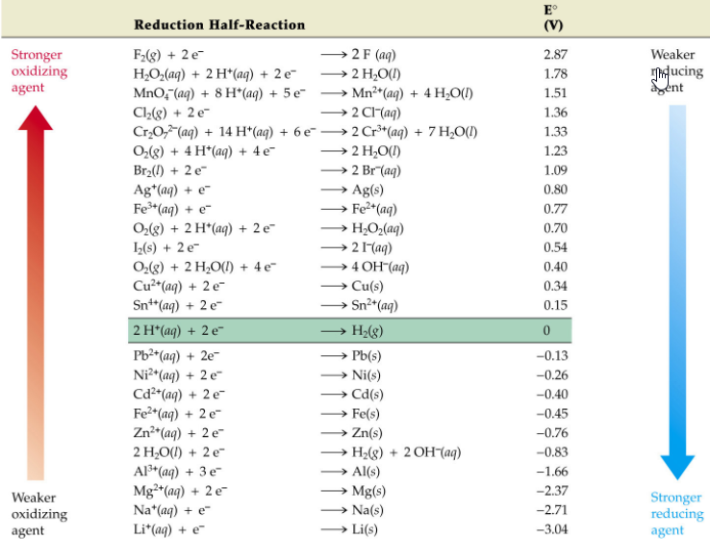
REDUCTION
REDUCTION
(potential)
Decreases as one goes DOWN this table. Notice that non-metals make the strongest oxidizing agents.
OXIDATION
OXIDATION (potential)
Decreases as one goes UP this table. Notice that metals make the strongest reducing agents.

Slide 23

CALCULATING POTENTIALS IN HALF REACTIONS
Consider the reaction between magnesium metal & copper ions:
Mg⁰(s) + Cu²⁺(aq) → Mg²⁺(aq) + Cu⁰(s)
In this reaction magnesium metal (Mg) is being _____ to magnesium ion, while copper ion (Cu⁺²) in aqueous solution is being _____ to copper metal (solid).
Looking at the standard reduction potentials table for each element we find the following:
Mg²⁺ (aq) + 2 e⁻ → Mg (s) E⁰ = _____volts (SRP)
Cu²⁺ (aq) + 2 e⁻ → Cu (s) E⁰ = _____ volts (SRP)
?
?

Slide 24
CALCULATING POTENTIALS IN HALF REACTIONS
Consider the reaction between magnesium metal & copper ions:
Mg⁰(s) + Cu²⁺(aq) → Mg²⁺(aq) + Cu⁰(s)
In this reaction magnesium metal (Mg) is being oxidized to magnesium ion, while copper ion (Cu⁺²) in aqueous solution is being reduced to copper metal (solid).
Looking at the standard reduction potentials table for each element we find the following:
Mg²⁺ (aq) + 2 e⁻ → Mg (s) E⁰ = -2.37 volts (SRP)*
Cu²⁺ (aq) + 2 e⁻ → Cu (s) E⁰ = +0.34 volts (SRP)
*notice magnesium is NOT reduced but oxidized
oxidation
reduction

Slide 25
CALCULATING POTENTIALS IN HALF REACTIONS
Consider the reaction between magnesium metal & copper ions:
Mg⁰(s) + Cu²⁺(aq) → Mg²⁺(aq) + Cu⁰(s)
Change the SRP to match the actual reaction. In the above reaction, magnesium is oxidized and copper is reduced. Therefore:
Oxid ½ reaction: Mg(s) → Mg²⁺(aq) + 2 e⁻ E⁰ = +2.37 volts*
Red ½ reaction: Cu²⁺(aq) + 2 e⁻ → Cu(s) E⁰ = +0.34 volts
net potential for the overall reaction: +2.71 V
*notice the sign for the oxidation ½ reaction was reversed
This represents the theoretical voltage produced in this electrochemical cell.
oxidation
reduction

Slide 26
Types of Electrochemical Cells
Electrolysis
    non-spontaneous
    redox reaction
    applied voltage
    produces redox rxn
Splits into elements.
Voltaic Cells
  spontaneous
  redox reaction
    produces
    electricity
    ---------------------
Dry Cells
  Alkaline
  Batteries
    Lead Storage
    Batteries
    Fuel Cells
Electrolytic Cells
Recharging
Batteries
    non-spontaneous
    redox reaction
    reverses redox
rxns to restore e-
Electroplating
  Non-spontaneous
  redox reaction
    applies layer of
    metal coating
Notes:
Timing ≈ 0.5 min
There are two basic types of electrochemical cells: voltaic and electrolytic.
Voltaic cells run on spontaneous redox reactions that do not require any external energy input.
Electrolytic cells run on non-spontaneous redox reactions that do require external energy input.

Slide 27
Voltaic Cells
Also called Galvanic Cells. Electrons are spontaneously produced at the anode (oxidation) and migrate to the cathode so that reduction can occur. Each electrode is placed in an aqueous solution matching the electrode. The half reactions are kept separate in “cells,” connected by a salt bridge.
e–
e–
Wire
Oxidation
reduction
Anode
(-)
Cathode
(+)
Salt bridge
Cotton plugs
Zn(s) Zn²⁺(aq) + 2e–
ZnSO₄ solution
CuSO₂ solution
Cu²⁺(aq) + 2 e⁻ Cu(s)

Slide 28
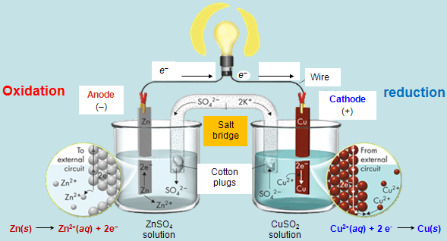
Voltaic Cells
Redox reactions in voltaic cells [dry cells, lead storage & alkaline batteries, fuel cells as in cars] take place in aqueous solutions (in this case ZnSO_{4(aq)} & CuSO_{4(aq)}) to allow ion migration.
The electrons are “pumped” from the anode towards the cathode, supplying electricity to some resistance (bulb, motor, cell, door bell, keypad, etc.).

Slide 29
Voltaic Cells
Electrons are produced at the anode so it is designated with a negative charge in voltaic cells. The electrons migrate and are attracted to the cathode, therefore, the cathode is often denoted with a positive sign.
To maintain electrical neutrality, ions must migrate: cations towards the cathode and anions towards the anode.
The salt bridge completes the circuit so that current (electrons) can flow. If the circuit is “broken,” the half reactions will not occur.

Slide 30
Electrochemical Cell
Electrochemistry Song:
“Start at the Anode”
By Mark Rosengarten
(3:28)
http://somup.com/cFX6oini35
Notes:
Timing ≈ 1.0
[Use highlight tool to highlight tool in table as topic is discussed.]
Many reactions involved the transfer of electrons, including photosynthesis in plants. Electrons can be transferred without forming ions, but any reaction that leads to the formation of ions must involve the transfer of electrons.
[Animate] Electrons form ions that have a full valence level. You can use the periodic table to determine the types of ion an atom will form. For example, sodium [highlight] is in Group 1. It has one valence electron. [highlight] Oxygen [highlight] is on the other side of the periodic table in Group 16. It has 6 valance electrons [highlight]
[Animate] It is more energetically favorable for sodium to lose one electron to get a valence level that has 8 electrons. [highlight] When an atom loses one or more electrons, it forms a positive ion. A sodium ion has a charge of plus one. [highlight]
[Animate] On the other hand, oxygen only needs to gain 2 electrons to get a valence shell with 8 electrons. [highlight] Atoms that gain one or more electrons form negative ions. An oxygen ion has a charge of minus two. [highlight]
[Animate] The charge of an ion depends on the number of electrons lost or gained. [Highlight 1 and Na⁺, and then 2 and O²⁻]. Elements in Group 1 always form ions with a charge of plus one because they lose one electron. Elements in Group 2 gain two electrons, so they form ions with a charge a plus two. Elements in Group 16 lose two electrons, so they form ions with a charge of minus two.
For main group elements, you can use the group of an element to determine the type of ion it is most likely to form. However, transition metals may form multiple ions. For example, iron may form ions that have a charge of plus two or plus three.
SOURCES:

Slide 31
Voltaic Cells
The electrons are the source of potential in the voltaic cell.
As the electrons leave the anode (Zn), the Zn metal disintegrates.
As the electrons reduce at the cathode (Cu), the Cu metal increases in mass at the cathode.
Once the redox reaction reaches equilibrium, the voltage is zero.

Slide 32
Calculate the POTENTIAL of the Zinc-Copper
Voltaic Cell
Standard Reduction Potentials (SRP)
Zn²⁺/Zn | Zn²⁺ + 2e– → Zn | –0.76
Cu²⁺/Cu | Cu²⁺ + 2e– → Cu | +0.34

Slide 33
REDUCTION
OXIDATION

Slide 34
Calculate the POTENTIAL of the Zinc-Copper
Voltaic Cell
Standard Reduction Potentials (SRP)
Zn²⁺/Zn | Zn²⁺ + 2e– → Zn | –0.76
Cu²⁺/Cu | Cu²⁺ + 2e– → Cu | +0.34
oxidation
Zn(s) + Cu²⁺(aq) → Zn²⁺(aq) + Cu(s)
Zn²⁺(aq) + 2 e⁻ → Zn(s) E⁰ = - 0.76 volt (SRP)
Cu²⁺(aq) + 2 e⁻ → Cu(s) E⁰ = +0.34 volts (SRP)
Oxid ½ reaction: Zn(s) → Zn²⁺(aq) + 2 e⁻ E⁰ = +0.76 volts*
Red ½ reaction: Cu²⁺(aq) + 2 e⁻ → Cu(s) E⁰ = +0.34 volts
net potential for the overall reaction: +1.10 V
*notice the sign for the oxidation ½ reaction was reversed
reduction

Slide 35
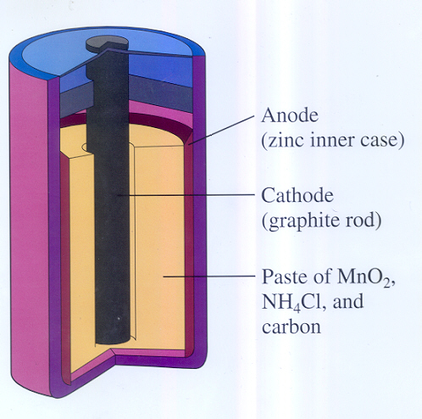
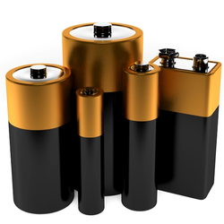
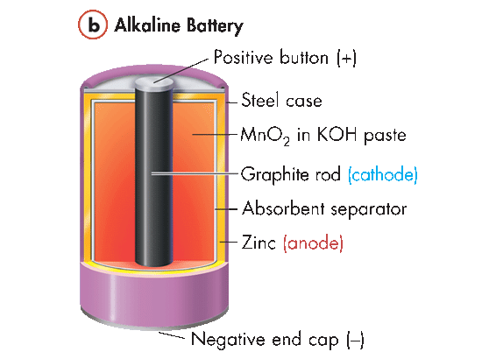
Voltaic Cells
Dry Cell
Alkaline Batteries
Positive button (+)
Steel case
MnO₂ in KOH paste
Graphite rod (cathode)
Absorbent separator
Zinc (anode)
Negative end cap (–)
A dry cell is a voltaic cell in which the electrolyte is a paste. Dry cells have a short shelf life and a voltage drop when used.
The alkaline battery is an improved dry cell. This change eliminates the buildup of ammonia gas and maintains the zinc electrode, which corrodes more slowly under basic, or alkaline, conditions.

Slide 36
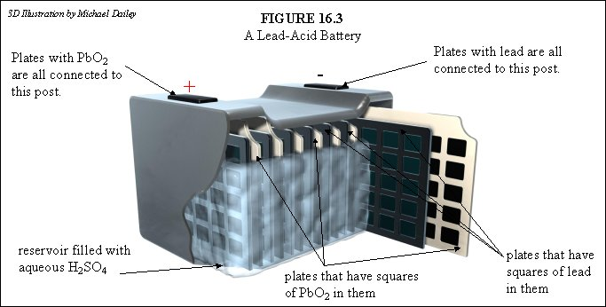
Voltaic Cells
A Lead Storage Battery is a group of voltaic cells connected together. A 12-V car battery consists of six voltaic cells connected together. The electrolyte for both half-cells is sulfuric acid. Using the same electrolyte for both half-cells allows the cell to operate without a salt bridge or porous separator.
Anode
oxidation
Cathode
reduction

Slide 37
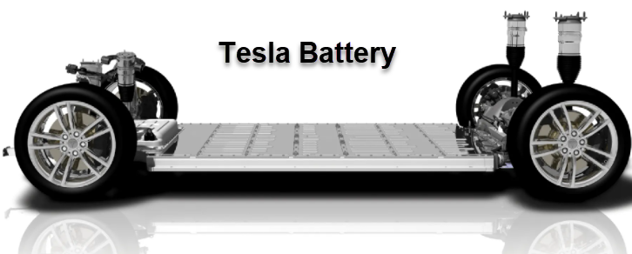
Voltaic Cells
Tesla Batteries are voltaic cells in which electrical energy is continuously obtained. Tesla batteries use thousands of lithium ion cells to power the vehicle. They run solely on battery power, meaning the electric motor cannot be charged automatically while driving. The energy generated and stored in the battery is then used to generate a small motor that powers the vehicle.

Slide 38
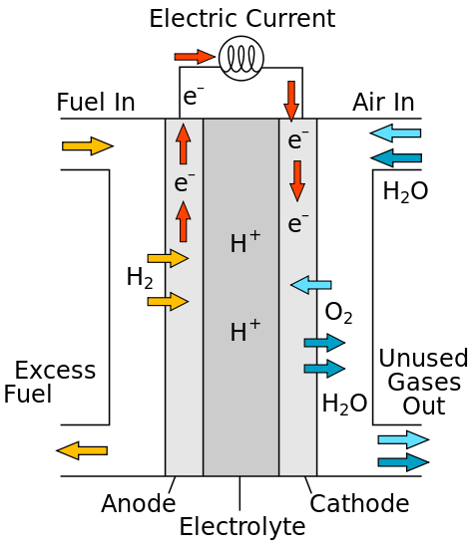
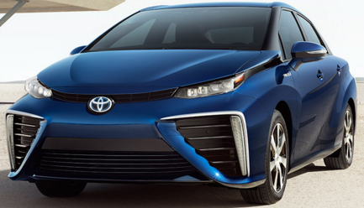
Voltaic Cells
Fuel Cells are voltaic cells in which electrical energy is continuously obtained. Fuel cells do not have to be recharged.
Fuel cells consist of an anode, a cathode, and an electrolyte that allows positively charged hydrogen ions (or protons) to move between the sides of the fuel cell. Fuel cells are 2-3 times more efficient than combustion engines, producing water and heat.

Slide 39
Spontaneity
Scientists use the known standard oxidation-reduction potentials to predict spontaneity: E⁰_{cell} value.
E⁰_{cell} = E⁰_{oxid} + E⁰_{red}
If the cell potential (E⁰_{cell}) for a given redox reaction is positive, then the reaction is spontaneous.
If the cell potential (E⁰_{cell}) is negative, then the reaction is nonspontaneous.
Zn(s) + 2Ag⁺(aq) → Zn²⁺(aq) + 2Ag(s)

Slide 40
Spontaneity
Scientists use the known standard oxidation-reduction potentials to predict spontaneity: E⁰_{cell} value.
E⁰_{cell} = E⁰_{oxid} + E⁰_{red}
The E⁰ values are for oxidation (reverse SRP) & reduction.
Zn(s) + 2Ag⁺(aq) → Zn²⁺(aq) + 2Ag(s)
Oxid ½ reaction: Zn(s) → Zn²⁺(aq) + 2 e⁻ E⁰ = +0.76 volts*
Red ½ reaction: 2Ag⁺(aq) + 2 e⁻ → 2Ag(s) E⁰ = +0.80 volts
E⁰_{cell} = E⁰_{oxid} + E⁰_{red} = (+0.80 V) + (+0.76 V) = +1.56 V
Spontaneous Redox Reaction
*notice the sign for the oxidation ½ reaction was reversed

Slide 41
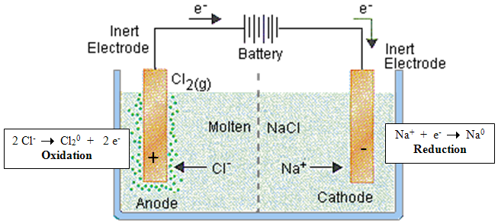
Electrolytic Cells
Electrolysis uses an electric current (“electro”) to split (“lysis”) a compound into its elements, including many important industrial reactions such as the electrolysis of brine (NaCl into sodium and chlorine gas), electrolysis of aluminum oxide to aluminum and oxygen gas, and the electrolysis of water into hydrogen and oxygen gases.

Slide 42
Electrolytic Cells
Non-spontaneous: The electrons are being forced in a direction opposite of a spontaneous reaction using an applied DC voltage.
The cathode (reduction) is designated negative [cations (positive sodium ions above) are attracted to it]. The power source forces reduction at the cathode: Na⁺ + e⁻ → Na⁰, forming sodium metal.
The anode (oxidation) is positive [anions (negative chlorine ions above) are attracted to it]: 2 Cl⁻ → Cl₂⁰ + 2 e⁻, forming chlorine gas

Slide 43
Electrolytic Cells
Use the SRP reference table to determine the potential required to electrolyze sodium chloride into its elements.
Oxid ½ reaction:
Red ½ reaction:

Slide 44
Electrolytic Cells
Use the SRP reference table to determine the potential required to electrolyze sodium chloride into its elements.
Oxid ½ reaction: 2 Cl⁻ → Cl₂⁰ + 2 e⁻ E⁰ = -1.36 volts
Red ½ reaction: 2(Na⁺ + e⁻ → Na⁰) E⁰ = -2.71 volts
E⁰_{cell} = E⁰_{oxid} + E⁰_{red} = (-1.36 V) + (-2.71 V) = -4.07 V
Non-Spontaneous Redox Reaction

Slide 45
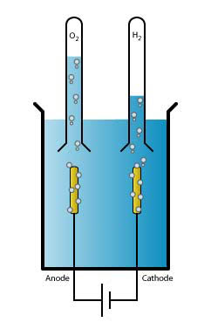
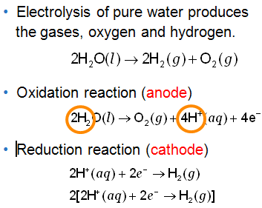

Electrolysis of Water
2 H₂O⁻²(l) → O₂⁰(g) + 4 H⁺(aq) + 4e⁻
Reduction Reaction (cathode)
2 H⁺(aq) + 2e⁻ → H₂⁰(g)
Notes:
Timing ≈ 1.0 minute
[display image of chlor-caustic soda plant only] Chlorine is used in a wide variety of industries, from materials engineering, waste water treatment to pharmaceuticals.
[exit plant image & animate chlor-alkali membrane image with 1st line of text] Electrolysis is used to produce chlorine from a salt solution known as brine.
At the anode, chloride (Cl–) is oxidized to chlorine (2Cl– → Cl₂ + 2e–). [teacher point out positive anode and chlorine gas produced in image on left side]
The ion-selective membrane allows the cation (Na⁺) to freely flow across, but prevents anions such as hydroxide (OH–) and chloride from diffusing across. [teacher point out in image] This is a semi-permeable membrane.
At the cathode, water is reduced to hydroxide and hydrogen gas (2H₂O + 2e– → H₂ + 2OH–). [Teacher point out negative cathode on the right side of image and production of hydrogen gas] Sodium reacts with hydroxide to produce NaOH [teacher point out in image].
The net process is the electrolysis of an aqueous solution of NaCl [animate orange oval] into industrially useful products sodium hydroxide (NaOH) and chlorine gas (Cl₂). [animate red ovals]
SOURCES:
“Cell room of a chlorine-caustic soda plant.JPG,” McGraw-Hill Pub. Co. (Albany, N.Y.), Public Domain, http://commons.wikimedia.org/wiki/File:Cell_room_of_a_chlorine-caustic_soda_plant.JPG
“Chloralkali membrane.svg,” Jkwchui, CCA-SA 3.0, http://en.wikipedia.org/wiki/File:Chloralkali_membrane.svg

Slide 46
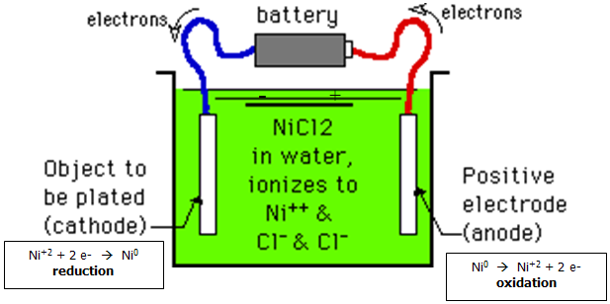

Electrolytic Cells
Electroplating
Non-Spontaneous Redox Reaction requiring a power source.
Electroplating is the deposition of a metallic coating [nickel in this case] on an object at the cathode by exposing it to a salt solution [e.g. nickel chloride in this case] of the metal to be deposited and then, putting a negative charge on the object, so positively charged metal ions [Ni⁺² ions in this case] in the salt solution are reduced to the metallic form at the anode.

Slide 47
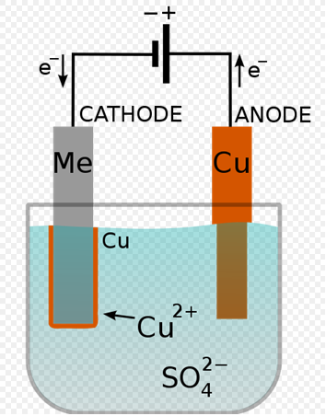
The Process of Electroplating
Anode (oxidation) [+ terminal]
Cu⁰(s) → Cu²⁺ + 2 e-
The anode is made of the metal used for the plating.
The anode metal gets used up.
Cathode (reduction) [- terminal]
Cu²⁺ + 2 e- → Cu⁰(s)
The cathode metal gets plated.
Electroplating is used to prevent corrosion, increase wear resistance, enhance the appearance of an object, and to build up thickness on undersized parts.
-
+
Notes:
Timing ≈ 1.0 minute
[display image to the right] Another application of electrolytic processes is electroplating. [teacher repeat definition from previous slide: Electroplating: the deposition of a thin layer of metal onto an object in an electrolytic cell.]
[animate orange oval] The anode and cathode are both connected to an external supply of direct current (typically a battery).
[animate blue arrow] The anode is connected to the positive terminal of the supply, and the cathode (the article to be plated) is connected to the negative terminal. [animate green arrow]
[animate anode text & half reaction equation] When the external power supply is switched on, the metal at the anode is oxidized from the zero valence state to form cations with a positive charge. These cations associate with the anions in the solution. For example, in an acid solution, copper is oxidized at the anode to Cu²⁺ by losing two electrons. The Cu²⁺ associates with the anion SO₄²⁻ in the solution to form copper sulfate. [teacher point out in image]
[animate Cathode text & half reaction equation] At the cathode, the Cu²⁺ is reduced to metallic copper by gaining two electrons. The result is the effective transfer of copper from the anode source to a metal plate covering the cathode.
An object can be plated by making it a cathode in a cell with ions of the plating metal in an electrolyte solution of the plating metal. [teacher explain that copper is the plating metal and copper sulfate as the electrolyte in this case.] The cathode is attached to the negative terminal of the battery.
[animate 1st bullet] Generally speaking, the anode of the electroplating electrolytic cell is made of the metal that is going to be plated on the object at the cathode.
[animate 2nd bullet] The cathode is made of the metal to be plated over and is normally less expensive and stronger than the plating metal.
Electroplating produces a very thin coating of these expensive metals on the surfaces of cheaper, but usually stronger metals, giving them the appearance and the chemical resistance of the expensive ones.
SOURCE:
http://en.wikipedia.org/wiki/File:Copper_electroplating.svg

Slide 48

Rechargeable Batteries
Electrolytic Cells
Typical Voltaic cell
(e.g. cell phone battery)
Recharging: The half cell reactions reverse
e-
e-
Load
e-
Battery
e-
Anode
-
Cathode
+
Cathode
-
Anode
+
Formerly the cathode
Notes:
[display left image] The voltaic cell, the battery, has a negative anode where oxidation takes place and a positive cathode where reduction takes place. [teacher point out each component: anode is -, cathode is +, current from anode to cathode]
During the discharge of a battery, which is a voltaic cell, lithium ions (Li⁺) carry the current from the negative anode to the positive cathode where the lithium ions are reduced to form lithium. [animate reduction equation below cathode] The load represents the device doing work (i.e. powering the cell phone). [teacher point out reduction which uses up electrons and the load (to do work)]
[animate Recharging text and right image] When an electrolytic cell charges a Voltaic cell, an external electrical power source (DC Power) applies a higher voltage than that produced by the battery, forcing the current to pass in the reverse direction. [teacher point out how components changed: anode is +, cathode is -, battery present, current reversed]
(animate oxidation half reaction equation) The lithium ions then migrate from the cathode to the anode, where they become embedded in the porous electrode material through oxidation.
It is important to note that because lithium reacts with water, the electrolytic solution used is non-aqueous.
SOURCES: “CellPhoneUsedBattery_336211_360x480.jpg,” Public Domain Photos, Public Domain, http://publicphoto.org/technology/cell-phone-used-battery/attachment/cell-phone-used-battery_336211/

Slide 49
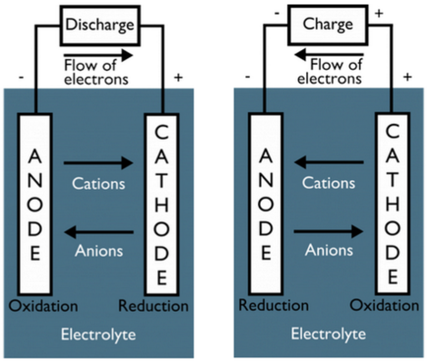
Rechargeable Batteries
Electrolytic Cells
When a battery (voltaic cell) is discharged, oxidation proceeds at the negative electrode (anode), and reduction occurs at the positive electrode cathode.
To recharge a battery (electrolysis), the direction of electric current flow is reversed so the opposite reactions take place.
Reduction proceeds at the former anode (negative electrode … now the cathode), and oxidation takes place at the former cathode (positive electrode … now the anode).
Notes:
[display left image] The voltaic cell, the battery, has a negative anode where oxidation takes place and a positive cathode where reduction takes place. [teacher point out each component: anode is -, cathode is +, current from anode to cathode]
During the discharge of a battery, which is a voltaic cell, lithium ions (Li⁺) carry the current from the negative anode to the positive cathode where the lithium ions are reduced to form lithium. [animate reduction equation below cathode] The load represents the device doing work (i.e. powering the cell phone). [teacher point out reduction which uses up electrons and the load (to do work)]
[animate Recharging text and right image] When an electrolytic cell charges a Voltaic cell, an external electrical power source (DC Power) applies a higher voltage than that produced by the battery, forcing the current to pass in the reverse direction. [teacher point out how components changed: anode is +, cathode is -, battery present, current reversed]
(animate oxidation half reaction equation) The lithium ions then migrate from the cathode to the anode, where they become embedded in the porous electrode material through oxidation.
It is important to note that because lithium reacts with water, the electrolytic solution used is non-aqueous.
SOURCES: “CellPhoneUsedBattery_336211_360x480.jpg,” Public Domain Photos, Public Domain, http://publicphoto.org/technology/cell-phone-used-battery/attachment/cell-phone-used-battery_336211/

Slide 50
Types of Electrochemical Cells
Electrolysis
    non-spontaneous
    redox reaction
    applied voltage
    produces redox rxn
Splits into elements.
Voltaic Cells
  spontaneous
  redox reaction
    produces
    electricity
    ---------------------
Dry Cells
  Alkaline
  Batteries
    Lead Storage
    Batteries
    Fuel Cells
Electrolytic Cells
Recharging
Batteries
    non-spontaneous
    redox reaction
    reverses redox
rxns to restore e-
Electroplating
  Non-spontaneous
  redox reaction
    applies layer of
    metal coating
Notes:
Timing ≈ 0.5 min
There are two basic types of electrochemical cells: voltaic and electrolytic.
Voltaic cells run on spontaneous redox reactions that do not require any external energy input.
Electrolytic cells run on non-spontaneous redox reactions that do require external energy input.

Slide 51
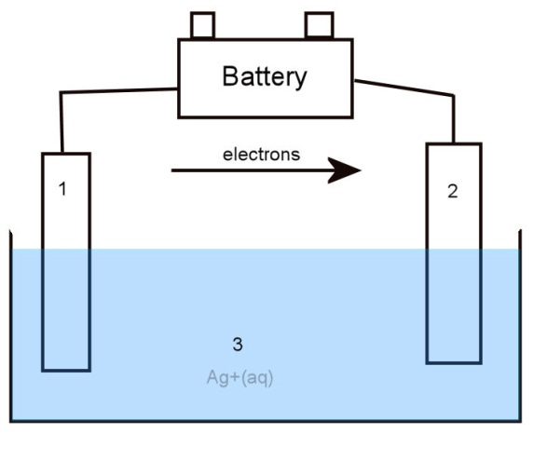
Practice Labeling Electrolytic Cells
The image to the right typifies an electrolytic cell. Identify the components:
The cathode is ___ (- or +).
The anode is ___ (- or +).
The electrolyte solution is ___.
Which half-reaction could occur at the anode?
O Ag⁺ + e– → Ag [reduction]
O Ag → Ag⁺ + e– [oxidation]
The reaction from this cell is spontaneous / non-spontaneous
4
Notes:
Hint Audio: Remember that if a voltage is applied, the reaction proceeding is not spontaneous.
Exit Audio: The next assignment will ask you to further detail electroplating and recharging batteries.
Source: Image by writer

Slide 52
Practice Labeling Electrolytic Cells
The image to the right typifies an electrolytic cell. Identify the components:
The cathode is 2 (-).
The anode is 1 (+).
The electrolyte solution is 3.
Which half-reaction could occur at the anode?
O Ag⁺ + e– → Ag [reduction]
!!! Ag → Ag⁺ + e– [oxidation]
The reaction from this cell is spontaneous / non-spontaneous
4
Notes:
Hint Audio: Remember that if a voltage is applied, the reaction proceeding is not spontaneous.
Exit Audio: The next assignment will ask you to further detail electroplating and recharging batteries.
Source: Image by writer

Slide 53
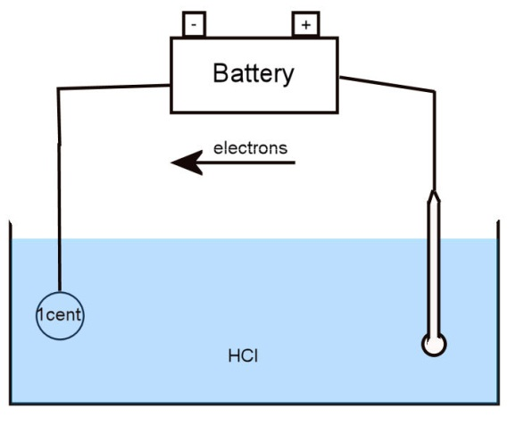
Practice with Electroplating
A galvanized nail (a nail coated in zinc) can be used to electroplate zinc on to a copper penny. The overall reaction for the diagramed cell shown above the diagram.
The penny acts as the anode / cathode
The nail acts as the anode / cathode
The electrolyte solution is ___
Which half reaction occurs at the penny?
O Zn²⁺ + 2e – → Zn
O Zn → Zn²⁺ + 2e–
Notes:
Timing ≈ 4.0 minutes
Entry Audio: Use the drop down menus and text areas to describe the pictured electrolytic cell.
Hint Audio: Zinc is stripped from the nail and plated on to the penny.
Exit Audio: The next slide will test your knowledge of rechargeable batteries.
Source: Image by writer

Slide 54
Practice with Electroplating
A galvanized nail (a nail coated in zinc) can be used to electroplate zinc on to a copper penny. The overall reaction for the diagramed cell shown above the diagram.
The penny acts as the anode / cathode
The nail acts as the anode / cathode
The electrolyte solution is HCl
Which half reaction occurs at the penny?
!!! Zn²⁺ + 2e – → Zn [reduction]
O Zn → Zn²⁺ + 2e–
Notes:
Timing ≈ 4.0 minutes
Entry Audio: Use the drop down menus and text areas to describe the pictured electrolytic cell.
Hint Audio: Zinc is stripped from the nail and plated on to the penny.
Exit Audio: The next slide will test your knowledge of rechargeable batteries.
Source: Image by writer

Slide 55
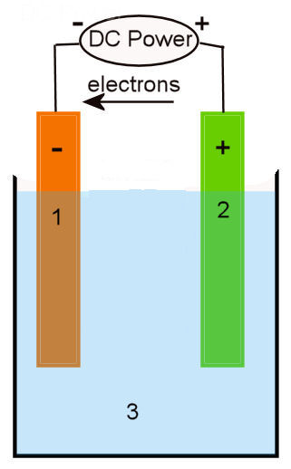
Practice with Rechargeable Batteries
Nickel cadmium batteries are rechargeable electrolytic / voltaic cells. The battery in the diagram is in the process of charging / discharging.
How can you determine this?
O The electrons flow from anode to cathode.
O Electrons flow from cathode to anode.
O This is a spontaneous reaction.
O This is a non-spontaneous reaction.
The nickel (III) oxie-hydroxide (Ni(OH)₂) cathode is labeled as ___.
The cadmium hydroxide (Cd(OH)₂) anode is labeled as ___.
The potassium hydroxide (KOH) electrolyte solution is labeled as ___.
Notes:
Timing ≈ 4.0 minutes
Entry Audio: Use the drop down menus and text areas to describe the nickel cadmium battery diagramed on the slide.
Hint Audio: A discharging reaction proceeds spontaneously, while the charging process requires the power supply. Electrode charges are reversed between charging and discharging.
Exit Audio: Now you should be familiar with electrolytic cells and their applications.
Source: Image by writer

Slide 56
Practice with Rechargeable Batteries
Nickel cadmium batteries are rechargeable electrolytic / voltaic cells. The battery in the diagram is in the process of charging / discharging.
How can you determine this?
!!! The electrons flow from anode to cathode.
!!! This is a non-spontaneous reaction (power source is required).
The nickel (III) oxie-hydroxide (Ni(OH)₂) cathode is labeled as 1. [- side]
The cadmium hydroxide (Cd(OH)₂) anode is labeled as 2. [+ side]
The potassium hydroxide (KOH) electrolyte solution is labeled as 3.
Notes:
Entry Audio: Use the drop down menus and text areas to describe the nickel cadmium battery diagramed on the slide.
Hint Audio: A discharging reaction proceeds spontaneously, while the charging process requires the power supply. Electrode charges are reversed between charging and discharging.
Exit Audio: Now you should be familiar with electrolytic cells and their applications.
Source: Image by writer

Slide 57
Electrodes in Voltaic Cells & Electrolytic Cells
Voltaic cells:
Chemical reactions generate electrical energy; spontaneous
Anode (oxidation) is negative, cathode (reduction) is positive.
Electrolytic cells:
Electrical energy decomposes chemical compounds; non-spontaneous
Anode (oxidation) is positive, cathode (reduction) is negative
Notes:
[display both images to the right only] In all electrochemical cells (voltaic & electrolytic cells) oxidation takes place at the anode [teacher point anode in both images] and reduction takes place at the cathode. [teacher point out cathode in both images]
Therefore, in both voltaic and electrolytic cells, electrons flow from the anode to the cathode in the external circuit. [teacher show flow in both images from anode to cathode and then through solution to complete circuit]
[animate 1st text line & sub-bullets] In voltaic cells: Chemical reactions are used to generate electrical energy. Electrons are produced at the anode, making it negative. [teacher circle negative anode on top image] Electrons are consumed at the cathode, making it positive. [teacher circle positive cathode on top image]
[animate 2nd major text line & sub-bullets] In electrolytic cells: Electrical energy provided to the cell is being used to decompose chemical compounds. This requires a power source. The anode is positive because it is connected to the positive terminal of the battery which attracts ions). [teacher circle positive anode on bottom image] The cathode is negative because it is connected to the negative terminal of the battery (which produces electrons). [teacher point out battery (power source) and circle negative cathode on bottom image]
The charges are reversed in an electrolytic cell because the anode is attached to the positive terminal of the voltage source (battery), which attracts ions to be oxidized. However, oxidation always takes place at the anode and reduction at the cathode in all electrochemical cells.
[teacher point out electrolytes in both images and then explain] Both electrochemical cells rely on solutions of electrolytes to provide ions that flow to and from the electrodes, allowing electric current to flow.
SOURCES:
“Galvanic cell with no cation flow.png,” Ohiostandard, CCA-SA 3.0, http://en.wikipedia.org/wiki/File:Galvanic_cell_with_no_cation_flow.png
“Electrólisis.png,” Mbarousse, Public Domain, http://commons.wikimedia.org/wiki/File:Electr%C3%B3lisis.png

Slide 58
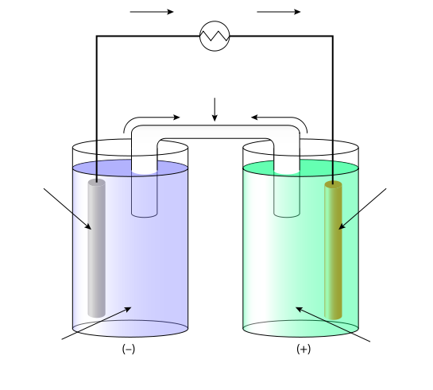
Review
e-
voltmeter
What type of electrochemical cell is this? _______________
This electrochemical cell was constructed using the following oxidation-reduction reaction:
Which metal is the anode?
O tin (Sn) O silver (Ag)
5
cations
anions
1
2
3
4
Indicate the number corresponding to each part of the cell:
tin electrode ___ silver electrode ___ AgNO₃ solution ___
Sn(NO₃)₂ solution ___ salt bridge ___

Slide 59
Review
e-
voltmeter
What type of electrochemical cell is this? Voltaic
This electrochemical cell was constructed using the following oxidation-reduction reaction:
Which metal is the anode?
Tin (Sn)
5
cations
anions
1
2
3
4
Indicate the number corresponding to each part of the cell:
tin electrode 1 silver electrode 2 AgNO₃ solution 4
Sn(NO₃)₂ solution 3 salt bridge 5

Slide 60
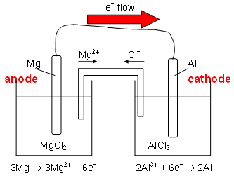
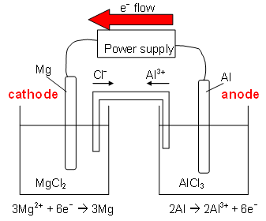
Review
Label the type of electrochemical cell represented by each diagram and whether it is spontaneous or non-spontaneous. Label the anode, cathode, and direction of electron flow in each diagram. What half reaction is taking place at each electrode?
?
?
?
?
?
?
?
?
?
?

Slide 61
Review
Label the type of electrochemical cell represented by each diagram and whether it is spontaneous or non-spontaneous. Label the anode, cathode, and direction of electron flow in each diagram. What half reaction is taking place at each electrode?
Voltaic Cell
Spontaneous
Electrolytic Cell
Non-spontaneous
oxidation
reduction
reduction
oxidation

Slide 62
Distinguish the types of Electrochemical Cells
?
  Spontaneous
  or Not?
  What drives them?
Splits into elements.
Voltaic Cells
  Spontaneous
  or Not?
  What does it
  Produce?
  Examples?
Electrolytic Cells
?
    non-spontaneous
    redox reaction
    reverses redox
rxns to restore e-
?
  Non-spontaneous
  redox reaction
    applies layer of
    metal coating
Notes:
There are two basic types of electrochemical cells: voltaic and electrolytic.
Voltaic cells run on spontaneous redox reactions that do not require any external energy input.
Electrolytic cells run on non-spontaneous redox reactions that do require external energy input.

Slide 63
Types of Electrochemical Cells
Electrolysis
    non-spontaneous
    redox reaction
    applied voltage
    produces redox rxn
Splits into elements.
Voltaic Cells
  spontaneous
  redox reaction
    produces
    electricity
    ---------------------
Dry Cells
  Alkaline
  Batteries
    Lead Storage
    Batteries
    Fuel Cells
Electrolytic Cells
Recharging
Batteries
    non-spontaneous
    redox reaction
    reverses redox
rxns to restore e-
Electroplating
  Non-spontaneous
  redox reaction
    applies layer of
    metal coating
Notes:
Timing ≈ 0.5 min
There are two basic types of electrochemical cells: voltaic and electrolytic.
Voltaic cells run on spontaneous redox reactions that do not require any external energy input.
Electrolytic cells run on non-spontaneous redox reactions that do require external energy input.

Slide 64
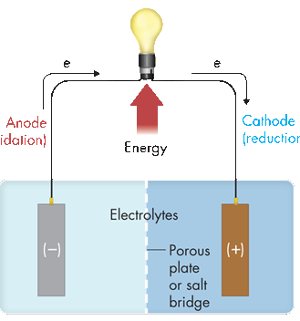
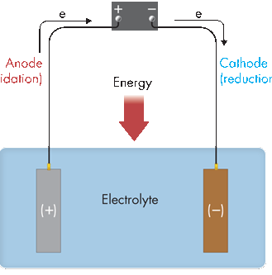
Electrolytic vs. Voltaic Cells
? Cell
? Cell
?
e–
e–
e–
e–
Anode (?)
Cathode (?)
Cathode (?)
Energy
Anode (?)
Energy
In both voltaic and electrolytic cells, electrons flow from the _______ to the __________ in the external circuit.
In a voltaic cell, the flow of electrons is the result of a ____________ redox reaction, whereas in an ____________ cell, electrons are caused to flow by an outside power source, such as a battery.
In a voltaic cell, the anode is the _________ electrode and the cathode is the _________ electrode. In an electrolytic cell, the signs are __________.

Slide 65
Electrolytic vs. Voltaic Cells
Voltaic Cell
Electrolytic Cell
Battery
e–
e–
e–
e–
Anode (oxidation)
Cathode (reduction)
Cathode (reduction)
Energy
Anode (oxidation)
Energy
In both voltaic and electrolytic cells, electrons flow from the anode to the cathode in the external circuit.
In a voltaic cell, the flow of electrons is the result of a spontaneous redox reaction, whereas in an electrolytic cell, electrons are caused to flow by an outside power source, such as a battery.
In a voltaic cell, the anode is the negative electrode and the cathode is the positive electrode. In an electrolytic cell, the signs are reversed.

Slide 66
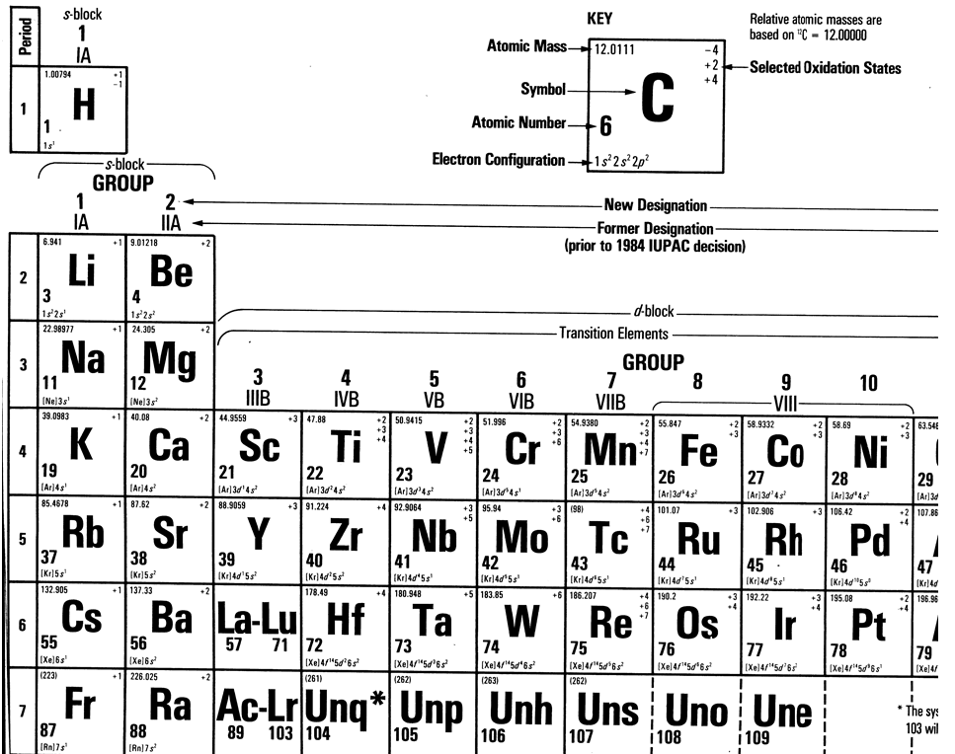

Slide 67
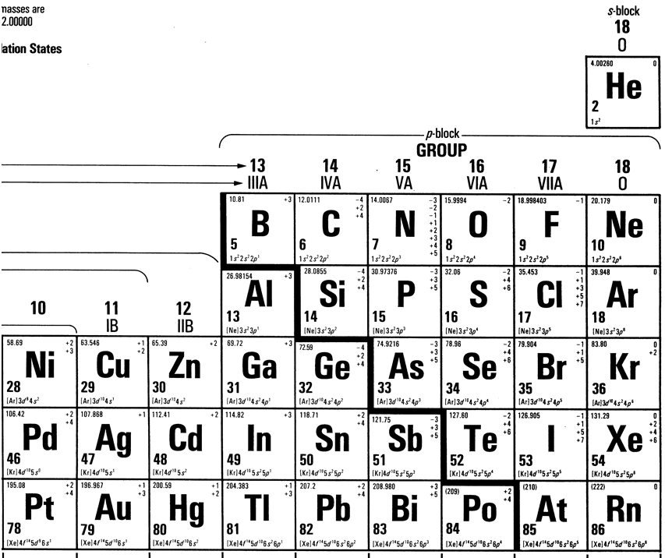

Slide 68
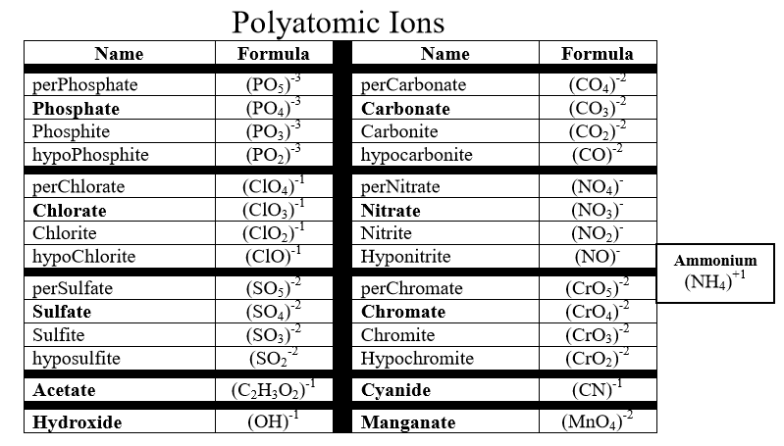

Slide 69
