Slide 1
Click “Slide Show”
Click “From Beginning”
Or
“From Current Slide”

Slide 2
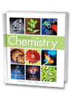
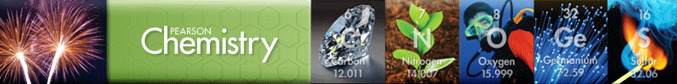
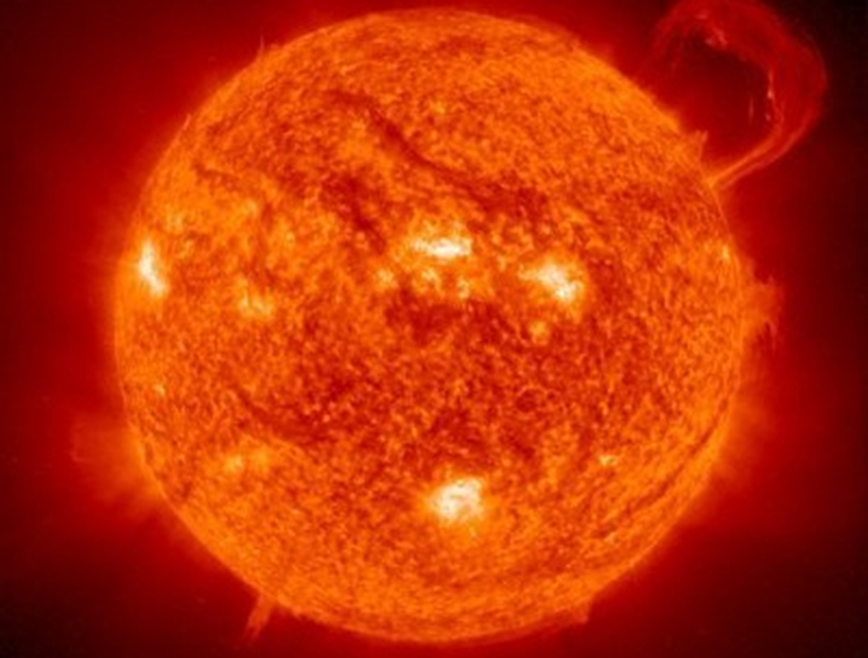
Chapter 17A
Thermochemistry
The Flow of Energy
Measuring and Expressing
Enthalpy Changes
Heat in Changes of State
Calculating Heats of Reaction

Slide 3
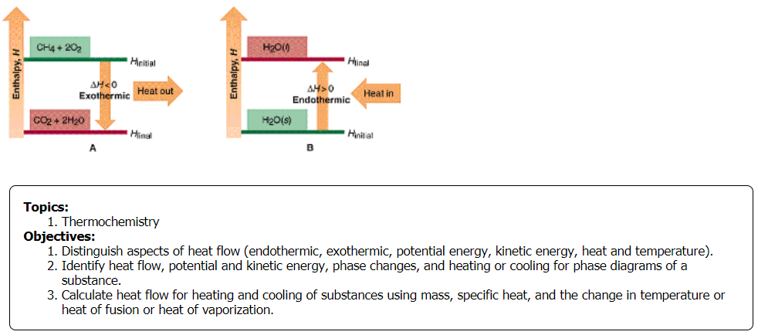

Slide 4
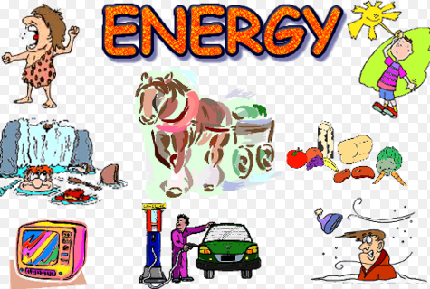
Name types of Energy.

Slide 5
Name types of Energy.
Kinetic &
Potential
Light
Nuclear
Mechanical
Heat
Chemical
Electrical
Magnetic
Sound

Slide 6
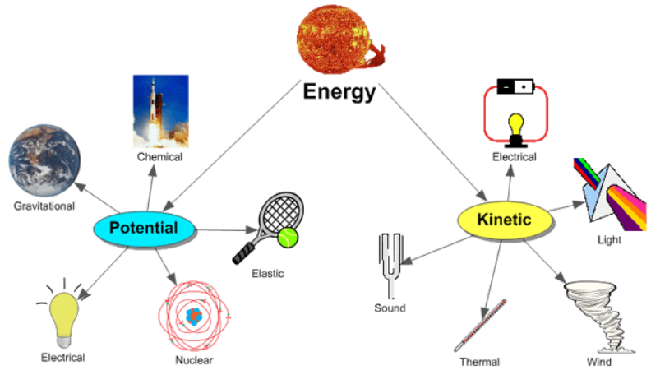
Energy & Work
All the “forms” of energy … Light, Nuclear, Mechanical, Heat, Chemical, Electrical, Magnetic, and Sound involve the interaction of PE & KE.
Potential Energy (PE) → stored or inherent (built in)
Kinetic Energy (KE) (energy of motion).

Slide 7
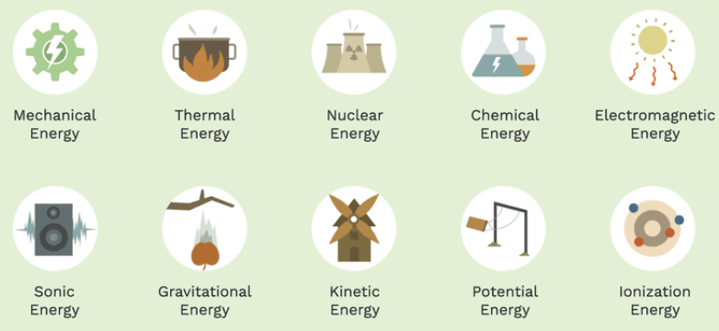
Energy
The capacity to do work (“joules” → KJ)
Unlike matter, energy has neither mass nor volume. Energy is detected only by its effects.

Slide 8

Energy
The capacity to do work (“joules” → KJ)
Potential Energy (PE) → stored energy
Every chemical substance contains a certain amount of energy, called chemical potential energy, which is stored in the chemical bonds of its atoms.
The kinds of atoms and their arrangement in a substance, determine the amount of potential energy stored in that substance.

Slide 9
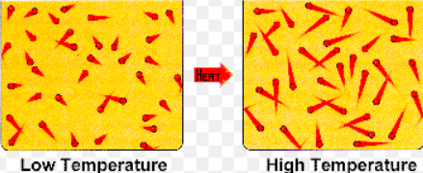
Energy
the capacity to do work (“joules” → KJ)
Kinetic Energy (KE) → energy of motion
  Temperature is a measure of the average kinetic energy of the particles in a sample of matter. The greater the KE of the particles in a sample, the hotter it feels.
Celsius and Kelvin temperatures are related by the following equation:
K = 273.15 + ⁰C

Slide 10
Energy associated with chemical changes and with physical changes
Endothermic ΔH = +
  heat flows into the system from the surroundings
Exothermic ΔH = ─
  heat flows from the system into the surroundings
Activation energy → The energy needed before a chemical reaction can take place (e.g. Powder needs to be airbourne before it can explode.)
  http://somup.com/cFX63NniZY (2:04)

Slide 11
Energy Units
Joule (J)
The joule (J) is the SI unit of energy. One joule of heat raises the temperature of 1 g of pure water 0.2390 ⁰C.
Calorie (C)
The amount of energy required to raise 1 gram of water, one degree Celsius.
      1 calorie = 4.18 joules [Reference Table 1]
      1 J = 2.39 X 10⁻¹ cal
      Food → 1000 calories = 1 Calorie (kilocalorie)

Slide 12
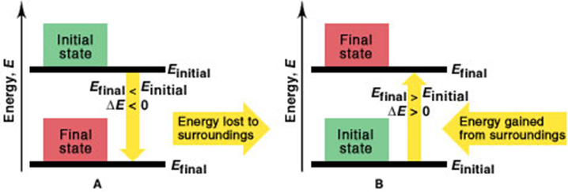
Heat
A form of energy that takes into account the quantity of matter
mass
    Units: calories (Kcal) or joules (KJ)
    Calorimeter → instrument used to measure heat
    Physical and chemical changes involve changes in energy:
      (1) Exothermic - releases energy or heat
      (2) Endothermic - gains/absorbs energy or heat
      Activation energy
(1)
(2)

Slide 13
Temperature
The measure of heat intensity: describes the average kinetic energy (KE) of the molecules in a system
    Units: measured in degrees
      Fahrenheit (°F)
      Celsius (°C); also called centigrade
      Kelvin (K)
        “Absolute temperature”
        Begins with 0 K (theoretical temperature)
        includes volume and motion

Slide 14
Temperature
The measure of heat intensity: describes the average kinetic energy (KE) of the molecules in a system.
    Conversions
      Fahrenheit and Celsius
        F = 9/5 C + 32
        C = 5/9 (F - 32)
      Kelvin vs. Celsius
        K = C + 273
        1 K increment = 1 C
Fill In Values
F | C | K
--- |  | 100
 | 0
 | 25
 |  | 373
--- | 110

Slide 15
Temperature
The measure of heat intensity: describes the average kinetic energy (KE) of the molecules in a system.
    Conversions
      Fahrenheit and Celsius
        F = 9/5 C + 32
        C = 5/9 (F - 32)
      Kelvin vs. Celsius
        K = C + 273
        1 K increment = 1 C
Fill In Values
F | C | K
--- | -173 | 100
32 | 0 | 273
77 | 25 | 298
212 | 100 | 373
--- | 110 | 383

Slide 16
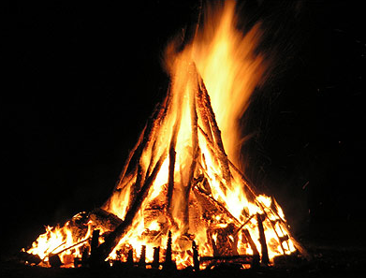
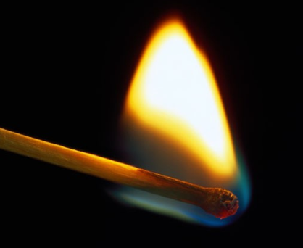
Temperature versus Heat
    Compare the temperature and heat of a match and a bonfire.

Slide 17
Temperature versus Heat
    Temperature involves the motion of molecules only
    Heat incorporates temperature and mass (amount)
    Example: burning a match verses a bonfire
      Temperature for both is the same (~400-600 °C)
      The bonfire contains MUCH more heat

Slide 18
Temperature versus Heat
    Temperature involves the average KE of molecules ONLY
    Heat incorporates temperature and mass
    example one: burning one match verses five matches
      Temperature for both is the same (~400-600 °C)
        Heat of one match = ~500 cal
        Heat of five matches = ~2500 cal
    example two: burning a match verses a bonfire or house
    The temperature of a bonfire or burning house is almost the same as a burning match (~400-600 °C)
    The heat of a match is ~500 cal while
    the heat of a bonfire or house is thousands of times greater

Slide 19

Heat flows from warm to cold
This represents KE

Slide 20
Heating and Cooling Curves
http://somup.com/cFX6DGni0X (1:12)
Inquiry Questions:
  Why doesn’t the temperature change as ice melts? As water boils?
  What kind of energy relationships are occurring as ice melts and then water boils?
  What do we call the stages when ice melts and water boils?

Slide 21
Heating and Cooling Curves
Inquiry Questions:
  Why doesn’t the temperature change as ice melts? As water boils? (PE vs. KE)
  What kind of energy relationships are occurring as ice melts and then boils? (Endothermic)
  What do we call the stages when ice melts (melting point) and water boils (boiling point)?

Slide 22
Phase Change Diagrams
Endothermic ΔH = +
    Heating Curve
    Heat flows into the system from the surroundings
Exothermic ΔH = ─
    Cooling Curve
    Heat flows from the system into the surroundings
Thermochemistry
22

Slide 23
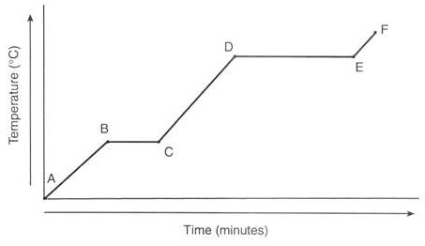
Phase Change Diagrams
Endothermic “Heating Curve”

Slide 24
Phase Change Diagrams
Endothermic “Heating Curve”
Label the phases

Slide 25
Phase Change Diagrams
Endothermic “Heating Curve”
gas
liquid
What about lines
BC and DE?
solid

Slide 26
Phase Change Diagrams
Endothermic “Heating Curve”
Liquid-gas
gas
liquid
Solid-liquid
solid

Slide 27
Phase Change Diagrams
Endothermic “Heating Curve”
Liquid-gas
gas
liquid
What energy
changes at each phase?
Solid-liquid
solid

Slide 28
Phase Change Diagrams
Endothermic “Heating Curve”
Line AB shows an increase in temperature
… by definition this is kinetic energy
KE

Slide 29
Phase Change Diagrams
Endothermic “Heating Curve”
Line BC shows NO increase in temperature … yet ice will melt
Therefore, energy must be added to melt the ice. This is potential energy.
PE
KE

Slide 30
Phase Change Diagrams
Endothermic “Heating Curve”
Line CD shows an increase in temperature
KE
… by definition this is kinetic energy
PE
KE

Slide 31
Phase Change Diagrams
Endothermic “Heating Curve”
Line DE shows NO increase in temperature … yet water will boil
PE
KE
Therefore, energy must be added to boil the water. This is potential energy.
PE
KE

Slide 32
Phase Change Diagrams
Endothermic “Heating Curve”
KE
Line AB shows an increase in temperature
PE
KE
PE
… by definition this is kinetic energy
KE

Slide 33
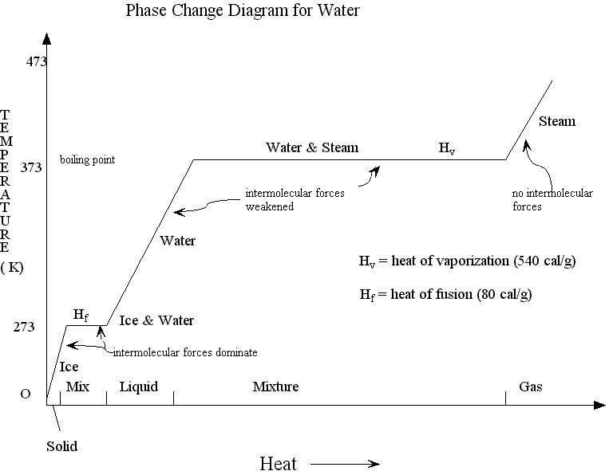

Slide 34
 | Graph | Temp | Phase | KE | PE
 | A B | -20 0 | s
 | B C | 0 | s l
 | C D | 0 100 | l
 | D E | 100 | l g
 | E F | 100 110 | g

Slide 35
Line AB shows an increase in temperature
Therefore, Potential Energy does not change
KE
 | Graph | Temp | Phase | KE | PE
 | A B | -20 0 | s
 | B C | 0 | s l
 | C D | 0 100 | l
 | D E | 100 | l g
 | E F | 100 110 | g
increase
constant

Slide 36
Line BC shows NO increase in temperature
Therefore, Kinetic Energy does not change
Since ice melts, potential energy must increase
PE
KE
 | Graph | Temp | Phase | KE | PE
 | A B | -20 0 | s
 | B C | 0 | s l
 | C D | 0 100 | l
 | D E | 100 | l g
 | E F | 100 110 | g
increase
constant
Melting pt
constant
increase

Slide 37
Line CD shows an increase in temperature
KE
Therefore, Potential Energy does not change
PE
KE
 | Graph | Temp | Phase | KE | PE
 | A B | -20 0 | s
 | B C | 0 | s l
 | C D | 0 100 | l
 | D E | 100 | l g
 | E F | 100 110 | g
increase
constant
Melting pt
constant
increase
increase
constant

Slide 38
Line DE shows NO increase in temperature
PE
KE
Therefore, Kinetic Energy does not change
PE
KE
Since water boils, potential energy must increase
 | Graph | Temp | Phase | KE | PE
 | A B | -20 0 | s
 | B C | 0 | s l
 | C D | 0 100 | l
 | D E | 100 | l g
 | E F | 100 110 | g
increase
constant
Melting pt
constant
increase
increase
constant
boiling pt
constant
increase

Slide 39
Line EF shows an increase in temperature
KE
PE
KE
Therefore, Potential Energy does not change
PE
KE
 | Graph | Temp | Phase | KE | PE
 | A B | -20 0 | s
 | B C | 0 | s l
 | C D | 0 100 | l
 | D E | 100 | l g
 | E F | 100 110 | g
increase
constant
Melting pt
constant
increase
increase
constant
boiling pt
constant
increase
increase
constant

Slide 40
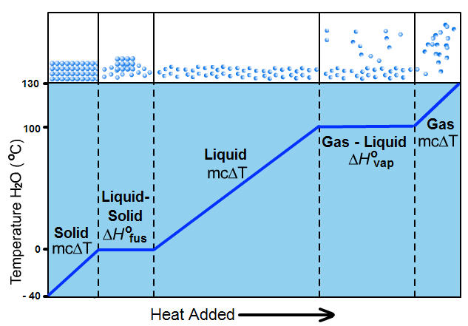
Notice the “equations” for each change
bp
liquid → gas
m∆H_{vap}
Solid → liquid
m∆H_{fus}
mp

Slide 41
Phase Change Diagrams
Endothermic ΔH = +
    Heating Curve
    heat flows into the system from the surroundings
Exothermic ΔH = ─
    Cooling Curve
    Heat flows from the system into the surroundings
Thermochemistry
41

Slide 42

Exothermic (Cooling) Curve
Label the phases & Energies
?
∆H_{c} = -∆H_{v}
Temperature
°C
?
∆H_{s} = -∆H_{f}
Heat

Slide 43
Exothermic (Cooling) Curve
gas
KE
PE
CP
∆H_{c} = -∆H_{v}
Temperature
°C
liquid
KE
PE
FP
∆H_{s} = -∆H_{f}
KE
solid
Heat

Slide 44
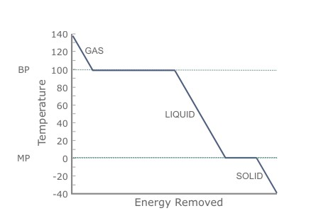
A
C
B
E
D
F
 | Graph | Temp | Phase | KE | PE
 | A B | 140 100 | g | ? | ?
 | B C | 100 | g l | ? | ?
 | C D | 100 0 | l | ? | ?
 | D E | 0 | l s | ? | ?
 | E F | 0 -40 | s | ? | ?

Slide 45
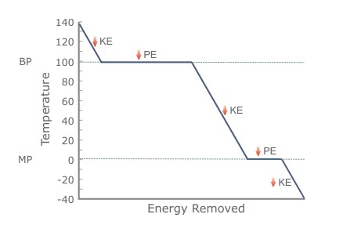
A
C
B
E
D
F
 | Graph | Temp | Phase | KE | PE
 | A B | 140 100 | g
 | B C | 100 | g l
 | C D | 100 0 | l
 | D E | 0 | l s
 | E F | 0 -40 | s
decrease
constant

Slide 46
A
C
CP
CP
CP
B
E
D
F
 | Graph | Temp | Phase | KE | PE
 | A B | 140 100 | g
 | B C | 100 | g l
 | C D | 100 0 | l
 | D E | 0 | l s
 | E F | 0 -40 | s
decrease
constant
Condensation pt
constant
decrease

Slide 47
A
C
CP
CP
CP
B
E
D
F
 | Graph | Temp | Phase | KE | PE
 | A B | 140 100 | g
 | B C | 100 | g l
 | C D | 100 0 | l
 | D E | 0 | l s
 | E F | 0 -40 | s
decrease
constant
Condensation pt
constant
decrease
decrease
constant

Slide 48
A
C
CP
CP
CP
B
FP
E
FP
D
F
 | Graph | Temp | Phase | KE | PE
 | A B | 140 100 | g
 | B C | 100 | g l
 | C D | 100 0 | l
 | D E | 0 | l s
 | E F | 0 -40 | s
decrease
constant
Condensation pt
constant
decrease
decrease
constant
Freezing pt
constant
decrease

Slide 49
A
CP
C
CP
B
FP
E
FP
D
F
 | Graph | Temp | Phase | KE | PE
 | A B | 140 100 | g
 | B C | 100 | g l
 | C D | 100 0 | l
 | D E | 0 | l s
 | E F | 0 -40 | s
decrease
constant
Condensation pt
constant
decrease
decrease
constant
Freezing pt
constant
decrease
decrease
constant

Slide 50
General Heating Curve
Fixed points (based on PE) … temp is “fixed”
Melting point Freezing point (s ↔ l)
Boiling point Condensation pt (l ↔ g)
Sublimation Deposition (s ↔ g)

Slide 51
Fixed points for water
Melting point Freezing point
0° C
Boiling point Condensation point
100° C

Slide 52
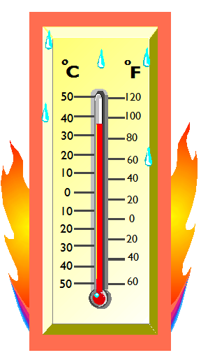
Quantitative Heat Measurements
Heat Equation: q = m c ∆T
KE
  q: change in heat energy for system or surroundings
  m: mass of substance
  c_{p}: specific heat of substance
c_{p} (H20): 1.0 cal/g∙⁰C = 4.18 j/g∙⁰C
c (ice): 0.5cal/g∙⁰C = 2.09 j/g∙⁰C
c (steam): 0.5cal/g∙⁰C = 2.09 j/g∙⁰C
∆ T: change in temperature (closed system)
∆ T = final Temp – initial Temp
∆ T = Tf – Ti

Slide 53
Heat of Fusion / Solidification
The amount of energy gained or released when a substance melts (s → l) or freezes (l → s)
PE
Melting (s → l): endothermic ∆Hf = +
Freezing (l → s): exothermic ∆Hf = -
∆H_{s} solidification
For water: ∆H_{f} = +80.0 cal/g = -∆H_{s}
80.0 cal/g x 4.18 j/cal = 334.4 j/g

Slide 54
Heat of Vaporization / Condensation
The amount of energy gained or released when a substance vaporizes (l → g) or condenses (g → l)
PE
vaporizing (l → g): endothermic ∆Hv = +
condensing (g → l): exothermic ∆Hv = -
∆H_{c} = condensation
For water: ∆H_{v} = +540. cal/g = -∆H_{c}
540. cal/g x 4.18 j/cal = 2.26 kJ/g

Slide 55
Notice the “equations” for each change
q = +
Endothermic
Heating Curve
liquid → gas
m(+∆H_{v})
Solid → liquid
m(+∆H_{f})

Slide 56
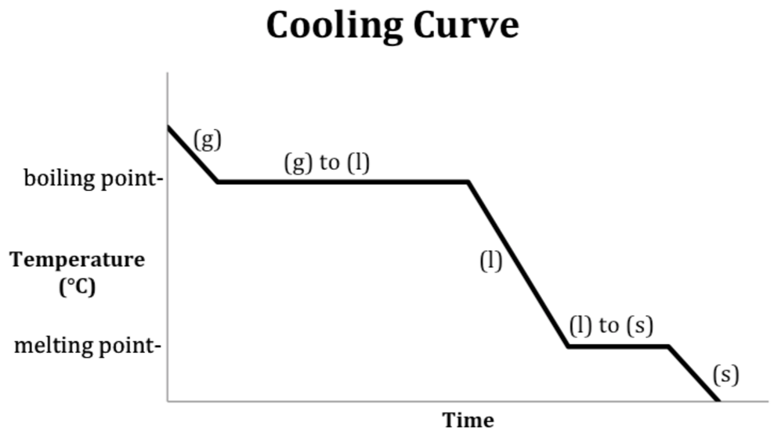
Notice the “equations” for each change
Heating/Cooling Curve?
Endo/Exothermic?
q = ?
q = ?
Condensation point-
q = ?
q = ?
Freezing
q = ?
q = ?

Slide 57
Notice the “equations” for each change
Exothermic
q = -
q = mc∆T = -
Condensation point
m(-∆H_{v})
q = mc∆T = -
freezing
m(-∆H_{f})
q = mc∆T = -

Slide 58
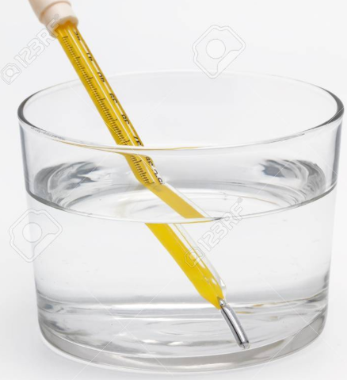
Quantitative Heat Measurements
How much heat flows when 20.0 g of water at 10.0 °C is heated to 40.0 °C? (Endo/Exothermic?)

Slide 59
Quantitative Heat Measurements
How much heat flows when 20.0 g of water at 10.0 °C is heated to 40.0 °C? (Endo/Exothermic?)
heating water → q _{liquid} = m c ∆T
q_{water} = (20.0 g)(1.00 cal/g·°C)(40.0° C – 10.0°C)
q_{water} = (20.0 g)(1.00 cal/g·°C)(30.0°C)
q_{water} = +600. cal x 4.18 J/cal = +2.51 kJ
Endothermic (heat is added or absorbed)

Slide 60
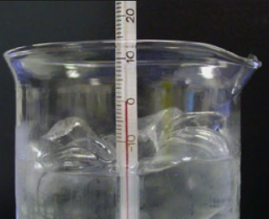
Quantitative Heat Measurements
How much heat flows when 20.0 g of water freezes at 0.0 °C? (Endo/Exothermic?)

Slide 61
Quantitative Heat Measurements
How much heat flows when 20.0 g of water freezes at 0.0 °C? (Endo/Exothermic?)
freezing water → q _{l→ s} = m ∆H_{f}
q_{ice} = (20.0 g)(80.0 cal/g)
q_{ice} = -1.6 x 10³ cal x 4.18 J/cal = -12.8 kJ
Exothermic (heat is “lost” or released)

Slide 62
Specific Heat of Water
The specific heat capacity, or simply the specific heat (C) of a substance, is the amount of heat it takes to raise the temperature of 1 g of the substance 1⁰ C.
Water has the second highest specific heat of all liquids.
Metals generally have low specific heats.
Specific Heats of Some Common Substances
Substance | Specific heat (c_{p})
 | J/(g·⁰C) | cal/(g·⁰C)
Liquid water | 4.18 | 1.00
Ethanol | 2.4 | 0.58
Ice | 2.1 | 0.50
Steam | 1.9 | 0.45
Chloroform | 0.96 | 0.23
Aluminum | 0.90 | 0.21
Iron | 0.46 | 0.11
Silver | 0.24 | 0.057

Slide 63

Specific Heat (C)
Some things heat up or cool down faster than others.
Land heats up and cools down faster than water
e.g. Michigan stays warmer in the winter due to the heat from the lakes (e.g. hot vegetables stay hot a long time because of their high water content)

Slide 64
Specific heat is ability of a substance to “hold” heat.
c water = 4.184 J / g°C
c sand = 0.664 J / g°C
This is why land heats up quickly during the day and cools quickly at night and why water takes longer.

Slide 65
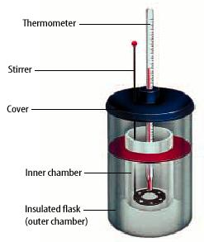

A calorimeter is used to measure the specific heat of a substance.
Rearrange q = mc∆T to solve for c:

Slide 66
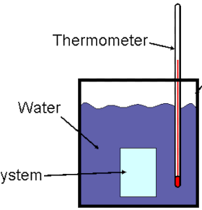
Closed system
Place a hot metal (~ 75 °C) in water (~25 °C)
Metal
What happens to the metal?
What happens to the water?
How does the heat compare?

Slide 67
Closed system
Place a hot metal (~ 75 C) in water (~25° C)
Metal
The metal cools off (loses heat); q = -
The water gains heat from the metal; q = +
- q_{metal} = q_{water}
_{Exothermic = Endothermic}

Slide 68
Assignments
Thermochemistry Worksheet (or Text Questions & Problems)
Heating & Cooling Curve Worksheet (or Text Questions & Problems)
LAB Heating & Cooling Curves of Water

