Slide 1
Nuclear Energy
Physical Science

Slide 2
Nucleus
in the
Classroom

Slide 3
Chemistry focuses on the ELECTRON of the atom …
e
e
e
e
Electrons determine
an atom’s chemical properties and behaviors

Slide 4
Nuclear Scientists focus on the nucleus of the atom
(They study nuclear particles and their potential energy)

Slide 5
Structure of the Atom
Nucleus
n = neutrons
p = protons
p
n
n
p
Electrons exist in energy orbitals around the nucleus

Slide 6
Isotopes → ISO “same” TOPE “type”
possess the same # of protons but a different # of neutrons
4
5
₂ He
₂ He
p
n
p
n
Isotopes of Helium
n
p
n
n
p

Slide 7
Atomic Number = 2
(protons)
Atomic Number = 2
(protons)
Atomic Mass = 5
Atomic Mass = 4
4
5
₂ He
₂ He
p
n
p
n
Isotopes of Helium
n
p
n
n
p

Slide 8
Isotope Properties
Isotopes of the same element have exactly the same chemical behavior because they possess the same # of electrons
Isotopes of the same element have different mass
Some isotopes are unstable (radioactive) and others are not
For example, ₆C¹² is stable (6 protons & 6 neutrons), but ₆C¹⁴ is not (6 protons & 8 neutrons)

Slide 9
We Are All Made of Isotopes
Most of the carbon in our cells is ₆C¹²,
but all living things have enough ₆C¹⁴ in them to produce
15.3 beta emissions per minute per gram of carbon.
Nothing is more “natural” than being radioactive!

Slide 10
Dating Past Events –
Archeology and Geology

Slide 11
Archeology
C¹⁴ is produced from C¹³ in the upper atmosphere by cosmic rays
Some of the carbon in carbon dioxide (CO₂) is C¹⁴
Living things like trees and plants incorporate the C¹⁴ in wood and fiber while they are alive

Slide 12
Archeology
C¹⁴ has a half-life of 5730 years
We can date old wooden objects by how much less radioactive they are than when the wood was alive!
The longer some organism has been dead, the less radioactivity it will have

Slide 13
After one half-life of 5730 years, C¹⁴ has ½ its original amount.
After two half-lives of 5730 years, C¹⁴ has 1/4 its original amount. (11,460 years)
After three half-lives of 5730 years, C¹⁴ has 1/8 its original amount. (17,190 years)

Slide 14
Half Life

Slide 15
If our body contains 400 grams of Carbon 14, how many years would it take to only have 25 grams?
400 grams → 200 grams → 100 grams
→ 50 grams → 25 grams =
4 half-lives
5730 years/half-life x 4 half-lives =
22,920 years

Slide 16
Types of Nuclear Radiation
Alpha (2p + 2n)
Nucleus
Beta (Electron)
Gamma (Photon)
Neutron

Slide 17
How far can each type of nuclear radiation travel?
How do outside forces of electricity and magnetism effect each particle?

Slide 18
Alpha (2p + 2n)
Short range, high ionization
Beta (Electron)
longer range, lower ionization
Nucleus
long range, no ionization
Gamma (Photon)
lower ionization
Neutron

Slide 19
Radioactive Isotopes Transmutate into Stable Isotopes
Alpha
(2p + 2n)
Alpha
(2p + 2n)
Alpha
(2p + 2n)
₈₈ Ra ²²⁶
₈₆ Rn ²²²
₈₄ Po ²¹⁸
₈₂ Pb ²⁰⁷
Radium
Radon
Polonium
Lead

Slide 20
Radium
Radium was discovered by Madame Marie Curie … for which she was awarded the Noble Peace Prize in Physics
The radioactive atom, Radium, is found in rocks and turns into Radon and eventually into Lead
Rocks that contain Radium can be dated by determining the amount of Helium and Lead in them (the more He & Pb, the older the rock).

Slide 21
Alpha radiation (an Alpha particle) is a Helium nucleus or Helium nuclide
Since the nucleus contains protons which are positively charged, the alpha particles will repel other positive charges
and be attracted to negative particles
When the alpha particle stops moving so fast, it acquires two electrons and becomes Helium gas which is “inert” or unreactive
+
+
+
-

Slide 22
Radium exists in small amounts in
most igneous rocks
Alpha
(2p + 2n)
It decays into radon which is a gas that can escape through cracks in the rock and leak into basements
₈₈ Ra ²²⁶
₈₆ Rn ²²²
Radium
Radon

Slide 23
Radon
Radon is a heavy gas that will accumulate in low areas unless ventilated
Radon damages internal organs and tissues if inhaled
It is recommended to use Radon detectors or monitors in basements as well as to circulate air to remove build-ups

Slide 24
If Radon is inhaled it can emit an alpha particle and turn into Polonium which is a solid that stays in the lung
Alpha
(2p + 2n)
₈₆ Rn ²²²
₈₄ Po ²¹⁸
Radon
Polonium

Slide 25
The particle will continue to emit alpha and beta particles until it decays into a stable isotope of Lead
Beta
(e-)
Alpha
(2p + 2n)
₈₄ Po ²¹⁸
₈₂ Pb ²⁰⁷
Polonium
Lead

Slide 26
Nuclides
Nuclear Energy focuses on the nucleus and nuclear particles
A “Nuclide” is the nucleus of an atom without consideration of the electrons outside the nucleus

Slide 27
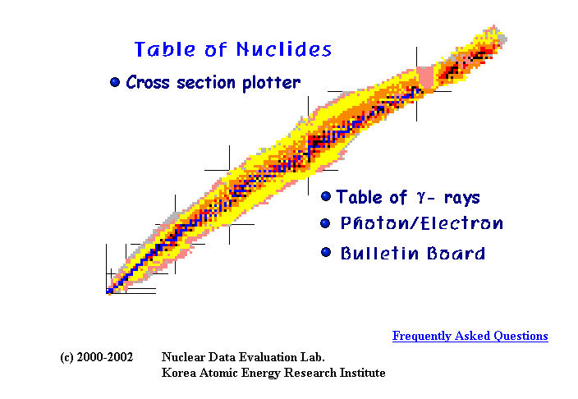
Table of Nuclides

Slide 28
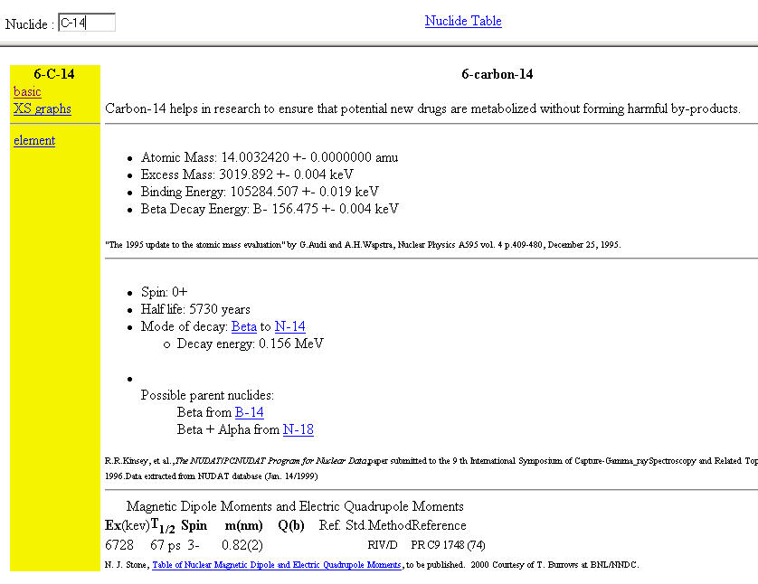
Chart Details

Slide 29
Part 2

Slide 30

Nuclear Energy

Slide 31
Enormous Energy
When nuclei split, the energy released is millions of times greater than a chemical reaction
Chemical energy is measured in electron volts, abbreviated ev
Even dynamite or TNT yields only a few electron volts of energy per atom during an explosion
Fission of U²³⁵ yields 200 million electron volts of energy per atom!

Slide 32
Einstein’s Theory of Relativity is based on nuclear reactions
E = mC ²
nucleus
A radioactive nucleus can decay or it can be split by bombarding it with subatomic particles
m₁

Slide 33
Einstein’s Theory of Relativity is based on nuclear reactions
E = mC ²
nucleus
The nucleus splits into smaller masses and releases huge amounts of energy
m₁

Slide 34
Einstein’s Theory of Relativity is based on nuclear reactions
E = mC ²
ENERGY
nucleus
m₁
m₂
m₃

Slide 35
Energy
Nucleus
m₂
m₁
m₃
The Mass of m₁ is greater than m₂ + m₃
E = ((m₁ - (m₂ + m₃)) c² or E = mc²
E → energy m → mass c → speed of photon

Slide 36
Managing Nuclear Power
Most nuclear energy is harnessed through a reaction called
nuclear fission

Slide 37
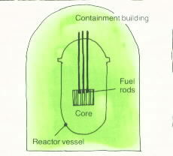
The nuclear fission reaction takes place in the “core” of the reactor vessel
Fuel rods contain the Uranium 235 for nuclear fission

Slide 38
Nuclear Fission Products Are Highly Radioactive, yielding even more energy
Energy
Nucleus
Alpha
Beta
Gamma
M₂
M₁
Alpha
Beta
Gamma
M₃

Slide 39
Most large atoms can be forced into nuclear fission although few isotopes fission well
Only two isotopes fission easily enough to maintain useful energy reactions: ₉₂U²³⁵ and ₉₄Pu²³⁹
Uranium 235 and Plutonium 239

Slide 40
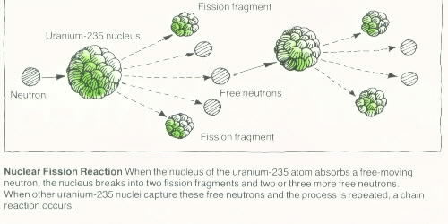
Uranium 235 ₉₂U²³⁵
is bombarded by a neutron to produce a chain reaction
Fission Fragment
Uranium 235 nucleus
Free Neutrons
Fission Fragment

Slide 41
The chain reaction produced continues the nuclear fission and is used in nuclear reactors

Slide 42
To start and maintain the Chain Reaction
Neutrons need to be slowed down by “Moderators” to allow for fission (splitting) rather than just bouncing off
Moderator
n
n
n
n
n
n
n
n
₉₂ U ²³⁵
n
₉₂ U ²³⁵

Slide 43
Moderators
Two good moderators are water and graphite (a carbon “allotrope”)
Reactors in the USA use water as a moderator and as a cooling agent
Chernobyl, Russia used graphite as a moderator and it caught fire, helping to spread radioactive material abroad

Slide 44
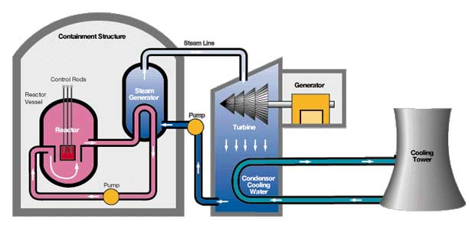
One use of nuclear fission in nuclear reactors is to produce electricity

Slide 45
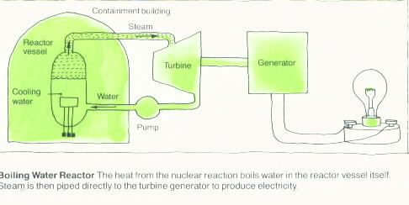
The heat from the nuclear reaction boils water
The steam produced turns a turbine generator
And the generator produces electricity

Slide 46
Nuclear Reactors
Are controlled nuclear reactions in which a fuel rod puts out energy for up to three years before it is replaced in a reactor
Nuclear weapons in comparison, release their energy all at once and are rated in thousands or millions of tons of TNT

Slide 47
Nuclear Reactors
WATER can be used …
  as a moderator to produce nuclear fission
  as a coolant for the steam (produced by the fission reaction
  as a temporary and SAFE storage place for the nuclear fuel rods

Slide 48
Nuclear Reactors
There is no real danger of a nuclear power plant exploding like a bomb because the % of Uranium 235 is too low
However …

Slide 49
The Downsides of Nuclear Power
A major international issue is the proliferation of nuclear weapons
A universal fear related to nuclear power is the radioactive waste produced and the issue of where to store that waste

Slide 50
Nuclear Weapons Proliferation
Only 0.7% (less than 1%) of naturally occurring uranium is U²³⁵, the rest is U²³⁸
It is very difficult to separate concentrated U²³⁵ from U²³⁸ because they are so chemically similar
The U²³⁵ concentration must be brought up to over 3% to be useful in a nuclear reactor and up to about 90% for a nuclear bomb

Slide 51
Nuclear Weapons Proliferation
Plutonium 239 is another fissionable isotope that works very well for nuclear reactions
Since Pu²³⁹ is chemically different than uranium, it is much easier to separate from U²³⁸ fuel rods and concentrate it into bomb material
Less technically advanced countries have obtained nuclear weapons by reprocessing fuel rods from nuclear power reactors

Slide 52
Reprocessing Fuel Rods
“Breeder reactors” are designed to enrich abundant U²³⁸ into fissionable Pu²³⁹ to replace the U²³⁵ that was consumed
Neutrons released at high energy do not get absorbed into a nucleus to produce fission, but they can change into a proton

Slide 53
Neutrons Can “Decay”
Neutrino
(no mass or charge)
Beta
(an electron)
neutron
proton
₀ n ¹
₁ p ¹
A high speed neutron can decay into a proton,
changing the atom into a different element.

Slide 54
“Nuclear Enrichment” changes U²³⁸ into Pu²³⁹
Beta
Beta
₀ n ¹
₉₂ U ²³⁸
₉₂ U ²³⁹
₉₄ Pu ²³⁹
Plutonium 239 can fission as well as ₉₂ U ²³⁵

Slide 55
is used to make nuclear warheads and other nuclear bomb materials and is very dangerous
Plutonium 239

Slide 56
Storage of Nuclear Waste
Most nuclear power plants in the United States store their used fuel rods in a “swimming pool” of water
If you piled all the nuclear waste ever produced in the U.S together, it would fill a football field twelve feet high
Coal waste is more than that in one day

Slide 57
Waste Storage
Eventually, the temporary storage in the “swimming pools” will need to be emptied
Current lack of a permanent storage facility leaves nuclear waste above ground “on site” at each nuclear power plant
“Yucca Mountain” in Nevada is a proposed site for permanent storage

Slide 58
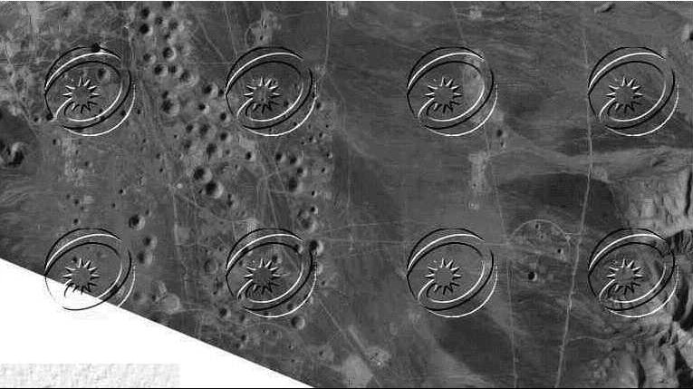
Waste Storage
Near Yucca Mountain is a Nevada bomb test site used for 825 underground tests
Surface craters produced when the ground below collapses after an underground explosion
Russian satellite image

Slide 59
Comparing
Monroe Coal Power Plant &
Ferme 2Nuclear Power Plants
 | Tons of Fuel Burned per year | Tons of Solid Waste per year | Electric Power kWh per year
Coal | ~ 9 million | ~560,000 | 20 Trillion
Nuclear | ~1 ton | ~1 ton | 8.5 trillion

Slide 60
Comparing
Monroe Coal Power Plant &
Ferme 2Nuclear Power Plants
 | Tons of Fuel Burned per year | Tons of Solid Waste per year | Electric Power kWh per year
Coal | ~ 9 million | ~560,000 | 20 Trillion
Nuclear | ~1 ton | ~1 ton | 8.5 trillion

Slide 61
Comparing
Monroe Coal Power Plant &
Ferme 2Nuclear Power Plants
 | Tons of Fuel Burned per year | Tons of Solid Waste per year | Electric Power kWh per year
Coal | ~ 9 million | ~560,000 | 20 Trillion
Nuclear | ~1 ton | ~1 ton | 8.5 trillion

Slide 62
Comparing
Monroe Coal Power Plant &
Ferme 2Nuclear Power Plants
 | Tons of Fuel Burned per year | Tons of Solid Waste per year | Electric Power kWh per year
Coal | ~ 9 million | ~560,000 | 20 Billion
Nuclear | ~1 ton | ~1 ton | 8.5 Billion

Slide 63
Comparing
Monroe Coal Power Plant &
Ferme 2Nuclear Power Plants
 | Tons of Fuel Burned per year | Tons of Solid Waste per year | Electric Power kWh per year
Coal | ~ 9 million | ~560,000 | 20 Billion
Nuclear | ~1 ton | ~1 ton | 8.5 Billion

Slide 65
Glass or thin Metal
Concrete
Water or Polyethylene
Paper
alpha
beta
gamma
neutron

