Slide 1
To View Slide Show
Click on “Slide Show” above
  Click on “From Current Slide”

Slide 2
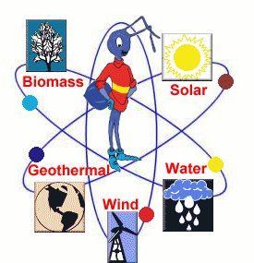
ENERGY SOURCES

Slide 3

Energy Sources
We use energy for many things:
to power our cars,
to heat and light our homes,
to heat our water and many other uses.
Where does this energy come from?

Slide 4
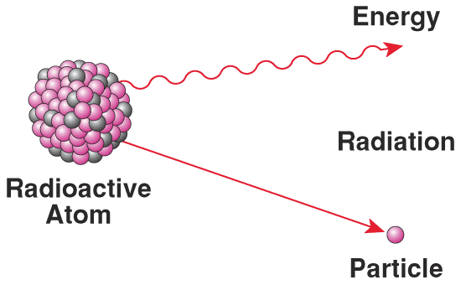
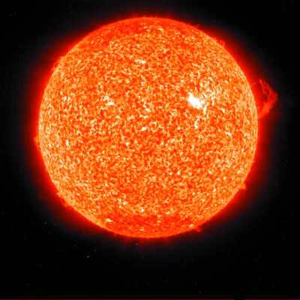
Energy Sources
There are two MAJOR energy sources that affect our Earth Systems
Internal (energy from radioactive decay of elements in the Earth)
External
(energy from the sun)

Slide 5
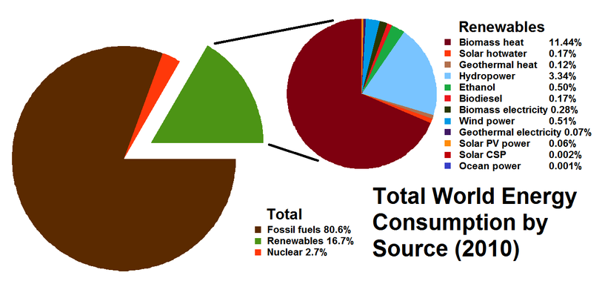
Two Types of Energy Sources
Notice, we use little Renewable Energy Sources
Renewable Sources
Nonrenewable Sources

Slide 6
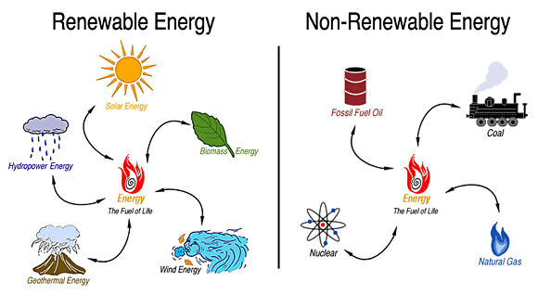
Two Types of Energy Sources
FOSSIL FUELS

Slide 7
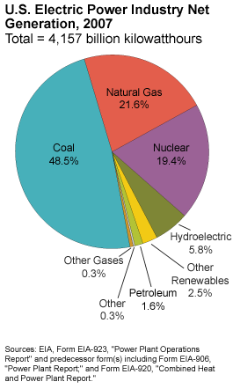
U.S. ENERGY CONSUMPTION BY SOURCE
What energy source produces most of the world’s electricity?
What is second?

Slide 8

Renewable Energy
Sources that CAN be replenished (can be used over and over).
Wind
Solar
Geothermal
Hydroelectric

Slide 9
Non-Renewable Energy
These sources CANNOT be replaced once they have been used (replenished).
Fossil Fuels
Coal
Petroleum
Natural gas
Manufactured items like plastics, vinyls
Nuclear Power

Slide 10
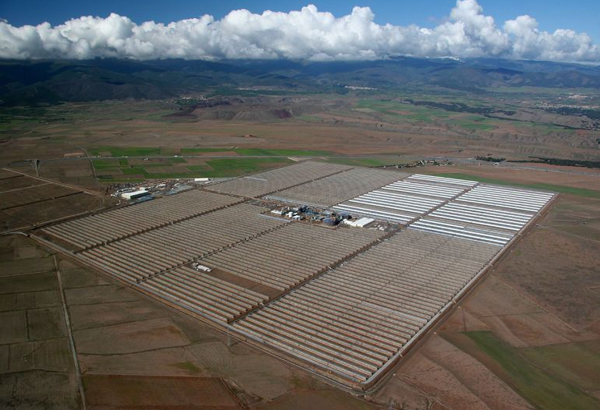
Renewable Energy
Solar Power Plant

Slide 11
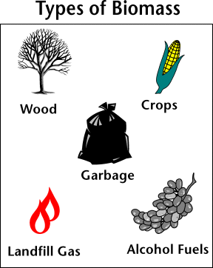
Biomass
Organic material made from plants and animals (it contains stored energy from the sun).
Biomass is a renewable energy source because we can always grow more trees and crops, and waste will always exist.
Renewable

Slide 12
Biomass
When burned, the chemical energy in biomass is released as heat.
If you have a fireplace, the wood you burn in it is a biomass fuel.
Wood waste or garbage can be burned to produce steam for making electricity, or to provide heat to industries and homes.
Renewable

Slide 13
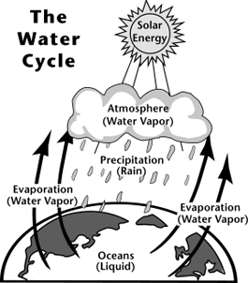
Hydropower
Hydropower is the renewable energy source that produces the most electricity in the United States.
Hydropower Relies on the Water Cycle
Renewable

Slide 14
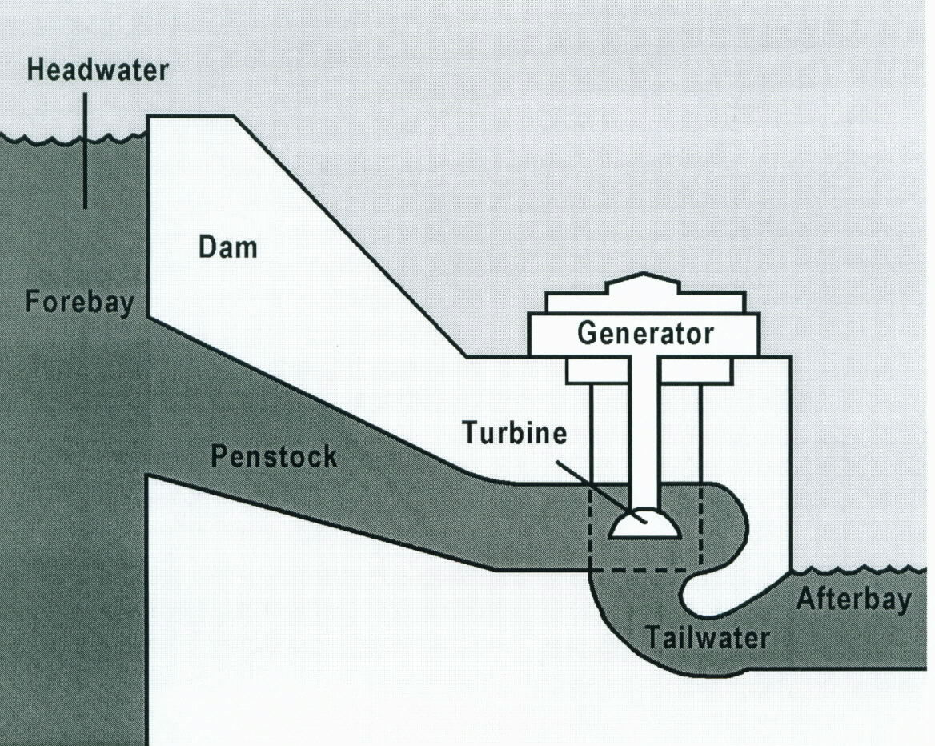
Hydropower
The amount of available energy in moving water is determined by its flow or fall; the more flow/fall, the more electricity can be generated).
The water flows through a pipe, or penstock, then pushes against and turns blades in a turbine to spin a generator to produce electricity.
Renewable

Slide 15
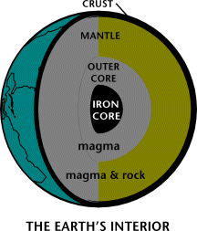
Geothermal
Geo (Earth) thermal (heat) energy is heat from within the Earth that mostly results from radioactive decay of elements (elements “break down” and this process gives off heat).
Renewable

Slide 16
Geothermal
USES
Direct use and district heating systems use hot water from springs or reservoirs near the surface (to heat water for use OR to heat homes).
Electricity generation power plants require water or steam at very high temperature to create electricity.
Geothermal heat pumps use stable ground or water temperatures near the Earth's surface to control building temperatures above ground.
Renewable

Slide 17
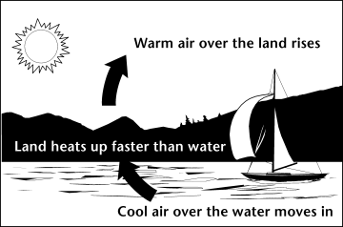
Wind
Wind is simply air in motion (it’s created by uneven heating of land and water).
Uneven heating of water and land causes wind
Renewable

Slide 18
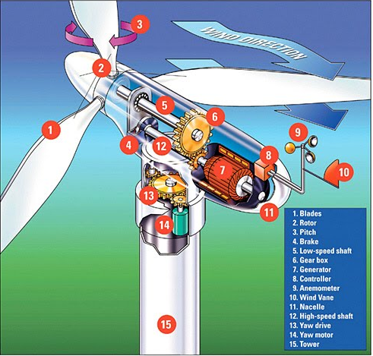
Wind
Today’s wind machines (also called wind turbines) use blades to collect the wind’s kinetic (moving) energy.
The blades turn and are connected to a drive shaft that turns an electric generator to produce electricity.
Renewable

Slide 19
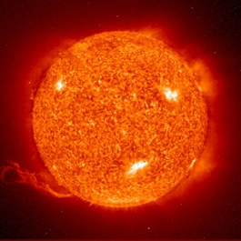
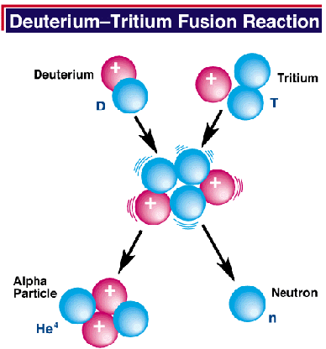
Solar
Solar energy is created by the process of fusion
(the combining of small atoms to make a larger atom) which produces a HUGE amount of energy.
Renewable

Slide 20
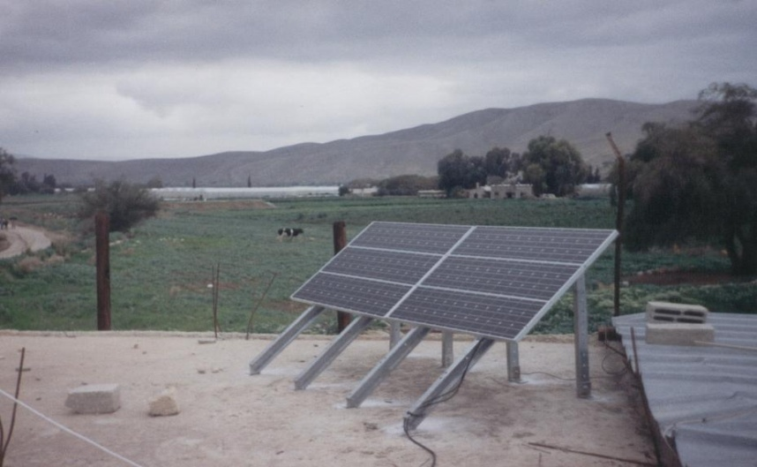
Solar
When converted to thermal (heat) energy, solar energy can be used to:
Heat water — for use in homes, buildings, or swimming pools
Heat spaces — inside homes, greenhouses, and other buildings
Renewable

Slide 21
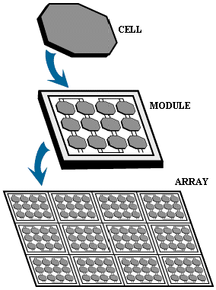
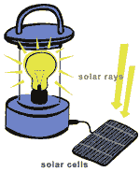
Solar
Solar energy can be converted to electricity using photovoltaics and by producing steam.
Photovoltaic (PV devices) or “solar cells” change sunlight directly into electricity.
Individual PV cells are grouped into panels and arrays of panels that can be used in a wide range of applications ranging from single small cells that charge calculator and watch batteries, to systems that power single homes, to large power plants covering many acres.

Slide 22
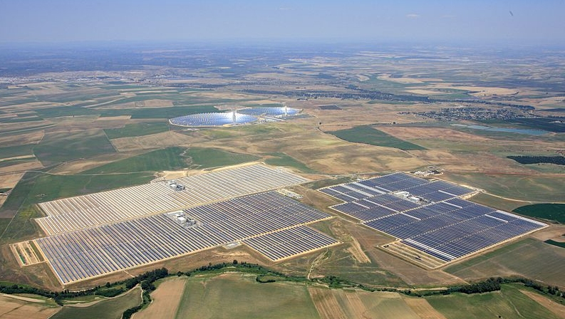
Solar
Concentrating Solar Power Plants
generate electricity by using the heat from solar thermal collectors to heat a fluid which produces steam that is used to power the generator.

Slide 23
Using Solar Energy for Homes
Solar energy is used to heat and light homes.
Passive solar energy is used when radiant energy is collected and not mechanically converted.
Example: positioning a home in the proper location to collect the maximum amount of radiant energy.
Active solar energy uses the radiant energy from the sun along with some mechanical equipment to utilize the radiant energy.
Example: PV Cells

Slide 24
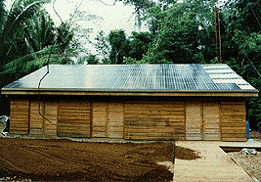

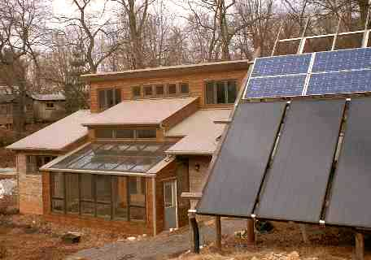
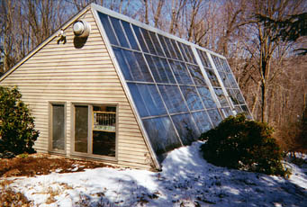
PASSIVE
Active
PASSIVE
Active

Slide 25
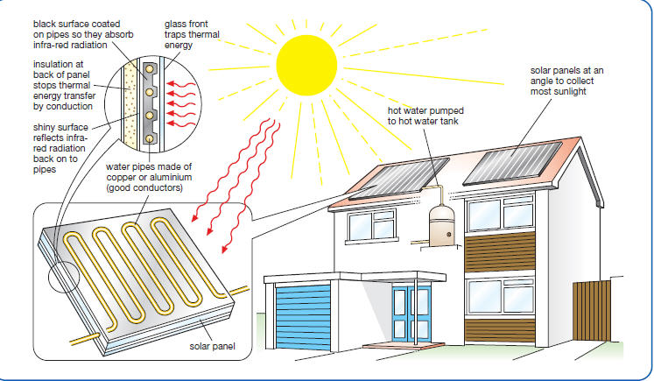
Passive Solar Energy

Slide 26
Non-Renewable Energy
These sources CANNOT be replaced once they have been used.
There is a finite amount of these energy sources (once it’s gone, it’s gone)
Coal
Petroleum
Natural gas

Slide 27
Fossil Fuels
Fossil fuels are fuels formed by natural processes such as anaerobic decomposition of buried dead organisms.
The age of the organisms and their resulting fossil fuels is typically millions of years, and sometimes exceeds 650 million years.
Fossil fuels contain high percentages of carbon and include coal, petroleum, and natural gas when decaying organic (formerly living) materials are subject to high pressure and temperature.
Nonrenewable

Slide 28
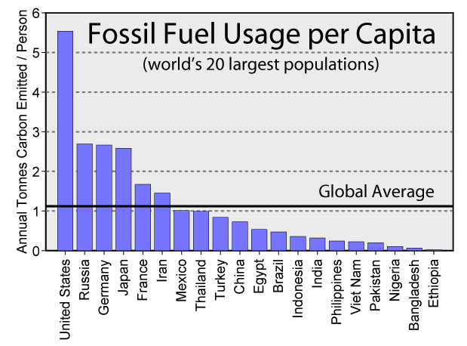

Slide 29
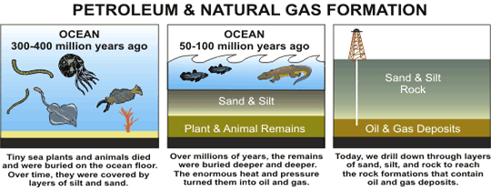
Fossil Fuel Oil
Oil was formed from the remains of animals and plants that lived millions of years ago in a marine (water) environment before the dinosaurs.
Over millions of years, the remains of these animals and plants were covered by layers of sand and silt. Heat and pressure from these layers helped the remains turn into what we today call crude oil.
Nonrenewable

Slide 30
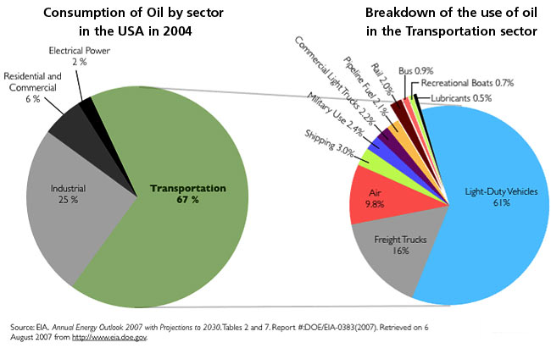

Slide 31
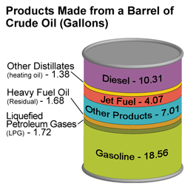
Fossil Fuel Oil
What is the major use of oil in the U.S.?
Specifically what type of transportation is most oil used for?
Nonrenewable

Slide 32
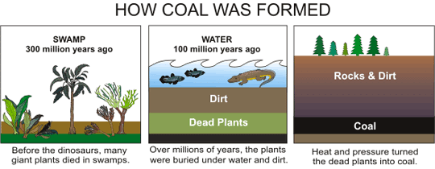
Coal
Coal is a nonrenewable energy source because it takes millions of years to create.
Coal is mined and then burned (at a power plant) to heat steam which spins a turbine which powers a generator which produces electricity.
Nonrenewable

Slide 33
Coal
Coal is classified into four main types, or ranks (anthracite, bituminous, subbituminous, and lignite), depending on the amounts and types of carbon it contains and on the amount of heat energy it can produce.
Anthracite has 86-97% carbon and, therefore, the highest heating value
Bituminous has 45-86% carbon and the 2nd highest heating value
Subbituminous has 35-45% carbon and the 3rd highest heating value
Lignite has 25-35% carbon and the lowest heating value.
Nonrenewable

Slide 34
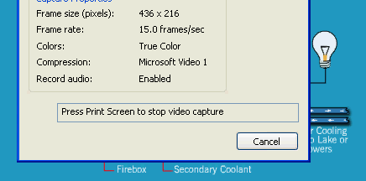
Coal Power Plant

Slide 35
Natural Gas
Over time, sand and silt changed to rock, covered the organic material, and trapped it beneath the rock.
Pressure and heat changed some of this organic material into coal, some into oil (petroleum), and some into natural gas — tiny bubbles of odorless gas.
Nonrenewable

Slide 36
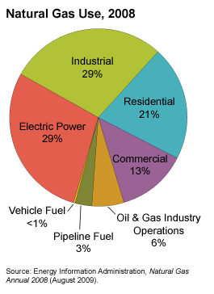
Where do we use the most gas in the U.S.?
What is second?
Nonrenewable

Slide 37
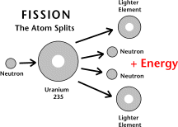
Nuclear
Nuclear energy is energy from the nucleus (core) of an atom.
Nonrenewable

Slide 38
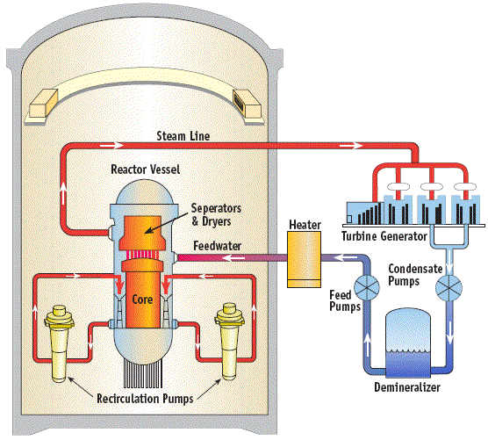
Nuclear
Electricity can be made from nuclear power at a nuclear power plant.
Fission of Uranium occurs and this releases a large amount of heat.
This heat turns water into steam.
The steam spins a turbine.
The spinning turbine powers a generator.
The generator generates electricity.
Nonrenewable

Slide 39
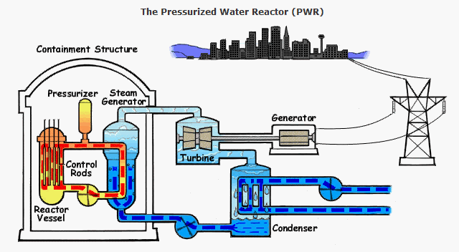
Nuclear Power Plant

Slide 40
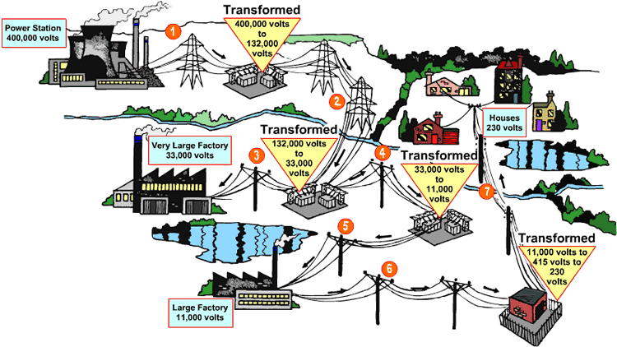
ELECTRICITY
Renewable and Non-Renewable resources are considered PRIMARY energy sources.
Most of these can be used to create electricity which is a SECONDARY source of energy.

Slide 41
ELECTRICITY
We can generate electricity from most renewable and nonrenewable energy sources
We will investigate electricity because so much of our energy needs are focused on how we produce it!

Slide 42
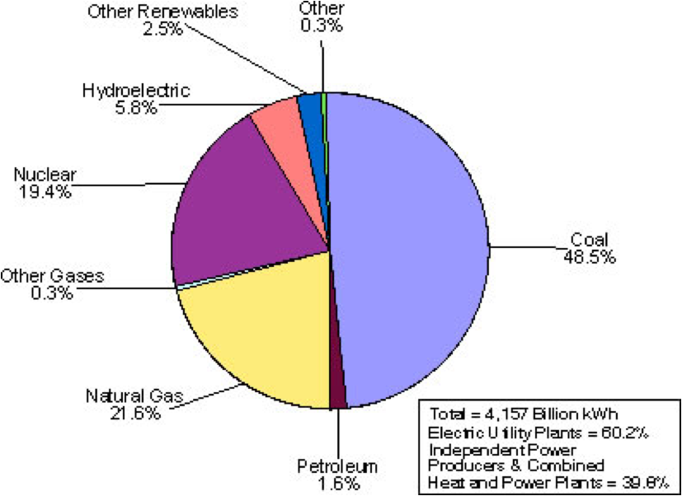
Electricity Production
Which resource is most used to produce electricity in the U.S.?

Slide 43
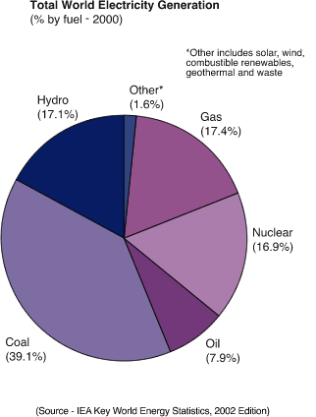
Electricity Production
Electricity is produced by many means, but the largest method is by burning coal.

Slide 44
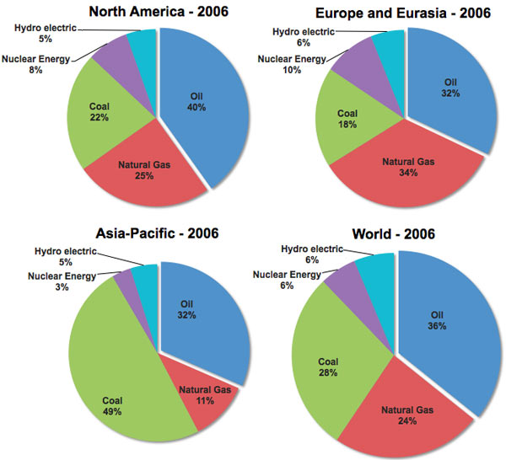

Slide 45
The Problem With Fossil Fuels
The burning of fossil fuels produces gases and aerosols that have been linked to having a negative effect on human health and the health of our planet.
Fossil fuels are the main source of energy for our electricity and transportation needs.

Slide 46
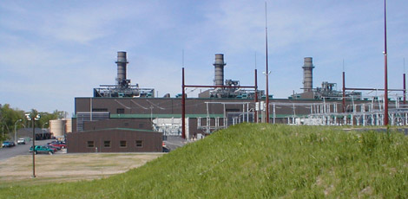

Pollution Generated
From Burning Coal
About 3 pounds of CO₂ are produced from creating 1 KWh of electricity.
Also, a by-product of coal combustion are aerosols (tiny particles which stay in the atmosphere)

Slide 47
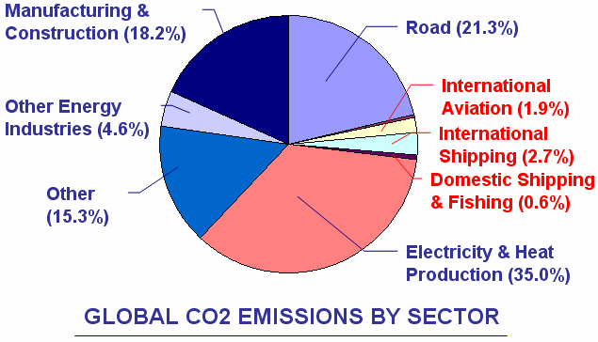

Slide 48
Quick Check
What is attributed to most of the Carbon Dioxide emissions on our planet?
Climate Change
What two sectors contribute to more than half of the Carbon emissions?
Heat & Electricity

Slide 49

Pollution Results
As a result of using fossil fuels as our primary source of fuel for electricity and transportation, we have generated damaging gases which cause health problems, acid rain, ground level ozone and possibly and change in global temperature.

Slide 50
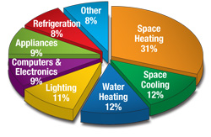
Energy Conservation
Where do we use the most energy?
In what areas can energy be most conserved in?

Slide 51
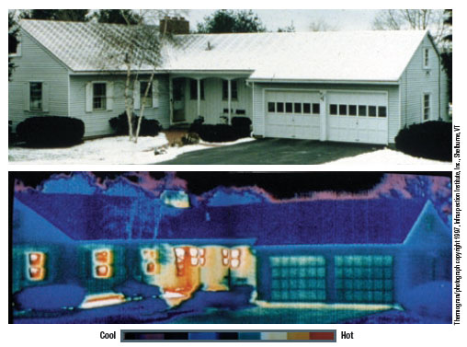
Energy Conservation Tips
Use high efficiency furnaces and air conditioning units.
Use less hot water for showers, dishes, clothes
Insulate any holes (fireplace) and windows (thermal pane)
Adjust thermostat at night and during day when not at home.

Slide 52
Other Energy Conservation Tips
Insulation makes a difference (ceiling, windows, doors).
Using digitally controlled heating/cooling programs to warm/cool only at times when it is needed.
Use occupancy / motion sensors for lights.
Use compact fluorescent lighting.
Turn off appliances when not in use, and/or unplug appliances so they don’t continue to draw electricity.

