Slide 1
Go to the “Slide Show” shade above
Click on “Play from Beginning”

Slide 2
DNA, RNA, and Protein Synthesis
Chapter 9

Slide 3
DNA and RNA
DNA and RNA are ? consisting of long chains (?) of monomers called ?.
Each of the #? strands of DNA is a DNA nucleotide polymer (chain).
A Nucleotide is composed of a
  ?
  ?
  ?
The nucleotides are joined to one another by a ? backbone

Slide 4
DNA and RNA
DNA and RNA are nucleic acids consisting of long chains (polymers) of monomers called Nucleotides.
Each of the two strands of DNA is a DNA nucleotide polymer (chain).
A Nucleotide is composed of a
  nitrogenous base
  five-carbon sugar
  phosphate group
The nucleotides are joined to one another by a Sugar-Phosphate backbone

Slide 5
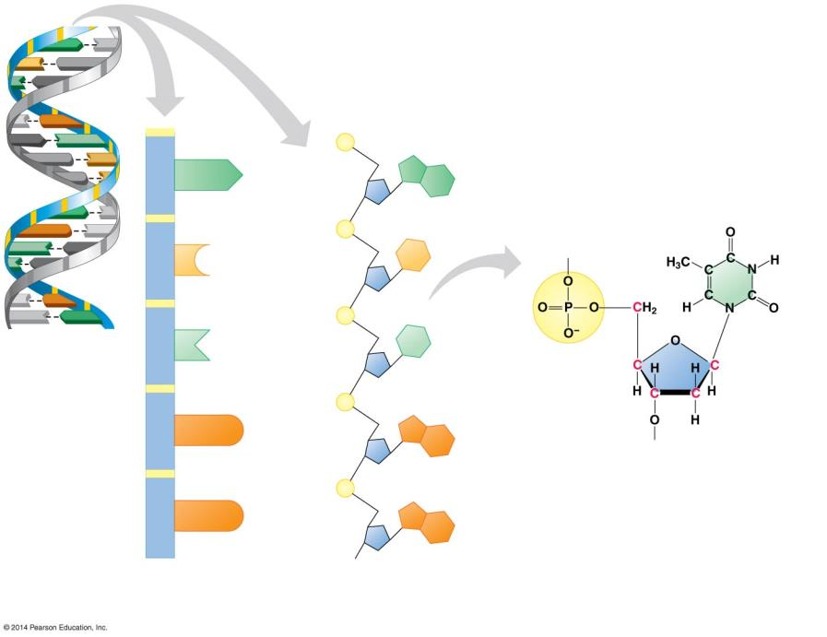
A
T
C
G
?
backbone
T
A
C
G
?
group
A
T
G
C
A
A
?
base
G
Nitrogenous base
(can be ?, ?, ?, or ?)
?
joining
nucleotides
A
T
?
G
C
T
A
C
C
T
A
C
G
T
A
DNA
Polymer?
Thymine
(T)
A DNA
structure?
T
T
?
group
G
G
?
(?)
DNA ?
G
G
Two representations
of a DNA polynucleotide
Notes:
Figure 10.2a-0 The structure of a DNA polynucleotide

Slide 6
A
T
C
G
Sugar-phosphate
backbone
T
A
C
G
Phosphate
group
A
T
G
C
A
A
Nitrogenous
base
G
Covalent
bond
joining
nucleotides
Nitrogenous base
(can be A, G, C, or T)
A
T
Sugar
G
C
T
A
C
C
T
A
C
G
T
A
DNA
nucleotide
Thymine
(T)
A DNA
double helix
T
T
Phosphate
group
G
G
Sugar
(deoxyribose)
DNA nucleotide
G
G
Two representations
of a DNA polynucleotide
Notes:
Figure 10.2a-0 The structure of a DNA polynucleotide

Slide 7

Question:
What would be the complementary RNA strand for the following DNA sequence?
DNA -GCGTATG-

Slide 8
Answer:
DNA -GCGTATG-
RNA -CGCAUAC-

Slide 9
Lesson Objectives
  By the end of this lesson, you should be able to:
Discuss the overall process of protein synthesis, including where in the cell it occurs and the stages involved.
Identify and describe DNA transcription.
Define “genetic code”.
Identify and describe RNA translation.
Identify and describe Protein Synthesis.
Distinguish Prokaryotic and Eukaryotic Protein Synthesis.
  Science Practice: Protein Synthesis
Notes:
#frame
instructional video
Timing ≈ 0.5 minutes
Living organisms need energy to accomplish the wide variety of tasks they attempt each day.
You will begin learning about how energy is captured from the Sun and stored in organic molecules.
[read objectives]

Slide 10
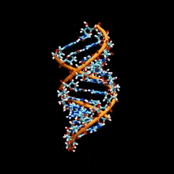
Overview
DNA contains the genetic information.
Every trait of an organism is controlled by DNA.

Slide 11
Genes control Phenotypic Traits through the Synthesis of Proteins
TRANSCRIPTION is the synthesis of RNA under the direction of DNA.
TRANSLATION is the synthesis of Proteins under the direction of RNA.
Genes provide the instructions for making specific Proteins.
Protein synthesis
Transcription
Translation

Slide 12
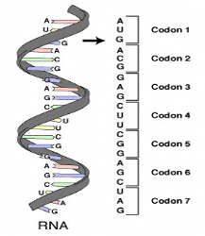
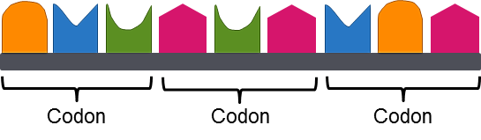
Cracking the Code
The genetic code was discovered by Marshall Nirenberg and J. Heinrich Matthaei in 1961.
The genetic code was based on codons, sequences of three bases that form a unit of the genetic code in DNA that determines a specific amino acid.
Amino acids are used to make proteins.
A
C
G
T
G
T
C
A
T
Notes:
Timing ≈ 1 min
Remind students that the genetic code is not just DNA, but how the DNA works to make proteins
[animate] In 1961, Marshall Nirenberg and J. Heinrich Matthaei, along with several other colleagues, were studying the bacteria E. coli to determine the sequence of DNA.
They quickly began studying the patterns created by the bases and they were able to determine that the DNA code is based on threes.
[animate] There are nonoverlapping triplets of bases, called codons, a sequence of three bases that form a unit of the genetic code in DNA that determines a specific amino acid, [animate] the building blocks of proteins
These codons make up the genetic code for all organisms. Point out codons on the image.
These triplet bases code for genetic traits including hair color, eye color, height, etc in humans as well as all the characteristics, functions, and structures of all organisms.
SOURCES:
“Deciphering the Genetic Code.” American Chemical Society. Last modified n.d. Accessed June 12, 2012. http://portal.acs.org/portal/acs/corg/content?_nfpb=true&_pageLabel=PP_ARTICLEMAIN&node_id=924&content_id=CNBP_023361&use_sec=true&sec_url_var=region1&__uuid=d61f79df-5cf7-4f1c-abc3-d00590951e68.
Codons. “RNA-codons.png,” TransControl. 2007 as CC-SA/GNU, Digital Image. http://commons.wikimedia.org/wiki/File:RNA-codons.png (accessed June 6, 2011).

Slide 13
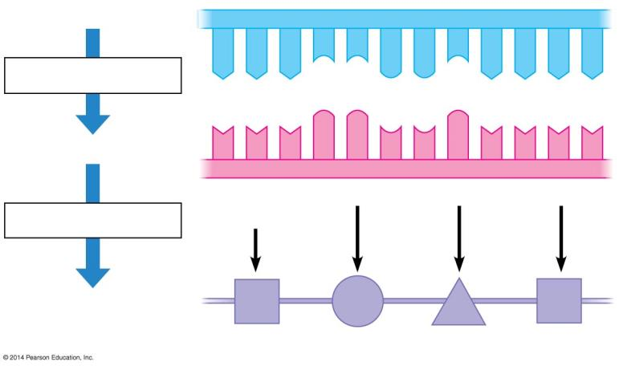
Unwound DNA
DNA Template (sense strand)
A A A C C G G C A A A A
Transcription
polymerase
RNA
U
U
U
G
G
C
C
G
U
U
U
U
Translation
Codon
Anti codon
Polypeptide
Amino acid chain
Notes:
Figure 10.7-1 Transcription and translation of codons (partial)

Slide 14
DNA to Protein
Animation
https://somup.com/c3hhF8OKq5 DNA to Protein (2:38)

Slide 15
Genetic Information is written in Codons by mRNA through Transcription.
The sequence of nucleotides in DNA provides a code for constructing a protein.
  Protein construction requires a conversion of a nucleotide sequence to an amino acid sequence.
  Transcription rewrites the DNA code into RNA, using the same nucleotide “language.”

Slide 16
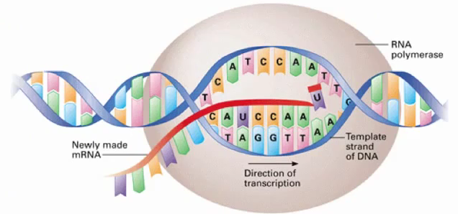
Transcription
Transcription is the process of forming a strand of RNA from a strand of DNA.
This process occurs in the nucleus (eukaryotic cells).
Since prokaryotes do not have a nucleus, the process occurs in their cytoplasm.
The cell must make RNA to send to the cytoplasm to tell the ribosomes how and which proteins to make.

Slide 17
Transcription
The RNA molecule is a faithful copy of a gene’s protein building instructions. This type of RNA is called messenger RNA (mRNA).
An enzyme called RNA Polymerase catalyzes this reaction.
The purpose of transcription is to copy one gene from the DNA molecule.

Slide 18
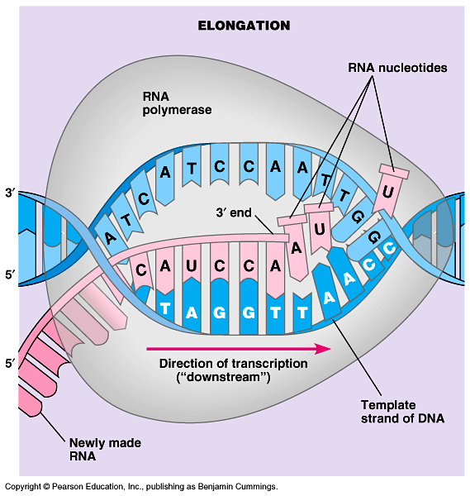
Steps of Transcription
RNA Polymerase:
Separates the DNA strands.
One strand of DNA is used as a template (sense strand).
New nucleotides are inserted according to the base pairing rules.
When transcribing RNA, Adenine pairs with uracil;
Cytosine pairs with guanine.

Slide 19
Steps of Transcription
This continues until the end is reached.
As the RNA polymerase moves along the DNA molecule, hydrogen bonds between the two strands of DNA are reformed.
A singled stranded RNA molecule has been transcribed.

Slide 20
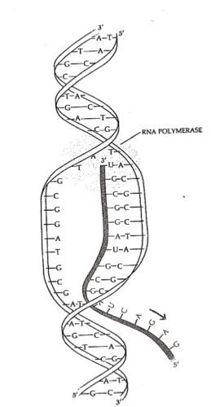
Steps of Transcription
The purpose of transcription is not to copy the entire length of the DNA molecule
but to copy only small portions – a gene’s worth
to be sent to the ribosome as the instructions for protein synthesis.

Slide 21
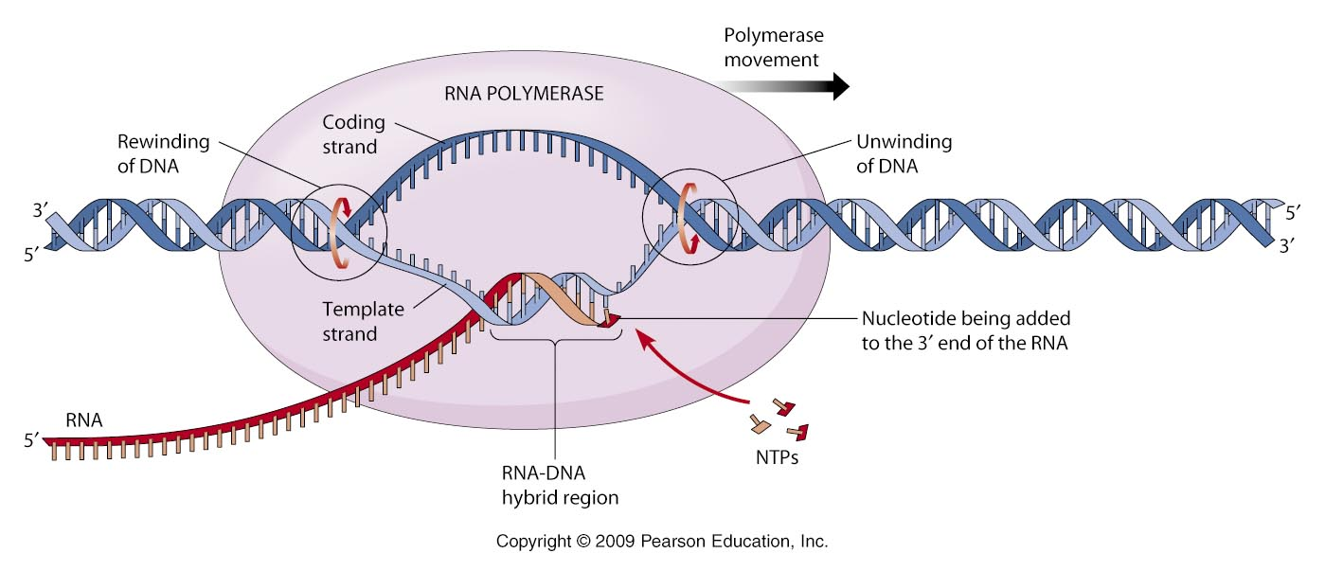
RNA Polymerase

Slide 22
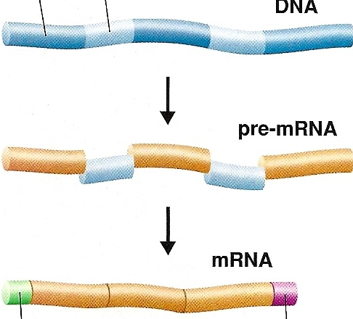
Eukaryotic RNA Processing and Editing
Once the RNA is transcribed it is not yet ready to be sent out to the cytoplasm.
It must be modified before it is ready to serve its purpose.
exon
intron
The mRNA is a copy of a small section of DNA.
This RNA contains sections called INTRONS.
and other sections called EXONS.

Slide 23
Eukaryotic RNA Processing and Editing
exon
intron
INTRONS are sequences of nitrogen bases that…
ARE NOT involved in the making of the protein.
These need to be cut out of the RNA before the RNA goes to the ribosomes.

Slide 24
Eukaryotic RNA Processing and Editing
intron
EXONS are the sequences of nitrogen bases that ARE involved in the making of the protein.
exon
exon
exon
When mRNA is formed, both the introns and exons are copied from the DNA.
intron
intron
exon
exon
However, the introns are cut out
of the RNA while the RNA is still inside the nucleus.
The remaining exons are spliced back together
by the enzyme Ligase, to form the final RNA.

Slide 25
Eukaryotic RNA Processing and Editing
intron
Finally, a CAP and TAIL
are added to form the final RNA molecule.
exon
The cap and tail help to identify the “front end” of the RNA from the “back end”.
exon
exon
cap
tail
The cap and tail help the ribosome to identify the start of the instructions and the end of the instructions.

Slide 26


If introns are not needed and will be cut out of the RNA, why are they there in the first place?
When introns are present in genes, it allows a single gene to code for more than one type of protein, depending on which segments are treated as introns and which are treated as exons.
When particular segments are cut out, one type of protein might result.
If different segments are cut out, a different type of protein would result.

Slide 27
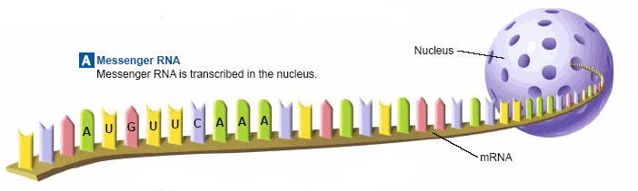
mRNA Transcript
mRNA leaves the nucleus through its pores and goes to the ribosomes.

Slide 28
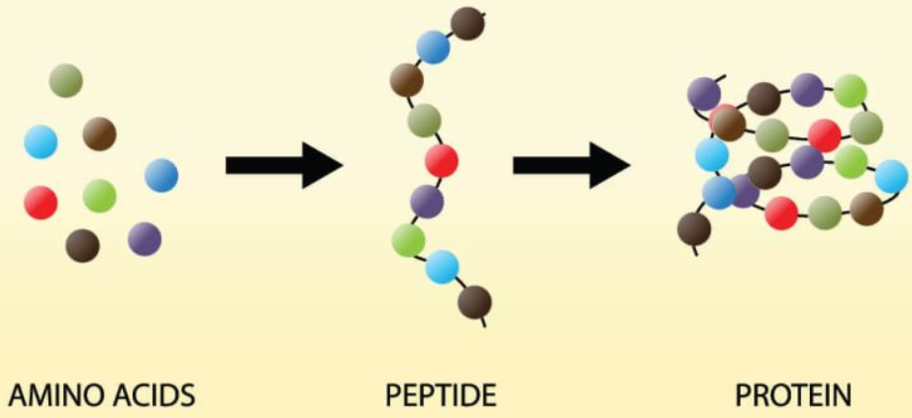
The Genetic Code
Proteins: are made by joining together long chains of amino acids.
The order in which the amino acids are joined:
determines the type of protein that is made.

Slide 29
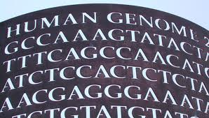
The Genetic Code
The “language” of mRNA instructions is called the GENETIC CODE.
Codons:
The genetic code is read three nitrogen bases
at a time.
A codon is a group of three nitrogen bases that specifies one amino acid.

Slide 30
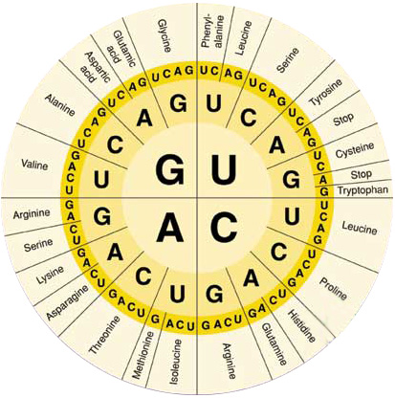
Genetic Information written in Codons is Translated into Amino Acid Sequences
The flow of information from gene to protein is based on a Triplet Code.
The genetic instructions for the amino acid sequence of a polypeptide chain (primary structure of a protein) are written in DNA and RNA as a series of non-overlapping three-base “words” called CODONS.

Slide 31
Genetic Information written in Codons is Translated into Amino Acid Sequences
Translation involves switching from the nucleotide “language” to the amino acid “language.”
Each amino acid is specified by a CODON.
  64 codons are possible
  Some amino acids have more than one possible codon

Slide 32
The Genetic Code dictates how Codons are Translated into Amino Acids
The Genetic Code is the amino acid translations of each of the nucleotide triplets.
  Three Nucleotides specify One Amino Acid.
  Sixty-one codons correspond to amino acids.
  AUG codes for methionine and signals the start of translation.
  Three “stop” codons signal the end of translation.

Slide 33
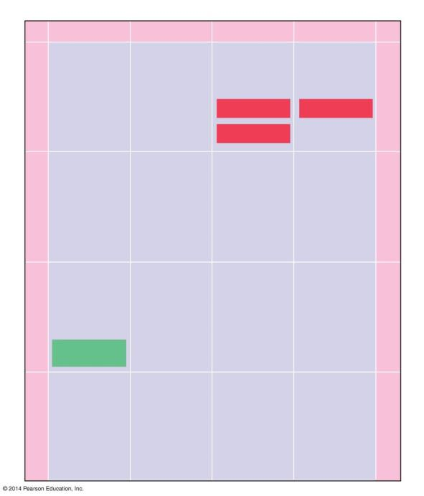
Second base of mRNA codon
U C A G
U
C
A
G
UUU
UCU
UAU
UGU
Phe
Tyr
Cys
U
UUC
UCC
UAC
UGC
Ser
UUA
UCA
UAA Stop
UGA Stop
Leu
UUG
UCG
UAG Stop
UGG
Trp
U
C
A
G
CUU
CCU
CAU
CGU
His
CUC
CCC
CAC
CGC
C
Leu
Pro
Arg
CUA
CCA
CAA
CGA
First base of mRNA codon
Gln
Third base of mRNA codon
CUG
CCG
CAG
CGG
AUU
ACU
AAU
AGU
U
C
A
G
Asn
Ser
A
AUC
lle
ACC
AAC
AGC
Thr
AUA
ACA
AAA
AGA
Lys
Arg
AUG
Met or
start
AAG
ACG
AGG
GUU
GCU
U
C
A
G
GAU
GGU
Asp
G
GUC
GCC
GAC
GGC
Val
Ala
Gly
GUA
GCA
GAA
GGA
Glu
GUG
GCG
GAG
GGG
Notes:
Figure 10.8a The genetic code used to translate RNA codons to amino acids

Slide 34
The Genetic Code
Use the code by reading from the center to the outside
Example: AUG codes for Methionine

Slide 35
The Genetic Code dictates how Codons are Translated into Amino Acids
The Genetic Code is
  redundant, with more than one codon for some amino acids.
  unambiguous, in that any codon for one amino acid does not code for any other amino acid.
  nearly universal, in that the genetic code is shared by organisms from the simplest bacteria to the most complex plants and animals.

Slide 36
Name the Amino Acids
GGG?
UCA?
CAU?
GCA?
AAA?

Slide 37
Name the Amino Acids
GGG?
glycine
UCA?
serine
CAU?
histidine
GCA?
alanine
AAA?
lysine

Slide 38
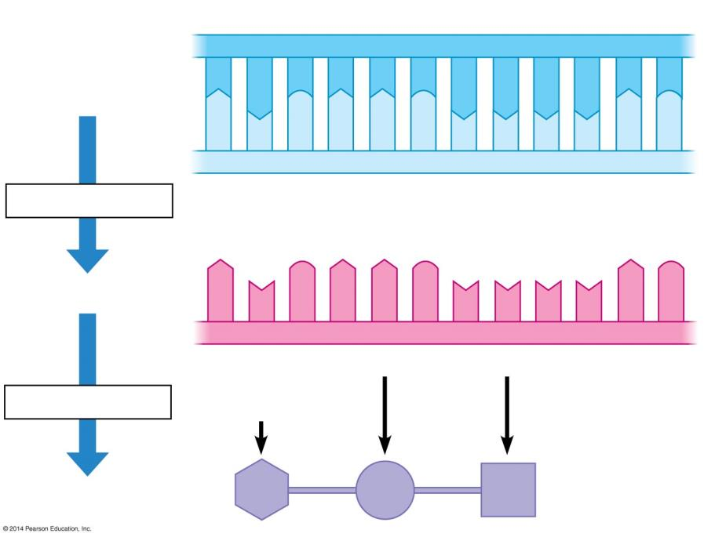
Strand to be transcribed
T A C T T C A A A A T C
1
A T G A A G T T T T A G
2
3
4 5 6 7 8 9 10 11 12 13 14 15
17
18
16
19
Met
Lys
Phe
Notes:
Figure 10.8b-3 Deciphering the genetic information in DNA (step 3)

Slide 39
Strand to be transcribed
T A C T T C A A A A T C
DNA
A T G A A G T T T T A G
Transcription
RNA
A U G A A G U U U U A G
Start
codon
Stop
codon
Translation
Polypeptide
Met
Lys
Phe
Notes:
Figure 10.8b-3 Deciphering the genetic information in DNA (step 3)

Slide 40
mRNA
A U G A A G U U U U A G
Phe
Translation
Stop
codon
Lys
Start
codon
Met
Notes:
Figure 10.8b-3 Deciphering the genetic information in DNA (step 3)

Slide 41
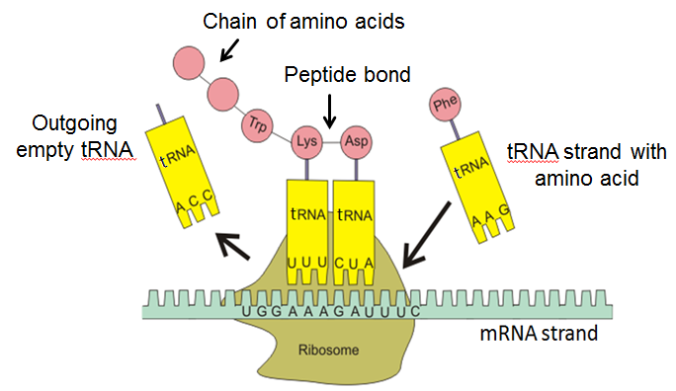
The Steps of Translation
Notes:
Timing ≈ 2 minutes
[please draw on the screen as needed to point out the steps of translation so students understand the diagram]
Please make sure the following is explained and point out the codon and anticodon for students.:
Initiation, elongation, termination.
In the first step initiation, the first codon of mRNA strand attaches to a ribosome (usually AUG is the codons and it signals the start of protein synthesis; anticodon tRNA pairs with complementary codon mRNA once that amino acid is in place the mRNA slides along the ribosome to the next codon
In the second step, elongation, amino acids are added as the second codon pairs with complementary anticodon.
Peptide bond created between first two amino acids that are created [highlight for students that the term elongation is a result of making a long chain of amino acids]
A chain of amino acids is formed ( the sequence of amino acids is key to the type of protein formed)
Termination of translation occurs when a stop codon is reached. This stop codon stops protein synthesis, adds a water molecule to the amino acid chain, releasing the protein from the tRNA and allowing the protein to exit the ribosome.
Once the protein is formed the gene is expressed.[emphasize through an example]

Slide 42
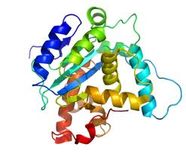
Protein Synthesis (Translation)
The synthesis of proteins is called TRANSLATION.
The cell must translate the base sequence of an mRNA molecule into the amino acid sequence of a protein.
The site of translation, or protein synthesis, is the ribosome.
The ribosome facilitates the orderly linking of amino acids into proteins.
During translation, the cell uses information from mRNA to produce PROTEINS.

Slide 43
Transfer RNA Molecules serve as Interpreters during Translation
Transfer RNA (tRNA) molecules function as an interpreter, converting the genetic message of mRNA into the language of proteins.
Transfer RNA molecules perform this interpreter task by:
  picking up the appropriate amino acid.
  using a special triplet of bases, called an Anticodon, to recognize the appropriate codons in the mRNA.

Slide 44
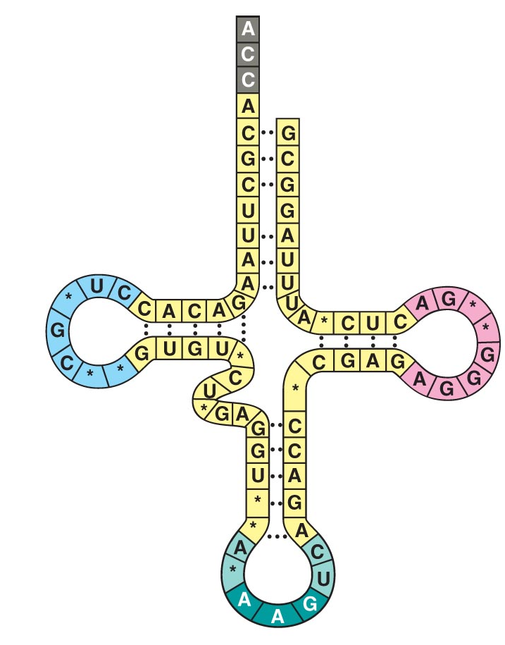
Transfer RNA
The function of tRNA is to transfer amino acids from the cytoplasm’s amino acid pool to a ribosome.
Amino acid will be attached here
Transfer RNA molecules are not all the same.
Each type of tRNA molecule links a particular mRNA codon with a particular amino acid.
As a tRNA arrives at a ribosome, it carries a specific amino acid at one end.
At the other end is a nucleotide triplet called an ANTICODON.
These three bases are the “ANTICODON”.

Slide 45
E.g. If an mRNA codon is UUC, this would translate as the amino acid phenylalanine.
The tRNA that delivers the amino acid phenylalanine has as its anticodon AAG.
Each tRNA is used repeatedly to locate a particular amino acid and deposit it at the ribosome.
It then leaves the ribosome to go and find another amino acid.
anticodon
Phenylalanine codon: UUC

Slide 46
Ribosomes build Polypeptides
Translation occurs on the surface of the Ribosome:
  Ribosomes coordinate the synthesis of polypeptides.
  Ribosomes have two subunits: small and large.
  Each subunit is composed of Ribosomal RNAs and Proteins.
  Ribosomal subunits come together during translation.
  Ribosomes have binding sites for mRNA and tRNAs.

Slide 47
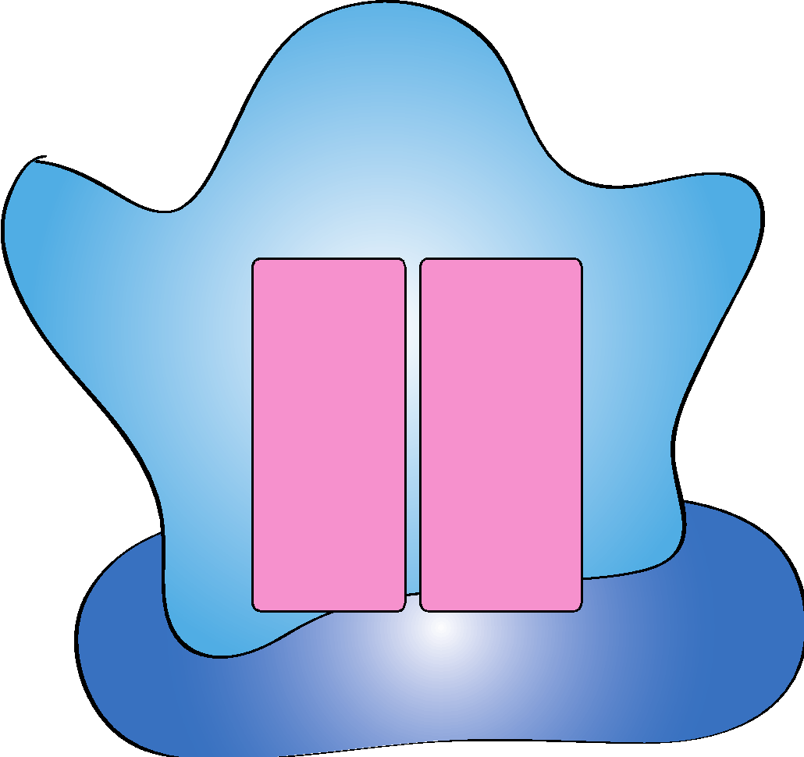
Ribosome
Ribosomes build Polypeptides
Large
subunit
P
Binding Site
A
Binding Site
mRNA
Small subunit

Slide 48
Translation
Three steps:
1. initiation: start codon (AUG)
2. elongation: amino acids linked
3. termination: stop codon
(UAG, UAA, or UGA)
Let’s Make a Protein !

Slide 49
Second base of RNA codon
U C A G
UUU
UCU
UAU
UGU
U
C
A
G
Phe
Tyr
Cys
U
UUC
UCC
UAC
UGC
Ser
UUA
UCA
UAA Stop
UGA Stop
Leu
UUG
UCG
UAG Stop
UGG
Trp
CUU
CCU
CAU
CGU
U
C
A
G
His
CUC
CCC
CAC
CGC
C
Leu
Pro
Arg
CUA
CCA
CAA
CGA
Gln
First base of RNA codon
Third base of RNA codon
CUG
CCG
CAG
CGG
AUU
ACU
AAU
AGU
U
C
A
G
Asn
Ser
A
AUC
lle
ACC
AAC
AGC
Thr
AUA
ACA
AAA
AGA
Lys
Arg
AUG
Met or
start
AAG
ACG
AGG
GUU
GCU
GAU
GGU
U
C
A
G
Asp
G
GUC
GCC
GAC
GGC
Val
Ala
Gly
GUA
GCA
GAA
GGA
Glu
GUG
GCG
GAG
GGG
Notes:
Figure 10.8a The genetic code used to translate RNA codons to amino acids

Slide 50
mRNA Joins the Ribosome
Large
subunit
P
Site
A
Site
mRNA
Small subunit
1. The large subunit and small subunit join with the mRNA.

Slide 51

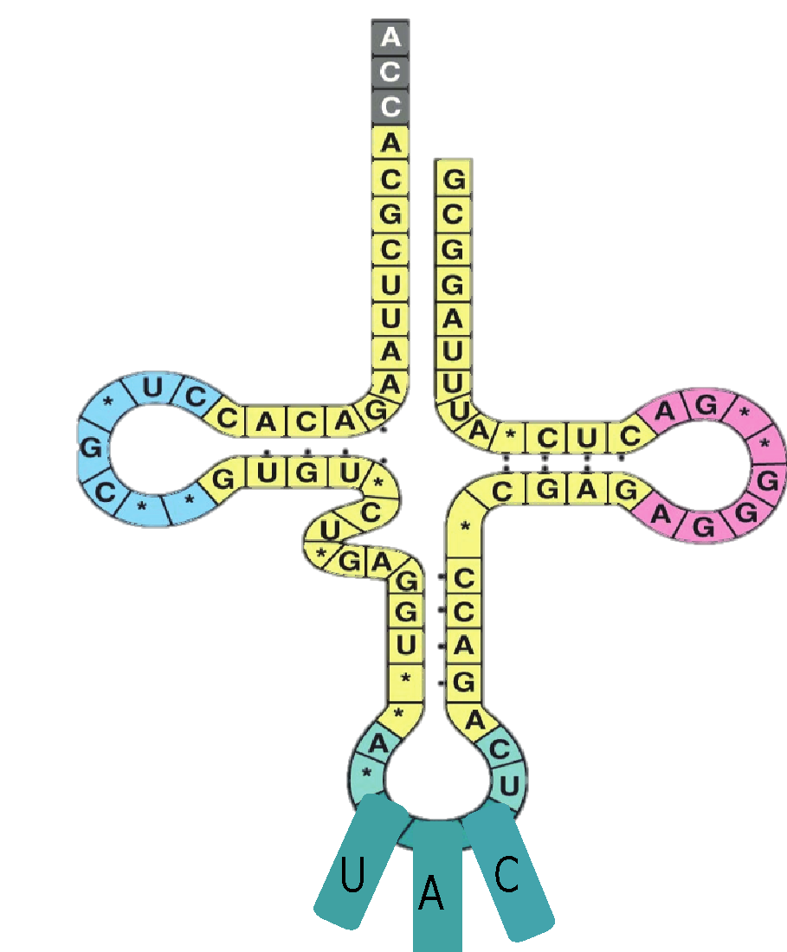
Initiation
Methionine
Transfer RNA
P
Site
A
Site
mRNA
Anticodon
Hydrogen Bonds
Start codon
The tRNA carrying the anticodon UAC fits in the P site to start translation.
Hydrogen bonds form between UAC and AUG (Start Codon).

Slide 52
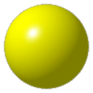
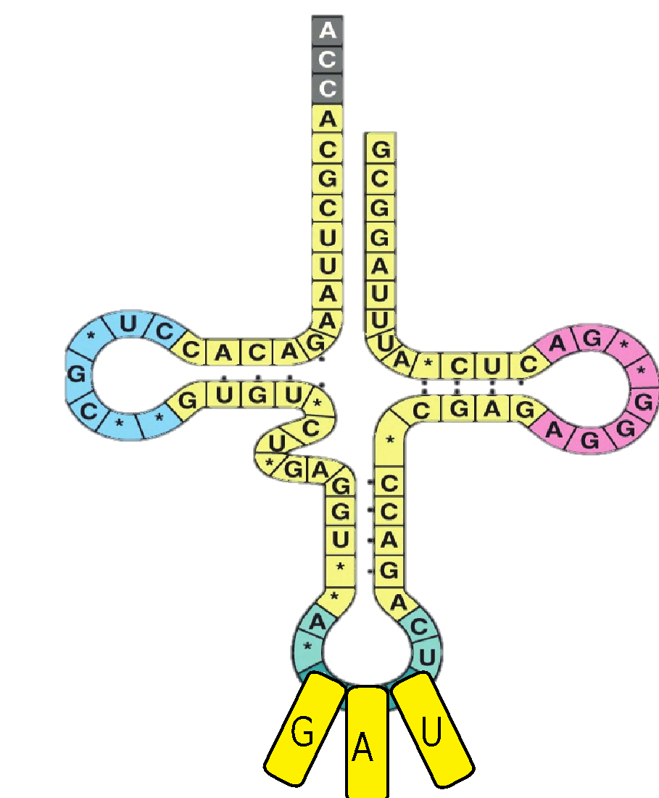

Elongation
Amino
Acid 2
Methionine
Transfer RNA
P
Site
A
Site
mRNA
Anticodon
Hydrogen Bonds
The next anticodon sits in the A site to start elongation.

Slide 53
Elongation
Peptide Bond
aa1
aa2
mRNA
Hydrogen Bonds
Hydrogen bonds form between the anticodons and the mRNA bases.
Peptide Bonds from between the two amino acids forming a chain of 2 amino acids.

Slide 54
Elongation
Transfer RNA leaves
aa1
aa2
mRNA
7. The mRNA moves over one codon moving the tRNA out of the ribosome.

Slide 55

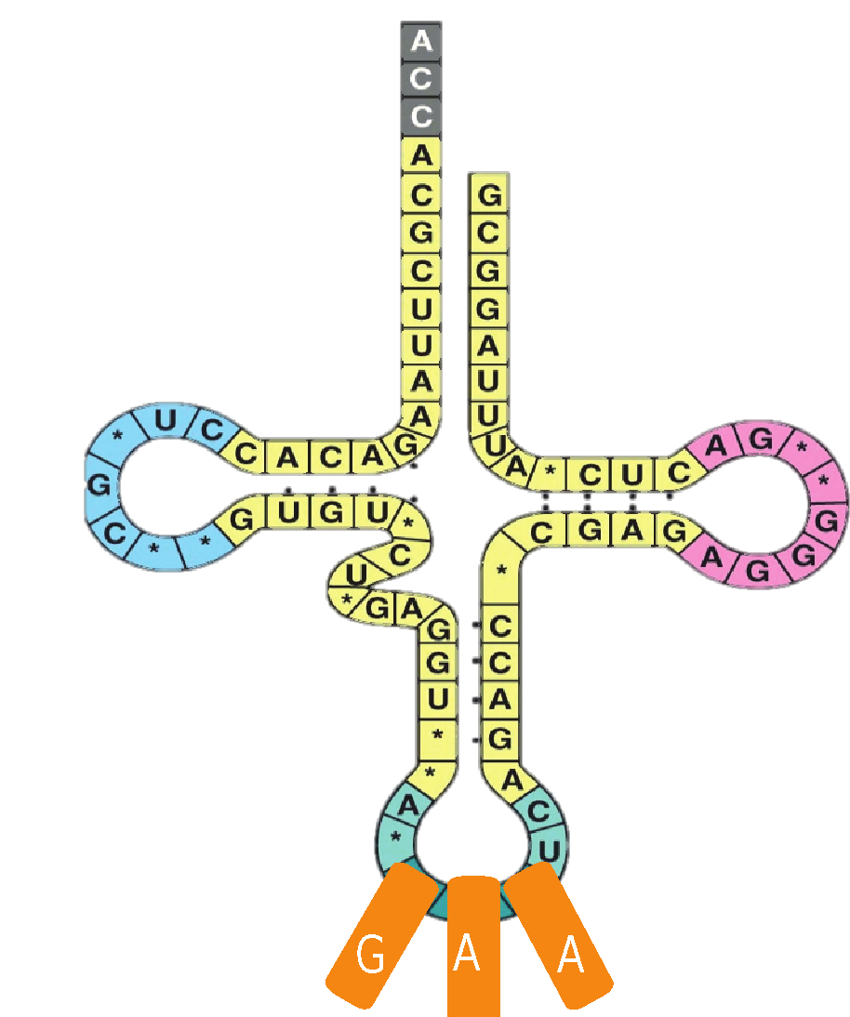
Elongation
aa3
aa1
aa2
mRNA
8. The next tRNA moves into place.

Slide 56
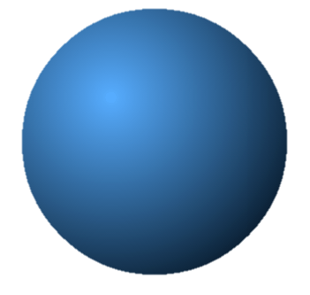
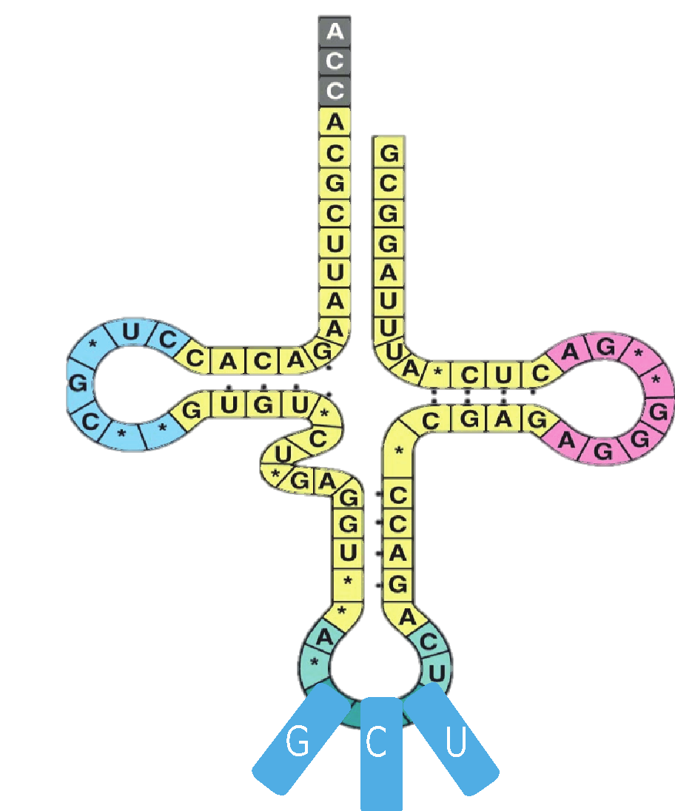
Elongation
aa4
Peptide Bonds
aa1
aa2
aa3
mRNA
Peptide bonds form between the two amino acids, forming a chain of 3 amino acids.

Slide 57
Elongation
aa4
Transfer RNA leaves
aa1
aa2
aa3
mRNA
10. The mRNA moves over one codon moving the tRNA out of the ribosome.

Slide 58
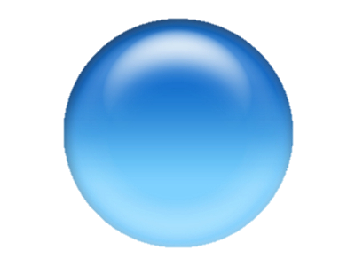
Elongation
aa4
aa1
aa2
aa3
mRNA
11. The next tRNA moves into place.

Slide 59
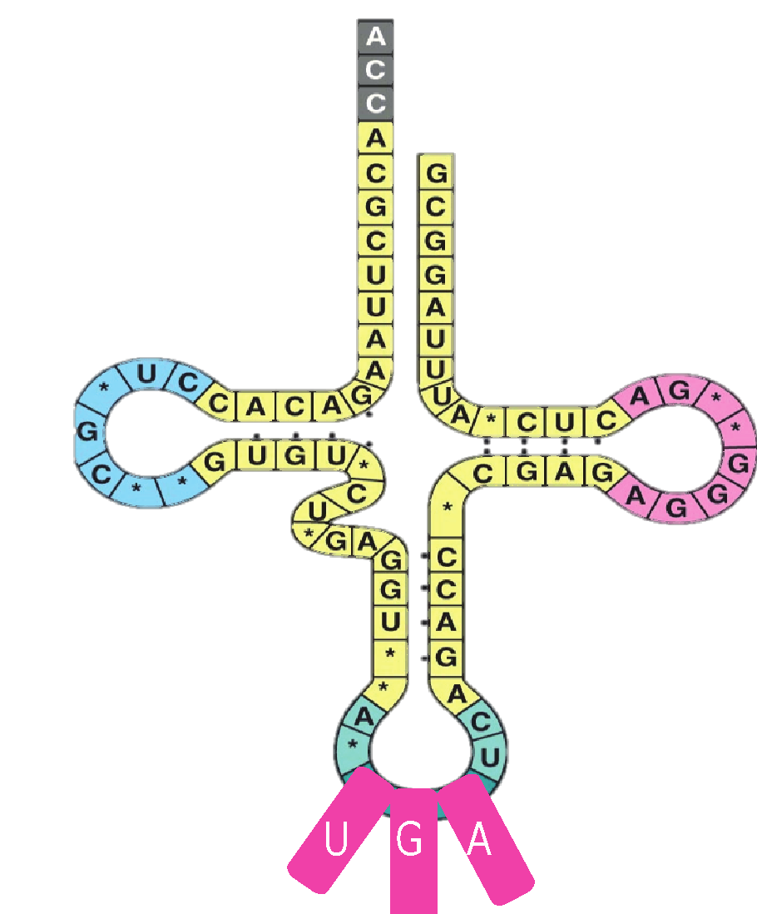
Elongation
aa4
Peptide Bonds
aa1
aa2
aa3
aa4
mRNA
12. Peptide bonds form between the two amino acids, forming a chain of 4 amino acids.

Slide 60

Elongation
aa5
Transfer RNA leaves
aa1
aa2
aa3
aa4
mRNA
13. The mRNA moves over one codon moving the tRNA out of the ribosome.

Slide 61
Elongation
aa1
aa5
aa2
aa3
aa4
mRNA
mRNA
14. The next tRNA moves into place.

Slide 62
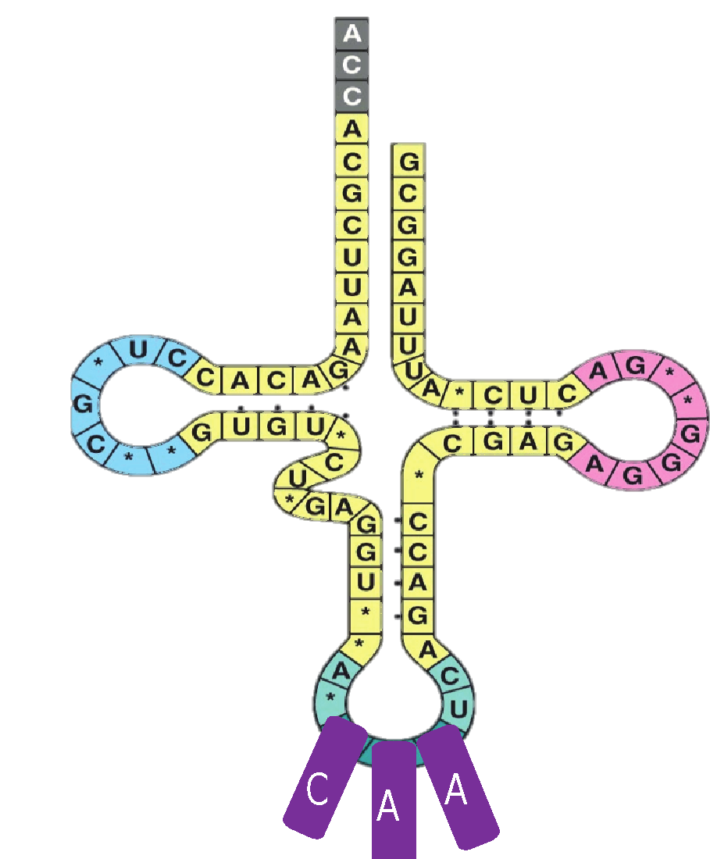
Elongation
aa1
aa6
aa2
Peptide Bonds
aa4
aa5
mRNA
15. Peptide bonds form between the two amino acids, forming a chain of 5 amino acids.

Slide 63
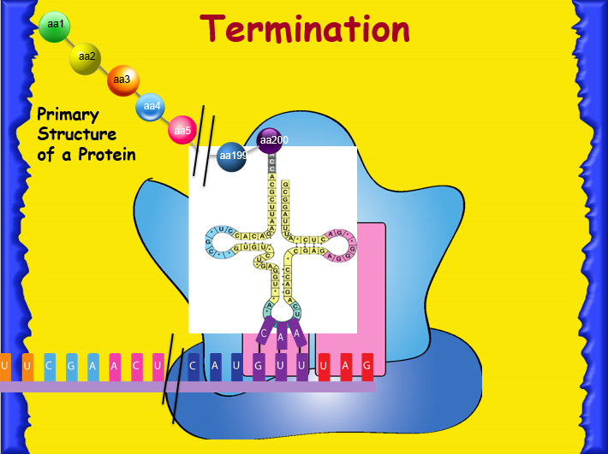
When the terminator codon is reached the amino acid linking stops.
There are NOT anticodons that match with UAG, UAA and UGA.
This ends the polypeptide chain.
Stop codon

Slide 64

End Product – The Protein!
The end products of protein synthesis is the PRIMARY structure of a protein.
A sequence of amino acids bonded together by peptide bonds.
aa1
aa2
aa3
Primary Structure of a Protein
aa4
aa5
aa200
aa199

Slide 65
Translation
Animation
https://somup.com/c3hhqnOKY2 Translation (Protein Synthesis) (2:38)

Slide 66
The Flow of Genetic Information in the cell is DNA → RNA → Protein
The Flow of Genetic Information is from DNA to RNA to Protein.
  In TRANSCRIPTION (DNA → RNA), the mRNA is synthesized on a DNA template.
  In Eukaryotic cells, transcription occurs in the nucleus, and the messenger RNA is processed before it travels to the cytoplasm.
  In Prokaryotes, transcription occurs in the cytoplasm.

Slide 67
The Flow of Genetic Information in the cell is DNA → RNA → Protein
TRANSLATION can be divided into four steps, all of which occur in the Cytoplasm:
  Amino acid attachment
  Initiation of polypeptide synthesis
  Elongation
  Termination

Slide 68
DNA → RNA → Protein
DNA
Transcription
mRNA
Ribosome
Translation
Protein
Prokaryotic Cell

Slide 69
DNA → RNA → Protein
Nuclear
membrane
DNA
Transcription
Pre-mRNA
Eukaryotic Cell
RNA Processing
mRNA
Ribosome
Translation
Protein

Slide 70
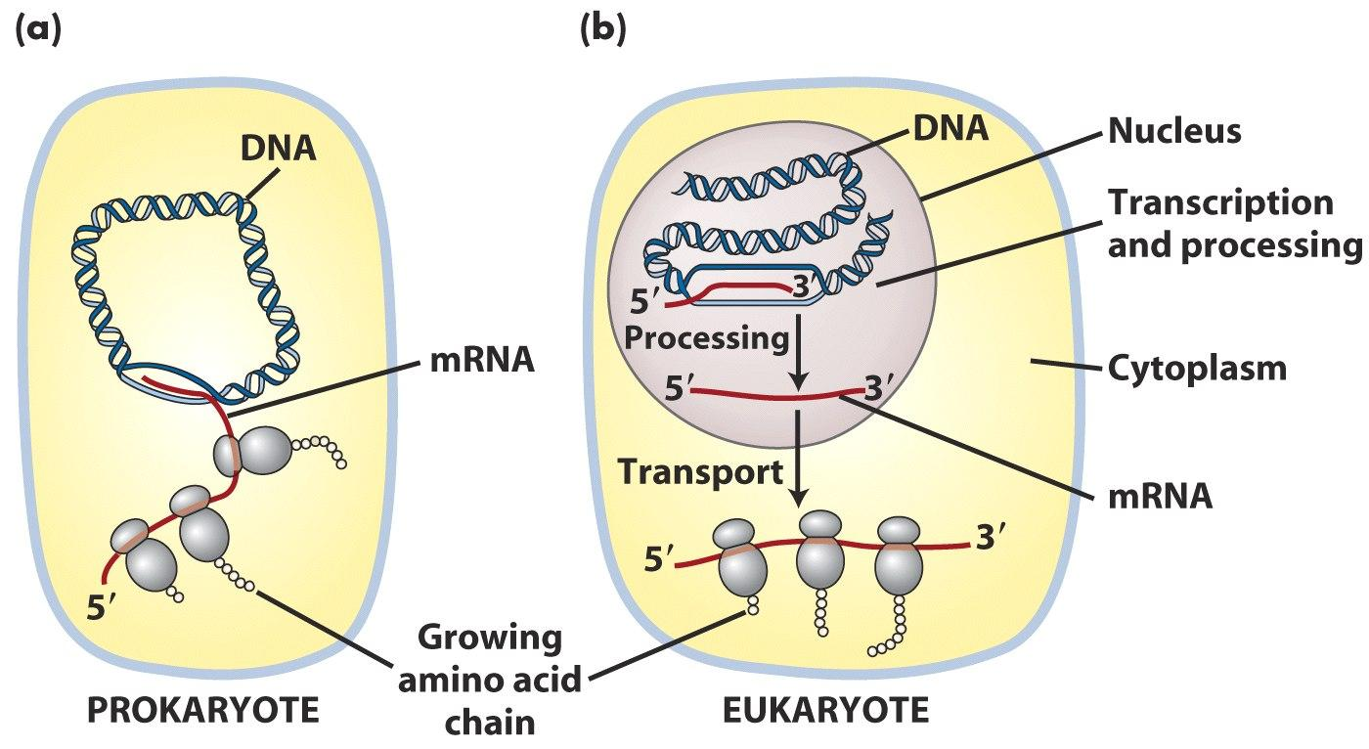
Important Note:
In Prokaryotes, translation can begin before transcription is complete.
Why can translation begin before transcription is complete in prokaryotes but not in eukaryotes??

Slide 71
Example: Putting It All together!
DNA → TAC TTA CAA ACC ATA ATT
mRNA →
tRNA →
Transcription
AUG
AAU
GUU
UGG
UAU
UAA
CODONS
Translation
UAC
UUA
CAA
ACC
AUA
AUU
ANTICODONS
Remember the codon is for mRNA.
Amino →
Acid
Sequence

Slide 72
Example: Putting It All together!
DNA → TAC TTA CAA ACC ATA ATT
mRNA →
tRNA →
Transcription
AUG
AAU
GUU
UGG
UAU
UAA
CODONS
Translation
UAC
UUA
CAA
ACC
AUA
AUU
ANTICODONS
Amino →
Acid
Sequence
Methionine
Asparagine
Valine
Tryptophan
Tyrosine
STOP

Slide 73
Afterwards…
Signal Sequences
  are added to proteins in the Endoplasmic Reticulum after they are synthesized by the ribosomes.
  direct a small number of nucleotides that are added to a protein in the ER.
  tell the cell where the protein is to be taken after it is made.

Slide 74
Gene Expression
When a gene is expressed, it means that the protein the gene codes for is being made.
When the gene is expressed, the trait the gene codes for is visible in some way.
All cells of the same organism contain the same exact info in their DNA.
In multicellular organisms not all genes are expressed by every cell.

Slide 75
Gene Expression
Not all areas of the DNA that code for proteins are transcribed into mRNA.
If they were, then every cell would have the same exact function and make the same exact proteins.
Each cell knows exactly what type of cell it is and which proteins it should make.
This allows cells to be grouped into tissue and organ systems.

Slide 76
Complete the Venn Diagram:
DNA vs. RNA
DNA
RNA
Notes:
#frame
Timing~ 1 minute
Entry audio: Read the statement below. Check off those statements that are true for Aerobic cellular respiration only.
[Side note to teacher: This is also the Skill objective: Organize data using specific grouping methods.]

Slide 77
Complete the Venn Diagram:
DNA vs. RNA
DNA
RNA
Single strand
Ribose sugar
A U G C
Nucleus (mRNA → cytoplasm)
tRNA (translation)
rRNA (ribosomes)
Genetic code
Double helix
Deoxyribose sugar
A T G C
Nucleolus
Nuclei acids
Nucleotides
Sugars
Nitrogen bases
Phosphate group
Notes:
#frame
Timing~ 1 minute
Entry audio: Read the statement below. Check off those statements that are true for Aerobic cellular respiration only.
[Side note to teacher: This is also the Skill objective: Organize data using specific grouping methods.]

