Slide 1
Edible Wild Plants

Slide 2
Animate Slides
Click on “Slide Show”
Click “From Beginning”

Slide 3
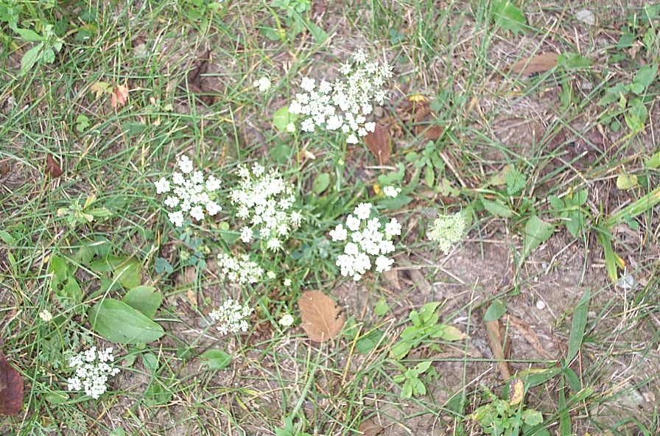
Wild Carrot
(Queen Anne's Lace)

Slide 4
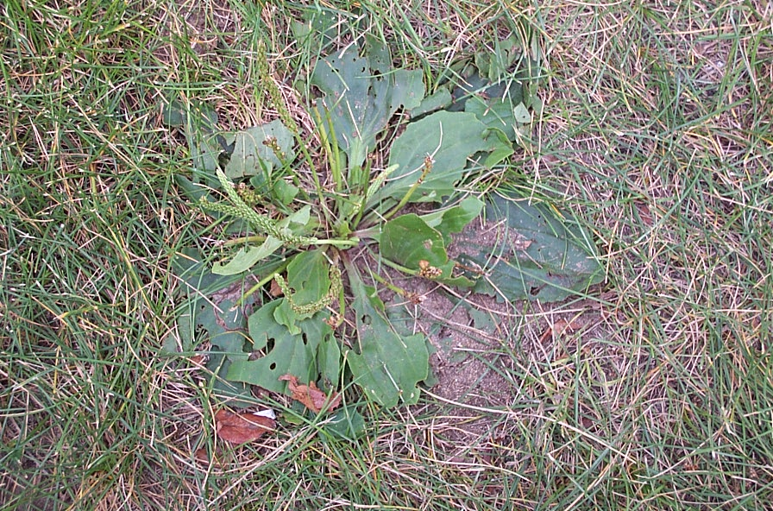
Plantain
(Common )

Slide 5
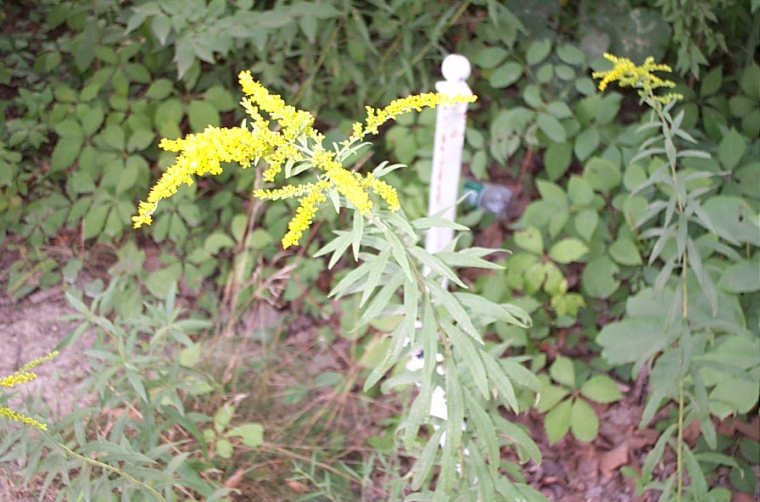
Goldenrod

Slide 6
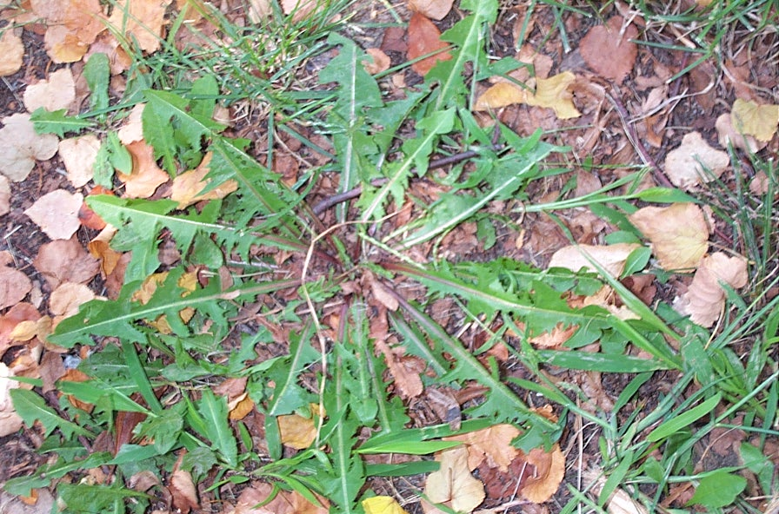
Dandelion

Slide 7
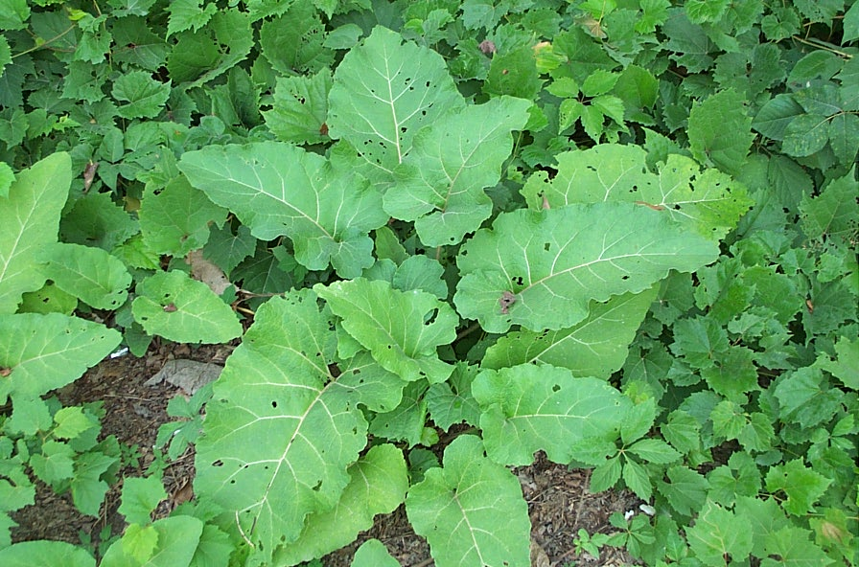
Burdock

Slide 8
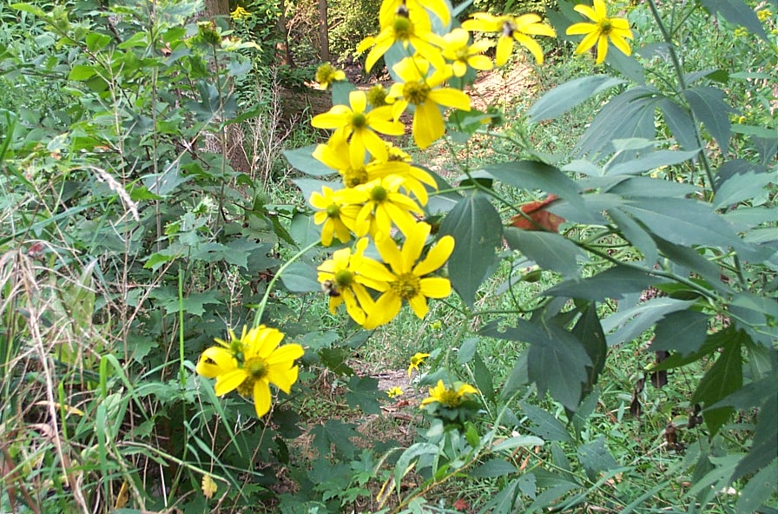
Jerusalem Artichoke

Slide 9
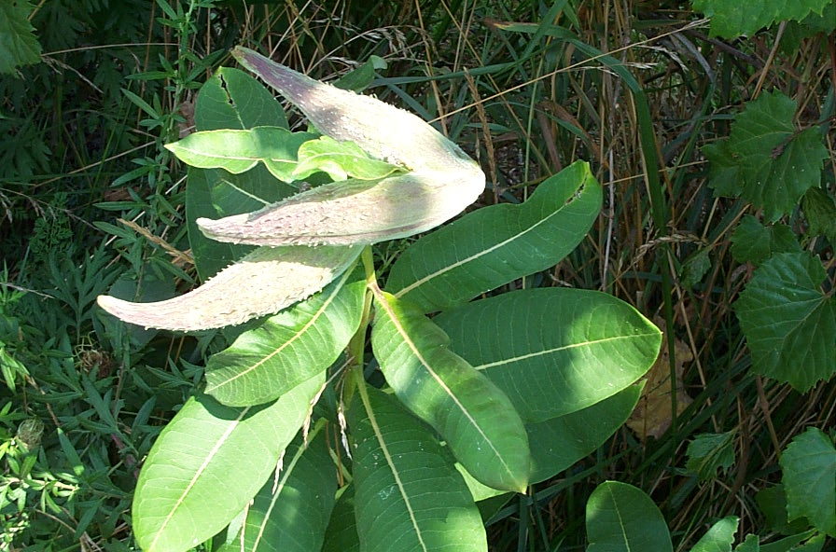
Milkweed

Slide 10
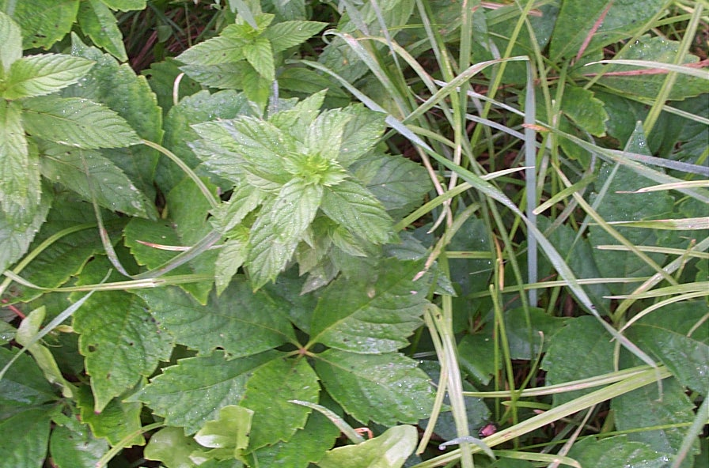
Wild Mint

Slide 11
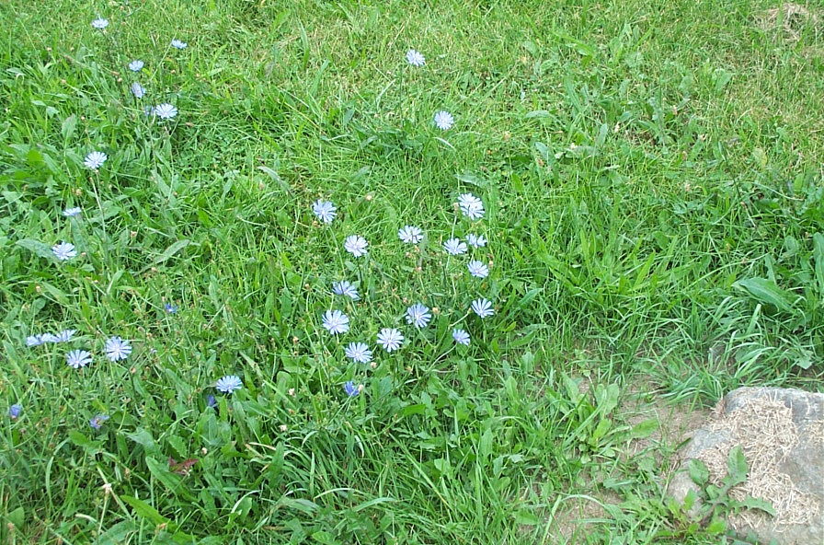
Chickory

Slide 12
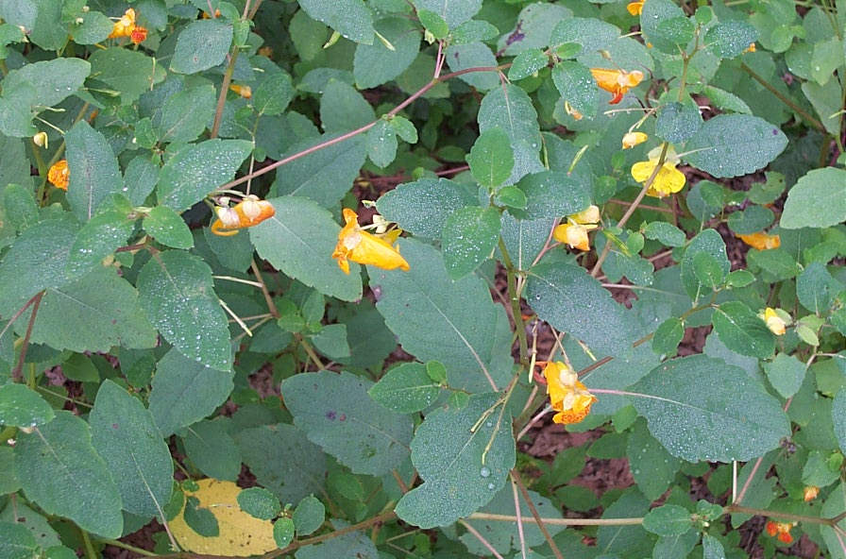
Jewelweed
(Touch Me Not)

Slide 13
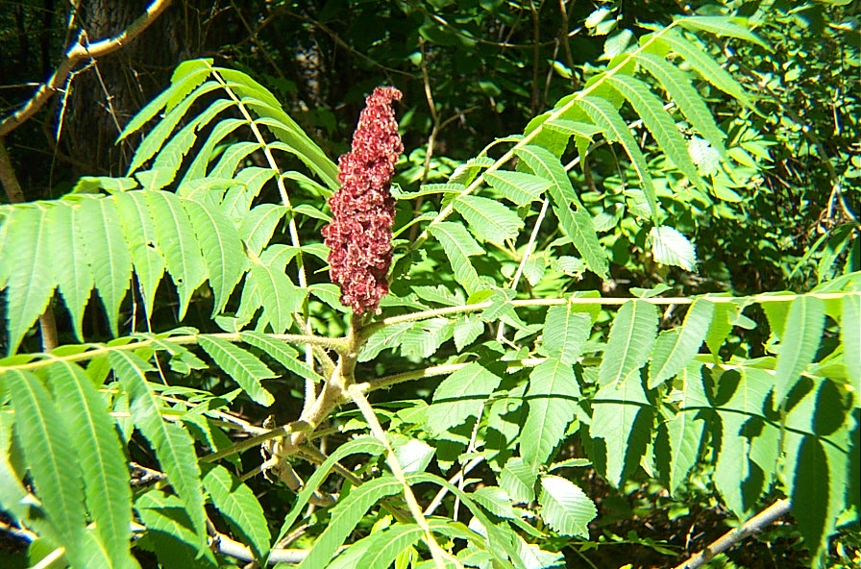
Sumac

Slide 14
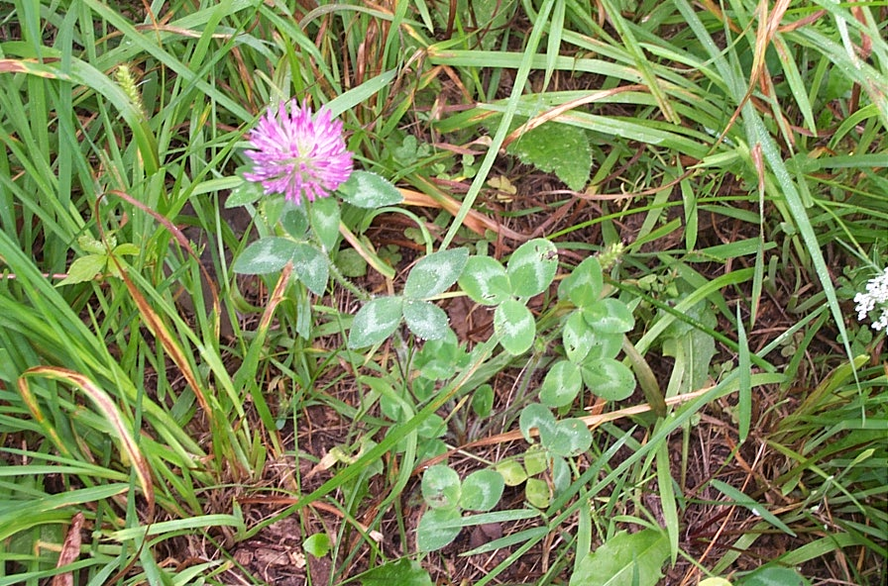
Clover

Slide 15
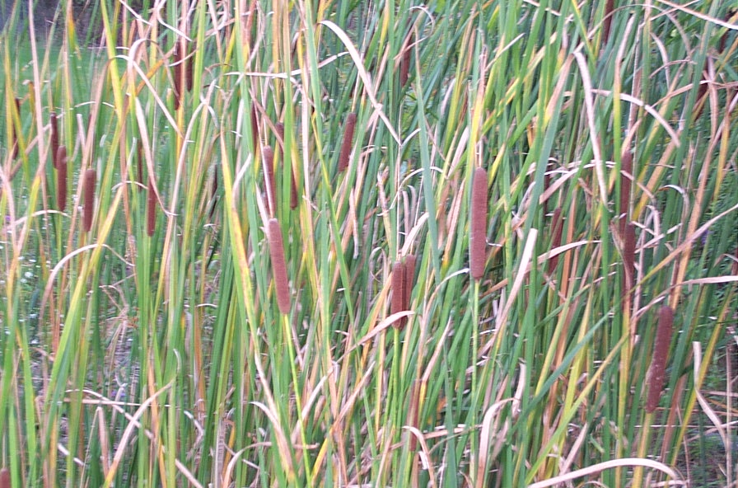
Cattail

Slide 16
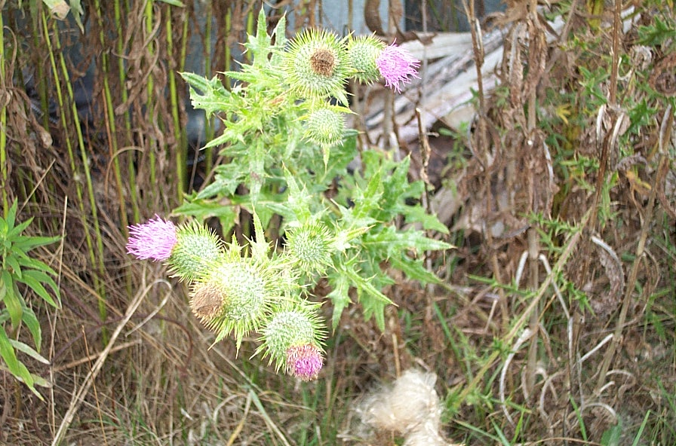
Bull Thistle

Slide 17
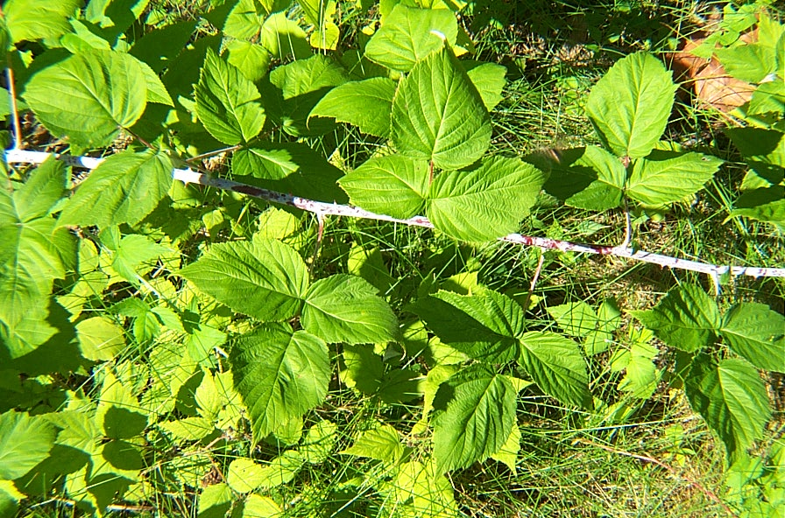
Raspberry

Slide 18
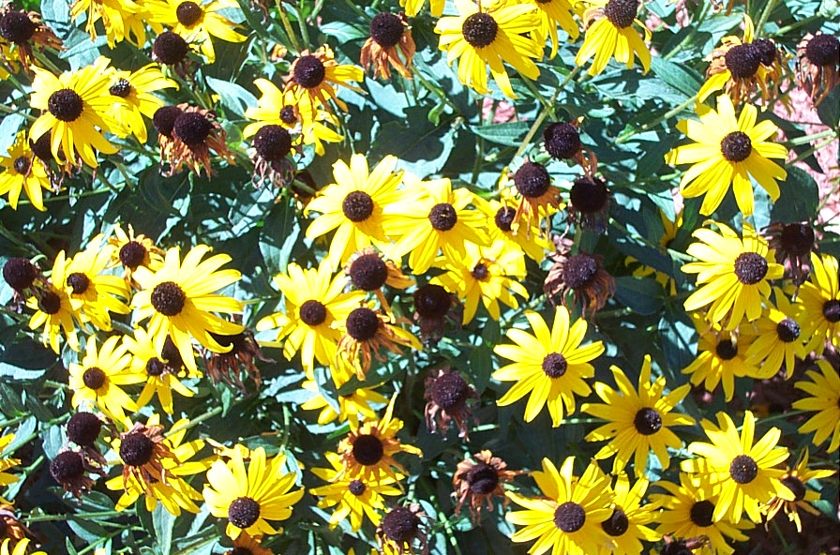
Black eyed Susan

Slide 19
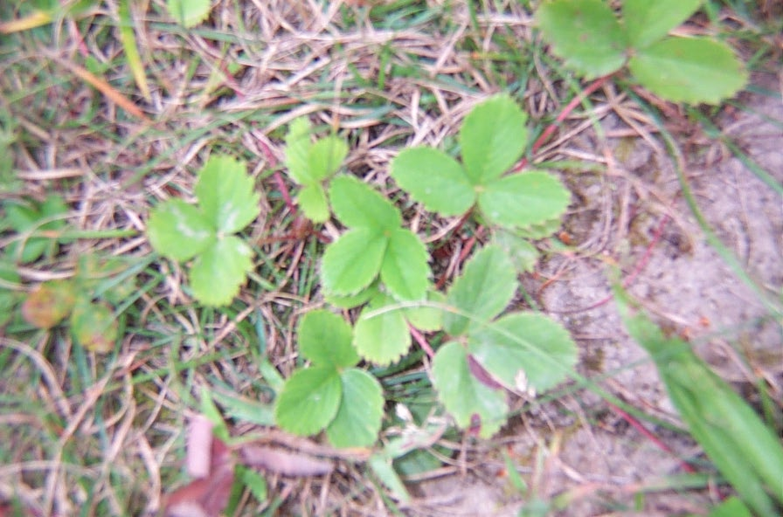
Wild Strawberry

Slide 20
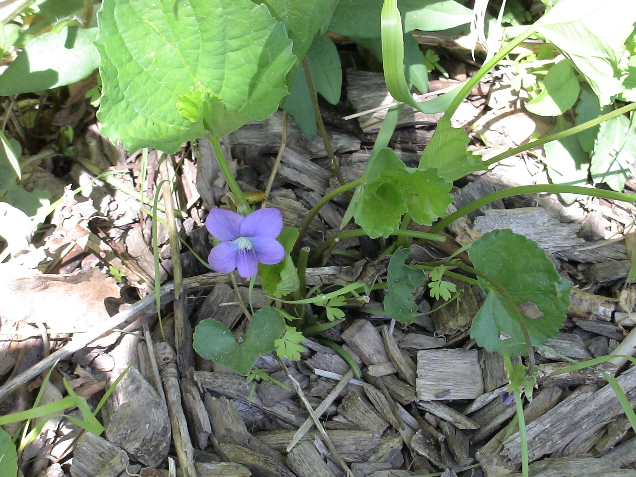
Violet

Slide 21
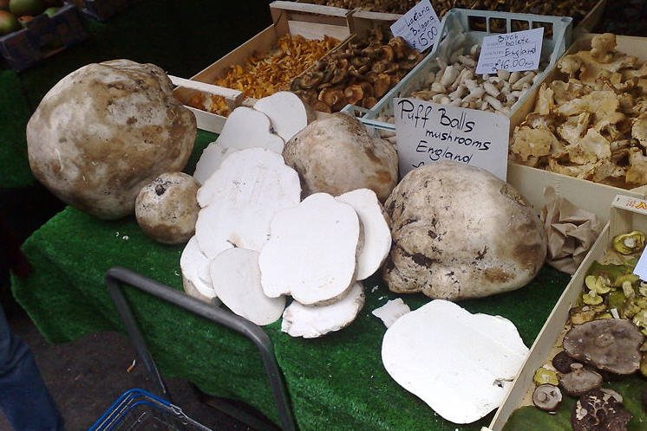
Puffballs

Slide 22
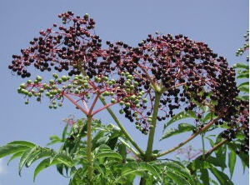
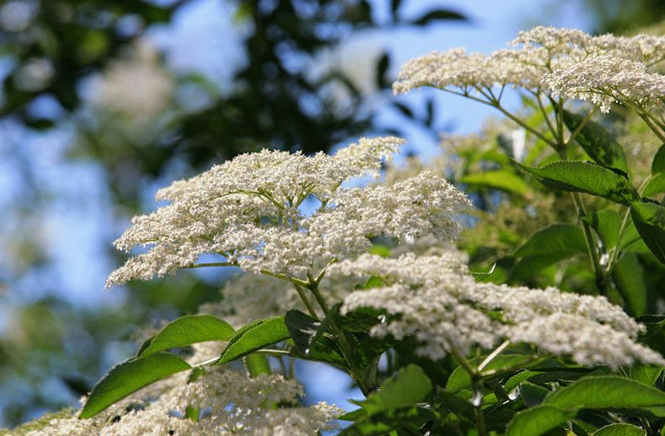
Elderberry

Slide 23
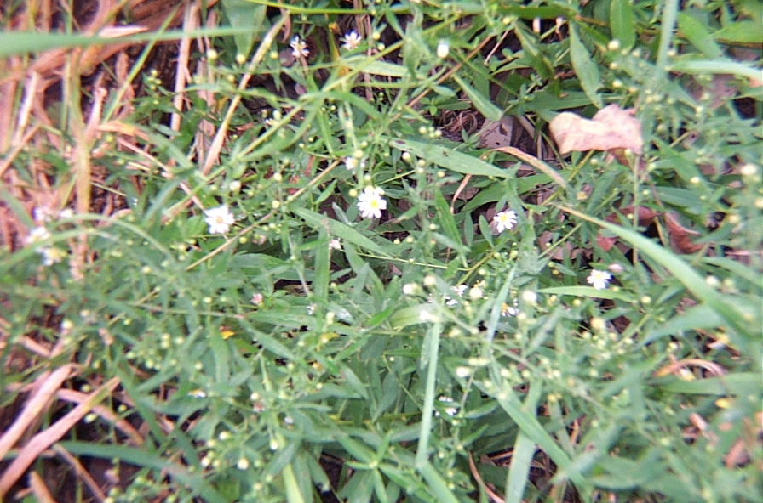
Aster

Slide 24
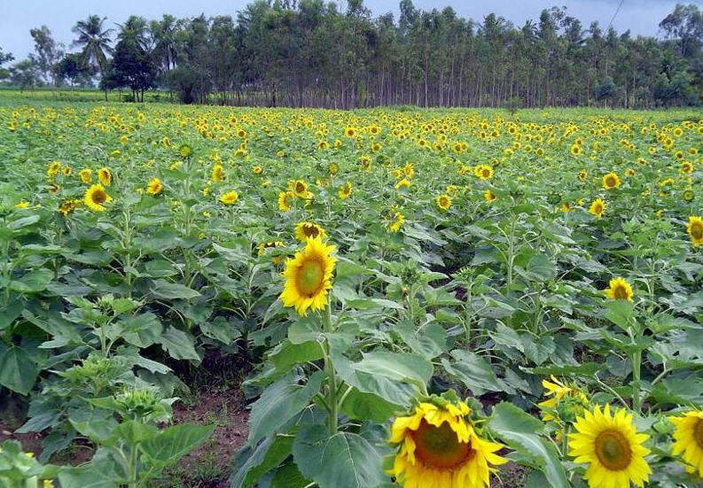
Sunflower

Slide 25
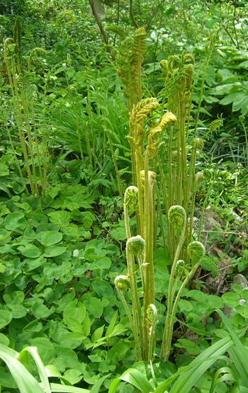
Fiddlehead fern

Slide 26
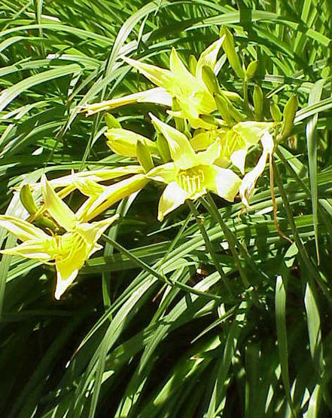
Daylily

Slide 27
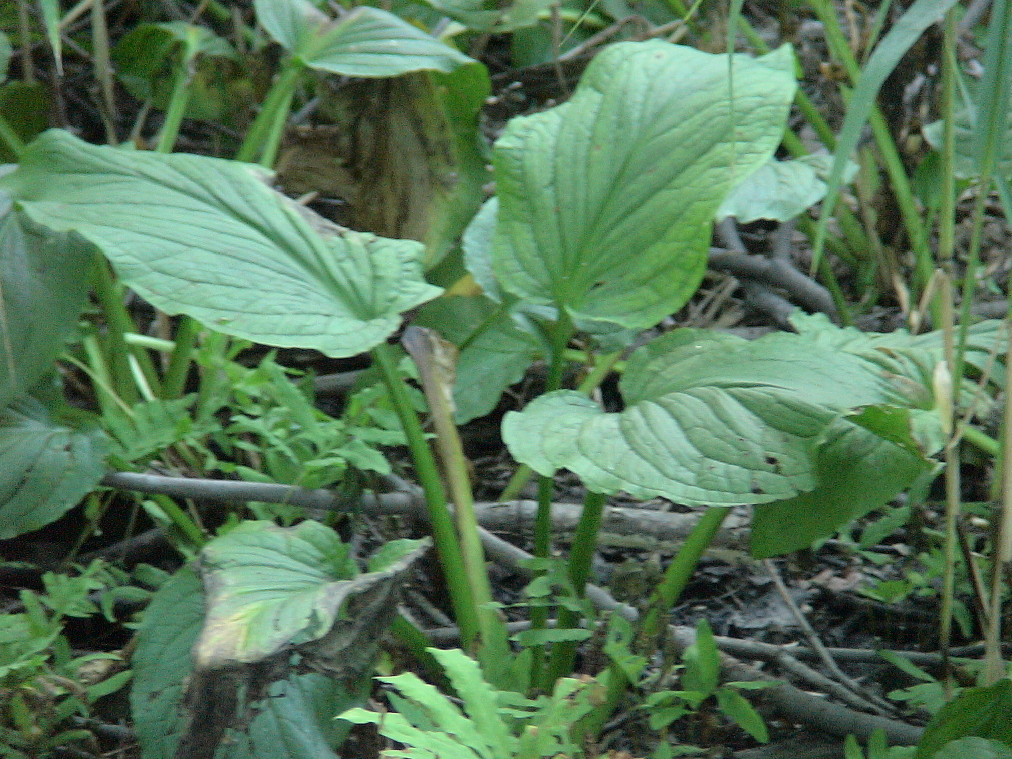
Skunk Cabbage

Slide 28
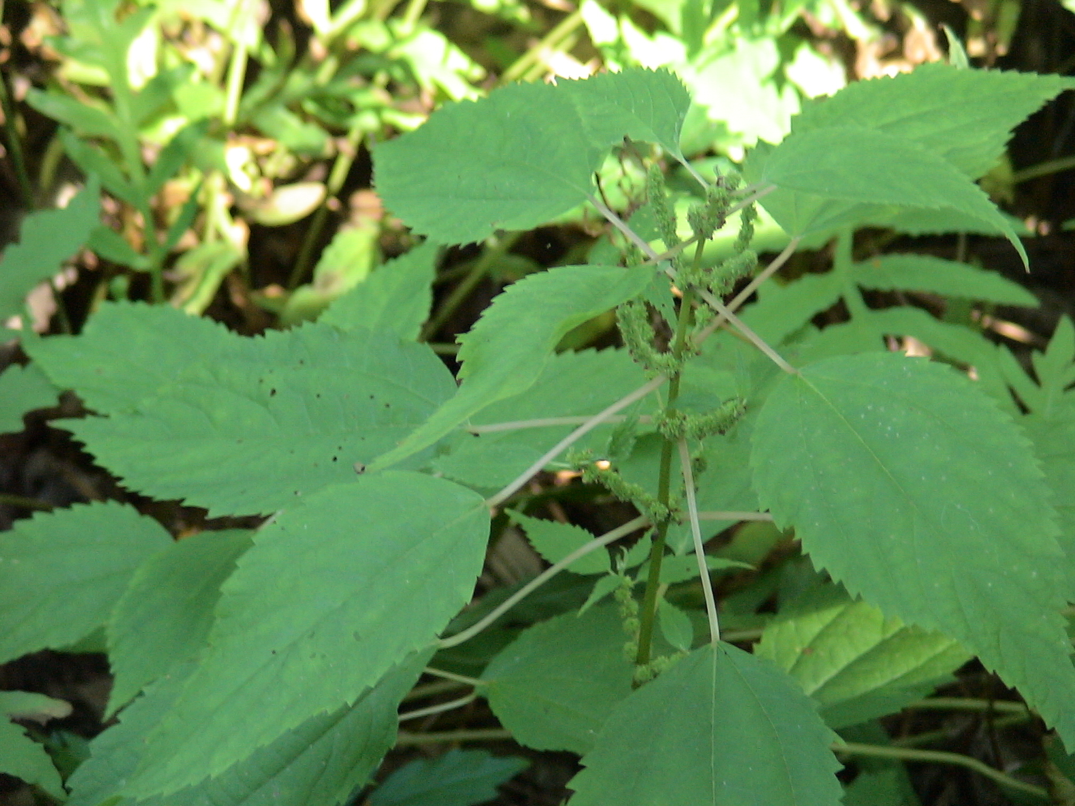
Stinging Nettle

Slide 29
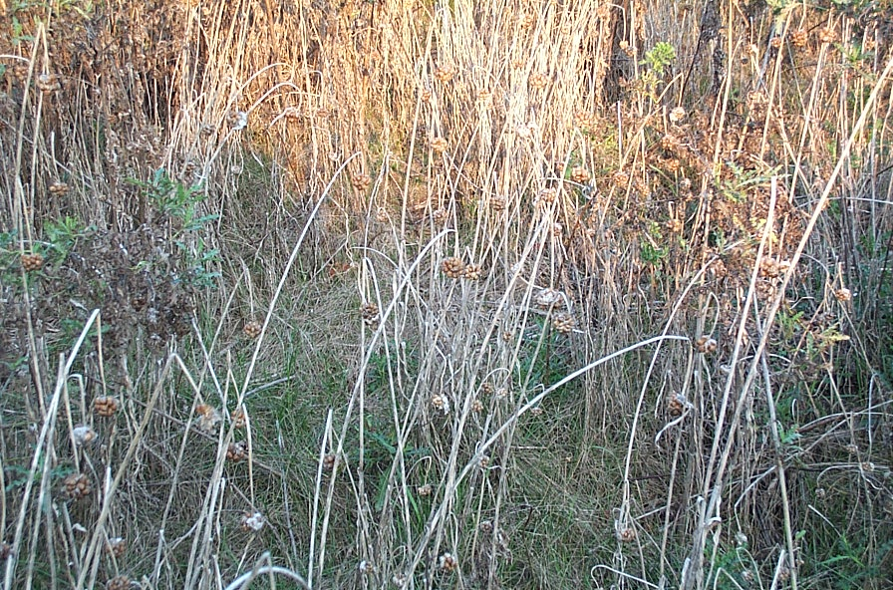
Wild Garlic

Slide 30
Round Two

Slide 31
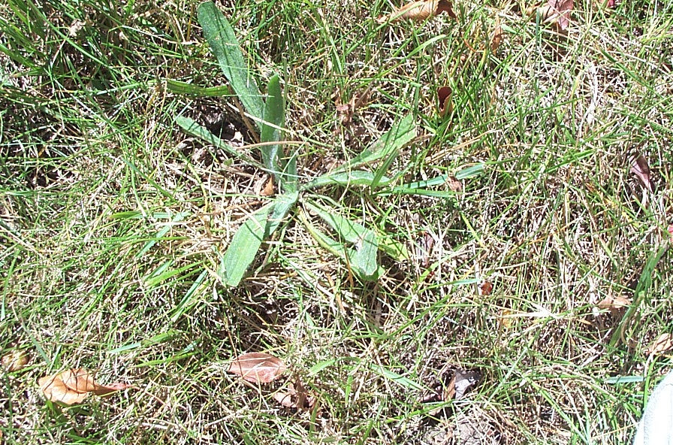
Plantain
(English )

Slide 32
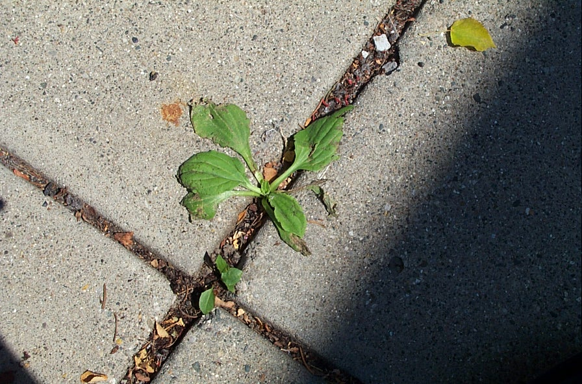
Common Plantain

Slide 33
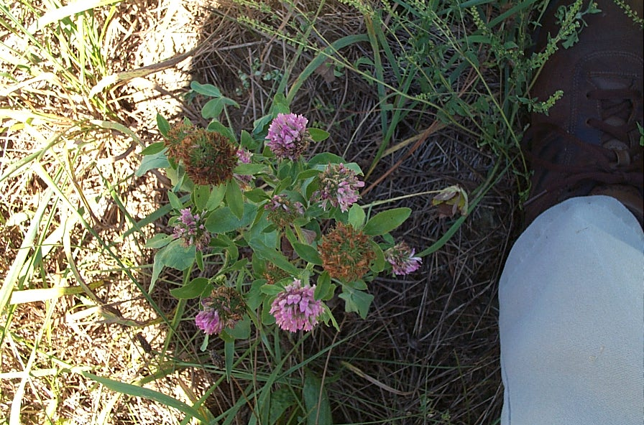
Clover

Slide 34
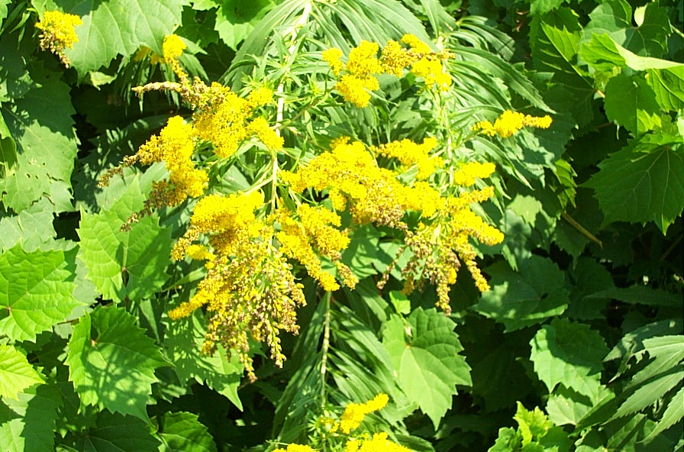
Goldenrod

Slide 35
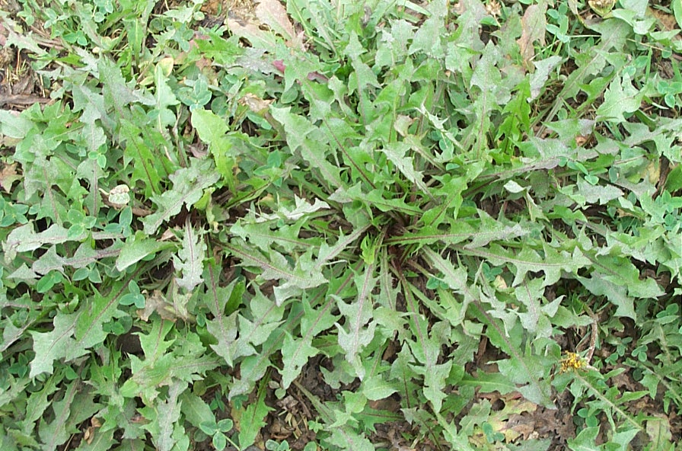
Dandelion

Slide 36
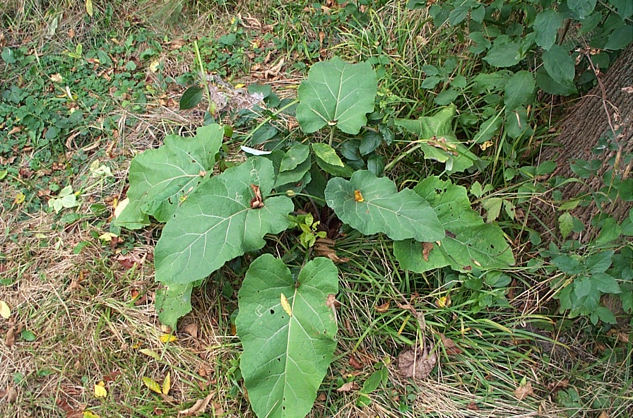
Burdock

Slide 37
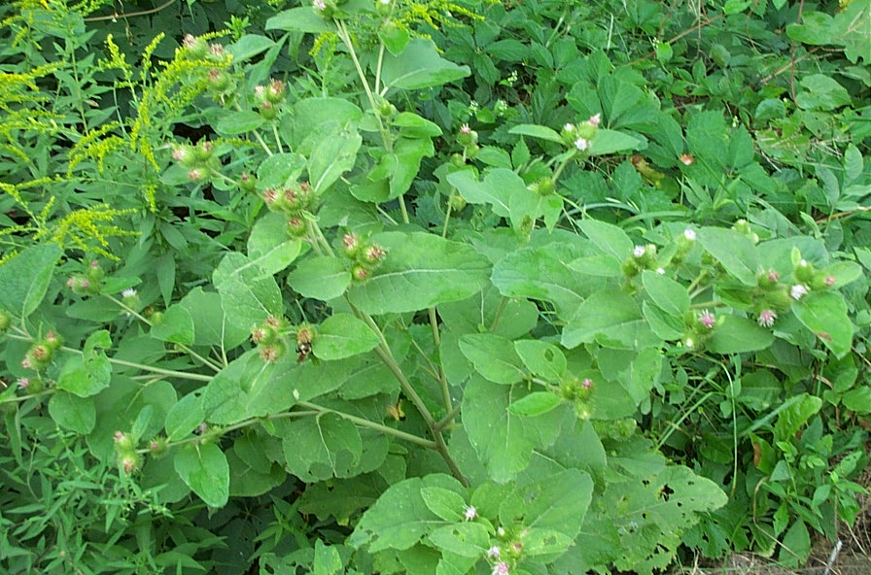
Burdock

Slide 38
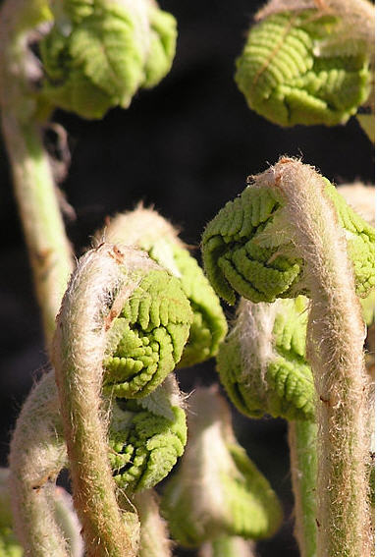
Fiddlehead fern

Slide 39
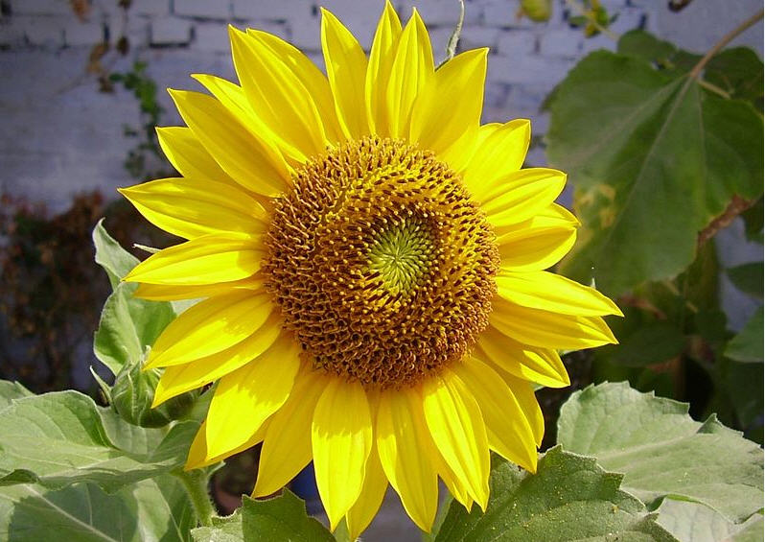
Sunflower

Slide 40
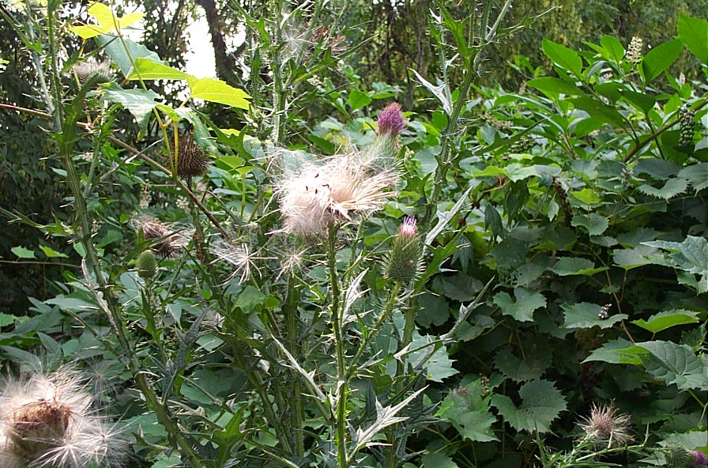
Bull Thistle

Slide 41
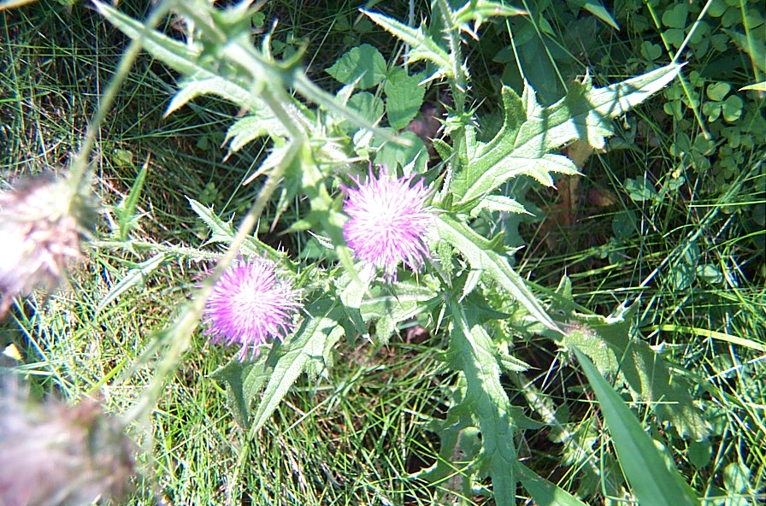
Bull thistle

Slide 42
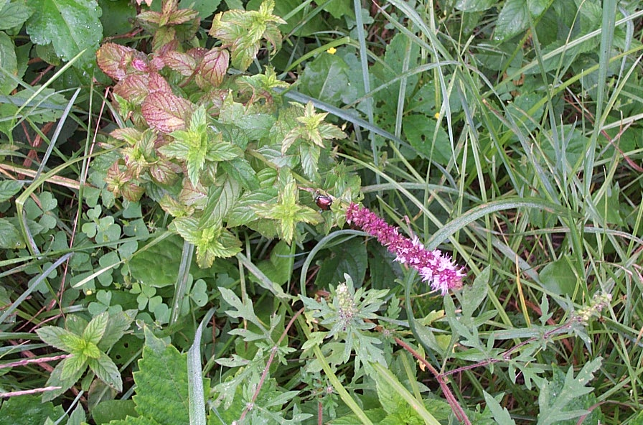
Wild Mint

Slide 43
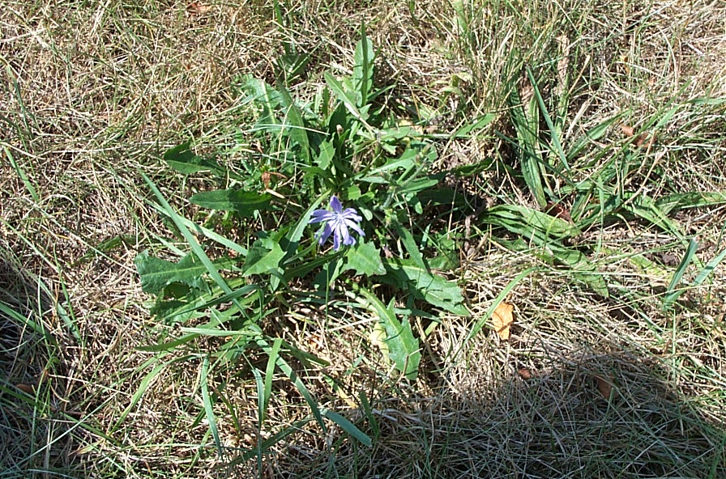
Chickory
(blue lettuce)

Slide 44
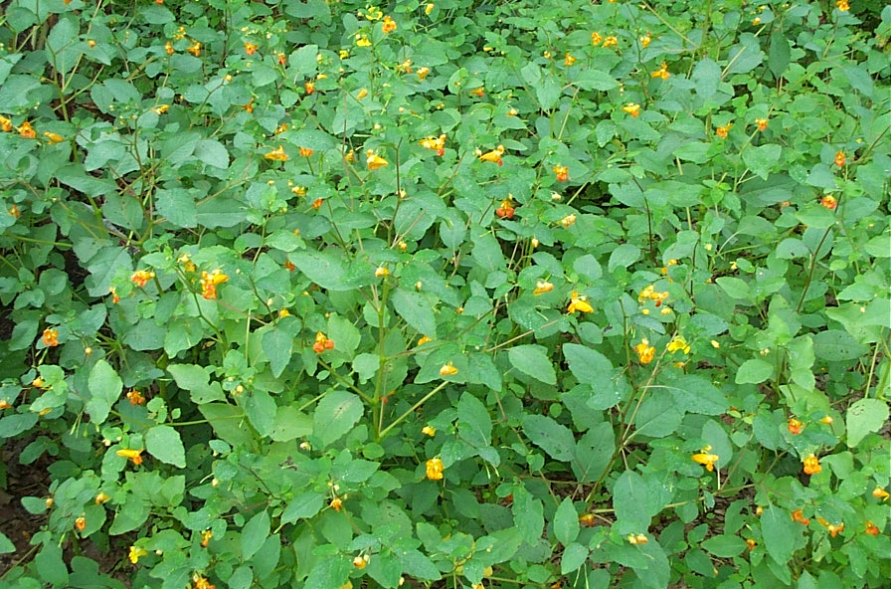
Jewelweed
(Touch Me Not)

Slide 45
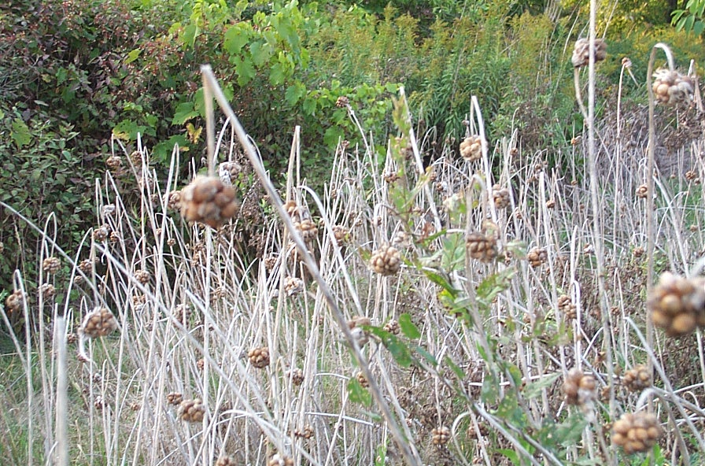
Wild Garlic

Slide 46
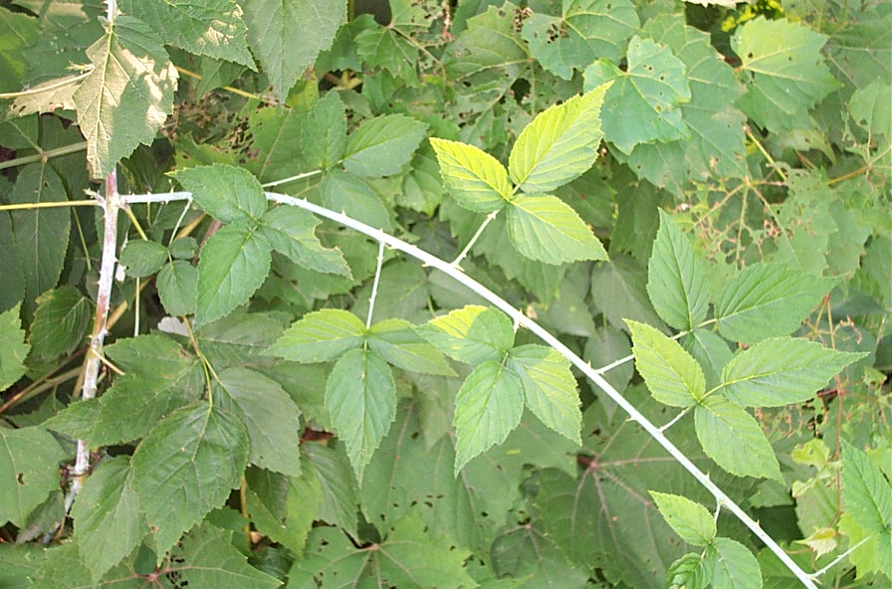
Raspberry

Slide 47
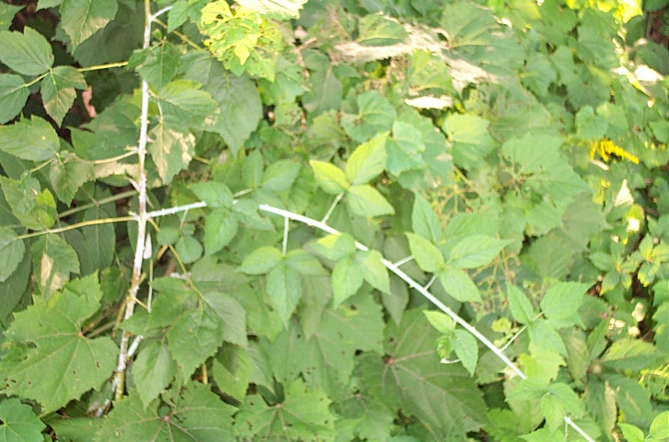
Raspberry

Slide 48
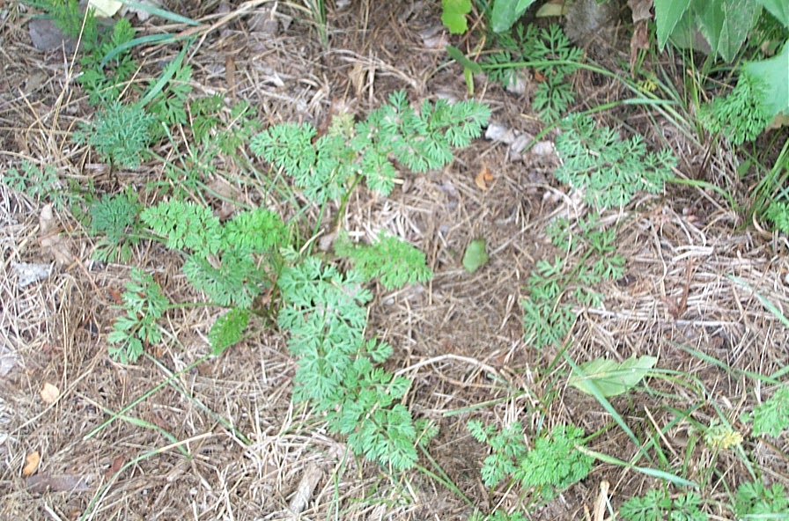
Wild Carrot

Slide 49
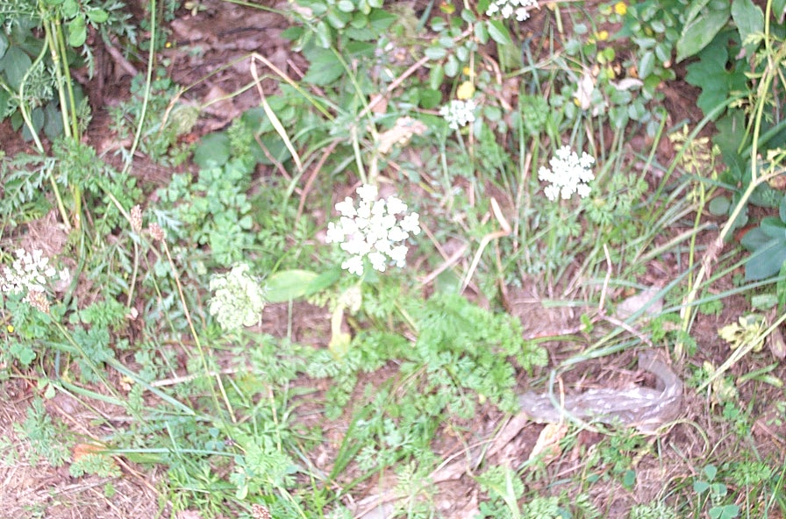
Wild Carrot

Slide 50
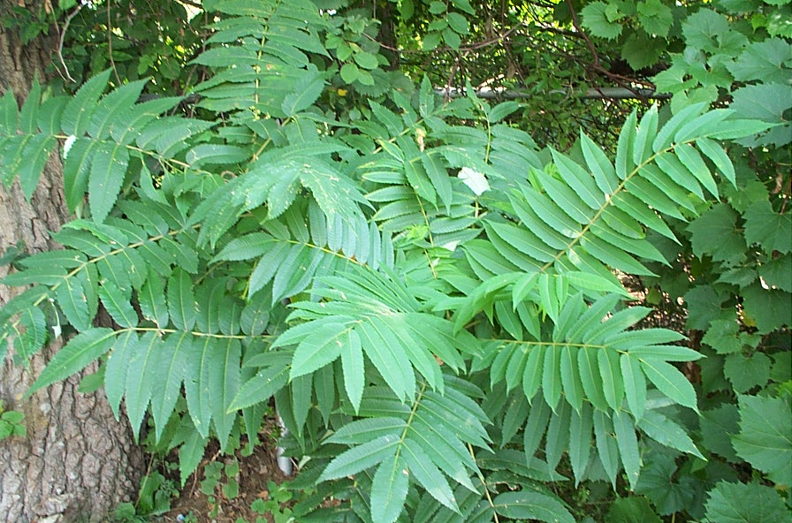
Sumac

Slide 51
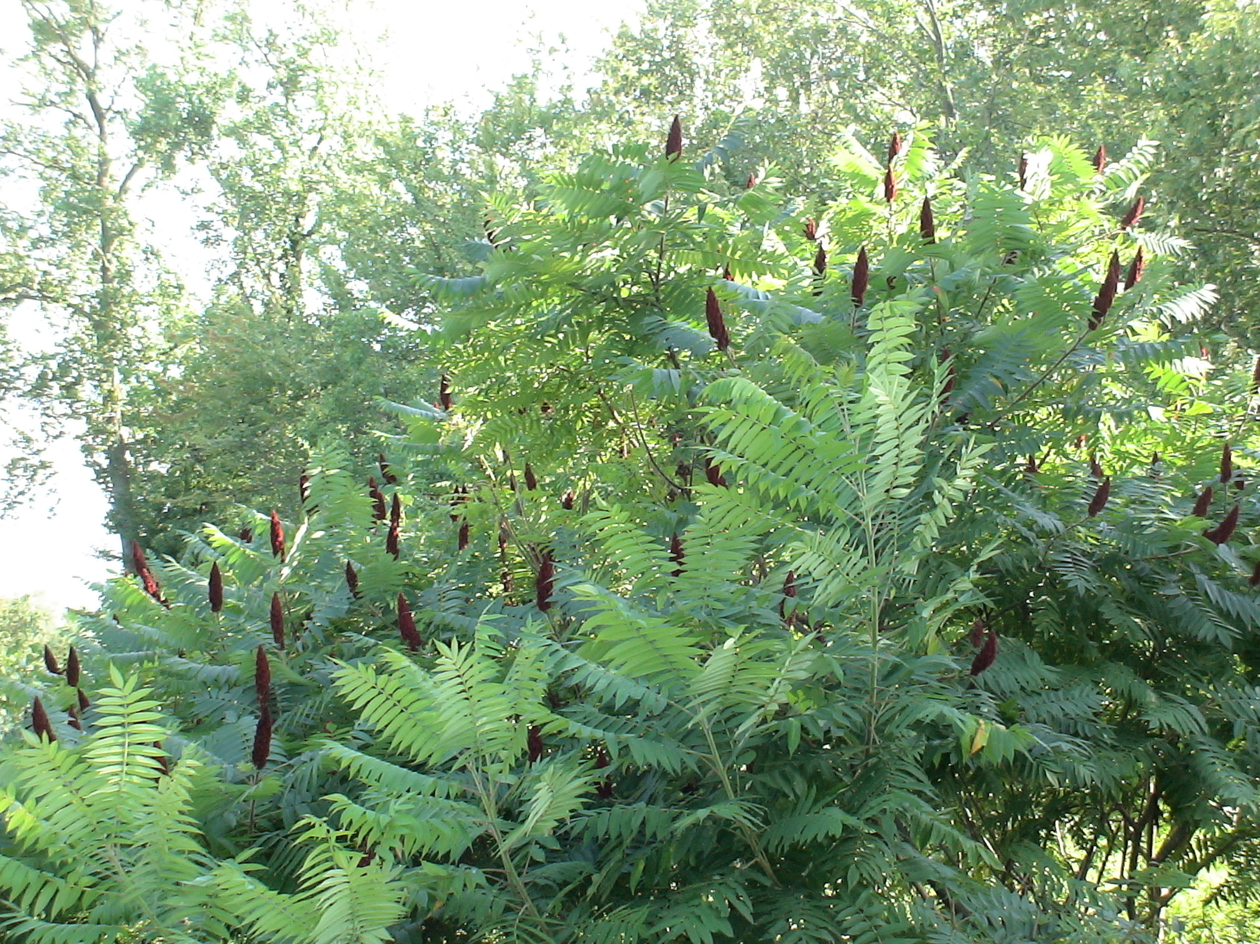
Sumac

Slide 52
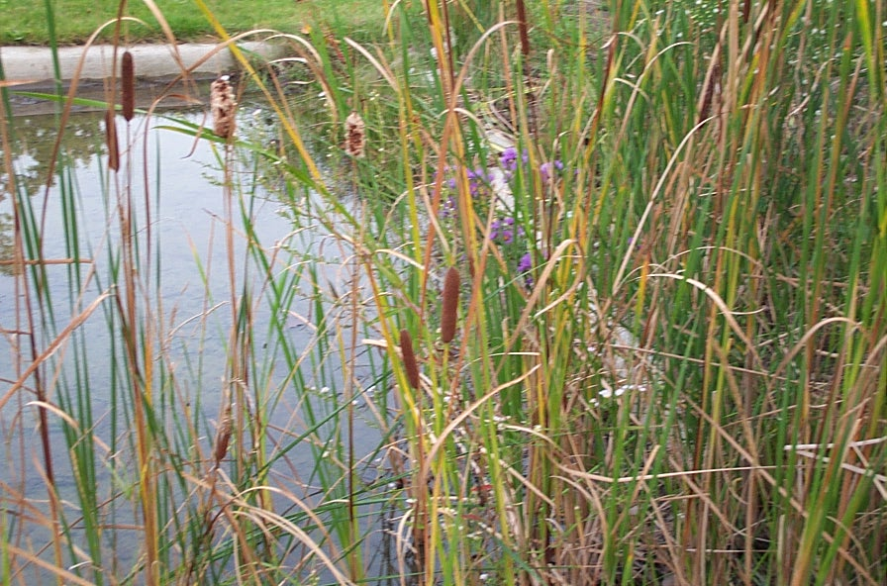
Cattail

Slide 53
Goldenrod

Slide 54
Chickory

Slide 55
Wild Mint

Slide 56
Burdock

Slide 57
Daylily

Slide 58
Jewelweed
(Touch Me Not)

Slide 59
Jewelweed
(Touch Me Not)

Slide 60
Milkweed

Slide 61
Jerusalem Artichoke

Slide 62
Bull Thistle

Slide 63
Dandelion

Slide 64
Jewelweed
(Touch Me Not)

Slide 65
Violets

Slide 66
Wild Asparagus

Slide 67
skunk cabbage

