Slide 1
Poisonous
and
Invasive Plants

Slide 2
Animate Slides
Click on “Slide Show”
Click “From Beginning”

Slide 3
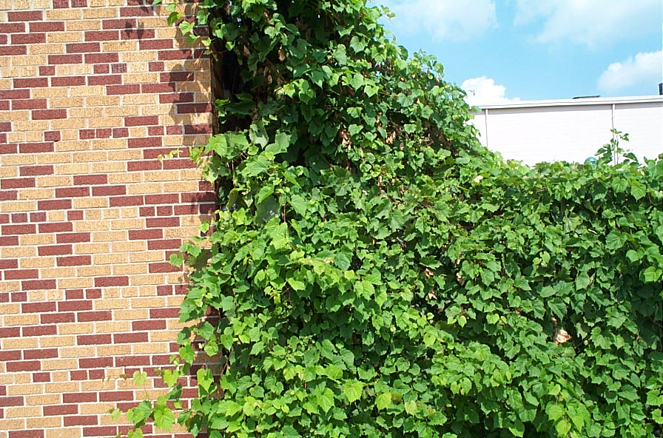
Wild Grape

Slide 4
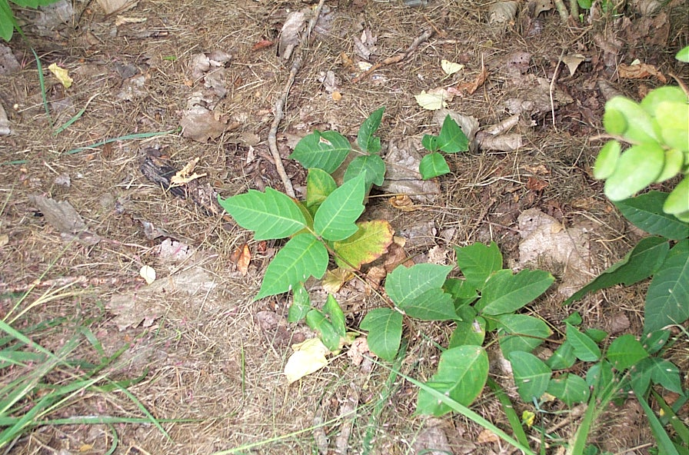
Poison Ivy

Slide 5
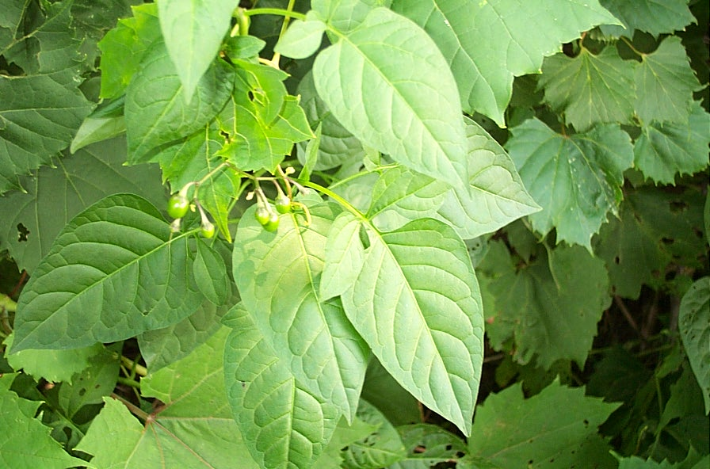
Bittersweet Nightshade

Slide 6
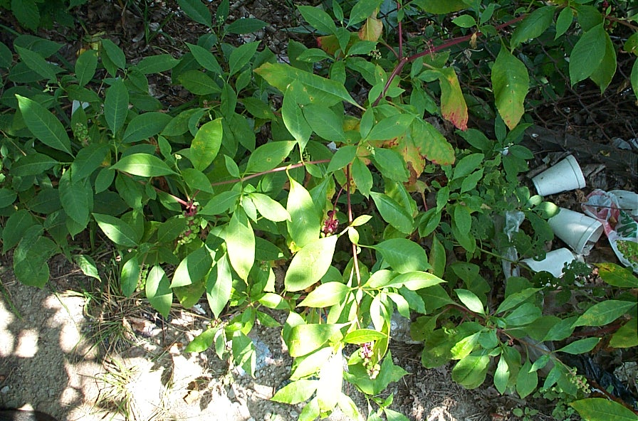
Pokeweed

Slide 7
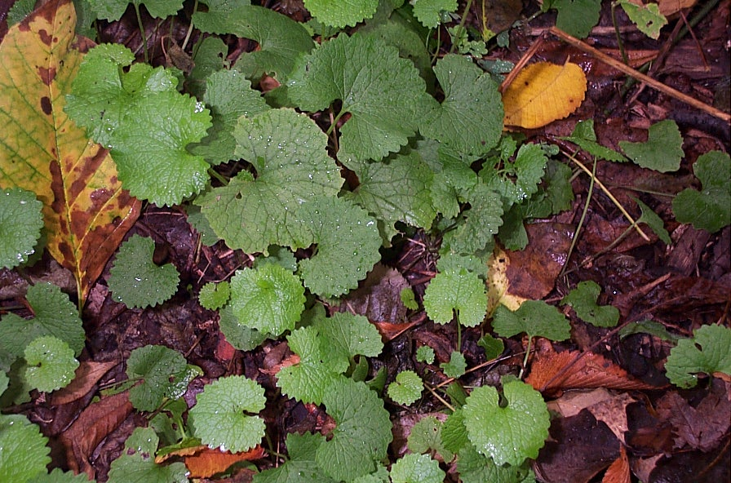
Garlic Mustard

Slide 8
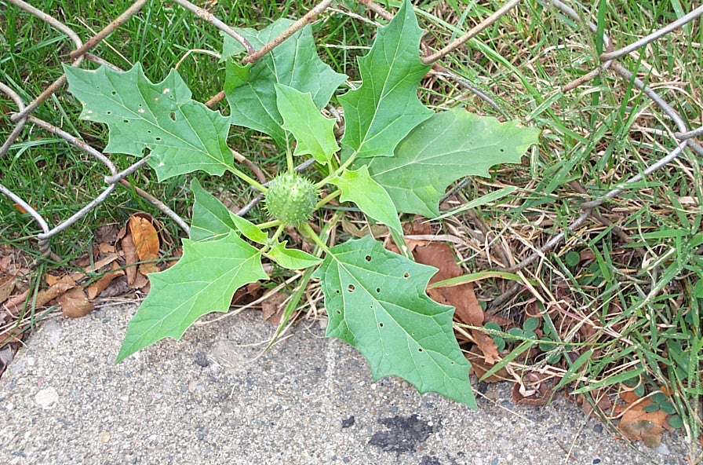
Jimson Weed

Slide 9
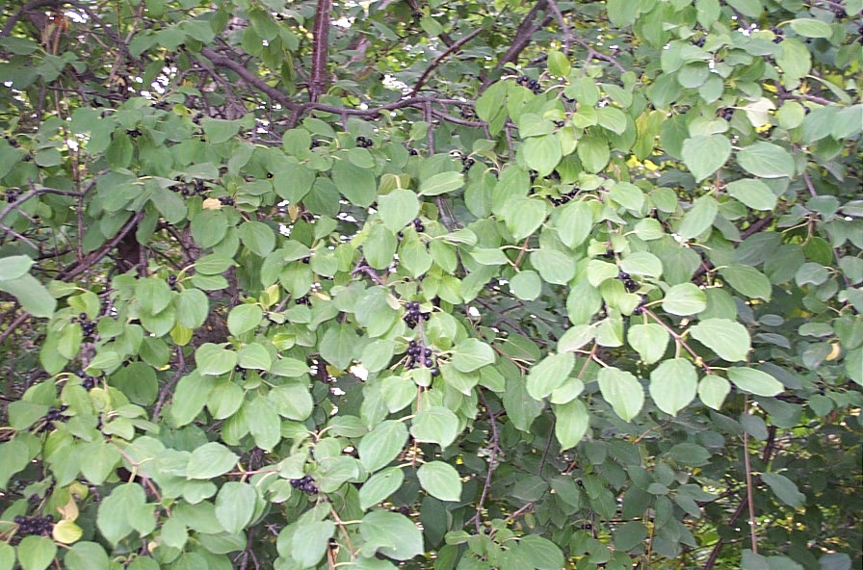
Common Buckthorn

Slide 10
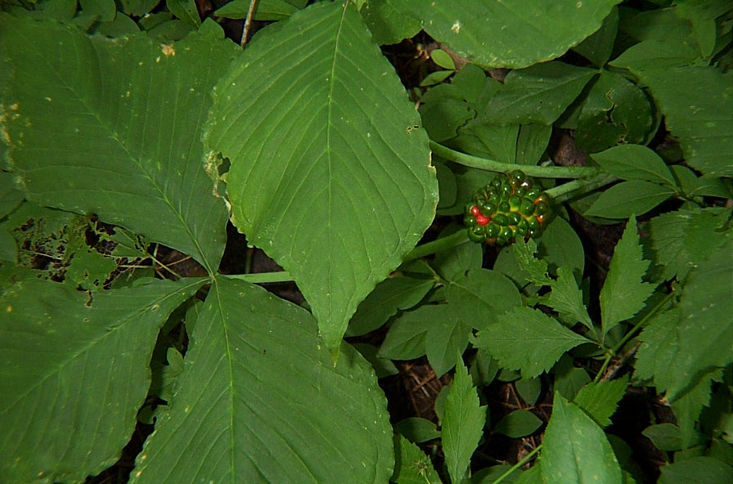
Jack in the Pulpit

Slide 11
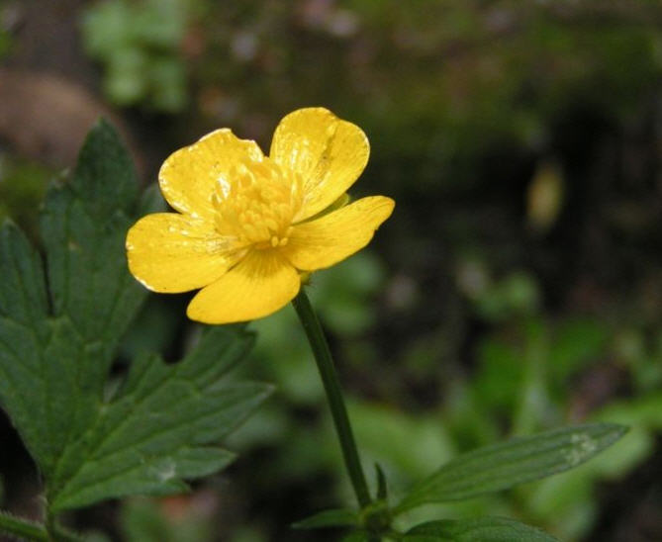
Buttercup

Slide 12
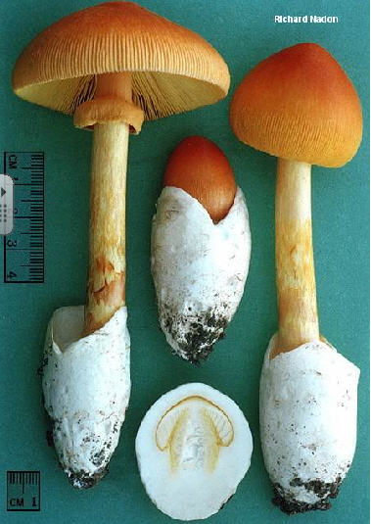
Amanita

Slide 13
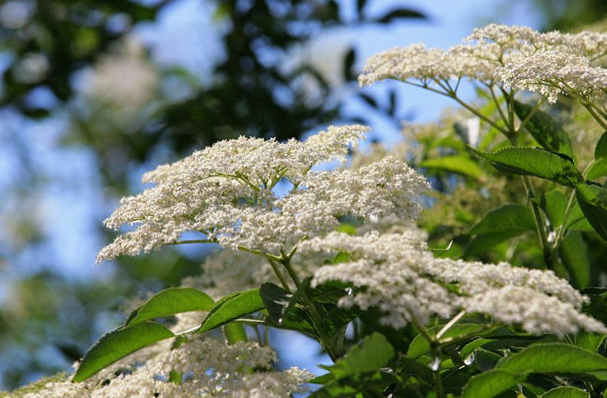
Elderberry

Slide 14
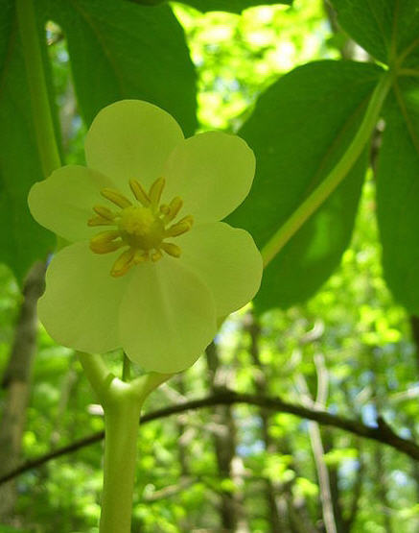
May Apple

Slide 15
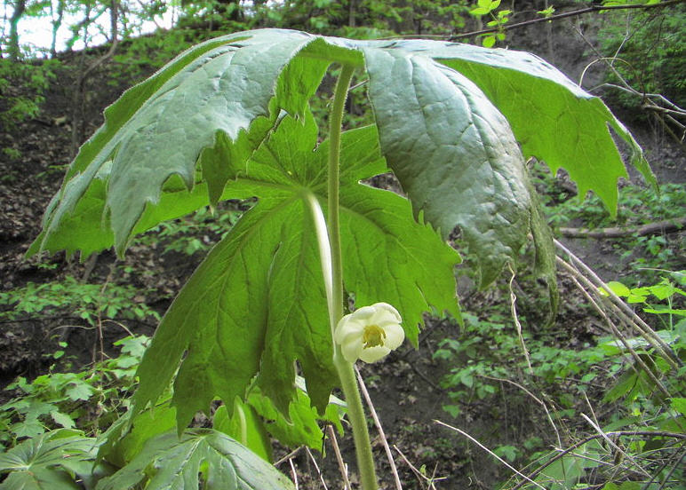
May Apple

Slide 16
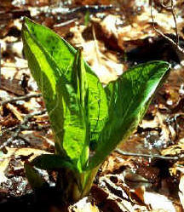
Skunk Cabbage

Slide 17
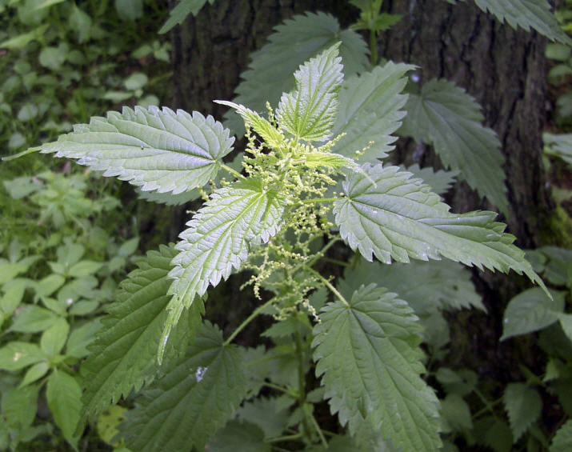
Stinging Nettle

Slide 18
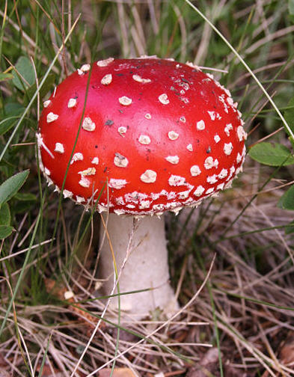
Poison Mushroom

Slide 19
Round Two

Slide 20
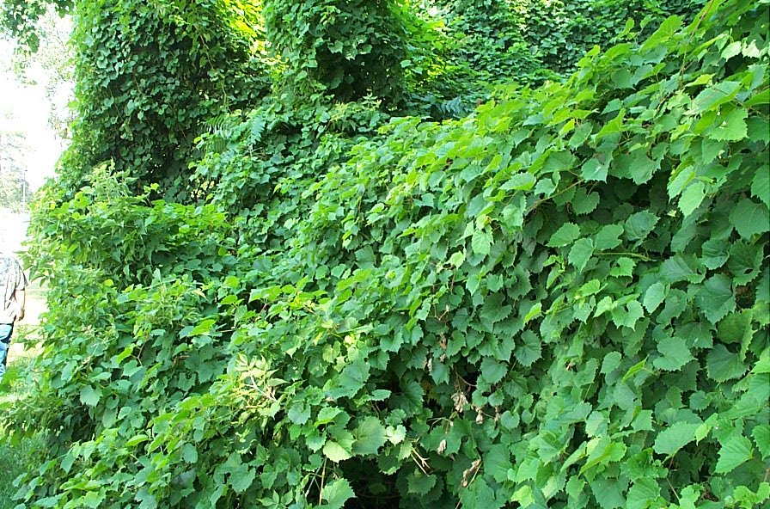
Wild Grape

Slide 21
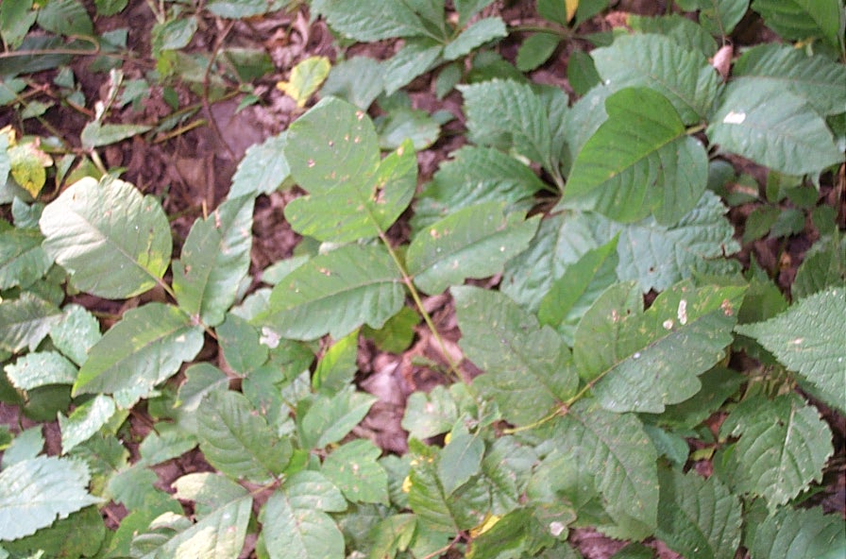
Poison Ivy

Slide 22
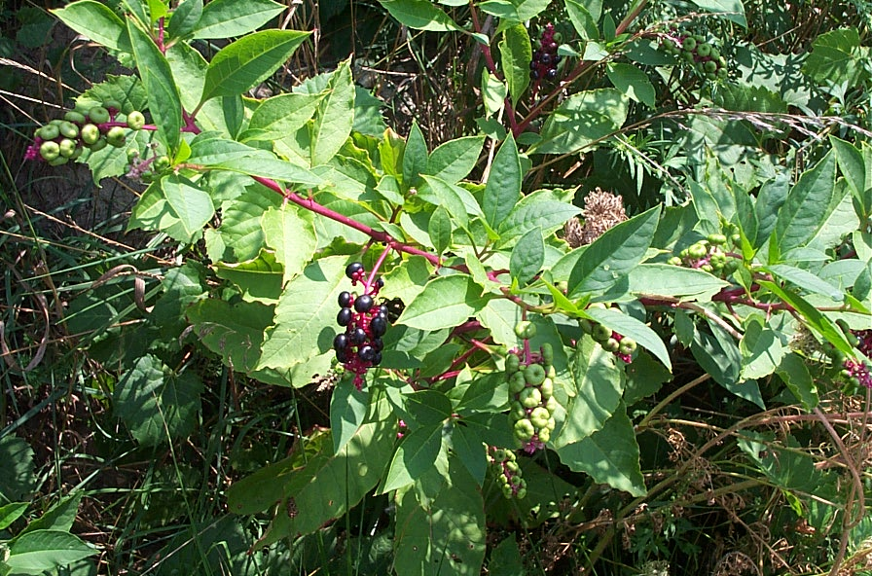
Pokeweed

Slide 23
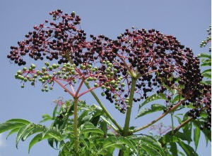
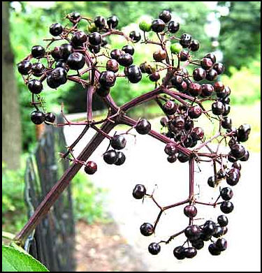
Elderberry

Slide 24
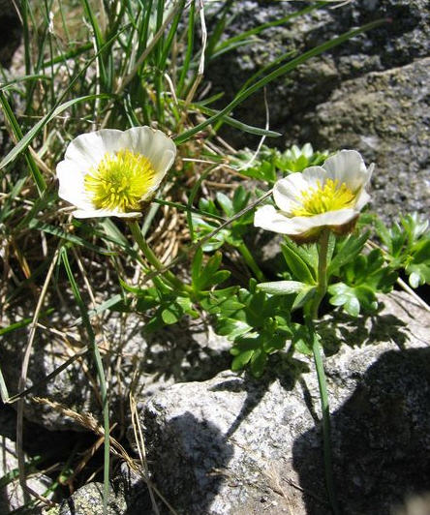
Buttercup

Slide 25
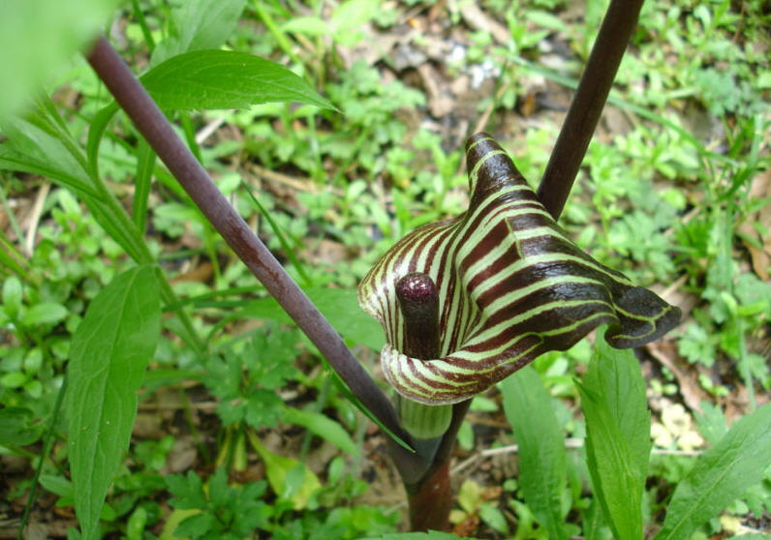
Jack in the Pulpit

Slide 26
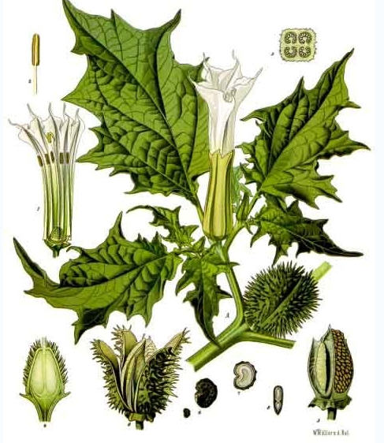
Jimson Weed

Slide 27
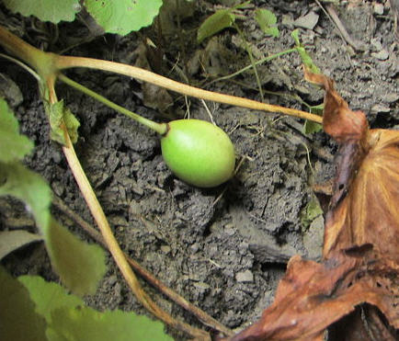
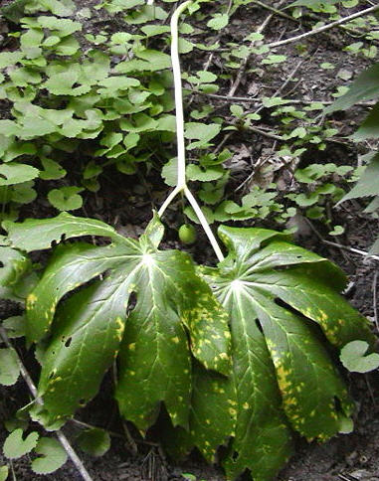
May Apple

Slide 28
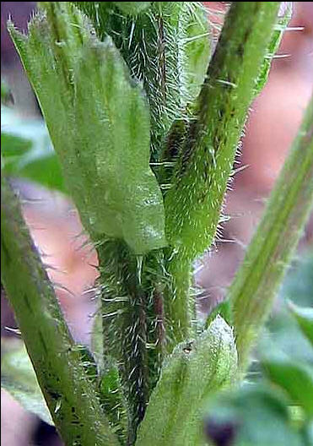
Stinging Nettle

Slide 29
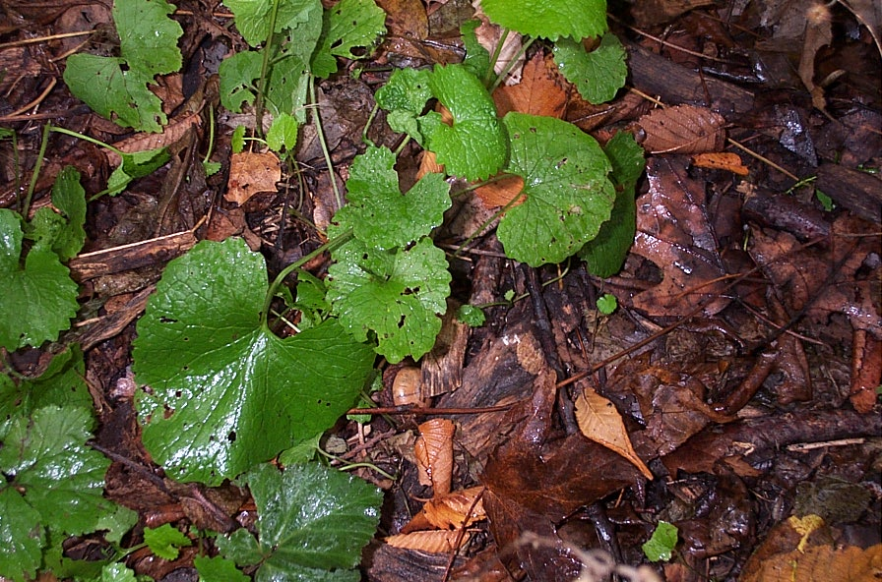
Garlic Mustard

Slide 30
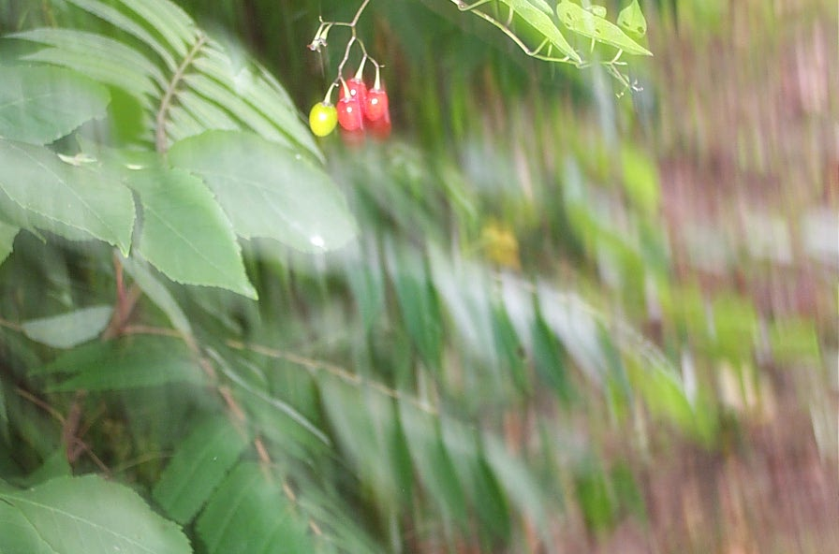
Bittersweet Nightshade

Slide 31
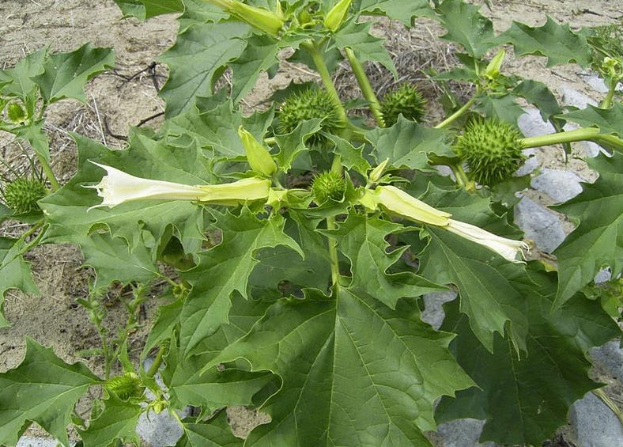
Jimson Weed

Slide 32
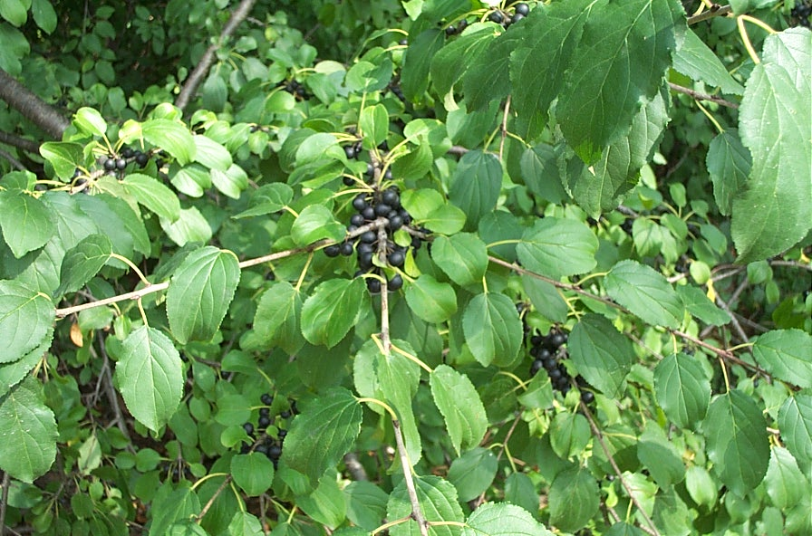
Common Buckthorn

Slide 33
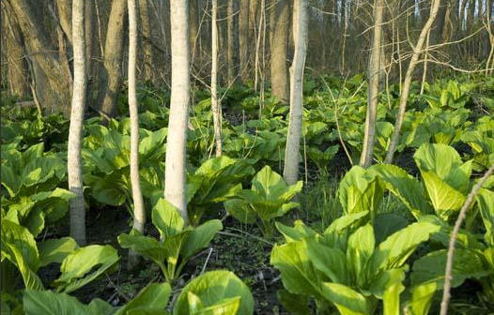
Skunk Cabbage

Slide 34
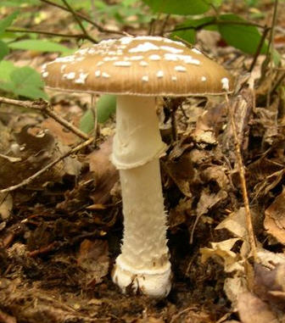
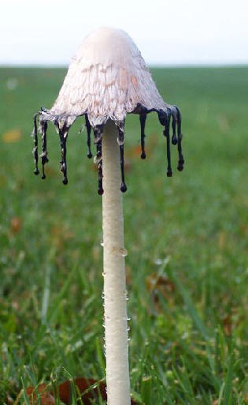
Poisonous
Edible

Slide 35
General Types of Poisoning
.Two Poisoning
1. Dermatitis: inflammation or irritation (rash) to the skin; therefore, one gets poisoned by handling or touching the plant.
2. Internal Poisoning: nausea, vomiting, dizziness, hallucinations; therefore, one gets poisoned by ingesting (eating) or inhaling (breathing in or absorbing through the skin).

Slide 36
General Rules for Berries
White berries (mistletoe, red osier, white snakeroot, white baneberry) are almost always poisonous.
Green berries usually represent immature or unripe berries and cause nausea or the “green apple quick step.”
Red berries can be poisonous: baneberry, snakeroot, nightshade, yew; but can also be edible: strawberry, cherry, raspberry, currents, chokecherry.
Blue or black berries are the safest to eat.

Slide 37
Mushrooms

Slide 38
.Rules for Distinguishing Mushrooms
Never eat a mushroom until you are ABSOLUTELY sure of its identity.
Be sure that all edible mushrooms collected are FRESH.
In general, brightly colored forms are poisonous.
Reject all forms of mushrooms that have a “cup” on the stem or head; or have a sac-like envelope at the base of the stem.

Slide 39
.Rules for Distinguishing Mushrooms
Avoid the early stage mushrooms (button stage) as it is very difficult to identify characteristics.
It is not wise to handle mushrooms when collecting or observing. Many are poisonous even to the touch or you may handle food which you eat. Always wash your hands after handling mushrooms.
Four species of mushrooms that are usually NOT poisonous: 1) Morels, 2) Puffballs, 3) Sulphur Polypores and 4) Shaggy Mane.

Slide 40
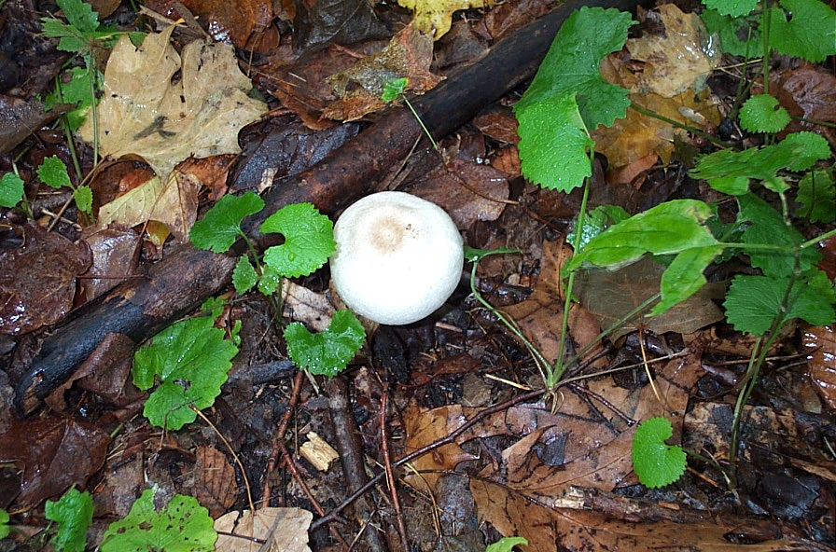
Garlic Mustard & Mushroom

Slide 41
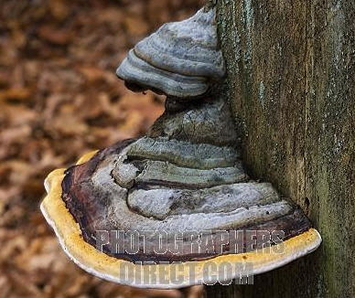
Polypore

Slide 42
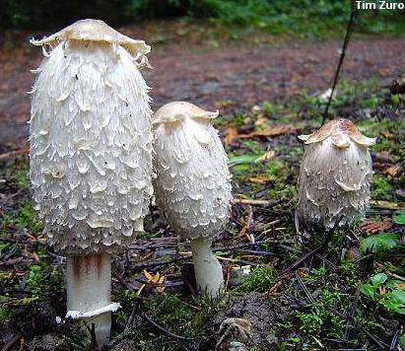
Shaggy Mane

Slide 43
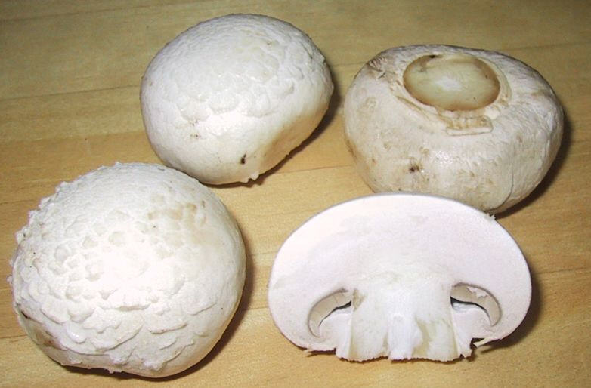
Puff Balls & Amanita

Slide 44
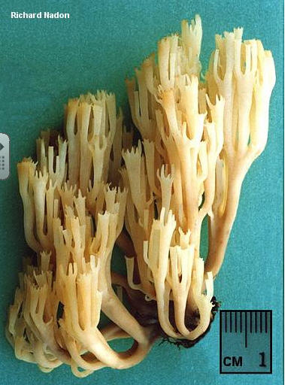
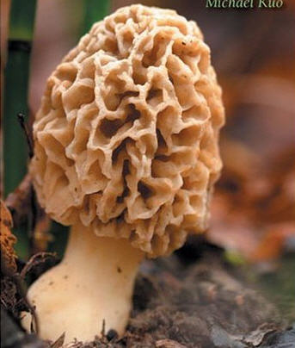
Morels

Slide 45
More
Examples

Slide 46
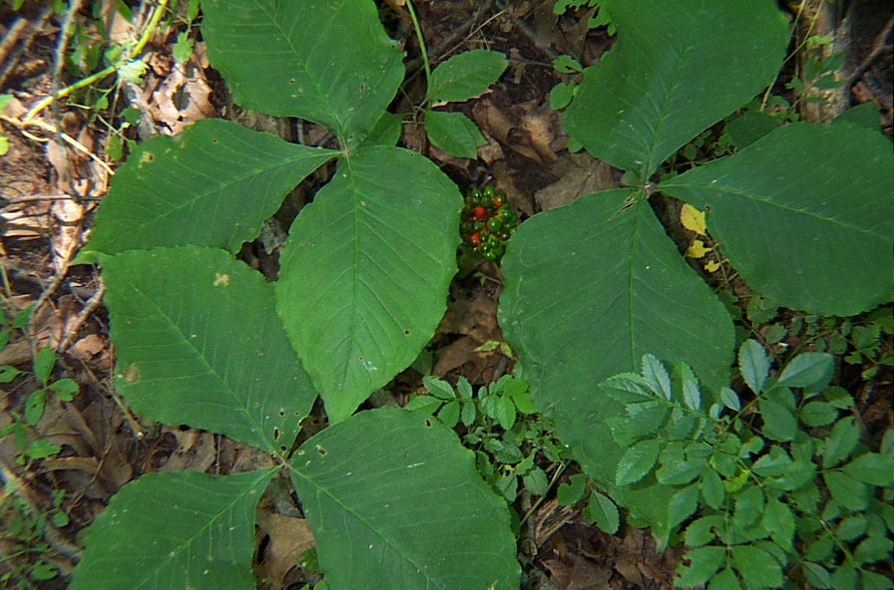
Jack in the Pulpit

Slide 47
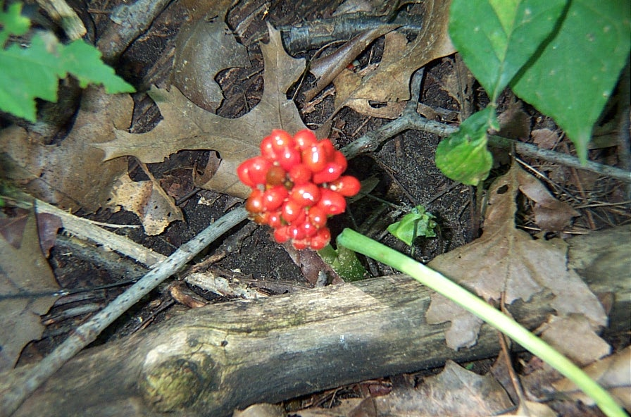
Jack in the Pulpit

Slide 48
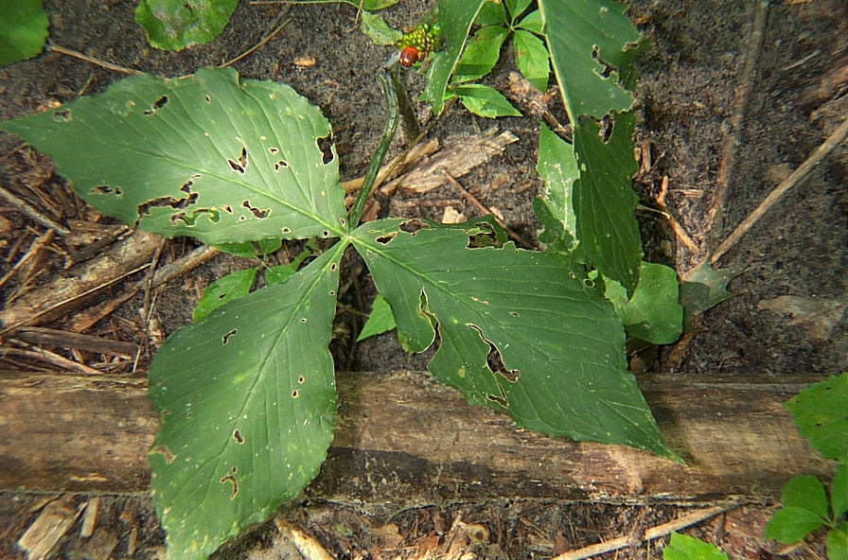
Jack in the Pulpit

Slide 49
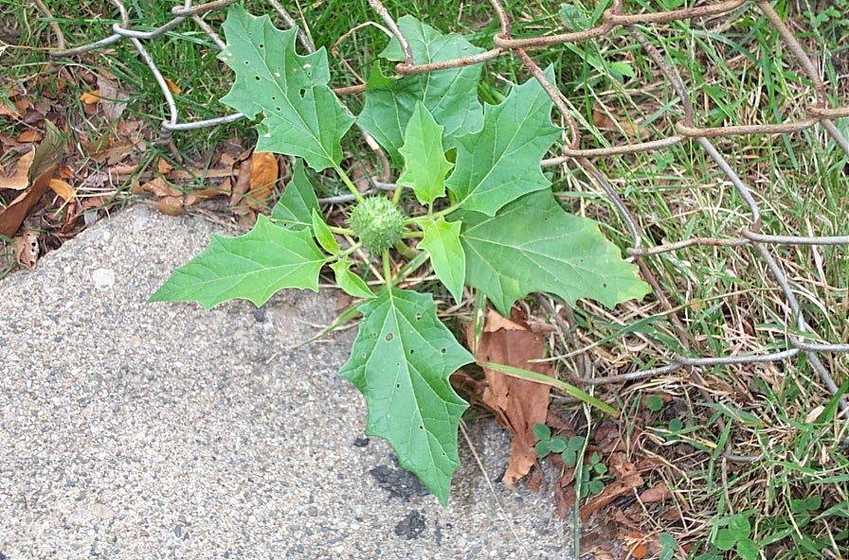
Jimson Weed

Slide 50
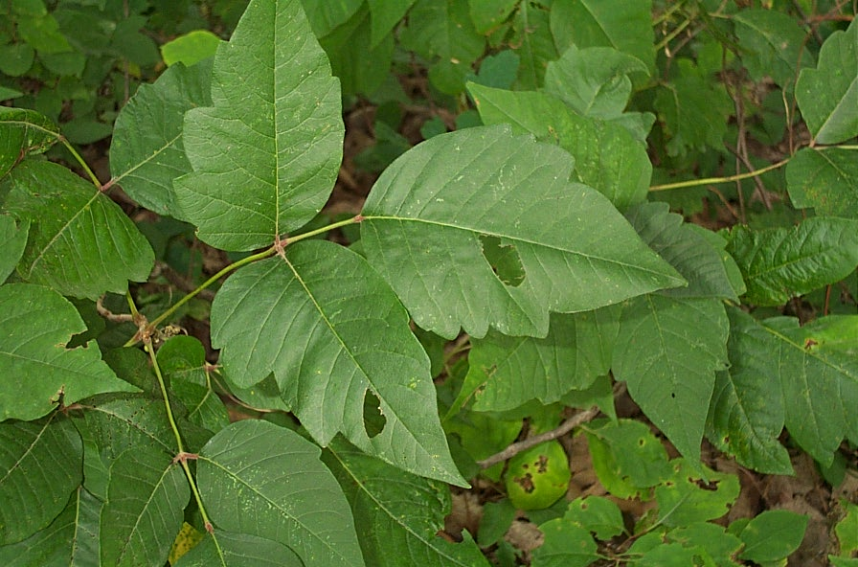
Poison Ivy

Slide 51
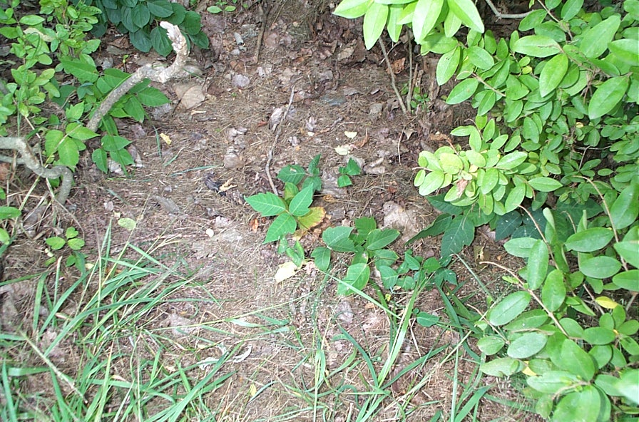
Poison Ivy

Slide 52
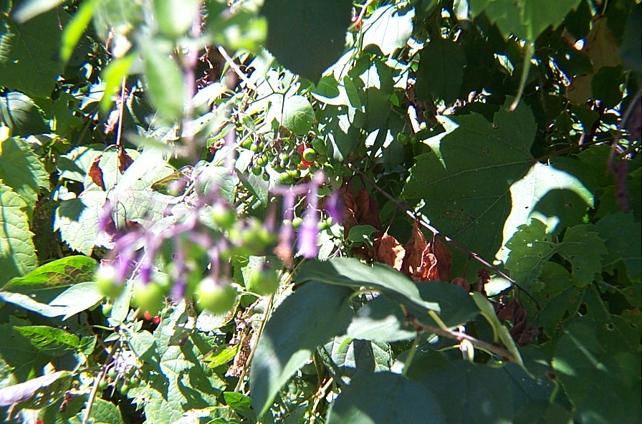
Bittersweet Nightshade

Slide 53
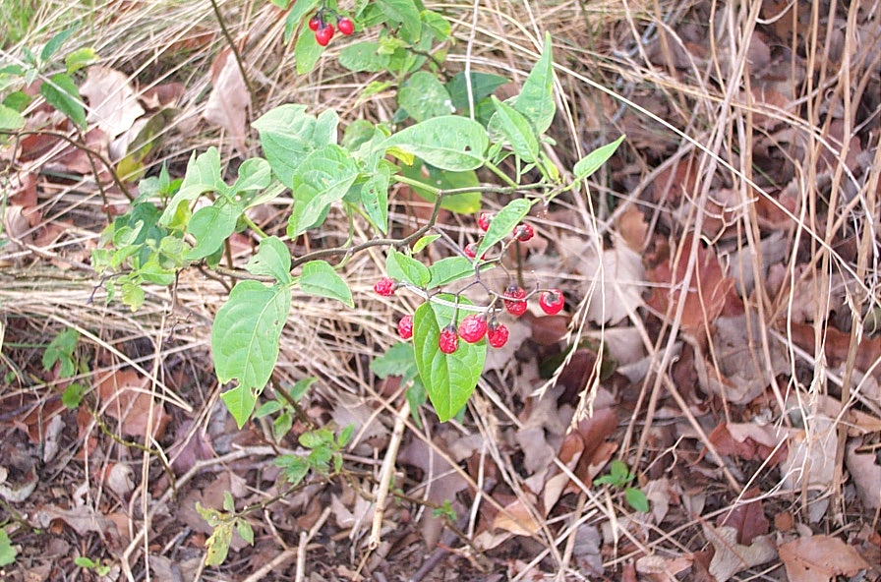
Bittersweet Nightshade

Slide 54
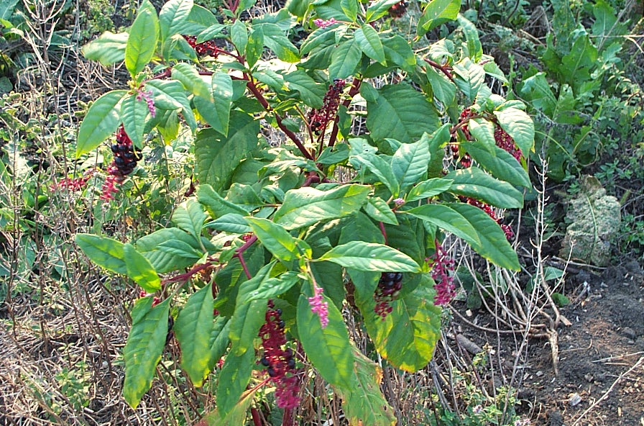
Pokeweed

Slide 55
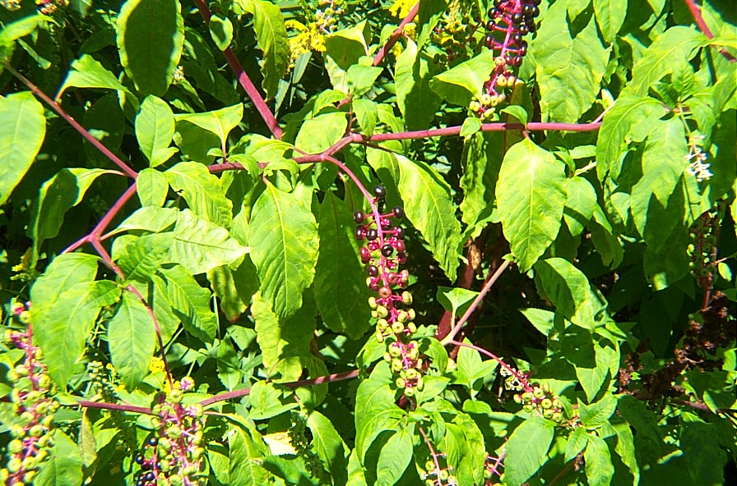
Pokeweed

Slide 56
Garlic Mustard

Slide 57
Wild Grape

Slide 58
May Apple

Slide 59
Skunk Cabbage

Slide 60
Osier (dogwood)

Slide 61
ragreed

