Slide 1
Click on “Slide Show”
Click “Play from Beginning”

Slide 2



Chapter 5
Electrons In Atoms
Revising the Atomic Model
Electron Arrangement in Atoms
Atomic Emission Spectra and
the Quantum Mechanical Model

Slide 3
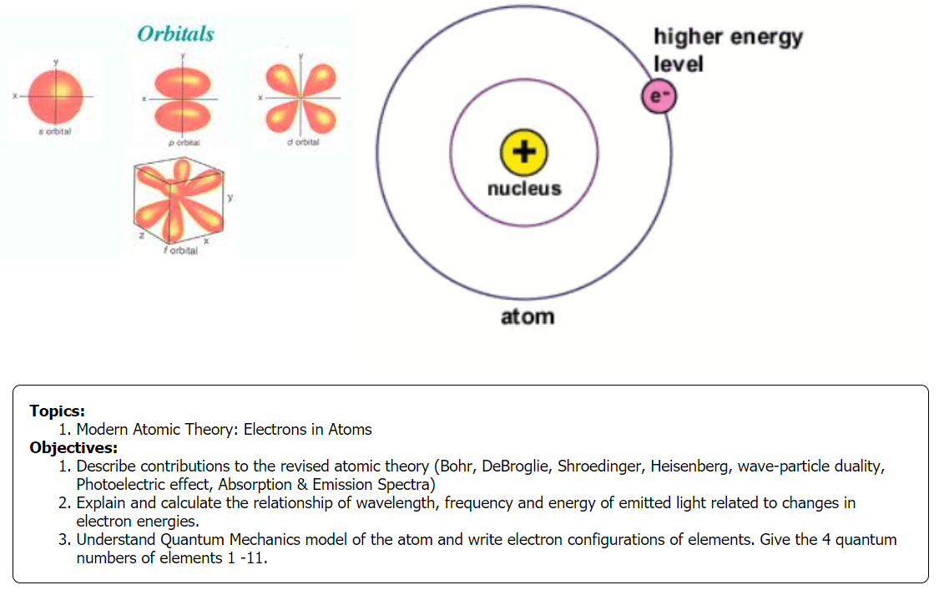

Slide 4
Simulation
“Models of the Hydrogen Atom”
showing the History of Atomic Theory.
https://screencast-omatic.com/watch/cD6ZXZj5Ma

Slide 5
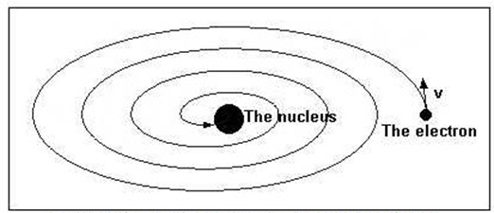
Modifying Atomic Theory
Limitations of Rutherford’s Atomic Model
Electrons are charged particles (unlike planets).
An accelerating electric charge would steadily lose energy and spiral in, toward the positively charged nucleus, colliding with it in a fraction of a second.
Rutherford’s model could not explain the highly peaked emission and absorption spectra of atoms that were observed.

Slide 6
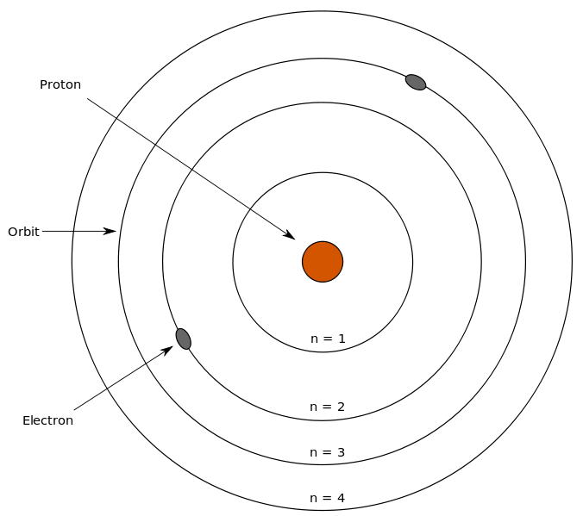
How was the modern understanding of the atom developed?
Notes:
Timing ≈ 0.5 min
Recap: The Bohr model of the atom explained many of scientists' observations about atomic behavior.
Connect: However, even the Bohr model could not explain all observations.
Preview: For example, the Bohr model could not explain why electrons stay in discrete orbits instead of just falling into the nucleus. So, scientists had to further modify the model as new data became available.
SOURCES:
http://commons.wikimedia.org/wiki/File:Bohr%27s_model.svg

Slide 7
Determine and explain the commonality of the following and how each may relate to Atomic Structure:
Staircase or ladder or bleacher
Pitches in a major scale
Radio stations on the AM or FM scale
You come up with your own example that fits

Slide 8
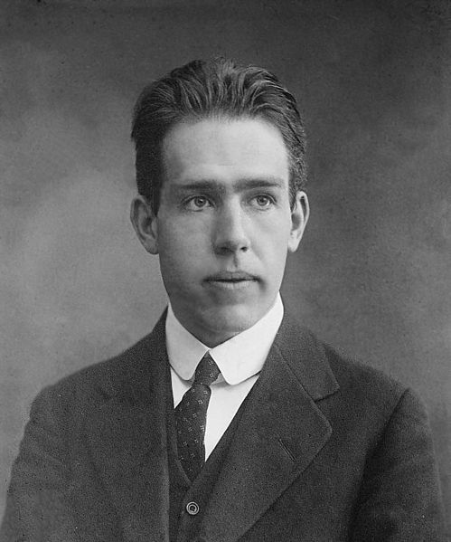
Energy Levels in Atoms
The Bohr Model
In 1913, Niels Bohr (1885–1962), a young Danish physicist and a student of Rutherford, developed a new atomic model.
Bohr proposed that an electron is found only in specific circular paths, or orbits, around the nucleus.
Bohr’s model only worked for the simple Hydrogen atom and his perspective was still “Newtonian” based (electrons are particles).

Slide 9

Energy Levels in Atoms
The Bohr Model
shows that atoms and molecules can only exist in certain energy states so he designated the electron orbitals as energy levels or quantum levels.
A change in the energy level of such a system involves the absorption or emission of a definite amount (QUANTA) of energy.
The rungs on this unusual ladder are somewhat like
the energy levels in Bohr’s model of the atom.
One can only stand ON the rungs of a ladder.
Similarly, the electrons in an atom cannot exist
between energy levels.
e-
e-
e-

Slide 10
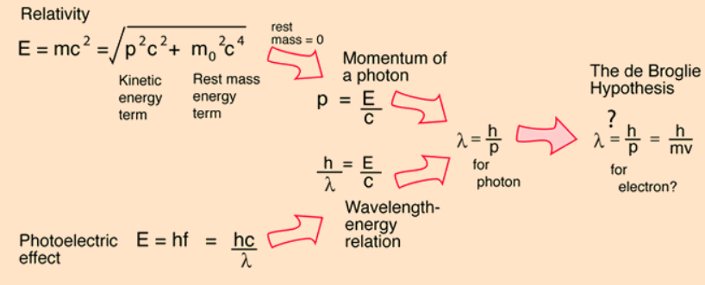
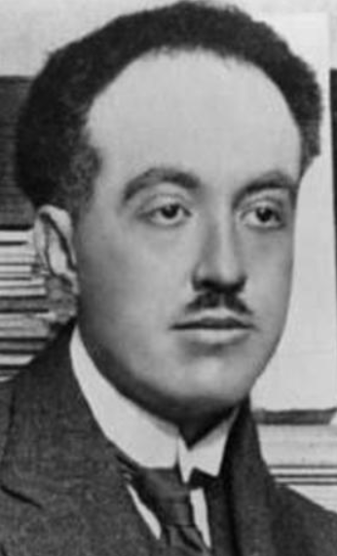
Wave-Particle Duality
Louis DeBroglie
Proposed that all matter and slow moving particles (e.g. electrons) have a dual nature.
Electrons can behave as waves (wavelength, reflection, refraction, diffraction) or particles (momentum).

Slide 11
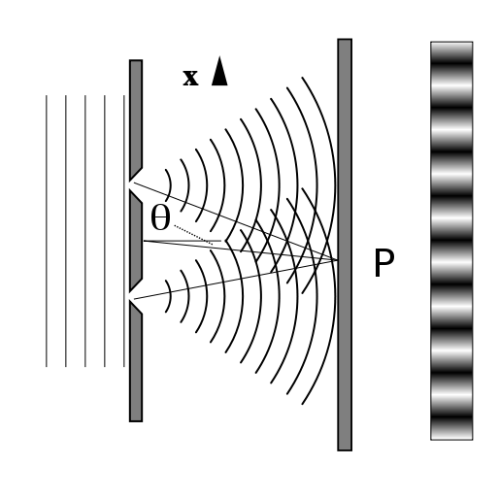
Modification: Wave-Particle Duality of Light
  Major Theories of Light:
  Newton (1704): Light behaves as a particle.
    With mass, acceleration, action/reaction.
  Young (early 1800s): Light behaves as a wave.
    Reflection, refraction, diffraction in double-slit experiment →
Notes:
Timing ≈ 1 min
[Animate stem and bullet 1] In 1704 Isaac Newton published his famous work Opticks. Here he set out his theory that light was made up of extremely small particles. This idea became [Animate sub-bullet] known as the “corpuscular theory”. This idea held sway for many years.
[Animate bullet 2 and picture] Thomas Young, beginning in 1801, offered diffraction data that strongly suggested that light was a wave.
[Animate sub-bullet] For example, light passing through two slits (teacher indicate slits on image) diffracts (teacher briefly explain diffraction), producing a diffraction pattern (teacher indicate), just as water waves do.
By the late 1800s, most scientists were beginning to accept that light is made up of waves.
SOURCE:
http://commons.wikimedia.org/wiki/File:Doubleslit.svg

Slide 12
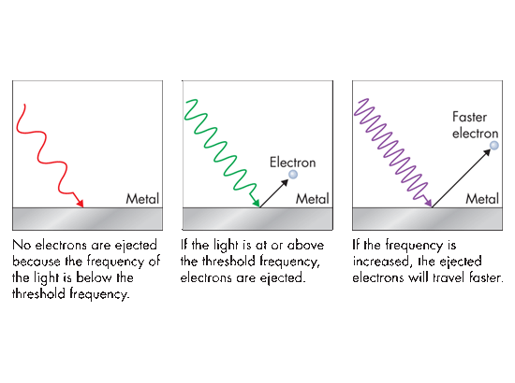
The Quantum Concept and Photons
The Photoelectric Effect → Shows “Quanta”
No electrons are ejected because the frequency of the light is below the threshold frequency.
If the light is at or above the threshold frequency, electrons are ejected.
If the frequency is increased, the ejected electrons will travel faster.
e.g. garage door opener; remote controls

Slide 13
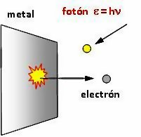
Photoelectric Effect: Discrete Particle & Wavelength
  Einstein explained the photoelectric effect incorporating Planck’s particle view (quantum) while proposing that light being a wave behaves as “Photons” or bundle of energy.
  Every Photon has a quantized amount of energy as described by E = hν.
    E = energy of photon
    h = Planck’s constant
    ν = frequency
Notes:
Timing ≈ 1 min
[Animate stem] The observation that the energy was related to the frequency and not the intensity gave Einstein the clue he needed to explain the photoelectric effect. [Animate bullet 1] He claimed that the electrons come off the metal as quanta (packets) of energy related to the frequency of the light driving them off. [Animate sub-bullet] This idea originated with Max Planck, the German physicist. Planck proposed in 1901 that the energy of a vibrating molecule could only take on certain values and was not continuous. He said that this energy was quantized. The energy would be related to a constant (Planck’s constant) and only certain energy levels would exist.
Einstein picked up on this idea and related it to the photoelectric effect. [Animate image] The electrons coming off a metal had energies related to the frequency of light (teacher point to light waves) striking the metal. [Animate bullet 2] This energy could be expressed as E = hv where [Animate sub-bullet] E = the energy of the electron, [Animate sub-bullet] h is Planck’s constant and the [Animate sub-bullet] Greek letter v (nu) is the frequency of light. Energy levels between these levels would not be seen.
The observation that lower-frequency light would not cause electrons to be emitted also fit the theory. These frequencies put too little energy into the system to dislodge an electron.
It may also help the student understand through an analogy. A 3' wall with different sized/aged people trying to climb over. Babies may not be able to climb over- no matter how many babies try, but all the able-bodied 6' people can easily climb over.
SOURCE:
http://commons.wikimedia.org/wiki/File:Fot%C3%B3n.jpg

Slide 14
Wave Particle Duality
Consider a Guitar
Wavelength → each string represents ½ wavelength from the bridge
Particle → the pulse sent on the string represents the particle nature of sound which travels back and forth on the string (longitudinal wave)

Slide 15
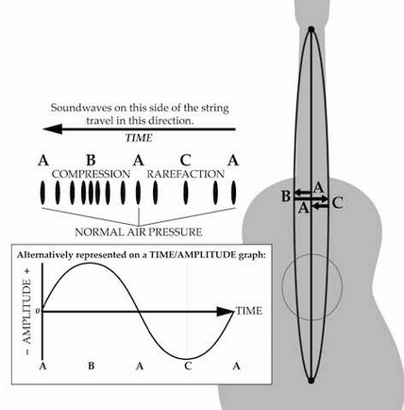
Guitar: Wave – Particle Duality
One string represent λ/2 (wave)
The sound travels as a pulse back & forth on the string (particle)

Slide 16
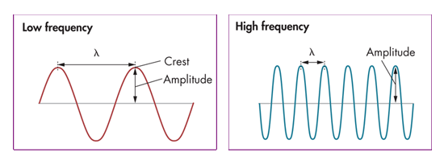
Light and Atomic Emission Spectra
Wavelength (λ) of light corresponds to its color; red light has the longest λ, 700 nm, & lowest frequency; violet, at 380 nm, has the shortest λ & highest frequency. units: meters
Frequency (ν) corresponds to energy; wave cycles to pass a given point per unit of time; units: hertz (hz, sec⁻¹)
Amplitude corresponds to brightness of the light.
λ vs ν ?

Slide 17
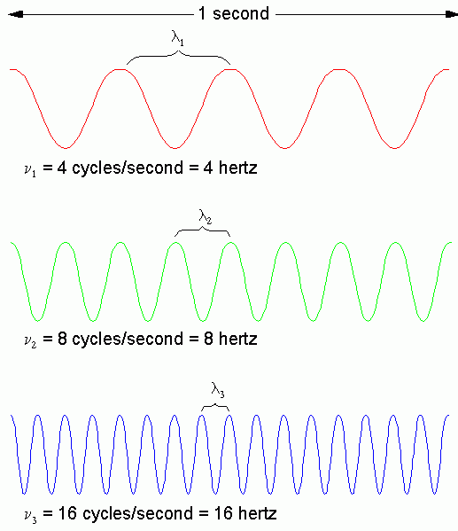
Wavelength, λ, and frequency, ν, are inversely proportional.
c = f λ
Frequency, ν, and energy are directly proportional. The higher the frequency, the higher the energy.
E = hν
h = 6.626 × 10^{–34} J·s
Planck’s constant.
Speed of light

Slide 18

  How does the energy of the higher energy levels of an atom compare with the energy of the lower energy levels of the atom?
  A. They are greater in magnitude than those of lower energy levels.
  B. They are lesser in magnitude than those of lower energy levels.
  C. There is no significant difference in the magnitudes.
  Which variable is directly proportional to frequency in relation to the speed of light?
  wavelength position velocity energy
  What are quanta of light called?
  quarks excitons muons photons
  Who predicted that all matter can behave as waves as well as particles?
  Einstein Schrodinger Planck Louis de Broglie

Slide 19
  How does the energy of the higher energy levels of an atom compare with the energy of the lower energy levels of the atom?
  A. They are greater in magnitude than those of lower energy levels.
  B. They are lesser in magnitude than those of lower energy levels.
  C. There is no significant difference in the magnitudes.
  Which variable is directly proportional to frequency in relation to the speed of light?
  wavelength position velocity energy
  What are quanta of light called?
  quarks excitons muons photons
  Who predicted that all matter can behave as waves as well as particles?
  Einstein Schrodinger Planck Louis de Broglie

Slide 20
Calculating the Energy of a Photon
Calculate the energy of a photon of red light with a wavelength of 5.77 x 10⁻⁵ cm. h = 6.626 x 10⁻³⁴ Js c = 2.998 x 10⁸ m/s

Slide 21
Calculating the Energy of a Photon
Calculate the energy of a photon of red light with a wavelength of 5.77 x 10⁻⁵ cm. h = 6.626 x 10⁻³⁴ Js c = 2.998 x 10⁸ m/s
NOTICE: there are two unknown variables (E, frequency). Therefore, we need to do a step in-between … c = νλ … ν = c/λ
Change to common units: λ = 5.77 x 10⁻⁵ cm x 1 m/100cm = 5.77 x 10⁻⁷ m
ν = 2.998 x 10⁸m/s / 5.77 x 10⁻⁷ m = 5.20 x 10¹⁴ 1/s
c
v
λ

Slide 22
Calculating the Energy of a Photon
Calculate the energy of a photon of red light with a wavelength of 5.77 x 10⁻⁵ cm. h = 6.626 x 10⁻³⁴ Js c = 2.998 x 10⁸ m/s
SUBSTITUTE frequency into the Energy equation:
E = hν
E = 6.626 x 10⁻³⁴ Js x 5.20 x 10¹⁴ 1/s
E = 3.44 x 10⁻¹⁹ J
You may use c = 3.000 x 10⁸ m/s
E
h
v

Slide 23
Calculating the Energy of a Photon
Calculate the energy of a photon of red light with a wavelength of 5.77 x 10⁻⁵ cm. h = 6.626 x 10⁻³⁴ Js c = 2.998 x 10⁸ m/s
Change to common units: λ = 5.77 x 10⁻⁵ cm x 1 m/100cm = 5.77 x 10⁻⁷ m
The easier way to do this: since ν = c/λ, replace “v” with “c/λ”
E = hν = hc/λ
E = 6.626 x 10⁻³⁴ Js x 2.998 x 10⁸ m/s / 5.77 x 10⁻⁷ m
E = 3.44 x 10⁻¹⁹ J
E
h
v

Slide 24


Evidence of “Quanta” of Energy
Hydrogen (g)
Helium (g)
  Johannes Rydberg studied emission spectra.
  Emission spectrum: a visible light spectrum in which wavelengths of light emitted by a substance show up as bright, colored lines
  Emission spectra for some metals produced discrete lines (e.g. quanta), not continuous or gradual.
  Determined a DIRECT relationship between frequency and energy.
Notes:
Timing ≈ 0.5 min
Recap: The photoelectric effect showed that the energy of light striking a metal affects the way electrons are ejected from the metal.
Connect: But why would this be so? One possibility is that the energy of the light waves relates in some way to the physical structure of the electron clouds.
Preview: Further evidence that electrons are not just randomly positioned within the atom comes from emission spectra, like those shown here. When an element is heated, it emits light in specific wavelengths. As you can see, some elements produce just a few wavelengths, while others produce a lot more. Let's learn how scientists used these spectra to further develop the model of the atom.
SOURCES:
http://commons.wikimedia.org/wiki/File:Emission_spectrum-H.png
http://commons.wikimedia.org/wiki/File:Helium_Emission_Spectrum.svg
http://commons.wikimedia.org/wiki/File:Emission_spectrum-Fe.png

Slide 25

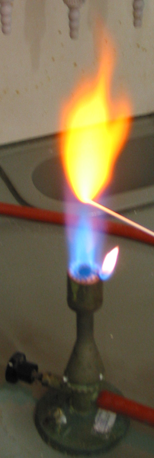



Flame Tests
Elements give off characteristic Emission Spectra (colors of light), as electrons transition between energy levels.
strontium
sodium
lithium
potassium
copper

Slide 26
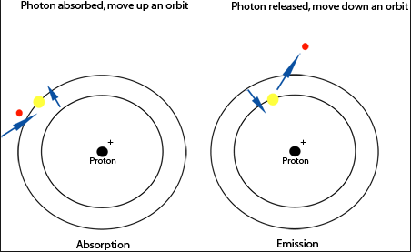
Light and Atomic Emission Spectra
Absorption & Emission Spectra
Photon strikes,
e- “excited”
Photon released, e- returns to ground state
Notice the movement of electrons based on the photon.

Slide 27
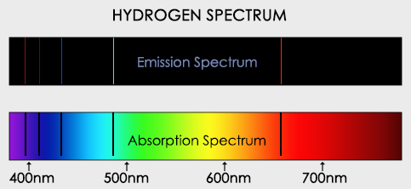
Absorption & Emission Spectra
The energy absorbed by an electron to move from its current energy level to a higher energy level.
  is identical to the energy of the light emitted by the electron as it drops back to its original energy level (Emission).
Emission Spectra are like “fingerprints” … no two elements have the same spectra.

Slide 28
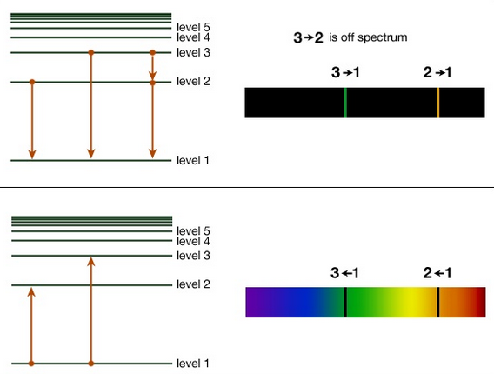
Electrons absorb heat or electrical energy to reach the EXCITED STATE → Absorption, dark line spectra
Electrons return to the GROUND STATE (most stable energy state) → Bright-Line Spectra
Energy is DISCRETE or QUANTIZED (like stairs)

Slide 29
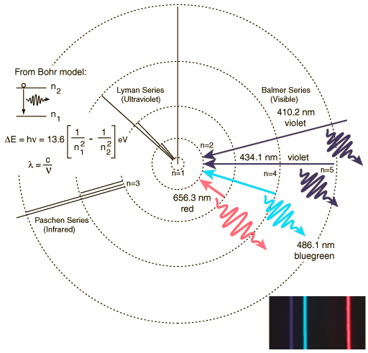
Explain this diagram in terms of energy, electrons & spectra

Slide 30
Electrons begin in the ground state (lowest energy level).
Energy is “absorbed” so electrons get “excited” to a higher energy level → (Absorption Spectra)
The “excited” state is UNSTABLE so the electrons will return to the ground state by giving off energy in the form of light (color) → Emission Spectra.
Energy absorbed” or “emitted” is in discrete bundles (quanta), not gradual.

Slide 31

“O, where oh where has my Electron gone?”
Erwin Schrödinger (1887–1961) worked from the premise that the electron was a wave and a particle. Therefore, its location could be statistically determined using previous diffraction techniques [Thomson Double Slit Diffraction pattern]
  Only certain energies could exist in which the wavelength form → “STANDING WAVES” (each note in music)
  Electrons cannot be found at a specific location, but in regions of high probability.
  E.g. where exactly is the sound when you play the guitar?
  ~90% of the time it is somewhere on or near the string that was plucked.
Notes:
Timing ≈ 1.5 min
One of the major drawbacks of the Bohr model was that it specified the location and momentum of the electron. This turned out not to be possible. [Animate stem] The Bohr concept has been replaced by the electron cloud model. This model indicates only the probability that an electron is somewhere in a given region of space.
Like the Bohr model, the electron-cloud model limits the energy levels where an electron can exist.
[Animate bullet 1] Unlike the Bohr model, the electron-cloud model does not tell us specifically where that electron might be.
[Animate bullet 2] (teacher explain)
[Animate bullet 3] We cannot locate the electron definitely. Because it does not require that the electron have a known position, it does not violate the uncertainty principle.
[Animate bullet 4] (teacher mention)
SOURCE:
http://commons.wikimedia.org/wiki/File:Hydrogen.svg

Slide 32
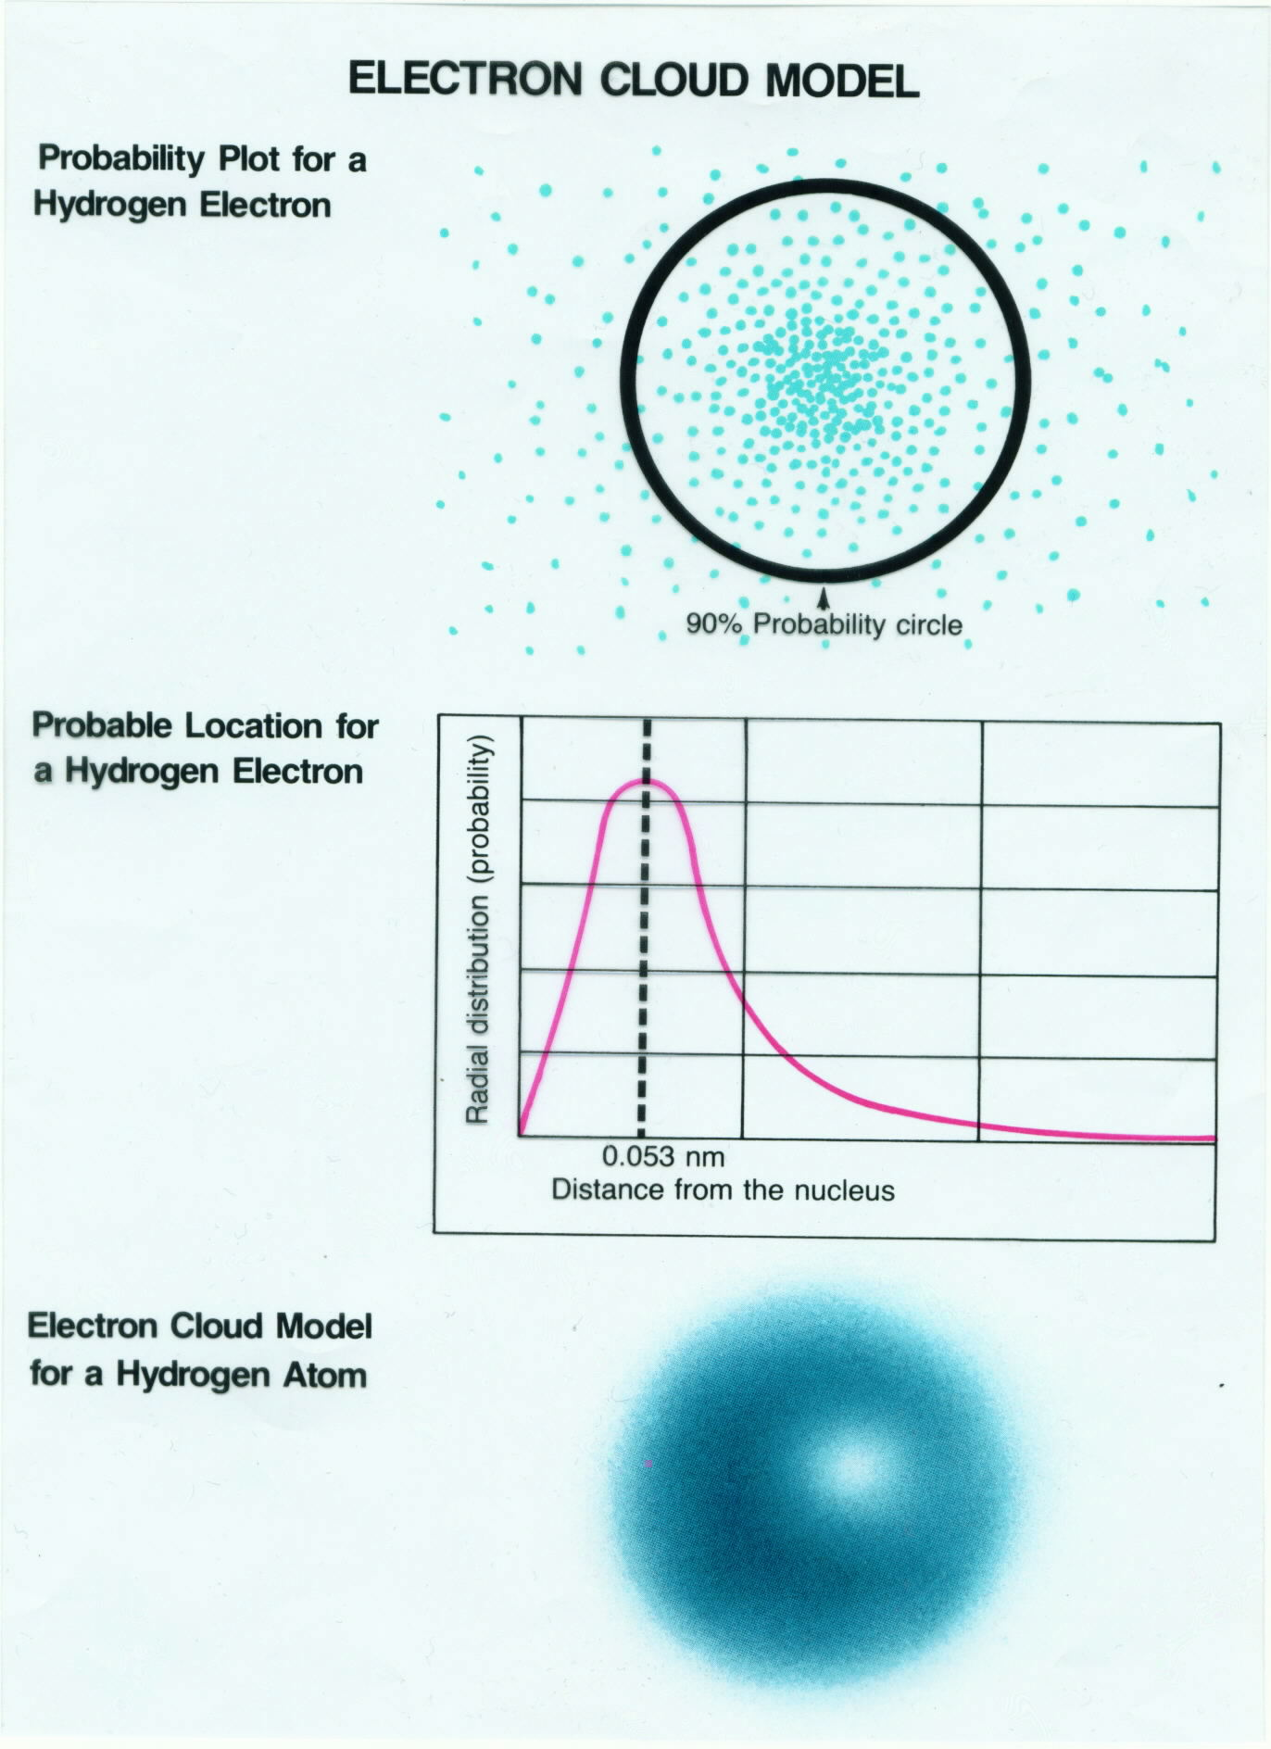
Electron Cloud
Schrödinger
Region of high probability (90%) for finding an electron
Developed the quantum numbers to describe the location of the electrons in the atom.

Slide 33

…
Alice in Wonderland

Slide 34
Atomic Orbitals
2 Electron Configurations
Electron Configuration Song (3:24)
https://screencast-o-matic.com/watch/cq6nYuuIbb

Slide 35
Quantum Mechanics
The Heisenberg Uncertainty Principle
Heisenburg noted and worked with the uncertainties in the position (ΔΧ) and momentum (Δρ) of small particles
He used the PROBABILITY of finding an electron between two points of a monochromatic wave (integrals of calculus)
He needed to use a “Pulse Wave” → constructive addition of many waves of various wavelength (antinodes) and destructive interference at the nodes
ΔΧ x Δρ = ~h/2
h → Planck’s constant → 6.6 x 10⁻³⁴ js

Slide 36
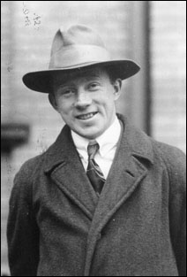
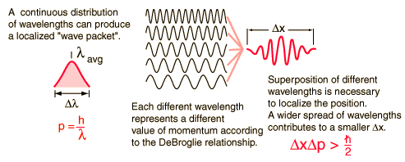

The Heisenberg Uncertainty Principle
The length of the guitar string ~ ΔΧ
The momentum of the sound “pulse” ~Δρ

Slide 37


Slide 38

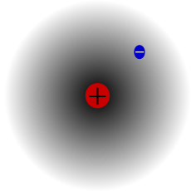
Quantum Mechanics: Electron Cloud Model
  The modern description of the electrons in atoms, the quantum mechanics model, came from the mathematical solutions (the Schrödinger equation).
  Electron Cloud model:
  Electrons in a cloud have regions of high probability (uncertain location).
  Electron clouds have different energy levels that are discrete.
  Cannot know the exact position of the electron.
Notes:
Timing ≈ 1.5 min
One of the major drawbacks of the Bohr model was that it specified the location and momentum of the electron. This turned out not to be possible. [Animate stem] The Bohr concept has been replaced by the electron cloud model. This model indicates only the probability that an electron is somewhere in a given region of space.
Like the Bohr model, the electron-cloud model limits the energy levels where an electron can exist.
[Animate bullet 1] Unlike the Bohr model, the electron-cloud model does not tell us specifically where that electron might be.
[Animate bullet 2] (teacher explain)
[Animate bullet 3] We cannot locate the electron definitely. Because it does not require that the electron have a known position, it does not violate the uncertainty principle.
[Animate bullet 4] (teacher mention)
SOURCE:
http://commons.wikimedia.org/wiki/File:Hydrogen.svg

Slide 39
Quantum Mechanics: Electron Cloud Model
  Demonstration:
  http://somup.com/crjT2YriIi
  Uncertainty Principle with Pennies (1:28)
Notes:
Timing ≈ 1.5 min
One of the major drawbacks of the Bohr model was that it specified the location and momentum of the electron. This turned out not to be possible. [Animate stem] The Bohr concept has been replaced by the electron cloud model. This model indicates only the probability that an electron is somewhere in a given region of space.
Like the Bohr model, the electron-cloud model limits the energy levels where an electron can exist.
[Animate bullet 1] Unlike the Bohr model, the electron-cloud model does not tell us specifically where that electron might be.
[Animate bullet 2] (teacher explain)
[Animate bullet 3] We cannot locate the electron definitely. Because it does not require that the electron have a known position, it does not violate the uncertainty principle.
[Animate bullet 4] (teacher mention)
SOURCE:
http://commons.wikimedia.org/wiki/File:Hydrogen.svg

Slide 40

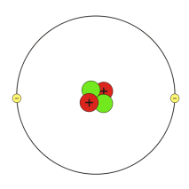

Understanding Atomic Structure
What scientist suggested each of the models shown below? Which best represents the modern understanding of the structure of the atom?
Model A
Model B
Model C
Notes:
Timing ≈ 0.5 min
Entry Audio: Think about what you know about the development of the modern atomic model. Check your memory by reviewing these models.
Hint Audio: The modern atomic model is sometimes called the electron cloud model.
Exit Audio: According to the modern atomic model, electrons are located in a cloud surrounding the nucleus.
SOURCES:
http://commons.wikimedia.org/wiki/File:Helium_atom_QM_rev1.svg
Helium Atom. “Helium-Bohr.svg,” Phrood. 2005 as CC-SA/GNU-GPL, svg image. http://commons.wikimedia.org/wiki/File:Helium-Bohr.svg (accessed July 12th, 2012)
Plum pudding model. “Plum pudding atom.svg,” Fastfission. 2005 as PD, svg image. http://commons.wikimedia.org/wiki/File:Plum_pudding_atom.svg (accessed July 12th, 2012)
Atomic Structure of Atom. “Helium atom QM rev1.svg,” Furmanj. 2008 as CC-Gen. http://commons.wikimedia.org/wiki/File:Helium_atom_QM_rev1.svg (accessed July 12th, 2012)

Slide 41
Understanding Atomic Structure
What scientist suggested each of the models shown below? Which best represents the modern understanding of the structure of the atom?
Model A
Rutherford & Bohr
Nucleus with orbiting electrons
Model B
Thomson
Plum Pudding
Model C
Electron Cloud
Schroedinger
Notes:
Timing ≈ 0.5 min
Entry Audio: Think about what you know about the development of the modern atomic model. Check your memory by reviewing these models.
Hint Audio: The modern atomic model is sometimes called the electron cloud model.
Exit Audio: According to the modern atomic model, electrons are located in a cloud surrounding the nucleus.
SOURCES:
http://commons.wikimedia.org/wiki/File:Helium_atom_QM_rev1.svg
Helium Atom. “Helium-Bohr.svg,” Phrood. 2005 as CC-SA/GNU-GPL, svg image. http://commons.wikimedia.org/wiki/File:Helium-Bohr.svg (accessed July 12th, 2012)
Plum pudding model. “Plum pudding atom.svg,” Fastfission. 2005 as PD, svg image. http://commons.wikimedia.org/wiki/File:Plum_pudding_atom.svg (accessed July 12th, 2012)
Atomic Structure of Atom. “Helium atom QM rev1.svg,” Furmanj. 2008 as CC-Gen. http://commons.wikimedia.org/wiki/File:Helium_atom_QM_rev1.svg (accessed July 12th, 2012)

Slide 42
How can scientists describe the arrangement of electrons in an atom?
Subshell | n | l | Maximum No. of Electrons
1s | 1 | 0 | 2
2s | 2 | 0 | 2
2p | 2 | 1 | 6
3s | 3 | 0 | 2
3p | 3 | 1 | 6
3d | 3 | 2 | 10
4s | 4 | 0 | 2
4p | 4 | 1 | 6
4d | 4 | 2 | 10
4f | 4 | 3 | 14
Notes:
Timing ≈ 0.5 min
Recap: You have learned about the three main quantum numbers, n, l, and m.
Connect: But, there are simpler ways of referring to the location of an electron in an atom.
Preview: In this part of the lesson, you will learn about shells and subshells--ways of organizing the orbitals in an atom.

Slide 43
Atomic Orbitals
2 Electron Configurations
Atomic Orbitals
An atomic orbital is represented pictorially as a region of space in which there is a high probability of finding an electron.
Every electron in an atom is assigned a QUANTUM NUMBER described by the Schrödinger equation - a mathematical expression
Quantum numbers indicate different energy states of electrons in an atom
Every electron can be described by FOUR quantum numbers and NO two electrons have the same 4 numbers.

Slide 44
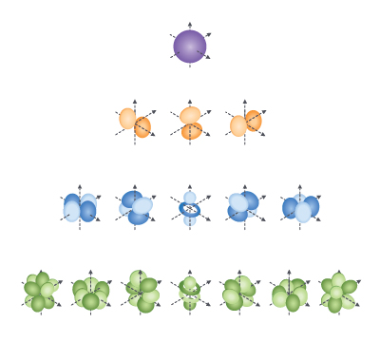
Atomic Orbitals → Quantum Numbers (4)
Quantum Numbers Made Easy ctr (11:22)
Notes:
Timing ≈ 2 min
[Animate stem] In the electron cloud model, electrons exist in orbitals [Animate bullet 1] (teacher briefly define). An atom may contain one or many orbitals depending on the number of electrons it has.
The location of an electron can be described by[Animate bullet 2] quantum numbers. Each orbital in an atom has a specific set of quantum numbers. There are three main quantum numbers that describe an orbital: [Animate sub-bullet 1] n, l, and m.
[Animate sub-bullet 2] The principal quantum number, n, describes the size of the orbital. The larger the value of n, the larger the orbital is.
[Animate sub-bullet 3] The angular momentum quantum number, l, describes the shape of the orbital. Orbitals can be spherical (teacher point to red s orbital), dumbbell-shaped (teacher point to yellow p orbitals), cloverleaf-shaped (teacher point to blue d orbitals), or even more complexly shaped (teacher point to green f orbitals). Remind students that although the shapes shown here have distinct edges, in reality electrons exist in clouds. This is a limitation of showing orbitals as visual models.
[Animate sub-bullet 4] The magnetic quantum number, m, describes the orientation of the orbital in space. (Teacher show how the three p orbitals have the same shape but different orientations). Relate to a person's address: when you write your address, you specify the street, the city, and the state. Similarly an electron has a principal quantum number, an angular momentum quantum number, and a magnetic quantum number. Together the three numbers specify where the electron is located in the atom.
Sources:
http://commons.wikimedia.org/wiki/File:Single_electron_orbitals.jpg
Image by ©education2020

Slide 45
Atomic Orbitals → Quantum Numbers (4)
    1 n (principal quantum number) = size of the e- cloud
    Corresponds to energy levels in the Bohr Model of the atom (7 Rows on Periodic Table)
Notes:
Timing ≈ 2 min
[Animate stem] In the electron cloud model, electrons exist in orbitals [Animate bullet 1] (teacher briefly define). An atom may contain one or many orbitals depending on the number of electrons it has.
The location of an electron can be described by[Animate bullet 2] quantum numbers. Each orbital in an atom has a specific set of quantum numbers. There are three main quantum numbers that describe an orbital: [Animate sub-bullet 1] n, l, and m.
[Animate sub-bullet 2] The principal quantum number, n, describes the size of the orbital. The larger the value of n, the larger the orbital is.
[Animate sub-bullet 3] The angular momentum quantum number, l, describes the shape of the orbital. Orbitals can be spherical (teacher point to red s orbital), dumbbell-shaped (teacher point to yellow p orbitals), cloverleaf-shaped (teacher point to blue d orbitals), or even more complexly shaped (teacher point to green f orbitals). Remind students that although the shapes shown here have distinct edges, in reality electrons exist in clouds. This is a limitation of showing orbitals as visual models.
[Animate sub-bullet 4] The magnetic quantum number, m, describes the orientation of the orbital in space. (Teacher show how the three p orbitals have the same shape but different orientations). Relate to a person's address: when you write your address, you specify the street, the city, and the state. Similarly an electron has a principal quantum number, an angular momentum quantum number, and a magnetic quantum number. Together the three numbers specify where the electron is located in the atom.
Sources:
http://commons.wikimedia.org/wiki/File:Single_electron_orbitals.jpg
Image by ©education2020

Slide 46
Atomic Orbitals → Quantum Numbers (4)
    1 n (principal quantum number) = size of the e- cloud
    Corresponds to energy levels in the Bohr Model of the atom (7 Rows on Periodic Table)
    2 sublevel = shape of the sublevel
Notes:
Timing ≈ 2 min
[Animate stem] In the electron cloud model, electrons exist in orbitals [Animate bullet 1] (teacher briefly define). An atom may contain one or many orbitals depending on the number of electrons it has.
The location of an electron can be described by[Animate bullet 2] quantum numbers. Each orbital in an atom has a specific set of quantum numbers. There are three main quantum numbers that describe an orbital: [Animate sub-bullet 1] n, l, and m.
[Animate sub-bullet 2] The principal quantum number, n, describes the size of the orbital. The larger the value of n, the larger the orbital is.
[Animate sub-bullet 3] The angular momentum quantum number, l, describes the shape of the orbital. Orbitals can be spherical (teacher point to red s orbital), dumbbell-shaped (teacher point to yellow p orbitals), cloverleaf-shaped (teacher point to blue d orbitals), or even more complexly shaped (teacher point to green f orbitals). Remind students that although the shapes shown here have distinct edges, in reality electrons exist in clouds. This is a limitation of showing orbitals as visual models.
[Animate sub-bullet 4] The magnetic quantum number, m, describes the orientation of the orbital in space. (Teacher show how the three p orbitals have the same shape but different orientations). Relate to a person's address: when you write your address, you specify the street, the city, and the state. Similarly an electron has a principal quantum number, an angular momentum quantum number, and a magnetic quantum number. Together the three numbers specify where the electron is located in the atom.
Sources:
http://commons.wikimedia.org/wiki/File:Single_electron_orbitals.jpg
Image by ©education2020

Slide 47
Atomic Orbitals → Quantum Numbers (4)
    1 n (principal quantum number) = size of the e- cloud
    Corresponds to energy levels in the Bohr Model of the atom (7 Rows on Periodic Table)
    2 sublevel = shape of the sublevel
    3 Orbital = orbital orientation
Notes:
Timing ≈ 2 min
[Animate stem] In the electron cloud model, electrons exist in orbitals [Animate bullet 1] (teacher briefly define). An atom may contain one or many orbitals depending on the number of electrons it has.
The location of an electron can be described by[Animate bullet 2] quantum numbers. Each orbital in an atom has a specific set of quantum numbers. There are three main quantum numbers that describe an orbital: [Animate sub-bullet 1] n, l, and m.
[Animate sub-bullet 2] The principal quantum number, n, describes the size of the orbital. The larger the value of n, the larger the orbital is.
[Animate sub-bullet 3] The angular momentum quantum number, l, describes the shape of the orbital. Orbitals can be spherical (teacher point to red s orbital), dumbbell-shaped (teacher point to yellow p orbitals), cloverleaf-shaped (teacher point to blue d orbitals), or even more complexly shaped (teacher point to green f orbitals). Remind students that although the shapes shown here have distinct edges, in reality electrons exist in clouds. This is a limitation of showing orbitals as visual models.
[Animate sub-bullet 4] The magnetic quantum number, m, describes the orientation of the orbital in space. (Teacher show how the three p orbitals have the same shape but different orientations). Relate to a person's address: when you write your address, you specify the street, the city, and the state. Similarly an electron has a principal quantum number, an angular momentum quantum number, and a magnetic quantum number. Together the three numbers specify where the electron is located in the atom.
Sources:
http://commons.wikimedia.org/wiki/File:Single_electron_orbitals.jpg
Image by ©education2020

Slide 48
Atomic Orbitals → Quantum Numbers (4)
    1 n (principal quantum number) = size of the e- cloud
    Corresponds to energy levels in the Bohr Model of the atom (7 Rows on Periodic Table)
    2 sublevel = shape of the sublevel
    3 Orbital = orbital orientation
    4 s (spin)
Notes:
Timing ≈ 2 min
[Animate stem] In the electron cloud model, electrons exist in orbitals [Animate bullet 1] (teacher briefly define). An atom may contain one or many orbitals depending on the number of electrons it has.
The location of an electron can be described by[Animate bullet 2] quantum numbers. Each orbital in an atom has a specific set of quantum numbers. There are three main quantum numbers that describe an orbital: [Animate sub-bullet 1] n, l, and m.
[Animate sub-bullet 2] The principal quantum number, n, describes the size of the orbital. The larger the value of n, the larger the orbital is.
[Animate sub-bullet 3] The angular momentum quantum number, l, describes the shape of the orbital. Orbitals can be spherical (teacher point to red s orbital), dumbbell-shaped (teacher point to yellow p orbitals), cloverleaf-shaped (teacher point to blue d orbitals), or even more complexly shaped (teacher point to green f orbitals). Remind students that although the shapes shown here have distinct edges, in reality electrons exist in clouds. This is a limitation of showing orbitals as visual models.
[Animate sub-bullet 4] The magnetic quantum number, m, describes the orientation of the orbital in space. (Teacher show how the three p orbitals have the same shape but different orientations). Relate to a person's address: when you write your address, you specify the street, the city, and the state. Similarly an electron has a principal quantum number, an angular momentum quantum number, and a magnetic quantum number. Together the three numbers specify where the electron is located in the atom.
Sources:
http://commons.wikimedia.org/wiki/File:Single_electron_orbitals.jpg
Image by ©education2020

Slide 49
Atomic Orbitals
2 Electron Configurations
Watch these Tutorials
Quantum Numbers Introduction (4:38)
https://screencast-o-matic.com/watch/cFQX3uqmHp
Principal Quantum Number (5:12)
https://screencast-o-matic.com/watch/cFQ2orqKA5
Second Quantum Number (5:22)
https://screencast-o-matic.com/watch/cFQ2DZqKCL

Slide 50
Atomic Orbitals
2 Electron Configurations
Watch these Tutorials
Third Quantum Number (6:25)
http://somup.com/cFQ2YOVSNt
Fourth Quantum Number (4:57)
https://screencast-o-matic.com/watch/cFQol4q7xH
Pauli Exclusion Principle & Hund’s Rule (4:41)
https://screencast-o-matic.com/watch/cFQ2bQqKmJ

Slide 51
PRINCIPAL QN
2 Electron Configurations
The numbers and types of atomic orbitals depend on the principal energy level, n.
Summary of Principal Energy Levels and Sublevels
Principal energy level (1 – 7) | Number of sublevels | Type of sublevel | Maximum number of electrons (2n²)
n = 1 | 1 | 1s (1 orbital) | 2
n = 2 | 2 | 2s (1 orbital), 2p (3 orbitals) | 8
n = 3 | 3 | 3s (1 orbital), 3p (3 orbitals), 3d (5 orbitals) | 18
n = 4 | 4 | 4s (1 orbital), 4p (3 orbitals), 4d (5 orbitals), 4f (7 orbitals) | 32

Slide 52
PRINCIPAL QN
2 Electron Configurations
The principal quantum number (1), n, always equals the number of sublevels (2) within that principal energy level.
The number of orbitals (3) in a principal energy level is equal to n².
A maximum of two electrons can occupy an orbital.
Therefore, the maximum number of electrons that can occupy a principal energy level (1) is given by the formula 2n².

Slide 53
Electron Sublevels – Second Quantum Number
  An electron sublevel (2) is a set of orbitals with the same principal quantum number (1), n, and the same quantum number (3)
  Represented by letters
    s
    p
    d
    f
Notes:
Timing ≈ 1 min
[Animate definition] Electron shells are further divided into subshells. A subshell is a set of orbitals with the same values of n and l.
[Animate bullet 1] For ease of reference, we use letters to identify different values of l.
[Animate sub-bullet 1] A subshell with l=0 is called an s orbital.
[Animate sub-bullet 2] A subshell with l=1 is called a p orbital.
[Animate sub-bullet 3] A subshell with l=2 is called a d orbital.
[Animate sub-bullet 4] A subshell with l=3 is called an f orbital.
[Animate bullet 2] The values of m for a given value of l tell you how many subshells there are of each type. For example, there is only one s subshell per electron shell, because m can have only one value (0) when l = 0. In contrast, there are seven f subshells because m can be -3, -2, -1, 0, 1, 2, or 3 for l = 3.
Source:
http://commons.wikimedia.org/wiki/File:Single_electron_orbitals.jpg

Slide 54
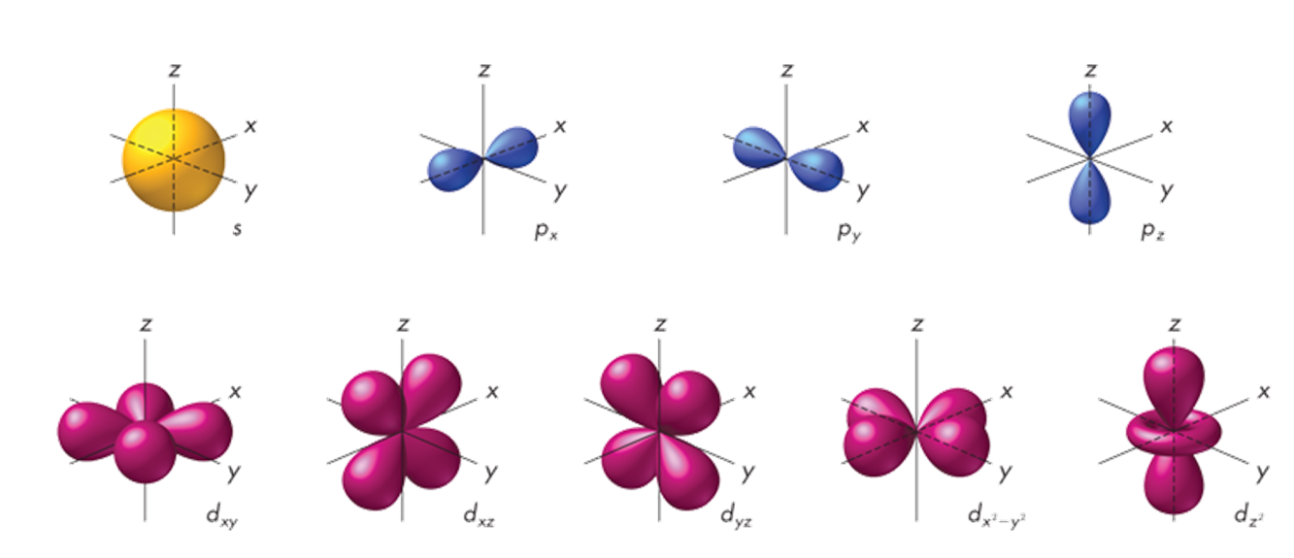
Second QN
2 Electron Configurations
Each energy sublevel corresponds to one or more orbitals of different shapes.
The s orbitals are spherical.
The p orbitals are dumbbell-shaped.
d & f orbitals are very complex.

Slide 55
Second QN
Energy Level | Sublevels | Actual
n = 1 | s | 1 s
n = 2 | s, p | 2 s 2 p
n = 3 | s, p, d | 3 s 3p 3 d
n = 4 | s, p, d, f | 4s 4 p 4 d 4 f
Recap of Quantum Numbers 1 & 2 (2:36)
http://somup.com/cFQ2FRVSLt

Slide 56
Third QN
Third Quantum Number (3)
Corresponds to the ORBITAL orientation in space
A region of high probability for finding electrons & the direction in space of each orbital
Each orbital can contain a maximum of 2 electrons
n² indicates the number of orbitals in a particular sublevel

Slide 57
Third QN
There are TWO electrons in each orbital (last column below)
Energy Level | Sublevel (# of orbitals) | Total # of Orbitals (n²) | Max. e– (2n²) in Energy Level | Orbital Diagram s p d f
n = 1 | s¹
n = 2 | s¹, p³
n = 3 | s¹, p³, d⁵
n = 4 | s¹, p³, d⁵, f⁷

Slide 58
Third QN
There are TWO electrons in each orbital (last column below)
Energy Level | Sublevel (# of orbitals) | Total # of Orbitals (n²) | Max. e– (2n²) in Energy Level | Orbital Diagram s p d f
n = 1 | s¹ | 1
n = 2 | s¹, p³ | 4
n = 3 | s¹, p³, d⁵ | 9
n = 4 | s¹, p³, d⁵, f⁷ | 16

Slide 59
Third QN
There are TWO electrons in each orbital (last column below)
Energy Level | Sublevel (# of orbitals) | Total # of Orbitals (n²) | Max. e– (2n²) in Energy Level | Orbital Diagram s p d f
n = 1 | s¹ | 1 | 2
n = 2 | s¹, p³ | 4 | 8
n = 3 | s¹, p³, d⁵ | 9 | 18
n = 4 | s¹, p³, d⁵, f⁷ | 16 | 32

Slide 60
Third QN
There are TWO electrons in each orbital (last column below)
Energy Level | Sublevel (# of orbitals) | Total # of Orbitals (n²) | Max. e– (2n²) in Energy Level | Orbital Diagram s p d f
n = 1 | s¹ | 1 | 2 | 0
n = 2 | s¹, p³ | 4 | 8 | 0 000
n = 3 | s¹, p³, d⁵ | 9 | 18 | 0 000 00000
n = 4 | s¹, p³, d⁵, f⁷ | 16 | 32 | 0 000 00000 0000000

Slide 61

2 Electron Configurations
Fourth QN
Pauli Exclusion Principle
An atomic orbital may contain at most two electrons. To occupy the same orbital, the two electrons must have opposite spins; that is, the electron spins must be paired.
Spin (4)
“clockwise” or “counterclockwise”
A vertical arrow indicates an electron and its direction of spin (↑ or ↓).
Values of “s” range from + ½ to – ½

Slide 62
Electron Configurations
2 Electron Configurations
A shorthand method for showing the electron configuration of an atom involves writing the energy level and the symbol for every sublevel occupied by an electron.
The number of electrons occupying that sublevel is indicated with a superscript.
For hydrogen, with one electron in a 1s orbital, the electron configuration is written 1s¹.
For oxygen, with two electrons in a 1s orbital, two electrons in a 2s orbital, and four electrons in 2p orbitals, the electron configuration is 1s² 2s² 2p⁴.
The sum of the superscripts equals the number of electrons in the atom.

Slide 63
PRACTICE
Do the electron configurations (4 QN):
Energy Level (1)
Sublevel (2)
Orientation (orbitals) (3)
Spin (4)
₁H¹
₂He⁴
₃Li⁷
₄Be⁹

Slide 64



PRACTICE
Do the electron configurations (4 QN):
Energy Level (1)
Sublevel (2)
Orientation (orbitals) (3)
Spin (4)
₁H¹
₂He⁴
₃Li⁷
₄Be⁹

Slide 65
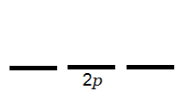

Hund’s Rule (Finish the e- configurations)
Within any sublevel (p, d or f), all the orbitals of that sublevel must contain 1 electron BEFORE any orbital can be filled (2 e- max.)
  Electrons added to empty orbitals have the same spin quantum number.
Boron
₅Be¹¹
1s
2s
Notes:
Timing ≈ 2 min
[Animate definition] The rule that tells us where carbon's next electron goes is Hund's rule. Hund's rule states that electrons in the same sublevel (p, d or f) are placed in individual orbitals before they are paired up in order to increase atomic stability.
Think about a mother with triplets. When she feeds them, she would not give two hamburgers to one child before all three have one. Electrons are the same way--they will not occupy an orbital that already contains an electron if there is another orbital in the same subshell that is empty. This makes sense because electrons repel each other.
[Animate second sentence] Hund's rule also says that as electrons are added to the orbitals, they all have the same spin quantum number until they start filling half-full orbitals. Remember, we use arrows to represent electrons; an up arrow represents a spin of + 1/2, and a down arrow represents a spin of -1/2.
[Animate diagrams on the right] Let's look at an example of Hund's rule by looking at the orbitals for boron, carbon, and fluorine. We'll show only the orbitals for n=2 for now. (teacher draw in arrows for electrons for each element showing how electrons fill the 2p orbitals)
Source:

Slide 66
Hund’s Rule (Finish the e- configurations)
Within any sublevel (p, d or f), all the orbitals of that sublevel must contain 1 electron BEFORE any orbital can be filled (2 e- max.)
  Electrons added to empty orbitals have the same spin quantum number.
Boron
₅Be¹¹
1s
2s
Carbon
₆C¹²
1s
2s
Notes:
Timing ≈ 2 min
[Animate definition] The rule that tells us where carbon's next electron goes is Hund's rule. Hund's rule states that electrons in the same sublevel (p, d or f) are placed in individual orbitals before they are paired up in order to increase atomic stability.
Think about a mother with triplets. When she feeds them, she would not give two hamburgers to one child before all three have one. Electrons are the same way--they will not occupy an orbital that already contains an electron if there is another orbital in the same subshell that is empty. This makes sense because electrons repel each other.
[Animate second sentence] Hund's rule also says that as electrons are added to the orbitals, they all have the same spin quantum number until they start filling half-full orbitals. Remember, we use arrows to represent electrons; an up arrow represents a spin of + 1/2, and a down arrow represents a spin of -1/2.
[Animate diagrams on the right] Let's look at an example of Hund's rule by looking at the orbitals for boron, carbon, and fluorine. We'll show only the orbitals for n=2 for now. (teacher draw in arrows for electrons for each element showing how electrons fill the 2p orbitals)
Source:

Slide 67
Hund’s Rule (Finish the e- configurations)
Within any sublevel (p, d or f), all the orbitals of that sublevel must contain 1 electron BEFORE any orbital can be filled (2 e- max.)
  Electrons added to empty orbitals have the same spin quantum number.
Boron
₅Be¹¹
1s
2s
Carbon
₆C¹²
1s
2s
Fluorine
₉F¹⁹
1s
2s
Notes:
Timing ≈ 2 min
[Animate definition] The rule that tells us where carbon's next electron goes is Hund's rule. Hund's rule states that electrons in the same sublevel (p, d or f) are placed in individual orbitals before they are paired up in order to increase atomic stability.
Think about a mother with triplets. When she feeds them, she would not give two hamburgers to one child before all three have one. Electrons are the same way--they will not occupy an orbital that already contains an electron if there is another orbital in the same subshell that is empty. This makes sense because electrons repel each other.
[Animate second sentence] Hund's rule also says that as electrons are added to the orbitals, they all have the same spin quantum number until they start filling half-full orbitals. Remember, we use arrows to represent electrons; an up arrow represents a spin of + 1/2, and a down arrow represents a spin of -1/2.
[Animate diagrams on the right] Let's look at an example of Hund's rule by looking at the orbitals for boron, carbon, and fluorine. We'll show only the orbitals for n=2 for now. (teacher draw in arrows for electrons for each element showing how electrons fill the 2p orbitals)
Source:

Slide 68
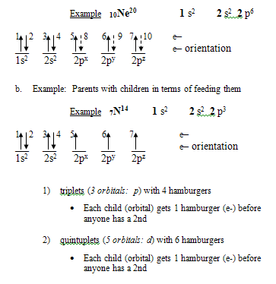
Hund’s
Rule

Slide 69
Electron Configurations
2 Electron Configurations
Aufbau Principle
6p
6s
5d
4f
5p
5s
4d
4p
4s
3d
3p
3s
Increasing energy
According to the Aufbau principle, electrons occupy orbitals of lowest energy first. In the Aufbau diagram, each box represents an atomic orbital.
2p
2s
1s

Slide 70
Electron Configurations
2 Electron Configurations
Aufbau Principle
6p
6s
5d
4f
5p
5s
4d
4p
4s
3d
3p
3s
Increasing energy
The aufbau diagram shows the relative energy levels of the various atomic orbitals.
Orbitals of greater energy are higher on the diagram.
2p
2s
1s

Slide 71
Electron Configurations
2 Electron Configurations
Aufbau Principle
6p
6s
5d
4f
5p
5s
4d
4p
4s
3d
3p
3s
Increasing energy
2p
The range of energy levels within a principal energy level can overlap the energy levels of another principal level.
2s
1s

Slide 72
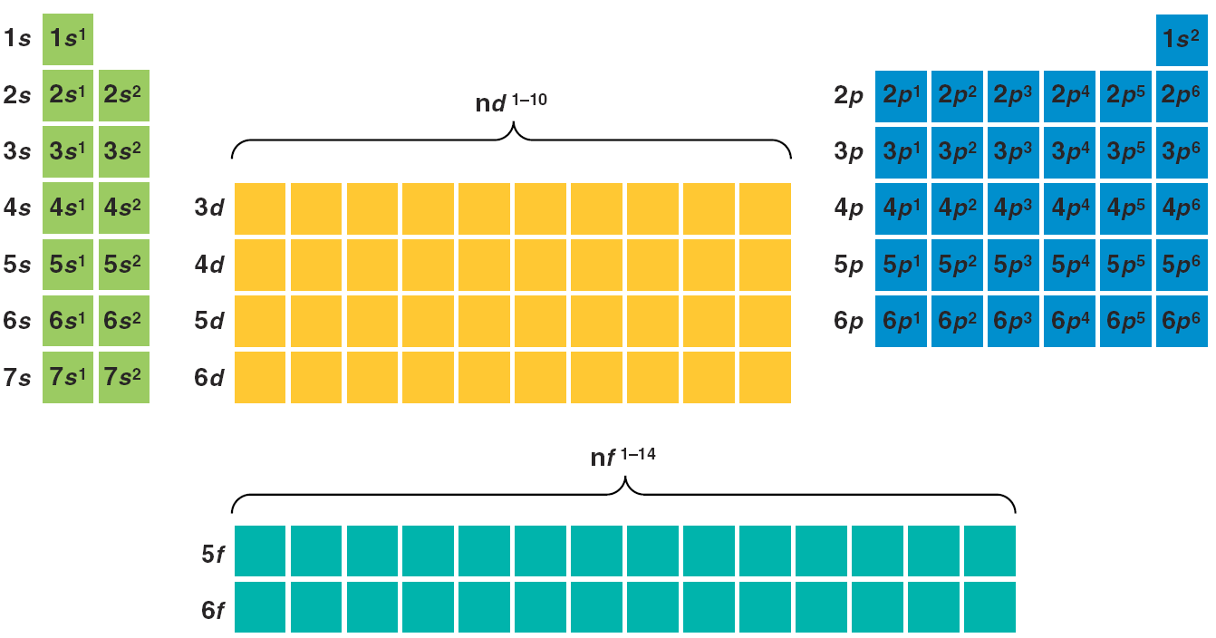
Group “A” and “B” Elements
  Create the electron configuration for each element by rows
A Groups
s block
A Groups
p block
B Groups
Transition
d block
B Groups – f block
Notes:
Timing ≈ 0.5 min
[teacher points out the “A” groups (left and right side of periodic table) and explains that valence electrons fill the s and p orbitals…(circle the “s” and “p” sublevels shown on table)]]
[teacher points out the “B” groups (middle of periodic table) and explains that valence is affected by the d and f sublevels … (circle the “d” and “f” sublevels shown on table)]
SOURCE:

Slide 73
Electron Configurations
2 Electron Configurations
Energetics of the Quantum Numbers (4:51)
http://somup.com/cFQoolVS98

Slide 74
Electron Configurations
2 Electron Configurations
Show 4 Quantum # (e- configuration) of elements 1 - 11
Electron Configurations of Selected Elements
Element | 1s | 2s | 2p_{x} 2p_{y} 2p_{z} | 3s | Electron configuration
H |  |  |  |  | 1s¹
He |  |  |  |  | 1s²
Li |  |  |  |  | 1s²2s¹
C |  |  |  |  | 1s²2s²2p²
N |  |  |  |  | 1s²2s²2p³
O |  |  |  |  | 1s²2s²2p⁴
F |  |  |  |  | 1s²2s²2p⁵
Ne |  |  |  |  | 1s²2s²2p⁶
Na |  |  |  |  | 1s²2s²2p⁶3s¹

Slide 75



Electron Configurations
2 Electron Configurations
One of these configurations will be on your test
Electron Configurations of Selected Elements
Element | 1s | 2s | 2p_{x} 2p_{y} 2p_{z} | 3s | Electron configuration
H |  |  |  |  | 1s¹
He |  |  |  |  | 1s²
Li |  |  |  |  | 1s²2s¹
C |  |  |  |  | 1s²2s²2p²
N |  |  |  |  | 1s²2s²2p³
O |  |  |  |  | 1s²2s²2p⁴
F |  |  |  |  | 1s²2s²2p⁵
Ne |  |  |  |  | 1s²2s²2p⁶
Na |  |  |  |  | 1s²2s²2p⁶3s¹

Slide 76
Using the Diagonal Rule to Write Electron Configurations [ENRICHMENT]
http://somup.com/cF6lFQnef7 Diagonal Rule & Electron Configuration Example (3:06)
1s
2s 2p
3s 3p 3d
4s 4p 4d 4f
5s 5p 5d 5f…
6s 6p 6d
7s… … …
Notes:
Timing ≈ 1 min
A simple diagram that helps us know the actual order of electron configuration for all of the elements on the Periodic Table is called the diagonal rule. This diagram shows the order in which orbitals are filled. You can use this diagram to write the electron configuration of an atom.
Let's look at an example. [Animate instructions and bullet 1] The first step is to identify the number of electrons in the atom. (teacher show how to use periodic table to determine number of electrons)
[Animate bullet 2] Next, write each subshell and the number of electrons in it. Add electrons until you reach the correct number. Show the number of electrons in each subshell as a superscript. (teacher show how to write each configuration: 1s ² 2s ² 2p ⁶ 3s ² 3p ⁶ 4s ² 3d ⁷ )
[Animate bullet 3] Finally, check your work by adding the superscripts together to make sure you get the right number of electrons. (teacher show how to add superscripts and that they match correct number of electrons)
SOURCE:
http://commons.wikimedia.org/wiki/File:Klechkovski_rule.svg

Slide 77
Using the Diagonal Rule to Write Electron Configurations [ENRICHMENT]
Write the complete electron configurations for cobalt (Co).
  Identify the number of electrons from the periodic table: ________
1s
2s 2p
3s 3p 3d
4s 4p 4d 4f
5s 5p 5d 5f…
6s 6p 6d
7s… … …
Notes:
Timing ≈ 1 min
A simple diagram that helps us know the actual order of electron configuration for all of the elements on the Periodic Table is called the diagonal rule. This diagram shows the order in which orbitals are filled. You can use this diagram to write the electron configuration of an atom.
Let's look at an example. [Animate instructions and bullet 1] The first step is to identify the number of electrons in the atom. (teacher show how to use periodic table to determine number of electrons)
[Animate bullet 2] Next, write each subshell and the number of electrons in it. Add electrons until you reach the correct number. Show the number of electrons in each subshell as a superscript. (teacher show how to write each configuration: 1s ² 2s ² 2p ⁶ 3s ² 3p ⁶ 4s ² 3d ⁷ )
[Animate bullet 3] Finally, check your work by adding the superscripts together to make sure you get the right number of electrons. (teacher show how to add superscripts and that they match correct number of electrons)
SOURCE:
http://commons.wikimedia.org/wiki/File:Klechkovski_rule.svg

Slide 78
Using the Diagonal Rule to Write Electron Configurations [ENRICHMENT]
Write the complete electron configurations for cobalt (Co).
  Identify the number of electrons from the periodic table: 27
  Fill the subshells according to the aufbau principle until the correct number of electrons is reached.
1s
2s 2p
3s 3p 3d
4s 4p 4d 4f
5s 5p 5d 5f…
6s 6p 6d
7s… … …
Notes:
Timing ≈ 1 min
A simple diagram that helps us know the actual order of electron configuration for all of the elements on the Periodic Table is called the diagonal rule. This diagram shows the order in which orbitals are filled. You can use this diagram to write the electron configuration of an atom.
Let's look at an example. [Animate instructions and bullet 1] The first step is to identify the number of electrons in the atom. (teacher show how to use periodic table to determine number of electrons)
[Animate bullet 2] Next, write each subshell and the number of electrons in it. Add electrons until you reach the correct number. Show the number of electrons in each subshell as a superscript. (teacher show how to write each configuration: 1s ² 2s ² 2p ⁶ 3s ² 3p ⁶ 4s ² 3d ⁷ )
[Animate bullet 3] Finally, check your work by adding the superscripts together to make sure you get the right number of electrons. (teacher show how to add superscripts and that they match correct number of electrons)
SOURCE:
http://commons.wikimedia.org/wiki/File:Klechkovski_rule.svg

Slide 79
Using the Diagonal Rule to Write Electron Configurations [ENRICHMENT]
Write the complete electron configurations for cobalt (Co).
  Identify the number of electrons from the periodic table: 27
  Fill the subshells according to the aufbau principle until the correct number of electrons is reached.
1s
2s 2p
3s 3p 3d
4s 4p 4d 4f
5s 5p 5d 5f…
6s 6p 6d
7s… … …
  1s² 2s² 2p⁶ 3s² 3p⁶ 4s² 3d⁷
  Check your work.
Notes:
Timing ≈ 1 min
A simple diagram that helps us know the actual order of electron configuration for all of the elements on the Periodic Table is called the diagonal rule. This diagram shows the order in which orbitals are filled. You can use this diagram to write the electron configuration of an atom.
Let's look at an example. [Animate instructions and bullet 1] The first step is to identify the number of electrons in the atom. (teacher show how to use periodic table to determine number of electrons)
[Animate bullet 2] Next, write each subshell and the number of electrons in it. Add electrons until you reach the correct number. Show the number of electrons in each subshell as a superscript. (teacher show how to write each configuration: 1s ² 2s ² 2p ⁶ 3s ² 3p ⁶ 4s ² 3d ⁷ )
[Animate bullet 3] Finally, check your work by adding the superscripts together to make sure you get the right number of electrons. (teacher show how to add superscripts and that they match correct number of electrons)
SOURCE:
http://commons.wikimedia.org/wiki/File:Klechkovski_rule.svg

Slide 80
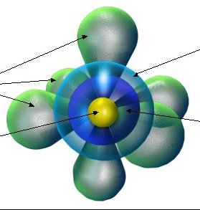
Building Atoms: Electron Configuration
2 Electron Configurations
[ENRICHMENT]
All forms of matter try to stay in their lowest possible energy state.
Ground state - The lowest possible energy state for a given substance
Each orbital can hold two electrons
Orbitals fill in order of increasing energy:
1s²,
2s², 2p⁶,
3s², 3p⁶,
4s², 3d¹⁰, 4p⁶,
5s², 4d¹⁰, 5p⁶,
6s², 4f¹⁴, 5d¹⁰, 6p⁶, Neon atom
7s², 5f¹⁴, 6d¹⁰, 7p⁶

Slide 81
Electron Configurations
2 Electron Configurations
[ENRICHMENT]
Exceptional Electron Configurations
Copper and Chromium are exceptions to the electron-filling rules.
The correct electron configurations are as follows:
Cr: 1s² 2s² 2p⁶ 3s² 3p⁶ 4s¹ 3d ⁵
Cu: 1s² 2s² 2p⁶ 3s² 3p⁶ 4s¹ 3d¹⁰
These arrangements give chromium a half-filled d sublevel and copper a filled d sublevel.
Some actual electron configurations differ from those assigned using the aufbau principle because although half-filled sublevels are not as stable as filled sublevels, they are more stable than other configurations.

Slide 82
2 Electron Configurations
[ENRICHMENT]
What is the correct electron configuration of a sulfur atom?
A. 1s²2s²2p⁴3s²3p⁶
B. 1s²2s²2p⁶3s²3p³
C. 1s²2s²2p⁶3s²3p⁴
D. 1s²2s²2p⁶3s⁶3p²

Slide 83
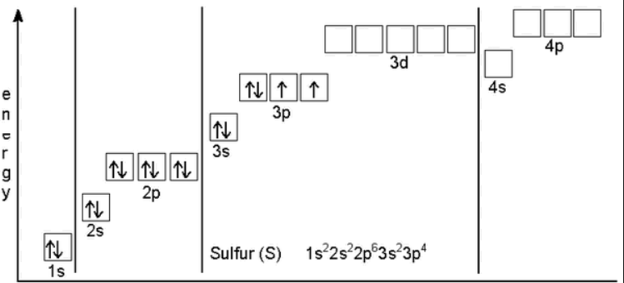
2 Electron Configurations
What is the correct electron configuration of a sulfur atom?
[ENRICHMENT]
A. 1s²2s²2p⁴3s²3p⁶
B. 1s²2s²2p⁶3s²3p³
C. 1s²2s²2p⁶3s²3p⁴
D. 1s²2s²2p⁶3s⁶3p²

Slide 84
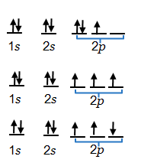
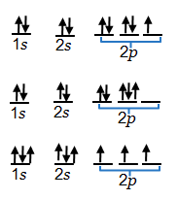
Represent Electron Configurations
Use the periodic table to answer the questions below.
Which diagram shows the correct electron configuration for nitrogen (N)?
Which diagram shows the correct electron configuration for fluorine (F)?
Notes:
Timing ≈ 2 min
Entry audio: Use your knowledge of electron configurations to answer the following questions.
Hint1 audio: Use the periodic table to determine the number of electrons nitrogen has. Remember that the atomic number is the same as the number of electrons. All orbitals need to be filled with an up electron first.
Hint2 audio: Use the periodic table to determine the number of electrons fluorine has. Remember that the atomic number is the same as the number of electrons. Remember, there can only be two electrons in each orbital.
Exit audio: When determining electron configurations, you can use the periodic table to find the number of electrons of an element. The number of electrons is the same as the atomic number. Electrons in the same sublevel are placed in individual orbitals before they are paired up, to increase atomic stability and only two electrons can occupy each energy level.

Slide 85
Represent Electron Configurations
Use the periodic table to answer the questions below.
Which diagram shows the correct electron configuration for nitrogen (N)?
Which diagram shows the correct electron configuration for fluorine (F)?
Notes:
Timing ≈ 2 min
Entry audio: Use your knowledge of electron configurations to answer the following questions.
Hint1 audio: Use the periodic table to determine the number of electrons nitrogen has. Remember that the atomic number is the same as the number of electrons. All orbitals need to be filled with an up electron first.
Hint2 audio: Use the periodic table to determine the number of electrons fluorine has. Remember that the atomic number is the same as the number of electrons. Remember, there can only be two electrons in each orbital.
Exit audio: When determining electron configurations, you can use the periodic table to find the number of electrons of an element. The number of electrons is the same as the atomic number. Electrons in the same sublevel are placed in individual orbitals before they are paired up, to increase atomic stability and only two electrons can occupy each energy level.

Slide 86
Describe Electron Configurations
Use the periodic table to give the electron configuration for the element. Show all 4 quantum numbers. Give the nuclear symbol of each element.
Ne:
P:
K:
Notes:
Timing ≈ 1.5 min
Entry audio: Use the periodic table to identify the element indicated by each electron configuration.
Hint Audio: Adding the superscripts together will give you the total number of electrons in an atom.
Exit audio: In the next section of the assignment you will be describing the specific number of electrons in energy levels.

Slide 87



Describe Electron Configurations
Use the periodic table to give the electron configuration for the element. Show all 4 quantum numbers.
₁₀Ne²⁰: 1s²2s²2p⁶
₁₅P³¹: 1s²2s²2p⁶3s²3p³
₁₉K³⁹: 1s²2s²2p⁶3s²3p⁶4s¹ [Ar]
Notes:
Timing ≈ 1.5 min
Entry audio: Use the periodic table to identify the element indicated by each electron configuration.
Hint Audio: Adding the superscripts together will give you the total number of electrons in an atom.
Exit audio: In the next section of the assignment you will be describing the specific number of electrons in energy levels.

Slide 88
Describe Electron Configurations
Use the periodic table [insert link to periodic table, tab 1] to fill in the numbers in the electron configurations shown below.
B: 1s² 2s^{A}2p^{B}
A =
B =
Nb: 1s²2s²2p⁶3s²3p⁶4s²3d¹⁰4p⁶5s^{F}4d^{G}
F =
G =
Na: 1s²2s^{C}p^{D}3s^{E}
C =
D =
E =
Ni: 1s²2s²2p⁶3s²3p⁶4s^{H}3d^{i}
H =
I =
Notes:
Timing ≈ 1.5 min
Entry audio: Use the periodic table to fill in the numbers in the electron configurations.
Hint audio: Remember that the number of electrons in each subshell is written as a superscript and the sum of the superscripts should equal the total number of electrons.
Exit audio: You can use the periodic table to determine the electron configuration of an element. The number of electrons in each subshell is written as a superscript and the sum of the superscripts should equal the total number of electrons.

Slide 89
Describe Electron Configurations
Use the periodic table [insert link to periodic table, tab 1] to fill in the numbers in the electron configurations shown below.
B: 1s² 2s^{A}2p^{B}
A = 2
B = 1
Nb: 1s²2s²2p⁶3s²3p⁶4s²3d¹⁰4p⁶5s^{F}4d^{G}
F = 2
G = 3
Na: 1s²2s^{C}p^{D}3s^{E}
C = 2
D = 6
E = 1
Ni: 1s²2s²2p⁶3s²3p⁶4s^{H}3d^{i}
H = 2
I = 8
Notes:
Timing ≈ 1.5 min
Entry audio: Use the periodic table to fill in the numbers in the electron configurations.
Hint audio: Remember that the number of electrons in each subshell is written as a superscript and the sum of the superscripts should equal the total number of electrons.
Exit audio: You can use the periodic table to determine the electron configuration of an element. The number of electrons in each subshell is written as a superscript and the sum of the superscripts should equal the total number of electrons.

Slide 90
  The quantum mechanical model of the atom
  a. Defines the exact path of an electron around the nucleus.
  b. Was proposed by Neils Bohr.
  c. Involves the probability of finding an electron in a certain position.
  d. No longer requires the use of energy levels.
  The maximum number of electrons in any orbital: ____.
  Give the maximum number of electrons in any single energy level for the s sublevel: ____; p sublevel _____; d sublevel _____; f sublevel _____.
  The letters s, p, d, f in an electron configuration indicate the ____.
  a. Spin of an electron c. Principle energy level
  b. Orbital shape d. Speed of an electron
  Emission of light from an atom occurs when an electron
  a. Drops to a lower energy level c. Moves within its atomic orbital
  b. Jumps to a higher energy level d. Falls into the nucleus
  Heisenberg’s principle dealt with the uncertainty of ____ and _____ of electrons.

Slide 91
  The quantum mechanical model of the atom
  a. Defines the exact path of an electron around the nucleus.
  b. Was proposed by Neils Bohr.
  c. Involves the probability of finding an electron in a certain position.
  d. No longer requires the use of energy levels.
  The maximum number of electrons in any orbital: 2.
  Give the maximum number of electrons in any single energy level for the s sublevel: 2; p sublevel 6; d sublevel 10; f sublevel 14.
  The letters s, p, d, f in an electron configuration indicate the ____.
  a. Spin of an electron c. Principle energy level
  b. Orbital shape d. Speed of an electron
  Emission of light from an atom occurs when an electron
  a. Drops to a lower energy level c. Moves within its atomic orbital
  b. Jumps to a higher energy level d. Falls into the nucleus
  Heisenberg’s principle dealt with the uncertainty of position & momentum (speed) of electrons.

Slide 92
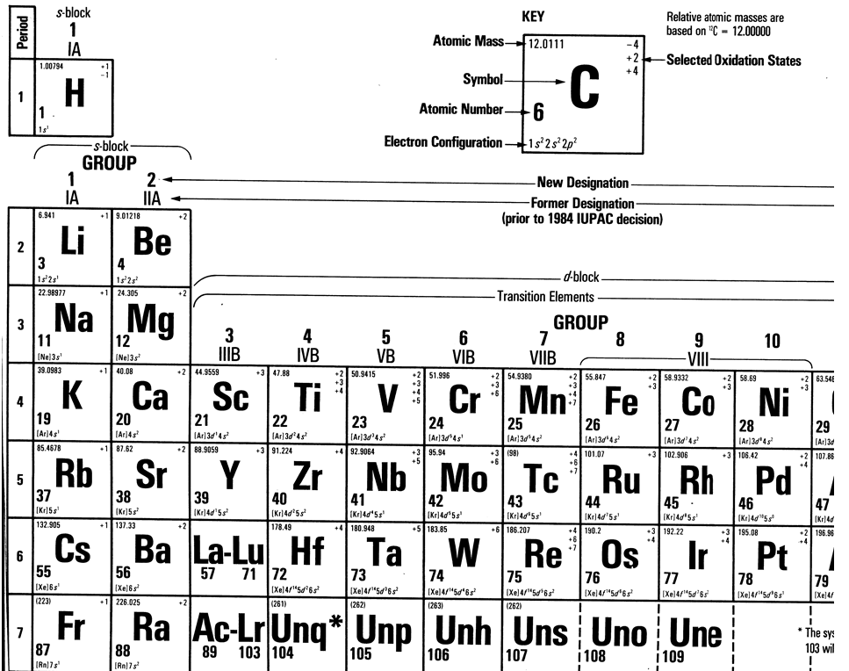

Slide 93
