Slide 1
Identifying
Wild Edible Plants
Trees and
Poisonous Plants

Slide 2
Animate Slides
Click on “Slide Show”
Click “From Beginning”

Slide 3
Distinguish Wild Edibles, Poison / Invasive Plants, Trees
For Trees, distinguish evergreen, armed, opposite, alternate
Simple v. Compound Leaves

Slide 4
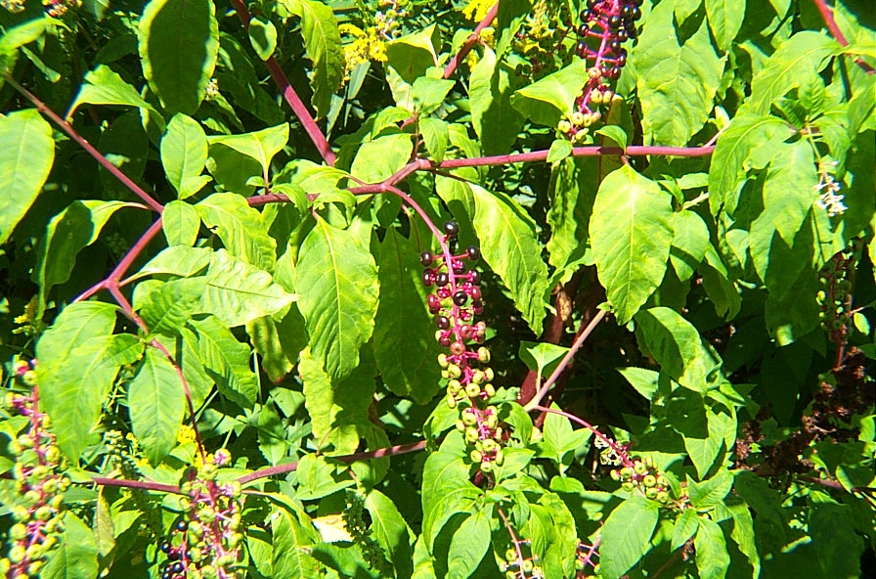
Pokeweed

Slide 5
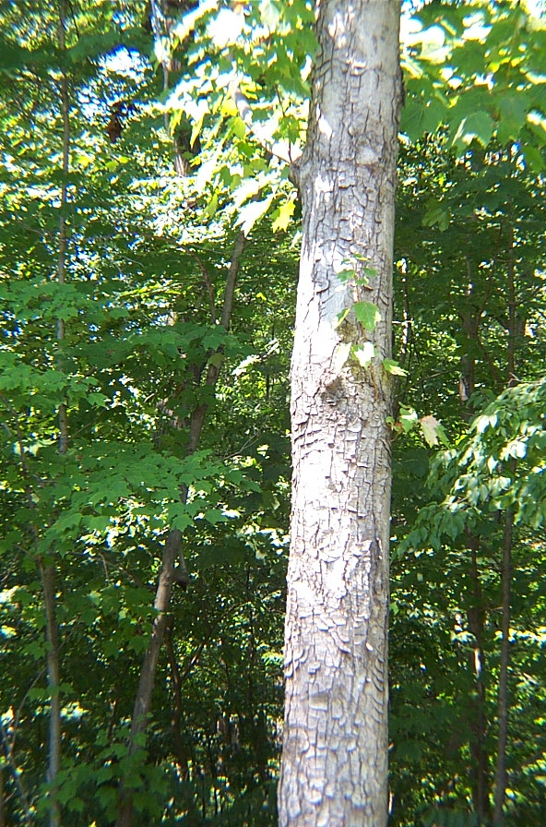
Red Maple

Slide 6
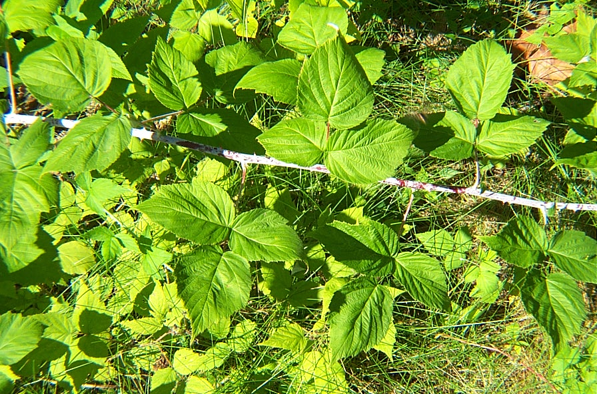
Raspberry

Slide 7
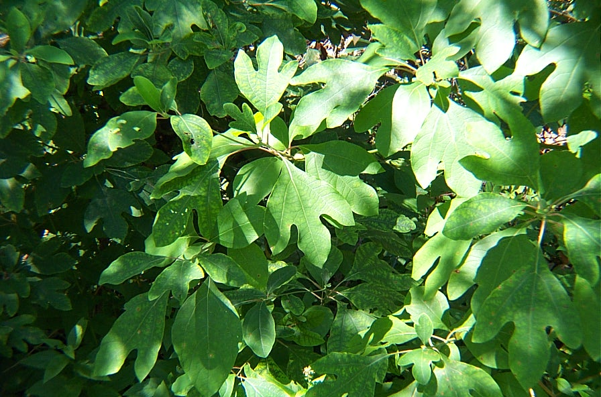
Sassafras

Slide 8
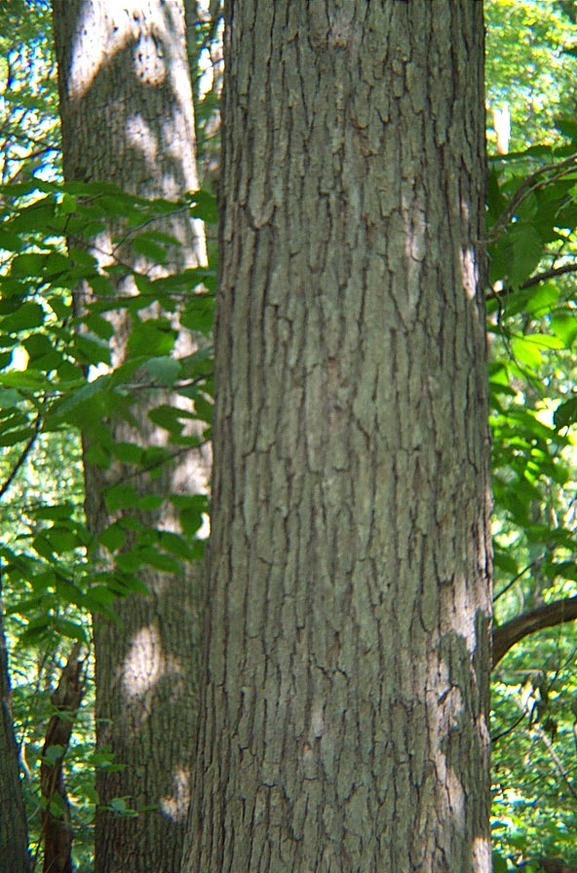
White Oak

Slide 9
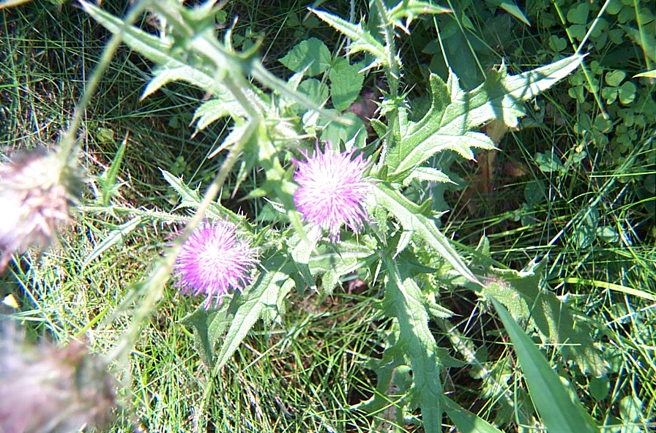
Bull thistle

Slide 10
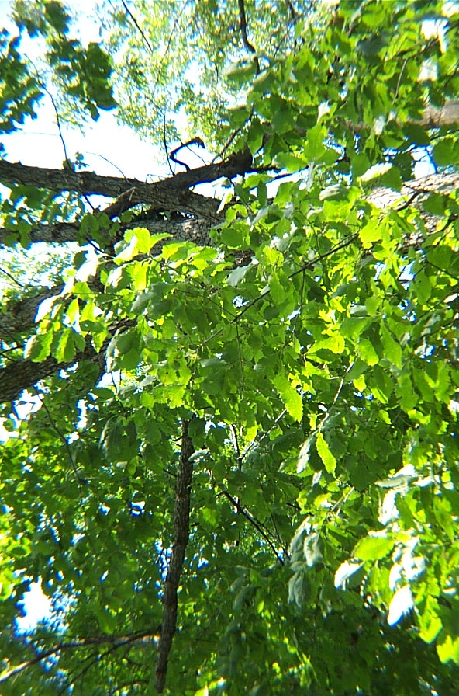
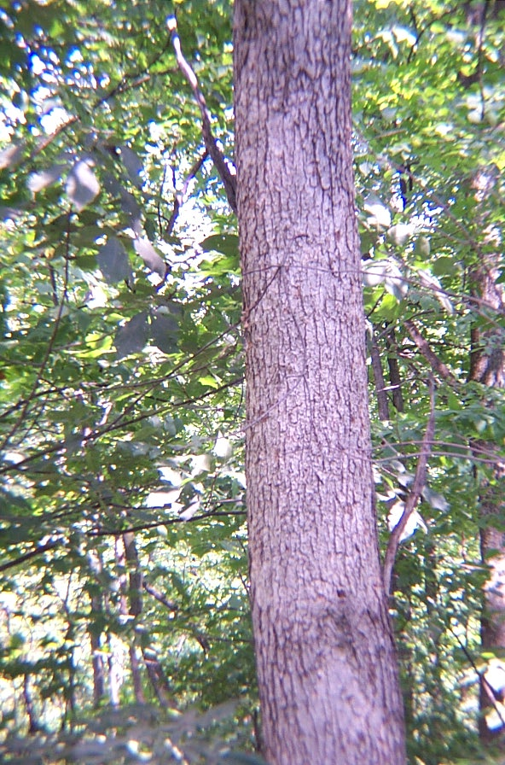
Chestnut Oak

Slide 11
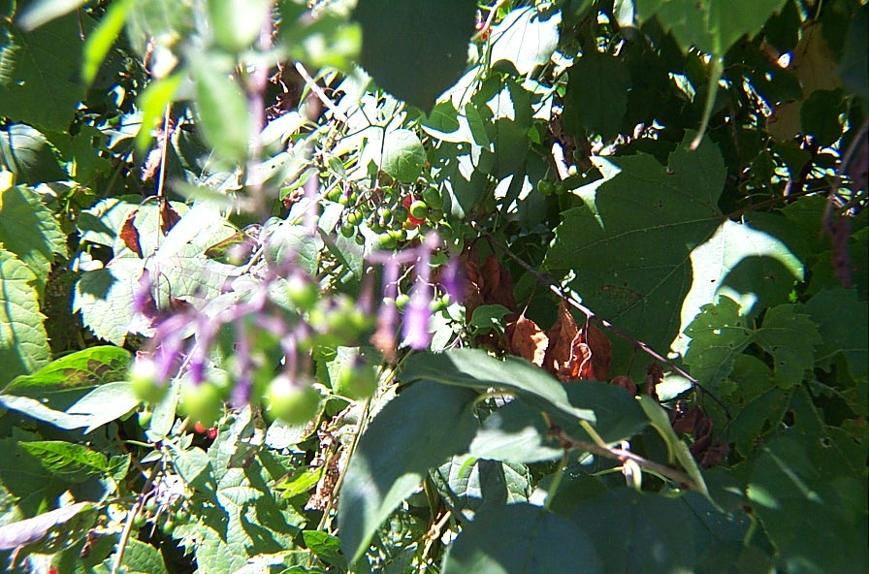
Bittersweet Nightshade

Slide 12
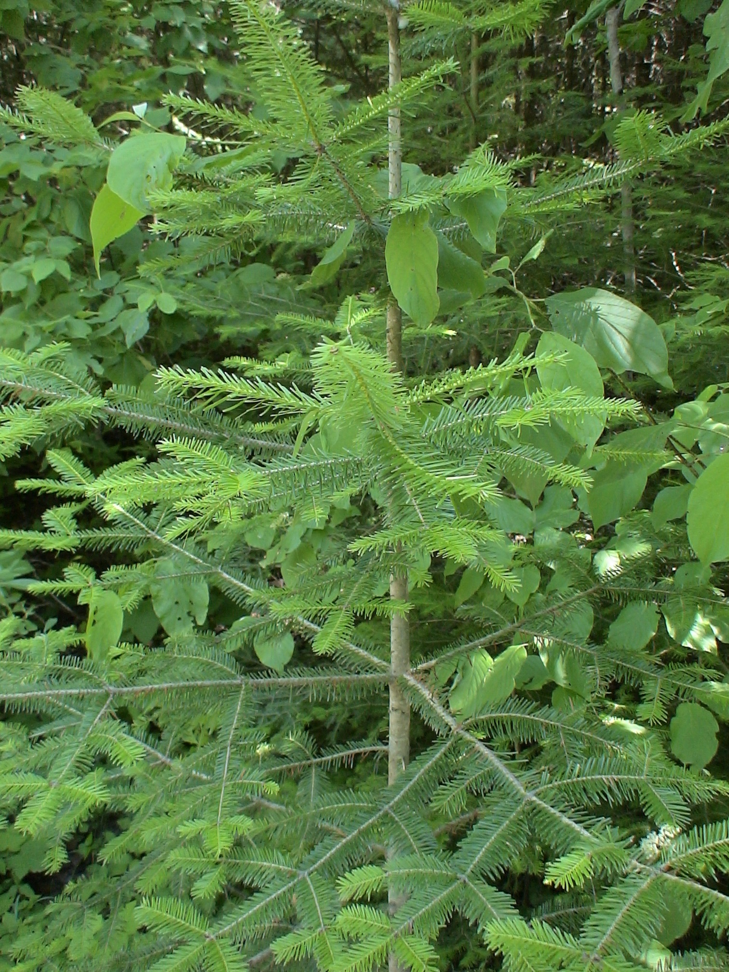
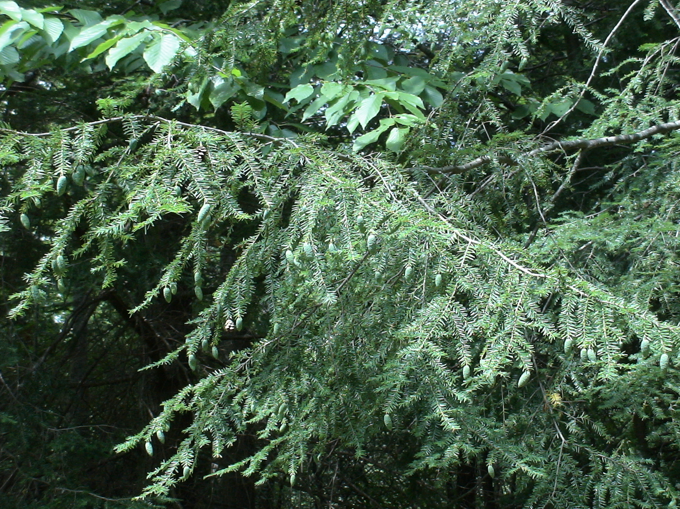
Hemlock

Slide 13
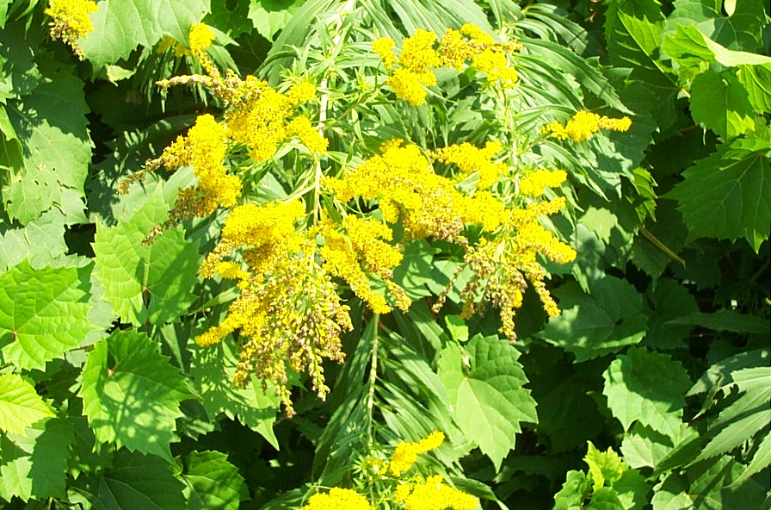
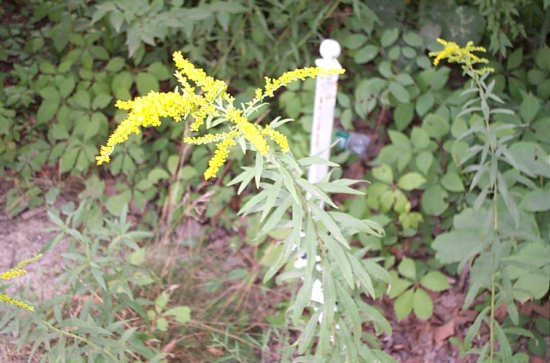
goldenrod

Slide 14
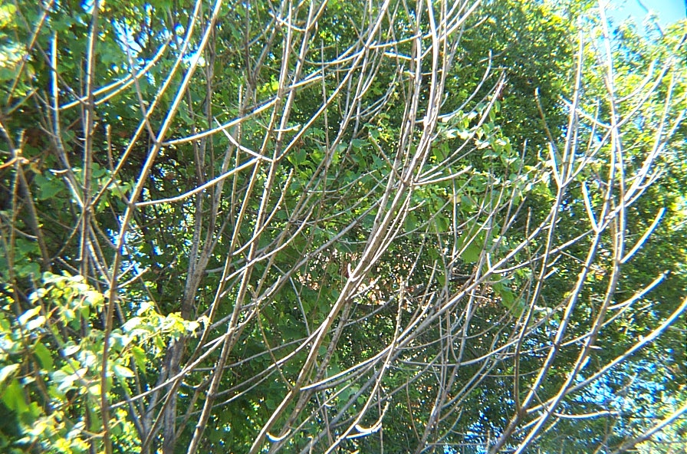
Ash

Slide 15
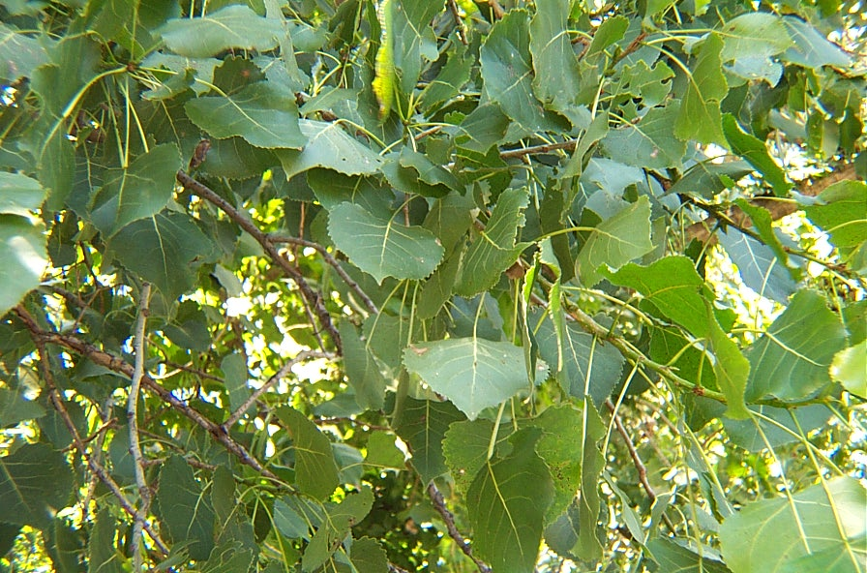
Aspen (poplar)

Slide 16
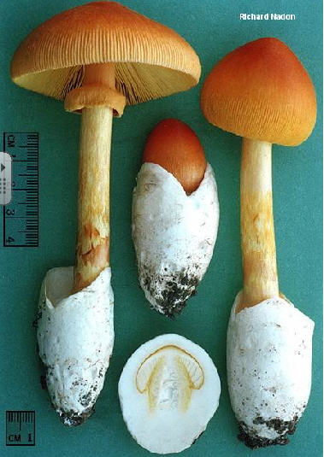
Mushroom

Slide 17
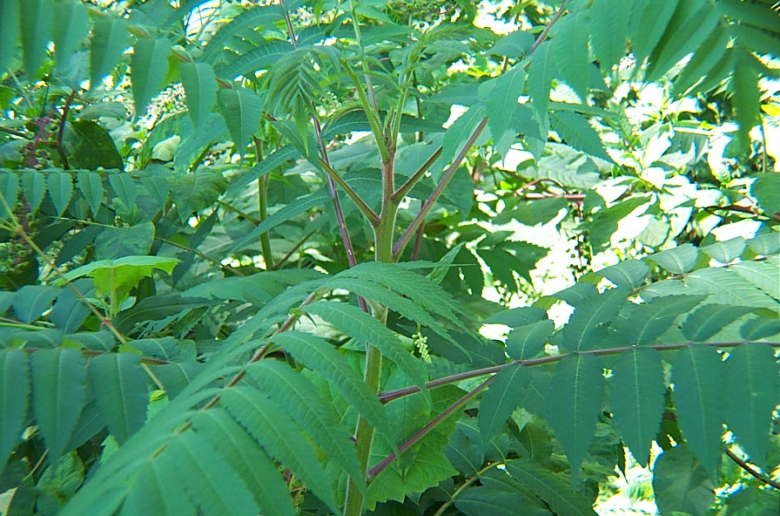
Sumac

Slide 18
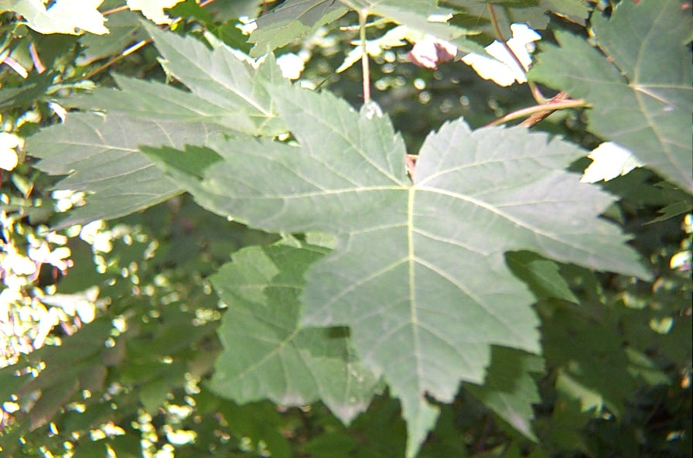
Red Maple
(Toothed Leaves)

Slide 19
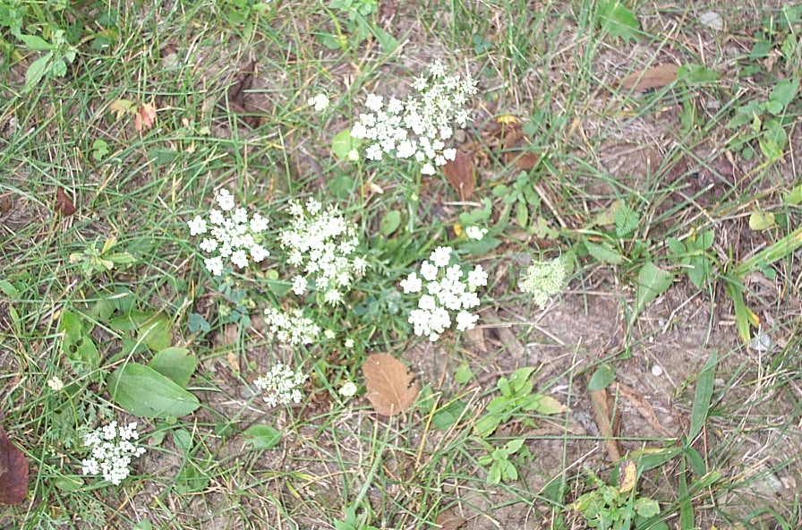
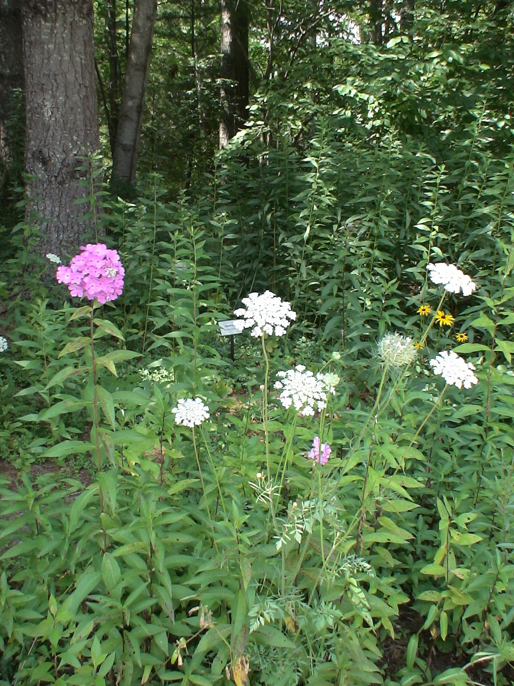
Wild Carrot

Slide 20
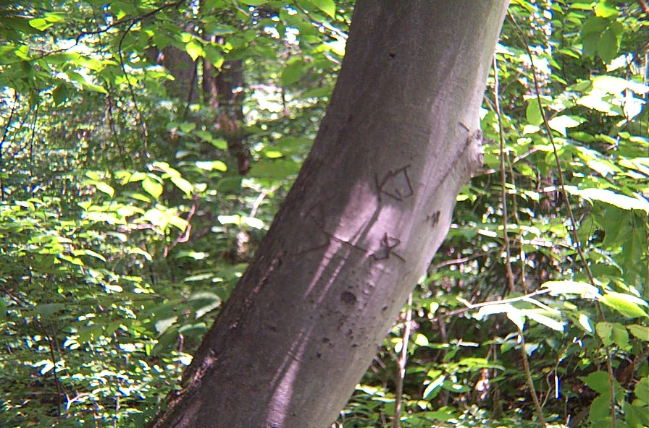
Beech

Slide 21
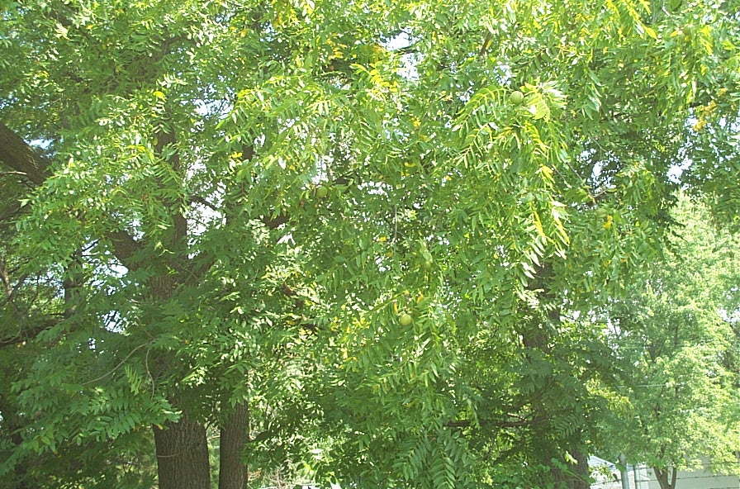
Walnut

Slide 22
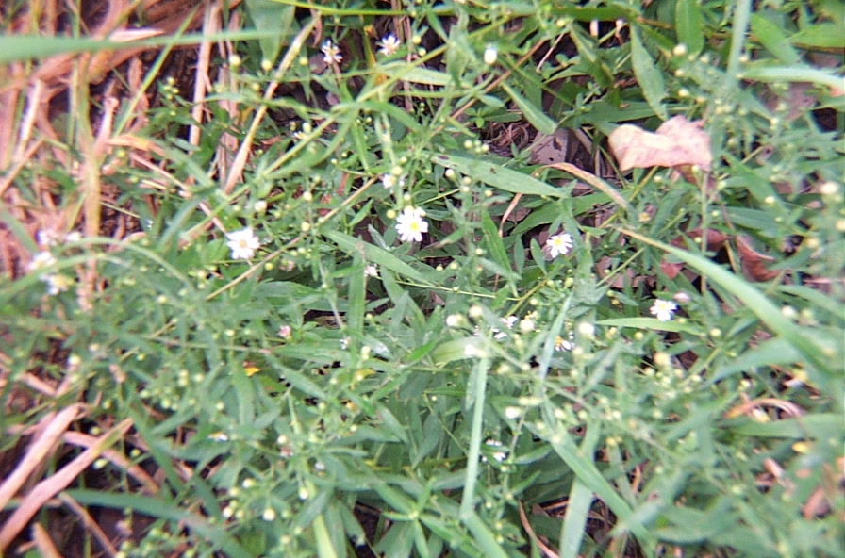
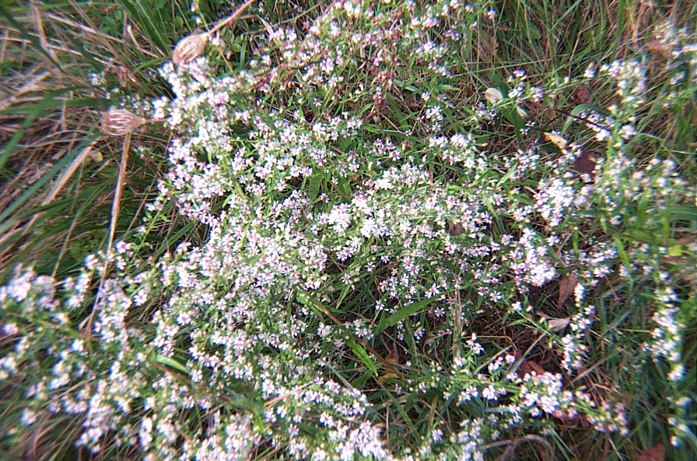
Aster

Slide 23
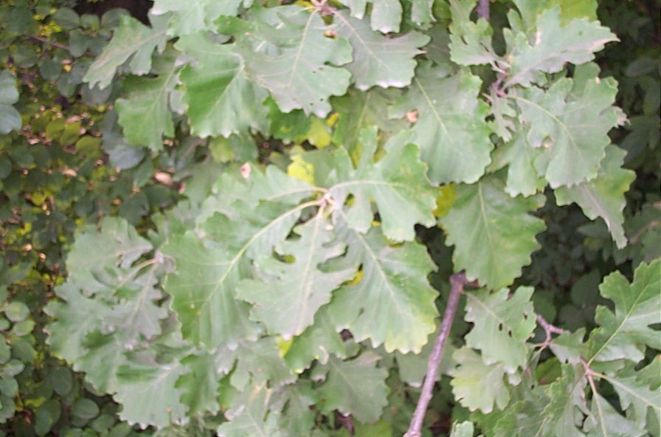
Chestnut Oak

Slide 24
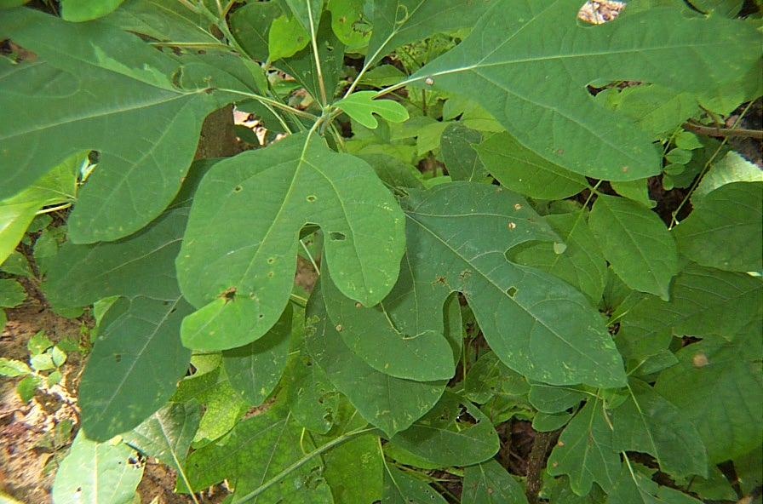
Sassafras

Slide 25
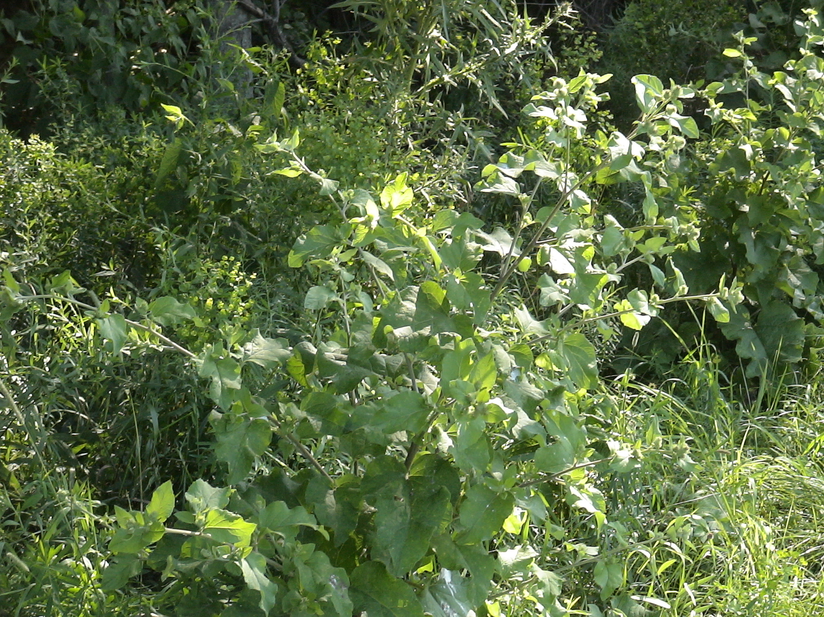
burdock

Slide 26
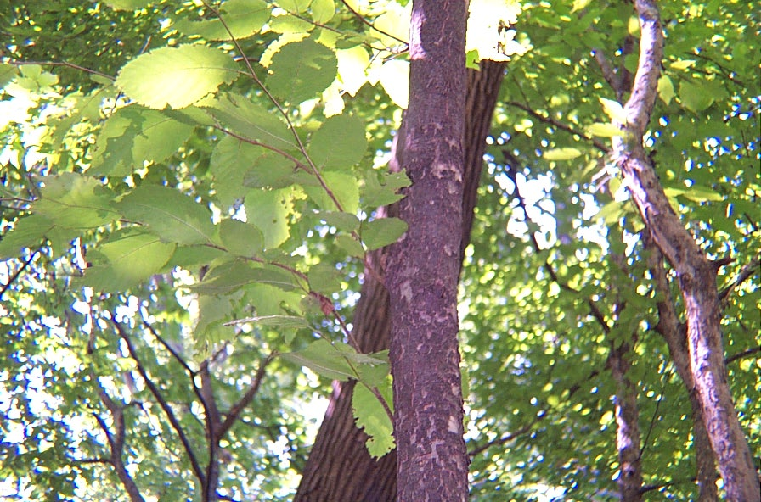
Hornbeam

Slide 27
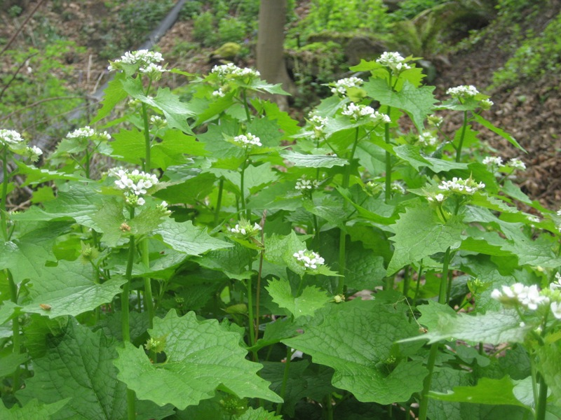
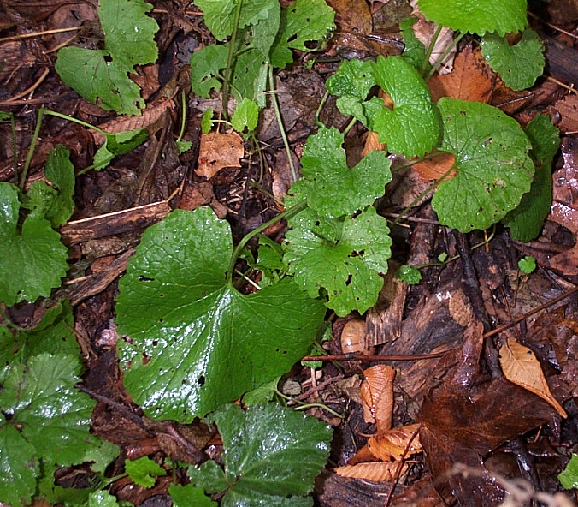
Garlic mustard

Slide 28
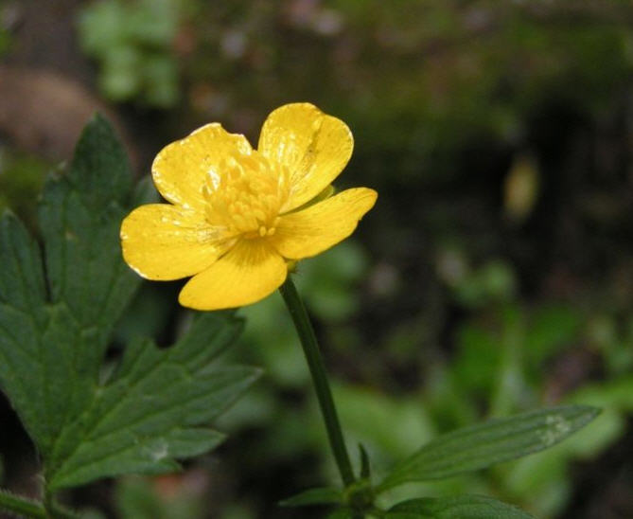
Buttercup

Slide 29
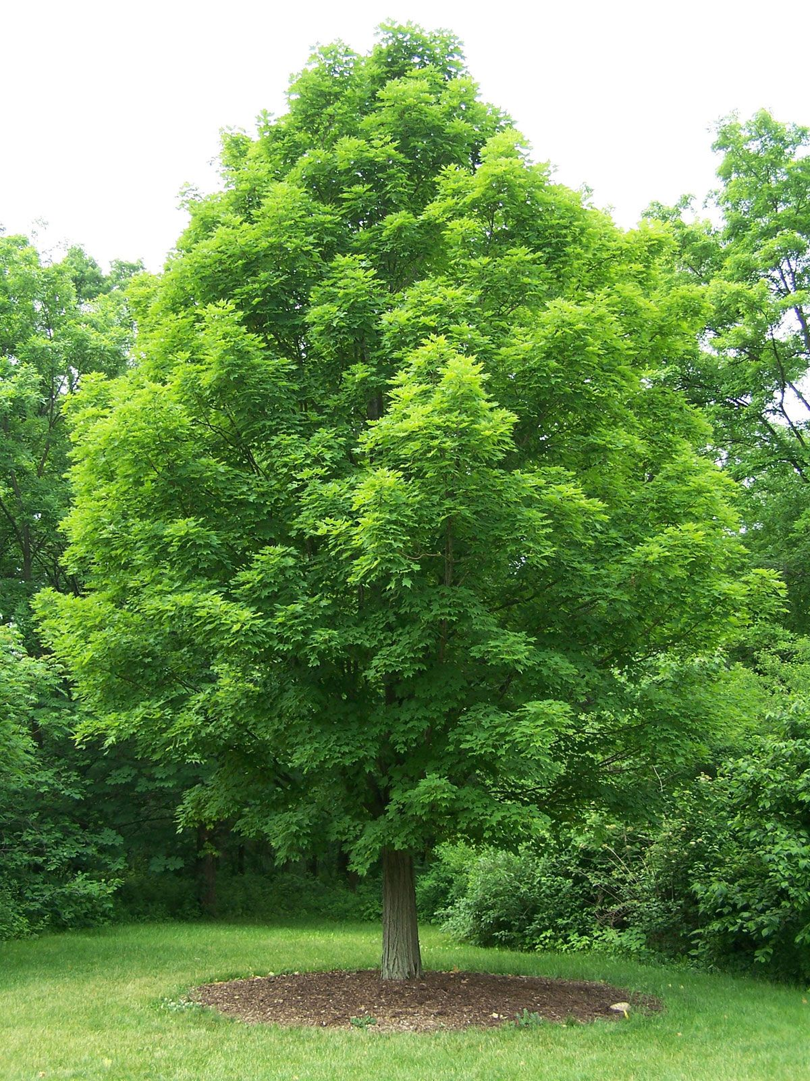
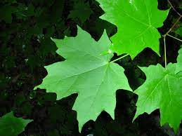
Sugar Maple

Slide 30
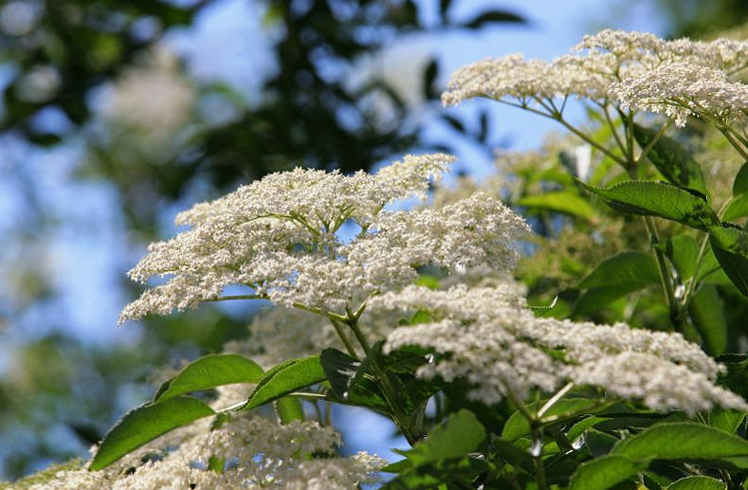
Elderberry

Slide 31
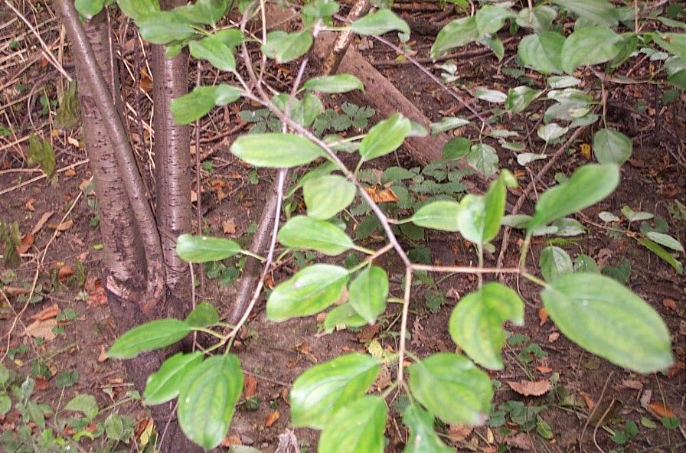
Birch

Slide 32
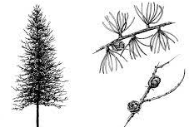
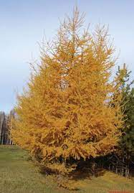
Tamarack

Slide 33
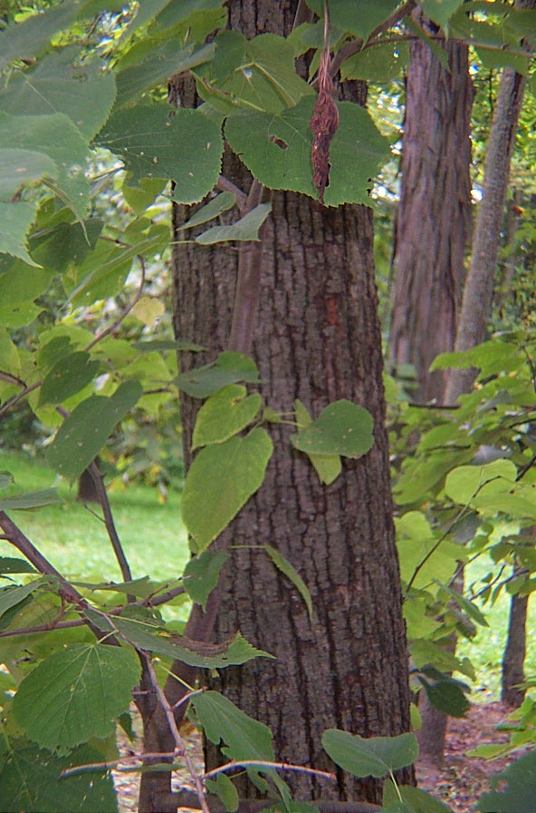
Basswood

Slide 34
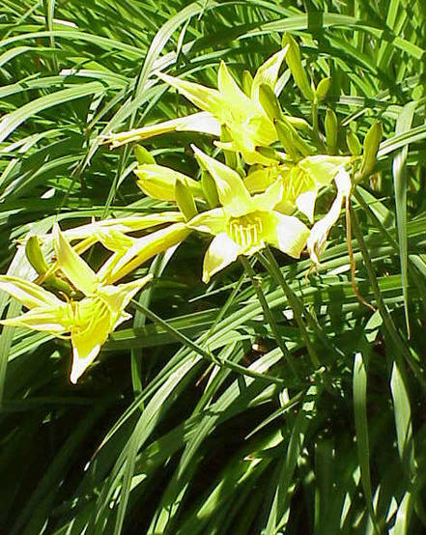
Daylily

Slide 35
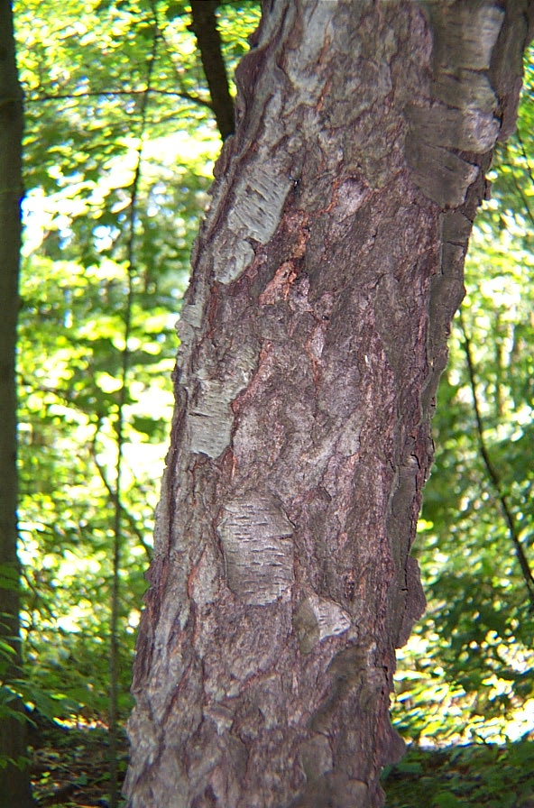
Cherry

Slide 36
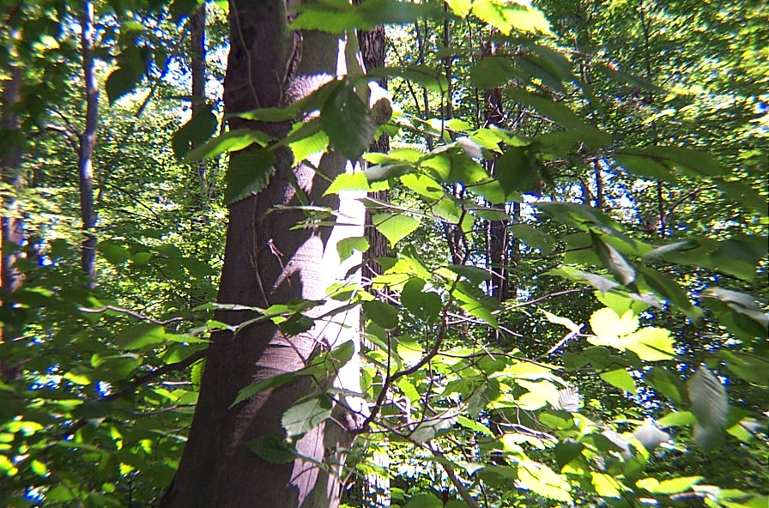
Beech

Slide 37
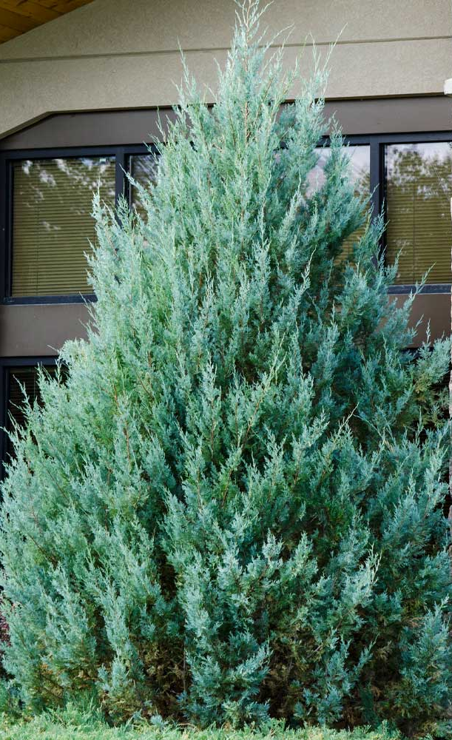
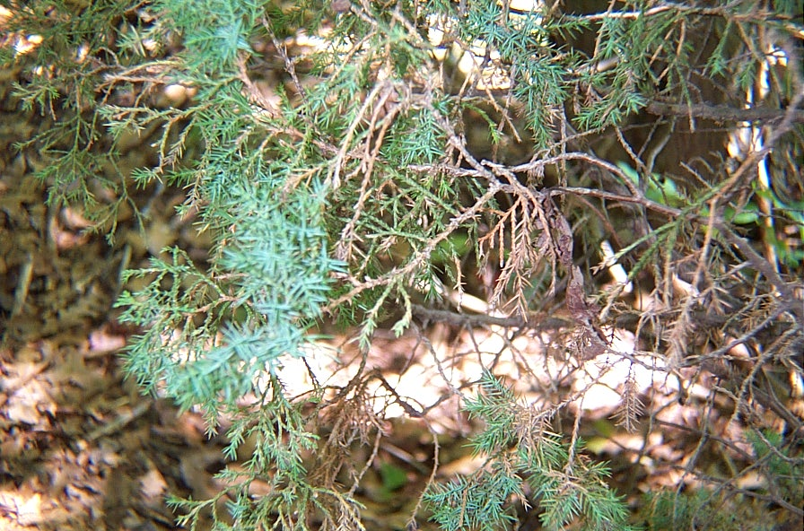
Juniper

Slide 38
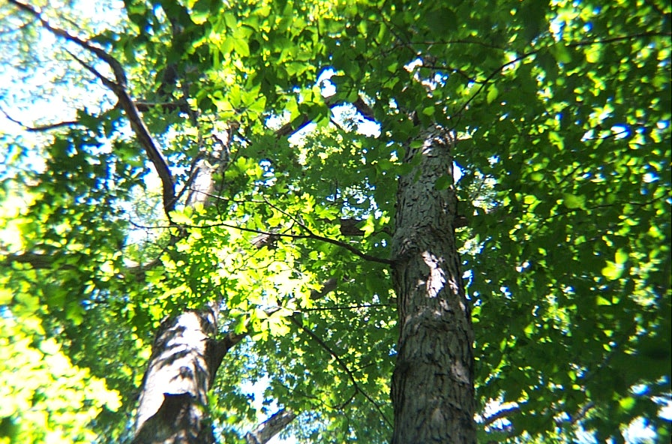
White Oak

Slide 39
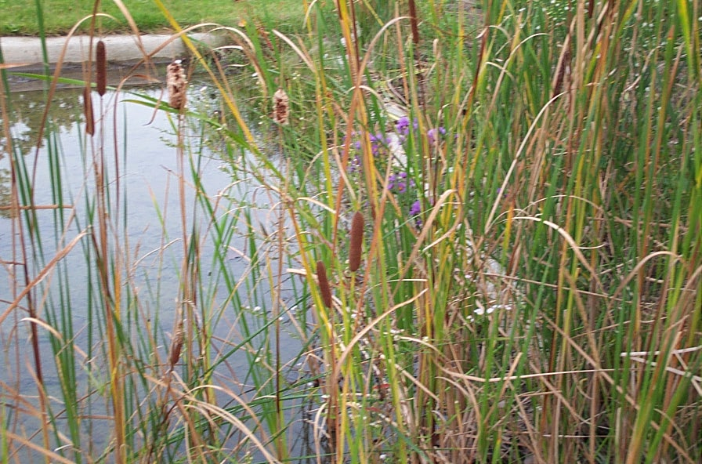
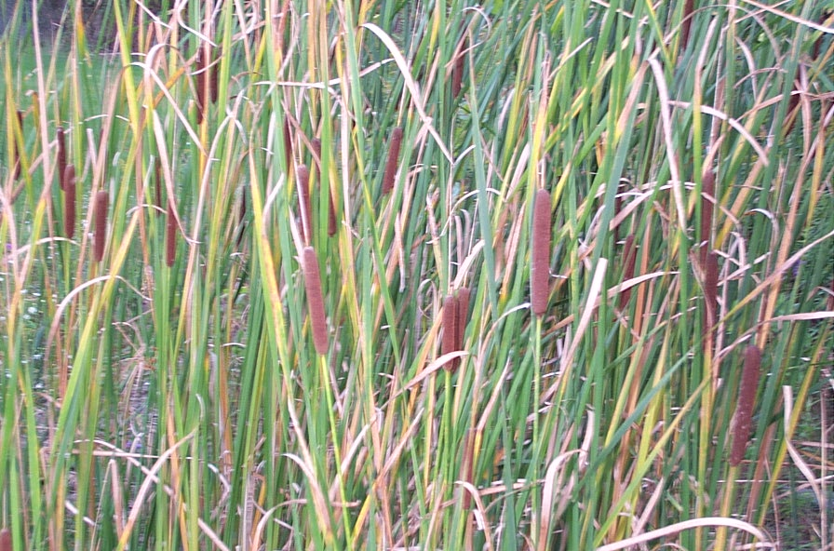
Cattail

Slide 40
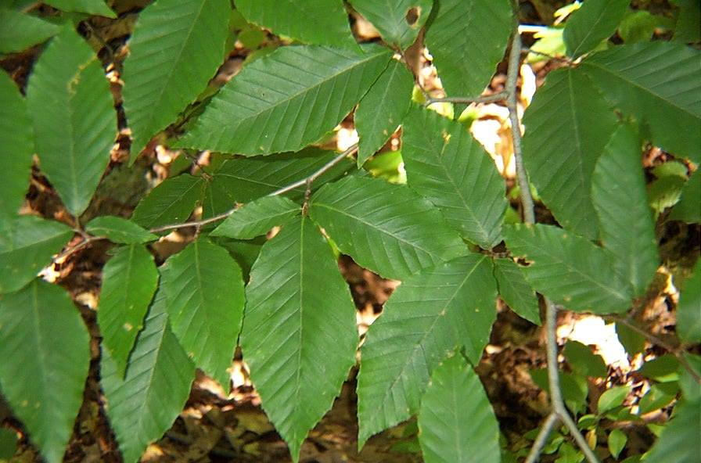
Beech

Slide 41
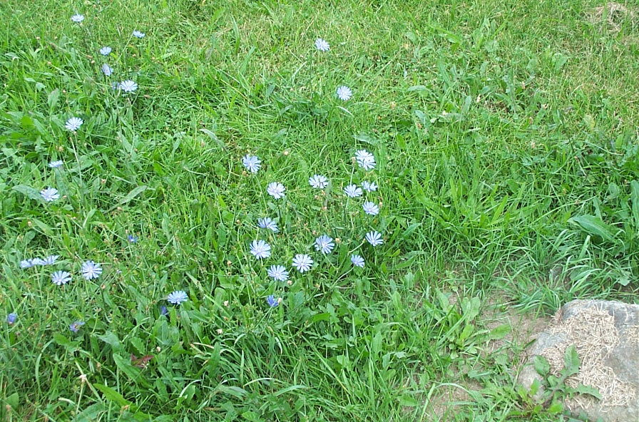
Chicory

Slide 42
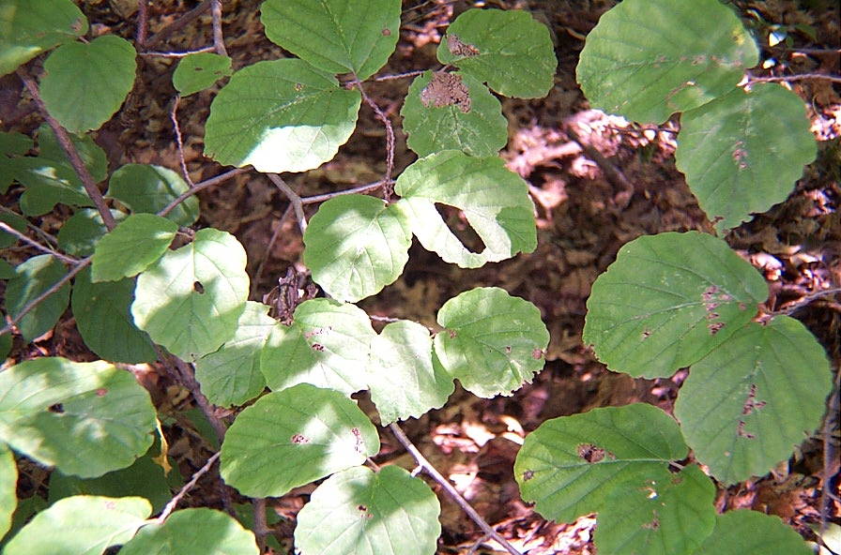
Alternate Dogwood

Slide 43
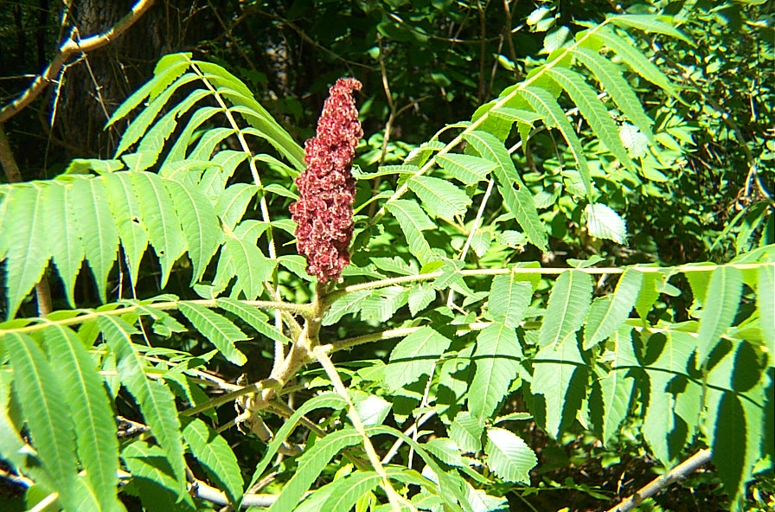
Sumac

Slide 44
Locust

Slide 45
Cherry

Slide 46
daylily

Slide 47
Shagbark Hickory

Slide 48
Jack in the Pulpit

Slide 49
Clover

Slide 50
Elderberry

Slide 51
Wild Strawberry

Slide 52
Crabapple

Slide 53
Ash

Slide 54
May Apple

Slide 55
Cherry

Slide 56
milkweed

Slide 57
White Oak

Slide 58
Red Pine

Slide 59
Black Eyed Susan

Slide 60
White Pine

Slide 61
Stinging Nettle

Slide 62
Aspen (poplar)

Slide 63
Apple

Slide 64
Daylily

Slide 65
Willow

Slide 66
Basswood

Slide 67
Hornbeam

Slide 68
Bull thistle

Slide 69
Bitternut Hickory

Slide 70
Musclewood
(blue Beech)

Slide 71
Dandelion

Slide 72
May Apple

Slide 73
Musclewood
(blue Beech)

Slide 74
CrabApple
(thorns)

Slide 75
Raspberry

Slide 76
Red Pine

Slide 77
Jimson Weed

Slide 78
Elm

Slide 79
Wild Mint

Slide 80
Lettuce

Slide 81
Jack in the Pulpit

Slide 82
Yew

Slide 83
Wild
Grape

Slide 84
Box Elder

Slide 85
Jewelweed
(Touch Me Not)

Slide 86
Red Pine

Slide 87
Skunk Cabbage

Slide 88
Shagbark Hickory

Slide 89
Violet

Slide 90
Shagbark Hickory

Slide 91
Chestnut Oak

Slide 92
Jerusalem Artichoke

Slide 93
Bitternut Hickory

Slide 94
Scotch Pine

Slide 95
Hornbeam

Slide 96
Striped Maple

Slide 97
Jewelweed
(Touch Me Not)

Slide 98
Basswood

Slide 99
Red Oak

Slide 100
Plantain

Slide 101
Buckthorn

Slide 102
Spruce

Slide 103
Ash

Slide 104
White Oak

Slide 105
Pignut Hickory

