Slide 1
Go to the “Slide Show” shade above
Click on “Play from Beginning”

Slide 2
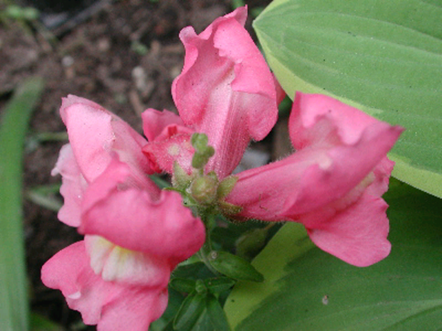
Inheritance Patterns
Chapter 13

Slide 3
Mendel’s LAW OF ? describes the Inheritance of a Single Character.
If the alleles of an inherited pair differ, then one determines the organism’s appearance and is called the ? Allele.
The other has no noticeable effect on the organism’s appearance and is called the ? Allele.
  The ? is the appearance or expression of a trait.
  The ? is the genetic makeup of a trait.
  The same ? (appearance) may be determined by more than one ?.

Slide 4
Mendel’s LAW OF SEGREGATION describes the Inheritance of a Single Character.
If the alleles of an inherited pair differ, then one determines the organism’s appearance and is called the Dominant Allele.
The other has no noticeable effect on the organism’s appearance and is called the Recessive Allele.
  The Phenotype is the appearance or expression of a trait.
  The Genotype is the genetic makeup of a trait.
  The same phenotype (appearance) may be determined by more than one genotype.

Slide 5
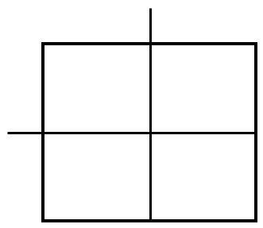
Using Probability and ? Squares to Work Genetics Problems
A homozygous tall pea plant (TT) is crossed with a homozygous short pea plant (tt). Use the law of ? to perform the Punnett square of the F₁ generation.
F₂ Generation
Phenotype:
Genotype:

Slide 6
Using Probability and ? Squares to Work Genetics Problems
A homozygous tall pea plant (TT) is crossed with a homozygous short pea plant (tt). Use the law of segregation to perform the Punnett square of the F₁ generation (both F₁ parents are Tt).
F₁ Generation
Sperm + egg → zygote
Tt Tt → F₂
T
t
F₂ Generation
Phenotype:
75% Tall
25% Short
Genotype:
25% Homozygous Tall
50% Heterozygous Tall
25% Homozygous Short
T
TT
Tt
t
Tt
tt

Slide 7
The LAW OF ? ? is revealed by tracking 2 Characters at once.
A ? Cross is a mating of parental varieties that differ in ? characters.
Mendel performed the following dihybrid cross with the following results:
  ? Generation: round yellow seeds × wrinkled green seeds
  ? Generation: all plants with round yellow seeds
  ? Generation:
    ?/16 had round yellow seeds
    ?/16 had wrinkled yellow seeds
    ?/16 had round green seeds
    ?/16 had wrinkled green seeds

Slide 8
The LAW OF INDEPENDENT ASSORTMENT is revealed by tracking Two Characters at once
A Dihybrid Cross is a mating of parental varieties that differ in two characters.
Mendel performed the following dihybrid cross with the following results:
  P Generation: round yellow seeds × wrinkled green seeds
  F₁ Generation: all plants with round yellow seeds
  F₂ Generation:
    9/16 had round yellow seeds
    3/16 had wrinkled yellow seeds
    3/16 had round green seeds
    1/16 had wrinkled green seeds

Slide 9
Lesson Objectives
  By the end of this lesson, you should be able to:
Define inheritance patterns that yield non-Mendelian dominance.
Describe incomplete dominance (blending) with examples.
Understand multiple alleles in terms of codominance and explain (map out) human blood typing, donors, recipients.
Understand sex determination, sex-linked traits & disorders.
Understand Polygenic Inheritance causing Continuous Variation, giving examples.
Explain Epistasis (gene modification).
  Science Practice: Build a Body & Blood Type Labs
Notes:
#frame
instructional video
Timing ≈ 0.5 minutes
Living organisms need energy to accomplish the wide variety of tasks they attempt each day.
You will begin learning about how energy is captured from the Sun and stored in organic molecules.
[read objectives]

Slide 10
Inheritance Patterns
Ways in which traits (genes) are inherited from generation to generation.
So far we have been discussing the traits controlled by one gene with only two alleles that are transmitted in a simple dominant/recessive nature.
There are many relationships which alleles can exhibit in nature that are NOT of a dominant/recessive nature.

Slide 11
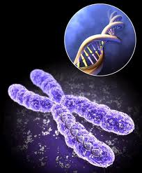
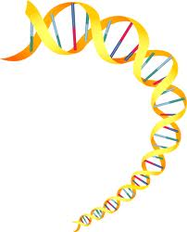
There are exceptions to Mendel’s principles. Not all genes show a pattern of dominance and recessiveness.
For some genes, there are more than two alleles.
Many times, traits are controlled by more than one gene.

Slide 12
Inheritance Patterns
  Incomplete “Intermediate” Dominance
  Multiple Alleles and Codominance
  Sex Determination & Sex-Linked Genes
  Polygenic Inheritance causing Continuous Variation
  Epistasis

Slide 13
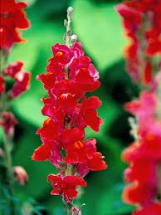
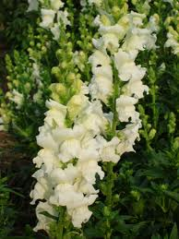
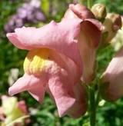
Incomplete Dominance
Occurs when there are no forms of the gene that are dominant.
F1 hybrids have an appearance somewhat in- between the phenotypes of the two parental varieties.
The resulting trait is a BLEND of the two parental traits.

Slide 14
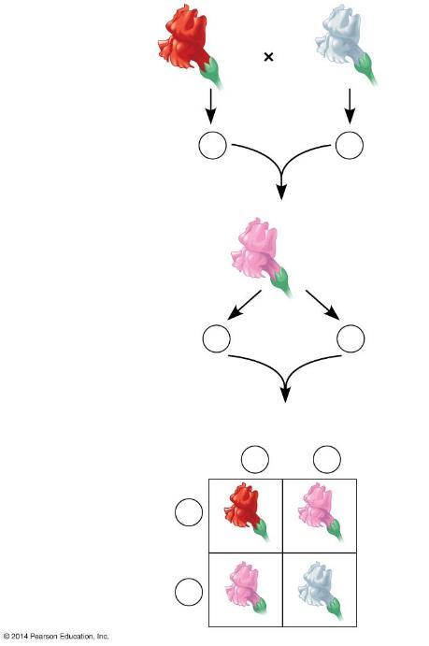
P generation
Red
RR
White
rr
Gametes
R
r
Notes:
Figure 9.11a-0 Incomplete dominance in snapdragon flower color

Slide 15
P generation
Red
RR
White
rr
Gametes
R
r
F₁ generation
Pink hybrid
Rr
Gametes
1
2
R
1
2
r
Notes:
Figure 9.11a-0 Incomplete dominance in snapdragon flower color

Slide 16
P generation
Red
RR
White
rr
Gametes
R
r
F₁ generation
Pink hybrid
Rr
Gametes
1
2
R
1
2
r
F₂ generation
Sperm
1
2
R
1
2
r
1
2
R
RR
Rr
Eggs
Snapdragon Flowers
1
2
Rr
rr
r
Notes:
Figure 9.11a-0 Incomplete dominance in snapdragon flower color

Slide 17
P generation
INTERMEDIATE dominance can also be expressed with BOTH alleles being dominant.
Red
RR
White
WW
Gametes
R
W
F₁ generation
Pink hybrid
Rr
The HETEROZYGOUS individuals show the intermediate effects of both alleles.
Gametes
1
2
R
1
2
W
F₂ generation
Sperm
1
2
R
1
2
W
1
2
R
RR
RW
Eggs
Snapdragon Flowers
1
2
RW
WW
W
Notes:
Figure 9.11a-0 Incomplete dominance in snapdragon flower color

Slide 18
Incomplete Dominance
Blending Inheritance, Co-Dominance Inheritance, Intermediate Dominance
The phenotype ratios and genotype ratios are always the same.
One can always tell that blending is involved if there are TWO EXTREMES and a “BLENDING” intermediate of these two extremes to make up the third characteristics.
If a phenotype shows 3 traits, it involves blending.
  Type of inheritance in which the HETEROZYGOUS individuals show the effects of both alleles.

Slide 19
Multiple Alleles: Many Genes have more than Two Alleles in the Population
Although each individual carries, at most, two different alleles for a particular gene, in cases of Multiple Alleles, more than two possible alleles exist in a Population.
Human ABO Blood Group phenotypes involve three alleles for a single gene (in the same locus).
The four human blood groups, A, B, AB, and O, result from combinations of these three alleles.
The A and B alleles are both expressed in heterozygous individuals, making both alleles Codominant.

Slide 20
Multiple Alleles
HUMAN ABO BLOOD TYPING
I^{A} | I = immunoglobulin (protein) on the Red Blood Cell; “A” is a polysaccharide
I^{B} | “B” is a polysaccharide on the immunoglobulin
i | Neither polysaccharide (“A” or “B” is present on the immunoglobulin of the red blood cell

Slide 21
Multiple Alleles
HUMAN ABO BLOOD TYPING
I^{A} | I = immunoglobulin (protein) on the Red Blood Cell; “A” is a polysaccharide
I^{B} | “B” is a polysaccharide on the immunoglobulin
i | Neither polysaccharide (“A” or “B” is present on the immunoglobulin of the red blood cell

Slide 22
Multiple Alleles
HUMAN ABO BLOOD TYPING
I^{A} | I = immunoglobulin (protein) on the Red Blood Cell; “A” is a polysaccharide
I^{B} | “B” is a polysaccharide on the immunoglobulin
i | Neither polysaccharide (“A” or “B”) is present on the immunoglobulin of the red blood cell

Slide 23
Multiple Alleles
HUMAN ABO BLOOD TYPING
        Blood Types and possible genotypes
Blood Type | Possible Genotype
A | I^{A} I^{A} or I^{A} i
B | I^{B} I^{B} or I^{B} i
AB | I^{A} I^{B}
O | i i

Slide 24
Multiple Alleles
HUMAN ABO BLOOD TYPING
        Blood Types and possible genotypes
Blood Type | Possible Genotype
A | I^{A} I^{A} or I^{A} i
B | I^{B} I^{B} or I^{B} i
AB | I^{A} I^{B}
O | i i

Slide 25
Multiple Alleles
HUMAN ABO BLOOD TYPING
        Blood Types and possible genotypes
Blood Type | Possible Genotype
A | I^{A} I^{A} or I^{A} i
B | I^{B} I^{B} or I^{B} i
AB | I^{A} I^{B}
O | i i

Slide 26
Multiple Alleles
HUMAN ABO BLOOD TYPING
        Blood Types and possible genotypes
Blood Type | Possible Genotype
A | I^{A} I^{A} or I^{A} i
B | I^{B} I^{B} or I^{B} i
AB | I^{A} I^{B}
O | i i

Slide 27
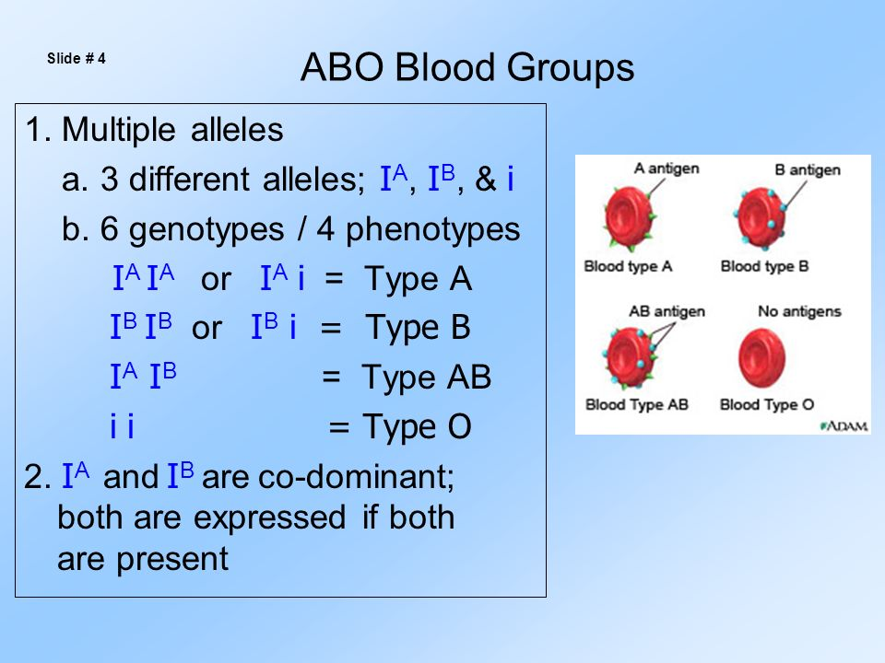
Dear Abby - YOU DECIDE THE SOLUTION SCIENTIFICALLY
“I discovered quite by accident that one of my children has an entirely different blood type than mine. I made some inquiries and have been informed it is not possible for me to be this boy’s father. Obviously my wife has been unfaithful to me. After more than 12 years of a fairly happy marriage, I am at a loss as to what I should do. Should I confront my wife with this and demand she tell me the whole story? Or since there is nothing I can do about it now, should I keep my mouth shut and try to live with this very disturbing knowledge? SHOCKED & UNDECIDED”
Dear Shocked,
You have been misinformed. It IS possible for a child to have an entirely different blood type than the father. So unless you have more conclusive evidence to support your suspicions, the word from here is “cool it, dad.”

Slide 28
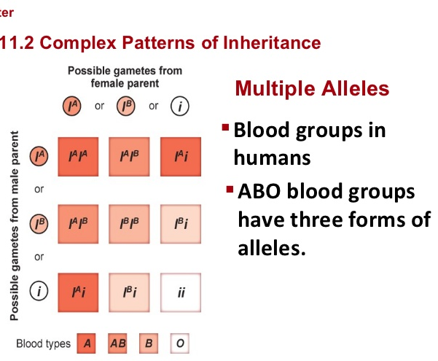

Slide 29
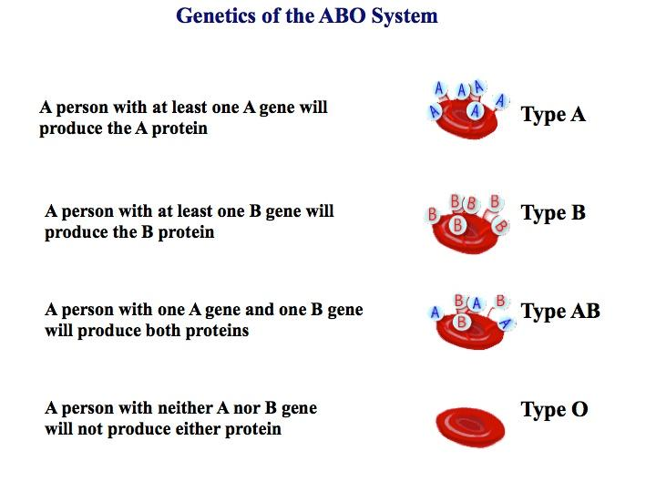
A person with blood type A will produce the A antigen (polysaccharide).
The body produces antibodies against antigen B (polysaccharide).

Slide 30
A person with blood type B will produce the B antigen (polysaccharide).
The body produces antibodies against antigen A (polysaccharide).

Slide 31
A person with blood type AB will produce both antigen A and antigen B (different polysaccharides).
The body does NOT produce antibodies against either antigen A and antigen B (Polysaccharides).

Slide 32
A person with blood type O will produce NEITHER antigen A or antigen B (polysaccharides).
The body produces antibodies against both antigen A and antigen B (Polysaccharides).

Slide 33
A person with blood type A will produce the A antigen (polysaccharide).
The body produces antibodies against antigen B (polysaccharide).
A person with blood type B will produce the B antigen (polysaccharide).
The body produces antibodies against antigen A (polysaccharide).
A person with blood type AB will produce both antigen A and antigen B (different polysaccharides).
The body does NOT produce antibodies against either antigen A and antigen B (Polysaccharides).
A person with blood type O will produce NEITHER antigen A or antigen B (polysaccharides).
The body produces antibodies against both antigen A and antigen B (Polysaccharides).

Slide 34
Antibodies
Our bodies possess antibodies which fight “foreign” substances called “antigens”.
Polysaccharides A and B are considered foreign substances (antigens) in a different person.
Typing Blood is extremely important when receiving blood from others.
Antibodies will cause agglutination in the blood when the polysaccharide is attacked by the antibody.
Person with Blood Type: | Produces Antibodies Against
A | B
B | A
O | A, B
AB | none

Slide 35
Blood Donation and Receiving
Complete the Table of possible recipients
and donors for a “blood bank”
Recipient | Donors
A | ?
B | ?
O | ?
AB | ?
Why do vampires stop work at midnight?
[To take a coffin break]

Slide 36
Blood Donation and Receiving
Table of possible recipients and donors for a “blood bank”
Recipient | Donors
A | A, O
B | B, O
O | O
AB | AB, A, B, O
A person with blood type O is a universal donor (can donate to any blood type) because type O forms antibodies against type A & B, but does not have any antigens for others to attack.
A person with blood type AB is a universal recipient (can receive any blood type) because type AB forms NO antibodies.

Slide 37
Multiple Alleles
Example:
homozygous male Type B (I^{B}I^{B})
x
heterozygous female Type A (I^{A}i)
I^{A}
i
I^{A}I^{B}
I^{B}i
I^{B}
1/2 = I^{A}I^{B}
1/2 = I^{B}i
I^{B}
I^{A}I^{B}
I^{B}i

Slide 38
Multiple Alleles
Charlie Chaplin (world famous comedian in original movies) was accused of being a child’s father in Court (1940).
Blood Type
O | Chapman
A | Mother
B | Child
?

Slide 39
Multiple Alleles
Charlie Chaplin (world famous comedian in original movies) was accused of being a child’s father in Court (1940).
Blood Type
O | Chapman
A | Mother
B | Child
NOT possible!
I^{A}
I^{A}
I^{A}
i
I^{A}i
I^{A}i
I^{A}i
ii
i
i
i
I^{A}i
I^{A}i
i
I^{A}i
ii

Slide 40
Multiple Alleles
If a boy has a blood type O and his sister has blood type AB, what are the genotypes and phenotypes of their parents?
Boy - type O (ii)
X
Girl - type AB (I^{A}I^{B})

Slide 41
Multiple Alleles
Answer:
I^{A}
i
Parents:
genotypes = I^{A}i and I^{B}i
phenotypes = A and B
I^{B}
I^{A}I^{B}
i
ii

Slide 42
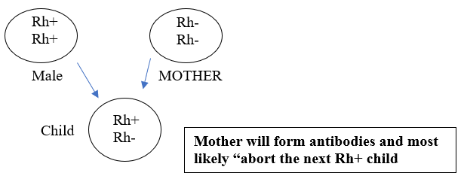
Rh Factor
There is another factor to consider, however (Rh factor).
Blood type is actually given as: O+, O-, A+, A-, B+, B-, AB+, AB-.
Discovered first in the Rhesus monkey, hence “Rh” factor.
Mothers can form antibodies against the “Rh factor” after having a child with the factor.
T wo alleles: Rh+ has the factor, Rh- does not have the factor.

Slide 43
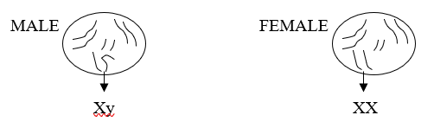
Sex Determination
1. The determination of sex is due to an accumulation of a number of genes located on Sex Chromosome.
2. Sex determination was first discovered in Fruit Flies (Drosophila melanogaster).

Slide 44
Sex Determination
1. Body cells vs. gametes in humans
22 homologous pairs of autosomes (44 chromosomes) – determine non-sex related traits
1 homologous pair of sex chromosomes (2 chromosomes) – determine sex related traits
2. Gametes
haploid chromosome number (23 chromosomes)
sex is determined by the sex chromosomes

Slide 45
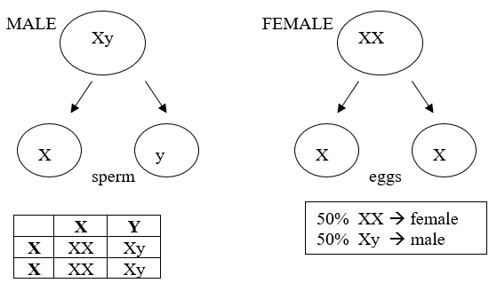
Sex Determination
The sex of the offspring is determined by the MALE gametes:
Sperm has TWO kinds of chromosome possibilities (X and y).
Eggs have only ONE kind of chromosome (X).

Slide 46
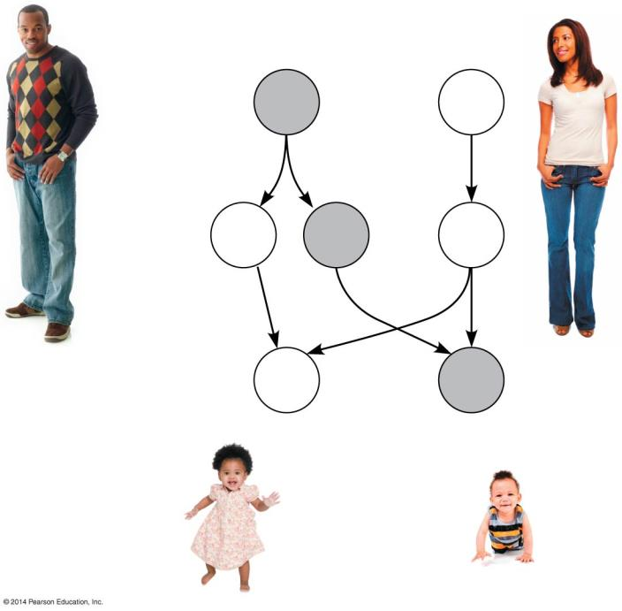
Male
Female
Parents
(diploid)
44
+
XY
44
+
XX
Gametes
(haploid)
22
+
X
22
+
Y
22
+
X
Sperm
Egg
Offspring
(diploid)
44
+
XX
44
+
XY
Female
Male
44 autosome
2 sex chromosomes
Notes:
Figure 9.20b-0 The X-Y system

Slide 47
Sex-Linked Genes
Traits that are inherited directly based on the sex chromosomes not on the autosomes.
Traits are most commonly carried on the X chromosome.
Sex-Linked Traits – carried only on the non-homologous portion of the X chromosome (where there is no matching allele in the y chromosome for the male).
Where ever there is a sex-linked trait, males always possess it, but females must be homozygous recessive to show the trait.

Slide 48
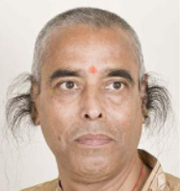
Sex-Linked Genes
The Y chromosome has very little genetic information and therefore, carries very little sex-linkage.
Holandric Traits – carried only on the y chromosome and therefore only appears in males.
Hypertrichosis pinnae - causes excessive hair in the ear.
Male infertility - males can't produce offspring.
Retinitous pigmentosa - causes gradual decline in vision.
Color blindness - inability to see some color or color differences.

Slide 49
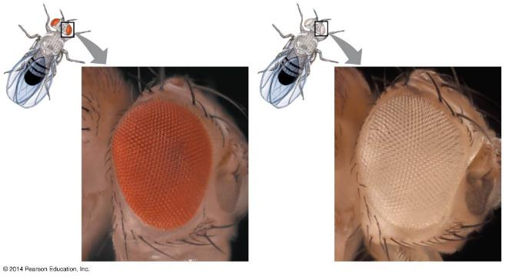
Sex-Linked Genes exhibit a unique pattern of inheritance
Sex-Linked Genes are located on either of the sex chromosomes.
All the other chromosomes (autosomes) are present but do not affect the transmission of the trait.
Example: White eye color in the fruit fly is an
X-linked recessive trait

Slide 50
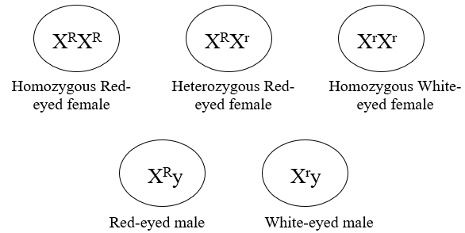
Sex-Linked Genes
Eye color in fruit flies

Slide 51
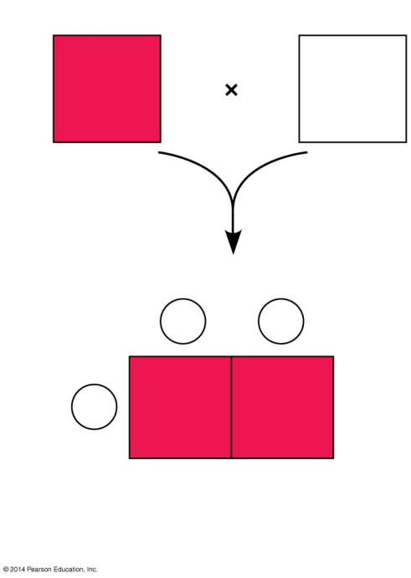
Female
Male
X^{R}X^{R}
X^{r}Y
R = red-eye allele
r = white-eye allele
Sperm
X^{r}
Y
Eggs
X^{R}
X^{R}X^{r}
X^{R}Y
Notes:
Figure 9.21b A homozygous, red-eyed female crossed with a white-eyed male

Slide 52
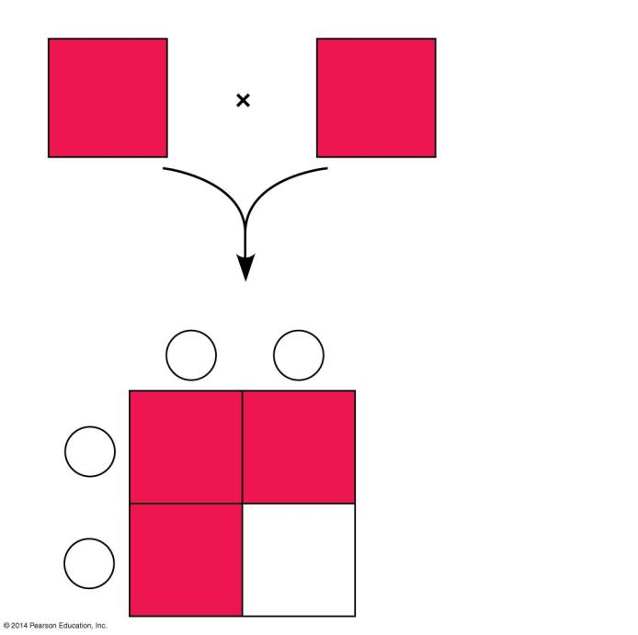
Female
Male
X^{R}X^{r}
X^{R}Y
R = red-eye allele
Sperm
r = white-eye allele
X^{R}
Y
X^{R}
X^{R}X^{R}
X^{R}Y
Eggs
X^{r}
X^{r}X^{R}
X^{r}Y
Notes:
Figure 9.21c A heterozygous female crossed with a red-eyed male

Slide 53
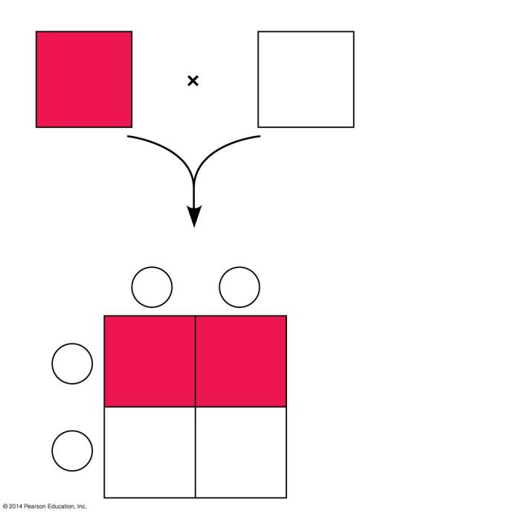
Female
Male
X^{R}X^{r}
X^{r}Y
R = red-eye allele
Sperm
r = white-eye allele
X^{r}
Y
X^{R}
X^{R}X^{r}
X^{R}Y
Eggs
X^{r}
X^{r}X^{r}
X^{r}Y
Notes:
Figure 9.21d A heterozygous female crossed with a white-eyed male

Slide 54
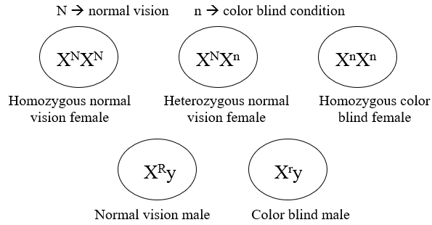
Human Sex-Linked Disorders affect mostly Males
Most sex-linked human disorders are
  due to recessive alleles
  seen mostly in males
A male receiving a single X-linked recessive allele from his mother will have the disorder.
A female must receive the allele from both parents to be affected.

Slide 55
Human Sex-Linked Disorders affect mostly Males
Recessive and Sex-Linked human disorders include:
  Hemophilia, characterized by excessive bleeding because hemophiliacs lack one or more of the proteins required for blood clotting.
  Red-Green Colorblindness, a malfunction of light-sensitive cells in the eyes.
  Duchenne Muscular Dystrophy, a condition characterized by a progressive weakening of the muscles and loss of coordination.

Slide 56
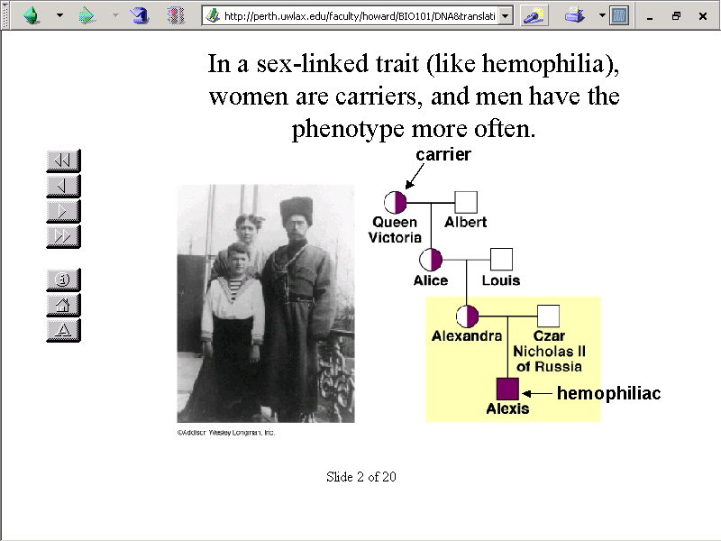
Sex-Linked Disorders

Slide 57
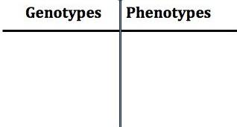
A normal woman, whose father had hemophilia, married a normal man. What is the chance of hemophilia in their children?
What is the genotype of the woman’s father?
What is the genotype of the woman?
What is the genotype of the man?

Slide 58
A normal woman, whose father had hemophilia, married a normal man. What is the chance of hemophilia in their children?
What is the genotype of the woman’s father?
What is the genotype of the woman?
What is the genotype of the man?
X^{h}Y
X^{H}X^{h}
X^{H}Y
X^{H} X^{h}
X^{H}
Y
X^{H}X^{H}
X^{H}X^{h}
1/4 X^{H}X^{H}
1/4 X^{H}X^{h}
1/4 X^{H}Y
1/4 X^{h}Y
2/4 Normal female
1/4 Normal male
1/4 Hemophiliac male
X^{H}Y
X^{h}Y

Slide 59
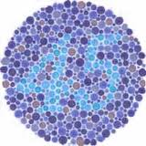
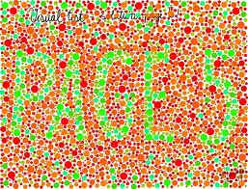

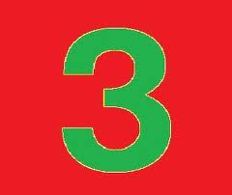
The gene for colorblindness is carried on the X chromosome and is recessive. A man, whose father was colorblind, has a colorblind daughter.
Is this man colorblind? How do you know?
Where did the man get his gene for colorblindness?
Must the fathers of all colorblind girls be colorblind? Explain.

Slide 60
The gene for colorblindness is carried on the X chromosome and is recessive. A man, whose father was colorblind, has a colorblind daughter.
Is this man colorblind? How do you know?
Yes. The colorblind daughter had to get one of her genes for colorblindness from her father.
Where did the man get his gene for colorblindness?
A man gets his gene for colorblindness from his mother. He gets his Y chromosome from his father.
Must the fathers of all colorblind girls be colorblind? Explain.
Yes. For a girl to be colorblind, she must inherit the colorblind gene from each parent.

Slide 61
Polygenic Inheritance: a Single Character may be Influenced by Many Genes
Many characters result from Polygenic Inheritance
  a single phenotypic characteristic results from the additive effects of two or more genes scattered on various homologous chromosomes.
  in different loci.
Many genes affect one individual trait, showing a gradation or gradient of small differences in expression. This is known as Continuous Variation in the phenotype.
  There is no clear-cut distinction in the genes – the number of genes involved is not known.
  Examples: Human Skin Color and Height

Slide 62
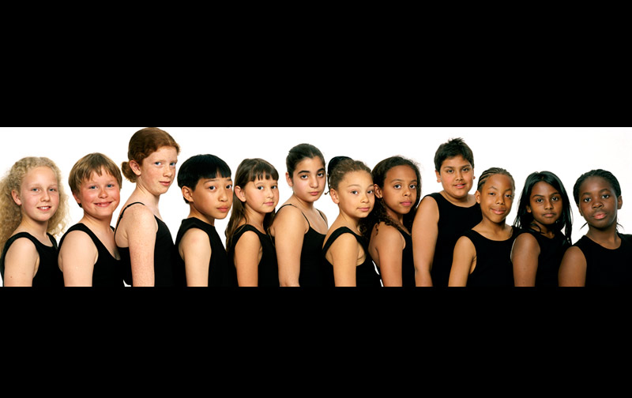
Continuous Variation in Human Skin Color as a Result of
Polygenic Inheritance

Slide 63
Polygenic Inheritance: a Single Character may be Influenced by Many Genes
Human Skin Color:
  This is controlled by as many as 6 genes, each with its own alleles.
  The alleles control the production of melanin, which is a pigment that colors skin.
  In this example, the calculation is performed with 3 genes each with 2 alleles.
  The cross is between two individuals heterozygous for all 3 genes.

Slide 64
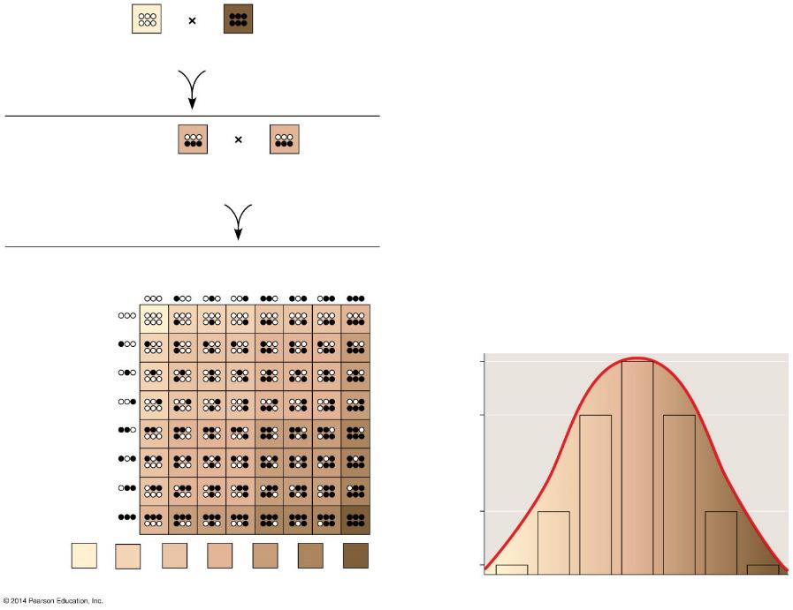
P generation
aabbcc
(very light)
AABBCC
(very dark)
  Allele Key:
  A = adds melanin B = adds melanin
  a = no melanin added b = no melanin added
Notes:
Figure 9.14-0 A model for polygenic inheritance of skin color

Slide 65
P generation
aabbcc
(very light)
AABBCC
(very dark)
  Allele Key:
  A = adds melanin B = adds melanin
  a = no melanin added b = no melanin added
F₁ generation
AaBbCc
(medium
shade)
AaBbCc
(medium
shade)
Notes:
Figure 9.14-0 A model for polygenic inheritance of skin color

Slide 66
P generation
aabbcc
(very light)
AABBCC
(very dark)
  Allele Key:
  A = adds melanin B = adds melanin
  a = no melanin added b = no melanin added
F₁ generation
AaBbCc
(medium
shade)
AaBbCc
(medium
shade)
Sperm
1
8
1
8
1
8
1
8
1
8
1
8
1
8
1
8
F₂ generation
1
8
1
8
20
64
1
8
1
8
15
64
Eggs
1
8
1
8
Fraction of population
1
8
1
8
6
64
1
64
1
64
6
64
15
64
20
64
15
64
6
64
1
64
Skin color
Notes:
Figure 9.14-0 A model for polygenic inheritance of skin color

Slide 67
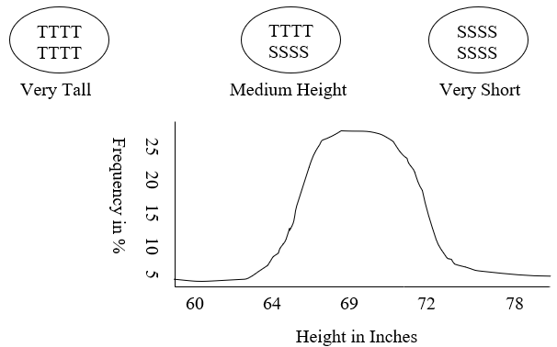
Polygenic Inheritance: a Single Character may be Influenced by Many Genes
Human Height
  Assume that 4 pairs of genes are involved (8 alleles).
  Extremes are represented by only a few individuals.
  Multiple Gene Inheritance has been found with up to 5 different genes involved.

Slide 68
Epistasis (Modifier Genes)
Occurs when one or more genes that do not code for a trait modify the way the trait is expressed.
Modifier Genes do not code directly for a trait, but influence how the gene or genes that do code for the trait are expressed.
So even though an organism may have a gene coding for a trait, the trait may not be expressed because of the epistatic interaction causing suppression of the trait for which the gene codes.

Slide 69
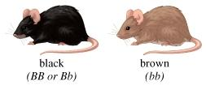
Epistasis (Modifier Genes)
Example: Mice Coat Colors
Mice have two coat colors: Black and Brown.
Black (BB/Bb) is dominant to the Brown (bb).
A mouse homozygous dominant or heterozygous will have black coat.
A mouse homozygous recessive will have Brown coat.
However, there is another gene that determines whether the pigment will be deposited or not.

Slide 70
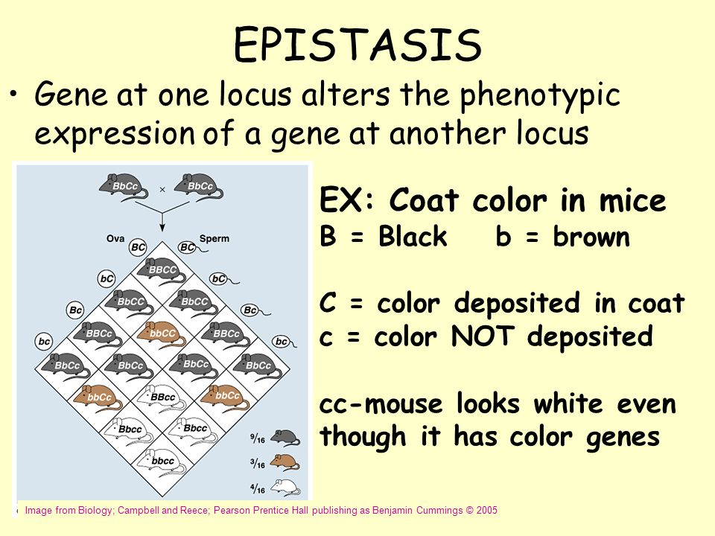

Slide 71
Epistasis (Modifier Genes)
One parent is homozygous dominant (BB) bald.
One parent is homozygous normal hair (bb).
Show the genotype and phenotype of the P, F₁, and F₂ generations.
Male & Female Pattern Baldness
The recessive trait causes hormone repression of the dominant trait.

Slide 72
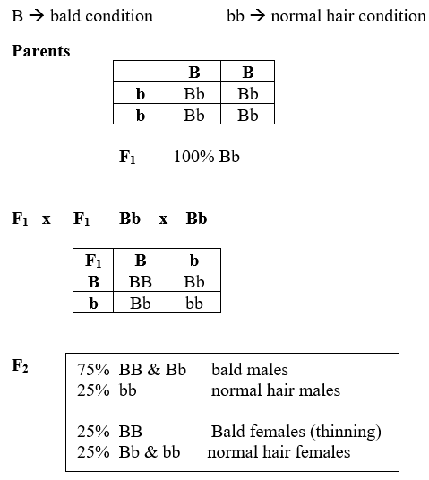
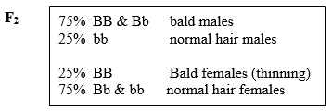
Epistasis (Modifier Genes)
Male & Female Pattern Baldness
The female sex hormone represses the expression of a dominant gene when in the HETEROZYGOUS state
In the heterozygous state, the recessive alleles cause repression by the female hormone, it’s as if the recessive alleles become dominant.

Slide 73
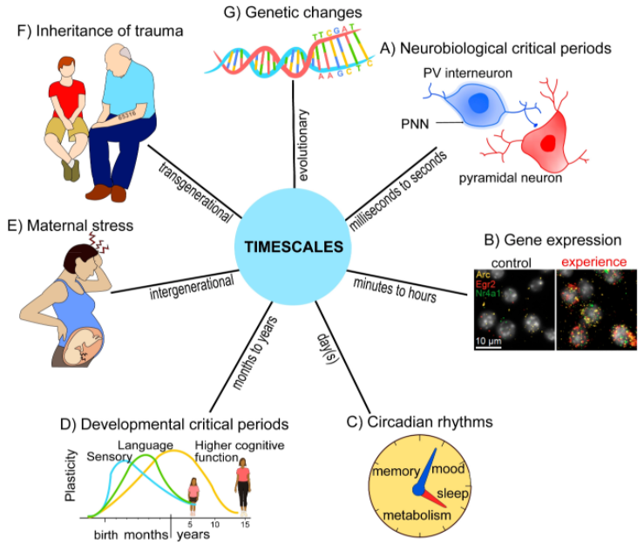
Genes and the Environment
Gene Expression is always the result of the interaction of:
Genetic Potential
with the
Environment

Slide 74
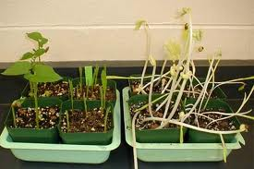
Genes and the Environment
A seedling may have the genetic capacity to be green, to flower, and to fruit, but it will never do these things if it is kept in the dark.
A tree may never grow tall if the soil is poor and no water is available.
Plants grown in light
Plants grown in darkness
In other words, the presence of the gene is not all that is required for the expression of a trait. The gene must be present along with the proper environmental conditions.
The Phenotype of any organism is the result of interaction between Genes and the Environment.

Slide 75
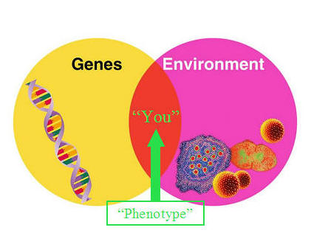
Genes and Environment
Environmental factors CANNOT change the genetic material.
Changes in an organism due to environmental factors are never passed from parent to offspring.

