Slide 1
To Animate
Click “Slide Show”
“From Beginning”
or
“From Current Slide”

Slide 2
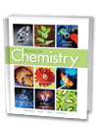

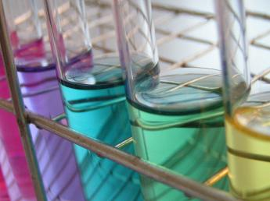
Chapter 15.1-2
Water and Aqueous
Systems
Chapter 16
Solutions
Properties of Solutions
Concentrations of Solutions
Colligative Properties
of Solutions
Calculations Involving
Colligative Properties

Slide 3
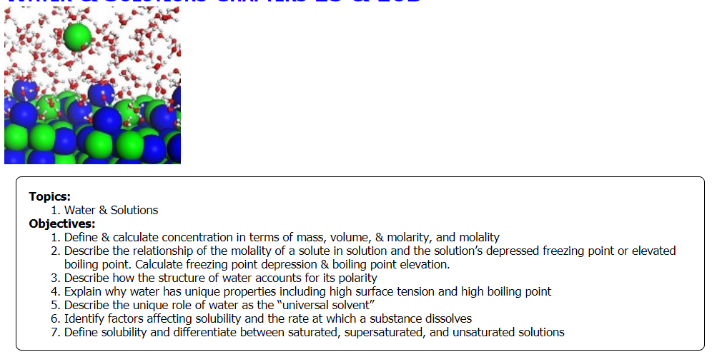
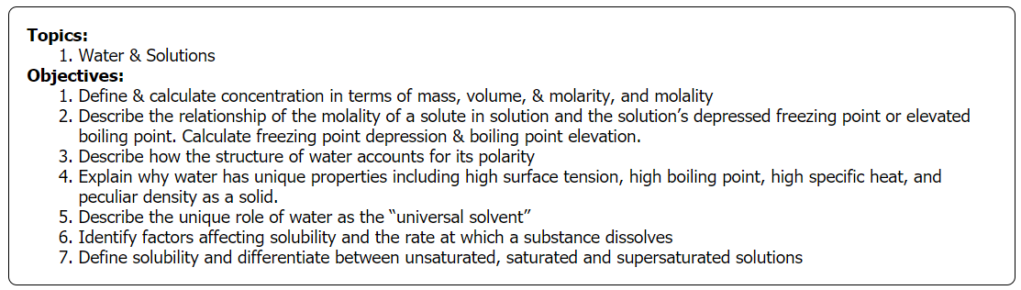

Slide 4
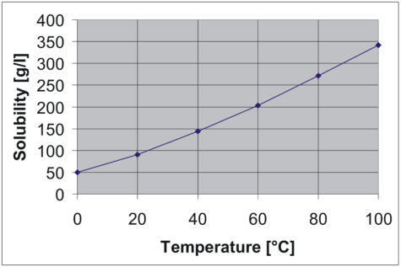
Analyze a Solubility Graph
Analyze the graph to describe the solubility of barium nitrate, BaNO₃.
At 60°C, ____ must be added to 1 L water to make a saturated solution.
At 25°C, the solubility is about ____.
A solution that contains 600 g BaNO₃ in 3 L H₂O at 70°C is _______________.
A solution that contains 300 g BaNO₃ in 2 L H₂O at 85°C will start to precipitate solid when it is cooled to ____°C.
Solubility vs. Temperature
of BaNO₃
Notes:
Timing ≈ 1.0
Entry Audio: Use the graph to describe how the solubility of barium nitrate changes with temperature.
Hint Audio: Any concentration along the line represents a saturated solution.
Exit Audio: The graph shows that the solubility of barium nitrate increases from 50 grams per liter at 0 degrees Celsius to almost 350 grams per liter at 100 degrees Celsius.
SOURCES:
http://commons.wikimedia.org/wiki/File:Solubility_Barium_nitrate.png

Slide 5
Analyze a Solubility Graph
Analyze the graph to describe the solubility of barium nitrate, BaNO₃.
At 60°C, 200 g must be added to 1 L water to make a saturated solution.
At 25°C, the solubility is about 100 g/L.
Solubility vs. Temperature
of BaNO₃
Notes:
Timing ≈ 1.0
Entry Audio: Use the graph to describe how the solubility of barium nitrate changes with temperature.
Hint Audio: Any concentration along the line represents a saturated solution.
Exit Audio: The graph shows that the solubility of barium nitrate increases from 50 grams per liter at 0 degrees Celsius to almost 350 grams per liter at 100 degrees Celsius.
SOURCES:
http://commons.wikimedia.org/wiki/File:Solubility_Barium_nitrate.png

Slide 6
Analyze a Solubility Graph
Analyze the graph to describe the solubility of barium nitrate, BaNO₃.
A solution that contains 600 g BaNO₃ in 3 L H₂O at 70°C is unsaturated.
600 g / 3 L = 200 g/L … it is below the line, meaning that more solute can be dissolved at that temperature.
A solution that contains 300 g BaNO₃ in 2 L H₂O at 85°C will start to precipitate solid when it is cooled to 40°C.
300 g / 2 L = 150 g/L … The saturation temperature for 150 g/L is shown by the arrows.
Solubility vs. Temperature
of BaNO₃
Notes:
Timing ≈ 1.0
Entry Audio: Use the graph to describe how the solubility of barium nitrate changes with temperature.
Hint Audio: Any concentration along the line represents a saturated solution.
Exit Audio: The graph shows that the solubility of barium nitrate increases from 50 grams per liter at 0 degrees Celsius to almost 350 grams per liter at 100 degrees Celsius.
SOURCES:
http://commons.wikimedia.org/wiki/File:Solubility_Barium_nitrate.png

Slide 7
Objectives
  Describe how the structure of water accounts for its polarity
  Explain why water has unique properties including high surface tension, high boiling point, high specific heat, and a peculiar density as a solid.
  Describe the unique role of water as the “universal solvent”
  Identify factors affecting solubility and the rate at which a substance dissolves
  Define solubility and differentiate between unsaturated, saturated, and supersaturated solutions
  Define & calculate concentration in terms of mass, volume, & molarity, and molality
  Describe the relationship of the molality of a solute in solution and the solution’s depressed freezing point or elevated boiling point. Calculate freezing point depression & boiling point elevation.
Notes:
Timing ≈ 0.5 minutes
Review the lesson’s objectives, which are listed on the slide. As a result of this lesson, you now should be able to do all of these things.
Sources: XXX

Slide 8
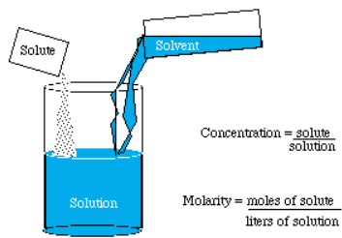
Solute Concentration
is helpful to know in order to describe solutions
is an important “real life” variable

Slide 9
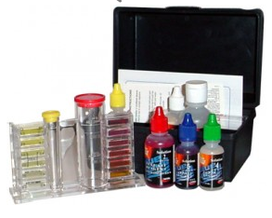
Expressing Concentration
    percent by mass (enrichment)
    percent by volume (enrichment)
    parts per billion (enrichment)
    Molarity
Notes:
Timing ≈ 0.5
There are different ways of expressing concentration. Examples include percent by mass, percent by volume, parts per million, parts per billion, and molarity.
In this lesson, we will focus on molarity (teacher circle).
SOURCE:
http://commons.wikimedia.org/wiki/File:US_Navy_060220-M-2061L-058_U.S._Marines_add_chlorine_crystals_to_the_water_in_order_to_create_a_water-purification_solution.jpg

Slide 10

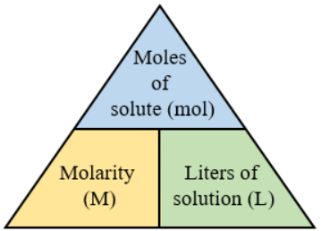
Molarity
The number of moles of solute in 1 liter of solution.
This term is the most used when describing concentration (symbolized by “[ ]”) in a general chemistry lab.
Solve for each variable:

Slide 11
Molarity
The number of moles of solute in 1 liter of solution.
This term is the most used when describing concentration (symbolized by “[ ]”) in a general chemistry lab.
M = mol / L
Moles = M x L
L = mol / M

Slide 12
Molarity
The number of moles of solute in 1 liter of solution
This term is the most used when describing concentration (symbolized by “[ ]”) in a general chemistry lab.
Volume of a liquid is more easily measured than mass, therefore, laboratory reagents are usually made up of a specific molarity to give us a standard.

Slide 13
Molarity Calculations (use AGES)
What is the molarity of a solution that contains 25 g of HCl (aq) in 150. mL of solution? (The molar mass of HCl is 36.45 g/mol.)
What should you find first?
What set up is correct to find moles?
What set up is correct to find liters?
Notes:
Time: ~1.0 min
Entry audio: Remember that molarity expresses the concentration of a solution in moles per liter.
Hint1 Audio: In stoichiometry, moles is the standard which we use to compare all measurements.
Hint2 Audio: Conversion factors cancel out the units we do not want and leave us with the desired units.
Hint3 audio: Since the two quantities you need are the number of moles of solute and the number of liters of solution, we need to determine the liters of solution.
Hint4 audio: Now take a look at the entire problem worked out for you. [animate equation]
Exit audio: In this problem, you were given the molar mass of the solute and you used it to calculate the number of moles of the solute. If you are not given the molar mass of the solute, you can calculate it using the atomic masses of each element.

Slide 14
Molarity Calculations
What is the molarity of a solution that contains 25 g of HCl (aq) in 150. mL of solution? (The molar mass of HCl is 36.45 g/mol.)
What should you find first? moles
What set up is correct to find moles?
25 g HCl x 1 mol HCl / 36.45 g HCl
What set up is correct to find liters? 150 ml x 1 L / 1000 ml
Notes:
Time: ~1.0 min
Entry audio: Remember that molarity expresses the concentration of a solution in moles per liter.
Hint1 Audio: In stoichiometry, moles is the standard which we use to compare all measurements.
Hint2 Audio: Conversion factors cancel out the units we do not want and leave us with the desired units.
Hint3 audio: Since the two quantities you need are the number of moles of solute and the number of liters of solution, we need to determine the liters of solution.
Hint4 audio: Now take a look at the entire problem worked out for you. [animate equation]
Exit audio: In this problem, you were given the molar mass of the solute and you used it to calculate the number of moles of the solute. If you are not given the molar mass of the solute, you can calculate it using the atomic masses of each element.

Slide 15
Molarity Calculations (use AGES)
How many moles of a 0.10 M NaOH _{(aq)} are contained in 200. ml? How many grams of solute are in this solution?
Notes:
Time: ~1.0 min
Entry audio: Remember that molarity expresses the concentration of a solution in moles per liter.
Hint1 Audio: In stoichiometry, moles is the standard which we use to compare all measurements.
Hint2 Audio: Conversion factors cancel out the units we do not want and leave us with the desired units.
Hint3 audio: Since the two quantities you need are the number of moles of solute and the number of liters of solution, we need to determine the liters of solution.
Hint4 audio: Now take a look at the entire problem worked out for you. [animate equation]
Exit audio: In this problem, you were given the molar mass of the solute and you used it to calculate the number of moles of the solute. If you are not given the molar mass of the solute, you can calculate it using the atomic masses of each element.

Slide 16
Molarity Calculations
How many moles of a 0.10 M NaOH _{(aq)} are contained in 200. ml? How many grams of solute are in this solution?
M = # moles of solute / # liters of solution
Find moles
0.10 M = X moles / 200. ml OR X moles = 0.1 M x 200 ml
X moles = 0.10 M x 0.200 L
X = 0.020 moles NaOH
Convert to grams
GFM of NaOH = 23 + 16 + 1 = 40.0 g / mole
0.020 moles x 40.0 g / 1 mole = 0.80 grams
Notes:
Time: ~1.0 min
Entry audio: Remember that molarity expresses the concentration of a solution in moles per liter.
Hint1 Audio: In stoichiometry, moles is the standard which we use to compare all measurements.
Hint2 Audio: Conversion factors cancel out the units we do not want and leave us with the desired units.
Hint3 audio: Since the two quantities you need are the number of moles of solute and the number of liters of solution, we need to determine the liters of solution.
Hint4 audio: Now take a look at the entire problem worked out for you. [animate equation]
Exit audio: In this problem, you were given the molar mass of the solute and you used it to calculate the number of moles of the solute. If you are not given the molar mass of the solute, you can calculate it using the atomic masses of each element.

Slide 17
Molarity Calculations (use AGES)
What is the molarity of a solution of NaCl if 500. ml of solution contains 11.6 grams of NaCl?
Notes:
Time: ~1.0 min
Entry audio: Remember that molarity expresses the concentration of a solution in moles per liter.
Hint1 Audio: In stoichiometry, moles is the standard which we use to compare all measurements.
Hint2 Audio: Conversion factors cancel out the units we do not want and leave us with the desired units.
Hint3 audio: Since the two quantities you need are the number of moles of solute and the number of liters of solution, we need to determine the liters of solution.
Hint4 audio: Now take a look at the entire problem worked out for you. [animate equation]
Exit audio: In this problem, you were given the molar mass of the solute and you used it to calculate the number of moles of the solute. If you are not given the molar mass of the solute, you can calculate it using the atomic masses of each element.

Slide 18
Molarity Calculations
What is the molarity of a solution of NaCl if 500. ml of solution contains 11.6 grams of NaCl?
M = # moles of solute / # liters of solution
Find moles
Na 1 x 23.0 g/mol = 23.0 g/mol
Cl 1 x 35.5 g/mol = 35.5 g/mol 58.5 g/mol
11.6 g x 1 mole / 58.5 g/mole = 0.198 moles NaCl
Find Molarity
M = 0.198 moles / 0.500 L → 0.396 M NaCl
Notes:
Time: ~1.0 min
Entry audio: Remember that molarity expresses the concentration of a solution in moles per liter.
Hint1 Audio: In stoichiometry, moles is the standard which we use to compare all measurements.
Hint2 Audio: Conversion factors cancel out the units we do not want and leave us with the desired units.
Hint3 audio: Since the two quantities you need are the number of moles of solute and the number of liters of solution, we need to determine the liters of solution.
Hint4 audio: Now take a look at the entire problem worked out for you. [animate equation]
Exit audio: In this problem, you were given the molar mass of the solute and you used it to calculate the number of moles of the solute. If you are not given the molar mass of the solute, you can calculate it using the atomic masses of each element.

Slide 19
Making Solutions (use AGES)
How would you prepare 25 liters of 0.10 M BaCl₂ solution, starting with solid BaCl₂?
Notes:
Time: ~1.0 min
Entry audio: Remember that molarity expresses the concentration of a solution in moles per liter.
Hint1 Audio: In stoichiometry, moles is the standard which we use to compare all measurements.
Hint2 Audio: Conversion factors cancel out the units we do not want and leave us with the desired units.
Hint3 audio: Since the two quantities you need are the number of moles of solute and the number of liters of solution, we need to determine the liters of solution.
Hint4 audio: Now take a look at the entire problem worked out for you. [animate equation]
Exit audio: In this problem, you were given the molar mass of the solute and you used it to calculate the number of moles of the solute. If you are not given the molar mass of the solute, you can calculate it using the atomic masses of each element.

Slide 20
Making Solutions
How would you prepare 25 liters of 0.10 M BaCl₂ solution, starting with solid BaCl₂?
M = # moles of solute / # liters of solution
Find moles
0.10 M = X moles / 25 L OR X moles = 0.1 M x 25 L
X = 2.5 moles BaCl₂
Convert Moles to Grams
GFM of BaCl₂ = 137.3 + (2)(35.45) = 208.2 g / mole
2.5 moles x 208.2 g / 1 mole = 520 grams
Place the 520 g BaCl₂ in an appropriate container and add sufficient water to give a final volume of 25 liters.
Notes:
Time: ~1.0 min
Entry audio: Remember that molarity expresses the concentration of a solution in moles per liter.
Hint1 Audio: In stoichiometry, moles is the standard which we use to compare all measurements.
Hint2 Audio: Conversion factors cancel out the units we do not want and leave us with the desired units.
Hint3 audio: Since the two quantities you need are the number of moles of solute and the number of liters of solution, we need to determine the liters of solution.
Hint4 audio: Now take a look at the entire problem worked out for you. [animate equation]
Exit audio: In this problem, you were given the molar mass of the solute and you used it to calculate the number of moles of the solute. If you are not given the molar mass of the solute, you can calculate it using the atomic masses of each element.

Slide 21
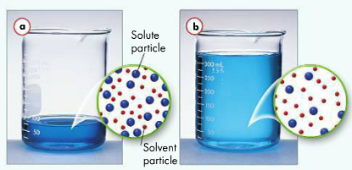
Using Concentrated Solutions
Both solutions above contain the same amount of solute. Which is more concentrated?
Which has a greater molarity?
Use the molarity equation to answer the following:
When dilution B was made, the ____ decreased, the ____ increased, and the ____ remains the same.

Slide 22
Using Concentrated Solutions
Both solutions above contain the same amount of solute. Which is more concentrated? A
Which has a greater molarity? A
Use the molarity equation to answer the following:
When dilution B was made, the molarity decreased, the volume of solution increased, and the moles of solute remains the same.

Slide 23

Using Concentrated Solutions
Dilutions
(Molarity) (Volume) = (Molarity) (Volume)
solution 1 solution 2
Usually one starts with a more concentrated solution and dilutes it with water to obtain the desired volume
This is more convenient than using molarity or moles

Slide 24
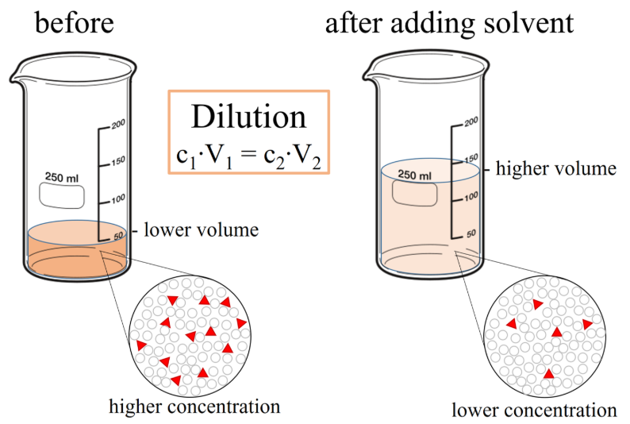
Using Concentrated Solutions
(Molarity) (Volume) = (Molarity) (Volume)
solution 1 solution 2

Slide 25
Making Dilutions (use AGES)
How would you prepare 100. ml of a 2.00 M HCl solution, starting with concentrated hydrochloric acid (12.0 M)?
Notes:
Time: ~1.0 min
Entry audio: Remember that molarity expresses the concentration of a solution in moles per liter.
Hint1 Audio: In stoichiometry, moles is the standard which we use to compare all measurements.
Hint2 Audio: Conversion factors cancel out the units we do not want and leave us with the desired units.
Hint3 audio: Since the two quantities you need are the number of moles of solute and the number of liters of solution, we need to determine the liters of solution.
Hint4 audio: Now take a look at the entire problem worked out for you. [animate equation]
Exit audio: In this problem, you were given the molar mass of the solute and you used it to calculate the number of moles of the solute. If you are not given the molar mass of the solute, you can calculate it using the atomic masses of each element.

Slide 26
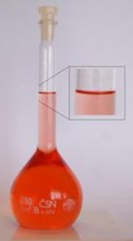
Making Dilutions
How would you prepare 100. ml (V₁) of a 2.00 M HCl (M₁) solution, starting with concentrated hydrochloric acid (12.0 M) (M₂)?
M₁V₁ = M₂V₂
Find Volume
V₂ = M₁V₁ / M₂
V₂ = (2.00 M) (100. ml) / (12.0 M)
X = 16.7 ml = 0.0167 L
Make the Dilution:
Place 16.7 ml of 12.0 M HCl in the container (flask) & add enough water to get a FINAL VOLUME of 100 ml
Notes:
Time: ~1.0 min
Entry audio: Remember that molarity expresses the concentration of a solution in moles per liter.
Hint1 Audio: In stoichiometry, moles is the standard which we use to compare all measurements.
Hint2 Audio: Conversion factors cancel out the units we do not want and leave us with the desired units.
Hint3 audio: Since the two quantities you need are the number of moles of solute and the number of liters of solution, we need to determine the liters of solution.
Hint4 audio: Now take a look at the entire problem worked out for you. [animate equation]
Exit audio: In this problem, you were given the molar mass of the solute and you used it to calculate the number of moles of the solute. If you are not given the molar mass of the solute, you can calculate it using the atomic masses of each element.

Slide 27
Making Dilutions (use AGES)
How could you prepare 250. mL of 0.20 M HCl using only a solution of 1.5 M HCl and water?
Notes:
Time: ~1.0 min
Entry audio: Remember that molarity expresses the concentration of a solution in moles per liter.
Hint1 Audio: In stoichiometry, moles is the standard which we use to compare all measurements.
Hint2 Audio: Conversion factors cancel out the units we do not want and leave us with the desired units.
Hint3 audio: Since the two quantities you need are the number of moles of solute and the number of liters of solution, we need to determine the liters of solution.
Hint4 audio: Now take a look at the entire problem worked out for you. [animate equation]
Exit audio: In this problem, you were given the molar mass of the solute and you used it to calculate the number of moles of the solute. If you are not given the molar mass of the solute, you can calculate it using the atomic masses of each element.

Slide 28
Making Dilutions
How could you prepare 250. mL (V₁) of 0.20 M HCl (M₁) using only a solution of 1.5 M HCl (M₂) & water?
M₁V₁ = M₂V₂
Find Volume
V₂ = M₁V₁ / M₂
V₂ = (0.20 M) (250. ml) / (1.5 M)
X = 33 ml = 0.033 L
Make the Dilution:
Place 33 ml of 1.5 M HCl in the container (flask) & add enough water to get a FINAL VOLUME of 250 ml.
Notes:
Time: ~1.0 min
Entry audio: Remember that molarity expresses the concentration of a solution in moles per liter.
Hint1 Audio: In stoichiometry, moles is the standard which we use to compare all measurements.
Hint2 Audio: Conversion factors cancel out the units we do not want and leave us with the desired units.
Hint3 audio: Since the two quantities you need are the number of moles of solute and the number of liters of solution, we need to determine the liters of solution.
Hint4 audio: Now take a look at the entire problem worked out for you. [animate equation]
Exit audio: In this problem, you were given the molar mass of the solute and you used it to calculate the number of moles of the solute. If you are not given the molar mass of the solute, you can calculate it using the atomic masses of each element.

Slide 29

Colligative Properties of Solutions
Colligative properties of solutions are properties that depend upon the concentration of solute molecules or ions, but not upon the identity of the solute.

Slide 30
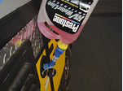
Colligative Properties of Solutions
Colligative properties include:
Freezing Point Depression
Boiling Point Elevation
Vapor Pressure Lowering
Osmotic Pressure

Slide 31
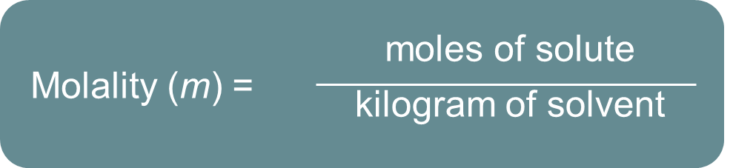
Colligative Properties of Solutions
Since colligative properties deal with the amount of particles in a solution, we need to learn a new way to calculate concentration.
Molality (m)
the number of moles of solute dissolved in 1 kilogram (1000 grams) of solvent. Molality is also known as molal concentration and is calculated by:

Slide 32
Calculating Molality (use AGES)
What is the molality (m) of a solution obtained by dissolving 45.0 grams of glucose (C₆H₁₂O₆) in 2000. grams of water?
Notes:
Time: ~1.0 min
Entry audio: Remember that molarity expresses the concentration of a solution in moles per liter.
Hint1 Audio: In stoichiometry, moles is the standard which we use to compare all measurements.
Hint2 Audio: Conversion factors cancel out the units we do not want and leave us with the desired units.
Hint3 audio: Since the two quantities you need are the number of moles of solute and the number of liters of solution, we need to determine the liters of solution.
Hint4 audio: Now take a look at the entire problem worked out for you. [animate equation]
Exit audio: In this problem, you were given the molar mass of the solute and you used it to calculate the number of moles of the solute. If you are not given the molar mass of the solute, you can calculate it using the atomic masses of each element.

Slide 33
Calculating Molality
What is the molality (m) of a solution obtained by dissolving 45.0 grams of glucose (C₆H₁₂O₆) in 2000. grams of water?
m = moles of solute
kg of solvent
Find moles
GMM of C₆H₁₂O₆ = (6 x 12.0 g/mol) + (12 x 1.00 g/mol) + (6 x 16.0 g/mol)
molar mass = 180. g / mole
45.0 g x 1 mole / 180 g = 0.250 moles
Find molality
m = 2000. g x 1 kg/1000 g = 2.00 kg
m = 0.250 moles / 2.00 kg = 0.125 m
Notes:
Time: ~1.0 min
Entry audio: Remember that molarity expresses the concentration of a solution in moles per liter.
Hint1 Audio: In stoichiometry, moles is the standard which we use to compare all measurements.
Hint2 Audio: Conversion factors cancel out the units we do not want and leave us with the desired units.
Hint3 audio: Since the two quantities you need are the number of moles of solute and the number of liters of solution, we need to determine the liters of solution.
Hint4 audio: Now take a look at the entire problem worked out for you. [animate equation]
Exit audio: In this problem, you were given the molar mass of the solute and you used it to calculate the number of moles of the solute. If you are not given the molar mass of the solute, you can calculate it using the atomic masses of each element.

Slide 34
Boiling Point Elevation
The change in boiling point is proportional to the molality of the solution:
∆T_{b} = K_{b} x m
where K_{b} is the molal boiling point elevation constant, a property of the solvent.

Slide 35
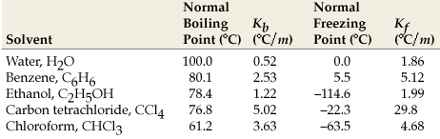
Boiling Point Elevation
A 1 molal solution of water will boil at 100.512 C rather than 100.00 C.
0.51

Slide 36
Boiling Point Elevation
How molality influences the boiling point of pure water:
molality | moles of solute per 1000 g of H₂0 | BP | ∆T
0 m | pure water | 100.00 C | 0.00 C
1 m | 1 mole / 1000 g | 100.51 C | 0.51 C
2 m | 2 moles / 1000 g | 101.02 C | 1.02 C
3 m | 3 moles / 1000 g | 101.53 C | 1.53 C
10 m | 10 moles / 1000 g | 105.10 C | 5.10 C

Slide 37
Freezing Point Depression and Solution Concentration
Freezing point depression:
the decrease in freezing point of a solution as a function of the number of particles dissolved in solution.
molality
1.0
2.0
3.0
4.0
Molality | Freezing Point (°C)
0 | 0.00
1.0 | −1.86
2.0 | −3.72
3.0 | −5.58
4.0 | −7.44
−2.0
−4.0
F_{p}
−6.0
−8.0
Notes:
Timing ≈ 1 minute
[Animate definition] The freezing point depression is the decrease in freezing point of a solution as a function of the number of particles dissolved in a solution.
To see exactly how the freezing point of a solvent changes with solute concentration, let’s vary the molality of a glucose solution in water and follow the change in water’s freezing point.
[Animate table] From the table, you can see that at a molality of zero, there is no solute present so the freezing point is the normal freezing point of water, 0°C.
When you add 1.0 mole of glucose to 1 kg of water to make a 1.0 molal solution, the freezing temperature drops to −1.86°C.
When you add another 1.0 mole of glucose, the molality doubles and becomes 2.0 molal. At this concentration, the temperature drops another 1.86°C down to −3.72°C.
When you add another 1.0 mole of glucose, the molality triples and becomes 3.0 molal. At this concentration, the temperature drops another 1.86°C down to −5.58°C.
Finally, when you add another 1.0 mole of glucose, the molality quadruples and becomes 4.0 molal. At this concentration, the temperature drops another 1.86°C down to −7.44°C.
Do you see a pattern? If the pattern is difficult to see in the table of data, you may find it easier to see the trend if the data are graphed.
[Animate graph] The graph clearly shows that as the moles of solute increase, there is a corresponding decrease of 1.86 degrees in the freezing point. The change in freezing point of the solvent is directly related to the moles of solute added.
Sources: freezing point depression constant from: Zumdahl, S.S. and Zumdahl, S.A., Chemistry, sixth edition, Houghton Mifflin, New York (2003)

Slide 38
Freezing Point Depression
The change in freezing point can be found similarly:
∆T_{f} = K_{f} x m
where K_{f} is the molal freezing point
depression constant of the solvent.

Slide 39
Freezing Point Depression
A 1 molal solution of water will freeze at -1.86 C rather than 0 C.
−

Slide 40

Practice Calculating molality and fp depression
How many moles of ethylene glycol must be added to 1 kg of water to make a solution that lowers the freezing point 2.4°C? The freezing point depression constant for water is 1.86°C•kg/mol.
  Which equation will you use?
  What is the change in freezing point?
  What is the molality of the solution?
  How many moles of ethylene glycol will be needed to add to 2 kg of water to achieve this molality?
Notes:
Time ≈ 2 minutes
Entry Audio: How can you apply the equation for freezing point depression in a slightly different manner?
Hint1 Audio: You can rearrange the equation for freezing point depression to solve for the unknown quantity, which is molality in this case.
Hint2 Audio: Remember, the freezing point of water is 0.0°C and the change in freezing point is the difference between this and the freezing point of the solution.
Hint3 Audio: Remember, you can find the molality of the solution if you know the change in freezing point and the freezing point depression constant, K_{f,}, for the solvent.
Exit Audio: The equations for freezing point depression and boiling point elevation are general equations that can be rearranged algebraically to solve for any of the variables as an unknown, provided the other two variables are known.

Slide 41
Practice Calculating molality and fp depression
How many moles of ethylene glycol must be added to 1 kg of water to make a solution that lowers the freezing point 2.4°C? The freezing point depression constant for water is 1.86°C•kg/mol.
  Which equation will you use?
Rearrange: ΔT_{f} = K_{f} m
m = ΔT_{f} / K_{f}
  What is the change in freezing point?
ΔT_{f} = 2.4° C
  What is the molality of the solution?
m = ΔT_{f} / K_{f}
  m = (2.4° C) /1.86° C•kg/mol
  m = 1.3 molal = 1.3 mol/1 kg
  How many moles of ethylene glycol will be needed to add to 2 kg of water to achieve this molality?
  Since m = 1.3 molal
  = 1.3 moles/kg water
  Therefore, for 2 kg of water:
  1.3 moles/1 kg = ? moles/2 kg
  2.6 moles of solute are needed
Notes:
Time ≈ 2 minutes
Entry Audio: How can you apply the equation for freezing point depression in a slightly different manner?
Hint1 Audio: You can rearrange the equation for freezing point depression to solve for the unknown quantity, which is molality in this case.
Hint2 Audio: Remember, the freezing point of water is 0.0°C and the change in freezing point is the difference between this and the freezing point of the solution.
Hint3 Audio: Remember, you can find the molality of the solution if you know the change in freezing point and the freezing point depression constant, K_{f,}, for the solvent.
Exit Audio: The equations for freezing point depression and boiling point elevation are general equations that can be rearranged algebraically to solve for any of the variables as an unknown, provided the other two variables are known.

Slide 42
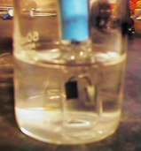
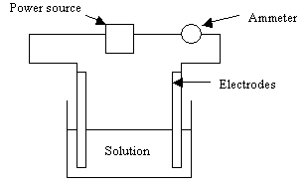
Colligative Properties of
Electrolytes
Electrolytes are ionic compounds that dissociate to form ions in solution and therefore, can conduct electricity.

Slide 43
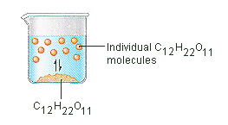
Colligative Properties of
NonElectrolytes
Sugar is a NON-electrolyte and has no ions in solution.
Therefore, 1 mol of sugar produces 1 mol of particles.

Slide 44
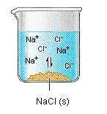
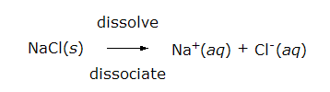
Colligative Properties of
Electrolytes
Salt is an electrolyte and has ions in solution.

Slide 45
Colligative Properties of
Electrolytes
NaCl will theoretically form 2 times the particles in solution as sugar .
1 mol
2 mol

Slide 46
Colligative Properties of
Electrolytes
Since colligative properties
(vapor pressure, boiling point elevation, freezing point depression, osmotic pressure) depend on the number of particles dissolved,
solutions of electrolytes (which dissociate in solution) should show greater changes than those of non-electrolytes.

Slide 47
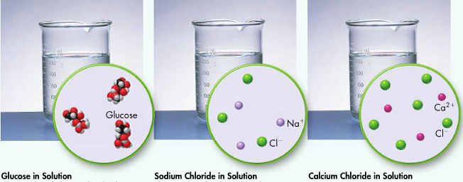
Colligative Properties of
Electrolytes vs NonElectrolytes
Notice the difference in moles produced when 3 moles of each substances is made into solutions of equal volume.

Slide 48
Colligative Properties of Electrolytes vs NonElectrolytes
Glucose produces 3 moles of solute in solution (no ions)
NaCl produces 6 moles of solute in solution (TWICE as much) … NaCl _{(aq)} → Na⁺ + Cl⁻ 2 moles of ions / NaCl _{(aq)}
CaCl₂ produces 9 moles of solute in solution (3 times as much) … CaCl_{2(aq)} → Ca⁺² + 2 Cl⁻ 3 moles of ions / CaCl_{2 (aq)}

Slide 49
Calculate Particle Concentration
  How many moles of particles are formed in solution when one mole of KBr is dissolved in water?
  Write the balanced chemical equation to show the dissolution process:
  Count the number of particles on the right side of the balanced equation:
  Compute the moles of particles produced by one mole of compound:
  How many moles of particles are formed in solution when one mole of Na₂SO₄ is dissolved in water?
  Write the balanced chemical equation to show the dissolution process:
  Count the number of particles on the right side of the balanced equation:
  Compute the moles of particles produced by one mole of compound:
Notes:
Timing ≈ 1 minute
[Animate 1st bullet] To determine the number of moles of particles produced by an electrolyte dissolving in solution, begin by writing the balanced chemical equation that describes the dissolution process.
[Animate 2nd bullet] Show each ion that dissolves in the balanced equation.
[Animate 3rd bullet] Then count the total number of ions produced per mole of the original compound. That number is equal to the number of moles of particles produced by one mole of compound when it dissolves in solution.
[Animate next question] And, repeat!

Slide 50
Calculate Particle Concentration
  How many moles of particles are formed in solution when one mole of KBr is dissolved in water?
  Write the balanced chemical equation to show the dissolution process:
    KBr(s) ⟶ K⁺(aq) + Br⁻(aq)
  Count the number of particles on the right side of the balanced equation:
    one K⁺(aq) & one Br⁻(aq) = 2 particles
  Compute the moles of particles produced by one mole of compound:
  one mole KBr produces 2 moles of particles
  How many moles of particles are formed in solution when one mole of Na₂SO₄ is dissolved in water?
  Write the balanced chemical equation to show the dissolution process:
    Na₂SO₄(s) ⟶ 2Na⁺(aq) + SO₄²⁻(aq)
  Count the number of particles on the right side of the balanced equation:
    2 Na⁺(aq) & 1 SO₄²⁻(aq) = 3 particles
  Compute the moles of particles produced by one mole of compound:
    one mole Na₂SO₄ produces three moles of particles
Notes:
Timing ≈ 1 minute
[Animate 1st bullet] To determine the number of moles of particles produced by an electrolyte dissolving in solution, begin by writing the balanced chemical equation that describes the dissolution process.
[Animate 2nd bullet] Show each ion that dissolves in the balanced equation.
[Animate 3rd bullet] Then count the total number of ions produced per mole of the original compound. That number is equal to the number of moles of particles produced by one mole of compound when it dissolves in solution.
[Animate next question] And, repeat!

Slide 51
Calculating fp depression & bp elevation
Find the boiling point elevation and the freezing point depression of Nickel II Bromide (electrolyte) if 0.121 mol are dissolved in 224 grams of water.
Find molality
Find molality of particles (ions)
Calculate fp depression and bp elevation
Notes:
Time: ~1.0 min
Entry audio: Remember that molarity expresses the concentration of a solution in moles per liter.
Hint1 Audio: In stoichiometry, moles is the standard which we use to compare all measurements.
Hint2 Audio: Conversion factors cancel out the units we do not want and leave us with the desired units.
Hint3 audio: Since the two quantities you need are the number of moles of solute and the number of liters of solution, we need to determine the liters of solution.
Hint4 audio: Now take a look at the entire problem worked out for you. [animate equation]
Exit audio: In this problem, you were given the molar mass of the solute and you used it to calculate the number of moles of the solute. If you are not given the molar mass of the solute, you can calculate it using the atomic masses of each element.

Slide 52
Calculating fp depression & bp elevation
Find the boiling point elevation and the freezing point depression of Nickel II Bromide (electrolyte) if 0.121 mol are dissolved in 224 grams of water (0.224 kg).
Find molality [m = mol solute/Kg solvent]
m = 0.121 moles / 0.224 kg = 0.540 m
Find molality of particles (ions)
NiBr_{2 (aq)} → Ni⁺² + 2 Br⁻¹ = 3 moles of ions x 0.54 m = 1.62 m
Calculate fp depression and bp elevation
∆T_{f} = k_{f} x m ∆T_{b} = k_{b} x m
= (-1.86 C)(1.62 m) = (0.52 C)(1.62 m)
= 0.00 C - 3.01 C = 0.84 C + 100.0 C
Fp = -3.01 C Bp = 100.84 C
Notes:
Time: ~1.0 min
Entry audio: Remember that molarity expresses the concentration of a solution in moles per liter.
Hint1 Audio: In stoichiometry, moles is the standard which we use to compare all measurements.
Hint2 Audio: Conversion factors cancel out the units we do not want and leave us with the desired units.
Hint3 audio: Since the two quantities you need are the number of moles of solute and the number of liters of solution, we need to determine the liters of solution.
Hint4 audio: Now take a look at the entire problem worked out for you. [animate equation]
Exit audio: In this problem, you were given the molar mass of the solute and you used it to calculate the number of moles of the solute. If you are not given the molar mass of the solute, you can calculate it using the atomic masses of each element.

Slide 53
Calculating fp depression & bp elevation
Find the boiling point elevation and the freezing point depression of Nickel II Bromide (electrolyte) if 0.121 mol are dissolved in 224 grams of water (0.224 kg).
ANOTHER WAY TO DO THE SAME PROBLEM
Find molality [m = mol solute/Kg solvent]
M = 0.121 moles / 0.224 kg = 0.540 m
Find molality of particles (ions)
NiBr_{2 (aq)} → Ni⁺² + 2 Br⁻¹ = 3 moles of ions
Calculate fp depression and bp elevation
∆T_{f} = k_{f} x mi ∆T_{b} = k_{b} x mi
= (1.86 C)(0.54 m)(3) = (0.52 C)(0.54 m)(3)
= 0.00 C - 3.01 C = 0.84 C + 100.0 C
Fp = -3.01 C Bp = 100.84 C
Notes:
Time: ~1.0 min
Entry audio: Remember that molarity expresses the concentration of a solution in moles per liter.
Hint1 Audio: In stoichiometry, moles is the standard which we use to compare all measurements.
Hint2 Audio: Conversion factors cancel out the units we do not want and leave us with the desired units.
Hint3 audio: Since the two quantities you need are the number of moles of solute and the number of liters of solution, we need to determine the liters of solution.
Hint4 audio: Now take a look at the entire problem worked out for you. [animate equation]
Exit audio: In this problem, you were given the molar mass of the solute and you used it to calculate the number of moles of the solute. If you are not given the molar mass of the solute, you can calculate it using the atomic masses of each element.

Slide 54
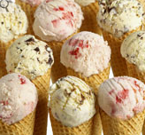
Freezing Point Depression
Making Ice Cream
uses this principle!

Slide 55
Making Ice Cream
Some simple ingredients to make ice cream:
½ Cup Whole Milk (half & half cream?)
4 Cups Crushed Ice
½ Teaspoon Vanilla Extract
1 Tablespoon Sucrose (table sugar)
How would you go about making ice cream?

Slide 56

Freezing Point Depression
Companies need to lower the freezing point to -15 C for ice cream’s consistency.

Slide 57
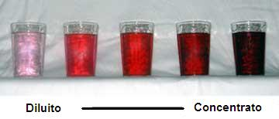
Review
Dilute Concentrated
(ENRICHMENT)
Notes:
Timing ≈ 0.5 minutes
There are a number of different concentration units that may be used in chemistry and various other contexts.

Slide 58
Calculating the Molarity of a Solution
Calculate the molarity of each of the following solutions:
A salt solution with a volume of 250. mL that contains 0.70 mol NaCl.
A salt solution that contains 0.90 g NaCl (molar mass = 58.0 g) in 100.0 mL of solution.
A sugar solution that contains 36.0 g glucose (molar mass = 180.06 g) in 2.0 L of solution.
A solution prepared by dissolving 14.7 g Ca(NO₃)₂ (molar mass = 164 g) in 750.0 mL of solution.
Notes:
Timing: ~5 min
Hint 1 audio: Use the equation for molarity and be sure to change the volume to liters.
Hint 2 audio: Use the periodic table to calculate the molar mass of the substance. Then, use the molarity equation and change volume to liters.
Hint 3 audio: Find moles of solute, then solve for molarity.
Hint 4 audio: Use the periodic table to calculate the molar mass of the substance. Then, use the molarity equation and change volume to liters.

Slide 59
Calculating the Molarity of a Solution
Calculate the molarity of each of the following solutions: M = mol solute/L solution
A salt solution with a volume of 250. mL that contains 0.70 mol NaCl.
M = mol/L → 0.70 mol/0.250 L = 2.8 M
A salt solution that contains 0.90 g NaCl (molar mass = 58.0 g) in 100.0 mL of solution.
Moles of NaCl → 0.90 g x 1 mol/58.0 g = 0.016 mol
M = mol/L → 0.016 mol/0.10 L = 0.16 M
A sugar solution that contains 36.0 g glucose (molar mass = 180.06 g) in 2.0 L of solution.
Moles of sugar → 36.0 g x 1 mol/180.06 g = 0.200 mol
M = mol/L → 0.200 mol/2 L = 0.10 M
A solution prepared by dissolving 14.7 g Ca(NO₃)₂ (molar mass = 164 g) in 750.0 mL of solution.
Moles of Ca(NO₃)₂ → 14.7 g x 1 mol/164 g = 0.090 mol
M = mol/L → 0.090 mol/0.7500 L = 0.120 M
Notes:
Timing: ~5 min
Hint 1 audio: Use the equation for molarity and be sure to change the volume to liters.
Hint 2 audio: Use the periodic table to calculate the molar mass of the substance. Then, use the molarity equation and change volume to liters.
Hint 3 audio: Find moles of solute, then solve for molarity.
Hint 4 audio: Use the periodic table to calculate the molar mass of the substance. Then, use the molarity equation and change volume to liters.

Slide 60
What is the molarity of a solution that contains 55 g of HCl in 250 mL of solution? (The molar mass of HCl is 36.45 g/mol.)

Slide 61
What is the molarity of a solution that contains 55 g of HCl in 250 mL of solution? (The molar mass of HCl is 36.45 g/mol.)
Asking for molarity of NaCl solution
Given solute mass = 25 g NaCl & solution volume = 150 mL
Equation M = moles of solute / liters of solution
Find Moles 55 g HCl x 1 mol HCl / 36.45 g HCl = 1.51 mol
Volume must be in liters: 250 mL x 1 L/1000 mL = 0.250 L
Solve for Molarity
  M = 1.51 mol / 0.250 L = 6.0 M HCl

Slide 62
  Find the new concentration of a solution if 25.0 mL of water is added to 125.0 mL of a 0.150 M NaCl solution?

Slide 63
  Find the new concentration (M₂) of a solution if 25.0 mL (V₂ = 125 ml + 25 ml) of water is added to 125.0 mL (V₁) of a 0.150 M (M₁) NaCl solution?
Asking for concentration of NaCl solution
Given 0.150 M NaCl, 25.0 mL & 125.0 mL water
Equation M₁V₁ = M₂V₂
Rearrange to solve for Final Molarity M₂ = M₁V₁ / V₂
Note: FINAL Volume → 125.0 mL + 25.0 mL = 150 mL
Solve for Molarity
  M₂ = (0.150 M)(125.0 mL) / (150.0 mL) = 0.125 M NaCl

Slide 64
  A teacher must dilute a 6.00 M HCl solution to a concentration of 3.00 M. If he needs 40.0 mL of 3.00 M HCl solution, what volume of 6.00 M HCl does he need? How much water does he need to add?

Slide 65
  A teacher must dilute a 6.00 M HCl (M₂) solution to a concentration of 3.00 M (M₁) . If he needs 40.0 mL (V₁) of 3.00 M (M₁) HCl solution, what volume of 6.00 M HCl does he need? How much water does he need to add?
Asking for volume of 6.00 M HCl solution needed
Given 40.0 mL of 2.00 M HCl, ? mL of 6.00 M HCl
Equation M₁V₁ = M₂V₂
Rearrange to solve for Final Volume V₂ = M₁V₁ / M₂
Solve for Volume
  V₂ = (40.0 mL)(3.00 M) / (6.00 M) = 20 mL of 6.00 M HCl
  How to make the actual solution:
  Add 20 ml of water to the 20 mL 6.00 M HCl (getting a total volume of 40 mL 3.00 M HCl)

Slide 66
You have 3.50 L of solution that contains 90.0 g of sodium chloride, NaCl. What is the molarity of that solution?

Slide 67
You have 3.50 L of solution that contains 90.0 g of sodium
chloride, NaCl. What is the molarity of that solution?
Asking for molarity of NaCl solution
Given solute mass = 90.0 g NaCl & solution volume = 3.50 L
Equation M = moles of solute / liters of solution
Find Moles
Solve for Molarity
molar mass NaCl = 23.0 g + 35.5 g = 58.5 g/mol

Slide 68
You have 0.8 L of a 0.5 M HCl solution. How many moles of HCl does this solution contain?

Slide 69
You have 0.8 L of a 0.5 M HCl solution. How many moles of HCl does this solution contain?
Asking for moles of HCl solution
Given molarity = 0.5 M HCl & solution volume = 0.8 L
Equation M = moles of solute / liters of solution
Rearrange to solve for Moles Mol = M ∙ liters of solution
Solve for Moles HCl solution

Slide 70
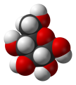








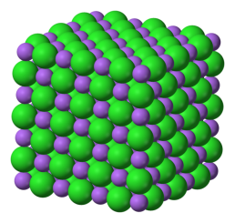
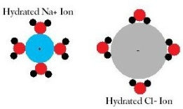
Nonelectrolytes vs. Electrolytes
  Nonelectrolytes:
  include all molecular compounds that do not have a full charge
  example: glucose
  disperse as molecules in solution (Dissolution)
  Electrolytes:
  include all ionic compounds
  dissociate into ions in solution
  example: NaCl
Notes:
Timing ≈ 0.5 minute
Remember the definitions of a nonelectrolyte and an electrolyte.
[Animate 1st bullet] A nonelectrolyte is a substance that does not carry electric charge when dissolved in water. Molecular compounds are examples of nonelectrolytes. [Animate 2nd bullet and image] Glucose is a molecular compound and a nonelectrolyte. [Animate 3rd bullet and image] Although it forms a crystalline structure in the solid state that is disrupted by water molecules, each molecule of glucose remains intact in solution, so there is a one-to-one correspondence between molecules of glucose and particles in solution.
[Animate 4th bullet] An electrolyte is a substance that carries an electric charge when dissolved in water. All ionic compounds fall into this category because they are composed of positively charged ions and negatively charged ions that [animate 5th bullet] dissociate into individual ions that become solvated by water molecules in solution. [Animate last bullet and image] NaCl is a good example of an electrolyte. In the solid state, it forms a crystalline array. But when placed in water, this crystalline array is disrupted so that each ion becomes surrounded by a shell of water molecules. Each formula unit of NaCl produces two particles in solution—a sodium ion and a chloride ion. There is a one-to-two correspondence between formula unit of NaCl and particles in solution.
Sources: NaCl crystal: http://commons.wikimedia.org/wiki/File:NaCl.png; Creative Commons Attribution-Share Alike 3.0 Unported license.; accessed 6/4/12
solvated NaCl ions in water: http://commons.wikimedia.org/wiki/File:Hydration.jpg; public domain; accessed 6/4/12
Beta-D-glucose molecule: http://commons.wikimedia.org/wiki/File:Beta-D-glucose-3D-vdW.png; public domain; accessed 6/4/12
Water molecule: http://commons.wikimedia.org/wiki/File:H2O_(water_molecule).jpg; public domain; accessed 6/5/12

Slide 71
Antifreeze protects a car from freezing and from overheating. Calculate the freezing-point depression of a solution containing exactly 100. g of ethylene glycol (C₂H₆O₂) antifreeze in 0.500 kg of water.

Slide 72
Antifreeze protects a car from freezing and from overheating. Calculate the freezing-point depression of a solution containing exactly 100. g of ethylene glycol (C₂H₆O₂) antifreeze in 0.500 kg of water.
FIND MOLES: Use molar mass
  C 2 x 12.0 g/mol + H 6 1 1.00 g/mol + O 2 x 16 g/mol = 62 g/mol
  100. g x 1 mol/62 g = 1.61 mol C₂H₆O₂
FIND MOLALITY: mol of solute / kg solvent
  m = 1.61 mol / 0.500 kg = 3.22 m
The molecule does NOT split into ions so the molal does not change.
ΔT_{f} = K_{f} × m
= 1.86 ºC/m x 3.22m = 5.99 ºC
New f.p. = 0.00 ºC - 5.99 ºC = - 5.99 ºC

Slide 73
What is the boiling point of a 1.50 m NaCl solution?

Slide 74
What is the boiling point of a 1.50 m NaCl solution?
Each formula unit of NaCl dissociates into two particles, according to the equation NaCl(s) → Na⁺(aq) + Cl–(aq).
The ionic compound SPLITS into ions so the molal changes (2 times the normal molal)
ΔT_{b} = K_{b} × m
= 0.512 ºC/m x 2(1.50 m)
= 1.54 ºC
New bp = 100 ºC + 1.54 ºC
= 101.54 ºC

Slide 75
Calculate the boiling-point elevation for 2 L of water containing a teaspoon of the salt CaCl₂ (about 30 g).

Slide 76
Calculate the boiling-point elevation for 2 L of water containing a teaspoon of the salt CaCl₂ (about 30 g).
The ionic compound SPLITS into ions so the molal changes (3 m)
CaCl₂ → Ca⁺² + 2Cl⁻
Density of water is 1 g/ml or 1 L/kg. Therefore, 2 L = 2 kg
1 mol CaCl₂
3 mol solute
30 g CaCl₂ × × = 0.8 mol solute
111.1 g CaCl₂
1 mol CaCl₂
mol solute
0.8 mol
m = = = 0.4 m
kg solvent
2 kg
ΔT_{b} = K_{b} × m = 0.512º C / m × 0.4 m = 0.2°C

Slide 77
Percent Concentration (ENRICHMENT)
  We have discussed concentration in previous units.
  percent by volume:
  percent by mass:
When calculating percent concentration, the units of solute quantity and solution quantity must be the same.
Notes:
Timing ≈ 1.0 minutes
A commonly used expression of concentration is percent concentration.
(animate definition and teacher read it) Percent concentration can be found in terms of either mass or volume. Like other percentages, it is a ratio multiplied by 100.
(animate 1st bullet & equation on right) Mass percent concentration is found by dividing the mass of the solute by the mass of the solution, and multiplying the result by 100%.
(animate 2nd bullet & equation on right) Volume percent concentration is found by dividing the volume of the solute by the volume of the solution, and multiplying the result by 100%.
(animate blue box) It is important to remember that if you are calculating a percent composition, you must use the same units for both the amount of solute and the amount of solution.

Slide 78
(ENRICHMENT)
What is the percent by volume of ethanol (C₂H₆O, or ethyl alcohol) in the final solution when 85 mL of ethanol is diluted to a volume of 250 mL with water?

Slide 79
(ENRICHMENT)
What is the percent by volume of ethanol (C₂H₆O, or ethyl alcohol) in the final solution when 85 mL of ethanol is diluted to a volume of 250 mL with water?
Substitute the known values into the equation and solve.
34% ethanol
volume of solute
Percent by volume = × 100%
volume of solution
85 mL ethanol
Percent by volume = × 100%
250 mL

Slide 80
(ENRICHMENT)
How many grams of glucose (C₆H₁₂O₆) are needed to make 2000 g of a 2.8% glucose solution?

Slide 81
(ENRICHMENT)
How many grams of glucose (C₆H₁₂O₆) are needed to make 2000 g of a 2.8% glucose solution?
Rearrange the equation to solve for Mass of solute.
Mass of solute = (Percent by Mass)(Mass of Solution) x 100%
Mass of solute = (2.8 %)(2000 g) x 100%
Mass of solute = (2.8 g/100 g)(2000 g)
56 g glucose
Mass of solute
Percent by mass = × 100%
Mass of solution

