Slide 1
Go to the “Slide Show” shade above
Click on “Play from Beginning”

Slide 2
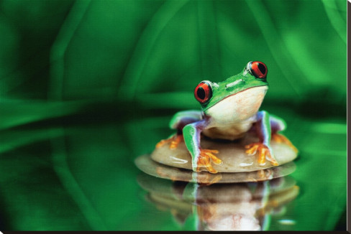
Kingdom Animalia I
Invertebrates
Learning CTR Online

Slide 3
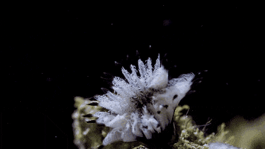
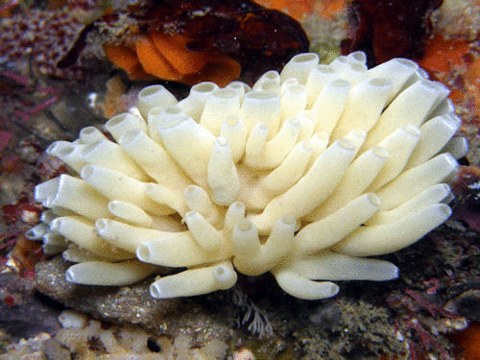
Chapter 26:
Kingdom Animalia I

Slide 4
Lesson Objectives
  By the end of this lesson, you should be able to:
Identify the two branches of the animal kingdom (invertebrates and vertebrates).
Explain five common characteristics of organisms in the animal kingdom.
Describe the process of embryonic maturation (blastula, gastrula, true tissues).
Distinguish the five Animal Body Plans and how this relates to animal phyla.
Understand and explain the general features of invertebrate animals (non-chordates), including porifera and cnidarians. … Phylum, Examples of organisms, Location, Symmetry, Body plan (tissue layers), Coelom relationship (acoelomate, pseudocoelomate, coelomate), Protostome or deuterostome, Reproduction, Special features
  Science Practice: Animal Phyla Project
Notes:
#frame
instructional video
Timing ≈ 0.5 minutes
Living organisms need energy to accomplish the wide variety of tasks they attempt each day.
You will begin learning about how energy is captured from the Sun and stored in organic molecules.
[read objectives]

Slide 5
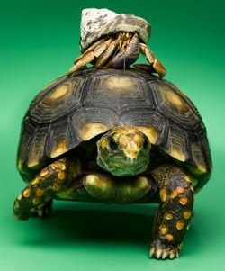
Animals are Divided into
Invertebrates
do NOT have a spinal column (“backbone”).
  Ex. Insects
  Most animals are invertebrates.
Vertebrates
have a spinal column (“backbone”).
  Ex. Mammals, Birds, Reptiles

Slide 6
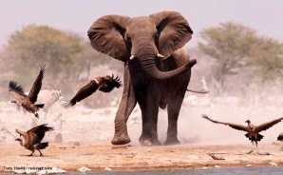
Characteristics of Animals
Multicellular
Eukaryotes
No Cell Walls
Ingestive Heterotrophs (take in food and internally digest it).
Go through a Blastula stage of development.
ZOOLOGY = Study of Animals

Slide 7
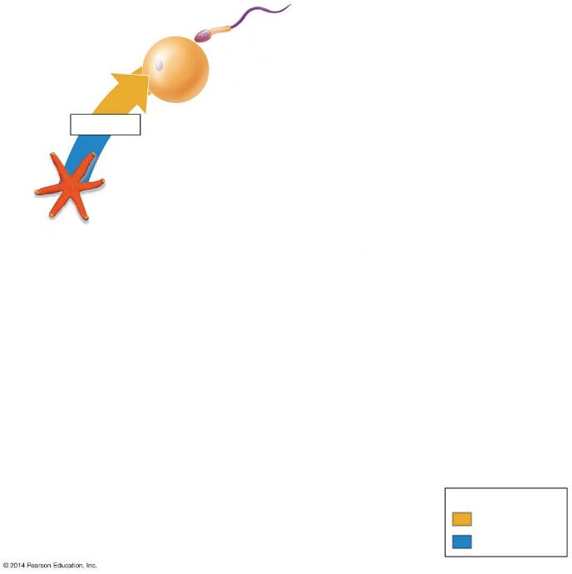
Sperm
1
Egg
Meiosis
6) Most adult animals are diploid and reproduce sexually …
  by eggs and sperm
    are produced by meiosis
    are the only haploid cells
Adult
Key
Haploid (n)
Diploid (2n)
Notes:
Figure 18.1b-1 The life cycle of a sea star (step 1)

Slide 8
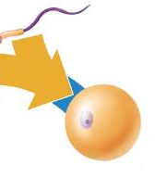
Sperm
Key
2
Haploid (n)
Zygote
(fertilized egg)
Diploid (2n)
1
Meiosis
Egg
Adult
Gametes fuse during fertilization to form a zygote.
Notes:
Figure 18.1b-2 The life cycle of a sea star (step 2)

Slide 9
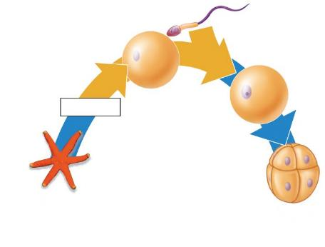
Sperm
Key
Haploid (n)
2
Zygote
(fertilized egg)
Diploid (2n)
1
Egg
Meiosis
3
3
Eight-cell
stage
Adult
    The zygote divides into cells.
Notes:
Figure 18.1b-3 The life cycle of a sea star (step 3)

Slide 10
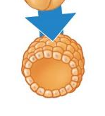
Sperm
Sperm
Key
Haploid (n)
2
2
Zygote
(fertilized egg)
Diploid (2n)
Zygote
(fertilized egg)
1
1
Egg
Meiosis
Egg
Meiosis
3
4
Blastula
(cross section)
4
The zygote divides by mitosis to form a hollow ball of cells called a BLASTULA.
Notes:
Figure 18.1b-4 The life cycle of a sea star (step 4)

Slide 11
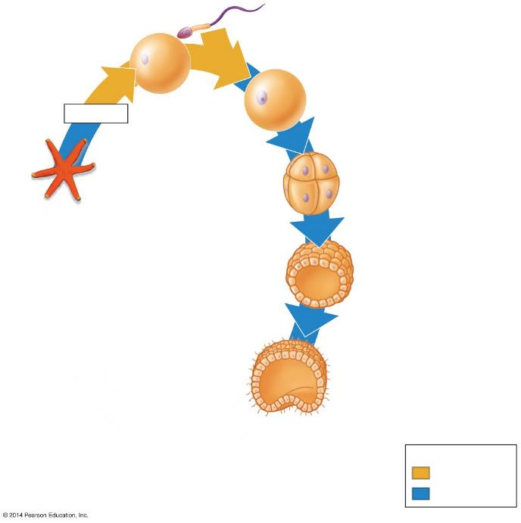
Sperm
Key
Haploid (n)
2
Zygote
(fertilized egg)
Diploid (2n)
1
Egg
Meiosis
3
Eight-cell
stage
Adult
4
One side of the blastula folds in and cells become rearranged to form a GASTRULA
Blastula
(cross section)
5
Early gastrula
(cross section)
Notes:
Figure 18.1b-5 The life cycle of a sea star (step 5)

Slide 12
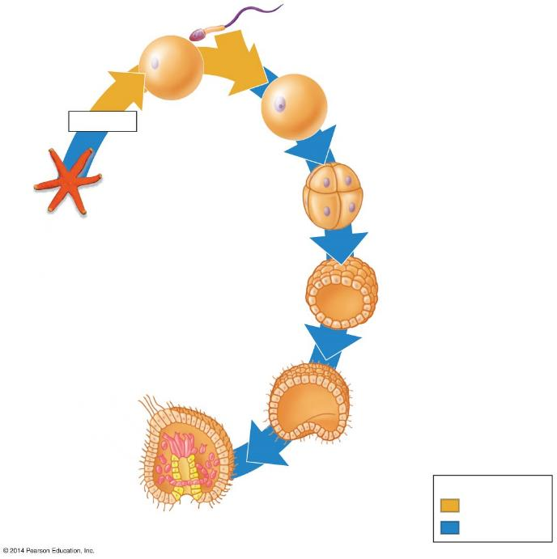
Sperm
Key
Haploid (n)
2
Zygote
(fertilized egg)
Diploid (2n)
1
Egg
Meiosis
3
Eight-cell
stage
Adult
The gastrula forms three Embryonic Layers
4
Blastula
(cross section)
Ectoderm
5
Early gastrula
(cross section)
Endoderm
6
Internal sac
Future mesoderm
Later gastrula
(cross section)
Notes:
Figure 18.1b-6 The life cycle of a sea star (step 6)

Slide 13
Gastula Development
  Endoderm
  forms a lining of the future digestive tract.
  Ectoderm
  forms an outer layer that will give rise to the skin and nervous system.
  Mesoderm
  forms a middle layer that will give rise to muscles and most internal organs.
Ectoderm
Endoderm
Future mesoderm

Slide 14
Maturation
After the gastrula stage, many vertebrate animals develop directly into adults.
Invertebrate and some vertebrate animals do NOT develop directly into adults.
Phyla of Invertebrates:
Porifera, Coelenterata (Cnidaria), Platyhelminthes (flat worms), Nematoda (round worms), Annelida (segmented worms), Echinodermata, Mollusca, and Arthropoda.

Slide 15
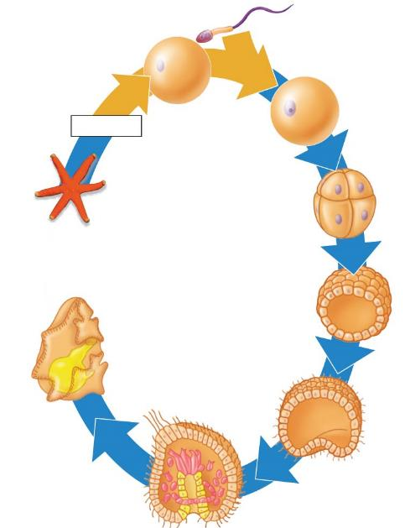
Sperm
Key
Haploid (n)
2
Zygote
(fertilized egg)
Diploid (2n)
  A Larva is an immature individual that looks different from the adult animal.
1
Egg
Meiosis
3
Eight-cell
stage
Some animals, such as the sea star, develop into one or more larval stages.
Adult
4
Blastula
(cross section)
Digestive tract
Larva
Ectoderm
5
7
Early gastrula
(cross section)
Endoderm
6
Internal sac
Future mesoderm
Later gastrula
(cross section)
Notes:
Figure 18.1b-7 The life cycle of a sea star (step 7)

Slide 16
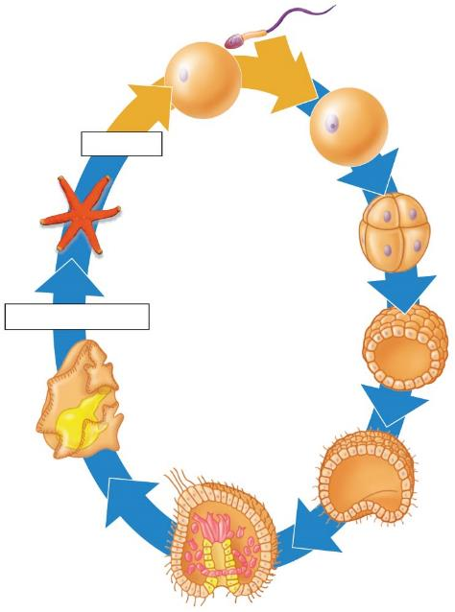
Sperm
Key
Haploid (n)
2
Zygote
(fertilized egg)
Diploid (2n)
1
Egg
Meiosis
3
  A larva undergoes a major change in body form.
  It becomes a mature adult that can reproduce.
Eight-cell
stage
Adult
8
Metamorphosis
4
Blastula
Metamorphosis
Digestive tract
Ectoderm
5
Larva
7
Early gastrula
(cross section)
Endoderm
6
Internal sac
Future mesoderm
Later gastrula
(cross section)
Notes:
Figure 18.1b-8 The life cycle of a sea star (step 8)

Slide 17
What are the two branches of the animal kingdom?
List five characteristics of animals.
List the embryonic tissues and what they produce.

Slide 18
What are the two branches of the animal kingdom? Invertebrates & vertebrates
List five characteristics of animals.
Multicellular
Eukaryotes
No Cell Walls
Ingestive Heterotrophs (take in food and internally digest it).
Go through a Blastula stage of development.
List the embryonic tissues and what they produce.
  Endoderm forms a lining of the future digestive tract.
  Ectoderm forms an outer layer that will give rise to the skin and nervous system.
  Mesoderm forms a middle layer that will give rise to muscles and most internal organs.

Slide 19
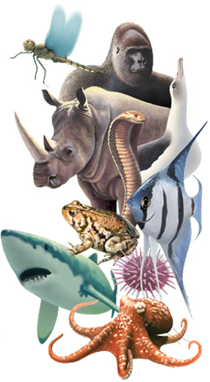
Creation of the Animal Kingdom
“And God said, Let the waters bring forth abundantly the moving creature that hath life, and fowl that may fly above the earth in the open firmament of heaven.
²¹ And God created great whales, and every living creature that moveth, which the waters brought forth abundantly, after their kind, and every winged fowl after his kind: and God saw that it was good.
²² And God blessed them, saying, Be fruitful, and multiply, and fill the waters in the seas, and let fowl multiply in the earth.
²³ And the evening and the morning were a fifth day.
²⁴ And God said, Let the earth bring forth the living creature after his kind, cattle, and creeping thing, and beast of the earth after his kind: and it was so.
²⁵ And God made the beast of the earth after his kind, and cattle after their kind, and every thing that creepeth upon the earth after his kind: and God saw that it was good.
³¹ And God saw every thing that he had made, and, behold, it was very good. And the evening and the morning were the sixth day.” Genesis 1: 20-31

Slide 20
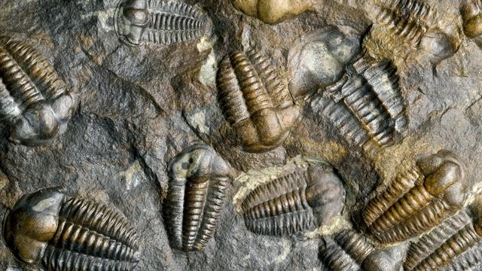
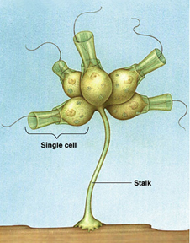
Animal Diversity
(according to Evolution)
Animals are believed to have descended from a common ancestor (an ancestral flagellated protist).
Most of today’s phyla of animals are believed to have appeared for the first time in the geological column during a period called “Cambrian Explosion”.

Slide 21
Animal’s Body Plan
Presence of True Tissues
Symmetry
Embryonic Tissue Layers
First Opening formed by Gastrulation
Presence of a Body Cavity

Slide 22
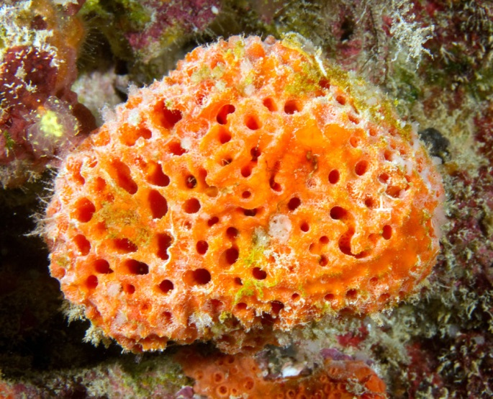
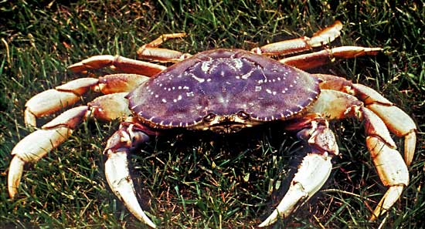
1) True Tissues
What is a Tissue?
Presence or Absence of true tissues separates animals into two groups:
  Sponges (simplest animals): NO true tissues.
  Animals with true tissues.

Slide 23
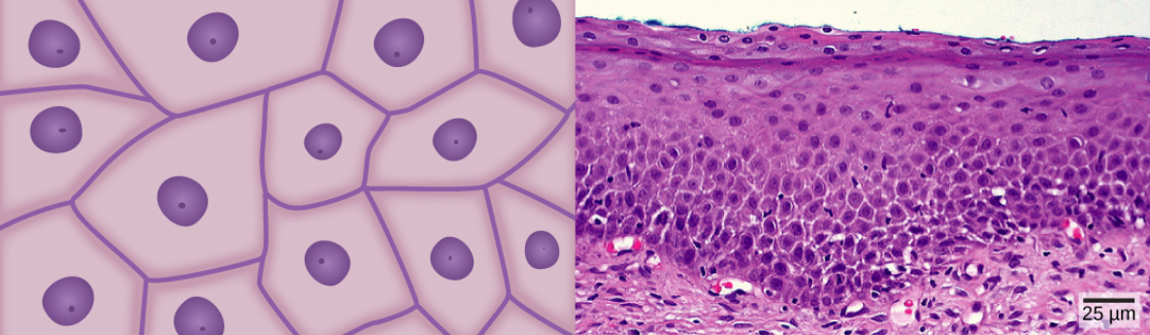
1) True Tissues
What is a Tissue?
Tissues are an integrated group of cells that share a common structure and a common function.
For example, epithelial, connective, nervous or muscle tissue).

Slide 24
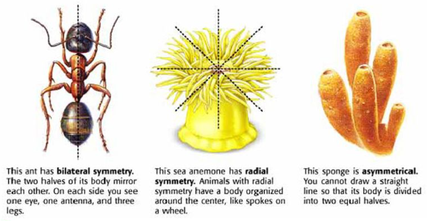
2) Body Symmetry
Symmetry is the arrangement of body parts around a central point or axis.
Asymmetry occurs when the body can’t be divided into into equal parts (sponges).

Slide 25
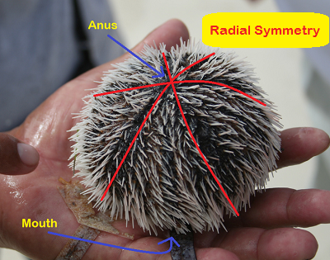

2) Body Symmetry
Radial Symmetry occurs when body parts are arranged around a central point like spokes on a wheel (jellyfish, sea stars, sea urchins).
Most animals with radial symmetry are sessile (attached) or sedentary (move very little).

Slide 26
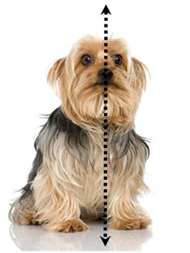
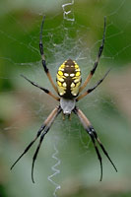

2) Body Symmetry
Bilateral Symmetry occurs when animals can be divided into equal halves along a single plane.
Organisms will have right and left sides that are mirror images of each other.

Slide 27
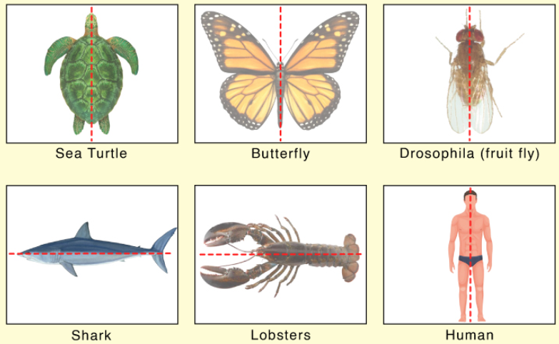
2) Body Symmetry
Animals with Bilateral Symmetry are usually motile.
  Have an anterior and posterior ends.
  Show Cephalization (tendency to concentrate sensory organs and a brain at the head or anterior end).

Slide 28
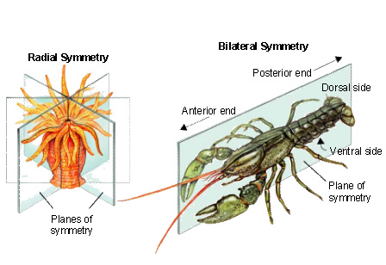
2) Body Symmetry

Slide 29
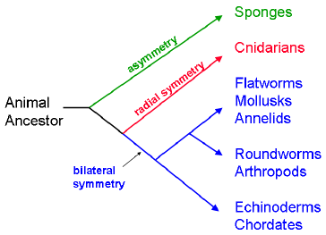
2) Body Symmetry
Evolution of Symmetry (simple to complex)
Sponges lack symmetry.
Cnidarians exhibit radial symmetry.
All other phyla listed have bilateral symmetry.

Slide 30
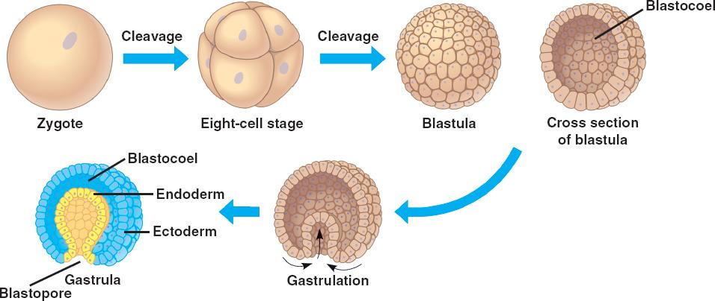
3) Embryonic Development
2 or 3 Tissue Layers

Slide 31
3) Embryonic Development
2 or 3 Tissue Layers
Future mesoderm

Slide 32
3) Embryonic Development
2 or 3 Tissue Layers
In animals with TRUE tissues, the Blastula folds in on itself to generate the Gastrula.
Gastrulas of Cnidarians (jellyfishes and their relatives) have two tissue layers:
  Ectoderm: Outside
  Endoderm: Inside
All other animals with true tissues have a third tissue layer:
  Mesoderm: between ectoderm & endoderm

Slide 33
Gastula Development
  Endoderm
  forms a lining of the future digestive tract.
  Ectoderm
  forms an outer layer that will give rise to the skin and nervous system.
  Mesoderm
  forms a middle layer that will give rise to muscles and most internal organs.
Ectoderm
Endoderm
Future mesoderm

Slide 34
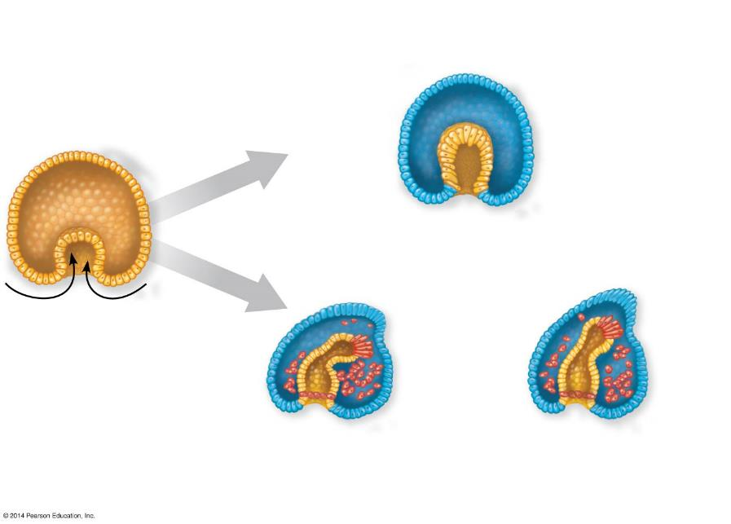
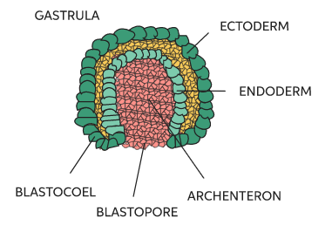
3) Embryonic development: tissue layers
Two layers (some animals)
Ectoderm
(outer layer)
Gastrulation
Endoderm
(inner layer)
Notes:
Figure 18.3-3 Tissue layers

Slide 35
3) Embryonic development: tissue layers
Two layers (some animals)
Ectoderm
(outer layer)
Gastrulation
Endoderm
(inner layer)
Three layers (most animals)
Future
anus
Future
mouth
Mesoderm
Future
digestive
tract
Future mouth
Future anus
Protostome
(“first mouth” in Greek)
Deuterostome
(“second mouth” in Greek)
Notes:
Figure 18.3-3 Tissue layers

Slide 36
4) Embryonic Development:
First Opening formed by Gastrulation
Animals with 3 tissue layers are divided into 2 groups:
  Protostomes if the first indentation (opening) during Gastrulation becomes the Mouth.
    Ex. Arthropods, Worms
    Deuterostomes if the 1st indentation (opening) during Gastrulation becomes the Anus & the mouth forms from a 2nd opening.
    Ex. Echinoderms, Chordates
Two layers (some animals)
Ectoderm
(outer layer)
Endoderm
(inner layer)
Gastrulation
Future
anus
Future
mouth
Mesoderm
Future
digestive
tract
Future mouth
Future anus
First opening
in embryo
Protostome
(“first mouth” in Greek)
Deuterostome
(“second mouth” in Greek)
Notes:
Figure 18.3-3 Tissue layers

Slide 37
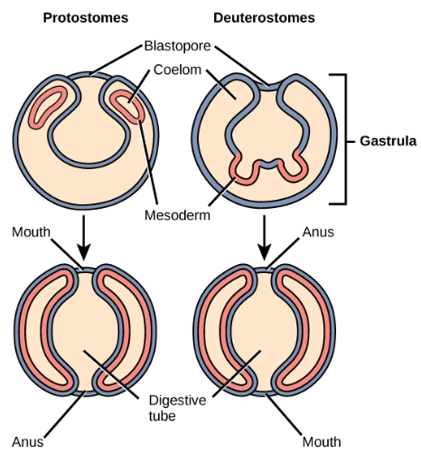
4) Embryonic Development:
First Opening formed by Gastrulation
  Protostomes if the first opening during Gastrulation becomes the Mouth.
    Ex. Arthropods, Worms
    Deuterostomes if the 1st opening during Gastrulation becomes the Anus & the mouth forms from a 2nd opening.
    Ex. Echinoderms, Chordates

Slide 38
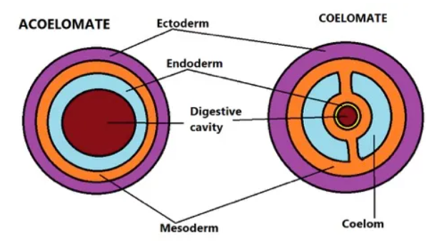
5) Coelom: Body Cavity
Most animals with 3 tissue layers have a Body Cavity or Coelom:
  Fluid-filled space between the outer body wall (ectoderm) and the digestive tube (endoderm) in which the internal organs are suspended.
  This body cavity helps protect the suspended organs from injury.

Slide 39
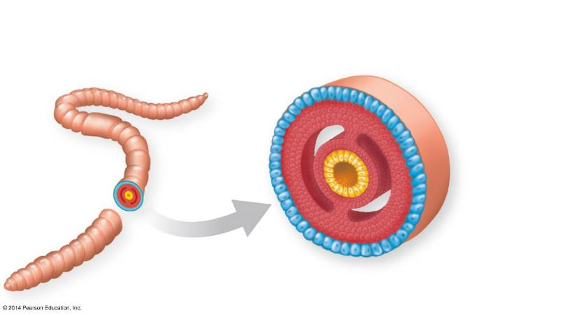
5) Coelom: Body Cavity
Embryonic development: body cavity
(helps protect organs from injury)
Body covering
(from ectoderm)
Body
cavity
Digestive tract
(from endoderm)
Tissue layer
lining body cavity
(from mesoderm)
Notes:
Figure 18.3-4 Body cavity

Slide 40
5) Coelom: Body Cavity
        Acoelomates (No Coelom)
        Animals that have no internal, fluid-filled body cavity separating its body wall from its digestive tract. E.g. Porifera (sponges), Platyhelminthes (flatworms).
        Pseudocoelomate
        Organisms with body cavity lined with patches of mesoderm, but not derived from the mesoderm, as in a true coelom, or body cavity. E.g. Nematodes (round worms).
        Coelomates
        Organisms with a body cavity, (“True Coelom”) that is derived from and lined with mesoderm. The coelom is the space (body cavity) between the digestive organs and the outer body wall.

Slide 41
What are two major ways to explain diversity?
List the five animal body plans.
Distinguish asymmetry, radial and bilateral symmetry.

Slide 42
What are two major ways to explain diversity? Creation (Genesis 1-2) & macroevolution (gradual, random)
List the five animal body plans.
Presence of True Tissues
Symmetry
Embryonic Tissue Layers
First Opening formed by Gastrulation
Presence of a Body Cavity
Distinguish asymmetry, radial and bilateral symmetry.
  Asymmetry no definite shape.
  radial body parts are arranged around a central point
  bilateral divided into equal halves along a single plane.

Slide 43
Give examples of phyla with each type of body symmetry.
Name and define the branches of animals with 3 embryonic tissue layers.
Name and define the 3 body cavity types in animals.

Slide 44
Give examples of phyla with each type of body symmetry.
Name and define the branches of animals with 3 embryonic tissue layers.
  Protostomes the first opening during Gastrulation → Mouth.
  Deuterostomes the first opening during Gastrulation → Anus.
Name and define the 3 body cavity types in animals.
  Acoelomate → no body cavity (flatworms)
        Pseudocoelomate → patches of mesoderm (round worms)
        Coelomates → derived from and lined with mesoderm.

Slide 45
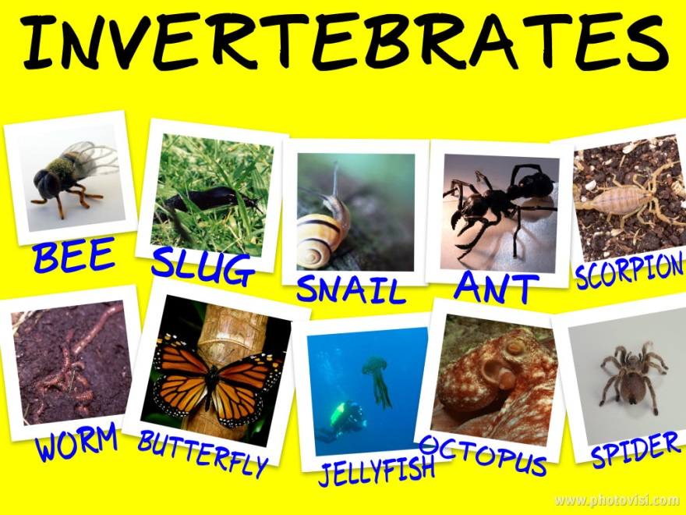
Invertebrates
“Simplest” animals.
Contain the greatest number of different species.
Do NOT have a backbone.
Includes sponges, cnidarians, flatworms, roundworms, mollusks, annelids, arthropods, and echinoderms.

Slide 46
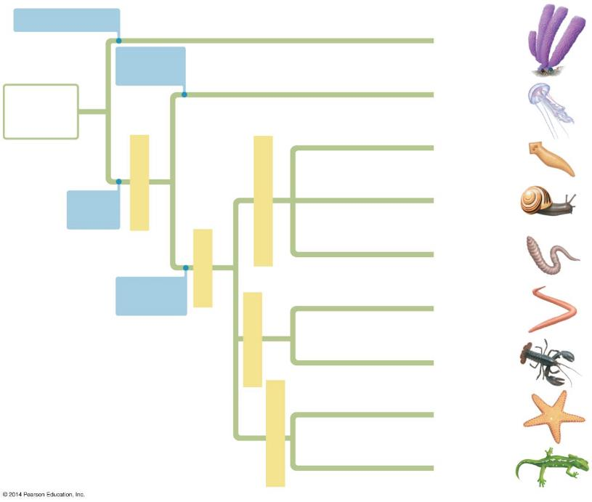
No true tissues
asymmetrical
Sponges
Radial
symmetry
Ancestral
colonial
protist
Cnidarians
Flatworms
2 Tissues
True
tissues
Protostomes
Mollusks
Annelids
3 Tissues
Bilateral
symmetry
Nematodes
Protostomes
exoskeleton
Invertebrates
Arthropods
Echinoderms
Deuterostomes
Chordates
vertebrates
Notes:
Figure 18.4 A current hypothesis of animal phylogeny

Slide 47
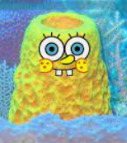
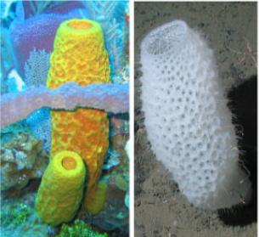
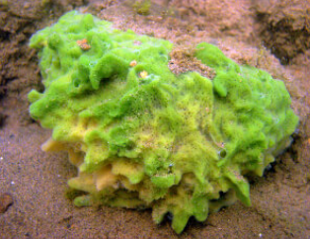
Phylum Porifera: Sponges
The phylum includes about 5,000 species of sponges, grouped into 3 classes depending mainly upon the types of skeleton found in them.
The Porifera may be defined as an asymmetrical or somewhat radially symmetrical, multicellular organism with a cellular grade of an organization without true tissues and organs.

Slide 48
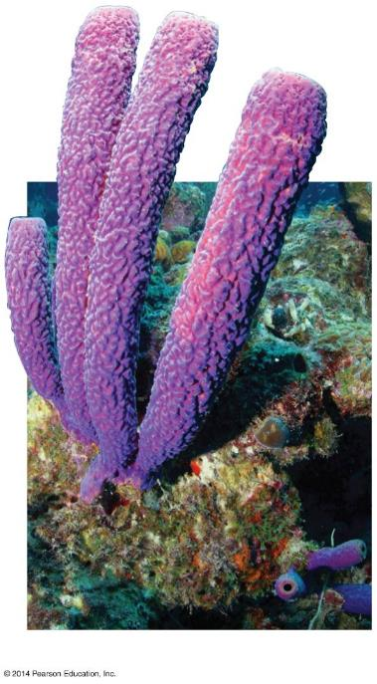
Phylum Porifera: Sponges
Simplest of all animals
  Lack true tissues and organs
Aquatic, mostly marine
Lack body symmetry (asymmetrical)
Hollow, Porous bodies
Sessile: generally remain anchored to their substrate.

Slide 49
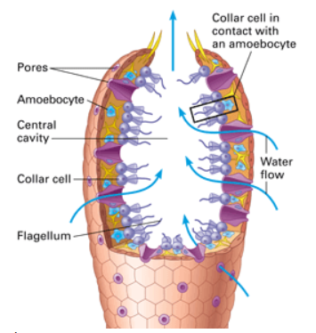
Phylum Porifera: Sponges
Body wall has outer layer of flattened cells and inner layer of flagellated “collar cells”.
Between these two layers is a jelly-like matrix that has many types of cells embedded in it (amoebocytes).
These cells digest food, store and transport nutrients, etc.

Slide 50
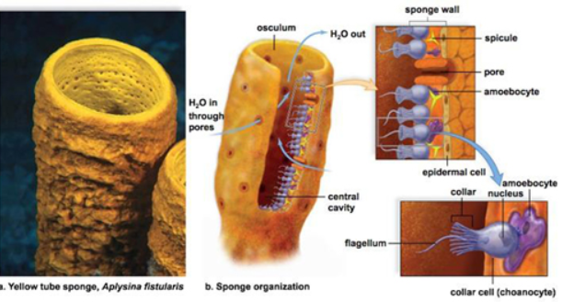
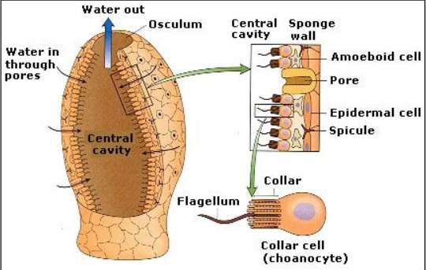
Porifera do not have a circulatory system.
Porifera have no coelom (acoelomate).
Porifera have no real body layers but they do have 2 cell layers:
an outer layer that makes up the epidermis
an inner layer that makes the inner cavities.

Slide 51
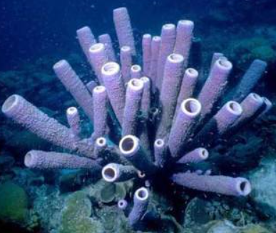
Porifera have specialized cells called choanocytes (collar cells). Choanocytes have a flagella, which is surrounded by collar composed of cytoplasm. Flagella produce water current to capture food.
Amoebocytes are cells that perform similar tasks of a circulatory system and store nutrients.

Slide 52
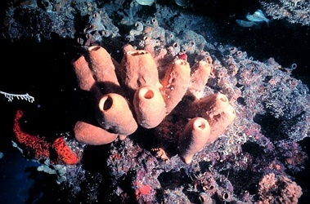
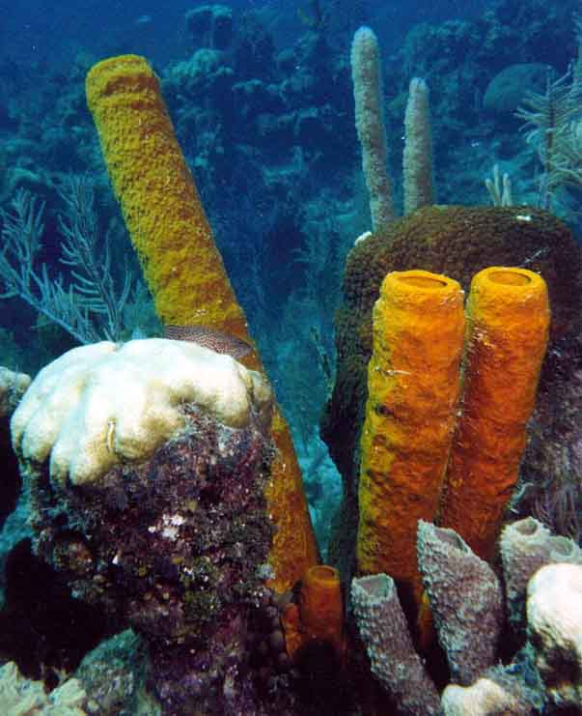
Phylum Porifera: Sponges
Filter Feeders
Movement of flagella on collar cells produces a current of water into the sponge’s central cavity.
Food particles are trapped and distributed to other cells.
Water and wastes exit through a large hole at the top.

Slide 53
Phylum Porifera: Sponges
Porifera have both Asexual and Sexual reproduction.
Hermaphrodites
Possess & release BOTH eggs and sperm into the water (SEXUAL reproduction).
Sponges can reproduce asexually by BUDDING … the unique ability of regeneration, a form of asexual reproduction. E.g. injury

Slide 54
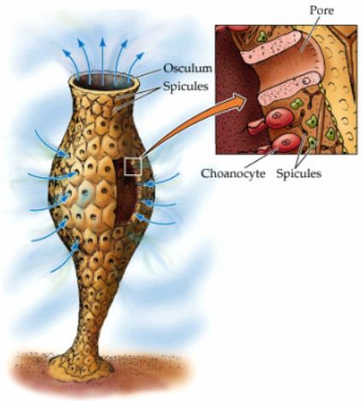
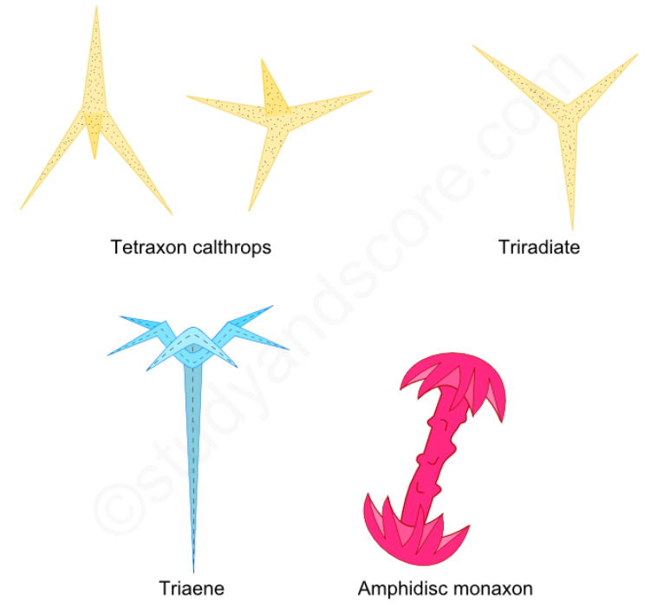
Phylum Porifera: Sponges
“Skeleton”
Spicules are microscopic crystalline structures that give rigidity and form.
Some spicules have toxic chemicals that help deter predators or catch prey.

Slide 55
Which branch of animals has the most species?
Sponges are phylum ___ and most are ___ (body symmetry). They are ___ (live in water) and ___ (attached to a substrate). They have no ___ tissues.
They are ___ (body cavity type). For circulation, digestion, and storage they have ___ cells and ___ and are called ___ feeders.
Sponges reproduce ___ with sperm and egg and are called ___ because they use both gametes. They reproduce ___ by ___ and can regenerate body parts.
Sponges’ skeletal system for form and rigidity come from ___ , which can also capture ___ and deter ___ .

Slide 56
Which branch of animals has the most species? invertebrates
Sponges are phylum porifera and most are asymmetrical (body symmetry). They are aquatic (live in water) and sessile (attached to a substrate). They have no true tissues.
They are acoelomate (body cavity type). For circulation, digestion, and storage they have collar cells and amoebocytes and are called filter feeders.
Sponges reproduce sexually with sperm and egg and are called hermaphrodites because they use both gametes. They reproduce asexually by budding and can regenerate body parts.
Sponges’ skeletal system for form & rigidity come from spicules, which can capture prey and deter predators.

Slide 57
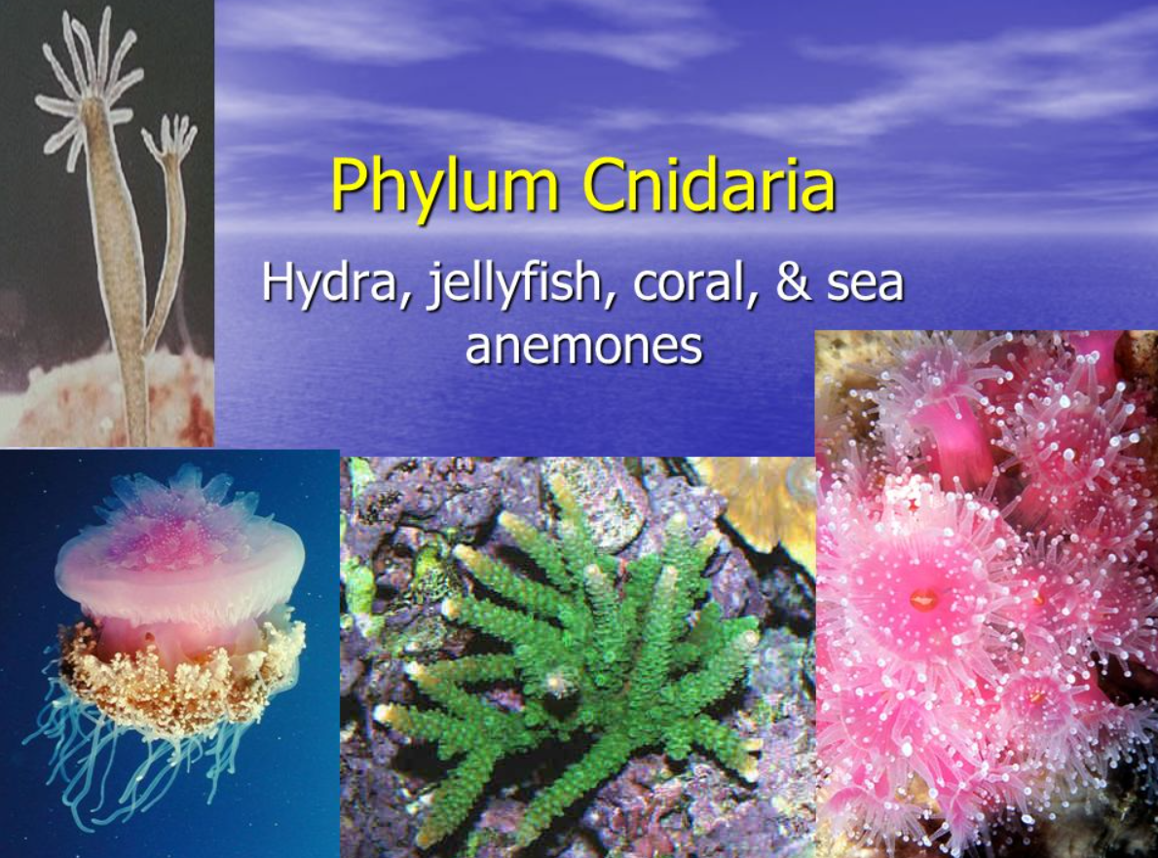
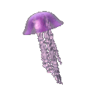
Phylum Cnidaria
57

Slide 58
Phylum Cnidaria
Includes hydras, jellyfish, coral, sea anemones
Aquatic (mostly marine)
Radial symmetry
Body Plans: 2 Tissue Layers
Ectoderm → protective & sensory
Endoderm → nutritive, glandular, digestion
Mesoglea → nerve network
Gastrovascular cavity → 2-way digestion
Acoelomate
Mouth surrounded by tentacles.
Nematocysts: (stinging cells)
58

Slide 59
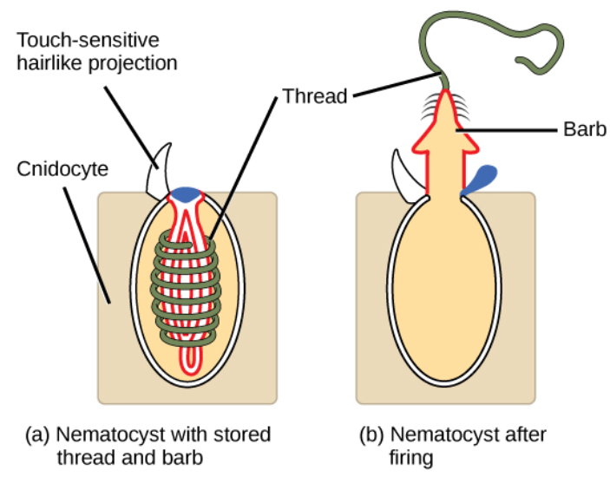
Phylum Cnidaria
Feeding Habits
Food is grabbed by tentacles and paralyzed with nematocysts to sting predators and prey.
CNIDOCYTES (stinging cells) found in the Tentacles. Each has a Nematocyst that has a coiled, harpoon-like stinger that shoots out when triggered.
59

Slide 60
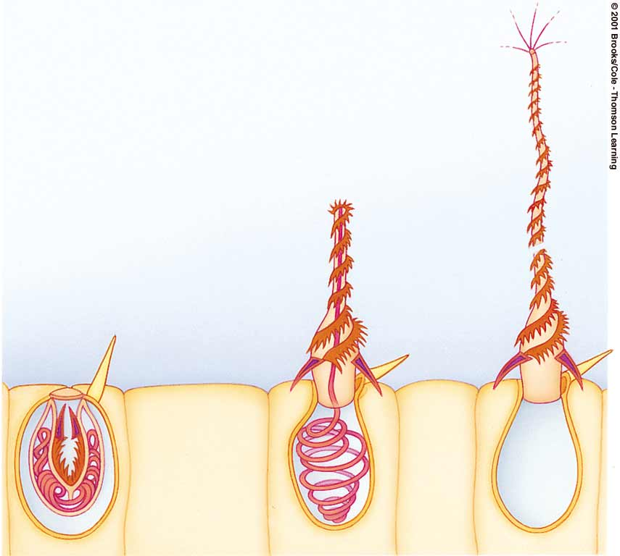
Nematocyst
https://somup.com/c36eqQURjS Cnidarian Warfare (Nematocysts) [1:34]
Barbed, threaded stinger
capsule’s lid
trigger
Nematocyst
Cnidocyte (cell)
60

Slide 61

Phylum Cnidaria
Life Forms
POLYP: mouth directed upward; hydra, Coral
MEDUSA: mouth directed downward; Jellyfish
Polyp
Medusa
61

Slide 62
62

Slide 63
Cnidarians have an incomplete digestive system with only one opening; the gastrovascular cavity serves as both a mouth and an anus.
Cnidarians carry out EXTRACELLULAR DIGESTION, where enzymes break down the food particles and cells lining the gastrovascular cavity absorb the nutrients.
An advantage of extracellular digestion is the capacity to eat larger food particles.
https://somup.com/c36eqgURXL (4:49) Cnidarians General Features
63

Slide 64

Phylum Cnidaria
Anatomy (polyp)
64

Slide 65

Phylum Cnidaria
REPRODUCTION
Cnidarians reproduce both sexually and asexually.
Some species can produce both eggs and sperm in the same organism. These organisms are called simultaneous hermaphrodites and release gametes into the ocean in egg-sperm bundles.
Some species are also either male or female and produce either eggs or sperm.
65

Slide 66
No true tissues
asymmetrical
1
2
Sponges
Radial
symmetry
4
Ancestral
colonial
protist
Cnidarians
3
7
Flatworms
2 Tissues
6
8
True
tissues
Protostomes
Mollusks
?
9
Annelids
5
3 Tissues
Bilateral
symmetry
10
Nematodes
Protostomes
exoskeleton
11
Invertebrates
Arthropods
13
Echinoderms
12
Deuterostomes
Chordates
vertebrates
14
Notes:
Figure 18.4 A current hypothesis of animal phylogeny

Slide 67
No true tissues
asymmetrical
Sponges
Radial
symmetry
Ancestral
colonial
protist
Cnidarians
Flatworms
2 Tissues
True
tissues
Protostomes
Mollusks
Annelids
3 Tissues
Bilateral
symmetry
Nematodes
Protostomes
exoskeleton
Invertebrates
Arthropods
Echinoderms
Deuterostomes
Chordates
vertebrates
Notes:
Figure 18.4 A current hypothesis of animal phylogeny

Slide 68

Animal Phyla Project
Download the worksheet.
Download the PowerPoint template.
Secure “google drive” access.

