Slide 1
Click on “Slide Show”
Click on
“From Current Slice”

Slide 2
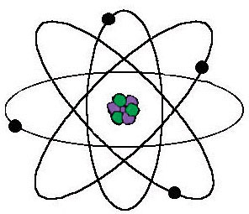
Chapters 39 – 40
Nuclear Energy

Slide 3
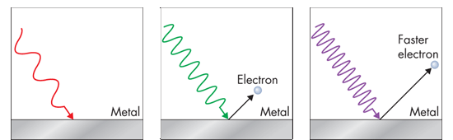
The Quantum Concept and Photons
The Photoelectric Effect → Shows “Quanta”
No electrons are ejected because the frequency of the light is below the threshold frequency.
If the light is at or above the threshold frequency, electrons are ejected.
If the frequency is increased, the ejected electrons will travel faster.
e.g. garage door opener; remote controls

Slide 4
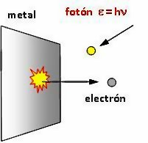
Photoelectric Effect: Discrete Particle & Wavelength
  Einstein explained the photoelectric effect incorporating Planck’s particle view (quantum) while proposing that light being a wave behaves as “Photons” or bundle of energy.
  Every Photon has a quantized amount of energy as described by E = hν.
    E = energy of photon
    h = Planck’s constant
    ν = frequency
Notes:
Timing ≈ 1 min
[Animate stem] The observation that the energy was related to the frequency and not the intensity gave Einstein the clue he needed to explain the photoelectric effect. [Animate bullet 1] He claimed that the electrons come off the metal as quanta (packets) of energy related to the frequency of the light driving them off. [Animate sub-bullet] This idea originated with Max Planck, the German physicist. Planck proposed in 1901 that the energy of a vibrating molecule could only take on certain values and was not continuous. He said that this energy was quantized. The energy would be related to a constant (Planck’s constant) and only certain energy levels would exist.
Einstein picked up on this idea and related it to the photoelectric effect. [Animate image] The electrons coming off a metal had energies related to the frequency of light (teacher point to light waves) striking the metal. [Animate bullet 2] This energy could be expressed as E = hv where [Animate sub-bullet] E = the energy of the electron, [Animate sub-bullet] h is Planck’s constant and the [Animate sub-bullet] Greek letter v (nu) is the frequency of light. Energy levels between these levels would not be seen.
The observation that lower-frequency light would not cause electrons to be emitted also fit the theory. These frequencies put too little energy into the system to dislodge an electron.
It may also help the student understand through an analogy. A 3' wall with different sized/aged people trying to climb over. Babies may not be able to climb over- no matter how many babies try, but all the able-bodied 6' people can easily climb over.
SOURCE:
http://commons.wikimedia.org/wiki/File:Fot%C3%B3n.jpg

Slide 5
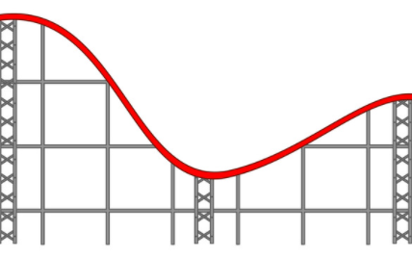
Photoelectric Effect: Discrete Particle & Wavelength
  Fun Application
  http://phet.colorado.edu/simulations/sims.php?sim=Photoelectric_Effect
Two metal balls (touching each other) are at the lowest point of the track. Roll a ball from the designated spectral color line to see the results.
V
B
G
To test intensity, roll TWO metals balls from the color line.
Y
O
R
Notes:
Timing ≈ 1 min
[Animate stem] The observation that the energy was related to the frequency and not the intensity gave Einstein the clue he needed to explain the photoelectric effect. [Animate bullet 1] He claimed that the electrons come off the metal as quanta (packets) of energy related to the frequency of the light driving them off. [Animate sub-bullet] This idea originated with Max Planck, the German physicist. Planck proposed in 1901 that the energy of a vibrating molecule could only take on certain values and was not continuous. He said that this energy was quantized. The energy would be related to a constant (Planck’s constant) and only certain energy levels would exist.
Einstein picked up on this idea and related it to the photoelectric effect. [Animate image] The electrons coming off a metal had energies related to the frequency of light (teacher point to light waves) striking the metal. [Animate bullet 2] This energy could be expressed as E = hv where [Animate sub-bullet] E = the energy of the electron, [Animate sub-bullet] h is Planck’s constant and the [Animate sub-bullet] Greek letter v (nu) is the frequency of light. Energy levels between these levels would not be seen.
The observation that lower-frequency light would not cause electrons to be emitted also fit the theory. These frequencies put too little energy into the system to dislodge an electron.
It may also help the student understand through an analogy. A 3' wall with different sized/aged people trying to climb over. Babies may not be able to climb over- no matter how many babies try, but all the able-bodied 6' people can easily climb over.
SOURCE:
http://commons.wikimedia.org/wiki/File:Fot%C3%B3n.jpg

Slide 6
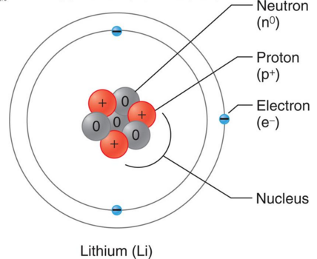
What’s Wrong with this picture?

Slide 7
What’s Wrong with this picture?
If “like” charges repel (which they do), how can protons exist in the same region of the atom without being repelled?
There must be a strong nuclear force that binds the protons together.

Slide 8
2
E = mc
Albert Einstein's theory of special relativity explains the strong nuclear force:
m → relativistic mass of a body
E → energy of motion (KE) of the body
c → the speed of light

Slide 9
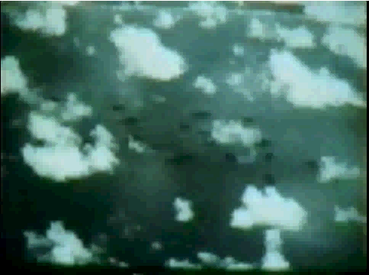
Click on the following Link
(Atomic Blast Action):
http://somup.com/cFX20qnjnh (4:48)
Nuclear Energy

Slide 10
Matter can be turned into energy,
and energy into matter.

Slide 11
Matter can be turned into energy,
and energy into matter.
Background:
Law of conservation of matter and energy → energy and/or matter cannot be created or destroyed.
The total mass and energy of the universe is constant.
Modification:
Matter and energy can be converted into each other.
Mass and energy together are conserved.

Slide 12
In one kilogram of pure water, the mass of hydrogen atoms amounts to just slightly more than 111 grams, or 0.111 kg. (i.e. 0.2 pounds)

Slide 13
Calculating the energy in the hydrogen atom
E = 0.111 kg x 300,000,000 m/s x 300,000,000 m/s
10,000,000,000,000,000 joules
Of Energy!!

Slide 14
The amount of energy in 30 grams of hydrogen atoms is equivalent to burning hundreds of thousands of gallons of gasoline!

Slide 15
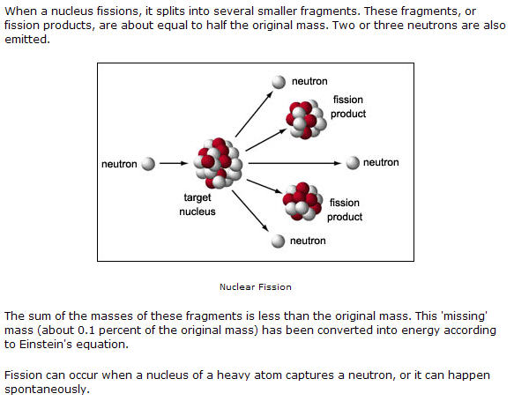

Slide 16
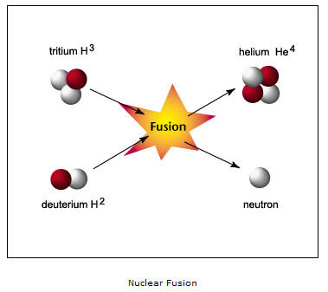

Slide 17
Two protons stuck together have less mass than two single separate protons!
Two protons stuck together have less mass than two single separate protons!
When the protons are forced together, this extra mass is released ... as energy!

Slide 18
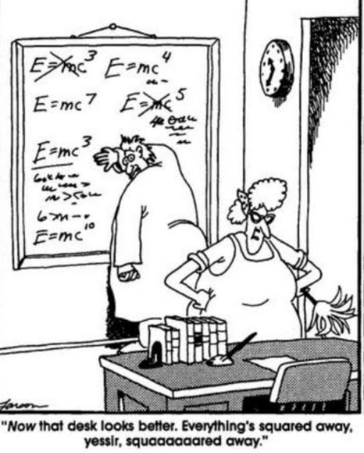
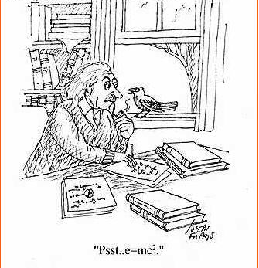
Typically this amounts to about 0.7% of the total mass, converted to an amount of energy predictable using the formula.

Slide 19
Because other scientists were confirming his theories, Albert Einstein
was able to see
where an understanding
of this formula would lead ...

Slide 20
Although peaceful by nature and politics, he helped write a letter to the President of the United States,
urging him to fund research into the development of an atomic bomb (The Manhattan Project)
... before the Nazis or Japan could develop their own first.

Slide 21
One of the most famous pacifists in history, and he had created the formula for weapons of mass destruction.
REGRETS

Slide 22
"Had I known that the Germans would not succeed in developing an atomic bomb, I would have done nothing."
Einstein

Slide 23
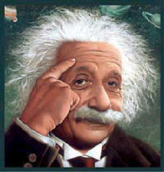
"I want to know God's thoughts; the rest are details.”
"Education is what remains after one has forgotten everything he learned in school.”
"Only two things are infinite, the universe and human stupidity, and I'm not sure about the former.”
“All religions, arts and sciences are branches of the same tree.”
“Science without religion is lame. Religion without science is blind."

Slide 24
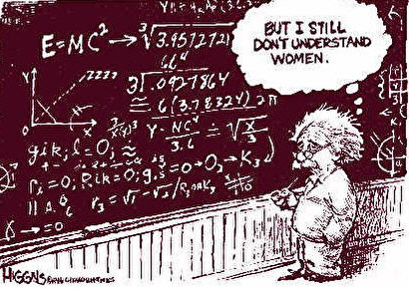

Slide 25
Lise MEITNER
A Jewish woman became the second woman to obtain a doctoral degree in physics at the University of Vienna in 1905. In 1907 she went to Berlin to attend lectures of Max Planck.
In 1926, Meitner became the first woman in Germany to assume a post of full professor in Physics, at the University of Berlin and became directly involved in research with German physicist Otto Hahn (1879-1968). Otto Frisch (Meitner’s nephew) discovered “nuclear fission.”
In 1933, Meitner was acting head of the Physics department of the Kaiser Wilhelm Institute for Chemistry when Hitler came into power. She was one of a very few allowed to stay under his antisemitic regime.
In 1936, the duo discovered that uranium would successfully fission when bombarded by “moderated” (slowed down in “heavy” water) neutrons but the discovery was not revealed in a publication.

Slide 26
Lise MEITNER
As events changed in Nazi Germany, in 1938, Dr. Lise Meitner successfully escaped Germany to escape Hitler’s inevitable attack and went to Stockholm, Sweden.
She (along three other colleagues) confirmed Einstein's famous equation, E = mc², which explained the source of the tremendous releases of energy in nuclear fission.
In 1944, Hahn was awarded the Nobel Prize for Physics for his research into fission, but Meitner was ignored.
The Nobel "mistake," never acknowledged, was partly rectified in 1966, when Hahn, Meitner, and Strassmann were awarded the U.S. Fermi Prize.

Slide 27
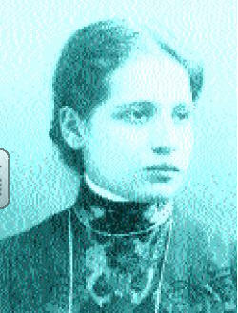
Lise MEITNER
Significantly
helped to confirm
Einstein’s
e = mc² equation.
But Otto Hahn was given full credit when she fled from under the Nazi regime.

Slide 28
Element 109 would be
given the official name
meitnerium (Mt)
in her honor
as a consolation.

Slide 29
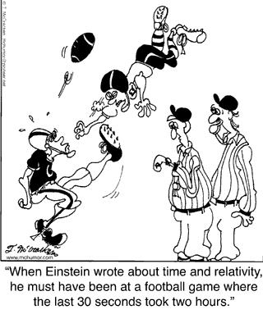

Slide 30
Radioactive Decay
Radioactive decay, also known as nuclear decay or radioactivity, is the process by which a nucleus of an unstable atom loses energy by emitting radiation.
Radioactive decay occurs when a material spontaneously emits radiation — including alpha particles, beta particles, gamma rays.

Slide 31
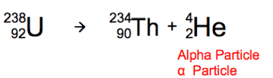
Alpha Decay
Radioactive Isotope
Daughter Product
A particle with two neutrons and two protons is ejected from the nucleus of a radioactive atom.
The particle is identical to the nucleus of a helium atom.

Slide 32
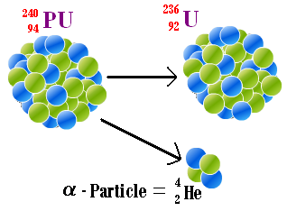
Alpha Decay
Pu
Radioactive Isotope
Daughter Product
Notice that the atomic mass & atomic number on each side of the arrow are equal.
Mass: 240 = 236 + 4
Atomic #: 94 = 92 + 2

Slide 33
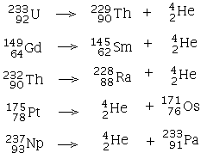
Alpha Decay Transmutation
Fill in the atomic masses & atomic numbers on each side of the arrow. Make sure they are equal on both sides.

Slide 34
Alpha Decay Transmutation
Fill in the atomic masses & atomic numbers on each side of the arrow. Make sure they are equal on both sides.

Slide 35
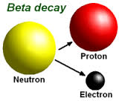
Beta Decay
A neutron in an atom's nucleus turns into a proton, an electron and an antineutrino.

Slide 36
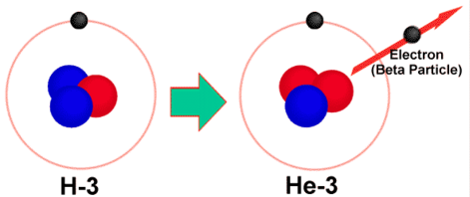
Beta Decay
The electron and antineutrino fly away from the nucleus, which now has one more proton than it started with.
Since an atom gains a proton during beta decay, it changes from one element to another (e.g. H to He).

Slide 37
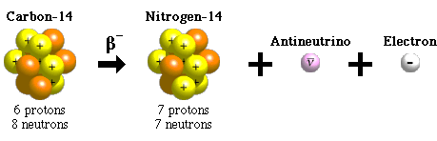

Beta Decay
RadioIsotope
Daughter Product
Since an atom gains a proton during beta decay, it changes from one element to another (e.g. C to N).

Slide 38
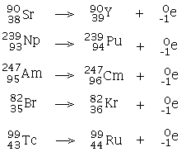
Beta Decay Transmutation
Fill in the atomic masses & atomic numbers on each side of the arrow. Make sure they are equal on both sides.

Slide 39
Beta Decay Transmutation
Fill in the atomic masses & atomic numbers on each side of the arrow. Make sure they are equal on both sides.

Slide 40
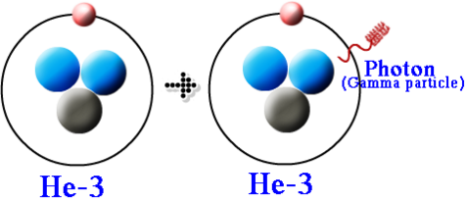
Gamma Decay
Gamma rays (e.g. photon) are NOT charged particles.
They are HIGH energy electromagnetic radiation with 10,000 times more energy than visible light.

Slide 41

Gamma Decay
0
0
Gamma rays have no mass and no charge.
They are the most dangerous type of radiation since they penetrate materials much more than alpha and beta particles.

Slide 42
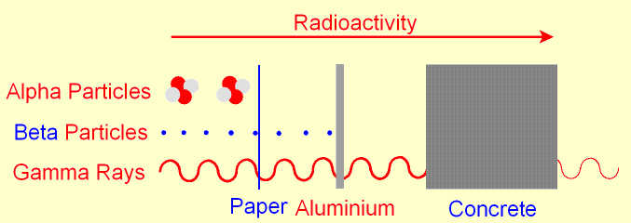
Penetration of Particles
Gamma rays have no mass & can penetrate most substances except thick lead.
Alpha particles can be stopped by paper.
Beta particles have little mass, can penetrate more than alpha particles, but possess much lower energy than gamma rays.

Slide 43
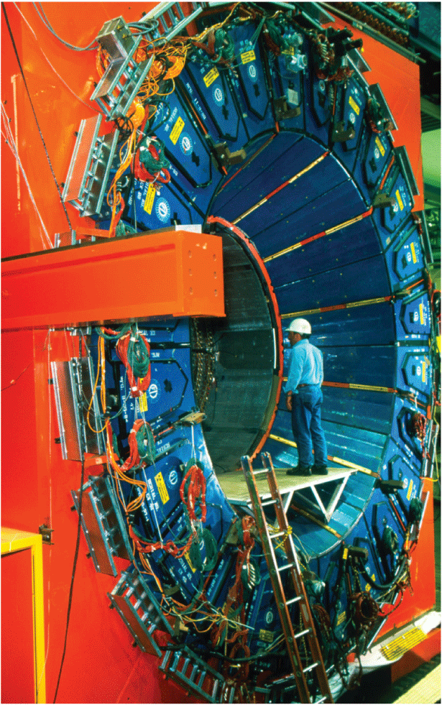
Particle Accelerators
Some transmutations require particles that are moving at extremely high speeds.
Particle accelerators cause charged particles to move very close to the speed of light.
The fast-moving particles collide with atomic nuclei.
Scientists have produced more than 3000 different isotopes.
This particle detector records subatomic particles produced in the Tevatron, the most powerful particle accelerator in the world. (Fermilab in Batavia, Illinois.)

Slide 44
Particle Accelerators
Scientists also conduct collision experiments in order to study nuclear structure.
  More than 200 different subatomic particles have been detected.
  A quark is a subatomic particle theorized to be among the basic units of matter.
  According to the current model of the atom, protons and neutrons are made up of quarks.

Slide 45
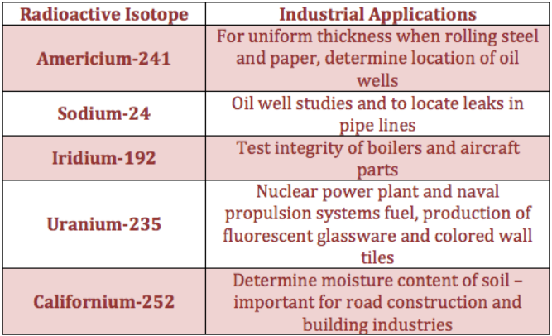
Radioactive Isotopes (RadioIsotopes)
Radiometric isotopes are used in industry, medicine, and to determine the age of rocks & formerly living organisms.
Carbon dating is used for formerly living organisms (trees, bones).

Slide 46
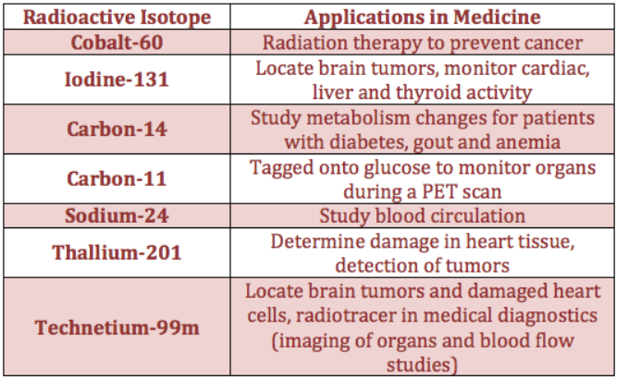
Radioactive Isotopes (RadioIsotopes)
Cobalt-60 is extensively used in treating cancer.
Iodine-131
is used to locate brain tumors, measure cardiac output, and determine liver and thyroid activity.

Slide 47
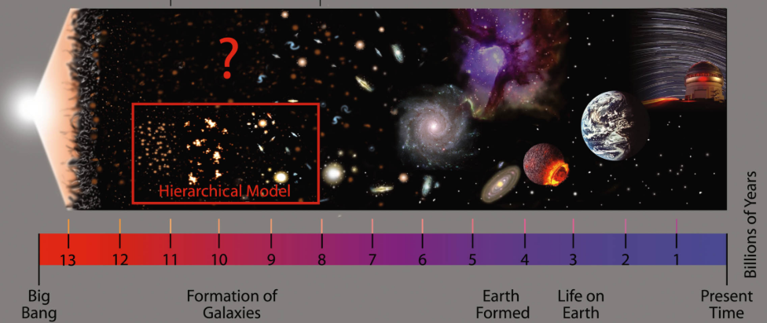
Radioactive Dating
According to the Theory of Evolution, the universe is over 13 Billion years old and our Earth is considered 4.5 Billion years old all based on radioactive dating. Fact or Fiction?

Slide 48
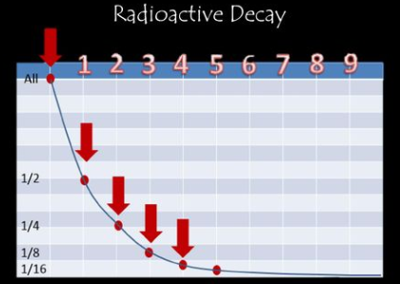
Radioactive Dating
Three assumptions of Radioactive dating:
1) The original amount of both mother and daughter elements is known.
2) The sample has remained in a closed system.
3) The rate of decay has remained constant throughout the past.
Radioisotopes are only reliable to 2-3 half-lives, not indefinitely.

Slide 49
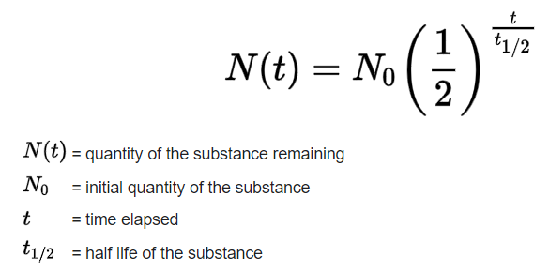
Radioactive Dating
Three assumptions of Radioactive dating:
1) The original amount of both mother and daughter elements is known.
2) The sample has remained in a closed system.
3) The rate of decay has remained constant throughout the past.
The half-life equation requires the original quantity.

Slide 50
Radioactive Dating
Addressing the assumptions of Radioactive dating:
1) Ensuring that any one of the assumptions is met is difficult at best, if not impossible.
2) Many dates have changed due to different procedures or materials used.
Emotion, reasoning, and bias dominate this topic on the part of Christians and evolutionists.
“As we overthrow reasonings and every high thing rising up against the knowledge of God …”
2 Corinthians 10:5

Slide 51
Radioactive Dating
Although evolutionists claim “absolute age” based on dating, we certainly cannot know precise dates, especially over 100’s, 1000’s, millions, and billions of years.
Some things to consider:
1) People often believe what they were taught even if it is proven false (e.g. prejudice).
2) Historians cannot even decide on exact dates within the past 6,000 years. How can scientists be so sure of millions of years ago?
3) We should not reject the fossil record, but neither should we compromise the Bible.

Slide 52
Radioactive decay
Radioactive isotopes are used based on the decay of specific atomic nuclei.
The moment in time at which a particular nucleus decays is unpredictable.
However, a collection of atoms of a radioactive nuclide decays exponentially at a rate described by half-life.
Half-life is usually given in units of years.

Slide 53
Half-Life
Measures the rate of decay of a radioactive isotope
The time it takes for ½ of an original quantity of a radioactive element to decay into another element.

Slide 54
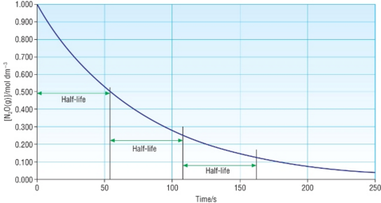
Half-Life
1.0
0.5
0.25
Half-life is the time it takes for a radioactive isotope to half its amount.
Reliability greatly decreases with each half-life. After 2-3 half lives, the dating of a sample is relatively unreliable.

Slide 55
Half-Life Example
Radium-226 has a ½ life of 1,620 years
This means ½ of a sample of radium will change into other elements after 1,620 years
After another 1,620 years (3240 years total), ½ the remaining radium will decay (leaving ¼ the original amount)

Slide 56
Half-Life
The shorter the half-life of an element, the faster it decays
The more radioactivity it gives off

Slide 57
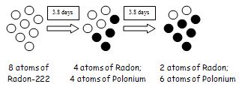
Half-Life Example
A sample of 8 atoms of Radon-222 has a ½ life of 3.8 days

Slide 58
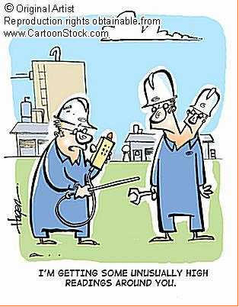
Dangers of Radioactive Decay
A feared and negative effect of radiation is cancer due to mutations.
  Alpha, beta, and gamma particles penetrate to our cells
Radiation also causes burns, hair loss, alter chemical reactions in the body, and many other severe side effects.

Slide 59
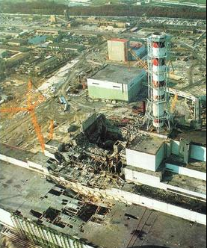
Dangers of Radioactive Decay
The Chernobyl disaster was the worst nuclear power plant accident in history in terms of cost and casualties.
Used graphite instead of heavy water as its coolant and neutron moderator.
Gives nuclear energy a “bad” name based on fear.

Slide 60
Half-Life Example
Carbon-14 has a ½ life of 5,730 years. If a fossil has 1/8 of its original carbon-14, how old is it?

Slide 61
Half-Life Example
Carbon-14 has a ½ life of 5,730 years. If a fossil has 1/8 of its original carbon-14, how old is it?
Each half-life took 5,730 years and there were three half-lives.
So, 5,730 x 3 = 17,190 years old
Now → 5730 yrs → 11,460 yrs → 17,190 yrs

Slide 62
Half-Life Example
The half-life of Zn-71 is 2.4 minutes. If one had 100.0 g at the beginning, how many grams would be left after 7.2 minutes has elapsed?

Slide 63
Half-Life Example
The half-life of Zn-71 is 2.4 minutes. If one had 100.0 g at the beginning, how many grams would be left after 7.2 minutes has elapsed?
7.2 / 2.4 = 3 half-lives
100.0 g → 50.0 g → 25.0 g → 12.5 g
y = a (1/2)^{t} y = (100 g) (1/2)³
X = 100 g^{(1/8)} = 12.5 g

Slide 64
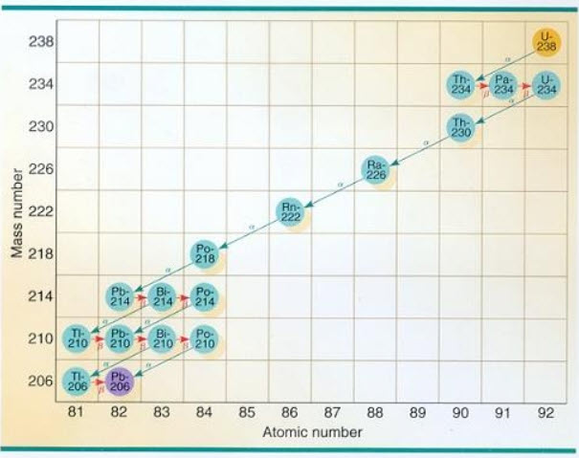
Uranium-238 Series
All the radioactive U-238 will eventually become stable lead, Pb. On the way to becoming lead, it will exist as a series of other elements.

Slide 65
SubAtomic Particles
Professor EHS Burhop of University College London suggesting that protons and neutrons were in fact NOT fundamental particles but that they had a structure.
The nucleus is a conglomeration of quarks which manifest themselves as protons and neutrons.
Each elementary particle has a corresponding antiparticle.
In 1964 Murray Gell-Mann and George Zweig proposed that all hadrons (mesons and baryons) were composed of particles that they called QUARKS.

Slide 66
Hadrons
Hadrons are particles that experience the strong nuclear force.
Baryon implied a heavy subatomic particle.
Meson implies particles with much lower masses.
Making an analogy to the animal kingdom, the term hadron corresponds to the term animal, while the terms meson and baryon might correspond to the classifications mammal and reptile.

Slide 67
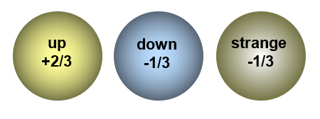
SubAtomic Particles
There are actually six quarks and their anti-quarks (same magnitude, but opposite sign) but in every day life we are only concerned with three types: the up quark, the down quark and the strange quark.

Slide 68
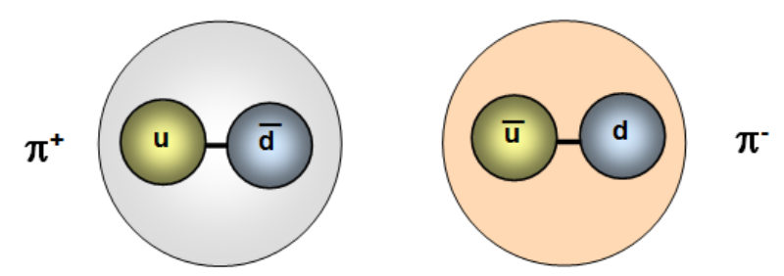
Quarks, Mesons, Baryons
Baryons are composed of three quarks while mesons are composed of two quarks.
One of the quarks in any meson is an anti-quark. For example a π+ meson is composed of one up quark and one anti-down quark.

Slide 69
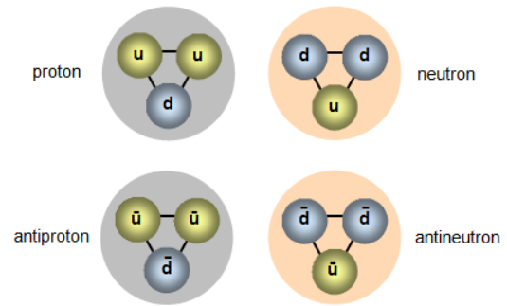
SubAtomic Particles
Protons and the Neutrons

