Slide 1
Go to the “Slide Show” shade above
Click on “Play from Beginning”

Slide 2
Chapter 10
Cell Reproduction Mitosis

Slide 3
Lesson Objectives
  By the end of this lesson, you should be able to:
Discuss the biological process of asexual cell division, called mitosis.
Review the theory of spontaneous generation and how it was disproved.
Review the Theory of Biogenesis.
Investigate the process of DNA replication.
Learn how DNA is packaged in the cell at various stages.
Discuss the events of the cell cycle.
  Science Practice: Mitosis in Onion Root Tip Cells
Notes:
#frame
instructional video
Timing ≈ 0.5 minutes
Living organisms need energy to accomplish the wide variety of tasks they attempt each day.
You will begin learning about how energy is captured from the Sun and stored in organic molecules.
[read objectives]

Slide 4
Introduction
Biogenesis:
  The idea that life can only come from other life forms.
  Every cell originates from another existing cell that is just like it.
All cells are derived from pre-existing cells.
New cells are produced for growth and to replace damaged or old cells.

Slide 5
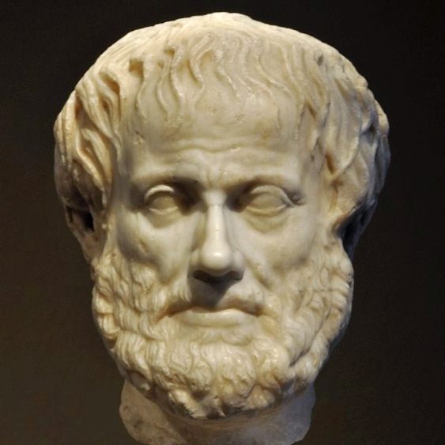
Spontaneous Generation
ABIOGENESIS: Belief that life can arise from nonliving materials … a major premise of gradualistic evolution.
Proposed by Aristotle.
Taught from 800 B.C. until 1700s (almost 2000 years).
Carolus Linnaeus, who is usually regarded as the founder of modern taxonomy promoted spontaneous generation.

Slide 6
Spontaneous Generation
John Needham
Used poor experimentation and stated that spontaneous generation exists.
In England, John Needham conducted an experiment in which he placed a broth, or gravy, into a bottle, heated the bottle to kill anything inside, then sealed it.
Days later, he reported the presence of life in the broth and announced that life had been created from nonlife.
In actuality, he did not heat it long enough to kill all the microbes.

Slide 7
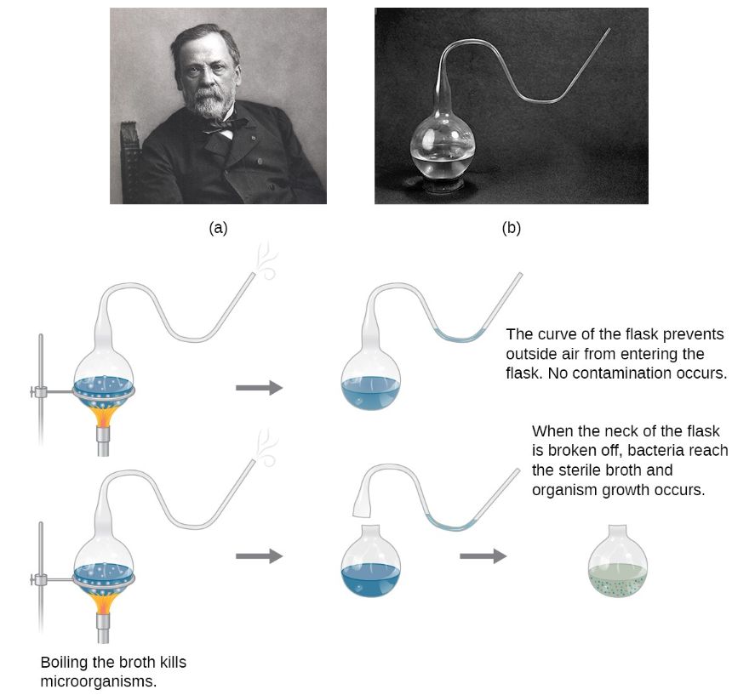
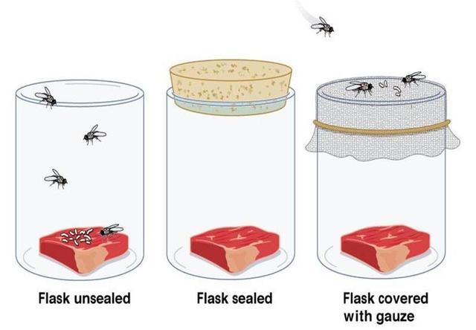
Disproving Spontaneous Generation
1668, Francesco Redi tested the meat maggot theory.
Louis Pasteur tested his idea of microorganisms.
Abiogenesis was thoroughly disproven by Pasteur in the mid 1800’s.

Slide 8
Spontaneous Generation
How does this square with Evolutionary Theory?
  It suggests that life originated out of the primordial soup as a result of a big bang.
  Sir Fred Hoyle calculated that the possibility of this happening on its own was slim to none.
The previously agnostic scientist Sir Fred Hoyle was driven to become a creationist of sorts when he tried to calculate the probability of such a chance assemblage.
“Precious little in the way of biochemical evolution could have happened on the earth. If one counts the number of trial assemblies of amino acid that are needed to give rise to the enzymes, the probability of their discovery by random shufflings turns out to be less than 1 in 1040,000.”
Morris, Henry M. (2002-05-31). The Biblical Basis for Modern Science (Kindle Locations 4963-4967). Master Books. Kindle Edition.

Slide 9
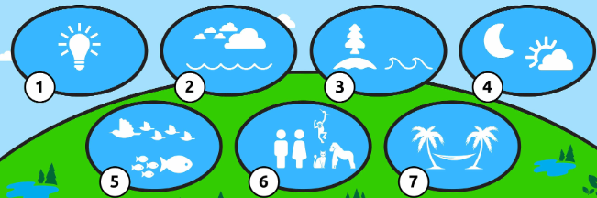
Spontaneous Generation
How does this square with Evolutionary Theory?
  God created “ex nihilo” (out of nothing).
  God created all organisms “After its Kind”?
Then God said, “Let the earth sprout vegetation, plants yielding seed, and fruit trees on the earth bearing fruit after their kind with seed in them”; and it was so. Genesis 1:11
God created the great sea monsters and every living creature that moves, with which the waters swarmed after their kind, and every winged bird after its kind; and God saw that it was good. Genesis 1:21
And God said, “Let the land produce living creatures according to their kinds: the livestock, the creatures that move along the ground, and the wild animals, each according to its kind.” And it was so.
God made the beasts of the earth after their kind, and the cattle after their kind, and everything that creeps on the ground after its kind; and God saw that it was good. Genesis 1:24-25

Slide 10
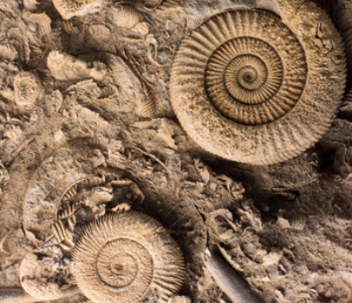
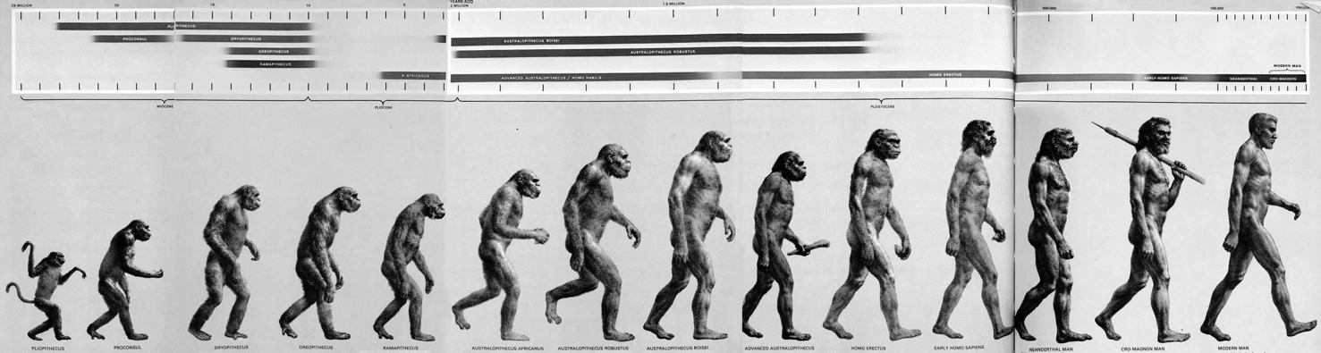
Spontaneous Generation
How does this square with Evolutionary Theory?
  What about transitional fossils?
Stephen Jay Gould of Harvard was perhaps the leading representative of this modern school of paleontologists. He made the following admission:
"All paleontologists know that the fossil record contains precious little in the way of intermediate forms; transitions between major groups are characteristically abrupt.”
Morris, Henry M. (2002-05-31). The Biblical Basis for Modern Science (Kindle Locations 7180-7183). Master Books. Kindle Edition.

Slide 11
Cell Division plays many Important Roles in the Lives of Organisms
The ability of organisms to reproduce their own kind is a key characteristic of life.
Cell Division
  is reproduction at the cellular level
  produces two “daughter” cells that are genetically identical to each other and the original “parent” cell
  requires the duplication of chromosomes, the structures that contain most of the cell’s DNA
  sorts new sets of chromosomes into the resulting pair of daughter cells.

Slide 12
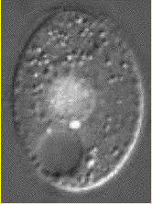
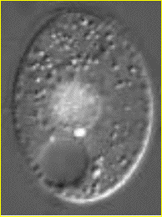
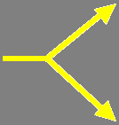
Identical Daughter Cells
Two identical daughter cells
Parent Cell

Slide 13
Cell Division plays many Important Roles in the Lives of Organisms
Living organisms reproduce by two methods:
  Asexual Reproduction
    produces offspring that are identical to the original cell or organism.
    involves inheritance of all genes from one parent.
  Sexual Reproduction
    produces offspring that are similar to the parents but show variations in traits.
    involves inheritance of unique sets of genes from two parents.

Slide 14
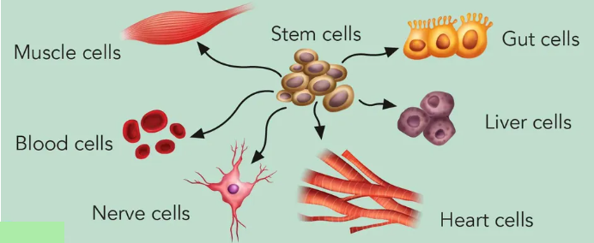
Cell Division plays many Important Roles in the Lives of Organisms
Cell Division is used for:
  reproduction of single-celled organisms.
  growth of multicellular organisms from a fertilized egg into an adult.
  repair and replacement of cells.
  production of sperm and eggs.

Slide 15
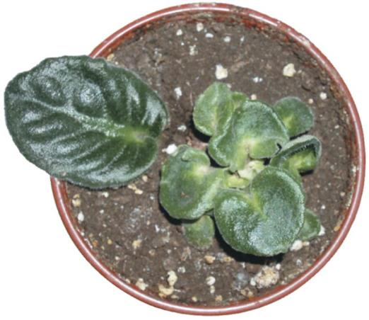
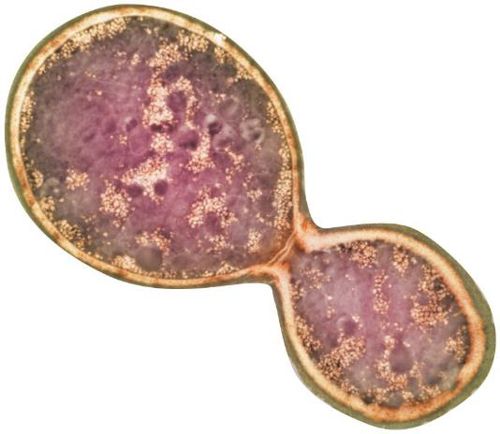
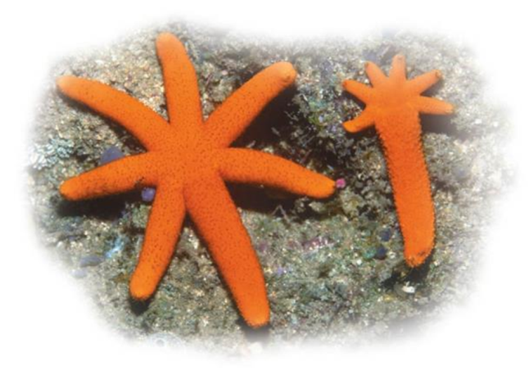
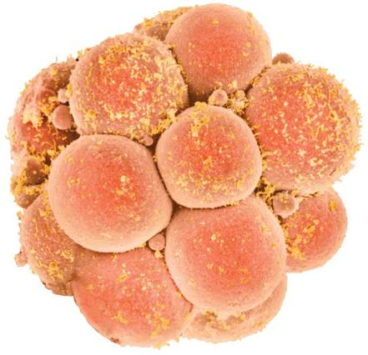
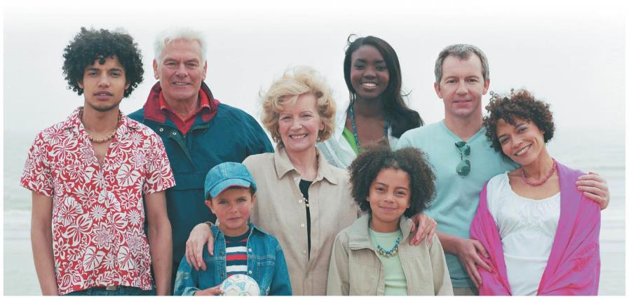
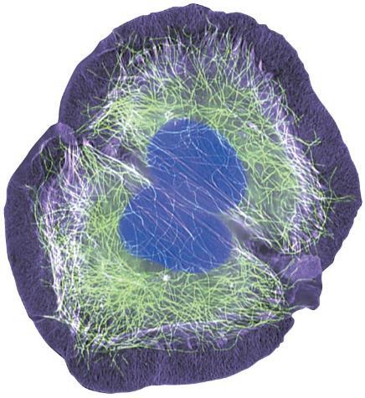
Cell Division plays many Important Roles in the Lives of Organisms

Slide 16
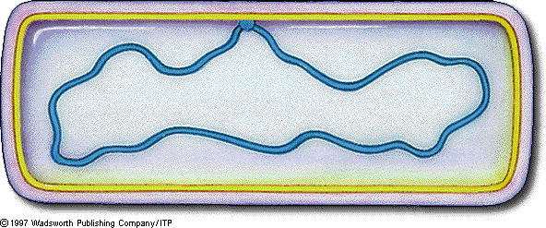
PROKARYOTES Reproduce by Binary Fission
Prokaryotes (single-celled bacteria and archaea) reproduce by Binary Fission (“dividing in half”).
The chromosome of a prokaryote is typically
  a single circular DNA molecule associated with proteins.
  much smaller than those of eukaryotes.

Slide 17
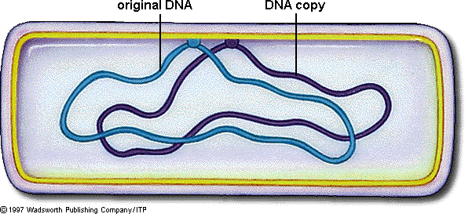
Prokaryotes Reproduce by Binary Fission
Binary Fission of a prokaryote occurs in three stages:
  1. Duplication of the chromosome and separation of the copies.
  2. Continued elongation of the cell and movement of the copies.
  3. Division into two daughter cells.

Slide 18
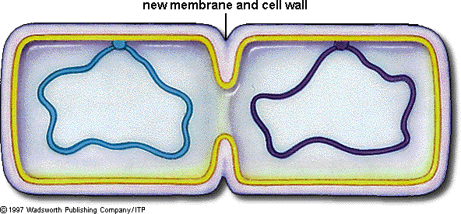
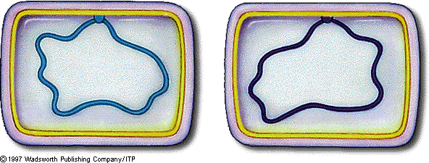
Prokaryotes Reproduce by Binary Fission
  3. Division into two daughter cells.

Slide 19
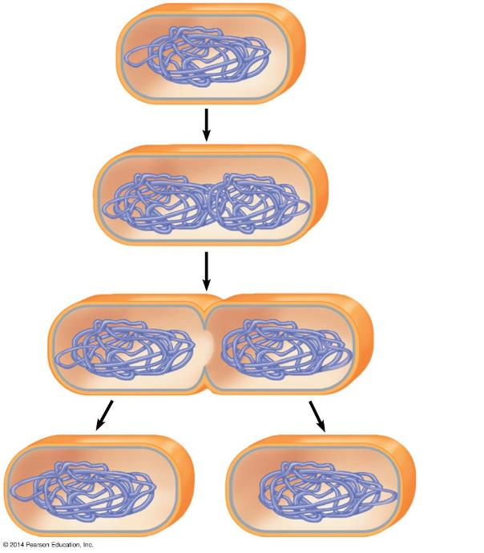
Plasma
membrane
Prokaryotic
chromosome
Cell wall
1
Duplication of the chromosome
and separation of the copies
2
Continued elongation of the
cell and movement of the copies
3
Division into
two daughter cells
Notes:
Figure 8.2a-3 Binary fission of a prokaryotic cell (step 3)

Slide 20
Prokaryotes Reproduce by Binary Fission
http://somup.com/c3fl0nOqmy
Binary Fission (1:18)
Notes:
Figure 8.2a-3 Binary fission of a prokaryotic cell (step 3)

Slide 21
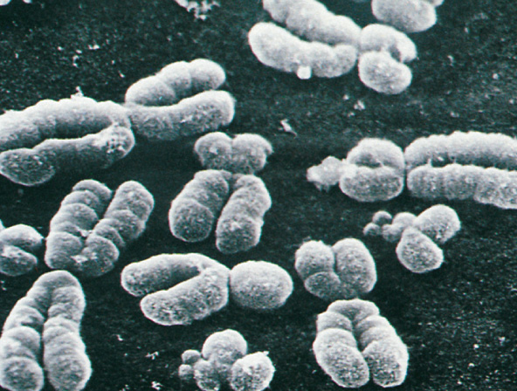
The Large, Complex Chromosomes of
EUKARYOTES Duplicate with Each Cell Division
Eukaryotic Cells
  are more complex and larger than prokaryotic cells.
  have more genes.
  store most of their genes on multiple chromosomes within the nucleus.

Slide 22
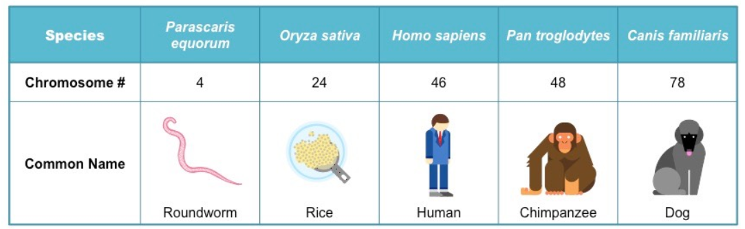
The Large, Complex Chromosomes of
EUKARYOTES Duplicate with Each Cell Division
Each eukaryotic species has a characteristic number of chromosomes in each cell nucleus.
Human Body Cells have 46 chromosomes or 23 identical pairs of chromosomes.

Slide 23
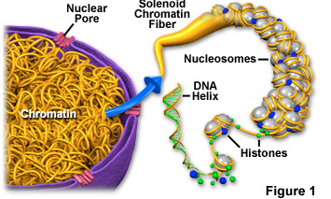
Eukaryotic Chromosomes
Each chromosome is composed of a single DNA molecule tightly coiled around proteins called Histones.

Slide 24
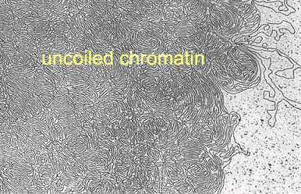
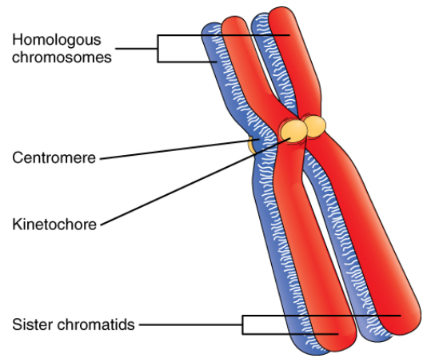
Eukaryotic Chromosomes
Chromosomes cannot be seen when cells are not dividing and are called Chromatin.
To prepare for division, the Chromatin becomes
  highly compact
  visible with a microscope.

Slide 25
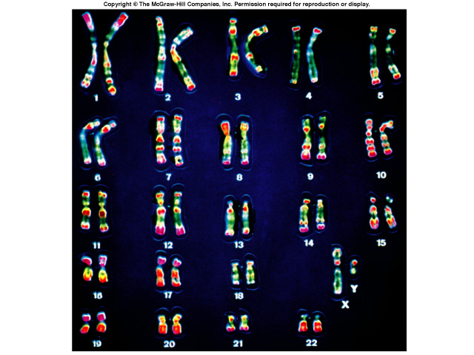
Human Karyotype
A picture of the chromosomes from a Human Cell arranged in pairs by size.

Slide 26
The Large, Complex Chromosomes of
Eukaryotes Duplicate with Each Cell Division
Before a eukaryotic cell begins to divide, it duplicates all of its Chromosomes, resulting in two copies called Sister Chromatids.
The sister chromatids are joined together along their lengths and are cinched especially tightly at a narrowed “waist” called the Centromere.
When a cell divides, the Sister Chromatids:
  separate from each other and
  sort into separate daughter cells.

Slide 27
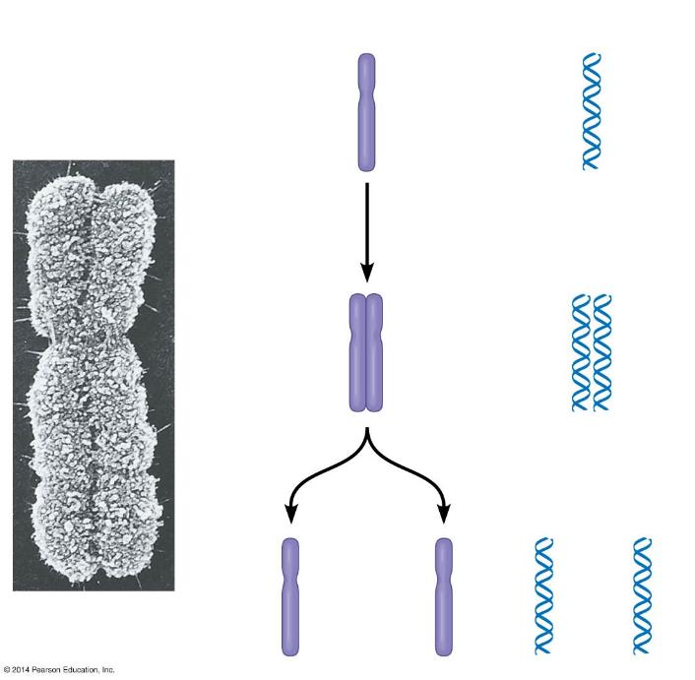
Chromosomes
Chromosomal DNA
molecules
Sister chromatids
Chromosome
duplication
Sister
chromatids
Centromere
Separation
of sister
chromatids
and
distribution
into two
daughter
cells
Notes:
Figure 8.3b-0 Chromosome duplication and distribution

Slide 28
The Cell Cycle includes Growing and Division Phases
The Cell Cycle is an ordered sequence of events that extends from the time a cell is first formed from a dividing parent cell until its own division.
The Cell Cycle consists of two stages, characterized as follows:
  Interphase: duplication of cell contents
    G₁ — growth, increase in cytoplasm
    S — duplication of chromosomes
    G₂ — growth, preparation for division
  Mitotic Phase: division
    Mitosis—division of the nucleus
    Cytokinesis—division of cytoplasm

Slide 29
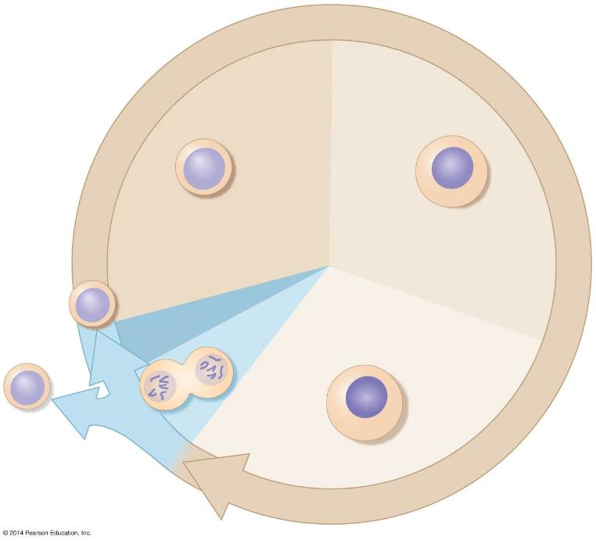

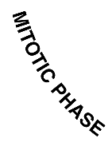
G₁
(first gap)
S
(DNA synthesis)
M
Cytokinesis
G₂
(second gap)
Mitosis
Notes:
Figure 8.4 The eukaryotic cell cycle

Slide 30
G₁
cell growth
(interphase begins
in daughter cells)
S
DNA is replicated
(chromosomes
are duplicated)
M
Cytoplasm divided
Mitosis
G₂
cell prepares for
Division (mitosis)
Notes:
Figure 8.4 The eukaryotic cell cycle

Slide 31
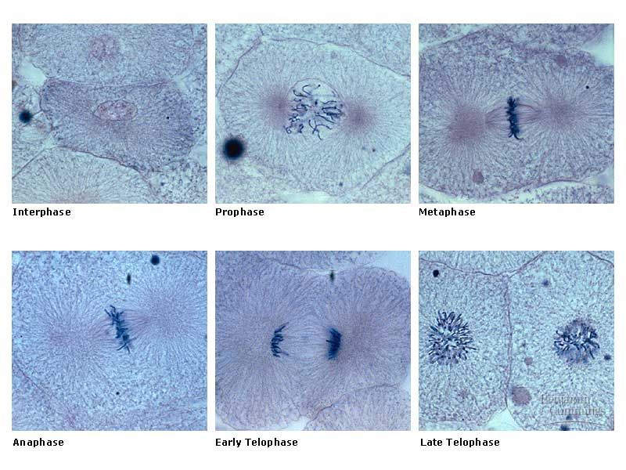
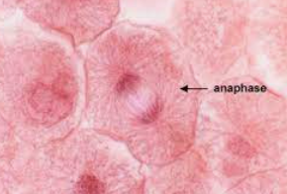
Cell Division is a Continuum of Dynamic Changes
Mitosis follows interphase and progresses through a series of stages:
  Prophase
  Metaphase
  Anaphase
  Telophase
Cytokinesis

Slide 32
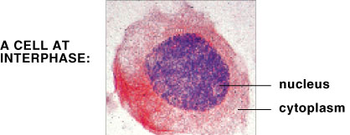
Cell Division is a Continuum of Dynamic Changes
INTERPHASE
  The cytoplasmic contents double.
  Centrioles appear [in animal cells].
  Chromosomes duplicate in the nucleus during the S Phase.

Slide 33
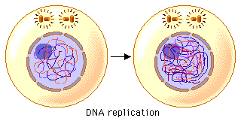
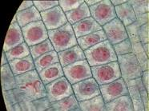
What’s Happening during Interphase?
Interphase accounts for 90% of the time of the cell cycle.

Slide 34
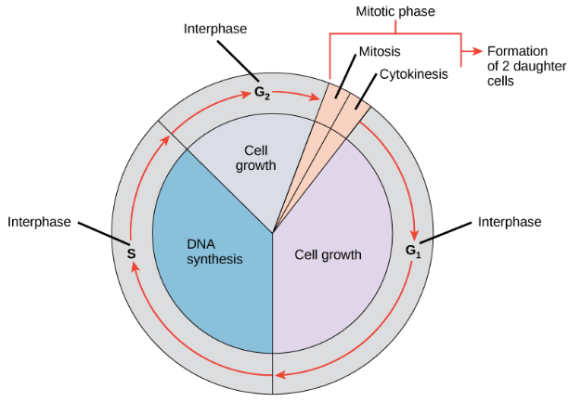
Interphase
DNA Replication occurs during the S Phase of the cell cycle.

Slide 35
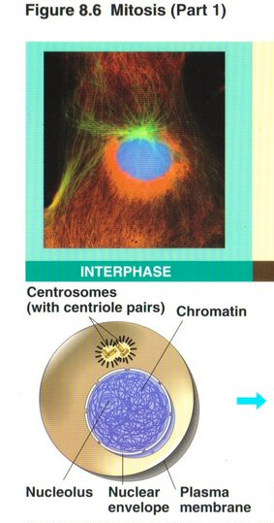
Interphase
Chromatin becomes condensed by wrapping around proteins called Histones.

Slide 36
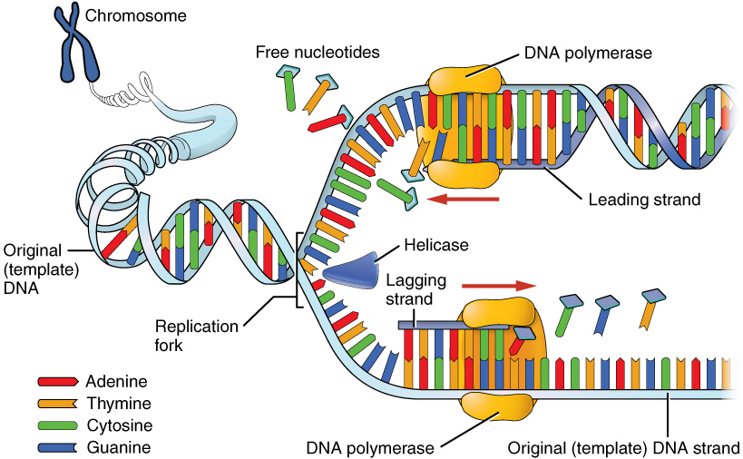
Interphase: DNA Replication
DNA is copied or replicated before cell division.
Each new cell will then have an identical copy of the DNA.
Original DNA strand
Two new, identical DNA strands

Slide 37
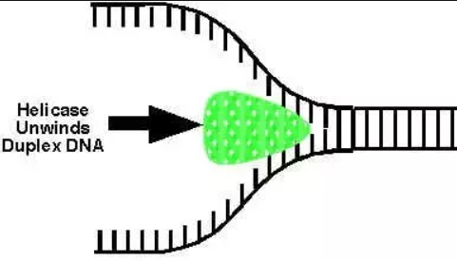
DNA Replication
Enzyme “Helicase” binds to the DNA at the replication origin and begins to “unzip” it by breaking the hydrogen bonds between the complementary bases of DNA.

Slide 38
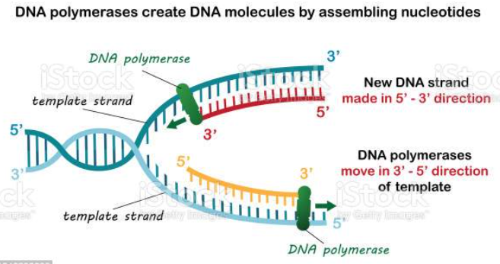
DNA Replication
“DNA Polymerase” binds to the unzipped DNA and begins linking new nucleotides across from the parent strand, forming a complementary daughter strand.

Slide 39
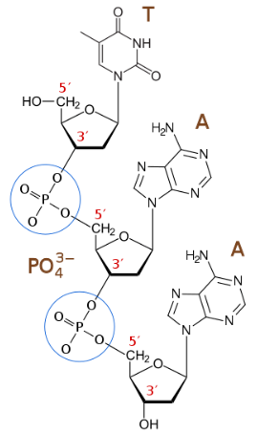
DNA Replication
“DNA Polymerase” binds to the unzipped DNA and begins linking new nucleotides across from the parent strand, forming a complementary daughter strand.

Slide 40
DNA Replication
Parent strand is separated into
  the LEADING strand and
  the LAGGING strand, both serving as templates for the daughter strand to be made.

Slide 41
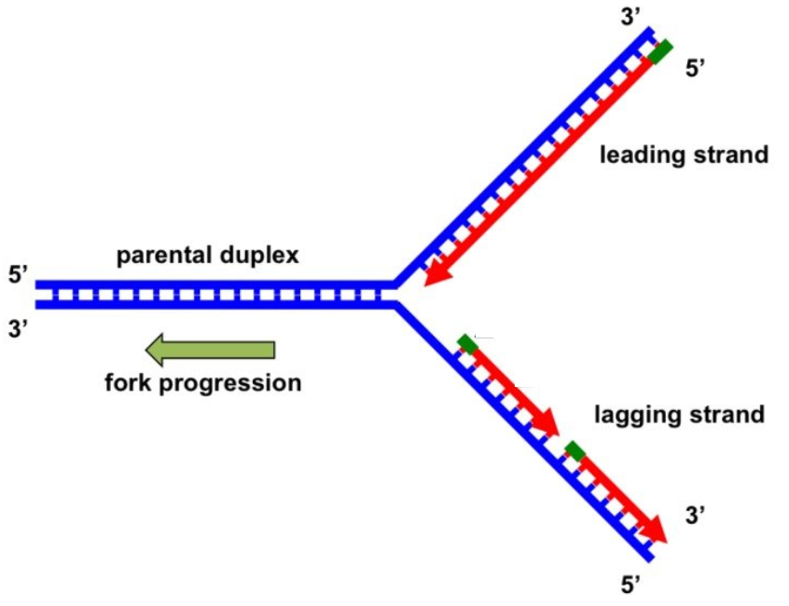
DNA Replication
This process occurs simultaneously on both parent strands, but in opposite directions.
Each replicated copy of DNA is composed of one parent strand and one daughter strand.

Slide 42
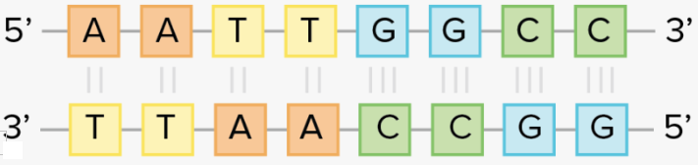
DNA Replication
The nitrogenous bases of DNA always align the same.
Adenine = Thymine [2 hydrogen bonds]
Guanine ≡ Cytosine [3 hydrogen bonds]

Slide 43
DNA Replication
http://somup.com/c3fl0hOqmJ (2:08) DNA Replication Animation
http://somup.com/c3fl0wOqHP (5:46) DNA Replication (Mitosis)
Notes:
Figure 8.2a-3 Binary fission of a prokaryotic cell (step 3)

Slide 44
Question:
What would be the complementary DNA strand for the following DNA sequence?
DNA -CGTATG-

Slide 45
Answer:
DNA -CGTATG-
DNA -GCATAC-

Slide 46
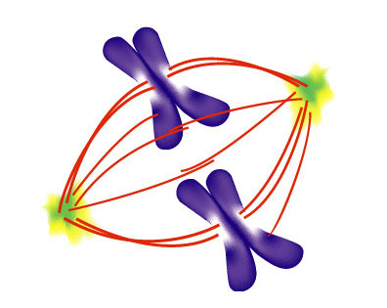
Cell Division is a Continuum of Dynamic Changes
A Mitotic Spindle
  is required to divide the chromosomes
  guides the separation of the two sets of daughter chromosomes, and
  is composed of Microtubules and associated proteins
Spindle Microtubules emerge from two Centrioles

Slide 47
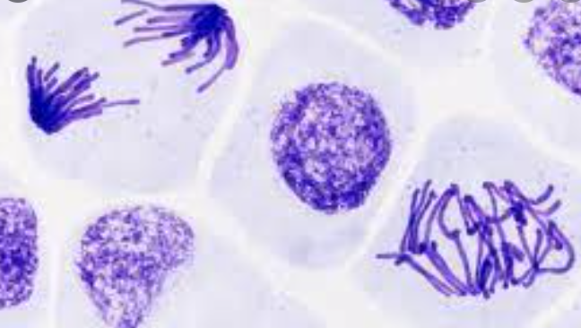
Cell Division is a Continuum of Dynamic Changes
PROPHASE
  In the nucleus, chromosomes become more tightly coiled and folded.
  In the cytoplasm, the mitotic spindle begins to form as microtubules rapidly grow out from the centrioles.

Slide 48
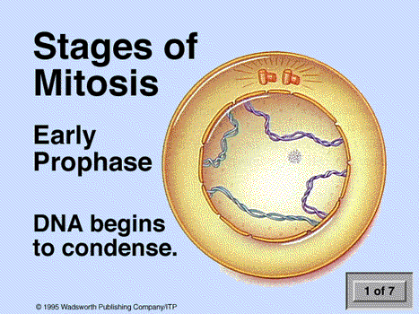

Slide 49
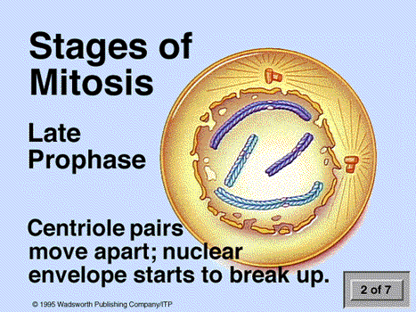

Slide 50
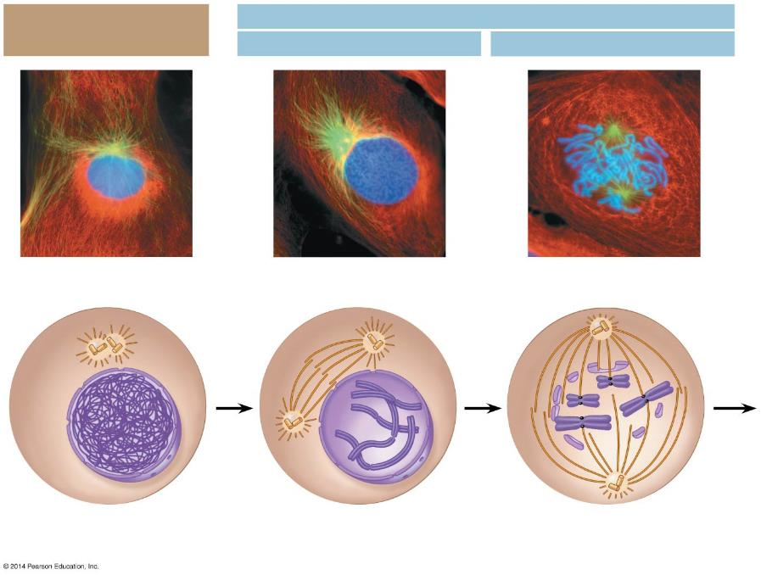
Mitosis
Interphase
Prophase
Prometaphase
Centrioles
Early mitotic
spindle
Fragments of
the nuclear envelope
Chromatin
Centrioles
Kinetochore
Nuclear
envelope
Centromere
Spindle
microtubules
Plasma
membrane
Chromosome, consisting
of two sister chromatids
Notes:
Figure 8.5-1 The stages of cell division by mitosis: interphase through prometaphase

Slide 51
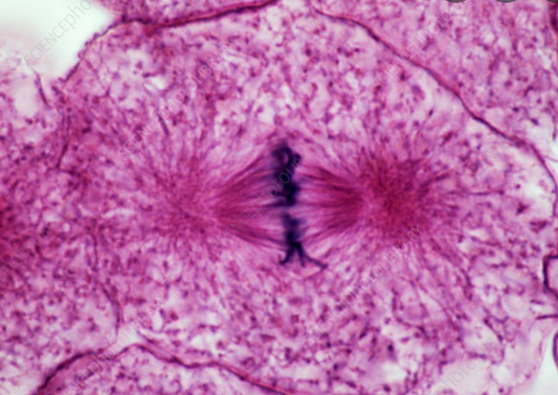
Cell Division is a Continuum of Dynamic Changes
METAPHASE
  The mitotic spindle is fully formed.
  Chromosomes align at the cell equator.
  Sister Chromatids are facing the opposite poles of the spindle.

Slide 52
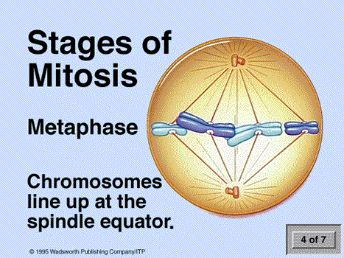

Slide 53

Cell Division is a Continuum of Dynamic Changes
ANAPHASE
  Sister Chromatids separate at the centromeres…
  …and are moved to opposite poles of the cell along the spindle microtubules.
  At the end of anaphase, the two ends of the cell have equal collections of chromosomes.

Slide 54


Slide 55

Cell Division is a Continuum of Dynamic Changes
TELOPHASE
  The cell continues to elongate.
  The nuclear envelope forms around chromosomes at each pole, establishing daughter nuclei.
  Chromatin uncoils.
  The mitotic spindle disappears.
Notes:
Teaching Tips
• Students might keep better track of the sequence of events in a cell cycle by simply memorizing the letters IPPMAT, which are the first letters of interphase, prophase, prometaphase, metaphase, anaphase, and telophase.
Active Lecture Tips
• See the Activity Student Demonstration of Mitosis and Meiosis Using Chromosome Cut-Outs as Models on the Instructor Exchange. Visit the Instructor Exchange in the MasteringBiology instructor resource area for a description of this activity.

Slide 56


Slide 57

Mitosis
Metaphase
Anaphase
Telophase and Cytokinesis
Metaphase plate
Cleavage
furrow
Nuclear
envelope
forming
Separated
chromosomes
Mitotic spindle
Notes:
Figure 8.5-6 The stages of cell division by mitosis: metaphase through cytokinesis

Slide 58
Cell Division is a Continuum of Dynamic Changes
During CYTOKINESIS, the cytoplasm is divided into separate cells.
Cytokinesis usually occurs simultaneously with Telophase.
In ANIMAL CELLS, cytokinesis occurs as
  a Cleavage Furrow forms from a contracting ring of microfilaments.
  the Cleavage Furrow deepens to separate the contents into two cells.

Slide 59

Cytokinesis
Cleavage furrow
Contracting ring of
microfilaments
Daughter cells
Notes:
Figure 8.6a-0 Cleavage of an animal cell

Slide 60

Cytokinesis differs for Plant and Animal Cells
In PLANT CELLS, cytokinesis occurs as
  a Cell Plate forms in the middle.
  the Cell Plate grows outward to reach the edges, dividing the contents into two cells.
  each cell now possesses a plasma membrane and cell wall.

Slide 61

Cytokinesis in Plant Cells
New
cell wall
Cell wall
of the
parent cell
Cell
wall
Daughter
nucleus
Cell plate
forming
Vesicles containing
cell wall material
Cell plate
Daughter cells
Notes:
Figure 8.6b-0 Cell plate formation in a plant cell

Slide 62


Slide 63


Slide 64

Locate Mitotic Stages

Slide 65
Locate Mitotic Stages

Slide 66

Mitosis in Onion Root Tips
Do you see any stages of mitosis?

Slide 67
Mitosis in Onion Root Tips
Do you see any stages of mitosis?
Prophase
Anaphase
Metaphase
Telophase
Cytokinesis

Slide 68
Growth Factors Signal the Cell Cycle Control System
The CELL CYCLE CONTROL SYSTEM is a cycling set of molecules in the cell that triggers and coordinates key events in the cell cycle.
CHECKPOINTS in the cell cycle can
  stop an event or
  signal an event to proceed.

Slide 69

Figure 8.8a
G₁ checkpoint
G₀
G₁
S
Control
system
M
G₂
M checkpoint
G₂ checkpoint
Notes:
Figure 8.8a A schematic model for the cell cycle control system

Slide 70
Growth Factors Signal the Cell Cycle Control System
There are Three Major Checkpoints in the Cell Cycle:
  G₁ Checkpoint:
    allows entry into the S phase or causes the cell to leave the cycle, entering a non-dividing G₀ phase.
  G₂ Checkpoint
    Is all DNA replicated? Is environment favorable? Has the cell grown enough?
  M Checkpoint
    Are all chromosomes aligned on spindle?

Slide 71


Slide 72

Cancer?
Unregulated mitosis
Benign
Malignant/ metastasis
Source?

Slide 73

Growing out of control, Cancer Cells produce Malignant Tumors
CANCER currently claims the lives of 20% of the people in the United States.
CANCER cells escape controls on the cell cycle.
CANCER cells divide excessively and invade other tissues of the body.

Slide 74

Growing out of control, Cancer Cells produce Malignant Tumors
A TUMOR is a mass of abnormally growing cells within otherwise normal tissue.
  Benign Tumors remain at the original site but may disrupt certain organs if they grow in size.
  Malignant Tumors can spread to other locations in a process called Metastasis.
  An individual with a malignant tumor is said to have CANCER.

Slide 75


Some Causes of Cancer

Slide 76


Slide 77

Growing out of control, Cancer Cells produce Malignant Tumors
Localized Tumors can be
  removed surgically and/or
  treated with concentrated beams of high-energy radiation.
Metastatic Tumors are treated with Chemotherapy.

