Slide 1
To View Slide Show
Click on “Slide Show” above
  Click on “From Current Slide”

Slide 2
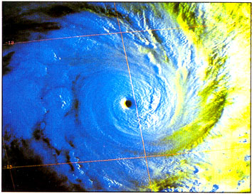
WEATHER

Slide 3
Focus Questions
Classify the composition of Earth’s atmosphere (gases, layers)?
Describe the major factors affecting weather?
List the major components of the hydrologic cycle.
Explain the various phases of water related to energy interactions.
Understand relative humidity & dew point related to temperature.
Define cloud formation and name & define the major types of clouds.
Explain how wind forms and factors that affect wind.

Slide 4
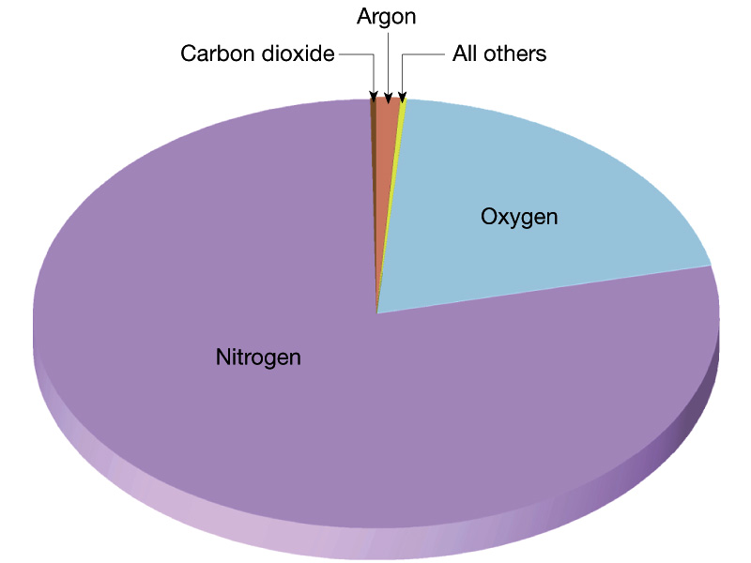
Composition of the Atmosphere
What are the major components of the atmosphere?
Which gases make up most of the atmosphere?

Slide 5
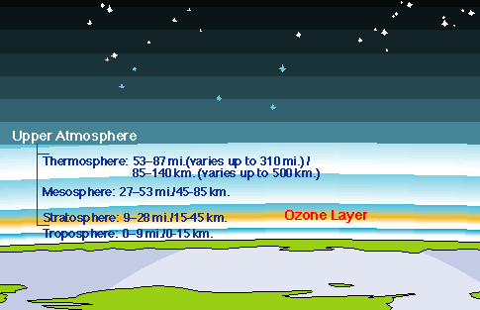
Layers of the Atmosphere
Exosphere
Ionosphere

Slide 6
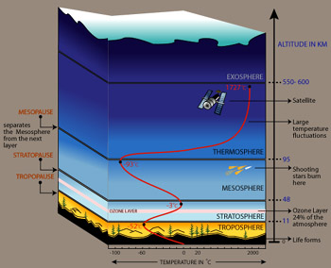
Layers of the Atmosphere

Slide 7
Layers of the Atmosphere
Ionosphere

Slide 8
Weather versus Climate
Weather – the state of the atmosphere at a given time and place.
Climate – long term prevalent weather conditions for a given region, or location.
Analogy:
Weather is like a person’s mood on a given day. Climate is like a person’s personality.

Slide 9
Factors Affecting Weather & Climate
Temperature (especially unequal distribution of heat on the earth)
Earth’s Tilt
Earth’s revolution around the sun
Humidity (amount of water vapor in atmosphere)
Latitude
Elevation
Topography and Geography (mountains, ocean, etc.)

Slide 10
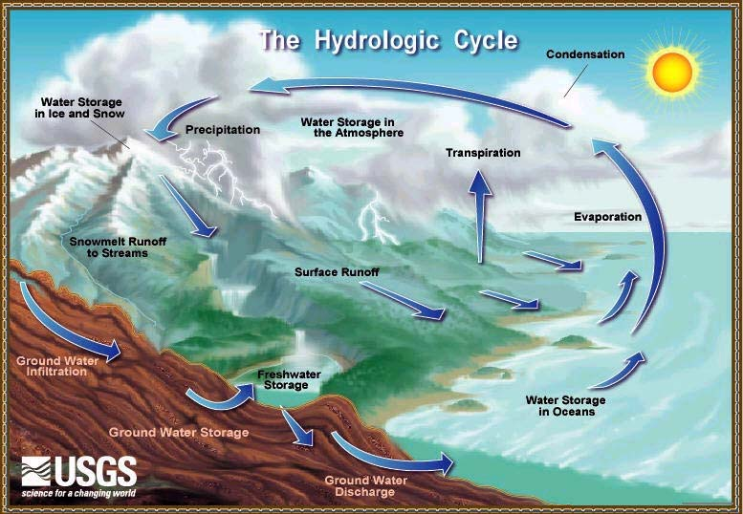

Slide 11
Hydrologic Cycle
https://screenpal.com/watch/cFQro3qRBf (0:41)
Animation without Labels
http://www.youtube.com/watch?v=Az2xdNu0ZRk

Slide 12
Evaporation / Condensation
Evaporation is when water is changed to water vapor
  Energy must be absorbed
  This process leaves the rest of the liquid a little bit cooler.
Condensation is when water vapor becomes liquid and releases energy
This takes place in cloud formation.

Slide 13
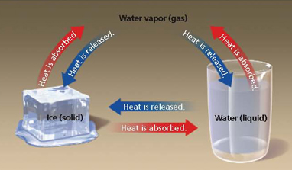
Energy Interactions

Slide 14
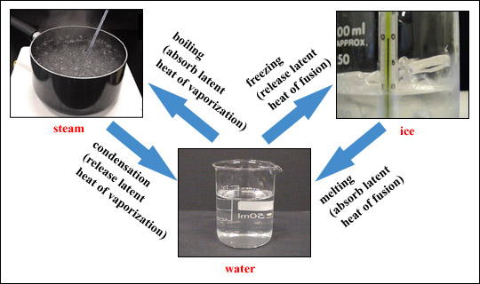
Energy Through the Water Cycle
State if energy released or gained for each phase change.

Slide 15
Energy Through the Water Cycle
Names of processes are Enrichment
Deposition
Releases Energy
Sublimation Gains Energy
Melting
Gains Energy
Boiling
Gains energy
Freezing Releases Energy
Condensing
Releases Energy

Slide 16
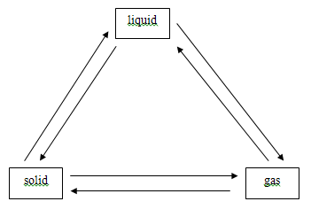
Distinguish between weather and climate.
Which Factors Affecting Weather & Climate deals
with unequal distribution of heat on the earth)?
With the amount of water vapor in atmosphere?
For each arrow, label whether energy is gained or lost

Slide 17
Distinguish between weather and climate.
Weather – the state of the atmosphere at a given time and place.
Climate – long term prevalent weather conditions for a given region, or location.
Which Factors Affecting Weather & Climate deals
with unequal distribution of heat on the earth)? temperature
With the amount of water vapor in atmosphere? humidity
3

Slide 18
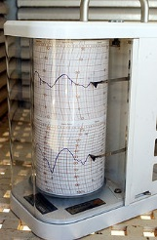
Relative Humidity
Relative Humidity
The ratio of moisture (water vapor) in the air compared to the amount of water vapor than can be held in the air at that temperature.
A hygrometer measures the humidity of air.

Slide 19
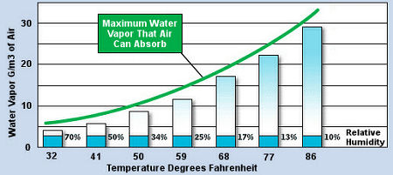
Relative Humidity
Warmer air
Lower R.H.
Cooler air
Higher R.H.
Notice the same amount of water at different temperatures yields a different Rel. Humid.

Slide 20
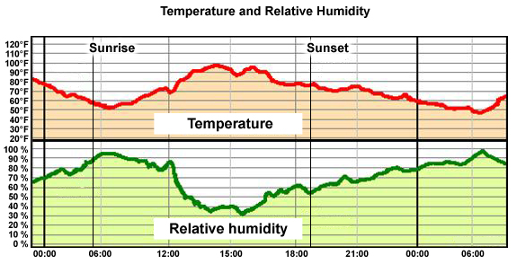
Cooler air
Higher R.H.
Cooler air
Higher R.H.
Warmer air
Lower R.H.
The cooler air temperature holds less water. Therefore, the higher relative humidity.
The warmer air temperature holds much more water. Therefore, the lower relative humidity.

Slide 21
Relative Humidity
Depends on temperature and pressure.
An increase in air temperature means a decrease in relative humidity.
  E.g. Cold air above boiling water will not hold as much water vapor as warm air over a cold water source.
Cooler air holds less water vapor
  this means that the water vapor turns to liquid (condenses into a cloud)
  Cold humid air can promote the formation of ice.

Slide 22
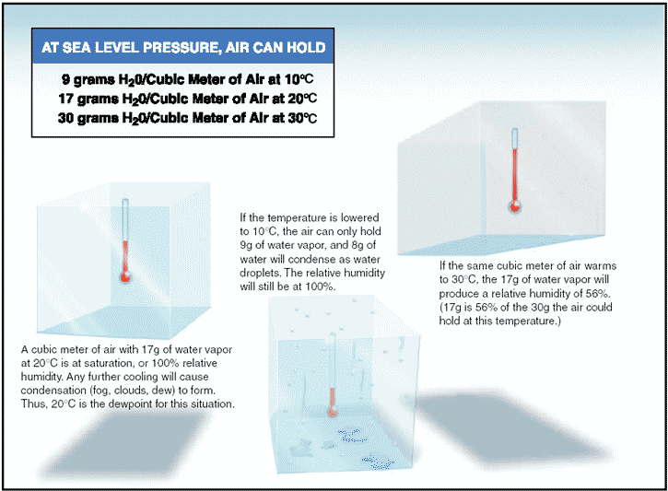
The figures in the chart show the maximum amount of water vapor one meter of air can hold at a particular temperature.
This is the saturation point at each temp.

Slide 23
Let’s assume that there is 17 grams of water vapor in each situation above … (next slides).

Slide 24
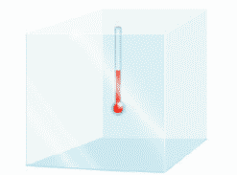
A cubic meter of air at 20º C can hold 17 grams of water vapor (see chart).
This is called saturation at 20º C, meaning that the cubic meter of air has 17 grams of water vapor.
This represents 100% relative humidity.
Any further cooling will cause condensation (fog, clouds, dew) to form.
Thus, 20º C is the dew point for this situation.

Slide 25

If the temperature is lowered to 10º C, the air can only hold 9 grams of water vapor.
The other 8 grams of water vapor will condense as water droplets forming clouds, fog or dew.
The relative humidity is still 100% because the temperature is different..

Slide 26
If the same cubic meter of air warms to 30º C, it can hold up to 30 grams of water vapor.
17 g / 30 g = 56 %
This will produce a relative humidity of 56% and represents the amount of water vapor air can hold at that temperature.

Slide 27
Dew Point
The dew point is a water-to-air saturation temperature.
The higher the dew point, the more moisture is in the air.
The dew point is associated with relative humidity.
  High relative humidity indicates that the dew point is closer to the current air temperature.
  100% Relative humidity indicates the dew point is equal to the current temperature and that the air is maximally saturated with water.

Slide 28
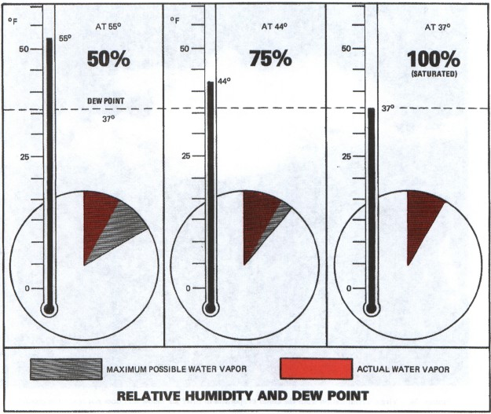

Slide 29
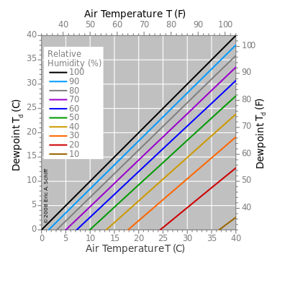
Dew Point
At temperatures below the dew point, water will leave the air.
Water condenses to form fog, dew or clouds.
Condensed water on a solid surface is called dew.
When frozen, it is called frost.

Slide 30

The State of the Atmosphere
To determine the condition of the atmosphere in a given location, the following factors can be measured:
  Temperature – thermometer
  Humidity – psychrometer or hygrometer
  Wind speed and direction – anemometer
  Air pressure – barometer

Slide 31
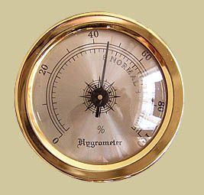
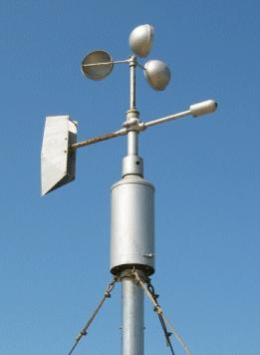
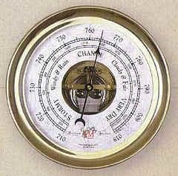
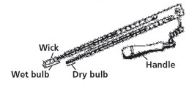
Atmospheric Tools
Anemometer
Hygrometer
Psychrometer
Barometer

Slide 32
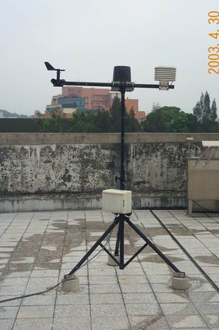
Anemometers measure wind speed and direction
anemometer

Slide 33
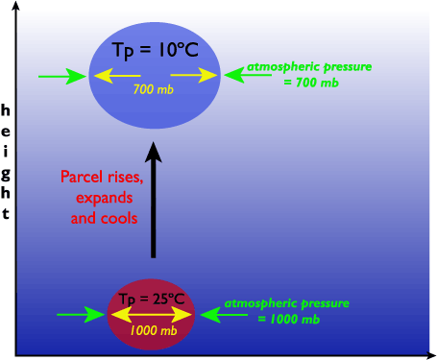
Air Pressure/Temperature/Density
As altitude (height) increases, pressure decreases.
Temperature also decreases.
Air that is cooler, holds less water vapor and will condense easier.

Slide 34
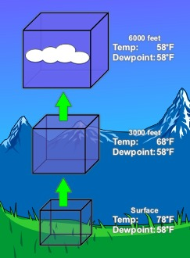
Adiabatic Temperature Change
When the temperature of air changes due to a change in pressure it is referred to as an adiabatic temperature change
This is what happens to air when it rises in the atmosphere.

Slide 35
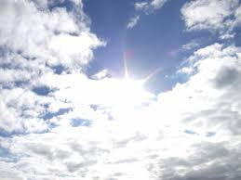
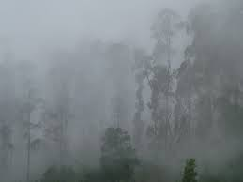
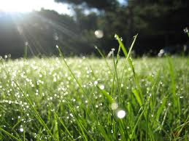
Fog
Clouds
All are forms of condensation
Dew

Slide 36
Clouds are groups of water droplets that form up in the atmosphere – above the ground.
Dew is condensation that occurs on objects on the ground.
Fog is cloud formation that occurs near the ground.

Slide 37
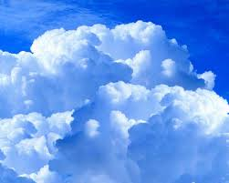
How Do Clouds Form? (Condensation)
Clouds form when air is cooled to it’s dew point (point of saturation) (e.g. lower pressure, higher elevation) which condenses the water vapor in the atmosphere.
Water vapor molecules attach to one another because they move slower in cooler air, and eventually attach to dust or smoke particles (condensation nuclei) in the atmosphere.
Once enough water is present – a cloud is formed.

Slide 38
Clouds
https://screenpal.com/watch/cFQUFCYimD
(0:30)

Slide 39
Cloud Formation Summary
Air needs to be cooled to its dew point
(the point where it turns from gas to liquid)
Water vapor needs condensation nuclei to condense on.
E.g. dust, salt in atmosphere, etc...
Air is most often cooled adiabatically in the atmosphere
(a change in temperature due to a change in pressure).

Slide 40
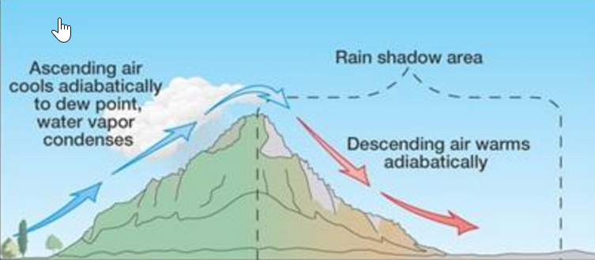
Adiabatic Cooling
The adiabatic process occurs when air rises or descends. No heat is added to or withdrawn from air.
Air pressure decreases with elevation (as air rises) and therefore expands.
The expanding air loses kinetic energy as the molecules slow down, decreasing temperature.
http://somup.com/cF6h2LnVWV (1:05)

Slide 41
Cloud cover affects
Earth’s temperature
Types of Clouds

Slide 42
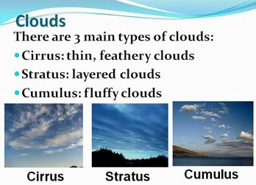
Clouds
There are 4 main types of Clouds
1
: Wispy
2
3

Slide 43
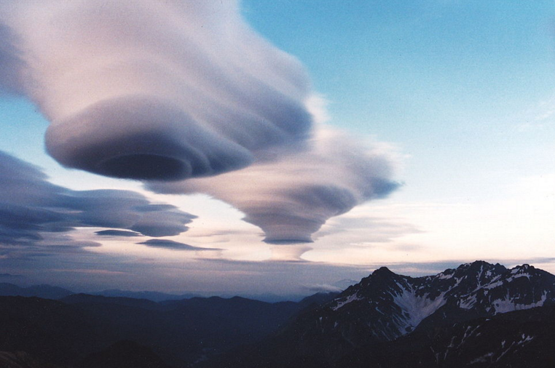
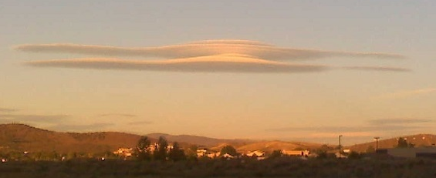
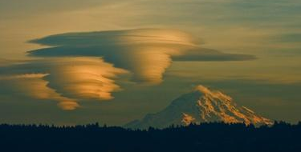
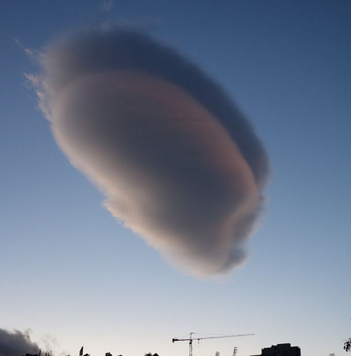
Lenticular Clouds
4

Slide 44
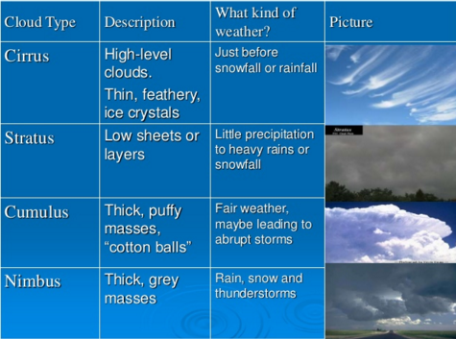
Cloud Formation Summary
A modifier for “precipitation”

Slide 45
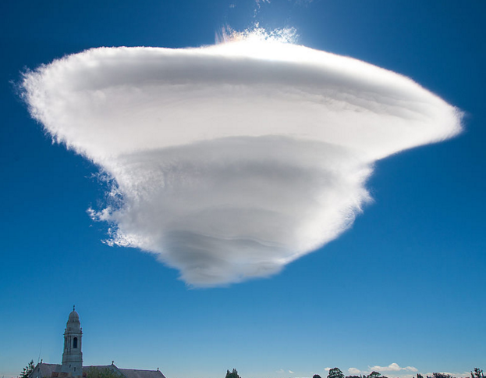
Lenticular Clouds
As air flows along the surface of the Earth, it encounters obstructions. These are man-made objects, such as buildings and bridges, and natural features, like hills, valleys, and mountains. All of them disrupt the flow of air into eddies (swirls).
“Lens shaped” clouds formed in pockets of low pressure. Air expands, cools, and forms a cloud.

Slide 46
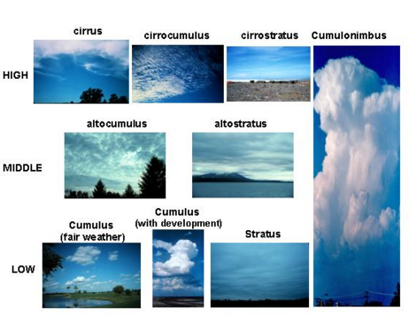

Clouds are classified by altitude
Lenticular

Slide 47

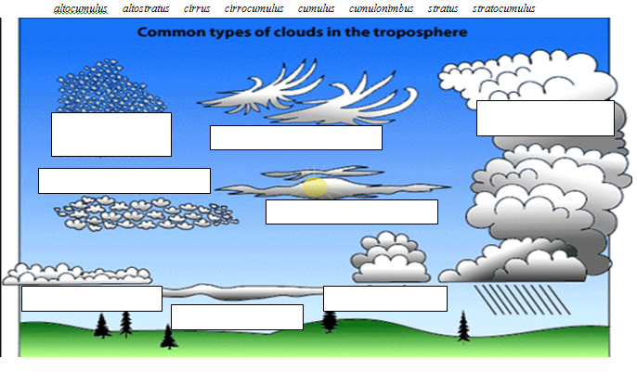

3
1
2
4
5
6
7
9
8

Slide 48
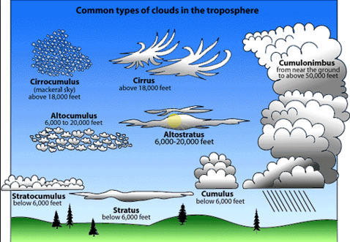
Lenticular
You are NOT responsible for “Alto” cloud formations

Slide 49
1. What common term refers to the amount of water vapor that is held in the air?
2. Stratus, cirrus, cumulus and nimbus are types of what?
3. What is the name of a scientist who studies weather?
4. What is the name of a weather instrument used to measure atmospheric pressure?
5. An anemometer is used to measure what?
6. Sounding like a sign of the Zodiac, what happens when falling ice crystals evaporate before they hit the ground?
7. What cloud term means 'sheet' or 'sheet-like' or 'layer'?
8. What is the line on a weather chart which joins points of equal pressure?
9. What common term refers to the movement of air from a high pressure to a low pressure zone?
10. What type of cloud is normally associated with thunderstorms?

Slide 50
1. What common term refers to the amount of water vapor that is held in the air? Humidity
2. Stratus, cirrus, cumulus and nimbus are types of what? Clouds
3. What is the name of a scientist who studies weather? Meteorologist
4. What is the name of a weather instrument used to measure atmospheric pressure? Barometer
5. An anemometer is used to measure what? Wind
6. Sounding like a sign of the Zodiac, what happens when falling ice crystals evaporate before they hit the ground? Virga
7. What cloud term means 'sheet' or 'sheet-like' or 'layer'? Stratus
8. What is the line on a weather chart which joins points of equal pressure? Isobar
9. What common term refers to the movement of air from a high pressure to a low pressure zone? Wind
10. What type of cloud is normally associated with thunderstorms? Cumulonimbus

Slide 51
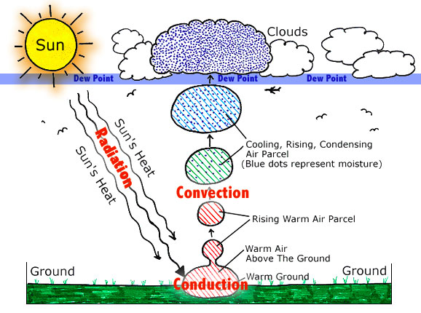

Slide 52
Cloud Formation Summary
Air is adiabatically cooled, most often by being lifted in these four ways:
  Buoyancy
  Orographic Lift
  Convergence
  Frontal Wedging

Slide 53
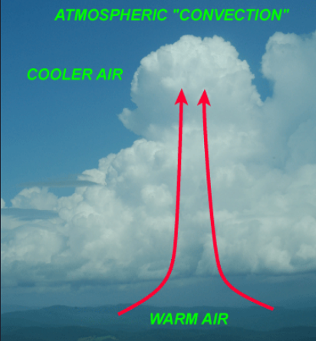
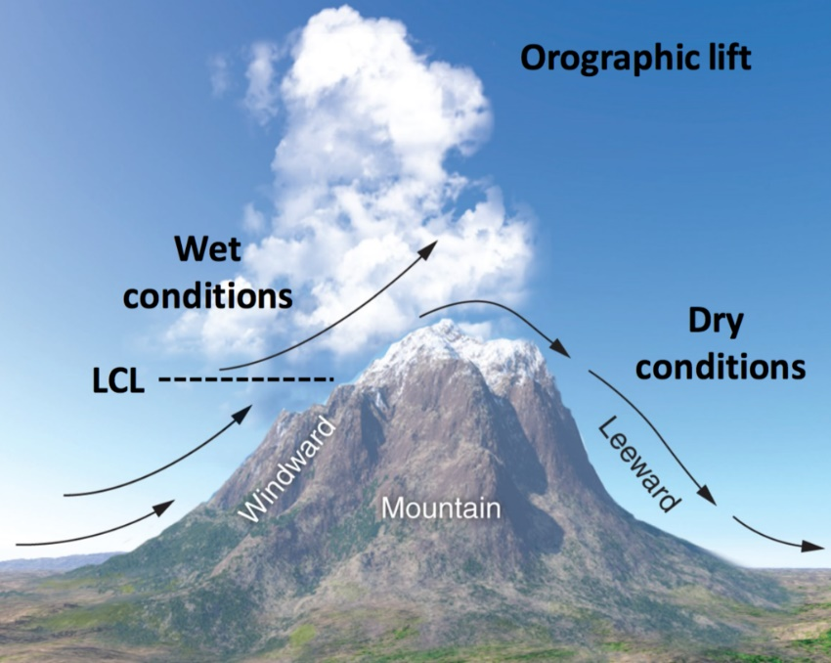
Primary Ways of Cloud Formation
Air rises due to it’s own buoyancy (heated air is less dense and will rise) this is known also as convection.
Air is forced as it travels over mountains; this is called orographic lifting.

Slide 54
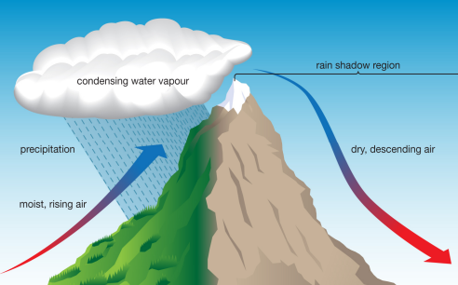
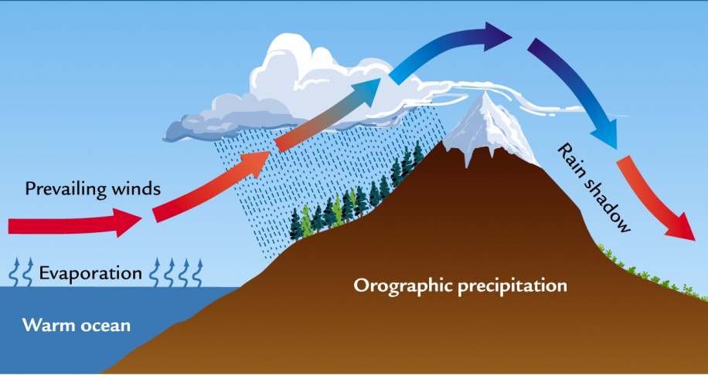
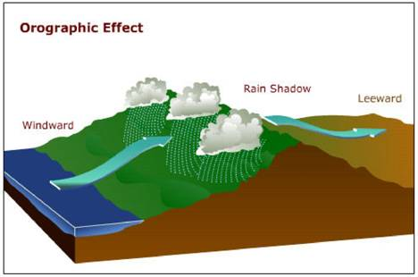
Orographic Lifting

Slide 55
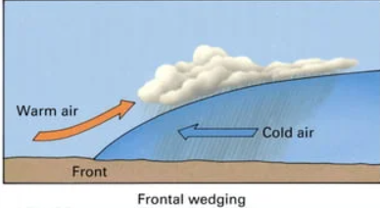
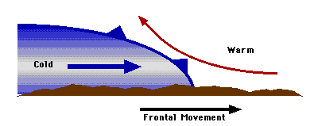
Primary Ways of Cloud Formation
Air is forced up due to another air mass, this is called frontal wedging.

Slide 56
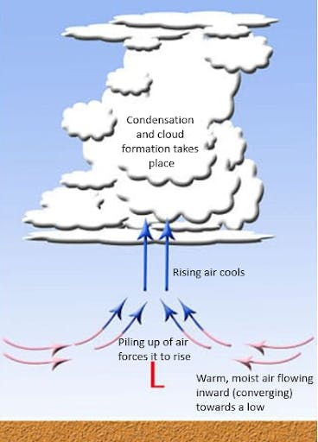
Primary Ways of Cloud Formation
Air is forced up due to convergence near low pressure zones.

Slide 57
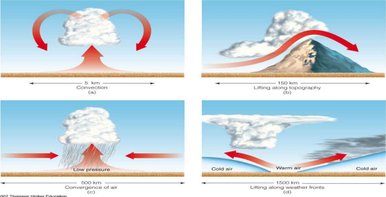

Slide 58
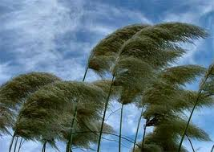
What Causes Wind?

Slide 59
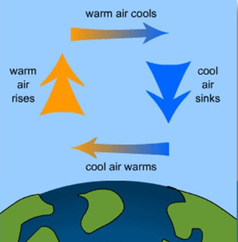
What Causes Wind?
Unequal Distribution of Thermal Energy (temperature)
Warm air rises (less dense), leaving a deficit of air and thereby lowering the air pressure – “LOWs”
Cold air sinks (more dense), creating a buildup of air and thereby raising the air pressure – “HIGHs”

Slide 60
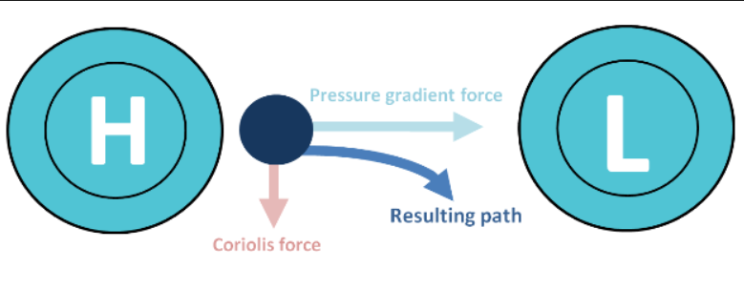
What Causes Wind?
Unequal Distribution of Pressure
Pressure differences create a pressure gradient and causes the wind to blow.
The direction of wind motion is always from higher pressure towards lower pressure.
The greater these differences, the greater the wind velocity.

Slide 61

Isobars
(The concentric circles)

Slide 62

Isobars
Lines of constant or equal pressure on a weather map
Air pressure is measured in millibars or mercury depending on the barometer.
Standard pressure
1013 millibars 101.3 kPa
760 mm Hg 29.92 in. Hg

Slide 63
Factors That Affect Wind
http://education-portal.com/academy/lesson/factors-that-affect-wind-pressure-gradient-forces-coriolis-effect-friction.html#lesson
(4:30 minutes without summary or 6:00 with summary)

Slide 64
Factors That Affect Wind
Pressure Gradient Force
Pressure differences create a pressure gradient and causes the wind to blow.
The greater these differences, the greater the wind velocity.
The direction of wind motion is always from higher pressure towards lower pressure.
The velocity of wind can be estimated from the spacing of isobars on a weather chart.
  The closer the isobars the steeper the pressure gradient, and the stronger the wind

Slide 65
Factors That Affect Wind
Friction Force
Frictional forces act to slow wind movement and to change the wind direction.
Winds in the lowest layers of atmosphere (at or near the earth's surface) are greatly influenced by the frictional force.
  The effect of friction is to reduce the wind speed.
  Friction is relatively low over the ocean surface.
  Different layers of the atmosphere have different wind velocities and these winds can affect each other as they intersect.

Slide 66

Factors That Affect Wind (and weather)
Coriolis Force (Effect)
Winds are curved or deflected to the right in the Northern Hemisphere due to Earth’s rotation.
Stand up. Toss an object straight in front of you at some target. Now, spin your body counter-clockwise and toss the object again at the same target as before.

Slide 67
Factors That Affect Wind
Coriolis Force (Effect)
Winds are curved or deflected to the right in the Northern Hemisphere due to Earth’s rotation.

Slide 68
Factors That Affect Wind
Coriolis Force (Effect)
Winds are curved or deflected to the left in the Southern Hemisphere due to Earth’s rotation.

Slide 69

Coriolis Effect
When the wind swirls counter-clockwise in the northern hemisphere or clockwise in the southern hemisphere, it is called cyclonic flow.

Slide 70
Coriolis Effect
When the wind swirls clockwise in the northern hemisphere or counter-clockwise in the southern hemisphere, it is called anticyclonic flow.

Slide 71

Low Pressure versus High Pressure
Winds blow into low pressure systems and swirl counterclockwise (in the Northern Hemisphere) around the low pressure center.
Pressure gradient force is represented by blue arrows.
The Coriolis force, always perpendicular to the velocity, is indicated by red arrows.

Slide 72

Low Pressure versus High Pressure
Winds within high-pressure areas flow outward and clockwise from the higher pressure areas near their centers towards the lower pressure areas further from their centers.
An Unusual Anticyclone in Southern Australia.
In the Northern Hemisphere,
winds blow clockwise.

Slide 73

The Coriolis force is zero at the equator and maximum at the poles.

Slide 74

Global Wind Belts
Air moves from higher pressure to lower pressure.
Global pressure belts move air in a pattern
The Coriolis Effect deflects wind, generating the global wind patterns.
https://screenpal.com/watch/cF6hoOYoxj (2:04)

