Slide 1
Click on “Slide Show”
Click “Play from Beginning”

Slide 2
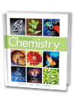

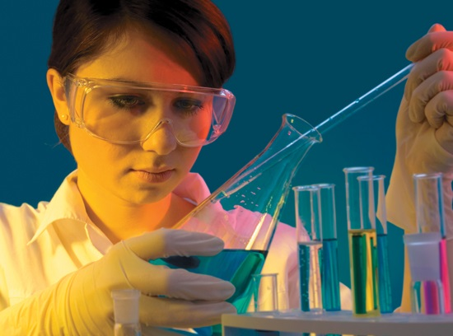
Chapter 1
Introduction to Chemistry
The Scope of Chemistry
Chemistry and You
Thinking Like a Scientist
Problem Solving in Chemistry

Slide 3
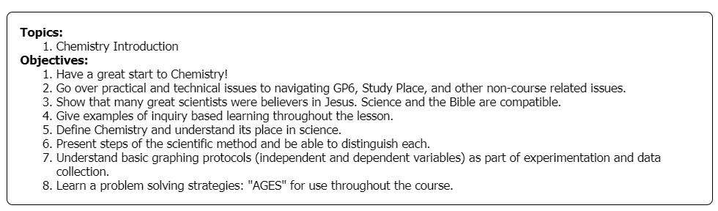

Slide 4
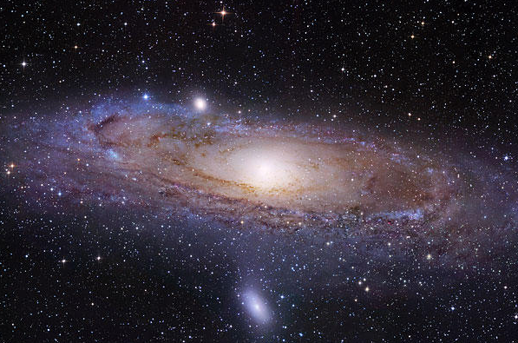
The Bible and Science
The Bible and Science:
are absolutely compatible without the need to compromise.
Many famous scientists sought to honor God by their endeavors:
Johann Kepler (1571-1630) – Astronomer
Awed by the power and wisdom of God, he once said that in his discoveries he was merely “thinking God’s thoughts after Him.
Blaise Pascal (1623-1662) – Mathematician (Pressure Law)
…maintained that “the only perfect knowledge [comes] through Christian revelation”
Robert Boyle (1627-1691) – “Father of Chemistry” (atom)
…convinced that the Bible is a divine revelation.

Slide 5
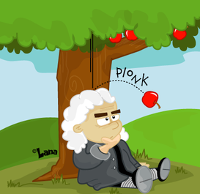
The Bible and Science
Sir Isaac Newton (1642-1727)
Einstein once paid tribute to Newton by suggesting that
his own work would have been impossible but for the
discoveries of Newton. “This most beautiful system of the sun, planets, and comets, could only proceed from the counsel and dominion of an intelligent and powerful Being.”
Michael Faraday (1791-1867) - Electromagnetism
…devoutly believed that God was the maker and sustainer of all things and like Louis Pasteur was inspired in his scientific work by his simple but steadfast belief in the will of God.
Wernher von Braun (1912-1977) - NASA Rocket Engineer
“There is certainly no scientific reason why God cannot retain the same position in our modern world that He held before we began probing His creation with the telescope and cyclotron.”

Slide 6

The Bible and Science
My goal this year, for this class, is that you also would experience joy in learning “How God did it,” in the context of many chemical processes.
I hope this class will both strengthen your faith in God, and cause you to want to worship Him more.

Slide 7
Inquiry Activity
Each student will describe ONE specific part of their body (e.g. top of head, face, ear, nose, cheeks, back of neck, throat, right shoulder, left arm, elbow, wrist, hand, knee, ankle, foot,)
Write 1-2 phrases in the chat box to describe your assigned body part.

Slide 8
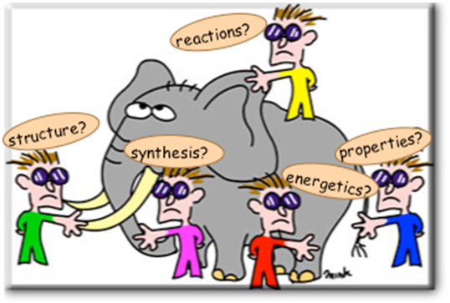
Do you remember the story about the group of blind men who encountered an elephant?
Each one moved his hands over a different part of the elephant's body— his trunk, an ear, or a leg— and came up with an entirely different description of the beast.
Chemistry can similarly be approached in different ways, each yielding a different, valid, and yet incomplete view of the subject. You will see this in the different areas as we discuss them.

Slide 9
Inquiry Activity
Everyone look at your hand.
What branches of science are involved?
Biology (arteries, veins, cells)
Chemistry (composition, structure)
Physics (movement)
Earth Science (life form & environment)

Slide 10
Chemistry (focuses on):
the study of the composition, structure, and properties of matter;
the processes that matter undergoes,
and the energy changes that accompany these processes.

Slide 11
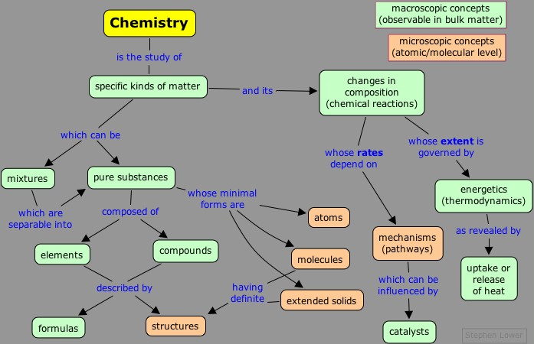
Flow Chart of Chemistry

Slide 12
Inquiry Activity
Is Air real?
(Can you prove it?)

Slide 13
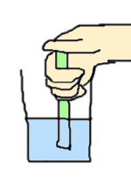
Inquiry Activity
Is Air real?
Imagine getting a glass of water and placing a straw in it.
  Cover the open end of the straw and pull up on the straw. What happens?
  Open the straw, take it out of the water. Now, cover the end again and place it back in the water … while the end is covered. What happens?

Slide 14
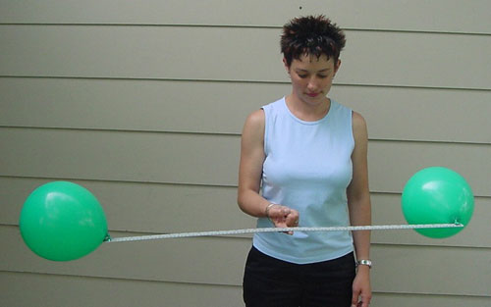
MATTER
Matter
Anything that has mass and takes up space.
Air is matter.

Slide 15
MATTER
Air is matter.
If air is let out of the balloon on the right, the balance will tip … because air does have mass.

Slide 16

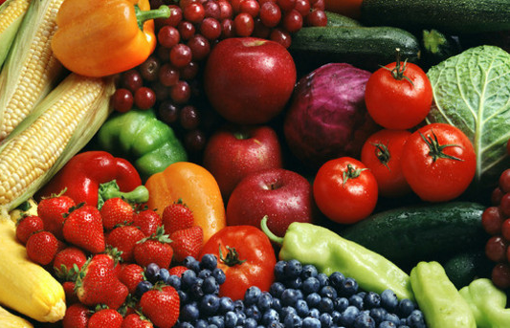

2 Why Study Chemistry?
Reasons to study chemistry:
Chemistry can be useful in explaining the natural world, preparing people for career opportunities, and producing informed citizens based on evidence (energy, matter).
Technology is the means by which a society provides its members with those things they need and desire.
Modern research in chemistry can lead to technologies that help man produce food and energy, improve human life, and expand our knowledge of the universe.

Slide 17
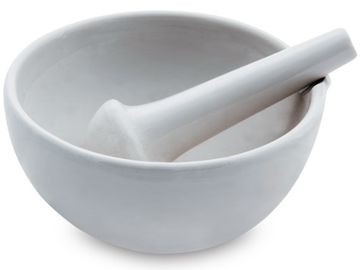
An Experimental Approach to Science
2 Why Study Chemistry?
Chemistry comes from the word alchemy.
Alchemists were concerned with searching for a way to change other metals, such as lead, into gold.
Alchemists developed the tools and techniques for working with chemicals.
They designed equipment that is still in use today, including beakers, flasks, tongs, funnels, and the mortar and pestle.

Slide 18
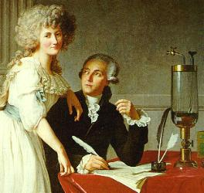
An Experimental Approach to Science
3 Thinking Like a Scientist
Antoine-Laurent Lavoisier
French scientist in the late 1700’s who revolutionized the science of chemistry. He helped to transform it from a science of observation to the science of measurement that it is today; E.g. he designed a balance that could measure mass to the nearest 0.0005 gram.
He also settled a long-standing debate about how materials burn. He was able to show (evidence) that oxygen is required for a material to burn. Because oxygen is invisible, people did not consider it as real.

Slide 19

The Nature of Science
3 Thinking Like a Scientist
Science proceeds by trial and error.
Science is fallible because of fallen man.
What was scientifically thought true in the past is sometimes superseded by later scientific discoveries.
There is no place for arrogance in real science. We must always be willing to be proved wrong.
A consistent need in science is the evidence.

Slide 20
EXAMPLES OF
Poor Observation &
“JUMPING TO CONCLUSIONS”

Slide 21

Visual:
Draw a triangle on your notes page. You will be shown a triangle that has a message written within it.
You will have THREE seconds to observe the contents of the triangle.
Observe, and write EXACTLY what you observe

Slide 22
Paris
in the
the spring

Slide 23
Write
what
you saw

Slide 24
Look Again:
Paris
in the
the spring

Slide 25
SCIENCE IS IMPORTANT BECAUSE
… We tend to make poor observations

Slide 26
Acoustic:
Listen to the teacher give you a problem to solve
OR
click the link to the Youtube video on the next slide
Write down how many sheep are left.
Listen again to check your answer

Slide 27

http://somup.com/cqjOXxetNJ

Slide 28
59 sheep are left
If you listen closely, the sound bite was, “A man had sixty SICK sheep and one dies” …
Observations (including hearing) are very crucial to accurate data collection and solving of problems

Slide 29
SCIENCE IS IMPORTANT BECAUSE …
We often make observations with bias
In other words, we have a prejudged solution BEFORE observing.
OR we make the observation FIT INTO OUR already decided mindset.

Slide 30
The Nature of a Scientific Law:
An educated guess, confirmed over and over again by experimentation
3 Thinking Like a Scientist
Accurate Observation
Experimentation
Scientific Theory
Scientific Law
Formulate Hypothesis
Place in the boxes
Experimentation
Hypothesis
Law
Observation
Theory

Slide 31
The Nature of a Scientific Law:
An educated guess, confirmed over and over again by experimentation
3 Thinking Like a Scientist
Accurate Observation
Experimentation
Scientific Theory
Scientific Law
Formulate Hypothesis

Slide 32
Scientific Method
Click link:
https://screencast-o-matic.com/watch/cF6erAYlWN
What was that?
How did that happen?
Can that happen again?
Where was that?

Slide 33
Scientific Method
Observation (using senses) includes questioning and collecting data.
This leads to proposed solutions (hypothesis). We want to know the answer to our questions.
This leads to experimentation (testing our proposed solution). 1 John 4:1

Slide 34
Scientific Method
When experimentation (testing) can be repeated again and again and we recognize a pattern, our rationale minds want an explanation (Theory).
When events in nature are repeated without any exception, a scientific law is formulated.

Slide 35
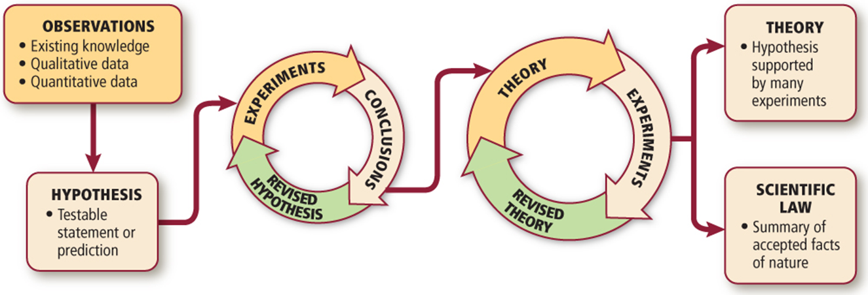
The Scientific Method
3 Thinking Like a Scientist
Hypothesis: possible solution based on accurate observation.
Experiment: “controlled” testing of the hypothesis.

Slide 36
The Scientific Method
3 Thinking Like a Scientist
Theory: repeatable pattern, giving explanation of observations.
Scientific law: concise summary of observations and experiments found in nature that have not yet been refuted.

Slide 37
The Scientific Method
3 Thinking Like a Scientist
Hypothesis: possible solution based on accurate observation.
Experiment: “controlled” testing of the hypothesis.
Theory: repeatable pattern, giving explanation of observations.
Scientific law: concise summary of observations and experiments found in nature that have not yet been refuted.

Slide 38
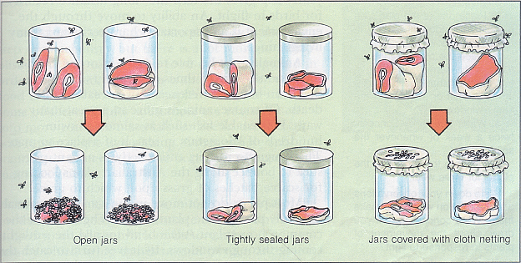
Disproving poor “science”
3 Thinking Like a Scientist >
Redi’s experiments tested the hypothesis of spontaneous generation for macroscopic organisms:
Are maggots created spontaneously?
No Cover

Slide 39
Disproving poor “science”
3 Thinking Like a Scientist >
Redi’s experiments showed that when the jars were sealed, no maggots appeared on the meat.
Jars are sealed

Slide 40
Disproving poor “science”
3 Thinking Like a Scientist >
Redi’s experiments gave solid evidence against the opinion of spontaneous generation for macroscopic organisms:
Are maggots created spontaneously? NO
No Cover
Jars are sealed

Slide 41
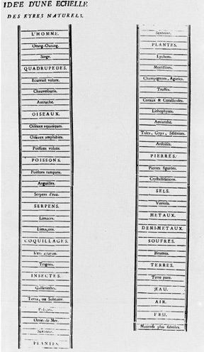
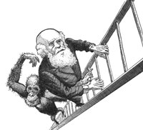
Spontaneous generation of microscopic organisms
3 Thinking Like a Scientist
Jean Baptiste Lamarck (1744-1829)
FALSELY believed that as creatures strive for greater perfection and move up the evolutionary “ladder,” new organisms arise, by spontaneous generation, to fill the vacated places on the lower rungs.

Slide 42
3 Thinking Like a Scientist
Spontaneous generation proven wrong but still used
Disproof of the traditional ideas of spontaneous generation (life coming from non-living material) is no longer controversial among professional biologists.
YET, Evolutionists still claim that life arises in simple form from nonlife by way of a long and complicated series of chemical steps.
This is NOT good science.

Slide 43
Spontaneous generation of microscopic organisms
3 Thinking Like a Scientist
John Needham (1713-1781) believed a “Life force,” able to trigger spontaneous generation, existed in molecules of all inorganic matter.
Boiling broth too long killed the life force.
Sealing the flask prevented air from reaching the broth, which was also needed for the life force to work to spontaneously create life.
By 1860, the debate was so heated that the Paris Academy of Sciences offered a prize for any experiments that would prove or disprove spontaneous generation.
In 1864, Louis Pasteur won the prize for his experiment which disproved spontaneous generation of microscopic organisms.

Slide 44
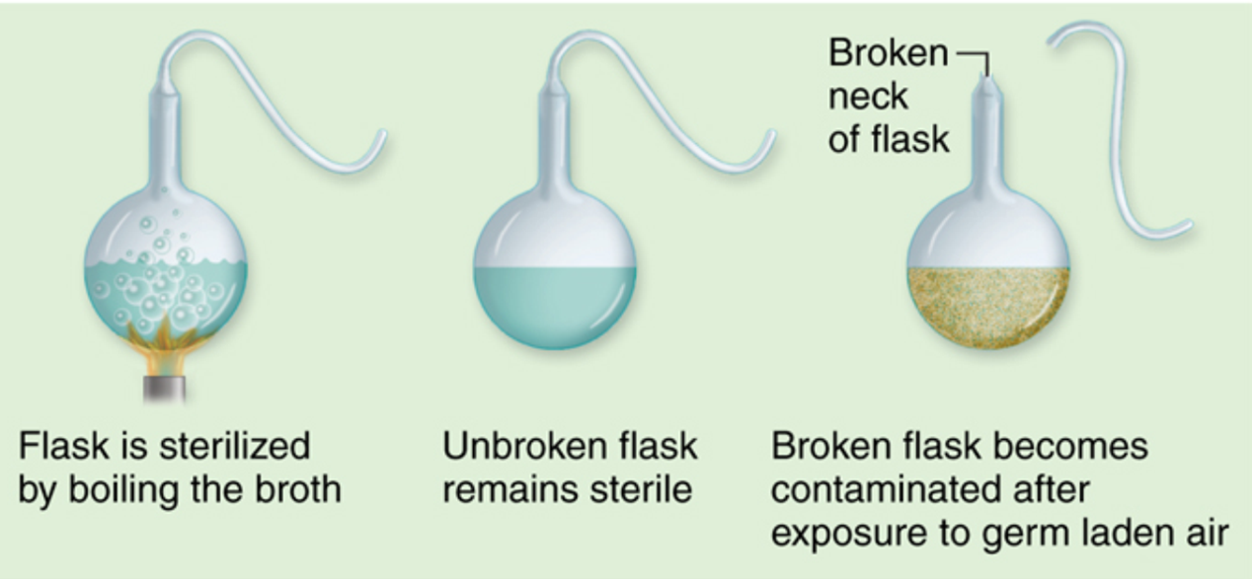
Spontaneous generation
3 Thinking Like a Scientist
Pasteur’s experiments
1864 - used broth in swan-necked flasks and flasks with cotton balls in the ends.
Air was able to enter flasks, but microorganisms were filtered out. Some of his flasks on display today, in France, are still sterile.

Slide 45
Information Overload
3 Thinking Like a Scientist
How do we process so much information?
How do we collect, organize, and analyze observations and data?
Scientist use reports, tables, charts, and graphs.

Slide 46
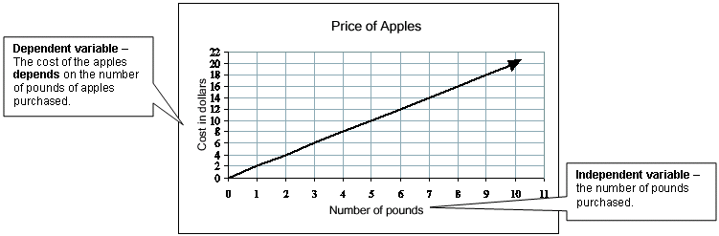
An independent variable is the variable that is NOT changed or controlled in a scientific experiment. It is used to test the effects on the dependent variable.
3 Thinking Like a Scientist
Dependent and Independent Variables
A dependent variable is the variable being tested and measured in a scientific experiment. Its value depends on the value of the independent variable, and it will change as the independent variable’s value changes.
Which variable is which?

Slide 47
An independent variable is the variable that is NOT changed or controlled in a scientific experiment. It is used to test the effects on the dependent variable.
3 Thinking Like a Scientist
Dependent and Independent Variables
A dependent variable is the variable being tested and measured in a scientific experiment. Its value depends on the value of the independent variable, and it will change as the independent variable’s value changes.

Slide 48
3 Thinking Like a Scientist
Dependent and Independent Variables
Compare brands of paper towels, to see which holds the most liquid. If one were to graph the results what would be the independent and dependent variables?

Slide 49
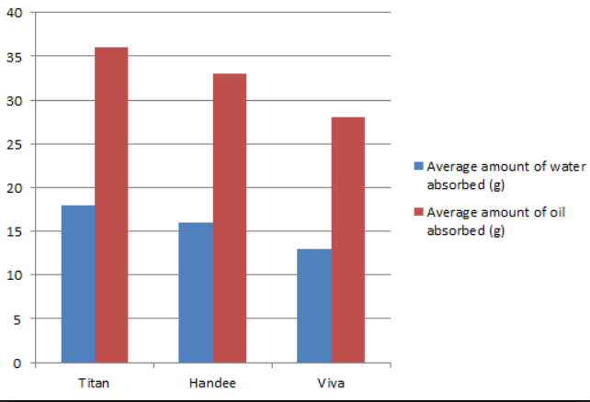
3 Thinking Like a Scientist
Dependent and Independent Variables
The brand of paper towel would be the independent variable because it is determined already and does not change.
The amount of liquid absorbed by the paper towel would change (DEPENDENT variable) based on the different brand of paper towel.

Slide 50
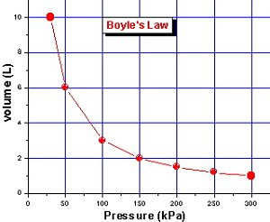
3 Thinking Like a Scientist
Dependent and Independent Variables
Where do the variables go?
What are the dependent and independent variables for Boyle’s Law?

Slide 51
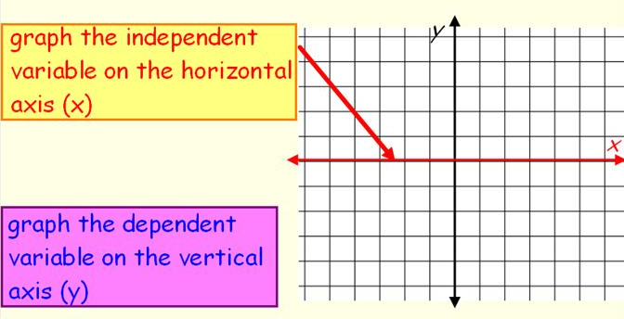
The independent variable is graphed on the x axis [pressure]
The dependent variable is graphed on the y axis. [volume]
3 Thinking Like a Scientist
Dependent and Independent Variables

Slide 52
3 Thinking Like a Scientist
Dependent and Independent Variables
Every valid experiment needs a “control”. What does that mean?

Slide 53
3 Thinking Like a Scientist
Dependent and Independent Variables
Every valid experiment needs a “control”. What does that mean?
In a valid experiment only ONE variable can be tested at a time in order to isolate or compare the results.
An experiment where all aspects involved in the experiment are treated exactly the same except for one deviation, is an example of a controlled experiment.
The control is the independent Variable in which all factors remain the same except what is being tested for.

Slide 54
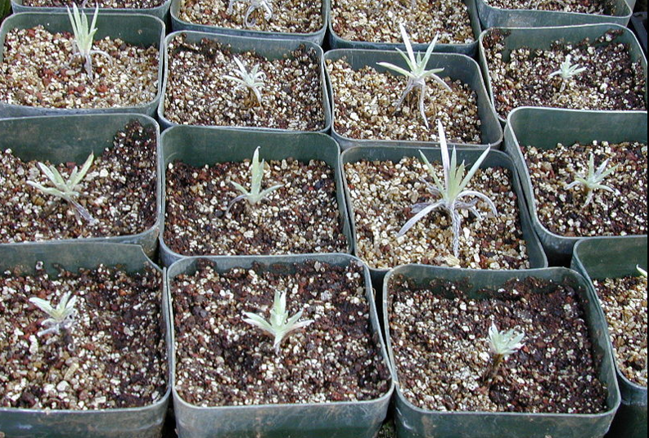
3 Thinking Like a Scientist
Dependent and Independent Variables
An example of a scientific control might be testing plant fertilizer by giving it to only half the plants in a garden.
What is the control group and the experimental group in this experiment?

Slide 55
3 Thinking Like a Scientist
Dependent and Independent Variables
The plants that receive no fertilizer are the control group, because they establish the baseline level of growth that the fertilizer-treated plants will be compared against.
Without a control group, the experiment cannot determine whether the fertilizer-treated plants grow more than they would have if untreated.

Slide 56
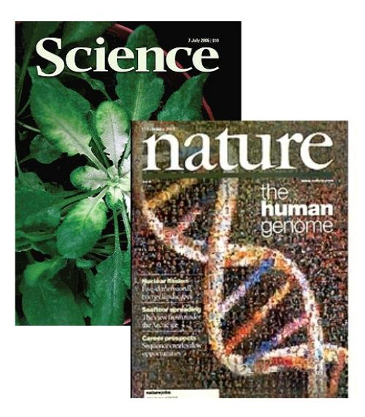
Collaboration and Communication
3 Thinking Like a Scientist
Collaboration
Science progresses when scientists collaborate. Collective insight and expertise increases the reliability of observations and conclusions, and the ability to solve scientific problems.
Scientists publish their research results in scientific journals where they are reviewed by experts in the author’s field.
Iron sharpens iron (Proverbs 27:17).
Reviewers may find errors in experimental design or challenge the author’s conclusions in order to advance science, not harm it.

Slide 57
One for the “AGES”
4 Problem Solving
Solving word problems involves analysis, calculation, and evaluation:
A → What is the problem “Asking” for?
G → What is “Given” in the problem?
E → What “Equation” is best to use?
S → Solve the problem and ask, Does your answer make “Sense”?

Slide 58
4 Problem Solving
Convert 12 m to cm

Slide 59
4 Problem Solving
Convert 12 m to cm
A → cm
G → 12 m … 1 m = 100 cm
E → 12 m x 100 cm / 1 m =
S → centimeters are smaller than meters so there should be more centimeters than meters.

Slide 60
4 Problem Solving
Convert 12 m to cm
Multiply 12 m by “1” → using an equality
100 cm = 1 m
Set up a Conversion Factor that cancels out the undesired unit and leaves the desired unit.
12 m x 10² cm/1 m … m cancels out
Change to scientific notation using ↑↓
12 becomes1.2 (# > 1 < 10)… # ↓ by 1 decimal place, therefore exponent ↑ by one … 10³
1.2 x 10³ cm

