Slide 1
To View Slide Show
Click on “Slide Show” above
Click on “From Current Slide”

Slide 2
Objectives
1. Describe the Pleistocene extinction and possible causes.
2. Define what ice ages are and distinguish glacial and interglacial periods throughout Earth’s history.
3. Explain Milankovitch’s ice age theory components.
4. Define paleoclimatology and explain how scientists monitor Earth’s climate throughout history.
5. Describe glaciers and glaciation, giving the types of glaciers and how glaciers are formed.
6. Understand how glaciers are identified using topographic maps.
7. Explain the formation of the Great Lakes.
8. Describe isostatic rebound.
9. Practical apply paleoclimatology in reading various graphs about ice age.

Slide 3
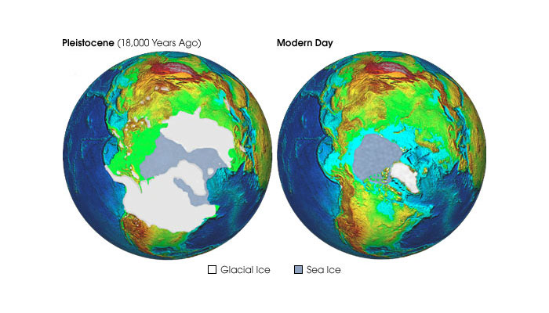
Ice Ages

Slide 4
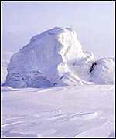
We are in an Ice Age right now!
Glaciers are visible today.
When the polar ice caps cover a smaller area, such as present day, it is referred to as an interglacial period.
When the polar ice caps cover a larger area, it is referred to as a glacial period.
Polar Ice Caps
Greenland

Slide 5
Ice Age Components
An ice age consists of two parts that make up one Milankovitch cycle:
Glacial period (cooler with at least one polar ice cap)
Interglacial period (warmer)

Slide 6
Ice Ages
For 90% of the Earth’s history, no polar ice caps were present.
There have been 5 major ice ages:
¹ 2 billion years ago
² 840 million years ago (lasted for 240 million years!)
^{3 & 4} 2 ice ages (during the Paleozoic era)
⁵ Present ice age (began approximately 3 million years ago)

Slide 7
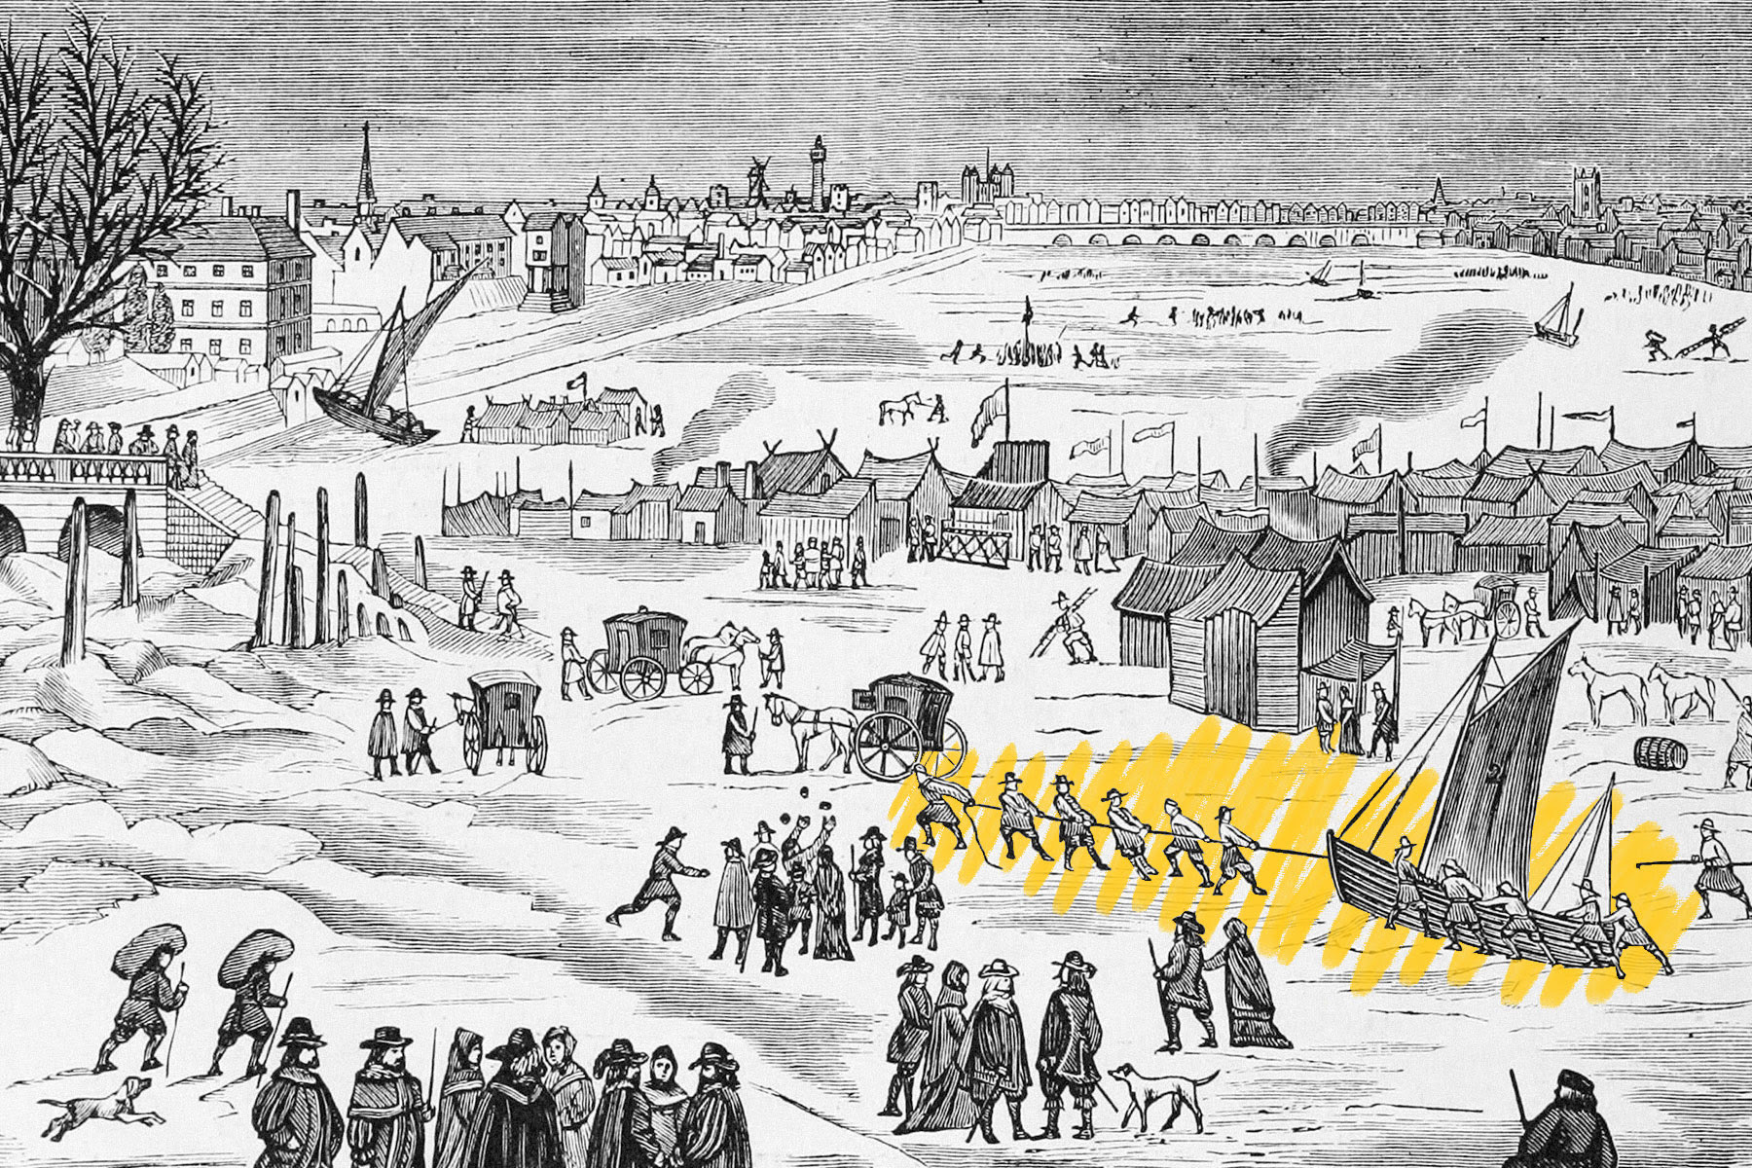
Climate Between 14th – 19th Centuries

Slide 8
Climate Between 14th – 19th Centuries
Saber-toothed tigers and woolly mammoths weren’t roaming the Earth during the last ice age — Leonardo da Vinci and Michelangelo were.
A period of global cooling, known as the “Little Ice Age,” spanned the late Middle Ages through the Renaissance era, ending around the dawn of the Industrial Revolution in the mid-1800s.
Some locations cooled down more than others, including northern Europe and western North America, which experienced temperature fluctuations between 1.8 and 3.6 degrees Fahrenheit cooler than the thousand-year averages for those regions.

Slide 9
Climate Between 14th – 19th Centuries
This drastic change in climate had several possible causes. One leading theory points to a decrease in sunspot activity, which caused less solar radiation to reach Earth’s surface. Significant changes in atmospheric patterns also might have contributed to cooler temperatures in some regions. Or an increase in volcanic eruptions could have been the culprit, causing gas and ash to spew into the atmosphere, cooling the Earth.
Some experts suggest it was a combination of all these things. Researchers at University College London believe the temperature drop was exacerbated by an entirely different issue: the depopulation of the Americas following the arrival of European colonists. Mass warfare and disease caused the deaths of 56 million indigenous people by 1600. Large areas of once-cultivated land turned into forests, absorbing massive amounts of carbon dioxide and preventing it from reaching the atmosphere to warm the planet.

Slide 10
Climate Between 14th – 19th Centuries
The impacts of the Little Ice Age were global, causing food shortages in parts of Europe, Asia, and Africa. China’s long-standing Ming dynasty fell in 1644, partially due to agricultural woes. Widespread famine uprooted the regular order of society, and Europe’s medieval feudal system (which relied on peasants growing crops for their lords) collapsed (partly due to climate change, though many other factors contributed), giving way to markets and trade systems.
This new way of life led into the 17th-century Age of Enlightenment, when exploration, religion, art, and philosophy transformed European society.

Slide 11
Late Pleistocene Extinction
Approximately 11,000 years ago, many animals went extinct across North America (this happened towards the end of the Pleistocene epoch).
Before this extinction occurred, many of the animals that existed in North America were similar (in size and diversity) to animals in modern-day Africa.
These animals were referred to as “megafauna” which means “large animals.”

Slide 12
Examples of Megafauna from Pleistocene Epoch
Saber-tooth tiger
Mastodon
Macrauchenia
Diprotodon

Slide 13
Late Pleistocene Extinction
Although scientists don’t exactly know the cause of extinction, they have identified three mechanisms which may have caused the extinction:
Human hunting
Environmental causes related to climate change
Hyperdisease (highly infectious disease)

Slide 14
What Causes an Ice Age?
It is unclear what causes Ice Ages to occur, but current theories point to the changing position of the continents which causes:
Mountain building events
Different global wind patterns
Different global ocean current patterns
Amount of seafloor spreading (effects sea level)
Notes:
Positioning of the continents could have blocked the warmer ocean currents from reaching the poles which, therefore, allows ice sheets to build.
Uplift of large areas (such as tibet) past the snow line accumulated large amounts of snow, thereby increasing albedo of earth’s surface (which caused a cooling of the earth’s surface)

Slide 15
What Causes Glacial to Interglacial Changes?
The Ice Age Theory as described by Serbian scientist, Milutin Milankovitch, points to three variations in the earth-sun geometry.
Eccentricity – stretching of earth’s orbit (100,000 year cycle)
Obliquity – change of the earth’s axial tilt (41,000 year cycle)
Precession – “wobble” of the earth’s axis of rotation (~26,000 year cycle)

Slide 16
Eccentricity, Obliquity, and Precession
eccentricity
obliquity
precession

Slide 17
Eccentricity
The shape of Earth’s orbit isn’t quite a perfect circle. It is more like a “stretched out” circle or an oval.
Mathematicians and astronomers call this shape an “ellipse”.
An ellipse can be long and skinny or it can be very round.
Scientists need a way to describe how round or “stretched out” an ellipse is. They use a number to describe this, and call it the eccentricity of the ellipse.

Slide 18
Eccentricity

Slide 19
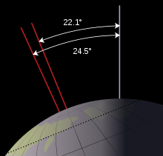
Obliquity
Also known as axial tilt.
The angle between an object's rotational axis and its orbital axis.

Slide 20
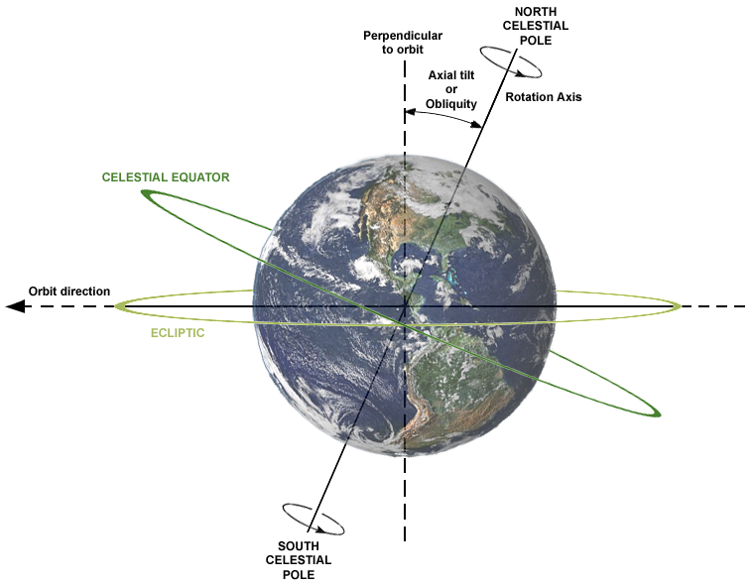
Obliquity

Slide 21
Obliquity
Axial tilt affects the distribution of solar radiation on Earth’s surface

Slide 22
Obliquity
When the tilt is decreased, polar regions receive less sunlight.

Slide 23
Obliquity
When the tilt is increased, polar regions receive more sunlight.

Slide 24
Obliquity
The earth’s axial tilt varies from 22.1° to 24.5° at periods close to 41,000 years

Slide 25
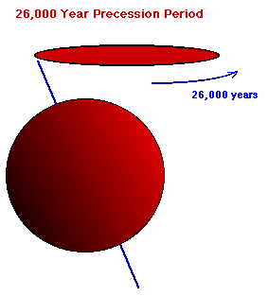
Precession
The Earth's rotation axis is not fixed in space.
Like a rotating toy top, the direction of the rotation axis executes a slow precession with a period of 26,000 years.
Notes:
Precession affects how severe or moderate the seasons are depending on which portion of the “wobble” the earth is on. For example, you could have a cool summer which allows ice in higher latitudes to last throughout the summer.

Slide 26
Precession
Is a change in the orientation of the rotational axis of a rotating body.
Precession affects how severe or moderate the seasons are depending on which portion of the “wobble” the earth is on.
For example, you could have a cool summer which allows ice in higher latitudes to last throughout the summer.

Slide 27
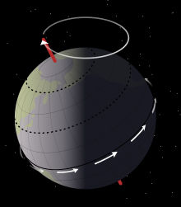
Precession
http://somup.com/cZnhq5pi2n (1:42)

Slide 28
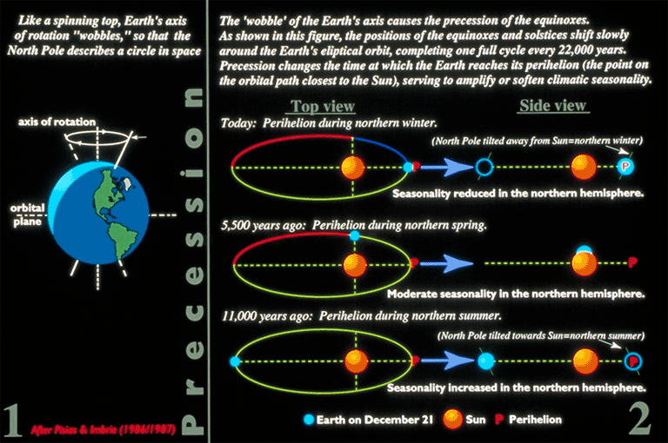
Precession
It takes 26,000 years for one full precession
Notes:
Precession affects how severe or moderate the seasons are depending on which portion of the “wobble” the earth is on. For example, you could have a cool summer which allows ice in higher latitudes to last throughout the summer.

Slide 29
PALEOCLIMATOLOGY
The study of ancient climates.
Using ice core samples, rock core samples, tree ring and sediment samples, scientists can piece together some of the history of the earth’s climate.
The following slide shows an example of these samples which then provided information to create graphs (slides 26-30)

Slide 30
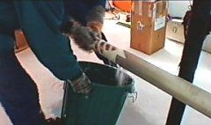
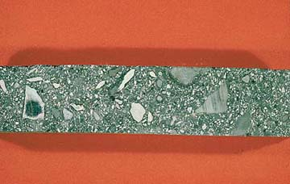
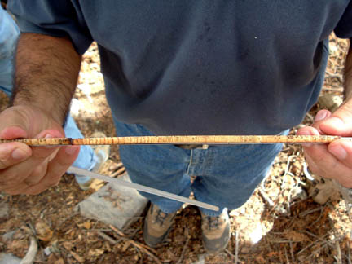
Core Samples
Ice
Rock
Tree

Slide 31
PALEOCLIMATOLOGY
The upcoming slides show graphs representing the core sample information.
The zero line represents the average global temperature from the year 1950 (an average year for the 20th century).

Slide 32
The Last 2,400 Years (Graph 1)
2,400 years ago
Present Day
Zero line is global avg. in 1950 and is called the “Normal” Line

Slide 33
Last 12,000 Years (Graph 2)
Zero line is global avg. in 1950
Coming out of last glacial period
Note the many years of warmer climate than today.

Slide 34
Last 100,000 Years (Graph 3)
Current Interglacial Period
Zero line is global avg. in 1950
Last Glacial Period (Wisconsin)

Slide 35
Last 420,000 Years (Graph 4)
Interglacial Periods
Interglacial periods are warmer and last 10-15,000 years
Glacial periods are when ice caps expand & last 50-100,000 years
Glacial Periods

Slide 36
Last 3 Million Years (Graph 5)
3 million years ago
Present Day

Slide 37
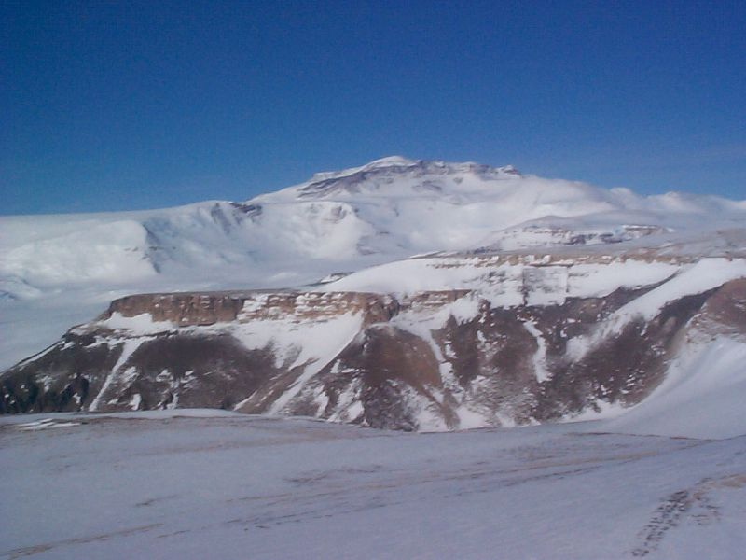
Glaciers and Glaciation

Slide 38
Types of Glaciers
Alpine – Formed in mountainous areas; relatively small in size.
Continental – large expansive ice sheets (these cover Antarctica and Greenland today); these are the glaciers we will be studying.

Slide 39
What forms a glacier?
Ice is formed from recrystallized snow.
Individual flakes of snow turn to rounded chunks of icy material.
As more snow falls, the pressure compacts the layers of the icy snow.
When the glacier gets big enough, ice at the base deforms and the glacier flows.
Glacier Formation https://screenpal.com/watch/cFQUFsYimH (4:39)

Slide 40
Glacial Calving https://screenpal.com/watch/cFQUqVYiHX (3:46)

Slide 41
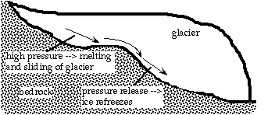
How Does a Glacier Move?

Slide 42
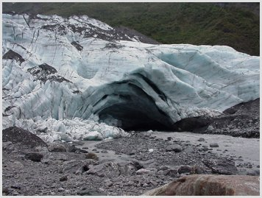
Glacial Lobe (alpine) as it Advances

Slide 43
Receding Glacier topography
floodplain

Slide 44
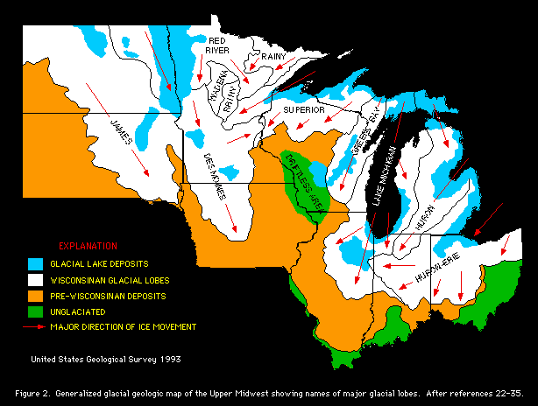
Glaciers in the Midwest

Slide 45
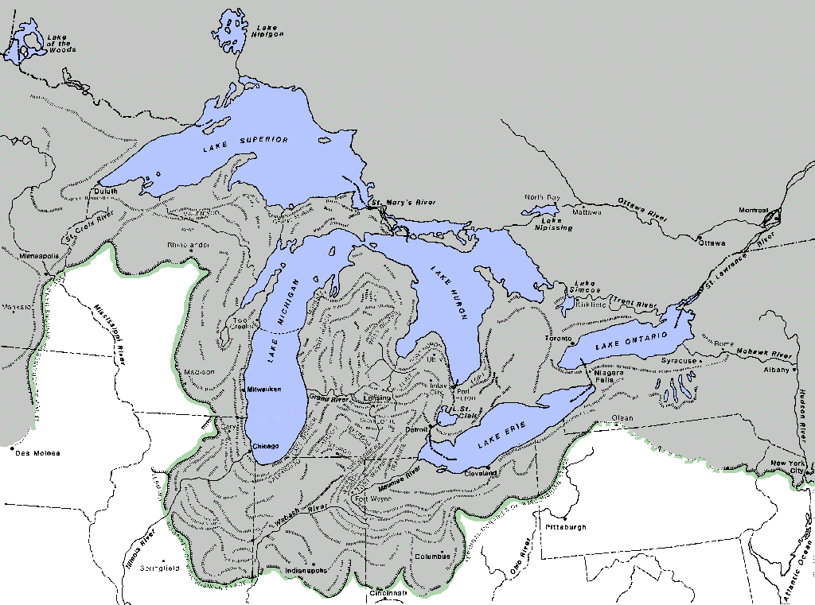
Notes:
Extent of the Wisconsinan glaciers (in gray maximum advance marked in green) in the Great Lakes area
Source: Adapted from, BU 04-R THE GLACIAL LAKES AROUND MICHIGAN: 1988; Farrand, W. R. Digital image made by Steven E. Wilson, DEQ OGS .

Slide 46
Using Maps to Identify Glacial Features
Topographic Maps show lines called contours. These lines connect equal areas of elevation.
Areas that have contour lines close together indicate that there is a greater change in elevation in a short distance (either up or down).

Slide 47
Northwest Michigan
Notice the contour lines that make concentric circles … they are closer together

Slide 48
Formation of the Great Lakes
During the last glacial period, lobes of ice carved their way into softer sediment over this region of North America.
When the climate warmed, the glacier retreated, and melted into the depressions left by the ice lobes, creating the great lakes.
Formation of the Great Lakes http://somup.com/cZn12epj5B (5:33)

Slide 49
Formation of the Great Lakes

Slide 50
Isostatic Rebound
Due to the heavy weight of the ice sheet, the lithosphere of the earth was pushed deeper into the asthenosphere in the locations where the ice was.
As the glacial sheet melted back, the lithosphere began to slowly “bob” back up – and still is adjusting back up.
For this reason, the great lakes drain to the north and east, out the St. Lawrence River to the Atlantic Ocean.

Slide 51
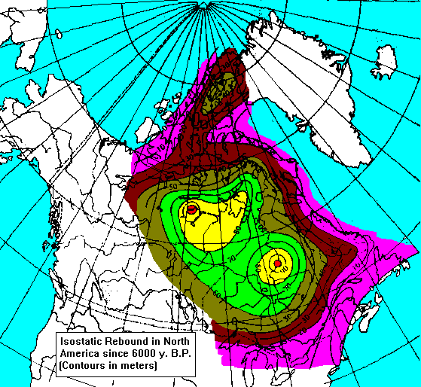

Slide 52
Paleoclimate Graph 1 Analysis Questions
1. What does the zero line on the graphs represent? Why would this number be used?
2. Describe in words the average global temperature for the past 2,400 years compared to the zero line.

Slide 53
The Last 2,400 Years (Graph 1)
Present Day
2,400 years ago

Slide 54
Paleoclimate Graph 1 Analysis Questions
1. What does the zero line on the graphs represent? Why would this number be used?
Zero line is global avg. in 1950 and is called the “Normal” Line
2. Describe in words the average global temperature for the past 2,400 years compared to the zero line.
Temperatures fluctuate above and below the “normal” line

Slide 55
Paleoclimate Graph 2
Analysis Questions
Describe the significance of graph #2.

Slide 56
Last 12,000 Years (Graph 2)
Zero line is global avg. in 1950
Coming out of last glacial period

Slide 57
Paleoclimate Graph 3
Analysis Questions
From approximately 100,000 years ago to 15,000 years ago the earth’s temperature was __ the “normal” temperature. What is this period?

Slide 58
Last 100,000 Years (Graph 3)
Current Interglacial Period
Zero line is global avg. in 1950
Last Glacial Period (Wisconsin)

Slide 59
Paleoclimate Graph 4
Analysis Questions
1. What is the pattern in graph #4?
2. According to the pattern, how should the earth’s temperature change in the next 1,000 – 3,000 years?

Slide 60
Last 420,000 Years (Graph 4)
Interglacial Periods
Glacial Periods

Slide 61
Paleoclimate Graph 4
Analysis Questions
1. What is the pattern in graph #4?
Each interglacial period is relatively short
2. According to the pattern, how should the earth’s temperature change in the next 1,000 – 3,000 years?
We should proceed into a glacial period.

Slide 62
Paleoclimate Graph
Analysis Questions
What is a significant difference between glacial periods and interglacial periods?
Interglacial periods are warmer and last 10-15,000 years
Glacial periods are when ice caps expand & last 50-100,000 years

Slide 63
Paleoclimate Graph 5
Analysis Questions
Describe the significance of graph #5.
How has the earth’s climate changed over the past 3 million years?

Slide 64
Last 3 Million Years (Graph 5)
3 million years ago
Present Day

Slide 65
Paleoclimate Graph 5
Analysis Questions
Describe the significance of graph #5.
We are presently in the 5th ice age according to earth history theory.
How has the earth’s climate changed over the past 3 million years?
The climate has cooled over the past 3 million years.

