Slide 1
Click “Slide Show”
Click “From Beginning”
or
“From Current Slide

Slide 2
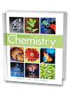
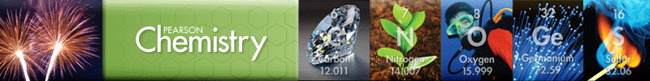
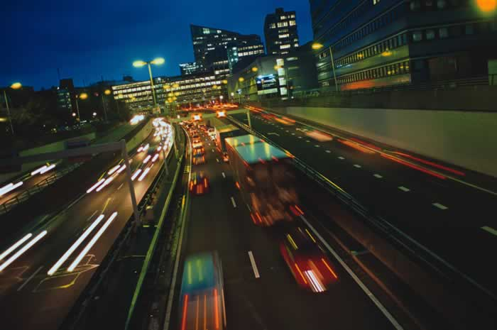
Chapter 18
Reaction Rates and Equilibrium
Rates of Reaction
The Progress of Chemical
Reactions
Reversible Reactions
and Equilibrium
Solubility Equilibrium
Free Energy and Entropy

Slide 3
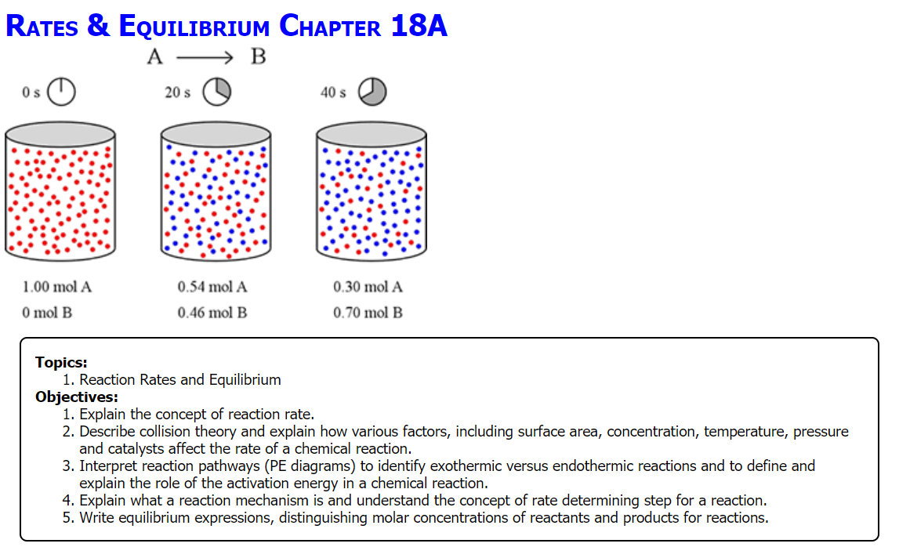

Slide 4
Identifying Reaction Energy
2H₂(g) + O₂(g) → 2H₂O(l) + 136.6 kcal
Heat is a:
O reactant
O product
This reaction is:
O exothermic
O endothermic
The ΔH value is:
O positive
O negative
2HgO(s) + 43.4 kcal → 2Hg(l) + O₂(g)
Heat is a:
O reactant
O product
This reaction is:
O exothermic
O endothermic
The ΔH value is:
O positive
O negative
Notes:
Timing ≈ 0.5 minute
Entry audio: Review energy changes by identifying the correct statements about each reaction.
Hint1 audio: Reactants are shown on the left side of the arrow, and products appear on the right. The reason the energy appears positive in the equation is because it is a product. If you move the heat energy to the reactants’ side of the equation, it will be negative.
Hint2 audio: Energy must be added to the reactants for this reaction to proceed.
Exit audio: Now we will review how enthalpy of reaction can be calculated.

Slide 5
Identifying Reaction Energy
2H₂(g) + O₂(g) → 2H₂O(l) + 136.6 kcal
Heat is a:
product (right side)
This reaction is:
exothermic (heat is released)
The ΔH value is:
negative (exothermic)
ΔH = -68.3 kcal/mol
2HgO(s) + 43.4 kcal → 2Hg(l) + O₂(g)
Heat is a:
Reactant (left side)
This reaction is:
Endothermic (heat is absorbed)
The ΔH value is:
Positive (endothermic)
ΔH = +21.7 kcal/mol

Slide 6
Identifying Reaction Energy
Flaming Bubbles (exothermic reaction)
https://screencast-o-matic.com/watch/cFe0DXD4w2

Slide 7

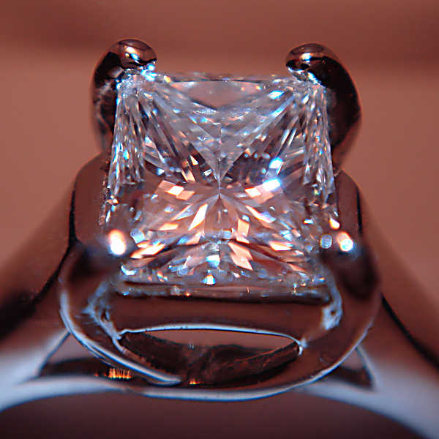
Diamond and graphite are both made of pure carbon yet have very different properties.
Diamond spontaneously reacts to form graphite. Theoretically, graphite can be made into diamond as well.

Slide 8
Spontaneity Versus Reaction Rate
The conversion of diamond to graphite is “spontaneous” (it is self sustaining):
C(diamond) → C(graphite)
Why is it NOT common to see diamond jewelry changing into graphite?
What would be some ways to expedite this reaction?

Slide 9
Lesson Objectives
  Explain the concept of reaction rate.
  Describe collision theory and explain how various factors, including concentration, temperature, and pressure affect the rate of a chemical reaction.
  Interpret reaction pathways (PE diagrams) to identify exothermic versus endothermic reactions and to define and explain the role of the activation energy in a chemical reaction.
  Explain what a reaction mechanism is and understand the concept of rate determining step for a reaction.
  Write equilibrium expressions, distinguishing molar concentrations of reactants and products for reactions.

Slide 10


Reaction Rate
Reaction rate is how fast reactants are converted into products.
Reaction rate tells how the concentration of reactant or product change with time.
  Reaction rates depend on “activation energy”.
Reaction rate affects how chemical and physical reactions proceed.

Slide 11
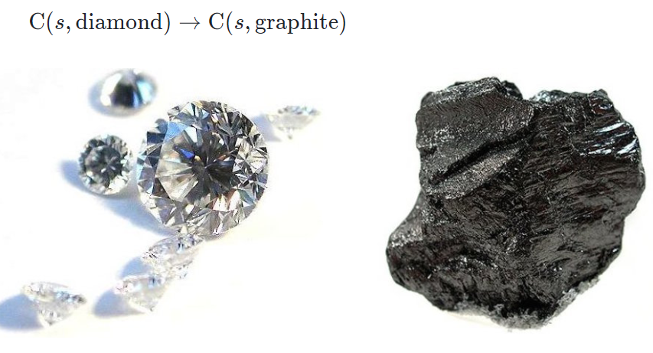
Reaction Rates
Reaction rate is related to kinetics (molecular motion of reactants interacting).
Theoretically, diamond can turn to graphite, but the reaction rate is 0.
Reaction rate does NOT indicate the extent of a reaction (how much product or reactant exists at equilibrium).

Slide 12
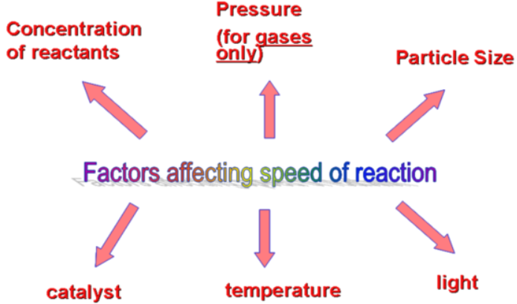
Collisions & Reaction Rate
  What affects the rate at which a reaction proceeds?
  What is the common aspect related to all these factors?

Slide 13
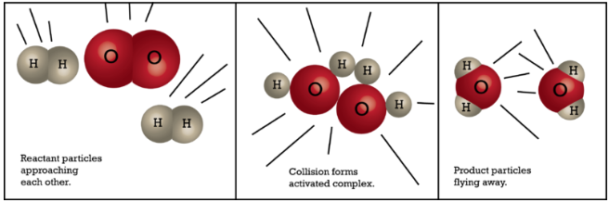
Collisions & Reaction Rate
  Reactants must collide to form products.
  Reaction rate depends on the collisions.

Slide 14
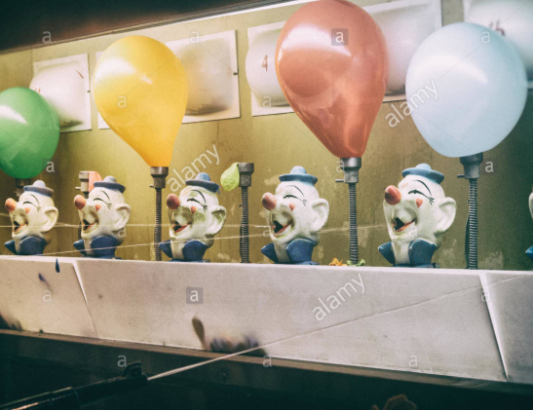
Collisions & Reaction Rate
  What parameters are important regarding collisions?
  Consider trying to score a goal in soccer … how does the player score a goal?
  Consider a boxing match … if there is no knockout, how do judges determine the winner?
  Consider the carnival game of using a spray gun to hit a target in order to fill a balloon (so it pops).

Slide 15
Collision Theory
  Every reaction begins with collisions of molecules or particles
    TWO Important parameters:
  The number of collisions
    Balloons stay “filled” because air molecules constantly collide against the sides of the balloon. Without sufficient collisions, the balloon will deflate.
  The effectiveness of the collisions
    Sufficient energy
    one may hit a billiard cue ball into another ball, but if the energy is insufficient, the ball will not go in the desired pocket.
    Proper orientation of reactant particles
One may have the correct key to the correct lock, but the key must be inserted right side up into the lock hole or it won’t work.

Slide 16
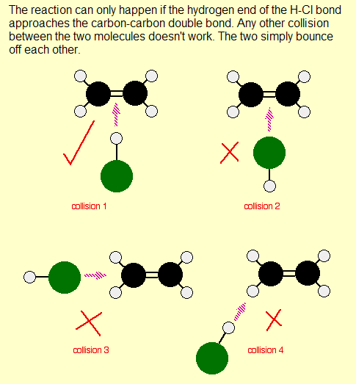
Collision Theory:
Effectiveness
The reaction can only happen if the hydrogen end of the H-Cl bond strikes the C=C (double bond).
Any other collision between the two molecules doesn’t work.
They simply bounce off each other.

Slide 17
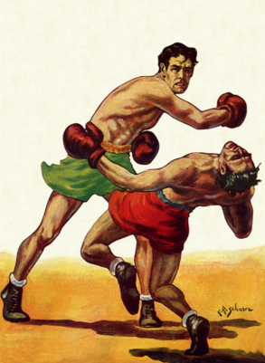
Real Life Application of Collision Theory - BOXING
Boxers are scored by the “collision theory”.
Each time a boxer “hits” their opponent (NUMBER of collisions) effectively (with sufficient force / energy & orientation) they score a point.

Slide 18
Real Life Application of Collision Theory - BOXING
A boxer can hit their opponent many times, but is there EFFECTIVENESS (sufficient force or ENERGY to their blows)? They want to maximize the energy behind each collision.
The ORIENTATION of the blows a boxer inflicts on his opponent means everything.
e.g. To hit someone in the stomach verses the jaw makes a difference. To punch using the fist versus a back hand makes a difference, etc.

Slide 19
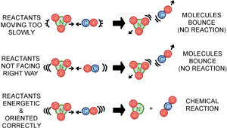
Effective Collisions (Energy & Orientation)
Energy to overcome the activation energy barrier:
  comes from kinetic energy of colliding molecules
    kinetic energy must be high enough
    collisions must be aligned adequately (orientation)
    there must be enough collisions (number)
Notes:
Timing ≈ 1.5
In order for a collision to be effective, that is, for it to lead to products, the electrons of the reacting particles must be moved out of their meta-stable bonding orbitals so the atoms can adopt a new arrangement of bonds. This takes an initial input of energy. An energy source available to all reactions is the kinetic energy of the individual molecules.
(animate 1st bullet) The first postulate of collision theory is that the energy needed to overcome the activation energy barrier comes from the kinetic energy of random collisions. Molecules must collide to react.
Although collision theory postulates that molecules must collide to react, not all collisions lead to reactions. You would be unfortunate indeed if all collisions led to reactions as you would spontaneously combust while sitting at your computer.
(animate 2nd bullet) Reacting molecules must collide hard enough to disrupt the electrons in the bonding orbitals. This is not easy. Electrons have a strong electrostatic repulsion to each other and resist overlapping orbitals. Only a tiny fraction of molecules typically have enough kinetic energy to initiate a reaction.
(animate 3rd bullet) In addition to requiring collisions be energetic enough to overcome activation energy, collision theory also recognizes that the orientation of the colliding molecules affects the reaction. Molecules must collide in the correct orientation for the relevant parts to react.
Thus collision theory predicts that reactions that have high activation energies and/or require very specific orientations tend to have lower rates because fewer collisions are effective.
SOURCES:
http://www.wiley.com/college/boyer/0470003790/reviews/kinetics/kinetics_effectors.htm

Slide 20
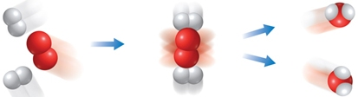
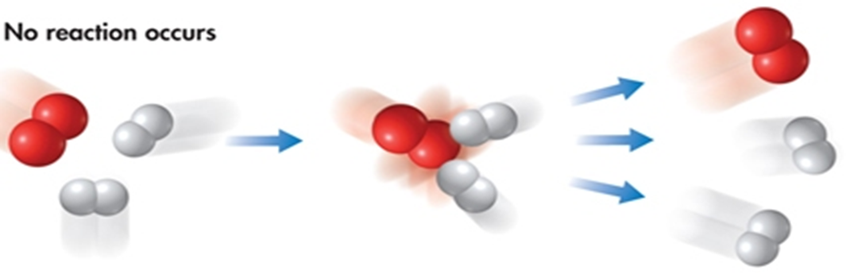
Effective Versus Ineffective Collisions
Effective collisions of reactants (oxygen and hydrogen molecules) produce product (water molecules):
Ineffective collisions of oxygen and hydrogen molecules produce no reaction; the reactants bounce apart unchanged.

Slide 21
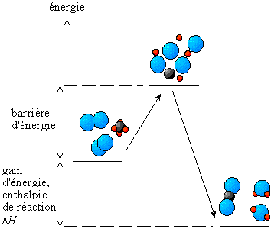
Collision Theory
Explains activation energy and how chemical reactions happen.
Every chemical reaction begins with a collision of reactants,
which produces an intermediate state that is meta-stable and has enough energy to overcome the activation energy
to form the products.
Intermediate
Reactants
Products

Slide 22
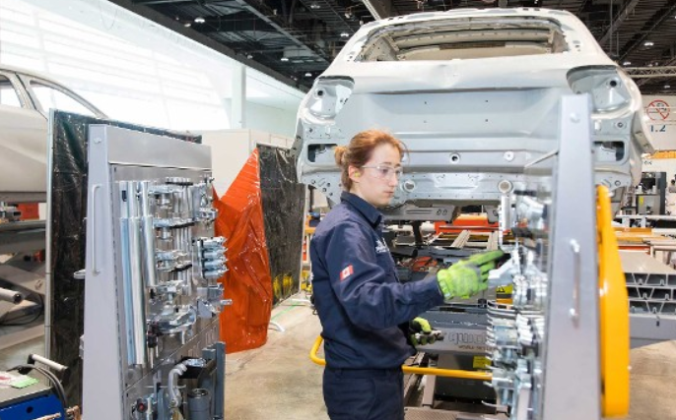
Collision Theory in Real Life
Chemists use collision theory to figure out how to slow down the corrosion of steel and how to create fuels that burn more efficiently (speed up reaction).
Intermediate
Reactants
Products

Slide 23
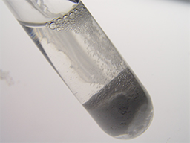
Factors Affecting Reaction Rate
  Reactions require collisions.
  There are many factors that affect the frequency and energy of collisions and thereby affect reaction rate
    ?
    ?
    ?
    ?
    ?
Notes:
http://commons.wikimedia.org/wiki/File:Strontium_Carbonate_and_Nitric_acid.jpg

Slide 24
Factors Affecting Reaction Rate
  Reactions require collisions.
  There are many factors that affect the frequency and energy of collisions and thereby affect reaction rate
    Surface area (particle size)
    Concentration of reactants
    Pressure
    Temperature
    Catalysts or Inhibitors
Notes:
http://commons.wikimedia.org/wiki/File:Strontium_Carbonate_and_Nitric_acid.jpg

Slide 25
Effects of Surface Area on Reaction Rate
  Reactions occur at surfaces.
  Increasing surface area increases the number of particle collisions.
V = 1 cm³ V = 1 cm³ V = 1 cm³
SA = 6 cm² SA = 12 cm² SA = 24 cm²
Which group of cubes will react the fastest?
Notes:
Timing ≈ 1.5
(animate 1st bullet) Reactions in solution or in the gas phase allow the reactant particles to collide one on one. However, in the solid phase, molecules are not free to roam about independently. They are stuck together in groups of billions of billions. Only molecules at the surface of the solid particles can collide with other reactants. The available surface area limits how fast these reactions can happen.
(animate 2nd bullet) Consequently, any increase in the surface area will increase the rate of reaction.
(animate 3rd bullet & image) The easiest and most common way to increase the surface area of a solid is to break it into smaller pieces. Although its total volume does not change, its surface area increases significantly (teacher show how increasing # particles increases SA using cubes)
This explains why smoking is strictly prohibited around grain silos, but you don't have to worry about using flour around your gas stove. Grains of wheat are small, only a few millimeters on a side and they will burn, but not very fast. Grinding wheat into a fine flour creates particles a thousand times smaller. In a grain silo, the air above the main body of grain quickly becomes filled with very tiny grain dust particles. In the air the particles can easily mix and collide with oxygen molecules and the reaction rate can be explosively fast. These tiny particles offer a huge reaction surface area, and even a tiny spark can produce a large explosion. In contrast, the particles in a bag of flour or grain are much larger and are packed together. Because oxygen can’t reach the interior molecules in a pile of grain the effective surface area is small and the reaction slow. They have much less surface area, so any reaction that begins quickly stops due to lack of access to reactants.
(animate blue box) Because increasing surface area of a solid reactant increases the number of particle collisions that can occur, increasing surface area increases reaction rate.

Slide 26
Effects of Surface Area on Reaction Rate
  The easiest and most common way to increase the surface area of a solid is to break it into smaller pieces.
  Although its total volume does not change, its surface area increases significantly.
V = 1 cm³ V = 1 cm³ V = 1 cm³
SA = 6 cm² SA = 12 cm² SA = 24 cm²
As the surface area of a solid reactant increases, reaction rate increases.
Notes:
Timing ≈ 1.5
(animate 1st bullet) Reactions in solution or in the gas phase allow the reactant particles to collide one on one. However, in the solid phase, molecules are not free to roam about independently. They are stuck together in groups of billions of billions. Only molecules at the surface of the solid particles can collide with other reactants. The available surface area limits how fast these reactions can happen.
(animate 2nd bullet) Consequently, any increase in the surface area will increase the rate of reaction.
(animate 3rd bullet & image) The easiest and most common way to increase the surface area of a solid is to break it into smaller pieces. Although its total volume does not change, its surface area increases significantly (teacher show how increasing # particles increases SA using cubes)
This explains why smoking is strictly prohibited around grain silos, but you don't have to worry about using flour around your gas stove. Grains of wheat are small, only a few millimeters on a side and they will burn, but not very fast. Grinding wheat into a fine flour creates particles a thousand times smaller. In a grain silo, the air above the main body of grain quickly becomes filled with very tiny grain dust particles. In the air the particles can easily mix and collide with oxygen molecules and the reaction rate can be explosively fast. These tiny particles offer a huge reaction surface area, and even a tiny spark can produce a large explosion. In contrast, the particles in a bag of flour or grain are much larger and are packed together. Because oxygen can’t reach the interior molecules in a pile of grain the effective surface area is small and the reaction slow. They have much less surface area, so any reaction that begins quickly stops due to lack of access to reactants.
(animate blue box) Because increasing surface area of a solid reactant increases the number of particle collisions that can occur, increasing surface area increases reaction rate.

Slide 27
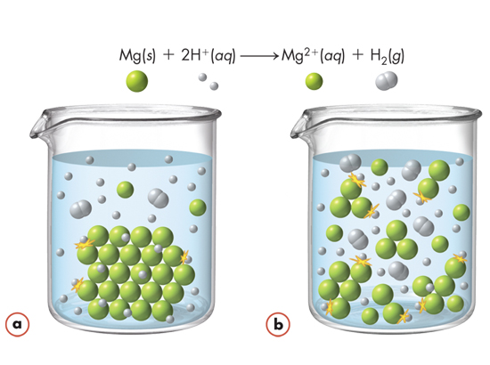
Surface Area Affecting Reaction Rates
When a piece of magnesium is placed in dilute acid, hydrogen ions can collide with magnesium atoms.
Mg(s) + 2H⁺(aq) → Mg²⁺(aq) + H₂(g)
Only atoms at the surface of the metal are available for reaction.
Dividing the metal into smaller pieces increases the surface area and the number of collisions.

Slide 28

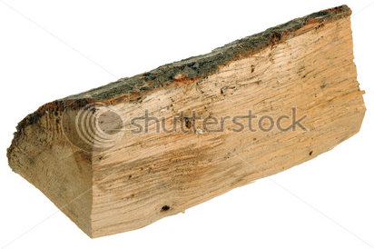
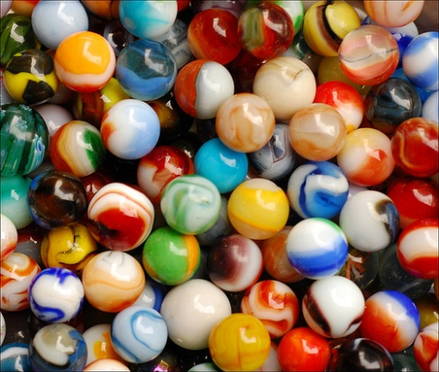
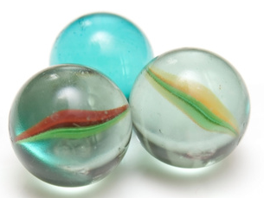
Surface Area and Reaction Rate
Kindling burns faster than a large log:
It is easier to find an individual marble (left) than in a box of marbles (right):

Slide 29
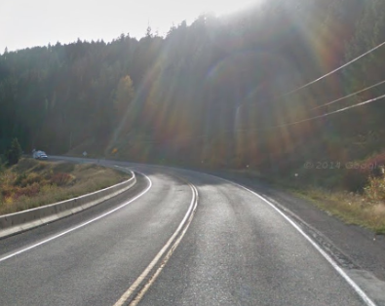
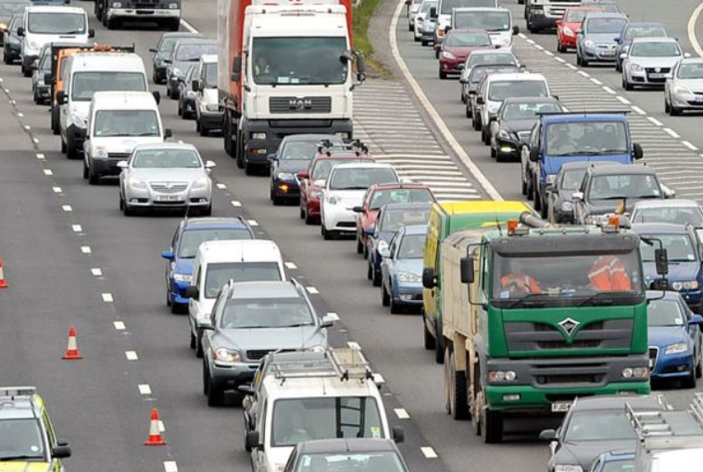
Effect of Concentration on Reaction Rate
  Which highway will tend to have the most accidents and why?
Notes:
Timing ≈ 1
Car collisions are more likely where cars are more concentrated. For example, collisions in parking lots are fairly common compared to collisions on residential streets even though the speeds are if anything lower in parking lots.
(animate 1st bullet) As we’ve seen, collision theory predicts that increasing the temperature of a chemical reaction will increase the speed of colliding particles and consequently the reaction rate. Collision theory also accounts for the effects of increasing the concentration of particles. Collisions are more likely when the particles are closer together.
In most laboratory situations, reactions happen in solutions. Increasing reactant concentration in solution is straightforward. Just add more reactant to the solution.
(animate 2nd bullet) Collision theory predicts that increasing the concentration of colliding particles increases the reaction rate. For example, hydrochloric acid reacts vigorously with magnesium. However, a 0.001 M solution of HCl will react much more slowly with magnesium than will a 1.0 M HCl solution.
This property is often used to help reduce the negative effects of toxic substances. For example, treatment for accidental ingestion of many poisons includes drinking large quantities of water or milk. This extra liquid helps to dilute the poison, reducing the rate at which it enters the bloodstream and hopefully reducing its negative effects. Similarly, concentrated sulfuric acid can cause severe burns. If concentrated acid is spilled on the skin or a reactive surface, flushing with large amounts of water is often the most effective treatment. Adding so much water dilutes the acid and reduces its corrosive ability.
(animate blue box) Increasing the concentration of reactants increases reaction rate by increasing the frequency of collisions.
SOURCES:
“cars o plenty” by Creativity103 at http://www.flickr.com/photos/creative_stock/3436598429/ (Attribution 2.0 Generic (CC BY 2.0))

Slide 30
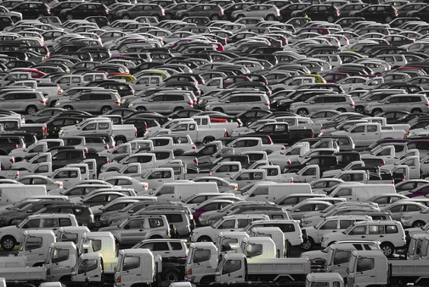
Effect of Concentration on Reaction Rate
  The higher the concentration of reactants, the more frequently reactant molecules collide and the faster the reaction proceeds to product(s). [Kinetic Theory]
The concentration (number of particles in a given volume) affects the rate at which reactions occur.
How are concentration and reaction rate related?
Notes:
Timing ≈ 1
Car collisions are more likely where cars are more concentrated. For example, collisions in parking lots are fairly common compared to collisions on residential streets even though the speeds are if anything lower in parking lots.
(animate 1st bullet) As we’ve seen, collision theory predicts that increasing the temperature of a chemical reaction will increase the speed of colliding particles and consequently the reaction rate. Collision theory also accounts for the effects of increasing the concentration of particles. Collisions are more likely when the particles are closer together.
In most laboratory situations, reactions happen in solutions. Increasing reactant concentration in solution is straightforward. Just add more reactant to the solution.
(animate 2nd bullet) Collision theory predicts that increasing the concentration of colliding particles increases the reaction rate. For example, hydrochloric acid reacts vigorously with magnesium. However, a 0.001 M solution of HCl will react much more slowly with magnesium than will a 1.0 M HCl solution.
This property is often used to help reduce the negative effects of toxic substances. For example, treatment for accidental ingestion of many poisons includes drinking large quantities of water or milk. This extra liquid helps to dilute the poison, reducing the rate at which it enters the bloodstream and hopefully reducing its negative effects. Similarly, concentrated sulfuric acid can cause severe burns. If concentrated acid is spilled on the skin or a reactive surface, flushing with large amounts of water is often the most effective treatment. Adding so much water dilutes the acid and reduces its corrosive ability.
(animate blue box) Increasing the concentration of reactants increases reaction rate by increasing the frequency of collisions.
SOURCES:
“cars o plenty” by Creativity103 at http://www.flickr.com/photos/creative_stock/3436598429/ (Attribution 2.0 Generic (CC BY 2.0))

Slide 31
Effect of Concentration on Reaction Rate
Cramming more particles into a fixed volume increases the concentration of reactants, and, thus, the frequency of collisions.
As concentration of reactants increases, reaction rate increases.
Notes:
Timing ≈ 1
Car collisions are more likely where cars are more concentrated. For example, collisions in parking lots are fairly common compared to collisions on residential streets even though the speeds are if anything lower in parking lots.
(animate 1st bullet) As we’ve seen, collision theory predicts that increasing the temperature of a chemical reaction will increase the speed of colliding particles and consequently the reaction rate. Collision theory also accounts for the effects of increasing the concentration of particles. Collisions are more likely when the particles are closer together.
In most laboratory situations, reactions happen in solutions. Increasing reactant concentration in solution is straightforward. Just add more reactant to the solution.
(animate 2nd bullet) Collision theory predicts that increasing the concentration of colliding particles increases the reaction rate. For example, hydrochloric acid reacts vigorously with magnesium. However, a 0.001 M solution of HCl will react much more slowly with magnesium than will a 1.0 M HCl solution.
This property is often used to help reduce the negative effects of toxic substances. For example, treatment for accidental ingestion of many poisons includes drinking large quantities of water or milk. This extra liquid helps to dilute the poison, reducing the rate at which it enters the bloodstream and hopefully reducing its negative effects. Similarly, concentrated sulfuric acid can cause severe burns. If concentrated acid is spilled on the skin or a reactive surface, flushing with large amounts of water is often the most effective treatment. Adding so much water dilutes the acid and reduces its corrosive ability.
(animate blue box) Increasing the concentration of reactants increases reaction rate by increasing the frequency of collisions.
SOURCES:
“cars o plenty” by Creativity103 at http://www.flickr.com/photos/creative_stock/3436598429/ (Attribution 2.0 Generic (CC BY 2.0))

Slide 32
Effect of Concentration on Reaction Rate
  Concentration can increase by:
    Decreasing volume
    Adding more reactants
Notes:
Remember that solids and liquids are generally insensitive to pressure changes. Therefore, pressure changes affect reaction rates only for reactions involving gases.
Remember that many reactions are reversible--the products can react to produce the reactants, under the right conditions. Suppose you have a reaction in which two moles of gas react to form three moles of gas. If you increase the pressure on this reaction system, the products will experience a greater increase in concentration than will the reactants. In this case, then, increasing pressure would actually decrease the reaction rate for the forward reaction.
(animate blue box) Therefore, when it comes to pressure dependence, you must compare the number of moles of gases in the reactants and the products. If there are more moles of gas in the reactants, then increasing pressure increases reaction rate because it increases reactant concentration.

Slide 33
Predict Reaction Rates
Hydrogen peroxide (H₂O₂) readily decomposes to form water and oxygen gas:
2H₂O₂(aq) → 2H₂O(l) + O₂(g)
Which concentration of hydrogen peroxide (1%, 5%, 30%) would produce the fastest reaction? Explain using kinetic theory.
A chemical engineer is developing a process for producing a new chemical. One step in the process involves reacting a solution of potassium hydroxide with a solid reactant. Which of the following actions would most likely increase the reaction rate for this step?
using larger pieces of the solid reactant
using a more concentrated potassium hydroxide solution
adding water to the system

Slide 34
Predict Reaction Rates
Hydrogen peroxide (H₂O₂) readily decomposes to form water and oxygen gas:
2H₂O₂(aq) → 2H₂O(l) + O₂(g)
Which concentration of hydrogen peroxide (1%, 5%, 30%) would produce the fastest reaction? Explain using kinetic theory.
Percentage by mass or volume of solute in the solution indicates concentration. Higher concentration means more frequent collisions & faster reaction.
A chemical engineer is developing a process for producing a new chemical. One step in the process involves reacting a solution of potassium hydroxide with a solid reactant. Which of the following actions would most likely increase the reaction rate for this step?
using a more concentrated potassium hydroxide solution

Slide 35
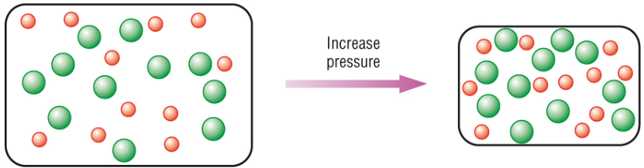
Effect of Pressure on Reaction Rate
  Reactions involving GASES:
    Increasing pressure increases concentration and therefore, the number of collisions, which increases reaction rate.
Notes:
Remember that solids and liquids are generally insensitive to pressure changes. Therefore, pressure changes affect reaction rates only for reactions involving gases.
Remember that many reactions are reversible--the products can react to produce the reactants, under the right conditions. Suppose you have a reaction in which two moles of gas react to form three moles of gas. If you increase the pressure on this reaction system, the products will experience a greater increase in concentration than will the reactants. In this case, then, increasing pressure would actually decrease the reaction rate for the forward reaction.
(animate blue box) Therefore, when it comes to pressure dependence, you must compare the number of moles of gases in the reactants and the products. If there are more moles of gas in the reactants, then increasing pressure increases reaction rate because it increases reactant concentration.

Slide 36
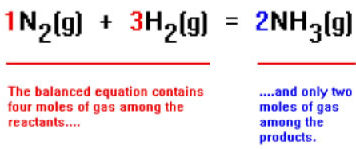
Effect of Pressure on Reaction Rate
  Reactions involving GASES:
    Solids & liquids are generally insensitive to pressure.
Increasing pressure increases reaction rate if the reactants contain more moles of gas than the products.
  Will the reaction rate favor products or reactants?
  Explain.
Notes:
Remember that solids and liquids are generally insensitive to pressure changes. Therefore, pressure changes affect reaction rates only for reactions involving gases.
Remember that many reactions are reversible--the products can react to produce the reactants, under the right conditions. Suppose you have a reaction in which two moles of gas react to form three moles of gas. If you increase the pressure on this reaction system, the products will experience a greater increase in concentration than will the reactants. In this case, then, increasing pressure would actually decrease the reaction rate for the forward reaction.
(animate blue box) Therefore, when it comes to pressure dependence, you must compare the number of moles of gases in the reactants and the products. If there are more moles of gas in the reactants, then increasing pressure increases reaction rate because it increases reactant concentration.

Slide 37
Effect of Pressure on Reaction Rate
  Reactions involving GASES:
    Solids & liquids are generally insensitive to pressure.
Increasing pressure increases reaction rate if the reactants contain more moles of gas than the products.
Notes:
Remember that solids and liquids are generally insensitive to pressure changes. Therefore, pressure changes affect reaction rates only for reactions involving gases.
Remember that many reactions are reversible--the products can react to produce the reactants, under the right conditions. Suppose you have a reaction in which two moles of gas react to form three moles of gas. If you increase the pressure on this reaction system, the products will experience a greater increase in concentration than will the reactants. In this case, then, increasing pressure would actually decrease the reaction rate for the forward reaction.
(animate blue box) Therefore, when it comes to pressure dependence, you must compare the number of moles of gases in the reactants and the products. If there are more moles of gas in the reactants, then increasing pressure increases reaction rate because it increases reactant concentration.

Slide 38

Effect of Pressure on Reaction Rate
Predict the effects of an increase in pressure for each of the following reactions.
N₂(g) + 3H₂(g) → 2NH₃(g)
increased rate, decreased rate, no change in rate
SnO₂(s) + 2H₂(g) → Sn(s) + 2H₂O(g)
increased rate, decreased rate, no change in rate
AgNO₃(aq) + Cu(s) → Cu(NO₃)(aq) + Ag(s)
increased rate, decreased rate, no change in rate
Na₂CO₃(s) + 2HCl(aq) → CO₂(g) + H₂O(l) + 2NaCl(aq)
increased rate, decreased rate, no change in rate

Slide 39
Effect of Pressure on Reaction Rate
Predict the effects of an increase in pressure for each of the following reactions.
N₂(g) + 3H₂(g) → 2NH₃(g)
increased rate … more moles of reactant gas (on the left)
SnO₂(s) + 2H₂(g) → Sn(s) + 2H₂O(g)
no change in rate … equal number of moles on each side of reaction
AgNO₃(aq) + Cu(s) → CuNO₃(aq) + Ag(s)
no change in rate … involving solids & liquids (not affected by pressure)
Na₂CO₃(s) + 2HCl(aq) → CO₂(g) + H₂O(l) + 2NaCl(aq)
decreased rate … more moles of product gas (on the right)

Slide 40
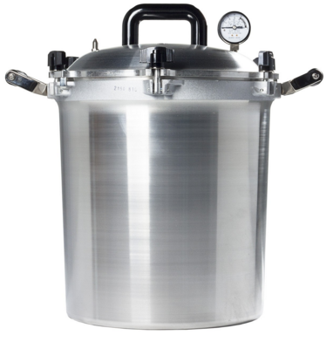
Effect of Temperature on Reaction Rate
  Increasing temperature means that the average Kinetic Energy (KE) of the particles increases.
  Increasing the average KE (motion/energy) of the particles increases the number and effectiveness of collisions.
How are temperature and reaction rate related?
Notes:
Timing ≈ 1
The higher the heat, the faster food cooks. The colder the food, the slower it spoils. Temperature clearly affects reaction rates. Collision theory provides a simple explanation for this effect.
(animate 1st bullet) According to kinetic-molecular theory, temperature represents the average kinetic energy of a substance--the particles have a distribution of speeds, as we have seen (teacher review M-B distributions on graph)
(animate 2nd bullet) Only those particles with sufficient energy to overcome the activation energy barrier react. (animate minimum energy label on graph; teacher explain that only particles to the right of the line can react)
(animate 3rd bullet) Heating up the system gives more particles enough kinetic energy and the reaction rate increases. We can understand this effect in terms of the Maxwell-Boltzmann distribution diagrams. Temperature represents a wide distribution of velocities among the particles in a system. Changing the temperature shifts the entire distribution towards higher velocities. Compare the number of particles to the right of the vertical line for the 773K distribution curve to that of the 1023K curve. The result is that the shift of the distribution curve caused by a modest increase in temperature (about 30%) increases the number of particles with sufficient kinetic energy to react by about 400%. Of course, the exact effect of temperature depends on the details of the activation energy for a given reaction, that is, where the vertical line appears on the speed axis.
(animate blue box) Therefore, in general, as temperature increases, reaction rate increases, because the number of molecules with sufficient energy to react increases.
SOURCE:
http://commons.wikimedia.org/wiki/File:Maxwell-Boltzmann_distribution.png

Slide 41
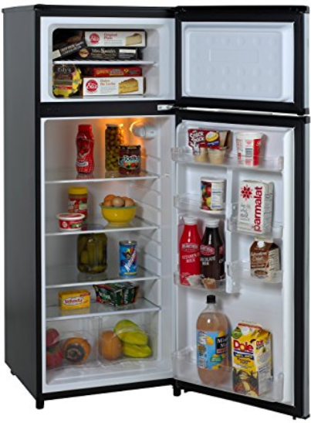
Effect of Temperature on Reaction Rate
General / Approximate Rule:
Reaction rate will double for every +10º C
Applying a cover to a cooking pan increases the potential temperature and cooks the food faster.
A pressure cooker at 110º C will cook food twice as fast as a pot at 100º C.
As temperature increases, reaction rate increases.
Reaction rate will halve for every -10º C (refrigerator).
Notes:
Timing ≈ 1
The higher the heat, the faster food cooks. The colder the food, the slower it spoils. Temperature clearly affects reaction rates. Collision theory provides a simple explanation for this effect.
(animate 1st bullet) According to kinetic-molecular theory, temperature represents the average kinetic energy of a substance--the particles have a distribution of speeds, as we have seen (teacher review M-B distributions on graph)
(animate 2nd bullet) Only those particles with sufficient energy to overcome the activation energy barrier react. (animate minimum energy label on graph; teacher explain that only particles to the right of the line can react)
(animate 3rd bullet) Heating up the system gives more particles enough kinetic energy and the reaction rate increases. We can understand this effect in terms of the Maxwell-Boltzmann distribution diagrams. Temperature represents a wide distribution of velocities among the particles in a system. Changing the temperature shifts the entire distribution towards higher velocities. Compare the number of particles to the right of the vertical line for the 773K distribution curve to that of the 1023K curve. The result is that the shift of the distribution curve caused by a modest increase in temperature (about 30%) increases the number of particles with sufficient kinetic energy to react by about 400%. Of course, the exact effect of temperature depends on the details of the activation energy for a given reaction, that is, where the vertical line appears on the speed axis.
(animate blue box) Therefore, in general, as temperature increases, reaction rate increases, because the number of molecules with sufficient energy to react increases.
SOURCE:
http://commons.wikimedia.org/wiki/File:Maxwell-Boltzmann_distribution.png

Slide 42
Effect of Temperature on Reaction Rates
Refrigeration decreases the temperature and slows the rate of food spoilage.
Food deteriorates four times as fast at room temperature (25º C) than in a refrigerator (5º C). Explain using kinetic theory.
On a camping trip at 2300 m elevation, you find that your water boils at 92°C instead of 100°C. You know this is due to the lower atmospheric pressure at higher altitudes. The question is, how will this affect your cooking times? Do you expect the time to boil your spaghetti noodles to be longer or shorter than at sea level?

Slide 43
Effect of Temperature on Reaction Rates
Refrigeration decreases the temperature and slows the rate of food spoilage.
Food deteriorates four times as fast at room temperature (25º C) than in a refrigerator (5º C). Explain using kinetic theory.
Kinetic theory deals with the molecules
Lower temperature reduces molecular speeds and energy of motion, decreasing the number of effective collisions.
On a camping trip at 2300 m elevation, you find that your water boils at 92°C instead of 100°C. You know this is due to the lower atmospheric pressure at higher altitudes. The question is, how will this affect your cooking times? Do you expect the time to boil your spaghetti noodles to be longer or shorter than at sea level?
Boiling at a lower temperature means less heat energy is cooking the food. Therefore, less effective collisions & longer cooking time.

Slide 44
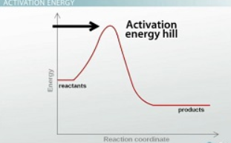
Effect of Temperature on Reaction Rates
Increasing temperature in essence lowers the activation energy of reaction.
Activation Energy, E_{A}, is the energy required to bring reactants to the point where they can rearrange to form products.

Slide 45
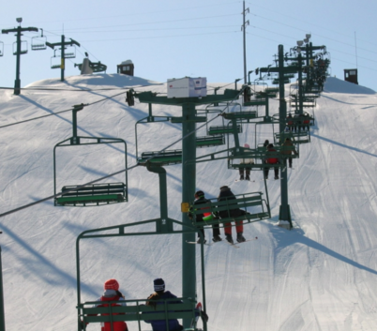
Effect of Temperature on Reaction Rates
In order for a reaction to occur between stable molecules (reactants), a certain amount of energy (Ea → activation energy) must be applied to weaken the chemical bonds holding the reactant molecules together.
Like taking a ski lift to the top of the hill!

Slide 46
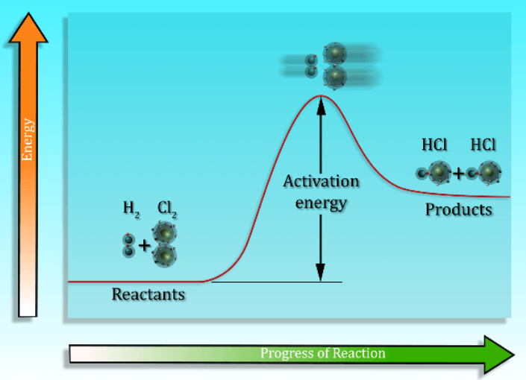
Potential Energy Diagrams
The minimum energy that colliding particles must have in order to react is called the activation energy, E_{A}.
Activation energy is needed for any reaction or change but is not part of the heat or energy of reaction (∆H).

Slide 47
Potential Energy Diagrams
Bedouin Culture Story – a sheik had 17 purebred horses.
He wanted to give his eldest son ½ of his horses, the 2nd son 1/3 of the horses, and his youngest son 1/9 of the horses.
Can the sheik do give the inheritance?
Eldest son 1/2 ? horses
2nd son 1/3 ? horses
Youngest son 1/9 ? horses
? horses
His brother offered the same breed of horse as activation energy.

Slide 48
Potential Energy Diagrams
Bedouin Culture Story – a sheik had 17 purebred horses.
He wanted to give his eldest son ½ of his horses, the 2nd son 1/3 of the horses, and his youngest son 1/9 of the horses. Can the sheik give the inheritance?
His brother offered the same breed of horse as activation energy.
Eldest son 1/2 9 horses
2nd son 1/3 6 horses
Youngest son 1/9 2 horses
17 horses
So, the brother gets his horse back and the sons get their inheritance!
Without E_{A}, this “reaction” could not take place.

Slide 49
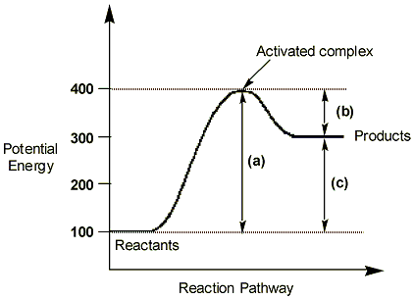
Potential Energy Diagrams
What are the major aspects involved in a chemical reaction?

Slide 50
Potential Energy Diagrams
(a) Activation Energy (E_{A}) of the forward reaction (begins at PE of reactants up to the peak of the curve)
(b) Activation Energy (E_{A}) of the reverse reaction (treat “products” as “reactants”)
(c) +∆H (heat of reaction)
Overall, the forward reaction describes an endothermic energy change (i.e. uphill).
∆H_{forward} = ∆H_{products} > ∆H_{reactants}
∆H_{forward} = +

Slide 51
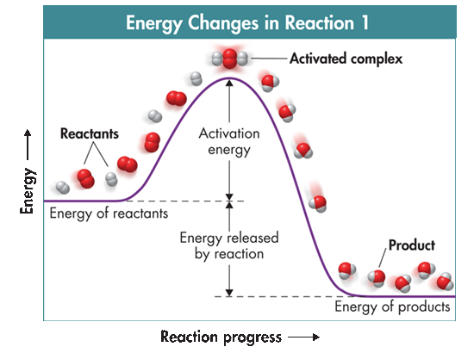
Potential Energy Diagrams
When two reactant particles collide, they often form an activated complex, which is an unstable, intermediate, arrangement of atoms that forms for a moment at the peak of the activation energy barrier.
-∆H

Slide 52
Potential Energy Diagrams
The activation-energy barrier must be crossed before reactants are converted to products.
E_{A} is always positive since energy must be added in to form the activated complex.
-∆H

Slide 53
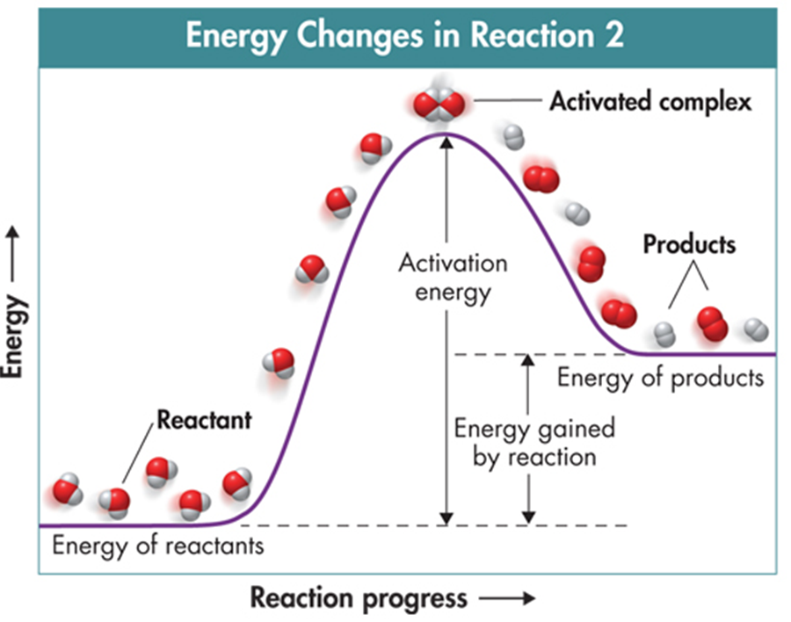
Potential Energy Diagrams for a reversible reaction
55 kJ
25 kJ
Reaction 1 shows (type of rxn)?
E_{A} =
∆H =
Equation?
Reaction 2 shows (type of rxn)?
E_{A} =
∆H =
Equation?

Slide 54
Potential Energy Diagrams for a reversible reaction
E_{A} = 30 kJ
E_{A} = 55 kJ
∆H = -25 kJ
∆H = +25 kJ
Reaction 1 shows an exothermic reaction (“downhill”).
E_{A} = +30 kJ
∆H = -25 kJ
reactants → products + 25 kJ
Reaction 2 shows an endothermic reaction (“uphill”).
E_{A} = +55 kJ
∆H = +25 kJ
reactants + 25 kJ → products

Slide 55
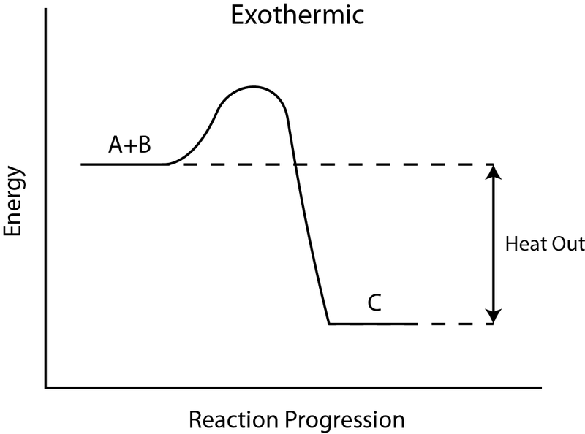
Calculate ΔH_{rxn} & E_{A} of reversible reaction
  Reaction Type?
  E_{A} =
  ΔH_{rxn} =
CH₄(g) + O₂(g) ↔ CO₂(g) + 2H₂O(g)
+324.4 kJ
CH₄(g) + O₂(g)
–74.8 kJ
Energy
CO₂(g) + 2H₂O(g)
–877.14 kJ

Slide 56
Calculate ΔH_{rxn} & E_{A} of reversible reaction
  Exothermic (“Downhill”)
  E_{A} = [+324.4] – [-74.8]
  E_{A} = 399.2 kJ
  ΔH_{rxn} = ΔH_{f,products} – ΔH_{f,reactants}
  ΔH_{rxn} = [-877.14 kJ] – [-74.8 kJ]
  ΔH_{rxn} = -802.3 kJ
CH₄(g) + O₂(g) ↔ CO₂(g) + 2H₂O(g)
+324.4 kJ
Activated complex
E_{A}
CH₄(g) + O₂(g)
–74.8 kJ
reactants
ΔH_{rxn}
Energy
CO₂(g) + 2H₂O(g)
–877.14 kJ
products

Slide 57
Calculate ΔH_{rxn} & E_{A} of reversible reaction
  Reaction Type?
  E_{A rev} =
  ΔH_{rev rxn} =
CH₄(g) + O₂(g) ↔ CO₂(g) + 2H₂O(g)
+324.4 kJ
CH₄(g) + O₂(g)
–74.8 kJ
Energy
CO₂(g) + 2H₂O(g)
–877.14 kJ

Slide 58
Calculate ΔH_{rxn} & E_{A} of reversible reaction
  Endothermic (“Uphill”)
  E_{A rev} = [+324.4] – [-877.14 kJ]
  E_{A rev} = +1201.5 kJ
  ΔH_{rxn} = ΔH_{f,products} – ΔH_{f,reactants}
  ΔH_{rxn} = [-74.8 kJ] – [- 877.14 kJ]
  ΔH_{rxn} = +802.3 kJ
CH₄(g) + O₂(g) ↔ CO₂(g) + 2H₂O(g)
+324.4 kJ
Activated complex
CH₄(g) + O₂(g)
–74.8 kJ
Products
ΔH_{rxn}
E_{A rev}
Energy
CO₂(g) + 2H₂O(g)
–877.14 kJ
Reactants

Slide 59
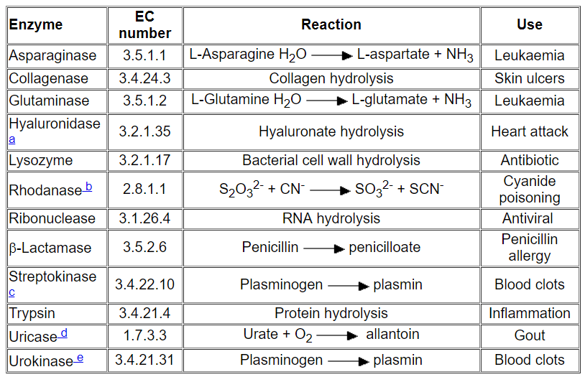
Factors Affecting Reaction Rates
Catalysts
Increasing the temperature is not always the best way to increase the rate of a reaction. Using a catalyst is often better.
Therapeutic Enzymes

Slide 60
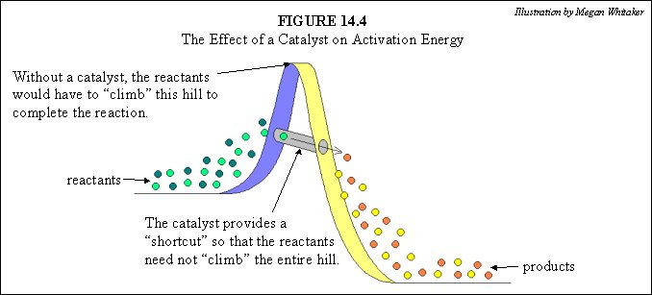
Factors Affecting Reaction Rates
Catalysts
A catalyst is a substance that increases the rate of a reaction without being used up during the reaction. (e.g. the “horse” in the Bedouin story)
Catalysts permit reactions to proceed along a lower energy path.

Slide 61
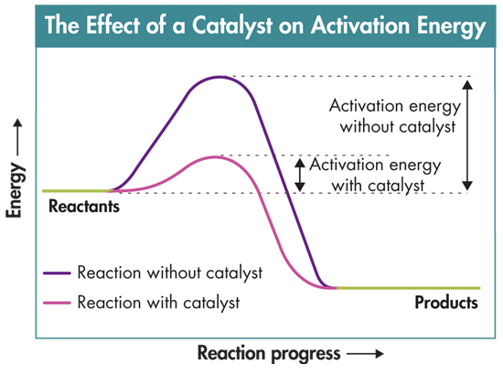
Factors Affecting Reaction Rates
Catalysts
The rate of reaction of hydrogen and oxygen at room temperature is negligible. But with a small amount of platinum (Pt) as a catalyst, the reaction is rapid.
Pt
2H₂(g) + O₂(g) 2H₂O(l)
Pt is not consumed & therefore, is not a reactant in the chemical equation.
The catalyst is often written above the yield arrow.

Slide 62
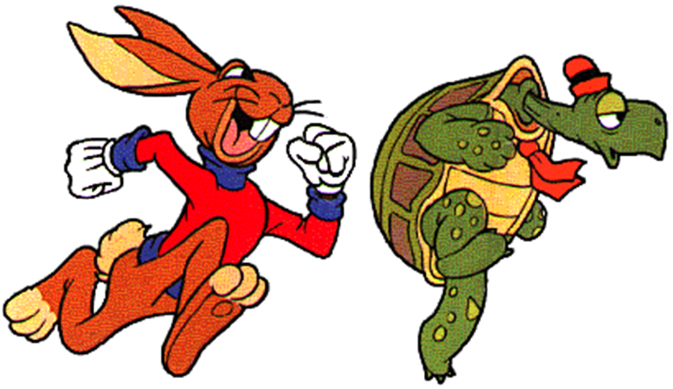
Factors Affecting Reaction Rates
Inhibitors
are substances that interfere with the action of a catalyst. Some inhibitors work by reaction with, or “poisoning,” the catalyst itself.
Thus, the inhibitor reduces the amount of catalyst available for a reaction and are often called “negative catalysts”.
Reactions slow or even stop when a catalyst is inhibited.

Slide 63
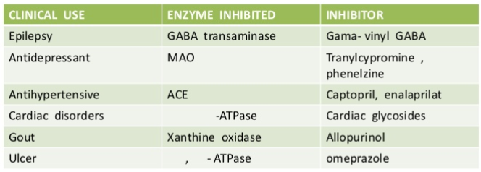
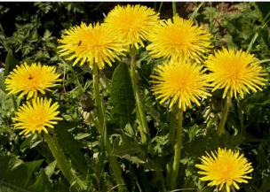
Factors Affecting Reaction Rates
Inhibitors
Examples of Enzyme inhibitors used in various human disease states:
Biocides are chemicals that can kill a living organism, and are commonly used in agriculture, the food industry and medicine.
Many are enzyme inhibitors. Triclosan is an antibacterial/antifungal disinfectant that inhibits an enzyme involved in fatty acid synthesis. It is used in toothpaste, soaps and other cleaning products.

Slide 64

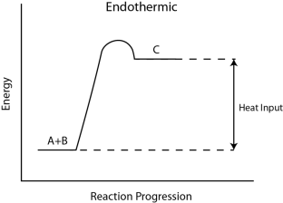
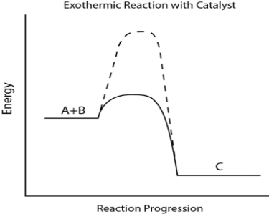
Labeling Energy Diagrams
B
C
B
D
C
A
A
D
Activation energy of forward reaction ___
Activation energy with catalyst ___
Energy of products ___
Energy of reactants ___
Heat of reaction ______
Reaction type ______
E_{A} of forward reaction ___
E_{A} with catalyst ___
Energy of products ___
Energy of reactants ___
Heat of reaction ______
Reaction type ______

Slide 65
Labeling Energy Diagrams
B
C
B
D
C
A
∆H = +
A
∆H = -
D
activation energy of forward reaction B
activation energy with catalyst C
energy of products D
energy of reactants A
Heat of reaction D – A
Reaction type EXOthermic
E_{A} of forward reaction A→B
E_{A} with catalyst A→C
Energy of products D
Energy of reactants A
Heat of reaction D – A
Reaction type ENDOthermic

Slide 66
Reaction Mechanisms
Rates of reaction depend on reaction mechanism. An elementary reaction is a reaction in which reactants are converted to products in a single step.
This type of reaction has only one activation-energy peak and one activated complex.

Slide 67
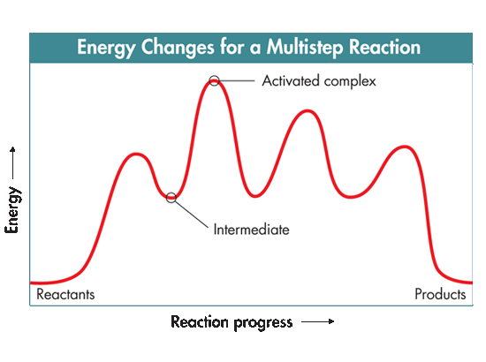
Reaction Mechanisms
Most chemical reactions involve multiple steps (a path or sequence of steps) in which reacting molecules collide, rearrange, etc. and eventually form products.
2
3
1
4

Slide 68
Reaction Mechanisms
The series of elementary reactions or steps that take place during the course of a complex reaction is called a reaction mechanism.
The reaction rate depends on the frequency of contact of the reactants in the rate-determining step, the slowest step.

Slide 69
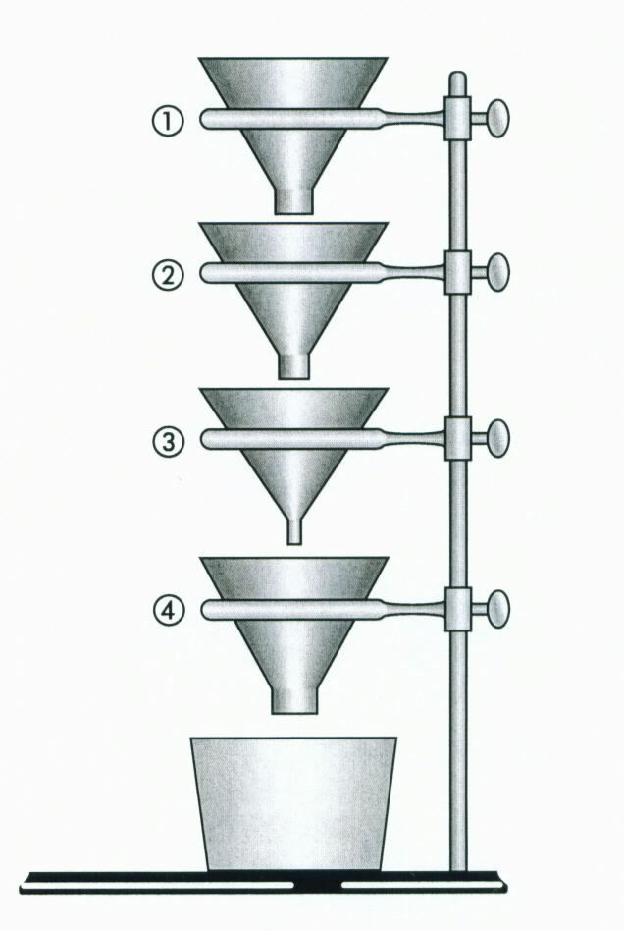
Reaction Mechanisms
Rate-Determining Step
Usually there is one particular step in a reaction that is slower than all the other steps.
Therefore, the “rate determining step” (the slowest step) is most responsible for the rate of the overall reaction.
Which funnel represents the rate-determining step?

Slide 70
Reaction Mechanisms
Rate-Determining Step
Usually there is one particular step in a reaction that is slower than all the other steps.
Therefore, the “rate determining step” (the slowest step) is most responsible for the rate of the overall reaction.
EXAMPLE: Relay Race
Usually, the fastest runners are the 1st and last leg of a relay race.
The rate determining runners are either 2nd or 3rd runners in the relay.

Slide 71
Rate-Determining Steps
Reaction Mechanisms
Many times, one cannot determine the reaction mechanism using the overall chemical reaction:
NO₂(g) + CO(g) → NO(g) + CO₂(g)
Experiments have shown that the mechanism consists of the two steps shown below.
2NO₂ + NO → 2NO + NO₃ (slow)
NO₃ + CO → NO₂ + CO₂ (fast)
Add these two reactions together (Hess’ Law):

Slide 72
Rate-Determining Steps
Reaction Mechanisms
Many times, one cannot determine the reaction mechanism using the overall chemical reaction:
NO₂(g) + CO(g) → NO(g) + CO₂(g)
Experiments have shown that the mechanism consists of the two steps shown below.
2NO₂ + NO → 2NO + NO₃ (slow)
NO₃ + CO → NO₂ + CO₂ (fast)
In adding these reactions, the intermediates that show up on both the reactant and product side are eliminated, and the remaining species are added, resulting in the overall reaction:
NO₂(g) + CO(g) → NO(g) + CO₂(g)

Slide 73
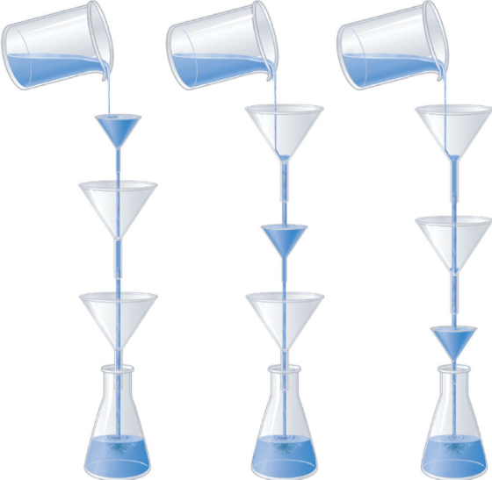
Rate-Determining Steps
Reaction Mechanisms
The rate determining step is important in deriving an accurate rate equation:
Rate = k[A]^{x}[B]^{y} → rate of reactants reacting
Enrichment

Slide 74
Rate-Determining Steps
Reaction Mechanisms
A reaction between NO and H₂ occurs in the following three-step process:
NO + NO → N₂O₂ (fast) Rate = k[NO]²
N₂O₂ + H₂ → N₂O + H₂O (slow) Rate = k[N₂O₂][H₂ ]
N₂O + H₂ → N₂ + H₂O (fast) Rate = k[N₂O][H₂ ]
What is the rate determining step?
Write the balanced equation for the overall reaction (Hess’ Law).
Are there any intermediates? If so, state what they are.

Slide 75
Rate-Determining Steps
Reaction Mechanisms
A reaction between NO and H₂ occurs in the following three-step process:
NO + NO → N₂O₂ (fast) Rate = k[NO]²
N₂O₂ + H₂ → N₂O + H₂O (slow) Rate = k[N₂O₂][H₂ ]
N₂O + H₂ → N₂ + H₂O (fast) Rate = k[N₂O][H₂ ]
What is the rate determining step? 2nd step (slow)
Write the balanced equation for the overall reaction.
2NO + 2H₂ → N₂ + 2H₂O
Are there any intermediates? If so, state what they are.
The intermediates in this reaction are N₂O₂ and N₂O. Both show up on the reactant and product side. Therefore, in adding all three elementary reactions together, N₂O₂ and N₂O can be canceled out, and they will not show up in the overall reaction equation.

Slide 76
Reversible Reactions
  Up until now, you may have assumed that any chemical equation we write represents a reaction that proceeds from reactants to products only.
  This is true of: 2H_{2 (g)} + O_{2 (g)} → 2H₂O _{(g).}
  In principle, however, almost all reactions are reversible to some extent under the right conditions.
  Forward Reaction: CO_{2(aq)} + H₂O_{(l)} → H₂CO_{3(aq)}
  Reverse Reaction: H₂CO_{3(aq)} → CO_{2(aq)} + H₂O_{(l)}

Slide 77
Reversible Reactions
  Forward Reaction: CO_{2(aq)} + H₂O_{(l)} → H₂CO_{3(aq)}
  Reverse Reaction: H₂CO_{3(aq)} → CO_{2(aq)} + H₂O_{(l)}
  Reactions that can proceed in both directions (forward and reverse) use a double arrow system:
  CO_{2(aq)} + H₂O_{(l)} ← H₂CO_{3(aq)}
  The length of each arrow is significant, indicating whether the forward or reverse reaction is favored.

Slide 78
Equilibrium
Review and tutorial:
https://screencast-o-matic.com/watch/cqeOqX0Lxd

Slide 79
Equilibrium
Chemical reactions do not proceed forever. We can classify reactions as follows:
Irreversible reactions that go to completion:
Explosions are nonreversible reactions and to go to completion.
CH₄ + O₂ CO₂ + 2 H₂O
When no reactants can be detected, you can say that the reaction has gone to completion or is irreversible.
No Reaction
No products can be detected.
Equilibrium
Both reactants and products coexist.

Slide 80
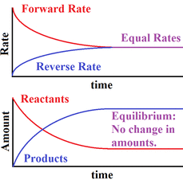
Equilibrium
Chemical equilibrium is the state in which both reactants and products are present in concentrations which have no further tendency to change with time.
Usually, this state results when the forward reaction proceeds at the same rate as the reverse reaction and concentrations of the reaction components no longer change.

Slide 81
Dynamic Equilibrium
  Dynamic Equilibrium:
  a condition in a chemical system in which the rates of forward and reverse reactions are equal.
Although the rates of the forward and reverse reactions are equal at equilibrium, the concentrations of the components usually are not.
A + B ↔ C + D

Slide 82
Equilibrium Constant
Chemists use an Equilibrium constant (K_{eq}) to show the ratio of product concentrations to reactant concentrations at equilibrium.
The equilibrium constant is determined using molar concentrations and the stoichiometry of the reaction (coefficients are used as superscripts).
aA + bB ↔ cC + dD
  K_{eq} = [products]
  [reactants] [ ] → concentration

Slide 83

Equilibrium Constant
2 A + 3 B 4 C + 7 D
  K_{eq} =
  Example:
  2 HI _{(g)} H_{2 (g)} + I_{2 (g)}
  [H₂] = 0.14 M [ I₂] = 0.14 M [HI] = 0.72 M
K_{eq} =
K_{eq} =
K_{eq} =

Slide 84
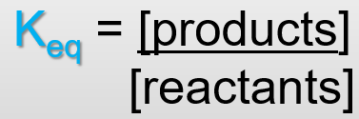
Equilibrium Constant
2 A + 3 B 4 C + 7 D
  K_{eq} = [C]⁴[D]⁷
  [A]²[B]³
  Example:
  2 HI _{(g)} H_{2 (g)} + I_{2 (g)}
  [H₂] = 0.14 M [ I₂] = 0.14 M [HI] = 0.72 M
K_{eq} = [H₂][ I₂] / [HI]²
K_{eq} = [0.14][0.14] / [0.72 M]²
K_{eq} = 3.8 x 10⁻²
What do you think this K_{eq} indicates?

Slide 85
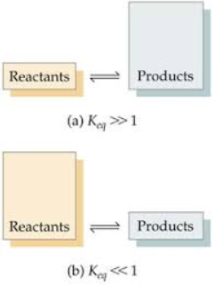

Equilibrium Constants
The direction and extent of a reaction can be predicted using the equilibrium constant, K_{eq}.
The size of the equilibrium constant, K_{eq}, indicates whether reactants or products are more common at equilibrium.
    When K < 1, the equilibrium lies to the left (reactants are favored), meaning there are more reactants than products.
    K_{eq} = 3.8 x 10⁻⁵
Notes:
Timing ≈ 0.5 min
The equilibrium constant allows equilibrium systems to be described quantitatively. [review bullet points]

Slide 86
Equilibrium Constants
    When K > 1, the equilibrium lies to the right (products are favored), meaning there are more products than reactants.
      K_{eq} = 3.1 x 10⁷
Notes:
Timing ≈ 0.5 min
The equilibrium constant allows equilibrium systems to be described quantitatively. [review bullet points]

Slide 87
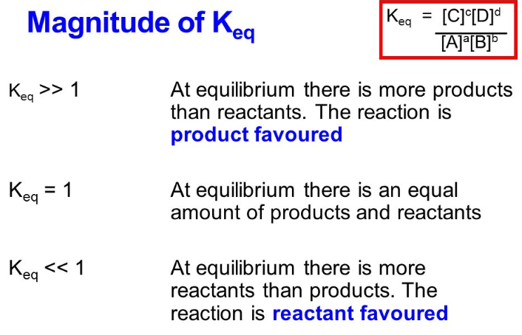
Equilibrium Constants
Notes:
Timing ≈ 0.5 min
The equilibrium constant allows equilibrium systems to be described quantitatively. [review bullet points]

Slide 88
Equilibrium Constants
Notes:
Timing ≈ 0.5 min
The equilibrium constant allows equilibrium systems to be described quantitatively. [review bullet points]

Slide 89
Writing an Equilibrium Constant Expression
  The reaction between hydrogen and nitrogen to form ammonia is a reversible reaction:
  3H_{2(g)} + N_{2(g)} 2NH_{3(g)}
  What is the equilibrium constant expression for this system?
What is the correct equilibrium constant expression for the equation shown below?
2Cl_{2(g)} + 2H₂O_{(g)} 4HCl + O_{2(g)}
Notes:
Timing ≈ 1.5 min
Let's look at an example of writing an equilibrium constant expression.
[animate 1st bullet] The first thing you need to do is identify the reactants, products, and coefficients. [teacher review reactants--H2 and N2--and product--NH3. identify coefficients and what they apply to, pointing out that N2 has a coefficient of 1]
[animate 2nd bullet] Now, you can write the expression for K. [teacher walk through writing expression K = [NH3]^2/[H2]^3[N2], pointing out relationship between coefficients and exponents and where reactants and products go]

Slide 90

Writing an Equilibrium Constant Expression
  The reaction between hydrogen and nitrogen to form ammonia is a reversible reaction:
  3H_{2(g)} + N_{2(g)} 2NH_{3(g)}
  What is the equilibrium constant expression for this system?
  K_{eq} = [NH₃]²
  [H₂]³[N₂]
What is the correct equilibrium constant expression for the equation shown below?
2Cl_{2(g)} + 2H₂O_{(g)} 4HCl + O_{2(g)}
$$K=\frac{[\text{HCl}]^{4}[O_{2}]}{[\text{C}{\text{l}}_{2}]^{2}[H_{2}O]^{2}}$$
Notes:
Timing ≈ 1.5 min
Let's look at an example of writing an equilibrium constant expression.
[animate 1st bullet] The first thing you need to do is identify the reactants, products, and coefficients. [teacher review reactants--H2 and N2--and product--NH3. identify coefficients and what they apply to, pointing out that N2 has a coefficient of 1]
[animate 2nd bullet] Now, you can write the expression for K. [teacher walk through writing expression K = [NH3]^2/[H2]^3[N2], pointing out relationship between coefficients and exponents and where reactants and products go]

Slide 91

Effects on Reaction Rate
Magnesium reacts with hydrochloric acid to form hydrogen gas and magnesium chloride according to the following equation:
Mg(s) + 2HCl(aq) → MgCl₂(aq) + H₂(g)
Which of the following actions would increase the rate of reaction? Check all that apply:
[ ] use hot hydrochloric acid solution
[ ] add water to the solution
[ ] use magnesium powder instead of a large piece of magnesium
[ ] increase the pressure on the system

Slide 92
Effects on Reaction Rate
Magnesium reacts with hydrochloric acid to form hydrogen gas and magnesium chloride according to the following equation:
Mg(s) + 2HCl(aq) → MgCl₂(aq) + H₂(g)
Which of the following actions would increase the rate of reaction? Check all that apply:
[X] use hot hydrochloric acid solution …
[ ] add water to the solution …
[X] use magnesium powder instead of a large piece of magnesium …
[ ] increase the pressure on the system
Increasing temperature > reaction rate
Water is the solvent; therefore, less reactants (lower concentration)
Increasing surface area > rxn rate
More gas in the products favors the reverse rxn if Pressure is increased.

Slide 93
Explain Why Reaction Rates Change
Match the collision theory explanation to the strategy proposed to change the rate of a chemical reaction.
Collision Theory Explanations
  Pressure
  Concentration
  Temperature
  Surface Area
Strategies for changing reaction rates
____ Refrigerate food to keep it from spoiling
____ Adding extra ingredients to a reaction solution
____ Compressing the air/fuel mixture inside an engine cylinder with a piston
____ Using a pressure cooker to raise the boiling point of water
____ Grinding a metal into a fine powder.

Slide 94
Explain Why Reaction Rates Change
Match the collision theory explanation to the strategy proposed to change the rate of a chemical reaction.
Collision Theory Explanations
  Pressure
  Concentration
  Temperature
  Surface Area
Strategies for changing reaction rates
C Refrigerate food to keep it from spoiling
B Adding extra ingredients to a reaction solution
A Compressing the air/fuel mixture inside an engine cylinder with a piston
A & C Using a pressure cooker to raise the boiling point of water
D Grinding a metal into a fine powder.

Slide 95
Label each letter on the PE diagram
A
B
C
E
D

Slide 96
PE diagram with Catalyst
PE
-∆H
PE

Slide 97
Equilibrium
Describe the following reactions [which reaction is favored? Are reactants or products are in greater concentration? Which arrow is longer?] … if the equilibrium constant is:
K_{eq} = 2.4 × 10³
K_{eq} = 5.85 × 10⁻³
    K = 1

Slide 98
Equilibrium
Describe the following reactions [which reaction is favored? Are reactants or products are in greater concentration? Which arrow is longer?] … if the equilibrium constant is
K_{eq} = 2.4 × 10³
Favors the forward reaction (more products than reactants) … longer arrow to the right
K_{eq} = 5.85 × 10⁻³
Favors the reverse reaction (more reactants than products) … longer arrow to the left
    K = 1
    Neither reactants nor products favored … arrow are equal length.

