Slide 1
Go to the “Slide Show” shade above
Click on “Play from Beginning”

Slide 2
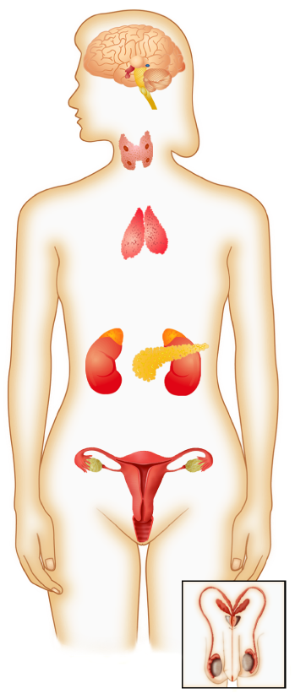
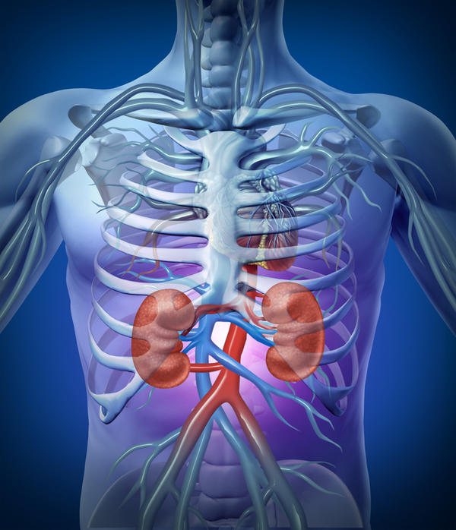
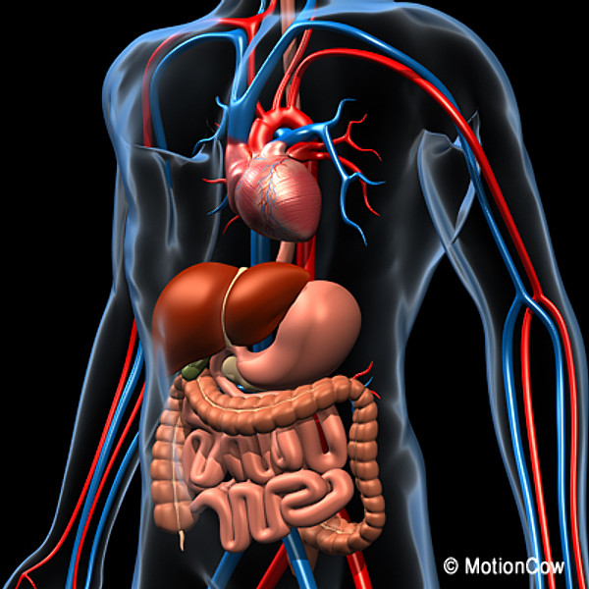
Human Anatomy & Physiology
Endocrine, Immune, Digestive, Excretory
Systems Chapter 31, 33

Slide 3
Lesson Objectives
  By the end of this lesson, you should be able to:
Recognize, identify, & define the anatomy and function of the human Endocrine system.
  Types of glands (exocrine versus endocrine).
  Positive / Negative feedback mechanism.
Recognize, identify, & define the anatomy and function of the human Immune system.
  Types of White Blood Cells; two general categories (innate vs. adaptive); Lines of defense.
  Acquired immunity (active vs. passive); Primary vs. Secondary response; Immune diseases.
Recognize, identify, & define the anatomy and function of the human Digestive system.
  Nutrients; Four stages of food processing; Two methods of digestion.
  Alimentary Canal (stomach to anus) with digestive accessory glands.
Recognize, identify, & define the anatomy and function of the human Excretory system.
  Homeostasis; excretory organs.
  Urinary system; Urine formation; Control of kidney function.
  Science Practice: Identify/Label the Systems (Endocrine, immune,
  digestive, excretory) Lab
Notes:
#frame
instructional video
Timing ≈ 0.5 minutes
Living organisms need energy to accomplish the wide variety of tasks they attempt each day.
You will begin learning about how energy is captured from the Sun and stored in organic molecules.
[read objectives]

Slide 4
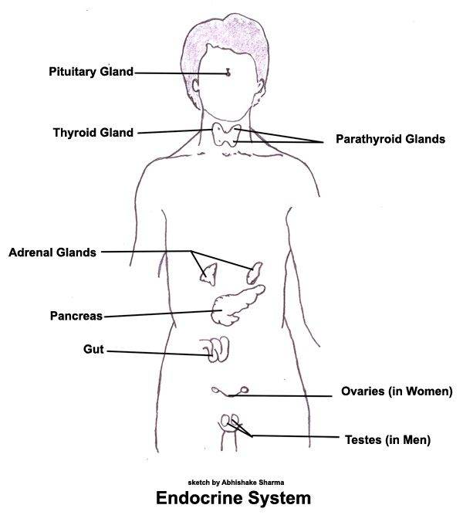
Endocrine System
  The endocrine system is made up of glands that release their products into the bloodstream.
  These products deliver messages throughout the body.
  The chemicals released by the endocrine system can affect almost every cell in the body.

Slide 5
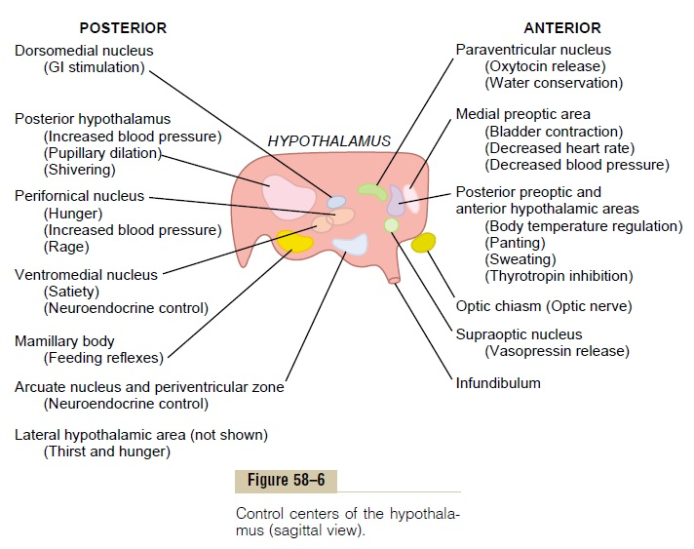
Enrichment

Slide 6
Enrichment

Slide 7
Positive Feedback
Enrichment
After labor begins the baby's head puts pressure on the cervix, causing the cervix to stretch.
This stimulates stretch receptors the trigger the mother's hypothalamus to release oxytocin, which increases the uterine contractions and pushes the baby against the cervix.
This causes the cervix to stretch farther and the cycle continues.

Slide 8
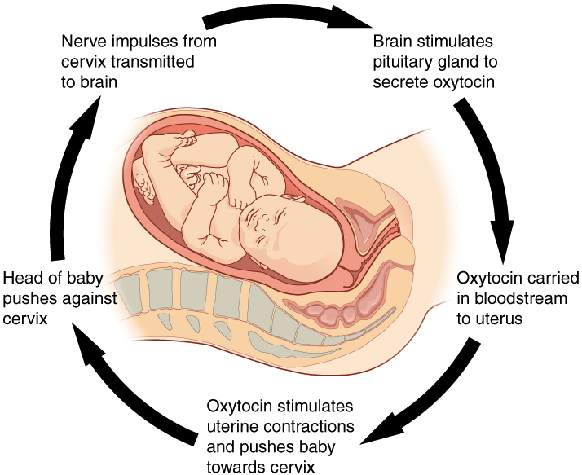
Positive Feedback
Enrichment

Slide 9
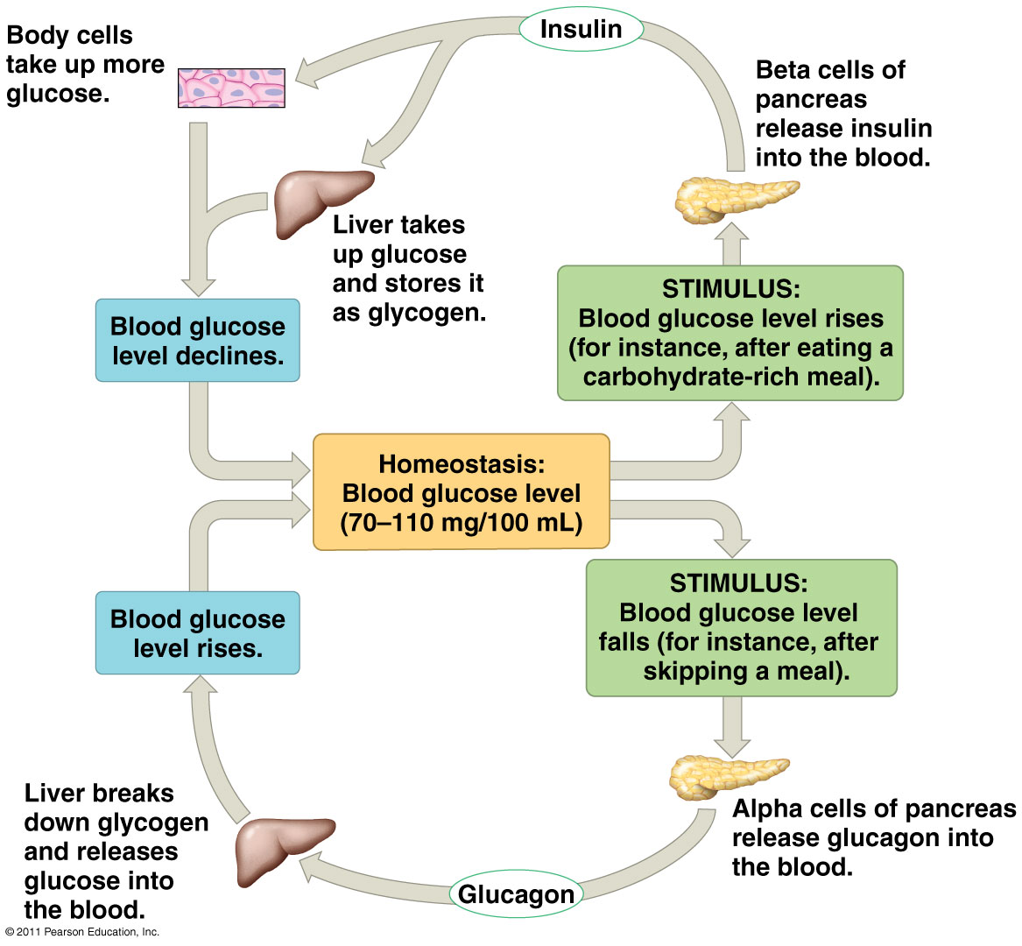
Blood Glucose Regulation
Negative
Feedback
Mechanism
Enrichment

Slide 10
Enrichment
Hormones can be classified into Two Groups:
  The Water-soluble Hormones are made of proteins.
      Most hormones produced by the endocrine glands are water-soluble.
      Cannot pass through the phospholipid bilayer of the plasma membrane, but they can bring about cellular changes without entering their target cells.
  The Lipid-soluble Hormones include the steroid hormones, small molecules made from cholesterol.
      Pass through the phospholipid bilayer.
      Bind to receptors inside the cell.

Slide 11
Enrichment
Hormone Signaling involves three stages:
  Reception of the signal occurs when a hormone
  binds to a specific receptor protein on or in the target cell.
  Signal Transduction converts the signal from one form to another.
  Response is a change in the cell’s behavior.
Notes:
3 stages: Reception 🡪 Signal Transduction 🡪 Response
Example: Epinephrine (“Fight or Flight” signal) – Heart cells respond by increasing heart beat; Liver cells respond by providing glucose to body cells.

Slide 12
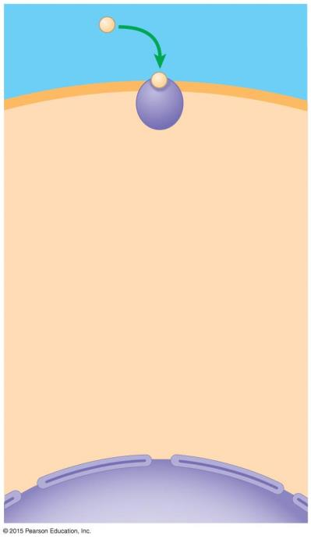
Interstitial fluid
Enrichment
Endocrine Process
Water-soluble
hormone
Receptor
protein
1
Target cell
Plasma
membrane
Nucleus
Notes:
Figure 26.2a-1 A hormone that binds a plasma membrane receptor (step 1)

Slide 13
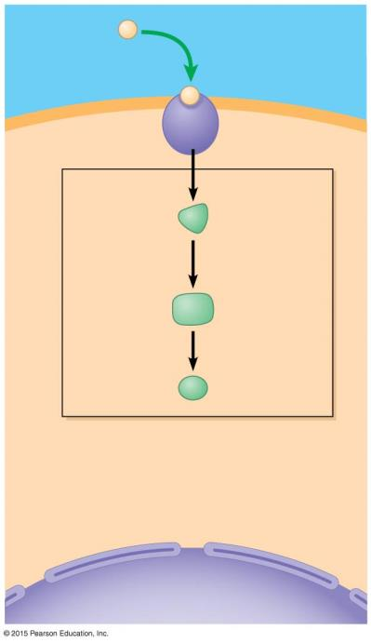
Interstitial fluid
Enrichment
Endocrine Process
Water-soluble
hormone
Receptor
protein
1
Target cell
Plasma
membrane
2
Signal
transduction
pathway
Relay
molecules
Nucleus
Notes:
Figure 26.2a-2 A hormone that binds a plasma membrane receptor (step 2)

Slide 14
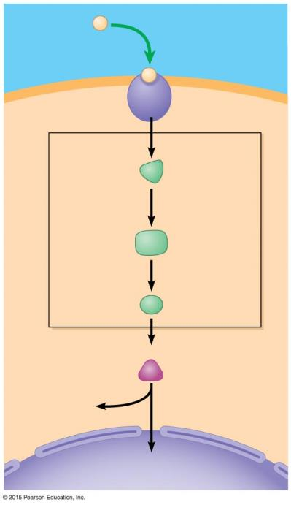
Interstitial fluid
Enrichment
Endocrine Process
Water-soluble
hormone
Receptor
protein
1
Target cell
Plasma
membrane
2
Signal
transduction
pathway
Relay
molecules
3
Cellular responses
Cytoplasmic
response
or
Gene regulation
Nucleus
Notes:
Figure 26.2a-3 A hormone that binds a plasma membrane receptor (step 3)

Slide 15
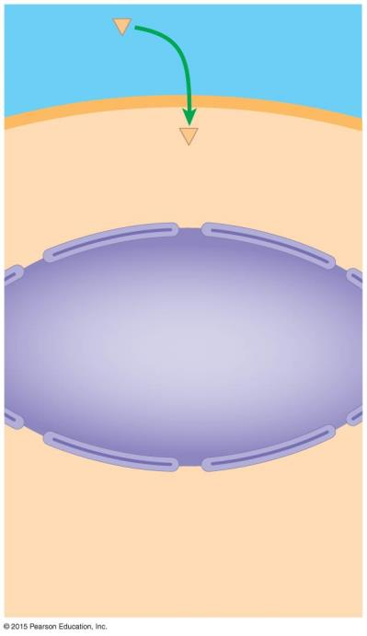
Steroid
hormone
Interstitial fluid
Enrichment
Endocrine Process
1
Target cell
Nucleus
Notes:
Figure 26.2b-1 A hormone that binds an intracellular receptor (step 1)

Slide 16
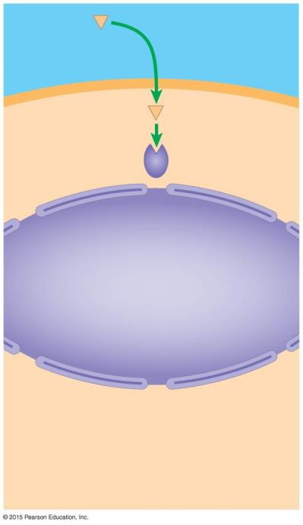
Steroid
hormone
Interstitial fluid
Enrichment
Endocrine Process
1
Target cell
2
Receptor
protein
Nucleus
Notes:
Figure 26.2b-2 A hormone that binds an intracellular receptor (step 2)

Slide 17
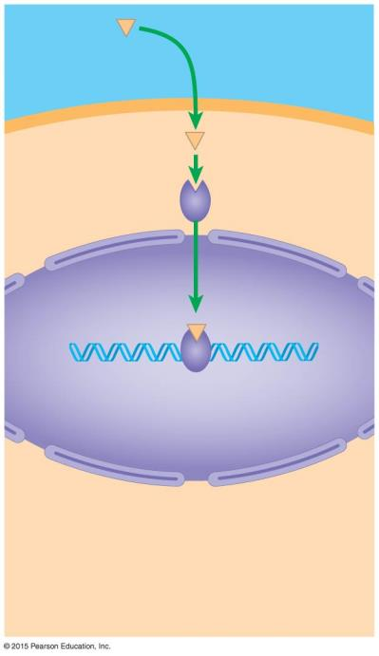
Steroid
hormone
Interstitial fluid
Enrichment
Endocrine Process
1
Target cell
2
Receptor
protein
Nucleus
3
Hormone-
receptor
complex
DNA
Notes:
Figure 26.2b-3 A hormone that binds an intracellular receptor (step 3)

Slide 18
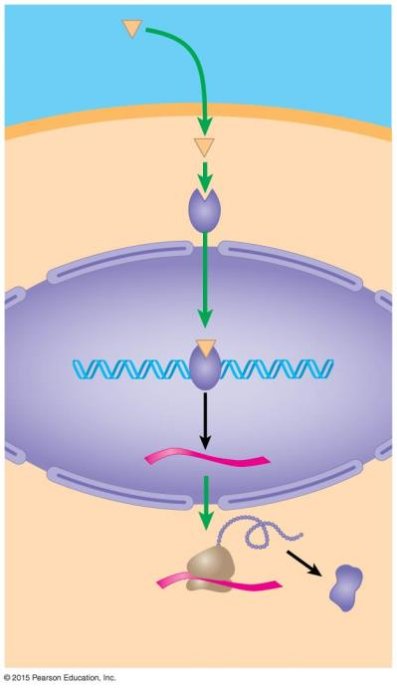
Steroid
hormone
Interstitial fluid
Enrichment
Endocrine Process
1
Target cell
2
Receptor
protein
Nucleus
3
Hormone-
receptor
complex
DNA
4
Transcription
mRNA
New
protein
Cellular response:
activation of a gene and
synthesis of new protein
Notes:
Figure 26.2b-4 A hormone that binds an intracellular receptor (step 4)

Slide 19
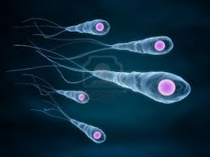
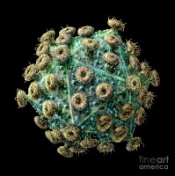
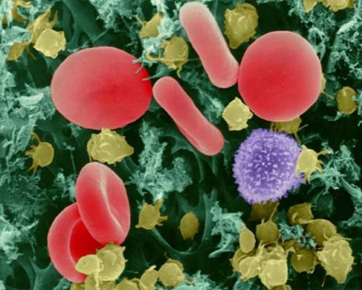
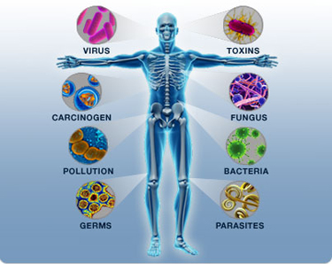
Immune System

Slide 20
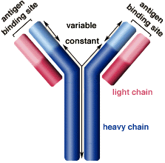
Adaptive Immunity Enrichment
Defends against specific antigens
Two Branches:
  1) HUMORAL (Antibody-Mediated)
    B Cells → Plasma Cells → Antibodies
    Antibodies: Y-shaped proteins that recognize specific antigen
    Gets rid of pathogens in the body fluids
    Two Types:
      Active: person makes his own antibodies
      Passive: Person receives antibodies from someone else (Ex. Nursing a Baby)
Notes:
Antigens are any molecules that elicits an adaptive immune response.

Slide 21
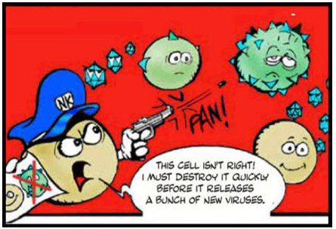
Adaptive Immunity
Enrichment
  2) CELL-MEDIATED
    Cytotoxic T Cells
    Gets rid of pathogens inside body cells.
    Attacks cells of our body that are already infected.
Macrophages → Helper T Cells → Activates Cell-Mediated and Humoral Immunity.
Notes:
Antigens are any molecules that elicits an adaptive immune response.

Slide 22
Macrophages
Enrichment
Humoral Immune Response
(Antibodies)
Cell-Mediated Immune Response
(Cytotoxic T Cells)
B cell
Helper T cell
Cytotoxic T cell
Plasma cell
Tag for destruction
Identify and destroy
Infected cell
Antibodies

Slide 23
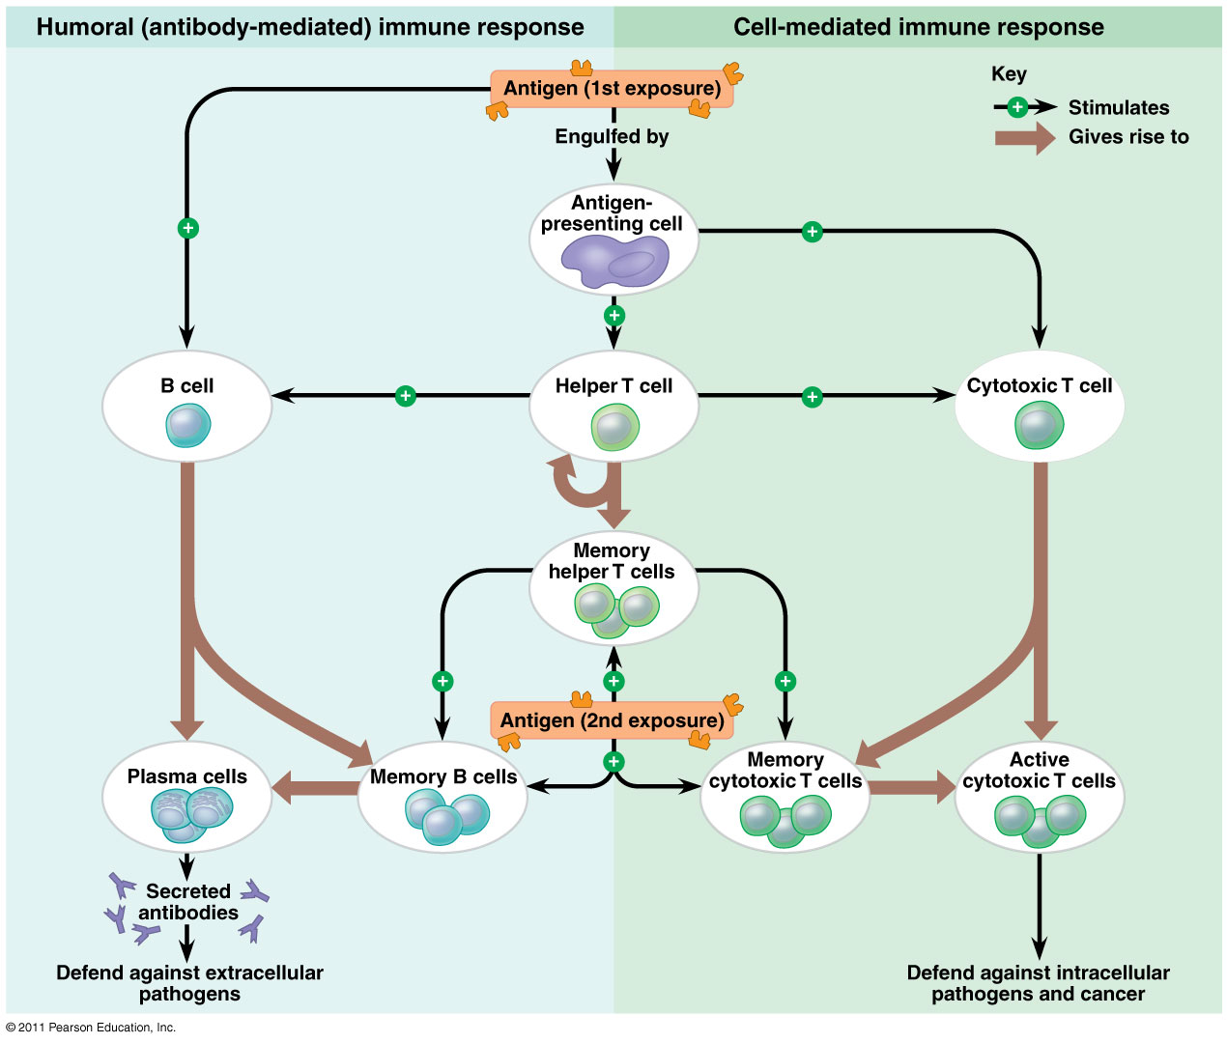
Enrichment

Slide 24
Digestive System

Slide 25
Nutrient Calories Sources/Examples Functions
Enrichment
Carbohydrates
Proteins
Lipids
Vitamins
Minerals
Water
4/gram
Bread, pasta, grains, potatoes
fuel source used for energy production
fuel source, raw material for making new proteins, enzymes, antibodies, hormones, pigments, cell structure
fuel source, insulation, cell membranes, nerve cells, hormones
Coenzymes (assist enzyme function)
bone and teeth formation, hemoglobin, acid/base balance
most nutrients move into and out of cells dissolved in fluid
4/gram
Eggs, nuts, meat, beans, fish
9/gram
Butter, fats, oils,
bacon (yummm), mayonnaise
0
Fruits, vegetables, dairy products
Ex: vit. A, C, D, B12, E
0
Milk, meat, bananas, fish
Ex: Calcium, iron, potassium, sodium, iodine
About 60% of the body is made of water Ex: blood and body fluid
0

Slide 26
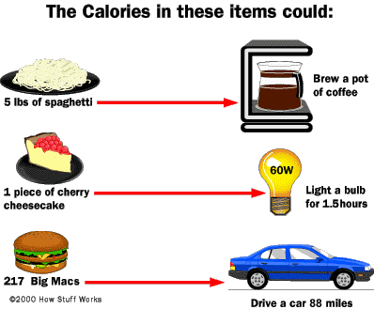
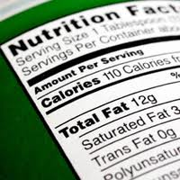
Enrichment
Calories = ENERGY CONTENT
Careful! 1 Calorie (or kilocalorie) = 1000 calories

Slide 27
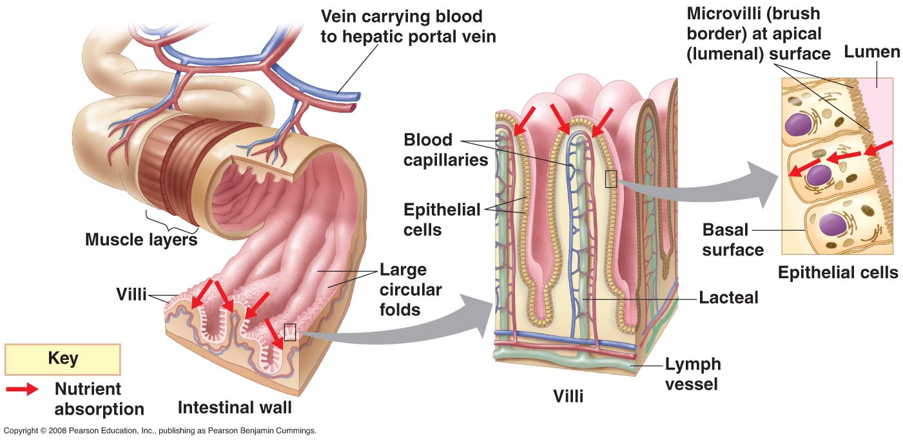
Absorption in Small intestine
Enrichment

Slide 28
Enzymes of the Small Intestine
Enrichment
Nutrient
Enzyme
Product of Reaction
Nucleic Acid | Nuclease | Nucleotides
Starch | Pancreatic Amylase | Maltose
Maltose | Maltase | Glucose + Glucose
Lactose | Lactase | Glusose + Galactose
Sucrose | Sucrase | Glucose + Fructose
Protein | Peptidase | Amino Acids
Fat | Lipase | 1 Glycerol + 3 Fatty Acids

Slide 29
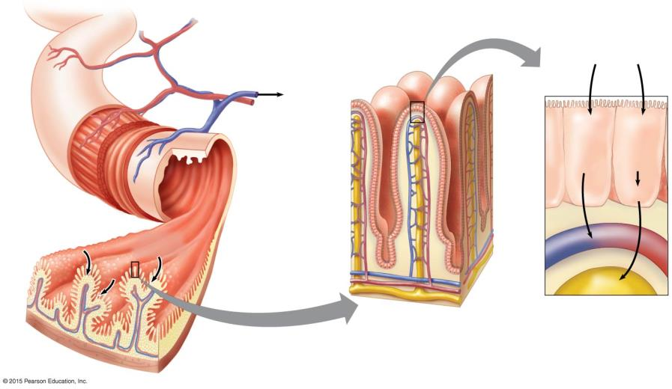
Enrichment
Lumen of
intestine
Nutrient
absorption
Vein carrying
blood to the liver
Microvilli
Epithelial
cells
Amino
acids
and
sugars
Fatty
acids
and
glycerol
Muscle
layers
Lumen
Blood
capillaries
Fats
Large
circular folds
Villi
Nutrient
absorption
Lymph
vessel
Blood
Lymph
Villi
Epithelial cells of
a villus
Intestinal wall
Notes:
Figure 21.10b-0 Structure and function of the small intestine

Slide 30
Hormones of the Digestive System
Enrichment
Hormones:
  - Chemical messengers sent from one organ (usually through the bloodstream) to control the activity of another (target) organ.
1. Gastrin
produced by stomach
stimulates gastric juice production
2. Secretin
produced by small intestine
stimulates bicarbonate production
3. CCK (cholecystokinin)
produced by small intestine
stimulates pancreatic juice and bile secretion

Slide 31
FOOD
Enrichment
Carbohydrates
  Their chemical digestion begins in the mouth.
  Amylase in saliva breaks down carbohydrates into simple sugars.
  In the small intestine, Pancreatic Amylase finishes digesting these into glucose.
  Glucose is transported through the walls of the villi (small intestine) and into the blood.

Slide 32
FOOD
Proteins
  Their chemical digestion begins in stomach.
  Hydrochloric Acid activates Pepsin produced by glands in the stomach lining.
  Pepsin breaks the protein into small amino acid chains.
  In the small intestine these chains are broken down into individual amino acids by Trypsin and Chemotrypsin from the pancreas and the intestinal lining.
  The amino acids enter the blood through the villi (small intestine).
Enrichment

Slide 33
FOOD
Lipids
  Their chemical digestion begins in small intestine.
  Bile is made by the Liver and stored in the Gallbladder until is needed to aid in fat digestion.
  In the small intestine, bile breaks up the lipids into droplets = Emulsification
  This allows the lipids to mix with water, which is necessary so Lipase from the pancreas and the small intestine can more easily get to the lipid molecules and digest them.
  After being digested they are absorbed into the body through the villi (small intestine).
Enrichment

Slide 34
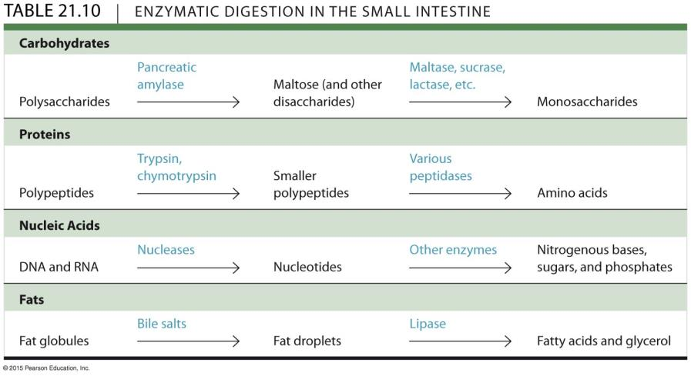
Enrichment
Notes:
Table 21.10 Enzymatic digestion in the small intestine

Slide 35
Excretion

Slide 36
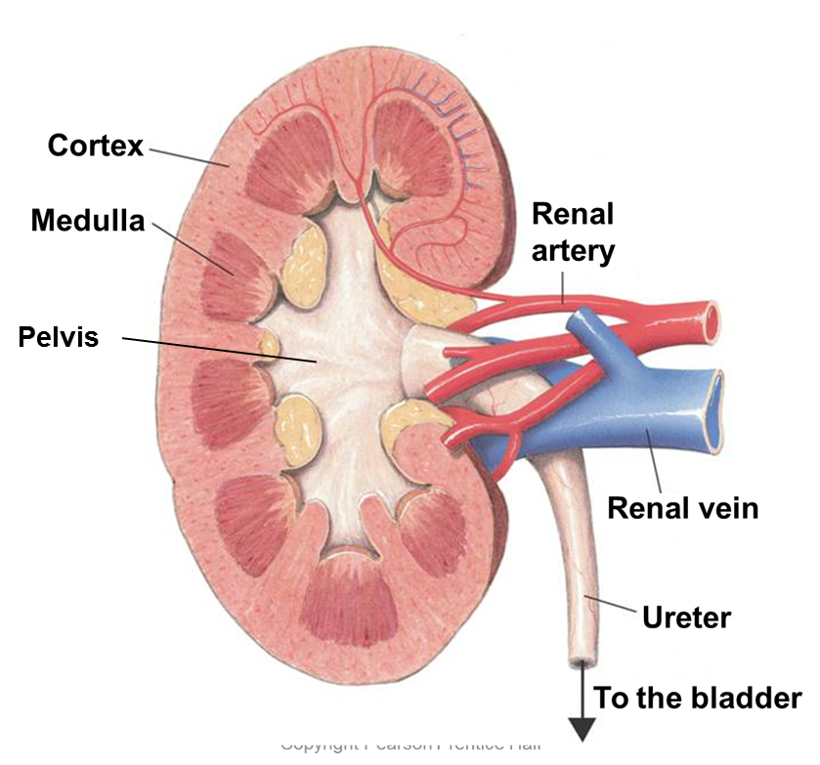
Kidney Structure
Enrichment
Renal Cortex
  Outer-most area
Renal Medulla
  Middle area
Renal Pelvis
  Inner-most area

