Slide 1
Click “Slide Show”
Click “From Beginning”
or
“From Current Slide”

Slide 2
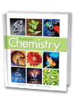


Chapter 20
Oxidation-Reduction Reactions
The Meaning of Oxidation
and Reduction
Oxidation Numbers
Describing REDOX Equations

Slide 3
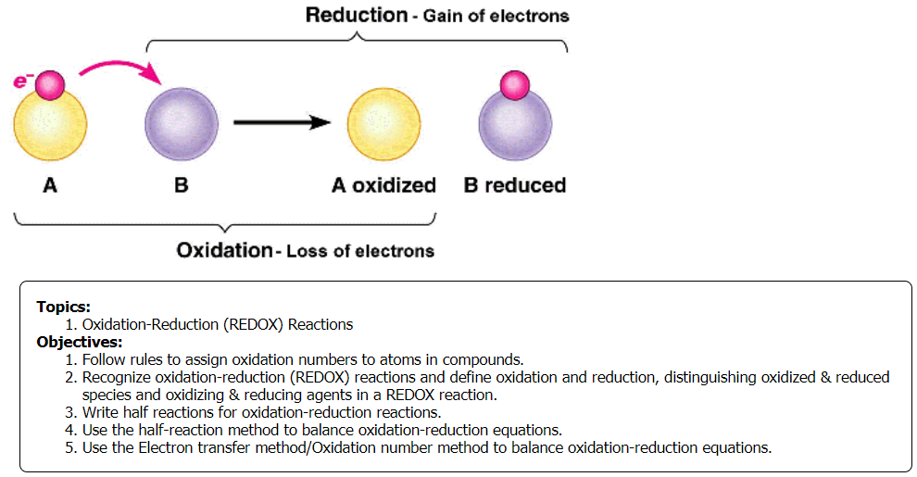

Slide 4
Reviewing Oxidation State (charge of ions)
Complete the chart
What is necessary to form positive ions?
What is necessary to form negative ions?
What determines the charge of an ion?
Atom | Na | Mg | O | Cl
Valence electrons
Electrons gained
Electrons lost
Ion
Notes:
Timing ≈ 1.0
[Use highlight tool to highlight tool in table as topic is discussed.]
Many reactions involved the transfer of electrons, including photosynthesis in plants. Electrons can be transferred without forming ions, but any reaction that leads to the formation of ions must involve the transfer of electrons.
[Animate] Electrons form ions that have a full valence level. You can use the periodic table to determine the types of ion an atom will form. For example, sodium [highlight] is in Group 1. It has one valence electron. [highlight] Oxygen [highlight] is on the other side of the periodic table in Group 16. It has 6 valance electrons [highlight]
[Animate] It is more energetically favorable for sodium to lose one electron to get a valence level that has 8 electrons. [highlight] When an atom loses one or more electrons, it forms a positive ion. A sodium ion has a charge of plus one. [highlight]
[Animate] On the other hand, oxygen only needs to gain 2 electrons to get a valence shell with 8 electrons. [highlight] Atoms that gain one or more electrons form negative ions. An oxygen ion has a charge of minus two. [highlight]
[Animate] The charge of an ion depends on the number of electrons lost or gained. [Highlight 1 and Na⁺, and then 2 and O²⁻]. Elements in Group 1 always form ions with a charge of plus one because they lose one electron. Elements in Group 2 gain two electrons, so they form ions with a charge a plus two. Elements in Group 16 lose two electrons, so they form ions with a charge of minus two.
For main group elements, you can use the group of an element to determine the type of ion it is most likely to form. However, transition metals may form multiple ions. For example, iron may form ions that have a charge of plus two or plus three.
SOURCES:

Slide 5
Reviewing Oxidation State (charge of ions)
What is necessary to form positive ions?
e- are lost for cations
What is necessary to form negative ions?
e- are gained for anions
What determines the charge of an ion?
the number of electrons lost or gained.
Atom | Na | Mg | O | Cl
Valence electrons | 1 | 2 | 6 | 7
Electrons gained | 0 | 0 | 2 | 1
Electrons lost | 1 | 2 | 0 | 0
Ion | Na⁺ | Mg⁺² | O²⁻ | Cl⁻
Notes:
Timing ≈ 1.0
[Use highlight tool to highlight tool in table as topic is discussed.]
Many reactions involved the transfer of electrons, including photosynthesis in plants. Electrons can be transferred without forming ions, but any reaction that leads to the formation of ions must involve the transfer of electrons.
[Animate] Electrons form ions that have a full valence level. You can use the periodic table to determine the types of ion an atom will form. For example, sodium [highlight] is in Group 1. It has one valence electron. [highlight] Oxygen [highlight] is on the other side of the periodic table in Group 16. It has 6 valance electrons [highlight]
[Animate] It is more energetically favorable for sodium to lose one electron to get a valence level that has 8 electrons. [highlight] When an atom loses one or more electrons, it forms a positive ion. A sodium ion has a charge of plus one. [highlight]
[Animate] On the other hand, oxygen only needs to gain 2 electrons to get a valence shell with 8 electrons. [highlight] Atoms that gain one or more electrons form negative ions. An oxygen ion has a charge of minus two. [highlight]
[Animate] The charge of an ion depends on the number of electrons lost or gained. [Highlight 1 and Na⁺, and then 2 and O²⁻]. Elements in Group 1 always form ions with a charge of plus one because they lose one electron. Elements in Group 2 gain two electrons, so they form ions with a charge a plus two. Elements in Group 16 lose two electrons, so they form ions with a charge of minus two.
For main group elements, you can use the group of an element to determine the type of ion it is most likely to form. However, transition metals may form multiple ions. For example, iron may form ions that have a charge of plus two or plus three.
SOURCES:

Slide 6
Identifying Ions
Give the number of electrons each atom will gain or lose to have a full valence level. Then, show the charge of the ion that is most likely to be formed by each atom (ignore multiple oxidation states). Is it a cation or an anion? Use the periodic table to help you.
A calcium atom, Ca, will ____________ forming a ______________
A fluorine atom, F, will ____________ forming a ______________
A lithium atom , Li, will ____________ forming a ______________
An argon atom, Ar, will ____________ forming a ______________
An aluminum atom, Al, will ____________ forming a ______________
A sulfur atom, S, will ____________ forming a ______________
A potassium atom, K, will ____________ forming a ______________
A boron atom, B, will ____________ forming a ______________
An iodine atom, I, will ____________ forming a ______________
A nitrogen atom, N, will ____________ forming a ______________
Notes:
Timing ≈ 1.0
Entry audio: Knowing where an element is in the periodic table can help you determine whether it forms ions by gaining or losing electrons. Use the dropdown menus to select the number of electrons each atom will gain or lose to have a full valence level.
Hint1 audio: Calcium, lithium, and aluminum have fewer electrons to lose than to gain to get a valance level with 8 electrons. Fluorine only has one electron to gain to complete it valance level. Argon is a noble gas, so it already has a full valance level.
Hint2 audio: [none]
Exit audio: The charge of an ion depends on how many electrons it gains or loses. An atom that gains one electron, such as fluorine, iodine, and bromine will have a charge of minus one. These ions have one more electron than protons. An atom that loses three electrons, such as aluminum or boron, has a charge of plus three. These ions have three fewer electrons than protons.
SOURCES:

Slide 7
Identifying Ions
Give the number of electrons each atom will gain or lose to have a full valence level. Then, show the charge of the ion that is most likely to be formed by each atom (ignore multiple oxidation states). Is it a cation or an anion? Use the periodic table to help you.
A calcium atom, Ca, will lose 2 e- forming a Ca⁺² cation
A fluorine atom, F, will gain 1 e- forming a F⁻¹ anion
A lithium atom , Li, will lose 1 e- forming a Li⁺¹ cation
An argon atom, Ar, will not gain or lose electrons nor form an ion (INERT gas)
An aluminum atom, Al, will lose 3 e- forming a Al⁺³ cation
A sulfur atom, S, will gain 2 e- forming a S⁻² anion
A potassium atom, K, will lose 1 e- forming a K⁺¹ cation
A boron atom, B, will lose 3 e- forming a B⁺³ cation
An iodine atom, I, will gain 1 e- forming a I⁻¹ anion
A nitrogen atom, N, will gain 3 e- forming a N⁻³ anion
Notes:
Timing ≈ 1.0
Entry audio: Knowing where an element is in the periodic table can help you determine whether it forms ions by gaining or losing electrons. Use the dropdown menus to select the number of electrons each atom will gain or lose to have a full valence level.
Hint1 audio: Calcium, lithium, and aluminum have fewer electrons to lose than to gain to get a valance level with 8 electrons. Fluorine only has one electron to gain to complete it valance level. Argon is a noble gas, so it already has a full valance level.
Hint2 audio: [none]
Exit audio: The charge of an ion depends on how many electrons it gains or loses. An atom that gains one electron, such as fluorine, iodine, and bromine will have a charge of minus one. These ions have one more electron than protons. An atom that loses three electrons, such as aluminum or boron, has a charge of plus three. These ions have three fewer electrons than protons.
SOURCES:

Slide 8
Describe Ion Formation
The reaction below shows sodium chloride forming from its elements, sodium & chlorine. Complete the statements below, describing this reaction.
2Na(s) + Cl₂(g) → 2NaCl(s)
Before bonding, the charge (oxidation state) of sodium is ___ and the charge (oxidation state) of chlorine is ___.
Sodium (atoms / ions) react with chlorine (atoms / ions) to form the (ionic / covalent) compound, sodium chloride. This is a ____ reaction.
The sodium atom (loses / gains) one electron to become a(n) (cation / anion), while the chlorine atom (loses / gains) one electron to become a(n) (cation / anion).
The charge of the sodium ion in NaCl is ___, and the charge of the chloride ion in NaCl is ___.
Notes:
Timing ≈ 1.0
Entry audio: Sodium chloride is an ionic compound that can form by the reaction shown here. Which statements describe this reaction? Check all that apply.
Hint audio: [none]
Exit audio: When sodium and chlorine react to form sodium chloride, electrons must be transferred from one atom to another to form ions. Each sodium atom loses one electron, which is gained by a chlorine atom. The sodium atom forms an ion with a charge of plus one, while the chlorine forms an ion with a charge of minus one. The electrostatic attraction between the positive and negative ions forms the ionic bonds that hold the ions together in sodium chloride.
SOURCES:

Slide 9
Describe Ion Formation
Sodium chloride is an ionic compound (metal + non-metal; END > 1.7). The reaction below shows how sodium chloride forms from sodium and chlorine. Complete the statements below to describe this reaction:
2Na⁰(s) + Cl₂⁰(g) → 2Na⁺¹Cl⁻¹(s)
Before bonding, the charge (oxidation state) of sodium is 0 and the charge (oxidation state) of chlorine is 0.
Sodium (atoms / ions) react with chlorine (atoms / ions) to form the (ionic / covalent) compound, sodium chloride. This is a synthesis reaction.
The sodium atom (loses / gains) one electron to become a(n) (cation / anion), while the chlorine atom (loses / gains) one electron to become a(n) (cation / anion).
The charge of the sodium ion in NaCl is +1, and the charge of the chloride ion in NaCl is −1.
Notes:
Timing ≈ 1.0
Entry audio: Sodium chloride is an ionic compound that can form by the reaction shown here. Which statements describe this reaction? Check all that apply.
Hint audio: [none]
Exit audio: When sodium and chlorine react to form sodium chloride, electrons must be transferred from one atom to another to form ions. Each sodium atom loses one electron, which is gained by a chlorine atom. The sodium atom forms an ion with a charge of plus one, while the chlorine forms an ion with a charge of minus one. The electrostatic attraction between the positive and negative ions forms the ionic bonds that hold the ions together in sodium chloride.
SOURCES:

Slide 10
Lesson Objectives
  Follow rules to assign oxidation numbers to atoms in compounds.
  Recognize oxidation-reduction (REDOX) reactions and define oxidation and reduction, distinguishing oxidized & reduced species and oxidizing & reducing agents in a REDOX reaction.
  Write half reactions for oxidation-reduction reactions.
  Use the half-reaction method to balance oxidation-reduction equations.
  Use the Electron transfer method/Oxidation number method to balance oxidation-reduction equations.
Notes:
Timing ≈ 0.5
Atoms are oxidized or reduced when they gain or lose electrons to form ions. In this lesson, you’ll learn how oxidation and reduction are defined as well as how to identify what is oxidized and what is reduced.
You will learn how to assign oxidation numbers to atoms and how to recognize an oxidation-reduction, or redox, reaction. You will also learn about common redox reactions.

Slide 11
Oxidation - Reduction
REDOX (oxidation-reduction) reactions result from the competition for electrons between atoms. This is indicated by a change in oxidation numbers of atoms. Which of the following (or both) is a Redox reaction?
HCl + NaOH NaCl + HOH
Ca + Cl₂ CaCl₂

Slide 12
Oxidation - Reduction
REDOX (oxidation-reduction) reactions result from the competition for electrons between atoms. This is indicated by a change in oxidation numbers of atoms. Which of the following (or both) is a Redox reaction?
H⁺Cl⁻ + Na⁺O⁻²H⁺¹ Na⁺Cl⁻ + H⁺¹O⁻²H⁺¹
This is NOT a REDOX reaction … no change in oxidation numbers.
Ca⁰ + Cl₂⁰ Ca⁺²Cl₂⁻¹
REDOX reaction → notice the change in oxidation numbers for both Ca (0 to +2) and Cl (0 to -1).

Slide 13

Oxidation - Reduction
REDOX
An abbreviation that combines the concepts of “Reduction” and “Oxidation.”
Oxidation and reduction occur SIMULTANEOUSLY and cannot occur one without the other [laws of conservation of mass and charge].

Slide 14
Review of Oxidation Numbers
An oxidation number is the charge an atom or ion possesses to indicate its degree of oxidation or reduction.
As a general rule, a bonded atom’s oxidation number is the charge that it would have if the electrons in the bond were assigned to the atom of the more electronegative element.
Summary of Rules for determining Oxidation State of Atoms
1. The oxidation number for an atom in its elemental (unbonded) form is always zero (includes “Professor HOFBrINCl” elements).
    Na⁰, Fe⁰, S⁰
2. The oxidation number of a monoatomic ion = charge of the monatomic ion.
Na⁺¹, Fe⁺³, S²⁻

Slide 15
Review of Oxidation Numbers
3. Oxygen’s oxidation number is –2 (except in “peroxides”)
i.e. H⁺¹O⁻²H⁺¹ i.e. H₂⁺¹O₂⁻¹
4. Hydrogen’s oxidation number is +1 (except in “hydrides”)
i.e. H⁺¹O⁻²H⁺¹ i.e. Na⁺¹H⁻¹
5. Group 1A (1) metals [alkali metals] always have an oxidation state of +1 in a compound.
6. Group 2A (2) metals [alkaline earth metals] always have an oxidation number of +2 in a compound
7. Fluorine [VIIA (17)] always has an oxidation number of -1 in a compound.
8. The algebraic sum of oxidation states in a compound = 0.
9. The algebraic sum of the oxidation states in a polyatomic ion equals the charge on the ion (see Reference Table 1, Chart F or Polyatomic Ion Chart).

Slide 16
Reduction
Any chemical change in which there is a DECREASE in oxidation number of an atom (formerly defined by the loss of oxygen).
There is a GAIN of electrons from an atom in the reaction.
2Na⁰ + S⁰ → Na₂⁺¹S⁻²
The oxidation number of S REDUCES from 0 to -2.
The element S gains two electrons.
S is “reduced” in the redox reaction.
reduction
Electronegativity:
Na 0.9 S 2.6

Slide 17
Reduction
The particle or atom that decreases in oxidation number is said to be REDUCED. The more electronegative atom is reduced.
The particle or atom that is reduced acts as an oxidizing agent in a Redox reaction.
2Na⁰ + S⁰ → Na₂⁺¹S⁻²
S is reduced in the redox reaction.
S is the oxidizing agent in the redox reaction, meaning that Na⁰ will be oxidized.
reduction
Electronegativity:
Na 0.9 S 2.6

Slide 18
Oxidation
Any chemical change in which there is an INCREASE in oxidation number of an atom (formerly defined by the gain of oxygen).
There is a LOSS of electrons from an atom in the reaction.
2Na⁰ + S⁰ → Na₂⁺¹S⁻²
The oxidation number of Na increases from 0 to +1.
The element Na loses two electrons total.
Na is oxidized in the redox reaction.
Electronegativity:
Na 0.9 S 2.6
oxidation

Slide 19
Oxidation
The particle or atom that increases in oxidation number is said to be OXIDIZED.
The particle or atom that is oxidized acts as a reducing agent in a Redox reaction.
2Na⁰ + S⁰ → Na₂⁺¹S⁻²
Na is oxidized in the redox reaction.
Na is the reducing agent in the redox reaction, meaning that S⁰ will be reduced.
Electronegativity:
Na 0.9 S 2.6
oxidation

Slide 20
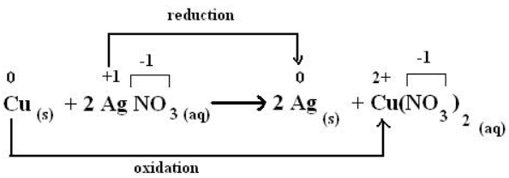
Oxidation - Reduction
REDOX
Redox reactions result from the competition for electrons between atoms to produce the most stable configuration.
For covalent compounds the more electronegative atom reduces.
This is indicated by a change in the expected oxidation numbers of atoms as they progress from reactants to products.

Slide 21
Oxidation-Reduction (REDOX) Reactions
An oxidation-reduction reaction occurs when electrons are transferred from one substance to another: REDOX.
Reducing Agent
Oxidized Atom or Ion
loses e-
Oxidation
e
Oxidizing Agent
e
Reduced Atom or Ion
Reduction
gains e-
Notes:
Timing ≈ 1.5 min
Reactions in which oxidation and reduction occur are called oxidation-reduction reactions. An oxidation-reduction reaction is a reaction in which electrons are transferred from one substance to another substance. These reactions are often called redox reactions.
[Animate image on right.] Although you have learned about the oxidation and reduction processes separately, they always occur together in a reaction. If one atom or ion loses electrons, another must gain those electrons. The atom or ion that is oxidized transfers electrons to the atom or ion that is reduced.
[Animate 1st bullet]The substance that oxidized is called the reducing agent because it provides the electrons the other substance needs to be reduced.
[Animate 2nd bullet] Similarly, the substance that reduced is called the oxidizing agent because it takes the electrons the other substance needs to lose to be oxidized.
[Animate 2nd image on right] [highlight parts of chemical equation as they are discussed.] Let’s take a look for the overall reaction for the formation of iron oxide, rust. Iron metal and elemental oxygen are the reactants. They are both pure elements, so the iron and oxygen atoms have an oxidation state of zero. In iron oxide, the oxidation state of oxygen is minus two. Therefore, the oxidation state of iron is plus three.
The oxidation state of iron changed from zero to plus three. Each iron atom gained three electrons, so iron was oxidized. The electrons from the iron were transferred to the oxygen. The oxidation state of the oxygen decreases by two, so they were reduced.
Because iron was oxidized, it is the reducing agent. Oxygen is the oxidizing agent because it was reduced. Both the oxidizing and reducing agents are on the left (reactant) side of the redox equation.
SOURCES

Slide 22
Oxidation-Reduction (REDOX) Reactions
An oxidation-reduction reaction occurs when electrons are transferred from one substance to another: REDOX.
  The substance that is oxidized is called the reducing agent (gives electrons to other substance).
Reducing Agent
Oxidized Atom or Ion
loses e-
Oxidation
e
Oxidizing Agent
e
Reduced Atom or Ion
Reduction
gains e-
Notes:
Timing ≈ 1.5 min
Reactions in which oxidation and reduction occur are called oxidation-reduction reactions. An oxidation-reduction reaction is a reaction in which electrons are transferred from one substance to another substance. These reactions are often called redox reactions.
[Animate image on right.] Although you have learned about the oxidation and reduction processes separately, they always occur together in a reaction. If one atom or ion loses electrons, another must gain those electrons. The atom or ion that is oxidized transfers electrons to the atom or ion that is reduced.
[Animate 1st bullet]The substance that oxidized is called the reducing agent because it provides the electrons the other substance needs to be reduced.
[Animate 2nd bullet] Similarly, the substance that reduced is called the oxidizing agent because it takes the electrons the other substance needs to lose to be oxidized.
[Animate 2nd image on right] [highlight parts of chemical equation as they are discussed.] Let’s take a look for the overall reaction for the formation of iron oxide, rust. Iron metal and elemental oxygen are the reactants. They are both pure elements, so the iron and oxygen atoms have an oxidation state of zero. In iron oxide, the oxidation state of oxygen is minus two. Therefore, the oxidation state of iron is plus three.
The oxidation state of iron changed from zero to plus three. Each iron atom gained three electrons, so iron was oxidized. The electrons from the iron were transferred to the oxygen. The oxidation state of the oxygen decreases by two, so they were reduced.
Because iron was oxidized, it is the reducing agent. Oxygen is the oxidizing agent because it was reduced. Both the oxidizing and reducing agents are on the left (reactant) side of the redox equation.
SOURCES

Slide 23
Oxidation-Reduction (REDOX) Reactions
An oxidation-reduction reaction occurs when electrons are transferred from one substance to another: REDOX.
  The substance that is oxidized is called the reducing agent (gives electrons to other substance).
  The substance that is reduced is called the oxidizing agent (takes electrons from other substance).
Reducing Agent
Oxidized Atom or Ion
loses e-
Oxidation
e
Oxidizing Agent
e
Reduced Atom or Ion
Reduction
gains e-
Notes:
Timing ≈ 1.5 min
Reactions in which oxidation and reduction occur are called oxidation-reduction reactions. An oxidation-reduction reaction is a reaction in which electrons are transferred from one substance to another substance. These reactions are often called redox reactions.
[Animate image on right.] Although you have learned about the oxidation and reduction processes separately, they always occur together in a reaction. If one atom or ion loses electrons, another must gain those electrons. The atom or ion that is oxidized transfers electrons to the atom or ion that is reduced.
[Animate 1st bullet]The substance that oxidized is called the reducing agent because it provides the electrons the other substance needs to be reduced.
[Animate 2nd bullet] Similarly, the substance that reduced is called the oxidizing agent because it takes the electrons the other substance needs to lose to be oxidized.
[Animate 2nd image on right] [highlight parts of chemical equation as they are discussed.] Let’s take a look for the overall reaction for the formation of iron oxide, rust. Iron metal and elemental oxygen are the reactants. They are both pure elements, so the iron and oxygen atoms have an oxidation state of zero. In iron oxide, the oxidation state of oxygen is minus two. Therefore, the oxidation state of iron is plus three.
The oxidation state of iron changed from zero to plus three. Each iron atom gained three electrons, so iron was oxidized. The electrons from the iron were transferred to the oxygen. The oxidation state of the oxygen decreases by two, so they were reduced.
Because iron was oxidized, it is the reducing agent. Oxygen is the oxidizing agent because it was reduced. Both the oxidizing and reducing agents are on the left (reactant) side of the redox equation.
SOURCES

Slide 24
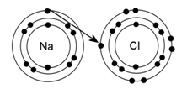
Oxidizing and Reducing Agents
In the formation of NaCl, a sodium atom loses an electron (becoming a cation) to a chlorine atom (becoming an anion).
Electronegativity:
Na 0.9 Cl 3.2
Sodium gets oxidized and acts as the reducing agent and donates its single valence electron to the chlorine ion.
Notes:
Timing ≈ 1.0 minute
In a redox reaction, the reducing agent donates electrons to the oxidizing agent.
By donating electrons, the sodium cation reduces the chlorine anion.
By accepting electrons, the chlorine anion oxidizes sodium.
(1st animation) Upon the formation of a molecule of NaCl, the sodium atom has been oxidized (lost an electron) and the chlorine atom has been reduced (gained an electron).
An easy pneumonic device to remember the difference between oxidation and reduction is LEO and GER:
Loss of Electron = Oxidation
Gain of Electron = Reduction
Remember that the reducing agent does the reducing (donates an electron to be gained by the oxidizer) and gets oxidized, while the oxidizing agent does the oxidizing (accepts an electron donated by the reducer) and gets reduced.
SOURCES:

Slide 25
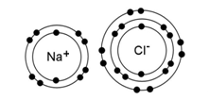
Oxidizing and Reducing Agents
In the formation of NaCl, a sodium atom loses an electron (becoming a cation) to a chlorine atom (becoming an anion).
Electronegativity:
Na 0.9 Cl 3.2
Sodium gets oxidized and acts as the reducing agent and donates its single valence electron to the chlorine ion.
Chlorine is reduced as the oxidizing agent, and accepts an electron to allow both ions to lose their charges.
Notes:
Timing ≈ 1.0 minute
In a redox reaction, the reducing agent donates electrons to the oxidizing agent.
By donating electrons, the sodium cation reduces the chlorine anion.
By accepting electrons, the chlorine anion oxidizes sodium.
(1st animation) Upon the formation of a molecule of NaCl, the sodium atom has been oxidized (lost an electron) and the chlorine atom has been reduced (gained an electron).
An easy pneumonic device to remember the difference between oxidation and reduction is LEO and GER:
Loss of Electron = Oxidation
Gain of Electron = Reduction
Remember that the reducing agent does the reducing (donates an electron to be gained by the oxidizer) and gets oxidized, while the oxidizing agent does the oxidizing (accepts an electron donated by the reducer) and gets reduced.
SOURCES:

Slide 26
Describe Oxidation-Reduction Reactions
Determine which species is oxidized and which is reduced. Which is the oxidizing agent and which is the reducing agent? Explain.
2H₂(g) + O₂(g) → 2H₂O(s)
Notes:
Timing ≈ 1.0
Entry audio: Use what you know to describe the redox reaction between sodium and chlorine that forms sodium chloride.
Hint1 audio: The oxidation numbers of sodium and chlorine atoms are zero. The oxidation number of sodium increases to plus one, so sodium is oxidized. The oxidation number of chlorine is reduced to minus one, so chlorine is reduced. The terms oxidizing agent and reducing agent are used to describe the reactants.
Hint2 audio: [none]
Exit audio: The substance that is oxidized transfers electrons to the substance that reduced. In the first reaction, sodium transfers electrons to chlorine. In the second reaction, aluminum transfers electrons to zinc, so aluminum is oxidized while zinc is reduced. In many redox reactions, there are also atoms or ions that are not oxidized or reduced. In the second reaction, the oxidation number of the chlorine atom does not change.
SOURCES:

Slide 27
Describe Oxidation-Reduction Reactions
Determine which species is oxidized and which is reduced. Which is the oxidizing agent and which is the reducing agent? Explain.
2H₂⁰(g) + O₂⁰(g) → 2H₂⁺¹O⁻²(s)
Oxygen atoms are reduced because they gain electrons. Oxygen is the oxidizing agent because it accepts electrons FROM hydrogen.
Hydrogen atoms are oxidized because they lose electrons. Hydrogen is the reducing agent because it transfers electrons TO oxygen.
oxidation
reduction
Electronegativity:
H 2.2 O 3.5
Notes:
Timing ≈ 1.0
Entry audio: Use what you know to describe the redox reaction between sodium and chlorine that forms sodium chloride.
Hint1 audio: The oxidation numbers of sodium and chlorine atoms are zero. The oxidation number of sodium increases to plus one, so sodium is oxidized. The oxidation number of chlorine is reduced to minus one, so chlorine is reduced. The terms oxidizing agent and reducing agent are used to describe the reactants.
Hint2 audio: [none]
Exit audio: The substance that is oxidized transfers electrons to the substance that reduced. In the first reaction, sodium transfers electrons to chlorine. In the second reaction, aluminum transfers electrons to zinc, so aluminum is oxidized while zinc is reduced. In many redox reactions, there are also atoms or ions that are not oxidized or reduced. In the second reaction, the oxidation number of the chlorine atom does not change.
SOURCES:

Slide 28
Describe Oxidation-Reduction Reactions
Determine which species is oxidized and which is reduced. Which is the oxidizing agent and which is the reducing agent? Explain.
2Al(s) + 3ZnCl₂(aq) → 3Zn(s) + 2AlCl₃(aq)
Notes:
Timing ≈ 1.0
Entry audio: Use what you know to describe the redox reaction between sodium and chlorine that forms sodium chloride.
Hint1 audio: The oxidation numbers of sodium and chlorine atoms are zero. The oxidation number of sodium increases to plus one, so sodium is oxidized. The oxidation number of chlorine is reduced to minus one, so chlorine is reduced. The terms oxidizing agent and reducing agent are used to describe the reactants.
Hint2 audio: [none]
Exit audio: The substance that is oxidized transfers electrons to the substance that reduced. In the first reaction, sodium transfers electrons to chlorine. In the second reaction, aluminum transfers electrons to zinc, so aluminum is oxidized while zinc is reduced. In many redox reactions, there are also atoms or ions that are not oxidized or reduced. In the second reaction, the oxidation number of the chlorine atom does not change.
SOURCES:

Slide 29
Describe Oxidation-Reduction Reactions
Determine which species is oxidized and which is reduced. Which is the oxidizing agent and which is the reducing agent? Explain.
2Al⁰(s) + 3Zn⁺²Cl₂⁻¹(aq) → 3Zn⁰(s) + 2Al⁺³Cl₃⁻¹(aq)
Zinc atoms are reduced because they gain electrons. Zinc is the oxidizing agent because it accepts electrons FROM aluminum.
Aluminum atoms are oxidized because they lose electrons. Aluminum is the reducing agent because it transfers electrons TO zinc.
Notice that chlorine is NOT part of the REDOX reaction.
oxidation
reduction
Notes:
Timing ≈ 1.0
Entry audio: Use what you know to describe the redox reaction between sodium and chlorine that forms sodium chloride.
Hint1 audio: The oxidation numbers of sodium and chlorine atoms are zero. The oxidation number of sodium increases to plus one, so sodium is oxidized. The oxidation number of chlorine is reduced to minus one, so chlorine is reduced. The terms oxidizing agent and reducing agent are used to describe the reactants.
Hint2 audio: [none]
Exit audio: The substance that is oxidized transfers electrons to the substance that reduced. In the first reaction, sodium transfers electrons to chlorine. In the second reaction, aluminum transfers electrons to zinc, so aluminum is oxidized while zinc is reduced. In many redox reactions, there are also atoms or ions that are not oxidized or reduced. In the second reaction, the oxidation number of the chlorine atom does not change.
SOURCES:

Slide 30
Recognize Oxidation-Reduction Reactions
Which reactions below are oxidation-reduction reactions? Explain.
[ ] FeS(s) + 2HCl(aq) → H₂S(g) + FeCl₂(g)
[ ] AgNO₃(aq) + NaCl(aq) → AgCl(s) + NaNO₃
[ ] 2C₃H₆(g) + 9O₂(g) → 6CO₂(g) + 6H₂O(g)
[ ] Fe₂O₃(s) + 3CO(g) → 2Fe(l) + 3CO₂(g)
Notes:
Timing ≈ 1.0 minute
Entry audio: Identify which of the reactions are oxidation-reduction reactions. Check all that apply.
Hint audio: In both of the first two equations, the ions present in the reactants are also present in the products.
Exit audio: The reaction of propane with oxygen is an oxidation reduction reaction. Notice that oxygen is uncombined in the reactants, but in compounds in the products. The reaction of iron oxide is also a redox reaction. Iron changes from being in a compound to being uncombined in the products. Also, the ratio of carbon to oxygen changed, so the oxidation number of carbon changed.
SOURCES:

Slide 31
Recognize Oxidation-Reduction Reactions
Which reactions below are oxidation-reduction reactions? Explain.
[ ] Fe⁺²S⁻² (s) + 2H⁺Cl⁻(aq) → H₂⁺S⁻² (g) + Fe⁺²Cl₂⁻(g)
[ ] Ag ⁺NO₃⁻(aq) + Na⁺Cl⁻(aq) → Ag⁺Cl⁻(s) + Na⁺NO₃⁻
The first 2 reactions have no change in oxidation states for any atom.
[X] 2C₃⁻²H₆(g) + 9O₂⁰(g) → 6C⁺⁴O₂(g) + 6H₂O⁻²(g)
[X] Fe₂⁺³O₃⁻²(s) + 3C⁺²O⁻²(g) → 2Fe⁰(l) + 3C⁺⁴O₂⁻²(g)
oxidation
reduction
reduction
oxidation
Notes:
Timing ≈ 1.0 minute
Entry audio: Identify which of the reactions are oxidation-reduction reactions. Check all that apply.
Hint audio: In both of the first two equations, the ions present in the reactants are also present in the products.
Exit audio: The reaction of propane with oxygen is an oxidation reduction reaction. Notice that oxygen is uncombined in the reactants, but in compounds in the products. The reaction of iron oxide is also a redox reaction. Iron changes from being in a compound to being uncombined in the products. Also, the ratio of carbon to oxygen changed, so the oxidation number of carbon changed.
SOURCES:

Slide 32
Recognize Oxidation-Reduction Reactions
Identify the oxidizing and reducing agents:
Cr₂O₃(s) + 2Al(s) → 2Cr(s) + Al₂O₃(s)
Oxidizing agent: ___ Reducing agent: ___
Identify the oxidizing and reducing agents:
Mg(s) + CuCl₂(s) → MgCl₂(aq) + Cu(s)
Oxidizing agent: ___ Reducing agent: ___
Notes:
Timing ≈ 1.0 minute
Entry audio: Identify which of the reactions are oxidation-reduction reactions. Check all that apply.
Hint audio: In both of the first two equations, the ions present in the reactants are also present in the products.
Exit audio: The reaction of propane with oxygen is an oxidation reduction reaction. Notice that oxygen is uncombined in the reactants, but in compounds in the products. The reaction of iron oxide is also a redox reaction. Iron changes from being in a compound to being uncombined in the products. Also, the ratio of carbon to oxygen changed, so the oxidation number of carbon changed.
SOURCES:

Slide 33
Recognize Oxidation-Reduction Reactions
Identify the oxidizing and reducing agents:
Cr₂⁺³O₃⁻²(s) + 2Al⁰(s) → 2Cr⁰(s) + Al₂⁺³O₃⁻²(s)
Oxidizing agent: Cr Reducing agent: Al
(reduced: +3 to 0) (oxidized: 0 to +3)
gained e- (from Al) lost e- (to Cr)
Identify the oxidizing and reducing agents:
Mg⁰(s) + Cu⁺²Cl₂⁻¹(s) → Mg⁺²Cl₂⁻¹(aq) + Cu⁰(s)
Oxidizing agent: Cu Reducing agent: Mg
(reduced: +2 to 0) (oxidized: 0 to +2)
gained e- (from Mg) lost e- (to Cu)
reduction
oxidation
oxidation
reduction
Notes:
Timing ≈ 1.0 minute
Entry audio: Identify which of the reactions are oxidation-reduction reactions. Check all that apply.
Hint audio: In both of the first two equations, the ions present in the reactants are also present in the products.
Exit audio: The reaction of propane with oxygen is an oxidation reduction reaction. Notice that oxygen is uncombined in the reactants, but in compounds in the products. The reaction of iron oxide is also a redox reaction. Iron changes from being in a compound to being uncombined in the products. Also, the ratio of carbon to oxygen changed, so the oxidation number of carbon changed.
SOURCES:

Slide 34
Half Reactions
REDOX reactions are considered in 2 parts.
Each reaction of the 2 parts is called a ½ reaction (half rxn)
Mg⁰ + S⁰ → Mg⁺²S⁻²
Oxidation half reaction Mg⁰ → Mg⁺² + 2 e-
Reduction half reaction S⁰ + 2 e- → S⁻²
REDOX reactions are driven by ELECTRONS.
oxidation
reduction

Slide 35
Half Reactions
Mg⁰ + S⁰ → Mg⁺²S⁻²
Oxidation half reaction Mg⁰ → Mg⁺² + 2 e-
Reduction half reaction S⁰ + 2 e- → S⁻²
The electron number must be balanced for both half reactions.
If one half reaction loses e- (oxidized), the other must gain e-.
If one half reaction gains e- (reduced), the other must lose e-.
In this redox reaction, 2 e- are lost & gained overall.
oxidation
reduction

Slide 36

Half Reactions
Fe₂O₃ + 3CO → 2Fe + 3CO₂
Write the half reactions for this chemical reaction.

Slide 37
Half Reactions
Fe₂⁺³O₃⁻² + 3C⁺²O⁻² → 2Fe⁰ + 3C⁺⁴O₂⁻²
Oxidation half reaction
3 ( C⁺² → C⁺⁴ + 2e- ) = 3 C⁺² → 3 C⁺⁴ + 6 e-
Reduction half reaction
2 ( Fe⁺³ + 3e- → Fe⁰ ) = 2 Fe⁺³ + 6 e- → 2 Fe⁰
In this redox reaction, 6 e- are lost and gained overall.
Notice the coefficients of the half reactions & overall reaction.
Notice that oxygen is NOT part of the REDOX reaction.
reduction
oxidation

Slide 38
Examples of Oxidation-Reduction Reaction
Oxidation-reduction reactions include:
  Combustion
C₄^{-2.5}H₁₀⁺(g) + O₂⁰(g) → C⁺²O₂⁻²(g) + 5H₂⁺O⁻²(g)
  Synthesis
  2Mg⁰ (s) + O₂⁰ → 2Mg⁺²O⁻²(s)
  Decomposition
  Mg₃⁺²N₂⁻³(s) → 3Mg⁰ (s) + N₂⁰ (g)
  Single Replacement
  2Al⁰ + Fe₂⁺³O₃⁻² → Al₂⁺³O₃⁻² + 2Fe⁰
Notes:
Timing ≈ 1.5 min
Oxidation-reduction reaction is one way to classify reactions. However, many other types of reactions can be classified as oxidation-reduction reactions.
[Animate] All combustion reactions are oxidation-reduction reactions. The reaction of propane with oxygen is both a combustion reaction and a redox reaction.
[Animate] Many synthesis reactions, including those involved in photosynthesis are redox reactions. In the overall reaction, water and carbon dioxide combine to produce glucose and oxygen. There are actually many redox reactions that occur to produce this overall reaction.
[Animate] Metals and metal compounds undergo many redox reactions. Remember rusting is a redox reaction of iron. Silver also under goes a redox reaction with hydrogen sulfide in the air. This reaction produces tarnish on silver. Notice that this reaction is also a single displacement reaction, in which silver displaces hydrogen. Single-displacement reactions are also redox reactions.
[Animate] Finally, many of the reactions that occur in all living organisms are redox reactions. Metabolism includes a complex set of reactions that both break down molecules, such as glucose, to release energy and synthesize molecules that are needed in the body. The overall reaction for the metabolism of glucose is basically the reverse of photosynthesis.
SOURCES
http://commons.wikimedia.org/wiki/File:Flames,_closeup.jpg
http://commons.wikimedia.org/wiki/File:Phytoplankton_Bloom_in_the_Bay_of_Biscay_detail.jpg
http://commons.wikimedia.org/wiki/File:Drikkekanne_Norsk_Folkemuseum_NF.1950-0001.jpg
http://commons.wikimedia.org/wiki/File:Sled_dog_yakut_laika.jpg

Slide 39
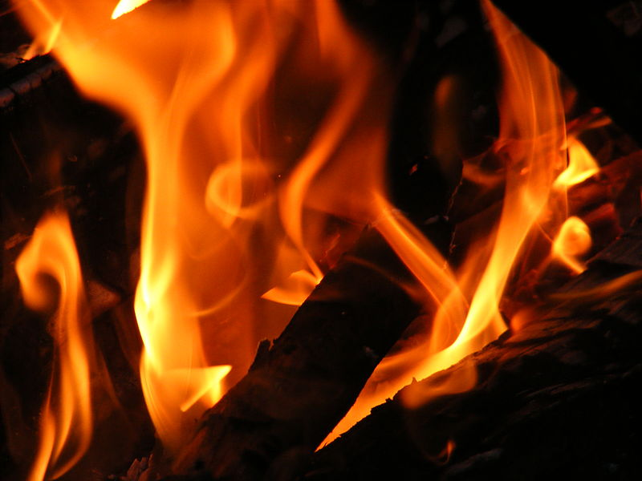
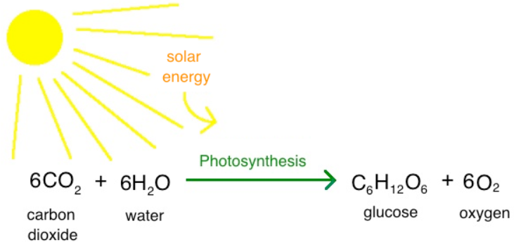

Examples of Oxidation-Reduction Reaction
Oxidation-reduction reactions include:
  Combustion
  Photosynthesis
  Many reactions of metals (tarnish)
  Many biochemical reactions, including metabolic reactions.
Notes:
Timing ≈ 1.5 min
Oxidation-reduction reaction is one way to classify reactions. However, many other types of reactions can be classified as oxidation-reduction reactions.
[Animate] All combustion reactions are oxidation-reduction reactions. The reaction of propane with oxygen is both a combustion reaction and a redox reaction.
[Animate] Many synthesis reactions, including those involved in photosynthesis are redox reactions. In the overall reaction, water and carbon dioxide combine to produce glucose and oxygen. There are actually many redox reactions that occur to produce this overall reaction.
[Animate] Metals and metal compounds undergo many redox reactions. Remember rusting is a redox reaction of iron. Silver also under goes a redox reaction with hydrogen sulfide in the air. This reaction produces tarnish on silver. Notice that this reaction is also a single displacement reaction, in which silver displaces hydrogen. Single-displacement reactions are also redox reactions.
[Animate] Finally, many of the reactions that occur in all living organisms are redox reactions. Metabolism includes a complex set of reactions that both break down molecules, such as glucose, to release energy and synthesize molecules that are needed in the body. The overall reaction for the metabolism of glucose is basically the reverse of photosynthesis.
SOURCES
http://commons.wikimedia.org/wiki/File:Flames,_closeup.jpg
http://commons.wikimedia.org/wiki/File:Phytoplankton_Bloom_in_the_Bay_of_Biscay_detail.jpg
http://commons.wikimedia.org/wiki/File:Drikkekanne_Norsk_Folkemuseum_NF.1950-0001.jpg
http://commons.wikimedia.org/wiki/File:Sled_dog_yakut_laika.jpg

Slide 40
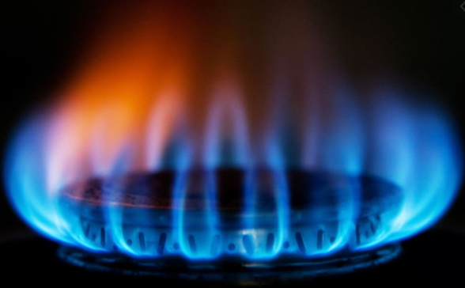
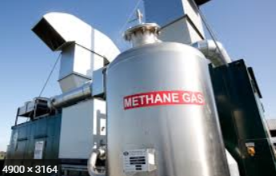
Examples of Oxidation-Reduction Reaction
Combustion
C⁻⁴H₄⁺¹(g) + 5O₂⁰(g) → C⁺⁴O₂⁻²(g) + H₂⁺¹O⁻²(g)
oxidation
reduction
Notes:
Timing ≈ 1.5 min
Oxidation-reduction reaction is one way to classify reactions. However, many other types of reactions can be classified as oxidation-reduction reactions.
[Animate] All combustion reactions are oxidation-reduction reactions. The reaction of propane with oxygen is both a combustion reaction and a redox reaction.
[Animate] Many synthesis reactions, including those involved in photosynthesis are redox reactions. In the overall reaction, water and carbon dioxide combine to produce glucose and oxygen. There are actually many redox reactions that occur to produce this overall reaction.
[Animate] Metals and metal compounds undergo many redox reactions. Remember rusting is a redox reaction of iron. Silver also under goes a redox reaction with hydrogen sulfide in the air. This reaction produces tarnish on silver. Notice that this reaction is also a single displacement reaction, in which silver displaces hydrogen. Single-displacement reactions are also redox reactions.
[Animate] Finally, many of the reactions that occur in all living organisms are redox reactions. Metabolism includes a complex set of reactions that both break down molecules, such as glucose, to release energy and synthesize molecules that are needed in the body. The overall reaction for the metabolism of glucose is basically the reverse of photosynthesis.
SOURCES
http://commons.wikimedia.org/wiki/File:Flames,_closeup.jpg
http://commons.wikimedia.org/wiki/File:Phytoplankton_Bloom_in_the_Bay_of_Biscay_detail.jpg
http://commons.wikimedia.org/wiki/File:Drikkekanne_Norsk_Folkemuseum_NF.1950-0001.jpg
http://commons.wikimedia.org/wiki/File:Sled_dog_yakut_laika.jpg

Slide 41
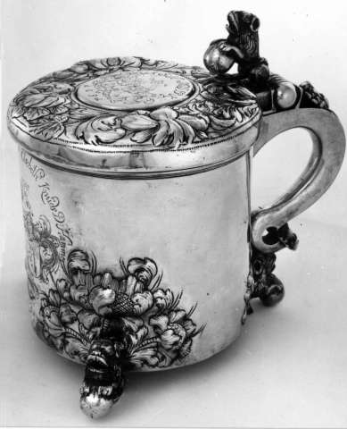
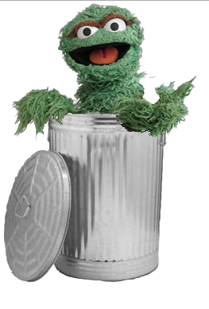
Examples of Oxidation-Reduction Reaction
Metal trash cans made from uncoated steel would corrode or rust if left outside in the rain.
Silverware and silver cups can tarnish as shown to the right.
Notes:
Timing ≈ 1.5 min
Oxidation-reduction reaction is one way to classify reactions. However, many other types of reactions can be classified as oxidation-reduction reactions.
[Animate] All combustion reactions are oxidation-reduction reactions. The reaction of propane with oxygen is both a combustion reaction and a redox reaction.
[Animate] Many synthesis reactions, including those involved in photosynthesis are redox reactions. In the overall reaction, water and carbon dioxide combine to produce glucose and oxygen. There are actually many redox reactions that occur to produce this overall reaction.
[Animate] Metals and metal compounds undergo many redox reactions. Remember rusting is a redox reaction of iron. Silver also under goes a redox reaction with hydrogen sulfide in the air. This reaction produces tarnish on silver. Notice that this reaction is also a single displacement reaction, in which silver displaces hydrogen. Single-displacement reactions are also redox reactions.
[Animate] Finally, many of the reactions that occur in all living organisms are redox reactions. Metabolism includes a complex set of reactions that both break down molecules, such as glucose, to release energy and synthesize molecules that are needed in the body. The overall reaction for the metabolism of glucose is basically the reverse of photosynthesis.
SOURCES
http://commons.wikimedia.org/wiki/File:Flames,_closeup.jpg
http://commons.wikimedia.org/wiki/File:Phytoplankton_Bloom_in_the_Bay_of_Biscay_detail.jpg
http://commons.wikimedia.org/wiki/File:Drikkekanne_Norsk_Folkemuseum_NF.1950-0001.jpg
http://commons.wikimedia.org/wiki/File:Sled_dog_yakut_laika.jpg

Slide 42
Examples of Oxidation-Reduction Reaction
2Ag⁰(s) + H₂⁺¹S⁻²(g) → Ag₂⁺¹S⁻² (s) + H₂⁰(g)
oxidation
reduction
Notes:
Timing ≈ 1.5 min
Oxidation-reduction reaction is one way to classify reactions. However, many other types of reactions can be classified as oxidation-reduction reactions.
[Animate] All combustion reactions are oxidation-reduction reactions. The reaction of propane with oxygen is both a combustion reaction and a redox reaction.
[Animate] Many synthesis reactions, including those involved in photosynthesis are redox reactions. In the overall reaction, water and carbon dioxide combine to produce glucose and oxygen. There are actually many redox reactions that occur to produce this overall reaction.
[Animate] Metals and metal compounds undergo many redox reactions. Remember rusting is a redox reaction of iron. Silver also under goes a redox reaction with hydrogen sulfide in the air. This reaction produces tarnish on silver. Notice that this reaction is also a single displacement reaction, in which silver displaces hydrogen. Single-displacement reactions are also redox reactions.
[Animate] Finally, many of the reactions that occur in all living organisms are redox reactions. Metabolism includes a complex set of reactions that both break down molecules, such as glucose, to release energy and synthesize molecules that are needed in the body. The overall reaction for the metabolism of glucose is basically the reverse of photosynthesis.
SOURCES
http://commons.wikimedia.org/wiki/File:Flames,_closeup.jpg
http://commons.wikimedia.org/wiki/File:Phytoplankton_Bloom_in_the_Bay_of_Biscay_detail.jpg
http://commons.wikimedia.org/wiki/File:Drikkekanne_Norsk_Folkemuseum_NF.1950-0001.jpg
http://commons.wikimedia.org/wiki/File:Sled_dog_yakut_laika.jpg

Slide 43
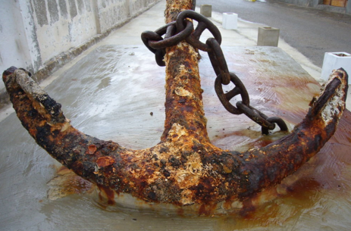
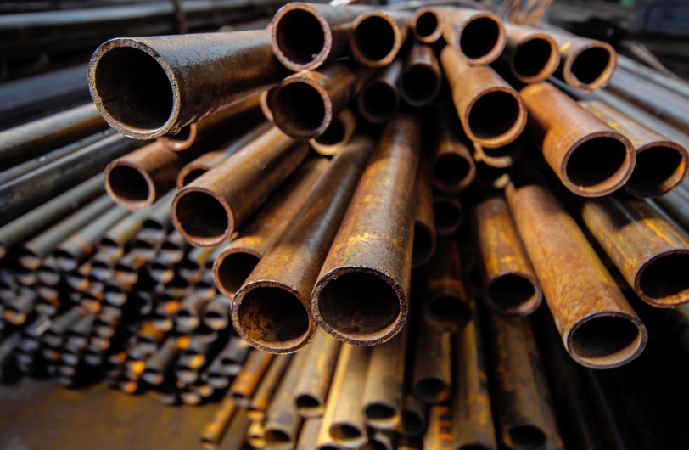
Corrosion
What happens when you leave your bike, skateboard, or wagon outside for a period of time?
Many metals corrode, tarnish, or oxidize when exposed to weather.
Can you identify the common chemical characteristic of all metal corrosion?
Notes:
Timing ≈ 1.5 min
Oxidation-reduction reaction is one way to classify reactions. However, many other types of reactions can be classified as oxidation-reduction reactions.
[Animate] All combustion reactions are oxidation-reduction reactions. The reaction of propane with oxygen is both a combustion reaction and a redox reaction.
[Animate] Many synthesis reactions, including those involved in photosynthesis are redox reactions. In the overall reaction, water and carbon dioxide combine to produce glucose and oxygen. There are actually many redox reactions that occur to produce this overall reaction.
[Animate] Metals and metal compounds undergo many redox reactions. Remember rusting is a redox reaction of iron. Silver also under goes a redox reaction with hydrogen sulfide in the air. This reaction produces tarnish on silver. Notice that this reaction is also a single displacement reaction, in which silver displaces hydrogen. Single-displacement reactions are also redox reactions.
[Animate] Finally, many of the reactions that occur in all living organisms are redox reactions. Metabolism includes a complex set of reactions that both break down molecules, such as glucose, to release energy and synthesize molecules that are needed in the body. The overall reaction for the metabolism of glucose is basically the reverse of photosynthesis.
SOURCES
http://commons.wikimedia.org/wiki/File:Flames,_closeup.jpg
http://commons.wikimedia.org/wiki/File:Phytoplankton_Bloom_in_the_Bay_of_Biscay_detail.jpg
http://commons.wikimedia.org/wiki/File:Drikkekanne_Norsk_Folkemuseum_NF.1950-0001.jpg
http://commons.wikimedia.org/wiki/File:Sled_dog_yakut_laika.jpg

Slide 44
Corrosion
Can you identify the common chemical characteristic of all metal corrosion?
Electron transfer from the metal to an oxidizing agent. The metal gets oxidized and the oxidizing agent (often oxygen) is reduced.
Stage 1: Fe⁰_{(s)} + O₂⁰_{(g)} + H₂⁺¹O⁻²_{(l)} → Fe⁺²(O⁻²H)₂⁻¹_{(s)}
Add more water due to exposure:
Fe⁺²(O⁻²H⁺¹)₂⁻¹_{(s)} + O₂⁰_{(g)} + H₂⁺¹O⁻²_{(l)} → Fe⁺³(O⁻²H⁺¹)₃⁻¹_{(s)}
Salts, acids, temperature, and exposure all accelerate corrosion.
Coating the metal, reducing exposure, and replacing metal with plastic or alloys decreases corrosion.
oxidation
reduction
Notes:
Timing ≈ 1.5 min
Oxidation-reduction reaction is one way to classify reactions. However, many other types of reactions can be classified as oxidation-reduction reactions.
[Animate] All combustion reactions are oxidation-reduction reactions. The reaction of propane with oxygen is both a combustion reaction and a redox reaction.
[Animate] Many synthesis reactions, including those involved in photosynthesis are redox reactions. In the overall reaction, water and carbon dioxide combine to produce glucose and oxygen. There are actually many redox reactions that occur to produce this overall reaction.
[Animate] Metals and metal compounds undergo many redox reactions. Remember rusting is a redox reaction of iron. Silver also under goes a redox reaction with hydrogen sulfide in the air. This reaction produces tarnish on silver. Notice that this reaction is also a single displacement reaction, in which silver displaces hydrogen. Single-displacement reactions are also redox reactions.
[Animate] Finally, many of the reactions that occur in all living organisms are redox reactions. Metabolism includes a complex set of reactions that both break down molecules, such as glucose, to release energy and synthesize molecules that are needed in the body. The overall reaction for the metabolism of glucose is basically the reverse of photosynthesis.
SOURCES
http://commons.wikimedia.org/wiki/File:Flames,_closeup.jpg
http://commons.wikimedia.org/wiki/File:Phytoplankton_Bloom_in_the_Bay_of_Biscay_detail.jpg
http://commons.wikimedia.org/wiki/File:Drikkekanne_Norsk_Folkemuseum_NF.1950-0001.jpg
http://commons.wikimedia.org/wiki/File:Sled_dog_yakut_laika.jpg

Slide 45
Balancing Redox Equations
Two different methods are used for balancing redox equations. Both are based on the fact that the total number of electrons gained in reduction must equal the total number of electrons lost in oxidation.
In the electron transfer or oxidation-number-change method, balance a redox equation by comparing the increases and decreases in oxidation numbers. This method is used especially when dealing with Electrochemistry.
In the half-reaction method, write and balance the oxidation and reduction half-reactions separately before combining them into a balanced redox equation. This tends to work best with simpler chemical reactions.

Slide 46
Electron Transfer – Oxidation Number Method
1. Write formulas for products and reactants in “skeletal” (unbalanced) equations.
HNO_{3(aq)} + H₃PO_{3(aq)} → NO_{(aq)} + H₃PO_{4(aq)} + H₂O_{(l)}
2. Assign oxidation numbers (states) to each element on both sides of the equation.

Slide 47
Electron Transfer – Oxidation Number Method
1. Write formulas for products and reactants in “skeletal” (unbalanced) equations.
HNO_{3(aq)} + H₃PO_{3(aq)} → NO_{(aq)} + H₃PO_{4(aq)} + H₂O_{(l)}
2. Assign oxidation numbers (states) to each element on both sides of the equation.
H⁺¹N⁺⁵O₃⁻²_{(aq)} + H₃⁺¹P⁺³O₃⁻²_{(aq)} → N⁺²O⁻²_{(aq)} + H₃⁺¹P⁺⁵O₄⁻²_{(aq)} + H₂⁺¹O⁻²_{(l)}
Notice that Nitrogen and Phosphorus change oxidation states from reactants to products. This reveals the redox reaction.

Slide 48
Electron Transfer – Oxidation Number Method
?
?
H⁺¹N⁺⁵O₃⁻²_{(aq)} + H₃⁺¹P⁺³O₃⁻²_{(aq)} → N⁺²O⁻²_{(aq)} + H₃⁺¹P⁺⁵O₄⁻²_{(aq)} + H₂⁺¹O⁻²_{(l)}
3. Select the atom that is oxidized (loses e-, increases oxidation number from reactant to products) and select the atom that is reduced (gains e-, decreases in oxidation number from reactants to products).
Oxidation half reaction
Reduction half reaction

Slide 49
Electron Transfer – Oxidation Number Method
reduction
oxidation
H⁺¹N⁺⁵O₃⁻²_{(aq)} + H₃⁺¹P⁺³O₃⁻²_{(aq)} → N⁺²O⁻²_{(aq)} + H₃⁺¹P⁺⁵O₄⁻²_{(aq)} + H₂⁺¹O⁻²_{(l)}
3. Select the atom that is oxidized (loses e-, increases oxidation number from reactant to products) and select the atom that is reduced (gains e-, decreases in oxidation number from reactants to products).
Oxidation half reaction P⁺³ → P⁺⁵ + 2 e-
Reduction half reaction N⁺⁵ + 3 e- → N⁺²

Slide 50
Electron Transfer – Oxidation Number Method
reduction
oxidation
H⁺¹N⁺⁵O₃⁻²_{(aq)} + H₃⁺¹P⁺³O₃⁻²_{(aq)} → N⁺²O⁻²_{(aq)} + H₃⁺¹P⁺⁵O₄⁻²_{(aq)} + H₂⁺¹O⁻²_{(l)}
4. Write balanced half-reactions (oxidation and reduction)
5. Inspect the half-reactions, checking for conservation of mass (same number of atoms on both sides) and conservation of charge (same total charge on both sides)
6. Combine the half-reactions so that the number of electrons lost in oxidation equals the number of electrons gained in reduction
Oxidation half reaction ( P⁺³ → P⁺⁵ + 2 e- ) ?
Reduction half reaction ( N⁺⁵ + 3 e- → N⁺² ) ?

Slide 51
Electron Transfer – Oxidation Number Method
H⁺¹N⁺⁵O₃⁻²_{(aq)} + H₃⁺¹P⁺³O₃⁻²_{(aq)} → N⁺²O⁻²_{(aq)} + H₃⁺¹P⁺⁵O₄⁻²_{(aq)} + H₂⁺¹O⁻²_{(l)}
4. Write balanced half-reactions (oxidation and reduction)
5. Inspect the half-reactions, checking for conservation of mass (same number of atoms on both sides) and conservation of charge (same total charge on both sides)
6. Combine the half-reactions so that the number of electrons lost in oxidation equals the number of electrons gained in reduction
Oxidation half reaction 3 ( P⁺³ → P⁺⁵ + 2 e- ) … 6 e- lost
3P⁺³ → 3P⁺⁵ + 6 e-
Reduction half reaction 2 ( N⁺⁵ + 3 e- → N⁺² ) … 6 e- gained
2N⁺⁵ + 6 e- → 2N⁺²

Slide 52
Electron Transfer – Oxidation Number Method
H⁺¹N⁺⁵O₃⁻²_{(aq)} + H₃⁺¹P⁺³O₃⁻²_{(aq)} → N⁺²O⁻²_{(aq)} + H₃⁺¹P⁺⁵O₄⁻²_{(aq)} + H₂⁺¹O⁻²_{(l)}
Oxidation half reaction 3P⁺³ → 3P⁺⁵ + 6 e-
Reduction half reaction 2N⁺⁵ + 6 e- → 2N⁺²
7. Return to the overall chemical equation and add in appropriate coefficients (based on the half-reactions) to atoms that were oxidized and reduced.

Slide 53
Electron Transfer – Oxidation Number Method
H⁺¹N⁺⁵O₃⁻²_{(aq)} + H₃⁺¹P⁺³O₃⁻²_{(aq)} → N⁺²O⁻²_{(aq)} + H₃⁺¹P⁺⁵O₄⁻²_{(aq)} + H₂⁺¹O⁻²_{(l)}
Oxidation half reaction 3P⁺³ → 3P⁺⁵ + 6 e-
Reduction half reaction 2N⁺⁵ + 6 e- → 2N⁺²
7. Return to the overall chemical equation and add in appropriate coefficients (based on the half-reactions) to atoms that were oxidized and reduced.
2HNO_{3(aq)} + 3H₃PO_{3(aq)} → 2NO_{(aq)} + 3H₃PO_{4(aq)} + H₂O _{(l)}
8. Finish by inspecting the entire chemical equation ensuring conservation of mass & charge for all atoms (reactants & products).
11 hydrogen atoms, 2 nitrogen atoms, 3 phosphorus atoms, and 15 oxygen atoms on each side of the equation

Slide 54
Balance the Redox Reaction
Copper (s) + Nitric Acid (aq) → Copper II Nitrate (aq) + Nitrogen II Oxide + Water

Slide 55
Balance the Redox Reaction
Copper (s) + Nitric Acid (aq) → Copper II Nitrate (aq) + Nitrogen II Oxide + Water
Cu⁰ _{(s)} + H⁺N⁺⁵O₃⁻²_{(aq)} → Cu⁺²(N⁺⁵O₃⁻²)_{2(aq)} + N⁺²O⁻²_{(g)} + H₂⁺O⁻²_{(l)}
Oxidation half reaction 3 ( Cu (s) → Cu²⁺ (aq) + 2 e⁻ )
3Cu_{(s)} → 3Cu²⁺_{aq)} + 6 e⁻
Reduction half reaction 2 ( N⁺⁵_{(aq)} + 3 e⁻ → N⁺²_{(g)} )
2N⁺⁵_{(aq)} + 6 e⁻ → 2N⁺²_{(g)}
3Cu_{(s)} + 8HNO_{3(aq)} → 3Cu(NO₃)_{2(aq)} + 2NO_{(g)} + 4H₂O_{(l)}
3 copper atoms, 8 nitrogen atoms, 8 hydrogen atoms,
and 24 oxygen atoms on each side of the equation
oxidation
reduction

Slide 56
Half Reaction Method
H₂S_{(g)} + O_{2(g)} → SO_{2(g)} + H₂O_{(l)}
Use the half reaction method to analyze the redox reaction and to balance the chemical reaction.

Slide 57
Half Reaction Method
H₂⁺¹S⁻² + O₂⁰ → S⁺⁴O₂⁻² + H₂⁺¹O⁻²
Oxidation half reaction
2 ( S⁻² → S⁺⁴ + 6e- ) = 2S⁻² → 2S⁺⁴ + 12 e-
Reduction half reaction
3 ( O₂⁰ + 4e- → 2O⁻² ) = 3O₂⁰ + 12 e- → 6O⁻²
In this redox reaction, 12 e- are lost & gained overall.
Use the moles from the ½ reactions to balance the overall chemical equation:
2H₂S_{(g)} + 3O_{2(g)} → 2SO_{2(g)} + 2H₂O_{(l)}
oxidation
reduction

Slide 58
Half Reaction Method
Al_{(s)} + AgNO_{3(aq)} → Al(NO₃)_{3(aq)} + Ag_{(s)}
Use the half reaction method to analyze the redox reaction and to balance the chemical reaction.

Slide 59
Half Reaction Method
Al⁰ + Ag⁺¹NO₃⁻¹ → Al⁺³(NO₃)₃⁻¹ + Ag⁰
Oxidation half reaction Al → Al⁺³ + 3e-
Reduction half reaction
3 ( Ag⁺¹ + e- → Ag⁰ ) = 3Ag⁺¹ + 3e- → 3Ag⁰
In this redox reaction, 3 e- are lost & gained overall.
Use the moles from the ½ reactions to balance the overall chemical equation:
Al_{(s)} + 3AgNO_{3(aq)} → Al(NO₃)_{3(aq)} + 3Ag_{(s)}
oxidation
reduction

Slide 60
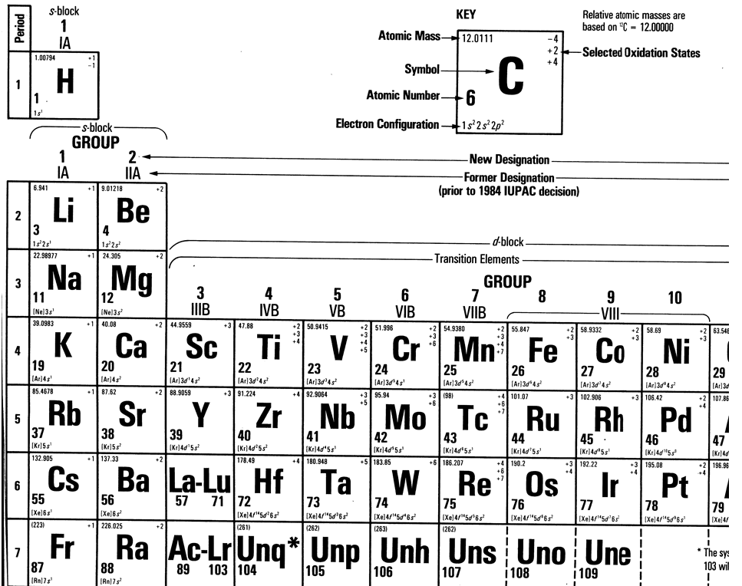

Slide 61
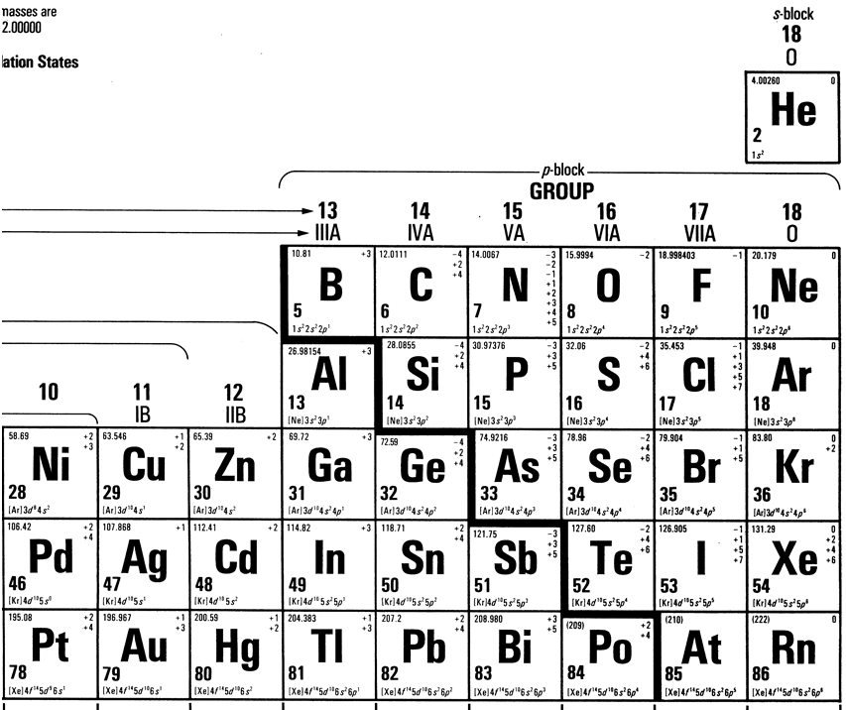

Slide 62
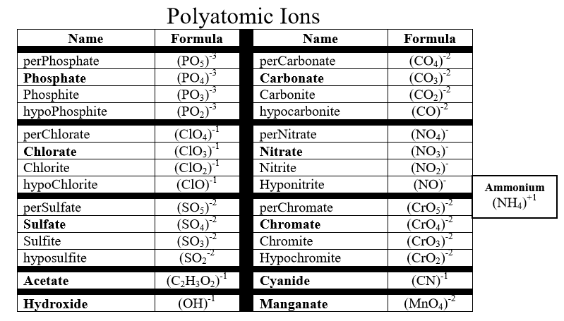

Slide 63
