Slide 1
Click on “Slide Show”
Click “Play from Beginning”

Slide 2
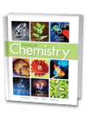

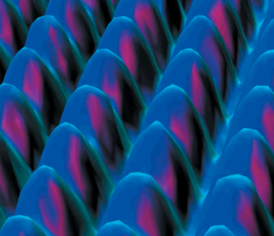
Chapter 4
Atomic Structure
Defining the Atom
Structure of the Nuclear Atom
Distinguishing Among Atoms

Slide 3
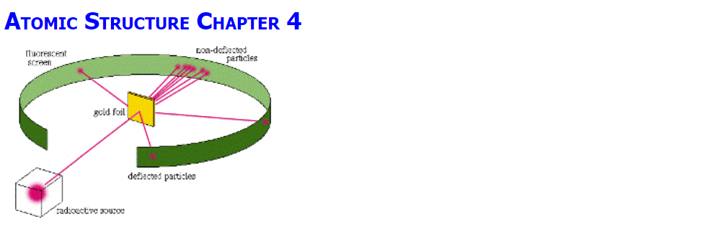
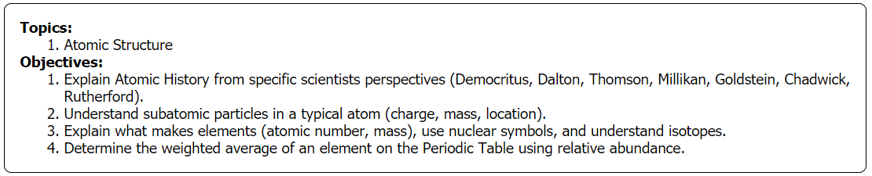

Slide 4
Watch the video and consider what causes what you observe.
http://somup.com/cFQ22DVSKM
Light, sparks, pie tin, Styrofoam, toy (1:15)

Slide 5

Early Models of the Atom
Democritus
  Greek philosopher (460 – 370 BC)
  Coined the term “Atom”
“Matter consists of discrete,
indivisible particles”
Democritus held a very general theory with no experimental evidence
Democritus’ ideas were rejected by Plato & Aristotle (fathers of philosophy and ancient “scientific thinking”) … & therefore, set aside

Slide 6
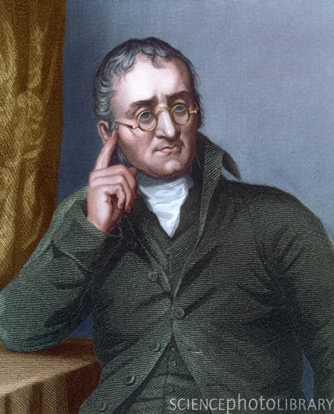
John Dalton 1766-1844
Dalton’s Atomic Theory (1808)
1. All elements are composed of extremely
small, indivisible particles called "atoms."
2. All atoms of the same element have the same chemical properties. Atoms of
different elements have different properties.
3. In the course of an ordinary chemical reaction, no atom of one element disappears or is changed into an atom of another element.
4. Compounds are formed when atoms are joined together in simple, whole-number ratios (Law of “Multiple Proportions”).

Slide 7

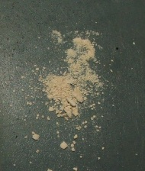
Dalton’s Work
  Forming Tin oxides
  Discovered that tin reacts with a fixed ratio of oxygen.
    100 g tin reacts with 27 g (SnO)
    or 13.5 g oxygen (SnO₂) … [definite proportions]
  Oxygen is always consumed in a 1:2 ratio BETWEEN the compounds (multiple proportions).
SnO
SnO₂
Each tin atom can combine with one or two oxygen atoms. The atoms cannot combine in any other ratios.
Notes:
Timing ≈ 2 min
[Animate pictures] Proust had found that tin oxides were either 88.1% tin and 11.9% oxygen (teacher circle left-hand photo and write in percentages), or 78.7% tin and 21.3 % oxygen. (teacher circle right-hand photo and write in percentages) Proust had obtained these numbers by breaking down the tin oxide using heat.
[Animate stem] Dalton did the opposite: he formed tin oxides by allowing tin to react with oxygen. [Animate bullet 1] When he started with 100 g of tin Dalton noted that sometimes the tin reacted with 13.5 g of oxygen and sometimes with 27 g of oxygen, but never with other amounts of oxygen.
[Animate bullet 2] Dalton realized that the amounts of oxygen being taken up by the tin was a whole number ratio of 1:2 (teacher show how 1:2 ratio is obtained).
[Animate bullet 3] Dalton deduced that there must be atoms of tin and atoms of oxygen, and [Animate blue box] each atom of tin will react with either 1 or 2 oxygen atoms to form two different compounds of tin oxide.
SOURCES:
http://commons.wikimedia.org/wiki/File:Tin%28II%29_oxide.jpg
http://commons.wikimedia.org/wiki/File:Tin_dioxide_2.JPG

Slide 8
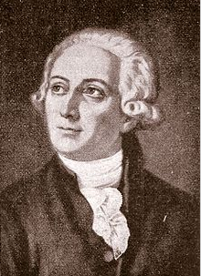
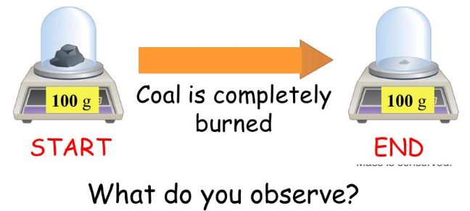
Lavoisier, ~1770
The Law of Conservation Of Mass
Matter cannot be created nor destroyed.
There is no detectable change in mass in an ordinary chemical reaction.
All compounds/elements that react are just rearranging their atoms.

Slide 9
Acrylic Tape
Watch the video “Electrostatic Force”
http://somup.com/cF6elPnVza (2:59)
or
Take TWO separate pieces of acrylic tape ~ 7.5 cm long (3 inches).
Hold them “back” to “back” so the NON sticky sides are facing each other.
Bring them together slowly and observe.

Slide 10
Acrylic Tape
NOW, take TWO other separate pieces of acrylic tape ~ 7.5 cm long (3 inches).
Hold them by the ends and place one on top of the other on your table so that one sticks to the table & the other sticks to the NON sticky side of the one on the table.
Pull the pieces off the table. Pull them apart and then bring them together slowly “back” to “back” & observe.

Slide 11
Acrylic Tape
In the first case you should have noticed “attraction”
In the second case, “Repulsion”
-
-
-
+
+
+
WHY?

Slide 12
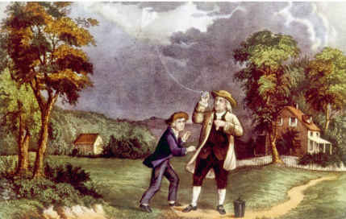
Historical Overview
2 Structure of the Atom
Benjamin Franklin
Learned from experiments with
thunderstorms, that lightning
is a flow of electrical energy
through the atmosphere.
He arbitrarily decided that there must be “charges” … and called them charge “A” and charge “B”.

Slide 13
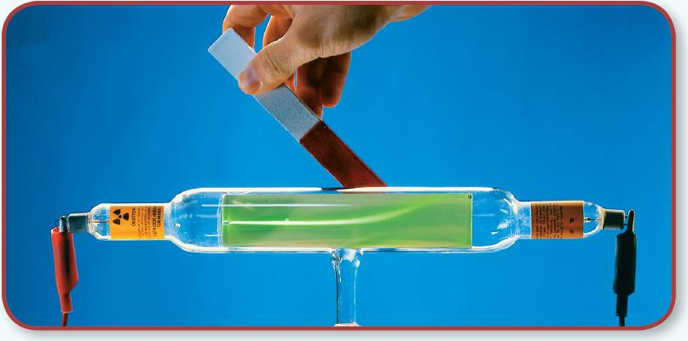
2 Structure of the Atom
Subatomic Particles
Electrons
A “cathode ray” can also be deflected by a magnet.
http://somup.com/cF6eVJnVy6 (1:07)

Slide 14
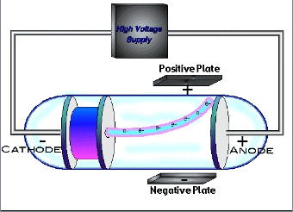
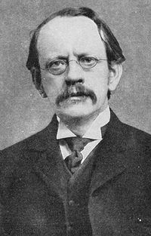
Electron: J.J. Thomson
2 Structure of the Atom
In 1897, JJ Thomson got the same result as Crookes with any gas he used, which contradicted Dalton’s assumption that all atoms are indivisible.
He theorized the existence of a particle common to all atoms → using the charged plates on either side of the tube, he showed the particle was negatively charged.

Slide 15
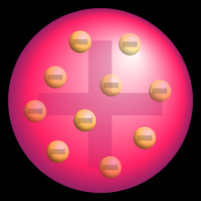
The Plum Pudding Model
2 Structure of the Atom
  Thomson's results led to the proposal of a new atomic model, the plum pudding model.
  Electrons floating in a sea of positive charges
  Modification of Dalton’s model of a solid, indivisible sphere
  Recognition of the existence of electrons and the neutrality of the whole atom
Notes:
Timing ≈ 0.5 min
[Animate stem] Thomson's results led to the proposal of a new atomic model, the plum-pudding model. Plum pudding was a common dessert at the time. It consisted of raisins baked into a breadlike custard.
[Animate bullet 1] In this model, an atom is a mass of positively charged material in which electrons float, like the raisins in plum pudding--or the chocolate chips in a cookie or the raisins in a bagel.
[Animate bullet 2] This model is different from Dalton's model of an atom as a solid, indivisible sphere.
[Animate bullet 3] The positive charge in the main mass of the atom balances out the negative charge from the electrons, so the atom is still neutral.
Image: http://en.wikipedia.org/wiki/Plum_pudding_model

Slide 16
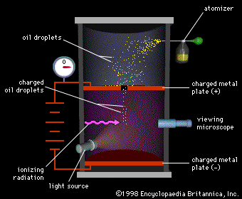
Millikan’s Oil Drop Experiment
2 Structure of the Atom
http://somup.com/cF6eVdnVyl (1:14)
Millikan repeatedly measured charges between the positive and negatively charged plates and found that they were always a multiple of
1.60 x 10⁻¹⁹ coulomb.
Millikan called this the
charge on the electron.

Slide 17
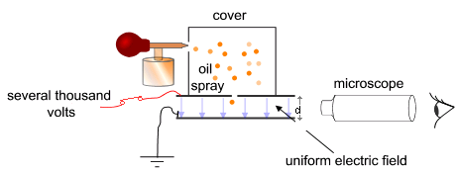
Millikan’s Oil Drop Experiment
  Oil drop experiment
  Measured rate of fall of charged oil droplets.
  Determined the charge on an electron.
  Thomson’s experiment: mass-to-charge ratio for an electron.
Together, Millikan’s and Thomson’s results allowed for the determination of the mass and charge of the electron.
Notes:
Timing ≈ 1 min
[Animate stem] An American scientist, Robert Millikan, used an ingenious method to determine the actual charge, in coulombs (teacher explain that this is a unit to express charge), on an electron
(teacher use diagram to explain experiment) He sprayed oil droplets into an electric field. The droplets became charged as they entered the system through a spray nozzle. Millikan was able to apply just enough of an electric field to keep a charged oil droplet in mid air, while all the other droplets fell away. [Animate bullet 1] The one droplet was allowed to fall and Millikan was able to use mathematics to compare the pull of gravity on the droplet with the pull of the electrical field on the oil drop to [Animate bullet 2] determine the charge.
[Animate bullet 3] Thomson's results had allowed him to determine the ratio of mass to charge for an electron.
[Animate blue box] Together, the results of Millikan and Thomson gave the mass and the charge on an electron. (teacher briefly show how knowing ratio of mass to charge and charge allows you to calculate mass--write equation)
SOURCE:
http://commons.wikimedia.org/wiki/File:Simplified_scheme_of_Millikan%E2%80%99s_oil-drop_experiment.png

Slide 18
Modify the Theory
The pictures show two different models of the atom.
Which model best represents Dalton’s atomic theory?
Which model best represents the modifications to the theory that Thomson’s results made necessary?
–
–
–
–
–
–
–
Model A
Model B
Notes:
Timing ≈ 0.5 min
Entry Audio: Thomson’s discovery that the atom contains electrons required that the accepted model of the atom be changed.
Hint Audio: Which model best represents an indivisible atom?
Exit Audio: As a result of Thomson’s work, the accepted model of the atom changed.

Slide 19
Modify the Theory
The pictures show two different models of the atom.
Which model best represents Dalton’s atomic theory?
Which model best represents the modifications to the theory that Thomson’s results made necessary?
–
–
–
–
–
–
–
Model A
Model B
Thomson
“plum pudding”
Dalton
Indivisible particle
Notes:
Timing ≈ 0.5 min
Entry Audio: Thomson’s discovery that the atom contains electrons required that the accepted model of the atom be changed.
Hint Audio: Which model best represents an indivisible atom?
Exit Audio: As a result of Thomson’s work, the accepted model of the atom changed.

Slide 20
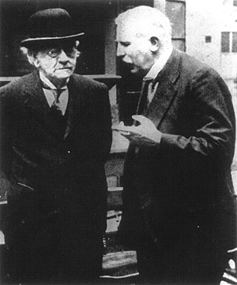
Testing the Plum Pudding Model
  Ernest Rutherford (right) developed an experiment to test the plum pudding model of JJ Thomson (left).
http://somup.com/cF6eVsnVyD
Empty space (0:48)
http://somup.com/cF6eVMnVyb Rutherford (0:47)
Notes:
Timing ≈ 2 min
The plum-pudding model adequately explain Thomson's results. However, another scientist, [Animate stem] Ernest Rutherford, worked with his graduate students to develop an experiment to test whether this model was accurate.
[Animate bullet 1 and diagram] In this experiment positively charge particles are fired at small amount of gold foil.
A detector surrounded the foil to detect any particles that bounced off or passed through the foil.
SOURCE:
source of sample image: http://www.daviddarling.info/encyclopedia/R/Rutherfords_experiment_and_atomic_model.html

Slide 21
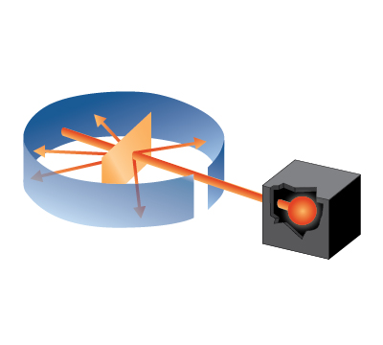
Rutherford’s Experiment (1871–1937)
  He shot alpha particles (+) at a thin sheet of gold foil.
  Reflected particles are detected at various angles.
Gold Foil
Stream of Particles
Detecting Screen
Slit
Notes:
Timing ≈ 2 min
The plum-pudding model adequately explain Thomson's results. However, another scientist, [Animate stem] Ernest Rutherford, worked with his graduate students to develop an experiment to test whether this model was accurate.
[Animate bullet 1 and diagram] In this experiment positively charge particles are fired at small amount of gold foil.
A detector surrounded the foil to detect any particles that bounced off or passed through the foil.
SOURCE:
source of sample image: http://www.daviddarling.info/encyclopedia/R/Rutherfords_experiment_and_atomic_model.html

Slide 22
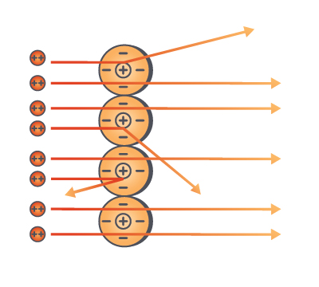
Rutherford’s Results: Discovery of the Nucleus
  Most particles pass straight through gold foil (99%)
  A few particles deflected at very large angles ???
  Conclusions:
  ?
Nucleus
Diagram is not drawn to scale
Notes:
Timing ≈ 1 min
[Animate stem, bullet 1, and diagram] The results of Rutherford's experiment were unexpected. He observed that most of the particles passed straight through the foil, but a few were [Animate bullet 2] deflected 9 (teacher, explain reason for deflection) at very steep angles. A commonly used analogy is firing a bullet at a piece of tissue paper and having it bounce back at you.
[Animate stem 2] Rutherford concluded two things from the gold foil experiment:
[Animate bullet 3] There is a lot of space in atoms – as a matter of fact most of an atom is space, with the tiny electrons somehow located within this space. (teacher point out that the diagram on the slide is not to scale--the nuclei are actually much, much smaller than shown here).
[Animate bullet 4] Positive charge is concentrated at the center of the atom – Rutherford had discovered the nucleus
[Animate bullet 5] The volume of the nucleus is small compared to the volume of the atom, but most of the mass of the atom is concentrated there.
SOURCE:
http://www.tutorvista.com/content/science/science-i/structure-atom/structure.php

Slide 23
Rutherford’s Results: Discovery of the Nucleus
  Most particles pass straight through gold foil (99%)
  A few particles deflected at very large angles ???
  Conclusions:
  Atom: mostly empty space.
  Positive charge is concentrated in small, central region (nucleus).
  Volume of nucleus: small; mass: large.
Nucleus
Diagram is not drawn to scale
Notes:
Timing ≈ 1 min
[Animate stem, bullet 1, and diagram] The results of Rutherford's experiment were unexpected. He observed that most of the particles passed straight through the foil, but a few were [Animate bullet 2] deflected 9 (teacher, explain reason for deflection) at very steep angles. A commonly used analogy is firing a bullet at a piece of tissue paper and having it bounce back at you.
[Animate stem 2] Rutherford concluded two things from the gold foil experiment:
[Animate bullet 3] There is a lot of space in atoms – as a matter of fact most of an atom is space, with the tiny electrons somehow located within this space. (teacher point out that the diagram on the slide is not to scale--the nuclei are actually much, much smaller than shown here).
[Animate bullet 4] Positive charge is concentrated at the center of the atom – Rutherford had discovered the nucleus
[Animate bullet 5] The volume of the nucleus is small compared to the volume of the atom, but most of the mass of the atom is concentrated there.
SOURCE:
http://www.tutorvista.com/content/science/science-i/structure-atom/structure.php

Slide 24
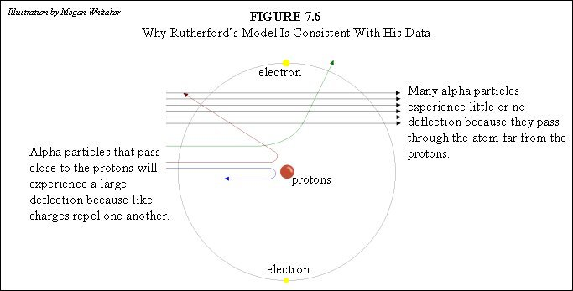
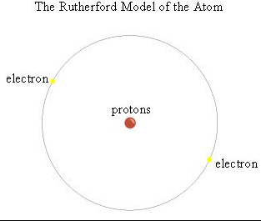
Led to the Initial Planetary Model of the Atom
Dense, positive nucleus of atom orbited by electrons.

Slide 25
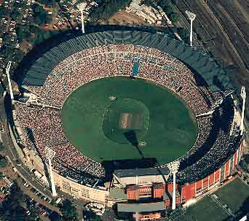
Relative Size of the Hydrogen Atom ENRICHMENT
Diameter of the ATOM ~ the size of Houston astrodome
with a NUCLEUS the size of a marble
e-

Slide 26
Modifying the Atomic Model
Place the models in chronological order and state who is responsible for each model (Dalton, Rutherford, Thomson)?
Atom
–
–
+
–
–
+
–
–
+
+
+
–
–
+
–
–
A
B
C
Notes:
Timing ≈ 0.5 min
Entry Audio: Just as Thomson’s results required a modification to Dalton’s theory, Rutherford’s results required a modification to Thomson’s plum pudding model.
Hint Audio: Which model shows the positive charge concentrated at the center of the atom?
Exit Audio: As a result of Rutherford’s experiment, the plum pudding model was modified. Further research has caused even more revision to this model giving way to the modern atomic theory.

Slide 27
Modifying the Atomic Model
Place the models in chronological order and state who is responsible for each model (Dalton, Rutherford, Thomson)?
Atom
–
–
+
–
–
+
–
–
+
+
+
–
–
+
–
–
Dalton
Indivisible particle
Rutherford
“nucleus”
(positive center) with orbiting electrons
Thomson
Plum pudding
Notes:
Timing ≈ 0.5 min
Entry Audio: Just as Thomson’s results required a modification to Dalton’s theory, Rutherford’s results required a modification to Thomson’s plum pudding model.
Hint Audio: Which model shows the positive charge concentrated at the center of the atom?
Exit Audio: As a result of Rutherford’s experiment, the plum pudding model was modified. Further research has caused even more revision to this model giving way to the modern atomic theory.

Slide 28
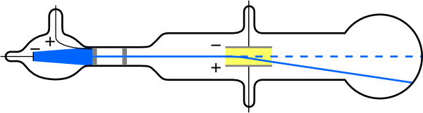
2 Structure of the Atom
Subatomic Particles
Protons
In 1886, Eugen Goldstein (1850–1930) observed a cathode-ray tube to discover a new particle.
Protons were originally called “canal rays” in the CRT, electrons were called “cathode rays”.
“Canal Rays” responded opposite to the “cathode rays” (electrons) indicating an opposite charge.
+
-

Slide 29
2 Structure of the Atom
Subatomic Particles
Neutrons
Physicist James Chadwick (1891–1974) confirmed the existence of yet another subatomic particle: the neutron.
Chadwick bombarded Beryllium with alpha particles and found a new particle was released.
No charge (did not deflect under electric or magnetic field influence).
Essentially the same mass as the proton.
Highly penetrable particle (could penetrate 10-20 cm into lead).

Slide 30
Atomic Mass Unit
The atomic mass unit is the unit used to express the mass of an atom.
One-twelfth the mass of a C-12 atom
Corresponds to 1.660538921 × 10⁻²⁴ g
Notes:
Timing ≈ 0.5 min
The three types of particles within the atom do not have the same mass. Remember that all of the particles are very small. If the mass of a paperclip is about one gram, all of the particles are much smaller than the paperclip (6 with 23 zeros times smaller than the paperclip!)
Scientists use the unit [Animate definition] amu, or atomic mass unit, to describe the mass of subatomic particles on an atomic scale.
[Animate bullet 1] The atomic mass unit is 1/12th the mass of a C-12 atom and [Animate bullet 2] corresponds to 1.660538921×10⁻²⁴ g

Slide 31
2 Structure of the Atom
This table summarizes the properties of the subatomic particles.
Properties of Subatomic Particles
Particle | Symbol | Relative charge | Relative mass (mass of proton = 1) | Actual mass (g)
Electron | e– | 1– | 1/1840 amu | 9.11 × 10^{–28}
Proton | p⁺ | 1+ | 1 amu | 1.66 × 10^{–24}
Neutron | n⁰ | 0 | 1 amu | 1.66 × 10^{–24}

Slide 32
2 Structure of the Atom
This table summarizes the properties of the subatomic particles.
Properties of Subatomic Particles
Particle | Symbol | Relative charge | Relative mass (mass of proton = 1) | Actual mass (g)
Electron | e– | 1– | 1/1840 amu | 9.11 × 10^{–28}
Proton | p⁺ | 1+ | 1 amu | 1.66 × 10^{–24}
Neutron | n⁰ | 0 | 1 amu | 1.66 × 10^{–24}

Slide 33
Atom History Song
2 Structure of the Atom
http://somup.com/cFQ22rVSKR
Mark Rosengarten Atom History (4:14)

Slide 34
The Atom
The Atom is the smallest particle of an element that has the same properties as the element.
The atom can be divided into two parts:
  Nucleus: Central portion of the atom
  Orbitals: Regions surrounding the nucleus
Orbitals
Nucleus
Notes:
Timing ≈ 0.5 min
[Animate definition of atom] Atoms are the smallest particles of an element that cannot be broken down further without changing the properties of the element. Remember that when cutting the aluminum can, there was a smallest particle that you could reach. This smallest particle is the atom. [Animate The atom can be divided into two parts:]
All atoms have a similar arrangement. [Animate The atom can be divided into two parts:]
[Animate bullet 1] An atom contains a nucleus, which is in the center of the atom.
[Animate bullet 2] The atom also has orbitals surrounding the nucleus. The orbitals are in reality electron clouds that describe possible locations of the electrons.
The smaller particles of the atom, which are known as subatomic particles, are found in either of these atomic locations.
SOURCES:

Slide 35
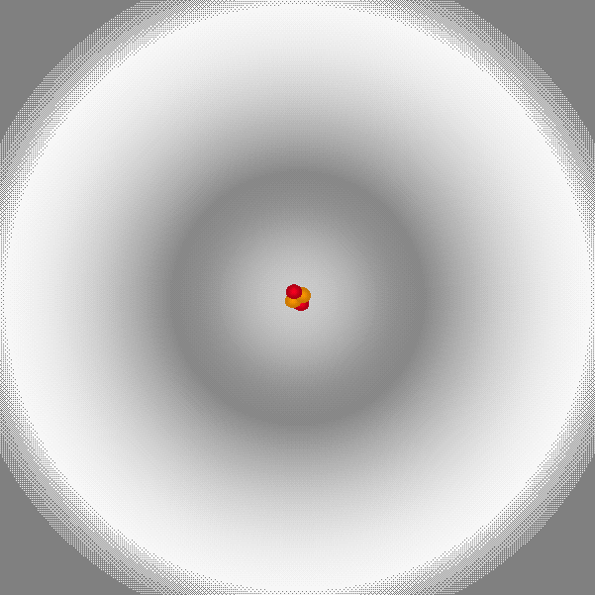
The Atom
Atom is the smallest particle of an element that has the same properties as the element.
The atom can be divided into two parts:
  Nucleus: Central portion of the atom
  Orbitals: Regions surrounding the nucleus
Orbitals
Nucleus
Notes:
Timing ≈ 0.5 min
[Animate definition of atom] Atoms are the smallest particles of an element that cannot be broken down further without changing the properties of the element. Remember that when cutting the aluminum can, there was a smallest particle that you could reach. This smallest particle is the atom. [Animate The atom can be divided into two parts:]
All atoms have a similar arrangement. [Animate The atom can be divided into two parts:]
[Animate bullet 1] An atom contains a nucleus, which is in the center of the atom.
[Animate bullet 2] The atom also has orbitals surrounding the nucleus. The orbitals are in reality electron clouds that describe possible locations of the electrons.
The smaller particles of the atom, which are known as subatomic particles, are found in either of these atomic locations.
SOURCES:

Slide 36
Charged Particles in the Atom
The atom is made of three particles: protons, electrons, and neutrons.
+
–
Protons are positively charged.
Electrons are negatively charged.
Neutrons are not charged.
Notes:
Timing ≈ 0.5 min
The atom is made of three different types of particles. They are protons, neutrons, and electrons. These particles have different properties that can be described by the charge on the particle.
[Animate proton diagram and partial definition] A proton provides one positive charge to the atom.
[Animate electron diagram and partial definition] The electron is a negatively charged particle. The charge on an electron is equal in magnitude but opposite in sign to that on a proton (teacher explain).
[Animate neutron diagram and partial definition] The neutron is a neutral particle.
An atom can have any combination of each of these subatomic particles. In an atom that does not have a charge, or is said to be neutral, the number of protons is equal to the number of electrons. However, the number of neutrons can vary between different atoms-even atoms of the same element.

Slide 37
N
+
-
+
-
N
  Different elements have different particle counts and arrangements

Slide 38
HELIUM ATOM
Energy
Level
proton
N
+
-
+
-
N
electron
neutron
  Different elements have different particle counts and arrangements

Slide 39
Determine the Locations of Subatomic Particles
Type the name of the location of each particle.
Particle Charge Location ~Mass
? +1 ? ?
? 0 ? ?
? -1 ? ?
A
B
Notes:
Timing ≈ 0.5 min
Exit audio: Protons and neutrons are found in the nucleus of the atom. Electrons surround the nucleus in orbitals.

Slide 40
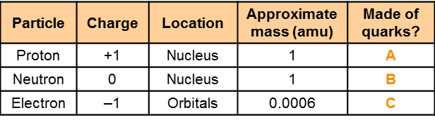
Determine the Locations of Subatomic Particles
A
B
0
Notes:
Timing ≈ 0.5 min
Exit audio: Protons and neutrons are found in the nucleus of the atom. Electrons surround the nucleus in orbitals.

Slide 41
What is the structure of the atom?
13
Al
Aluminum
26.98
14
Si
Silicon
28.09
15
P
Phosphorus
30.974
How do we distinguish atoms of different elements?
Notes:
Timing ≈ 0.5 min
Recap: All elements are made of small particles called atoms.
Connect: These atoms are made of smaller particles, called protons, neutrons, and electrons. All elements are different from each other because of the number of each type of subatomic particle in each type of atom.
Preview: The element Aluminum [Animate left box] is different from other elements, like silicon [Animate right box], because of its atomic structure. Now that you understand the particles that make up the atom, [Animate preview] let's see how the each of the subatomic particles are used to distinguish different elements.
SOURCES:
Aluminum : Albedo-ukr uploaded December 22, 2007 http://commons.wikimedia.org/wiki/File:Aluminum.svg
Silicon: Albedo-ukr uploaded December 26, 2007 http://commons.wikimedia.org/wiki/File:Silicon.svg

Slide 42
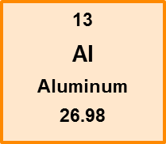
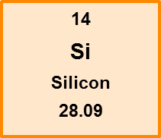
Atomic number
Atomic number (Z)
  Number of protons in an atom
  Differs for each element
Every atom of a given element has the same atomic number, and atomic number can be used to identify an element.
Notes:
Timing ≈ 1 min
[Animate bullet 1] The number of protons in an atom is the atom's atomic number. Atomic number is often represented by the symbol Z (teacher underline).
[Animate bullet 2] Each element has a unique atomic number that is equal to the number of protons in the nucleus of every atom of that element. (emphasize that protons, not neutrons or electrons, determines atomic number)
[Animate bullet 3 and green bullet] All of the elements in the periodic table are organized by their atomic number.
[Animate Al box] The atomic number is the number written above the element in the periodic table. For example, the element Aluminum has an atomic number of 13 (teacher circle 13). This means that there are 13 protons in the nucleus of all aluminum atoms. As you go across the periodic table, the atomic number increases by 1. The element to the right of aluminum in the periodic table is Silicon[Animate Si box]. It has an atomic number of 14, 1 more than aluminum, (teacher circle 14).
Atomic number is a characteristic property of an element. If you know the number of protons in an atom, you know for certain what element that atom is an atom of [Animate blue box].

Slide 43
Mass number (A)
  Total number of protons + neutrons
  Usually varies from atom to atom
  Aluminum-27
  Al-27
  ²⁷Al
?
27
13
Al
?
# neutrons = ?
Notes:
Timing ≈ 2 min
The mass number provides the total mass of the nucleus, or the [Animate bullet 1] total number of protons and neutrons.
Just as atomic number is represented by Z, mass number is often represented by A (teacher underline).
[Animate bullet 2] The mass number can be different in different atoms, even atoms of the same element.
[Animate Ways to represent an atom] You can show the mass number of an atom in different ways. Let us use Al as our example. The mass number of aluminum is 27.
[Animate bullet 3] One way is to write the name of the element followed by the mass number.
[Animate bullet 4] You may also see it abbreviated using the chemical symbol.
[Animate bullet 5] Sometimes mass number is placed as a superscript to the left of the chemical symbol.
[Animate diagram with labels] When the mass number and atomic number both need to be shown, the mass number is shown as a superscript (teacher circle) and the atomic number is shown as a subscript (teacher circle). For aluminum, you already know that the atomic number is 13. This tells you that the number of protons in aluminum is 13.
[Animate equations] If you know the atomic number (teacher circle Z in equation) and the mass number (teacher circle A) you can calculate the number of neutrons, N (teacher circle) in the atom (teacher explain Al example).
[Animate blue box] It is important to remember this: all atoms of a given element have the same atomic number. However, atoms of the same element may have different mass numbers. We explore this more later in this lesson.

Slide 44
Mass number (A)
  Total number of protons + neutrons
  Usually varies from atom to atom
  Aluminum-27
  Al-27
  ²⁷Al
Mass number
27
13
Al
Atomic number
# neutrons = A – Z
27 – 13 = 14 neutrons
All atoms of an element have the same atomic number, but atoms of the same element can have different mass numbers.
Notes:
Timing ≈ 2 min
The mass number provides the total mass of the nucleus, or the [Animate bullet 1] total number of protons and neutrons.
Just as atomic number is represented by Z, mass number is often represented by A (teacher underline).
[Animate bullet 2] The mass number can be different in different atoms, even atoms of the same element.
[Animate Ways to represent an atom] You can show the mass number of an atom in different ways. Let us use Al as our example. The mass number of aluminum is 27.
[Animate bullet 3] One way is to write the name of the element followed by the mass number.
[Animate bullet 4] You may also see it abbreviated using the chemical symbol.
[Animate bullet 5] Sometimes mass number is placed as a superscript to the left of the chemical symbol.
[Animate diagram with labels] When the mass number and atomic number both need to be shown, the mass number is shown as a superscript (teacher circle) and the atomic number is shown as a subscript (teacher circle). For aluminum, you already know that the atomic number is 13. This tells you that the number of protons in aluminum is 13.
[Animate equations] If you know the atomic number (teacher circle Z in equation) and the mass number (teacher circle A) you can calculate the number of neutrons, N (teacher circle) in the atom (teacher explain Al example).
[Animate blue box] It is important to remember this: all atoms of a given element have the same atomic number. However, atoms of the same element may have different mass numbers. We explore this more later in this lesson.

Slide 45
“Nuclear Symbols”
Mass number
He
Atomic number

Slide 46
“Nuclear Symbols”
Mass number
He
2
Atomic number
2 protons

Slide 47
“Nuclear Symbols”
4
Mass number
He
2 protons & 2 neutrons
2
Atomic number
2 protons

Slide 48
Due to Word Processing
Mass number
He
4
2 protons & 2 neutrons
2
Atomic number
2 protons

Slide 49
“Nuclear Symbols”
4
Mass number
He
2 protons & 2 neutrons
2
Atomic number
2 protons
In a neutral atom
number of electrons = number of protons

Slide 50
3 Distinguishing Among Atoms
Determining the Composition of an Atom
  What is the atomic number (Z) and atomic mass (A) for each element? How many protons, electrons, and neutrons are in each atom?
9
4
Be Ne Na
20
10
23
11

Slide 51
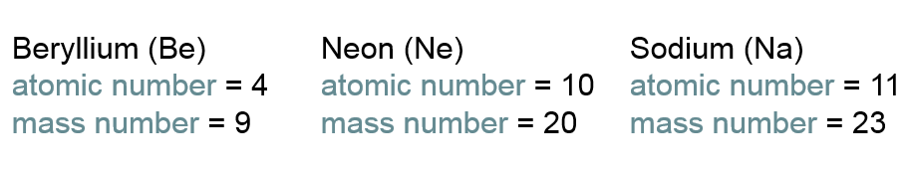
3 Distinguishing Among Atoms
Determining the Composition of an Atom
  What is the atomic number (Z) and atomic mass (A) for each element? How many protons, electrons, and neutrons are in each atom?
9
4
Be Ne Na
20
10
23
11
Be has 4 protons, 5 neutrons, and 4 electrons
Ne has 10 protons, 10 neutrons, and 10 electrons
Na has 11 protons, 12 neutrons, and 11 electrons

Slide 52

Nuclear symbols are used by scientist as a standard way to represent elements, showing both the atomic and mass numbers [Which is which?]
₁H¹
Hydrogen has ? proton, ? neutrons, and ? electron

Slide 53
Nuclear symbols are used by scientist as a standard way to represent elements, showing both the atomic and mass numbers
mass number
₁H¹
atomic #
Hydrogen has 1 proton, 0 neutrons, and 1 electron

Slide 54
Nuclear symbols are used by scientist as a standard way to represent elements, showing both the atomic and mass numbers [Which is which?]
₇N¹⁴
Nitrogen has ? protons, ? neutrons, and ? electrons

Slide 55
Nuclear symbols are used by scientist as a standard way to represent elements, showing both the atomic and mass numbers
mass number
atomic #
₇N¹⁴
Nitrogen has 7 protons, 7 neutrons, and 7 electrons

Slide 56
Nuclear symbols are used by scientist as a standard way to represent elements, showing both the atomic and mass numbers [Which is which?]
₂₆Fe⁵⁶
Iron has ? protons, ? neutrons, and ? electrons

Slide 57
Nuclear symbols are used by scientist as a standard way to represent elements, showing both the atomic and mass numbers
mass number
atomic #
₂₆Fe⁵⁶
Iron has 26 protons, 30 neutrons, and 26 electrons

Slide 58
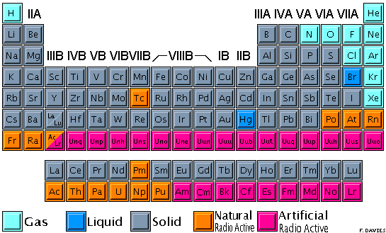

Slide 59
Example: Magnesium
Elements are often represented in the following format in tables or charts
Atomic #
12
Mg
Element Symbol
24.305
Atomic Mass
(this is an average mass)

Slide 60
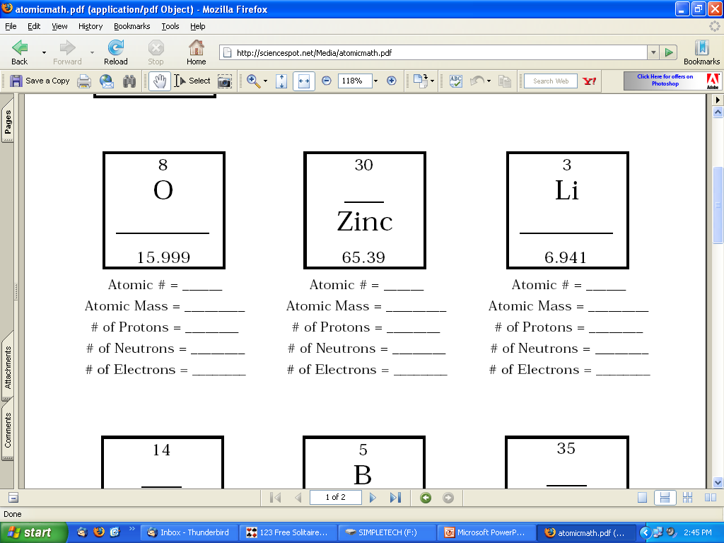
Nuclear symbol?

Slide 61
₃₀Zn⁶⁵
30
65
30
35
30

Slide 62
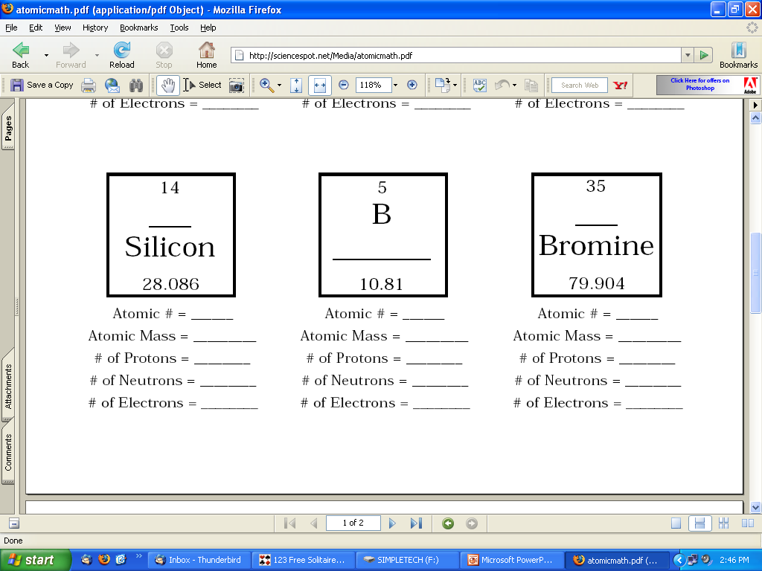
Nuclear symbol?

Slide 63
₃₅Br⁸⁰
35
80
35
45
35

Slide 64
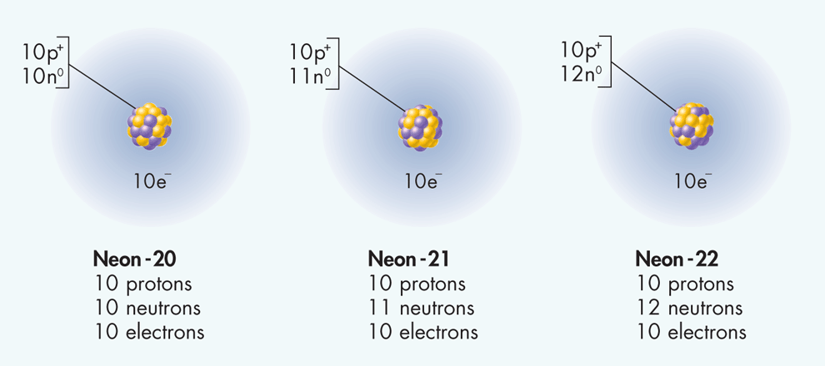
Isotopes
3 Distinguishing Among Atoms
Isotopes are atoms that have the same number of protons but different numbers of neutrons. Therefore, they have the same chemical properties.
Neon-20, neon-21, and neon 22 are isotopes of neon.

Slide 65
Isotopes
3 Distinguishing Among Atoms
Isotopes are atoms that have the same number of protons but different numbers of neutrons. Therefore, they have the same chemical properties.
Neon-20, neon-21, and neon 22 are isotopes of neon.

Slide 66
Isotopes of Neutral Atoms
Atoms of the same element with different mass numbers.
  Number of protons are the same
  Number of electrons are the same
  Number of neutrons are different
Isotope | Z | n | A
Sn-112 | 50 | 62 | 112
Sn-114 | 50 | 64 | 114
Sn-115 | 50 | 65 | 115
Sn-116 | 50 | 66 | 116
Sn-117 | 50 | 67 | 117
Sn-118 | 50 | 68 | 118
Sn-119 | 50 | 69 | 119
Notes:
Timing ≈ 0.5 min
[Animate green word and orange bullet] Atoms of the same element can have different mass numbers. When they do, they are isotopes of each other (teacher discuss green bullets a bit).
[Animate table] Look at the following example of the six different isotopes of aluminum. Remember that the atomic number (teacher circle Z) of an element is always the same, but the mass number (teacher circle A) for an element can be different. Aluminum-30 has 3 more neutrons in its nucleus than Aluminum-27, but they both have 13 protons and 13 electrons. Similarly, Aluminum-24 has 5 fewer neutrons than Aluminum-29, but again they both have 13 protons and 13 electrons (teacher circle or underline where appropriate to focus students on part of table you are discussing and relate to green bullets when appropriate).
Briefly point out that when people talk about radioactive elements, such as U-238 or C-14 for dating, they're talking about specific isotopes.

Slide 67
Atomic Mass
3 Distinguishing Among Atoms
  An atomic mass unit (amu) is defined as one-twelfth of the mass of a carbon-12 atom.
  This isotope of carbon has been assigned a mass of exactly 12 atomic mass units.
  In nature, most elements occur as a mixture of two or more isotopes.
  Each isotope of an element has a fixed mass and a natural percent abundance.

Slide 68
Atomic Mass
3 Distinguishing Among Atoms
  An atomic mass unit (amu) is defined as one-twelfth of the mass of a carbon-12 atom.
  This isotope of carbon has been assigned a mass of exactly 12 atomic mass units.
  In nature, most elements occur as a mixture of two or more isotopes.
  Each isotope of an element has a fixed mass and a natural percent abundance.
₆C¹²

Slide 69

3 Distinguishing Among Atoms
Natural Percent Abundance of Stable Isotopes of Some Elements
Name | Symbol | Natural percent abundance | Mass (amu) | Atomic mass
Hydrogen | H H H | 99.985 0.015 negligible | 1.0078 2.0141 3.0160 | 1.0079
Helium | He He | 0.0001 99.9999 | 3.0160 4.0026 | 4.0026
Carbon | C C | 98.89 1.11 | 12.000 13.003 | 12.011
Oxygen | O O O | 99.759 0.037 0.204 | 15.995 16.995 17.999 | 15.999
Chlorine | Cl Cl | 75.77 24.23 | 34.969 36.966 | 35.453
1
1
2
1
3
1
3
2
4
2
12
6
13
6
16
8
17
8
18
8
35
17
37
17

Slide 70
3 Distinguishing Among Atoms
Natural Percent Abundance of Stable Isotopes of Some Elements
Name | Symbol | Natural percent abundance | Mass (amu) | Atomic mass
Hydrogen | H H H | 99.985 0.015 negligible | 1.0078 2.0141 3.0160 | 1.0079
Helium | He He | 0.0001 99.9999 | 3.0160 4.0026 | 4.0026
Carbon | C C | 98.89 1.11 | 12.000 13.003 | 12.011
Oxygen | O O O | 99.759 0.037 0.204 | 15.995 16.995 17.999 | 15.999
Chlorine | Cl Cl | 75.77 24.23 | 34.969 36.966 | 35.453
1
1
2
1
3
1
3
2
4
2
12
6
13
6
16
8
17
8
18
8
35
17
37
17

Slide 71
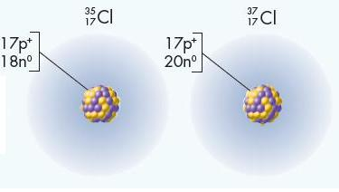
Atomic Mass
3 Distinguishing Among Atoms
Chlorine exists as chlorine-35 and chlorine-37.
Chlorine’s atomic mass on the Periodic Table is 35.453 amu. (Notice it is not exactly in-between.)
Which isotope is more abundant?

Slide 72
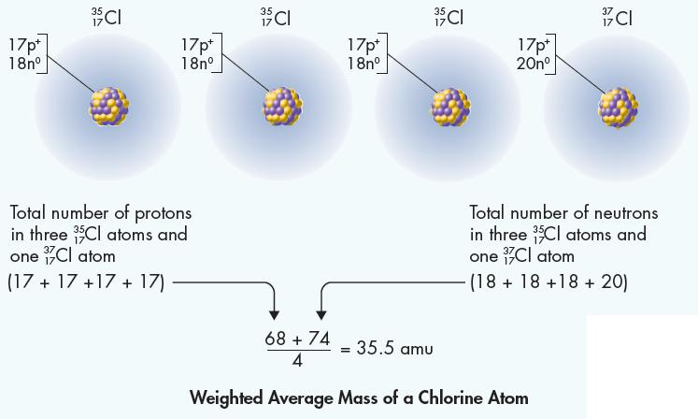
Atomic Mass
3 Distinguishing Among Atoms
In nature there is 76% Cl-35 than 24% Cl-37, therefore, the atomic mass of chlorine, 35.453 amu, is closer to 35 than to 37.

Slide 73
Calculating Average Atomic Mass
The average atomic mass is the weighted average mass of all isotopes of an element.
Abundance of aluminum isotopes:
100% is from Al-27
Therefore, no isotopes
Al-26 is radioactive (not natural)
Notes:
Timing ≈ 0.5 min
[Animate definition] In the periodic table, the number below the elemental symbol represents the average atomic mass of the element [Animate two orange boxes] (teacher point to average atomic mass of Al and Si).

Slide 74
Average Atomic Mass
Abundance of silicon isotopes:
92.2297% is from Si-28
4.6832% is from Si-29
3.0872% is from Si-30
How do you arrive at a mass of 28.09?
Notes:
Timing ≈ 0.5 min
[Animate stem 1] The average atomic mass is an average number that takes into account the abundance of all isotopes of an element.
[Animate bullet 1 and Al box] For aluminum, almost 100% of the isotopes found in nature are from aluminum-27. That is why in the periodic table, the number for the average atomic mass of aluminum is 26.982 [teacher circle], which is the same atomic mass of Al-27. Other isotopes exist, however, in very small amounts.
[Animate stem 2 and Si box] Silicon on the other hand, is made of 3 different isotopes [Animate bullets 2,3, and 4] that are fairly abundant. The average of the mass of these isotopes by their abundance determines the average atomic mass of that element.

Slide 75
Atomic Mass
3 Distinguishing Among Atoms
The weighted average mass reflects both the mass and the relative abundance (%) of the isotopes as they occur in nature.
  Multiply the mass of each isotope by its natural abundance and add the products.
92.2297% (28) + 4.6832% (29) + 3.0872% (30) =
OR
0.9223(28) + 0.0468(29) + 0.03087(30) = 28.09
25.82 + 1.36 + 0.93

Slide 76
Atomic Mass
3 Distinguishing Among Atoms
Carbon has two stable isotopes: carbon-12, natural abundance 98.89%, and carbon-13, natural abundance 1.11%.
What is the Average Atomic Mass of C-12?

Slide 77
Atomic Mass
3 Distinguishing Among Atoms
Carbon has two stable isotopes: carbon-12, natural abundance 98.89%, and carbon-13, natural abundance 1.11%.
The mass of carbon-12 is 12.000 amu;
The mass of carbon-13 is 13.003 amu.
The atomic mass of carbon is calculated as follows:
= (12.000 amu x 0.9889) + 13.003 amu x 0.0111)
= (11.867 amu) + (0.144 amu)
= 12.011 amu

