Slide 1
Go to the “Slide Show” shade above
Click on “Play from Beginning”

Slide 2
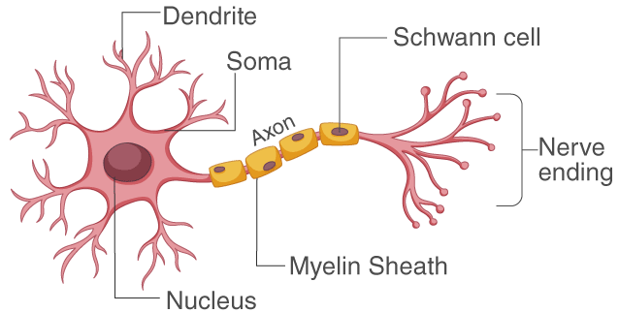
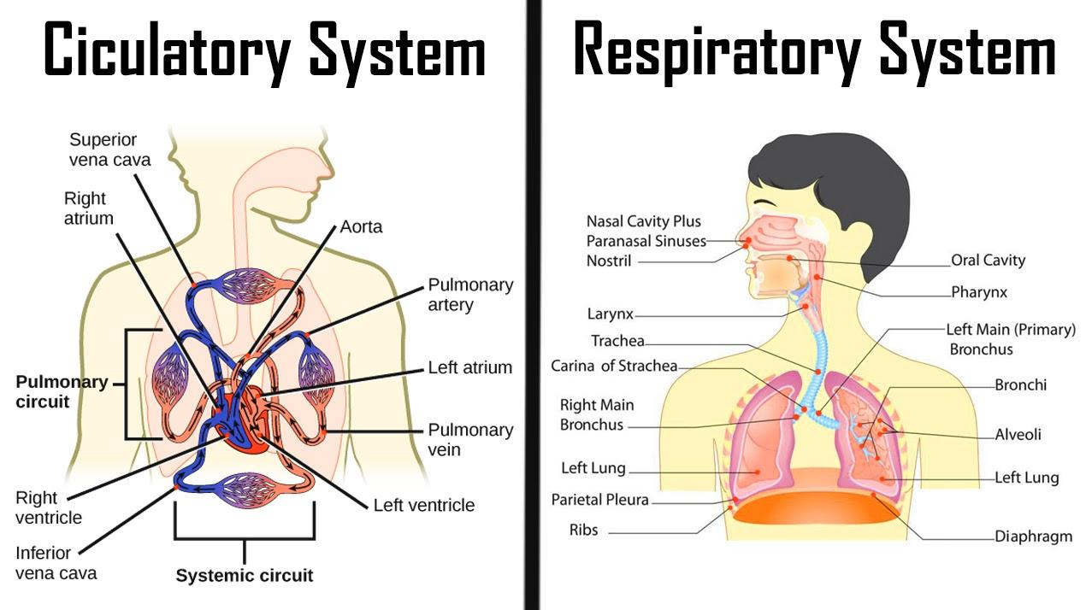
Human Anatomy & Physiology Nerves, Circulation, Respiration
Chapter 32

Slide 3
Regulating the internal environment (pH, water, temperature) involves ___.
Protecting the body from infection and cancer involves the ___ and ___ systems.
List four main types of tissue in the body and their function.
What are “skeletal, smooth, and cardiac”?
3

Slide 4
Regulating the internal environment (pH, water, temperature) involves homeostasis.
Protecting the body from infection & cancer involves the lymphatic & immune systems.
List four main types of tissue in the body and their function.
epithelial (cover, protect), connective (bind, support), muscle (movement), nerves (communication)
What are “skeletal, smooth, & cardiac”?
muscle tissues
4

Slide 5
Lesson Objectives
  By the end of this lesson, you should be able to:
Recognize, identify, and define the anatomy and function of the human nervous system.
  Central vs. Peripheral Nervous System
  Neurons, Synapses
  Membrane Potential
Recognize, identify, and define the anatomy and function of the human circulatory system.
  Blood Vessels
  The Heart
  Types of Blood
Recognize, identify, and define the anatomy and function of the human respiratory system.
  Inhalation vs. Exhalation
  Transport and exchange of Gases
  Science Practice: Circulation Rest & Exercise Lab
Notes:
#frame
instructional video
Timing ≈ 0.5 minutes
Living organisms need energy to accomplish the wide variety of tasks they attempt each day.
You will begin learning about how energy is captured from the Sun and stored in organic molecules.
[read objectives]

Slide 6
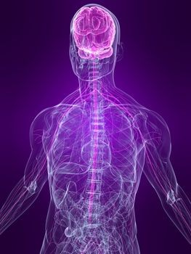
The Nervous System
Nervous and Endocrine systems work together to coordinate body functions.
COMMUNICATION within this system relies on NEURONS.
Neurons are nerve cells that transmit information via electrical and chemical signals.
MAIN FUNCTIONS:
  Receive Sensory Information
  Integrate the information
  Coordinate a Response

Slide 7
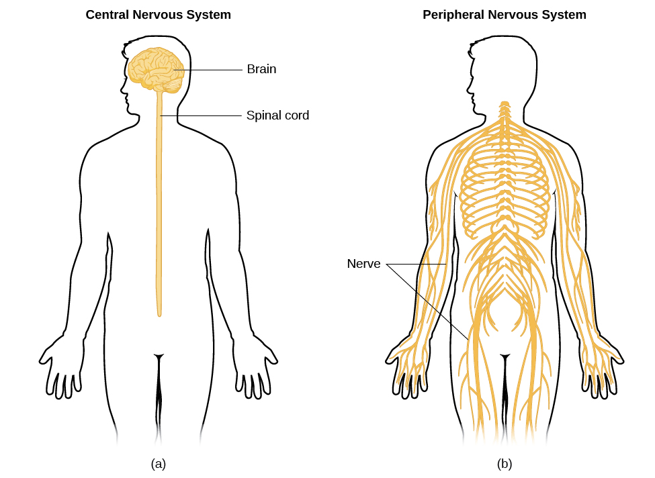
The Nervous System
Two Main Divisions:
  Central Nervous System (CNS)
    Brain
    Spinal Cord
  Peripheral Nervous System (PNS)
    Nerves which convey information between the CNS and the rest of the body.

Slide 8
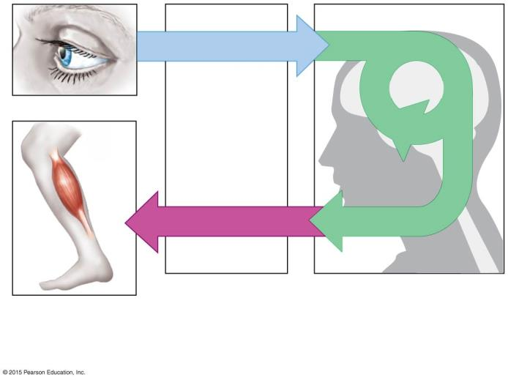
Sensory receptor
Sensory input
Integration
Motor output
Brain and spinal cord
Effector cells
Peripheral nervous
system (PNS)
Central nervous
system (CNS)
Notes:
Figure 28.1a Organization of a nervous system

Slide 9
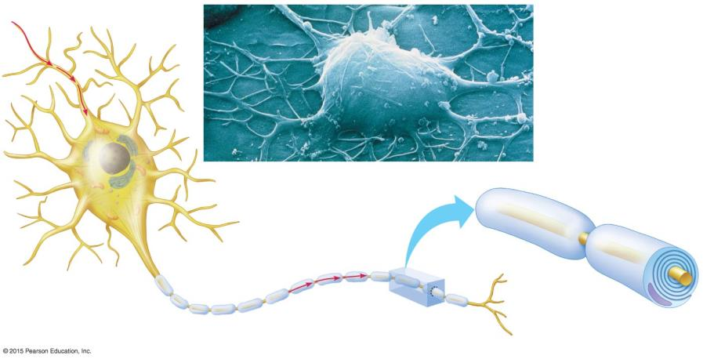
Neurons
Cell body
Nucleus
Cell body
  CELL BODY: contains the nucleus and other cell organelles.
Notes:
Figure 28.2-0 Structure of a myelinated motor neuron; Myelin Sheath 🡪 analogous to the plastic insulation that covers many electrical wires.

Slide 10
  DENDRITES
  receive signals from other neurons and convey this information toward the cell body.
Nucleus
Cell body
Dendrites
Notes:
Figure 28.2-0 Structure of a myelinated motor neuron; Myelin Sheath 🡪 analogous to the plastic insulation that covers many electrical wires.

Slide 11

  AXON: transmit signals to other cells.
    Wrapped in fatty Myelin Sheaths.
    Nodes of Ranvier: Gaps between cells that form Myelin Sheaths.
      Speed signal conduction along an axon.
Signal direction
Nucleus
Node of
Ranvier
Nodes of
Ranvier
Signal
pathway
Myelin sheath
Synaptic
terminals
Cell body
Dendrites
Axon
    A typical axon has hundreds of branches, each with a Synaptic Terminal at the very end.
Notes:
Figure 28.2-0 Structure of a myelinated motor neuron; Myelin Sheath 🡪 analogous to the plastic insulation that covers many electrical wires.

Slide 12
  SCHWANN CELLS wrap around axons of motor and sensory neurons to form the myelin sheath.
Signal direction
Nucleus
Node of
Ranvier
Signal
pathway
Layers
of myelin
Nodes of
Ranvier
Schwann
cell
Synaptic
terminals
Cell body
Dendrites
Nucleus
Myelin sheath
Schwann
cell
Axon
Notes:
Figure 28.2-0 Structure of a myelinated motor neuron; Myelin Sheath 🡪 analogous to the plastic insulation that covers many electrical wires.

Slide 13
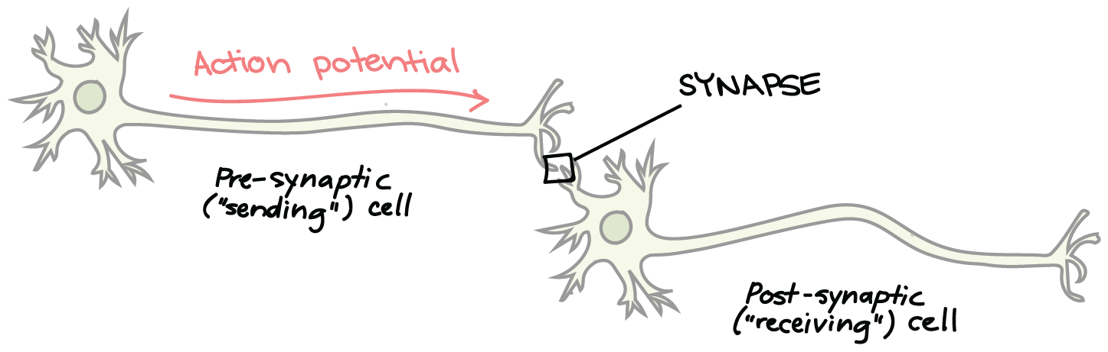
SYNAPSE
  The junction between a synaptic terminal and another cell is called a Synapse, or relay point.
    At a synapse, electrical or chemical signals are transmitted to other neurons or effector cells.

Slide 14
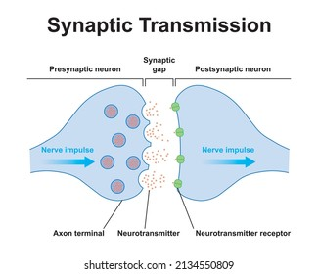
Neurons communicate at Synapses
Synapses are relay points between a synaptic terminal of a sending neuron and a receiving cell, which could be another neuron.
The sending (presynaptic) cell secretes a chemical signal, a Neurotransmitter, which crosses the Synaptic Cleft.
The neurotransmitter binds to a specific receptor on the surface of the receiving (postsynaptic) cell.

Slide 15
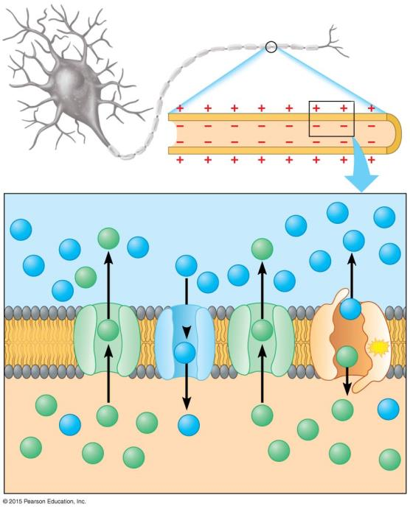
Nerve function depends on charge differences across neuron membranes.
At REST, when a neuron is not transmitting a signal, a neuron’s plasma membrane has potential energy—the MEMBRANE POTENTIAL, in which
  just INSIDE the cell is slightly negative.
  just OUTSIDE the cell is slightly positive.

Slide 16
Neuron
Axon
Plasma
membrane
Outside of neuron: more POSITIVE charges.
OUTSIDE
Na⁺
Na⁺
Na⁺
Na⁺
K⁺
Na⁺
Na⁺
Na⁺
K⁺
Na⁺
Na⁺
Na⁺
Na⁺
K⁺
Na⁺
Na⁺
Na⁺
Na⁺
Na⁺
Plasma
membrane
K⁺
K⁺
Na⁺
K⁺
ATP
INSIDE of neuron: fewer positive charges .. more NEGATIVE.
K⁺
K⁺
K⁺
K⁺
Na⁺
Na⁺
K⁺
Na⁺
K⁺
K⁺
K⁺
K⁺
K⁺
K⁺
INSIDE
K⁺
Notes:
Figure 28.3-0 How the resting potential is generated

Slide 17
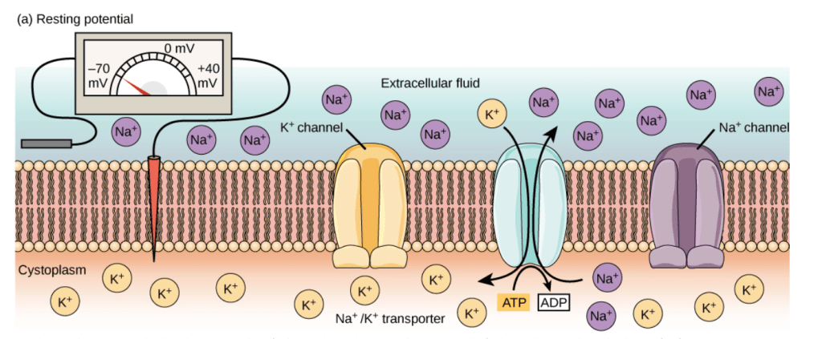
Nerve function depends on charge differences across neuron membranes.
The Resting Potential is the voltage across the plasma membrane of a resting neuron.
All voltage-gated Na+ channels and most voltage-gated K+ channels are closed.

Slide 18
Sodium-Potassium (Na⁺-K⁺) Pumps
use energy from ATP to actively move Na⁺ out of the neuron and K⁺ into the neuron.
The resting potential exists because of differences in ion concentration of the fluids inside and outside the neuron.
Low K⁺/high Na⁺
Na⁺
Na⁺
  OUTSIDE the neuron, K⁺ is low and Na⁺ is high.
Na⁺
Na⁺
K⁺
Na⁺
Na⁺
Na⁺
K⁺
Na⁺
Na⁺
Na⁺
Na⁺
K⁺
Na⁺
channel
Na⁺
Na⁺
Na⁺
Na⁺
Na⁺
Plasma
membrane
K⁺
K⁺
Na⁺-K⁺ pump
Na⁺
K⁺
ATP
  INSIDE the neuron, K⁺ is high and Na⁺ is low.
K⁺ channel
K⁺
K⁺
K⁺
K⁺
Na⁺
Na⁺
K⁺
Na⁺
K⁺
K⁺
K⁺
K⁺
K⁺
K⁺
High K⁺/low Na⁺
K⁺
Notes:
Figure 28.3-0 How the resting potential is generated

Slide 19
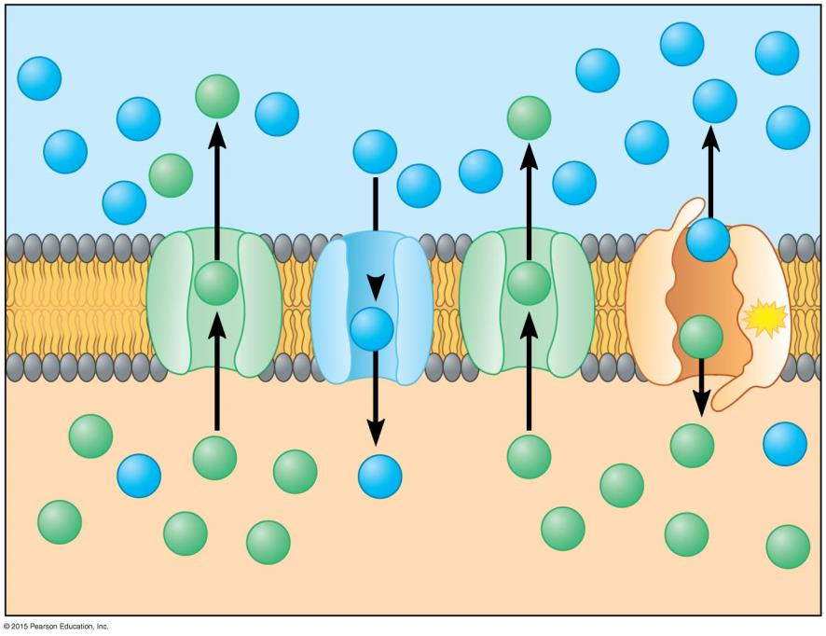
Outside of neuron
Na⁺
Na⁺
Low K⁺/high Na⁺
Na⁺
K⁺
Na⁺
Na⁺
Na⁺
K⁺
Na⁺
Na⁺
Na⁺
Na⁺
channel
Na⁺
K⁺
Na⁺
Na⁺
Na⁺
Na⁺
K⁺
K⁺
Na⁺ -K⁺
pump
Plasma
membrane
Na⁺
ATP
K⁺
K⁺ channel
K⁺
K⁺
Na⁺
K⁺
K⁺
Na⁺
K⁺
Na⁺
K⁺
K⁺
K⁺
High K⁺/low Na⁺
K⁺
K⁺
K⁺
K⁺
Inside of neuron
Notes:
Figure 28.3-2 How the resting potential is generated (part 2)

Slide 20
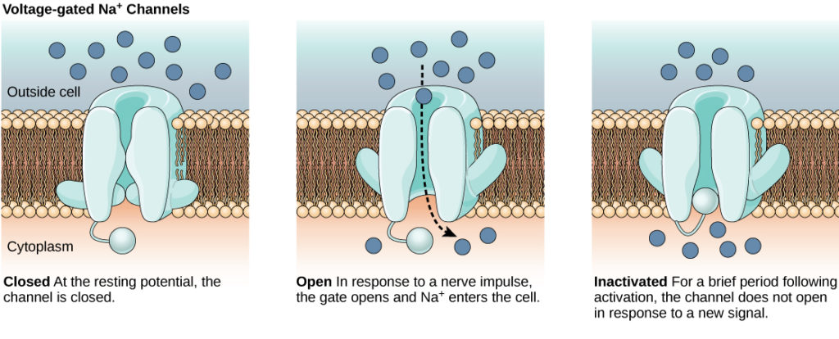
Membrane Potential
The lipid bilayer membrane that surrounds a neuron is impermeable to charged molecules or ions.
To enter or exit the neuron, ions must pass through special proteins called ion channels that span the membrane.
Ion channels have different configurations: open, closed, and inactive.

Slide 21
Action Potentials
A nerve signal, called an Action Potential,
  is a change in the membrane voltage.
  that transmits a nerve signal along an axon.
The rapid flip-flop of the membrane potential is
  a result of the rapid movements of ions across the membrane.
  at Na⁺ and K⁺ voltage-gated channels,
  that open and close in response to stimuli.
They propagate in a one-way chain reaction along a neuron.
They are all-or-none events.

Slide 22
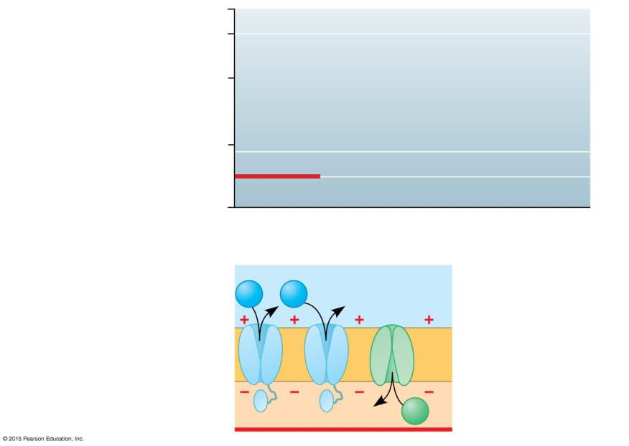
+50
Membrane Potential over time
A Nerve Signal begins as a change in the Membrane Potential.
0
Membrane potential
(mV)
−50
1
Resting potential
−100
Time (msec)
1
Resting State
Voltage-gated Na⁺ & K⁺
channels are closed;
Resting potential is
maintained by Sodium-Potassium channels (not shown).
Sodium
channel
Potassium
channel
Na⁺
Na⁺
Outside
of neuron (+)
Plasma membrane
K⁺
Inside of neuron (-)
Notes:
Figure 28.4-1 The action potential (part 1)

Slide 23
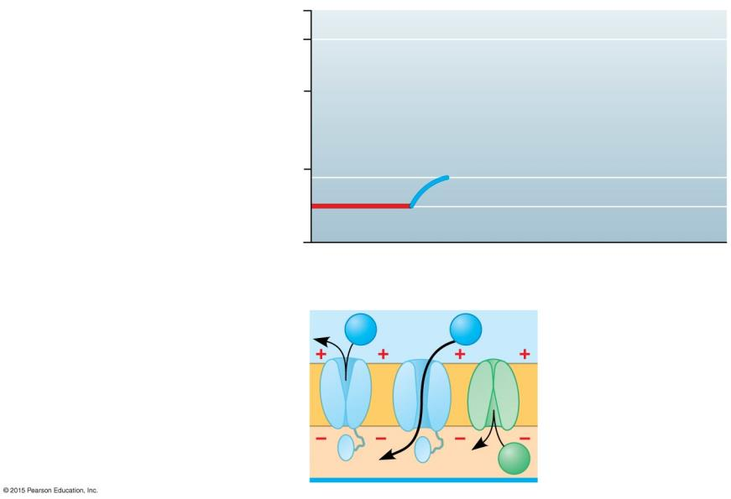
+50
Action
potential
A Stimulus is any factor that causes a nerve signal to be generated.
0
Membrane potential
(mV)
2
−50
Threshold
1
Resting potential
−100
Time (msec)
2
DEPOLARIZATION
A stimulus opens some Na⁺ channels;
If THRESHOLD is reached, an action potential is triggered.
Outside
of neuron (+)
Na⁺
Na⁺
K⁺
Inside of neuron (-)
Notes:
Figure 28.4-2 The action potential (part 2)

Slide 24
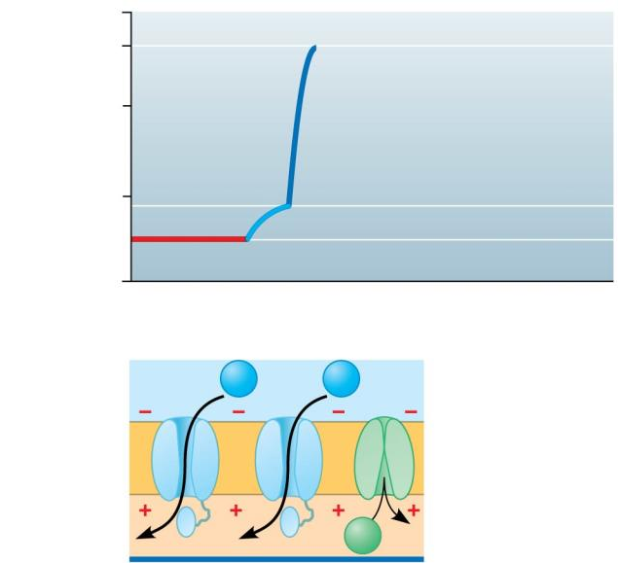
+50
Action
potential
3
Additional Na⁺ channels open.
K⁺ channels are
closed;
The interior of cell becomes more positive.
Membrane polarity
REVERSES
from resting state.
0
3
Membrane potential
(mV)
−50
Threshold
2
1
Resting potential
−100
Time (msec)
Na⁺
Na⁺
Outside
of neuron (-)
K⁺
Inside of neuron (+)
Notes:
Figure 28.4-3 The action potential (part 3)

Slide 25
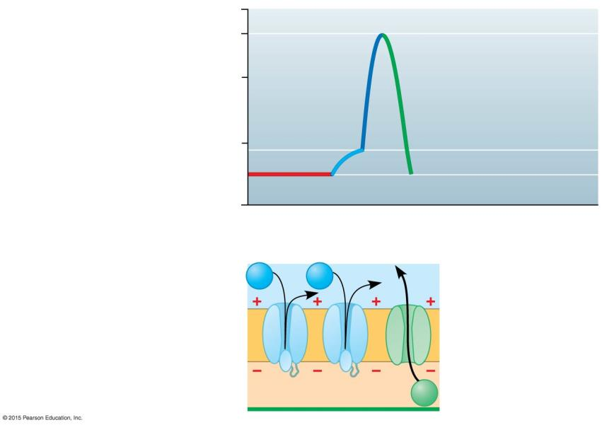
+50
Action
potential
4
0
3
Membrane potential
(mV)
4
REPOLARIZATION
Na⁺ channels close and inactivate;
K⁺ channels open and K⁺ rushes out;
The interior of cell is more negative than outside again.
2
−50
Threshold
1
1
Resting potential
−100
Time (msec)
Na⁺
Na⁺
Outside
of neuron (+)
Inside of neuron (-)
K⁺
Notes:
Figure 28.4-4 The action potential (part 4)

Slide 26
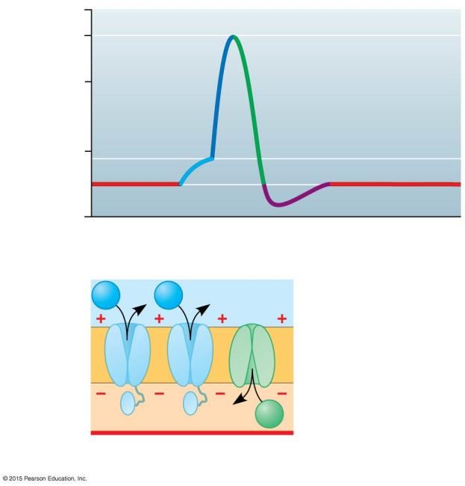
+50
Action
potential
0
3
Membrane potential
(mV)
4
2
−50
Threshold
1
1
Resting potential
−100
Time (msec)
Na⁺
Na⁺
K⁺
1
Return to resting state.
Notes:
Figure 28.4-6 The action potential (part 6)

Slide 27
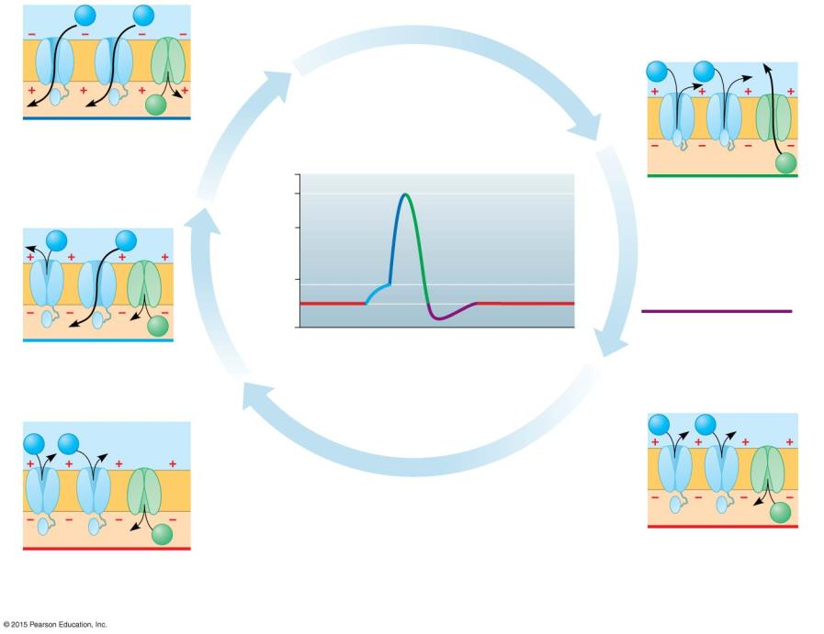
Na⁺
Na⁺
Na⁺
Na⁺
K⁺
3
+50
K⁺
?
potential
4
0
3
4
Na⁺
Na⁺
Membrane potential
(mV)
2
−50
?
1
1
K⁺
−100
? potential
Time (msec)
2
Sodium
channel
Potassium
channel
Na⁺
Na⁺
Na⁺
Na⁺
Outside
of neuron
Plasma membrane
K⁺
K⁺
Inside of neuron
1
1
Notes:
Figure 28.4-0 The action potential

Slide 28
Na⁺
Na⁺
Na⁺
Na⁺
K⁺
3
Additional Na⁺ channels open,
K⁺ channels are closed;
interior of cell becomes
more positive. MEMBRANE
POLARITY REVERSES from resting state.
+50
K⁺
Action
potential
4
REPOLARIZATION: Na⁺
channels close and
inactivate; K⁺ channels
open, and K⁺ rushes out;
interior of cell is more
negative than outside.
0
3
4
Na⁺
Na⁺
Membrane potential
(mV)
2
−50
Threshold
1
1
K⁺
−100
Resting potential
DEPOLARIZATION: A stimulus
opens some Na⁺ channels; if
THRESHOLD is reached, an action potential is triggered.
Time (msec)
2
Sodium
channel
Potassium
channel
Na⁺
Na⁺
Na⁺
Na⁺
Outside
of neuron
Plasma membrane
K⁺
K⁺
Inside of neuron
Return to resting state.
1
1
RESTING STATE: Voltage-gated Na⁺
and K⁺ channels are closed;
resting potential is maintained by
Sodium-Potassium Pump channels (not shown).
Notes:
Figure 28.4-0 The action potential

Slide 29
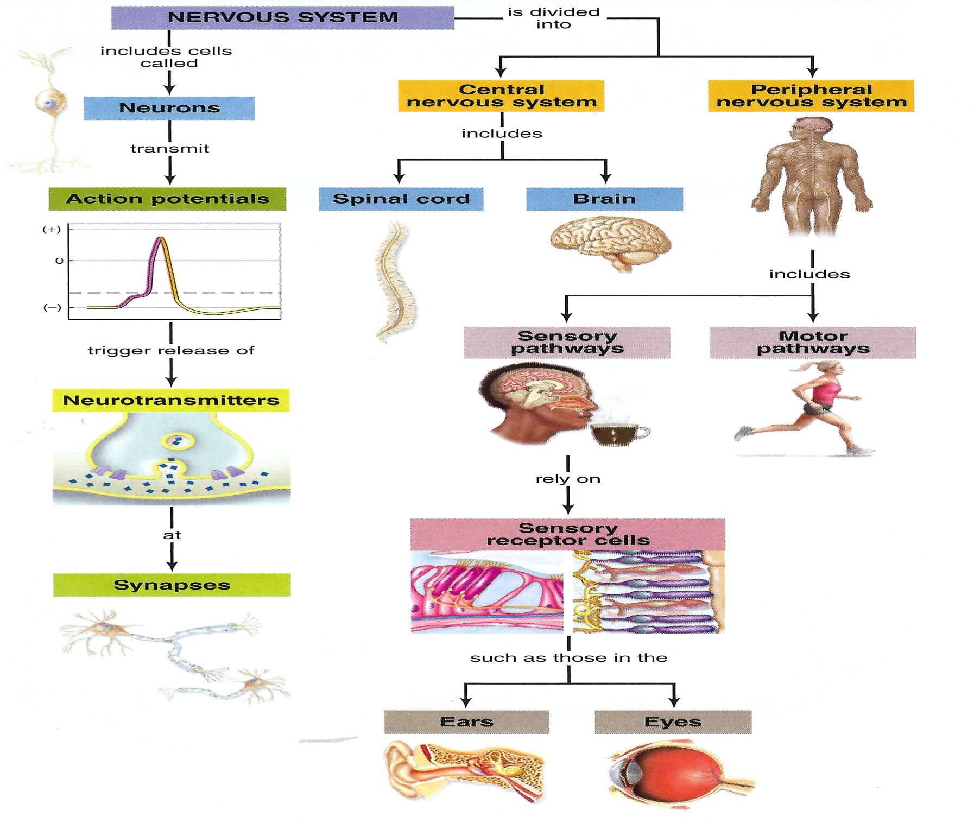
1
2
6
9
3
7
8
10
11
4
12
5
13
14

Slide 31
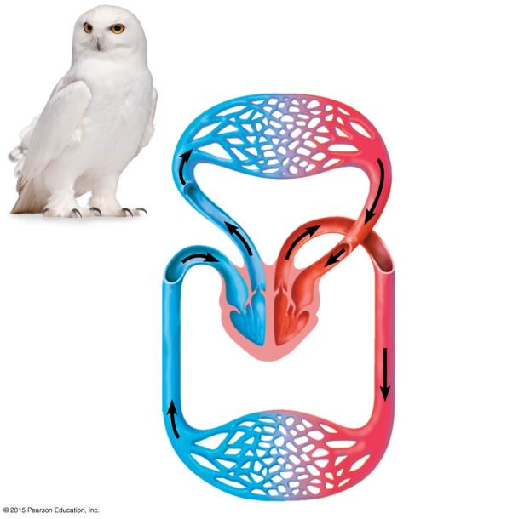
Circulatory System
Lung
capillaries
Pulmonary
circuit
Atrium
Atrium
Ventricle
Ventricle
Right
Left
Systemic
circuit
BIRDS & MAMMALS:
Double Circulation and Four-Chambered Heart
Systemic
capillaries
Notes:
Figure 23.2c The double circulation and four-chambered heart of a bird or mammal

Slide 32
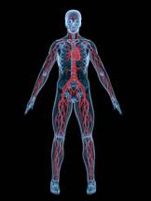
The Circulatory System facilitates exchange with all Body Tissues.
To sustain life, the body must
  acquire nutrients
  exchange gases
  dispose of waste products.
The Circulatory System facilitates these exchanges. It consists of:
  a muscular pump (heart)
  a circulatory fluid (blood)
  a set of tubes (vessels) to carry the circulatory fluid.

Slide 33
The Circulatory System facilitates exchange with all Body Tissues.
The vertebrate circulatory system is often called a CARDIOVASCULAR SYSTEM, with three main types of vessels:
  Arteries carry blood AWAY from the heart to body organs and tissues.
  Veins return blood TO the heart.
  Capillaries convey blood BETWEEN arteries and
  veins within each tissue.

Slide 34
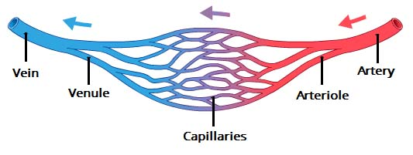
The Circulatory System facilitates exchange with all Body Tissues.
Large ARTERIES branch into Arterioles, which give rise to Capillaries, which branch into networks called Capillary Beds, which infiltrate every organ and tissue in the body.
Capillaries converge into Venules, which in turn converge into larger VEINS that return blood to the Heart.

Slide 35
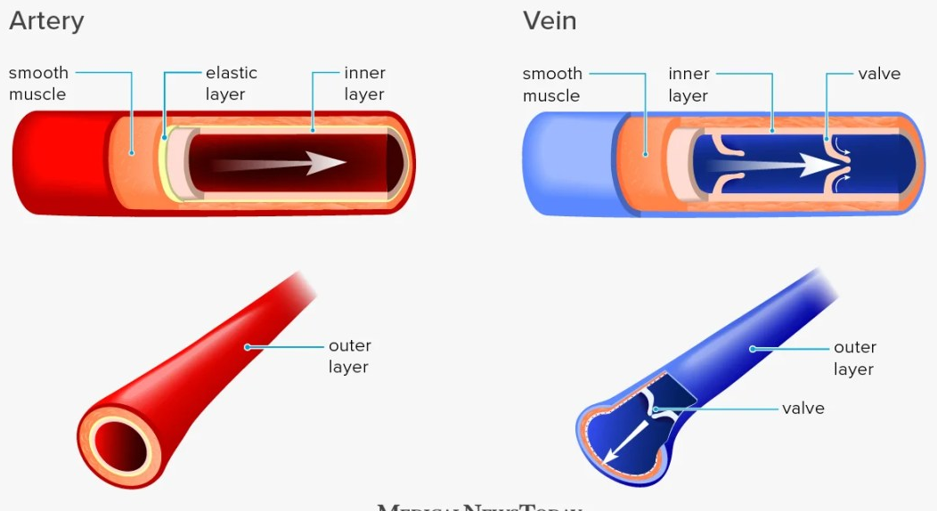
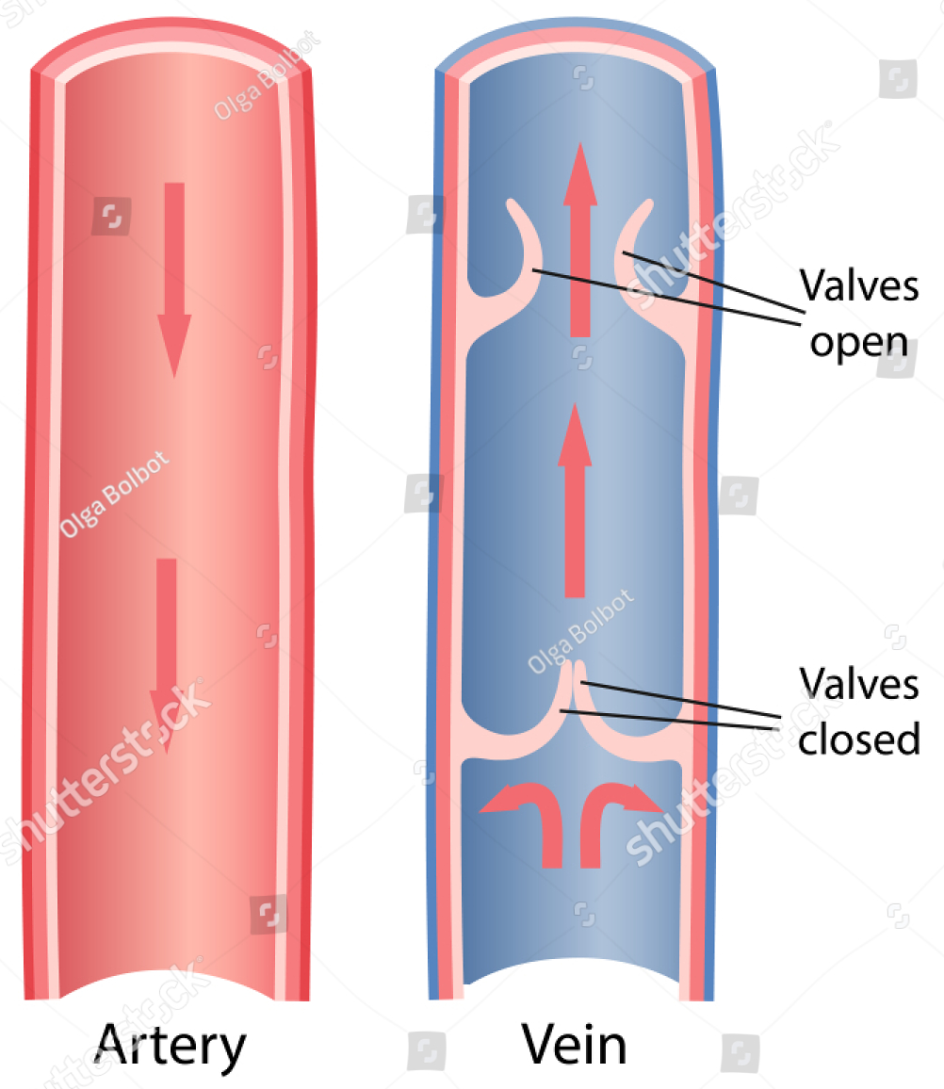
The Circulatory System facilitates exchange with all Body Tissues.
ARTERIES carry oxygenated blood from the heart throughout the body except for the pulmonary arteries, which carry deoxygenated blood to the lungs.
VEINS have thinner walls and possess VALVES to prevent blood from reversing (varicose veins).

Slide 36
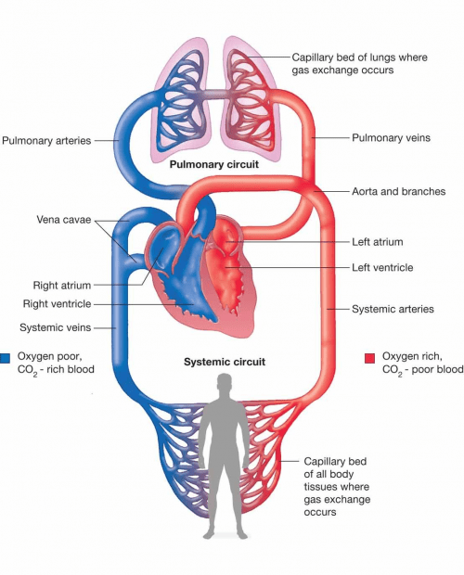
The Circulatory System facilitates exchange with all Body Tissues.
Land vertebrates have a Double Circulation:
  The PULMONARY CIRCUIT carries oxygen-poor blood between the heart and the lungs.
  The SYSTEMIC CIRCUIT carries oxygen-rich blood between the heart and the rest of the body.

Slide 37
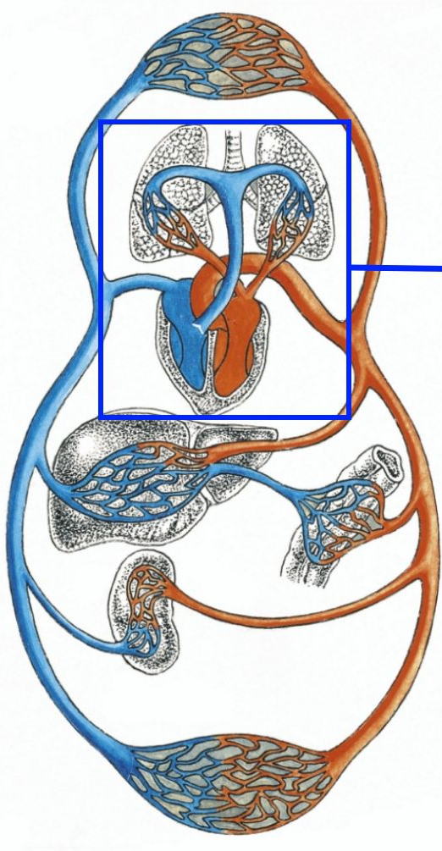
The Circulatory System facilitates exchange with all Body Tissues.
In all Birds and Mammals, the heart has four chambers with two atria and two ventricles.
SYSTEMIC CIRCUIT
PULMONARY CIRCUIT
The left side receives and pumps only oxygen-rich blood.
The right side of the heart handles only oxygen-poor blood.

Slide 38
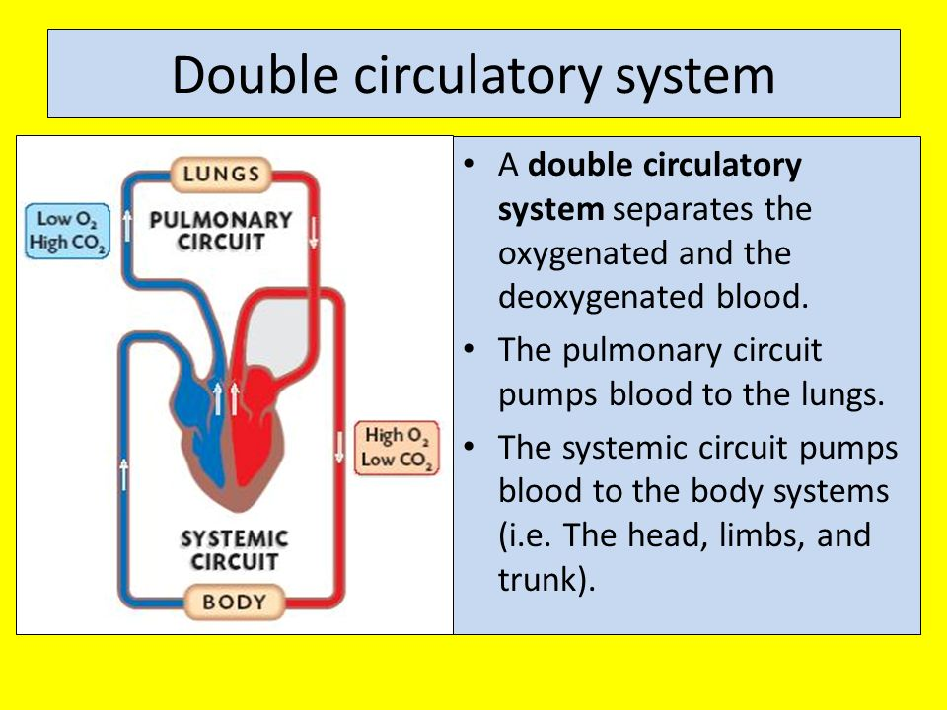
Circulatory System

Slide 39
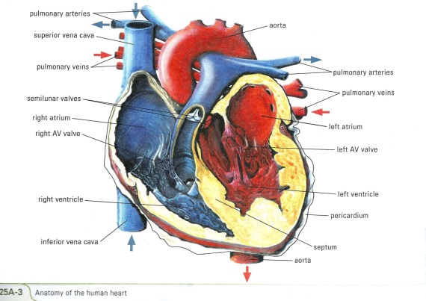
HEART
Main component of the circulatory system.
Muscular Organ (Cardiac Muscle), about the size of your fist, that pumps the blood.
4 chambers with 4 valves through which blood must pass on each trip around the body.
Avg 70 beats per minute.
Pumps Oxygen-rich blood coming from the lungs to all parts of the body through a network of blood vessels.
Pacemaker → special tissue inside the heart that causes it to beat automatically.

Slide 40

HEART
The heart has 4 hollow spaces called chambers.
ATRIA: upper, thin-walled chambers.
Blood enters the heart through the atria.
VENTRICLES: lower, larger, thick-walled chambers
Blood leaves the heart through the ventricles.

Slide 41
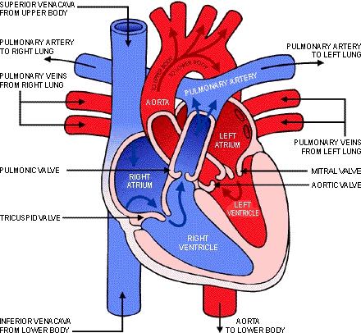
Heart
Four Valves in the heart direct the flow of blood:
ATRIOVENTRICULAR Valves
(Mitral & Tricuspid Valves)
  ONE WAY valves separate the atrium and ventricle on each side of the heart.
  Allow blood to flow in only one direction: from atria to ventricles.
SEMILUNAR Valves
(Pulmonary & Aortic Valves)
  ONE WAY valves allow blood to leave the ventricles, but not return.

Slide 42
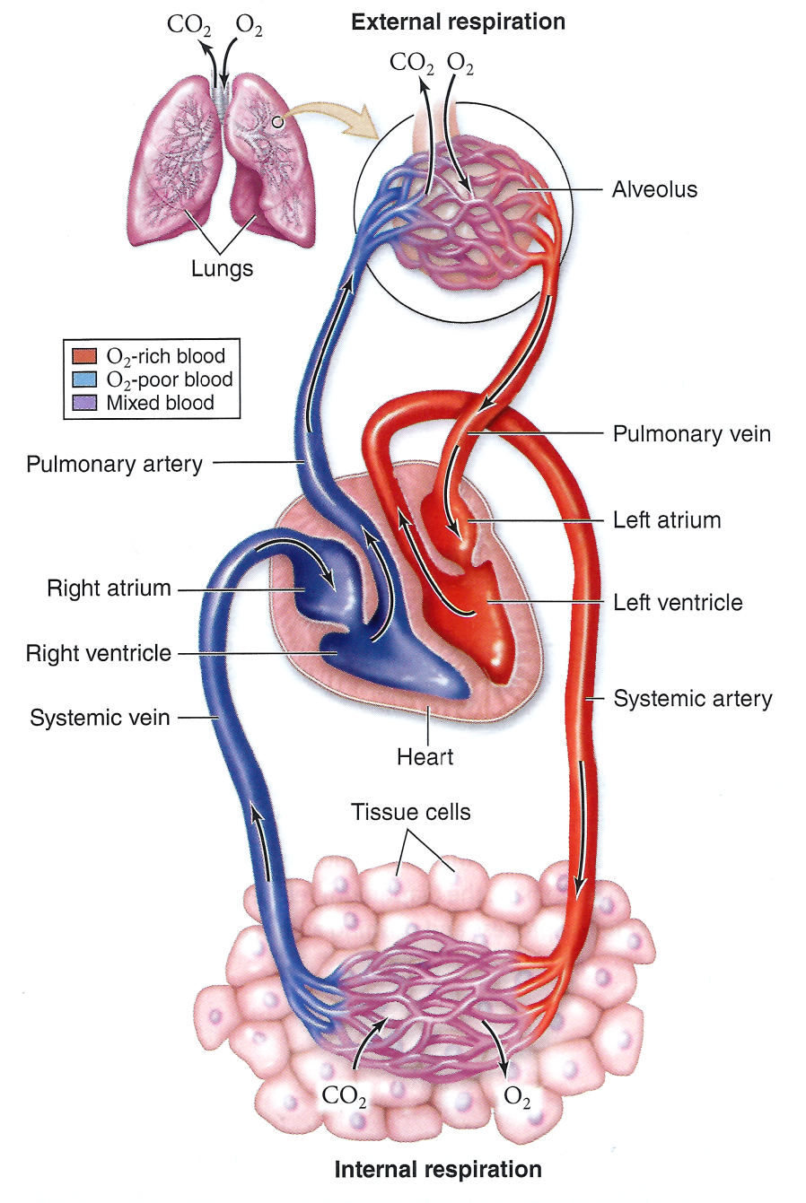
Heart
Each side of the heart pumps blood to a different part of the circulatory system.
PULMONARY CIRCULATION
Right Side of Heart pumps blood from the heart to the lungs.
  Oxygen-poor blood is pumped by the right side of the heart through the lungs.
  There it gives off carbon dioxide and picks up oxygen.
  This oxygen-rich blood is then returned to the left side of the heart by the pulmonary VEINS.

Slide 43
Heart
SYSTEMIC CIRCULATION
Left Side of Heart pumps blood FROM the heart to the rest of the body
  Oxygen-rich blood leaves the heart to supply the body with oxygenated blood
  By the time blood returns from this systemic circulation, cells throughout the body have absorbed much of the blood’s oxygen, and exchanged carbon dioxide for it.
  This blood is now oxygen-poor and ready for another trip to the lungs to become oxygen-rich again.

Slide 44
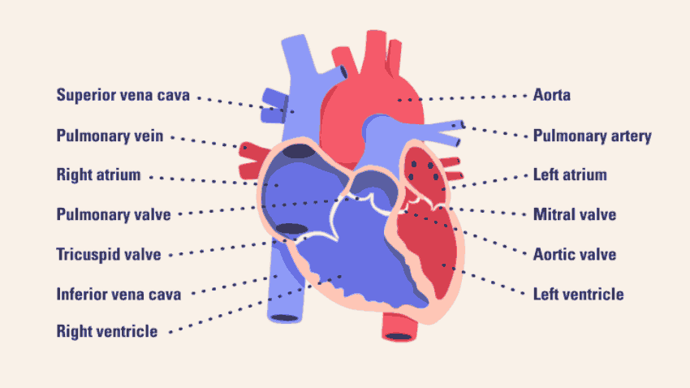
Blood Flow
1) Oxygen-poor blood from the body enters the inferior and superior Vena Cava.
Vena Cava empty into the Right Atrium.
Blood passes through the Right AV (Tricuspid) Valve into the Right Ventricle.

Slide 45
Blood Flow
4) Right Ventricle pumps oxygen-poor blood into pulmonary artery through the semilunar valve (to the lungs).
5) Pulmonary arteries transport blood to the lungs for gas exchange.
Blood simultaneously picks up oxygen and discharges carbon dioxide and other wastes.

Slide 46
Blood Flow
6) Pulmonary Veins carry oxygenated blood from the lungs to the Left Atrium.
7) Blood passes through the Left AV Valve into the Left Ventricle.
8) Left Ventricle pumps oxygen-rich blood into Aorta (Largest artery in the body) through the semilunar valve (to the body).

Slide 47
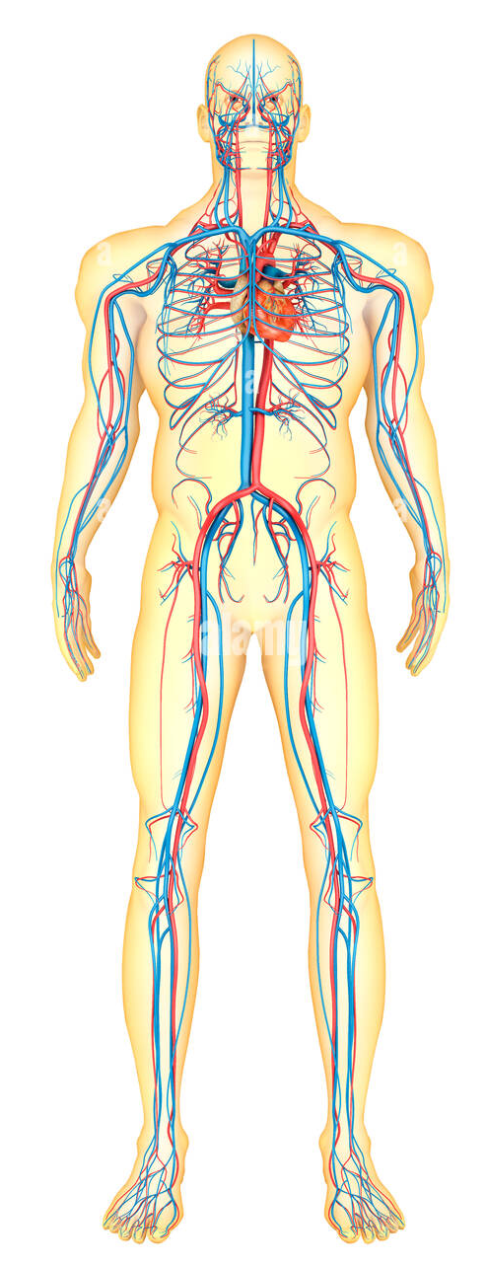
Blood Flow
9) As the blood passes through the capillaries, it delivers oxygen to the cells and absorbs carbon dioxide from them.
10) By the time the blood enters the veins, it is deoxygenated.
11) The veins collect the deoxygenated blood and return it to the heart.

Slide 48
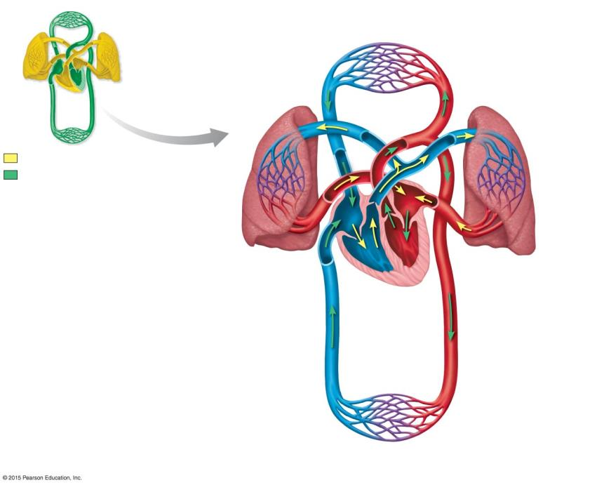
Capillaries of head,
chest, and arms
1
Superior vena cava
4
7
Pulmonary artery
7
Pulmonary artery
10
Aorta
Pulmonary circuit
12
Systemic circuit
Lung
capillaries
13
Pulmonary
vein
7
Pulmonary
vein
8
Right
atrium
Left
atrium
5
9
Right
ventricle
6
Aorta
Left
ventricle
11
Inferior
vena cava
10
3
Capillaries of abdominal
region and legs
2
Notes:
Figure 23.3-4 The human cardiovascular system illustrates the double circulation of mammals (step 4)

Slide 49
Capillaries of head,
chest, and arms
Superior vena cava
Pulmonary artery
Pulmonary artery
Aorta
Pulmonary circuit
Systemic circuit
Lung
capillaries
Pulmonary
vein
Pulmonary
vein
Right
atrium
Left
atrium
Right
ventricle
Left
ventricle
Aorta
Inferior
vena cava
Capillaries of abdominal
region and legs
Notes:
Figure 23.3-4 The human cardiovascular system illustrates the double circulation of mammals (step 4)

Slide 50
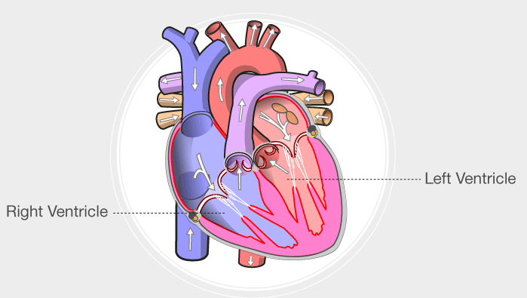
Heart
One drop of blood may circulate through the body at the rate of once every 23 seconds.
The walls of the Left Ventricle are about 3 times thicker than the walls of the right ventricle.
RIGHT Ventricle has to pump blood only to the lungs.
LEFT Ventricle has to push to the rest of the body.

Slide 51
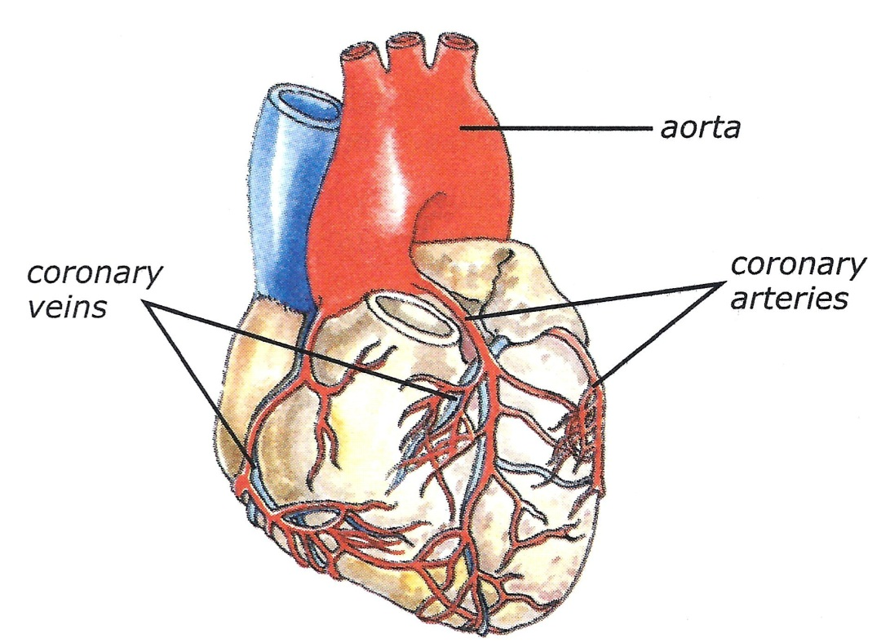
Nourishing the Heart
The muscle of the heart receives almost no nourishment from the blood that flows through its chambers.
The heart’s nourishment is supplied primarily by two CORONARY ARTERIES.
These arteries branch from the aorta and enter the heart muscle.

Slide 52
Blood Pressure
When the heart contracts, both atria function together, and then both ventricles function together.
Both the right and left atria receive blood at the same time.
When atria contract, both AV valves open and blood flows into the ventricles (SYSTOLE).
After a brief pause, both ventricles contract, the AV valves close, and the semilunar valves open. (DIASTOLE).
The blood is then pumped into the pulmonary artery and aorta at the same time.

Slide 53
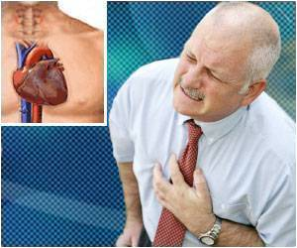
Heart Attacks
Each year more than 700,000 people in the United States die of a heart attack.
The most common warning sign of a heart attack is a dull pain, ache or “heaviness” in the center of the chest.
This sensation may spread to the neck, shoulders, and arms.
Person may feel weak, nauseated, short of breath and sweaty.
Caused by a decreased supply of blood to
the heart muscle
  Occluded Coronary Arteries

Slide 54
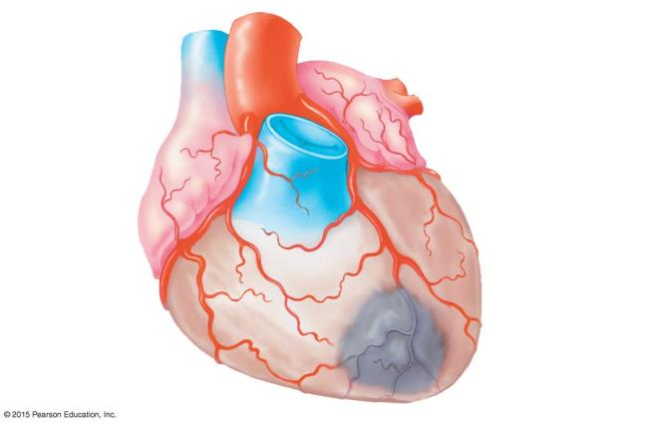
Superior
vena cava
Aorta
Pulmonary
artery
Left coronary
artery
Right
coronary
artery
Blockage
Dead muscle
tissue
Notes:
Figure 23.6a Blockage of a coronary artery, resulting in a heart attack

Slide 55
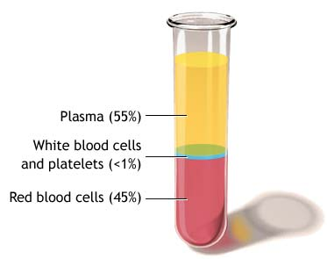
THE BLOOD
The average adult has about FIVE liters of blood inside of their body
Parts of Blood:
  Plasma – straw-colored part of blood that makes a little more than half the substance of blood.
  White Blood Cells (WBC)
  Red Blood Cells
  (RBC)
  Platelets

Slide 56
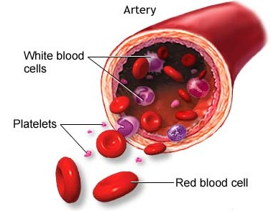
BLOOD CELL FUNCTIONS
RED BLOOD CELLS
  Deliver oxygen, nutrients and others to body tissues.
  Remove waste and carbon dioxide from body tissues.
WHITE BLOOD CELLS
  Fight disease, infection.
PLATELETS
  Clot to prevent blood loss.

Slide 57
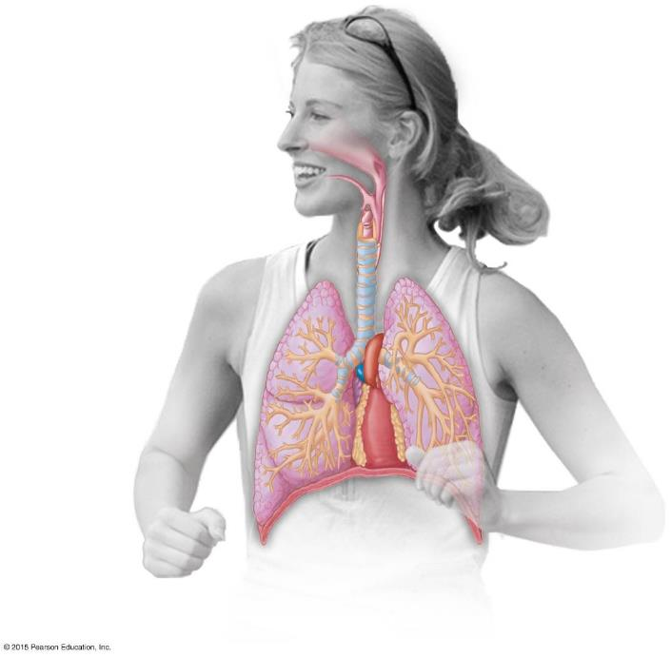
Respiratory System
Nasal cavity
Pharynx
Esophagus
Larynx
Trachea
Right lung
Bronchus
Left lung
Bronchiole
Diaphragm
(Heart)
Notes:
Figure 22.6-1 The anatomy of the human respiratory system and details of the alveoli (part 1)

Slide 58
Respiratory System
Nasal cavity
Pharynx
Esophagus
Larynx
Trachea
Right lung
Bronchus
Left lung
Bronchiole
Diaphragm
(Heart)
Notes:
Figure 22.6-1 The anatomy of the human respiratory system and details of the alveoli (part 1)

Slide 59
Respiratory System
Gas Exchange involves the Respiratory and Circulatory systems in servicing your body’s cells.
Three Phases of Gas Exchange occur in humans:
  Breathing.
  Transport of gases by the circulatory system.
  Exchange of gases with body cells:
    Body tissues take up oxygen and release carbon dioxide.

Slide 60
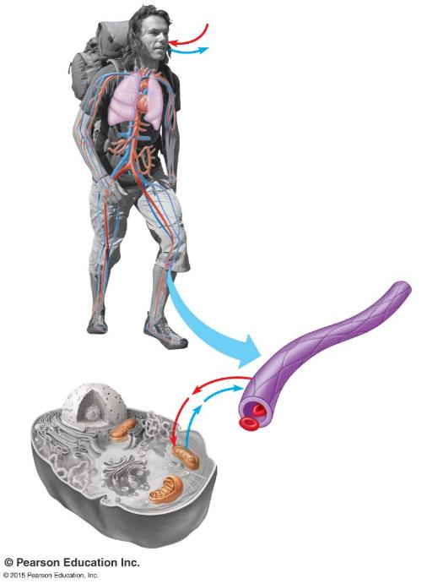
O₂
1
Breathing
CO₂
Lung
  Exhalation (breathe out carbon dioxide)
  Inhalation (take in oxygen)
Heart
Blood
vessels
Capillary
Capillary
O₂
CO₂
Mitochondria
Cell
Notes:
Figure 22.1 The three phases of gas exchange in a human

Slide 61
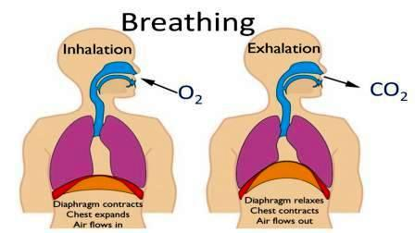
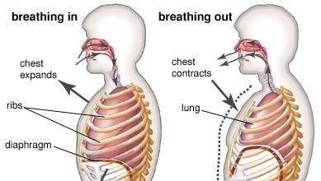
Breathing
Ventilation of the lungs through alternating inhalation and exhalation.
Air is not moved by the lungs, but by the muscles surrounding the lungs: Diaphragm and Rib Cage Muscles.

Slide 62
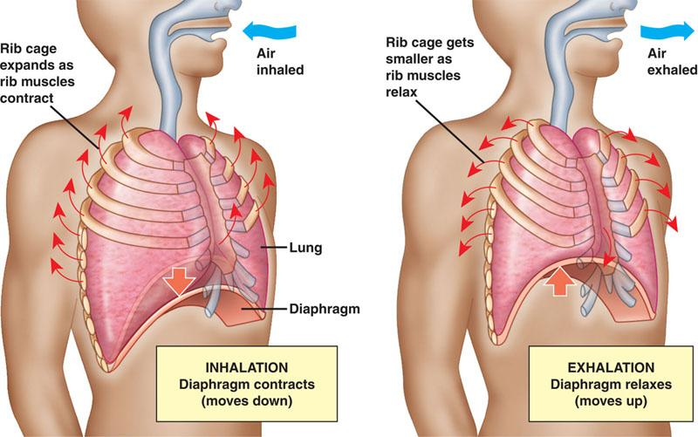
INHALING
  The Diaphragm
  separates the abdominal cavity from the thoracic cavity & helps ventilate the lungs.
  Diaphragm lowers,
  Rib Cage moves up and out;
  Lungs expand,
  air rushes in.

Slide 63
EXHALING
  Diaphragm relaxes and moves up,
  Rib Cage moves down and in;
  Pressure in the Lungs increases,
  and air is pushed out of the lungs.

Slide 64
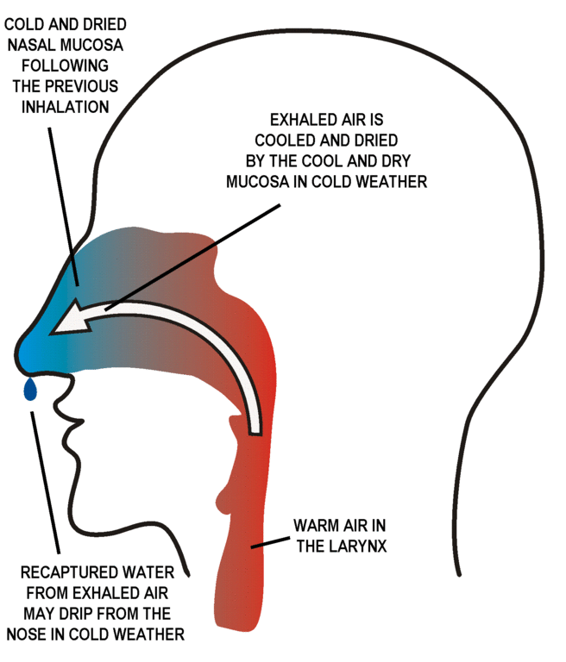
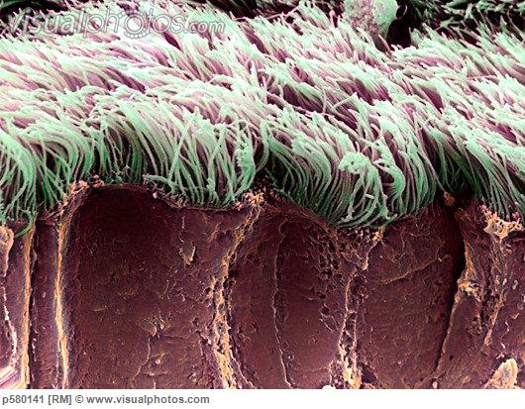
Pathway In
In humans, AIR is
  inhaled through the Nostrils into the Nasal Cavity.
  filtered by hairs and mucous surfaces.
  warmed and humidified.
  sampled for odors.

Slide 65
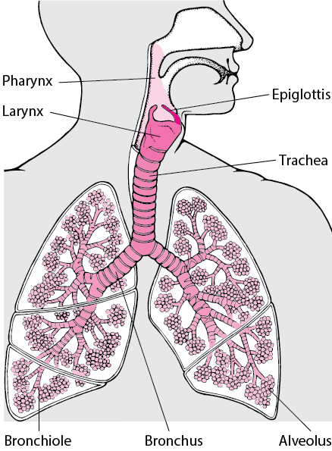
Pathway to the Lungs
From the Nasal Cavity, air next passes
  to the Pharynx,
  then to the Larynx, past the Vocal Cords,
  into the Trachea, held open by cartilage rings;
  into the paired Bronchi,
  into Bronchioles,
  to the Alveoli, grapelike clusters of air sacs, where gas exchange occurs.

Slide 66
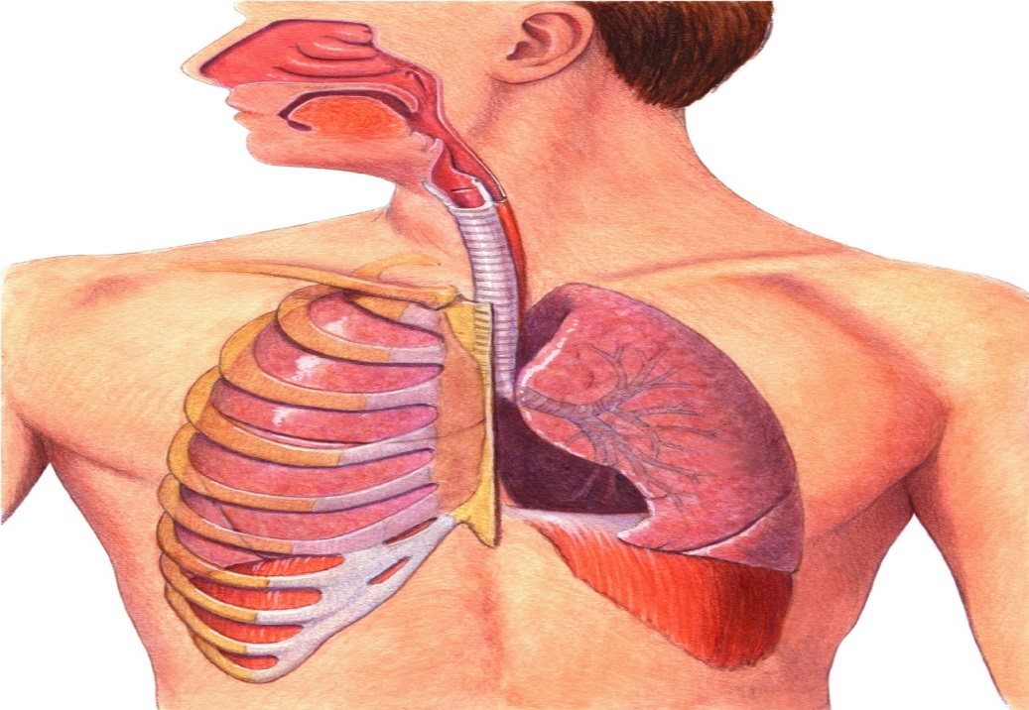
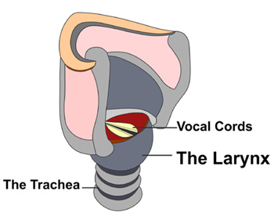
The Human Respiratory System
The epiglottis covers the entrance to the trachea when you swallow.
  At the top of the trachea is the larynx (voice box):
    contains two elastic folds of tissue called vocal cords.
Larynx
Epiglottis
Notes:
The respiratory system is responsible for the exchange of oxygen and carbon dioxide.

Slide 67

The Human Respiratory System
  Air then moves into the trachea (windpipe).
Trachea
Notes:
The respiratory system is responsible for the exchange of oxygen and carbon dioxide. Air moves through the nose, pharynx, larynx, trachea, and lungs.

Slide 68
The Human Respiratory System
    Air then passes through the trachea into two large passageways in the chest cavity called bronchi.
    Each bronchus leads into one of the lungs.
Lungs
Bronchus
Notes:
The respiratory system is responsible for the exchange of oxygen and carbon dioxide. Air moves through the nose, pharynx, larynx, trachea, and lungs. After reaching the lungs, the trachea branches into smaller and smaller tubes called bronchioles, which end in alveoli, or air sacs.

Slide 69
The Human Respiratory System
In each lung, the bronchus subdivides into smaller bronchioles.
Bronchioles
Notes:
The respiratory system is responsible for the exchange of oxygen and carbon dioxide. After reaching the lungs, the trachea branches into smaller and smaller tubes called bronchioles, which end in alveoli, or air sacs.

Slide 70
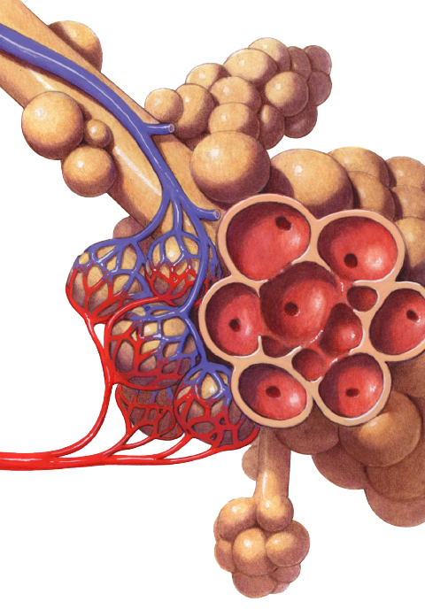
The Human Respiratory System
Alveoli
Bronchioles subdivide into millions of tiny air sacs called alveoli (s: alveolus).
Bronchiole
Notes:
The respiratory system is responsible for the exchange of oxygen and carbon dioxide. After reaching the lungs, the trachea branches into smaller and smaller tubes called bronchioles, which end in alveoli, or air sacs.

Slide 71
The Human Respiratory System
Alveoli are grouped in clusters.
A network of capillaries surrounds each alveolus.
Pulmonary artery
Pulmonary vein
Capillaries
Notes:
The respiratory system is responsible for the exchange of oxygen and carbon dioxide.

Slide 72



Alveoli: Gas Exchange
O₂
  Gas exchange takes place in the alveoli.
  Oxygen diffuses from the alveoli into the blood.
  Carbon dioxide diffuses from the blood into the alveolus.
CO₂
Capillary
Notes:
Gas exchange occurs by diffusion across the membrane of an alveolus and a capillary.

Slide 73

To the
heart
From the
heart
Nasal cavity
Oxygen-
rich
blood
Left lung
Oxygen-poor
blood
Pharynx
(Esophagus)
Larynx
Bronchiole
Trachea
Right lung
O₂
CO₂
Bronchus
Bronchiole
Alveoli
Diaphragm
Blood capillaries
(Heart)
Notes:
Figure 22.6-0 The anatomy of the human respiratory system (left) and details of the alveoli (right)

Slide 74
Gas Exchange
Alveoli walls are only one cell thick.
Many tiny Capillaries surround the alveoli; their walls are also one cell thick.
In alveoli,
  O₂ diffuses into the blood.
  CO₂ diffuses into the alveoli.
Oxygen in the air passes through the walls of both the alveoli and the capillaries to enter the blood.
Carbon Dioxide in the blood can pass just as easily into the alveoli.

Slide 75

To the
heart
From the
heart
Oxygen-
rich
blood
Oxygen-poor
blood
Bronchiole
CO₂
O₂
Alveoli
Blood capillaries
Notes:
Figure 22.6-2 The anatomy of the human respiratory system and details of the alveoli (part 2)

Slide 76
O₂
1
Breathing
CO₂
Lung
Heart
2
Circulatory
system
Transport of gases
by the circulatory
system throughout the body.
Blood
vessels
Capillary
Capillary
O₂
CO₂
Mitochondria
Cell
Notes:
Figure 22.1 The three phases of gas exchange in a human

Slide 77

O₂
1
Breathing
CO₂
Lung
Heart
2
Circulatory
system
Transport of gases
by the circulatory
system
Blood
vessels
Exchange of gases with body cells.
Capillary
3
Capillary
O₂
CO₂
Mitochondria
Cell
Notes:
Figure 22.1 The three phases of gas exchange in a human

