Slide 1
Tree Identification

Slide 2
Miscellaneous Trees

Slide 3
Animate Slides
Click on “Slide Show”
Click “From Beginning”

Slide 4
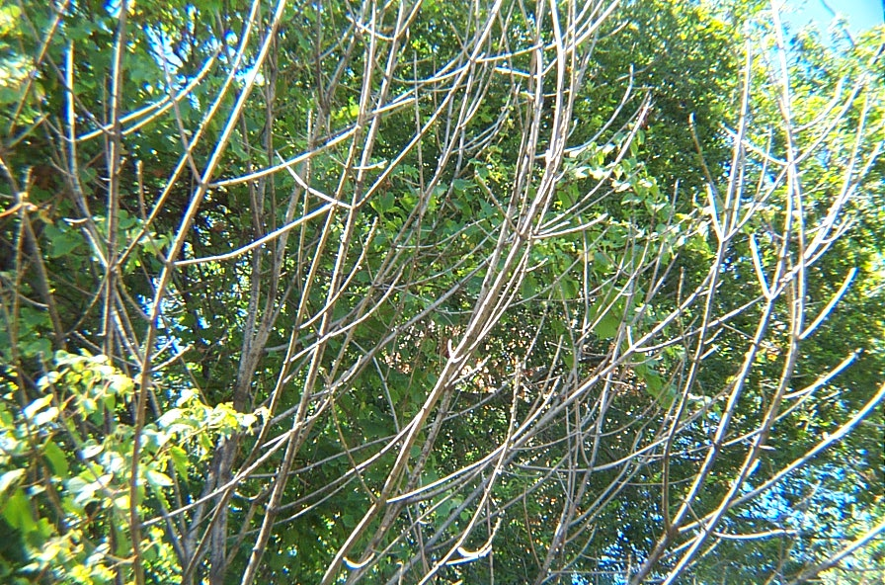
Ash

Slide 5
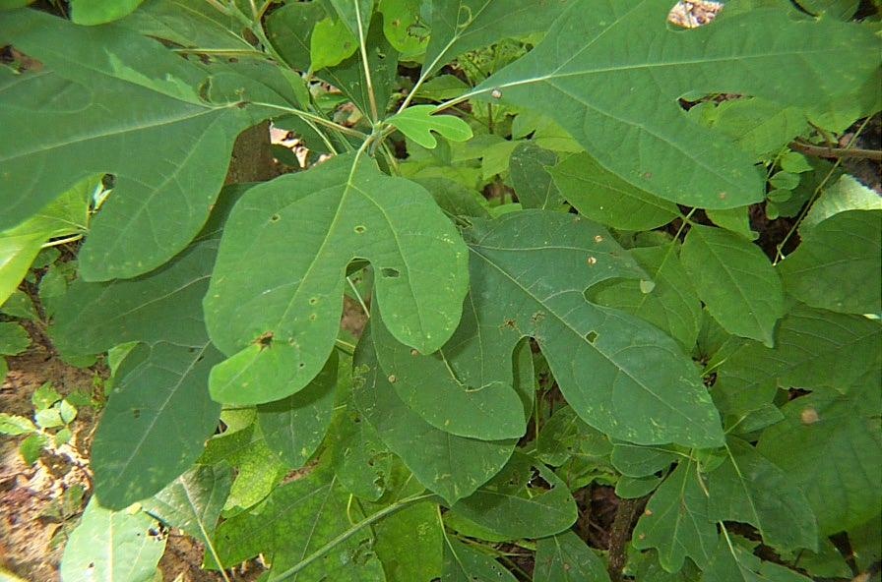
Sassafras

Slide 6
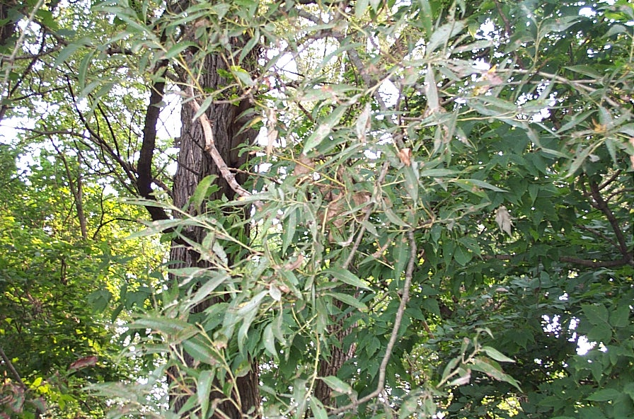
Willow

Slide 7
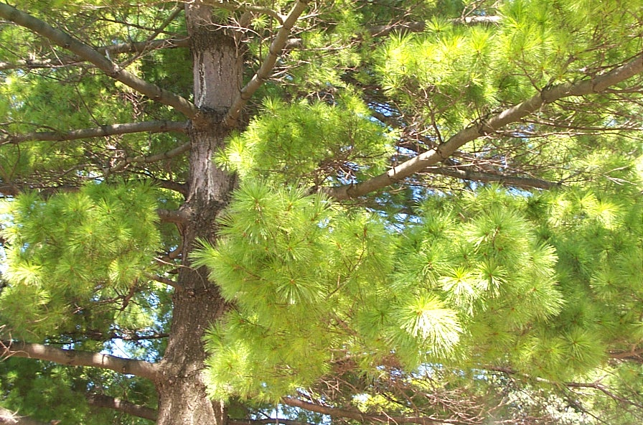
White Pine

Slide 8
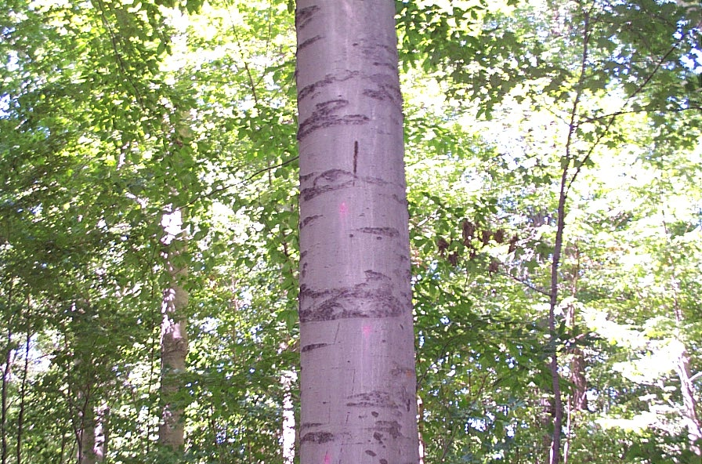
Birch

Slide 9
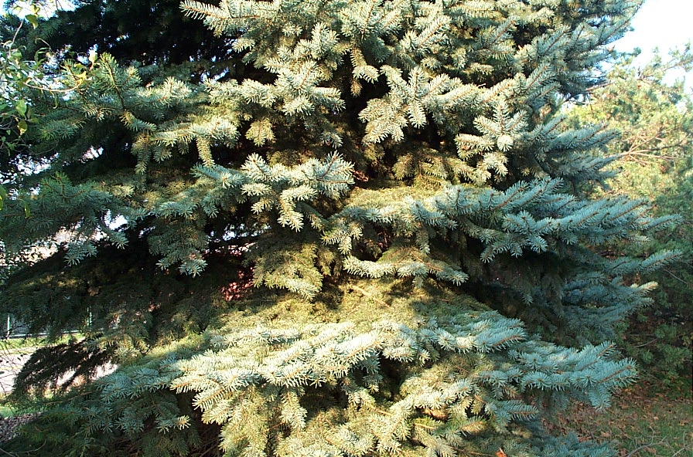
Spruce

Slide 10
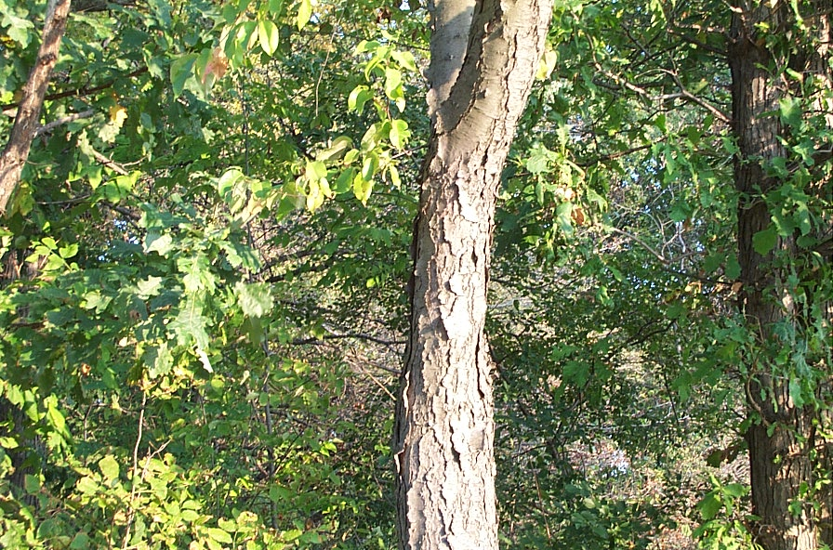
Chestnut Oak & Cherry

Slide 11
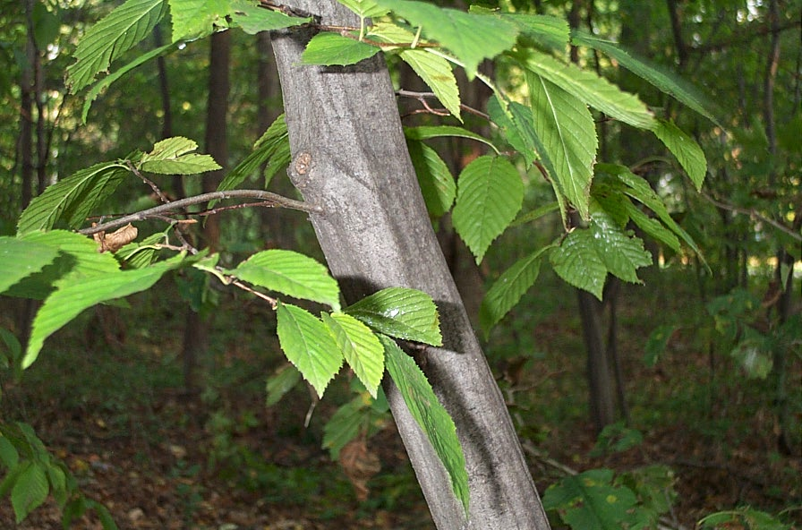
Musclewood

Slide 12
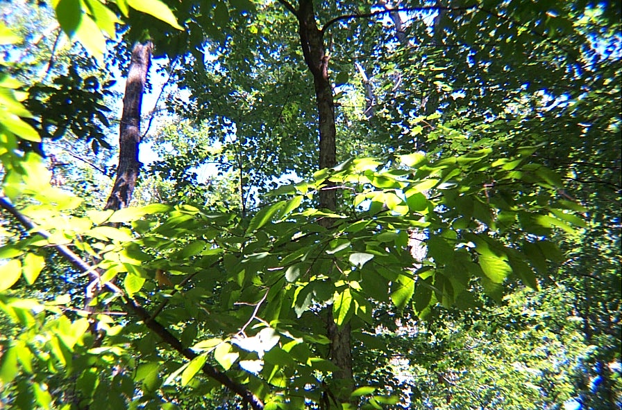
Hornbeam

Slide 13
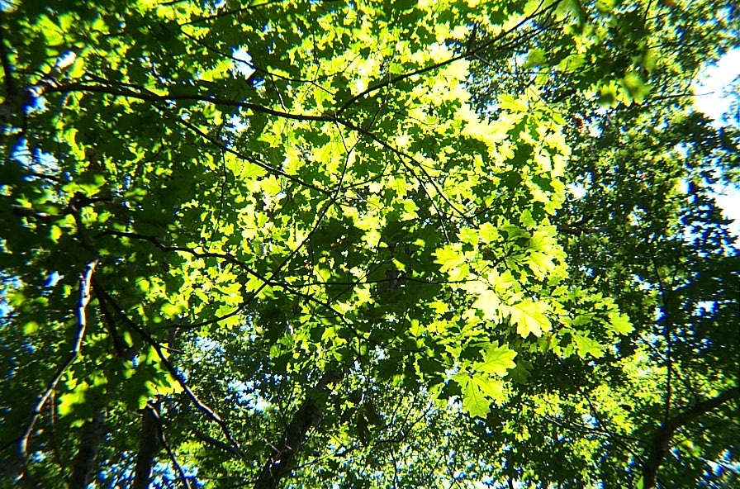
White Oak

Slide 14
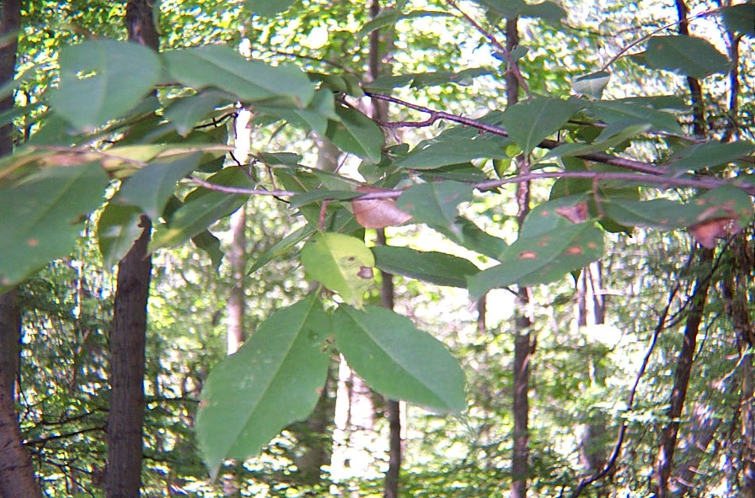
Cherry

Slide 15
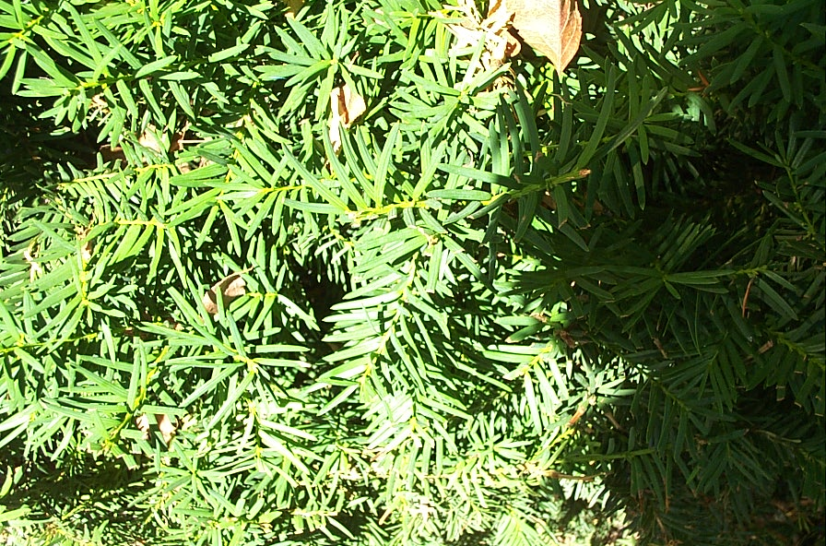
Yew

Slide 16
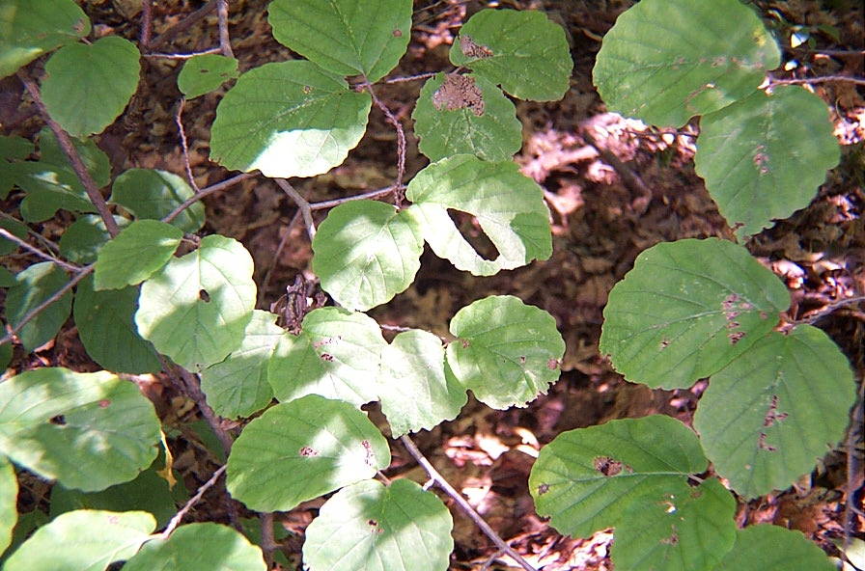
Alternate Dogwood

Slide 17
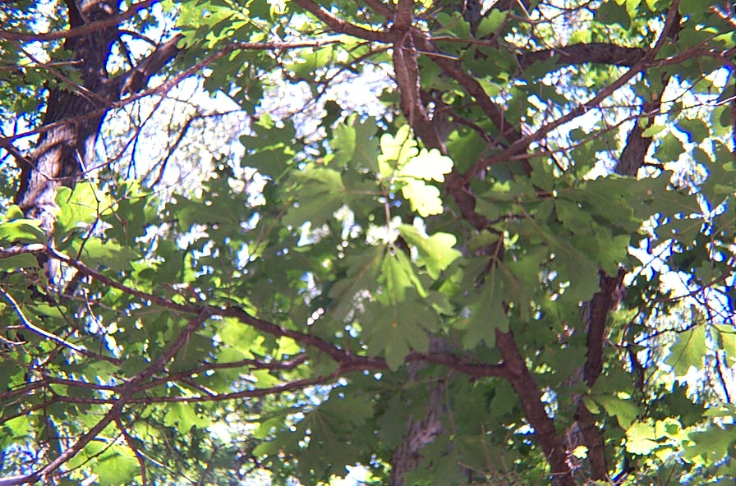
White Oak

Slide 18
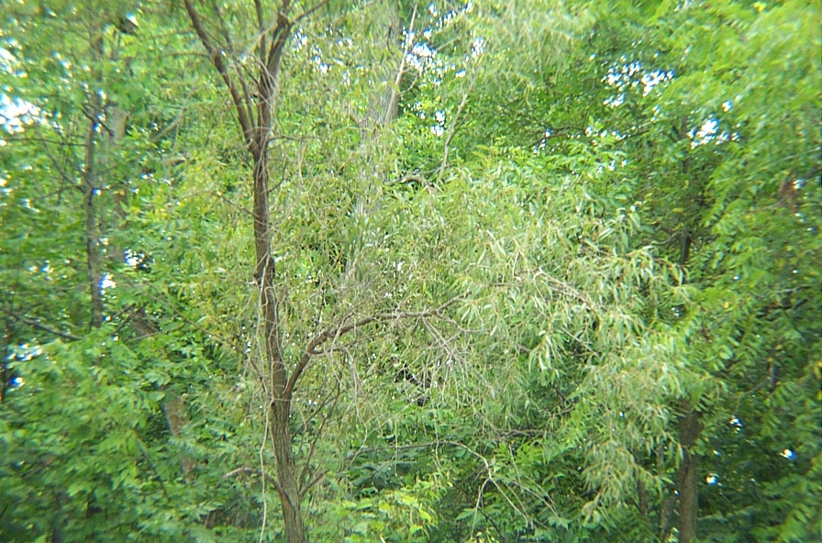
Willow

Slide 19
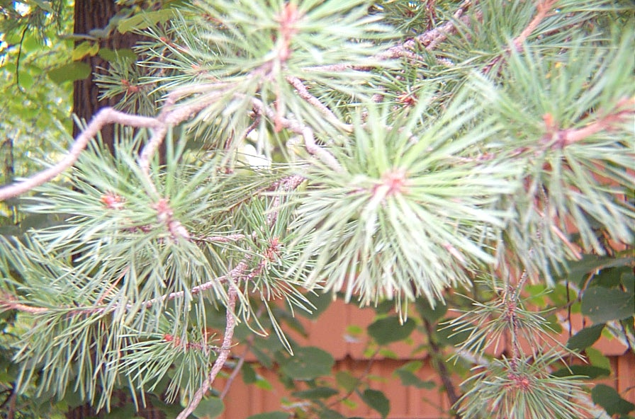
Red Pine

Slide 20
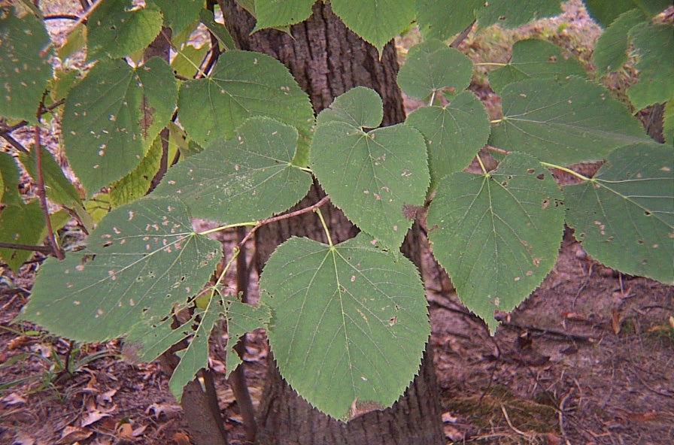
Basswood

Slide 21
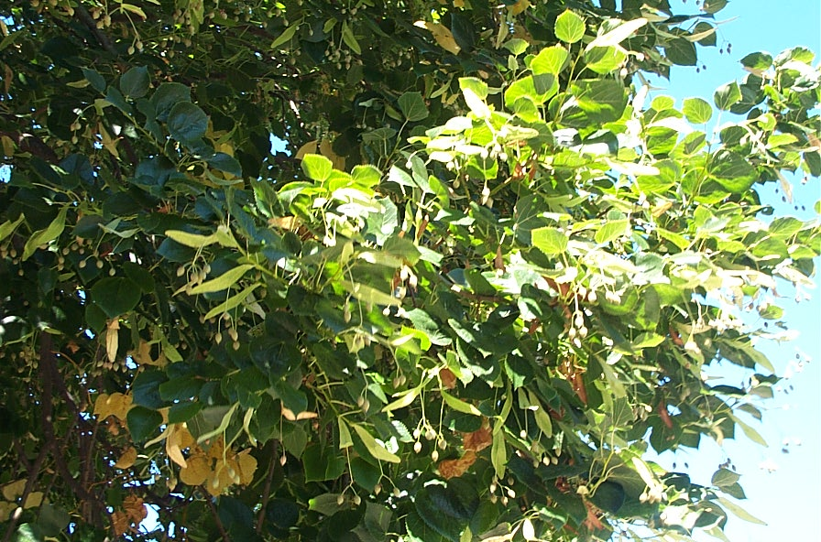
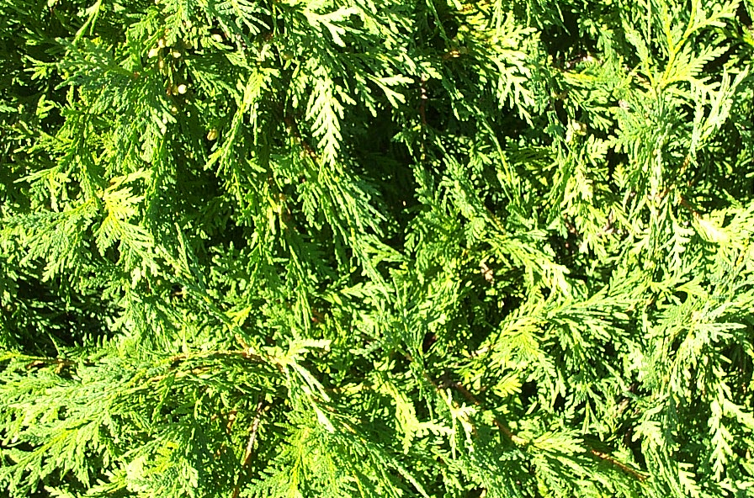
Cedar

Slide 22
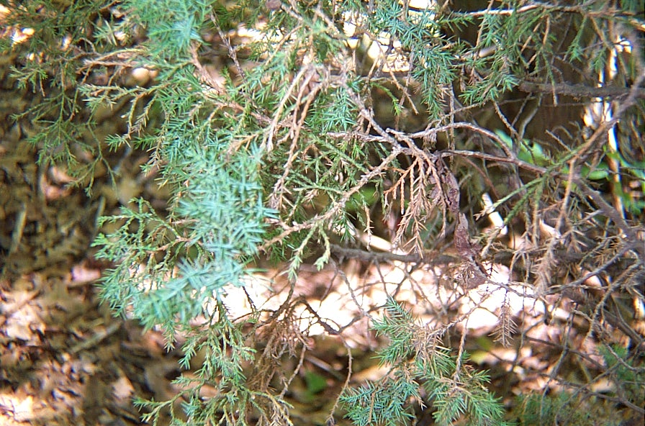
Juniper

Slide 23
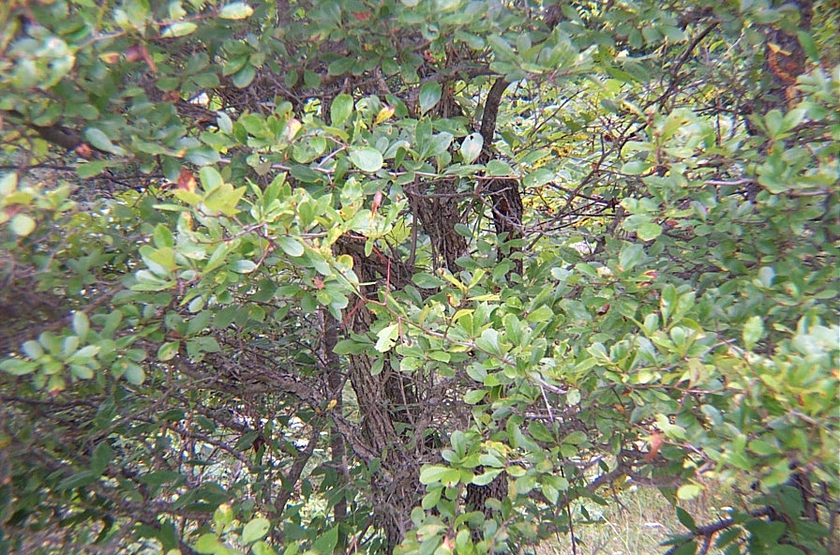
CrabApple
(thorns)

Slide 24
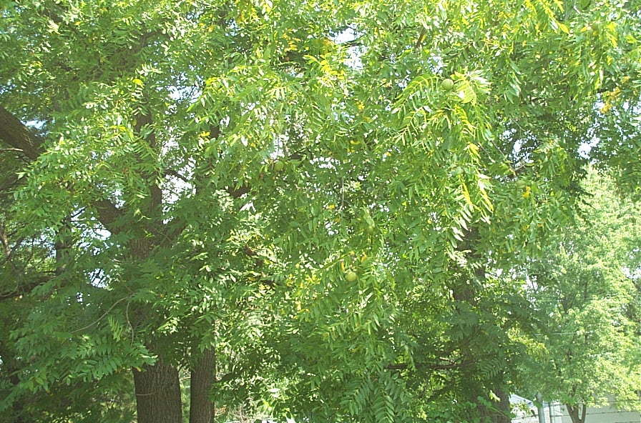
Walnut

Slide 25
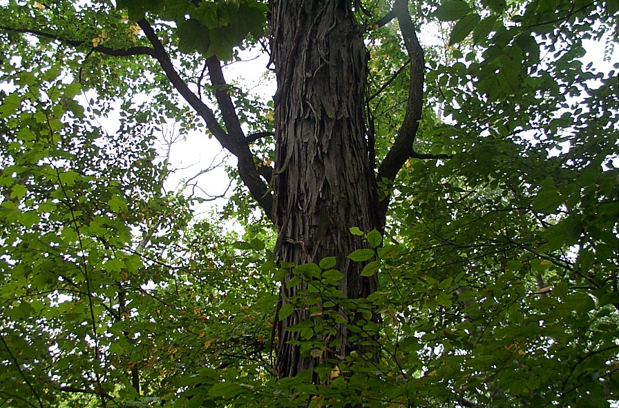
Shagbark Hickory

Slide 26
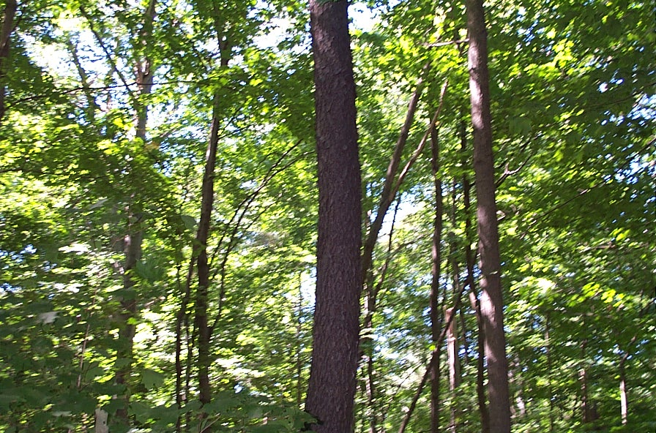
Cherry

Slide 27
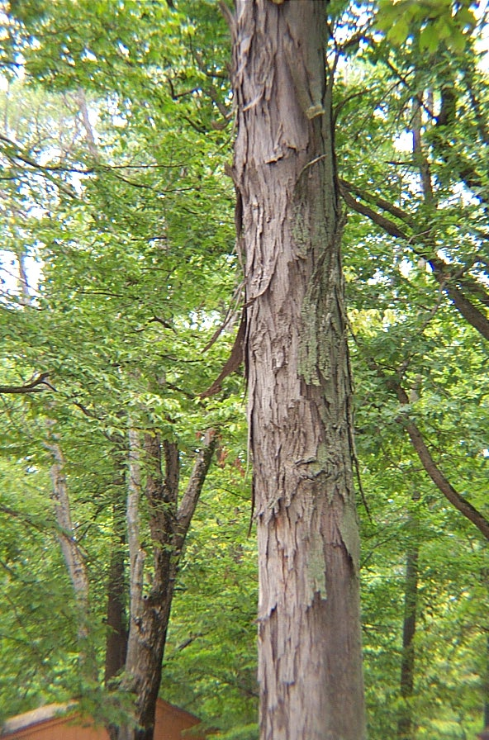
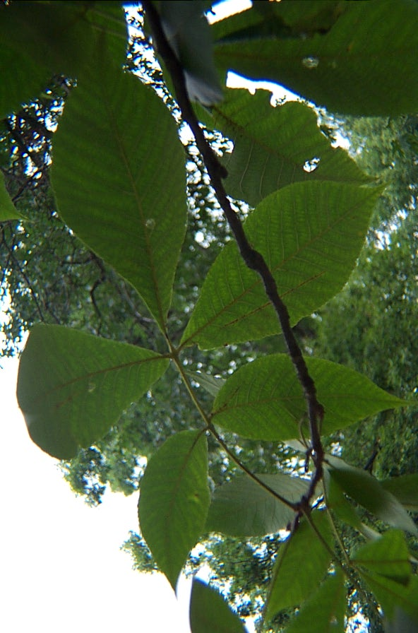
Shagbark Hickory

Slide 28
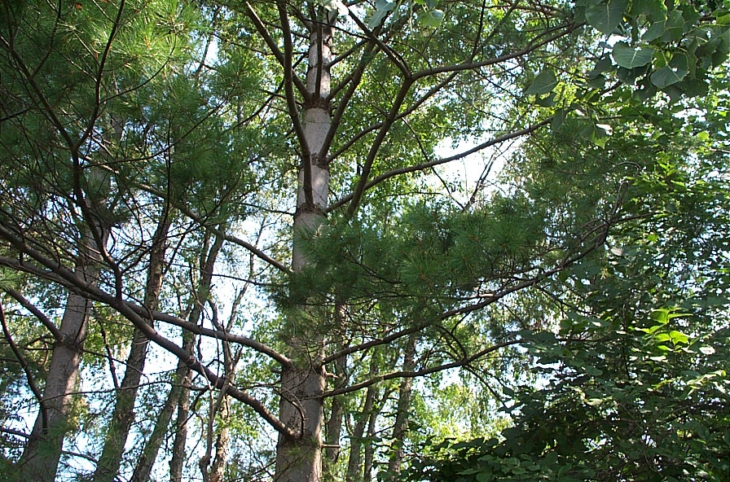
White Pine

Slide 29
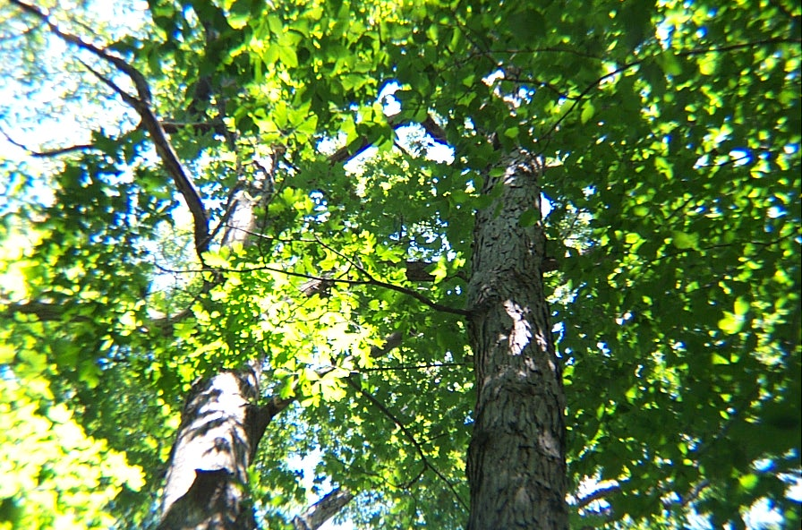
White Oak

Slide 30
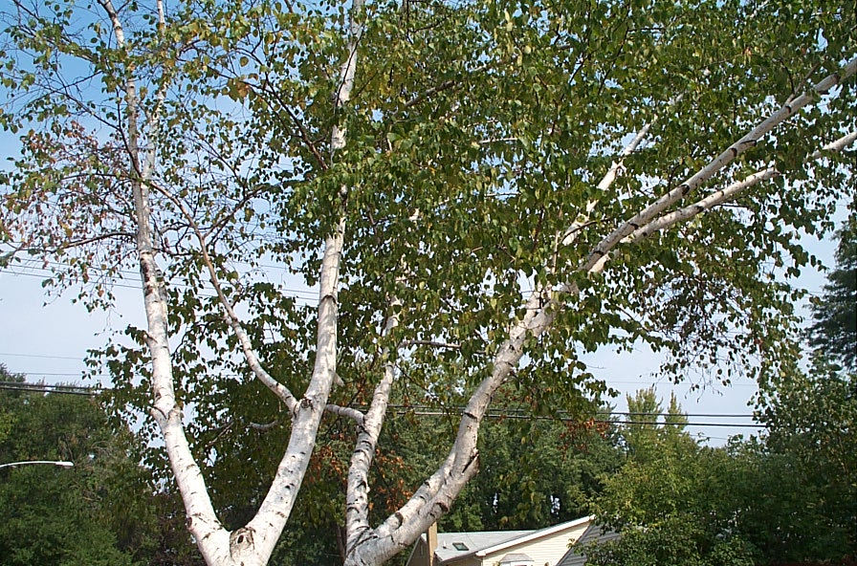
Birch

Slide 31
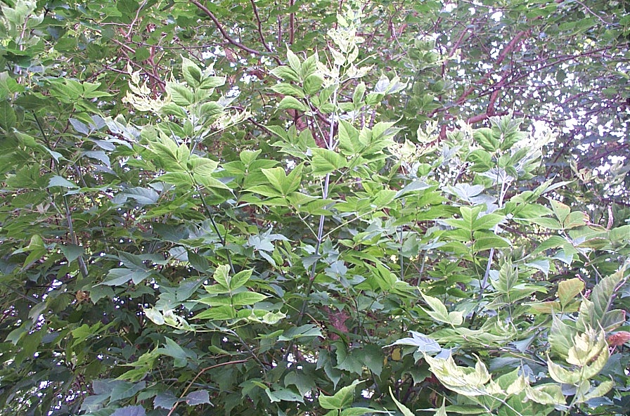
Box Elder

Slide 32
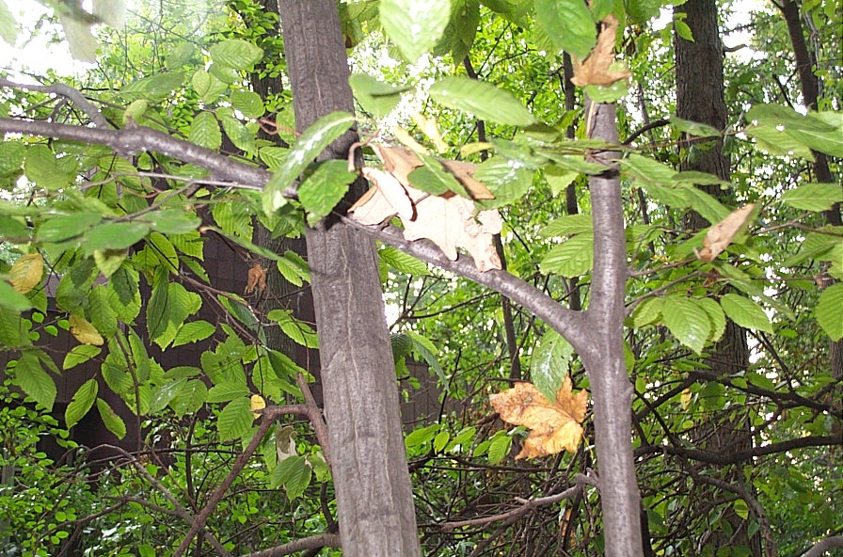
Musclewood
(blue beech)

Slide 33
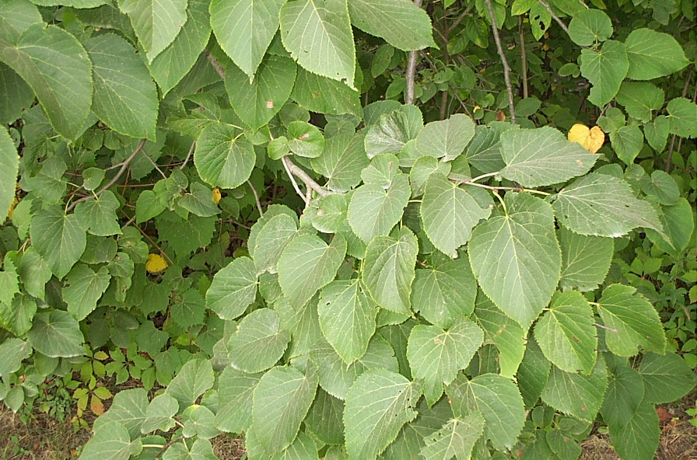
Aspen

Slide 34
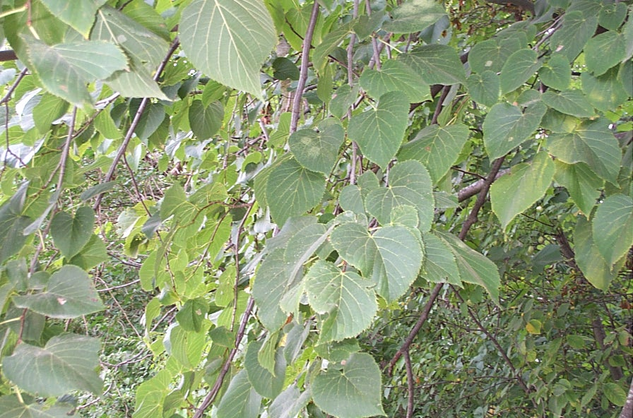
Aspen

Slide 35
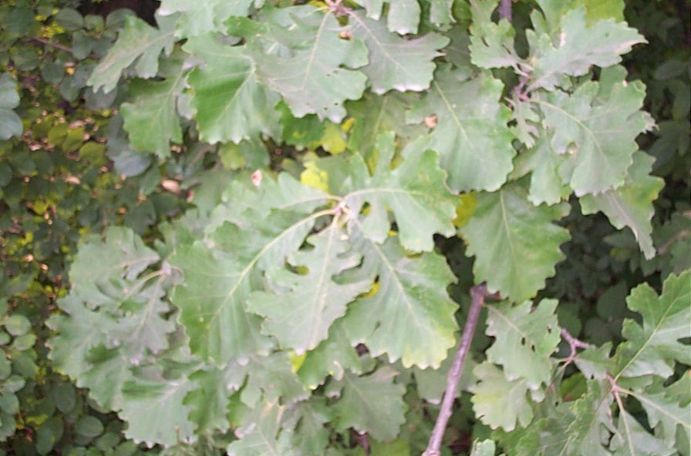
Chestnut Oak

Slide 36
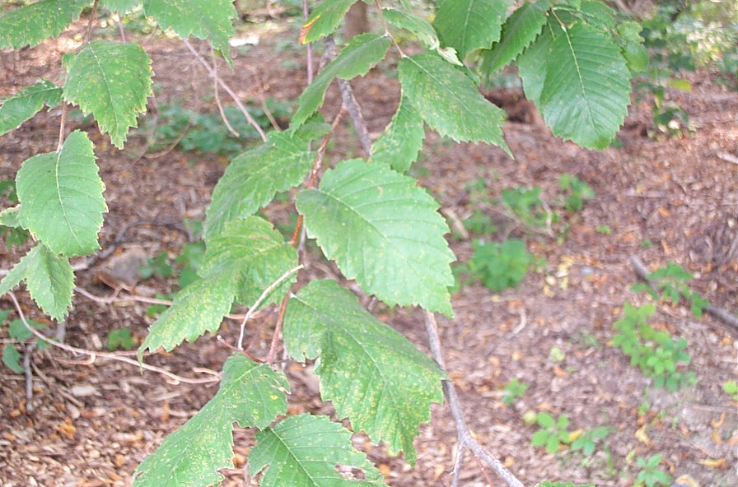
Elm

Slide 37
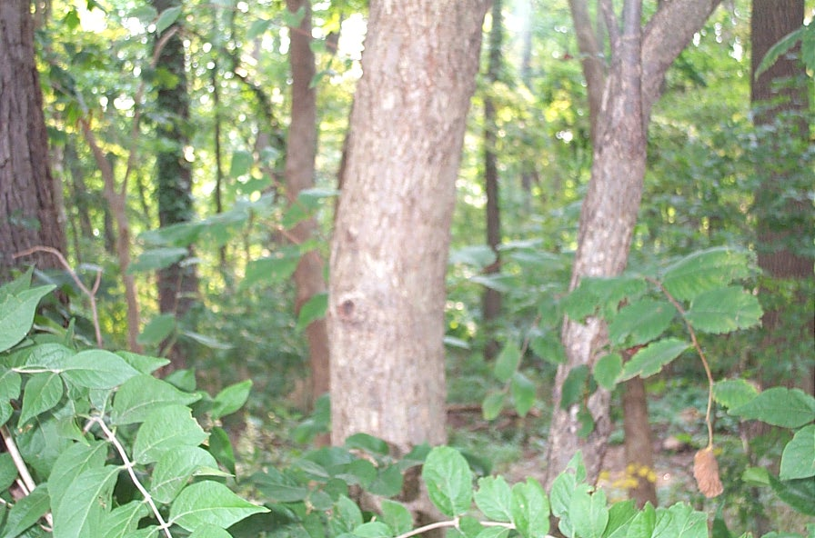
Hornbeam

Slide 38
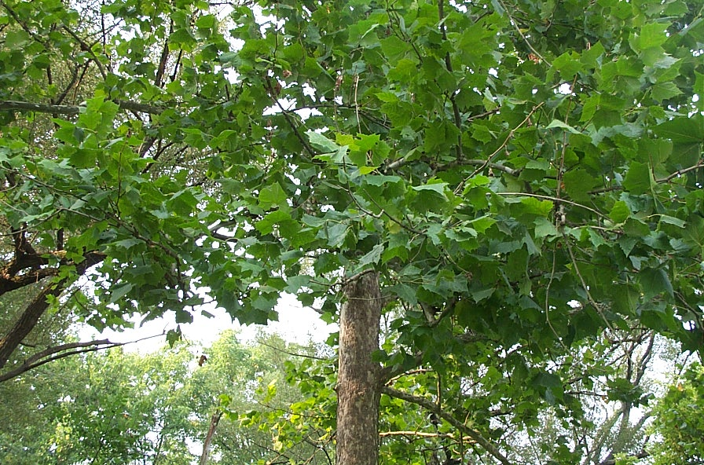
Sycamore

Slide 39
Aspen

Slide 40
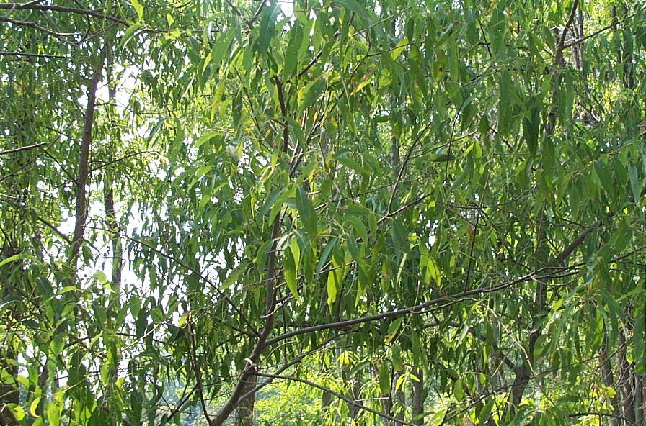
Cherry

Slide 41
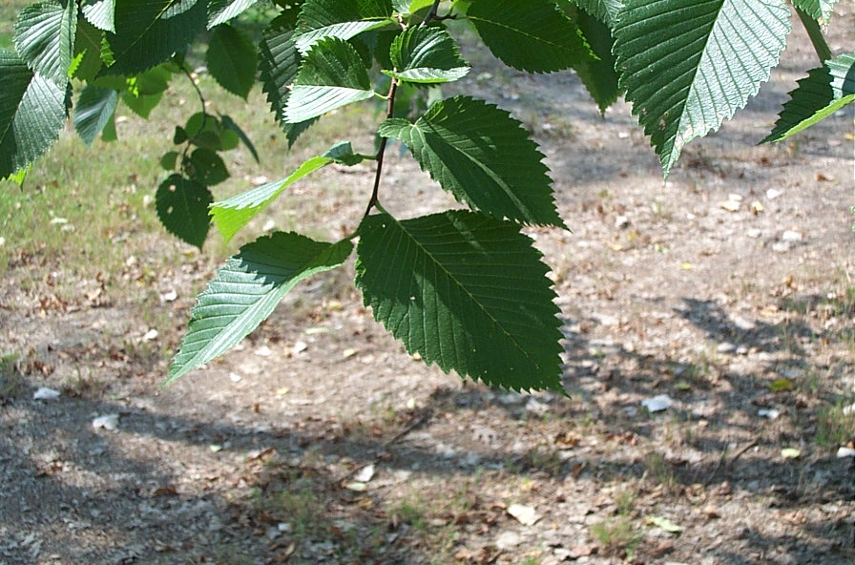
Elm

Slide 42
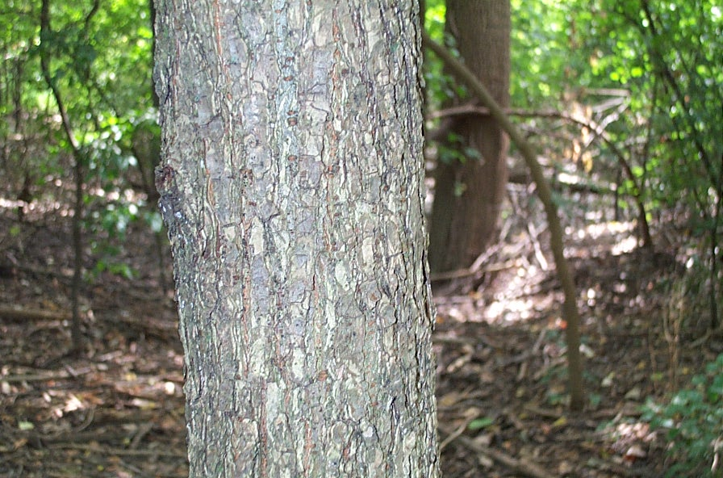
Hornbeam

Slide 43
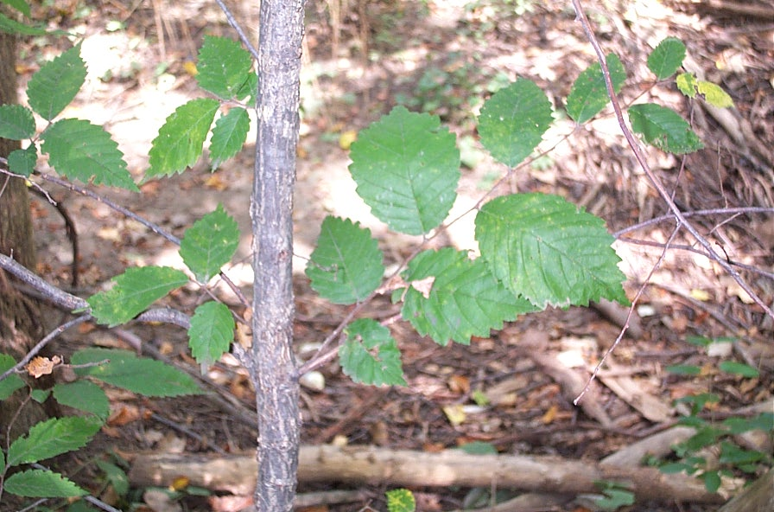
Hornbeam

Slide 44
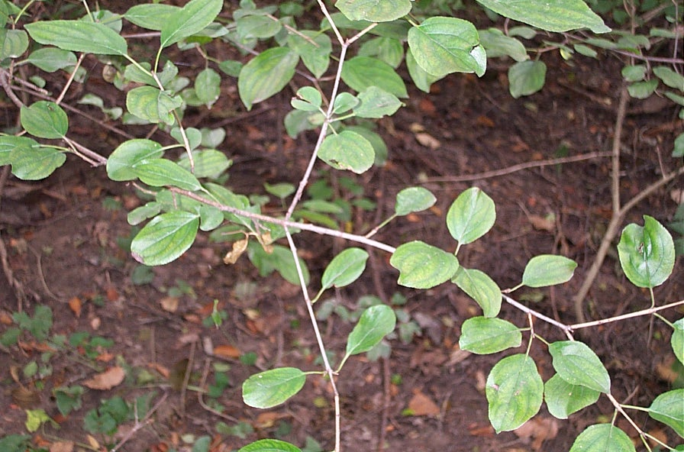
Dogwood

Slide 45
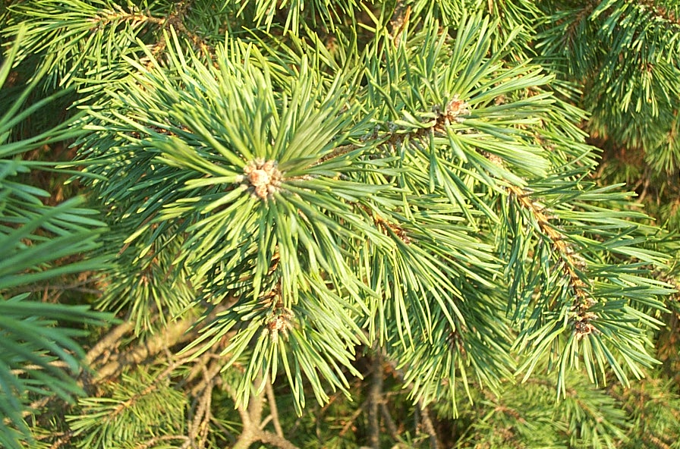
Spruce

Slide 46
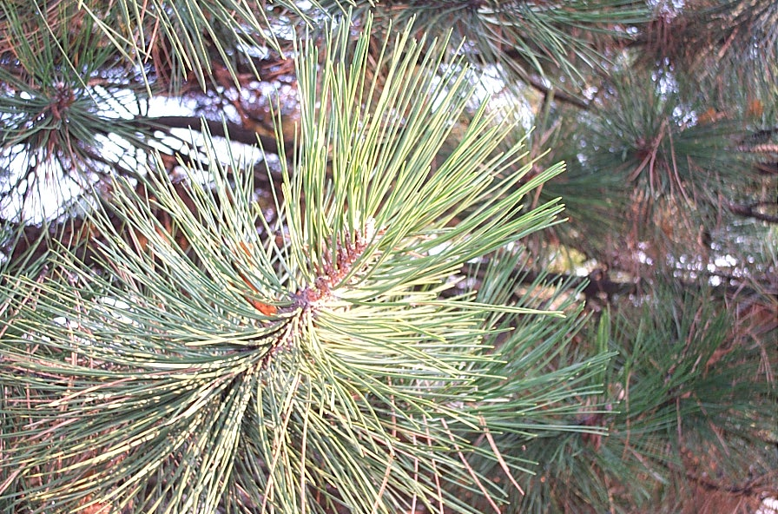
Red Pine

Slide 47
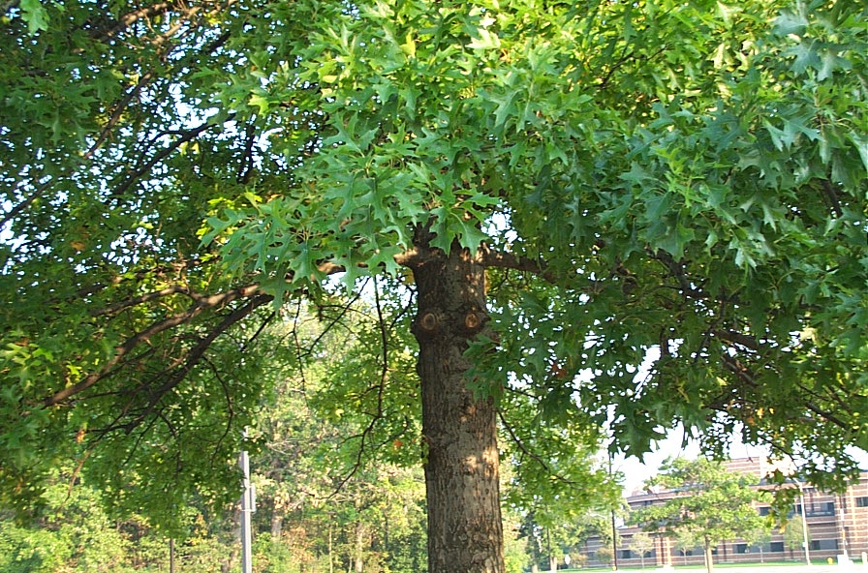
Red Oak

Slide 48
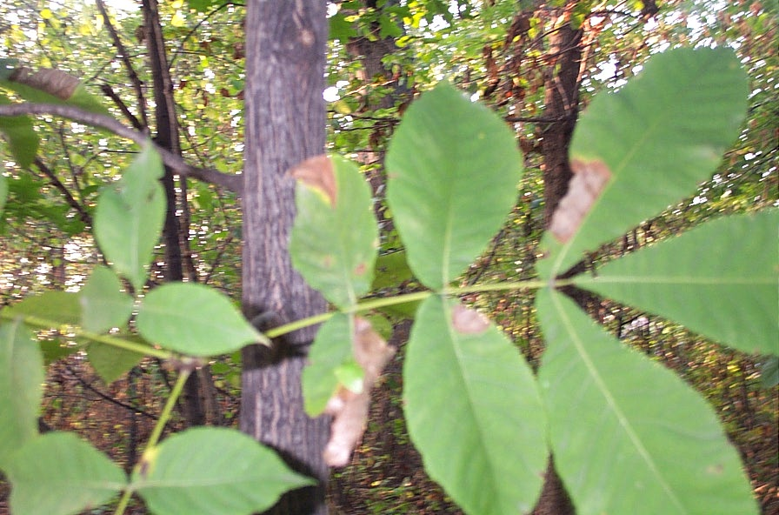
Hickory

Slide 49
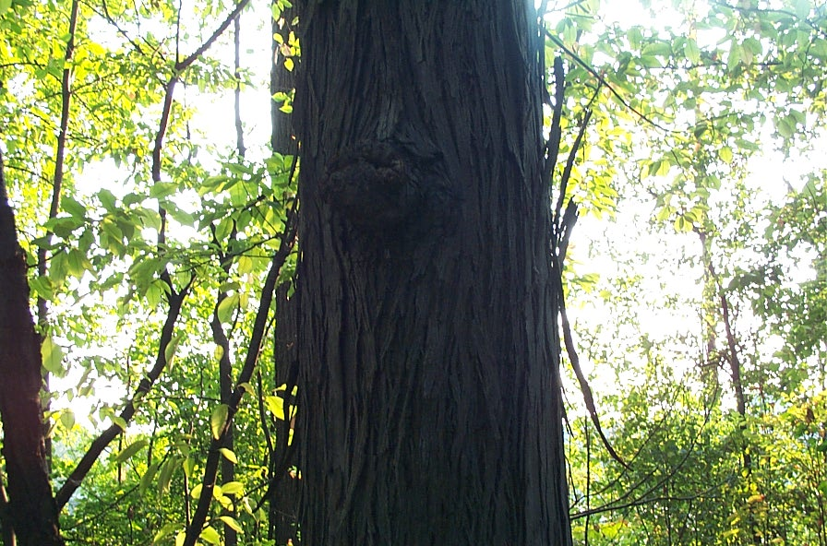
Shagbark Hickory

Slide 50
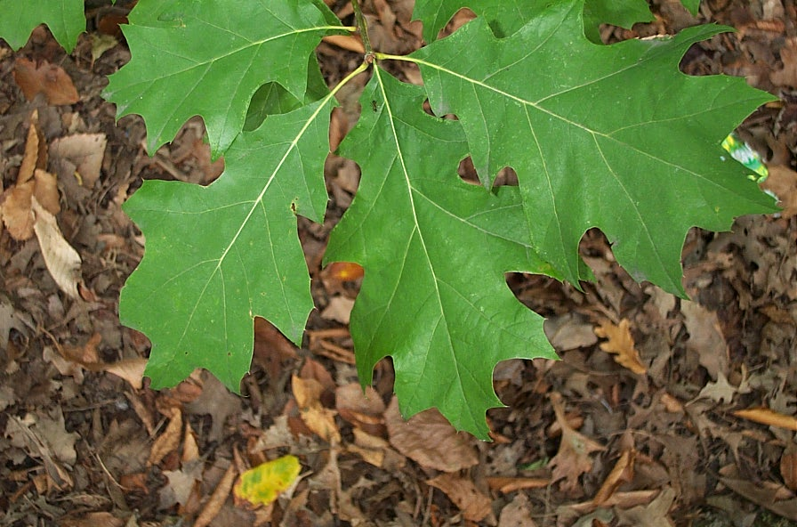
Red Oak

Slide 51
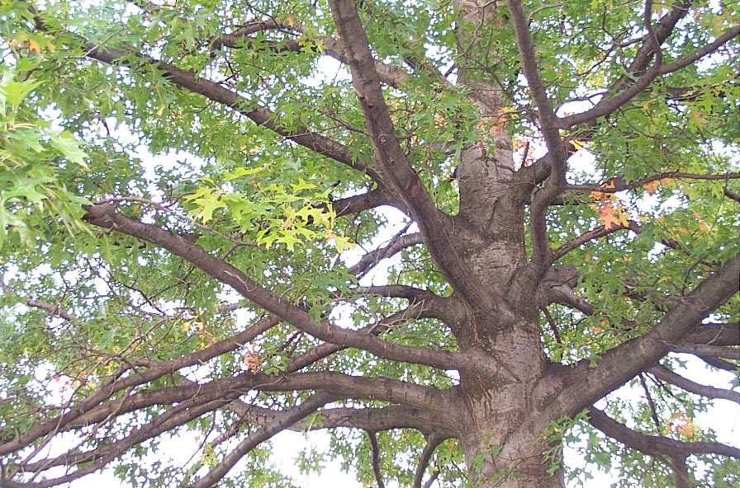
Red Oak

Slide 52
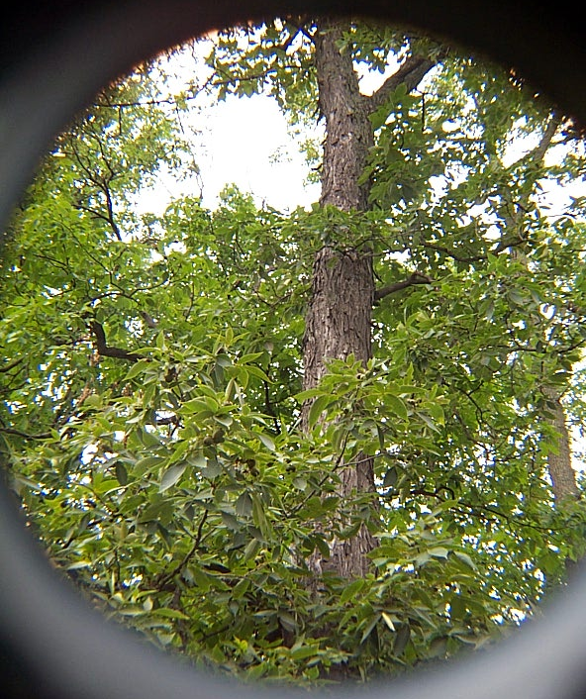
Shagbark Hickory

Slide 53
Dogwood

Slide 54
hemlock

Slide 55
White Oak

Slide 56
Hickory

Slide 57
Ash

Slide 58
Red Pine

Slide 59
Bitternut Hickory

Slide 60
Shagbark Hickory

Slide 61
Oak

Slide 62
Spruce

Slide 63
Spruce

Slide 64
Red Pine

