Slide 1
Click “Slide Show”
Click “From Beginning”
or
“From Current Slide”

Slide 2
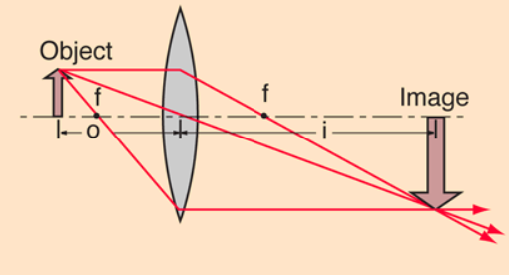
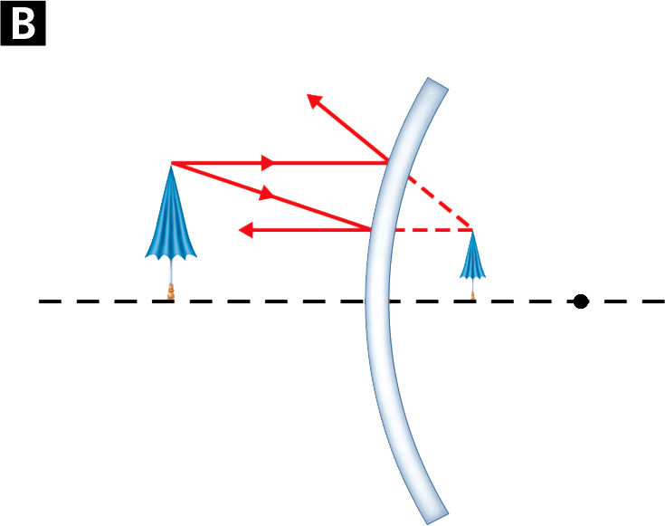
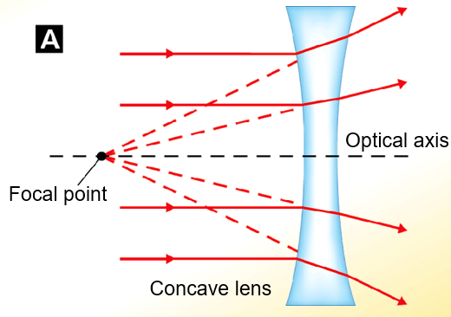
Optics Mirrors & Lenses
1
3
2
Focal point
Convex mirror

Slide 3

What is the relationship between frequency and wavelength: c = f λ?
Do radio waves have lower or higher frequency than visible light? What about X-rays compared to visible light?
Order the colors of the rainbow from highest to lowest frequency.

Slide 4
What is the relationship between frequency and wavelength: c = f λ? inverse
Radio waves have lower frequency than visible light. X-rays have higher frequency than visible light.
Order the colors of the rainbow from highest to lowest frequency. VIBGYOR
ROYBIV (longest to shortest wavelength)
Lowest f
Highest f
Longest λ
Shortest λ

Slide 5
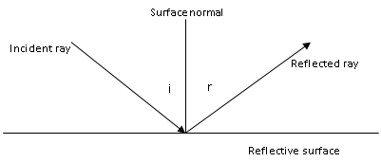
Title and label the following diagram:
2
1
3
5
6
4
What do you know about angles 5 & 6?

Slide 6


Label the following diagram:
Specular Reflection
I
R
Angles 5 = Angle 6
i = r
i = incident angle
r = refracted angle

Slide 7

Air is the top medium and glass is the bottom medium. Title and label the following diagram:
AIR
2
1
3
4
What do you know about the two media?
5
GLASS

Slide 8
Air is the top medium and glass is the bottom medium. Label the following diagram:
Refraction
AIR
i = incident angle
t = refracted angle
T = refracted ray
I
Refractive surface
Glass is more dense than air. So, the refracted ray bends TOWARD the normal.
T
t
GLASS

Slide 9

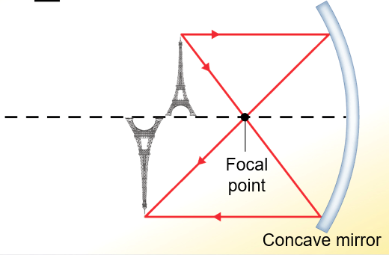
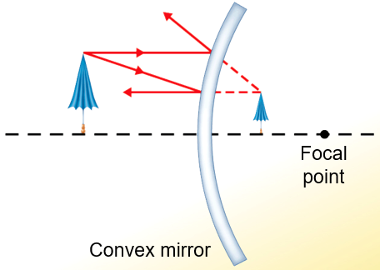
Mirrors
There are three types of mirrors that all operate according to the law of reflection:
Plane (Flat) Mirrors
Concave Mirrors
Convex Mirrors

Slide 10
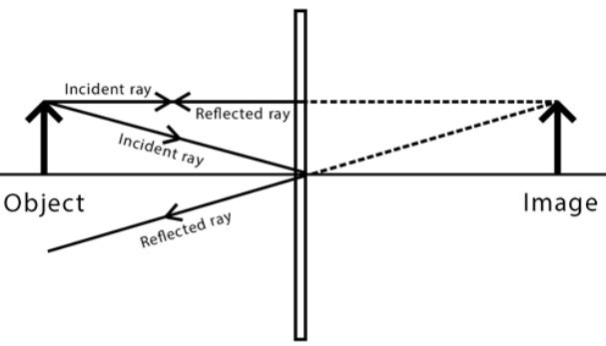
Plane (Flat) Mirrors
Plane mirrors produce VIRTUAL images, meaning they cannot be projected onto a screen.
The image appears the same distance behind the mirror as it is in front, and the image is right side up.

Slide 11
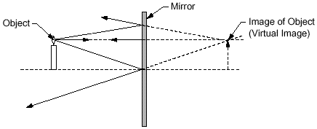
Plane (Flat) Mirrors
As the rays from the object are reflected by the mirror, the reflected rays appear to come from the image located behind the mirror at a distance equal to the object's distance from the mirror.
The image is called a virtual image since the rays do not actually pass through or come from the image; they just appear to come from the image as illustrated below.

Slide 12
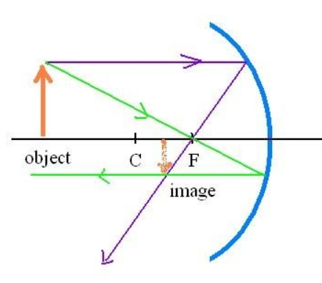
Making RAY Diagrams
Use THREE Rays to create an IMAGE in a mirror or lens.
1) From the top of the object parallel to the mirror/lens through the focal point
2) From the top of the object through the focal point and parallel to the mirror/lens
3) From the top of the object to or through the mirror/lens principle axis (center of the lens/mirror).
1
1
3
2
3
2

Slide 13
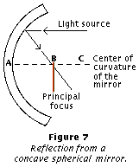
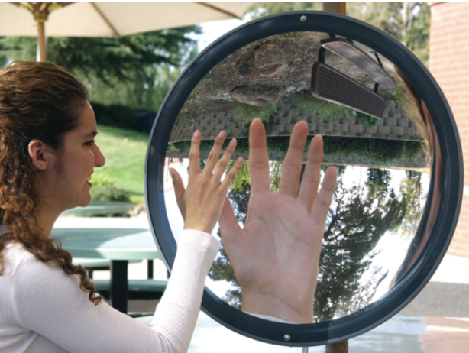
Spherical Mirrors (Concave)
The focal length of a spherical mirror is about one-half the radius of curvature of the mirror.
C = 2 f

Slide 14
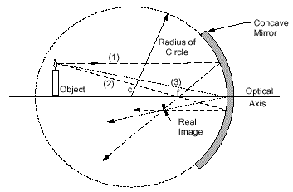
Spherical Mirrors (Concave)
Object is beyond the focal point of the mirror.
Image is REAL, Inverted, Reduced.

Slide 15
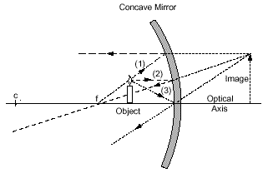
Spherical Mirrors (Concave)
Object is between the focal point and the mirror.
Image is VIRTUAL, Erect, Enlarged.
e.g. a makeup mirror
C = 2 f

Slide 16
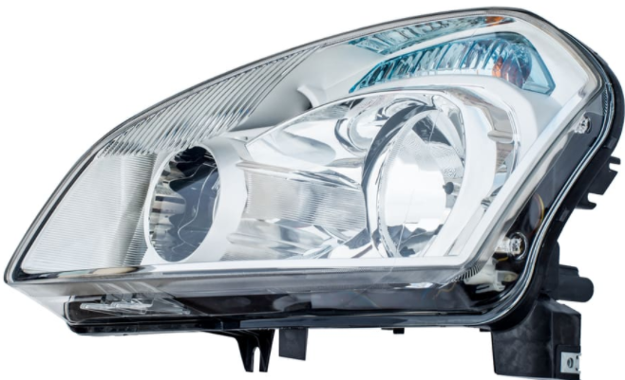

Concave Mirrors
When the inside surface of a curved mirror is the reflecting surface, the mirror is a concave mirror.
  The curvature of the reflecting surface causes the rays to come together.
  The point at which the light rays meet is called the focal point.
Concave mirrors in automobile headlights and flashlights direct the illumination from a light bulb into a beam.

Slide 17
Concave Mirrors
Concave mirrors can form “real” or “virtual” images.
  A real image is a copy of an object formed at the point where light rays actually meet. This occurs when the object is farther from the mirror than the focal point as shown.
  A real image can be viewed on a surface such as a screen.

Slide 18
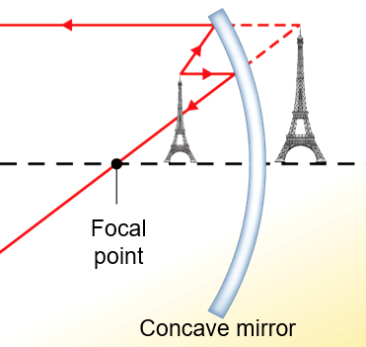
Concave Mirrors
Concave mirrors can form “real” or “virtual” images.
  A virtual image forms when the object is closer to the mirror than the focal point is, the reflected rays spread out and appear to come from behind the mirror to form a virtual image.
  Torch lights
  Automobile headlights

Slide 19
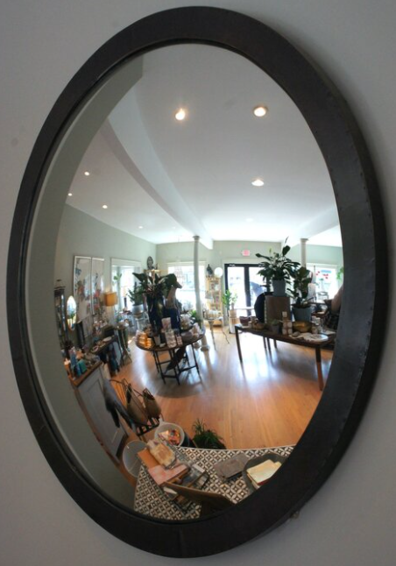
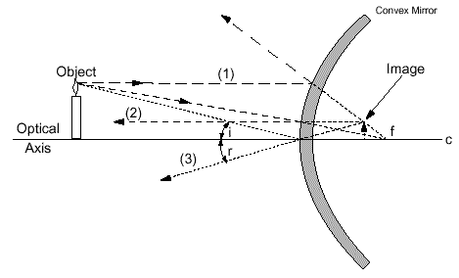
Spherical Mirrors (Convex)
Virtual, Upright (Erect), and Smaller Image (Reduced).
Magnifying glasses, telescopes

Slide 20
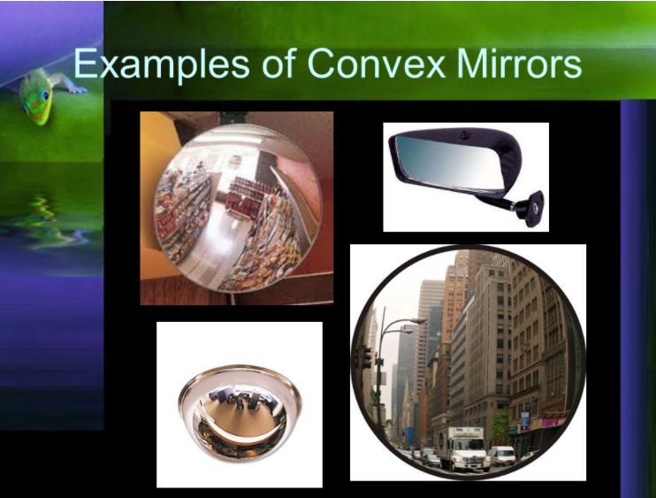
Spherical Mirrors (Convex)
Passenger side mirror on a vehicle; hallway safety mirrors to see around corners; optical instruments

Slide 21
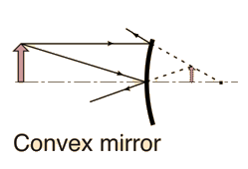
Convex Mirrors
Convex mirrors ONLY form “virtual” images.
  The virtual image forms BEHIND the mirror because the reflected rays off the mirror do NOT converge to a focus (no real image formed).
  The image is REDUCED and ERECT.
object
image

Slide 22
A real image formed by a mirror is
  always right-side up.
  always smaller than the object.
  able to be projected on a screen.
  only formed by convex mirrors.
According to the law of reflection, the angle of reflection is (greater than, less than, equal to) the angle of incidence.
An image of an object, formed by a convex mirror, is always
  upright and smaller than the object.
  upside down and smaller than the object.
  upright and larger than the object.
  upside down and larger than the object.

Slide 23
A real image formed by a mirror is
  always right-side up.
  always smaller than the object.
  able to be projected on a screen.
  only formed by convex mirrors.
According to the law of reflection, the angle of reflection is equal to the angle of incidence.
An image of an object, formed by a convex mirror, is always
  upright and smaller than the object.
  upside down and smaller than the object.
  upright and larger than the object.
  upside down and larger than the object.

Slide 24
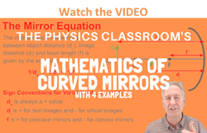
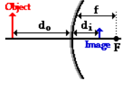

Mirror Equation
The mirror equation expresses the quantitative relationship between the object distance (d_{o}), the image distance (d_{i}), an the focal length (f).

Slide 25

Magnification Equation
The magnification equation relates the ratio of the image distance to the (d_{i}) object distance (d_{o}) or the image height (h_{i}) to the object height (h_{o}).
h_{i}
h_{o}

Slide 26
A 4.0-cm tall light bulb is placed a distance of 35.5 cm from a convex mirror having a focal length of -12.2 cm. Determine the image distance and the image size.
What is the problem asking for?
What information (amounts) are given?
What equation/formula/method relates?
Solve the problem (plug in numbers) and does it make sense?

Slide 27
A 4.0-cm tall (h₀) light bulb is placed a distance of 35.5 cm from a convex mirror (d₀) having a focal length of -12.2 cm (f). Determine the image distance (d_{i}) and the image size (h_{i}).
What is the problem asking for? Image distance (d_{i})
What information (amounts) is given? h_{o} = 4.0 cm; d_{o} = 35.5 cm; f = -12.2 cm
What equation/formula/method relates? 1/f = 1/d_{o} + 1/d_{i}
Solve the problem (plug in numbers) and does it make sense?
1/f = 1/do + 1/d_{i}
1/d_{i} = 1/(-12.2 cm) - 1/(35.5 cm)
1/d_{i} = -0.0820 cm⁻¹ - 0.0282 cm⁻¹
1/d_{i} = -0.110 cm⁻¹
d_{i} = -1 / 0.110 cm
d_{i} = -9.1 cm
Inside f, virtual image

Slide 28
A 4.0-cm tall (h₀) light bulb is placed a distance of 35.5 cm from a convex mirror (d₀) having a focal length of -12.2 cm (f). Determine the image distance (d_{i}) and the image size (h_{i}).
What is the problem asking for? Image size
What information (amounts) is given? h_{o} = 4.0 cm; d_{o} = 35.5 cm; d_{i} = -9.1 cm
What equation/formula/method relates? h_{i}/h_{o} = - d_{i}/d_{o}
Solve the problem (plug in numbers) and does it make sense?
h_{i} / h_{o} = - d_{i} / d_{o}
h_{i} = -d_{i} x h_{o} / d_{o}
h_{i} = -(-9.1 cm)(4.0 cm) / 35.5 cm
h_{i} = 1.0 cm
M = ¼ = 0.25 … reduced, erect

Slide 29
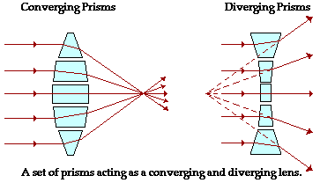
Lenses
If a piece of glass or other transparent material takes on the appropriate shape, it will be capable of taking parallel rays of incident light and either converging them to a point or appear to diverge them from a point. Such a piece of glass is referred to as a lens.

Slide 30
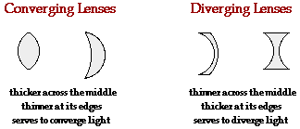
Lenses
A lens is a carefully ground or molded piece of transparent material which refracts light rays in such a way as to form an image. Lenses can be thought of as a series of tiny refracting prisms or lenses, each of which refracts light to produce their own image. When these prisms act together, they produce a bright enough image focused at a point.
convex
concave

Slide 31
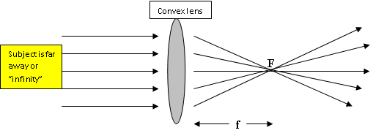
Converging Lenses
Convex lenses (converging) are always thicker in the center than the ends and normally produce an image by focusing light rays on the other side of the lens.
The image formed is INVERTED (upside down).
All lenses produce a REVERSED image.
Focal point
Focal distance

Slide 32
Converging Lenses
Convex lenses produce “REAL” images – light rays actually pass through the lens by convergence and can be projected (e.g. overhead projector or movie projector).
Incident Rays
object
image
Refracted Rays

Slide 33
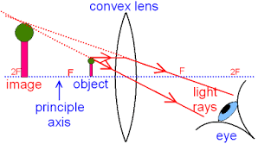
Converging Lenses
Convex lenses always produce VIRTUAL images and can also become MAGNIFYING glasses if the object is placed between the focal point and the lens.

Slide 34
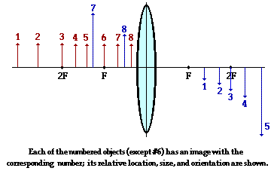
Converging Lenses
The image produced depends on where the object is located.

Slide 35
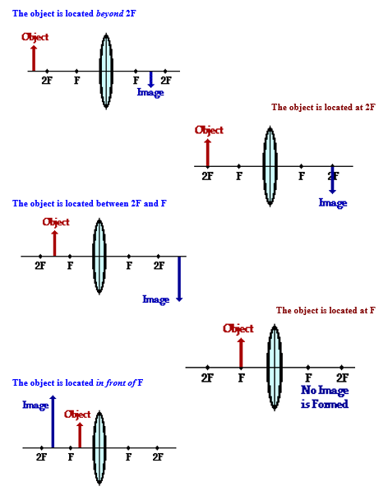
Converging Lenses
The image produced depends on where the object is located.

Slide 36
Converging (convex) Lenses
Watch video:
http://somup.com/c0f3oL44Mm (2:08)

Slide 37
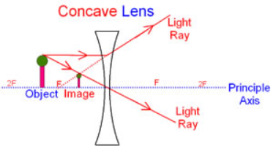
Diverging Lenses
Concave lenses (diverging) are thinner in the center than at the ends and ALWAYS produce a VIRTUAL image.
The VIRTUAL image is like an “optical illusion” to our brain. It is ERECT (upright), REDUCED in size, and on the same side of the lens as the object.

Slide 38
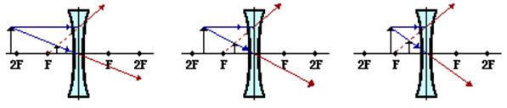
Diverging Lenses
All lenses produce a REVERSED image.
Concave lenses are used in peep holes in doors, rearview mirrors, and in lens systems for cameras and binoculars.
Object
Object
Object

Slide 39
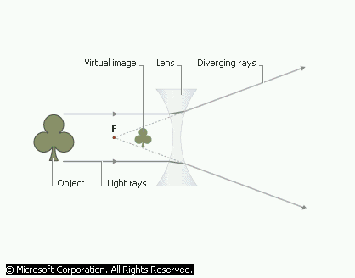
Diverging Lenses
Wide angle view
Reduced image size, but ERECT (right side up)
Used in lens systems for cameras and binoculars
Peep holes in doors, rearview mirrors
VIRTUAL IMAGE – “optical illusion” to the eye
Concave lenses are always thinner in the center than at the ends

Slide 40
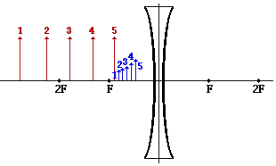
Diverging Lenses
Another characteristic of the images of objects formed by diverging lenses pertains to how a variation in object distance effects the image distance and size. The diagram below shows five different object locations (drawn and labeled in red) and their corresponding image locations (drawn and labeled in blue).
The diagram shows that as the object distance is decreased, the image distance is decreased and the image size is increased. So as an object approaches the lens, its virtual image on the same side of the lens approaches the lens as well; and at the same time, the image becomes larger.

Slide 41
Diverging (concave) Lenses
Watch video:
http://somup.com/cFf0FsV5Gl (1:37)

Slide 42
Which type(s) of lens can form a real image?
  concave lens only
  convex lens only
  both concave and convex lenses
  neither concave nor convex lenses
  The ___ is the ratio of the speed of light in a vacuum to the speed of light in a material.
A virtual image is formed by
  concave lens only
  convex lens only
  both concave and convex lenses
  neither concave nor convex lenses

Slide 43
Which type(s) of lens can form a real image?
  concave lens only
  convex lens only
  both concave and convex lenses
  neither concave nor convex lenses
  The index of refraction is the ratio of the speed of light in a vacuum to the speed of light in a material.
A virtual image is formed by
  concave lens only
  convex lens only
  both concave and convex lenses
  neither concave nor convex lenses

Slide 44
Terms and Sign Conventions
object distance d_{o}, positive
image distance d_{i},
  POSITIVE if image is on side of outgoing light, i.e. same side of mirror, opposite side of lens: REAL image
  d_{i} is NEGATIVE if image is on same side of lens/behind mirror: VIRTUAL image
focal length f
  POSITIVE for concave mirror and converging lens; REAL images
  NEGATIVE for convex mirror and diverging lens; VIRTUAL images
object height h_{o}, positive
image height h_{i}
  POSITIVE if the image is upright, erect (VIRTUAL image)
  NEGATIVE if image is inverted (REAL image)
magnification m = h_{i} / h_{o}
    POSITIVE if upright, erect
    NEGATIVE if inverted

Slide 45
The lens equation expresses the quantitative relationship between the object distance (d_{o}), the image distance (d_{i}), an the focal length (f).
The magnification equation relates the ratio of the image distance to the (d_{i}) object distance (d_{o}) or the image height (h_{i}) to the object height (h_{o}).

Slide 46
+ / - Conventions
f is + for a concave mirror or convex lens (real image).
f is – for convex mirrors or concave lenses (virtual image).
d_{i} is + if the image is a real image and located on the object's side of the mirror or opposite side of lens.
d_{i} is - if the image is virtual and located behind the mirror or the same side of the lens as the object.
h_{i} is + if the image is upright / erect (virtual).
h_{i} is - if the image an inverted image (real).

Slide 47
A 4.00 cm tall light bulb is placed a distance of 45.7 cm from a double convex lens having a focal length of 15.2 cm. Determine the image distance and the image size.
What is the problem asking for?
What information (amounts) are given?
What equation/formula/method relates?
Solve the problem (plug in numbers) and does it make sense?

Slide 48
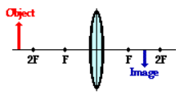
A 4.00 cm tall (h₀) light bulb is placed a distance of 45.7 cm from a double convex lens (d₀) having a focal length of 15.2 cm (f) . Determine the image distance (d_{i}) and the image size (h_{i}).
What is the problem asking for? Image distance (d_{i})
What information (amounts) is given? h_{o} = 4.0 cm; d_{o} = 45.7 cm; f = 15.2 cm
What equation/formula/method relates? 1/f = 1/d_{o} + 1/d_{i}
Solve the problem (plug in numbers) and does it make sense?
1/f = 1/do + 1/d_{i}
1/d_{i} = 1/(15.2 cm) - 1/(45.7 cm)
1/d_{i} = 0.0658 cm⁻¹ - 0.0219 cm⁻¹
1/d_{i} = 0.0439 cm⁻¹
d_{i} = 1 / 0.0439 cm
d_{i} = 22.8 cm (between f and 2f) & Real

Slide 49
A 4.00 cm tall (h₀) light bulb is placed a distance of 45.7 cm from a double convex lens (d₀) having a focal length of 15.2 cm (f). Determine the image distance (d_{i}) and the image size (h_{i}).
What is the problem asking for? Image size
What information (amounts) is given? h_{o} = 4.0 cm; d_{o} = 35.5 cm; d_{i} = 22.8 cm
What equation/formula/method relates? h_{i}/h_{o} = -d_{i}/d_{o}
Solve the problem (plug in numbers) and does it make sense?
h_{i} / h_{o} = -d_{i} / d_{o}
h_{i} = -d_{i} x h_{o} / d_{o}
h_{i} = -(22.8 cm)(4.00 cm) / 45.7 cm
h_{i} = -1.99 cm
Inverted (1/2 the size of object) & Real

Slide 50
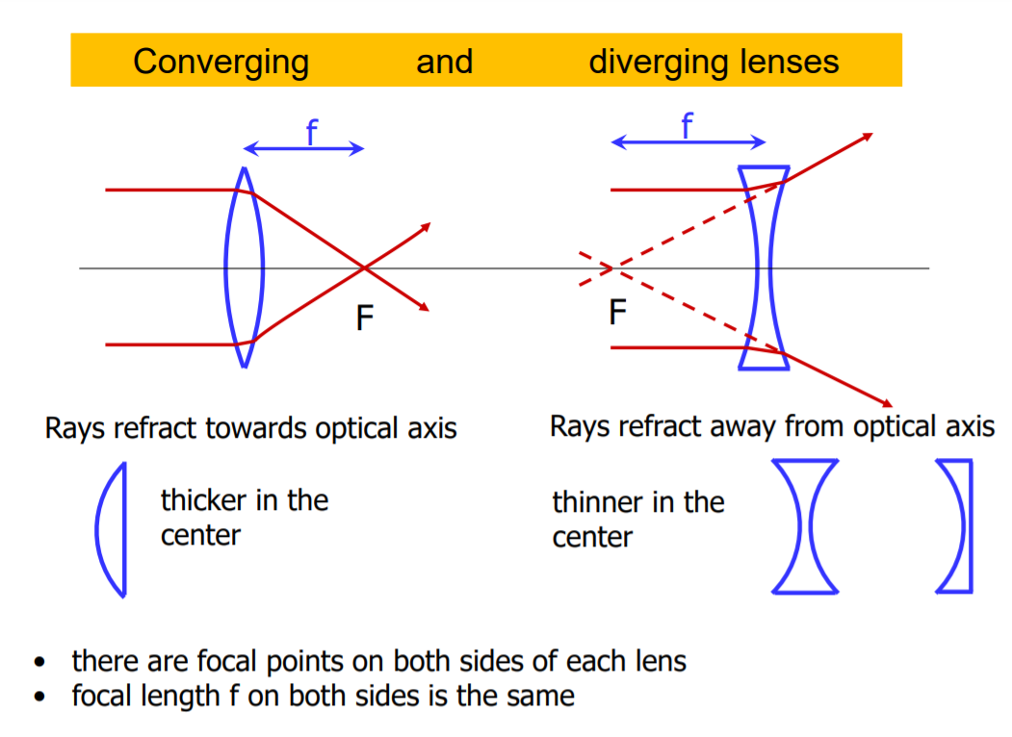

Slide 51
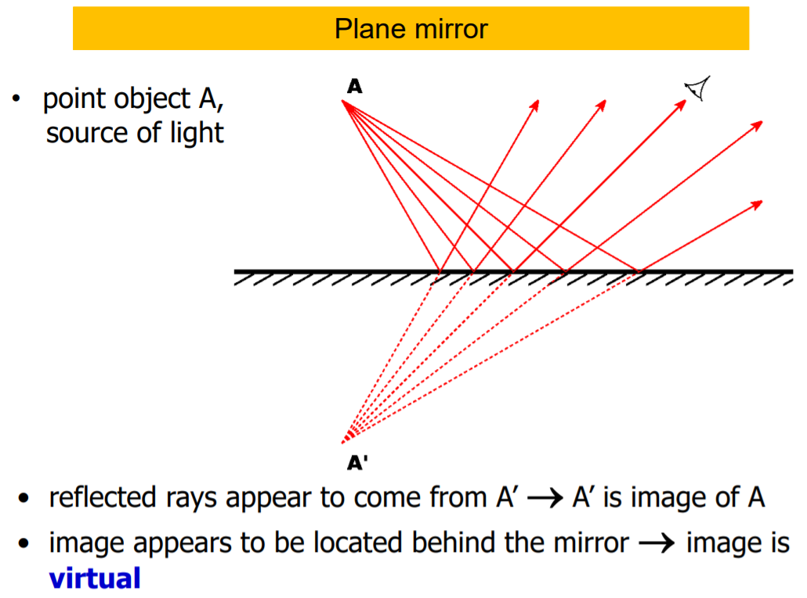

Slide 52
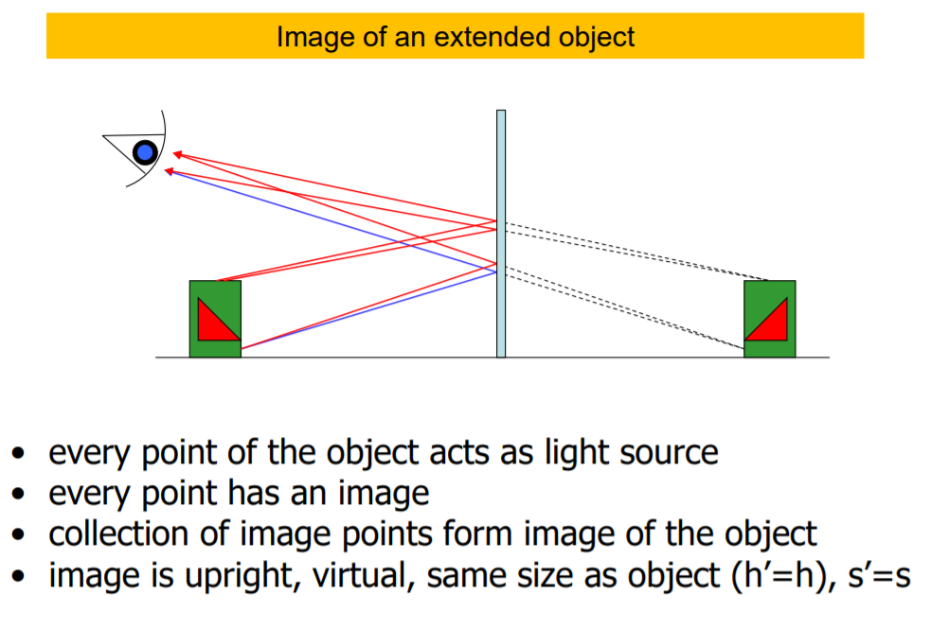

Slide 53
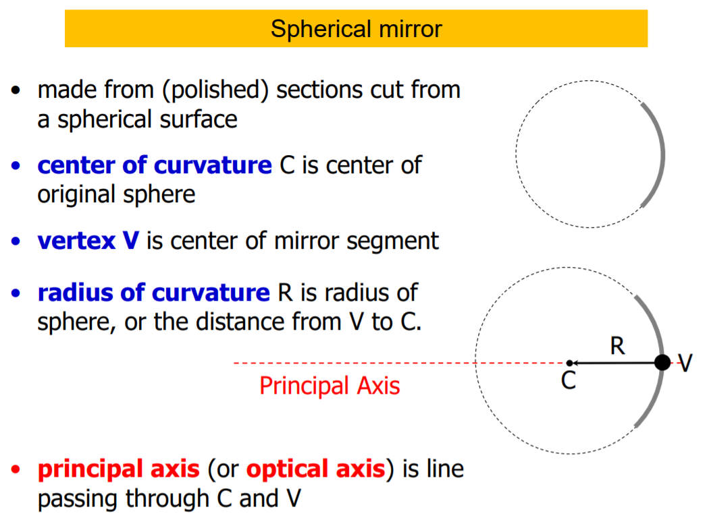
C = 2 f

Slide 54
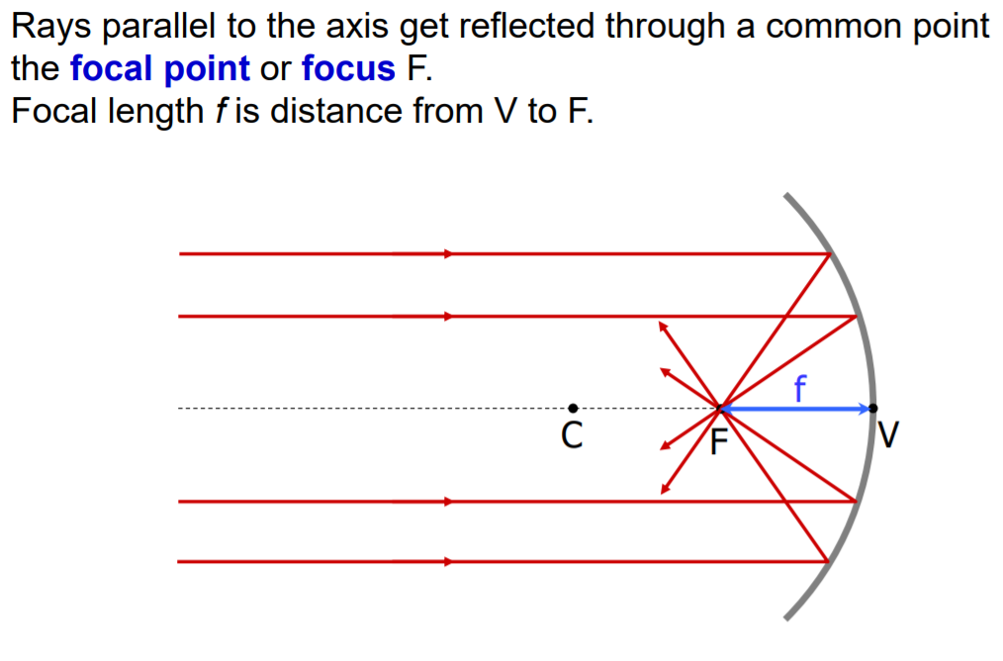
C = 2 f

Slide 55
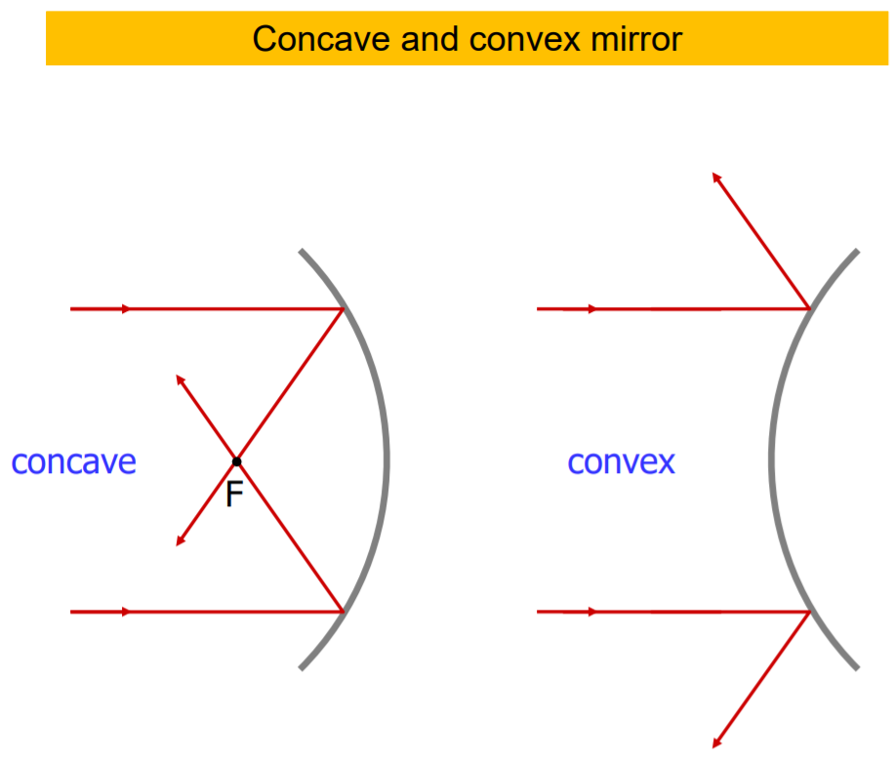

Slide 56
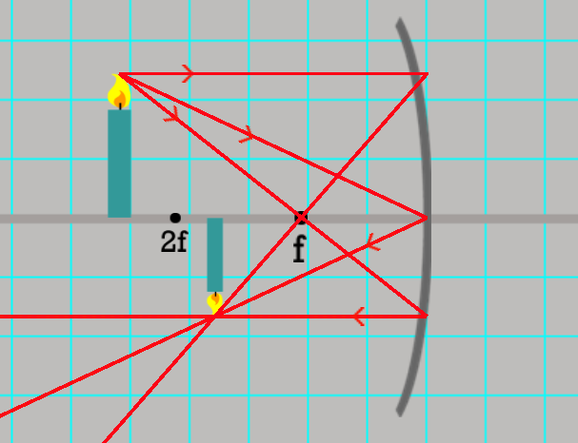
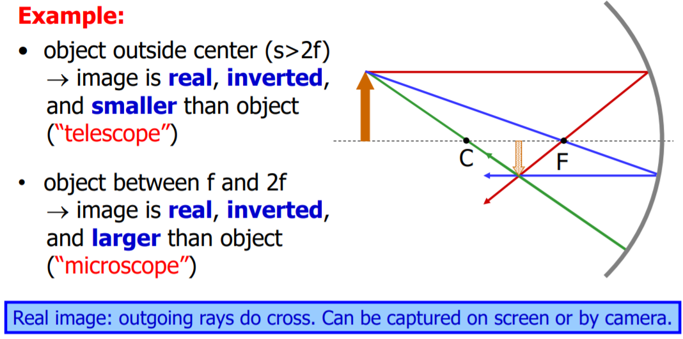
Ray Diagram for Concave Mirror

Slide 57
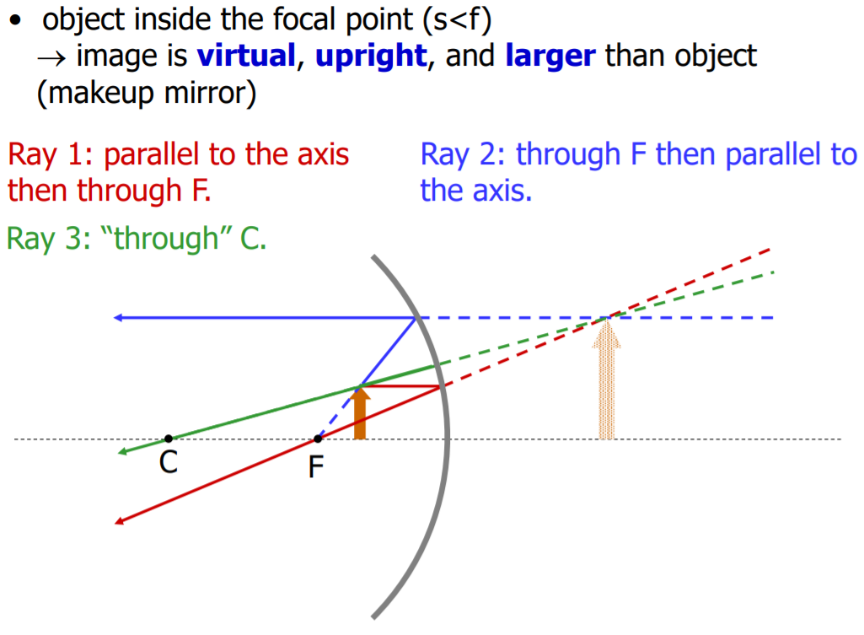
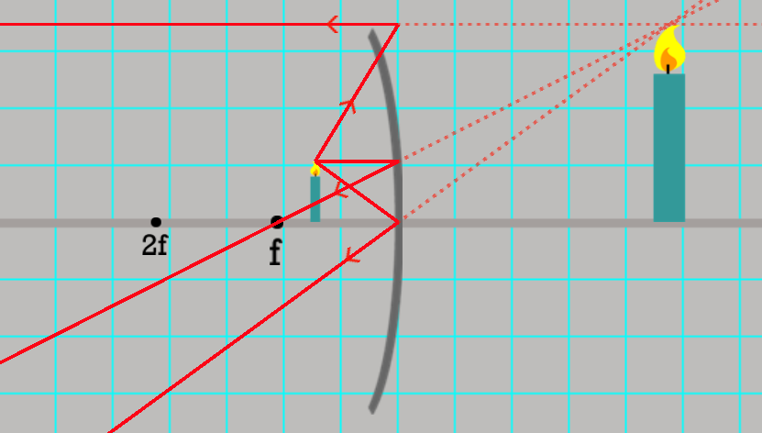
Ray Diagram for Concave Mirror
enter of mirror

Slide 58
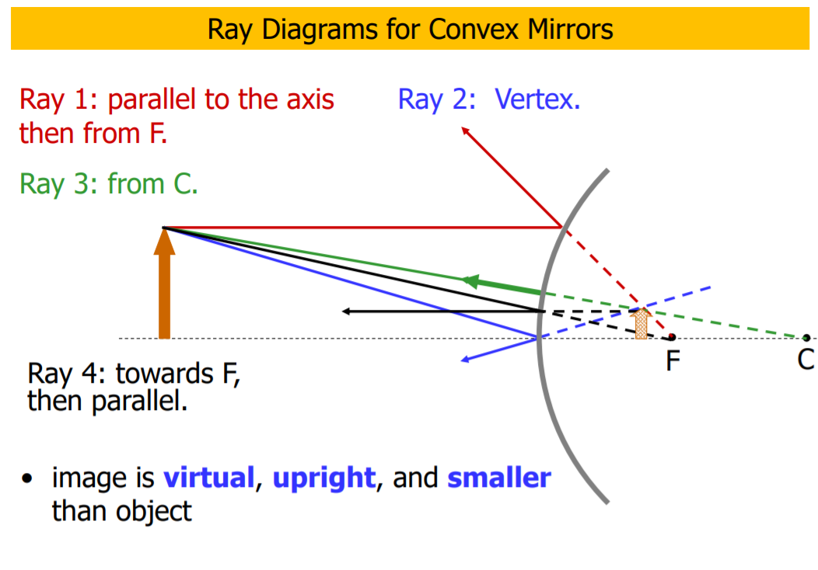
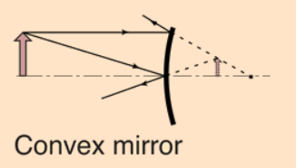

Slide 59
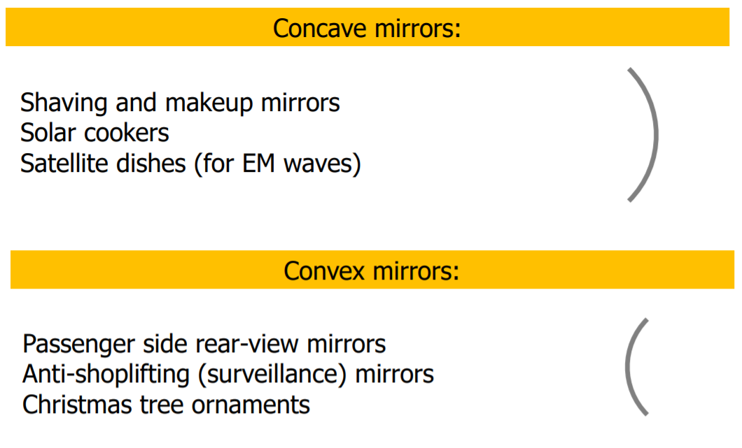

Slide 60
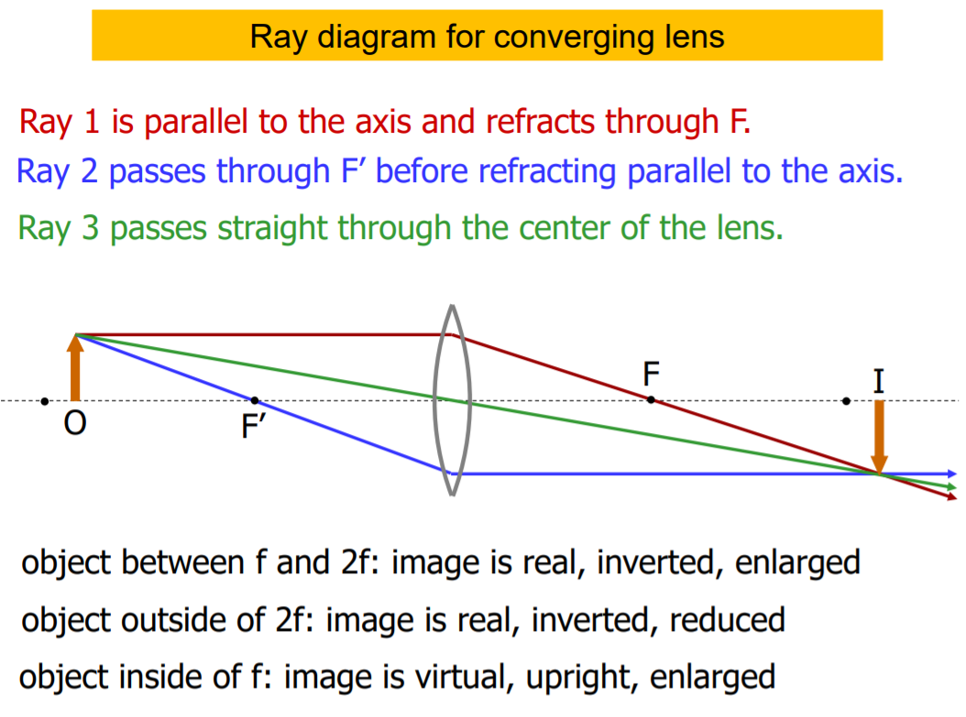

Slide 61
See problem Set
Mirrors & Lenses

