Slide 1
Click on “Slide Show”
Click “Play from Beginning”

Slide 2
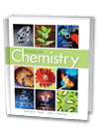
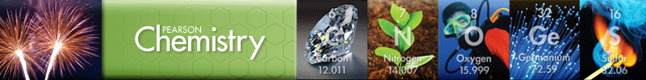
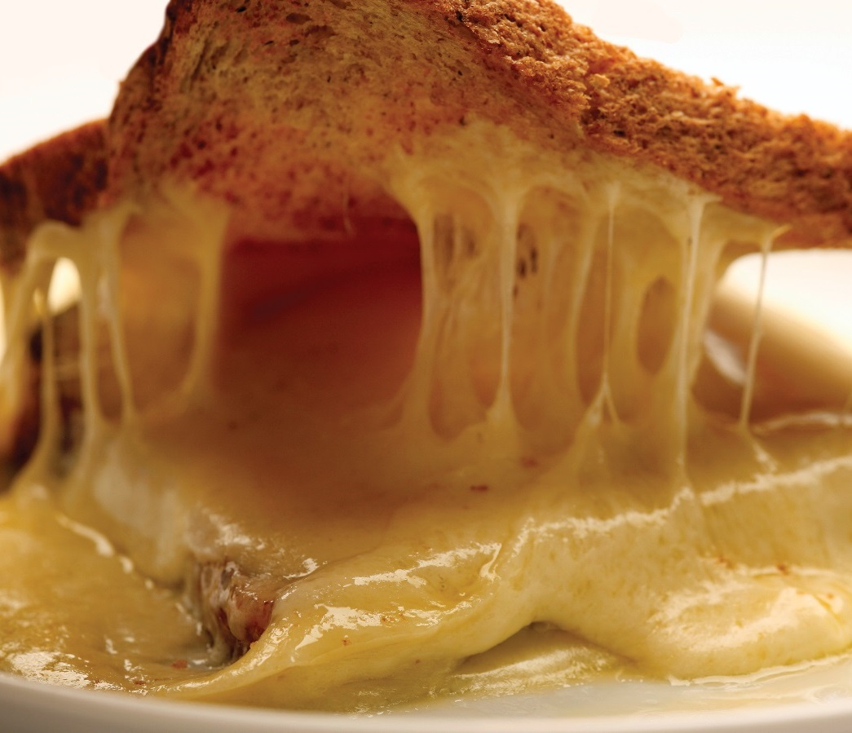
Chapter 2
Matter and Change
Properties of Matter
Mixtures
Elements and Compounds
Chemical Reactions (Changes)

Slide 3
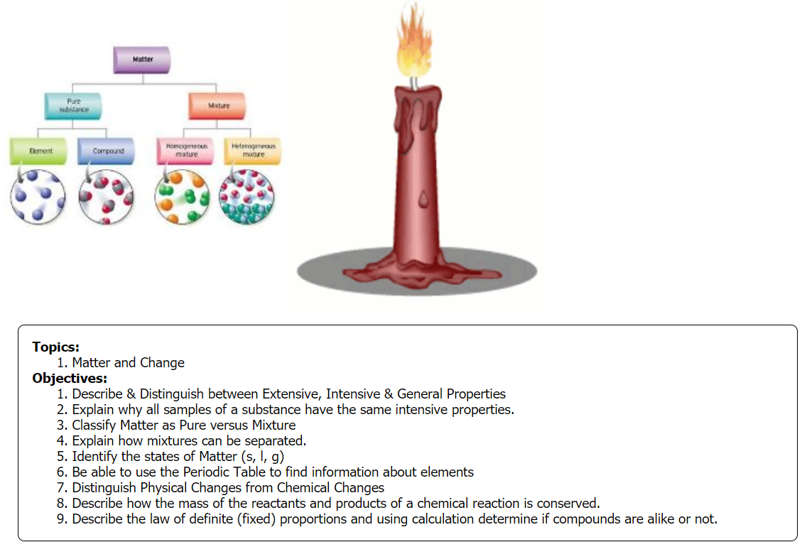

Slide 4

Find an item near you in the room.
Describe that item with a phrase or sentence (without saying what it is) so that someone else could find it if in the room using your description.
Write the description in the chat box.
What was the basis of your description?

Slide 5
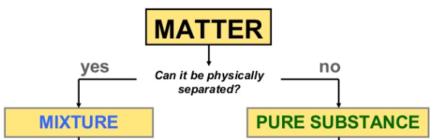
Consider what the “item” or “object” you chose is composed of?
Does the question above apply?

Slide 6
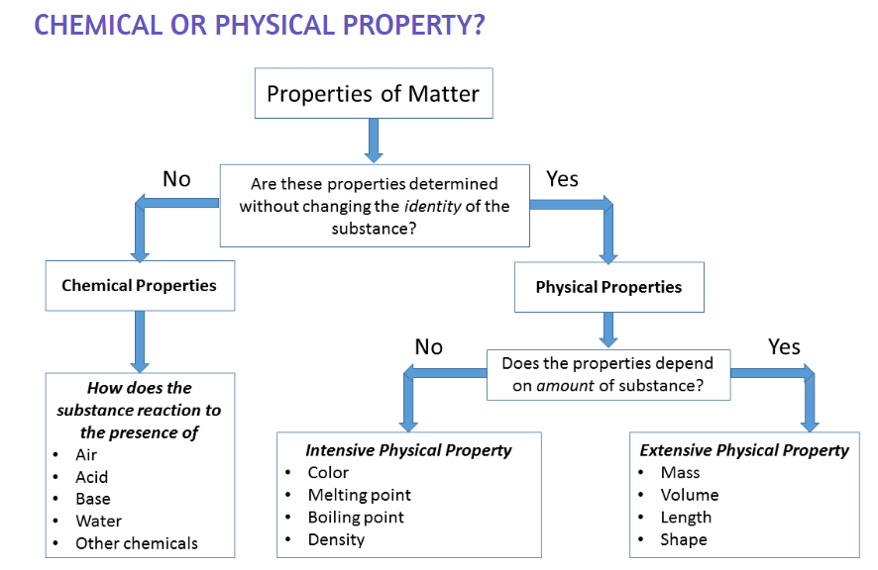
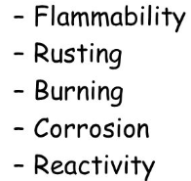
All substances possess either physical or chemical properties.

Slide 7
Classifying Matter
We use physical and chemical properties to identify, distinguish, choose certain materials over another, and to separate items or objects.
Physical Properties can be “extensive”, “intensive” or general.
Watch the video (1:53 min.)
https://screencast-o-matic.com/watch/cF660bY3h9

Slide 8


Describing Matter
Properties are used to describe matter & can be classified as extensive or intensive.
Extensive Properties
An extensive property depends on the amount of matter in a sample.
e.g. The mass of an object, a measure of the amount of matter the object contains, is an extensive property.
The mass of a basketball is greater than the mass of a golf ball.

Slide 9
Describing Matter
Extensive Properties
The volume of an object, a measure of the space occupied by the object, is an extensive property.
The volume of a basketball is greater than the volume of a golf ball.
Weight is also an extensive property; (mass x gravity).
Length can be an extensive property when describing how much wire or rope one needs. E.g. 2 m of rope

Slide 10
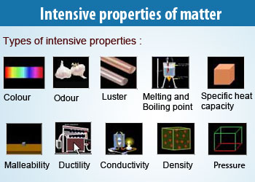
Describing Matter
  Intensive Properties - help IDENTIFY a substance; NOT based on the amount of matter.
Give some examples … intensive properties can be too general to identify a substance unless it is used in a particular way.

Slide 11
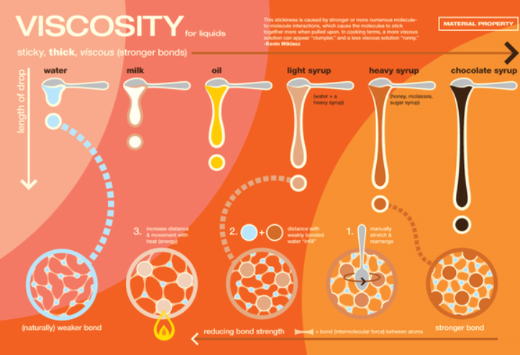

Describing Matter
  Intensive Properties - help IDENTIFY a substance; NOT based on the amount of matter.

Slide 12
Describing Matter
  Some Intensive Properties – may be “general”, depending on what is being compared.
e.g. color
Color is intensive when dealing with a traffic signal. However, it is general when no other parameters are given.
“I see something blue” does not help us identify that substance unless all the other items are non-blue.

Slide 13
Which physical properties are extensive versus intensive?
Physical Properties of Some Substances
Substance | State | Color | Melting point (°C) | Boiling point (°C)
Neon (0.2 L) | Gas | Colorless | –249 | –246
Oxygen (0.13 L) | Gas | Colorless | –218 | –183
Chlorine (0.1 L) | Gas | Greenish-yellow | –101 | –34
Ethanol (80 ml) | Liquid | Colorless | –117 | 78
Mercury (10 ml) | Liquid | Silvery-white | –39 | 357
Bromine (25 ml) | Liquid | Reddish-brown | –7 | 59
Water (2 L) | Liquid | Colorless | 0 | 100
Sulfur (100 g) | Solid | Yellow | 115 | 445
Sodium chloride | Solid | White | 801 | 1413
Gold (1 kg) | Solid | Yellow | 1064 | 2856
Copper (6 m) | Solid | Reddish-yellow | 1084 | 2562

Slide 14
Electrical Conductivity
Distinguishing / identifying table salt, sugar, and hydrochloric acid
https://screencast-o-matic.com/watch/cF6eq5YlsI (1:13 min.)
https://screencast-o-matic.com/watch/cF6eq8YlMI (1:31 min.)

Slide 15
Define the types of physical properties (extensive, intensive, general) and then label the following:
boiling point color conductivity density
ductility hardness length malleability
mass melting point odor solubility
state of matter taste volume weight

Slide 16
Graphic Organizer
Extensive (amount) | Intensive (identification) | General (both, unknown) | Intensive and/or General
length | boiling point | ductility | color
mass | density | hardness | conductivity
volume | melting point | malleability | taste
weight | solubility | state of matter

Slide 17
Classifying Matter
If you had to separate all matter into a few categories, what would they be?
List 2-4 categories in the chat box.
Consider coffee, aluminum cans, a mud puddle, cars, a diamond, water, oxygen, etc.

Slide 18
All matter consists of pure substances and mixtures.

Slide 19
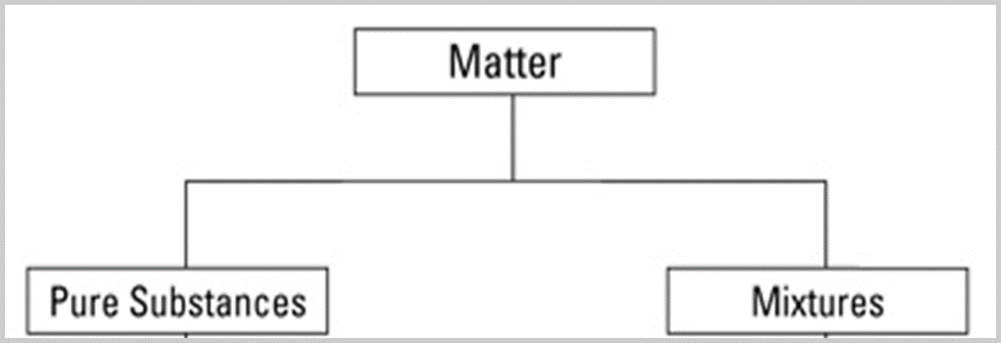
Classifying Matter
Elements
Compounds
Solutions
Heterogeneous
https://screencast-o-matic.com/watch/cF6XFbY0Im (1:52)

Slide 20
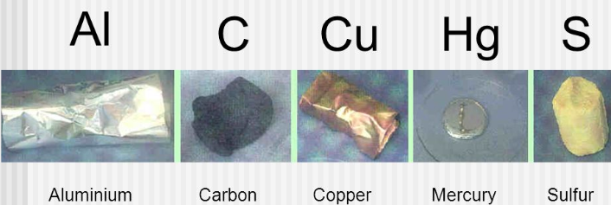
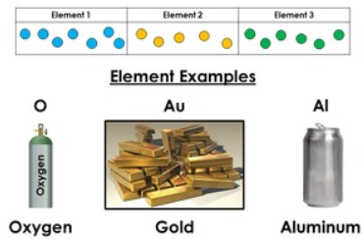
Pure Substances
Elements
Homogeneous (“same kind”) matter that cannot be broken down by ordinary chemical means.
An element has a fixed composition because it contains only one type of atom.

Slide 21
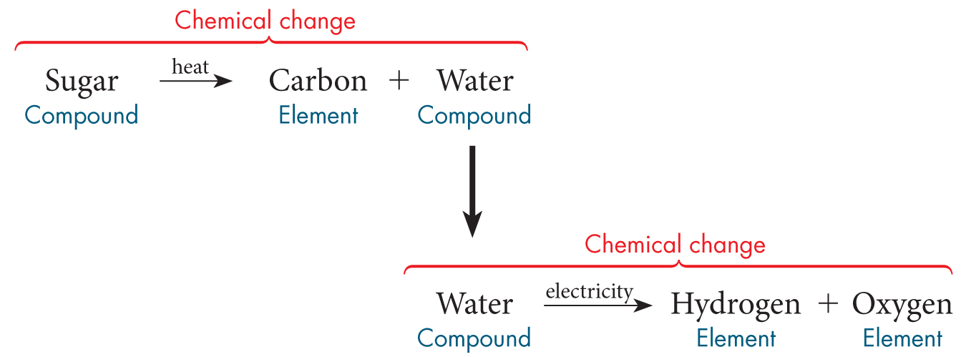
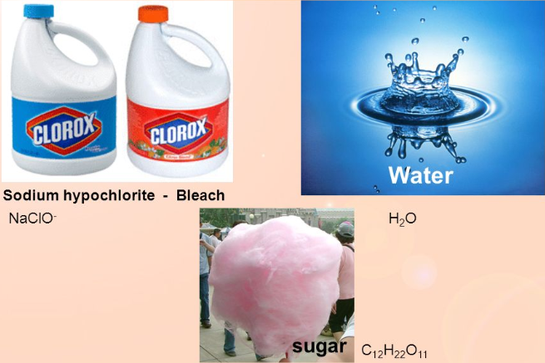
Pure Substances
Compounds
Homogeneous matter made up of two or more elements and/or compounds that are chemically combined in a fixed proportion.

Slide 22

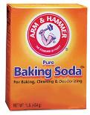
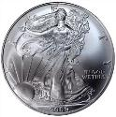



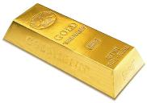
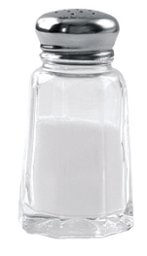
Which are elements versus compounds?
silver, copper, baking soda, gold, water, salt

Slide 23
Which are elements versus compounds?
silver, copper, baking soda, gold, water, salt
element
element
compound
element
compound
compound

Slide 24
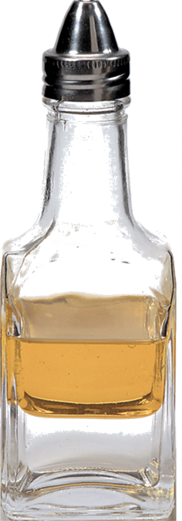
Mixtures
Mixtures do NOT have uniform composition or properties.
Each substance (atom/element/compound) in a mixture retains its own properties.
E.g. oil & vinegar →
Clear boundary between the oil and water

Slide 25
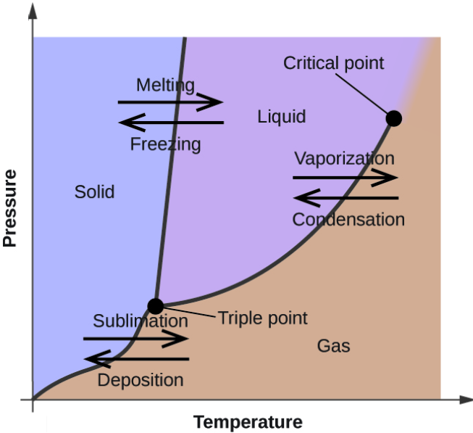
Mixtures
Substances are classified by “Phases”. Pure substances have only 1 Phase, mixtures have more than 1 phase.
The term phase is used to describe any part of a sample with uniform composition and properties; also called a “boundary”.

Slide 26
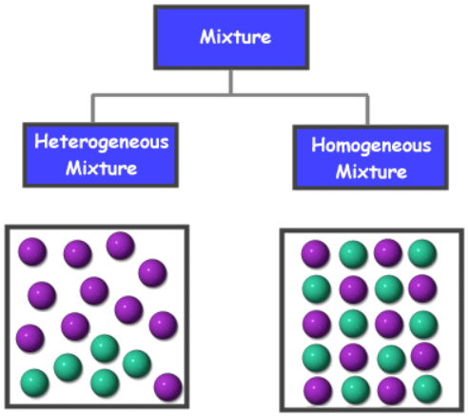
Mixtures can be classified by how well the parts of the mixture are distributed throughout the mixture (even or uneven).

Slide 27
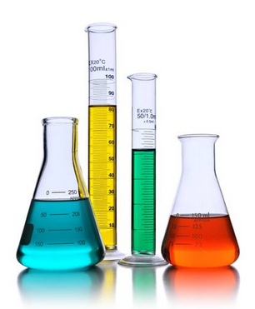
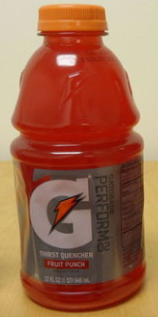

Homogeneous Mixtures
The substances are so evenly distributed that it is difficult to distinguish one substance in the mixture from another. Only one boundary or phase.
Called Solutions
E.g. air, apple juice, tea, alloys (steel, brass), soda pop, Gatorade.
Solutions can be any state of matter (s, l, or g).

Slide 28
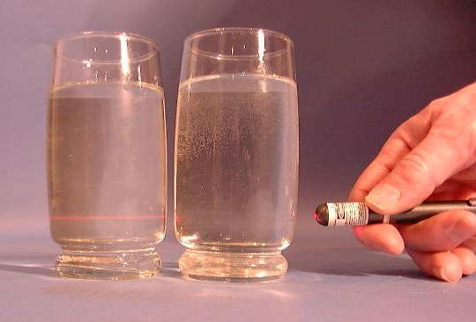
Homogeneous Mixtures
Solutions
Substances dissolve and form a homogeneous mixture.
Particles are too small to settle out.
Do Not separate into layers over time.
Cannot be filtered out.
NO Tyndall Effect → light passes through a transparent solution undetected.
solution

Slide 29
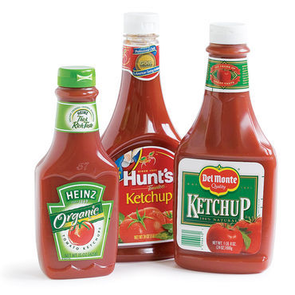

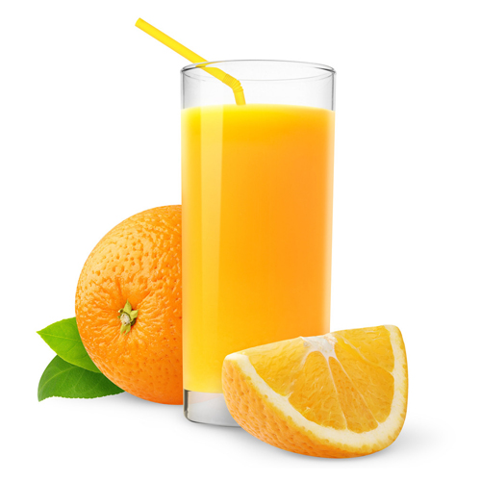

Heterogeneous Mixtures
Heterogeneous mixture
Appears to have more than one phase
Having parts with different characteristics → separated by definite boundaries
E.g. smoke, trail mix, protoplasm,
concrete, salsa, Italian salad dressing.

Slide 30
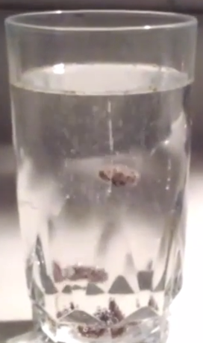
Heterogeneous Mixtures
“Different Kind”
http://somup.com/cqjhonebqd
Dancing Raisins (1:06)
Identify components of the mixture.

Slide 31
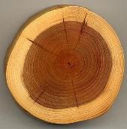
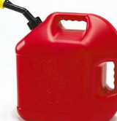
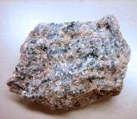
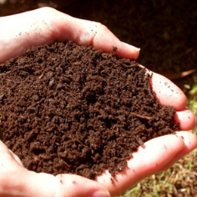
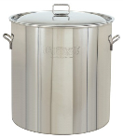
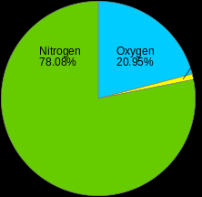
Distinguish between Homogeneous & Heterogeneous Mixtures:
Wood
Gasoline
in the can
Granite
Stainless Steel
Soil
AIR

Slide 32
Distinguish between Homogeneous & Heterogeneous Mixtures:
Heterogeneous
Wood
Gasoline
in the can
Granite
Homogeneous
Heterogeneous
Stainless Steel
Soil
AIR
Homogeneous
Homogeneous
Heterogeneous

Slide 33
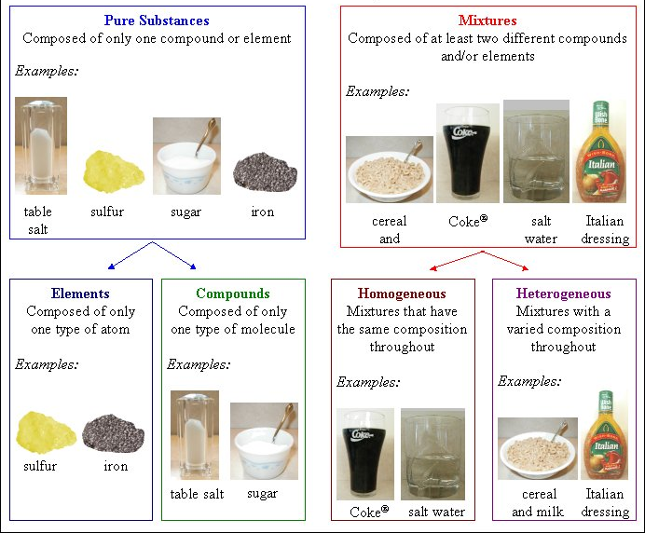

Matter
Name and define classes of Matter.
Place the 8 items in the proper category

Slide 34
Matter
Place the 8 items in the proper category

Slide 35
Matter

Slide 36
Classifying Matter
Pure Substances (Elements and Compounds)
Mixtures (Solutions, Heterogeneous)
Demonstrations (6:10)
https://screencast-o-matic.com/watch/cFQi2qqpdz

Slide 37
Critical Thinking / Review
How does a “phase” differ from a “state”?
Odor, color, and taste … do they indicate a physical or chemical change?
Why is a solution always a mixture, but not every mixture is a solution?

Slide 38
Critical Thinking / Review
How does a “phase” differ from a “state”?
A phase is a boundary that distinguishes composition … a state of matter is solid, liquid, gas, and plasma
Odor, color, and taste … do they indicate a physical or chemical change?
Odor, color, and taste can all indicate either change. Smelling a cup of coffee is physical, whereas smelling the exhaust of a car is chemical. Shade indicates a physical color change, but a blue flame is chemical. Tasting chocolate is a physical change, but having an acid burn ones tongue is chemical.
Why is a solution always a mixture, but not every mixture is a solution?
A solution is a homogeneous mixture (looks like one thing) … heterogeneous matter (non-uniform, suspension, colloids) are all mixtures

Slide 39
Separating Mixtures
Most of the things around us are mixtures.
To understand, analyze, and evaluate substances for the myriads of reasons (medicine, cleanliness, organization, functionality, etc.), we need to separate mixtures into their pure components.
Pick a mixture that comes to mind and give TWO reasons why you would want to separate it. [e.g. organize room or refrigerator]
Differences in physical properties are used to separate components of mixtures.

Slide 40
We can separate mixtures.

Slide 41
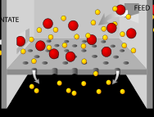
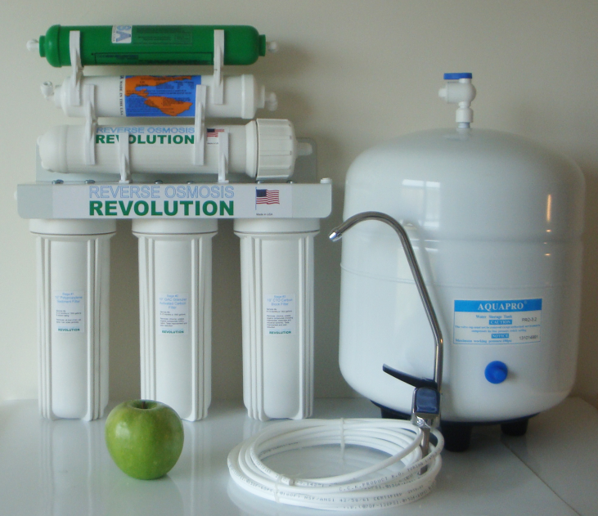
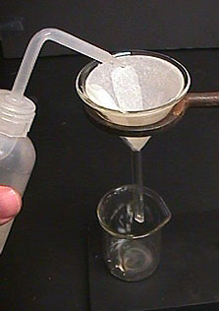
Separating HETEROgeneous Mixtures
Filtration is a process that separates elements of a heterogeneous mixture based on particle size.
Solutions cannot be filtered out.

Slide 42
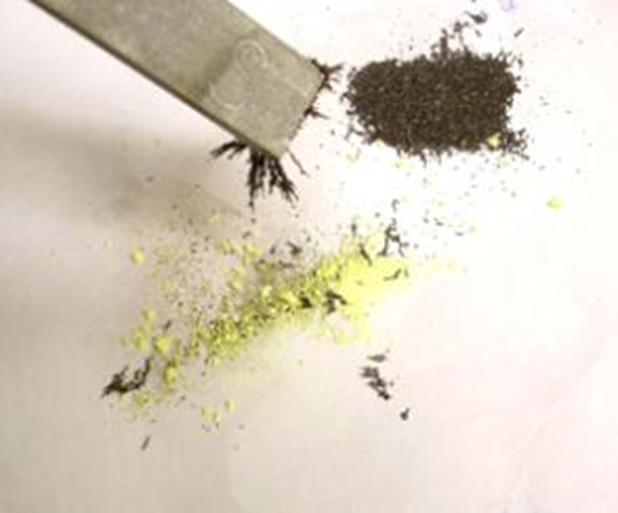
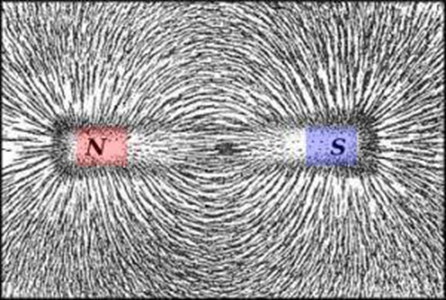
Separating Heterogeneous Mixtures
Magnetism: separates mixtures based on the presence of magnetic physical properties.
A magnetic substance’s molecules take on a specific alignment (domains), creating magnetic fields with force.
The strongest magnets are alloys of iron and boron (neodymium) & samarium-cobalt.

Slide 43
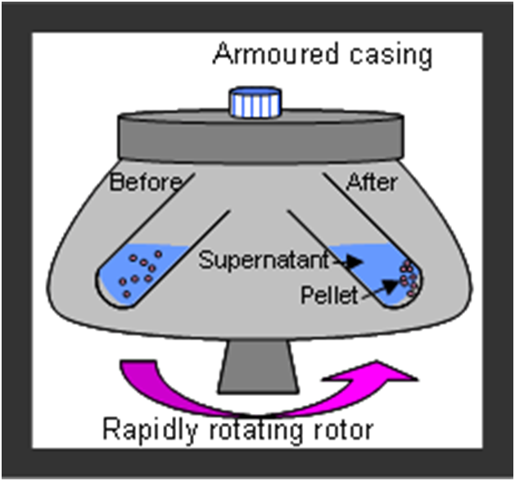
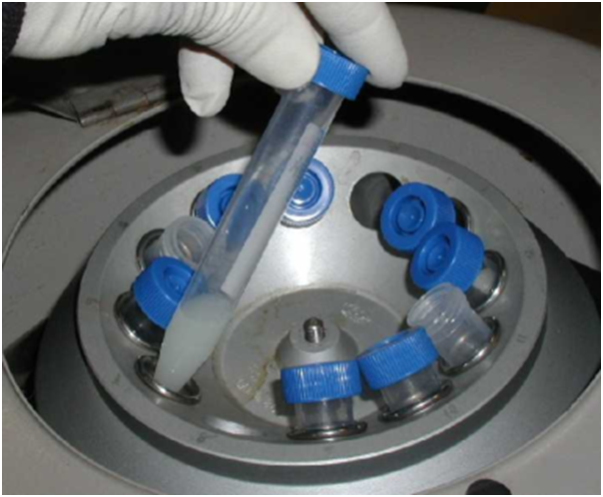
Separating Heterogeneous Mixtures
Centrifugation separates elements of a mixture based on different densities. E.g. hematocrit (Red blood cell separation) & protein analysis

Slide 44
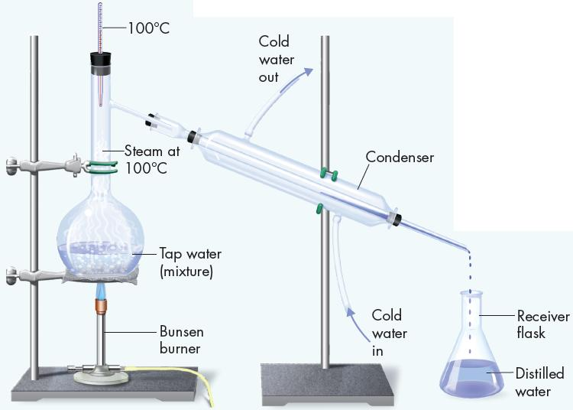
Separating HOMOgeneous Mixtures
Distillation Video Demonstration (2:32)
https://screencast-o-matic.com/watch/cFfnDFDGtZ

Slide 45
Separating HOMOgeneous Mixtures
Distillation, separates impurities in liquid (solutions) based on varying boiling points (intensive physical property).
A mixture is boiled to produce vaporization & then condensed to liquid again.
e.g. alcohol boils ~80 ºC while water boils ~100 ºC … so alcohol decants first.
e.g. “purified” or distilled water (bottled)

Slide 46
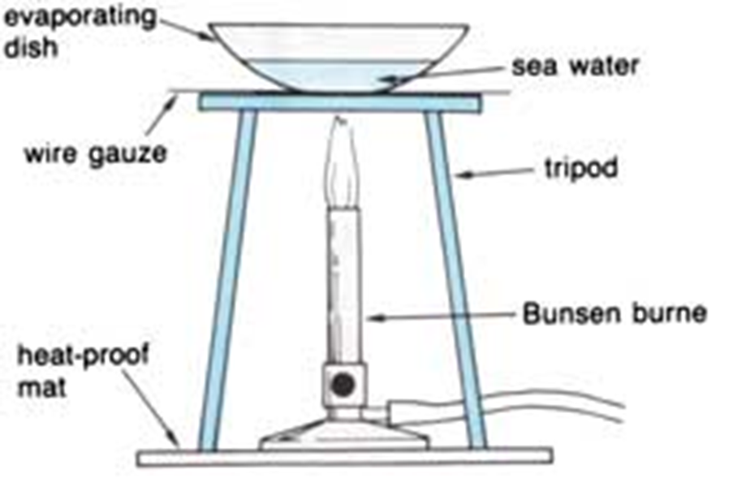
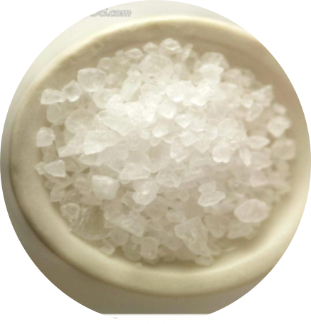
Separating Homogeneous Mixtures
Evaporation purifies dissolved solids from the liquid they are dissolved in;
also called crystallization.

Slide 47
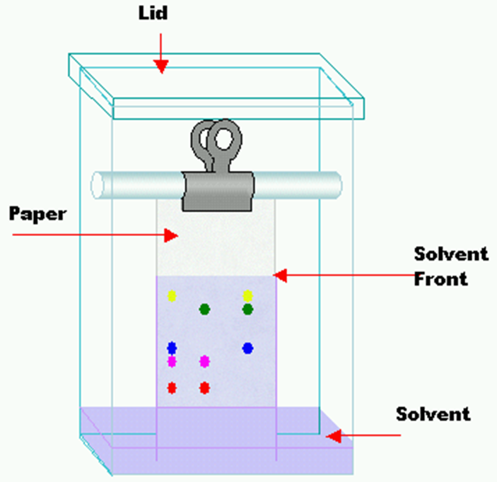
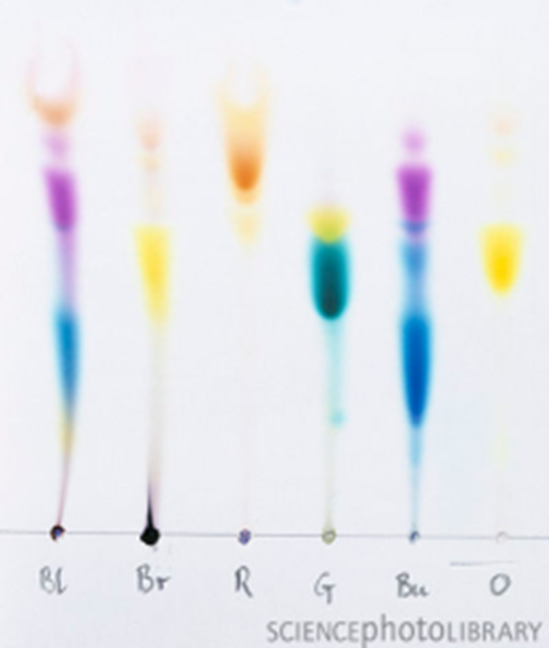
Separating Homogeneous Mixtures
Chromatography separates components of a mixture based on their differential migration due to density. 60% of chemical analysis worldwide is currently done with chromatography.

Slide 48
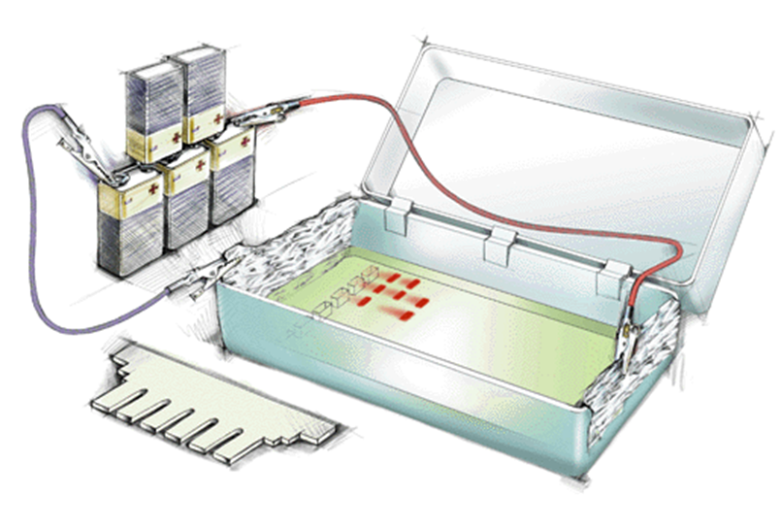
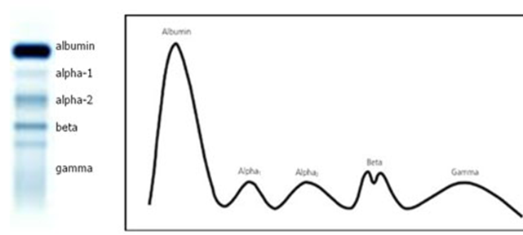
Separating Homogeneous Mixtures
Electrophoresis
Separates components of a mixture based on the differential movement of charged particles in a liquid or gel under the influence of an electric field. Used for Protein and DNA analysis and in forensics.

Slide 49
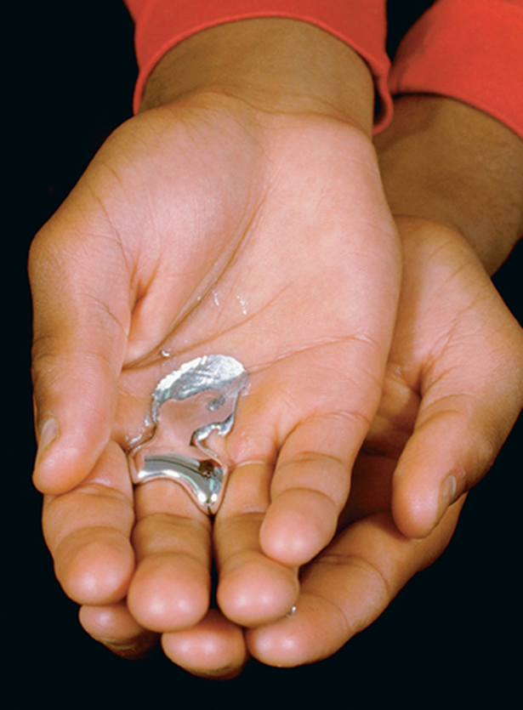
Physical Changes
Separating Mixtures is based on Physical Change
Any change that occurs without altering the chemical composition of a substance
NO new substance is formed and the physical & chemical properties of the constituents remains.
e.g. The element gallium can melt in a person’s hand (the melting point of gallium metal is 30˚C)

Slide 50
Physical Changes
Physical changes involve a change in outward appearance and arrangement, but NOT in chemical identity.
Physical changes can be reversible (putting a puzzle together) or irreversible (breaking a glass).
Physical changes often involve a reversible change from one state to another:
Solid ↔ Liquid ↔ Gas

Slide 51
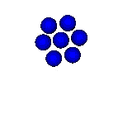


States of Matter
    Solids
        a. Definite shape
        b. Definite volume
        c. Tightly packed molecules
        d. Greater density than liquids or gases
        e. Usually least compressible of phases
        f. Molecules move slowest of all the phases

Slide 52


States of Matter
    Liquids
        a. NO definite shape
        b. Definite volume
        c. Less tightly packed molecules that take the shape of the container
        d. Lesser density than solids, but greater than gases (usually d ∞ 1/T)
        e. Relatively non-compressible except for extreme temperatures and pressures
        f. Molecules move slower than gases, faster than solids

Slide 53


States of Matter
    Gases
        a. NO definite shape
        b. NO definite volume
        c. Take the SHAPE and VOLUME of the container
        d. Least density of all phase
        e. Compressible
        f. Molecules move fastest of all the phases
        g. Must consider variables of pressure and temperature

Slide 54

States of Matter
Identify each state of matter
Give a brief description of each state of matter
Specifically describe their shape and volume

Slide 55
States of Matter

Slide 56
States of Matter
Gas Versus Vapor
A gas is a substance, like oxygen (O₂), that exists in the gaseous state at room temperature.
Vapor describes the gaseous state of a substance that is generally a liquid or solid at room temperature, as in water vapor.
Plasma is a high temperature physical state of matter in which atoms lose most of their electrons. Plasma is found in fluorescent bulbs.

Slide 57






Physical changes that occur in matter

Slide 58


4 Chemical Changes
Chemical Changes
Chemical changes
alter the chemical composition of a substance
produce NEW substances with physical & chemical properties DIFFERENT from the constituents.
e.g. Sodium (Na) explodes in air, Chlorine gas (Cl₂) is lethal
But table salt (NaCl) tastes great!

Slide 59






Chemical changes that occur in matter

Slide 60


Distinguish Physical & Chemical Changes
2HCl + CaCO₃ → CaCl₂ + CO₂ + H₂O H₂O (l) ↔ H₂O (s)
cutting hair burning of coal filing nails
A bonfire pealing or cracking an egg making a cake
washing your car a color change in a reaction dissolving sugar in water
popping a balloon with a pin exploding a hydrogen filled container
tearing a piece of paper kicking a football 40 yards exploding TNT
excavating of soil tarnishing of silverware burning of coal for heat

Slide 61
Answers
2HCl + CaCO₃ → CaCl₂ + CO₂ + H₂O … is a chemical reaction (chemical change)
Ice melting …. Is a physical change (changes state)
Washing your car physical … dirt is rinsed off
Dissolving sugar in water … physical … sugar & water still exist
A bonfire … chemical … combustion always produces a new substance
A color change in a reaction of elements or compounds … a general color change can be physical (you turn red when embarrassed), but the word “reaction” indicates a chemical change that produces a new substance is produced
Popping a balloon with a pin physical … still a balloon and pin
Exploding a hydrogen filled container … chemical … combustion always produces a new substance
Making a cake … physical when mixing ingredients … baking includes both physical (increase in size) and chemical changes (heat produces chemical reactions)
Burning of coal … chemical … combustion … new substance
Tearing a piece of paper … physical … no new substance, just smaller
Kicking a football 40 yards … physical … no new substance
Tarnishing of silverware … chemical … similar to rust … new substance
Excavating soil … physical … no new substance … just digging up the soil

Slide 62

4 Chemical Reactions
Recognizing Chemical Changes
How can we distinguish chemical change from physical?
Similarities of both physical & chemical changes:
Energy transfer (e.g. absorbed or released)
Often a state of matter change
Gas formation* (bubbles form when you boil water or open a carbonated drink [physical], but bubbles* also form when an acid reacts with metal [chemical].
Precipitate* (a solid forms in a liquid) rain [physical]; solutions chemically react to form to a precipitate* [chemical]
Color change or odor
CHEMICAL CHANGES:
NEW chemical substances form
a chemical “REACTION” occurred
Combustion
*very common

Slide 63
Physical Versus Chemical Properties (2:36)
https://screencast-o-matic.com/watch/cFQiooqpMR
Demonstrations Part 1 (5:01)
https://screencast-o-matic.com/watch/cFQilLqp5O
Demonstrations Part 2 (5:04)
https://screencast-o-matic.com/watch/cFQiI3qpGD

Slide 64

4 Chemical Reactions
Law of Mass Conservation
HCl + Na₂CO₃ → NaCl + H₂O + CO_{2 (g)}
A chemical reaction takes place & yields CO₂ gas.
This is a “closed” system, so nothing escapes.
What happens to mass from start to finish?

Slide 65
4 Chemical Reactions
Conservation of Mass
Chemical changes are based on chemical reactions that involve “reactants” ↔ “products”.
During any chemical reaction [based on a chemical change], the mass of the products is always equal to the mass of the reactants.
Consider when wood burns:
Wood _{(s)} + O_{2 (g)} → Ash + CO_{2 (g)} + H₂O _{(g)}
reactants products

Slide 66



4 Chemical Reactions
Conservation of Mass
Careful measurement shows
the TOTAL mass of the reactants [wood + O_{2 (g)}]
equals the TOTAL mass of the products [Ash + CO_{2 (g)} + H₂O _{(g)}].
In combustion:
The mass of the wood
…..plus the mass of the oxygen
will equal the mass of the CO₂ + water + ash.

Slide 67
Law of Mass Conservation Antoine Lavoisier 1787
Matter cannot be created or destroyed;
it can only change form (transformation).
Mass also remains constant for Physical Changes.
E.g. 10 g or ice melt to form 10 g of liquid water
The Law of Mass Conservation states that in any PHYSICAL or CHEMICAL change (reaction), mass is conserved.

Slide 68
4 Chemical Reactions
Fixed Proportions
The mass of any element is given on the Periodic table and never changes in chemistry.
The mass of a compound, however, is based on a fixed proportion of the elements that are chemically combined in the chemical reaction that formed that compound.
For any compound, the RATIO of elements BY MASS in that compound NEVER changes.
E.g. CO₂ contains the elements carbon, C, and oxygen, O, in a fixed proportion of 1:2. [The subscript for Carbon is 1]
Use the periodic table to find the masses of the elements:
C→ ? O → ?

Slide 69

4 Chemical Reactions
Fixed Proportions
The mass of any element is given on the Periodic table and never changes in chemistry.
The mass of a compound, however, is based on a fixed proportion of the elements that are chemically combined in the chemical reaction that formed that compound.
For any compound, the RATIO of elements BY MASS in that compound NEVER changes.
E.g. CO₂ contains the elements carbon, C, and oxygen, O, in a fixed proportion of 1:2. [The subscript for Carbon is 1]
Use the periodic table to find the masses of the elements:
C→ 12.0 O → 16.0 x 2 = 32.0 Total Mass = 44.0
CO₂ is always in the ratio of: $\frac{12.0 C}{32.0 O}$ by mass.

Slide 70

4 Chemical Reactions
Periodic Table

Slide 71
4 Chemical Reactions
Fixed Proportions
What if we have 44.0 g of CO₂ (1 mole). How many grams of each element are in 308.0 g of CO₂?

Slide 72


4 Chemical Reactions
Fixed Proportions
What if we have 44.0 g of CO₂ (1 mole). How many grams of each element are in 308.0 g of CO₂?
We note the fixed proportion of C to O from the formula = 1:2
Using the Periodic Table, we record the mass of each element [in 1 mole]:
C→ 12.0 g O → 16.0 x 2 = 32.0 g Total Mass = 44.0 g
We use ratios to determine the actual grams of each element in 308.0 g:
$\frac{308.0 g C}{44.0 g CO2}$ = 7 [moles]
7 [moles] x 12.0 g [C] = 84.0 g C
7 [moles] x 32.0 g [O] = 224.0 g O
224.0 g [C] + 84.0 g [O] = 308.0 g [total mass of CO₂]

Slide 73
4 Chemical Reactions
Fixed Proportions
Suppose you have a 30.1 g sample of a compound of carbon and hydrogen that decomposes to yield 24.0 g C and 6.1 g H.
You have another compound of carbon and hydrogen with a mass of 67.7 g that decomposes to yield 54.0 g C and 13.7 g H. Is this the same substance as the first sample?
What if a third compound of carbon and hydrogen has a mass of 80.0 g and decomposes to yield 60.0 g C and 20.0 g H. Is this the same substance as the first sample?

Slide 74
4 Chemical Reactions
Fixed Proportions
Suppose you have a 30.1 g sample of a compound of carbon and hydrogen that decomposes to yield 24.0 g C and 6.1 g H.
You have another compound of carbon and hydrogen with a mass of 67.7 g that decomposes to yield 54.0 g C and 13.7 g H. Is this the same substance as the first sample?
Ratio of C to H in 30.1 g sample: 24.0 g / 6.1 g = 3.9
Ratio of C to H in 67.7 g sample: 54.0 g / 13.7 g = 3.94
The ratios for both samples are almost identical, so one could say they both are the same compound.
What if a third compound of carbon and hydrogen has a mass of 80.0 g and decomposes to yield 60.0 g C and 20.0 g H. Is this the same substance as the first sample?
Ratio of C to H in 80.0 g sample: 60.0 g / 20.0 = 3.00
Based on the ratio, this compound is a different substance from the first two.

