Slide 1
Click on “Slide Show”
Click “Play from Beginning”

Slide 2


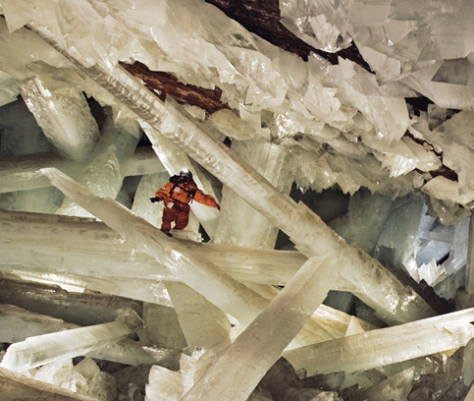
Chapter 7A
Ionic and Metallic Bonding
Ions
Ionic Bonds &
Forming Ionic Compounds
Properties of Ionic Compounds
Bonding in Metals

Slide 3
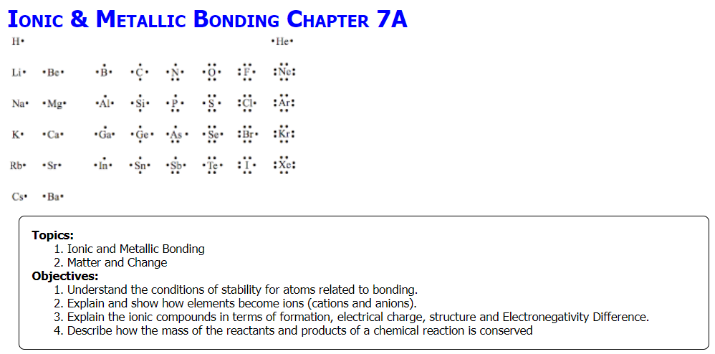

Slide 4
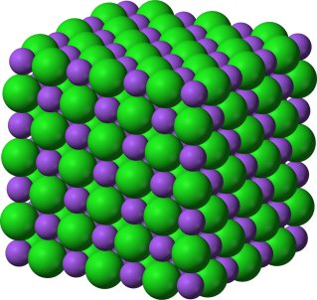
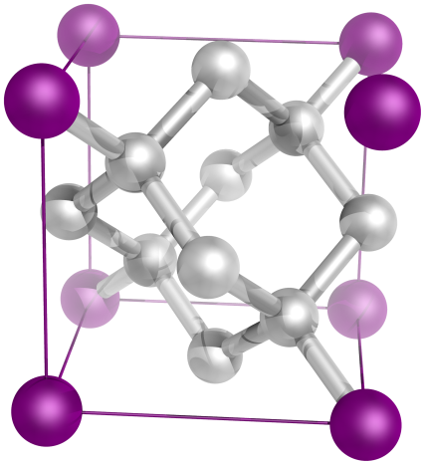
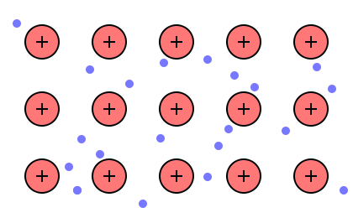
There are three main ways that elements can come together to form bonds.
Ionic
Covalent
Metallic
Notes:
#frame
Anchor Video
Timing ≈ 0.5 min
Recap: You've now learned about the three main types of bonds: ionic bonds, covalent bonds, and metallic bonds.
Connect: Each type of bond forms in a different way, and different types of atoms tend to form specific kinds of bonds.
Preview: Next, we will learn about how ionic and covalent bonds form.
SOURCES:
”Sodium-chloride-3D,” Ben Mills. 2010 as PD, Digital Image. http://commons.wikimedia.org/wiki/File:Sodium-chloride-3D-ionic.png (accessed August 3, 2012).
“Diamond crystal structure consists of a face centered cubic lattice, each edge measures 3.6 Å.,” Yassine Mrabet. 2009 as PD, Digital Image. http://commons.wikimedia.org/wiki/File:Carbon_lattice_diamond.png (accessed August 3, 2012).

Slide 5
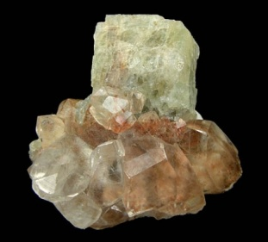

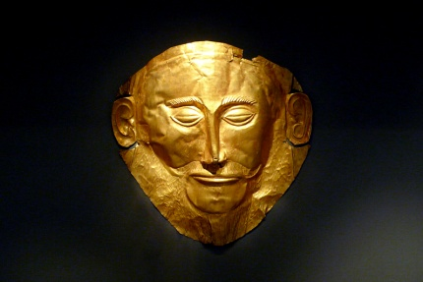
There are three main ways that elements can come together to form bonds.
Ionic
Covalent
Metallic
Notes:
#frame
Anchor Video
Timing ≈ 0.5 min
Recap: You've now learned about the three main types of bonds: ionic bonds, covalent bonds, and metallic bonds.
Connect: Each type of bond forms in a different way, and different types of atoms tend to form specific kinds of bonds.
Preview: Next, we will learn about how ionic and covalent bonds form.
SOURCES:
”Sodium-chloride-3D,” Ben Mills. 2010 as PD, Digital Image. http://commons.wikimedia.org/wiki/File:Sodium-chloride-3D-ionic.png (accessed August 3, 2012).
“Diamond crystal structure consists of a face centered cubic lattice, each edge measures 3.6 Å.,” Yassine Mrabet. 2009 as PD, Digital Image. http://commons.wikimedia.org/wiki/File:Carbon_lattice_diamond.png (accessed August 3, 2012).

Slide 6
Why Do Atoms Bond?
Conditions for Atoms to Bond
?
?
Notes:
Timing ≈ 0.5 min
Entry Audio: What causes atoms to bond in the first place?
[teacher goes through points on the slide with narrative] There are two main conditions that atoms want to attain: 1) electrical neutrality and 2) a full or complete valence (outer shell of electrons).
All atoms are electrically neutral before they bond. However, they are not stable because all but the inert/noble gases do not have complete valence shells. Metals want to lose electrons to complete their valence, while non-metals wants to gain electrons to complete their valence. Once a metals loses its outer electrons and becomes a cation, and a non-metal gains electrons to become an anion, an electrostatic attraction forms. This means that the positive charge bonds with the negative charge, forming a neutral compound.
Atoms have incomplete valence before they bond (except the inert/noble gases). This makes them unstable because they want a complete outer shell of 8 electrons. We call this the octet rule because most atoms want to have 8 electrons in their valence.
Exit Audio: It is the electrostatic attraction of a positive ion to a negative ion that causes ionic bonds.

Slide 7
Why Do Atoms Bond?
Conditions for Atoms to Bond
Electrical Neutrality
Atoms are neutral before bonding.
Ionic compounds are neutral because they have both cations and anions.
Complete Valence
Atoms have incomplete valence prior to bonding.
Atoms bond to complete their outer shell of electrons (8) (octet rule).
Notes:
Timing ≈ 0.5 min
Entry Audio: What causes atoms to bond in the first place?
[teacher goes through points on the slide with narrative] There are two main conditions that atoms want to attain: 1) electrical neutrality and 2) a full or complete valence (outer shell of electrons).
All atoms are electrically neutral before they bond. However, they are not stable because all but the inert/noble gases do not have complete valence shells. Metals want to lose electrons to complete their valence, while non-metals wants to gain electrons to complete their valence. Once a metals loses its outer electrons and becomes a cation, and a non-metal gains electrons to become an anion, an electrostatic attraction forms. This means that the positive charge bonds with the negative charge, forming a neutral compound.
Atoms have incomplete valence before they bond (except the inert/noble gases). This makes them unstable because they want a complete outer shell of 8 electrons. We call this the octet rule because most atoms want to have 8 electrons in their valence.
Exit Audio: It is the electrostatic attraction of a positive ion to a negative ion that causes ionic bonds.

Slide 8
Valence Electrons & the Octet Rule
Valence electrons occupy the highest energy level of an atom and is indicated by the GROUP A number (I-VIII).
The number of valence electrons largely determines the chemical properties of an element because valence electrons are usually the only electrons involved in chemical bonds.
The Octet Rule
Atoms desire to fill their valence (outermost energy level). This will cause them to achieve the electron configuration of a noble gas: ns²np⁶. This is to obtain a very stable, low-energy situation for the atoms.
An octet is a set of (8).

Slide 9
Lewis Structures (Electron Dot Diagrams)
Electron Dot Diagrams
Also called Lewis structures
Show valence electrons in the atoms of an element (dots)
Usually only the valence electrons are shown in electron dot (Lewis) structures.
Valence electrons include the outermost “s” and “p” orbitals:
X
Remember, each orbital can contain up to 2 e-
p
p
s
p

Slide 10
Lewis Structures (Electron Dot Diagrams)
Electron Dot Diagrams
Ctr notes (6:59)
https://screencast-o-matic.com/watch/cFQ3qbqSJ4
Lewis Structures (5 steps) (4:57)
https://screencast-o-matic.com/watch/cFQ3lKqS4e

Slide 11

Lewis Structures (Electron Dot Diagrams)
Give the nuclear symbol and e- dot diagrams:
Lithium Magnesium
Gallium Silicon
Phosphorus Oxygen
Fluorine Argon

Slide 12
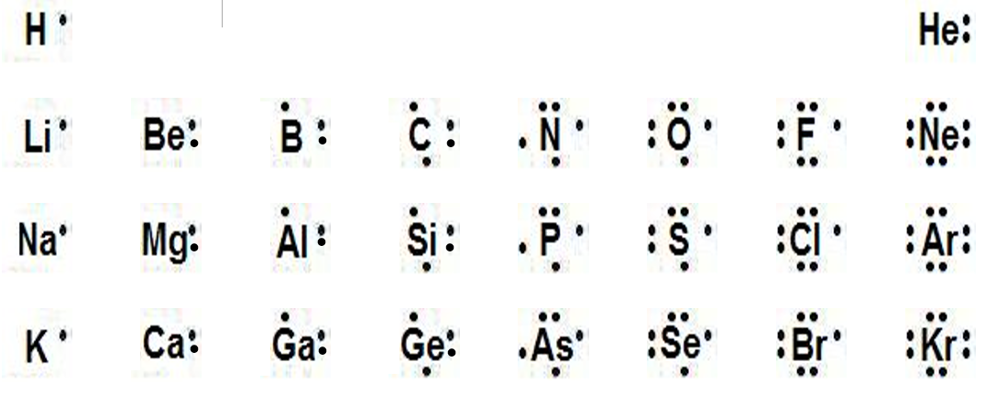
Lewis (Electron dot) Structures
Electron Dot Structures of Some Group A Elements
Period | Group
 | 1A | 2A | 3A | 4A | 5A | 6A | 7A | 8A
1
2
3
4
IA IIA IIIA IVA VA VIA VIIA VIIIA
₁₂Mg²⁴
₁₄Si²⁸
₁₅P³¹
₈O¹⁶
₉F¹⁹
₃Li⁷
₁₈Ar⁴⁰
₃₁Ga⁷⁰
Notice that all the electrons within a given “A” group (with the exception of helium) have the same number of electron dots in their structures.

Slide 13
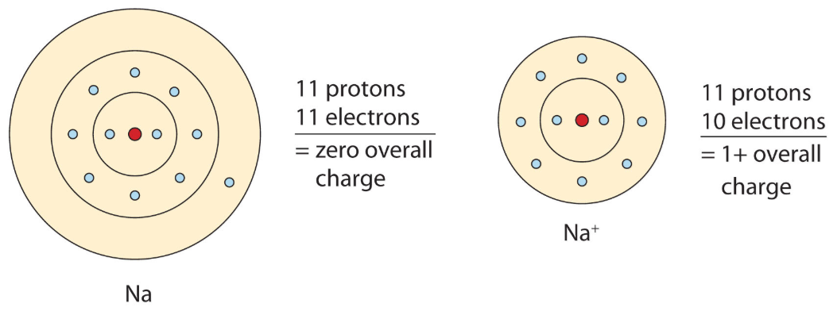
Formation of Cations
Formation of Cations
A neutral atom (unbonded) is electrically neutral because it has equal numbers of protons and electrons.
An ion forms when an atom or group of atoms loses or gains electrons. A positively charged ion, or cation, is produced when an atom loses one or more valence electrons.

Slide 14
Formation of Cations
Formation of Cations
Metals tend to lose their valence electrons (Low Ionization Energy), leaving a complete octet or valence in the next-lowest energy level.
A sodium atom (Na) forms a sodium cation (Na⁺).
+11 p 11 e- → +11 p 10 e- = +1 cation
A calcium atom (Ca) forms a calcium cation (Ca²⁺).
+20 p 20 e- → +20 p 18 e- = +2 cation

Slide 15
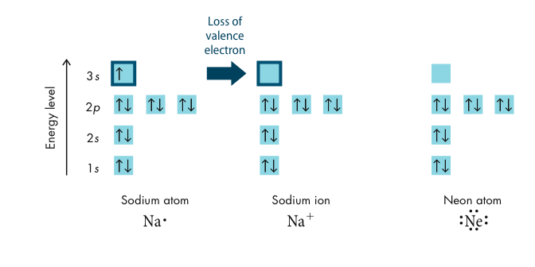
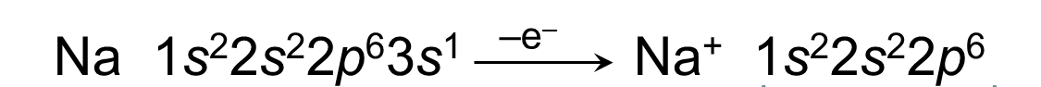
Formation of Cations
Group IA Cations
octet
Both the sodium ion and the neon atom have eight electrons in their valence shells (highest occupied energy levels).

Slide 16
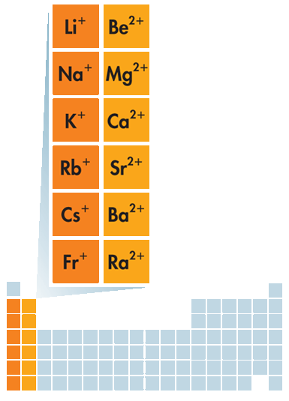

Formation of Cations
Remember that metals have a LOW Ionization Energy (I.E.), meaning they easily give up electrons when bonding.
Group 1A elements ALWAYS form 1+ cations.
Group 2A elements ALWAYS form 2+ cations.
Group 3A elements usually form +3 cations.
IA
IIA

Slide 17
Practice Making Cations
Give the nuclear symbol, p+, e-, charge, valence of each element BEFORE bonding.
Aluminum Magnesium
Potassium Boron

Slide 18
Practice Making Cations
Give the nuclear symbol, p+, e-, charge, valence of each element BEFORE bonding.
Aluminum Magnesium
₁₃Al²⁷ ₁₂Mg²⁴
13p 13e- = 0 12p + 12e- = 0
[Ne]3s²3p¹ [Ne]3s²
Potassium Boron
₁₉K³⁹ ₅B¹¹
19p + 19e- = 0 5 p + 5e- = 0
[Ar]4s¹ [He]2s²2p¹

Slide 19
Practice Making Cations
Give the cation of each element AFTER bonding (include p+, e-, charge, valence)
Aluminum Magnesium
Potassium Boron

Slide 20
Practice Making Cations
Give the cation of each element AFTER bonding (include p+, e-, charge, valence)
Aluminum Magnesium
Al⁺³ Mg⁺²
13p 10e- 12p 10e-
[Ne] → 2s²2p⁶ [Ne] → 2s²2p⁶
Potassium Boron
K⁺ B⁺³
19p 18e- 5 p 2e-
[Ar] → 3s²3p⁶ [He] → 1s²

Slide 21
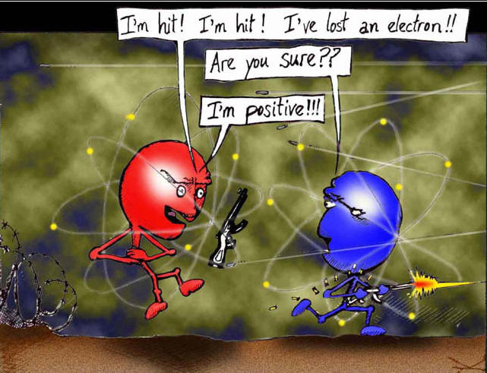

Slide 22
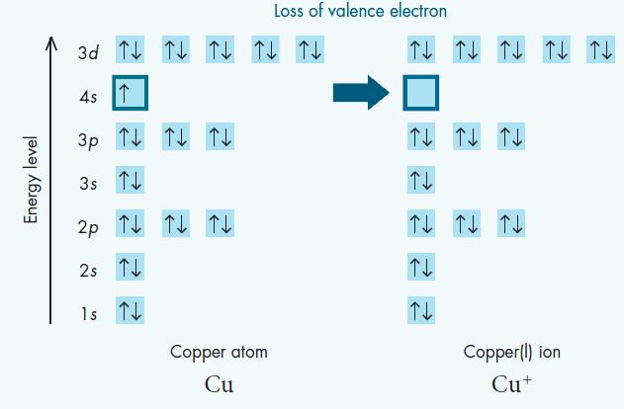
Formation of Cations
Transition Metal Cations
The charges of transition metal cations vary due to the “d” sublevel. E.g. A copper atom loses its lone 4s electron to form a copper ion (Cu⁺) with a pseudo noble-gas electron configuration:
[Ar]3d¹⁰4s¹
[Ar]3d¹⁰

Slide 23
Formation of Anions
Formation of Anions
An anion is produced when an atom gains or shares one or more valence electrons.
As with metals, atoms of nonmetals and metalloids form anions by filling their valence to attain noble gas electron configuration.
Cl 1s²2s²2p⁶3s²3p⁵
+e–
Cl– 1s²2s²2p⁶3s²3p⁶
octet

Slide 24
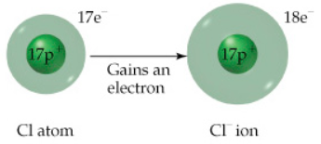
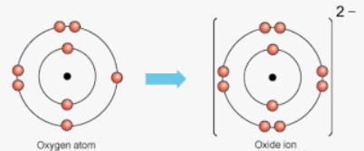
Formation of Anions
Formation of Anions
The name of an anion of a nonmetallic element is not the same as the element name. The name of the anion typically ends in -ide.
A chlorine atom (Cl) forms a chloride anion (Cl–).
An oxygen atom (O) forms an oxide anion (O^{2–}).

Slide 25
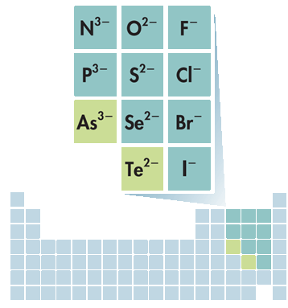
Formation of Anions
VA
VIA
VIIA
A chlorine atom (Cl) forms
a chloride anion (Cl-)
+17 p 17 e- →
+17 p 18 e- = -1 anion
An oxygen atom (O) forms
an oxide anion (O²⁻)
+8 p 8 e- → +8 p 10 e- = -2 anion

Slide 26
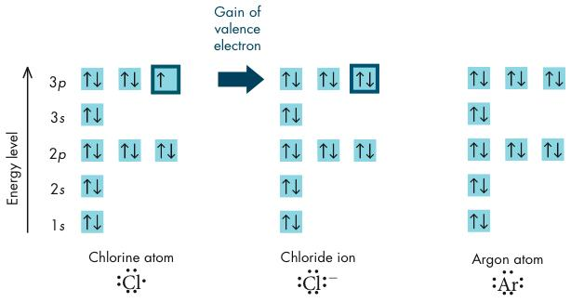
Formation of Anions
Chlorine atoms need one more valence electron
to achieve the electron configuration of the nearest noble gas
[Ar].

Slide 27
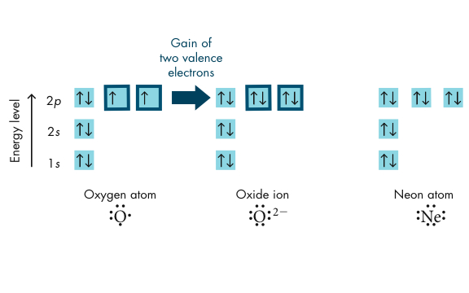
Formation of Anions
Oxygen is in Group VIA, and has six valence electrons.
An oxygen atom attains the electron configuration of neon by gaining two electrons (full valence).

Slide 28
Show e- dot diagram of the following atoms
& how they become ions (p+, e-, charge, ‘Kernel’):
Potassium Nitrogen
Sulfur Beryllium
Aluminum Bromine

Slide 29
Show e- dot diagram of the following atoms
& how they become ions (p+, e-, charge, ‘Kernel’):
Potassium Nitrogen
+19 p 18 e- +7 p 10 e-
+1 cation, [Ar]⁺¹ -3 anion, [Ne]⁻³
Sulfur Beryllium
+16 p 18 e- +4 p 2 e-
-2 anion, [Ar]⁻² +2 cation, [He]⁺²
Aluminum Bromine
+13 p 10 e- +35 p 36e-
+3 cation, [Ne]⁺³ -1 anion, [Kr]⁻¹

Slide 30
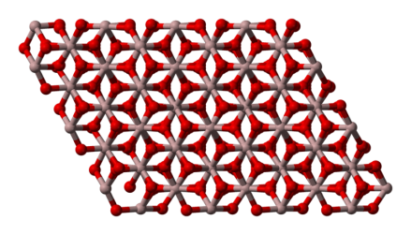
How Do Ionic Bonds Form between Atoms?
How Ionic Compounds Form
Sodium chloride, or table salt, is an ionic compound consisting of sodium cations and chloride anions.
An ionic compound is a compound composed of cations and anions.
Although they are composed of ions, ionic compounds are electrically neutral overall. The total positive charge of the cations equals the total negative charge of the anions.
Notes:
Timing ≈ 0.5 min
Recap: You know that metals tend to form positive ions and nonmetals tend to form negative ions.
Connect: Aluminum and oxygen form an ionic compound when they combine. The way atoms form ionic compounds is different from the way they form covalent compounds, and the resulting structures are different.
Preview: Next, you learn how these ions form when atoms combine to form ionic compounds.
SOURCES:
http://commons.wikimedia.org/wiki/File:Corundum-3D-balls.png, public domain

Slide 31
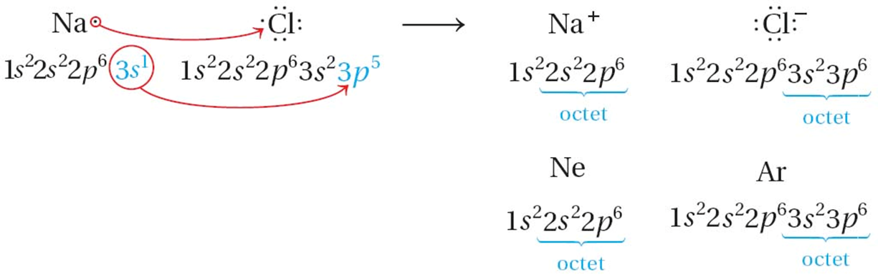
Formation of Ionic Compounds
Ionic Bonds
Anions and cations have opposite charges and attract one another by means of electrostatic forces which are called ionic bonds.
When sodium and chlorine react to form a compound, the sodium atom transfers its one valence electron to the chlorine atom.
NOTICE: +1 -1 = 0 (neutral)

Slide 32
Formation of Ionic Compounds
Ionic Bonds
To obtain electrical neutrality and stable octets, Sodium and chlorine atoms combine in a one-to-one ratio.
NOTICE: +1 -1 = 0 (neutral)

Slide 33
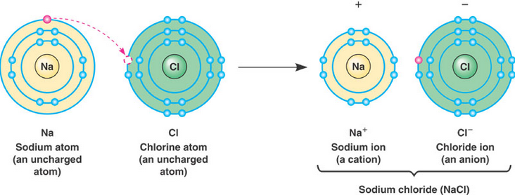
Ionic Bonds
An ionic bond is an attraction between two oppositely charged ions.
Atoms are most stable with electrical neutrality and full valence.
Na and Cl are electrically neutral, but their valence is NOT full
To become more stable, sodium transfers its electron to Chlorine
Electrostatic attraction between ions
Notes:
Timing ≈ 2 min
An ionic bond is an electrostatic attraction that holds two oppositely charged ions together.
Explain how ionic bonds form between metal and nonmetal atoms because of the large difference in electronegativity. Use sodium and chlorine as an example. [Animate image on left]
One or more electrons are transferred from a less electronegative atom (the metal, in this case, sodium) to a more electronegative atom (the nonmetal, in this case, chlorine). [Animate middle image]
As a result, the metal forms a positive cation and nonmetal forms a negative anion. [Point out that] The ions formed are stable because they have a complete valence or outer shell containing eight electrons. [Animate right image]
Explain that the electrostatic attraction between the positive (Na+) and negative (Cl-) ions forms an ionic bond.
SOURCES:
http://commons.wikimedia.org/wiki/File:Electron_shell_011_Sodium.svg
http://commons.wikimedia.org/wiki/File:Electron_shell_017_Chlorine.svg

Slide 34
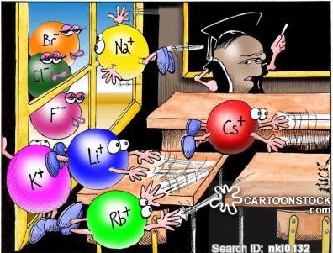
Perhaps one of you gentlemen would mind telling me just what it is outside the window that you find so attractive?

Slide 35
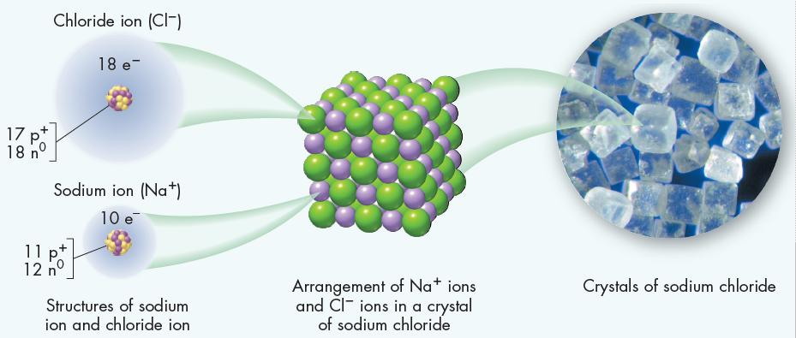
Formation of Ionic Compounds
We represent compounds (Ionic or Covalent) with a chemical formula showing the number of atoms of each element in a substance.
NaCl is the chemical formula for sodium chloride.

Slide 36
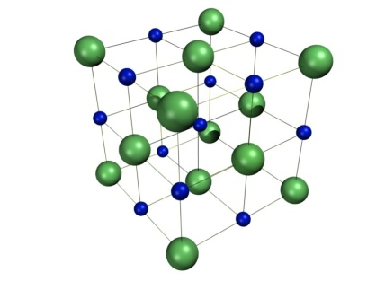
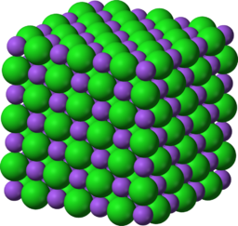
Formula Units or “Compounds”
  Technically, ionic compounds are not called molecules, because they do not exist as discrete units, but as collections of positively and negatively charged ions arranged in repeating patterns.
  Formula unit: the smallest repeating unit of an ionic compound.
Crystal Lattices
Ionic compounds do not form molecules.
Notes:
Timing ≈ 2 min
Entry Audio: Ionic compounds form crystals and the chemical formula for an ionic compound is called a formula unit.
A formula unit is the smallest repeating unit of an ionic compound. [Animate textbox on right]
Describe examples of formula units given in textbox and what they represent.
Explain that ionically bonded compounds do not form molecules, which are discrete units. They form crystals. They are called ionic compounds because they are made of ions and because they contain two or more different elements. [Animate blue box at bottom.]
A crystal is a solid in which the particles are arranged in a regular, repeating pattern. [Animate second image on right.]
Explain that a huge number of ions come together to form a crystal. Ions in a given compound, like sodium chloride, are always arranged in the same pattern. However, ions in other compounds may be arranged in different ways. Point out that the negative and positive charges are balanced, as the formula shows.
Explain that the formula unit gives the ratio of elements in a crystal. [Animate third image.] [Use pen tool to compare the number of sodium ions to the number of chloride ions.]
SOURCES:
http://commons.wikimedia.org/wiki/File:Sodium-chloride-3D-ionic.png
http://commons.wikimedia.org/wiki/File:Nacl-structure.jpg

Slide 37
Formation of Ionic Compounds
Formula Units
The chemical formula of an ionic compound refers to a ratio known as a formula unit. A formula unit is the lowest whole-number ratio of ions in an ionic compound.
Determine the formula unit of the following elements when they bond ionically (show the cation, anion and correct formula):
Sodium + Fluorine
Calcium + Chlorine
Aluminum + Oxygen

Slide 38
Formation of Ionic Compounds
Formula Units
Sodium + Fluorine
Calcium + Chlorine
Aluminum + Oxygen
1 Na⁺ 1 F⁻ → NaF
1 Ca²⁺ 2 Cl ⁻ → CaCl₂
2 Al³⁺, 3 O²⁻ → Al₂O₃
Remember that non-metals form anions that end in “-ide” … Name the compounds:
Sodium Fluoride
Calcium Chloride
Aluminum Oxide

Slide 39
Formation of Ionic Compounds ENRICHMENT
Criss-Cross Method
Making Formulas easy:
Place the cation 1st with its charge as a superscript
Place the anion 2nd with its charge as a superscript
Criss-Cross the superscripts without the + or -
Na⁺F⁻ → Na₁F₁
Ca²⁺Cl ⁻ → Ca₁Cl₂
Al³⁺O²⁻ → Al₂O₃
You do NOT have to write subscripts of “1”

Slide 40
Lewis Structures (Electron Dot Diagrams)
Ionic Bonds & Ionic Compounds Notes (4:30)
https://screencast-o-matic.com/watch/cFQZ21Ycvy
Ionic Bonding & Electron Configuration of H + F (4:23)
https://screencast-o-matic.com/watch/cFQqo9q8GK
Ionic Bonding & Electron Configuration of Na + S (3:19)
https://screencast-o-matic.com/watch/cFQTlGYV8n

Slide 41
Predicting Formulas of Ionic Compounds
Use electron dot structures to predict the formulas of the ionic compounds formed from the following elements:
Lithium and Fluorine

Slide 42
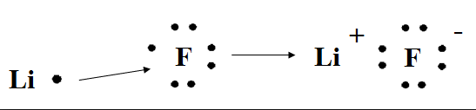
Predicting Formulas of Ionic Compounds
Use electron dot structures to predict the formulas of the ionic compounds formed from the following elements:
Lithium and Fluorine
In order to have a completely filled valence shell, the fluorine atom must gain one electron. These electrons come from one lithium atom, which loses one electron.
The formula of the compound formed is LiF which is electrically neutral and the atoms have full valence.

Slide 43
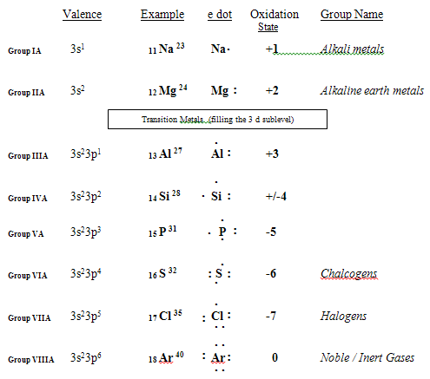
Lewis Structures (Electron Dot Diagrams)

Slide 44
Use Lewis structures to determine the formula of the ionic compound formed when potassium reacts with oxygen. Show the overall charge on the formula unit.

Slide 45
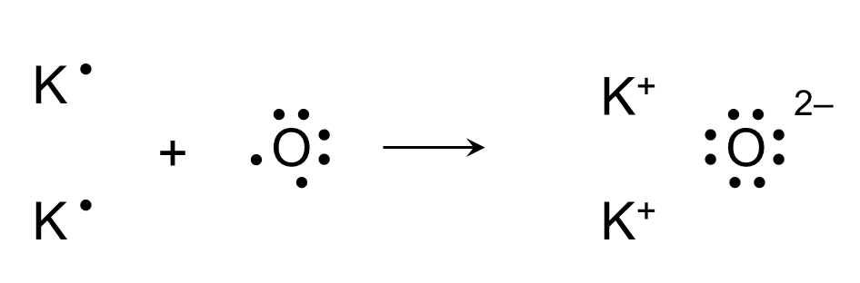
Use Lewis structures to determine the formula of the ionic compound formed when potassium reacts with oxygen. Show the overall charge on the formula unit
Criss-Cross:
K⁺O⁻²
K₂O
Overall Charge = 2(+1) -2 = 0
All the atoms have a full valence.

Slide 46
Use Lewis structures to determine the formula of the ionic compound formed when calcium reacts with fluorine. Show the overall charge on the formula unit.

Slide 47
Use Lewis structures to determine the formula of the ionic compound formed when calcium reacts with fluorine. Show the overall charge on the formula unit.
F
F
• •
• •
–
• •
• •
• •
• •
•
• •
•
F
F
Ca
+
Ca²⁺
•
• •
• •
–
• •
• •
• •
• •
•
• •
Criss-Cross:
Ca⁺²F⁻
CaF₂
Overall Charge = +2 + 2(-1) = 0
All the atoms have a full valence.

Slide 48
Use Lewis structures to determine the formula of the ionic compound formed when magnesium reacts with nitrogen. Show the overall charge on the formula unit.

Slide 49
Use Lewis structures to determine the formula of the ionic compound formed when magnesium reacts with nitrogen. Show the overall charge on the formula unit.
N
N
•
Mg
•
Mg²⁺
• •
^{3–}
•
•
• •
• •
• •
•
N
•
• •
N
Mg
+
Mg²⁺
•
•
• •
• •
^{3–}
•
•
• •
• •
Mg
•
• •
Mg²⁺
•
Mg₃N₂
Overall Charge = 3(+2) + 2(-3) = 0
All the atoms have a full valence.
Criss-Cross:
Mg⁺²N⁻³

Slide 50
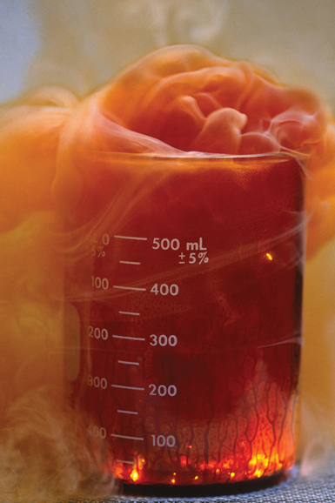
Use Lewis structures to determine the formula of the ionic compound formed when aluminum reacts with Bromine. Show the overall charge on the formula unit.

Slide 51
Use Lewis structures to determine the formula of the ionic compound formed when aluminum reacts with Bromine. Show the overall charge on the formula unit.
Br
Br
• •
• •
–
• •
• •
• •
• •
Br
Br
•
• •
• •
• •
–
+
• •
• •
Al³⁺
• •
• •
Br
Br
•
• •
• •
• •
–
• •
• •
• •
• •
•
• •
AlBr₃
Overall Charge = +3 + 3(-1) = 0
All the atoms have a full valence.
Criss-Cross:
Al⁺³Br⁻

Slide 52
Identify Ionic Compounds (END)
Element | Electronegativity
C | 2.5
Ca | 1.0
Cl | 3.2
H | 2.2
O | 3.4
Mg | 1.3
Na | 0.9
Si | 1.9
When elements that make up compounds or molecules have an END (ElectroNegativity Difference) greater than 1.7, we say they are ionic. Which of the following compounds are ionic compounds?
[ ] MgCl₂ [ ] H₂O
[ ] C₆H₁₂O₆ [ ] NaCl
[ ] MgO [ ] CaCl₂
[ ] Na₂O [ ] O₂
[ ] SiO₂ [ ] CH₄
Notes:
Timing ≈ 0.5 min
Entry: Review what you know about ionic compounds. Select the compounds that are ionic.
Hint: The difference in electronegativity between atoms determines the type of bond that forms between them.
Exit: The differences in electronegativity between calcium and chloride and between magnesium and oxygen are greater than 1.7, so they form ionic compounds. Compounds containing polyatomic ions, such as carbonate, form ionic compounds with other ions.
SOURCES:
http://www.webelements.com/periodicity/electronegativity_pauling/
http://acswebcontent.acs.org/games/pt.html

Slide 53
Identify Ionic Compounds
Element | Electronegativity
C | 2.5
Ca | 1.0
Cl | 3.2
H | 2.2
O | 3.4
Mg | 1.3
Na | 0.9
Si | 1.9
END greater than 1.7 → ionic.
[1.9] MgCl₂ [1.2] H₂O
[*] C₆H₁₂O₆ [2.3] NaCl
[2.1] MgO [2.2] CaCl₂
[2.5] Na₂O [0] O₂
[1.5] SiO₂ [0.3] CH₄
Simply subtract the Electronegativity of each element (do not multiply by subscripts)
*Find END of each element
(C-H = 0.3 … H-O = 1.2 … C-O = 0.9)
Notes:
Timing ≈ 0.5 min
Entry: Review what you know about ionic compounds. Select the compounds that are ionic.
Hint: The difference in electronegativity between atoms determines the type of bond that forms between them.
Exit: The differences in electronegativity between calcium and chloride and between magnesium and oxygen are greater than 1.7, so they form ionic compounds. Compounds containing polyatomic ions, such as carbonate, form ionic compounds with other ions.
SOURCES:
http://www.webelements.com/periodicity/electronegativity_pauling/
http://acswebcontent.acs.org/games/pt.html

Slide 54

Identify the Ions of Elements
What is the charge of each ion?
A lithium ion has a charge of ____.
A calcium ion has a charge of ____.
An aluminum ion has a charge of ____.
A fluorine ion has a charge of ____.
An oxygen ion has a charge of ____.
A phosphorus ion has a charge of ____.
A Selenium ion has a charge of ____.
An krypton ion has a charge of ____.
A Gallium ion has a charge of ____.
Which elements form an ionic compound? Check all that apply.
[ ] aluminum and oxygen
[ ] calcium and aluminum
[ ] fluorine and oxygen
[ ] lithium and fluorine
[ ] carbon and oxygen
[ ] sodium and fluorine
Notes:
Timing ≈ 1 min
Entry: Even if you do not know the electronegativity of elements, you can use the periodic table to predict the charge of the ions formed by atoms and whether two elements form an ionic compound. Start by predicting the charge of the ions formed by the given elements.
Hint1: Atoms of metals form positive ions; atoms of nonmetals tend to form negative ions.
Hint2: When metals join with nonmetals to form compounds, the bond is most likely ionic.
Exit: The type of ion formed by the atoms of an element depends on the number of valence electrons that atom has. Metals tend to lose electrons to form positive ions and nonmetals tend to gain electrons to form negative ions so that the resulting ions have full valance levels. Ionic compounds form between the positive and negative ions.

Slide 55
Identify the Ions of Elements
What is the charge of each ion?
A lithium ion has a charge of +1.
A calcium ion has a charge of +2.
An aluminum ion has a charge of +3.
A fluorine ion has a charge of -1.
An oxygen ion has a charge of -2.
A phosphorus ion has a charge of -3.
A Selenium ion has a charge of -2.
An krypton ion has a charge of 0.
A Gallium ion has a charge of +3.
Which elements form an ionic compound? Check all that apply.
[X] aluminum and oxygen
END = 3.5 - 1.5 = 2.0
[ ] calcium and aluminum
END = 1.5 - 1.0 = 0.5
[ ] fluorine and oxygen
END = 4.0 – 3.5 = 0.5
[X] lithium and fluorine
END = 4.0 - 1.0 = 3.0
[ ] carbon and oxygen
END = 3.5 – 2.6 = 0.9
[X] sodium and fluorine
END = 4.0 – 0.9 = 3.1
Notes:
Timing ≈ 1 min
Entry: Even if you do not know the electronegativity of elements, you can use the periodic table to predict the charge of the ions formed by atoms and whether two elements form an ionic compound. Start by predicting the charge of the ions formed by the given elements.
Hint1: Atoms of metals form positive ions; atoms of nonmetals tend to form negative ions.
Hint2: When metals join with nonmetals to form compounds, the bond is most likely ionic.
Exit: The type of ion formed by the atoms of an element depends on the number of valence electrons that atom has. Metals tend to lose electrons to form positive ions and nonmetals tend to gain electrons to form negative ions so that the resulting ions have full valance levels. Ionic compounds form between the positive and negative ions.

Slide 56
Explain How Ionic Bonds Form
How and why do ionic bonds form? Check all that apply.
[ ] Ionic bonds form between metal atoms and other metal atoms.
[ ] Ionic bonds form between metal atoms and nonmetal atoms.
[ ] The more electronegative atoms transfer one or more electrons to the less electronegative atom.
[ ] The less electronegative atoms transfers one or more electrons to the more electronegative atom.
[ ] The metal atom forms a cation and the nonmetal atom forms an anion.
[ ] The metal atom forms a anion and the nonmetal atom forms an cation.
[ ] The attraction between ions with the same charge forms an ionic bond.
[ ] The attraction between ions with an opposite charge forms an ionic bond.
[ ] Positive ions are called cations and negative ions are called anions.
[ ] Negative ions are called cations and positive ions are called anions.
Notes:
Timing ≈ 0.5 min
Entry: Ionic bonds form between ions. Check all the boxes that describe how and why they form.
Exit: Ionic bonds form because of the electrostatic attraction between positive ions and negative ions. Metals are less electronegative and form cations when they transfer electrons to more electronegative nonmetals, which form anions.

Slide 57
Explain How Ionic Bonds Form
How and why do ionic bonds form? Check all that apply.
[x] Ionic bonds form between metal atoms and nonmetal atoms.
[x] The less electronegative atoms transfers one or more electrons to the more electronegative atom.
[x] The metal atom forms a cation and the nonmetal atom forms an anion.
[x] The attraction between ions with an opposite charge forms an ionic bond.
[x] Positive ions are called cations and negative ions are called anions.
Notes:
Timing ≈ 0.5 min
Entry: Ionic bonds form between ions. Check all the boxes that describe how and why they form.
Exit: Ionic bonds form because of the electrostatic attraction between positive ions and negative ions. Metals are less electronegative and form cations when they transfer electrons to more electronegative nonmetals, which form anions.

Slide 58
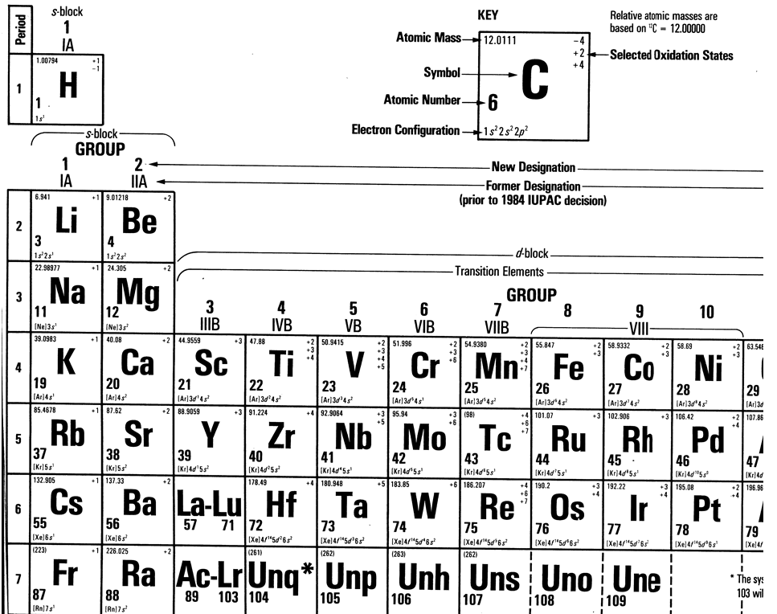

Slide 59
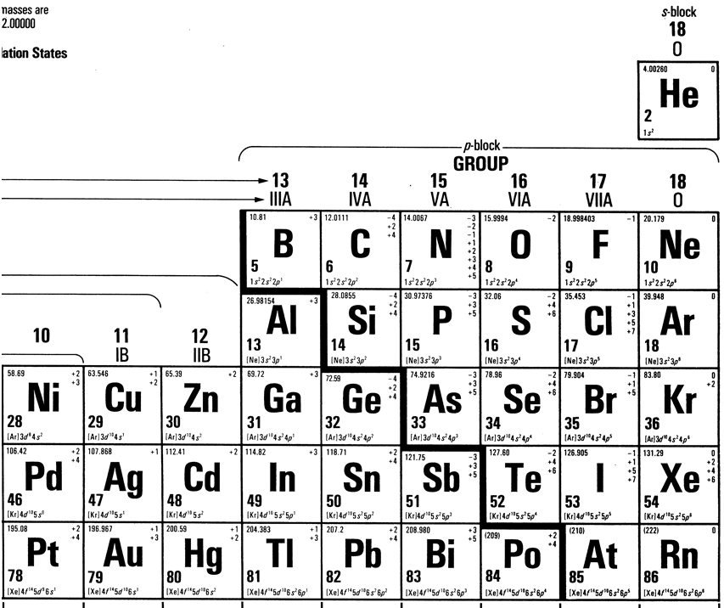

Slide 60
