Slide 1
Go to the “Slide Show” shade above
Click on “Play from Beginning”

Slide 2
Photosynthesis:
Using Light to Make Food
Chapter 7

Slide 3
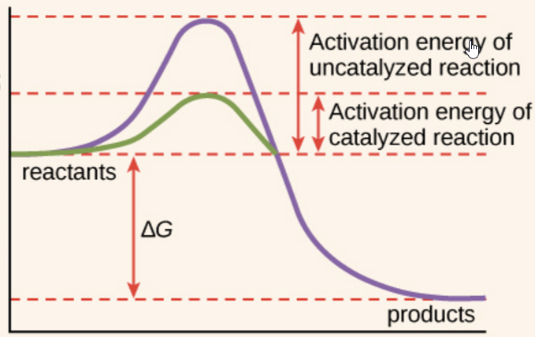
Enzymes
Put the steps of enzyme activity in order from first (1) to last (4).
[ ] The chemical reaction occurs.
[ ] A substrate enters the active site of enzyme.
[ ] New substances called “products” are formed.
[ ] The enzyme and the substrate bind to form the enzyme-substrate complex.
?
Label the diagram
?
?
heat
?
Notes:
#frame
Timing ~ 1 min
Entry audio: Use what you remember about the interaction between enzymes and substrates to put the steps of enzyme activity in order from first to last.
Hint audio: For a catalyzed reaction to begin, the substrate must enter the active site of the enzyme.
Exit audio: Enzyme activity begins when a substrate enters the active site on the enzyme. The two bind to form the enzyme-substrate complex. Then, the chemical reaction occurs, forming new substances, called products.

Slide 4
Enzymes
Put the steps of enzyme activity in order from first (1) to last (4).
[ 3 ] The chemical reaction occurs.
[ 1 ] A substrate enters the active site of enzyme.
[ 4 ] New substances called “products” are formed.
[ 2 ] The enzyme and the substrate bind to form the enzyme-substrate complex.
Label the diagram
heat
Notes:
#frame
Timing ~ 1 min
Entry audio: Use what you remember about the interaction between enzymes and substrates to put the steps of enzyme activity in order from first to last.
Hint audio: For a catalyzed reaction to begin, the substrate must enter the active site of the enzyme.
Exit audio: Enzyme activity begins when a substrate enters the active site on the enzyme. The two bind to form the enzyme-substrate complex. Then, the chemical reaction occurs, forming new substances, called products.

Slide 5

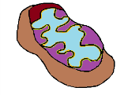
Energy Is ?
  ?
    Uses sunlight as the energy source
  ?
    Uses energy from sugars and other organic molecules
CO₂
CO₂
Sunlight energy
? in plant & animal cells
H₂O
H₂O
? for work
C ₆H₁₂O₆
? in plant cells
C ₆H₁₂O₆
HEAT
O₂
O₂
Notes:
Timing ≈ 1.5min
Both processes are energy based
Energy in photosynthesis and cellular respiration: cyclic, reactants of photosynthesis, are products of cellular respiration, and vice versa
[animate]
Photosynthesis
Uses solar energy to convert carbon dioxide and water to sugars and other organic molecules
[animate]
Reactants
CO₂+H₂O+Light energy
[animate]
Products
C₆H₁₂O₆+O₂
[animate]
Cellular respiration
Uses energy from sugars and other organic molecules
[animate]
Reactants
C₆H₁₂O₆+O₂
[animate]
Products
CO₂+H₂O+energy (ATP)
SOURCES:
Images by e2020

Slide 6
Energy Is Cyclic
  Photosynthesis
    Uses sunlight as the energy source
  Cellular respiration
    Uses energy from sugars and other organic molecules
CO₂
CO₂
Sunlight energy
Mitochondria in plant & animal cells
H₂O
H₂O
ATP for work
C ₆H₁₂O₆
Chloroplasts in plant cells
C ₆H₁₂O₆
HEAT
O₂
O₂
Notes:
Timing ≈ 1.5min
Both processes are energy based
Energy in photosynthesis and cellular respiration: cyclic, reactants of photosynthesis, are products of cellular respiration, and vice versa
[animate]
Photosynthesis
Uses solar energy to convert carbon dioxide and water to sugars and other organic molecules
[animate]
Reactants
CO₂+H₂O+Light energy
[animate]
Products
C₆H₁₂O₆+O₂
[animate]
Cellular respiration
Uses energy from sugars and other organic molecules
[animate]
Reactants
C₆H₁₂O₆+O₂
[animate]
Products
CO₂+H₂O+energy (ATP)
SOURCES:
Images by e2020

Slide 7
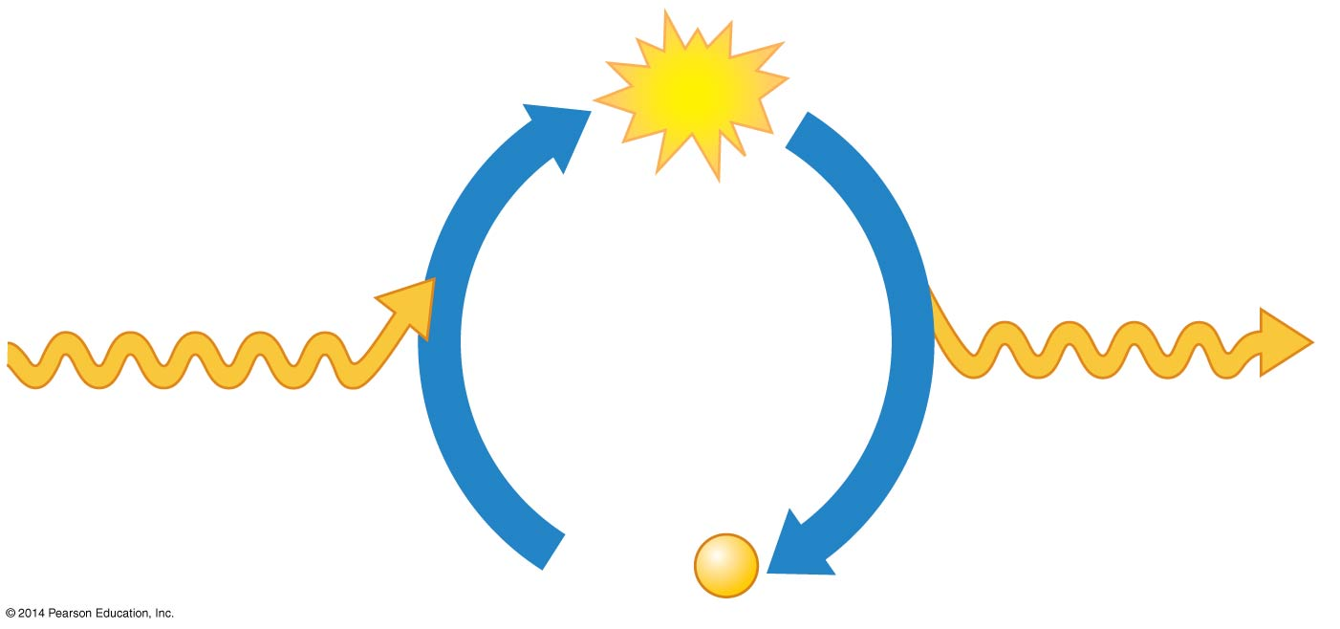
? drives Cellular Work by energy ? Exergonic and Endergonic Reactions
? synthesis
is ? (energy in)
?
ATP ?
is ? (energy out)
Energy from
cellular respiration
(?)
Energy for
cellular work
(?)
ADP +
?
Notes:
Figure 5.12c The ATP cycle

Slide 8
ATP drives Cellular Work by COUPLING Exergonic and Endergonic Reactions
ATP synthesis
is endergonic
ATP
ATP hydrolysis
is exergonic
Energy from
cellular respiration
(exergonic)
Energy for
cellular work
(endergonic)
ADP +
P
Notes:
Figure 5.12c The ATP cycle

Slide 9
Lesson Objectives
  By the end of this lesson, you should be able to:
Explain the importance of photosynthesis to living organisms.
Write the chemical equation for photosynthesis.
Summarize the process of photosynthesis (stages, components, chemicals, energy), including the two photo systems and the electron transport chain.
Identify and explain the components and process within the Calvin cycle.
  Science Practice: Study of the Cell (Elodea)
Notes:
#frame
instructional video
Timing ≈ 0.5 min
Transition: In the warm up, you thought about why plants might be important to living organisms and what Earth might be like without plants. During this lesson, you will learn about the process of photosynthesis, which is one way that plants are important to all living organisms.
[Preview the other objectives:]
You will also learn the chemical equation that summarizes the process of photosynthesis.
You will then explore the importance of photosynthesis to Earth’s organisms.
You will also briefly review the history of the discovery of photosynthesis and see how, with each new discovery, newer and more complex hypotheses led to new experimental methods, so that our understanding of photosynthesis increased over the years.

Slide 10
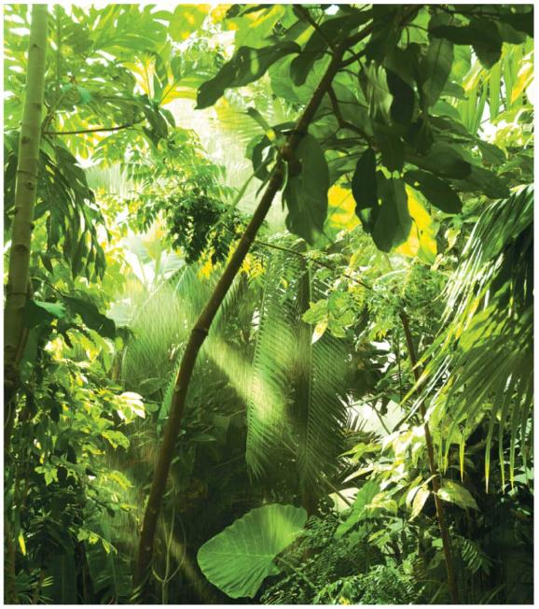
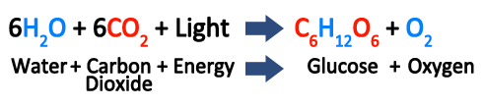
Photosynthesis Fuels Life
Plants are Autotrophs, which
  sustain themselves.
  do not usually consume organic molecules derived from other organisms.
  make their own food through the process of Photosynthesis, in which they convert CO₂ and H₂O to Sugars and other organic molecules.

Slide 11
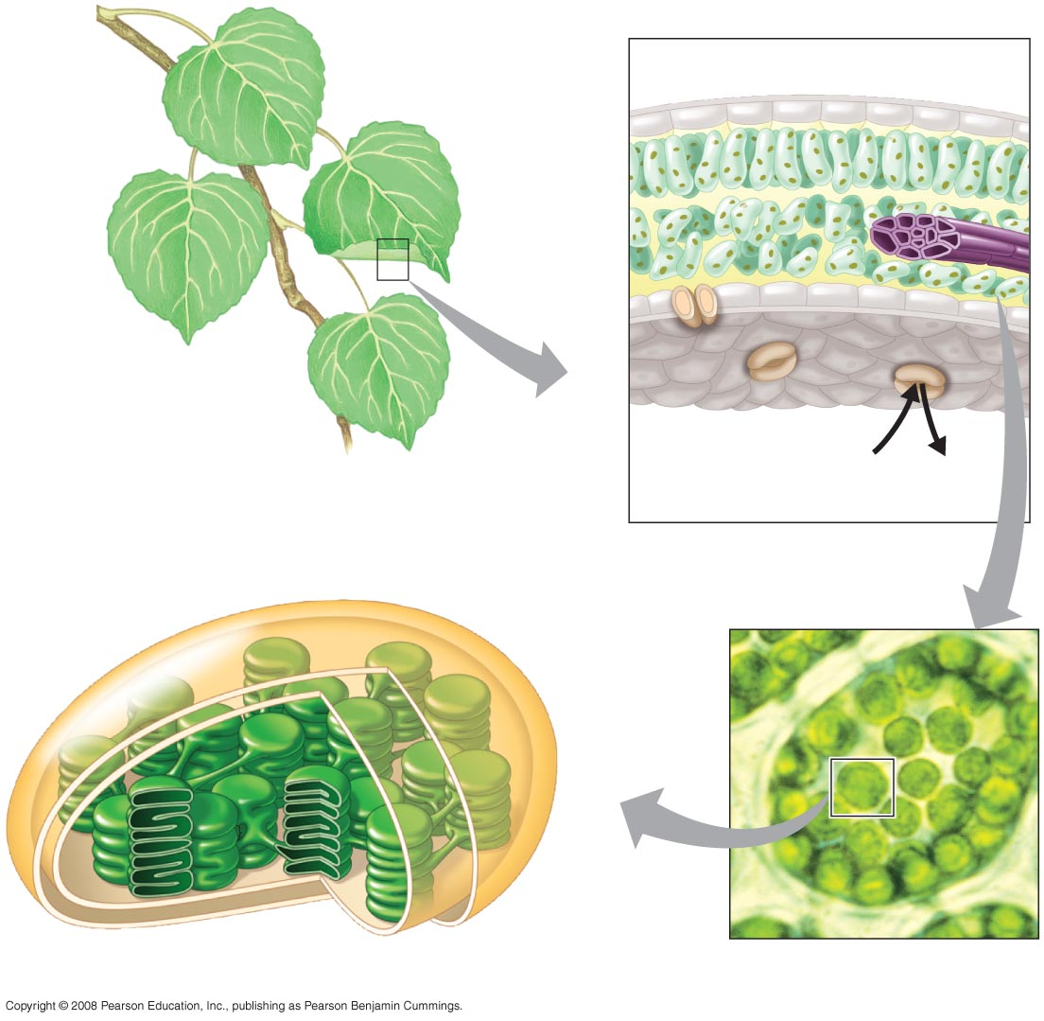
Where does photosynthesis occur?
Green Parts of Plants
  - Leaves and stems: contain chloroplasts (organelles).

Slide 12
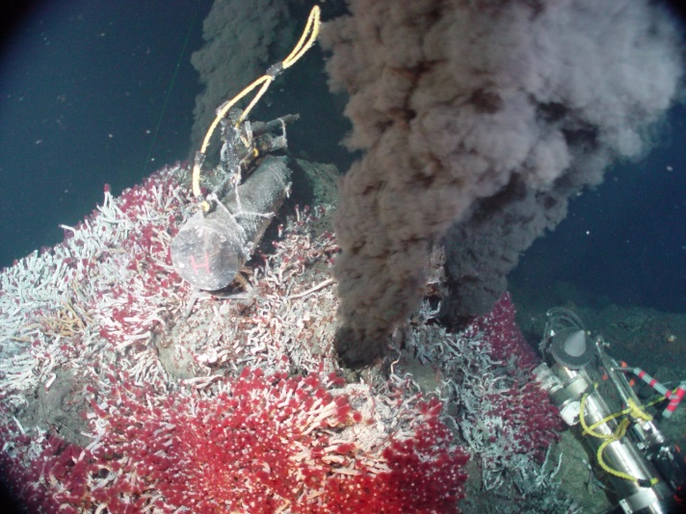
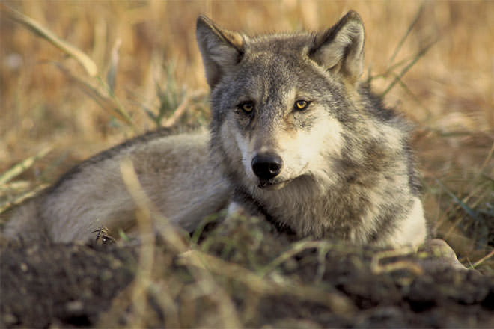
Photosynthesis Fuels Life
Photoautotrophs use the energy of light to produce organic molecules.
Chemoautotrophs are prokaryotes that use inorganic chemicals as their energy source.
Heterotrophs are consumers that feed on plants or animals or decompose organic material.

Slide 13
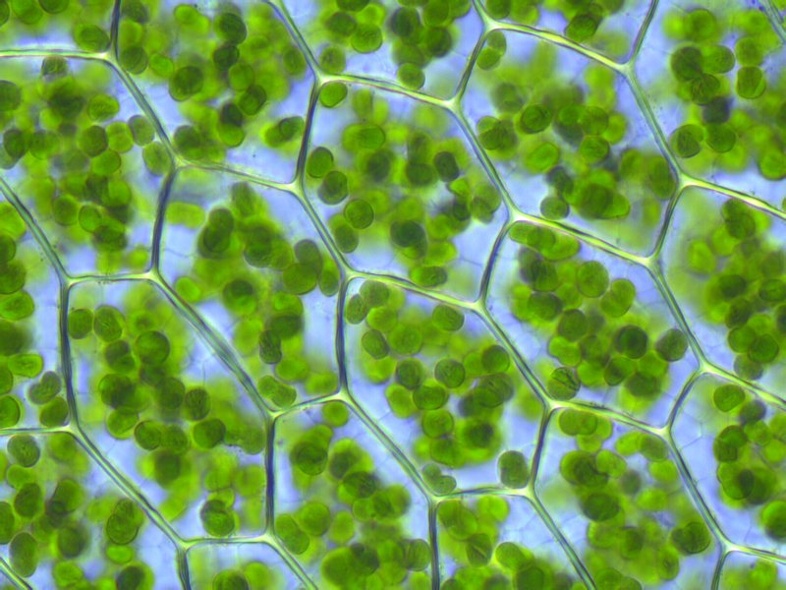
Photosynthesis Occurs in Chloroplasts in Plant Cells
Photosynthesis in plants takes place in CHLOROPLASTS.
CHLOROPHYLL
  is an important light-absorbing pigment in chloroplasts.
  is responsible for the green color of plants.
  plays a central role in converting solar energy to chemical energy.

Slide 14
Photosynthesis Occurs in Chloroplasts in Plant Cells
Chloroplasts are concentrated in the cells of the Mesophyll, the green tissue in the interior of the LEAF.
Stomata are tiny pores in the LEAF that allow
  Carbon Dioxide to enter
  Oxygen to exit.
Veins in the LEAF deliver Water absorbed by roots.

Slide 15
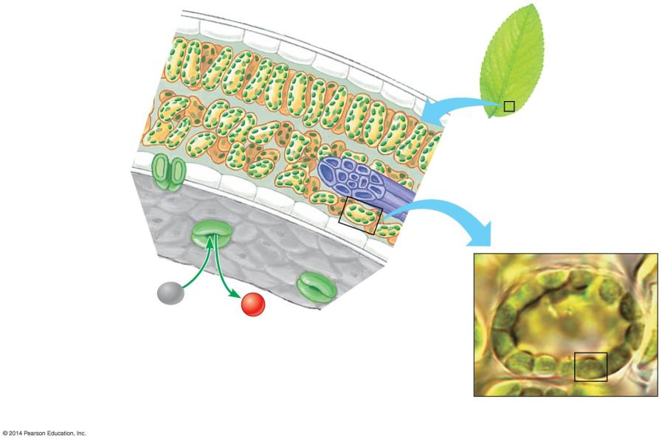
Leaf Cross Section
Mesophyll
Leaf
Vein
Mesophyll Cell
CO₂
O₂
Stoma
Chloroplast
Notes:
Figure 7.2-1 Zooming in on the location and structure of chloroplasts (part 1)

Slide 16
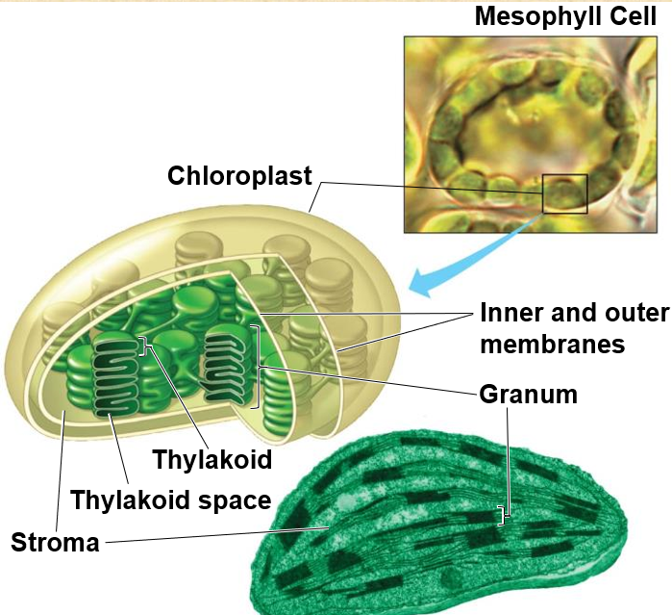
Photosynthesis Occurs in Chloroplasts in Plant Cells
CHLOROPLASTS
consist of an envelope of two membranes,
which encloses an inner compartment filled with a thick fluid called Stroma
that contains a system of interconnected membranous sacs called Thylakoids.

Slide 17
Photosynthesis Occurs in Chloroplasts in Plant Cells
THYLAKOIDS
  are often concentrated in stacks called Grana
  have an internal compartment called the Thylakoid Space,
  which has functions analogous to the outer compartment of a mitochondria in the generation of ATP.

Slide 18
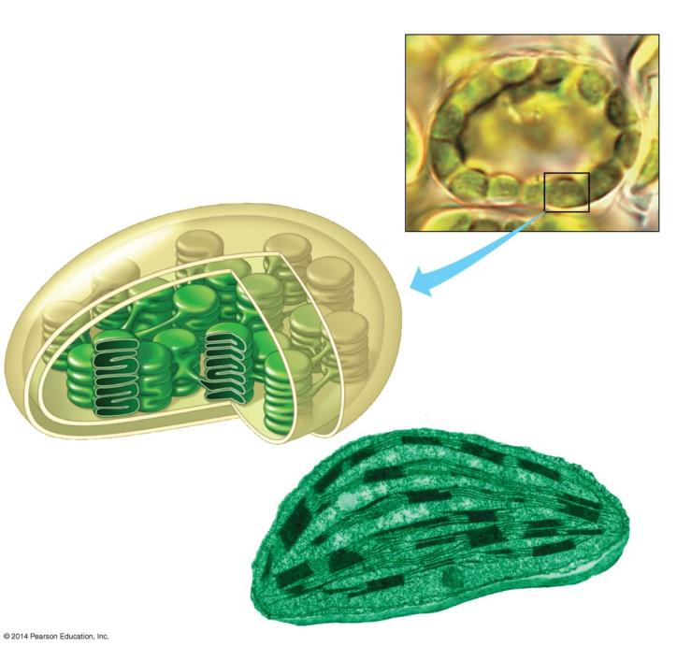
Mesophyll Cell
Chloroplast
Inner and outer
membranes
Granum
Thylakoid
Thylakoid space
Stroma
Notes:
Figure 7.2-2 Zooming in on the location and structure of chloroplasts (part 2)

Slide 19
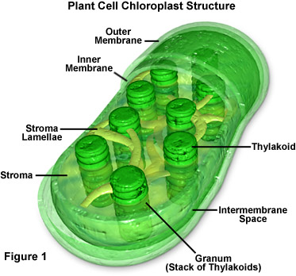
Grana (s: granum)
- stacks of thylakoids
Stroma
- semi-fluid material that contains enzymes and takes up space inside the chloroplast.

Slide 20
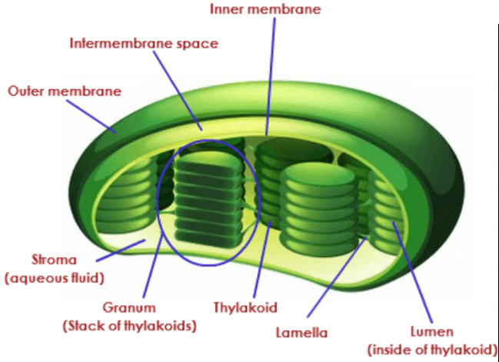
Photosynthesis Occurs in Chloroplasts in Plant Cells
THYLAKOID MEMBRANES also house much of the machinery that converts light energy to chemical energy.
CHLOROPHYLL MOLECULES
  Are embedded into the thylakoid membrane.
  Capture light energy.

Slide 21
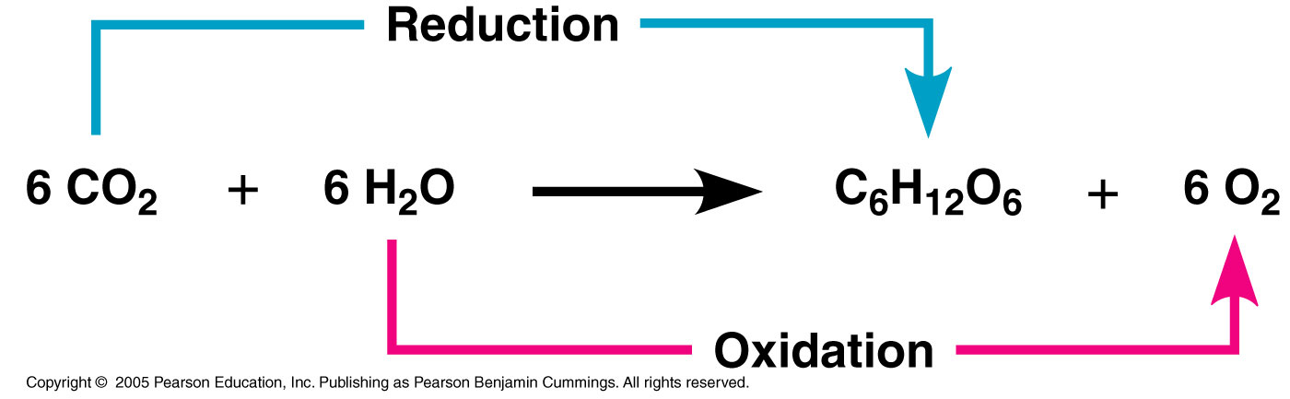
Photosynthesis is a Redox Process, as is Cellular Respiration
Photosynthesis, like Cell Respiration, is a Redox (Oxidation-Reduction) process.
CO₂ becomes reduced to Sugar as electrons, along with hydrogen ions (H⁺) from Water, are added to it.
Water molecules are oxidized when they lose electrons along with hydrogen ions.
e⁻
e⁻

Slide 22
Photosynthesis is a Redox Process, as is Cellular Respiration
Photosynthesis, like Cell Respiration, is a Redox (Oxidation-Reduction) process.
The electrons are transferred.
e⁻
e⁻

Slide 23
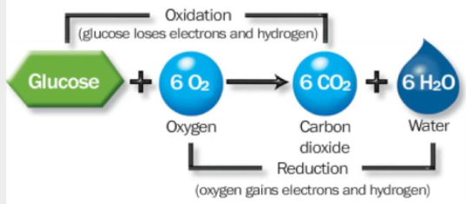
Photosynthesis is a Redox Process, as is Cellular Respiration
Cellular Respiration uses redox reactions to harvest the chemical energy stored in a glucose molecule.
  This is accomplished by oxidizing the sugar and reducing O₂ to H₂O.
  The electrons lose potential energy as they travel down the electron transport chain to O₂.
e⁻
e⁻

Slide 24
Photosynthesis is a Redox Process, as is Cellular Respiration
Cellular Respiration uses redox reactions to harvest the chemical energy stored in a glucose molecule.
The electrons are transferred (opposite direction to photosynthesis).
In contrast, the Photosynthesis (food-producing) redox reactions require an input of energy.
e⁻
e⁻

Slide 25
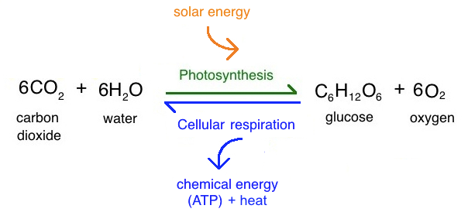
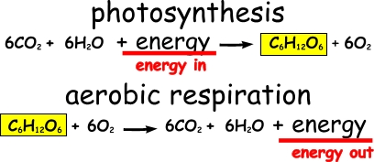
Endergonic
Exergonic

Slide 26
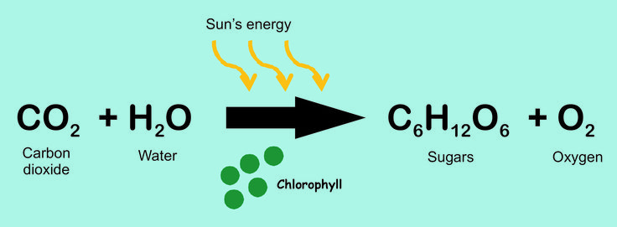
In PHOTOSYNTHESIS,
  light energy is captured by chlorophyll molecules to boost the energy of electrons.
  light energy is converted to chemical energy.
  chemical energy is stored in the chemical bonds of sugars.

Slide 27
The Two Stages of Photosynthesis Are Linked by ATP and NADPH
PHOTOSYNTHESIS occurs in two stages:
  1) LIGHT REACTIONS
    Occur in the Thylakoid Membranes.
    Water is split by an enzyme, providing a source of electrons and giving off Oxygen as a by-product.
    ATP is generated from ADP and a Phosphate group.
    Light energy is absorbed by the Chlorophyll molecules to drive the transfer of electrons and H⁺ from water to the electron acceptor NADP⁺, reducing it to NADPH.
    NADPH, produced by the light reactions, provides the “reducing power” for the Calvin Cycle.

Slide 28
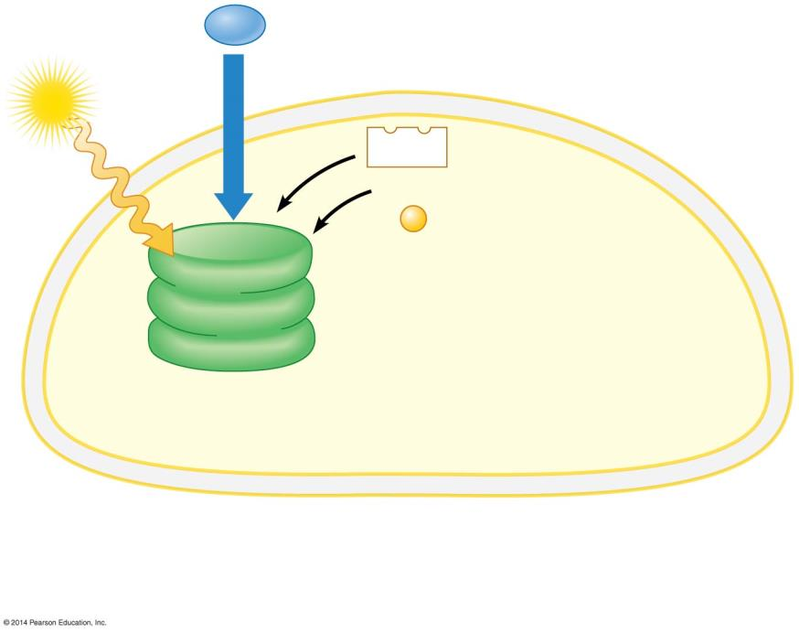


H₂O
    Water is split (by an enzyme), providing a source of electrons and giving off Oxygen as a by-product.
    ATP is generated from ADP and a Phosphate group.
Light
NADP ⁺
ADP
+
P
Light
Reactions
(in thylakoids)
Chloroplast
Notes:
Figure 7.5-1 An overview of the two stages of photosynthesis in a chloroplast (step 1)

Slide 29
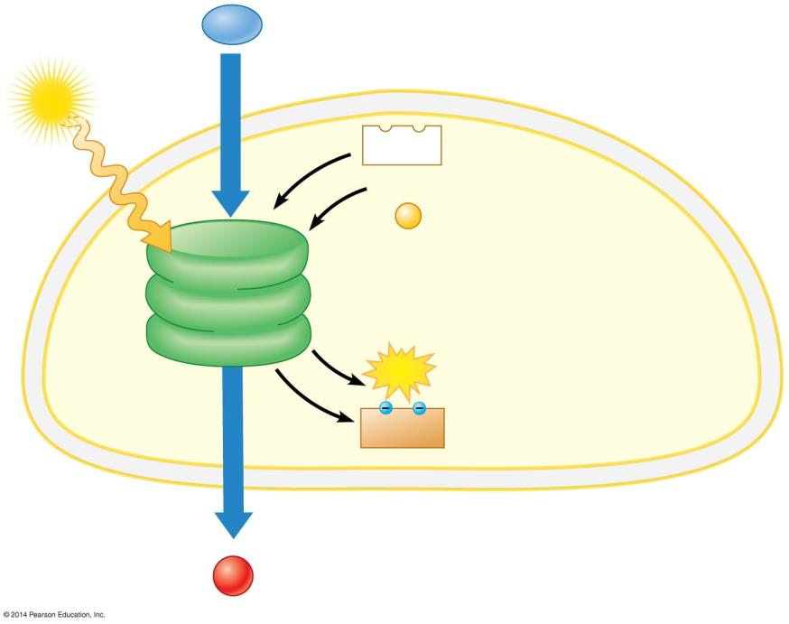
H₂O
Light
NADP ⁺
    Light energy is absorbed by the Chlorophyll molecules to drive the transfer of electrons and H⁺ from water to the electron acceptor NADP⁺, reducing it to NADPH.
ADP
+
P
Light
Reactions
(in thylakoids)
ATP
NADPH
Chloroplast
O₂
Notes:
Figure 7.5-2 An overview of the two stages of photosynthesis in a chloroplast (step 2)

Slide 30
The Two Stages of Photosynthesis Are Linked by ATP and NADPH
  2) CALVIN CYCLE
    Occurs in the Stroma of the Chloroplast.
    The Calvin Cycle is a cyclic series of reactions that assembles Sugar molecules using CO₂ and the energy-rich products of the light reactions.
    During the Calvin Cycle, CO₂ is incorporated into organic compounds in a process called Carbon Fixation.
    After Carbon Fixation, the carbon compounds are reduced to Sugars.
    The Calvin Cycle is often called the Dark Reactions, or Light-Independent Reactions, because none of the steps requires light directly.

Slide 31
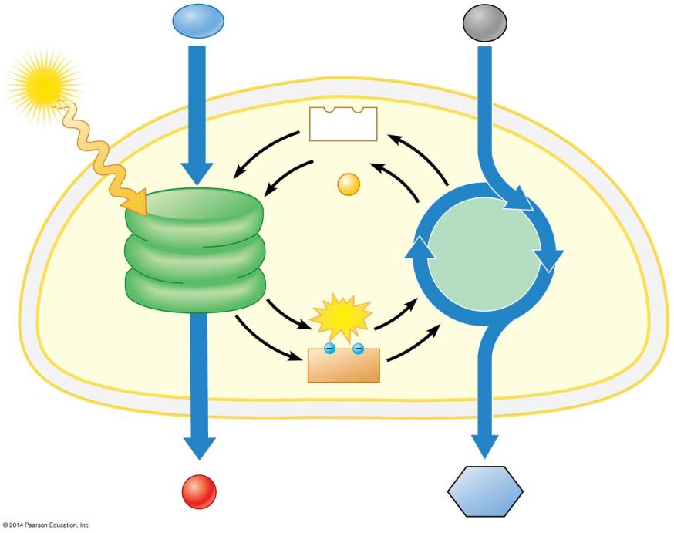
?
?
?
?
?
+
?
?
(in ?)
?
(in ?)
?
?
Chloroplast
/
?
Notes:
Figure 7.5-3 An overview of the two stages of photosynthesis in a chloroplast (step 3)
Notice that the light dependent reactions occurs in the thylakoid membranes and the light independent reactions occurs in the stroma. Whatever comes out of the light dependent reactions is used in the light independent reactions. Remember this all occurs in the chloroplasts…the light dependent in the thylakoid membrane and the light independent reactions in the gel surrounding the thylakoid

Slide 32
H₂O
CO₂
Light
NADP ⁺
ADP
+
P
Light
Reactions
(in thylakoids)
Calvin
Cycle
(in stroma)
ATP
NADPH
Chloroplast
O₂
Sugar
Notes:
Figure 7.5-3 An overview of the two stages of photosynthesis in a chloroplast (step 3)
Notice that the light dependent reactions occurs in the thylakoid membranes and the light independent reactions occurs in the stroma. Whatever comes out of the light dependent reactions is used in the light independent reactions. Remember this all occurs in the chloroplasts…the light dependent in the thylakoid membrane and the light independent reactions in the gel surrounding the thylakoid

Slide 33
The Light Reactions:
Converting Solar Energy to Chemical Energy

Slide 34
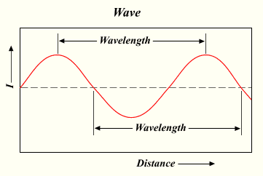
Visible Radiation absorbed by Pigments drives the Light Reactions
Sunlight contains energy called Electromagnetic energy or Radiation.
  Visible Light is only a small part of the Electromagnetic Spectrum, the full range of electromagnetic wavelengths.
  Electromagnetic energy travels in Waves
  The Wavelength is the distance between the crests of two adjacent waves.

Slide 35
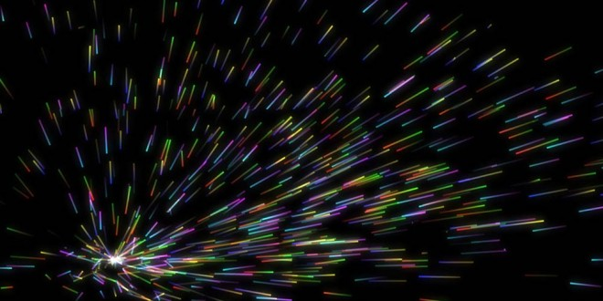
Visible Radiation absorbed by Pigments drives the Light Reactions
Light behaves as discrete packets of energy called Photons.
  A Photon is a fixed quantity of light energy.
  The shorter the wavelength, the greater the energy.

Slide 36
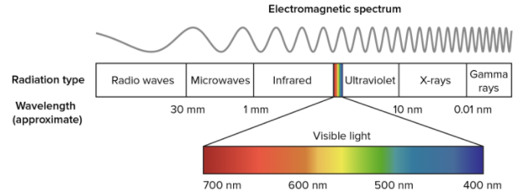
Longer wavelength
Shorter wavelength
Lower energy
Higher energy
10⁻⁵ nm 10⁻³ nm 1 nm 10³ nm 10⁶ nm 1 m 10³ m
Gamma
rays
X-rays
UV
Infrared
Micro-
waves
Radio
waves
Visible light
Notes:
Figure 7.6a The electromagnetic spectrum and the wavelengths of visible light
The light has different wave lengths. Radiant energy travels units called photons.
There is a part of the electromagnetic spectrum there is a visible spectrum and a bunch more that we cannot see. Even though we can only see the visible spectrum, this doesn’t mean the others do not exist…we are still getting bombarded with these other types of radiation. For this class we are only going to focus on this visible spectrum.

Slide 37
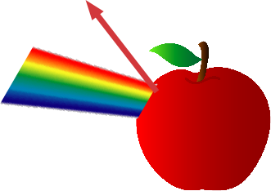

Why does a red apple appear red?
When white light strikes an object, some wavelengths are absorbed and some are reflected.
Wavelengths absorbed cannot be seen.
  A red apple absorbs all wavelengths of white light, except red.
  The red wavelength of light is reflected to our eye, and perceived as red.
A red apple appears red because it reflects light in the red wavelength.
Notes:
So black is the absorption of all colors, white is the reflection of all colors. Think about it…would you rather wear white or black on a hot summer’s day? Why? How about when it is cold?

Slide 38
Visible Radiation absorbed by Pigments drives the Light Reactions
PLANT PIGMENTS
  are built into the Thylakoid Membrane.
  absorb some wavelengths of light.
  reflect other wavelengths.
We see the color of the wavelengths that are reflected by pigments.
For example, Chlorophyll reflects green wavelengths.
  The energy provided by the sun to fuel photosynthesis comes from the wavelengths of light chlorophyll absorbs.
Notes:
Chlorophyll is the most important pigment present in the chloroplast of plant cells.

Slide 39
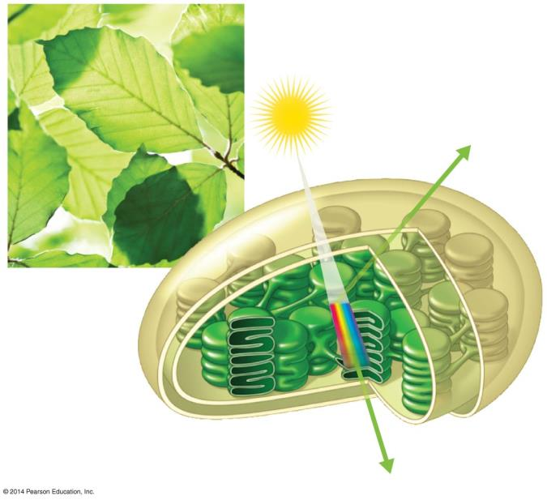
Light
Reflected
light
Chloroplast
Thylakoid
Absorbed
light
Reflected
light
Notes:
Figure 7.6b-0 The interaction of light with a chloroplast

Slide 40
Absorption of Light by Chlorophyll
Chlorophyll absorbs blue-violet and red light best
Absorption
violet blue green yellow orange red
Wavelength
Notes:
What are the peak wavelengths that chlorophyll absorbs best? Those are not the colors that you are seeing. What you are seeing is the green and yellow wavelengths … those are the wavelengths that are being reflected into your eyes.

Slide 41

Carotenoids:
Other types of photosynthetic pigments.
They enhance the absorption spectrum of chlorophyll so that more of the sun’s energy can be used in photosynthesis.
They “pass along” the energy they absorb to the chlorophyll.
Fall colors are due to the presence of carotenoids in leaves.
Notes:
Carotenoids are responsible for the yellow or orange shades of colors that we see…so they absorb blue-green shades of light. Another pigment that is present in purple or red leaves is anthocyanin. This is a pigment that photosynthesizes in these leaves.

Slide 42
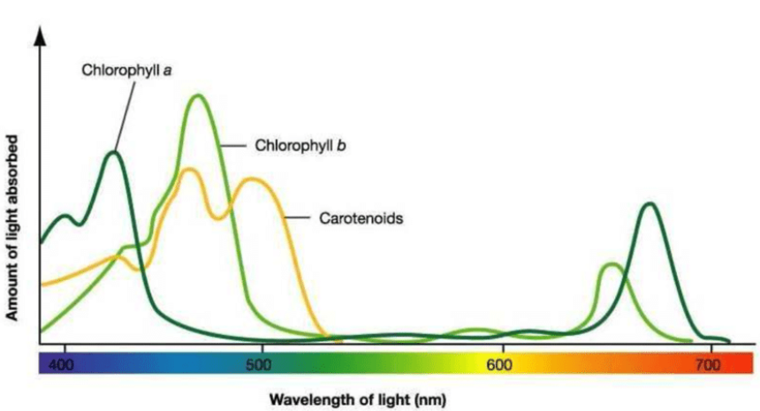
Why do leaves change colors in the Fall?
Plants stop producing chlorophyll during the fall, so they lose their green color.
Carotenoids are still present in the leaves.
Since they absorb green light and reflect other wavelengths (red, orange, yellow, brown), the leaves take on the color of the carotenoid that is present.
Notes:
The colder the fall the more brilliant the colors

Slide 43
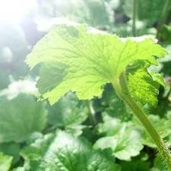
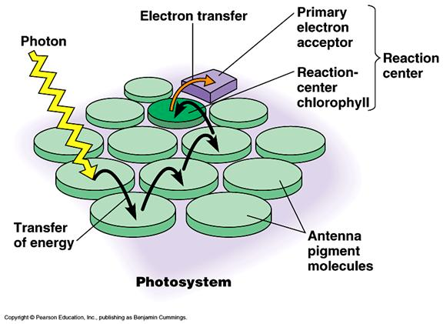
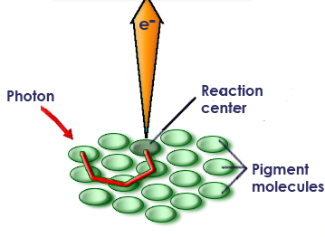
When chlorophyll absorbs light, energy is transferred directly to electrons in the chlorophyll molecule.
This raises the energy level of these electrons. These high-energy electrons make photosynthesis work.
Notes:
The high energy electrons push the photosynthesis reaction

Slide 44
Two Photosystems connected by an Electron Transport Chain generate ATP and NADPH
In the Light Reactions, light energy is transformed into the chemical energy of ATP and NADPH.
To accomplish this, electrons are
  removed from Water.
  passed from Photosystem II to Photosystem I.
  accepted by NADP⁺, reducing it to NADPH.
Between the two photosystems, the electrons
  move down an Electron Transport Chain and
  provide energy for the synthesis of ATP.

Slide 45
Light Reaction Summary
1. What is used (reactants)?
Water (H₂O)
2. What is produced?
  Oxygen (O₂)
3. What is the energy source?
  Sunlight
4. What are the by-products?
ATP and NADPH
5. Where does this occur?
Grana of the chloroplasts

Slide 46
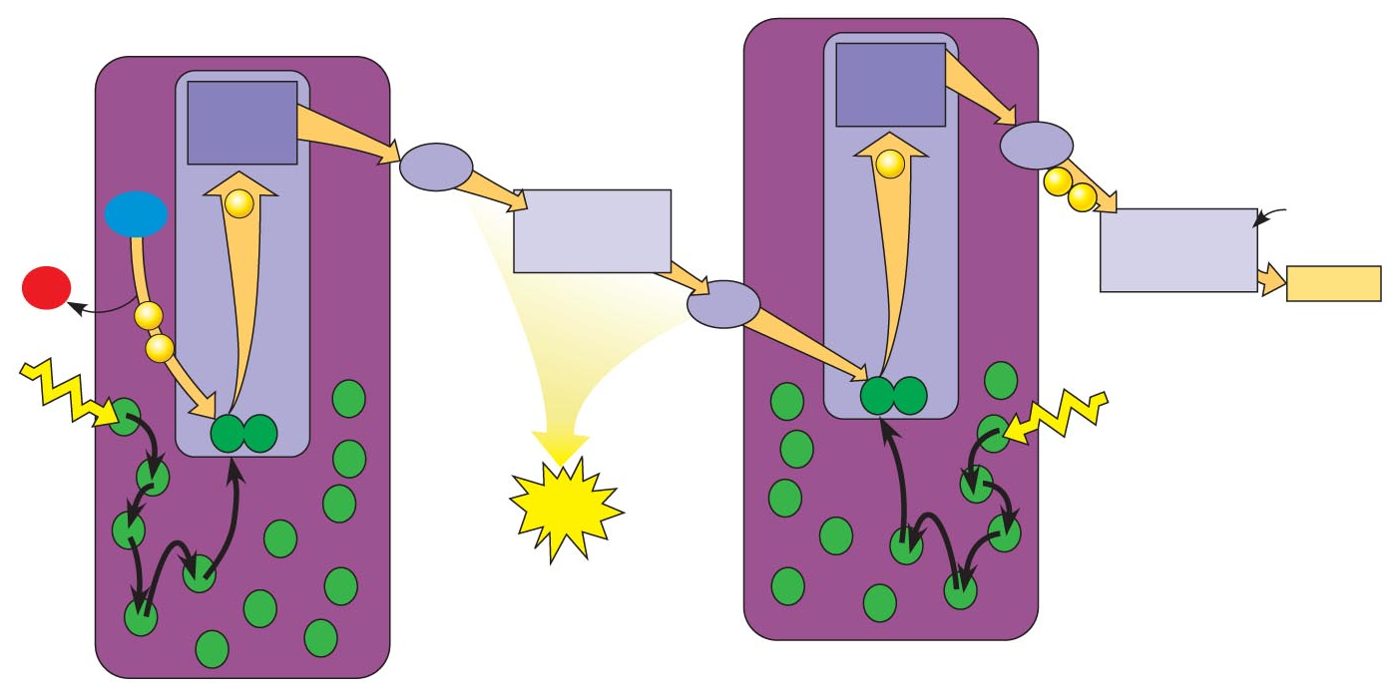
The Light Dependent Reactions - Photosystems
chlorophyll
Photosystem I
Photosystem II
There are two photosystems: Photosystem I and Photosystem II.
Photosystem:
A collection of pigment molecules (chlorophyll) that serve as the light collecting unit.
Notes:
Just to be clear…this process is occurring in the thylakoid membrane where the chlorophyll are located. In the light dependent reactions photosystem II comes before photosystem I. It was named this way because Photosystem I was discovered first…then later photosystem II was discovered and so PS I kept it’s name.

Slide 47
electron
acceptor
Electron transport chain
e⁻
Light
e⁻
e-
Photosystem I
Photosystem II
Chlorophyll molecules in photosystem II absorb light.
This light energy is absorbed by chlorophyll’s electrons, increasing their energy level.
These high-energy electrons are passed to the electron transport chain.
Notes:
The electron transport train is the truck that carries the electrons where they need to go. This electron acceptor is a pheophytin molecule (don’t mention this unless asked)

Slide 48
electron
acceptor
Electron transport chain
H₂0
e⁻
O₂
Light
e⁻
e⁻
e⁻
e⁻
Photosystem I
Photosystem II
The electrons that were lost must now be replaced.
Enzymes in the thylakoid membrane break apart water molecules into 2 electrons, 2 H+ ions, and 1 oxygen molecule.
These electrons replace the high-energy electrons that chlorophyll has lost to the electron transport chain.
Notes:
So, this is why you need light energy and water in the process of photosynthesis…and this is why O2 is a byproduct of photosynthesis.

Slide 49
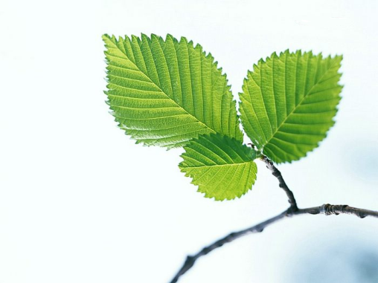



LIGHT REACTION OF PHOTOSYNTHESIS
sun
e-
Energy is released
in electron transport chain (ETC)
Electrons in
Chlorophyll get
excited
energy
ADP +P = ATP
ETC
e- e- e- e-
O₂
2H₂O
H+ H+
H+ H+
H+H+
H+H+
2NADPH
2 NADP

Slide 50
electron
acceptor
Electron transport chain
H₂0
e⁻
O₂
Light
e⁻
e⁻
e⁻
e⁻
Photosystem I
Photosystem II
The oxygen is considered a waste product and is released into the air.
This splitting apart of water molecules is responsible for nearly all of the oxygen in our atmosphere.
The hydrogen ions from the water are released inside the thylakoid.
Notes:
The oxygen is released through the stomata

Slide 51
electron
acceptor
Electron transport chain
H₂0
e⁻
e⁻
e⁻
O₂
e⁻
e⁻
e⁻
protein protein protein
Light
e⁻
e⁻
ATP
Photosystem I
Photosystem II
The high-energy electrons move through the electron transport chain from photosystem II to photosystem I.
As the electrons are passed down the electron transport chain, protein molecules use the energy from these electrons to create ATP.

Slide 52
electron
acceptor
electron
acceptor
Electron transport
chain
Electron transport chain
e⁻
e⁻
e⁻
H₂0
e⁻
e⁻
NADP⁺
+ H⁺
O₂
e⁻
NADPH
e⁻
e⁻
protein protein protein
Light
e⁻
Light
e⁻
ATP
Photosystem I
Photosystem II
The chlorophyll molecules in photosystem I absorb energy from the sun and use it to re-energize the electrons.
The electron carrier NADP+ picks up these high-energy electrons along with a H+ to form NADPH.

Slide 53
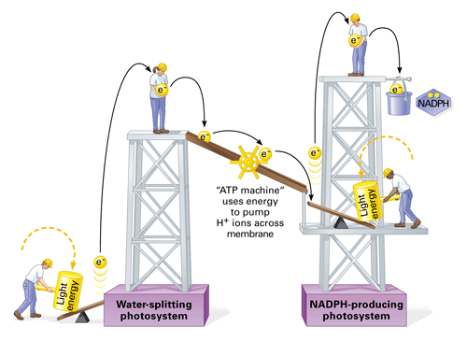

The Big Picture
The purpose of the Light-Dependent Reactions is to produce ATP and NADPH that are needed for the Light-Independent Reactions.
O2
O2
e-
O2
H+
H+
O2
H+
H+
H+
ATP
H2O
Photosystem II
Photosystem I
The reaction that takes place along the thylakoid membrane:
Water molecules are continuously split by an enzyme.
The hydrogen will accumulate inside the thylakoid.
The oxygen is released to the atmosphere (by-product).

Slide 54
The Big Picture
The purpose of the Light-Dependent Reactions is to produce ATP and NADPH that are needed for the Light-Independent Reactions.
O2
O2
e-
O2
H+
H+
O2
H+
H+
H+
ATP
H2O
Photosystem II
Photosystem I
The light-dependent reactions pass electrons continuously from Water to NADPH.
The two photosystems work together using the light energy from the sun to produce ATP and NADPH.

Slide 55
The Light Reactions take place within the Thylakoid Membranes
A Thylakoid Membrane includes numerous copies of
  the two photosystems and
  the electron transport chain.
Light energy absorbed by the two photosystems drives the flow of electrons from Water to NADPH.
The electron transport chain helps to produce the concentration gradient of H⁺ across the thylakoid membrane, which drives H⁺ through ATP synthase, producing ATP.

Slide 56
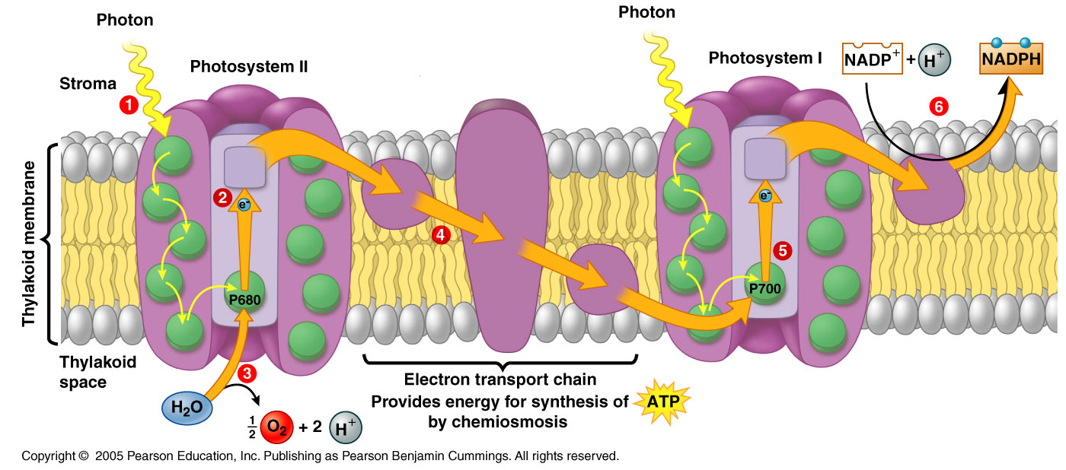


This diagram is a slice of a section of the thylakoid membrane. Embedded in the membrane are photosystems.
Photosystem II is a collection of chlorophyll molecules that absorb the light energy from the sun.

Slide 57


e-
e⁻
e⁻
e⁻
e⁻
e⁻
e⁻
When sunlight strikes the surface of the leaf, the chlorophyll molecules absorb the energy from the sun.
This light energy increases the energy level of the electrons in chlorophyll molecules.
These high-energy electrons are passed to the ETC (Electron Transport Chain) .

Slide 58

e-
e-
e-
e-
The electrons that were lost must now be replaced. Enzymes in the thylakoid membrane break apart water molecules into 2 electrons, 2 H⁺ ions, and 1 oxygen molecule.
These electrons replace the high-energy electrons that chlorophyll has lost to the electron transport chain (ETC).

Slide 59
e-
e-
e-
The oxygen is considered a waste product and is released into the air.
The hydrogen ions from the water are released inside the thylakoid space.

Slide 60


Electron Transport Chain
e-
e-
e-
ATP
The high-energy electrons move through the electron transport chain from photosystem II to photosystem I.
As the electrons are passed down the electron transport chain, protein molecules use the energy from these electrons to create ATP.

Slide 61


e-
e-
e-
Electron Transport Chain
e-
e-
e-
e-
e-
e-
ATP
The chlorophyll molecules in Photosystem I absorb energy from the sun and use it to re-energize the electrons.
These electrons are passed down a second electron transport chain to the electron acceptor called NADP+.

Slide 62
NADP+ joins with one hydrogen atom and two electrons to form …
NADPH in a space outside of the thylakoid.
This area of the chloroplast is called the stroma. It is a dense, enzyme-rich liquid area of the chloroplast outside of the thylakoid.
Notes:
the NADPH and the ATP are going to end up in the stroma

Slide 63
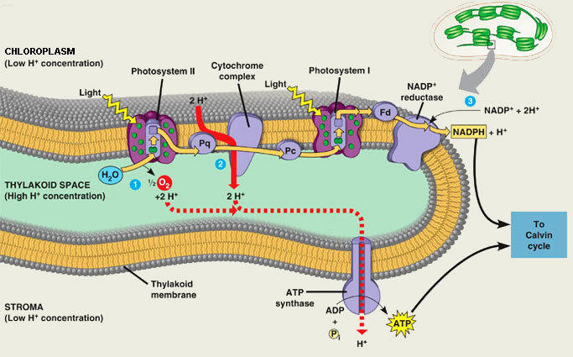


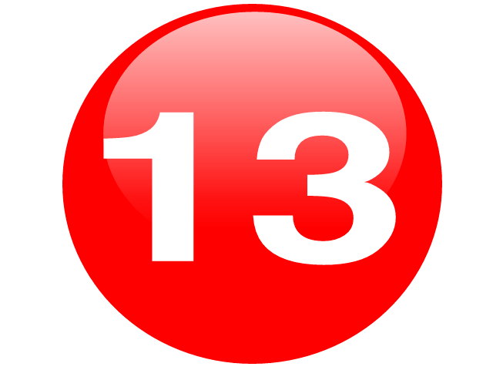


H⁺
H⁺
H⁺
H⁺
H⁺
H⁺
H⁺
H⁺
H⁺
Hydrogen ions flow from an area of high concentration inside the thylakoid space to an area of low concentration in the stroma.

Slide 64
H⁺
H⁺
H⁺
H⁺
H⁺
H⁺
H⁺
H⁺
H⁺
The hydrogen is flowing through a protein enzyme called ATP synthase.
As the hydrogen flows through ATP synthase, the protein rotates just like a turbine being turned by water.

Slide 65
H⁺
H⁺
H⁺
H⁺
H⁺
H⁺
H⁺
H⁺
H⁺
As this protein rotates, ATP synthase binds a phosphate to ADP to form ATP.

Slide 66
Hydrogen ions are pumped back inside the thylakoid space to keep the concentration of hydrogen very high inside of it.
NADPH and ATP are sent to the Calvin Cycle.

Slide 67
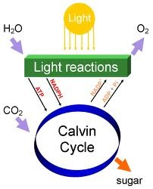
The purpose of the light reactions is to produce the high-energy compounds of ATP and NADPH which will be used in the light-independent reactions or “Dark Reactions”.

Slide 68
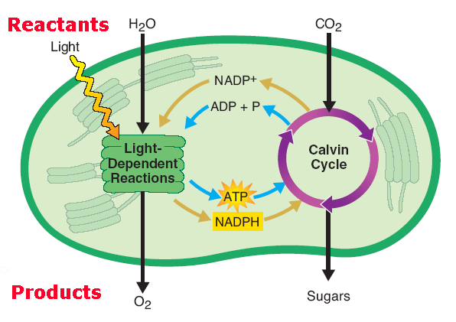
Photosynthesis Overview

Slide 69
Photosynthesis Overview
http://somup.com/c3eOI4TPqi (4:08)
Light Reactions of Photosynthesis

Slide 70
The Calvin Cycle:
Reducing CO₂ to Sugar

Slide 71
The Calvin Cycle
The Calvin Cycle, the Dark Reaction, or the Light-Independent Reactions …
occurs in the stroma of the chloroplast.
The purpose of this stage is to take carbon dioxide and the high-energy products from the light reaction (NADPH and ATP) and make glucose molecules.
Notes:
The bottom line of the calvin cycle is to take Carbon Dioxide and NADPH and ATP to make glucose. How many carbons does glucose have? 6 right? Well where are we going to get all of those carbons? From CO2

Slide 72
CALVIN CYCLE
The steps of the Calvin Cycle include
  Carbon Fixation
  Reduction
  release of one molecule of G3P
  regeneration of the starting molecule, Ribulose Biphosphate (RuBP).

Slide 73
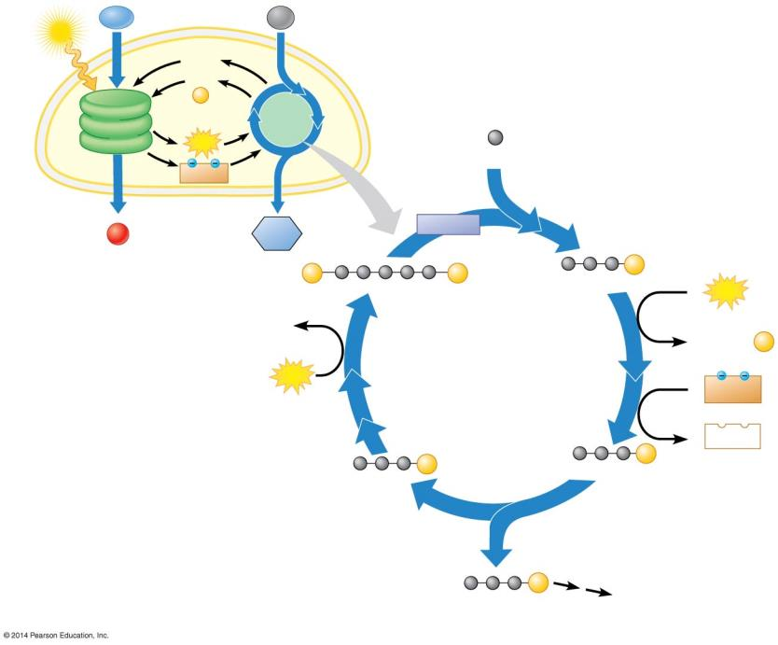
Light
H₂O
CO₂
NADP⁺
ADP
+
P
Light
Reactions
Calvin
Cycle
Input
ATP
3
Step 1
Carbon fixation
CO₂
NADPH
Chloroplast
Rubisco
O₂
Sugar
3
P
P
6
P
RuBP
3-PGA
6
ATP
3 ADP
P
Step 4
P
P
6 ADP + P
Regeneration of RuBP
CALVIN
CYCLE
3
ATP
6
NADPH
6
NADP⁺
5
P
6
P
G3P
G3P
Step 2
Reduction
Step 3
Release of one
molecule of G3P
1
P
G3P
Output
Glucose and other
compounds
Notes:
Figure 7.10-0 An overview of the Calvin cycle

Slide 74
CALVIN CYCLE
Can occur with or without light.
Calvin Cycle uses CO2 + ATP + NADPH to make a 3-Carbon Sugar = G-3-P (glyceraldehyde-3-phosphate)
A plant cell uses TWO G3Ps to make ONE 6-carbon molecule Glucose.
Two turns of the Calvin Cycle are required to make one molecule of GLUCOSE (6 Carbons).
Glucose is used by plants in cellular respiration to make many ATP molecules.

Slide 75
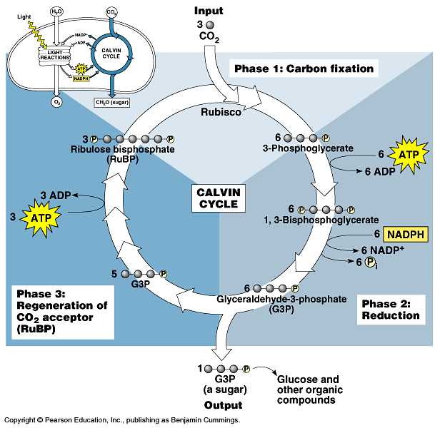
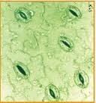
Steps of the Calvin Cycle
Stomata
4b
4a
Carbon dioxide is obtained from the atmosphere. It enters the leaf through the pores in the leaf called stomata.

Slide 76
Steps of the Calvin Cycle
This is referred to as Carbon Fixation.
4b
4a
The overall Calvin cycle combines the carbon from carbon dioxide with a 5-carbon sugar called RuBP – Ribulose Biphosphate.

Slide 77
Steps of the Calvin Cycle
4b
4a
This forms a very unstable 6-carbon compound that immediately breaks apart into 2 three carbon molecules.

Slide 78
Steps of the Calvin Cycle
4b
4a
A series of reactions involving ATP and NADPH converts this molecule into two molecules of G3P, which is a three-carbon compound [REDUCTION].
(Glyceraldehyde-3-phosphate)

Slide 79
Steps of the Calvin Cycle
There are 2 possibilities for G3P:
4b
4a
4a
Two molecules of G3P are combined together to form a molecule of Glucose.
Some of the G3P is converted by a series of reactions into more RuBP so that the reaction can occur again.
4b

Slide 80
Dark Reaction
Why is it called this?
  - Doesn’t depend on light in order to occur
Alternative names for the Dark Reaction
  1. Light Independent Reaction
  2. Carbon Fixation
  - Plants take Carbon Dioxide (inorganic) molecules and convert them into Glucose molecules (organic)
  3. C3 Pathway
  4. Calvin-Benson Cycle
Where does it occur?
  - Stroma

Slide 81
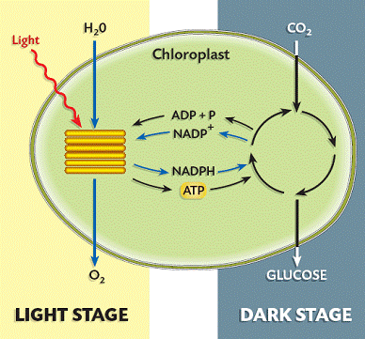

Slide 82
Photosynthesis Overview
http://somup.com/c3eOIgTPql (3:06)
Calvin Cycle of Photosynthesis

Slide 83
Dark Reaction
1. Where does it occur?
Stroma
2. What is produced?
Glucose and water
3. What is used?
Carbon Dioxide
4. What is the energy source?
  ATP
5. What are the by-products?
ADP and NADP

Slide 84
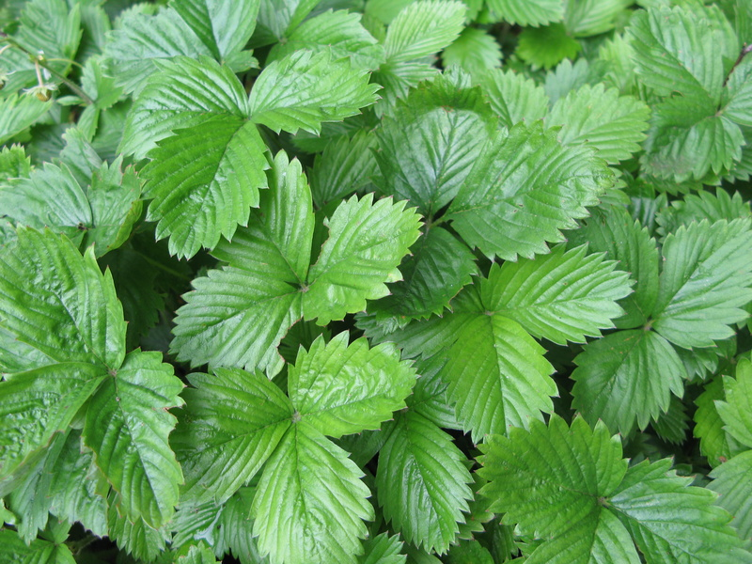
To Sum It All Up:
Solar Energy has been stored as Chemical Energy in Glucose

Slide 85
Comparing Photosynthesis with Respiration
Event | ? | ?
Function | Energy capture | Energy release
Reactants | ? | ?
Products | ? | ?
Where it takes place | Cells with Chlorophyll | ALL Cells
What happens to glucose | Synthesized | Broken down
What happens to energy | Energy from ? is used; Stored in Glucose | Energy from ? is used; Stored in ATP
Overall reaction | 6CO₂ + 6H₂O ==> C₆H₁₂O₆ + 6O₂ | C₆H₁₂O₆ + 6O₂ → 6CO₂ + 6H₂O + Energy (36 ATP)

Slide 86
Comparing Photosynthesis with Respiration
Event | Photosynthesis | Respiration
Function | Energy capture | Energy release
Reactants | CO₂ + H₂O | Glucose + O₂
Products | Glucose + O₂ | CO₂ + H₂O
Where it takes place | Cells with Chlorophyll | ALL Cells
What happens to glucose | Synthesized | Broken down
What happens to energy | Energy from sunlight is used; Stored in Glucose | Energy from glucose is used; Stored in ATP
Overall reaction | 6CO₂ + 6H₂O ==> C₆H₁₂O₆ + 6O₂ | C₆H₁₂O₆ + 6O₂ → 6CO₂ + 6H₂O + Energy (36 ATP)

