Slide 1
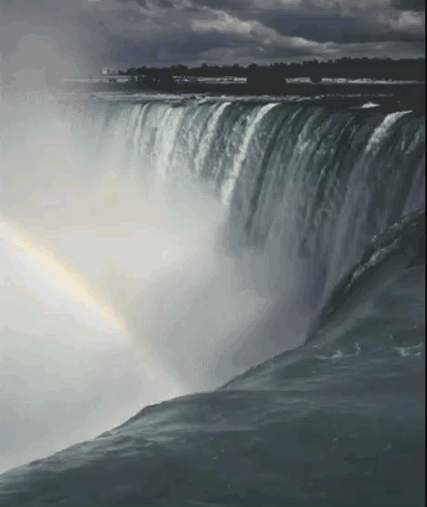
The Wonder of Water
Properties of Water

Slide 2
Focus Questions
What is water’s composition?
2. What is water’s chemical formula?
3. What is polarity in terms of molecules like water?
4. What kinds of molecules can water dissolve?

Slide 3
Trivia About Water
~____% of Earth’s water is fresh water.
_____% of the water on Earth is salt water.
Earth’s surface water is ____% of the world’s fresh water.
_____% of the fresh water on Earth is trapped in glaciers.
_____% of fresh water is in the ground.
Hydraulic Fracturing for natural gas, aka “_______” pollutes our water.
____% of the world’s water is frozen and therefore unusable.
Water covers _____% of the Earth’s surface.
Water can ________ more substances than any other liquid including sulfuric acid, salts, vinegar, and much more.
More than _____% of bottled water comes from a municipal water supply, the same place that tap water comes from.

Slide 4
Trivia About Water
~3% of Earth’s water is fresh water.
97% of the water on Earth is salt water.
Earth’s surface water is 0.3% of the world’s fresh water.
68.7% of the fresh water on Earth is trapped in glaciers.
30% of fresh water is in the ground.
Hydraulic Fracturing for natural gas, aka “Fracking” pollutes our water.
1.7% of the world’s water is frozen and therefore unusable.
Water covers 70.9% of the Earth’s surface.
Water can dissolve more substances than any other liquid including sulfuric acid, salts, vinegar, and much more.
More than 25% of bottled water comes from a municipal water supply, the same place that tap water comes from.

Slide 5
Freshwater – Why Care?
https://screencast-o-matic.com/watch/cFQr2MqRa7 (2:29)
https://screencast-o-matic.com/watch/cFQr29qRzl
(3:47) The Wonder of Water

Slide 6
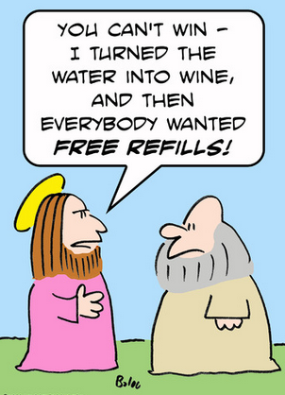

Slide 7
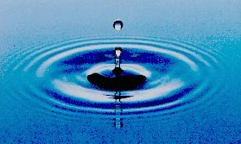
Composition of Water
Water is an unusual compound with unique physical properties.
As a result, it’s the compound of life. (Consider John 4:14)
And is the most abundant compound in the biosphere of Earth.
Water consists of only hydrogen and oxygen.

Slide 8
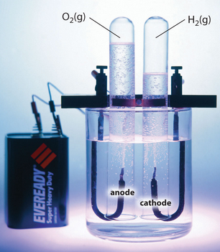
Electrolysis of Water
Water can be separated into its constituent elements (hydrogen and oxygen) using electricity

Slide 9
Electrolysis of Water
Click the link for a demonstration.
Look for the H₂ and O₂ molecules that “escape” by RISING UP.
Count the NUMBER of H₂ and O₂ and molecules.
https://screencast-o-matic.com/watch/cFQrohqRzm (0:31)

Slide 10
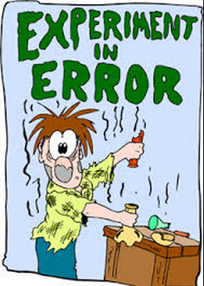
Experimental Error
In theory, there should be 2 molecules of H₂ released for every 1 molecule of O₂.
In REAL LIFE this is never the case.
How can we reduce experimental error?
Better equipment
Better procedures
Peer Review

Slide 11
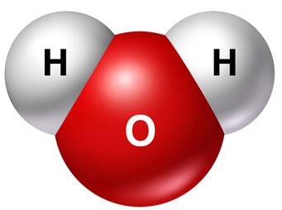
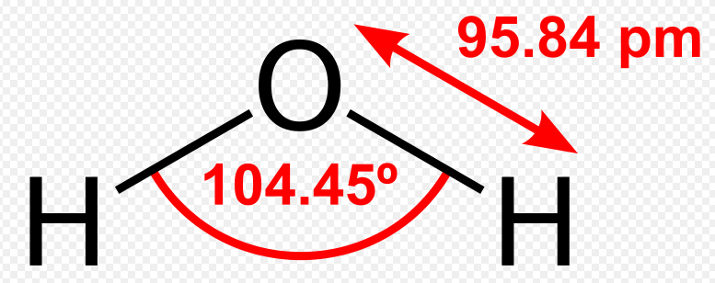
Chemical Formula of Water H₂O

Slide 12
Chemical Formulas
Use chemical symbols of elements (Periodic Table on page 320)
Show how many atoms of each element are involved in a formula.
Glucose C₆H₁₂O₆ has 6 Carbon atoms, 12 hydrogen atoms, and 6 oxygen atoms in ONE molecule.

Slide 13

Vinegar has 2 carbon atoms, 4 hydrogen atoms, and 2 oxygen atoms. What is vinegar’s chemical formula?
NaOH is sodium hydroxide, the active ingredient in “Drano”. How many atoms of each element are represented in the formula?
(Periodic Table on page 320)
Enrichment:
Al₂(SO₄)₃ is aluminum sulfate. How many atoms of each element are represented in the formula?

Slide 14
Vinegar has 2 carbon atoms, 4 hydrogen atoms, and 2 oxygen atoms. What is vinegar’s chemical formula?
C₂H₄O₂ or CH₃COOH
NaOH is sodium hydroxide, the active ingredient in “Drano”. How many atoms of each element are represented in the formula?
1 Sodium
1 Oxygen
1 Hydrogen
Enrichment:
Al₂(SO₄)₃ is aluminum sulfate. How many atoms of each element are represented in the formula?
2 Aluminum 3 Sulfur 12 oxygen
Multiply all element inside the parenthesis by the subscript “3”

Slide 15
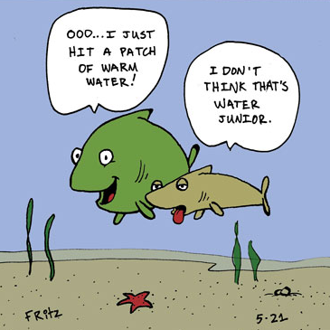

Slide 16
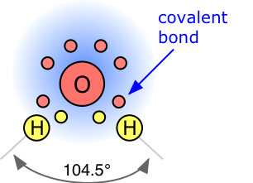
Water Chemistry
One drop of water contains approximately 1.67 x 10²¹ water molecules

Slide 17
Water Chemistry
One drop of water contains approximately 1.67 x 10²¹ water molecules
Water (H₂O) is formed by covalent bonds (sharing of electrons) between two Hydrogen atoms and one Oxygen atom.

Slide 18
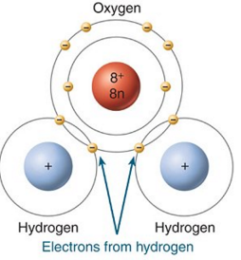
Water is a “Polar” Molecule
negative side
positive side

Slide 19
Water is a “Polar” Molecule
2 Hydrogen atoms each share 1 electron with one Oxygen atom in the covalent bond they make.
The Oxygen atom has 4 remaining electrons (not used in to hold the hydrogen atoms). →
This gives the Oxygen side of the molecule a negative charge, and the Hydrogen side a slight positive charge.
This creates the polar characteristic of water (opposite side of the molecule having opposite charges)
negative side
positive side

Slide 20
Water is a “Polar” Molecule
Like charges repel
Unlike charges attract
Electrostatic attraction video:
negative side
positive side
https://screencast-o-matic.com/watch/cF6elPYlbr (2:59)

Slide 21
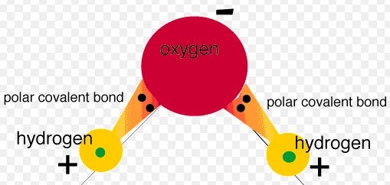
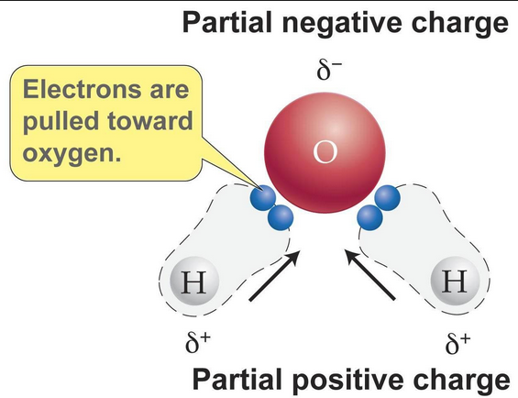
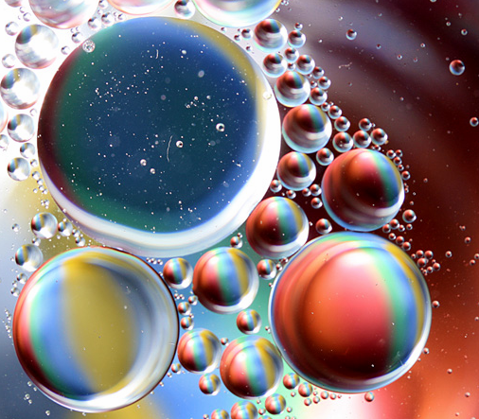
Water’s Polarity

Slide 22
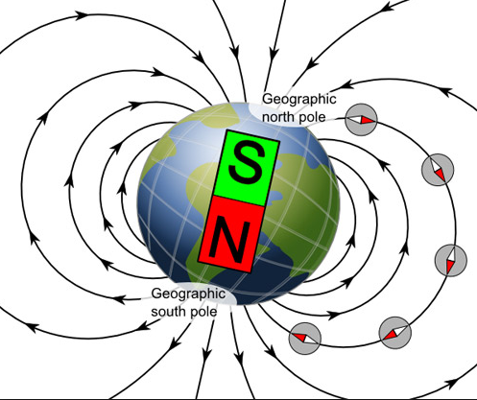
Water’s Polarity
Notice the “poles” on the earth and magnet.
How would you define “polarity”?

Slide 23
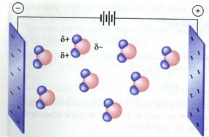
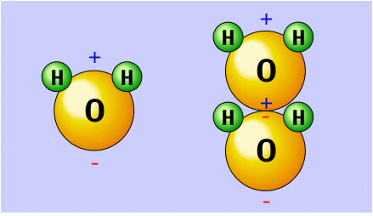
Polarity
The negative end of water is facing which charge?

Slide 24
Polarity
As a result of polarity, water molecules easily bond together.

Slide 25
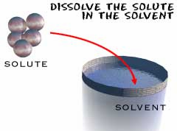
Water
Many substances dissolve in water so it is commonly referred to as the universal solvent.
Because of this, water in nature and in use is rarely pure and some properties may vary from those of the pure substance.

Slide 26
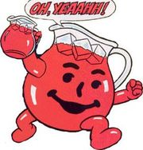
Water Dissolves Substances

Slide 27
Water Dissolves Substances
Because of it’s chemical composition, water is able to dissolve many ions and compounds.
Water uses it’s polarity (negative side to attract positive ions and it’s positive side to attract) and dissolve negative ions.

Slide 28
Water the Universal Solvent
Water’s ability to dissolve many things is a good and a bad property.
It’s good that water can dissolve salt, sugar, Kool aide etc…
But, it’s bad that water can dissolve toxic chemicals.

Slide 29
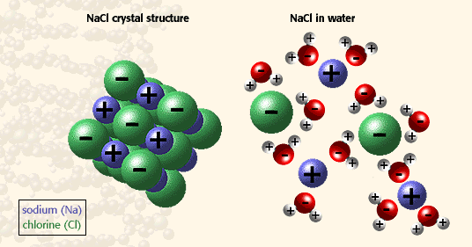
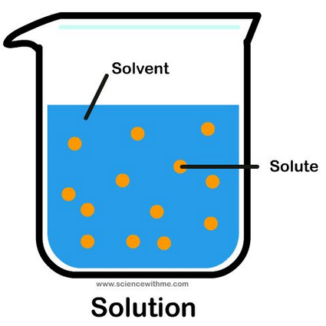
Dissolving Ionic Compounds

Slide 30
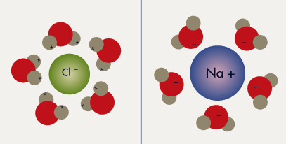
Dissolving Ionic Compounds

Slide 31
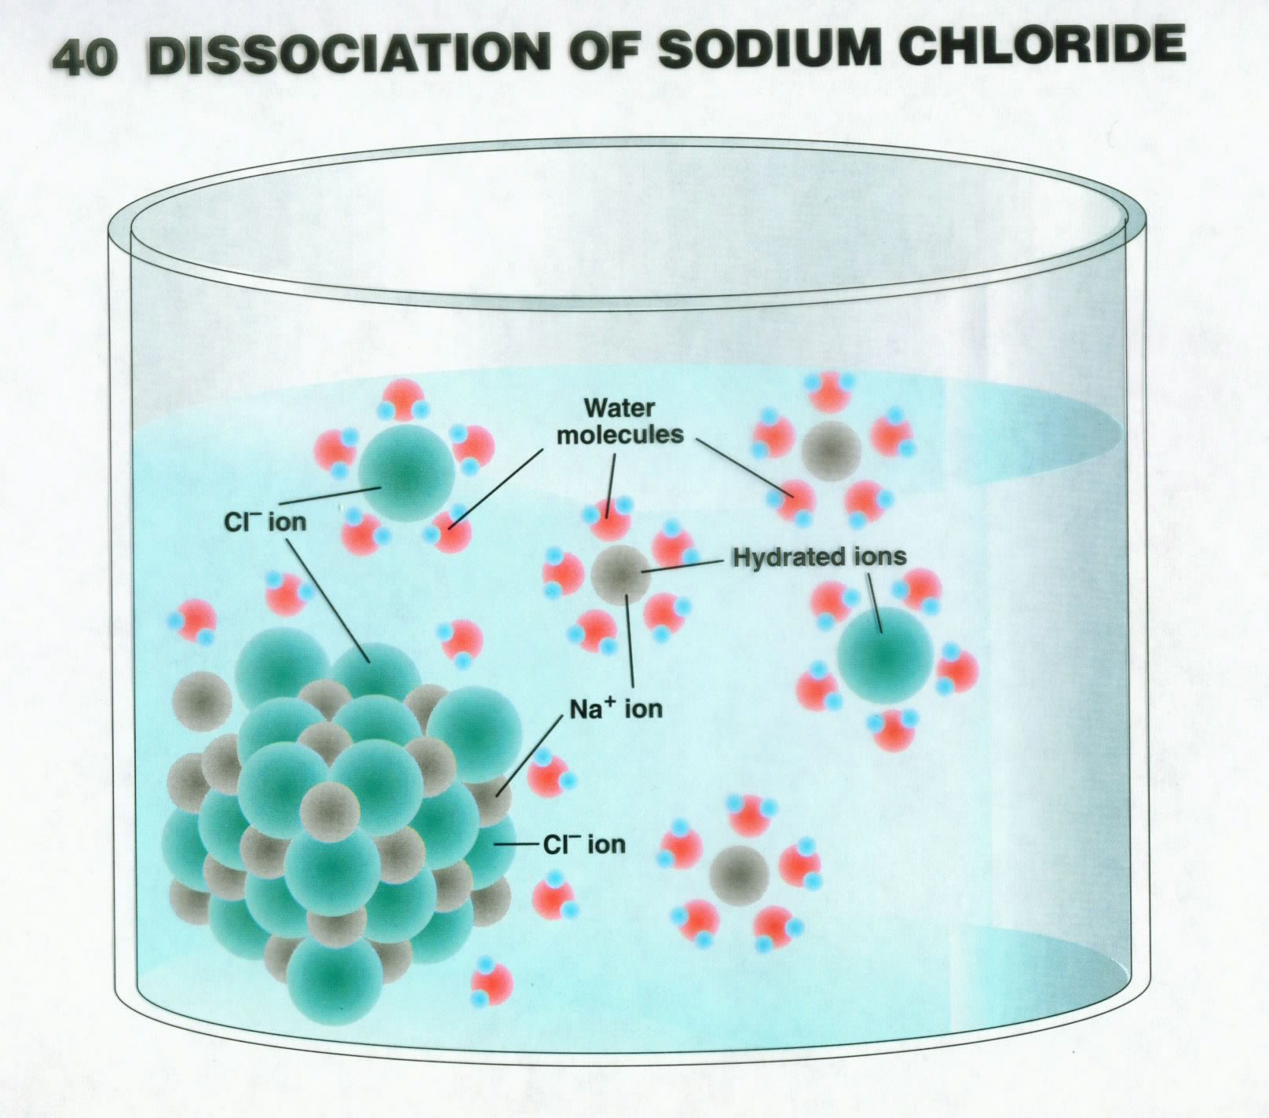

Slide 32
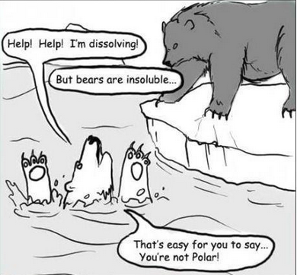
don’t dissolve

Slide 33
Like Dissolves Like
Refers to "polar" and "nonpolar" solvents and solutes.
Basic example: Water is polar. Oil is non polar. Water will not dissolve oil.
Water is polar. Salt (NaCl) is ionic (which is considered extremely polar). Like dissolves like, that means polar dissolves polar, so water dissolves salt.
https://screencast-o-matic.com/watch/cF6h2BYotW (2:24)

Slide 34
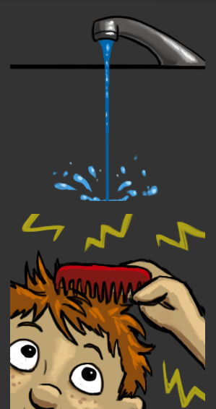
1
F₂ gas is a molecule composed of two atoms chemically bonded together. Is this molecule polar or nonpolar? Explain.
2
If the comb is brought near the water, will anything happen?
Water’s Polarity:
https://screencast-o-matic.com/watch/cFQUlaYixQ (0:39)

Slide 35
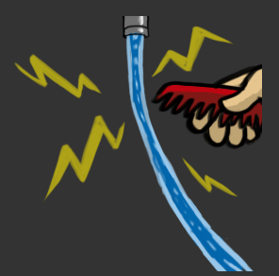
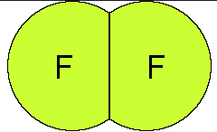
F₂ gas is a molecule composed of two atoms chemically bonded together. Is this molecule polar or nonpolar? Explain.
Fluorine gas is nonpolar because the two atoms are identical so electrons pull equally apart.
If the comb is brought near the water, will anything happen?
When you bring the charged comb near the faucet it is attracted to the polar end of the water. (in this case – to +).

Slide 36
1
Why are water molecules polar? (make a sketch)
2
Hexane has 7 carbon atoms (C) & 16 hydrogen atoms (H). What is its chemical formula?
3
If a substance dissolves in water, will it dissolve in vegetable oil, a nonpolar substance?

Slide 37
Why are water molecules polar?
The hydrogen and oxygen atoms “fight” over the electrons they share and oxygen pulls harder, making it slightly negative. The hydrogen end is slightly positive.
Hexane has 7 carbon atoms (C) & 16 hydrogen atoms (H). What is its chemical formula?
C₇H₁₆
If a substance dissolves in water, will it dissolve in vegetable oil, a nonpolar substance?
Vegetable oil does NOT dissolve in water because water is polar and oil is nonpolar. “Like dissolves like.” Water dissolves polar and ionic compounds.

Slide 38
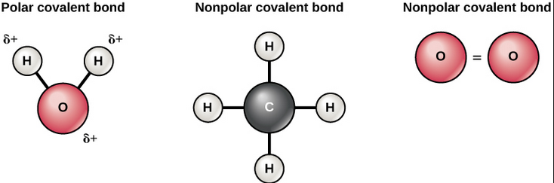
Label the bonds (covalent/ionic) and types of molecules (polar/nonpolar) below.
The lowest portion of Earth’s atmosphere.
Contains approximately 75% of the atmosphere’s mass & 99% of its water vapor & aerosols. This is the WEATHER zone.
+
+
—

Slide 39
Label the bonds (covalent/ionic) and types of molecules (polar/nonpolar) below.
Polar molecule
nonpolar molecule
nonpolar molecule
The lowest portion of Earth’s atmosphere.
Contains approximately 75% of the atmosphere’s mass & 99% of its water vapor & aerosols. This is the WEATHER zone.
Water is a unique molecule and produces particular bonds. Therefore, it exhibits special properties.
+
+
—
All the molecules have Covalent bonds

Slide 40
Focus Questions
Why does water have so many special properties?
2. What is hydrogen bonding?
3. What kind of special properties does water exhibit?
4. What is the difference between “hard” and “soft” water?

Slide 41
Properties of Water
(3:45)
http://somup.com/cFQU2CnVn2

Slide 42
Can you think of any special properties of Water?

Slide 43
Effects of Water’s Polarity
Universal Solvent
Hydrogen Bonding
Density of Water
Cohesion
Adhesion
Surface Tension
Capillary Action

Slide 44
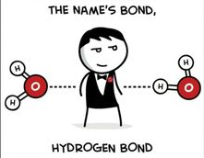
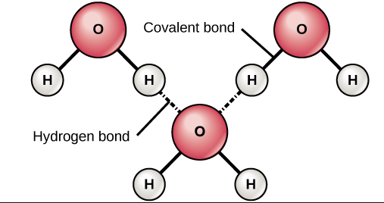
Hydrogen Bonds

Slide 45
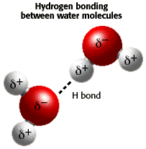

Slide 46
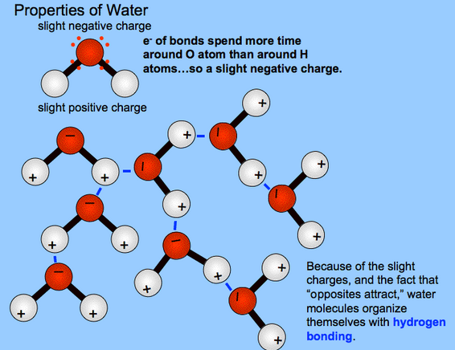


Slide 48
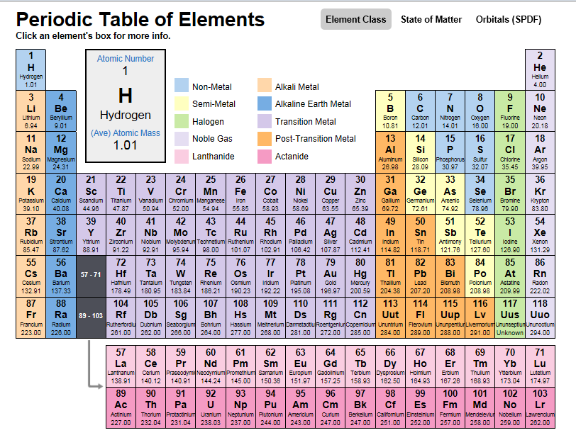
Unusual Property of Water
Periodic
Table

Slide 49
Unusual Property of Water
Hydrogen forms water (H₂0) & other similar compounds using elements of the same “FAMILY” → H₂S, H₂Se, and H₂Te.
Periodic
Table

Slide 50
Unusual Property of Water
Hydrogen forms water (H₂0) & other similar compounds using elements of the same “FAMILY” → H₂S, H₂Se, and H₂Te.
All four molecules have similar chemical properties (elements in same “family”).
The other three molecules are gases at room temperature, but water is a liquid.
Periodic
Table

Slide 51
Density of Water
Think about water in terms of its density.
For instance, what happens to water during a cold winter (e.g. lakes, ponds, & rivers)?
Compare water with a cube of metal like brass.
What would solid brass do in liquid brass?
What does ice do in liquid water?

Slide 52
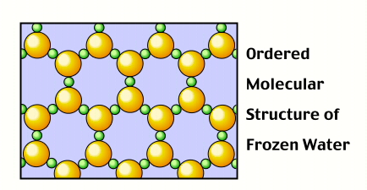
Unusual Property of Water
Water is the only substance whose solid form is less dense than its liquid form
In it’s solid form (ice), water is able to float because the molecules are spread further apart as a solid than as a liquid, making it less dense.

Slide 53
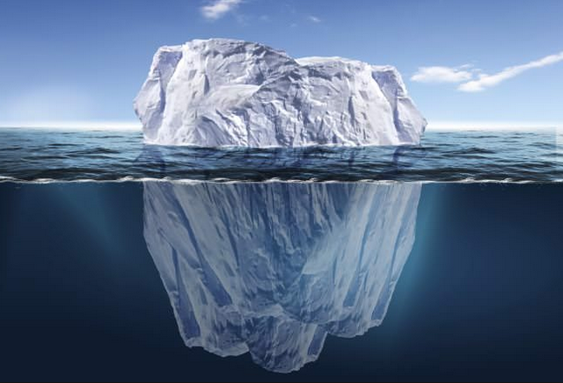
What would happen if ice’s density was greater than liquid water (as with all other substances)?

Slide 54
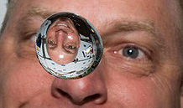
Cohesion
The action or property of “like” molecules sticking together
Water is strongly cohesive due to its hydrogen bonds
The cohesive character of water is clearly noticeable

Slide 55
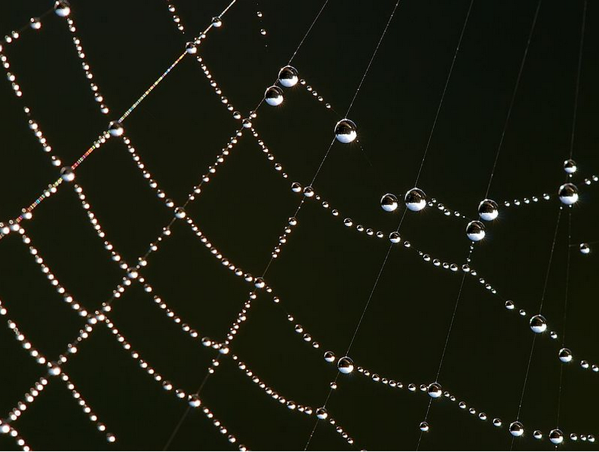
Adhesion
Dew drops clinging to a spider’s web
The action or property of “UNlike” molecules sticking together
E.g. Adhesive tape

Slide 56
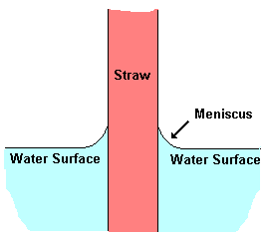
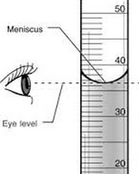
Cohesion & Adhesion
Cohesion and adhesion help explain phenomena such as meniscus, surface tension and capillary action.

Slide 57
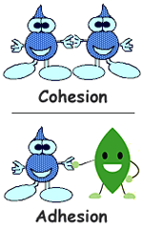
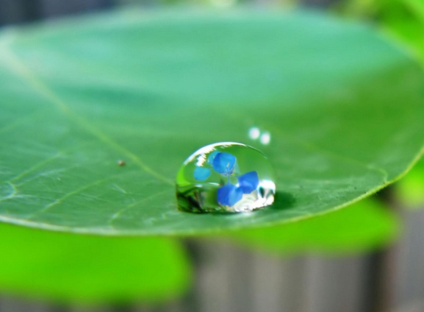
Cohesion & Adhesion

Slide 58
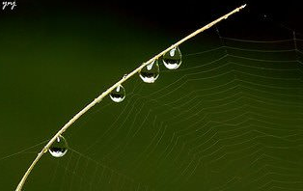
What makes these water droplets the way they are; i.e. hanging on the web, keeping their shape …? (Think: cohesion, adhesion, surface tension)

Slide 59
Cohesion causes water to form drops, surface tension causes them to be nearly spherical, and adhesion keeps the drops in place.

Slide 60
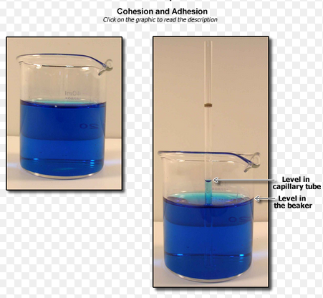
Capillary Action
Why does water “climb” up the tube against gravity?

Slide 61
Capillary Action
Cohesion & adhesion cause the liquid to work against gravity.
Cohesion holds the liquid together (sticks to itself)
Adhesion causes the liquid to stick to the sides of the tube

Slide 62
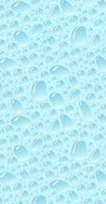
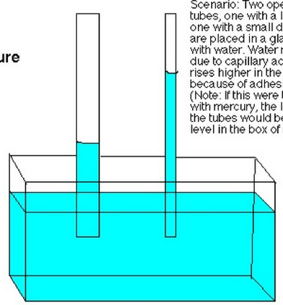
What is happening in the tubes?

Slide 63
Capillary Action
Liquids (water) can “climb” up thin columns (e.g. straws)
Due to cohesion & adhesion

Slide 64
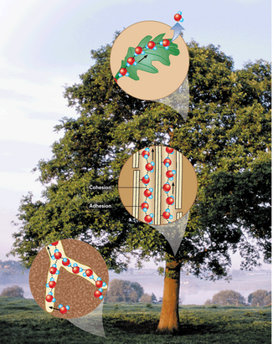
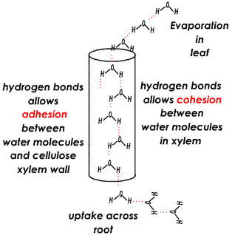
Transpiration

Slide 65
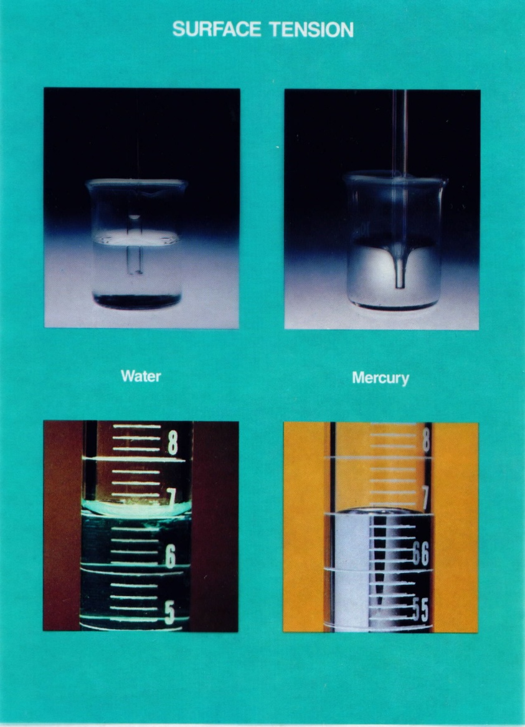
Describe each picture and explain the properties shown.

Slide 66
Surface Tension
Capillary action
Capillary action includes the high surface tension produced by cohesion and adhesion.
Mercury’s cohesion is so great it’s meniscus forms a “convex” shape.
Meniscus
Surface Tension → meniscus

Slide 67
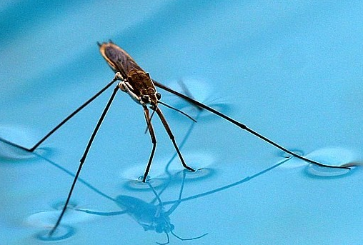

Slide 68
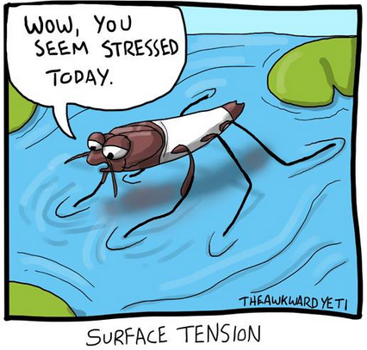

Slide 69
Surface Tension With Bill Nye
http://somup.com/cFQUoVnVnD
(4:06)
Balloon sucked into flask
Separating powder on water’s surface
Density demo

Slide 70
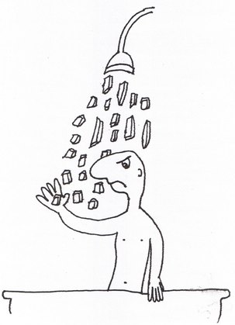
Remember how water dissolves ionic compounds and ions?
What kind of impact might that have on our water supplies?

Slide 71

Hard Water
Bathtub faucet with built up calcification (hard water) →
Water that contains a significant quantity of dissolved minerals (like calcium and magnesium).
Ca⁺² and Mg⁺² ions
Limestone, chalk

Slide 72


Slide 73
Hard Water Test
https://screencast-o-matic.com/watch/cFQropqRgE (1:18)
Hard water is to blame for dingy looking clothes, dishes with spots and residue, and bathtubs with lots of film and soap scum. Even hair washed in hard water may feel sticky and look dull.

Slide 74
Soft Water
Why would soft water make you feel "not quite clean"? One reason is that when soap and mineral scum are absent, your natural body oils make your skin feel oilier, which some people interpret as being “slimy”.
Water softening is the removal of calcium, magnesium, and certain other metal ions in hard water. The resulting soft water is more compatible with soap and extends the lifetime of plumbing.

Slide 75

Water is the only substance where all three states of matter (s, l, g) can be readily observed in everyday life (in nature)

Slide 76

Enrichment
A person can live about a month without food, but only about a week without water.
Water expands by 9% when it freezes. Frozen water (ice) is lighter than water, which is why ice floats in water.

Slide 77
Typical Water Usage – 2014 Enrichment
Bath | A full tub is about 36 gallons.
Shower | 2 gallons per minute. Old shower heads use as much as 5 gallons per minute.
Teeth brushing | <1 gallon, especially if water is turned off while brushing. Newer bath faucets use about 1 gallon per minute, whereas older models use over 2 gallons.
Hands/face washing | 1 gallon
Face/leg shaving | 1 gallon
Dishwasher | 4 to 10 gallons/load, depending of efficiency of dishwasher
Dishwashing by hand: | 20 gallons. Newer kitchen faucets use about 2.2 gallons per minutes, whereas older faucets use more.
Clothes washer | 25 gallons/load for newer washers. Older models use about 40 gallons per load.
Toilet flush | 3 gallons. Most all new toilets use 1.6 gallons per flush, but many older toilets used about 4 gallons.
Glasses of water | 8 oz. per glass (8 glasses drunk per day)
Outdoor watering | 5 to 10 gallons per minute

Slide 78

Water Usage
Enrichment

