Slide 1
Click on “Slide Show”
Click “Play from Beginning”

Slide 2


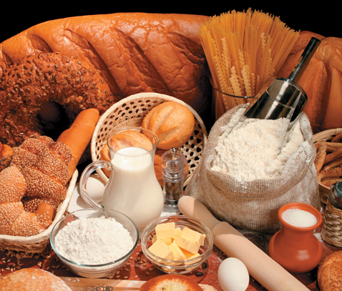
Chapter 12
Stoichiometry
The Arithmetic of
Equations
Chemical Calculations
Limiting Reagent and
Percent Yield

Slide 3
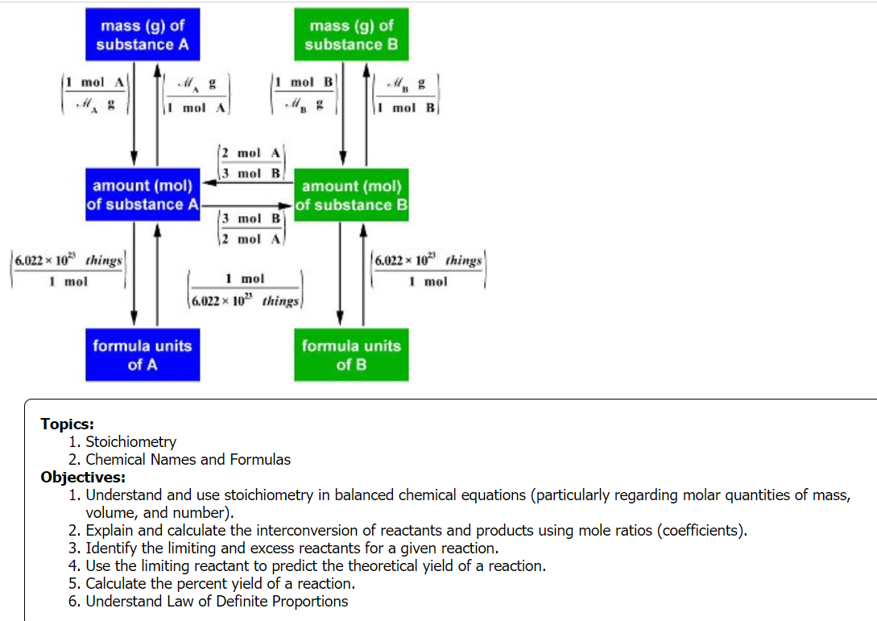

Slide 4
Solve Stoichiometric Problems
Consider the combustion of acetylene (C₂H₂) in a welding torch:
2C₂H₂(l) + 5O₂(g) ⟶ 4CO₂(g) + 2H₂O(g)
How many grams of oxygen would be required to react completely with 859 g C₂H₂?
Notes:
Timing ≈ 1 min
Entry audio: Refresh your memory on solving stoichiometry problems by completing these examples.
Hint1 audio: Make sure you find the molar mass, then change grams to moles, then use the mole ratio of oxygen to acetylene to find moles of oxygen, and convert moles to grams.
Hint2 audio: Use the periodic table to determine the molar mass of each substance and follow the steps of stoichiometry.
Exit audio: Now that you have reviewed some stoichiometry problems, we can begin to look at a useful application of stoichiometry: limiting reactants.

Slide 5
Solve Stoichiometric Problems
Consider the combustion of acetylene (C₂H₂) in a welding torch:
2C₂H₂(l) + 5O₂(g) ⟶ 4CO₂(g) + 2H₂O(g)
How many grams of oxygen would be required to react completely with 859 g C₂H₂?
Find mol C₂H₂: GMM = 26.0 g/mol
859 g x 1 mol/26.0 g = 33.0 mol
Mole ratio C₂H₂:O₂ = 2:5
Convert to mol O₂ → 33.0 mol/2 mol = X/5 mol X = 82.5 mol
Convert mol to grams GMM O₂ = 32.0 g/mol
82.5 mol x 32.0 g/mol = 2,640 g O₂
Notes:
Timing ≈ 1 min
Entry audio: Refresh your memory on solving stoichiometry problems by completing these examples.
Hint1 audio: Make sure you find the molar mass, then change grams to moles, then use the mole ratio of oxygen to acetylene to find moles of oxygen, and convert moles to grams.
Hint2 audio: Use the periodic table to determine the molar mass of each substance and follow the steps of stoichiometry.
Exit audio: Now that you have reviewed some stoichiometry problems, we can begin to look at a useful application of stoichiometry: limiting reactants.

Slide 6
Solve Stoichiometric Problems
How many grams of carbon dioxide would be formed if 38.9 g C₂H₂ reacted completely with oxygen?
2C₂H₂(l) + 5O₂(g) ⟶ 4CO₂(g) + 2H₂O(g)
Notes:
Timing ≈ 1 min
Entry audio: Refresh your memory on solving stoichiometry problems by completing these examples.
Hint1 audio: Make sure you find the molar mass, then change grams to moles, then use the mole ratio of oxygen to acetylene to find moles of oxygen, and convert moles to grams.
Hint2 audio: Use the periodic table to determine the molar mass of each substance and follow the steps of stoichiometry.
Exit audio: Now that you have reviewed some stoichiometry problems, we can begin to look at a useful application of stoichiometry: limiting reactants.

Slide 7
Solve Stoichiometric Problems
How many grams of carbon dioxide would be formed if 38.9 g C₂H₂ reacted completely with oxygen?
2C₂H₂(l) + 5O₂(g) ⟶ 4CO₂(g) + 2H₂O(g)
Find mol C₂H₂: GMM = 26.0 g/mol
38.9 g x 1 mol/26 g = 1.50 mol
Mole ratio C₂H₂:CO₂ = 2:4
Convert to mol CO₂ → 1.50 mol/2 mol = X/4 mol X = 3.00 mol
Convert mol to grams → GMM CO₂ = 44.0 g/mol
3.00 mol x 44.0 g/mol = 132 g CO₂
Notes:
Timing ≈ 1 min
Entry audio: Refresh your memory on solving stoichiometry problems by completing these examples.
Hint1 audio: Make sure you find the molar mass, then change grams to moles, then use the mole ratio of oxygen to acetylene to find moles of oxygen, and convert moles to grams.
Hint2 audio: Use the periodic table to determine the molar mass of each substance and follow the steps of stoichiometry.
Exit audio: Now that you have reviewed some stoichiometry problems, we can begin to look at a useful application of stoichiometry: limiting reactants.

Slide 8
Solve Stoichiometric Problems
How many liters of carbon dioxide would be formed if 38.9 g C₂H₂ reacted completely with oxygen?
2C₂H₂(l) + 5O₂(g) ⟶ 4CO₂(g) + 2H₂O(g)
Find mol C₂H₂: GMM = 26.0 g/mol
38.9 g x 1 mol/26 g = 1.50 mol
Mole ratio C₂H₂:CO₂ = 2:4
Convert to mol CO₂ → 1.50 mol/2 mol = X/4 mol X = 3.00 mol
Convert mol to liters → 22.4 L/mol CO₂
3.00 mol x 22.4 L/mol = 67.2 L CO₂
Notes:
Timing ≈ 1 min
Entry audio: Refresh your memory on solving stoichiometry problems by completing these examples.
Hint1 audio: Make sure you find the molar mass, then change grams to moles, then use the mole ratio of oxygen to acetylene to find moles of oxygen, and convert moles to grams.
Hint2 audio: Use the periodic table to determine the molar mass of each substance and follow the steps of stoichiometry.
Exit audio: Now that you have reviewed some stoichiometry problems, we can begin to look at a useful application of stoichiometry: limiting reactants.

Slide 9
Solve Stoichiometric Problems
How many molecules of carbon dioxide would be formed if 38.9 g C₂H₂ reacted completely with oxygen?
2C₂H₂(l) + 5O₂(g) ⟶ 4CO₂(g) + 2H₂O(g)
Find mol C₂H₂: GMM = 26.0 g/mol
38.9 g x 1 mol/26 g = 1.50 mol
Mole ratio C₂H₂:CO₂ = 2:4
Convert to mol CO₂ → 1.50 mol/2 mol = X/4 mol X = 3.00 mol
Convert mol to molecules → 6.02 x 10²³ molecules/mol CO₂
3.00 mol x 6.02 x 10²³ molecules /mol = 1.8 x 10²⁴ molecules
CO₂
Notes:
Timing ≈ 1 min
Entry audio: Refresh your memory on solving stoichiometry problems by completing these examples.
Hint1 audio: Make sure you find the molar mass, then change grams to moles, then use the mole ratio of oxygen to acetylene to find moles of oxygen, and convert moles to grams.
Hint2 audio: Use the periodic table to determine the molar mass of each substance and follow the steps of stoichiometry.
Exit audio: Now that you have reviewed some stoichiometry problems, we can begin to look at a useful application of stoichiometry: limiting reactants.

Slide 10
Suppose you wanted to make banana bread according to the following recipe:
½ cup sugar 1 cup butter 1 teaspoon vanilla
1 teaspoon salt 2 bananas 2 cups flour
1 teaspoon soda 2 eggs ¼ cup milk
¼ cup walnuts ¼ cup cherries ¼ cup choc chips
The problem is you have only 1 banana. What can you do assuming you want to use the recipe above?

Slide 11
Suppose you wanted to make banana bread according to the following recipe:
½ cup sugar 1 cup butter 1 teaspoon vanilla
1 teaspoon salt 2 bananas 2 cups flour
1 teaspoon soda 2 eggs ¼ cup milk
¼ cup walnuts ¼ cup cherries ¼ cup choc chips
The problem is you have only 1 banana. What can you do assuming you want to use the recipe above?
Cut the recipe in half for all ingredients … since you only have ½ the bananas you need.
Quantitative Analysis deals with ACTUAL quantities versus theoretical quantities. Often you have a “limiting” issue that prevents producing what you expected.

Slide 12
Lesson Objectives
  By the end of this lesson, you should be able to:
  Identify the limiting and excess reactants for a given reaction
  Use the limiting reactant to predict the theoretical yield of a reaction
  Calculate the percent yield of a reaction
  Science Practice: Use mathematical procedures including dimensional analysis and significant figures when solving limiting reactant and percent yield stoichiometry problems.
Notes:
Timing ≈ 0.5 min
You have learned how to calculate the theoretical amount of a product that can form in a reaction. However, most reactions are not ideal, yielding 100% of the expected product. In this lesson you will learn about stoichiometric calculations relating to real-world reactions
[Address the objectives very briefly]

Slide 13
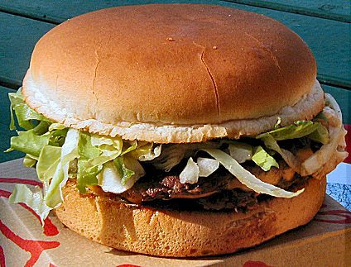
Do You Have Enough?
  You are making hamburgers for a group of friends at lunch.
  Each sandwich uses 0.25 lb ground beef + 1 bun (top & bottom)
  You have 2.5 lb ground beef and 8 buns
  How many sandwiches can be made?
Notes:
Timing ≈ 1 min
Let's consider an everyday situation first. Suppose you are making hamburgers for a group of friends for lunch.
[animate 1st bullet] Each hamburger requires a quarter pound of ground beef and one bun.
[animate 2nd bullet] If you have 2.5 lb of ground beef and eight buns, [animate 3rd bullet] how many sandwiches can you make?
[teacher walk through calculation using ground beef: if each burger requires 0.25 lb, then you can make 10 sandwiches.]
But look again at your "reactants". You have enough ground beef to make 10 sandwiches, but you have only 8 buns. You cannot make 10 sandwiches with only 8 buns. The number of buns you have limits the number of sandwiches you can make. You will be able to make 8 sandwiches, and you will have excess (or leftover) ground beef.
Source:
http://commons.wikimedia.org/wiki/File:Hamburger_sandwich.jpg

Slide 14
Do You Have Enough?
  You are making hamburgers for a group of friends at lunch.
  Each sandwich uses 0.25 lb ground beef + 1 bun (top & bottom)
  You have 2.5 lb ground beef and 8 buns
  How many sandwiches can be made?
  In THEORY:
  2.5 lb / 0.25 lb/burger = 10 burgers
  ACTUALLY, since you only have 8 buns,
  you can only make 8 burgers.
  You will therefore, have EXCESS
  ground beef because we run out of buns.
Notes:
Timing ≈ 1 min
Let's consider an everyday situation first. Suppose you are making hamburgers for a group of friends for lunch.
[animate 1st bullet] Each hamburger requires a quarter pound of ground beef and one bun.
[animate 2nd bullet] If you have 2.5 lb of ground beef and eight buns, [animate 3rd bullet] how many sandwiches can you make?
[teacher walk through calculation using ground beef: if each burger requires 0.25 lb, then you can make 10 sandwiches.]
But look again at your "reactants". You have enough ground beef to make 10 sandwiches, but you have only 8 buns. You cannot make 10 sandwiches with only 8 buns. The number of buns you have limits the number of sandwiches you can make. You will be able to make 8 sandwiches, and you will have excess (or leftover) ground beef.
Source:
http://commons.wikimedia.org/wiki/File:Hamburger_sandwich.jpg

Slide 15
Limiting and Excess Reactants
  Limiting Reactant:
  the reactant that controls the amount of product that forms; the reactant that is consumed completely during a reaction.
  Excess Reactant:
  any reactant that is not consumed completely during a reaction and is left over.
  Limiting Reactant: buns
  Excess Reactant: ground beef
Limiting & excess reactant determinations must be based on molar quantities & stoichiometric relationships.
Notes:
Timing ≈ 0.5 min
Just as there weren't enough buns to make all 10 hamburgers, often in a chemical reaction there is not enough of one reactant to use up all of another reactant. We use the term limiting reactant [animate definition] to describe the reactant that is used up first during a reaction. It is the limiting reactant because it limits how much product can form.
[animate 2nd definition] In contrast to the limiting reactant, an excess reactant is a reactant that is not completely consumed during the reaction. It is left over after the limiting reactant is used up.
When we were planning the number of sandwiches to make, we saw that the buns limited the number of sandwiches, and that there was excess ground beef. In chemistry terminology, we say that the buns were the limiting reactant [animate first bullet on right] and the ground beef was the excess reactant [animate 2nd bullet on right].
[animate blue box] it's important to remember that when you determine the limiting reactant for a reaction, you must compare molar quantities in their correct stoichiometric ratios. Let's look at an example to see what this means.
Source:
http://commons.wikimedia.org/wiki/File:Hamburger_sandwich.jpg

Slide 16
Limiting Reactants and Stoichiometry
Hydrogen and nitrogen react to produce ammonia according to the following equation:
3H₂(g) + N₂(g) ⟶ 2NH₃(g)
If 5.00 g H₂ react with 50.0 g N₂, what is the limiting reactant?
Find Moles based on Amount Given:
Use Mole ratios:
Compare Theoretical Values:
Notes:
Timing ≈ 1.5 min
Consider this reaction, which forms ammonia from hydrogen and nitrogen. If you have 5 g H2 and 50 g N2, which is the limiting reactant?
You might be tempted to say that H2 is the limiting reactant because there are fewer grams of it than of nitrogen. However, remember that when we do stoichiometry problems we have to compare molar quantities, not masses. So, our first step is to convert the masses to moles.
[teacher pull up periodic table and do mass → mole calculation, showing that there are 2.5 mol H2 and 1.78 mol N2]
Now, you might be tempted to say that N2 must be the limiting reactant, because there are fewer moles of N2 than of H2. But this is where the stoichiometry comes in. We know that 1 mol N2 is needed to react with 3 mol H2. How many moles of N2 would be needed to react with 2.5 mol H2? [teacher walk through stoichiometric calculation of 2.5 mol H2 to mol N2, showing that 0.83 mol N2 are needed to react with the available H2]
And how many moles of H2 would be needed to completely react with 1.78 mol N2? [teacher walk through stoichiometric calculation of 1.78 mol N2 to mol H2, showing that 5.25 mol H2 are needed]
So, we can see that we would need 5.25 mol H2 to completely react with the available N2, but we have only 2.5 mol available. At the same time we need 0.83 mol N2 to react with the available H2, and we have 1.78 mol available. Therefore, we have more than enough N2 to react with the H2. H2 is the limiting reactant [teacher label] and N2 is the excess reactant [teacher label].
Let’s look at from the angle of product: If we have 2.5 mol of H2, we could produce 1.67 mol of ammonia. [teacher show calculations using the 3:2 mole ratio] If we have 1.78 mol N2 available, we could produce 3.56 moles of ammonia [teacher show calculations using 1:2 mole ratio] Again, we see that H2 is the limiting reactant and N2 is the excess reactant.
As you can see from this example, it is extremely important to use both molar quantities and stoichiometric relationships to determine limiting and excess reactants.
Let's look at another example, focusing on the steps you can use to determine limiting reactant.

Slide 17
Limiting Reactants and Stoichiometry
Hydrogen and nitrogen react to produce ammonia according to the following equation:
3H₂(g) + N₂(g) ⟶ 2NH₃(g)
If 5.00 g H₂ react with 50.0 g N₂, what is the limiting reactant?
You cannot tell the limiting reactant based on grams, but only based on moles (the standard) AND the mole ratio. This is stoichiometry!
Find Moles based on Amount Given:
H₂ 5.00 g x 1 mol/2.00 g = 2.50 mol
N₂ 50.0 g x 1 mol/28.0 g = 1.80 mol
Use Mole ratios:
H₂ : N₂ = 3:1 theoretically
Yet, using ACTUAL mol of H₂ →
1.80/1 = X/3 X = 5.4 mol H₂
Compare Theoretical Values:
H₂ is the Limiting Reactant since 5.4 mol H₂ are needed to react with 1.80 mol N₂ and we only have 2.50 mol H₂ available.
Notes:
Timing ≈ 1.5 min
Consider this reaction, which forms ammonia from hydrogen and nitrogen. If you have 5 g H2 and 50 g N2, which is the limiting reactant?
You might be tempted to say that H2 is the limiting reactant because there are fewer grams of it than of nitrogen. However, remember that when we do stoichiometry problems we have to compare molar quantities, not masses. So, our first step is to convert the masses to moles.
[teacher pull up periodic table and do mass → mole calculation, showing that there are 2.5 mol H2 and 1.78 mol N2]
Now, you might be tempted to say that N2 must be the limiting reactant, because there are fewer moles of N2 than of H2. But this is where the stoichiometry comes in. We know that 1 mol N2 is needed to react with 3 mol H2. How many moles of N2 would be needed to react with 2.5 mol H2? [teacher walk through stoichiometric calculation of 2.5 mol H2 to mol N2, showing that 0.83 mol N2 are needed to react with the available H2]
And how many moles of H2 would be needed to completely react with 1.78 mol N2? [teacher walk through stoichiometric calculation of 1.78 mol N2 to mol H2, showing that 5.25 mol H2 are needed]
So, we can see that we would need 5.25 mol H2 to completely react with the available N2, but we have only 2.5 mol available. At the same time we need 0.83 mol N2 to react with the available H2, and we have 1.78 mol available. Therefore, we have more than enough N2 to react with the H2. H2 is the limiting reactant [teacher label] and N2 is the excess reactant [teacher label].
Let’s look at from the angle of product: If we have 2.5 mol of H2, we could produce 1.67 mol of ammonia. [teacher show calculations using the 3:2 mole ratio] If we have 1.78 mol N2 available, we could produce 3.56 moles of ammonia [teacher show calculations using 1:2 mole ratio] Again, we see that H2 is the limiting reactant and N2 is the excess reactant.
As you can see from this example, it is extremely important to use both molar quantities and stoichiometric relationships to determine limiting and excess reactants.
Let's look at another example, focusing on the steps you can use to determine limiting reactant.

Slide 18
Limiting Reactants and Stoichiometry
Hydrogen and nitrogen react to produce ammonia according to the following equation:
3H₂(g) + N₂(g) ⟶ 2NH₃(g)
If 5.00 g H₂ react with 50.0 g N₂, what is the limiting reactant?
You cannot tell the limiting reactant based on grams, but only based on moles (the standard) AND the mole ratio. This is stoichiometry!
Find Moles based on Amount Given:
H₂ 5.00 g x 1 mol/2.00 g = 2.50 mol
N₂ 50.0 g x 1 mol/28.0 g = 1.80 mol
Use Mole ratios:
H₂ : N₂ = 3:1 theoretically
Yet, using ACTUAL mol of H₂ →
2.50/3 = X/1 X = 0.830 mol N₂
Compare Theoretical Values:
H₂ is the Limiting Reactant since only 0.830 mol N₂ are needed to react with 2.50 mol H₂ and we have 1.80 mol N₂ available.
Notes:
Timing ≈ 1.5 min
Consider this reaction, which forms ammonia from hydrogen and nitrogen. If you have 5 g H2 and 50 g N2, which is the limiting reactant?
You might be tempted to say that H2 is the limiting reactant because there are fewer grams of it than of nitrogen. However, remember that when we do stoichiometry problems we have to compare molar quantities, not masses. So, our first step is to convert the masses to moles.
[teacher pull up periodic table and do mass → mole calculation, showing that there are 2.5 mol H2 and 1.78 mol N2]
Now, you might be tempted to say that N2 must be the limiting reactant, because there are fewer moles of N2 than of H2. But this is where the stoichiometry comes in. We know that 1 mol N2 is needed to react with 3 mol H2. How many moles of N2 would be needed to react with 2.5 mol H2? [teacher walk through stoichiometric calculation of 2.5 mol H2 to mol N2, showing that 0.83 mol N2 are needed to react with the available H2]
And how many moles of H2 would be needed to completely react with 1.78 mol N2? [teacher walk through stoichiometric calculation of 1.78 mol N2 to mol H2, showing that 5.25 mol H2 are needed]
So, we can see that we would need 5.25 mol H2 to completely react with the available N2, but we have only 2.5 mol available. At the same time we need 0.83 mol N2 to react with the available H2, and we have 1.78 mol available. Therefore, we have more than enough N2 to react with the H2. H2 is the limiting reactant [teacher label] and N2 is the excess reactant [teacher label].
Let’s look at from the angle of product: If we have 2.5 mol of H2, we could produce 1.67 mol of ammonia. [teacher show calculations using the 3:2 mole ratio] If we have 1.78 mol N2 available, we could produce 3.56 moles of ammonia [teacher show calculations using 1:2 mole ratio] Again, we see that H2 is the limiting reactant and N2 is the excess reactant.
As you can see from this example, it is extremely important to use both molar quantities and stoichiometric relationships to determine limiting and excess reactants.
Let's look at another example, focusing on the steps you can use to determine limiting reactant.

Slide 19
Limiting Reactants and Stoichiometry done another way [same example]
Hydrogen and nitrogen react to produce ammonia according to the following equation: 3H₂(g) + N₂(g) ⟶ 2NH₃(g)
If 5.00 g H₂ react with 50.0 g N₂, what is the limiting reactant?
Use the actual moles of reactants from the previous page.
H₂ 5.00 g x 1 mol/2.00 g = 2.50 mol
N₂ 50.0 g x 1 mol/28.0 g = 1.80 mol
Find the yield for both reactants, starting with mole ratios:
H₂ : NH₃ →
N₂ : NH₃ →
Notes:
Timing ≈ 1.5 min
Consider this reaction, which forms ammonia from hydrogen and nitrogen. If you have 5 g H2 and 50 g N2, which is the limiting reactant?
You might be tempted to say that H2 is the limiting reactant because there are fewer grams of it than of nitrogen. However, remember that when we do stoichiometry problems we have to compare molar quantities, not masses. So, our first step is to convert the masses to moles.
[teacher pull up periodic table and do mass → mole calculation, showing that there are 2.5 mol H2 and 1.78 mol N2]
Now, you might be tempted to say that N2 must be the limiting reactant, because there are fewer moles of N2 than of H2. But this is where the stoichiometry comes in. We know that 1 mol N2 is needed to react with 3 mol H2. How many moles of N2 would be needed to react with 2.5 mol H2? [teacher walk through stoichiometric calculation of 2.5 mol H2 to mol N2, showing that 0.83 mol N2 are needed to react with the available H2]
And how many moles of H2 would be needed to completely react with 1.78 mol N2? [teacher walk through stoichiometric calculation of 1.78 mol N2 to mol H2, showing that 5.25 mol H2 are needed]
So, we can see that we would need 5.25 mol H2 to completely react with the available N2, but we have only 2.5 mol available. At the same time we need 0.83 mol N2 to react with the available H2, and we have 1.78 mol available. Therefore, we have more than enough N2 to react with the H2. H2 is the limiting reactant [teacher label] and N2 is the excess reactant [teacher label].
Let’s look at from the angle of product: If we have 2.5 mol of H2, we could produce 1.67 mol of ammonia. [teacher show calculations using the 3:2 mole ratio] If we have 1.78 mol N2 available, we could produce 3.56 moles of ammonia [teacher show calculations using 1:2 mole ratio] Again, we see that H2 is the limiting reactant and N2 is the excess reactant.
As you can see from this example, it is extremely important to use both molar quantities and stoichiometric relationships to determine limiting and excess reactants.
Let's look at another example, focusing on the steps you can use to determine limiting reactant.

Slide 20
Limiting Reactants and Stoichiometry done another way [same example]
Hydrogen and nitrogen react to produce ammonia according to the following equation: 3H₂(g) + N₂(g) ⟶ 2NH₃(g)
If 5.00 g H₂ react with 50.0 g N₂, what is the limiting reactant?
Use the actual moles of reactants from the previous page.
H₂ 5.00 g x 1 mol/2.00 g = 2.50 mol
N₂ 50.0 g x 1 mol/28.0 g = 1.80 mol
Find the yield for both reactants, starting with mole ratios:
H₂ : NH₃ → 2.5 mol/3 mol → ?/2 mol = 1.67 mol NH₃
N₂ : NH₃ → 1.80 mol/1 mol → ?/2 mol = 3.60 mol NH₃
Again, we see that H₂ is the Limiting reactant because it will yield much less product, NH₃ , making N₂ the excess reactant.
Notes:
Timing ≈ 1.5 min
Consider this reaction, which forms ammonia from hydrogen and nitrogen. If you have 5 g H2 and 50 g N2, which is the limiting reactant?
You might be tempted to say that H2 is the limiting reactant because there are fewer grams of it than of nitrogen. However, remember that when we do stoichiometry problems we have to compare molar quantities, not masses. So, our first step is to convert the masses to moles.
[teacher pull up periodic table and do mass → mole calculation, showing that there are 2.5 mol H2 and 1.78 mol N2]
Now, you might be tempted to say that N2 must be the limiting reactant, because there are fewer moles of N2 than of H2. But this is where the stoichiometry comes in. We know that 1 mol N2 is needed to react with 3 mol H2. How many moles of N2 would be needed to react with 2.5 mol H2? [teacher walk through stoichiometric calculation of 2.5 mol H2 to mol N2, showing that 0.83 mol N2 are needed to react with the available H2]
And how many moles of H2 would be needed to completely react with 1.78 mol N2? [teacher walk through stoichiometric calculation of 1.78 mol N2 to mol H2, showing that 5.25 mol H2 are needed]
So, we can see that we would need 5.25 mol H2 to completely react with the available N2, but we have only 2.5 mol available. At the same time we need 0.83 mol N2 to react with the available H2, and we have 1.78 mol available. Therefore, we have more than enough N2 to react with the H2. H2 is the limiting reactant [teacher label] and N2 is the excess reactant [teacher label].
Let’s look at from the angle of product: If we have 2.5 mol of H2, we could produce 1.67 mol of ammonia. [teacher show calculations using the 3:2 mole ratio] If we have 1.78 mol N2 available, we could produce 3.56 moles of ammonia [teacher show calculations using 1:2 mole ratio] Again, we see that H2 is the limiting reactant and N2 is the excess reactant.
As you can see from this example, it is extremely important to use both molar quantities and stoichiometric relationships to determine limiting and excess reactants.
Let's look at another example, focusing on the steps you can use to determine limiting reactant.

Slide 21
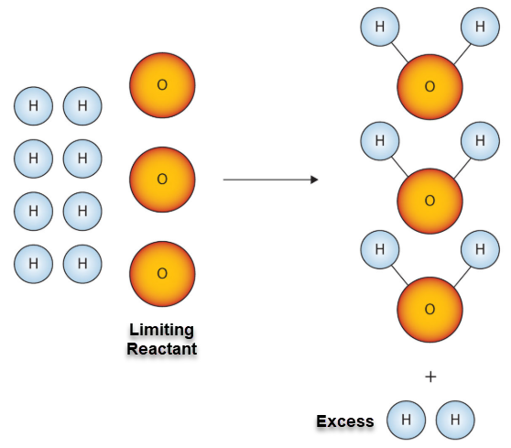
Limiting Reactants and Stoichiometry done another way [same example]
The limiting reactant limits the amount of the other reactant that can combine, and the amount of product that can be formed.
The excess reactant is NOT completely used up in the reaction.
Notes:
Timing ≈ 1.5 min
Consider this reaction, which forms ammonia from hydrogen and nitrogen. If you have 5 g H2 and 50 g N2, which is the limiting reactant?
You might be tempted to say that H2 is the limiting reactant because there are fewer grams of it than of nitrogen. However, remember that when we do stoichiometry problems we have to compare molar quantities, not masses. So, our first step is to convert the masses to moles.
[teacher pull up periodic table and do mass → mole calculation, showing that there are 2.5 mol H2 and 1.78 mol N2]
Now, you might be tempted to say that N2 must be the limiting reactant, because there are fewer moles of N2 than of H2. But this is where the stoichiometry comes in. We know that 1 mol N2 is needed to react with 3 mol H2. How many moles of N2 would be needed to react with 2.5 mol H2? [teacher walk through stoichiometric calculation of 2.5 mol H2 to mol N2, showing that 0.83 mol N2 are needed to react with the available H2]
And how many moles of H2 would be needed to completely react with 1.78 mol N2? [teacher walk through stoichiometric calculation of 1.78 mol N2 to mol H2, showing that 5.25 mol H2 are needed]
So, we can see that we would need 5.25 mol H2 to completely react with the available N2, but we have only 2.5 mol available. At the same time we need 0.83 mol N2 to react with the available H2, and we have 1.78 mol available. Therefore, we have more than enough N2 to react with the H2. H2 is the limiting reactant [teacher label] and N2 is the excess reactant [teacher label].
Let’s look at from the angle of product: If we have 2.5 mol of H2, we could produce 1.67 mol of ammonia. [teacher show calculations using the 3:2 mole ratio] If we have 1.78 mol N2 available, we could produce 3.56 moles of ammonia [teacher show calculations using 1:2 mole ratio] Again, we see that H2 is the limiting reactant and N2 is the excess reactant.
As you can see from this example, it is extremely important to use both molar quantities and stoichiometric relationships to determine limiting and excess reactants.
Let's look at another example, focusing on the steps you can use to determine limiting reactant.

Slide 22
Copper reacts with sulfur to form copper(I) sulfide according to the following balanced equation:
2Cu(s) + S(s) → Cu₂S(s)
What is the limiting reagent if 80.0 g Cu reacts with 25.0 g S?
Find Moles
Use Mole ratios:
Compare Theoretical Values:

Slide 23
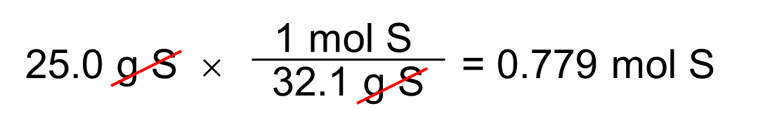
Copper reacts with sulfur to form copper(I) sulfide according to the following balanced equation:
2Cu(s) + S(s) → Cu₂S(s)
What is the limiting reagent if 80.0 g Cu reacts with 25.0 g S?
1 mol Cu
Find Moles
80.0 g Cu × = 1.26 mol Cu
63.5 g Cu
Use Mole ratios: Cu : S = 2:1 theoretically
Using ACTUAL mol of Cu → 1.26/2 = X/1 X = 0.630 mol S
Compare Theoretical Values:
Cu is the Limiting Reactant since only 0.630 mol S are needed to react with 1.26 mol Cu and we have 0.779 mol S available.
Mathematical Proportions can be done in different ways.

Slide 24
You could also solve for the actual moles of Sulfur instead.
Copper reacts with sulfur to form copper(I) sulfide according to the following balanced equation: 2Cu(s) + S(s) → Cu₂S(s)
What is the limiting reagent if 80.0 g Cu reacts with 25.0 g S?
Remember actual moles calculated: 1.26 mol Cu & 0.779 mol S
Use Mole ratios:
Compare Theoretical Values:

Slide 25
You could also solve for the actual moles of Sulfur instead.
Copper reacts with sulfur to form copper(I) sulfide according to the following balanced equation: 2Cu(s) + S(s) → Cu₂S(s)
What is the limiting reagent if 80.0 g Cu reacts with 25.0 g S?
Remember actual moles calculated: 1.26 mol Cu & 0.779 mol S
Use Mole ratios: S : Cu = 1:2 theoretically
Using ACTUAL mol of S → 0.779/1 = X/2 X = 1.56 mol Cu
Compare Theoretical Values:
Again we determine that Cu is the Limiting Reactant since 0.779 mol S require 1.56 mol Cu to react with, but we only have 1.26 mol Cu available.
It doesn’t matter which reactant you use. You would still identify copper as the limiting reagent.

Slide 26
Using the Limiting Reagent to Find the Quantity of a Product
What is the maximum number of grams of Cu₂S that can be formed when 80.0 g Cu reacts with 25.0 g S?
2Cu(s) + S(s) → Cu₂S(s)
Use Mole ratios:
Convert Moles to grams:

Slide 27
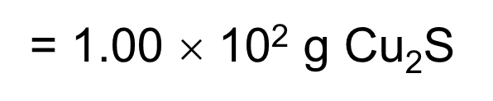
Using the Limiting Reagent to Find the Quantity of a Product
What is the maximum number of grams of Cu₂S that can be formed when 80.0 g Cu reacts with 25.0 g S?
2Cu(s) + S(s) → Cu₂S(s)
We already determined that the limiting reagent in this reaction is Cu. We calculated 1.26 mol Cu. Now, determine theoretical yield of product.
Use Mole ratios:
Cu : Cu₂S = 2:1 theoretically
ACTUAL mol of Cu → 1.26/2 = X/1 X = 0.630 mol Cu₂S
Convert Moles to grams:
0.630 mol Cu₂S x 159 g/mol = 100. g Cu₂S

Slide 28

Rust forms when iron, oxygen, and water react. One chemical equation for the formation of rust is:
2Fe + O₂ + 2H₂O → 2Fe(OH)₂
If 7.0 g of iron and 9.0 g of water are available to react, which is the limiting reagent?
Find Moles based on Amounts Given:
Use Mole ratios:
Compare Theoretical Values:

Slide 29
Rust forms when iron, oxygen, and water react. One chemical equation for the formation of rust is:
2Fe + O₂ + 2H₂O → 2Fe(OH)₂
If 7.0 g of iron and 9.0 g of water are available to react, which is the limiting reagent?
Find Moles based on Amounts Given:
Fe 7.0 g x 1 mol/55.8 g = 0.13 mol Fe
H₂O 9 g x 1 mol/18.0 g = 0.50 mol H₂O
Use Mole ratios: Fe : H₂O = 2:2 theoretically
Therefore, in theory, we need the same number of moles of both.
Compare Theoretical Values:
Fe is the Limiting Reactant since only 0.13 mol H₂O are needed to react with 0.13 mol Fe and we have 0.50 mol H₂O available.
Find Theoretical Yield: mol ratio of Fe : Fe(OH)₂ = 2:2 = 1:1
0.13 mol x 89.8 g/mol = 12 g Fe(OH)₂

Slide 30
How Can You Calculate the Amount of Product That Should Be Created in a Chemical Reaction?
Theoretical yield, like the theoretical distance you can drive on a tank of gas [darker line on map to the left], is actually a maximum possible yield.
In reality, the actual yield [green line] is less than the theoretical yield. In other words, you never drive as far on a tank as you calculate.
Actual yield
Theoretical yield
Notes:
Timing ≈ 0.5 min
Recap: You have now learned that the theoretical yield of a reaction, like the theoretical distance you can drive on a tank of gas [animate grey line], is actually a maximum possible yield. In reality, the actual yield [animation: remove grey line while green line wipes left] is less than the theoretical yield--you can never drive as far on a tank as you calculate. You would need to fill your gas tank before making the rest of the trip.
Connect: Consider the distance from the theoretical maximum distance and the actual distances [animate purple line again along with bracket]. The bracket shows the theoretical distance minus the actual distance traveled.
Preview: We can determine quantitatively what fraction or percent of the theoretical distance the car actually traveled. In chemistry we call this percent yield, which we will discuss next.
SOURCES:

Slide 31
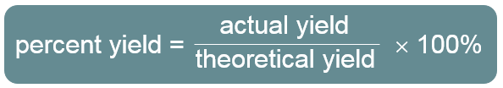
Percent Yield
The calculated or expected amount of product is called the theoretical yield.
The amount of product actually produced is called the actual yield.

Slide 32
Percent Yield
The percent yield is a measure of the efficiency of a reaction carried out in the laboratory.
Reactions do not always go to completion; when a reaction is incomplete, less than the calculated amount of product is formed.
Impure reactants and competing side reactions may cause unwanted products to form.
Actual yield can be lower than the theoretical yield due to a loss of product during filtration or in transferring between containers.

Slide 33
Determining Percent Yield
Butane (C₄H₁₀, 58.00 g/mol) is used in lighters and camp stoves. It reacts with oxygen according to the following equation:
2C₄H₁₀(l) + 13O₂(g) ⟶ 8CO₂(g) + 10H₂O(g)
At a particular setting, the reaction of 100.0 g C₄H₁₀ produces 285.0 g CO₂ (44.00 g/mol). What is the percent yield at this setting? Calculate theoretical yield and percent yield.
Find mol C₄H₁₀:
Mole ratio C₄H₁₀ : CO₂ =
Convert mol to g CO₂ →
Calculate Percent Yield CO₂:
Notes:
Timing ≈ 1.5 min
Let's look at a chemistry example. Campers can adjust the settings on a butane stove to determine the efficiency of the reaction. [teacher read question]
[animate 1st bullet] The first step is to calculate the theoretical yield of the reaction. [teacher show how to calculate theoretical yield, 303.4 g. calculation shown in sidebar]
[animate 2nd bullet] Now that we know the theoretical and actual yields, we can calculate percent yield. [teacher show how to calculate percent yield: 285/303.4 = 93.9%]

Slide 34
Determining Percent Yield
Butane (C₄H₁₀, 58.00 g/mol) is used in lighters and camp stoves. It reacts with oxygen according to the following equation:
2C₄H₁₀(l) + 13O₂(g) ⟶ 8CO₂(g) + 10H₂O(g)
At a particular setting, the reaction of 100.0 g C₄H₁₀ produces 285.0 g CO₂ (44.00 g/mol). What is the percent yield at this setting? Calculate theoretical yield and percent yield.
Find mol C₄H₁₀: 100.0 g x 1 mol/58.00 g = 1.720 mol
Mole ratio C₄H₁₀ : CO₂ = 2:8 → 1.720/2 = X/8 X = 6.880 mol CO₂
Convert mol to g CO₂ → 6.880 mol x 44.00 g/mol
= 302.7 g CO₂ theoretical yield
Actual Yield CO₂: 285.0 g
Notes:
Timing ≈ 1.5 min
Let's look at a chemistry example. Campers can adjust the settings on a butane stove to determine the efficiency of the reaction. [teacher read question]
[animate 1st bullet] The first step is to calculate the theoretical yield of the reaction. [teacher show how to calculate theoretical yield, 303.4 g. calculation shown in sidebar]
[animate 2nd bullet] Now that we know the theoretical and actual yields, we can calculate percent yield. [teacher show how to calculate percent yield: 285/303.4 = 93.9%]

Slide 35
Determining Percent Yield
Butane (C₄H₁₀, 58.00 g/mol) is used in lighters and camp stoves. It reacts with oxygen according to the following equation:
2C₄H₁₀(l) + 13O₂(g) ⟶ 8CO₂(g) + 10H₂O(g)
At a particular setting, the reaction of 100.0 g C₄H₁₀ produces 285.0 g CO₂ (44.00 g/mol). What is the percent yield at this setting? Calculate theoretical yield and percent yield.
Find mol C₄H₁₀: 100.0 g x 1 mol/58.00 g = 1.720 mol
Mole ratio C₄H₁₀ : CO₂ = 2:8 → 1.720/2 = X/8 X = 6.880 mol CO₂
Convert mol to g CO₂ → 6.880 mol x 44.00 g/mol
= 302.7 g CO₂ theoretical yield
Calculate Percent Yield CO₂: % yield = actual yield / theoretical yield x 100 %
285.0 g / 302.7 g x 100% = 94.15% CO₂
Notes:
Timing ≈ 1.5 min
Let's look at a chemistry example. Campers can adjust the settings on a butane stove to determine the efficiency of the reaction. [teacher read question]
[animate 1st bullet] The first step is to calculate the theoretical yield of the reaction. [teacher show how to calculate theoretical yield, 303.4 g. calculation shown in sidebar]
[animate 2nd bullet] Now that we know the theoretical and actual yields, we can calculate percent yield. [teacher show how to calculate percent yield: 285/303.4 = 93.9%]

Slide 36
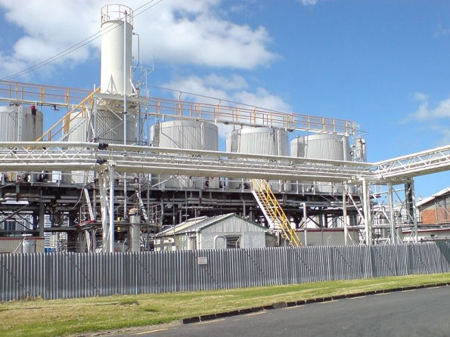
Importance of Percent Yield
  Comparing the percent yield for different experimental conditions helps identify the most efficient process.
  Finding percent yield helps to determine the cost of production.
  Large deviations in percent yield can indicate problems in a procedure or damage to equipment.
Notes:
Timing ≈ 0.5 min
Why are chemists interested in percent yield?
[animate 1st bullet] Many chemists and chemical engineers work on developing processes for making chemicals more efficiently--using less energy, producing less waste, or using less toxic chemicals. To compare the effectiveness of different processes, they may compare the percent yield of each process.
[animate 2nd bullet] It's also important in chemical manufacturing to know how much of a product you will get. If you know the percent yield of a particular reaction process, you can predict how much product (and how much waste) will form.
[animate 3rd bullet] Comparing percent yield of different production runs can help you identify problems in the system. If you usually get 85% yield and then one run yields only 50%, that's a sign that there may be a problem in the system.
SOURCES:
http://commons.wikimedia.org/wiki/File:Chemical_Plant_Western_Reclamation.jpg

Slide 37
Theoretical Yield, Actual Yield, and Percent Yield
  Theoretical yield is the maximum amount of product a reaction can form as determined by the limiting reactant.
  Actual yield is the observed amount of product formed in a specific reaction.
    Actual yield is always less than theoretical yield.
  Percent yield is the ratio of actual yield to theoretical yield, expressed as a percent.
Notes:
Timing ≈ 0.5 min
There are several ways to predict and describe the yield of a chemical reaction.
SOURCES:
CC:http://commons.wikimedia.org

Slide 38
Solving Problems Involving Limiting Reactants and Yield
  Identification of the limiting reactant allows the accurate determination of theoretical yield.
  Percent yield is a comparison of actual yield with theoretical yield.
Limiting reactant
Theoretical yield
Actual yield
Percent yield
Notes:
Timing ≈ 0.5 min
In this lesson, you learned about limiting and excess reactants and about reaction yield. In this assignment, you will apply what you have learned.

Slide 39

Review
  Calcium carbonate, found in seashells, is decomposed by heating:
  What is the theoretical yield of CaO if 24.8 g CaCO₃ is heated?
Find mol CaCO₃ →
Mole ratio CaCO₃ →
Convert mol to g CaO →

Slide 40
Review
  Calcium carbonate, found in seashells, is decomposed by heating:
  What is the theoretical yield of CaO if 24.8 g CaCO₃ is heated?
Find mol CaCO₃ → 24.8 g x 1 mol/100.1 g = 0.250 mol
Mole ratio CaCO₃ → CaO = 1:1 → 0.250 mol CaO
Convert mol to g CaO → 0.250 mol x 56.1 g/mol = 13.9 g CaO theoretical yield
If there is an excess of a reactant, then there is more than enough of that reactant and it will not limit the yield of the reaction.

Slide 41
Percent Yield
Review
Using the same problem … what is the percent yield if 13.1 g CaO is actually produced when 24.8 g CaCO₃ is heated?
Δ
CaCO₃(s) → CaO(s) + CO₂(g)

Slide 42
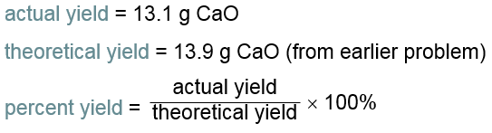
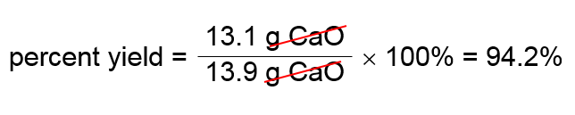
Percent Yield
Review
Using the same problem, what is the percent yield if 13.1 g CaO is actually produced when 24.8 g CaCO₃ is heated?
Δ
CaCO₃(s) → CaO(s) + CO₂(g)

Slide 43
Percent Yield
Review
Carbon tetrachloride, CCl₄, is a solvent that was once used in large amounts in dry cleaning. One reaction that produces carbon tetrachloride is: CS₂ + 3Cl₂ → CCl₄ + S₂Cl₂
What is the percent yield of CCl₄ if 617 kg is produced from the reaction of 872.8 kg of Cl₂?
Find mol Cl₂
Mole ratio Cl₂ :
Convert mol to g CCl₄
Calculate Percent Yield CCl₄

Slide 44
Percent Yield
Review
Carbon tetrachloride, CCl₄, is a solvent that was once used in large amounts in dry cleaning. One reaction that produces carbon tetrachloride is: CS₂ + 3Cl₂ → CCl₄ + S₂Cl₂
What is the percent yield of CCl₄ if 617 kg is produced from the reaction of 872.8 kg of Cl₂?
Find mol Cl₂
872.8 kg x 10³ g/1 kg x 1 mol/71.0 g = 12,293 mol
Mole ratio Cl₂ : CCl₄ = 3:1 → 12,293/3 = 4097.7 mol CCl₄
Convert mol to g CCl₄
4097.7 mol x 153.8 g/mol x 1 kg/10³ g = 630 kg CCl₄
theoretical yield
Calculate Percent Yield CCl₄ % yield = actual yield / theoretical yield x 100 %
617 kg / 630 kg x 100% = 97.9% CCl₄

Slide 45
Identify Limiting and Theoretical Yield
Acetylene torches are used for welding, but the thermite reaction can be useful in situations in which acetylene torches are inappropriate, such as welding underwater. The thermite reaction is described by the equation: Fe₂O₃ + 2Al ⟶ Al₂O₃ + 2Fe
A welder has 1.873 × 10² g Fe₂O₃ and 94.51 g Al in his welding kit. Which reactant will he run out of first? What is the theoretical yield and percent yield of aluminum oxide?

Slide 46
Identify Limiting and Excess Reactants
Acetylene torches are used for welding, but the thermite reaction can be useful in situations in which acetylene torches are inappropriate, such as welding underwater. The thermite reaction is described by the equation: Fe₂O₃ + 2Al ⟶ Al₂O₃ + 2Fe
A welder has 1.873 × 10² g Fe₂O₃ and 94.51 g Al in his welding kit. Which reactant will he run out of first? What is the theoretical yield and percent yield of aluminum oxide?
Find Moles based on Amount Given:
Fe₂O₃ 1.873 × 10² g x 1 mol/159.6 g = 1.174 mol Fe₂O₃
Al 94.51 g x 1 mol/27.00 g = 3.500 mol Al
Use Mole ratios: Fe₂O₃ : Al = 1:2 theoretically
Yet, using ACTUAL mol of Fe₂O₃ → 1.174/1 = X/2 X = 2.347 mol Al
Compare Theoretical Values:
Fe₂O₃ is the Limiting Reactant since only 2.347 mol Al are needed to react with 1.174 mol Fe₂O₃ and we have 3.500 mol Al available.
Determine theoretical yield and percent yield.

Slide 47
Identify Limiting and Excess Reactants
Acetylene torches are used for welding, but the thermite reaction can be useful in situations in which acetylene torches are inappropriate, such as welding underwater. The thermite reaction is described by the equation: Fe₂O₃ + 2Al ⟶ Al₂O₃ + 2Fe
A welder has 1.873 × 10² g Fe₂O₃ and 94.51 g Al in his welding kit. Which reactant will he run out of first? What is the theoretical yield of aluminum oxide?
Find Moles based on Amount Given:
Fe₂O₃ 1.873 × 10² g x 1 mol/159.6 g = 1.174 mol Fe₂O₃
Al 94.51 g x 1 mol/27.00 g = 3.500 mol Al
Use Mole ratios: Fe₂O₃ : Al = 1:2 theoretically
Yet, using ACTUAL mol of Fe₂O₃ → 1.174/1 = X/2 X = 2.347 mol Al
Compare Theoretical Values:
Fe₂O₃ is the Limiting Reactant since only 2.347 mol Al are needed to react with 1.174 mol Fe₂O₃ and we have 3.500 mol Al available.
Theoretical Yield of aluminum oxide
1:1 mole ratio of Fe₂O₃ : Al₂O₃
1.174 mol x 102.0 g/mol = 119.7 g Al₂O₃

Slide 48
Identify Limiting and Excess Reactants
Acetylene torches are used for welding, but the thermite reaction can be useful in situations in which acetylene torches are inappropriate, such as welding underwater. The thermite reaction is described by the equation: Fe₂O₃ + 2Al ⟶ Al₂O₃ + 2Fe
A welder has 1.873 × 10² g Fe₂O₃ and 94.51 g Al in his welding kit. Which reactant will he run out of first? What is the theoretical yield of aluminum oxide?
Find Moles based on Amount Given:
Fe₂O₃ 1.873 × 10² g x 1 mol/159.6 g = 1.174 mol Fe₂O₃
Al 94.51 g x 1 mol/27.00 g = 3.500 mol Al
Use Mole ratios: Fe₂O₃ : Al = 1:2 theoretically
Yet, using ACTUAL mol of Fe₂O₃ → 1.174/1 = X/2 X = 2.347 mol Al
Compare Theoretical Values:
Fe₂O₃ is the Limiting Reactant since only 2.347 mol Al are needed to react with 1.174 mol Fe₂O₃ and we have 3.500 mol Al available.
Theoretical Yield of aluminum oxide
1:1 mole ratio of Fe₂O₃ : Al₂O₃ . 1.174 mol x 102.0 g/mol = 119.7 g Al₂O₃
Percent Yield of aluminum oxide if actual yield = 105.8 g
% yield = actual yield / theoretical yield x 100 %
105.8 g / 119.7 g x 100% = 88 %

Slide 49
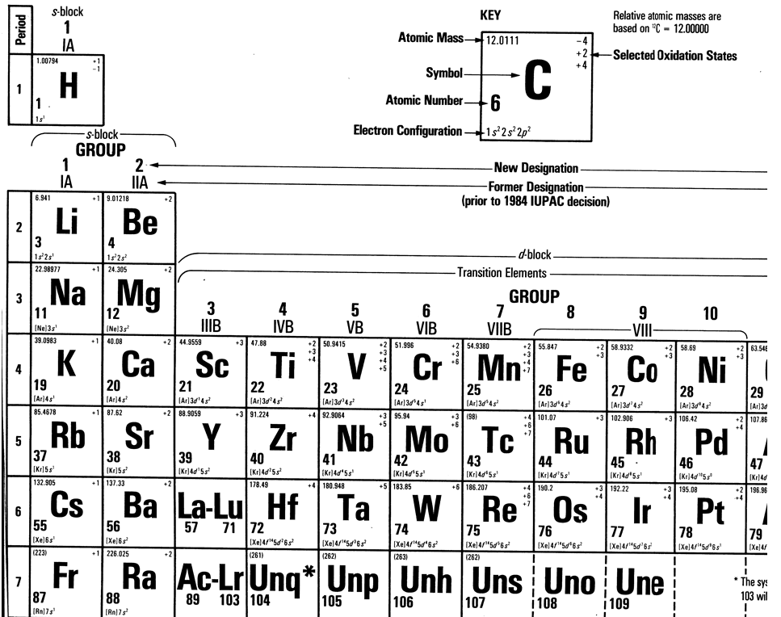

Slide 50
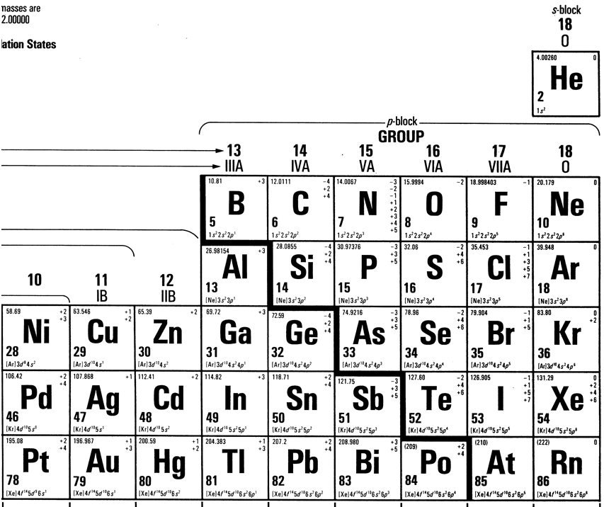

Slide 51
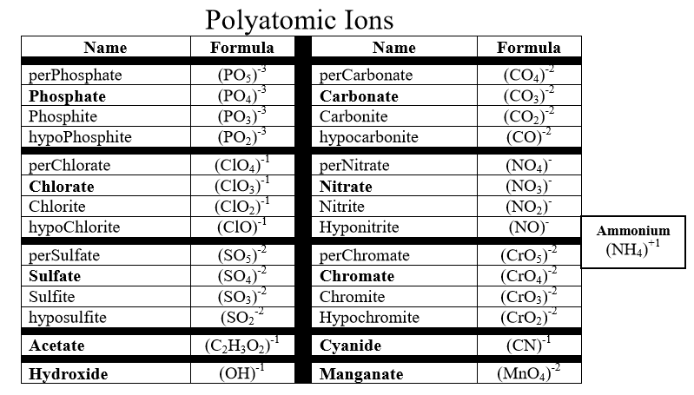

Slide 52
