Slide 1
Click “Slide Show”
Click “From Beginning”
or
“From Current Slide”

Slide 2
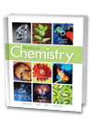
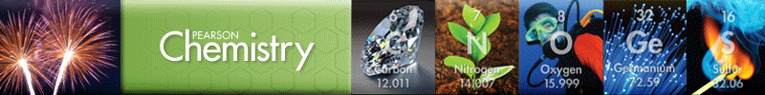
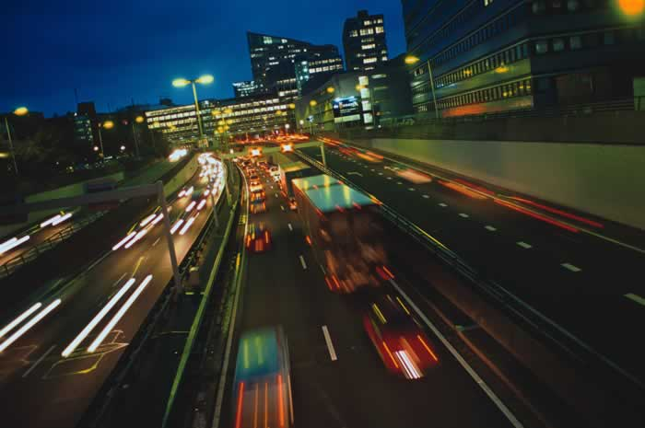
Chapter 18
Reaction Rates and Equilibrium
Rates of Reaction
The Progress of Chemical
Reactions
Reversible Reactions
and Equilibrium
Solubility Equilibrium
Free Energy and Entropy

Slide 3
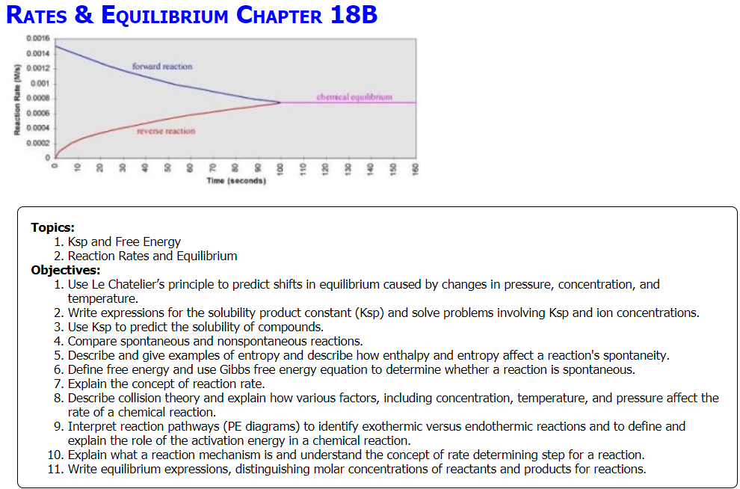

Slide 4

Equilibrium Constant
2 A + 3 B 4 C + 7 D
  K_{eq} = ?
  Reaction:
  2 HBr _{(g)} → H_{2 (g)} + Br_{2 (g)}
  [H₂] = 0.25 M [ Br₂] = 0.25 M [HBr] = 1.3 M
K_{eq} = ?
K_{eq} =
K_{eq} =

Slide 5
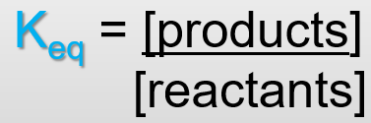
Equilibrium Constant
2 A + 3 B 4 C + 7 D
  K_{eq} = [C]⁴[D]⁷
  [A]²[B] ³
  Reaction:
  2 HBr _{(g)} H_{2 (g)} + Br_{2 (g)}
  [H₂] = 0.25 M [ Br₂] = 0.25 M [HBr] = 1.3 M
  K_{eq} = [H₂][Br₂]
  [HBr]²
K_{eq} = [0.25 M][0.25 M] / [1.3 M]²
K_{eq} = 3.7 x 10⁻²

Slide 6
Equilibrium Constant
  N_{2(g)} + O_{2(g)} 2NO_{(g)} reaches equilibrium. Find K_{eq} if the molar concentrations are: [N₂] = 0.50 M, [O₂] = 0.50 M, and [NO] = 0.020 M.
What does this K_{eq} indicate?
What does a K_{eq} of 3.8 × 10² indicate?
What does a K_{eq} of 5.4 × 10⁶ indicate?

Slide 7
Equilibrium Constant
  N_{2(g)} + O_{2(g)} 2NO_{(g)} reaches equilibrium. Find K_{eq} if the molar concentrations are: [N₂] & [O₂] are both 0.50 M, and [NO] = 0.020 M.
  K_{eq} = [NO]²
  [N₂][O₂]
  K_{eq} = [0.020 M]² / [0.50 M][0.50 M]
K_{eq} = 1.6 x 10⁻³
What does this K_{eq} indicate?
Favors the reverse reaction (more reactants than products) … longer arrow to the left
What does a K_{eq} of 3.8 × 10² indicate?
Favors the forward reaction (more products than reactants) … longer arrow to the right
What does a K_{eq} of 5.4 × 10⁶ indicate?
The reaction goes to completion … no reactants remain.

Slide 8
Lesson Objectives
  Use Le Chatelier’s principle to predict shifts in equilibrium caused by changes in pressure, concentration, and temperature.
Write expressions for the solubility product constant (K_{sp}) and solve problems involving K_{sp} and ion concentrations.
Use K_{sp} to predict the solubility of compounds.
Compare spontaneous and nonspontaneous reactions.
Describe and give examples of entropy and describe how enthalpy and entropy affect a reaction's spontaneity.
Define free energy and use Gibbs free energy equation to determine whether a reaction is spontaneous

Slide 9
Stresses to Chemical System
  External changes called stresses can disrupt a chemical system at equilibrium.
  Stresses include:
  Change in concentration
  Change in pressure
  Change in temperature
Chemical system at equilibrium
Notes:
Timing ≈ 0.5 min
Think about a system that has reached equilibrium. It does not undergo any net change but simply continues to run both forward and reverse reactions at the same rate.
You could disrupt this equilibrium by adding more reactant. Such an action would immediately change the concentration of reactant, which would affect the system.
In fact, any change in concentration of reactants or products would disrupt the equilibrium. The change could be either an addition or a subtraction. If you add or remove any component of the system, it will lose its equilibrium state.
[animate 1st paragraph] This type of external change is called a stress. A stress is a change that is imposed on a system from the outside.
[animate subhead and 2st bullet] What are some other stresses that can disrupt a system at equilibrium?
[animate 2nd bullet] For systems that contain gases, a change in pressure can be a stress.
[animate 3rd bullet] Finally, a change in temperature can also be a stress that disrupts a chemical system at equilibrium.
As we move forward in this lesson, you will deal with each of these types of stresses and their effects on equilibrium systems.

Slide 10
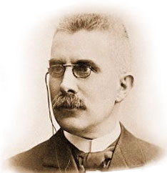
Le Chatelier’s Principle
Le Chatelier’s principle:
If a stress is applied to a chemical system at equilibrium, the system will respond by shifting in a direction to counteract the stress and a new equilibrium will be established.
Notes:
Timing ≈ 0.5 min
Henry Le Chatelier was a French chemist who described the response of a chemical equilibrium to stress. Le Chatelier observed that any system at equilibrium can be forced out of equilibrium by various disturbances. However, when this happens, Le Chatelier found that the system will react to counteract the change imposed on it, and then will establish a new equilibrium state.
Chemists now refer to this general idea as Le Chatelier’s principle.
SOURCES:
Henry Le Chatelier: http://commons.wikimedia.org/wiki/File:Lechatelier.jpg; public domain; accessed 6/29/12

Slide 11
Increasing Reactant Concentration shifts equilibrium to yield more product (relieve stress by favoring the forward reaction).
What will happen to the system?
Notes:
Timing ≈ 1 min
Let’s look at the details of a chemical system at equilibrium that undergoes a stress caused by addition of reactant molecules.
[animate left] We start with the system at equilibrium. The equilibrium constant, K, can be calculated using the equilibrium concentrations of reactants and products. If you count the number of blue product molecules and the number of red reactant molecules, these numbers can stand in for concentration. The calculated value of K is 0.25.
[animate middle] If we add three more red reactant molecules to this system, the equilibrium becomes disrupted because the concentration of reactant has changed. How does the system respond? The additional reactant molecules increase the rate of collisions between reactant molecules, which increases the forward reaction rate. As a result, more product is made as the equilibrium shifts to the right.
[animate right] Eventually, a new equilibrium is established. This equilibrium has the same equilibrium constant as the original system. You can verify this by counting the number of blue product molecules and the number of red reactant molecules, and inserting these values into the expression for K.
When you look at these results, you can see that some reactant molecules reacted to form product. The system shifted to reduce the added reactant via reaction to form product.
Thus, addition of reactant causes an equilibrium to shift toward product formation to reduce the stress of added reactant.
SOURCES:
sketch created by writer

Slide 12
Increasing Reactant Concentration shifts equilibrium to yield more product (relieve stress by favoring the forward reaction).
More reactants means more collisions of reactants.
Notes:
Timing ≈ 1 min
Let’s look at the details of a chemical system at equilibrium that undergoes a stress caused by addition of reactant molecules.
[animate left] We start with the system at equilibrium. The equilibrium constant, K, can be calculated using the equilibrium concentrations of reactants and products. If you count the number of blue product molecules and the number of red reactant molecules, these numbers can stand in for concentration. The calculated value of K is 0.25.
[animate middle] If we add three more red reactant molecules to this system, the equilibrium becomes disrupted because the concentration of reactant has changed. How does the system respond? The additional reactant molecules increase the rate of collisions between reactant molecules, which increases the forward reaction rate. As a result, more product is made as the equilibrium shifts to the right.
[animate right] Eventually, a new equilibrium is established. This equilibrium has the same equilibrium constant as the original system. You can verify this by counting the number of blue product molecules and the number of red reactant molecules, and inserting these values into the expression for K.
When you look at these results, you can see that some reactant molecules reacted to form product. The system shifted to reduce the added reactant via reaction to form product.
Thus, addition of reactant causes an equilibrium to shift toward product formation to reduce the stress of added reactant.
SOURCES:
sketch created by writer

Slide 13
Increasing Product Concentration shifts equilibrium to yield more reactants (relieve stress by favoring the reverse reaction).
What will happen to the system?
Notes:
Timing ≈ 1 min
Does the same type of shift occur if product is added to a chemical system at equilibrium?
[animate left] Let’s start with the same system we used earlier. Again, we start with the system at equilibrium. The equilibrium constant, K, is 0.25.
[animate middle] If we add three more blue product molecules to this system, what happens? The equilibrium becomes disrupted because the concentration of product has changed. These added product molecules increase the rate of collisions between product molecules, which increases the reverse reaction rate. As a result, more reactant is made as the equilibrium shifts to the left.
[animate right] Eventually, a new equilibrium is established. This equilibrium has the same equilibrium constant as the original system.
In this case, the addition of product causes an equilibrium to shift toward reactant formation to reduce the stress of added product.
SOURCES:
sketch created by writer

Slide 14
Increasing Product Concentration shifts equilibrium to yield more reactants (relieve stress by favoring the reverse reaction).
More products means more collisions of products.
Notes:
Timing ≈ 1 min
Does the same type of shift occur if product is added to a chemical system at equilibrium?
[animate left] Let’s start with the same system we used earlier. Again, we start with the system at equilibrium. The equilibrium constant, K, is 0.25.
[animate middle] If we add three more blue product molecules to this system, what happens? The equilibrium becomes disrupted because the concentration of product has changed. These added product molecules increase the rate of collisions between product molecules, which increases the reverse reaction rate. As a result, more reactant is made as the equilibrium shifts to the left.
[animate right] Eventually, a new equilibrium is established. This equilibrium has the same equilibrium constant as the original system.
In this case, the addition of product causes an equilibrium to shift toward reactant formation to reduce the stress of added product.
SOURCES:
sketch created by writer

Slide 15
Changes in Reactant or Product Concentration
aA + bB cC + dD
Change | Direction of equilibrium shift | Effect on K
Increase reactant concentration
Increase product concentration
Decrease reactant concentration
Decrease product concentration
Notes:
Timing ≈ 1 min
Let’s summarize what has been established so far.
[animate 1st line of table] You observed that an increase in reactant concentration resulted in a shift toward product formation and that these changes did not affect the equilibrium constant, K.
[animate 2nd line of table] Next, you observed that an increase in product concentration resulted in a shift toward reactant formation. In this case, too, the changes did not affect the equilibrium constant.
We can summarize the general effect of added reactant or product according to Le Chatelier’s principle this way: An equilibrium will shift in the direction away from added reactant or added product and establish a new equilibrium.
[animate 3rd line of table] Knowing these effects, you should be able to predict what happens if there is a decrease in either reactant or product concentration. Take the case of a decrease in reactant concentration. In this case, the equilibrium will respond to reduce the stress. Since reactant is being removed, the system will respond by replenishing some of this loss. The equilibrium shifts left toward reactants, but without changing the equilibrium constant, K.
[animate 4th line of table] Finally, consider what happens when product concentration is decreased. Again, the system will respond to reduce the stress. To make up for the loss of product, the system will shift to the right without a change in the equilibrium constant.

Slide 16
Changes in Reactant or Product Concentration
aA + bB cC + dD
Change | Direction of equilibrium shift | Effect on K
Increase reactant concentration | Shift right toward products | K remains constant
Increase product concentration | Shift left toward reactants | K remains constant
Decrease reactant concentration | Shift left toward reactants | K remains constant
Decrease product concentration | Shift right toward products | K remains constant
Notes:
Timing ≈ 1 min
Let’s summarize what has been established so far.
[animate 1st line of table] You observed that an increase in reactant concentration resulted in a shift toward product formation and that these changes did not affect the equilibrium constant, K.
[animate 2nd line of table] Next, you observed that an increase in product concentration resulted in a shift toward reactant formation. In this case, too, the changes did not affect the equilibrium constant.
We can summarize the general effect of added reactant or product according to Le Chatelier’s principle this way: An equilibrium will shift in the direction away from added reactant or added product and establish a new equilibrium.
[animate 3rd line of table] Knowing these effects, you should be able to predict what happens if there is a decrease in either reactant or product concentration. Take the case of a decrease in reactant concentration. In this case, the equilibrium will respond to reduce the stress. Since reactant is being removed, the system will respond by replenishing some of this loss. The equilibrium shifts left toward reactants, but without changing the equilibrium constant, K.
[animate 4th line of table] Finally, consider what happens when product concentration is decreased. Again, the system will respond to reduce the stress. To make up for the loss of product, the system will shift to the right without a change in the equilibrium constant.

Slide 17
Predicting Equilibrium Shift due to Concentration
SO_{2 (g)} + NO_{2 (g)} ⇌ SO_{3 (g)} + NO _{(g)}
  For the equilibrium system described by the equation above, what will happen if SO₃ is removed?
  O equilibrium shifts right
  O equilibrium shifts left
  What will happen if NO is added?
  O equilibrium shifts right
  O equilibrium shifts left
  For the equilibrium system described by the equation above, what will happen if SO₂ is removed?
  O equilibrium shifts right
  O equilibrium shifts left
  What will happen if NO₂ is added?
  O equilibrium shifts right
  O equilibrium shifts left
Notes:
Time ≈ 1.0 min
Entry audio: How well can you use Le Chatelier’s principle to predict the direction of change when either reactant or product concentration is changed?
Hint1 audio: Remember that Le Chatelier’s principle states that a system at equilibrium will shift to counteract a stress. How could this system counteract the removal of a product?
Hint2 audio: Think about how this system could counteract the addition of a product.
Hint3 audio: In this case, a reactant is being removed. How could this system counteract the removal of a reactant?
Hint4 audio: This is an example of an addition of a reactant. How will the equilibrium react to the addition of a reactant to reduce its impact?
Exit audio: For any homogeneous system at equilibrium where all of the reactants and products are in the same phase, a change in the concentration of any reactant or any product will disrupt the equilibrium. According to Le Chatelier’s principle, this will cause the equilibrium to shift to reduce the disruption. If a product or reactant is added, the equilibrium will shift in the direction away from the addition to use up this added material. If a product or reactant is removed, the equilibrium will shift in the direction toward this loss to replenish some of the lost material.

Slide 18
Predicting Equilibrium Shift due to Concentration
SO_{2 (g)} + NO_{2 (g)} ⇌ SO_{3 (g)} + NO _{(g)}
  For the equilibrium system described by the equation above, what will happen if SO₃ is removed?
  The equilibrium shifts to the right (to replace product). Favors forward reaction.
  What will happen if NO is added?
  The equilibrium shifts to the left (to remove product). Favors reverse reaction.
  For the equilibrium system described by the equation above, what will happen if SO₂ is removed?
  The equilibrium shifts to the left (to replace the reactant). Favors reverse reaction.
  What will happen if NO₂ is added?
  The equilibrium shifts to the right (to remove reactant). Favors forward reaction.
Notes:
Time ≈ 1.0 min
Entry audio: How well can you use Le Chatelier’s principle to predict the direction of change when either reactant or product concentration is changed?
Hint1 audio: Remember that Le Chatelier’s principle states that a system at equilibrium will shift to counteract a stress. How could this system counteract the removal of a product?
Hint2 audio: Think about how this system could counteract the addition of a product.
Hint3 audio: In this case, a reactant is being removed. How could this system counteract the removal of a reactant?
Hint4 audio: This is an example of an addition of a reactant. How will the equilibrium react to the addition of a reactant to reduce its impact?
Exit audio: For any homogeneous system at equilibrium where all of the reactants and products are in the same phase, a change in the concentration of any reactant or any product will disrupt the equilibrium. According to Le Chatelier’s principle, this will cause the equilibrium to shift to reduce the disruption. If a product or reactant is added, the equilibrium will shift in the direction away from the addition to use up this added material. If a product or reactant is removed, the equilibrium will shift in the direction toward this loss to replenish some of the lost material.

Slide 19
Stressing the system with Pressure causes a shift reducing the amount of gas molecules present that are colliding.
What will happen to the system?
The reactants had more moles of gas particles so they are more affected by pressure (# of collisions).
Notes:
Timing ≈ 1 min
So far, you have looked at changes in concentrations of reactants, products, and common ions. How does a change in pressure affect chemical systems at equilibrium?
Changes in pressure can exert a disruptive effect on systems, but only in a system that contains at least one gaseous reactant or product. Solid or liquid chemical systems are not affected by changing pressures.
[animate left] Observe the system shown in the diagram. Both the reactant and product in this system are gases that have established an equilibrium in a closed container. The equilibrium constant for this system is given.
[animate middle] If pressure is increased on this system by an external force that pushes down on the lid of the container, the gases are forced into a smaller volume. These increased concentrations lead to an increased rate of intermolecular collisions. The equilibrium becomes disrupted because the concentrations of both the reactant and product have changed.
To relieve this stress, the system shifts to reduce the effect of this increased pressure. It does so by shifting in a direction that results in fewer gas molecules. Fewer molecules exert less pressure.
[animate right] In this case, the system shifts to the right because the product side has only one molecule for every two molecules present on the reactant side. Eventually, a new equilibrium is established.
Notice that this new equilibrium has the same equilibrium constant as the original system. Changing pressure does not affect the equilibrium constant, K.
We can summarize the general effect of changing pressure according to Le Chatelier’s principle this way: When pressure is increased, an equilibrium will shift in the direction that reduces the total number of gas molecules. When pressure is decreased, an equilibrium will shift in the direction that increases the total number of gas molecules. In any case, changing pressure does not change the equilibrium constant, K.
SOURCES:
sketch created by writer

Slide 20
Stressing the system with Pressure causes a shift reducing the amount of gas molecules present that are colliding.
More mol of gas reactants means more collisions of reactants.
The reactants had more moles of gas particles so they are more affected by pressure (# of collisions).
Notes:
Timing ≈ 1 min
So far, you have looked at changes in concentrations of reactants, products, and common ions. How does a change in pressure affect chemical systems at equilibrium?
Changes in pressure can exert a disruptive effect on systems, but only in a system that contains at least one gaseous reactant or product. Solid or liquid chemical systems are not affected by changing pressures.
[animate left] Observe the system shown in the diagram. Both the reactant and product in this system are gases that have established an equilibrium in a closed container. The equilibrium constant for this system is given.
[animate middle] If pressure is increased on this system by an external force that pushes down on the lid of the container, the gases are forced into a smaller volume. These increased concentrations lead to an increased rate of intermolecular collisions. The equilibrium becomes disrupted because the concentrations of both the reactant and product have changed.
To relieve this stress, the system shifts to reduce the effect of this increased pressure. It does so by shifting in a direction that results in fewer gas molecules. Fewer molecules exert less pressure.
[animate right] In this case, the system shifts to the right because the product side has only one molecule for every two molecules present on the reactant side. Eventually, a new equilibrium is established.
Notice that this new equilibrium has the same equilibrium constant as the original system. Changing pressure does not affect the equilibrium constant, K.
We can summarize the general effect of changing pressure according to Le Chatelier’s principle this way: When pressure is increased, an equilibrium will shift in the direction that reduces the total number of gas molecules. When pressure is decreased, an equilibrium will shift in the direction that increases the total number of gas molecules. In any case, changing pressure does not change the equilibrium constant, K.
SOURCES:
sketch created by writer

Slide 21
Predicting Shift of Equilibrium due to Pressure
  N_{2 (g)} + 3H_{2 (g)} ⇌ 2NH_{3 (g)}
  For the equilibrium system described by the equation above, how many moles of reactant and product gas are there?
  __ mol reactant molecules
  __ mol product molecules
  What will happen if pressure is increased?
  O equilibrium shifts right
  O equilibrium shifts left
  PCl_{5 (g)} ⇌ PCl_{3 (g)} + Cl_{2 (g)}
  For the equilibrium system described by the equation above, how many moles of reactant and product gas are there?
  __ mol reactant molecules
  __ mol product molecules
  What will happen if pressure is decreased?
  O equilibrium shifts right
  O equilibrium shifts left
Notes:
Time ≈ 1.0 min
Entry audio: Use your understanding of Le Chatelier’s principle to predict the direction of change in gaseous chemical systems at equilibrium.
Hint1 audio: Remember to count the number of reactant and product molecules using the coefficients from the balanced chemical equation for the system.
Hint2 audio: Remember that the stress of increased pressure can be relieved by decreasing the total number of molecules in the system.
Hint3 audio: Remember to use the balanced chemical equation to assess which side of the equation contains more molecules than the other.
Exit audio: An important point to emphasize here is that pressure changes only affect systems that contain at least one gaseous reactant or product. Like changes in concentration, a change in pressure does not change the equilibrium constant, K. A change in pressure only changes the equilibrium concentrations of the reactants and products.

Slide 22
Predicting Shift of Equilibrium due to Pressure
  N_{2 (g)} + 3H_{2 (g)} ⇌ 2NH_{3 (g)}
  For the equilibrium system described by the equation above, how many moles of reactant and product gas are there?
  4 mol reactant molecules (g)
  2 mol product molecules (g)
  What will happen if pressure is increased?
  Equilibrium shifts right to decrease mol of reactants. Favors forward reaction.
  PCl_{5 (g)} ⇌ PCl_{3 (g)} + Cl_{2 (g)}
  For the equilibrium system described by the equation above, how many moles of reactant and product gas are there?
  1 mol reactant molecules (g)
  2 mol product molecules (g)
  What will happen if pressure is decreased?
  Equilibrium shifts right to increase mol of products. Favors forward reaction.
Notes:
Time ≈ 1.0 min
Entry audio: Use your understanding of Le Chatelier’s principle to predict the direction of change in gaseous chemical systems at equilibrium.
Hint1 audio: Remember to count the number of reactant and product molecules using the coefficients from the balanced chemical equation for the system.
Hint2 audio: Remember that the stress of increased pressure can be relieved by decreasing the total number of molecules in the system.
Hint3 audio: Remember to use the balanced chemical equation to assess which side of the equation contains more molecules than the other.
Exit audio: An important point to emphasize here is that pressure changes only affect systems that contain at least one gaseous reactant or product. Like changes in concentration, a change in pressure does not change the equilibrium constant, K. A change in pressure only changes the equilibrium concentrations of the reactants and products.

Slide 23
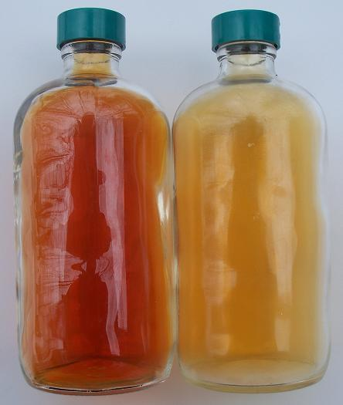
Stressing the system by Temperature causes a shift in equilibrium based on how heat flows
  Exothermic reaction
  reactants → products + heat
    Adding heat causes shift to LEFT (favors reverse reaction to relieve the stress of high energy products)
    Removing heat causes shift to RIGHT
2NO_{2(g)} N₂O_{4(g)} Brown Colorless
Notes:
Timing ≈ 1 min
Consider another type of stress. Changing temperature can affect any chemical system at equilibrium. This stress is not restricted to gaseous systems, but affects all systems in equilibrium.
Here, the effects are related to how heat is involved in the reaction being observed. If the reaction is exothermic, heat is released. You can write heat on the product side to show that it is transferred to the environment as the reaction takes place. Just think of heat as a product of the reaction. Using this approach, you can imagine that if the temperature is increased for this type of reaction at equilibrium, that the equilibrium will tend to shift away from the side producing the heat. In other words, the equilibrium will shift in the direction that will absorb the added heat.
If you place an exothermic reaction at equilibrium on ice, the equilibrium will shift toward the products. In this case, you are removing heat from the system and the equilibrium will shift in the direction to produce heat. The equilibrium will shift to the right.
Take the system shown in the image so that you can observe this firsthand. The reaction of NO₂ to produce N₂O₄ is an exothermic reaction. NO₂ is a brown gas and N₂O₄ is colorless. If you have an equilibrium system of NO₂ and N₂O₄, you can see a darkening of brown color as you heat it, which indicates that the reactant, NO₂, is being favored. Then, if you place the system on ice, you can observe the color shifting toward a lighter and lighter color as N₂O₄ is favored.
For an endothermic reaction, the effects of changing temperature are the opposite of those of the exothermic case. In an endothermic reaction, heat is absorbed. You can write heat on the reactant side of the equation to show that heat is absorbed from the environment as the reaction takes place. You can think of heat as a reactant in this case. When temperature is increased, an endothermic reaction at equilibrium will shift toward the products because it will shift in the direction that allows absorption of the added heat. When temperature is decreased, an endothermic reaction will shift toward the reactants.
In any case, an important difference between changing temperature and changing concentration or pressure is that the equilibrium constant, K, does change when you change the temperature. This is the only stressor that causes a change in the equilibrium constant. Temperature affects K because temperature affects the energy of the reactant and product molecules, which affects the ease with which they react.
SOURCES:
NO2-N2O4: http://commons.wikimedia.org/wiki/File:NO2-N2O4.jpg; public domain; accessed 7/2/12

Slide 24
Stressing the system by Temperature causes a shift in equilibrium based on how heat flows
  Endothermic reaction
  reactants + heat → products
    Adding heat causes shift to RIGHT (favors forward reaction to relieve the stress of high energy reactants)
    Removing heat causes shift to LEFT
2NO_{2(g)} N₂O_{4(g)} Brown Colorless
Notes:
Timing ≈ 1 min
Consider another type of stress. Changing temperature can affect any chemical system at equilibrium. This stress is not restricted to gaseous systems, but affects all systems in equilibrium.
Here, the effects are related to how heat is involved in the reaction being observed. If the reaction is exothermic, heat is released. You can write heat on the product side to show that it is transferred to the environment as the reaction takes place. Just think of heat as a product of the reaction. Using this approach, you can imagine that if the temperature is increased for this type of reaction at equilibrium, that the equilibrium will tend to shift away from the side producing the heat. In other words, the equilibrium will shift in the direction that will absorb the added heat.
If you place an exothermic reaction at equilibrium on ice, the equilibrium will shift toward the products. In this case, you are removing heat from the system and the equilibrium will shift in the direction to produce heat. The equilibrium will shift to the right.
Take the system shown in the image so that you can observe this firsthand. The reaction of NO₂ to produce N₂O₄ is an exothermic reaction. NO₂ is a brown gas and N₂O₄ is colorless. If you have an equilibrium system of NO₂ and N₂O₄, you can see a darkening of brown color as you heat it, which indicates that the reactant, NO₂, is being favored. Then, if you place the system on ice, you can observe the color shifting toward a lighter and lighter color as N₂O₄ is favored.
For an endothermic reaction, the effects of changing temperature are the opposite of those of the exothermic case. In an endothermic reaction, heat is absorbed. You can write heat on the reactant side of the equation to show that heat is absorbed from the environment as the reaction takes place. You can think of heat as a reactant in this case. When temperature is increased, an endothermic reaction at equilibrium will shift toward the products because it will shift in the direction that allows absorption of the added heat. When temperature is decreased, an endothermic reaction will shift toward the reactants.
In any case, an important difference between changing temperature and changing concentration or pressure is that the equilibrium constant, K, does change when you change the temperature. This is the only stressor that causes a change in the equilibrium constant. Temperature affects K because temperature affects the energy of the reactant and product molecules, which affects the ease with which they react.
SOURCES:
NO2-N2O4: http://commons.wikimedia.org/wiki/File:NO2-N2O4.jpg; public domain; accessed 7/2/12

Slide 25
Predicting Equilibrium Shift due to Temperature
  2POCl_{3 (g)} + heat ⇌ 2PCl_{3 (g)} + O_{2 (g)}
  For the equilibrium system described by the equation above, what happens if temperature is decreased?
  O equilibrium shifts right
  O equilibrium shifts left
  What happens if temperature is increased?
  O equilibrium shifts right
  O equilibrium shifts left
  2CO _{(g)} ⇌ CO_{2 (g)} + C _{(s)} + heat
  For the equilibrium system described by the equation above, what happens if temperature is increased?
  O equilibrium shifts right
  O equilibrium shifts left
  What happens if temperature is decreased?
  O equilibrium shifts right
  O equilibrium shifts left
Notes:
Time ≈ 1.0 min
Entry audio: Use your understanding of Le Chatelier’s principle to predict how temperature will affect a chemical system at equilibrium.
Hint1 audio: Remember: you can think of heat the same way you think of a reactant or product when you are evaluating direction of change according to Le Chatelier’s principle.
Hint2 audio: Remember that when you increase temperature, you are adding heat, and when you decrease temperature, you are removing heat from the system.
Exit audio: All stresses imposed on a system at equilibrium react in basically the same way according to Le Chatelier’s principle. The system responds to a stress by counteracting or minimizing the stress. In all types of stress—changes in concentration, pressure, or temperature—the system reacts by shifting in a direction to lessen the stress. In only one case does the equilibrium constant, K, change, and that is when temperature changes are involved.

Slide 26
Predicting Equilibrium Shift due to Temperature
  2POCl_{3 (g)} + heat ⇌ 2PCl_{3 (g)} + O_{2 (g)}
  For the equilibrium system described by the equation above, what happens if temperature is decreased?
  Equilibrium shifts left to restore the heat that was lost. Favors reverse reaction.
  What happens if temperature is increased?
  Equilibrium shifts right to absorb the excess heat added. Favors forward reaction.
  2CO _{(g)} ⇌ CO_{2 (g)} + C _{(s)} + heat
  For the equilibrium system described by the equation above, what happens if temperature is increased?
  Equilibrium shifts left to absorb the excess heat added. Favors reverse reaction.
  What happens if temperature is decreased?
  Equilibrium shifts right to restore the heat that was lost. Favors forward reaction.
Notes:
Time ≈ 1.0 min
Entry audio: Use your understanding of Le Chatelier’s principle to predict how temperature will affect a chemical system at equilibrium.
Hint1 audio: Remember: you can think of heat the same way you think of a reactant or product when you are evaluating direction of change according to Le Chatelier’s principle.
Hint2 audio: Remember that when you increase temperature, you are adding heat, and when you decrease temperature, you are removing heat from the system.
Exit audio: All stresses imposed on a system at equilibrium react in basically the same way according to Le Chatelier’s principle. The system responds to a stress by counteracting or minimizing the stress. In all types of stress—changes in concentration, pressure, or temperature—the system reacts by shifting in a direction to lessen the stress. In only one case does the equilibrium constant, K, change, and that is when temperature changes are involved.

Slide 27
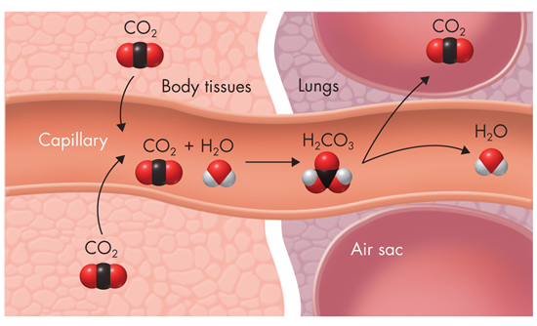

Real Life Application of Le Châtelier’s Principle
An equilibrium between carbonic acid, carbon dioxide, and water exists in the blood stream, maintaining blood pH:
During exercise, the [CO₂] in the blood increases.
This shifts the equilibrium in the direction of carbonic acid (to the right, favoring the forward reaction), which breaks down to HCO₃⁻ and H⁺.
The kidneys excrete extra H⁺.

Slide 28
Real Life Application of Le Châtelier’s Principle
An equilibrium between carbonic acid, carbon dioxide, and water exists did in the blood stream, maintaining blood pH:
During exercise, the [CO₂] in the blood increases. This shifts the equilibrium in the direction of carbonic acid, which breaks down to HCO₃⁻ and H⁺. The kidneys excrete extra H⁺.
The increase in the level of CO₂ also triggers an increase in the rate of breathing. With more breaths per minute, excess CO₂ is removed through the lungs.
The removal of CO₂ causes the equilibrium to shift toward the reactants, which reduces the amount of H₂CO_{3 (aq)} in the blood.

Slide 29
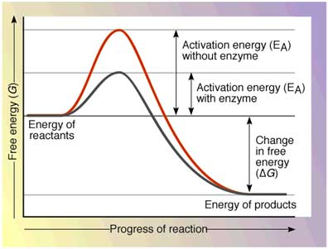
Catalysts and Equilibrium
Catalysts decrease the time it takes to establish equilibrium.
However, they do not affect the amounts of reactants and products present at equilibrium.

Slide 30
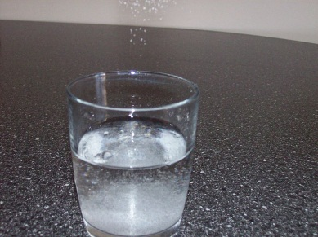
Dissolving Solids
Any finite quantity of solvent has a maximum amount of solute it can dissolve at a given temperature and pressure.
After the maximum quantity of solute is reached, a solution is said to be saturated.
Any solute not dissolved will settle onto the bottom of the solution’s container.
Solid begins to settle out of solution.
Some solids are only slightly soluble in a solvent.
Notes:
You used solubility rules to predict whether a compound would be soluble or not. In other words, the rules give you qualitative information about solubility. A more precise way of identifying how soluble a compound—a quantitative measure—is needed.
Sources: “Preparing isinglass fining solution,” Agne27, CCA-SA 3.0 http://commons.wikimedia.org/wiki/File:Preparing_isinglass_fining_solution.JPG
“a solution of NaCl in water,” Poecus, Public Domain, http://commons.wikimedia.org/wiki/File:SoluzioneSale.jpg

Slide 31
This table provides some general rules for the solubility of ionic compounds in water. But even the “insoluble” compounds dissolve a tiny amount.
Solubility of Ionic Compounds in Water
Compounds | Solubility | Exceptions
Salts of Group 1A metals and ammonia | Soluble | Some lithium compounds
Ethanoates, nitrates, chlorates, and perchlorates | Soluble | Few exceptions
Sulfates | Soluble | Compounds of Pb, Ag, Hg, Ba, Sr, and Ca
Chlorides, bromides, and iodides | Soluble | Compounds of Ag and some compounds of Hg and Pb
Sulfides and hydroxides | Most are insoluble | Alkali metal sulfides and hydroxides are soluble. Compounds of Ba, Sr, and Ca are slightly soluble.
Carbonates, phosphates, and sulfites | Insoluble | Compounds of the alkali metals and of ammonium ions

Slide 32
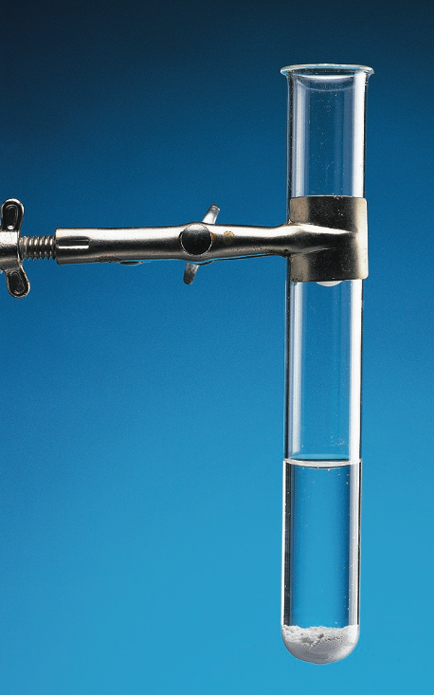
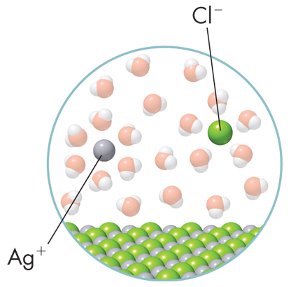
The Solubility Product Constant
When the “insoluble” compound silver chloride is mixed with water, a very small amount of silver chloride actually does dissolve in the water.
An equilibrium is established between the solid and the dissolved ions in the saturated solution. The equilibrium-constant expression is:
AgCl(s) Ag⁺(aq) + Cl–(aq)
[Ag⁺] × [Cl–]
K_{eq} =
[AgCl]

Slide 33
The Solubility Product Constant
When the “insoluble” compound silver chloride is mixed with water, a very small amount of silver chloride actually does dissolve in the water.
An equilibrium is established between the solid and the dissolved ions in the saturated solution. The equilibrium-constant expression is:
However, since so little product is actually produced, and the reactant compound concentration does not change the equilibrium, we ignore it:
AgCl(s) Ag⁺(aq) + Cl–(aq)
[Ag⁺] × [Cl–]
K_{eq} =
[AgCl]
K_{sp} =
[Ag⁺] × [Cl–]

Slide 34
The Solubility Product Constant
To compare the solubility of salts, it is useful to have a constant that reflects only the concentrations of the dissolved ions.
This constant is called the solubility product constant, represented by K_{sp}.
K_{sp} represents the maximum extent that a solid can be dissolved in solution.
The smaller the numerical value of the solubility product constant, the lower the solubility of the compound. Therefore, less ions dissolve in solution.
K_{sp} = [A⁺]ª × [B⁻]^{b}

Slide 35
The Solubility Product Constant
The table below lists the K_{sp} values for some ionic compounds that are slightly soluble in water.
Which substances are most soluble? Least soluble?
Which would precipitate out fastest? Slowest?
Solubility Product Constants (K_{sp}) at 25ºC
Ionic compound | K_{sp} | Ionic compound | K_{sp} | Ionic compound | K_{sp}
Halides AgCl AgBr AgI PbCl₂ PbBr₂ PbI₂ PbF₂ CaF₂ | 1.8 × 10^{–10} 5.0 × 10^{–13} 8.3 × 10^{–17} 1.7 × 10^{–5} 2.1 × 10^{–6} 7.9 × 10^{–9} 3.6 × 10^{–8} 3.9 × 10^{–11} | Sulfates PbSO₄ BaSO₄ CaSO₄ | 6.3 × 10^{–7} 1.1 × 10^{–10} 2.4 × 10^{–5} | Hydroxides Al(OH)₃ Zn(OH)₂ Ca(OH)₂ Mg(OH)₂ Fe(OH)₂ | 3.0 × 10^{–34} 3.0 × 10^{–16} 6.5 × 10^{–6} 7.1 × 10^{–12} 7.9 × 10^{–16}
 |  | Sulfides NiS CuS Ag₂S ZnS FeS CdS PbS | 4.0 × 10^{–20} 8.0 × 10^{–37} 8.0 × 10^{–51} 3.0 × 10^{–23} 8.0 × 10^{–19} 1.0 × 10^{–27} 3.0 × 10^{–28}
 |  |  |  | Carbonates CaCO₃ SrCO₃ ZnCO₃ Ag₂CO₃ BaCO₃ | 4.5 × 10^{–9} 9.3 × 10^{–10} 1.0 × 10^{–10} 8.15 × 10^{–12} 5.0 × 10^{–9}
Chromates PbCrO₄ Ag₂CrO₄ | 1.8 × 10^{–14} 1.2 × 10^{–12}

Slide 36
The Solubility Product Constant
The table below lists the K_{sp} values for some ionic compounds that are slightly soluble in water. Which substances are most soluble? Least soluble? Which would precipitate out fastest? Slowest?
Solubility Product Constants (K_{sp}) at 25ºC
Ionic compound | K_{sp} | Ionic compound | K_{sp} | Ionic compound | K_{sp}
Halides AgCl AgBr AgI PbCl₂ PbBr₂ PbI₂ PbF₂ CaF₂ | 1.8 × 10^{–10} 5.0 × 10^{–13} 8.3 × 10^{–17} 1.7 × 10^{–5} 2.1 × 10^{–6} 7.9 × 10^{–9} 3.6 × 10^{–8} 3.9 × 10^{–11} | Sulfates PbSO₄ BaSO₄ CaSO₄ | 6.3 × 10^{–7} 1.1 × 10^{–10} 2.4 × 10^{–5} | Hydroxides Al(OH)₃ Zn(OH)₂ Ca(OH)₂ Mg(OH)₂ Fe(OH)₂ | 3.0 × 10^{–34} 3.0 × 10^{–16} 6.5 × 10^{–6} 7.1 × 10^{–12} 7.9 × 10^{–16}
 |  | Sulfides NiS CuS Ag₂S ZnS FeS CdS PbS | 4.0 × 10^{–20} 8.0 × 10^{–37} 8.0 × 10^{–51} 3.0 × 10^{–23} 8.0 × 10^{–19} 1.0 × 10^{–27} 3.0 × 10^{–28}
 |  |  |  | Carbonates CaCO₃ SrCO₃ ZnCO₃ Ag₂CO₃ BaCO₃ | 4.5 × 10^{–9} 9.3 × 10^{–10} 1.0 × 10^{–10} 8.15 × 10^{–12} 5.0 × 10^{–9}
Chromates PbCrO₄ Ag₂CrO₄ | 1.8 × 10^{–14} 1.2 × 10^{–12}

Slide 37
Finding the Ion Concentrations in a Saturated Solution
What is the K_{sp} of lead(II) chromate if the lead ions and chromate ions have a molar concentration of 1.3 × 10^{–7} M in a saturated solution of lead(II) chromate at 25ºC?
PbCrO₄(s) Pb²⁺(aq) + CrO₄^{2–}(aq)

Slide 38
Finding the Ion Concentrations in a Saturated Solution
What is the K_{sp} of lead(II) chromate if the lead ions and chromate ions have a molar concentration of 1.3 × 10^{–7} M in a saturated solution of lead(II) chromate at 25ºC?
PbCrO₄(s) Pb²⁺(aq) + CrO₄^{2–}(aq)
K_{sp} = [Pb²⁺] x [CrO₄^{2–}]
K_{sp} = (1.3 × 10^{–7} M) (1.3 × 10^{–7} M)
K_{sp} = 1.7 × 10^{–14}
The equilibrium is greatly skewed to the left (favoring the reverse reaction). This makes sense since the ionic compound is only slightly soluble, meaning few ions (product) are formed.

Slide 39

Comparing Solubility Using Ksp
Place the following compounds in order from MOST soluble to LEAST soluble at 25ºC.
K_{sp} at 25ºC
Ionic compound | K_{sp}
CaSO₄ | 2.4 × 10^{–5}
PbF₂ | 3.6 × 10^{–8}
SrCO₃ | 9.3 × 10^{–10}
ZnS | 3.0 × 10^{–23}
A. PbF₂
B. ZnS
C. SrCO₃
D. CaSO₄

Slide 40
Comparing Solubility Using Ksp
Place the following compounds in order from MOST soluble to LEAST soluble at 25ºC.
K_{sp} at 25ºC
Ionic compound | K_{sp}
CaSO₄ | 2.4 × 10^{–5}
PbF₂ | 3.6 × 10^{–8}
SrCO₃ | 9.3 × 10^{–10}
ZnS | 3.0 × 10^{–23}
Most: CaSO₄
PbF₂
SrCO₃
Least: ZnS
ZnS would precipitate out the fastest since it is least soluble and cannot dissolve the excess ions present.

Slide 41
Practical Applications of Ksp
K_{sp} allows comparison of slightly soluble electrolytes
Example of using solubility product constants [Ref Table M]
CaSO_{4 (s)} [K_{sp} = 2.4 x 10⁻⁵]
BaSO_{4 (s)} [K_{sp} = 1.1 x 10⁻¹⁰]
Which is more soluble?
Which would precipitate out of solution first?

Slide 42
Practical Applications of Ksp
K_{sp} allows comparison of slightly soluble electrolytes
Example of using solubility product constants [Ref Table M]
CaSO_{4 (s)} [K_{sp} = 2.4 x 10⁻⁵]
BaSO_{4 (s)} [K_{sp} = 1.1 x 10⁻¹⁰]
Calcium Sulfate is more soluble than Barium Sulfate because
K_{sp} = [Ca²⁺] x [SO₄^{2–}] can dissolve more ions in solution.
Barium Sulfate would precipitate out of solution first and at a lower concentration than Calcium Sulfate. It cannot dissolve the as many ions in solution.

Slide 43
Practical Applications of Ksp
K_{sp} allows predictions to determine if a precipitate will form when two solutions are mixed …
AB _{(s)} ⇌ A⁺ _{(aq)} + B⁻ _{(aq)}
1) if [A⁺][B⁻] > K_{sp}, the solution will/will not precipitate?
2) if [A⁺][B⁻] < K_{sp}, no precipitate will/will not form?

Slide 44
Practical Applications of Ksp
K_{sp} allows predictions to determine if a precipitate will form when two solutions are mixed …
AB _{(s)} ⇌ A⁺ _{(aq)} + B⁻ _{(aq)}
1) if [A⁺][B⁻] > K_{sp}, the solution will precipitate.
K_{sp} < [A⁺] x [B–] … shows that the solution cannot dissolve the amount of ions present.
E.g. [A⁺][B⁻] can dissolve 10⁻⁵ ions, but Ksp is 10⁻⁸ …
meaning it can only dissolve 10⁻⁸ ions.
2) if [A⁺][B⁻] < K_{sp}, no precipitate will form.
K_{sp} > [A⁺] x [B–] … shows that the solution can dissolve more than the amount of ions present.

Slide 45
Finding the Ion Concentrations in a Saturated Solution
What is the K_{sp} of calcium fluoride if the calcium and fluoride ions have molar concentrations of 2.6 × 10^{–4} M and 3.8 × 10^{–4} M respectively in a saturated solution at 25ºC?
Which ionic compound will precipitate out of solution first, BaSO_{4 (s)} [K_{sp} = 1.1 x 10⁻¹⁰] or CaF₂?

Slide 46
Finding the Ion Concentrations in a Saturated Solution
What is the K_{sp} of calcium fluoride if the calcium and fluoride ions have molar concentrations of 2.6 × 10^{–4} M and 3.8 × 10^{–4} M respectively in a saturated solution at 25ºC?
CaF₂ (s) Ca⁺² (aq) + 2F⁻ (aq)
K_{sp} = [Ca⁺²][F⁻]²
K_{sp} = [Ca⁺²] x [F⁻]²
K_{sp} = (2.6 × 10^{–4} M) (3.8 × 10^{–4} M)²
K_{sp} = 3.8 × 10^{–11}
Which ionic compound will precipitate out of solution first, BaSO_{4 (s)} [K_{sp} = 1.1 x 10⁻¹⁰] or CaF₂?
CaF₂ is less soluble (10^{–11} < 10^{–10}) and therefore, will precipitate out first.

Slide 47
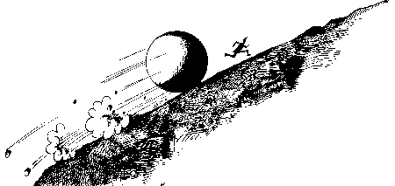
Spontaneous vs Nonspontaneous Processes
?

Slide 48
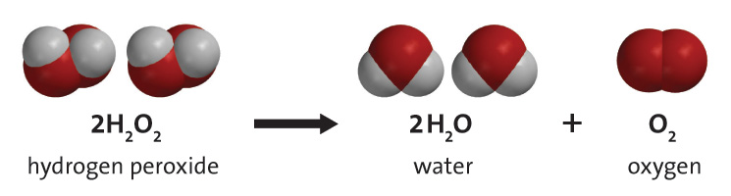
Spontaneous vs Nonspontaneous Processes
Spontaneity (Free Energy): ∆G
How can one predict whether a reaction will occur under certain conditions in a given amount of time?
How can one decide whether a reaction at a certain temperature and pressure will be spontaneous?

Slide 49
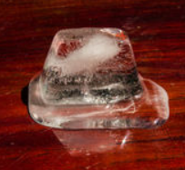
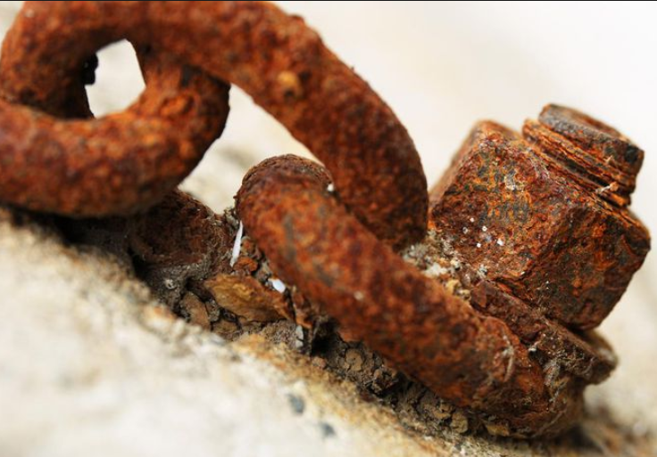
Spontaneous vs Nonspontaneous Processes
Spontaneity (Free Energy): ∆G
Spontaneous Reactions
Reactions that take place without exertion of outside forces.
Ice melts when placed on a table (room temperature)
Iron(III) Hydroxide (rust) forms on metals outdoors
Spontaneity does NOT relate to RATE of Reaction

Slide 50
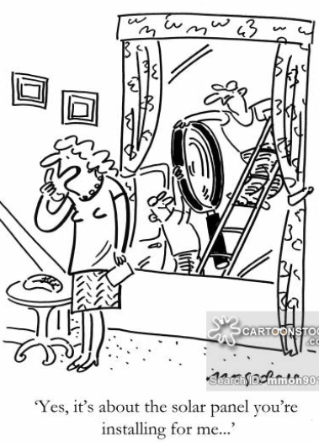
Spontaneous vs Nonspontaneous Processes
Spontaneity
(Free Energy): ∆G
The free energy of a system is a measure of the amount of usable energy (energy that can do work) in that system
The concept of Free Energy provides a measure of how much usable energy is released (or consumed) when that reaction takes place.

Slide 51
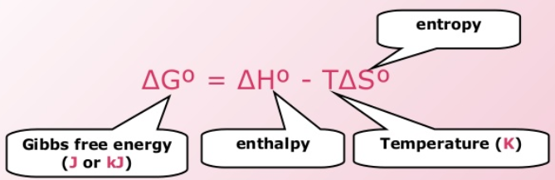
Spontaneous vs Nonspontaneous Processes
Spontaneity (Free Energy): ∆G
Free energy depends on three main factors:
  Enthalpy in chemistry refers to energy stored in bonds, and the change in enthalpy is the difference in bond energies between the products and the reactants.
  Entropy is the change of the system during a reaction (becoming more or less orderly).
  Temperature (KE of the molecules in the system).

Slide 52

Spontaneous vs Nonspontaneous Processes
Exothermic Reactions (-∆H) are usually, but not always, spontaneous at room temperature and 1 atm.
Fireworks displays are the result of highly favored, spontaneous reactions.
Spontaneous reactions produce large amounts of products and release free energy.

Slide 53
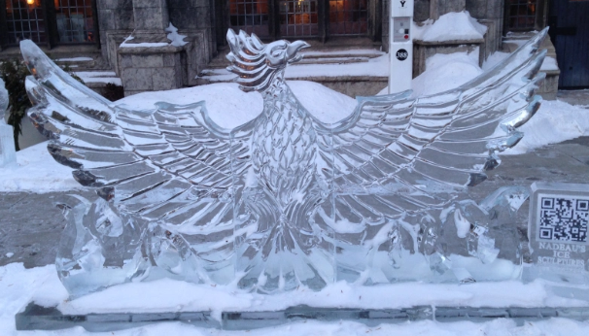
Spontaneous vs Nonspontaneous Processes
Exothermic Reactions (-∆H) are usually, but not always, spontaneous at room temperature and 1 atm.
The lit match is an Exothermic Reaction (-∆H).
But the size of the ice sculpture and the outdoor conditions make the melting non-spontaneous.
Enthalpy is NOT always a reliable indicator of spontaneity.
Imagine a 0 C day. Will a lit match melt the sculpture?

Slide 54
Spontaneous vs Nonspontaneous Processes
Endothermic Reactions (+∆H) are usually NOT spontaneous at room temperature and 1 atm. Chemical reactions that do NOT favor the formation of products are called nonspontaneous.
Enthalpy is NOT a reliable
indicator of spontaneity.

Slide 55
Spontaneous vs Nonspontaneous Processes
Endothermic Reactions (+∆H)
Ba(OH)₂.8H₂O(s) + 2 NH₄SCN(s) → Ba(SCN)₂(s) + 10 H₂O(l) + 2 NH₃(g)
A LIQUID was produced = ENDOthermic heat flow
http://somup.com/cYeXldhBRL
But the reaction produced a drop of 21 ⁰C (exothermic).
Enthalpy is NOT always a reliable indicator of spontaneity.

Slide 56
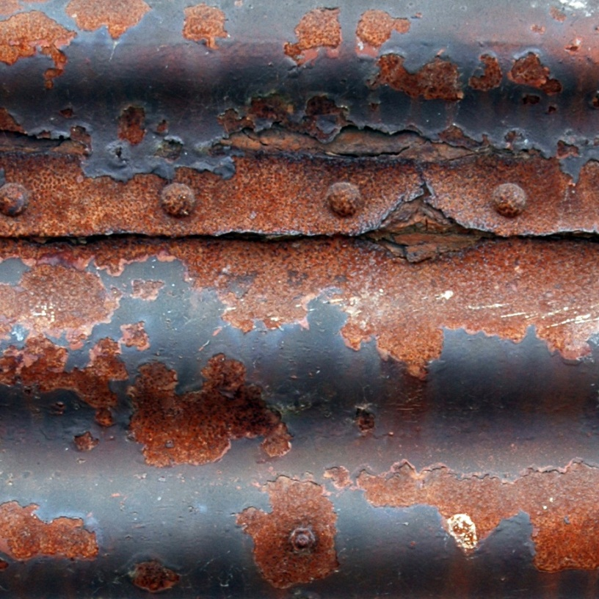
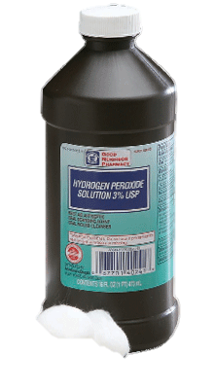
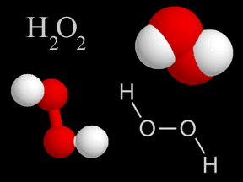
Spontaneous Processes
Some spontaneous reactions are so slow that they appear to be nonspontaneous.
Hydrogen peroxide decomposing
Iron rusting
2 H₂O₂ (aq)→ 2H₂O (l) + O₂ (g)
4 Fe(s) + 3 O₂(g) → 2 Fe₂O₃(s)

Slide 57
Spontaneous vs Nonspontaneous Processes
In nearly all reversible reactions, one reaction is favored over the other.
The forward reaction is spontaneous and releases free energy.
The reverse reaction of carbon dioxide and water to form carbonic acid, however, is a nonspontaneous reaction.
H₂CO₃(aq) CO₂(g) + H₂O(l)
<1% >99%

Slide 58
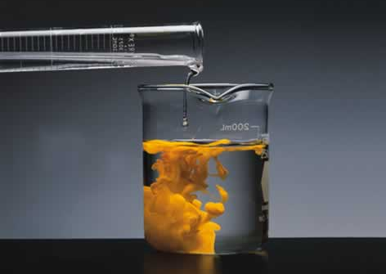
Spontaneous vs Nonspontaneous Processes
Cd(NO₃)₂(aq) + Na₂S(aq) CdS(s) + 2 NaNO₃(aq)
A precipitate of cadmium sulfide forms spontaneously.
The reverse reaction is nonspontaneous.

Slide 59
Spontaneity (Free Energy): ∆G
Which of the following is ALWAYS true of spontaneous reactions?
They produce heat and are not reversible at the stated conditions.
They release free energy and favor the formation of products at the stated conditions.
They are coupled with a nonspontaneous reaction and are easily reversible at the stated conditions.
Spontaneity is / is not related to reaction rate.
Some spontaneous / non-spontaneous reactions proceed very slowly and may appear not to be self sustaining.
If the forward reaction is non-spontaneous, most likely the reverse reaction is spontaneous / non-spontaneous.

Slide 60
Spontaneity (Free Energy): ∆G
Which of the following is ALWAYS true of spontaneous reactions?
They produce heat and are not reversible at the stated conditions.
They release free energy and favor the formation of products at the stated conditions.
They are coupled with a nonspontaneous reaction and are easily reversible at the stated conditions.
Spontaneity is not related to reaction rate.
Some spontaneous reactions proceed very slowly and may appear not to be self sustaining.
If the forward reaction is non-spontaneous, most likely the reverse reaction is spontaneous.

Slide 61
Spontaneity (Free Energy): ∆G
Free Energy reflects the capacity of a substance to supply useful work in a reaction.
∆G _{rxn} = ∑∆G _{products} - ∑∆G _{reactants}
∆G _{rxn} = - the reaction is spontaneous and capable of producing useful work.
∆G _{rxn} = + the reaction is non-spontaneous … work must be applied to the reaction. However, the reverse reaction would be spontaneous (∆ G _{rxn} = -).
∆G _{rxn} = 0 the reaction is at equilibrium … there is no driving force to make the reaction go forward or reverse.

Slide 62
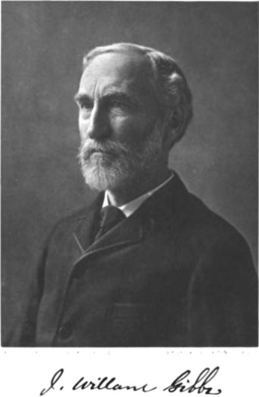
Spontaneity (Free Energy): ∆G
Free Energy reflects the capacity of a substance to supply useful work in a reaction.
∆G _{rxn} = ∑∆G _{products} - ∑∆G _{reactants}
Free Energy is calculated in a manner completely analogous to ∆ H_{rxn}. Reverse reactions use opposite sign.
∆G _{total} = ∆G₁ + ∆G₂ + ∆G₃ …

Slide 63
Entropy ∆S → 2nd Law of Thermodynamics
Entropy is the measure of “disorder” or “randomness”
∆S _{rxn} = - … low entropy … more “order”
∆S _{rxn} = + … high entropy … more “disorder”
Beaker shatters when dropped
Rivers become polluted
Wilderness trails get littered
Students don’t push in chairs

Slide 64
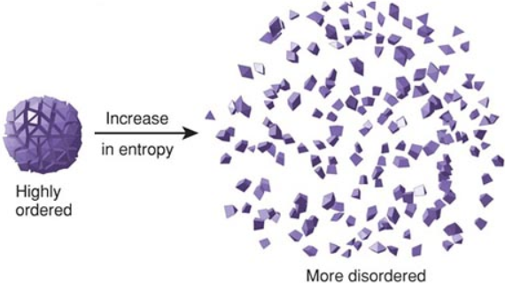
Entropy ∆S → 2nd Law of Thermodynamics
Entropy is the measure of “disorder” or “randomness”
∆S _{rxn} = - … low entropy … more “order”
∆S _{rxn} = + … high entropy … more “disorder”
∆S _{rxn} = ∑∆S _{products} - ∑∆S _{reactants}
Entropy increases as temperature increases.

Slide 65
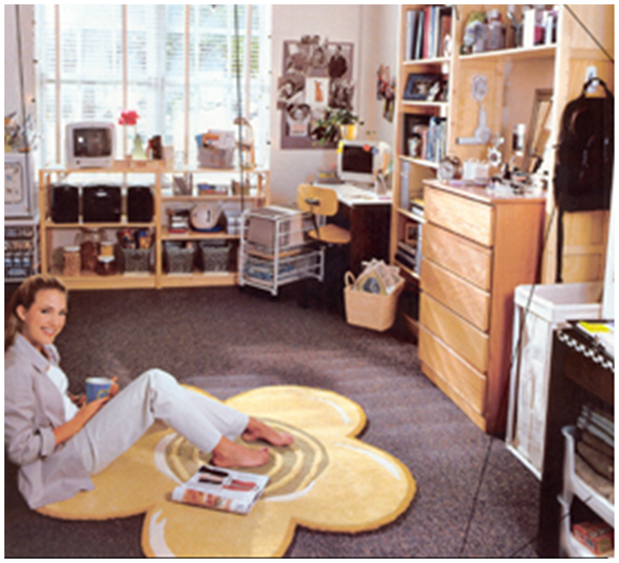
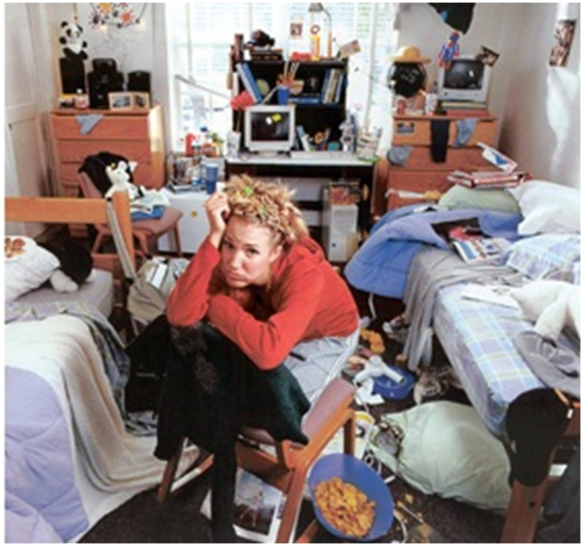
Entropy ∆S → 2nd Law of Thermodynamics
Units: J/mol K or cal/mol K
The Entropy of the universe must always either stay the same or increase (more disorder). Proponents of the big bang theory and evolution must side step this law of nature with fancy wording, purposeful contradiction, and often unpleasant attacks.

Slide 66
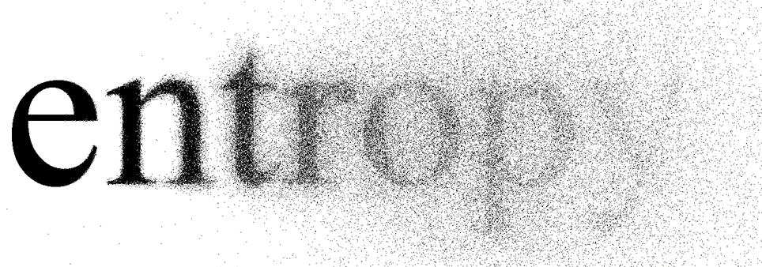
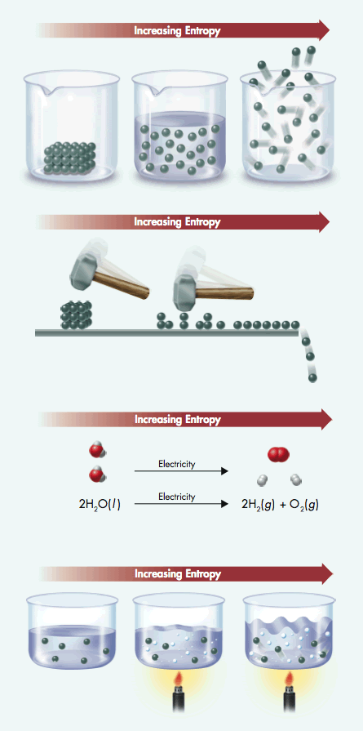
Entropy ∆S
Entropy increases in substances as they change phase from solid to liquid to gaseous.

Slide 67
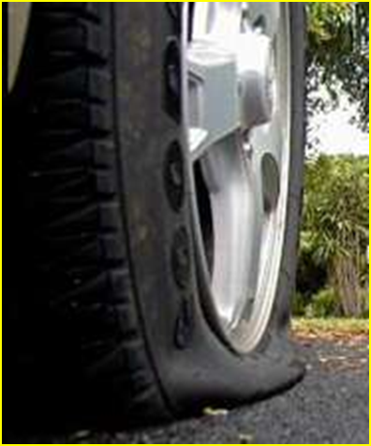
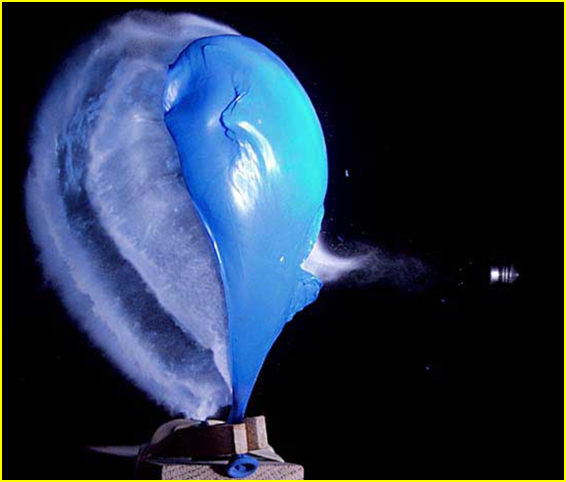
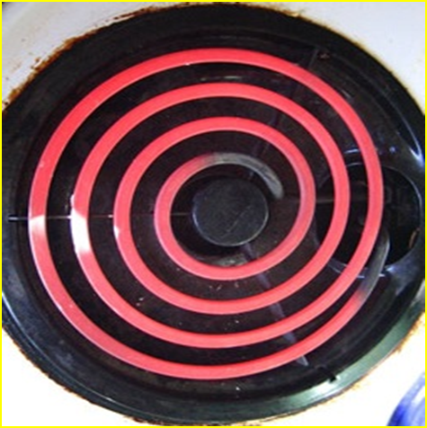
Entropy ∆S
              High pressure air whooshes “randomly” from a punctured tire…..or from a balloon.
              Hot things cool down. Kinetic energy flows in the direction of hotter to cooler because that direction of dispersal results in a greater amount of spreading out of energy than the reverse.

Slide 68
Entropy ∆S
  Entropy increases when a substance is divided into parts. For instance, entropy increases when an ionic compound dissolves in water.
Entropy tends to increase in chemical reactions in which the total number of product molecules is greater than the total number of reactant molecules.

Slide 69
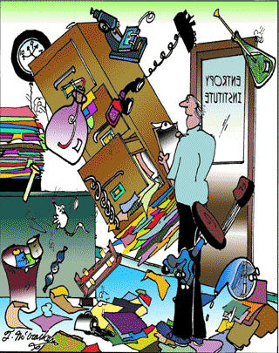
Entropy ∆S
Entropy tends to increase when the temperature increases. As the temperature rises, the molecules move faster and faster, which increases the disorder.

Slide 70
Which of the following would have an increase in the entropy of the reaction system?
2NH₄NO₃(s) → 2N₂(g) + 4H₂O(l) +O₂(g)
2H₂(g) + O₂(g) → 2H₂O(l)
C₃H₈(g) + 5O₂(g) → 3CO₂(g) + 4H₂O(l)
2Fe(s) + O₂(g) + 2H₂O(l) → 2Fe(OH)₂(s)

Slide 71
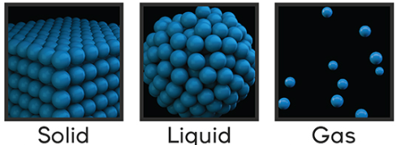
Which of the following would have an increase in the entropy of the reaction system?
2NH₄NO₃(s) → 2N₂(g) + 4H₂O(l) +O₂(g)
2H₂(g) + O₂(g) → 2H₂O(l)
C₃H₈(g) + 5O₂(g) → 3CO₂(g) + 4H₂O(l)
2Fe(s) + O₂(g) + 2H₂O(l) → 2Fe(OH)₂(s)
The products are mostly in the gas phase → more random (+∆S).

Slide 72
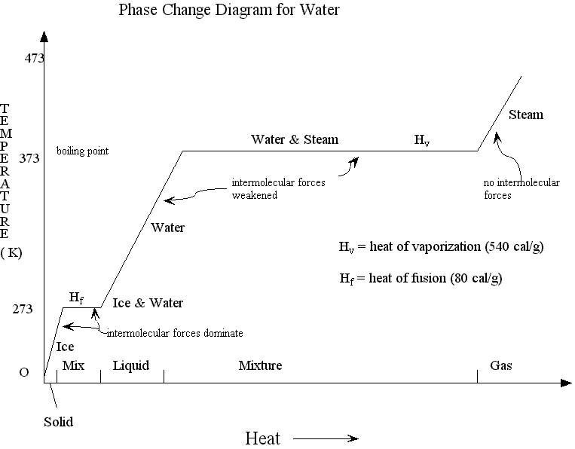
Does the heating (endothermic) curve of water (or any substance) increase or decrease entropy? Why?

Slide 73
Does the heating (endothermic) curve of water (or any substance) increase or decrease entropy? Why?
Entropy would increase because entropy (+∆S) and temperature are directly proportional. Faster moving molecules increases disorder.

Slide 74
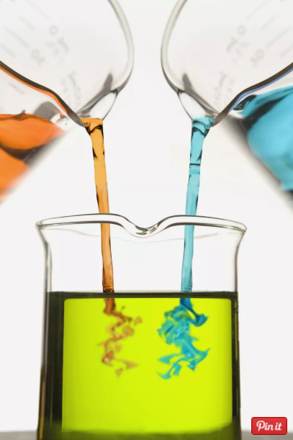
Free Energy Change
Gibbs Free Energy Equation
∆G = ∆ H - T ∆S
Free Energy = Enthalpy - (Temperature)(Entropy)
The equation: ΔG = ΔH - T ΔS is used to calculate the change in Gibbs free energy (ΔG).
ΔH is the change in enthalpy
ΔS is the change in entropy
T is the temperature in Kelvins.

Slide 75
Free Energy Change
Gibbs Free Energy Equation
∆G = ∆ H - T ∆S
Free Energy = Enthalpy - (Temperature)(Entropy)
The energy change for a chemical reaction (∆G) depends on:
a. breaking bonds and making bonds (∆H)
b. randomness (∆S)
c. absolute temperature (K)

Slide 76

Free Energy ∆G
Free Energy combines ENTHALPY and ENTROPY to measure the spontaneity of a reaction.
∆G = ∆ H - T ∆S [T in K = C + 273]
If ∆G is negative (-), the reaction is spontaneous
If ∆G is positive (+), the reaction is NOT spontaneous … the reverse reaction would be spontaneous.

Slide 77
For the following reaction: C(s) + O₂(g) → CO₂(g)
The entropy change, ΔS, is 3.0 J/mol·K. The enthalpy change, ΔH, is –394 kJ/mol with the system being at 298 K.
Will this reaction occur spontaneously? Describe all components.

Slide 78
For the following reaction: C(s) + O₂(g) → CO₂(g)
The entropy change, ΔS, is 3.0 J/mol·K. The enthalpy change, ΔH, is –394 kJ/mol with the system being at 298 K.
Will this reaction occur spontaneously? Describe all components.
∆G = ∆ H - T ∆S
ΔG = –394 kJ/mol – (298 K)(0.0030 kJ/mol·K)
ΔG = –395 kJ/mol
The reaction is spontaneous (as indicated by the –ΔG).
Exothermic, constant temperature, increased entropy (more disorder)

Slide 79
For the following reaction: 2NO (g) + O₂ (g) → 2 NO₂(g)
∆H⁰ is -114.2 kJ/mol and ∆S⁰ = -0.147 kJ/mol K.
Will this reaction be spontaneous at 532⁰ C (805 K)?

Slide 80
For the following reaction: 2NO (g) + O₂ (g) → 2 NO₂(g)
∆H⁰ is -114.2 kJ/mol and ∆S⁰ = -0.147 kJ/mol K.
Will this reaction be spontaneous at 532⁰ C (805 K)?
∆G = ∆ H - T ∆S
ΔG = -114.2 kJ/mol – (805 K )(-0.147 kJ/mol K)
ΔG = +4 .1 kJ/mol
The reaction is NONspontaneous (as indicated by +ΔG).
Exothermic, decreased entropy (less random) along with high temperature

Slide 81
∆ H | ∆ S | ∆ G = ∆ H - T ∆ S Remarks |  | Example
- Exothermic | + Disordered | Always spontaneous (∆ G = -) at all temperatures; The reverse rxn always non-spontaneous (∆ G = +) |  | Water always flows downhill; instant ice packs become cold when “broken”, but cannot return to warm
+ Endothermic | - Ordered | Always NON-spontaneous (∆ G = +) at all temperatures; reverse reaction always spontaneous (∆ G = -) |  | Water cannot flow uphill, but it can flow downhill
+ Endothermic | + Disordered | Spontaneous (∆ G = -) at higher temperatures; Non-spontaneous at lower temperatures (∆ G =+) |  | A beaker will shatter if dropped from a height, but may not shatter if close to the floor
- Exothermic | - Ordered | Spontaneous (∆ G = -) at lower temperatures; Non-spontaneous at higher temperatures (∆ G =+) |  | Ammonium thiocyanate & barium hydroxide form a COLD solution when mixed; However, at high temperatures, the reaction may not produce much cold

Slide 82
∆ H | ∆ S | ∆ G = ∆ H - T ∆ S | Example
- Exothermic Teacher does not intervene | + Disordered Students left to themselves | Always spontaneous (∆ G = -) at all temperatures; reverse rxn always non-spontaneous (∆ G = +) Classrooms will always become more DISORDERLY w/o teacher intervention | Chairs do NOT get pushed in
+ Endothermic Teacher intervenes with much energy | - Ordered Students practice pushing in chairs | Always NON-spontaneous (∆ G = +) at all temperatures; Classroom always becomes more ORDERLY with teacher intervention & student habit | Chairs get pushed in
+ Endothermic Teacher intervenes with much or little energy | + Disordered Students left to themselves | Spontaneous (∆ G = -) at higher temperatures → students have high kinetic energy (ambitious, conscientious) Non-spontaneous at lower temperatures (∆ G =+) → students have low kinetic energy (lazy, preoccupied) | Chairs get pushed in Chairs do NOT get pushed in
- Exothermic Teacher does not intervene | - Ordered Students practice pushing in chairs | Spontaneous (∆ G = -) at lower temperatures; → students have low kinetic energy (lazy, preoccupied) Non-spontaneous at high temperatures (∆ G =+) → students have high kinetic energy (ambitious, conscientious) | Chairs do NOT get pushed in Chairs get pushed in

Slide 83
Key Concepts
Spontaneous reactions produce large amounts of products and release free energy.
Reactions in which entropy increases as reactants form products tend to be favored.
The size and direction of enthalpy changes and entropy changes together determine whether a reaction is spontaneous.
When the value of ΔG is negative, a process is spontaneous. When the value is positive, a process is nonspontaneous.
ΔG = ΔH – TΔS
When a reaction is exothermic (- Δ H), and entropy increases (phases goes to disorder, e.g. l → g; +ΔS), the reaction is spontaneous (- Δ G).

Slide 84
Factors Affecting Equilibrium: Le Châtelier’s Principle
H₂CO₃(aq) CO₂(aq) + H₂O(l)
How does decreasing the concentration of CO₂ affect this system?
How does increasing the concentration of CO₂ affect this system?
H₂CO₃(aq) CO₂(aq) + H₂O(l)
How does decreasing the concentration of H₂CO₃ affect this system?
How does increasing the concentration of H₂CO₃ affect this system?

Slide 85
Factors Affecting Equilibrium: Le Châtelier’s Principle
Add CO₂
Direction of shift
H₂CO₃(aq) CO₂(aq) + H₂O(l)
Remove CO₂
Direction of shift
Add H₂CO₃ Direction of shift
H₂CO₃(aq) CO₂(aq) + H₂O(l)
Remove H₂CO₃ Direction of shift

Slide 86
Factors Affecting Equilibrium: Le Châtelier’s Principle
N₂(g) + 3H₂(g) 2NH₃(g) + heat
How does adding heat affect this system?
How does removing heat affect this system?
N₂(g) + 3H₂(g) 2NH₃(g)
How does increasing pressure affect this system?
How does decreasing pressure affect this system?

Slide 87
Factors Affecting Equilibrium: Le Châtelier’s Principle
Add heat
Direction of shift
N₂(g) + 3H₂(g) 2NH₃(g) + heat
Remove heat (cool)
Direction of shift
Add pressure
Direction of shift
N₂(g) + 3H₂(g) 2NH₃(g)
Reduce pressure
Direction of shift

Slide 88
Applying Le Châtelier’s Principle
What effect will each of the following changes have on the equilibrium position for this reversible reaction?
PCl₅(g) + heat PCl₃(g) + Cl₂(g)
a. Cl₂ is added.
b. Pressure is increased.
c. Heat is removed.
d. PCl₃ is removed as it forms.

Slide 89
Applying Le Châtelier’s Principle
What effect will each of the following changes have on the equilibrium position for this reversible reaction?
Add Cl₂
Direction of shift
PCl₅(g) + heat PCl₃(g) + Cl₂(g)
Increase pressure
Direction of shift
PCl₅(g) + heat PCl₃(g) + Cl₂(g)
Remove heat
Direction of shift
PCl₅(g) + heat PCl₃(g) + Cl₂(g)
PCl₅(g) + heat PCl₃(g) + Cl₂(g)
Remove PCl₃
Direction of shift

