Slide 1
Go to the “Slide Show” shade above
Click on “Play from Beginning”

Slide 2
Natural Selection Survival of the fittest
And Color Adaptations

Slide 3
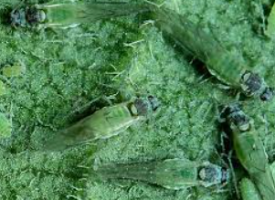
Adaptations
1. Cryptic Colorations – Camouflage
An animal blends in with its environment to avoid detection.
Dark moth on a dark tree vs. a white moth on a dark tree, “walking sticks,” leaf frog, clown fish (resembles coral), lichen katydid

Slide 4
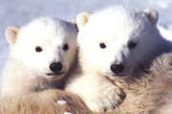
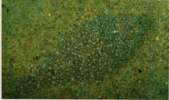
Cryptic coloration
http://www.polar-bears-polar-bears.com/
Can you see the fish?
http://chalk.richmond.edu/education/projects/webunits/adaptations/camou1.html

Slide 5
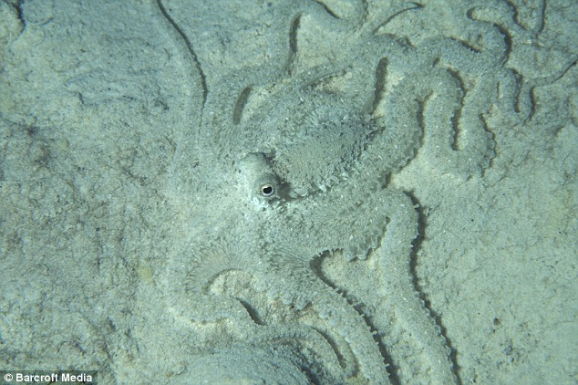
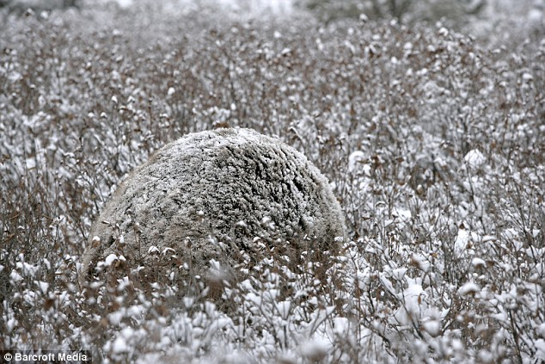
Cryptic coloration
This is a grizzly bear hiding in the bushes and the snow – Scary, eh?
http://www.dailymail.co.uk/sciencetech/article-1080207/Masters-disguise-Stunning-pictures-tricks-used-creatures-camouflage-themselves.html

Slide 6
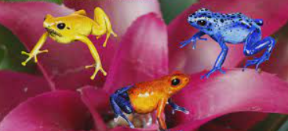
Adaptations
2. Aposematic Colorations
“Sematic” means ‘to warn’ … “Apo” means ‘away’.
Usually bright colored animals in which the brightness warns the predator to stay away.
Defenses of these organisms include: poison (ivy), venom (snakes), quills (porcupine), bad taste (Monarch butterfly), odor (skunk), ink (octopus), stingers (bees), coral snake, poison dart frog.
Predators have to learn the defense mechanism.

Slide 7
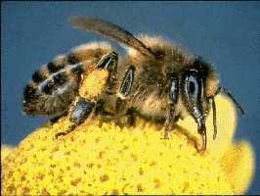
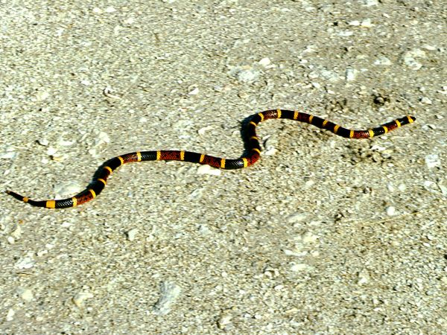
Aposematic coloration
http://www.indianchild.com/honey_bee.htm
http://animals.nationalgeographic.com/animals/reptiles/eastern-coral-snake.html

Slide 8
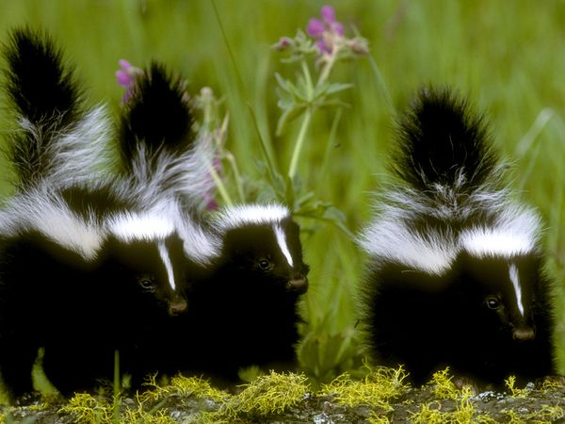
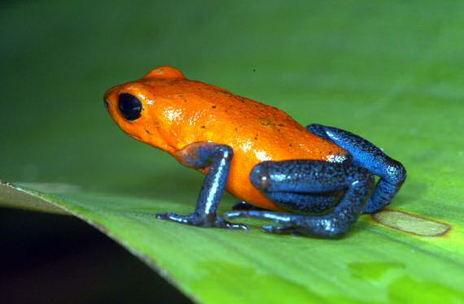
Aposematic coloration
http://animals.nationalgeographic.com/animals/mammals/skunk.html
http://www.casarioblanco.com/poison-dart-frog.html

Slide 9
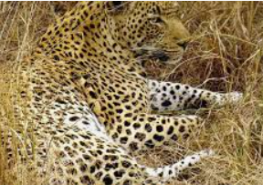
Adaptations
3. Disruptive Colorations
Coloration that is broken up or disrupts the shape of the animal.
It makes it difficult to see their body.
Tiger, zebra, cheetah, etc.

Slide 10
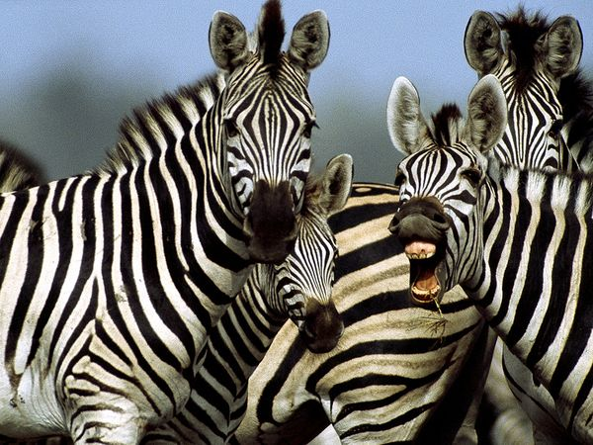
Disruptive coloration
http://animals.nationalgeographic.com/animals/mammals/zebra.html

Slide 11
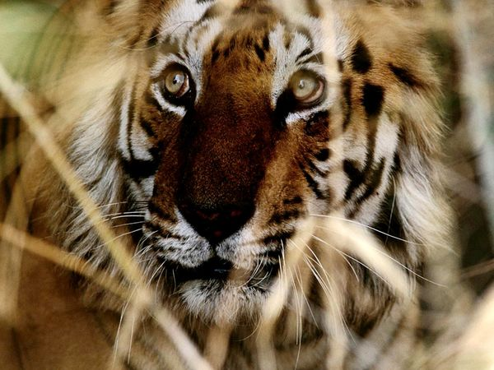
Disruptive coloration
http://httanimals.nationalgeographic.com/animals/photos/tigers.html#bengal-tiger-face_6445_600x450.jpg

Slide 12
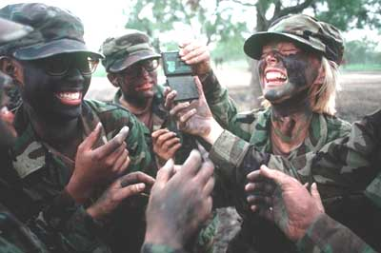
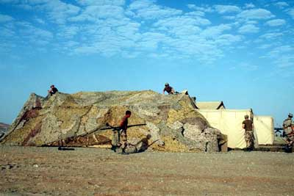
Disruptive coloration
http://science.howstuffworks.com/enlarge-image.htm?terms=Military+Camouflage&gallery=1&page=1

Slide 13
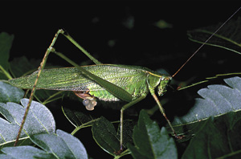
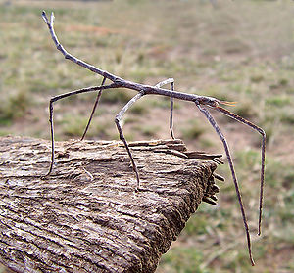
Mimicry
http://hortipm.tamu.edu/pestprofiles/other/katydid/katydid.html
http://en.wikibooks.org/w/index.php?title=File:Ctenomorpha_chronus02.jpg&filetimestamp=20050623080152

Slide 14
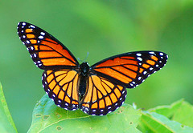
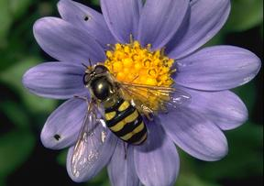
Mimicry
http://www.ohio-nature.com/viceroy-butterfly.html
http://www.eduwebs.org/bugs/syrphid_flies.htm

Slide 15
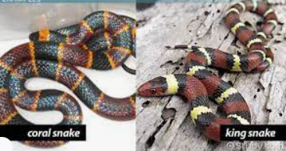
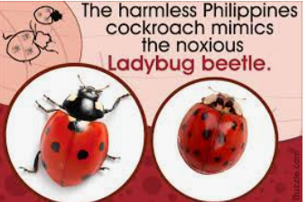
Adaptations
4. Mimicry
An animal mimics the shape, color, or behavior of another organism.
Batesian mimicry – uses aposematic symbols yet lacks defenses.
Mantispid fly resembles a wasp; ‘walking stick;’ Viceroy butterfly (?)

Slide 16
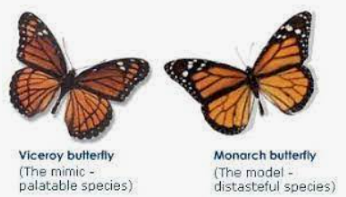
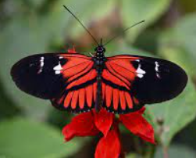
Adaptations
4. Mimicry
Müllerian mimicry – the mimic possesses defenses as well
Species of butterflies coexisting (all unpalatable)

Slide 17
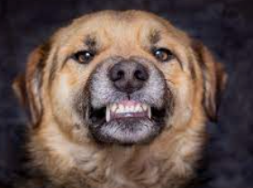
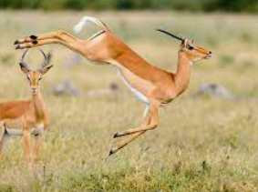
Behavior Patterns
Opossum plays dead.
Rabbits zig zag
Dogs bark and bare their teeth.
Birds swoop.
Bears stand and growl

Slide 18
Natural Selection
Operates when nature and/or the environment selects which variations or adaptation are helpful or advantageous and those which are not
We often want to look at the FITNESS of an organism → meaning the ability to survive and reproduce
We can measure “fitness” by how many offspring survive to reproduce the next generation
To increase “fitness,” organisms may use “Sexual Selection”

Slide 19
Sexual Selection
1) Females chose the traits (genes) in males that they want to pass on to their offspring.
Bucks (male deer) compete for the “right” to mate a doe when in estrus.
2) Female penguins fight over who gets the male penguin for mating … the weaker or feeble fighters lose out.
3) Female insects use “pheromones” to attract male insects.
4) What kind of guy do you want? The traits you exhibit attract certain guys.
Responsible, dedicated, reliable, trustworthy, diligent
Attractive, strong, sexy, ???
What guarantees your offspring will survive?

Slide 20
Sexual Selection
Who has the “Good Genes?”

Slide 21
Sexual Selection
Organisms not only need to survive, they need to reproduce and have offspring that survive.
In order to ensure some “benefit” for her offspring, females often choose males with genes best suited for their particular environment.

Slide 22
Sexual Selection
In other words, females look for characteristics in males that may signify that the male has “Good genes”.
Females want to pass on these genes to their offspring.

Slide 23
Bower birds
Males build huge nests on the ground to impress mates.
They use berries, flowers etc to decorate them.
Birds from different regions prefer to decorate with different colors (red, blue, green or white)

Slide 24
Peacocks
Peacocks -
Females look for males with long, ornamental tail feathers. The longer tailed males seem to live longer.

Slide 25
Barn Swallows
Barn Swallows-
Females prefer males with long tail feathers. It is believed that males with longer tail feathers carry fewer parasites.

Slide 26
Song Birds - Tree Swallow
Song birds -
Several species of song birds sing their own special song. Females listen for specific sequences, tones, pitches etc when choosing mates.

Slide 27
Song birds
Scarlet Tanager -

Slide 28
Song birds
Northern Mockingbird

Slide 29
Fowl
Dominant jungle fowl roosters -
The presence of a large comb on the rooster’s head may indicate that he has a better immune system than other males.

Slide 30
Nuptial gifts
Some males bring females a tasty treat to increase their chances for mating. These treats are called Nuptial gifts.

Slide 31
Nuptial gifts
Male chimpanzees -
Often supply chunks of meat to potential mates.

Slide 32
Nuptial gifts
Praying Mantis -
Unfortunately for the male mantis, he often becomes the gift. After mating, the female usually eats the male.
This also happens to the male Australian redback spider.
Too bad guys!

Slide 33
Nuptial gifts
Scorpionfly -
These guys do one of two things:
1. Present dead insects to the female as a gift
2. Secrete saliva onto leaves and offer it as food

Slide 34
Summary
These are just a few examples of sexual selection.
Organisms not only need to survive, they need to reproduce to carry on their family tree.
Organisms often mate with those they feel have “Good genes” to pass on to their offspring.

Slide 35
Summary
Different organisms look for different things to indicate “Good genes”.
Examples are:
Looks
Songs
Dance
Nuptial gifts
Creation of a nest or home

Slide 36
What are you looking for in a mate?
Hmmmmmmmmm

