Slide 1
Go to the “Slide Show” shade above
Click on “Play from Beginning”

Slide 2
Organism Reproduction: Meiosis
Chapter 11

Slide 3
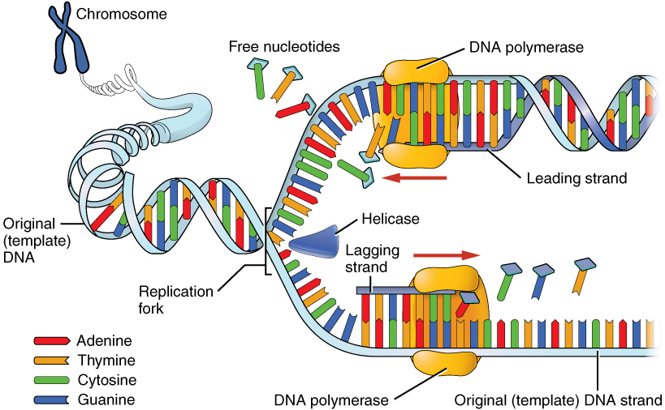
DNA Replication
  ?
  ? Enzyme
  ?
  ? Enzyme
  ?
  ?
  ?
  ? Nitrogenous Bases
  ? Enzyme

Slide 4
DNA Replication

Slide 5
Question:
What would be the complementary DNA strand for the following DNA sequence?
DNA -TAGGCT-

Slide 6
Answer:
DNA -TAGGCT-
DNA -ATCCGA-

Slide 7
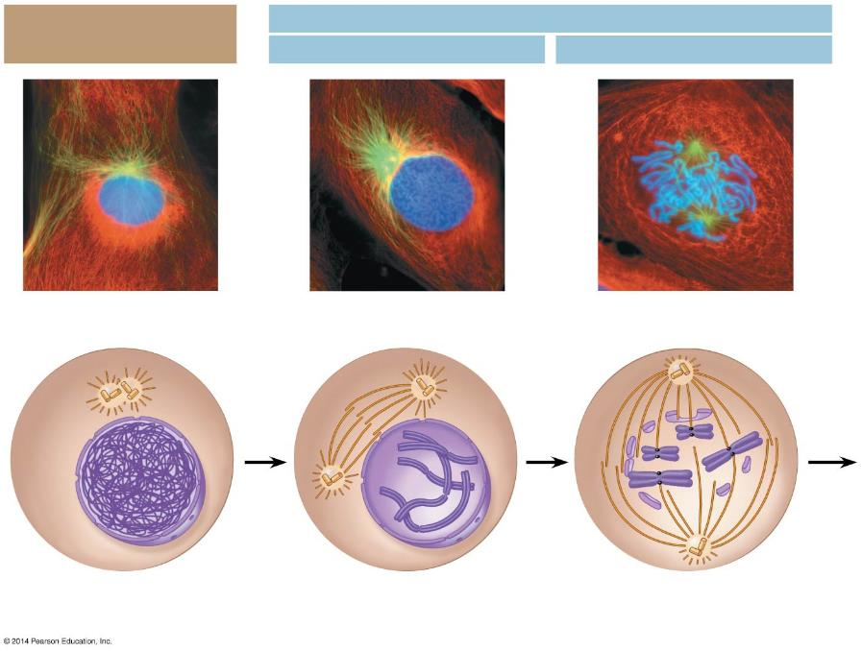
  ?
Mitosis
Interphase
  ?
Prometaphase
Prophase
  ?
  ?
Fragments of
the nuclear envelope
Centrioles
Chromatin
Early mitotic
spindle
Centrioles
  ?
Kinetochore
  ?
  ?
Nuclear
envelope
Centromere
Spindle
microtubules
Plasma
membrane
  ?
Chromosome, consisting
of two sister chromatids
Notes:
Figure 8.5-1 The stages of cell division by mitosis: interphase through prometaphase

Slide 8
Mitosis
Interphase
Prophase
Prometaphase
Centrioles
Early mitotic
spindle
Fragments of
the nuclear envelope
Chromatin
Centrioles
Kinetochore
Nuclear
envelope
Centromere
Spindle
microtubules
Plasma
membrane
Chromosome, consisting
of two sister chromatids
Notes:
Figure 8.5-1 The stages of cell division by mitosis: interphase through prometaphase

Slide 9
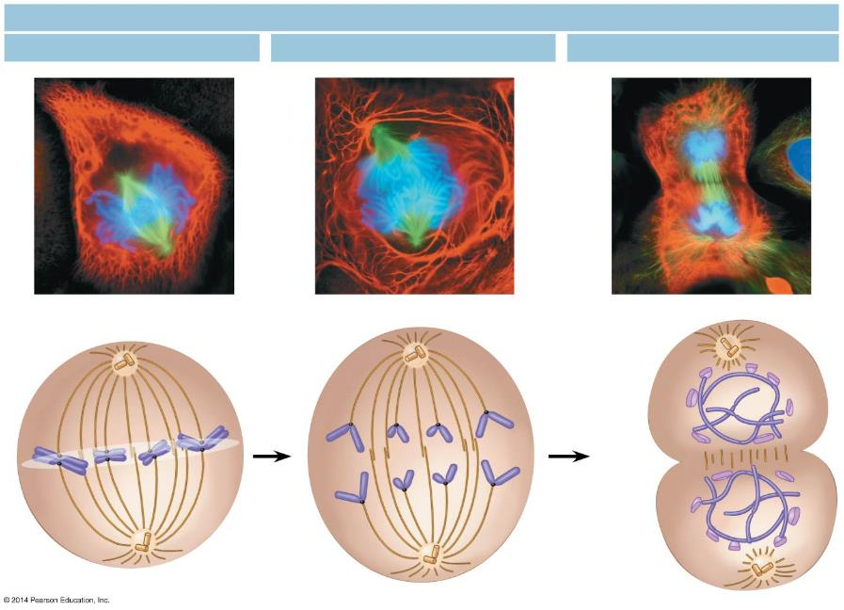
Mitosis
  ?
  ?
Metaphase
  ?
Telophase and Cytokinesis
Anaphase
Metaphase plate
  ?
Cleavage
furrow
  ?
Nuclear
envelope
forming
  ?
  ?
Separated
chromosomes
Mitotic spindle
Notes:
Figure 8.5-6 The stages of cell division by mitosis: metaphase through cytokinesis

Slide 10
Mitosis
Metaphase
Anaphase
Telophase and Cytokinesis
Metaphase plate
Cleavage
furrow
Nuclear
envelope
forming
Separated
chromosomes
Mitotic spindle
Notes:
Figure 8.5-6 The stages of cell division by mitosis: metaphase through cytokinesis

Slide 11
Lesson Objectives
  By the end of this lesson, you should be able to:
Investigate the asexual cell/organism reproductive processes of binary fission and budding.
Review more information regarding chromosomes and how they align during the sexual reproductive cell division process of meiosis.
Illustrate the steps of meiosis (two major stages of meiosis I and meiosis II).
Identify and define the differences between male and female meiosis in humans.
Describe ways in which genetic variation occurs – the roles of crossing over and independent assortment in meiosis.
Explain the importance of meiosis to living organisms.
  Science Practice: Meiosis Simulation
Notes:
#frame
instructional video
Timing ≈ 0.5 minutes
Living organisms need energy to accomplish the wide variety of tasks they attempt each day.
You will begin learning about how energy is captured from the Sun and stored in organic molecules.
[read objectives]

Slide 12
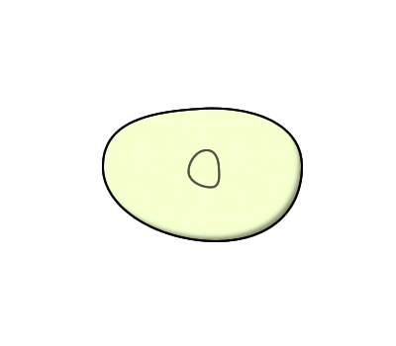
Processes of Asexual Reproduction
  Binary fission
  The process of cell division (asexual reproduction).
  in prokaryotic organisms
  by which the parent cell divides into two genetically identical cells.
  Produces two identical cells in prokaryotes.
Notes:
Timing ≈ 0.5min
Asexual reproduction happens differently in prokaryotes and eukaryotes. This is because the process of cell division is different in prokaryotes than it is in eukaryotes. We’re going to look at prokaryotes first.
[animate]
The process of cell division (asexual reproduction) in prokaryotic organisms by which the parent cell divides into two genetically identical cells.
-Go through the animation
-This is a relatively simple process of division where the dna gets copied and then the cell divides equally to generate 2 identical cells.
SOURCES:
Binary fission animation. “Binary Fission Anim.,” ZabMilenko. 2004 as CC/GNU, Digital Animation. http://en.wikipedia.org/wiki/File:Binary_fission_anim.gif (accessed March 4, 2011).

Slide 13
Asexual Reproduction
Advantages
Disadvantages
It is faster.
Large numbers of offspring are produced.
The parent does not have to find a mate.
All of the offspring are exactly alike. There is no variation.
The ability to adapt to a changing environment is greatly reduced.

Slide 14
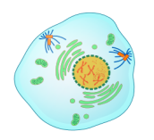
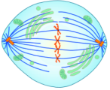
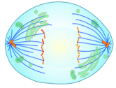
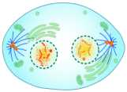
Processes of Asexual Reproduction
  Mitosis is the process of cell division by which exact copies of chromosomes are divided
  to create two daughter cells,
  each with a complete set of identical chromosomes.
  Has four steps (PMAT)
  Produces two identical cells in eukaryotes.
Prophase
Metaphase
Anaphase
Telophase
Notes:
Timing ≈ 1 minute
Now lets look at how asexual reproduction happens in eukaryotes. It is still going to occur through cell division, but since the cells of eukaryotes are more complicated, the process is more complicated too.
[animate]
Mitosis is The process of cell division by which exact copies of chromosomes are divided to create two daughter cells, each with a complete set of identical chromosomes.
[animate]
-There are 4 steps to cell division through mitosis, and we sometimes refer to them as PMAT (“p-mat”) to stand for the 4 steps, prophase, metaphase, anaphase, and telophase
-Go through the picture and explain the steps briefly (prophase- chromosomes condense, metaphase-chromosomes line up in the middle, anaphase-chromosomes pull apart, telophase-cells prep for division)
[animate]
-This form of cell division also creates 2 identical cells but in eukaryotes.
-This is the process of cell division that makes new cells and allows your body to grow and heal.
-Mitosis can also generate new organisms through budding and spore formation. Budding is when a new offspring is generated from a section of the parent and happens mostly in protists and plants, though some animals like sponges can bud as well. Spore formation is reproduction from spores that separate from the parent to form a new organism.
SOURCES:
Mitosis. “MITOSIS cells secuence.svg,” Mariana Ruiz Villarreal. 2008 as PD, Digital Image. http://commons.wikimedia.org/wiki/File:MITOSIS_cells_secuence.svg (accessed March 3, 2011).

Slide 15
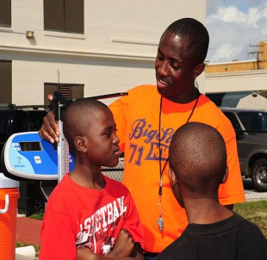
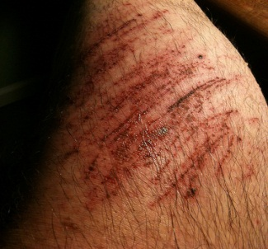
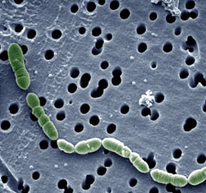
Importance of mitosis to Living Organisms
Living organisms depend on asexual reproduction for life.
Growth Allows organisms to grow.
Repair Replaces damaged or dead cells.
Reproduction Creates new organisms
Photo by Chuck B.
Notes:
Timing ≈ .5 min
Asexual reproduction is an important process to living things.
Living organisms depend on mitosis for life. Remember that this is the process that allows for asexual reproduction! But what does that allow living things to do?
As cells are duplicated and divided, new cells are formed.
These cells allow the organism to continue to grow.
[Animate]
For example, when a baby is born they are not the same size as an adult
The DNA in the cells of the baby is duplicated and cells are then divided.
As the cells divide these new cells help in the growth of the baby into adulthood.
Their body cells, skin cells, heart cells, bone cells, etc. all continue to reproduce for growth of the baby.
This is also the same with plants.
[Animate]
Organisms also depend on mitosis for repair.
The duplication of cells and the division during mitosis allows new cells to be formed that replace old or damaged cells.
This helps the organism repair and replace damaged cells and dead cells.
Without mitosis old cells would never be replaced because new cells would not be formed.
[Animate]
Reproduction also occurs, creating new cells
Organisms, like bacteria, rely on binary fission to create new bacteria because they only reproduce asexually.
Your body cells go through mitosis continuously for growth, repair and reproduction.
Ultimately, the purpose of mitosis is to allow organisms to grow, repair, and reproduce new cells in order to survive.
SOURCES:
Scab. “Do you want to see my scabs?” Chuck B. 2011 as CC, Digital Image. http://www.flickr.com/photos/82479320@N00/6551976743/ (accessed April 23, 2012).
Growth. “US Navy 110426-N-00332-114 Students measure the height and body weight of fourth and fifth grade students from Lindenwood Elementary School.jpg, “ US NAVY. 2011 as PD, digital image. http://commons.wikimedia.org/wiki/File:US_Navy_110426-N-00332-114_Students_measure_the_height_and_body_weight_of_fourth_and_fifth_grade_students_from_Lindenwood_Elementary_School.jpg (accessed May 21st, 2012)

Slide 16
Overview
Asexual Reproduction results in the production of organisms that are genetically identical, called clones.
Organisms formed through Sexual Reproduction receive half their chromosomes from the male parent and half from the female parent.

Slide 17
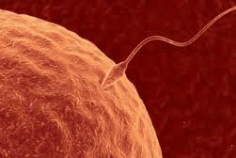
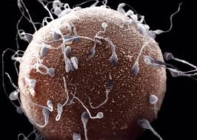
Sexual Reproduction
Sexual reproduction requires two parent cells.
Each parent cell passes HALF its genes to its offspring.
Must have male and female:
male to produce sperm
and female to produce eggs.

Slide 18
Sexual Reproduction
Advantages
Disadvantages
All of the offspring are genetically different from each other (variation).
The parent must find a mate.
Fewer offspring will be produced.
It takes longer.

Slide 19
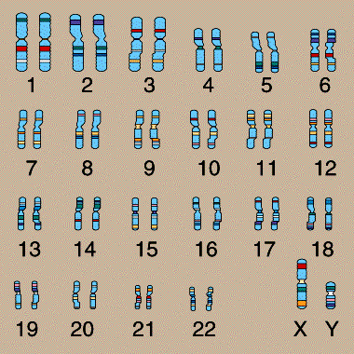
Chromosomes are Matched in Homologous Pairs
In humans, Somatic (Body) Cells have 46 chromosomes forming 23 pairs of Homologous Chromosomes.
Homologous Chromosomes are the two copies of each chromosome, one coming from the mother and one coming from the father.

Slide 20
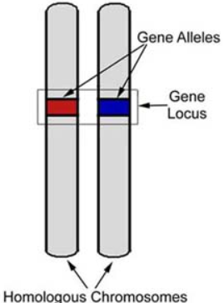
Chromosomes are Matched in Homologous Pairs
Homologous Chromosomes are matched in
  length
  centromere position
  staining pattern
A LOCUS (plural, loci) is the position of a gene.
Different versions of a gene may be found at the same locus on the two chromosomes of a homologous pair.

Slide 21
Chromosomes are Matched in Homologous Pairs
The human Sex Chromosomes X and Y differ in size and genetic composition.
The other 22 pairs of chromosomes are Autosomes with the same size and genetic composition.

Slide 22
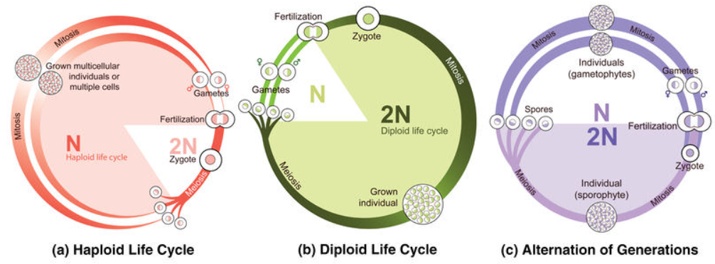
Gametes have a Single Set of Chromosomes
An organism’s Life Cycle is the sequence of stages leading from the adults of one generation to the adults of the next.
Humans and many animals and plants are Diploid (2n), because all somatic cells contain pairs of homologous chromosomes.

Slide 23
Gametes have a Single Set of Chromosomes
GAMETES
  are eggs and sperm
  are Haploid (n) because each cell has a single set of chromosomes.
The human life cycle begins when a haploid sperm fuses with a haploid egg in Fertilization.
The Zygote, formed by fertilization, is now diploid.
Mitosis of the zygote and its descendants generates all the somatic cells into the adult form.

Slide 24
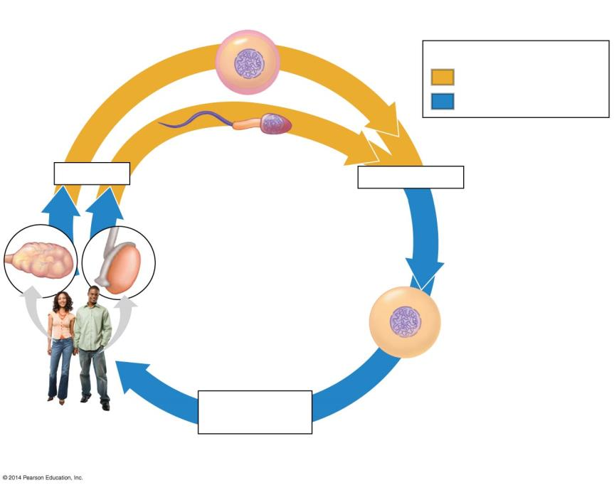
Haploid gametes (n = 23)
n
Key
n
Haploid stage (n)
Egg cell
Diploid stage (2n)
n
n
Sperm cell
Meiosis
Fertilization
Ovary
Testis
2n
Diploid
zygote
(2n = 46)
Mitosis and
development
Multicellular
diploid adults
(2n = 46)
Notes:
Figure 8.12a The human life cycle

Slide 25
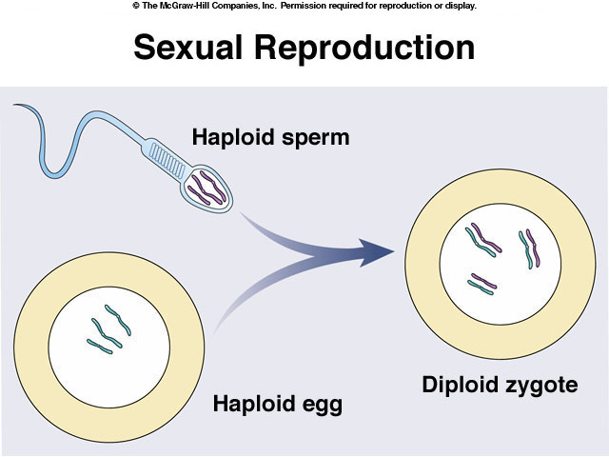
Fertilization: “Putting it all together”
2n = 46
n =23

Slide 26
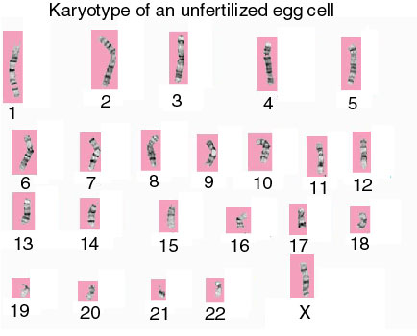
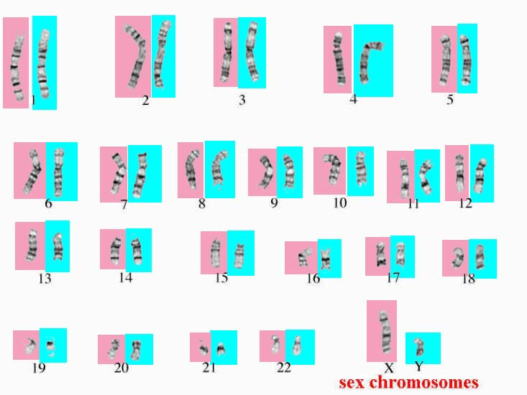
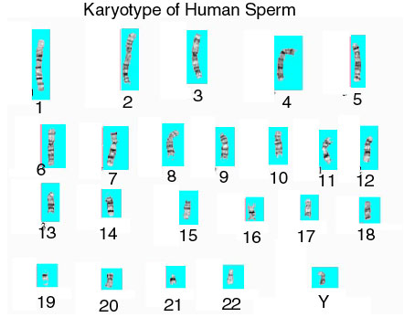
Fertilization – “Putting it all together”

Slide 27
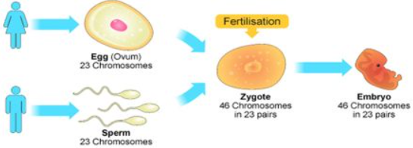
Gametes have a Single Set of Chromosomes
Gametes (haploid sex cells) are made by MEIOSIS in the ovaries and testes.
MEIOSIS is a type of cell division that produces haploid gametes in diploid organisms.
Two haploid gametes may then combine in fertilization to restore the diploid state in the zygote.
Fertilization
Notes:
Student Misconceptions and Concerns
• Students might not immediately see the need for meiosis in sexual reproduction. Consider an example of what would happen over many generations if gametes were produced by mitosis. The resulting genetic doubling is prevented if each gamete has only half the genetic material of the adult cells.
Teaching Tips
• Consider helping students think through mitosis and meiosis by developing an analogy to pairs of shoes. In this case, any given species has a certain number of pairs of shoes, or homologous chromosomes.
• In the shoe analogy, females have 23 pairs of matching shoes, while males have 22 matching pairs and 1 odd pair . . . maybe a sandal and a sneaker!
• You might want to get your students thinking by asking them why eggs and sperm are different. (This depends upon the species, but within vertebrates, eggs and sperm are specialized for different tasks. Sperm are adapted to move to an egg and donate a nucleus. Eggs contain a nucleus and most of the cytoplasm of the future zygote. Thus eggs are typically larger, nonmotile, and full of cellular resources to sustain cell division and growth.)
Active Lecture Tips
• See the Activity Student Demonstration of Mitosis and Meiosis Using Chromosome Cut-Outs as Models on the Instructor Exchange. Visit the Instructor Exchange in the MasteringBiology instructor resource area for a description of this activity.

Slide 28
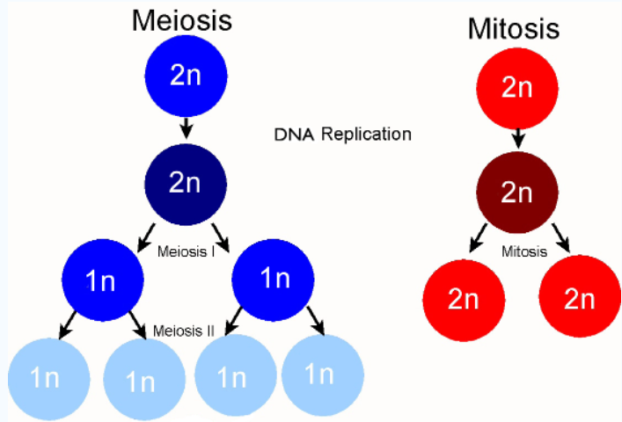
Gametes have a Single Set of Chromosomes
MEIOSIS reduces the chromosome number by HALF:
    Daughter cells contain half the number of chromosomes as the parent cell.
    Preceded by Replication and followed by two divisions: Meiosis I and Meiosis II.
Notes:
Student Misconceptions and Concerns
• Students might not immediately see the need for meiosis in sexual reproduction. Consider an example of what would happen over many generations if gametes were produced by mitosis. The resulting genetic doubling is prevented if each gamete has only half the genetic material of the adult cells.
Teaching Tips
• Consider helping students think through mitosis and meiosis by developing an analogy to pairs of shoes. In this case, any given species has a certain number of pairs of shoes, or homologous chromosomes.
• In the shoe analogy, females have 23 pairs of matching shoes, while males have 22 matching pairs and 1 odd pair . . . maybe a sandal and a sneaker!
• You might want to get your students thinking by asking them why eggs and sperm are different. (This depends upon the species, but within vertebrates, eggs and sperm are specialized for different tasks. Sperm are adapted to move to an egg and donate a nucleus. Eggs contain a nucleus and most of the cytoplasm of the future zygote. Thus eggs are typically larger, nonmotile, and full of cellular resources to sustain cell division and growth.)
Active Lecture Tips
• See the Activity Student Demonstration of Mitosis and Meiosis Using Chromosome Cut-Outs as Models on the Instructor Exchange. Visit the Instructor Exchange in the MasteringBiology instructor resource area for a description of this activity.

Slide 29
Meiosis Forms Haploid Gametes
Meiosis must reduce the chromosome number by half.
Fertilization then restores the diploid (2n) number.
from mom
from dad
child
Too
much!
Meiosis reduces chromosome number
The correct number!

Slide 30
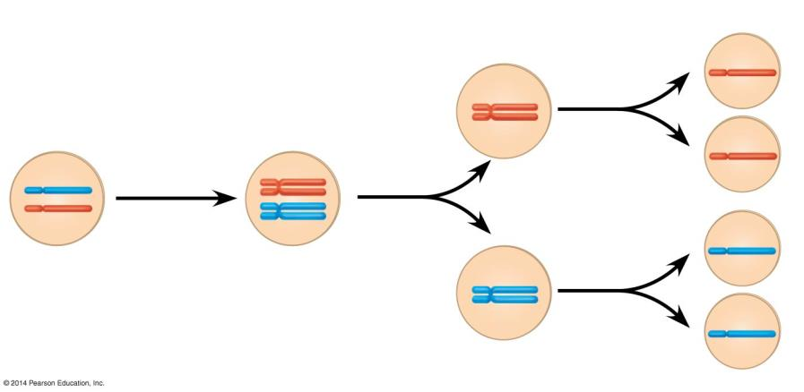
Interphase
Meiosis I
Meiosis II
Sister
chromatids
3
1
2
Sister chromatids
separate
Haploid cells
Chromosomes
duplicate
Homologous
chromosomes
separate
A pair of
homologous
chromosomes
in a diploid
parent cell
A pair of
duplicated
homologous
chromosomes
Notes:
Figure 8.12b How meiosis halves chromosome number

Slide 31
MEIOSIS reduces the Chromosome Number from Diploid (2n) to Haploid (n)
Meiosis and Mitosis are preceded by the duplication of chromosomes (DNA Replication).
However,
  Meiosis is followed by two consecutive cell divisions
  Mitosis is followed by only one cell division.
Meiosis involves one duplication of chromosomes followed by two divisions,
Each of the four daughter cells produced possess an haploid set of chromosomes.

Slide 32
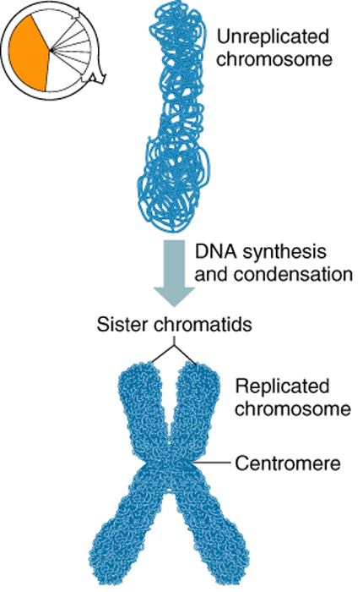
MEIOSIS reduces the Chromosome Number from Diploid (2n) to Haploid (n)
INTERPHASE:
Like mitosis, meiosis is preceded by an interphase.
during which the chromosomes duplicate.
Replicated copies are called sister chromatids
Held together at centromere
Notes:
Replication is the process of duplicating chromosome. The new copy of a chromosome is formed by DNA synthesis during S-phase. The chromosome copies are called sister chromatids. Sister chromatids are held together at the centromere.

Slide 33
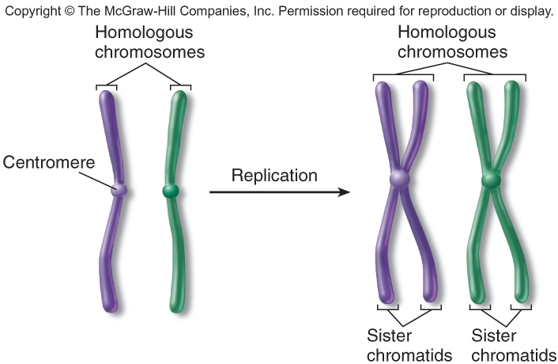
A Replicated Chromosome
Homologous chromosomes are chromosomes that share: the same structural features (e.g. same size, same banding patterns, same centromere positions). The same genes at the same loci positions (while the genes are the same, alleles may be different).

Slide 34
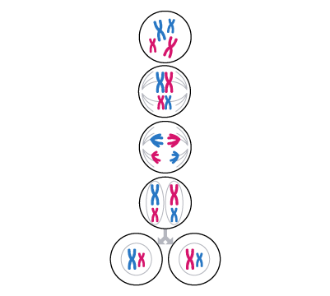
MEIOSIS reduces the Chromosome Number from Diploid (2n) to Haploid (n)
MEIOSIS I – Prophase I key events:
  The nuclear membrane dissolves.
  Chromatin tightly coils up.
  Homologous chromosomes, each composed of two sister chromatids, come together in pairs in a process called Synapsis.

Slide 35
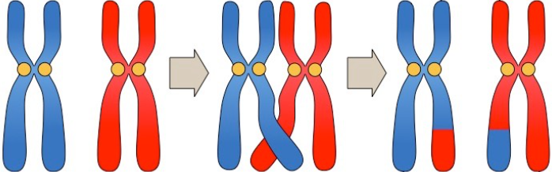
MEIOSIS reduces the Chromosome Number from Diploid (2n) to Haploid (n)
MEIOSIS I – Prophase I key events:
  During synapsis, chromatids of homologous chromosomes exchange segments in a process called Crossing Over.
  The chromosome tetrads move toward the center of the cell.

Slide 36

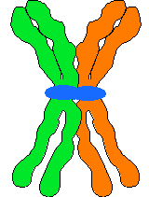

Tetrads Form in Prophase I
Homologous chromosomes
align with sister chromatids).
Joining to form a TETRAD.
Synapsis

Slide 37
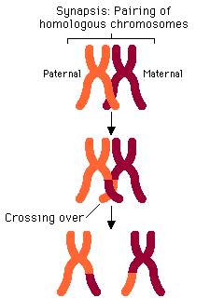
Crossing-Over
Homologous chromosomes in a tetrad cross over each other.
Pieces of chromosomes or genes are exchanged.
Produces Genetic Recombination in the offspring.

Slide 38
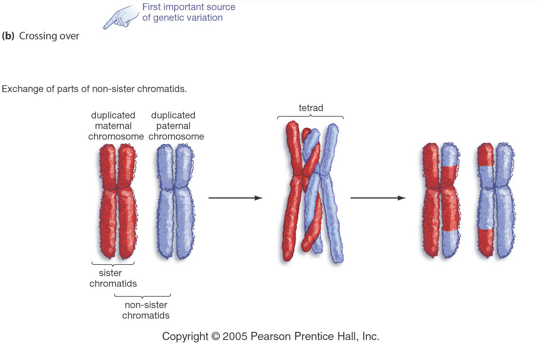
Crossing-Over
Crossing-Over multiplies the already huge number of different gamete types produced.

Slide 39
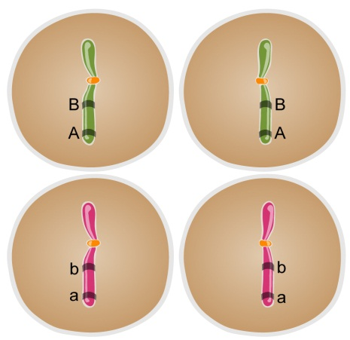
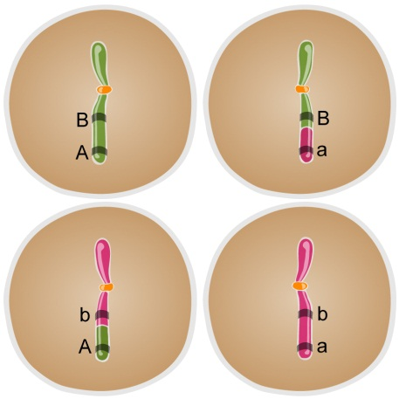
The Process of Meiosis: Crossing Over
WITHOUT crossing over
With crossing over
Notes:
Timing ≈ 1 min
In prophase one, a special process occurs that allows for genetic variation.
[animate]
-draw on the diagram as needed. Sections of chromosomes that code for particular traits are called genes (for example, you have a gene for the shape of your ears or the size of your teeth.
-If crossing over didn’t occur, the genes on a particular chromosome stay the same. The 4 haploid gametes that are produced have chromosomes that are identical to the parent’s chromosomes
[animate]
-In the prophase stage of meiosis I, crossing over does occur. This allows for the genes to be mixed up between the chromosmes which means that the resulting 4 cells have different combinations of DNA. This result in a new combination of genetic information for the cell for a specific trait. (example: flower color or stem height in plants can be altered or exchanged during crossing over, meaning that whereas before there were tall purple plants, now there might be a short purple plant.
Crossing over can occur at any place on the chromosome and can affect any trait of an organism.
Explain that genetic variation is important to species because it allows for a variety or traits to exist and help in new situations. That genetic variation is provided through this process
SOURCES:
Images by e2020
Glencoe Online Learning Center. “Sexual Reproduction and Meiosis.” McGraw-Hill. Last modified n.d. Accessed June 8, 2011. http://highered.mcgraw-hill.com/sites/9834092339/student_view0/chapter11/meiosis_with_crossing_over.html.

Slide 40
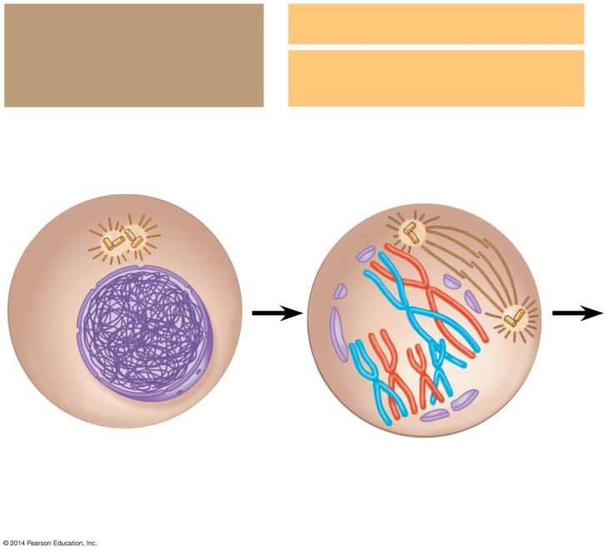
  ?
  ?
Interphase:
Chromosomes
duplicate
Meiosis I:
  ?
  ?
Prophase I
  ?
Sites of
crossing over
  ?
Centrioles
  ?
Spindle
Tetrad
  ?
  ?
Nuclear
envelope
Chromatin
  ?
  ?
Sister
chromatids
Fragments
of the nuclear
envelope
  ?
Notes:
Figure 8.13-2 The stages of meiosis (part 2)

Slide 41
Interphase:
Chromosomes
duplicate
Meiosis I:
Prophase I
Sites of
crossing over
Centrioles
Spindle
Tetrad
Nuclear
envelope
Chromatin
Sister
chromatids
Fragments
of the nuclear
envelope
Notes:
Figure 8.13-2 The stages of meiosis (part 2)

Slide 42
MEIOSIS reduces the Chromosome Number from Diploid (2n) to Haploid (n)
MEIOSIS I – Metaphase I:
Tetrads align at the cell equator.
Homologous chromosome alignment.

Slide 43
MEIOSIS reduces the Chromosome Number from Diploid (2n) to Haploid (n)
MEIOSIS I – Anaphase I:
  Homologous Pairs Separate and move toward opposite poles of the cell.
  Unlike mitosis, the sister chromatids making up each doubled chromosome remain attached.
  When the Homologous Pairs are pulled apart, this reduces the diploid number (2n) to the haploid number (n).

Slide 44
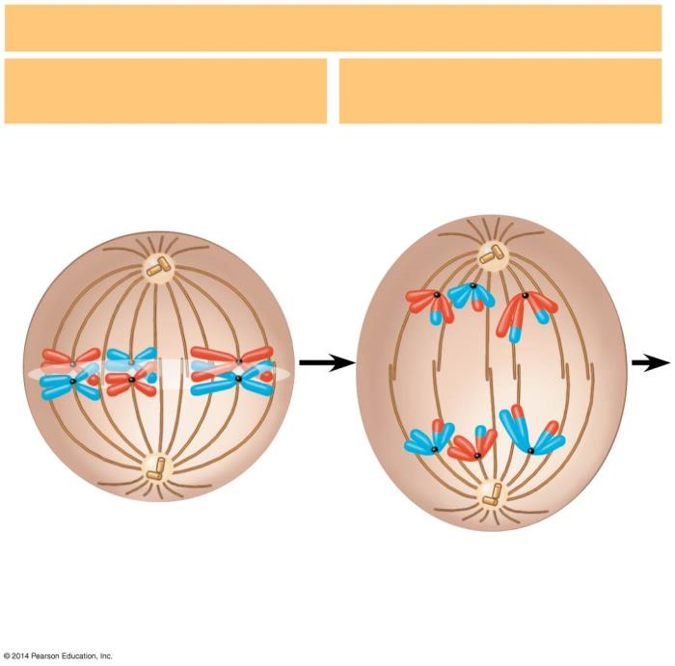
Meiosis I: continued
  ?
  ?
Metaphase I
Anaphase I
  ?
Sister chromatids
remain attached
Metaphase
plate
  ?
Centromere
  ?
  ?
Homologous
chromosomes
separate
Notes:
Figure 8.13-3 The stages of meiosis (part 3)

Slide 45
Meiosis I: continued
Metaphase I
Anaphase I
Sister chromatids
remain attached
Metaphase
plate
Centromere
Homologous
chromosomes
separate
Notes:
Figure 8.13-3 The stages of meiosis (part 3)

Slide 46
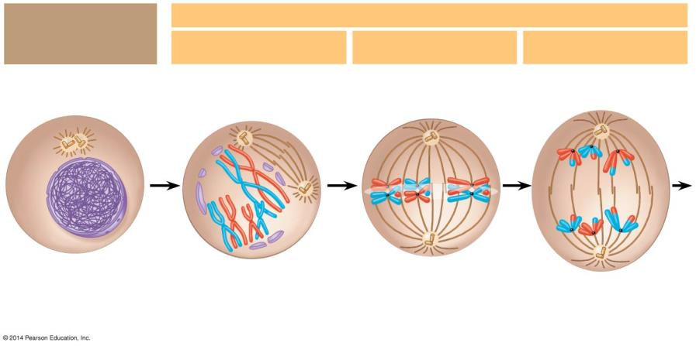
Interphase:
Chromosomes
duplicate
Meiosis I: Homologous chromosomes separate
Prophase I
Metaphase I
Anaphase I
Sites of
crossing over
Sister chromatids
remain attached
Centrioles
Spindle
Tetrad
Metaphase
plate
Nuclear
envelope
Chromatin
Sister
chromatids
Fragments
of the nuclear
envelope
Centromere
Homologous
chromosomes
separate
Notes:
Figure 8.13-1 The stages of meiosis (part 1)

Slide 47
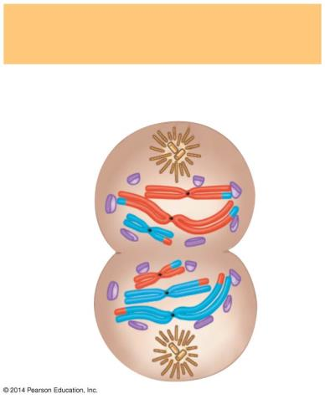
MEIOSIS reduces the Chromosome Number from Diploid (2n) to Haploid (n)
MEIOSIS I – Telophase I
Duplicated chromosomes have reached the poles.
Usually, cytokinesis occurs along with telophase.
These cells are haploid; but there are two copies of the same genetic information in the chromosomes in each of the two cells formed.
Telophase I and
Cytokinesis
Cleavage
furrow

Slide 48
MEIOSIS reduces the Chromosome Number from Diploid (2n) to Haploid (n)
MEIOSIS I – Telophase I
Nuclear envelope reassembly.
Spindle disappears.
2 new cells form with duplicate chromosomes in each.
Telophase I and
Cytokinesis
Cleavage
furrow

Slide 49
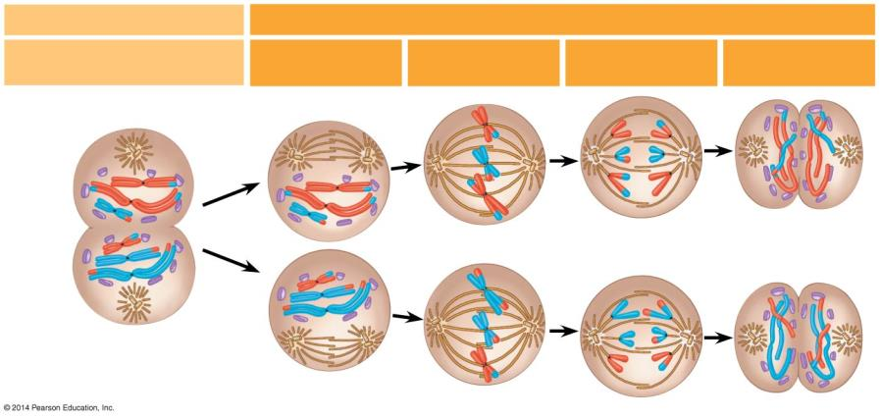
Meiosis II Summary
Meiosis II: Sister chromatids separate
Telophase I and
Cytokinesis
Prophase II
Metaphase II
Anaphase II
Telophase II
and Cytokinesis
Cleavage
furrow
Sister chromatids
separate
Haploid
daughter
cells forming
Notes:
Figure 8.13-4 The stages of meiosis (part 4)

Slide 50
MEIOSIS reduces the Chromosome Number from Diploid (2n) to Haploid (n)
MEIOSIS II follows MEIOSIS I without chromosome duplication.
Each of the two haploid cells that are products of MEIOSIS I enters MEIOSIS II.
MEIOSIS II – Prophase II
  A spindle forms and moves chromosomes toward the middle of the cell.
  Chromatin coils into chromosomes.

Slide 51
MEIOSIS reduces the Chromosome Number from Diploid (2n) to Haploid (n)
MEIOSIS II – Metaphase II
Duplicated chromosomes align at the cell equator like they are in mitosis.
Chromosomes attach to spindle fiber.
MEIOSIS II – Anaphase II
  Sister chromatids separate.
  Individual chromosomes move toward opposite poles.
  Centromeres split.

Slide 52
MEIOSIS reduces the Chromosome Number from Diploid (2n) to Haploid (n)
MEIOSIS II – Telophase II
  Chromosomes have reached the poles of the cell.
  A nuclear envelope forms around each set of chromosomes.
  With Cytokinesis, sister chromatids separate into FOUR HAPLOID CELLS are produced.
Watch Animation

Slide 53
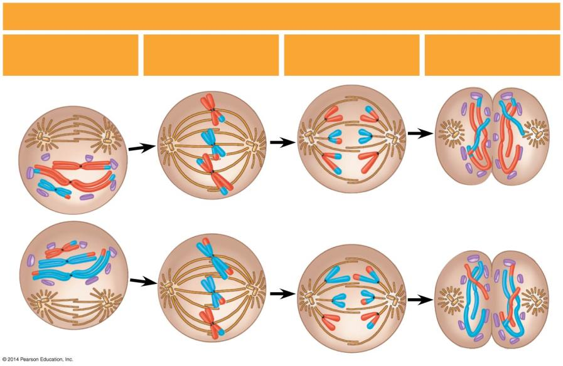
Meiosis II: Sister chromatids separate
Telophase II
and Cytokinesis
  ?
  ?
  ?
  ?
Prophase II
Metaphase II
Anaphase II
  ?
  ?
Sister chromatids
separate
Haploid
daughter
cells forming
Notes:
Figure 8.13-6 The stages of meiosis (part 6)

Slide 54
Meiosis II: Sister chromatids separate
Telophase II
and Cytokinesis
Prophase II
Metaphase II
Anaphase II
Sister chromatids
separate
Haploid
daughter
cells forming
Notes:
Figure 8.13-6 The stages of meiosis (part 6)

Slide 55
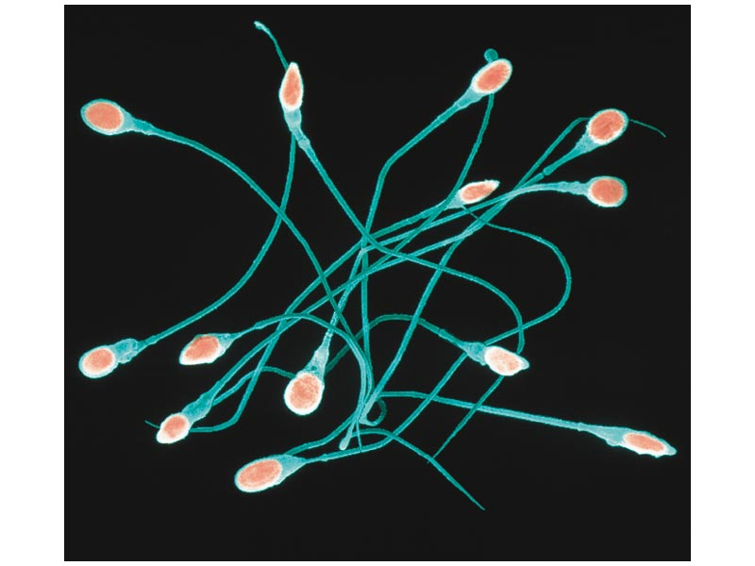
Meiosis in Human Males
Occurs in the testes.
Two divisions produce 4 sperm cells.
Starts at the beginning of puberty.
Men produce about 250,000,000 sperm per day.

Slide 56
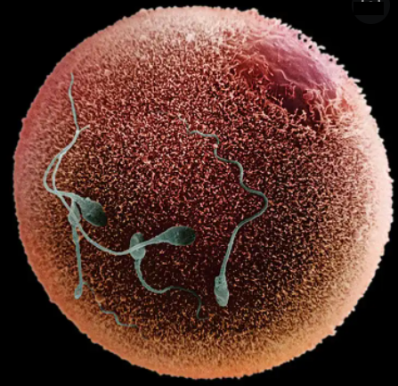
Meiosis in Human Females
Occurs in the ovaries.
Produces 3 polar bodies that die and 1 egg.
Polar bodies die because of unequal division of cytoplasm.
Immature egg called Oocyte.
Starting at puberty, one oocyte matures into an Egg every 28 days.

Slide 57
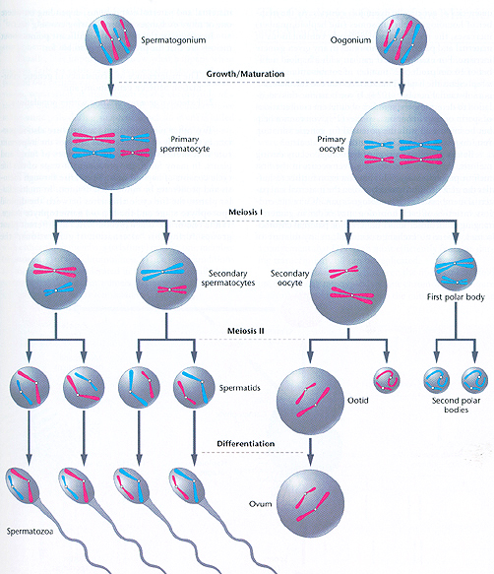
Meiosis in Humans

Slide 58
Mitosis and Meiosis have Important Similarities and Differences
Mitosis and Meiosis both begin with diploid (2n) parent cells that have chromosomes duplicated during the previous Interphase.
However, the End Products Differ:
  Mitosis produces two genetically identical diploid (2n) somatic daughter cells.
  Meiosis produces four genetically unique haploid gametes.

Slide 59
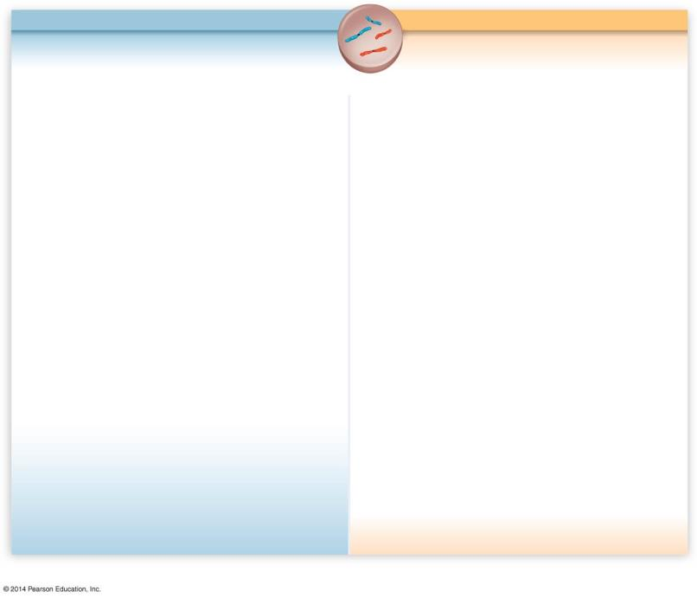
MITOSIS
MEIOSIS I
Parent cell
2n = 4
Notes:
Figure 8.14-1 Comparison of mitosis and meiosis (step 1)

Slide 60
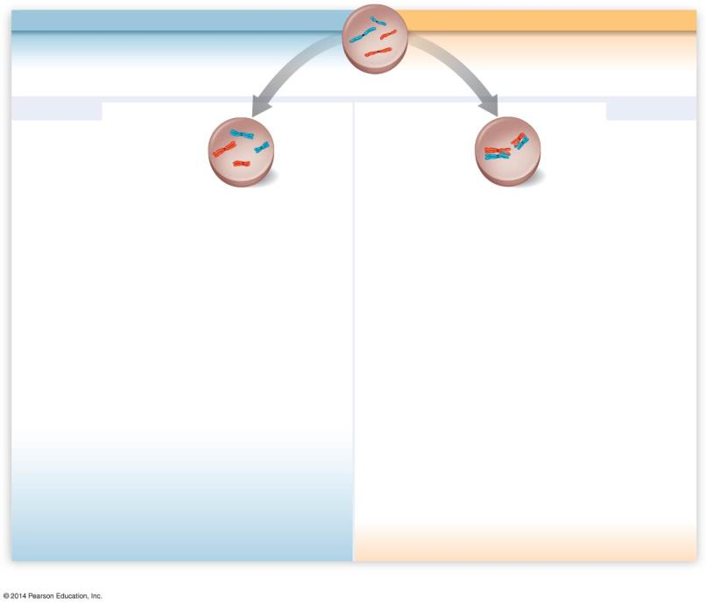
MITOSIS
MEIOSIS I
Chromosomes
are duplicated
Chromosomes
are duplicated
Parent cell
2n = 4
Prophase
Prophase I
Homologous
chromosomes
pair up
Homologous
chromosomes
remain separate
Crossing over
Notes:
Figure 8.14-2 Comparison of mitosis and meiosis (step 2)

Slide 61
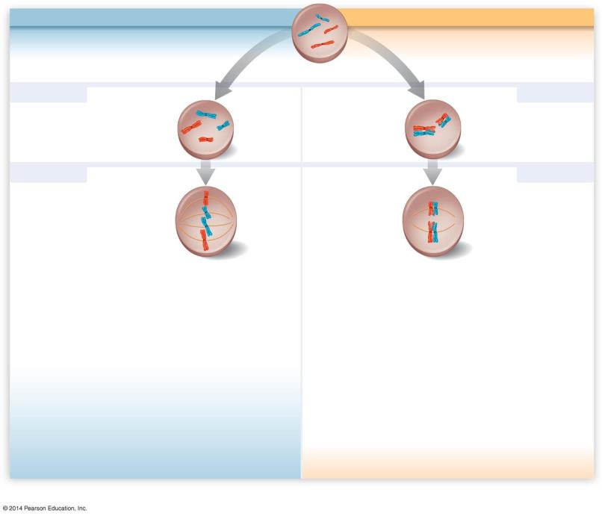
MITOSIS
MEIOSIS I
Chromosomes
are duplicated
Chromosomes
are duplicated
Parent cell
2n = 4
Prophase
Prophase I
Homologous
chromosomes
pair up
Homologous
chromosomes
remain separate
Crossing over
Metaphase
Metaphase I
Chromosomes
line up at the
metaphase plate
Pairs of
homologous
chromosomes
line up at the
metaphase plate
Notes:
Figure 8.14-3 Comparison of mitosis and meiosis (step 3)

Slide 62
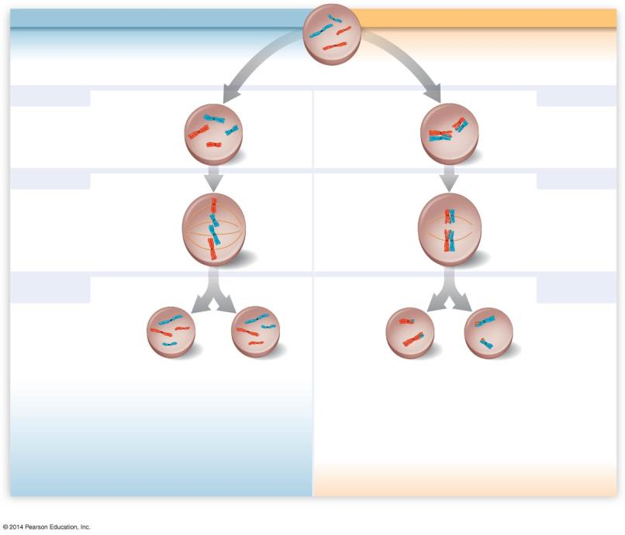
MITOSIS
MEIOSIS I
Chromosomes
are duplicated
Chromosomes
are duplicated
Parent cell
2n = 4
Prophase
Prophase I
Homologous
chromosomes
pair up
Homologous
chromosomes
remain separate
Crossing over
Metaphase
Metaphase I
Chromosomes
line up at the
metaphase plate
Pairs of
homologous
chromosomes
line up at the
metaphase plate
Anaphase
Telophase
Anaphase I
Telophase I
Homologous
chromosomes
are separated
Sister
chromatids
are separated
Sister chromatids
remain attached
2n
2n
n = 2
n = 2
Notes:
Figure 8.14-4 Comparison of mitosis and meiosis (step 4)

Slide 63
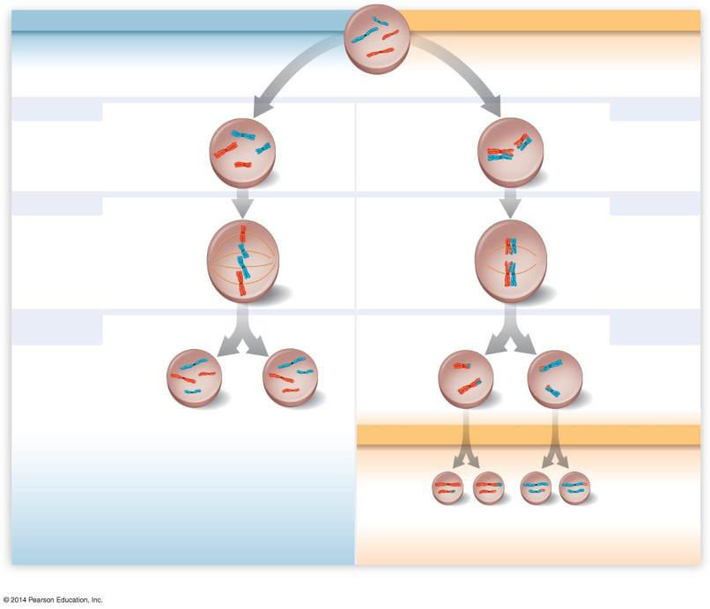
MITOSIS
MEIOSIS I
Chromosomes
are duplicated
Chromosomes
are duplicated
Parent cell
2n = 4
Prophase
Prophase I
Homologous
chromosomes
pair up
Homologous
chromosomes
remain separate
Crossing over
Metaphase
Metaphase I
Chromosomes
line up at the
metaphase plate
Pairs of
homologous
chromosomes
line up at the
metaphase plate
Anaphase
Telophase
Anaphase I
Telophase I
Homologous
chromosomes
are separated
Sister
chromatids
are separated
Sister chromatids
remain attached
2n
2n
n = 2
n = 2
MEIOSIS II
Sister
chromatids
are separated
n
n
n
n
Notes:
Figure 8.14-5 Comparison of mitosis and meiosis (step 5)

Slide 64
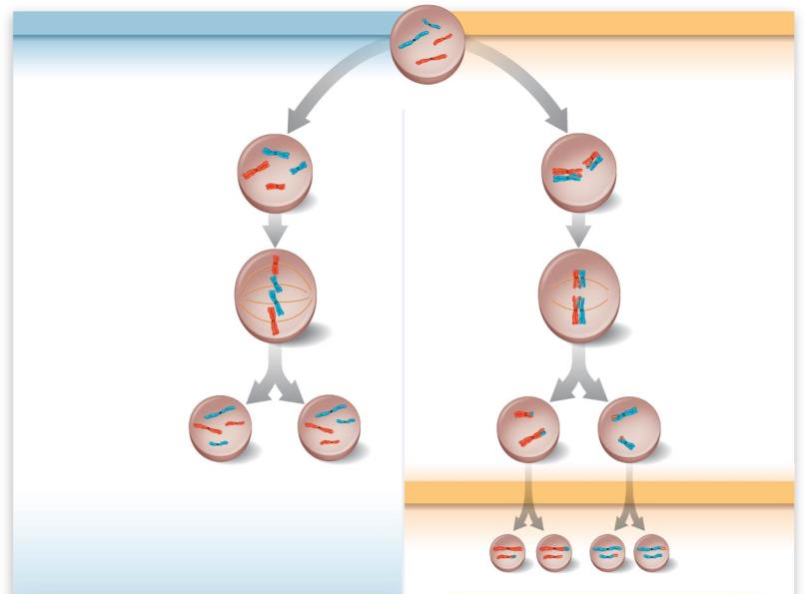
MITOSIS
MEIOSIS I
MEIOSIS II
One division of the nucleus and cytoplasm.
Result: Two genetically identical diploid cells.
Used for: Growth, tissue repair, asexual reproduction.
Two divisions of the nucleus and cytoplasm.
Result: Four genetically unique haploid cells.
Used for: Sexual reproduction.
Notes:
Figure 8.14-6 Comparison of mitosis and meiosis (step 6)

Slide 65
Comparison of Divisions
 | Mitosis | Meiosis
Number of divisions
Number of daughter cells
Genetically identical?
Chromosome #
Where
When
Role

Slide 66
Comparison of Divisions
 | Mitosis | Meiosis
Number of divisions | 1 | 2
Number of daughter cells | 2 | 4
Genetically identical? | Yes | No
Chromosome # | Same as parent | Half of parent
Where | Somatic Cells | Sex Organs (Ovaries and Testes)
When | Throughout life | At Puberty
Role | Growth and Repair | Sexual Reproduction

